Slide 1
Spatially Complete Global Surface Albedos Derived from MODIS Data
Michael D. King,^{1,2} Crystal B. Schaaf,³ Nandana Amarasinghe,^{2,4} and
Steven Platnick²
¹LASP/University of Colorado
²NASA Goddard Space Flight Center
³Boston University
⁴Science Systems, and Applications, Inc.
Operational MODIS surface albedo data product (MOD43B3/MCD43B3)
0.47, 0.56, 0.67, 0.86, 1.24, 1.64, 2.1, 0.3-0.7, 0.7-5.0, 0.3-5.0
1 arc min (~2 km) latitude-longitude spatial resolution (C004)
16-day periodicity (001, 017, …, 353) (C004)
Limitations
Spatial and temporal gaps due to cloud cover and seasonal snow
Motivation
Ancillary input for ground-based (AERONET), airborne, and satellite remote sensing
Land surface and climate modeling
Global change research projects

Slide 2
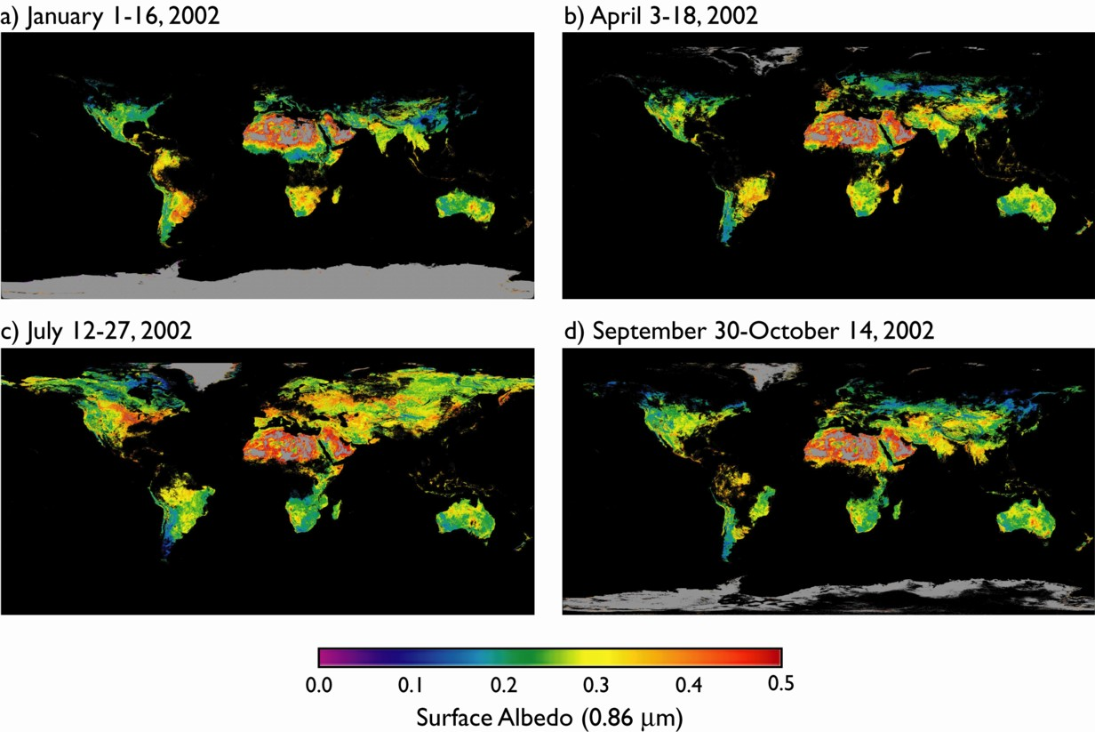
Conditioned MOD43B3 Albedo Maps λ = 0.858 µm
Moody et al. (2005)
1 arc min (~2 km)

Slide 3
Spatially Complete Albedo Maps λ = 0.858 µm
Moody et al. (2008)
1 arc min (~2 km)

Slide 4
New Improvements to Land Surface Albedo (Collection 5)
Enhanced spatial resolution
30 arc sec (~1 km) latitude-longitude spatial resolution
Based on reprojected averages of the underlying 500 m data
Increased resolution of time sampling
8-day periodicity (001, 009, 017, …, 361), based on 16-days of observations
Utilizes both Terra & Aqua data for increased number of angular samples
Performed phenological gap-filling on BRDF model parameters
RossThickLiSparse Reciprocal model
Kernel-driven linear model that relies on the weighted sum of an isotropic parameter and two functions (or kernels) of viewing and illumination geometry
Phenology established on a per pixel basis (using 20 months of data – 4 months before and 4 months after a year)

Slide 5
New Improvements to Land Surface Albedo (Collection 5)
Data use high quality results primarily
If there are large stretches of missing data the poorer quality results are considered (but weighted very low)
High quality data are used primarily (replacing temporal data)
Temporal fits are used secondarily
If missing data remains, use regional curves per latitude band and continent
Spatial smoothing fills in remaining gaps
Temporal fits are used secondarily
Data available for 2001,…,2009 completed

Slide 6
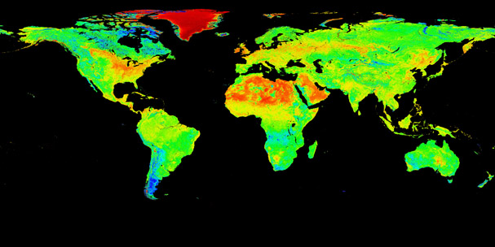
Spatially Complete White-sky Albedo Maps λ = 0.858 µm
July 12-27, 2004
July 12-27, 2004
0.0
0.2
0.4
0.6
0.8
1.0
Surface Albedo (0.86 µm)
Crystal Schaaf
30 arc sec (~1 km)

Slide 7
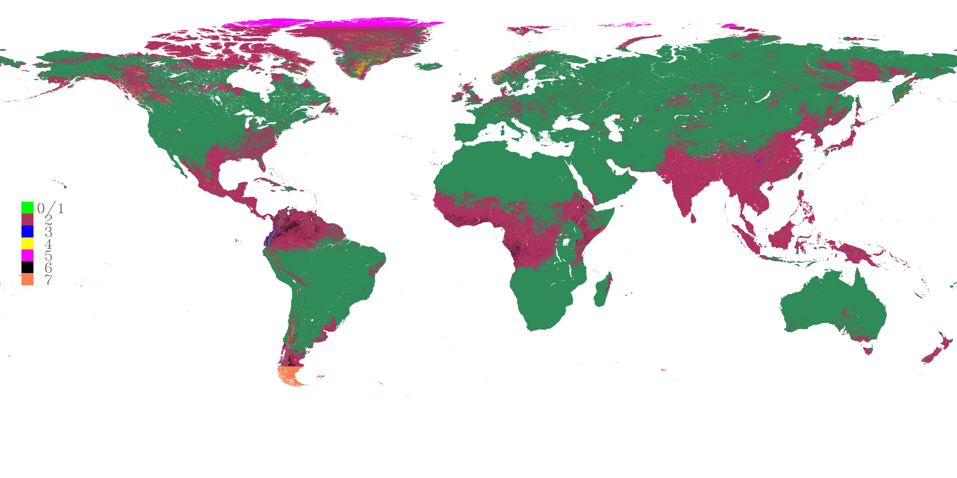
Spatially Complete Albedo QA Maps
July 12-27, 2004
High quality data
Spatially smoothed pixels
Temporally fitted pixels
Spatially fitted pixels between 80°N-90°N
Spatially fitted pixels
Solar zenith angle between 70° and 82°
Two part spatial fitting with temporal averages
Crystal Schaaf
30 arc sec (~1 km)
Notes:
In order to provide spatially complete global maps, the gap-filled BRDF parameters products are developed through the following major steps: (1) the use of the high quality data for that time period; (2) a phenological temporal curve fitting exercise for pixels without high quality retrievals; (3) a spatially fitting exercise; and as a last resort (4) a spatially smoothing effort. The majority highest quality full inversion values from MCD43D were used primarily for our temporal fitting effort. Lower quality pixels made from a mixture of full and magnitude inversions were only used to condition the temporal fit in areas of persistent missing data and were weighted lower to minimize their effects. The spatial fitting was only attempted on the small number of pixels where the parameter time series was still not able to be completed. In this case, a value was borrowed from pixels within 1 degree of latitude. This filled the majority of the remaining missing pixels but at the end, a spatial smoothing exercise was performed over the last few scattered pixels that had not yet been filled. The status of each pixel can be found in the Quality Assurance (QA) map, in which values between 0 and 1 represent our majority high-quality full inversion values (a green color on the example picture); value 2 indicates our temporally fitted pixels (maroon); value 3 indicates our spatially fitted pixels (blue); value 4 indicates spatially smoothed pixels (yellow); value 5 is being used for spatially fitted pixels in the region between 80N-90N (magenta); and finally due to residual cloud contamination in equatorial South America and equatorial Africa, an additional two part spatial fitting was applied with temporal averages in these areas and flagged as value 6 (black); and 7 (coral) indicates the areas where the solar zenith angle is between 70 and 82 degree; and finally the QA of 15 indicates filled values. The example white sky albedo true color images use WSA ranges from 0-0.3+ RGB.

Slide 8
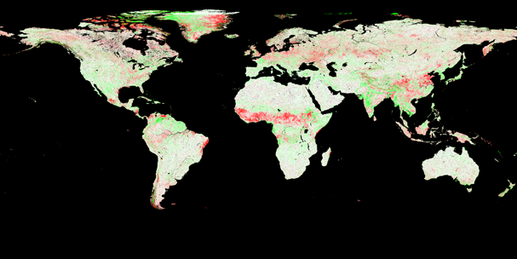
Spatially Complete White-sky Albedo Maps λ = 0.858 µm
Moody 16-day – Schaaf 8-day
July 12-27, 2004
-0.10
-0.05
0.0
0.05
0.10
Surface Albedo Difference (0.86 µm)

Slide 9
Plans for Cloud Optical Properties (Collection 6)
1 arc min (~2 km) latitude-longitude spatial resolution
Average 30 arc sec files to reduce file size
Use 8-day periodicity (production rules)
Direct broadcast needs yet to be evaluated
May want to use every other 8-day file (since they are based on 16-days) to reduce the number of files to be served
Extension of gap-filled albedo dataset to solar zenith angle of 81.4° necessary for cloud team, but is beyond angles preferred by Boston University
If we make these files available on the MODIS atmosphere web site (as currently for Moody et al.’s data), we may ’redact’ this extended range
May use a representative year (subject to discussion)
Enables one set of files to be used for both forward processing and reprocessing
Effect of this new gap-filled dataset on cloud optical properties not yet evaluated

Slide 10
Spectral Albedo of Snow
Used near real-time ice and snow extent (NISE) dataset
Distinguishes land snow and sea ice (away from coastal regions)
Identifies snow
Projected onto an equal-area 1’ angle grid
Aggregate snow albedo from MOD43B3 product
Surface albedo flagged as snow
Aggregate only snow pixels whose composite NISE snow type is >90% and flagged as snow in any 16-day period
Hemispherical multiyear statistics
Separate spectral albedo by ecosystem (MOD12Q1)
Results represent ‘average’ snow conditions
Additional sources of variability include snow depth, snow age, grain size, contamination (soot), and, in the case of black-sky albedo, solar zenith angle
Notes:
Clouds obscure trends over large regions
Usually full growth stage is obscured
Even 10°x30° may not observe complete temporal trend

Slide 11
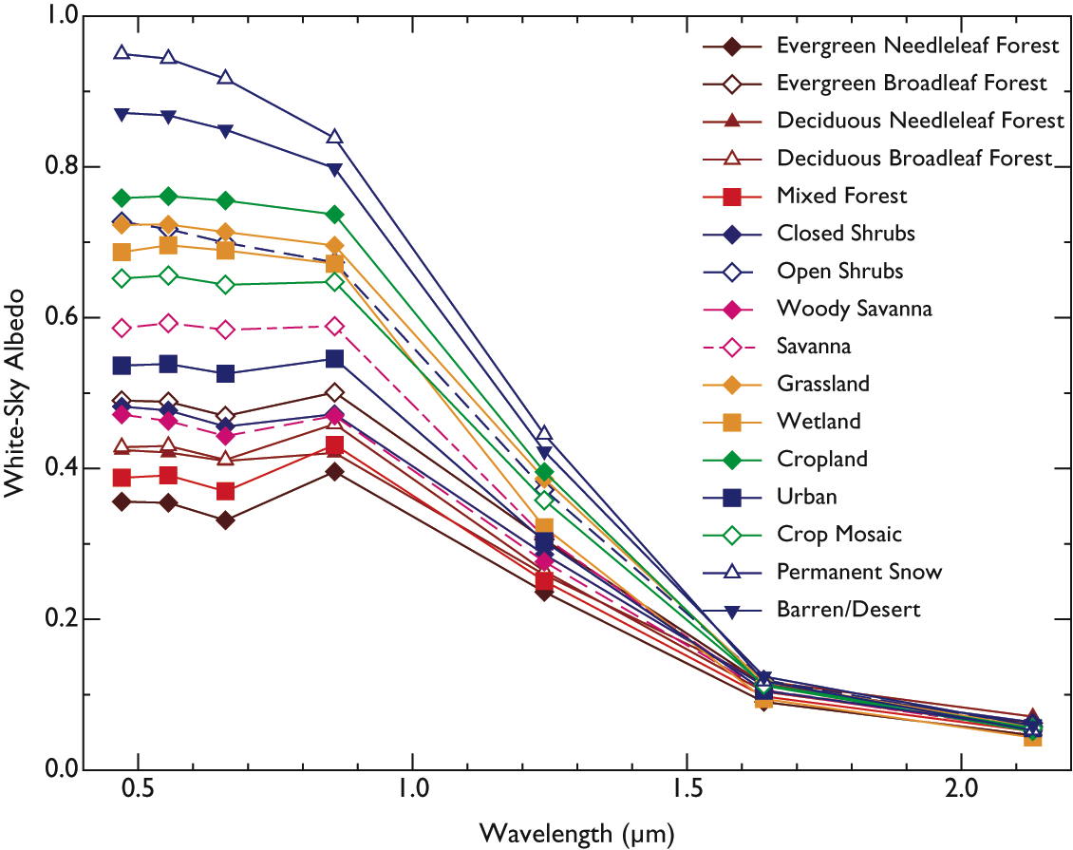
Snow Albedo by IGBP Ecosystem Northern Hemisphere Multiyear Average (2000-2004)

Slide 12
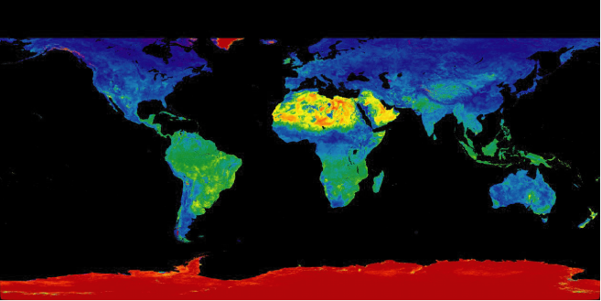
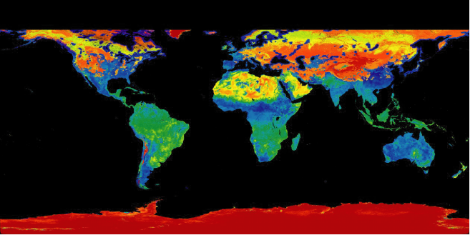
Spatially Complete White-Sky Albedo January 1-16, 2002
Snow-free
0.8
0.6
Surface Albedo (0.86 µm)
Snow-covered
0.4
0.2
0.0

