Slide 1
Determining the accuracy of MODIS Sea-Surface Temperatures – an Essential Climate Variable
Peter J. Minnett & Robert H. Evans
Meteorology and Physical Oceanography Rosenstiel School of Marine and Atmospheric Science University of Miami, Miami, USA

Slide 2
Uncertainty estimates of satellite – derived SSTs
Determined by comparisons with:
Drifting and moored buoys (subskin SST)
Ship-based radiometers (skin SST)
Often expressed as a global mean and standard deviation, thereby hiding regional, seasonal and geophysical effects.
Analysis of SST fields can reveal instrumental artifacts

Slide 3
Uncertainty estimates
Each processing step is prone to additional error sources.
From Cornillon et al, 2010, Sea-Surface Temperature Error Budget White Paper. (http://www.ssterrorbudget.org/ISSTST/)

Slide 4
Uncertainty estimates
Each processing step is prone to additional error sources.
From Cornillon et al, 2010, Sea-Surface Temperature Error Budget White Paper. (http://www.ssterrorbudget.org/ISSTST/)

Slide 5
Spatial distribution of errors
Areas of high bias errors can be related to geophysical phenomena: aerosols, upwelling, diurnal heating, anomalous humidity distributions ….

Slide 6
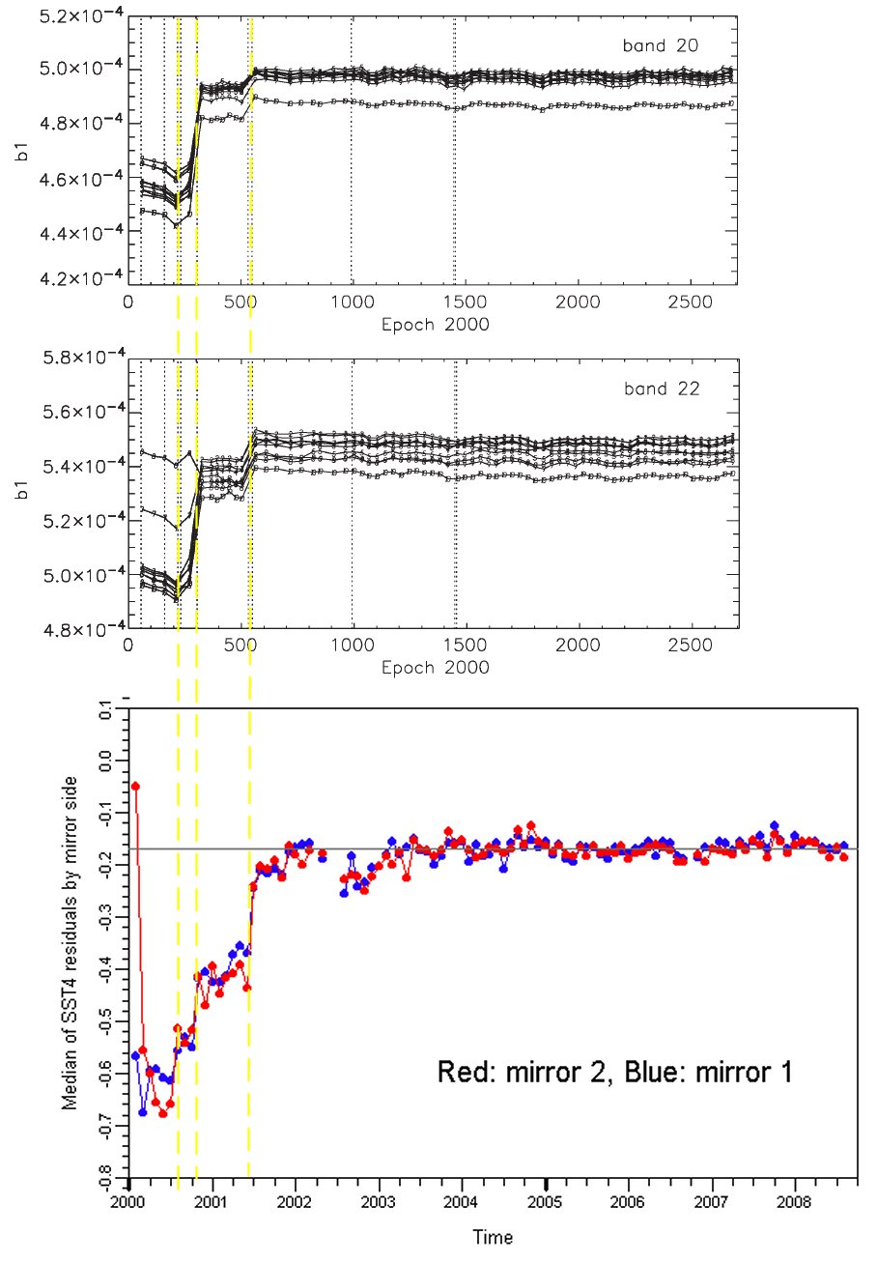
Development of Version 6, , Collection 6 SST algorithm Correction to SST4 bias resulting from TERRA configuration changes
MODIS-Terra calibration changes for channels 20 and 22.
Median of SST4 residuals estimated using 4µ channels.
Calibration issues during 2000 and 2001 had considerable impact on SST retrievals based on 4µm bands.
X-axis is time: 2000-2009

Slide 7
MODIS TERRA Mirror side and Scan Angle corrections to SST (also computed for AQUA)
Cross-scan
effect order 0.15K
Mirror side offset order 0.1K

Slide 8
CEOS definitions
Calibration:
The process of quantitatively defining system responses to known, controlled signal inputs. Thus, a calibrated product is the output from the complete calibrated data generation chain. In the case of satellite-based measurements, vicarious calibration is indirect calibration achieved by simulating the signal at the satellite sensor input based on independently measured geophysical parameters, and comparing it to the actual signal measured by the sensor. The outcome of the comparison can be used to calibrate the sensor output.
Validation:
The process of assessing, by independent means, the quality of the data products derived from system outputs. Validation ensures that the quality of the products is properly assessed. In the case of satellite-based measurements, this is done via quantification of the uncertainties in Level 1b and Level 2 products. Thus, a validated product is the output from the complete validated data generation chain.
Traceability:
Refers to an unbroken chain of comparisons relating an instrument's measurement to a known standard. Calibration to a traceable standard can be used to determine an instrument's precision, accuracy and stability.

Slide 9
CEOS definitions
Calibration:
The process of quantitatively defining system responses to known, controlled signal inputs. Thus, a calibrated product is the output from the complete calibrated data generation chain. In the case of satellite-based measurements, vicarious calibration is indirect calibration achieved by simulating the signal at the satellite sensor input based on independently measured geophysical parameters, and comparing it to the actual signal measured by the sensor. The outcome of the comparison can be used to calibrate the sensor output.
Validation:
The process of assessing, by independent means, the quality of the data products derived from system outputs. Validation ensures that the quality of the products is properly assessed. In the case of satellite-based measurements, this is done via quantification of the uncertainties in Level 1b and Level 2 products. Thus, a validated product is the output from the complete validated data generation chain.
Traceability:
Refers to an unbroken chain of comparisons relating an instrument's measurement to a known standard. Calibration to a traceable standard can be used to determine an instrument's precision, accuracy and stability.
Calibration is a pre-launch calibration.
On orbit, they are self-calibrating radiometers…
Validation is post-launch:
Identify instrumental artifacts
Performance of the atmospheric correction algorithm
Calibration and validation are traceable to SI standards

Slide 10
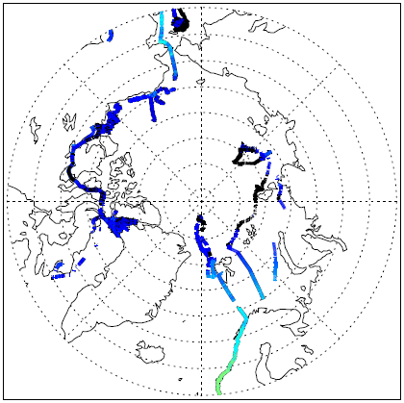
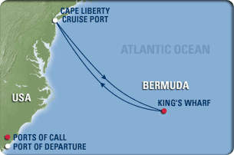
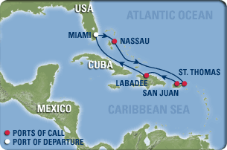
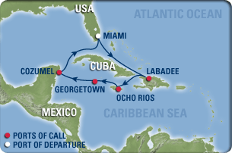
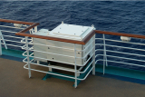
M-AERI cruises for MODIS, AATSR & AVHRR validation
Explorer of the Seas
Explorer of the Seas: near continuous operation December 2000 – December 2007. Restarted February 2010.

Slide 11
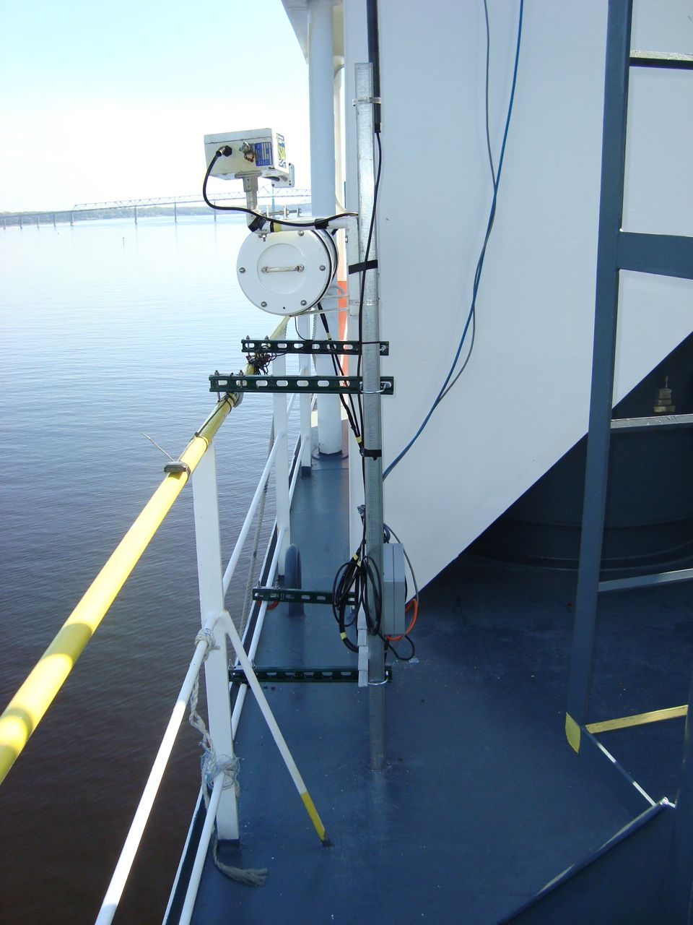
ISAR cruises for MODIS, AATSR & AVHRR validation

Slide 12
Internal Calibration

Slide 13
NIST water-bath black-body calibration target
See: Fowler, J. B., 1995. A third generation water bath based blackbody source, J. Res. Natl. Inst. Stand. Technol., 100, 591-599

Slide 14
Traceability to NIST TXR

Slide 15
Next-generation ship-based FTIR spectroradiometer
M-AERI Mk-2 undergoing tests at RSMAS.

Slide 16
CDR of SST
Satellite-derived SSTs
NIST Traceable error statistics
M-AERI, ISAR…. measurements
Matchup analysis of collocated measurements
Laboratory calibration
NIST-designed water-bath blackbody calibrator
NIST-traceable thermometers
NIST TXR for radiometric characterization

Slide 17
Future
New ship-based spectroradiometers
New spacecraft radiometers
Better buoy temperatures
Use modified Argo profilers, gliders
More (autonomous) radiometers, also on UAVs
Improved atmospheric correction formulations
“Forward” solution for the atmospheric effect

Slide 18
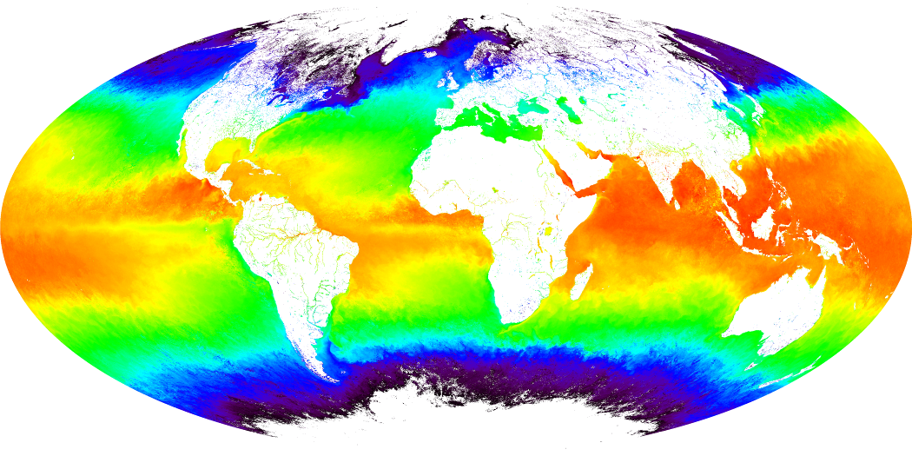
Questions?
Acknowledge support from MODIS Science Team, Dr Vince Salomonson, and NASA PO program, Dr Eric Lindstrom

