Slide 1
IASI – MODIS TEB Comparisons
Chris Moeller, Dave Tobin, Bob Holz, Greg Quinn
University of Wisconsin
MODIS Calibration Mtg
May 17, 2011

Slide 2
Data Set Characteristics
SNOs for Year 2009 (~3000 matchups)
MODIS L1A data processed to L1B using MODISL1DB V1.5 (equivalent to Collection 5)
No spectral shifts applied to MODIS RSR
No destriping of MODIS L1B data
Filtering applied to remove cases with highly structured scenes

Slide 3
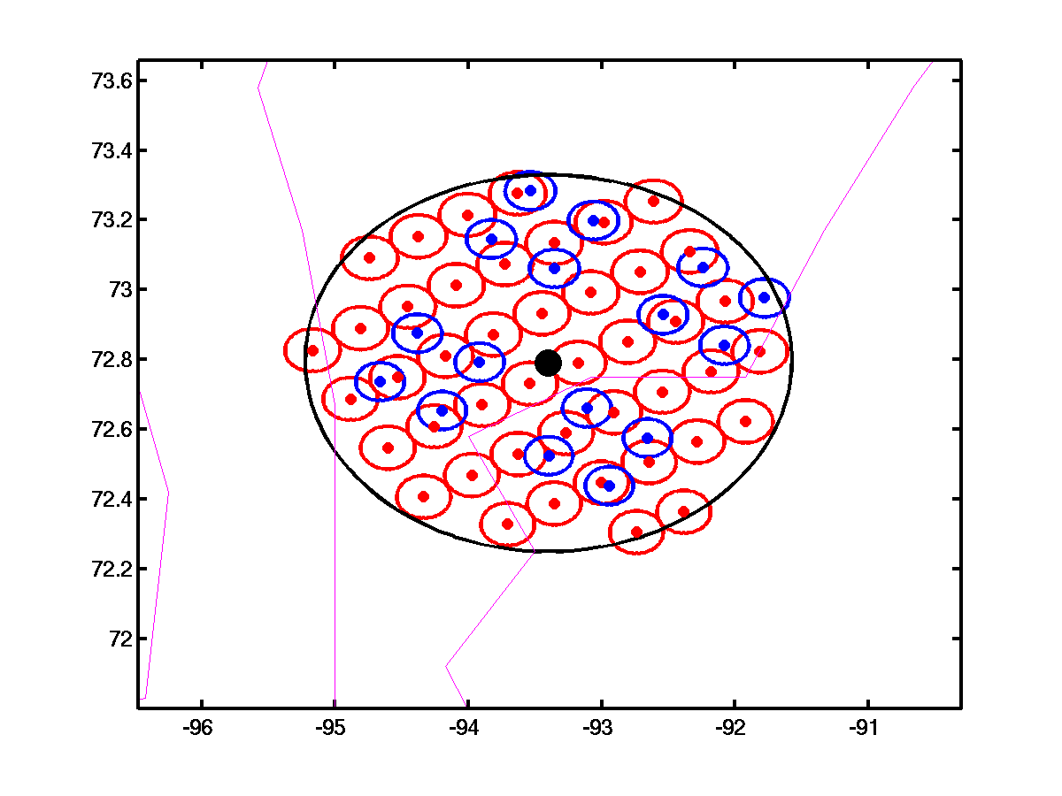
SNO Representation
Up to +/- 20 minute time offset accepted
Data within 50km radius of SNO point is used
(about 7700 MODIS pixels)
Latitude
Longitude

Slide 4
IASI – MODIS TEB Comparisons: MWIR (20-25) and PV LWIR (27-30) Bands
Aqua MODIS bands by and large performing well (not much scene temperature dependence) but some bands may benefit from spectral adjustment or small adjustment of offset coefficient.
Terra MWIR and LWIR PV bands showing very significant biases for cold scene temperatures. Offset coefficient problem seems likely.

Slide 5
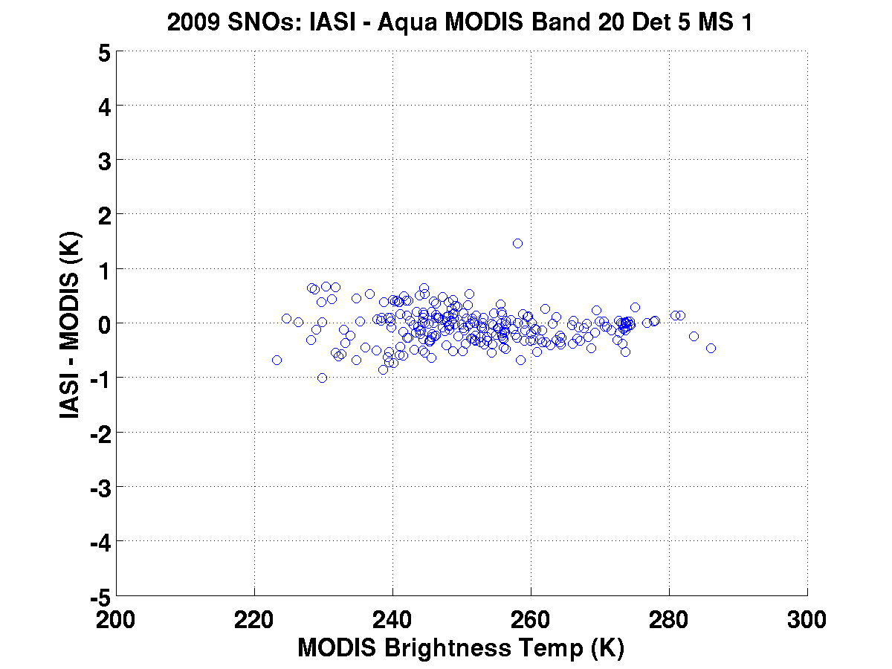
Ideal performance. No scene temperature dependence and bias close to zero.

Slide 6
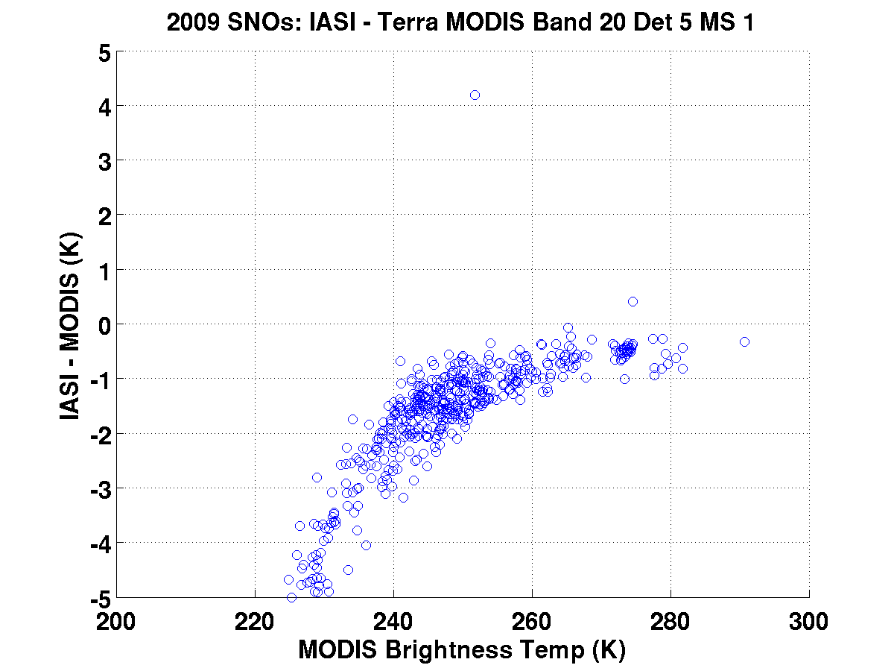
Large scene temperature dependence in bias. This behavior suggests a calibration offset coefficient problem and/or spectral problem

Slide 7
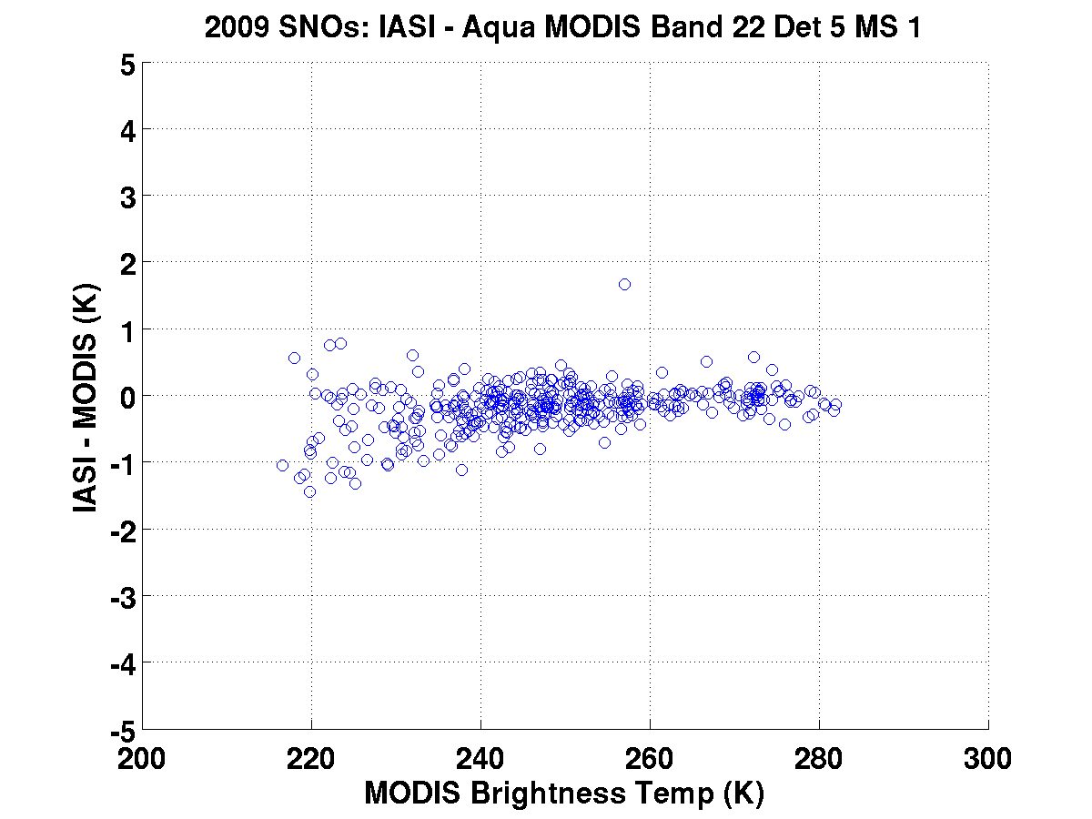

Slide 8
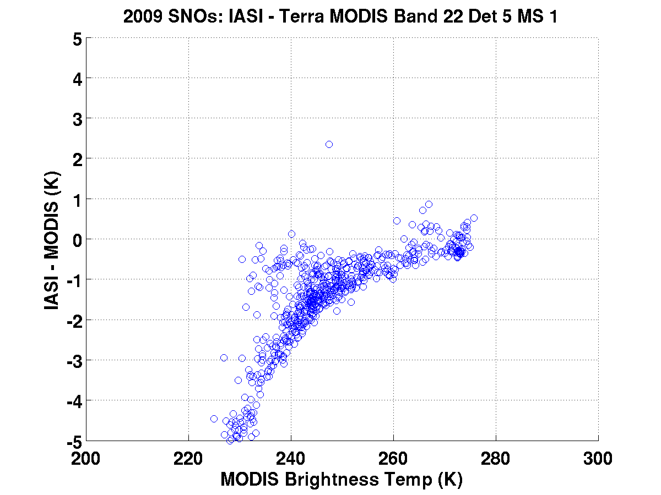
Similar behavior to Terra band 20. This behavior is present in all Terra bands 20-30.

Slide 9
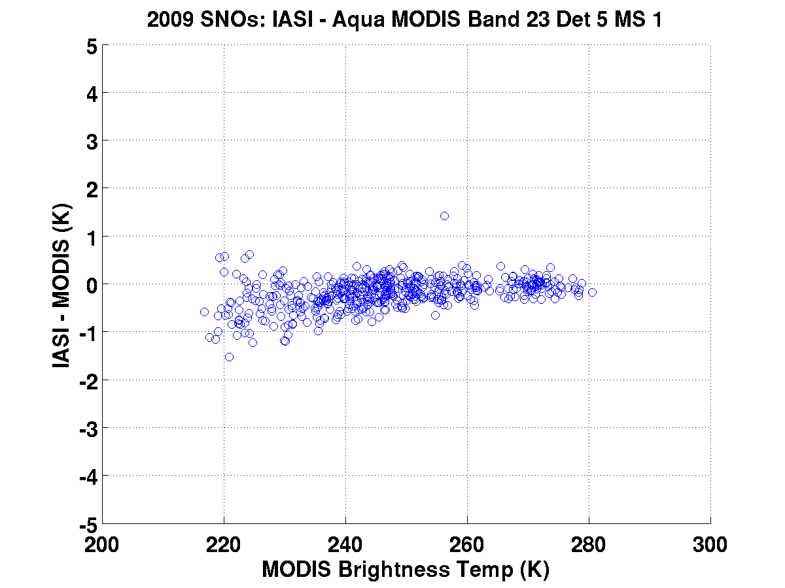

Slide 10
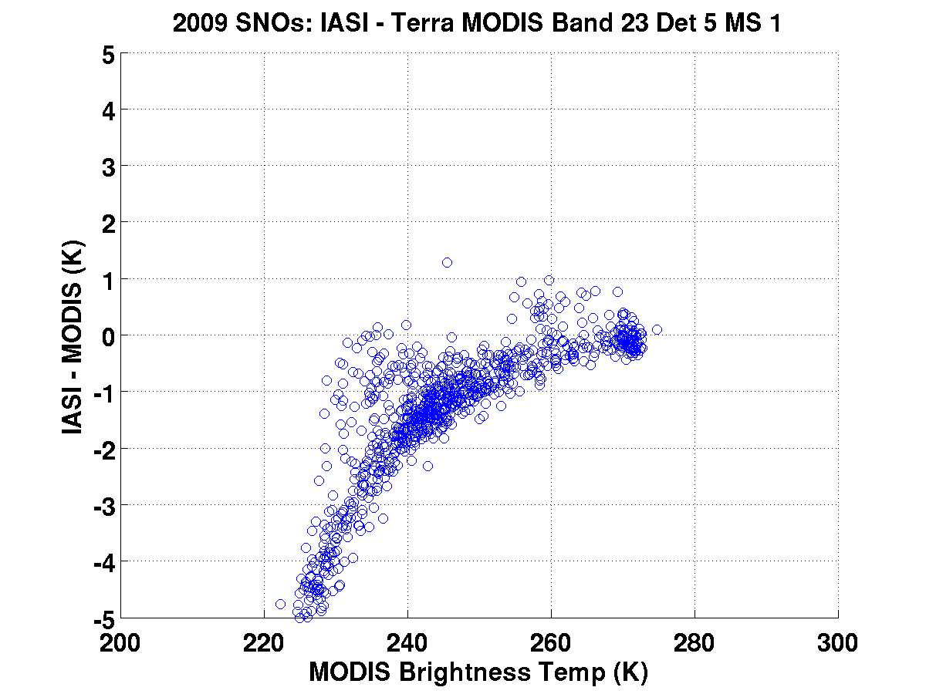

Slide 11
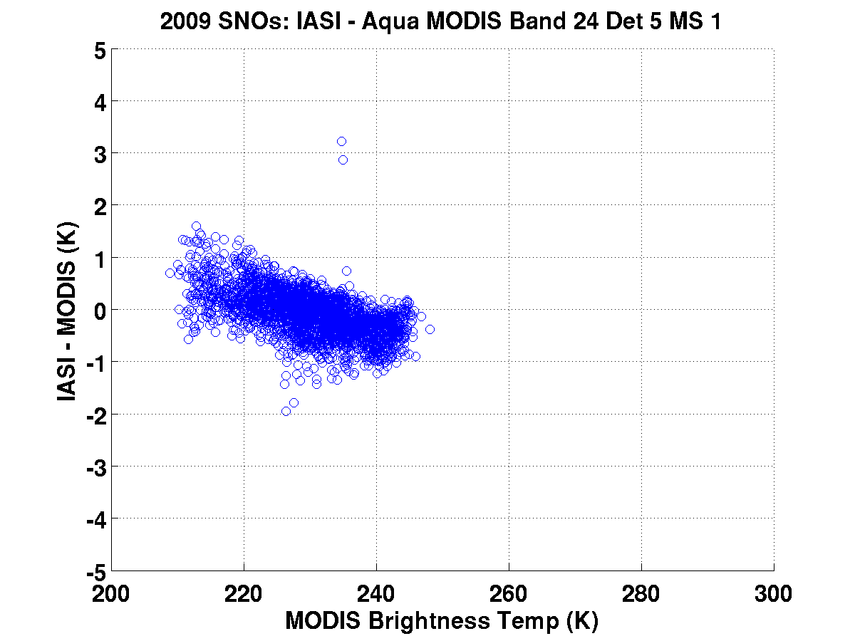
Spectral adjustment needed?

Slide 12
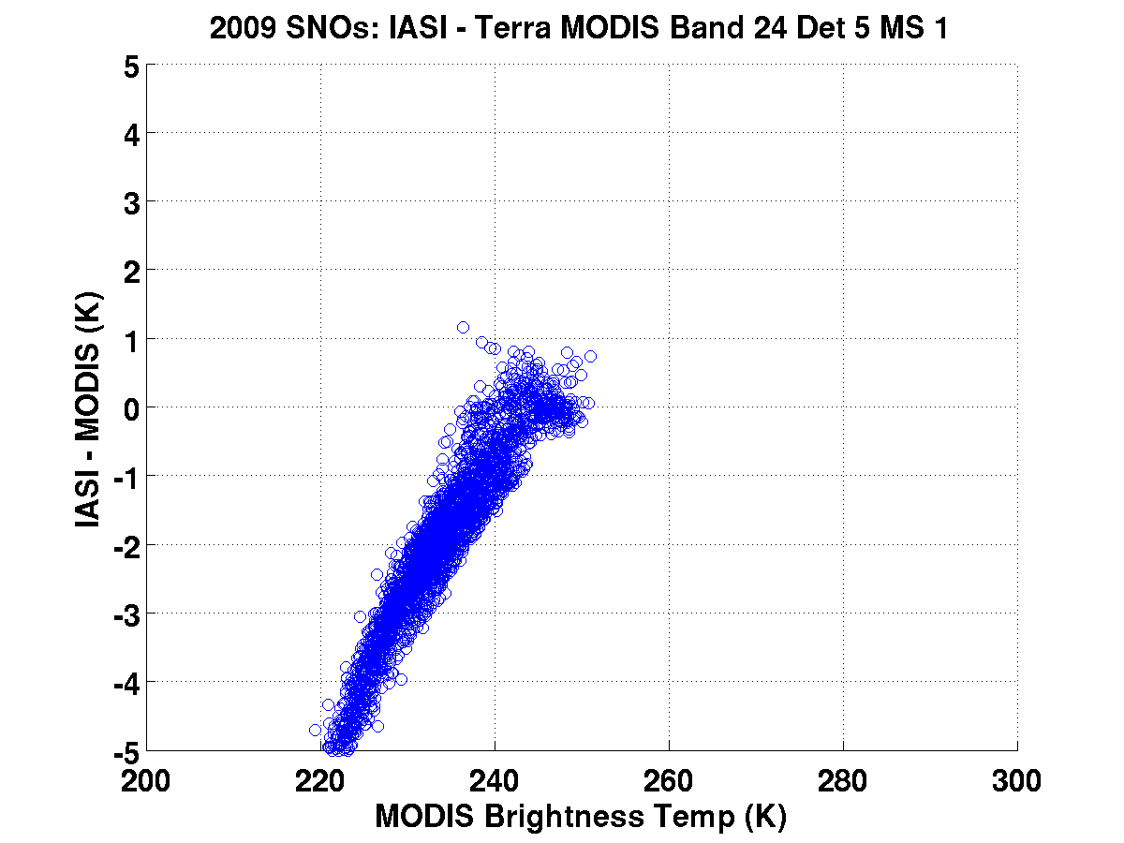

Slide 13
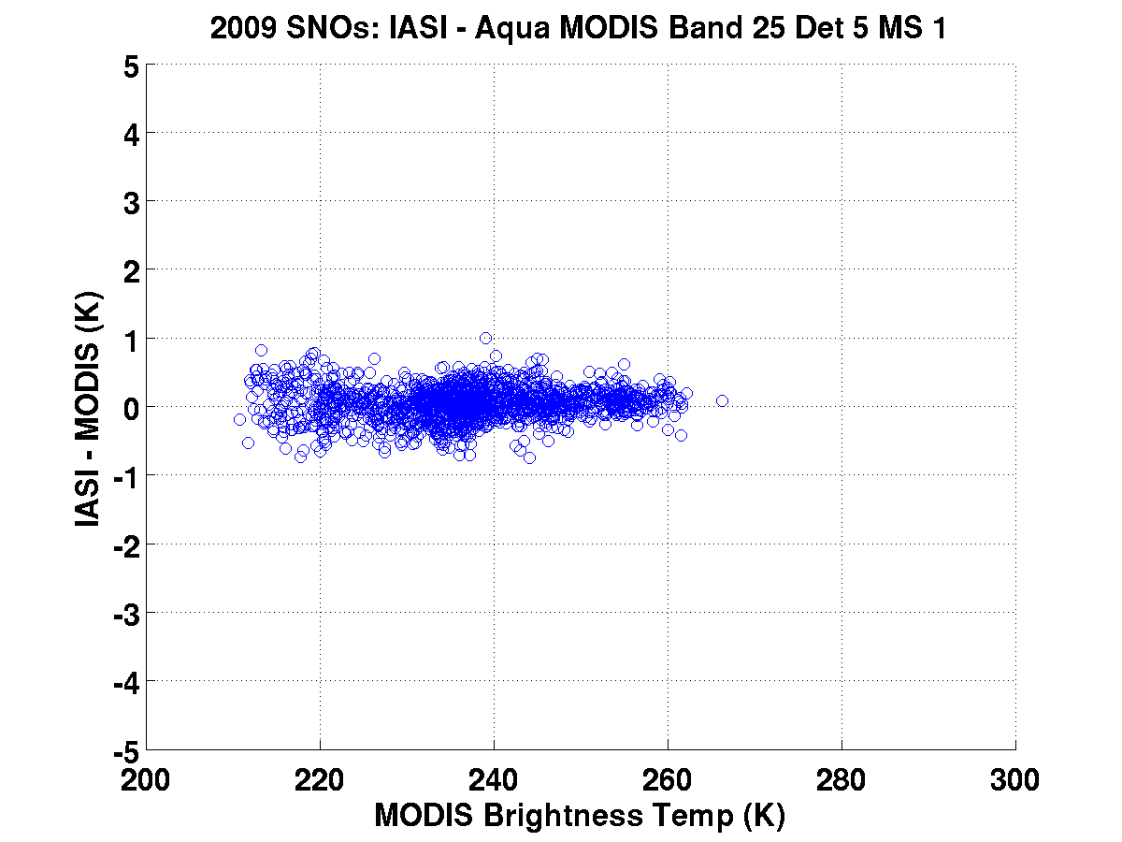

Slide 14
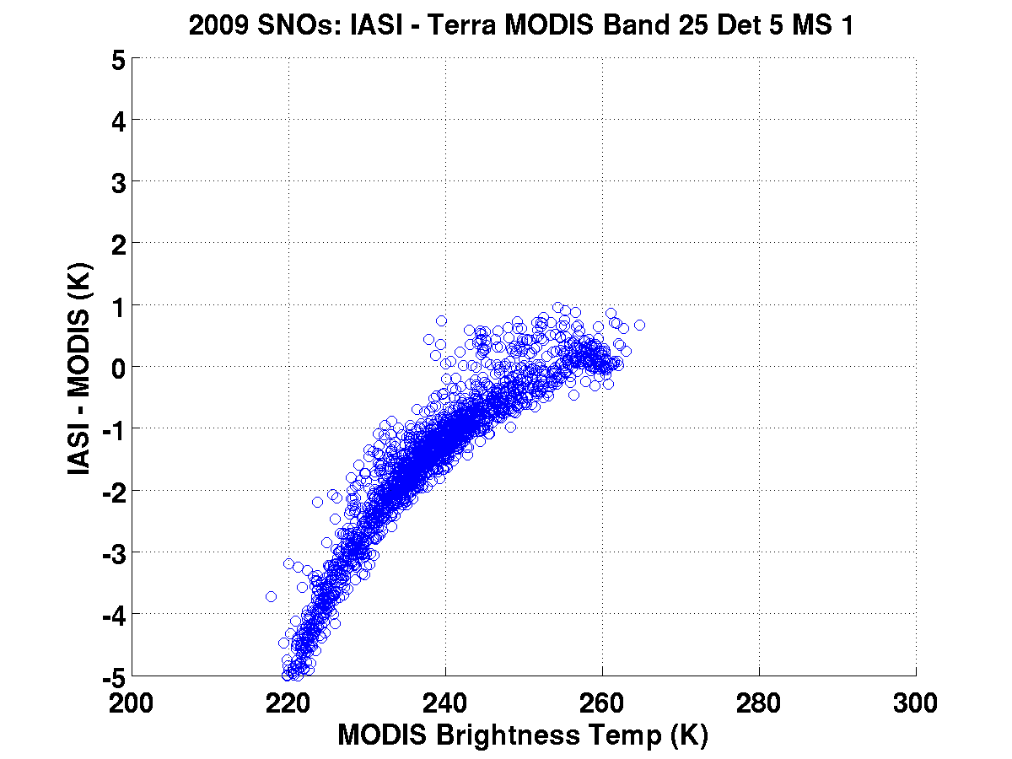

Slide 15
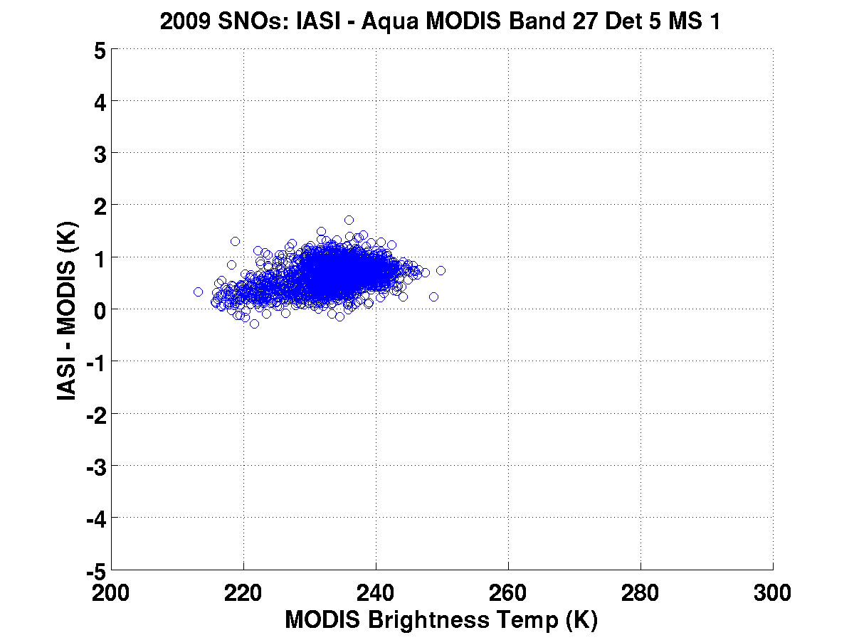
Spectral adjustment needed?

Slide 16
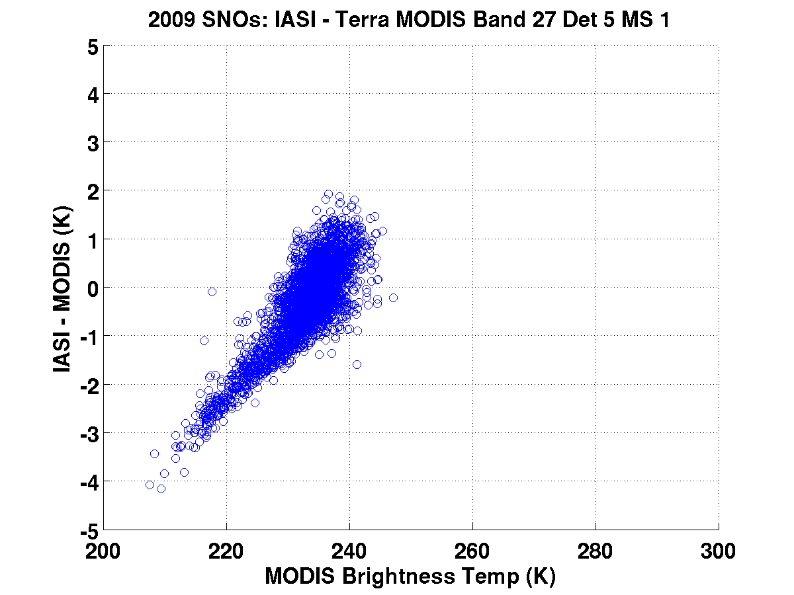

Slide 17
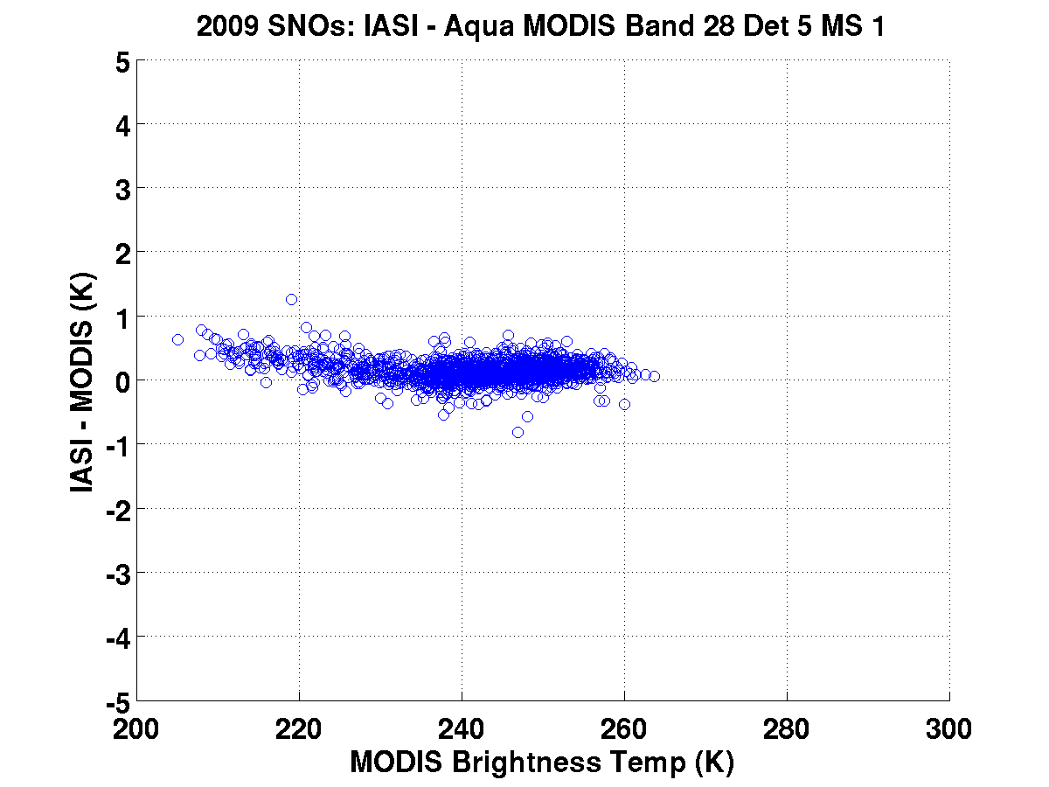
Spectral adjustment needed?

Slide 18
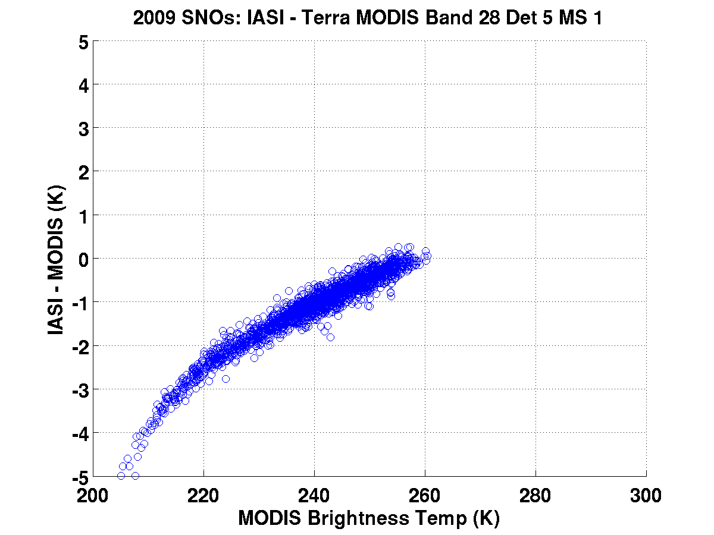

Slide 19
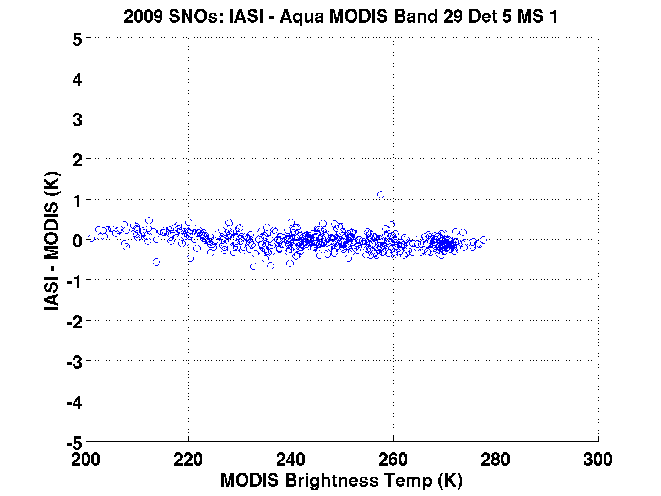

Slide 20
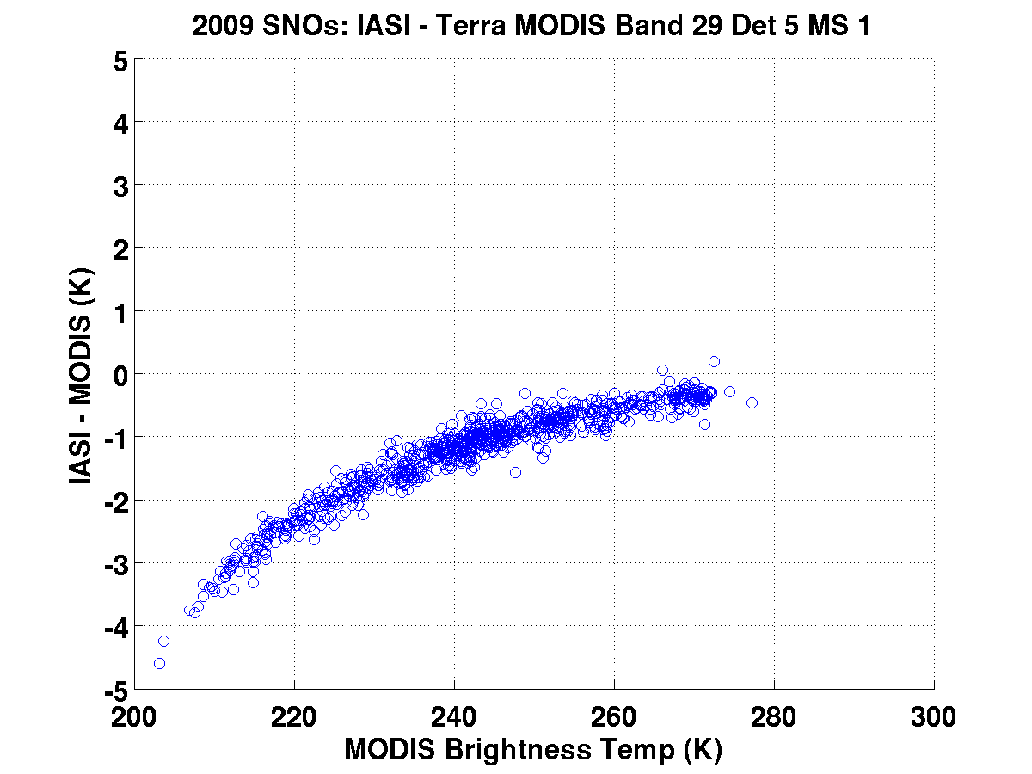

Slide 21
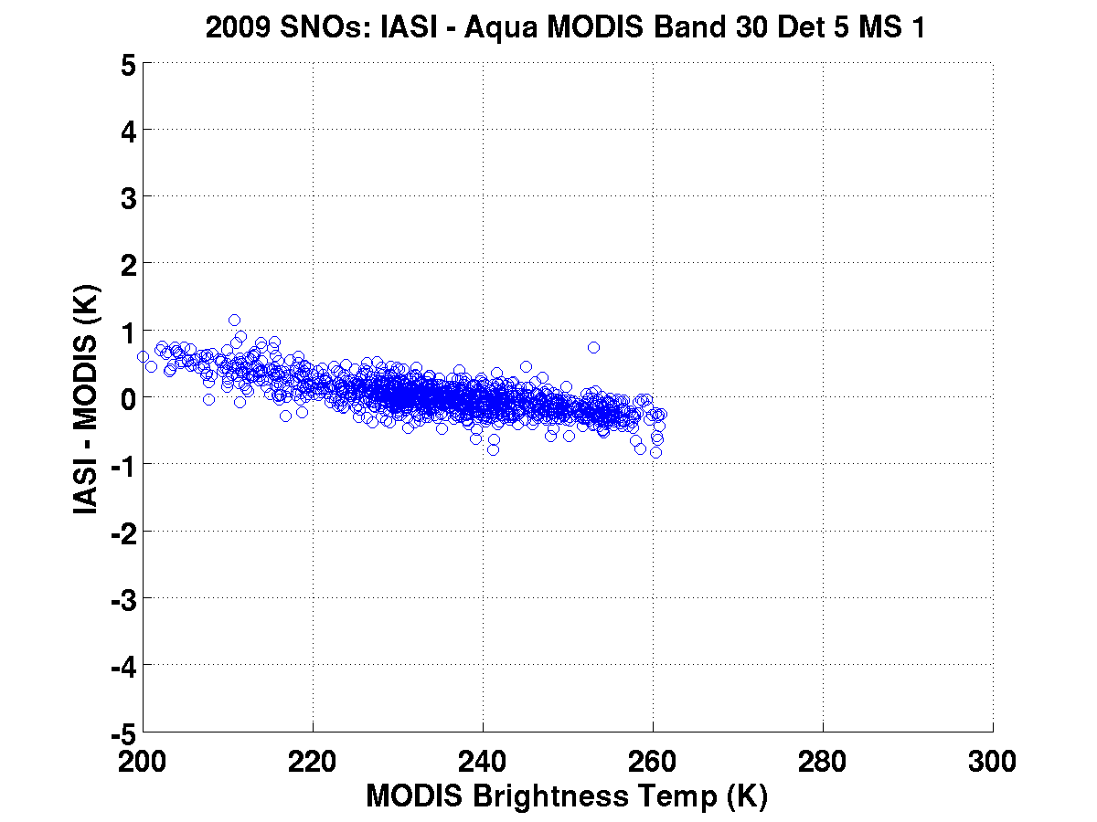
Spectral adjustment needed?

Slide 22
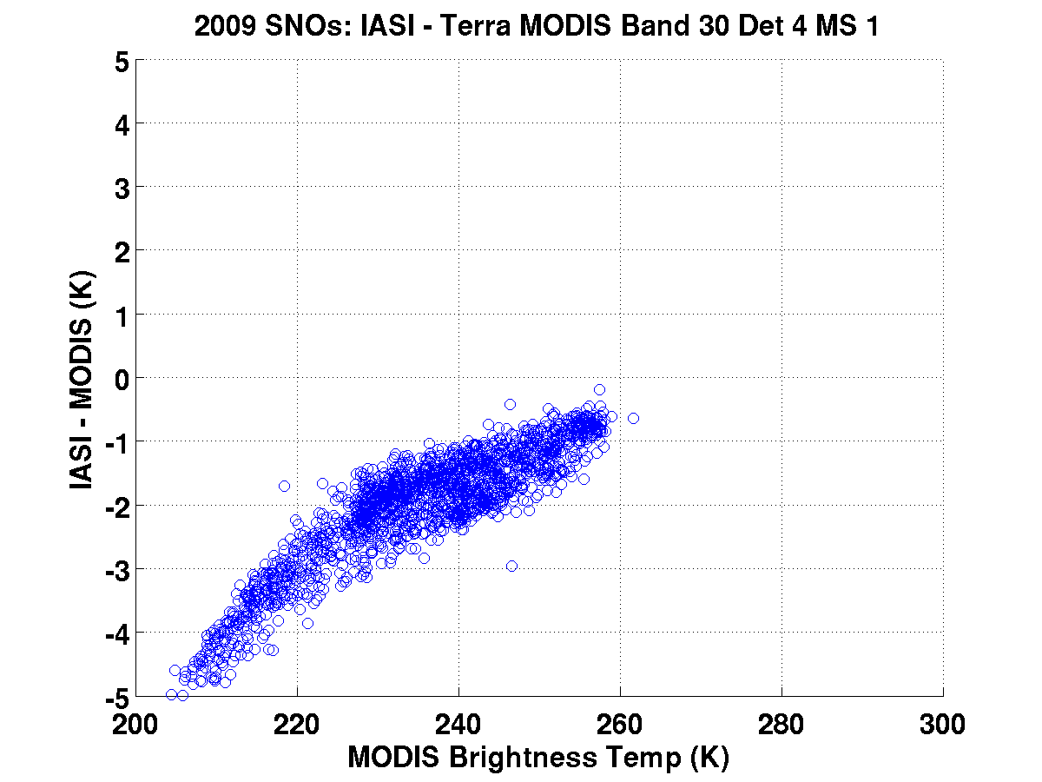

Slide 23
IASI – MODIS TEB Comparisons: PC LWIR Bands (31-36)
Aqua and Terra MODIS bands performing similarly.
B31 and B32 are similarly biased at cold end for both sensors
Slope in B33-36 plots similar for both sensors suggesting possible similar spectral adjustment for both sensors. Also suggests that Terra optical crosstalk correction was highly effective.

Slide 24
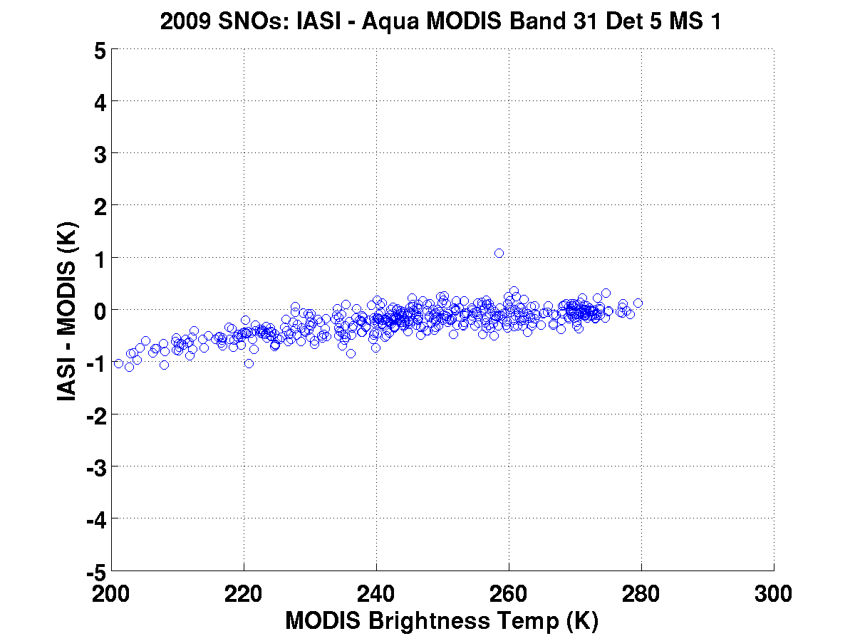
AIRS-MODIS cold scene bias is also observed in IASI-MODIS comparisons

Slide 25
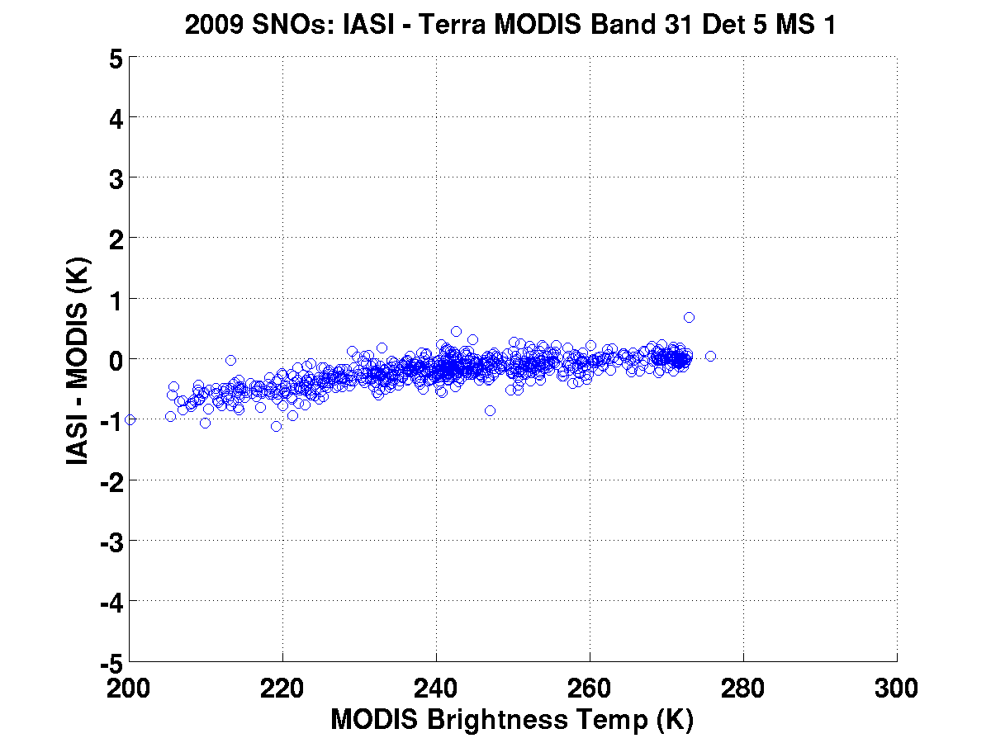
Also observed in Terra MODIS

Slide 26
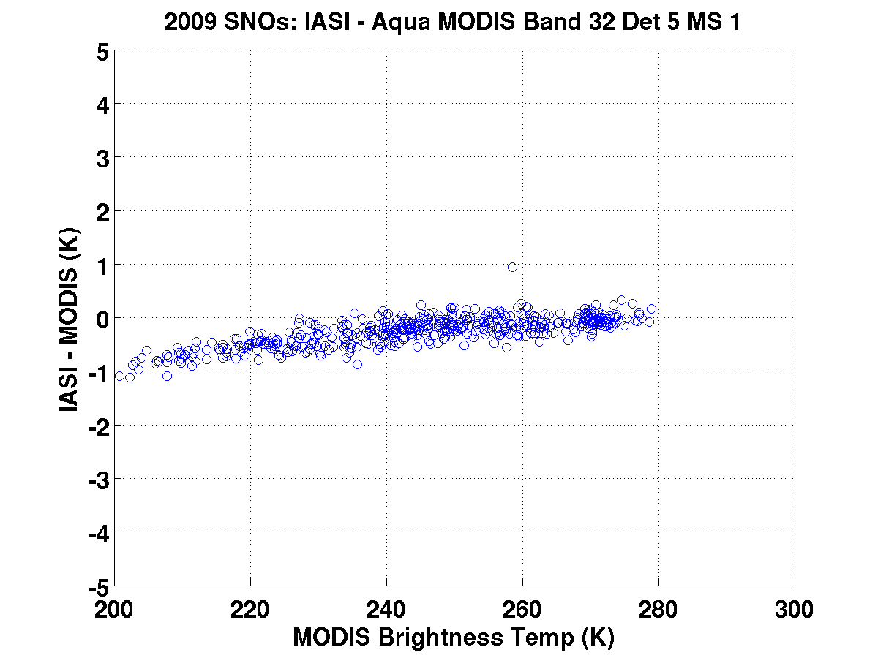

Slide 27
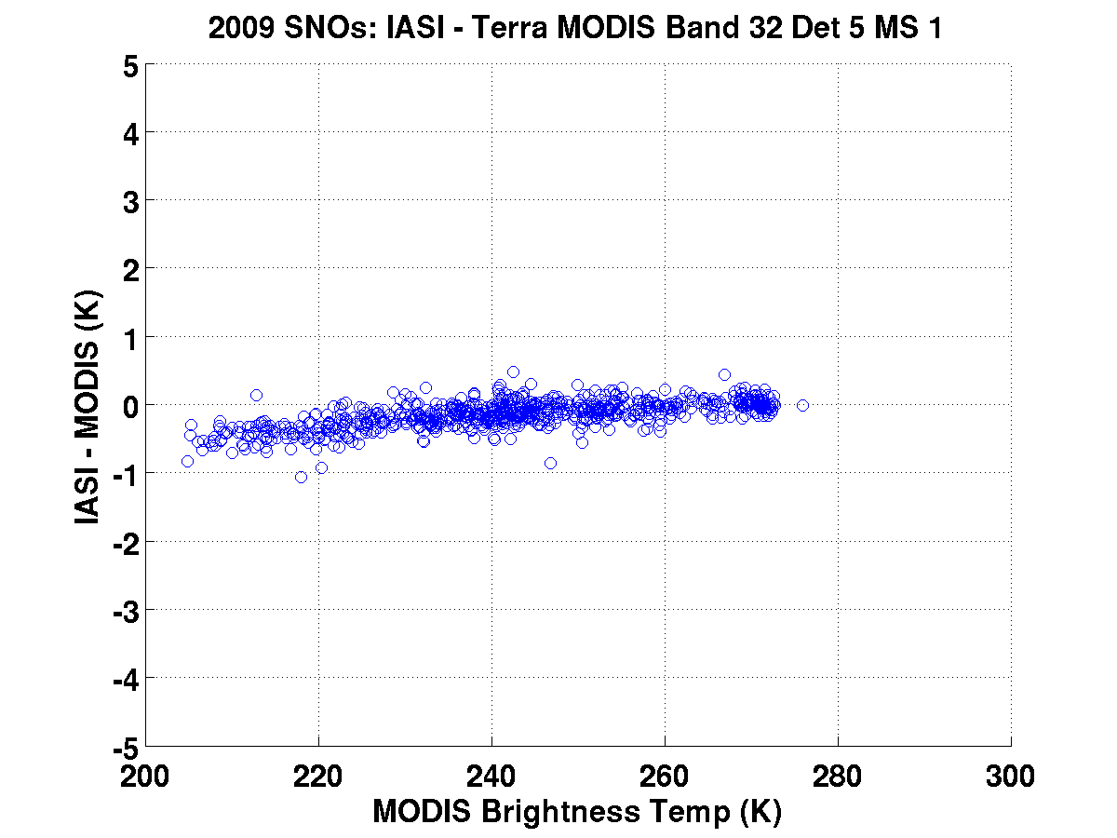

Slide 28
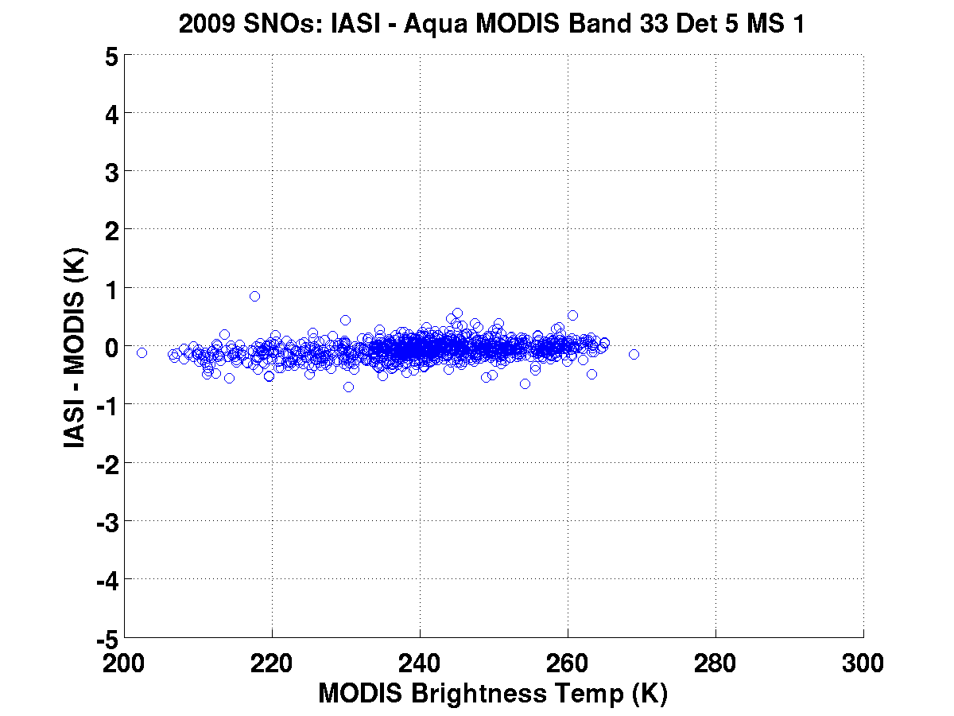

Slide 29
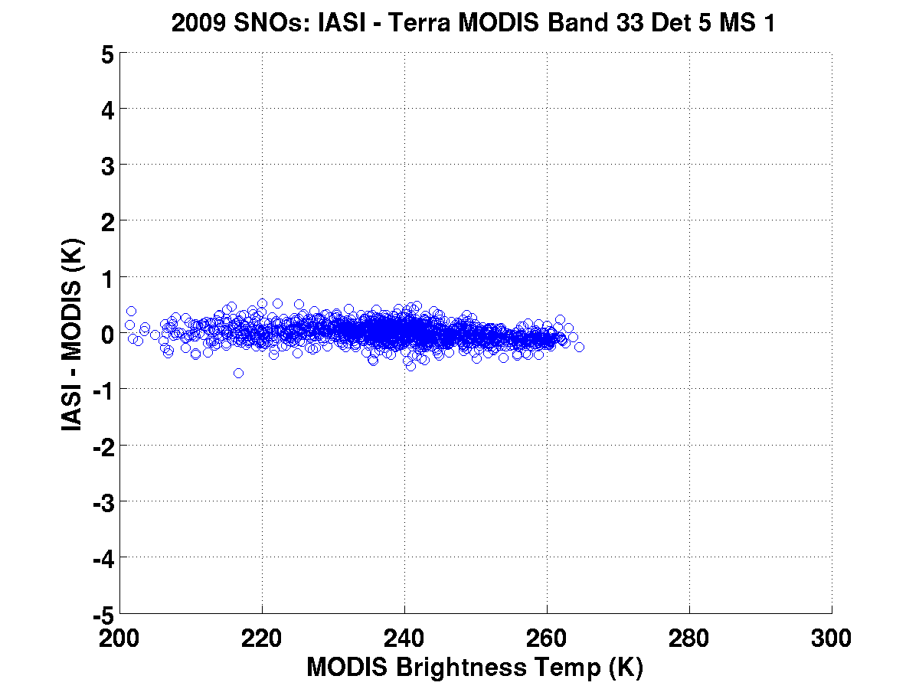

Slide 30
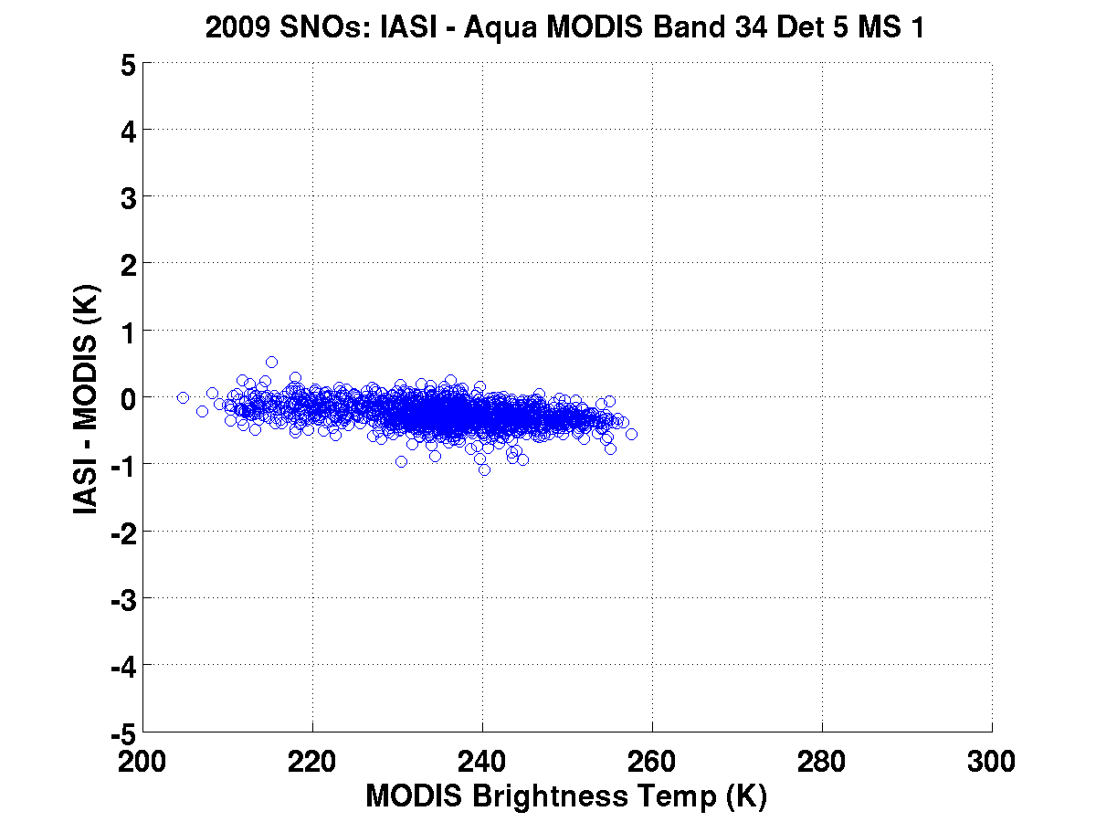
Spectral adjustment needed?

Slide 31
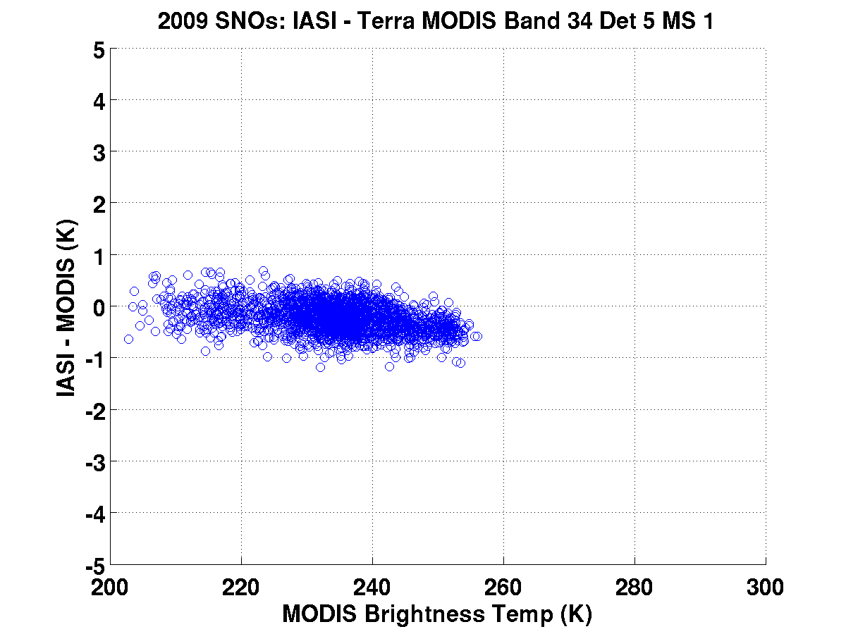

Slide 32
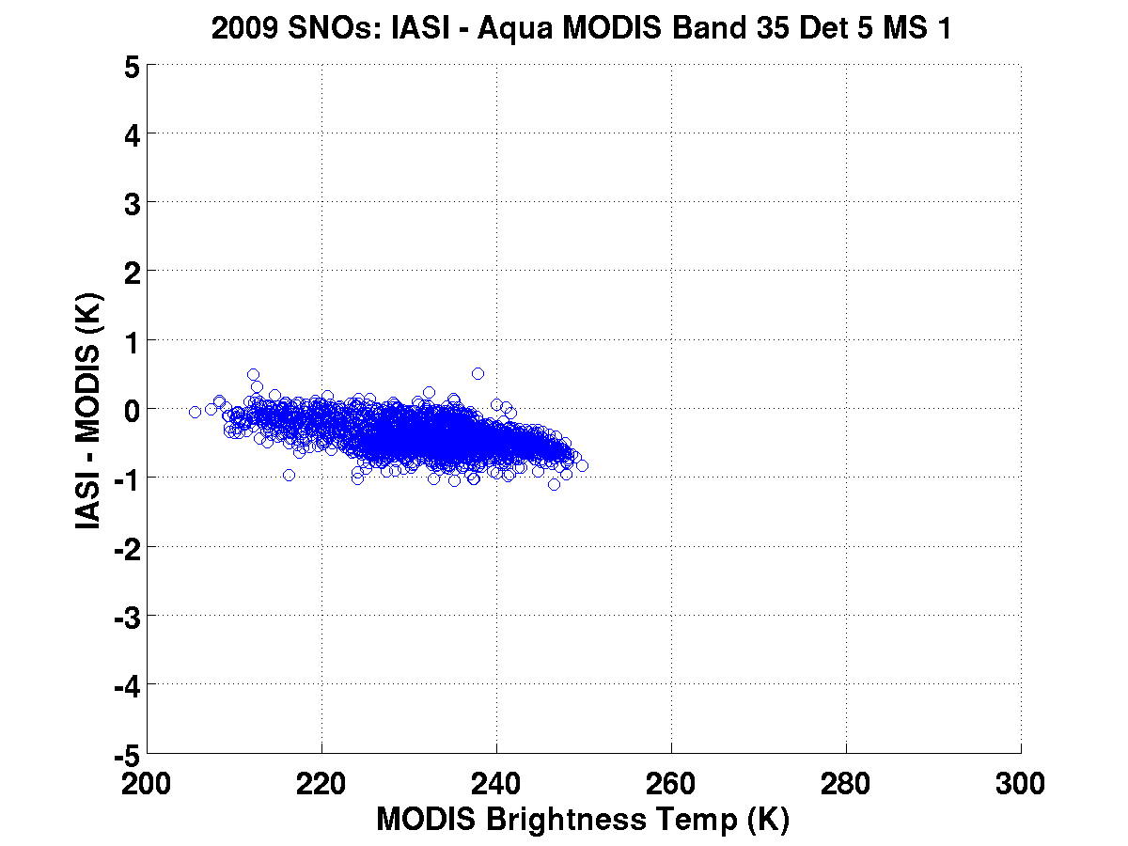
Spectral adjustment needed?

Slide 33
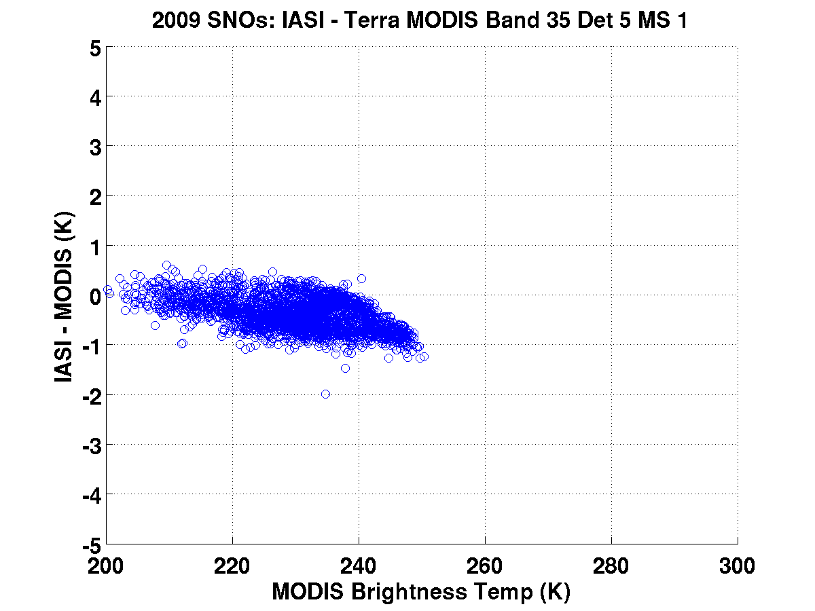

Slide 34
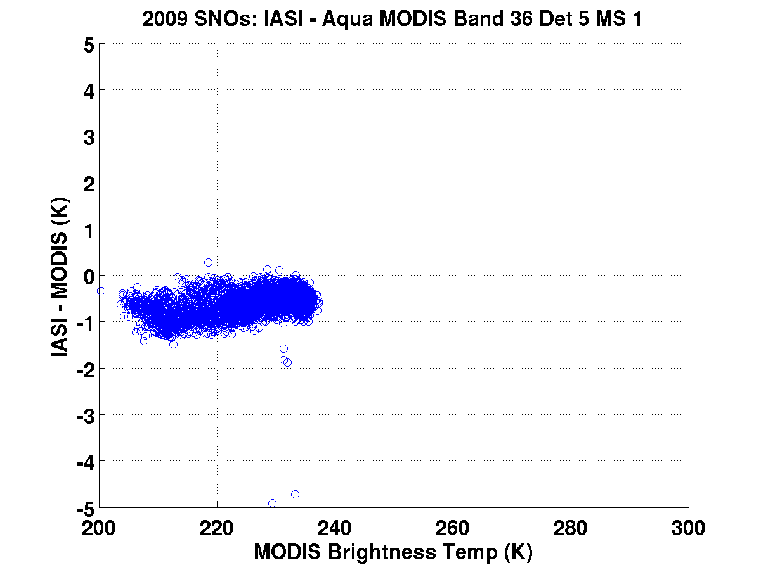
Spectral adjustment needed?

Slide 35
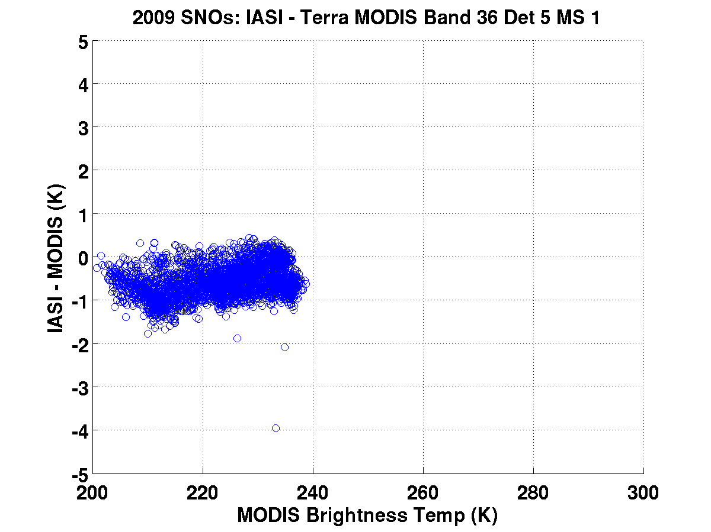

Slide 36
IASI – MODIS TEB Comparisons: Caveats and What’s to Come
IASI radiometric calibration has been shown to be high quality (similar to that of Aqua AIRS) but need to investigate to see if some of the scene temperature dependence may be due to IASI performance.
This analysis uses only 2009 data. Other years should be processed to corroborate these findings.
SNOs do not capture global variability of earth scenes nor sensor performance. Using full year of data mitigates this to some extent.
AIRS-MODIS comparisons have suggested an effective spectral shift to MODIS bands 34-36. This shift will be applied to IASI-MODIS comparisons for corroboration.
Recommendation:
test new offset coefficients for Terra Bands 20 – 30 in attempt to explain Terra cold scene behavior.

