Slide 1
Calibration assessment over desert site
Eric Vermote

Slide 2
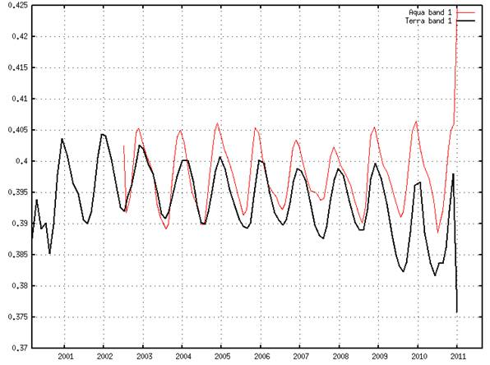
Surface Reflectance (smoothed) observed over desert site –band 1

Slide 3
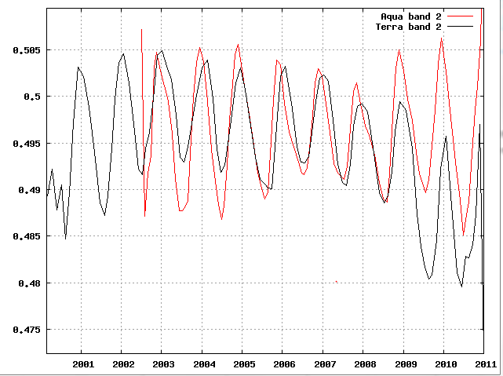
Surface Reflectance (smoothed) observed over desert site –band 2

Slide 4
Method for monitoring degradation
Where the offset (between -8 and 8) is chosen to match viewing geometry (or AOI)
Where i is between 0 and 15

Slide 5
Terra band 1
Aqua band 1
Terra band 2
Aqua band 2

Slide 6
Terra Band 1

Slide 7
Terra Band 2

Slide 8
Aqua Band 1

Slide 9
Aqua Band 2

Slide 10
Conclusion
The jump observed in Terra band 1 and 2 surface reflectance is in part of fully due to degradation not accounted for in collection 5 Level 1B due to introduction of extra solar diffuser degradation in April 2009 for almost all bands (1 to 4 and 8 – 19) 1.3% decrease in m1 -> 1.3% decrease in TOA reflectance

