Slide 1
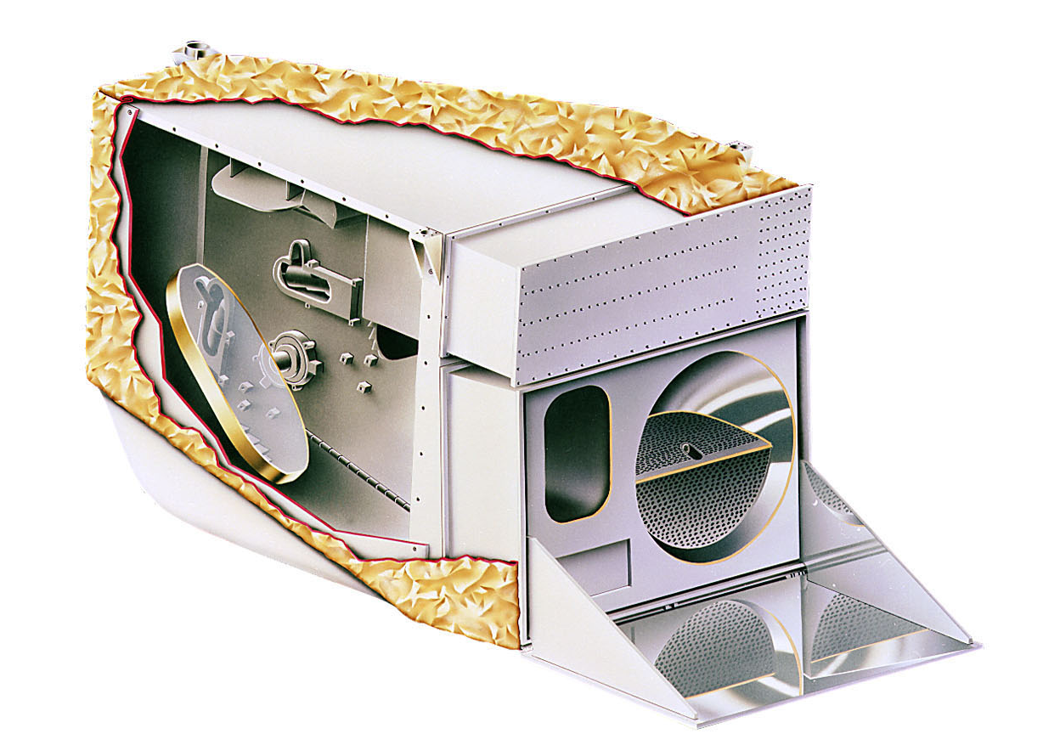
MODIS Calibration Workshop
Backup Slides
Jack Xiong
Biospheric Sciences Branch 614.4, NASA/GSFC
and
MODIS Characterization Support Team (MCST)
MODIS Calibration Workshop, College Park, MD 20706 (May 17, 2011)

Slide 2
Backup Table of Contents
General: pages 3-4
RSB: pages 5-19
TEB: pages 20-58
Spectral/Spatial: pages 59-63
C6 QA: pages 64-69

Slide 3
MODIS Focal Plane Assemblies (FPA)
S: scan direction; T: track direction
B13 and B14 have 2 columns of detectors for TDI high and low gain output
Page 3

Slide 4
MODIS Key Specifications
Page 4

Slide 5


RSB Calibration
Backup Slides
MODIS Characterization Support Team (MCST)
MCST Workshop at MST Meeting (May 17, 2011)

Slide 6
MODIS RSB Calibration Using SD/SDSM
EV Radiance:
Solar Irradiance E_{SUN}:
0.4-0.8 μm Thuillier et al., 1998;
0.8-1.1 μm Neckel and Labs, 1984;
Above 1.1 μm Smith and Gottlieb, 1974
Others:
Thermal leak applied for SWIR bands (B5-7, B26)
Leak coefficients determined from EV night time data
B26 de-striping algorithm added (from C. Moeller of Wisconsin)
Page 6

Slide 7
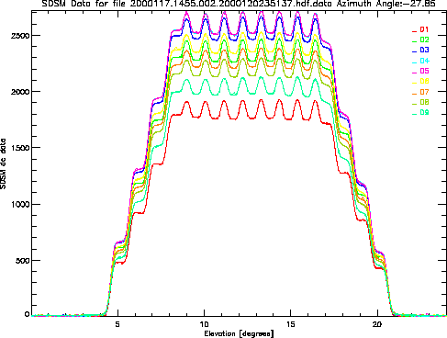
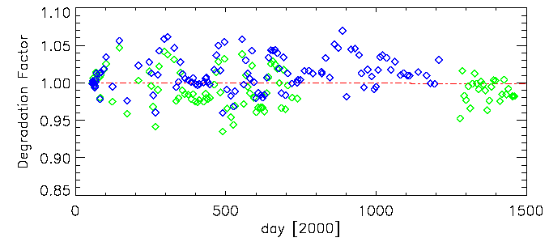
SDSM for SD Degradation
Normalize to SDSM D9 is adequate
(Leland and Arecchi, 1995, SPIE, 2475, 384)
SDSM data from Yaw
Terra MODIS SDSM D9 show no obvious degradation from over five years’ on-orbit trending (observations)
Normalize to SDSM D9 at 936nm
Blue: open mode; Green: close mode
Page 7

Slide 8
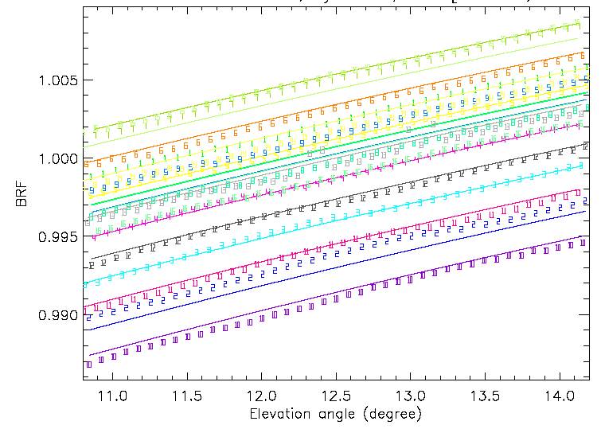
Solar Diffuser BRF Validation (on-orbit)
  On-orbit BRF validation performed (yaw maneuvers)
  Bands 1-4 and 17-19 used to validate the BRF (bands 8-16 saturate without SD screen, SWIR bands have xtalk)
  Pre-launch BRF curves used to fit the observations
  Measurements (Terra MODIS) agree with pre-launch values to within ±0.25%* (consistency checked among different detectors within a band; * B2 min/max difference is -0.22%/0.41%
  Pre-launch BRF is used in the m1 calculation
Terra MODIS B3 BRF
fitting (solid line); on-orbit data (symbols)
Page 8

Slide 9
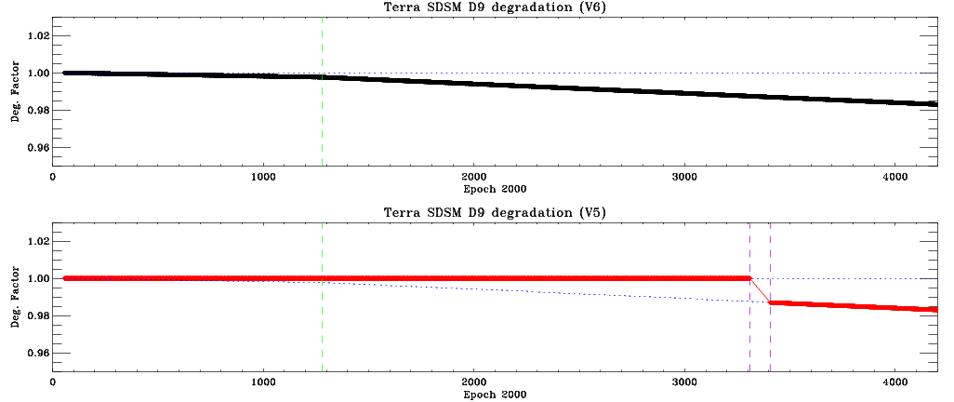
Terra D9 Degradation

Slide 10
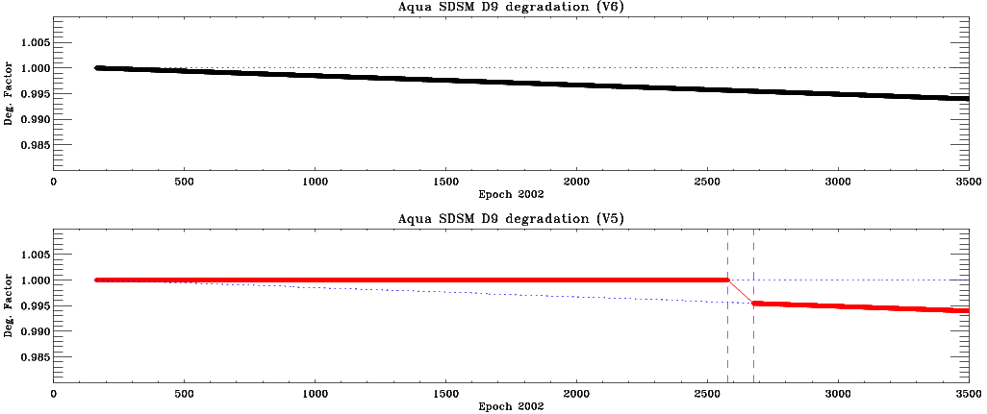
Aqua D9 Degradation

Slide 11
MODIS Polarization Effect
TOA (Top-of-Atmosphere) reflectance
  B, D, M, and θ are band, detector, mirror side, and angle of incidence
  a and δ are instrument’s polarization factor and phase angle,
    which were measured prelaunch but change on orbit
  f and μ are degree of the incident light’s polarization and the
    direction of larger axis of the incident light’s polarization
    4
EV mirror side ratio
Page 11

Slide 12
Terra L1B MS Ratio at Different Latitudes
Page 12

Slide 13
Terra L1B MS Ratio at Different Latitudes
Page 13

Slide 14
Terra L1B MS Ratio at Different Latitudes
Page 14

Slide 15
Terra L1B MS Ratio in at Different Latitudes
Page 15

Slide 16
Terra Instrument Response MS Ratio
Page 16

Slide 17
Terra Instrument Response MS Ratio
Page 17

Slide 18
Aqua L1B MS Ratio at Different Latitudes
Page 18

Slide 19
Aqua L1B MS Ratio at Different Latitudes
Page 19

Slide 20
TEB Calibration
Backup Slides
MODIS Characterization Support Team (MCST)
MCST Workshop at MST Meeting (May 17, 2011)

Slide 21
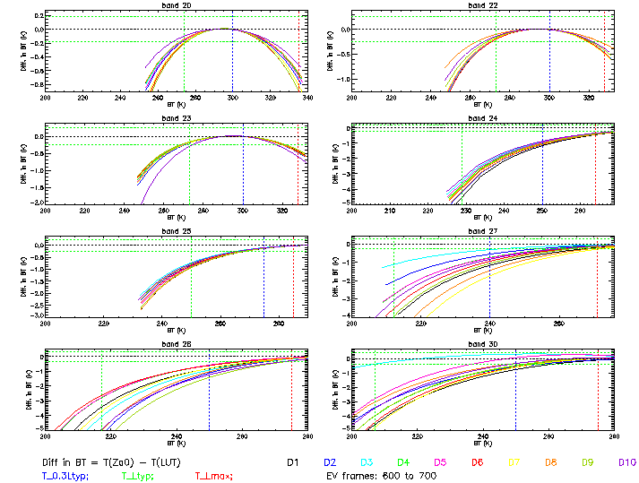
Estimated L1B Impact due to zero a0
ΔT = C6 – C5

Slide 22
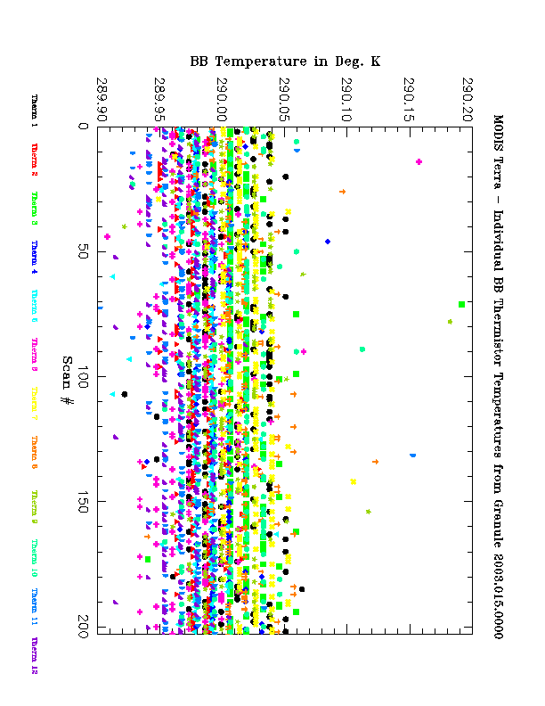
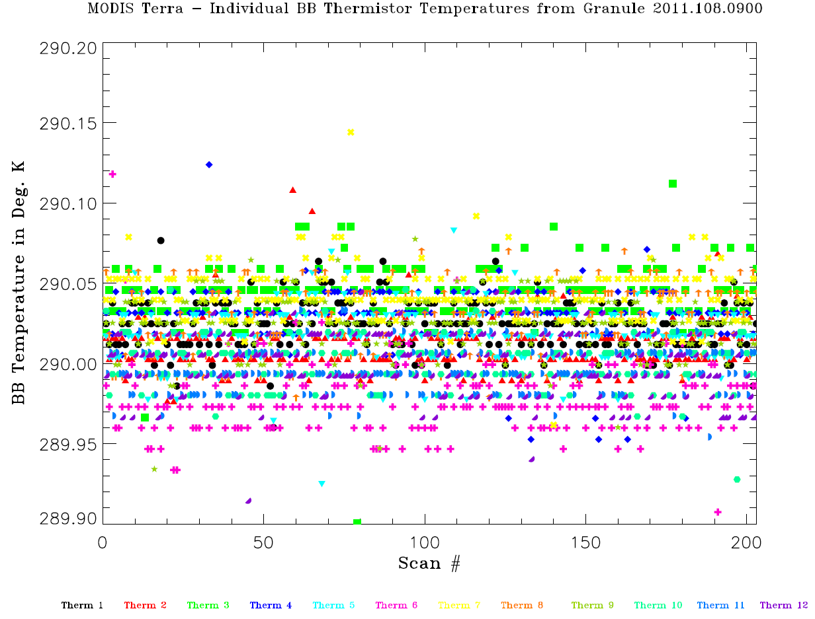
Terra BB Short-term Stability
1-granule, scan-by-scan, 12 individual BB thermistors
Therm 1 Therm 2 Therm 3 Therm 4 Therm 5 Therm 6 Therm 7 Therm 8 Therm 9 Therm 10 Therm 11 Therm 12
Page 22

Slide 23
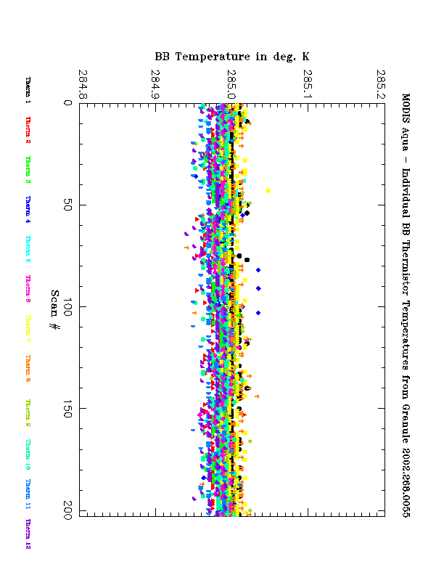
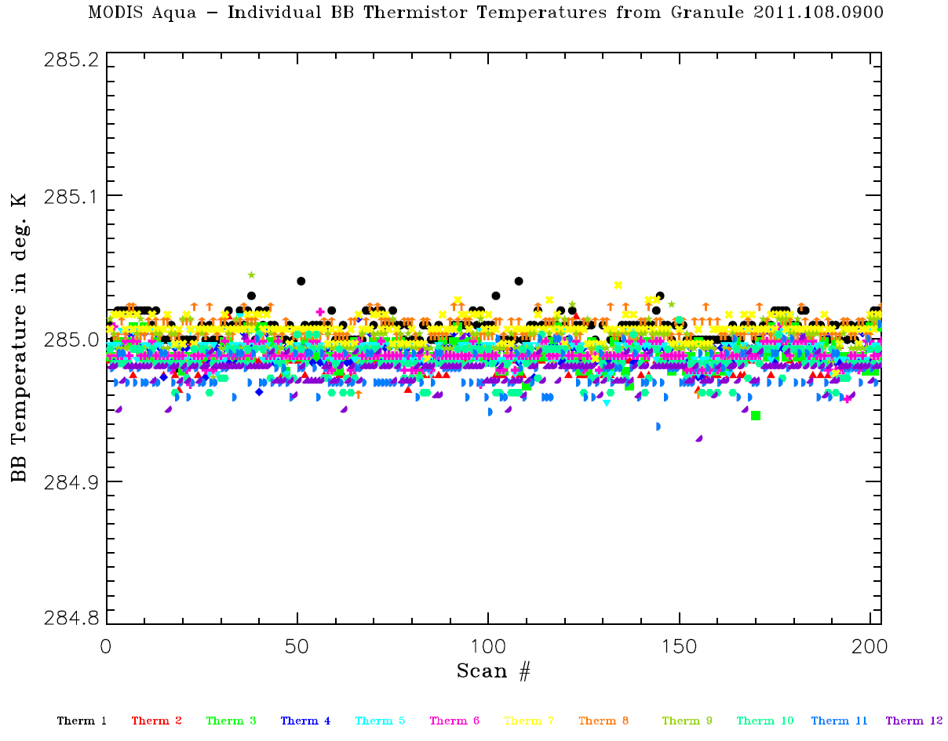
Aqua BB Short-term Stability
1-granule, scan-by-scan, 12 individual BB thermistors
Therm 1 Therm 2 Therm 3 Therm 4 Therm 5 Therm 6 Therm 7 Therm 8 Therm 9 Therm 10 Therm 11 Therm 12
Page 23

Slide 24
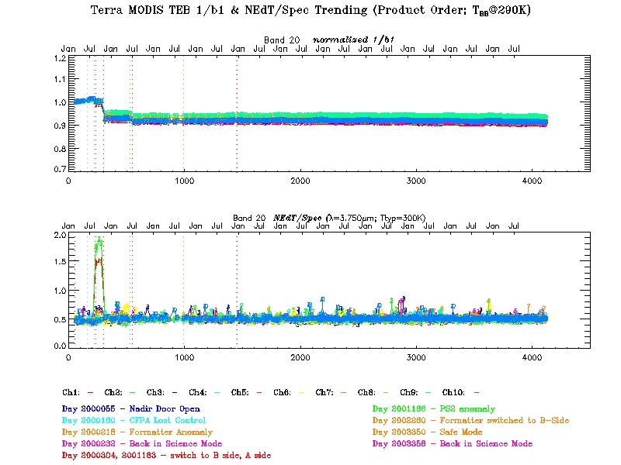
Page 24

Slide 25
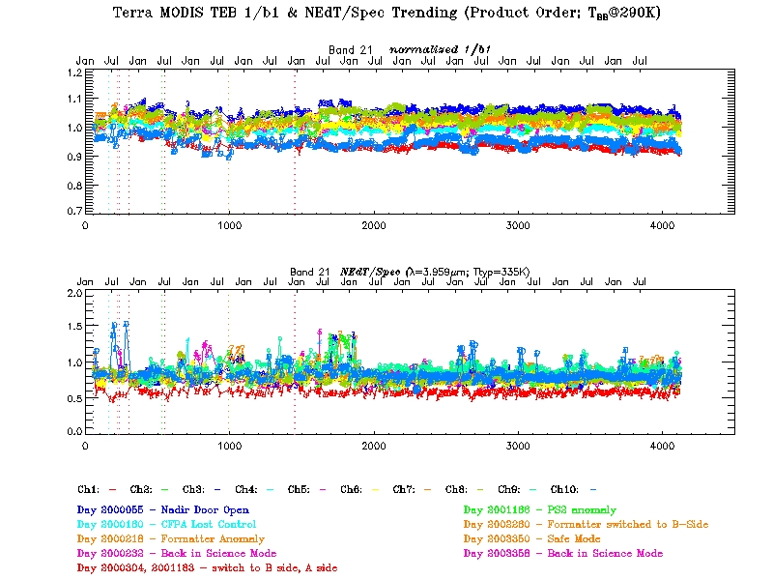
Page 25

Slide 26
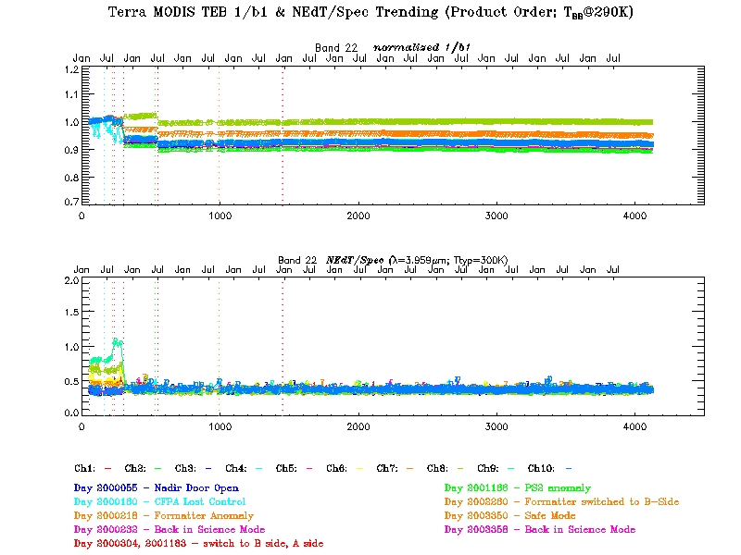
Page 26

Slide 27
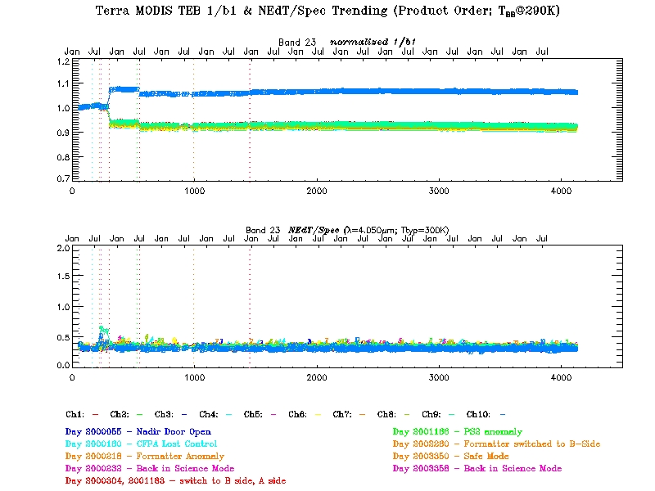
Page 27

Slide 28
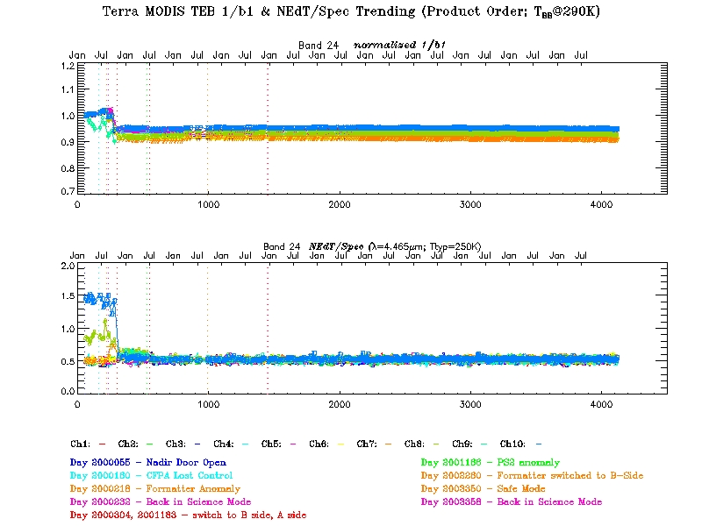
Page 28

Slide 29
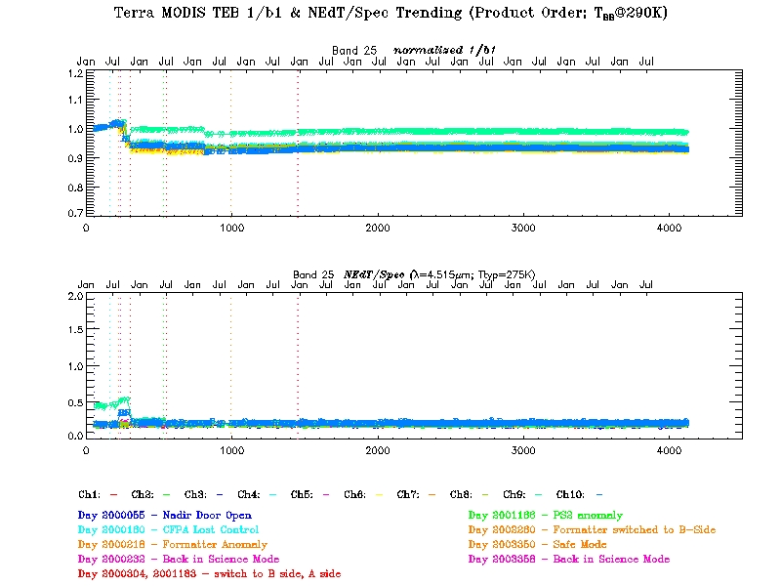
Page 29

Slide 30
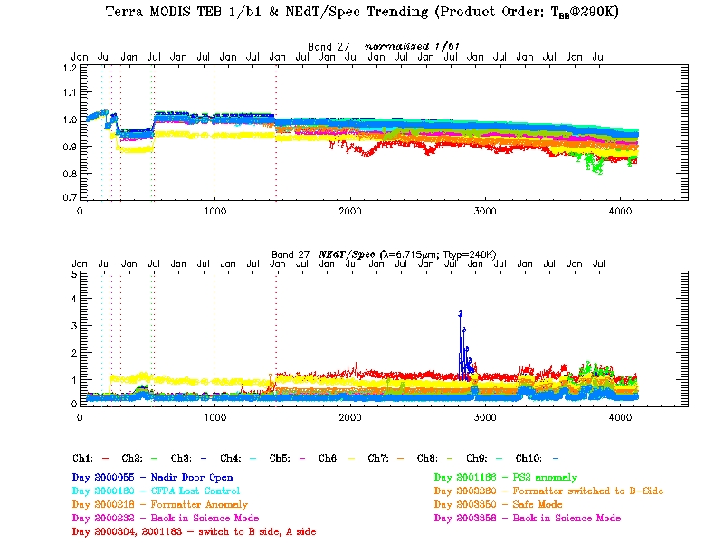
Page 30

Slide 31
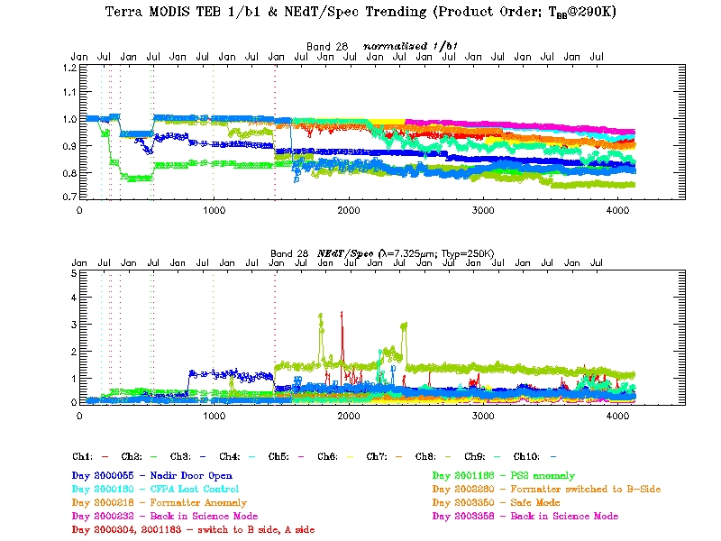
Page 31

Slide 32
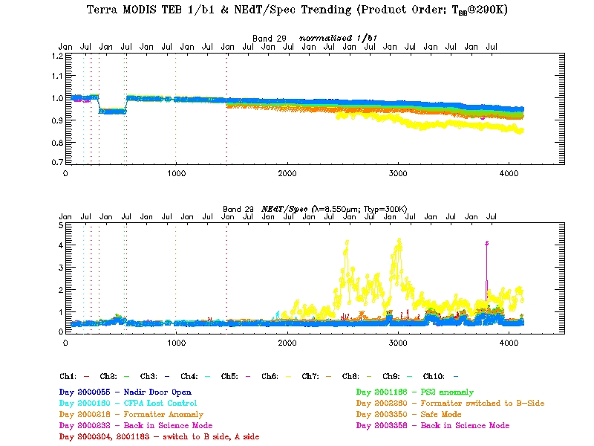
Page 32

Slide 33
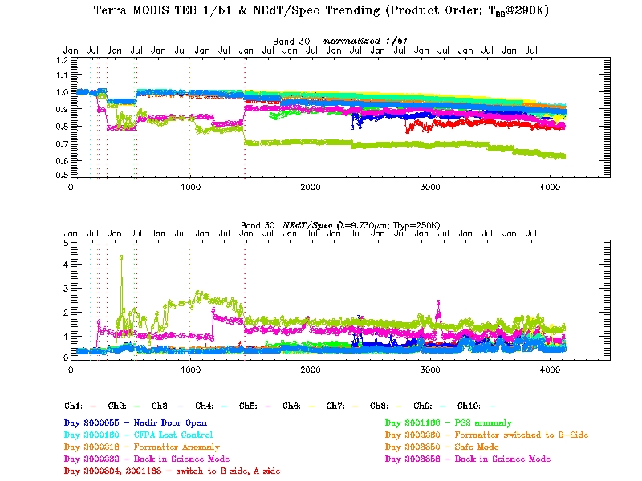
Page 33

Slide 34
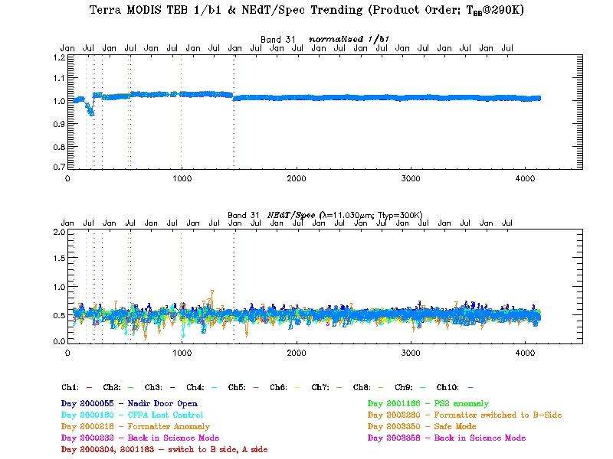
Page 34

Slide 35
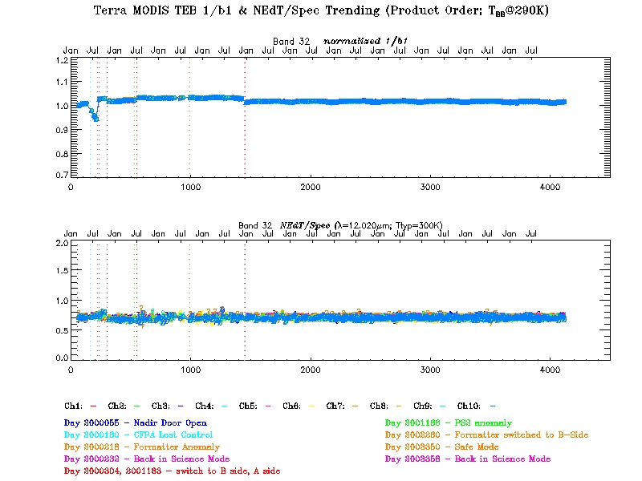
Page 35

Slide 36
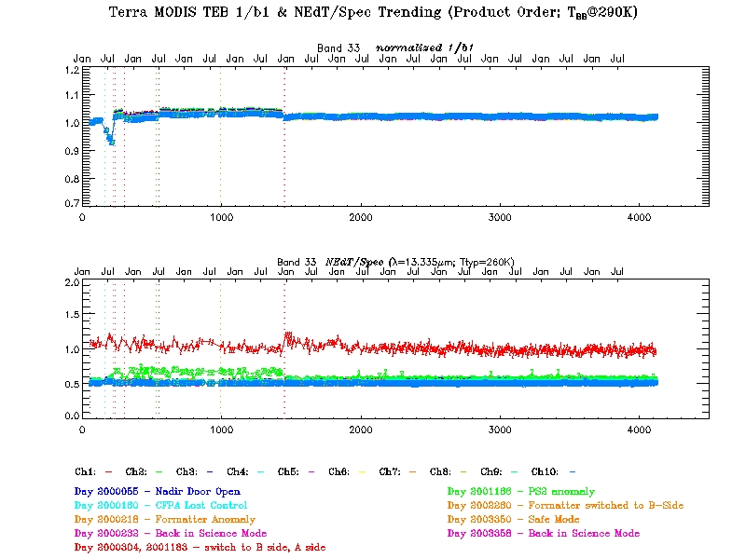
Page 36

Slide 37
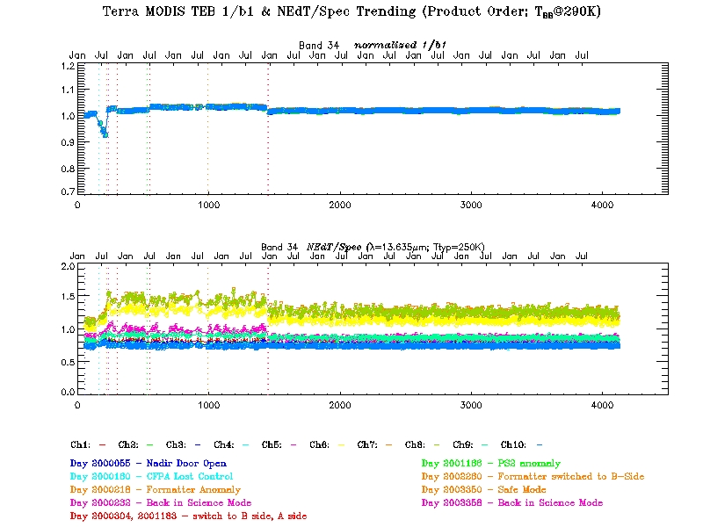
Page 37

Slide 38
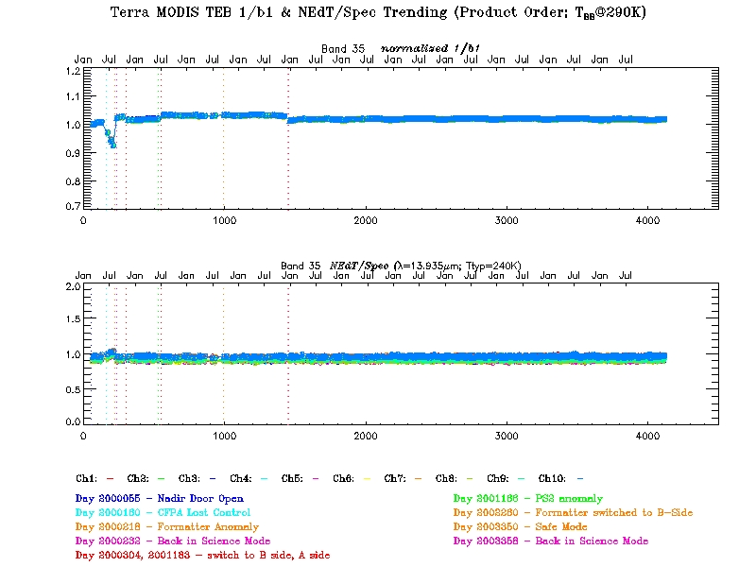
Page 38

Slide 39
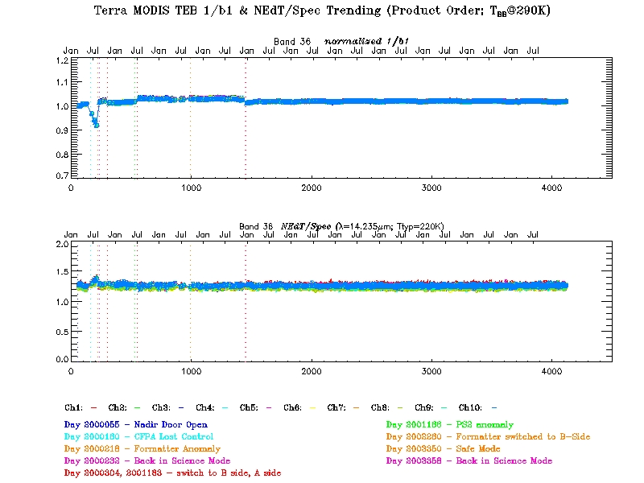
Page 39

Slide 40
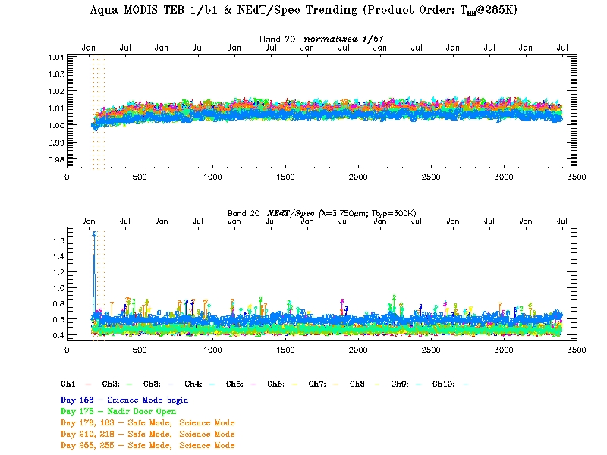
Page 40

Slide 41
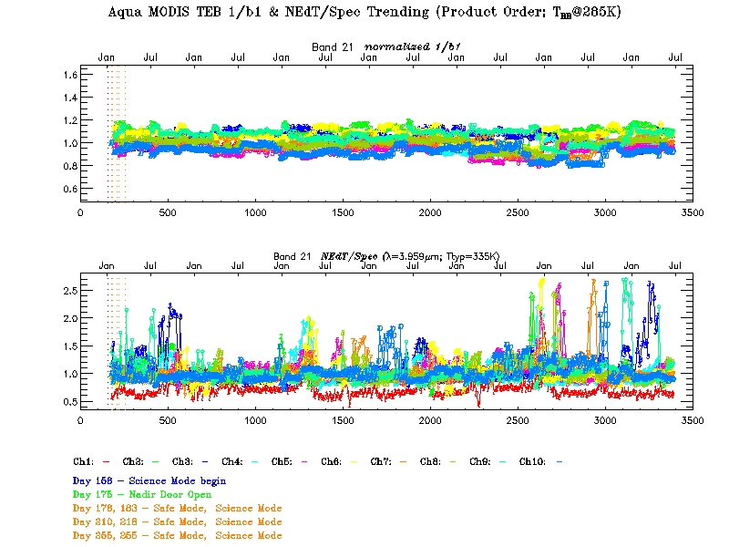
Page 41

Slide 42
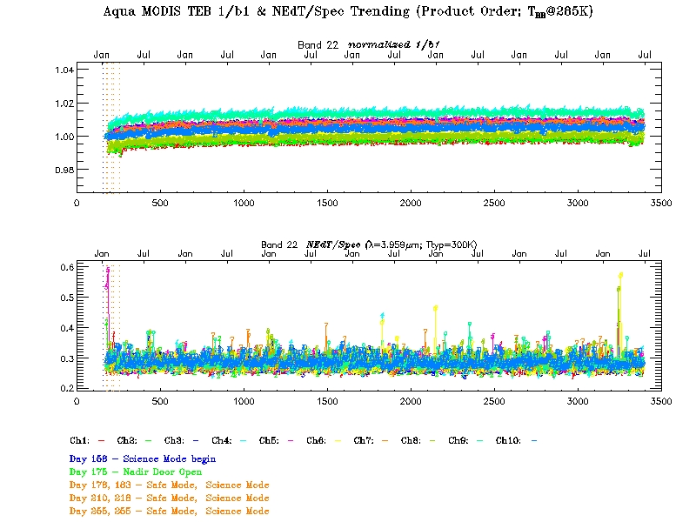
Page 42

Slide 43
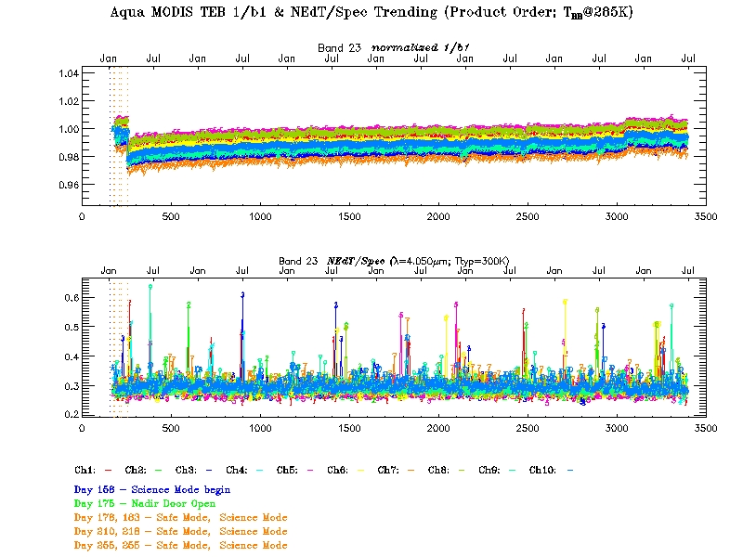
Page 43

Slide 44
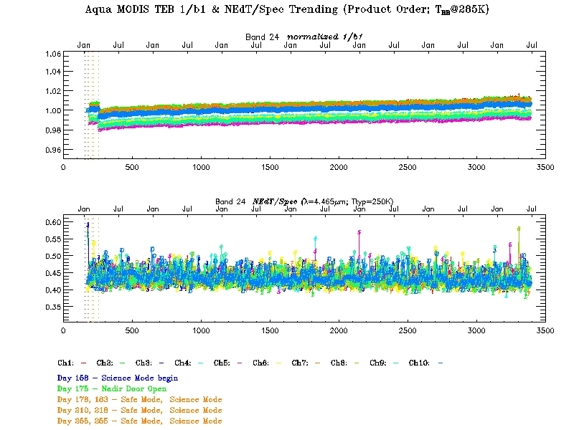
Page 44

Slide 45
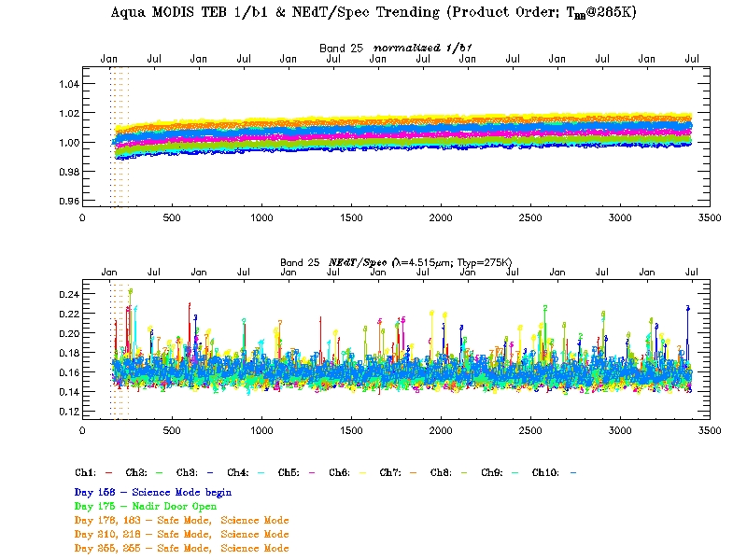
Page 45

Slide 46
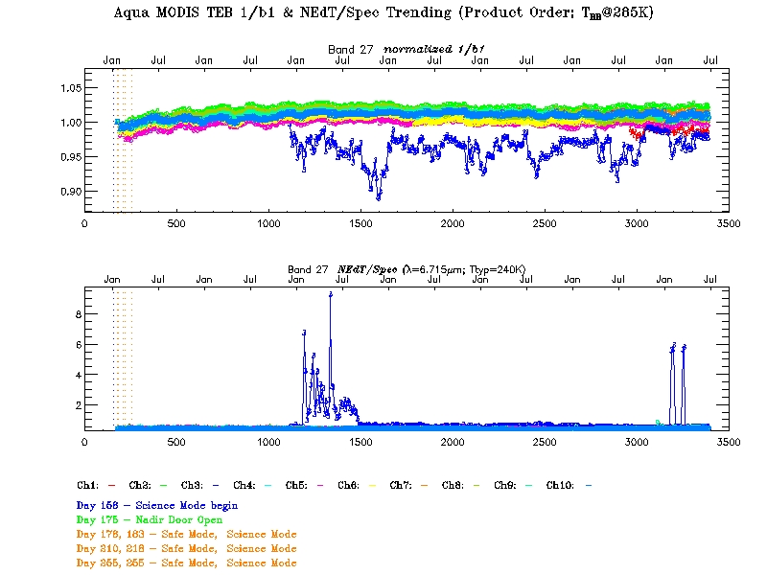
Page 46

Slide 47
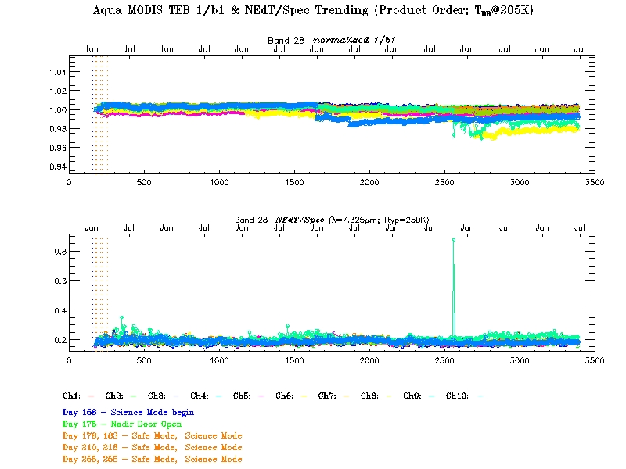
Page 47

Slide 48
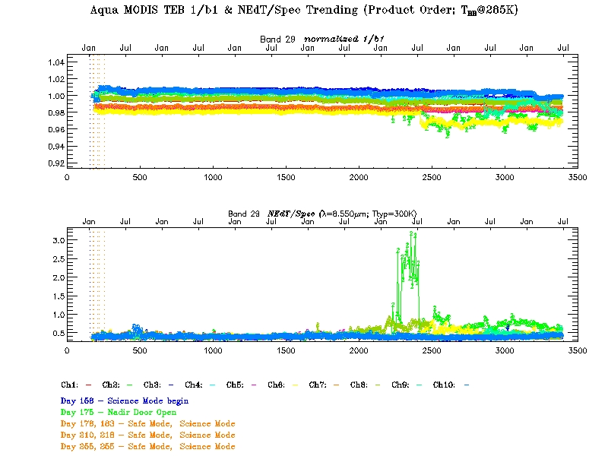
Page 48

Slide 49
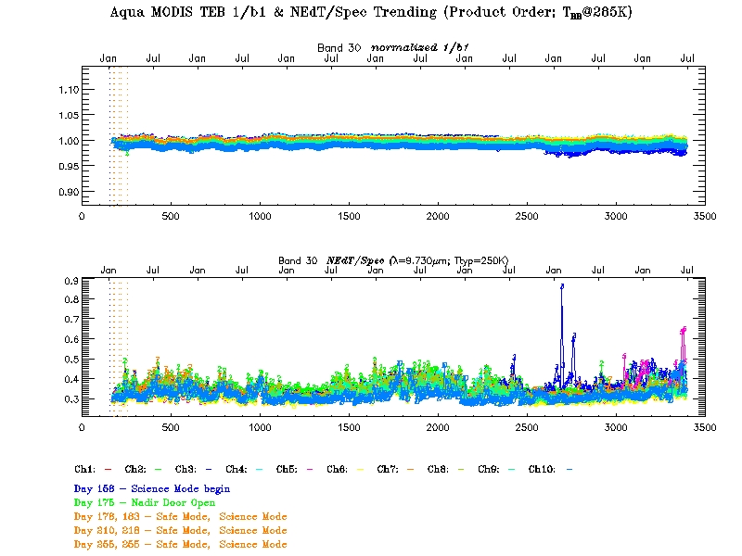
Page 49

Slide 50
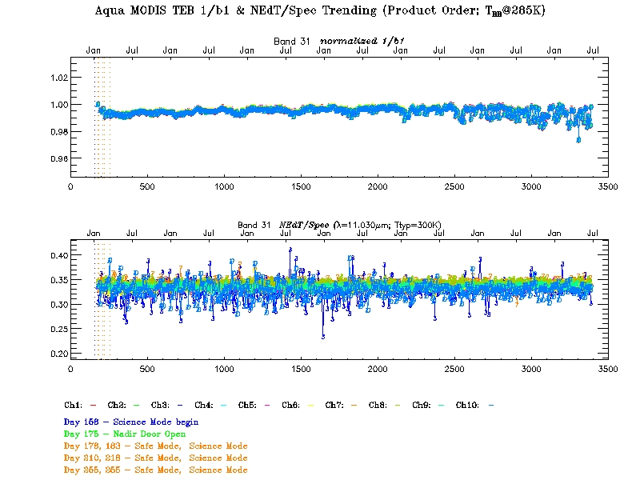
Page 50

Slide 51
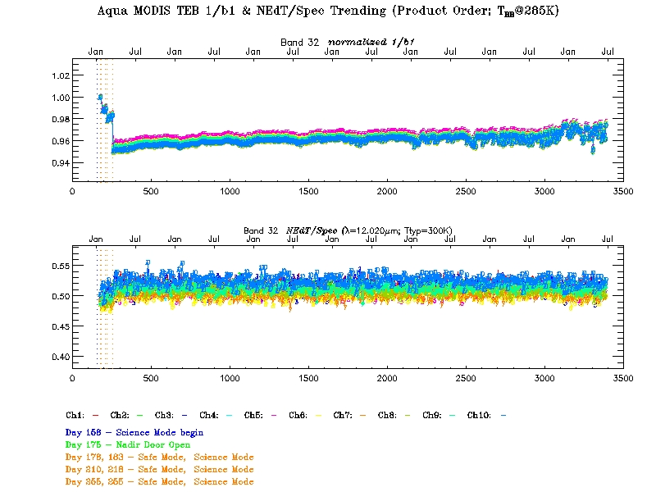
Page 51

Slide 52
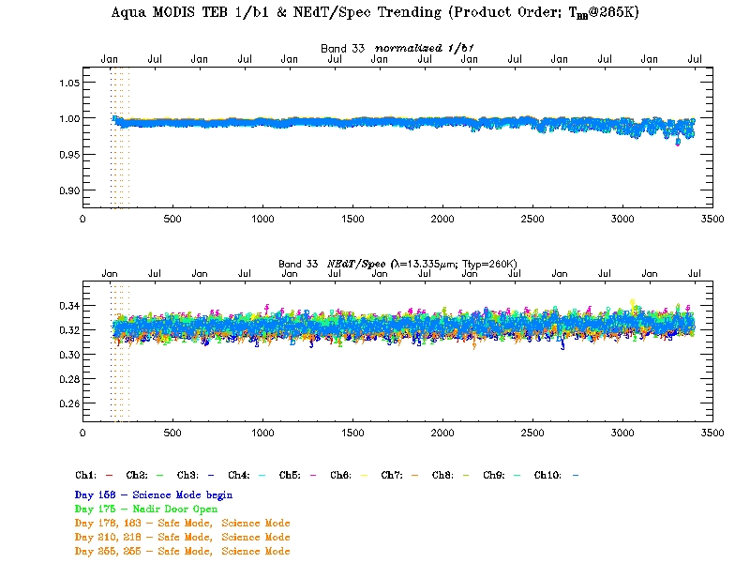
Page 52

Slide 53
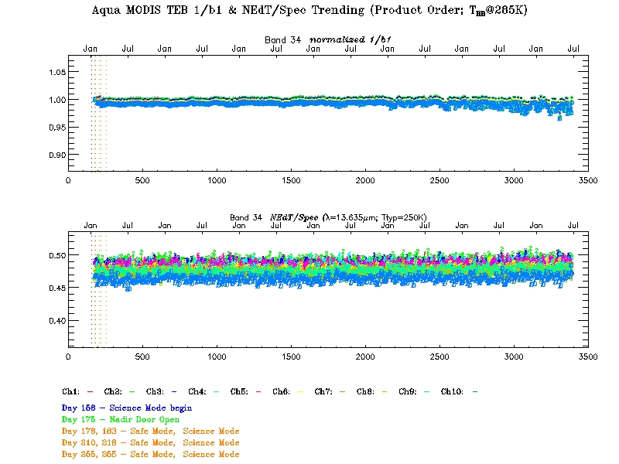
Page 53

Slide 54
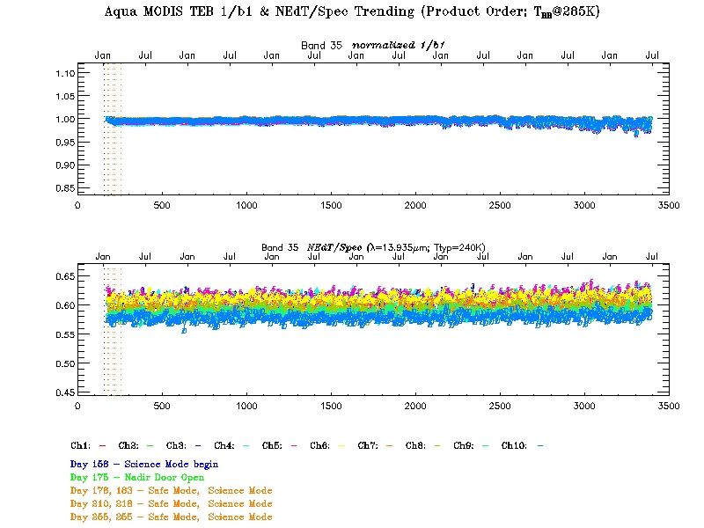
Page 54

Slide 55
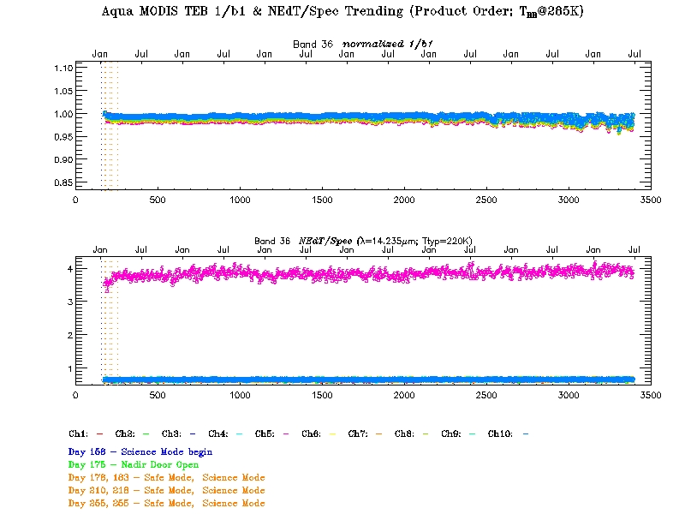
Page 55

Slide 56
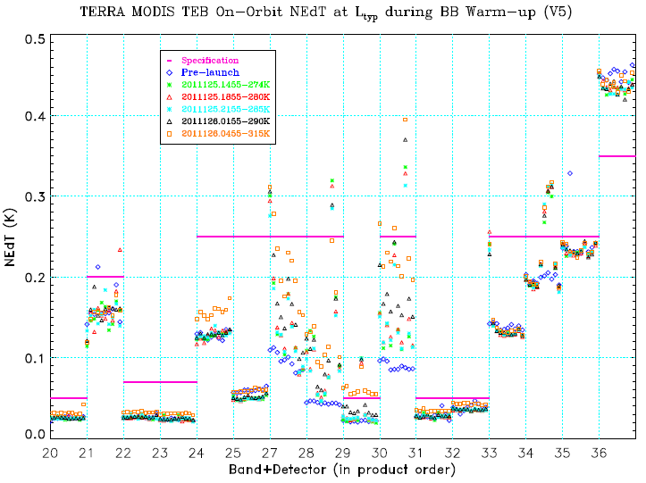
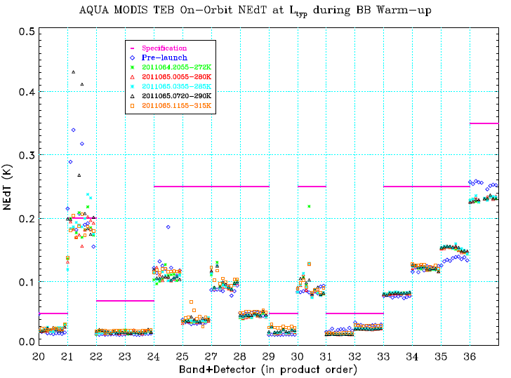
NEdT trending during BB WUCD
Page 56

Slide 57
Terra MODIS Noisy Detector History
Detectors in Product Order
Page 57

Slide 58
Aqua MODIS Noisy Detector History
Detectors in Product Order
Day/Year | Band | 20 | 21 |  |  | 27 | 29 |  | B36
 | Spec NEdT [K] | 0.05 | 0.20 |  |  | 0.25 | 0.05 |  | 0.35
 | Detector # | 10 | 3 | 9 | others | 3 | 2 | 8 | 5
Pre-launch | - | 0.05 | 0.16 | 0.28 | near 0.2 | 0.10 | 0.02 | 0.02 | 1.34
175/2002 | Nadir door open | 0.03 | 0.23 | 0.23 | near 0.2 | 0.09 | 0.02 | 0.02 | 1.28
183/2002 | Back from safe mode | 0.03 | 0.20 | 0.25 | near 0.2 | 0.09 | 0.02 | 0.02 | 1.31
218/2002 | Back from safe mode | 0.03 | 0.19 | 0.26 | near 0.2 | 0.09 | 0.02 | 0.02 | 1.32
255/2002 | Back from safe mode | 0.03 | 0.23 | 0.20 | near 0.2 | 0.09 | 0.02 | 0.02 | 1.36
102/2003 | - | 0.03 | 0.43 | 0.19 | near 0.2 | 0.09 | 0.02 | 0.02 | 1.31
201/2003 | - | 0.03 | 0.18 | 0.18 | near 0.2 | 0.09 | 0.02 | 0.02 | 1.29
010/2005 | - | 0.03 | 0.17 | 0.19 | near 0.2 | 0.23 | 0.02 | 0.02 | 1.35
359/2007 | - | 0.03 | 0.18 | 0.21 | near 0.2 | 0.13 | 0.02 | 0.05 | 1.34
038/2008 | - | 0.03 | 0.19 | 0.19 | near 0.2 | 0.14 | 0.05 | 0.05 | 1.34
Page 58

Slide 59
Spectral/Spatial
Backup Slides
MODIS Characterization Support Team (MCST)
MCST Workshop at MST Meeting (May 17, 2011)

Slide 60
Page 60
Notes:
Consider band 2. Prelaunch, on-orbit → design slit function. (future)
The system band width tolerance shall be +-0.5% of the corresponding center wavelength in the table.
The edge range shall not exceed 50% of the BW in any spectral bands.
Band 1 CW +- 5nm BW 25nm, band 19 CW+-1nm BW+- 25nm from ‘Specification for the MODIS-N(Nadir)’ OCT 5, 1990.

Slide 61
Page 61

Slide 62
Cold FPA
Cold FPA
Page 62

Slide 63
A known problem between bands on Cold FPA and bands on warm FPA
Cold FPA
Cold FPA
Page 63

Slide 64
Collection 6 QA
Backup Slides
MODIS Characterization Support Team (MCST)
MCST Workshop at MST Meeting (May 17, 2011)

Slide 65
QA C6 Improvements
Fill Values replace Interpolation in L1B for Inoperable Detectors
  Code change needed
Subframe level QA flags
  Code change needed
  New QA LUT

Slide 66
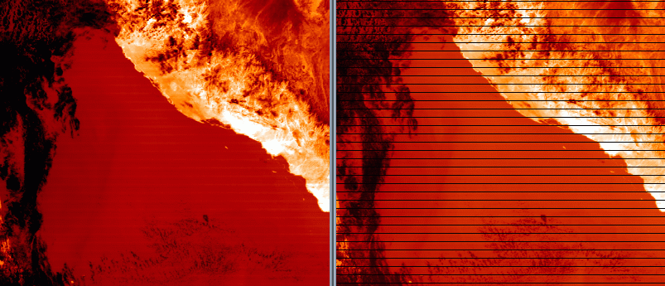
QA C6 LUT – Fill vs Interpolation
C5: Inoperable detectors filled with interpolated value from adjacent detectors
C6: Science Team request to have no interpolation, explicit fill value for inoperable detectors
Collection 5
Collection 6
Terra Band 29

Slide 67
QA C6 LUT – Subframe Flags
C5: QA flags only on detector level
C6: L1B code change implemented to allow QA flags at subframe level.
  New QA LUT
  Terra Band 2 Detectors 29 & 30 Subframe 1 flagged as ‘Noisy’ for V6 (known crosstalk issue)

Slide 68
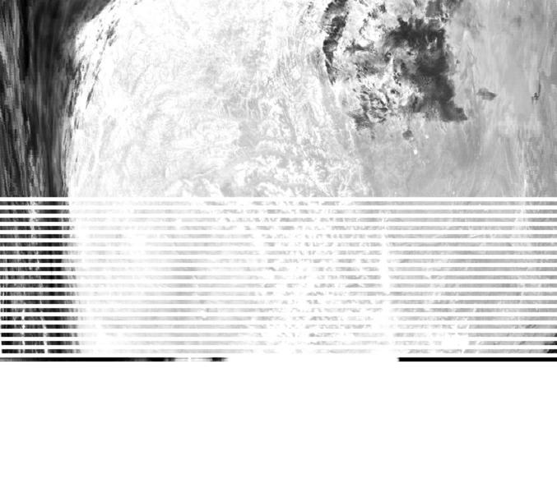
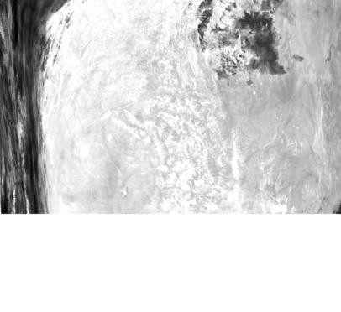
C6 L1B Code Change
Sector Rotation Timing Fix
  Anomaly in TEB data during certain sector rotation events (lunar calibrations)
Anomaly causes artificially high radiance band immediately before sector rotation
Collection 5
Collection 6
Plots courtesy of S. Devadiga

Slide 69
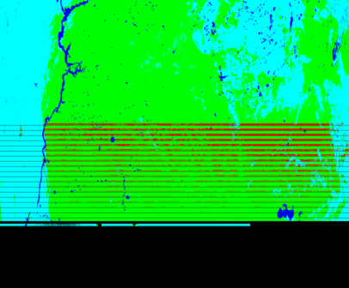
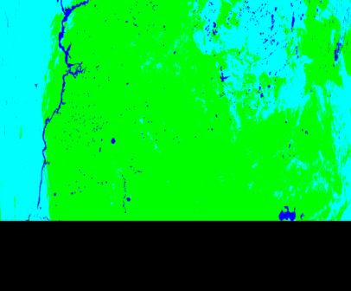
C6 L1B Code Change
Fire Granule MYD14.A2008343.2235
C5 Fire Product using C5 L1B
C5 Fire Product using C6 L1B
Plots courtesy of S. Devadiga

