Slide 1
From UV to fluorescence, a semi-analytical ocean color model for MODIS and beyond
Stéphane Maritorena & Dave Siegel
Earth Research Institute
University of California, Santa Barbara

Slide 2
Objective:
Add new or improved features to the GSM model
- Develop a fluorescence module
- Investigate and add a UV component
- Make the GSM model hyperspectral and adaptable to multispectral sensors like MODIS
- Develop a complete end-to-end error budget (inputs, model, outputs)
- Apply the model and error budget to the MODIS data

Slide 3
Expand GSM into the UV
412 nm channel in OC sensors is designed to detect CDOM.
Phytoplankton and CDOM absorption can be of similar magnitude around 412 nm
UV bands have the potential to better separate CDOM and phytoplankton absorption
No UV bands in MODIS or VIIRS. HyspIRI, ACE, GEO-CAPE
From Morrison & Nelson (2004)

Slide 4
GSM and UV – Preliminary results
Synthetic data set created from the SeaBAM
Inversion using GSM with and without the UV bands (a_{ph}(UV) coefficients from a small data set, spectral shape of CDM and b_{bp} expanded in the UV)
The CDM and CHL retrievals are generally better when the UV is used.
The use of the UV bands does seem to influence the BBP retrievals much.

Slide 5
GSM and UV – The Plan
Put together a large in situ data set with radiometry and IOPs in the UV
SeaBASS, U.S. CO2 CLIVAR Repeat Hydrography project, Bermuda Bio-optical Project (BBOP) and the Plumes & Blooms project.
QC the data set
Seasonality, MAA, photoprotection in a_{ph}(UV)
Tune GSM (350-650 nm ?)

Slide 6
GSM and Fluorescence
Preliminary tests using the Huot et al. (2005, 2007) model
Uses the strong relationship between fluorescence line height (FLH) and phytoplankton absorption in the blue.
In the ~620 to 710 nm range, reflectance is parameterized as a "classic", no-fluorescence, b_{b}(λ)/a(λ) term + a "fluorescence" term:
R(λ) = f(b_{b}(λ)/aλ)) + Rf(λ)
The fluorescence term is a function of a_{ph}(443), K_{d}(443), the attenuation of the fluorescence signal, kf(λ) and incident irradiance:
Rf = f(a_{ph}(443), K_{d}(443), kf(λ), E_{d}(λ))

Slide 7
Fluorescence model (Huot et al., 2007)
K_{d}(443) = (1+0.005 Θ_{s}) (a_{w}(443) + a_{CDM}(443) + a_{Φ}(443) + 4.18[1-0.52 exp(-10.8(a_{w}(443) + a_{CDM}(443) + a_{Φ}(443))] (b_{bw}(443)+b_{bp}(443))
a_{Φ}(443), b_{bp}(443), a_{cdm}(443): unknowns common with GSM
Original bands: 620, 665, 683 and 709 nm
M1, M2, M3: unknowns (M4 is a constant)

Slide 8
Preliminary results GSM w/ Fluorescence
Coastlooc data set
2 modes:
Full spectrum inversion (needs band weighting)
2 steps: 1) “Classic” GSM run for visible bands then 2) Run fluorescence module
Other data sets
Better Chls? Better aph? Quantum yield?
Notes:
Black: In situ spectrum Red: GSM without fluorescence bands Green: GSM w/ fluorescence

Slide 9
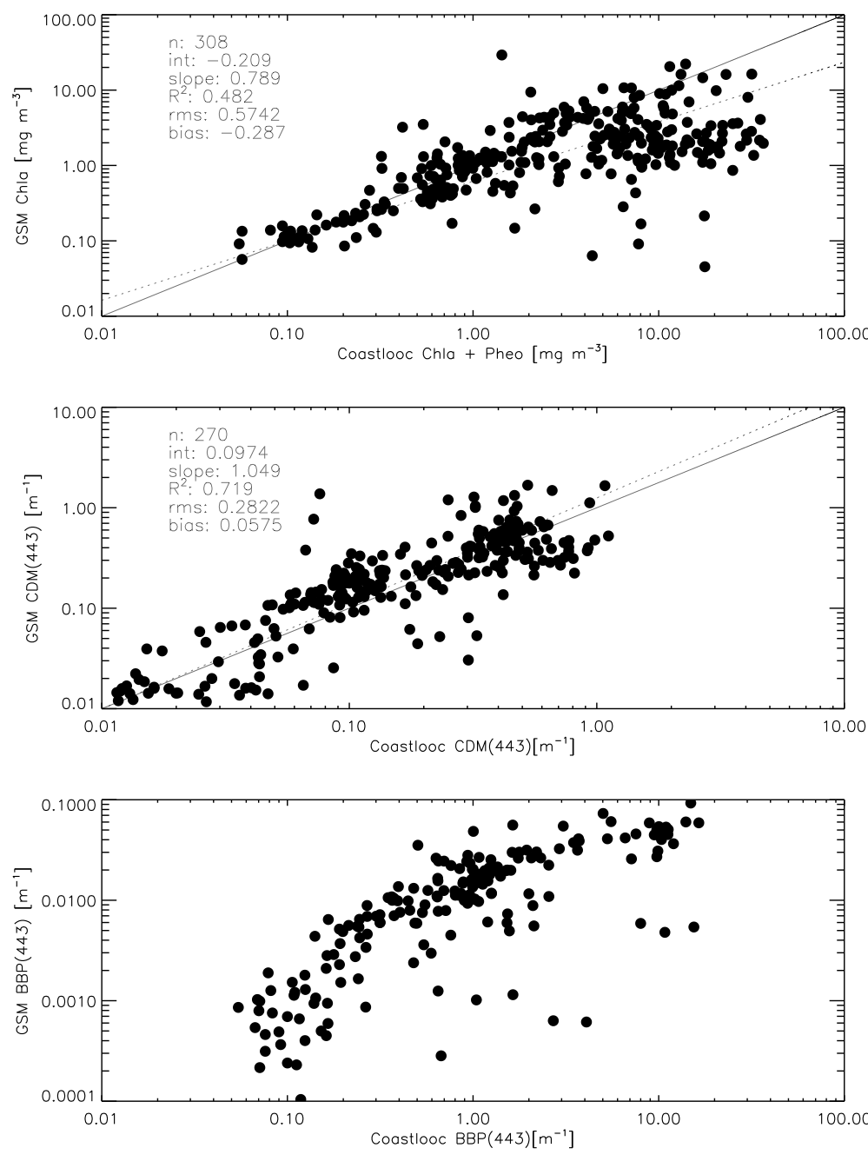
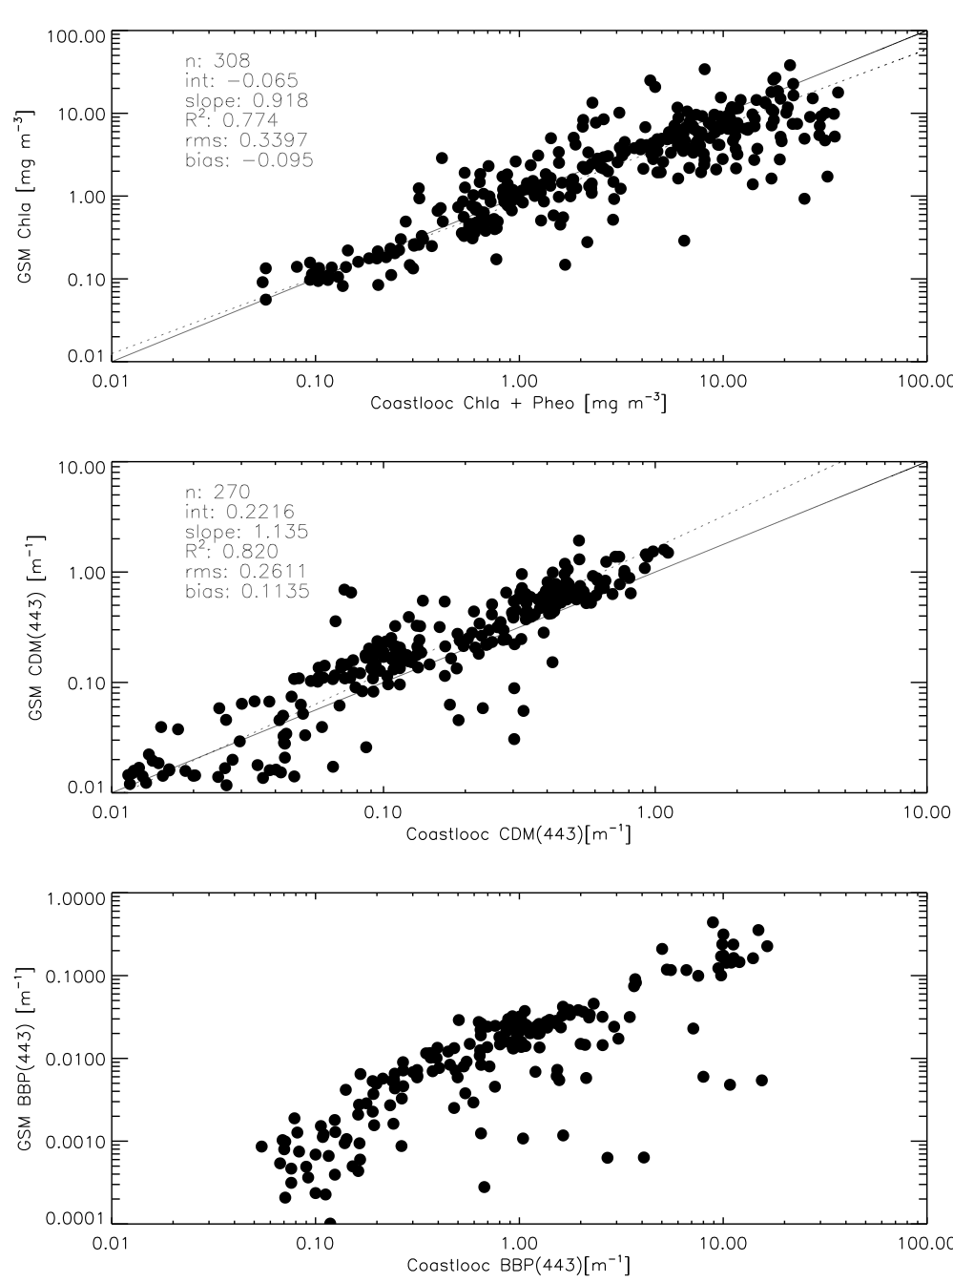
Flexible bands GSM
Original tuning was for SeaWiFS 6 visible bands
Parameters can be adapted for other bands
Adapt the future model so it can handle any wavelength
Original 5 bands version
All bands version

Slide 10
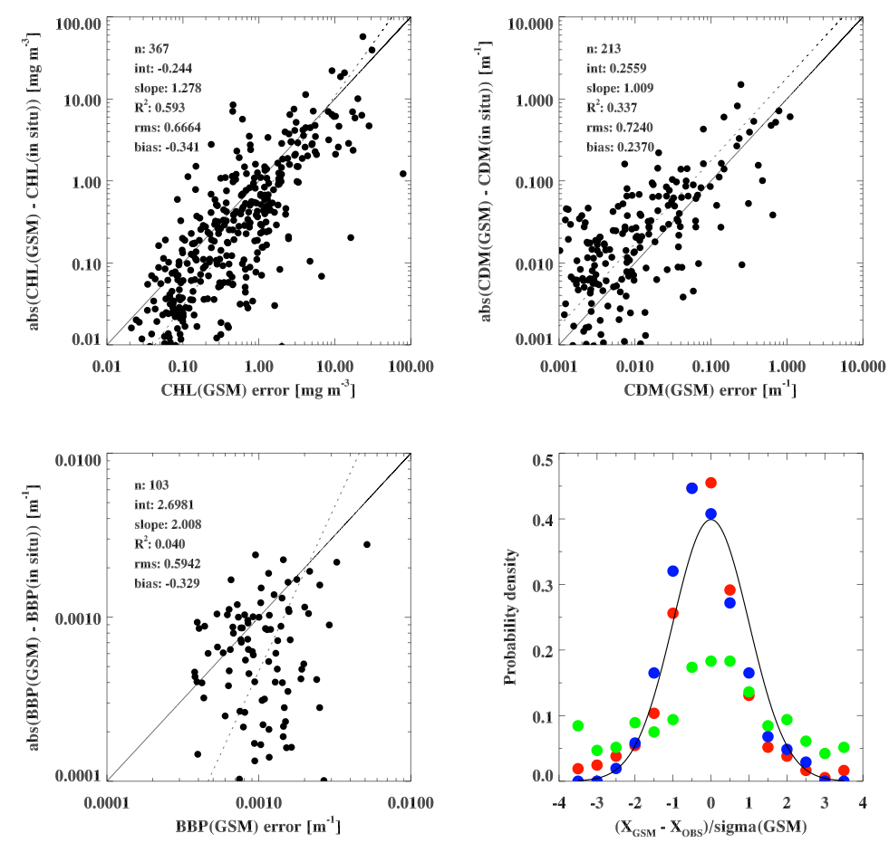
Error budget (input, model, output)
Maritorena et al. (2010)

Slide 11
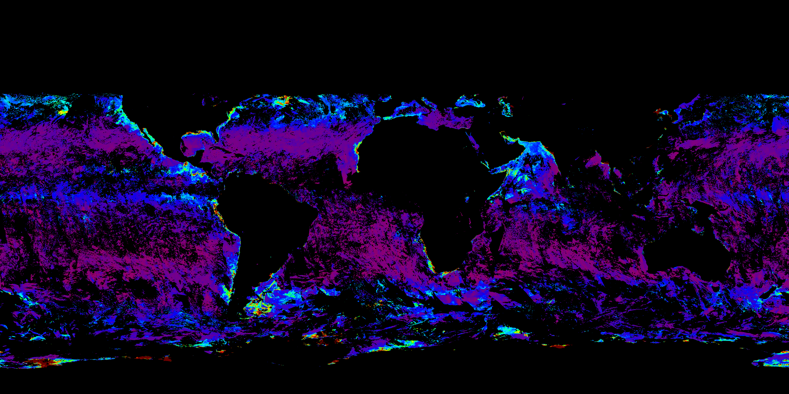
Apply the new model to MODIS data

Slide 12
Summary
Expand GSM in the UV
Add a Fluorescence module
Update parameterization in some components
Make the model “wavebands flexible”
Uncertainty budget
Apply to MODIS data

