Slide 1
Sea Surface Temperature algorithm refinement and validation though ship-based infrared spectroradiometry
Peter J Minnett
Meteorology and Physical Oceanography
Rosenstiel School of Marine and Atmospheric Science University of Miami

Slide 2
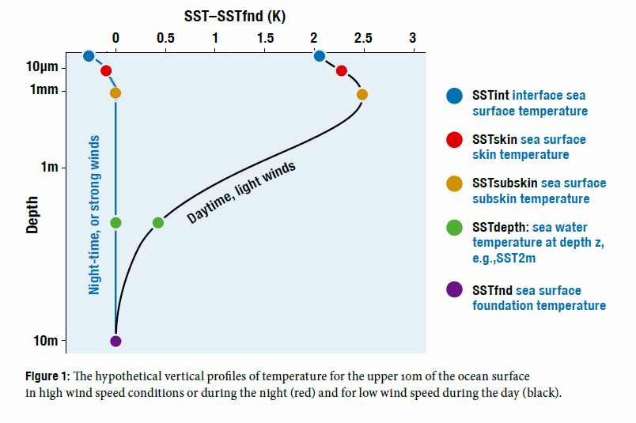
What is SST?
The infrared emission from the ocean originates from the uppermost <1mm of the ocean – the skin layer.
The atmosphere is in contact with the top of the skin layer.
Ocean-to-atmosphere heat flow through the skin layer is by molecular conduction: this causes, and results from, a temperature gradient through the skin layer.
Conventional measurements of SST are from submerged thermometers – a “bulk” temperature.
T_{depth} below the influence of diurnal heating is the “foundation” temperature.
From Eifler, W. and C. J. Donlon, 2001: Modeling the thermal surface signature of breaking waves. J. Geophys. Res., 106, 27,163-27,185.

Slide 3
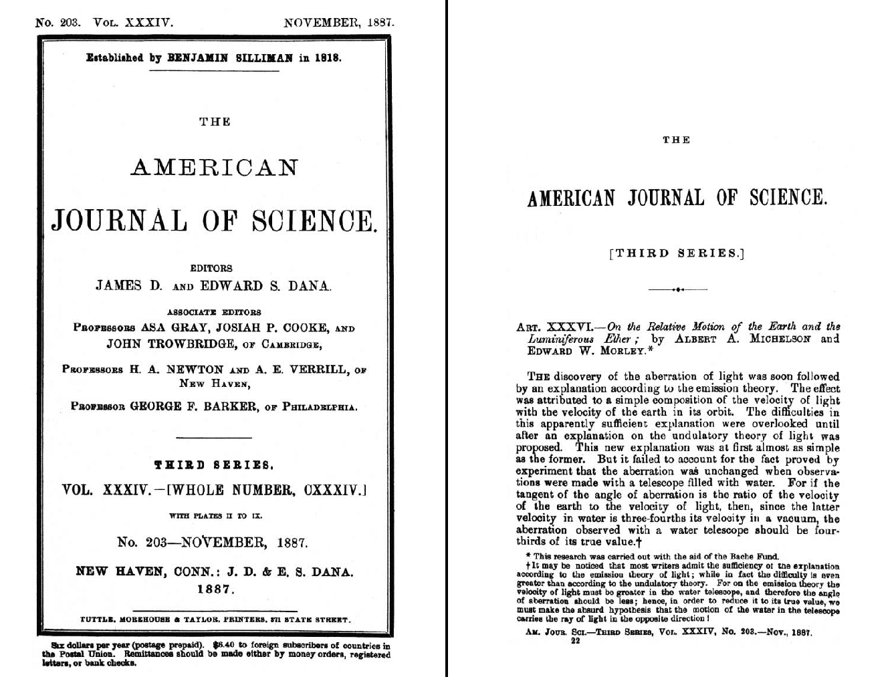
Marine-Atmospheric Emission Radiance Interferometer
The M-AERI is a Michelson-Morley Fourier-transform infrared (FTIR) interferometric spectroradiometer. These were first developed in the 1880’s to make accurate measurements of the speed of light. Here we use it to make very accurate measurements of the sea-surface temperature, air temperature and profiles of atmospheric temperature and humidity. We also measure surface emissivity and the temperature profile through the skin layer, which is related to the flow of heat from the ocean to the atmosphere.

Slide 4
Michelson interferometer

Slide 5
The innards…..

Slide 6
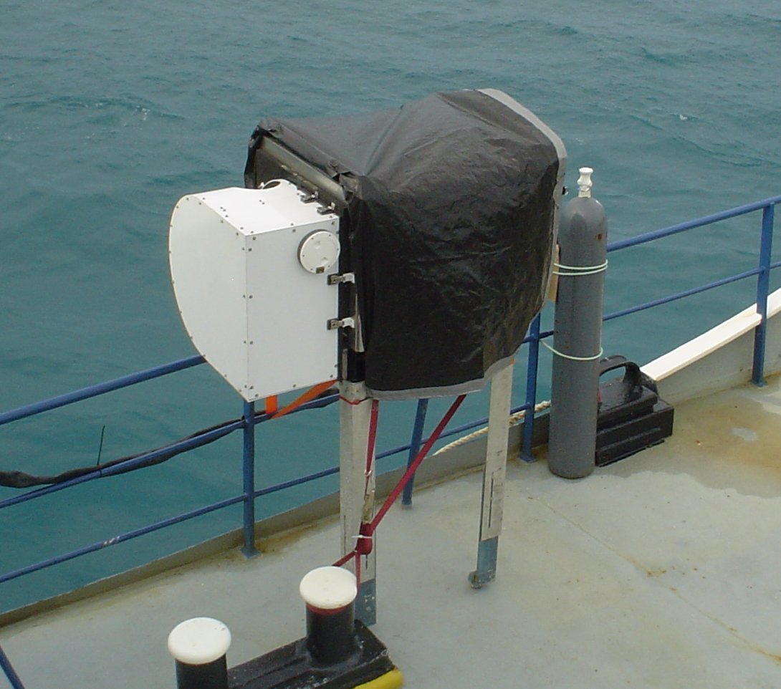
Marine - Atmospheric Emitted Radiance Interferometer. M-AERI
Oscillating yoke provides a robust infrared radiometer for shipboard deployments.
Visible laser used for wavelength calibration.
Two blackbodies used for radiometric calibration.

Slide 7
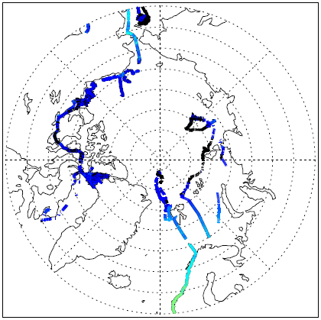
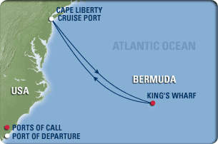
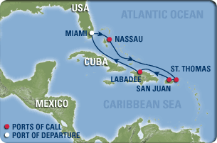
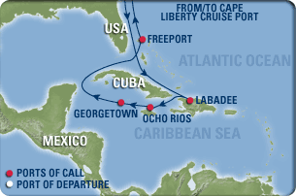
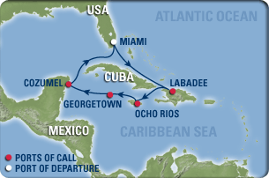
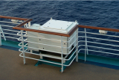
M-AERI cruises for MODIS, AATSR & AVHRR validation
Explorer of the Seas
Explorer of the Seas: near continuous operation December 2000 – December 2007. Restarted February 2010.

Slide 8
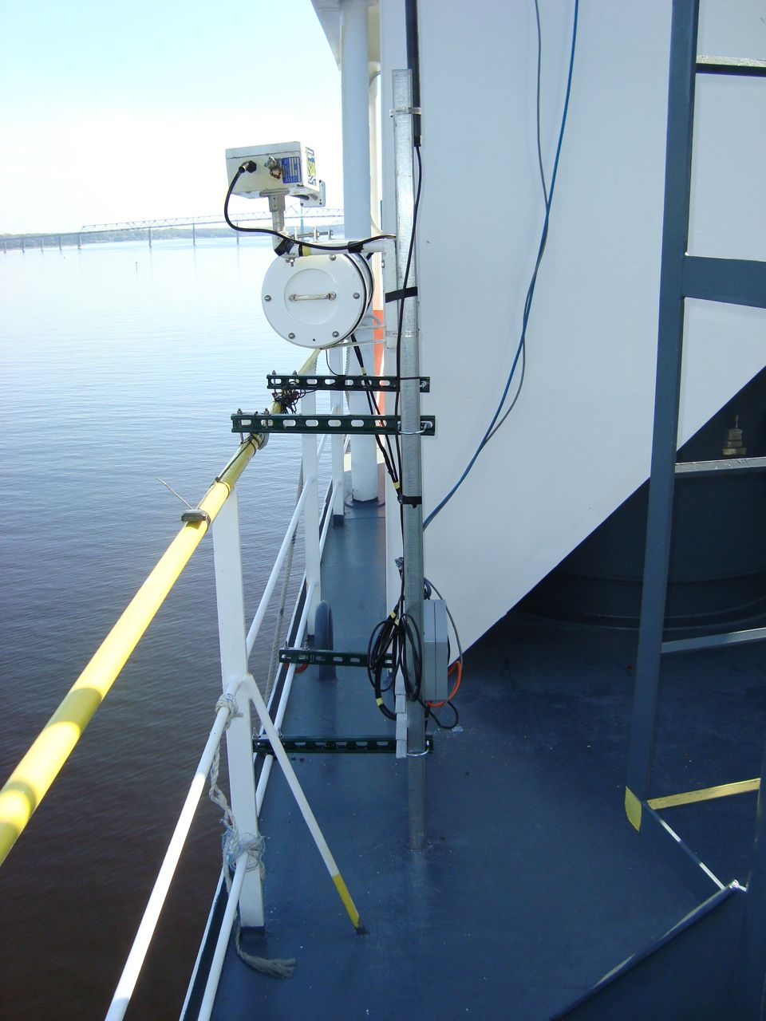
ISAR cruises for MODIS, AATSR & AVHRR validation

Slide 9
Measuring skin SST from ships
Scan-mirror mechanism for directing the field of view at complementary angles.
Excellent calibration for ambient temperature radiances.
Moderately good calibration at low radiances.

Slide 10
Sea surface emissivity (ɛ)
Conventional wisdom gave decreasing ε with increasing wind.
Not confirmed by at-sea hyperspectral measurements
Improved modeling confirms at-sea measurements.
Hanafin, J. A. and P. J. Minnett, 2005: Infrared-emissivity measurements of a wind-roughened sea surface. Applied Optics., 44, 398-411.
Nalli, N. R., P. J. Minnett, and P. van Delst, 2008: Emissivity and reflection model for calculating unpolarized isotropic water surface-leaving radiance in the infrared. I: Theoretical development and calculations. Applied Optics, 47, 3701-3721.
Nalli, N. R., P. J. Minnett, E. Maddy, W. W. McMillan, and M. D. Goldberg, 2008: Emissivity and reflection model for calculating unpolarized isotropic water surface-leaving radiance in the infrared. 2: Validation using Fourier transform spectrometers. Applied Optics, 47, 4649-4671.

Slide 11
Internal Calibration

Slide 12
NIST water-bath black-body calibration target
See: Fowler, J. B., 1995. A third generation water bath based blackbody source, J. Res. Natl. Inst. Stand. Technol., 100, 591-599

Slide 13
Traceability to NIST TXR

Slide 14
CDR of SST
Satellite-derived SSTs
NIST Traceable error statistics
M-AERI, ISAR…. measurements
Matchup analysis of collocated measurements
Laboratory calibration
NIST-designed water-bath blackbody calibrator
NIST-traceable thermometers
NIST TXR for radiometric characterization

Slide 15
Next-generation ship-based FTIR spectroradiometer
M-AERI Mk-2 undergoing tests at RSMAS.

Slide 16
Mk1 & Mk2

Slide 17
Sky emission measurements
Atmospheric emission from zenith
Radiance units
Measurements taken in Quebec City, February 24, 2011.
Wavenumber cm⁻¹

Slide 18
Comparison with LBLRTM simulations

Slide 19
Comparison with Arctic M-AERI measurements
M-AERI spectrum
from I/B Oden
M-AERI Mk 2 spectrum
from Quebec
M-AERI & M-AERI Mk 2 spectra
M-AERI Mk 2 & LBLRTM simulated spectra

Slide 20
M-AERI Cruise opportunities
Continue with Explorer of the Seas
Two additional RCCL cruise liners
NOAA Ship Ronald H Brown – Pirata moorings; July – August 2011
R/V Kilo Moana – Samoa to Hawaii; November 2011
Cunard Queen Victoria, Long Beach to Hawaii; February 2012 (tbc)
VIIRS validation ???

Slide 21
Ron Brown cruise 2011

Slide 22
Equation Discovery using Genetic Algorithms
Darwinian principles are applied to algorithms that “mutate” between successive generations
The algorithms are applied to large data bases of related physical variables to find robust relationships between them. Only the “fittest” algorithms survive to influence the next generation of algorithms.
Here we apply the technique to the MODIS matchup-data bases.
The survival criterion is the size of the RMSE of the SST retrievals when compared to buoy data.

Slide 23
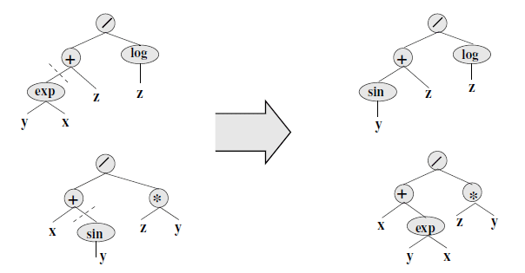
Successive generations of algorithms
The formulae are represented by tree structures; the “recombination” operator exchanges random subtrees in the parents. Here the parent formulae (y^{x}+z)/log(z) and (x+sin(y))/zy give rise to children formulae (sin(y)+z)/log(z) and (x+y^{x})/zy. The affected subtrees are indicated by dashed lines.
Subsets of the data set can be defined in any of the available parameter spaces.
(From Wickramaratna, K., M. Kubat, and P. Minnett, 2008: Discovering numeric laws, a case study: CO₂ fugacity in the ocean. Intelligent Data Analysis, 12, 379-391.)

Slide 24
Fittest Algorithm
The “fittest” algorithm takes the form:
where:
T_{i} is the brightness temperature at λ= i µm
θ_{s} is the satellite zenith angle
θ_{a} is the angle on the mirror (a feature of the MODIS paddle-wheel mirror design)
Which looks similar to the NLSST:

Slide 25
Variants of the new algorithms
Coefficients are different for each equation
Note: No T_{sfc}

Slide 28
Preliminary Results
The new algorithms with regions give smaller errors than NLSST or SST₄
T_{sfc} term no longer required
Night-time 4µm SSTs give smallest errors
Aqua SSTs are more accurate than Terra SSTs
Regression-tree induced in one year can be applied to other years without major increase in uncertainties
SVM results do not out-perform GA+Regression Tree algorithms

Slide 29
Next steps
Can some regions be merged without unacceptable increase in uncertainties?
180ºW should not necessarily always be a boundary of all adjacent regions.
Iterate back to GA for regions – different formulations may be more appropriate in different regions.
Allow scan-angle term to vary with different channel sets.
Introduce “regions” that are not simply geographical.
Suggestions?

Slide 30
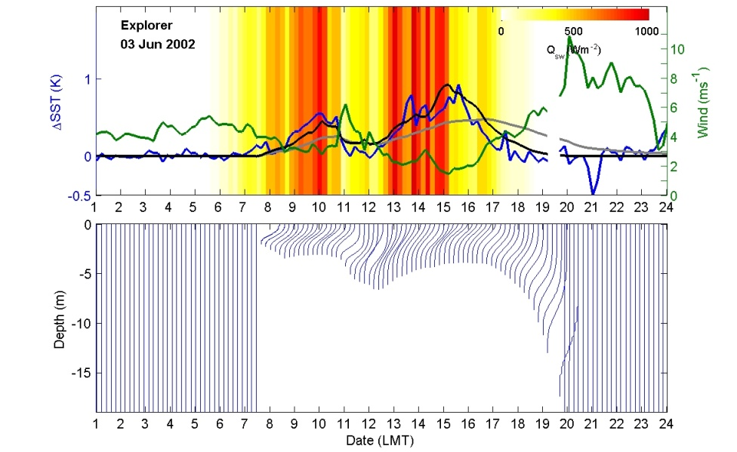
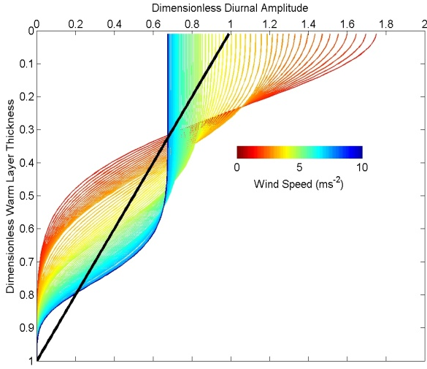
Modeling Diurnal Warming and Cooling
Prior models generally failed to raise temperatures sufficiently quickly, were not sufficiently responsive to changes in the wind speed, and retained too much heat into the evening and the night.
New diurnal model that links the advantages of bulk models (speed) with the vertical resolution provided by turbulent closure models.
Profiles of Surface Heating (POSH) model:
NonDim Heat Content
Surface forcing: (NWP or in situ)
+
NonDim Depth (z)
See Gentemann, C. L., P. J. Minnett, and B. Ward (2009). Profiles of Ocean Surface Heating (POSH): a new model of upper ocean diurnal thermal variability. Journal of Geophysical Research 114: C07017.
Notes:
Bulk models run quickly but do not provide upper ocean vertical structure. Turbulence closure models (such as Kantha/Clayson and others) run more slowly but provide information on the vertical structure of the diurnal warm layer. POSH runs like a bulk but through a non-dimensional empirical fit to heat content and diurnal warm layer depth, provides vertical structure. Extensive validation of model to MAERI skin measurements of diurnal warm layer and comparisons to satellite data.

Slide 31
Diurnal Heating in Shallow Water (Xiaofang Zhu)
How does the presence of the sea floor influence diurnal heating and cooling?
Can a 1-D model be used in a hydro-dynamically complex situation to simulate the diurnal signals?
Are satellite skin SSTs a good representation of the T_{depth} at the surface of coral reefs, for example?

Slide 32
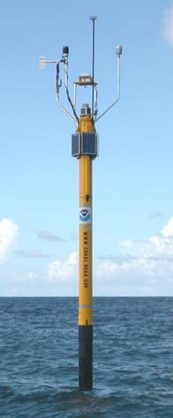
NOAA's Integrated Coral Observing Network (ICON) Pylon
Surface measurements include light (three band UV and PAR measurements), wind, air temperature, pressure, humidity and precipitation.
Underwater measurements include light and temperature (CTD) measurements at nominal 1m and 3m depth
Station water depths: about 6 meters
Data resolution
Nearby tidal station
http://ecoforecast.coral.noaa.gov/

Slide 33
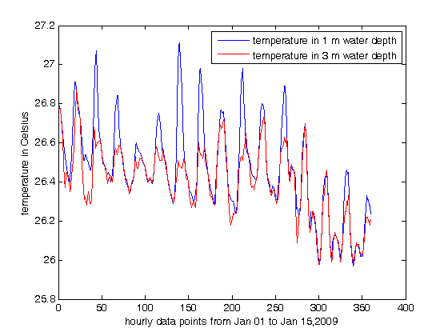
Diurnal temperature signals

Slide 34
Little Cayman Coral Reef Temperatures
Internally recording thermometers added to the ICON pylon to resolve vertical temperature structure.
Significant differences are measured:

Slide 35
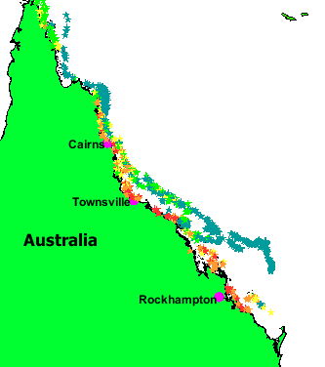
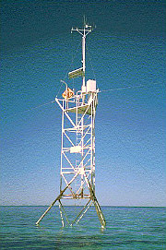
The Australian Great Barrier Reef.
This map shows the reef surveys that were conducted in response to the bleaching events. The red colors indicate where the bleaching was observed to be severe while the green shows low levels of bleaching. From http://www.reeffutures.org/topics/ toolbox/ webmaps.cfm#
Automatic weather stations will provide measurements of surface forcing for the model. E.g. at Davies Reef ~100km NE of Townsville, North Queensland. (http://www3.aims.gov.au/pages/facilities/weather-stations/weather-stations-images.html)

Slide 36
Temperature loggers on the GBR
Data are obtained from in-situ data loggers deployed on the reef.
Temperatures every 30 minutes and are exchanged and downloaded approximately every 12 months by divers.
Temperature loggers on the reef-flat are generally placed just below Lowest Astronomical Tide level.
Reef-slope (or where specified as Upper reef-slope) generally refers to depths 5 - 9 m while
Deep reef-slope refers to depths of ~20 m.

Slide 37
Diurnal heating signal on the GBR
Example of the large diurnal heating during the 2006 bleaching event in the Keppel Islands (Great Barrier Reef). In situ temperatures were measured at 6m depth during the peak of the bleaching that killed 35% of coral in this area.

Slide 38
Future
Continue MODIS (VIIRS?) validation cruises, including M-AERI Mk2
Continue research into CDR generation
Continue improving atmospheric correction algorithms
Continue research into upper ocean thermal structure (skin effect, diurnal heating….)

Slide 39
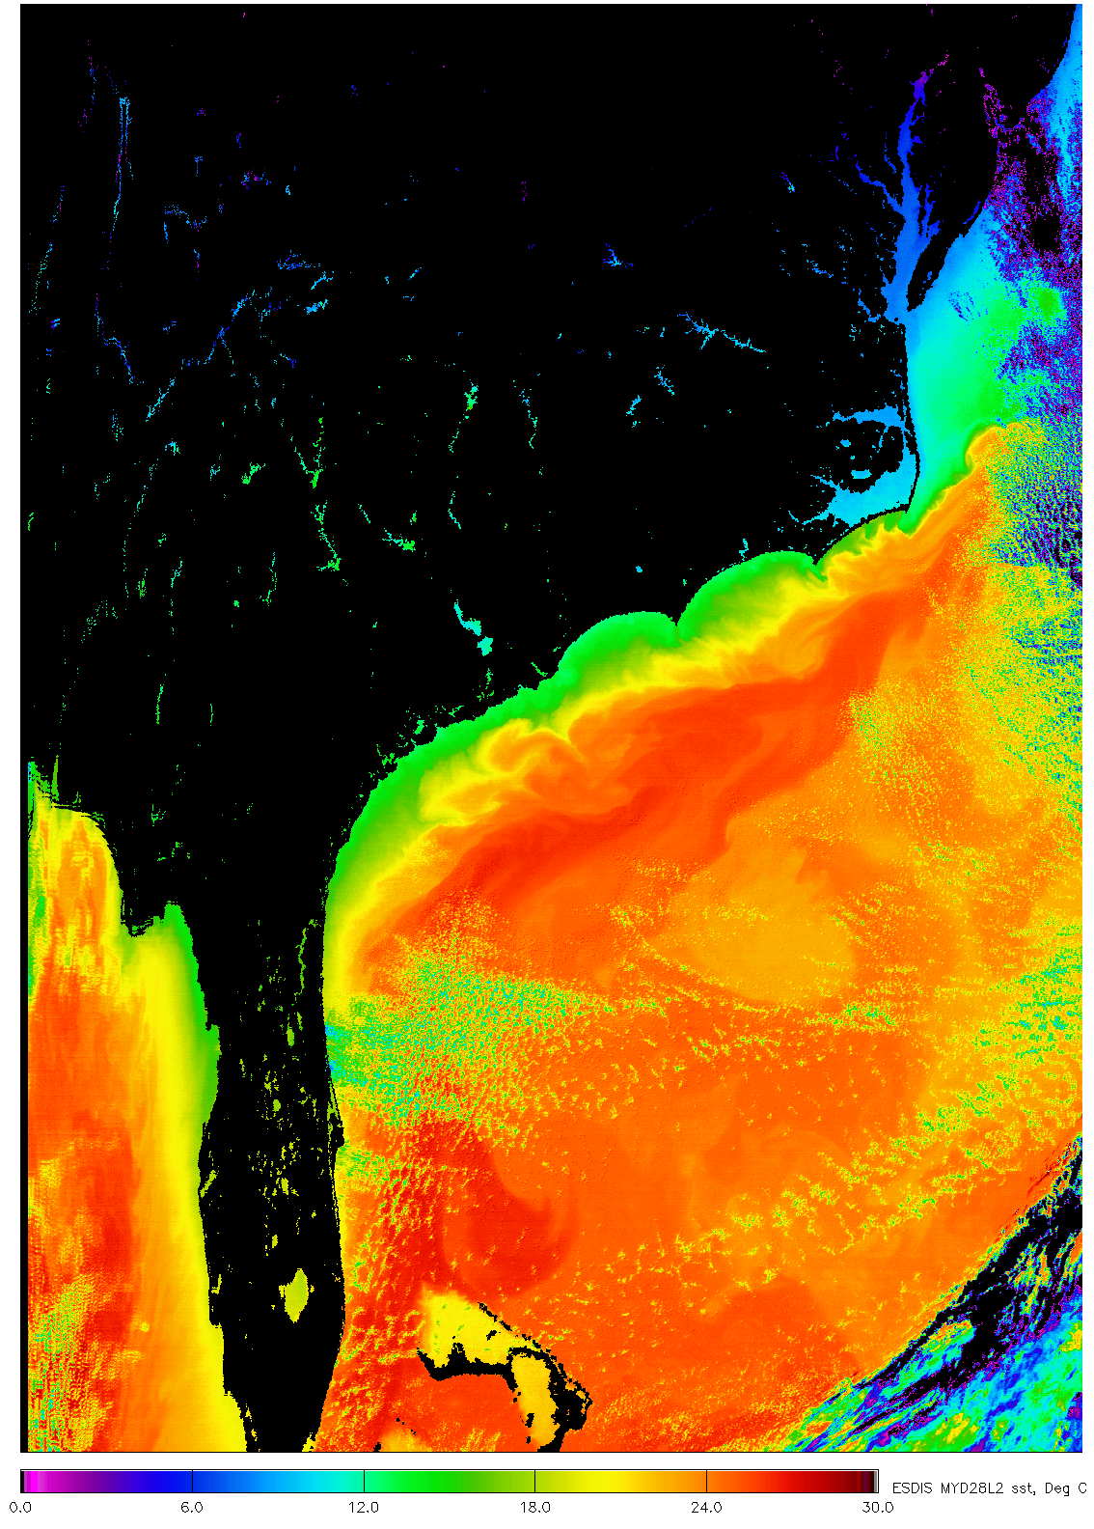
Aqua MODIS SST
Thank you for your attention.
Questions?

Slide 40
MODIS SST atmospheric correction algorithms
The form of the daytime and night-time algorithm for measurements in the long wave atmospheric window is:
SST = c₁ + c₂ * T₁₁ + c₃ * (T₁₁-T₁₂) * T_{sfc} + c₄ * (sec (θ) -1) * (T₁₁-T₁₂)
where T_{n} are brightness temperatures measured in the channels at n μm wavelength, T_{sfc} is a ‘climatological’ estimate of the SST in the area, and θ is the satellite zenith angle. This is based on the Non-Linear SST algorithm.
[Walton, C. C., W. G. Pichel, J. F. Sapper and D. A. May (1998). "The development and operational application of nonlinear algorithms for the measurement of sea surface temperatures with the NOAA polar-orbiting environmental satellites." Journal of Geophysical Research 103 27,999-28,012.]
The MODIS night-time algorithm, using two bands in the 4μm atmospheric window is:
SST4 = c₁ + c₂ * T_{3.9} + c₃ * (T_{3.9}-T_{4.0}) + c₄ * (sec (θ) - 1)
Note, the coefficients in each expression are different. They can be derived in three ways:
empirically by regression against SST values derived from another validated satellite instrument
empirically by regression against SST values derived surface measurements from ships and buoys
theoretically by numerical simulations of the infrared radiative transfer through the atmosphere.

Slide 41
Genetic Mutation of Equations
The initial population of formulae is created by a generator of random algebraic expressions from a predefined set of variables and operators. For example, the following operators can be used: {+, -, /, ×, √, exp, cos, sin, log}. To the random formulae thus obtained, we can include “seeds” based on published formulae, such as those already in use.
In the recombination step, the system randomly selects two parent formulae, chooses a random subtree in each of them, and swaps these subtrees.
The mutation of variables introduces the opportunity to introduce different variables into the formula. In the tree that defines a formula, the variable in a randomly selected leaf is replaced with another variable.

Slide 42
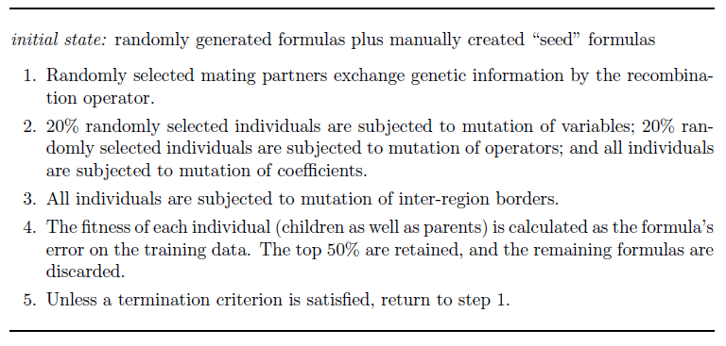
GA-based equation discovery

Slide 43
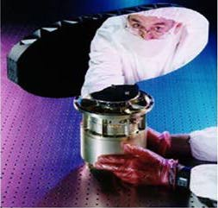
MODIS scan mirror effects
Mirror effects: two-sided paddle wheel has a multi-layer coating that renders the reflectivity in the infrared a function of wavelength, angle of incidence and mirror side.

Slide 44
Regression tree
Regions identified by the regression tree algorithm
The tree is constructed using
input variables: latitude and longitude
output variable: Error in retrieved SST
Algorithm recursively splits regions to minimize variance within them
The obtained tree is pruned to the smallest tree within one standard error of the minimum-cost subtree, provided a declared minimum number of points is exceeded in each region
Linear regression is applied separately to each resulting region (different coefficients result)

Slide 49
Regression tree performance
Terra 2004 SSTday
NLSST (no regions) – RMSE: 0.581
New formula (no regions) – RMSE: 0.615
New formula (with regions) – RMSE: 0.568
Terra 2004 SST4 (night)
SST4 (no regions) – RMSE: 0.528
New formula (no regions) – RMSE: 0.480
New formula (with regions) – RMSE: 0.456

Slide 50
Support Vector Machines (SVM)
Best accuracy observed when data set is large (lower accuracy when splitting into regions)
Terra 2004 SSTday –
RMSE (no region): 0.513, RMSE (with regions): 0.557
Problems:
Computational costs
Black-box approach

