Slide 1
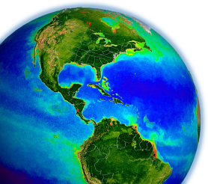
Summary of Ocean Break-out
Bryan Franz
and the
MODIS Ocean Science Team
MODIS Science Team Meeting
20 May 2011, College Park, MD

Slide 2
Senior Review Panel Question 6 for Terra:
“Provide statistics/data on product use: What is the use of each product (quantitative comparison) and what is the use of products from each instrument?”
Number of MODIS data granules distributed in 2010 by product type
Number of MODIS data users in 2010 for each product type

Slide 3
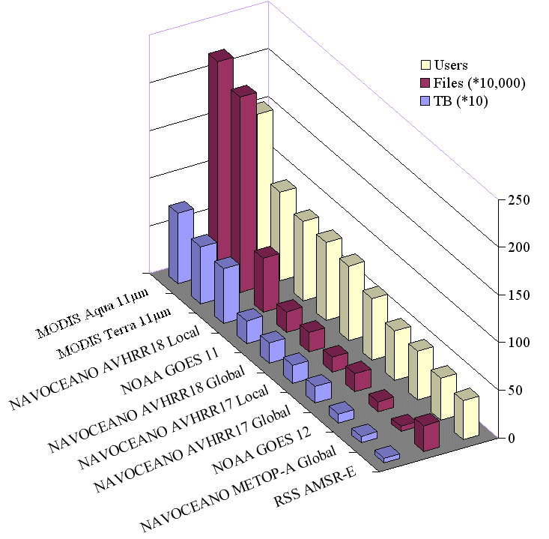
L2P SSTs from the JPL PO-DAAC
MODIS SSTs are the most requested L2P SST data sets at the NASA JPL PO-DAAC.
Data from Ed Armstrong

Slide 4
Ocean Science Team Members
MODIS
NPP/VIIRS
Barney Balch
Peter Cornillon
Heidi Sosik (Hui Feng)
Bryan Franz*
Watson Gregg
Antonio Mannino
Stephane Maritorena
Galen McKinley (Colleen Mouw)
Peter Minnett
Norm Nelson
Crystal Thomas
Toby Westberry
Barney Balch
Watson Gregg
Peter Minnett
Dave Siegel
Kevin Turpie*
Menghua Wang
Additional Speakers
Chuck McClain
Sam Ahmed
Fred Patt
Zia Ahmad
* Discipline Leads

Slide 5
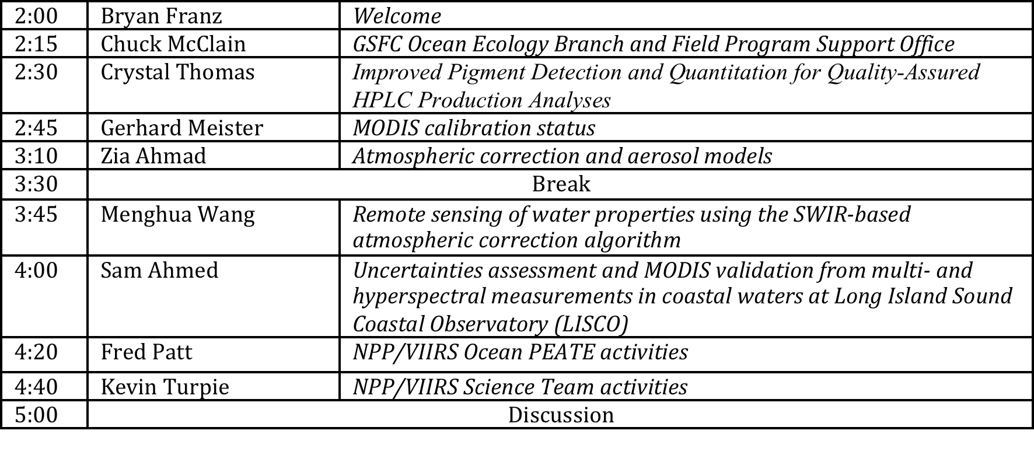
Ocean Break-out Agenda
May 18

Slide 6
Ocean Ecology Branch Organization
Ocean Biology Processing Group
Data Processing-
Distribution
SeaDAS
Aquarius
NPP Ocean PEATE
(Code 610.2)
Calibration &
Validation
SeaBASS
610.2: Global Change
Data Center
Field Support Group & HPLC Analysis Team
Ocean Carbon Research & Laboratory
Field & Satellite Sensor Development

Slide 7
NASA NPP SDS Level 1 Requirements
2.1.2.1 The SDS shall be designed with the assumption that the operational IPO IDPS generated NPP EDRs do not require reprocessing or re-computation in order to support climate research needs. Consequently, the SDS will not be designed to routinely generate climate data products which require long-term archival in the ADS.
2.1.2.3 In developing the SDS, the Project shall assume that EDRs produced by the IDPS are climate quality and put in place the capability to test that hypothesis in order to contribute to improving the quality of future EDRs. The SDS shall provide suggested algorithm improvements to the IDPS.
The SDS is NOT tasked to produce data products for distribution.
Fred Patt
Notes:
evaluation of EDRs only
in support of nasa viirs ocean science team

Slide 8
NASA VIIRS Ocean Science Team
▼ Evaluate sensor artifacts (e.g, crosstalk) and potential corrections based on
  Prelaunch: Characterization data and simulated data.
  Postlaunch: Flight data and in situ data, if available.
▶ Evaluate VIIRS RSB Rad Cal (solar, lunar, & vicarious).
▶ Process VIIRS flight data with NASA algorithms to compare against operational products.
▶ Sensor-to-sensor and self-consistency checks; will include in situ data, if available.
▶ Expect to produce a postlaunch quality report after one year.
RSB - Reflective Solar Bands
Rad Cal - Radiometric Calibration
Kevin Turpie

Slide 9
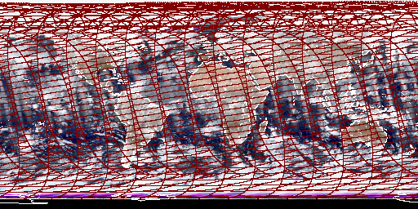
VIIRS DATA SIMULATOR
▶ The VIIRS Data Simulator was designed to provide the ocean team with a better fidelity product for evaluating instrument effects to EDR quality. Key features:
  Can generate global time series.
  Ability to include sensor response and artifacts.
  Helps to prepare team and infrastructure for postlaunch evaluation.
Quasi-true color browse image showing global production by the VIIRS Data Sim-ulator for one day.

Slide 10
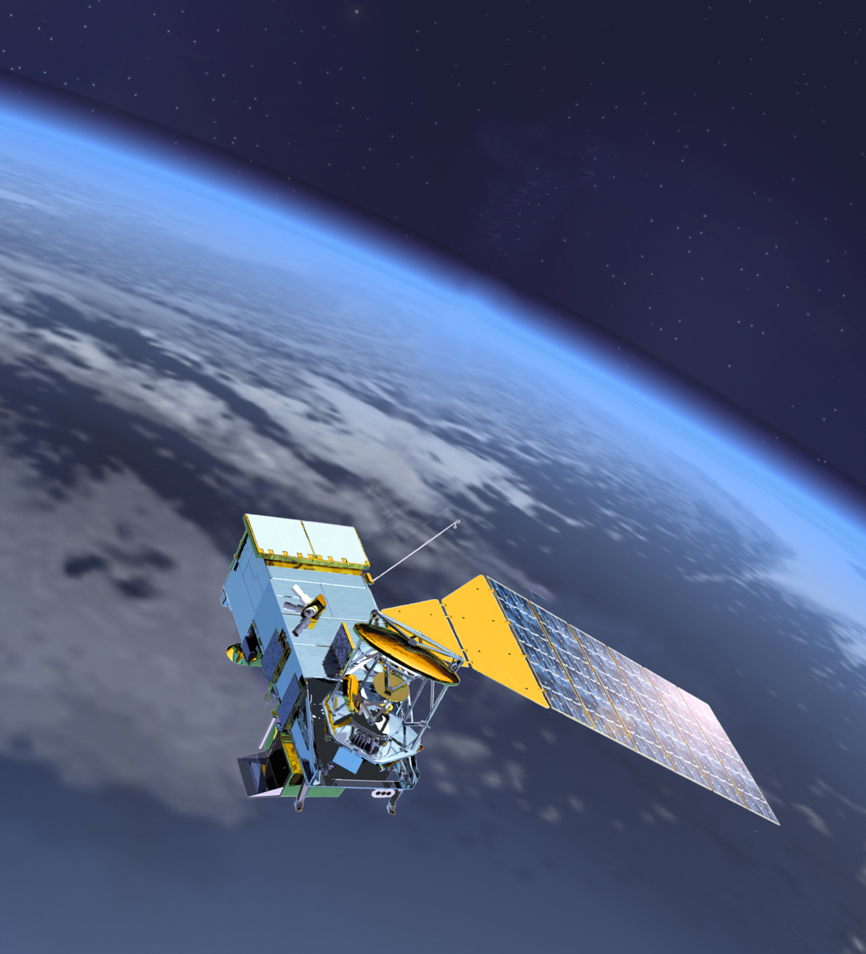
VIIRS DATA SIMULATOR
▶ Based on MODIS Aqua L3:
  L3 provides global surface fields.
  VIIRS viewing geometry, w/ aggregation and bow-tie deletion.
  l2gen atmospheric RT modeling provides TOA radiances.
  VIIRS response and artifacts applied (see below).
  Includes clouds and land radiances as well as ocean.
  NASA algorithms used to produce “L2” VIIRS products.
▶ Sensor artifacts currently included:
  Spectral effects of optical crosstalk.
  Spectral/spatial effects of electronic crosstalk.
  VIIRS RSR, w/ OOB.
  VIIRS polarization response.
  VIIRS RVS.
▶ Artifacts to be included shortly:
  Noise (VIIRS SNR)
  Stray light (NFR)

Slide 11
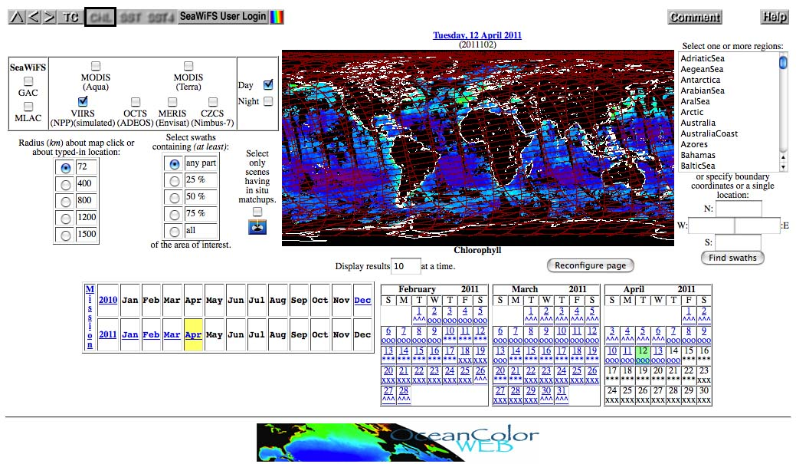
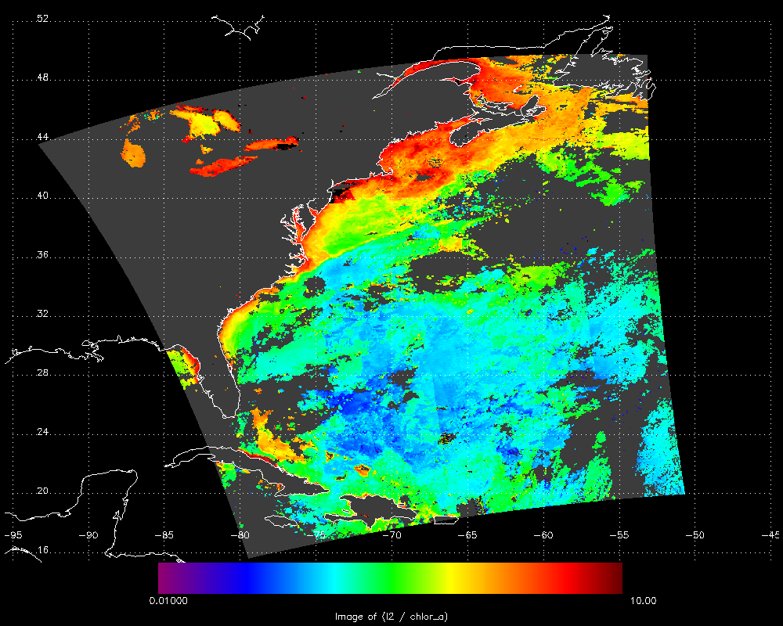
VIIRS DATA SIMULATOR
VIIRS OC Derived Chl a
▶ L1, L2, & L3 simulated data will be available to science team members via restricted access to the oceancolor website. (L3 pending testing)
▶ Not operational yet, pending discussion with NPP Science Team members.

Slide 12
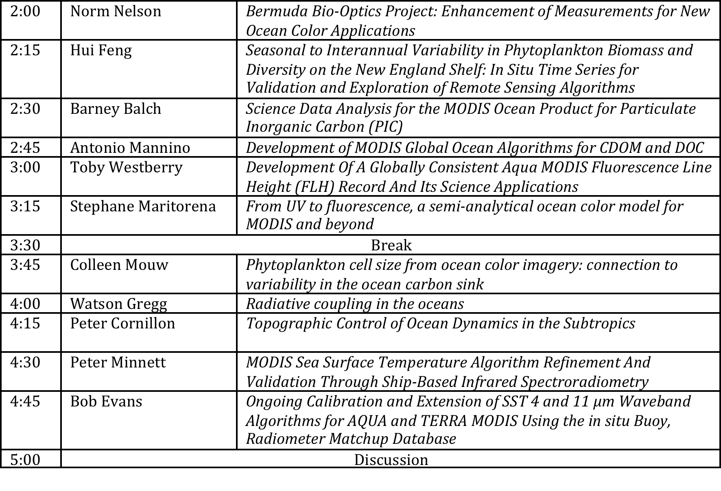
Ocean Break-out Agenda
May 19
Notes:
opportunity to get to know the new team
algorithm maintenance, new product development, validation, modeling, and fundamental research
which is a lot for 12 accepted proposals

Slide 13
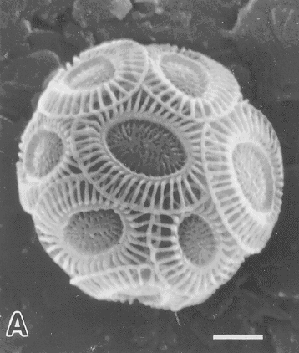
Merged 2-band/3-band algorithm for Particulate Inorganic Carbon
(suspended calcium carbonate)
The NASA PIC algorithm has broadened our spatial view of truly global PIC phenomena
e.g. The “Great Calcite Belt”
This high PIC feature has been validated
It covers 20% of global ocean
The NASA PIC algorithm has broadened our temporal view of global PIC
e.g. Global patterns of PIC standing stock
e.g. Will be important for evaluating global impacts of ocean acidification
Barney Balch
Notes:
reason for tracking PIC is that the calcification process is effected by ocean acidification

Slide 14
Expanded MODIS Product Suite
OLD
NEW
nLw(λ)
Chlorophyll a
K_{d}(490)
Ångstrom
AOT
Epsilon
R_{rs}(λ)
Chlorophyll a
K_{d}(490)
Ångstrom
AOT
POC
PIC
CDOM_index
PAR
iPAR
FLH
R_{rs}(412)
R_{rs}(443)
R_{rs}(469)
R_{rs}(488)
R_{rs}(531)
R_{rs}(547)
R_{rs}(555)
R_{rs}(645)
R_{rs}(667)
R_{rs}(678)
land bands
revised band center

Slide 15
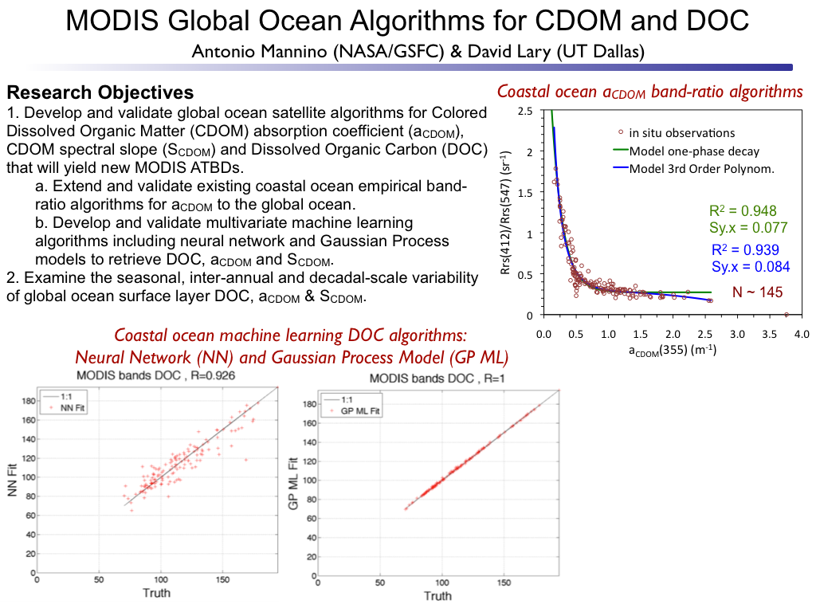
Antonio Mannino

Slide 16
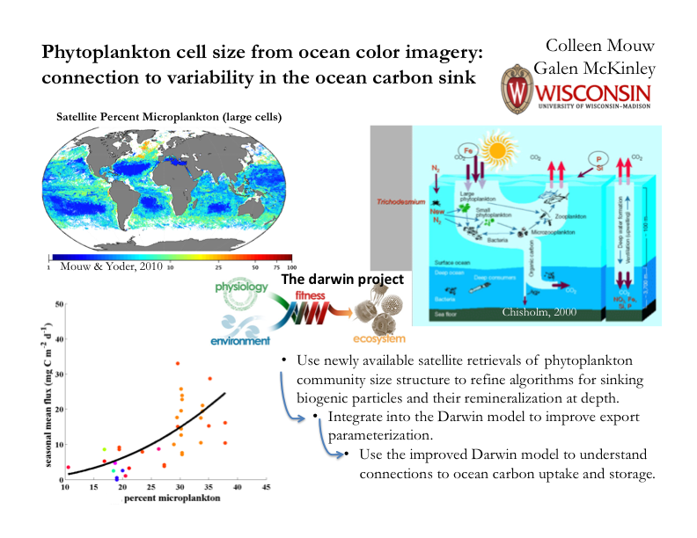
2000
Colleen Mouw
Notes:
evaluate effect of size changes on ocean carbon uptake through modeling
long-term interest in impact of climate change on species change

Slide 17
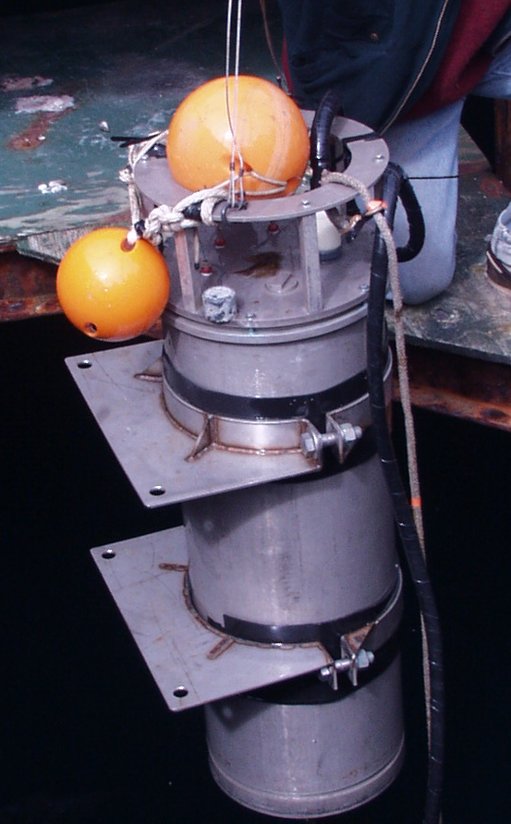
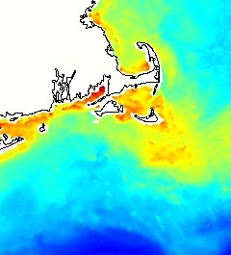

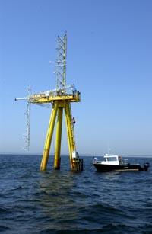


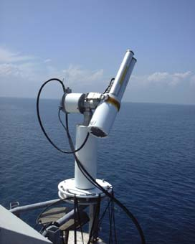
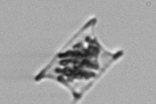


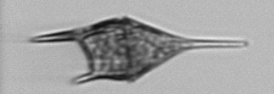
Phytoplankton Biomass and Diversity on the New England Shelf:
In Situ Time Series for Validation and Exploration of Remote Sensing Algorithms
PI: Heidi M. Sosik, Woods Hole Oceanographic Institution
Co-I: Hui Feng, University of New Hampshire
Goal: Use unique time series to evaluate algorithms that extend MODIS ocean color data beyond chlorophyll to functional group or size-class-dependent phytoplankton retrievals
Approach: End-to-end time series observations, with step by step algorithm evaluation and error analysis
single cells → phytoplankton community → bulk water optical properties → sea surface optical properties (air and water) → MODIS optical properties
Martha’s Vineyard Coastal Observatory
Tower mounted
AERONET-OC
Submersible Imaging
Flow Cytometry
MODIS products

Slide 18
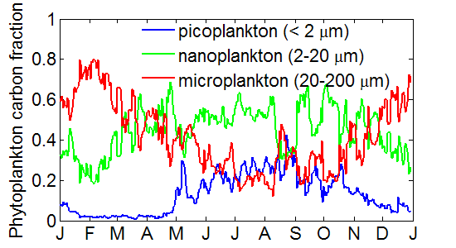
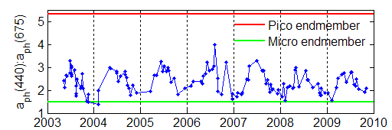
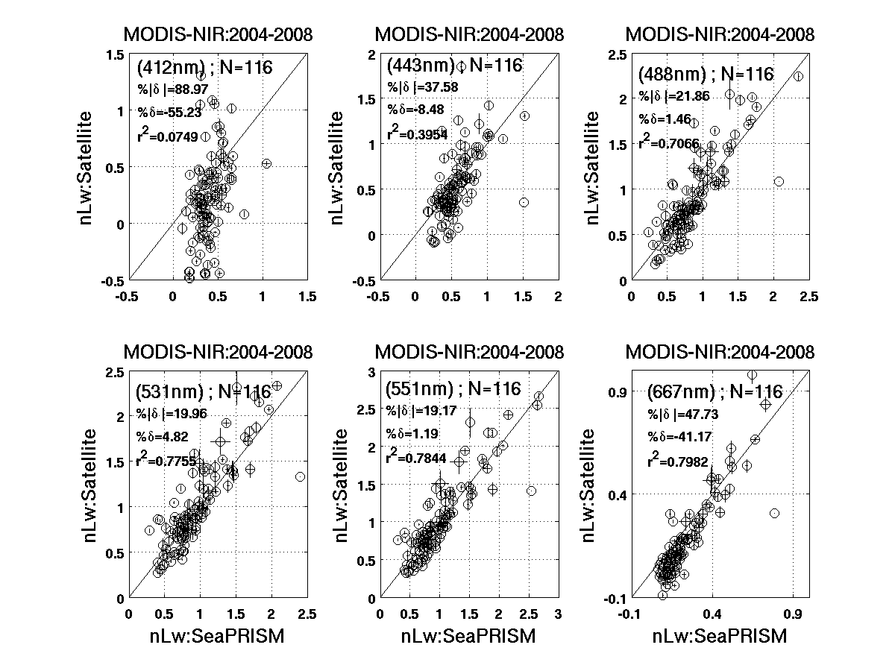
The study site presents important Opportunities and Challenges
Predictable seasonal switch in phytoplankton dominance
  large diatoms in winter
  small cells in summer
Phytoplankton community changes impact bulk optical properties ( (discrete samples)
  Seasonality strong
  Interannual variability also evident
MODIS products influenced by atmospheric correction and other potential issues
  Well-known for northeast US waters
  Unique dataset to evaluate new approaches
nLw: MODIS
nLw: AERONET-OC
Notes:
a) Climatological seasonality in phytoplankton size classes at MVCO from high temporal resolution in situ flow cytometry. Carbon budgets are determined by summing contributions of individual cells.
b) Phytoplankton absorption (a_{ph}) properties at MVCO from analysis of discrete samples collected during the MODIS era.

Slide 19
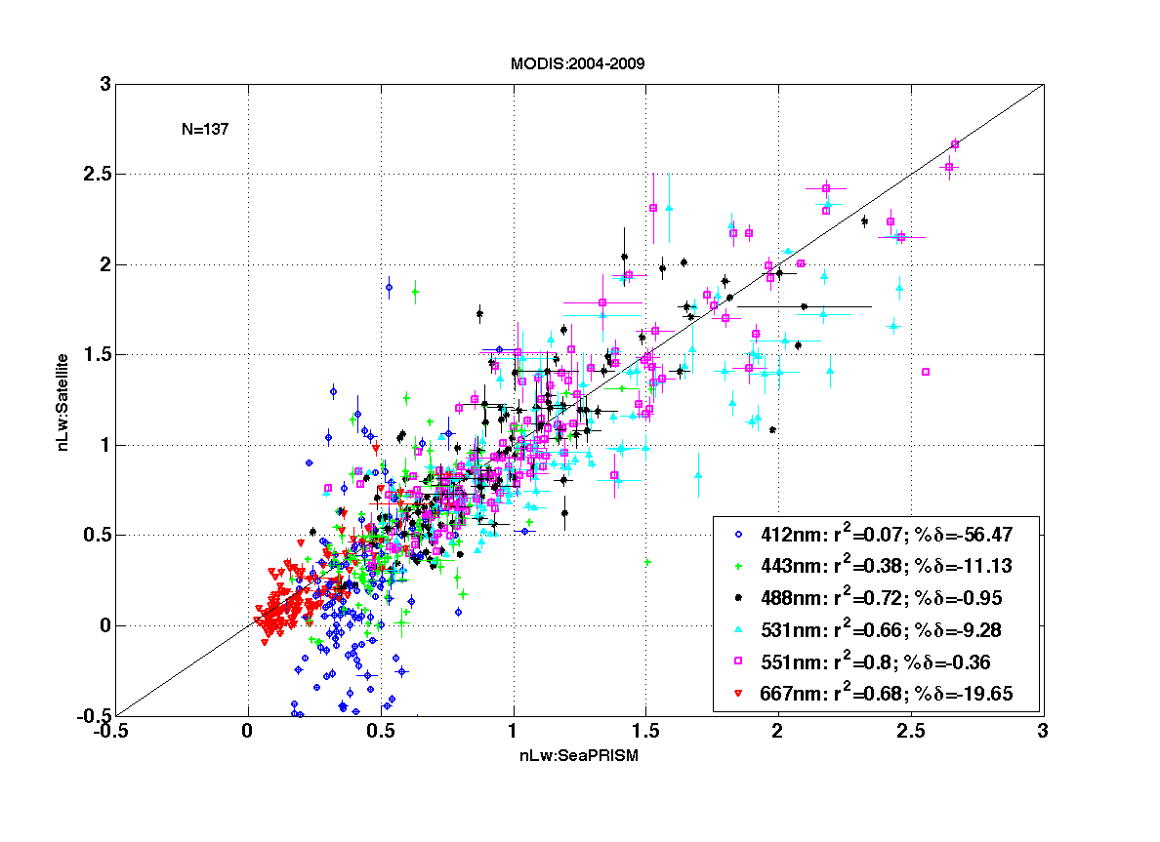
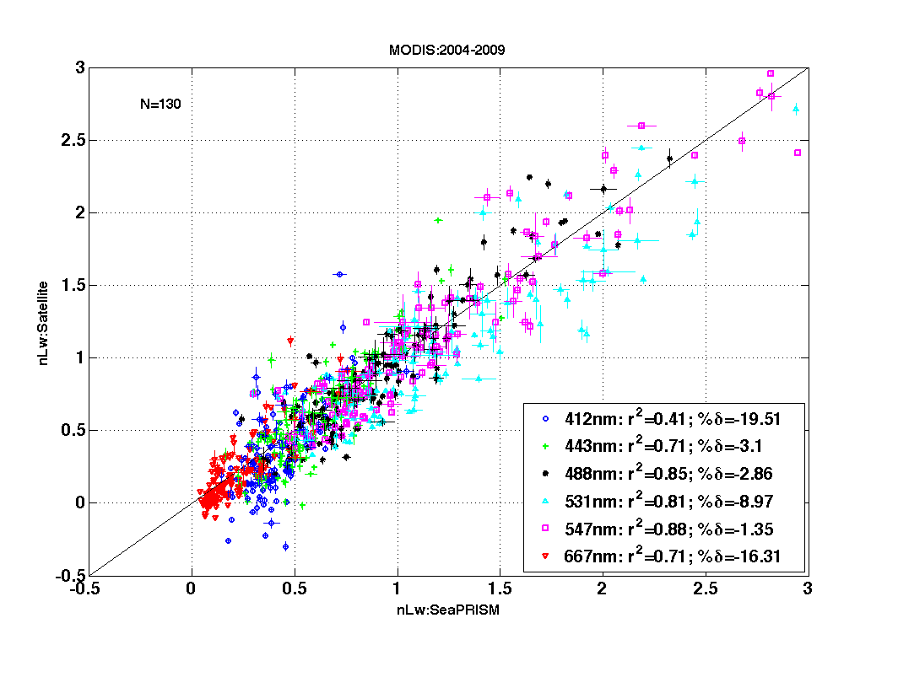
Scatterplot of Matchups in nLw spectra
MODIS-Aqua Version 5
MODIS-Aqua Version 6
( Reprocessing 2009 )
Notes:
Overal performance apparently improved:
less scatterness and higher correlation
nlw412 improved most remarked

Slide 20
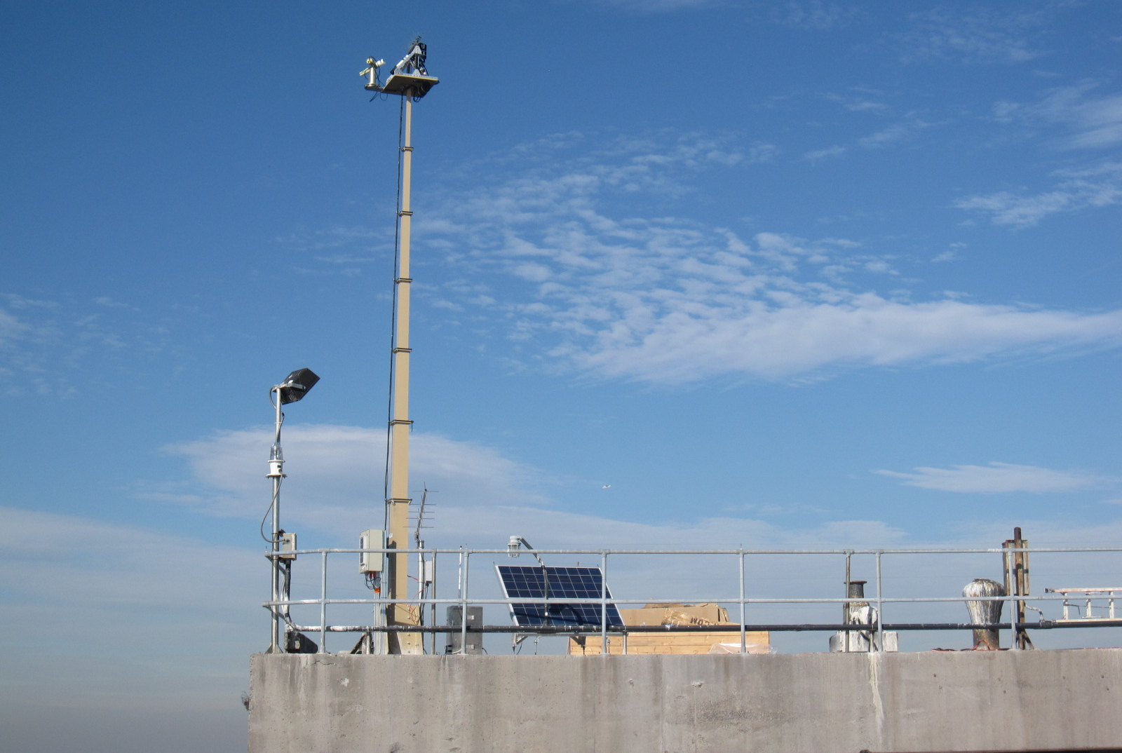
LISCO site Characteristics
Platform: Collocated multispectral SeaPRISM and hyperspectral HyperSAS instrumentations since October 2009
LISCO Tower
Instrument Panel
Retractable Instrument Tower
12 meters
Sam Ahmed
Notes:
20

Slide 21
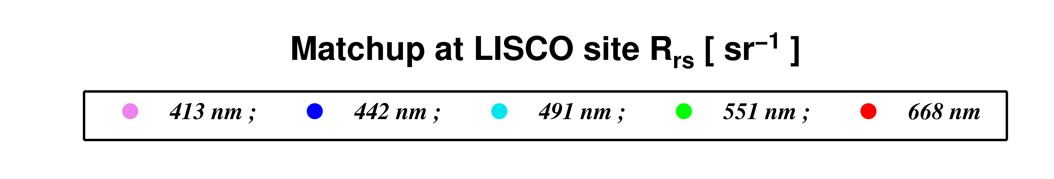
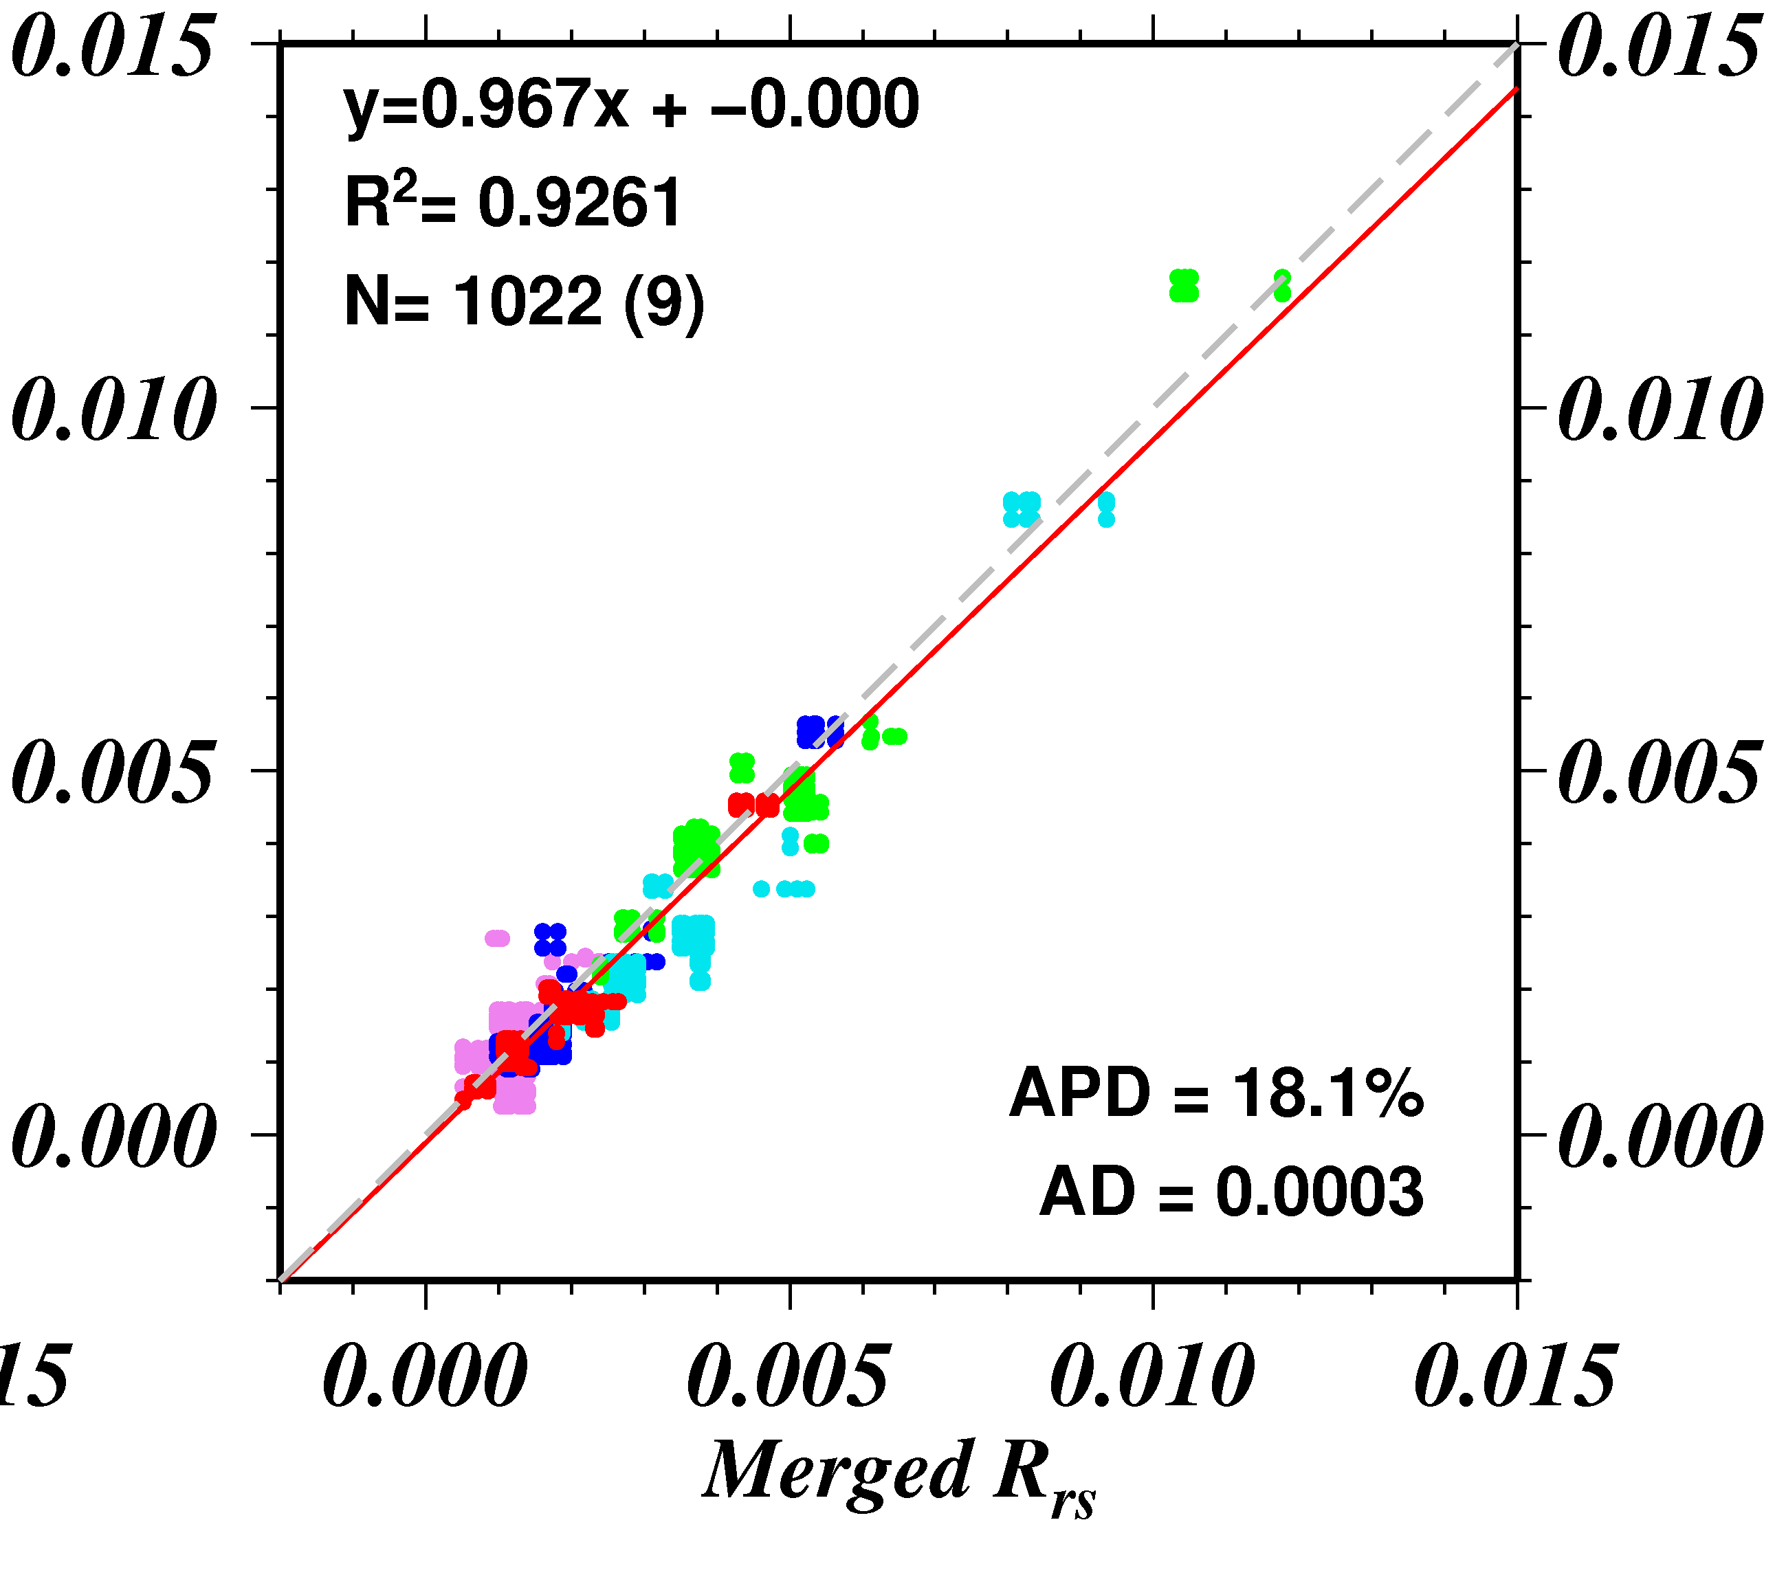
Satellite Validation
Use of merged in situ data:
Improve correlation and regression
Reduce dispersion
in comparison to the two datasets taken separately
HyperSAS APD=23.6%
SeaPRISM=23.7%
Merged APD =18.1%
(APD is driven by very low values, but the Absolute Diff. stays very low in respect to the radiometric resolution of the satellite)
MODIS R_{rs}
→Collocated instruments permit data quality assurance
→ Very high-quality data for calibration purposes

Slide 22
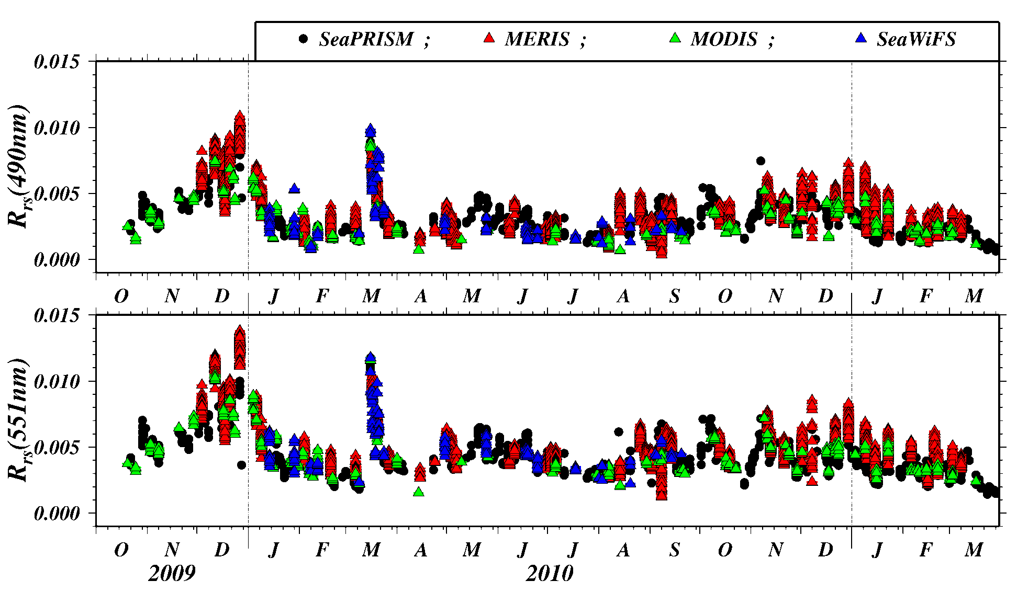
Satellite Validation
Time Series of Water Remote Sensing Reflectance (R_{rs}) [sr⁻¹]
→ Consistency in seasonal variations observed from the platform and from space
Notes:
multi-mission, common processing using NASA software

Slide 23
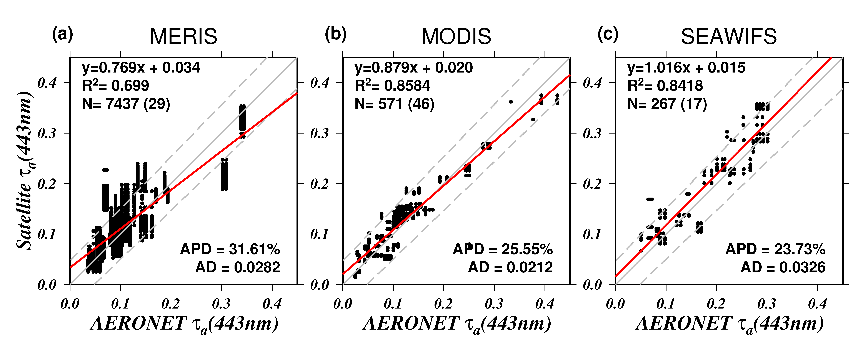
Satellite Validation
Aerosol Optical Thickness Validation
1:1 line
AERONET Uncertainty
Regression Line
Strong Correlation and most of the matchup points are within the AERONET uncertainty for all satellite (best performance for MODIS-AQUA)
→ Representativeness of LISCO site - suitable for aerosol retrieval

Slide 24
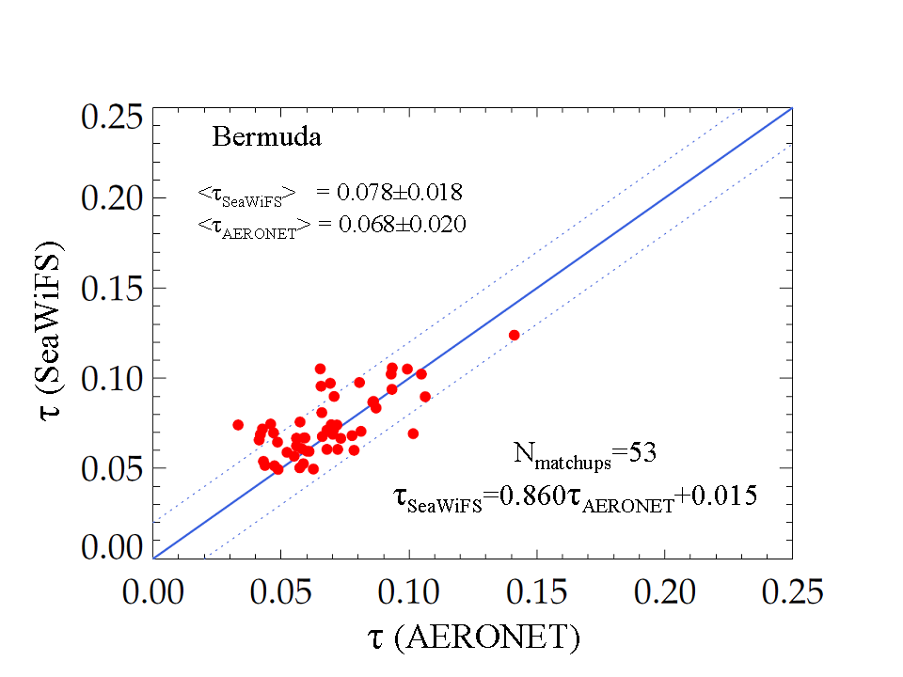
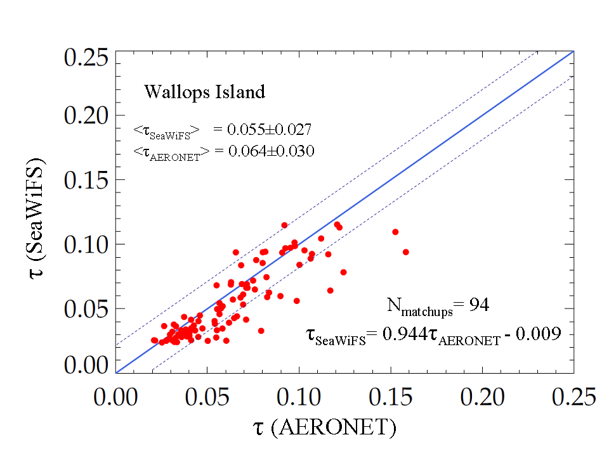
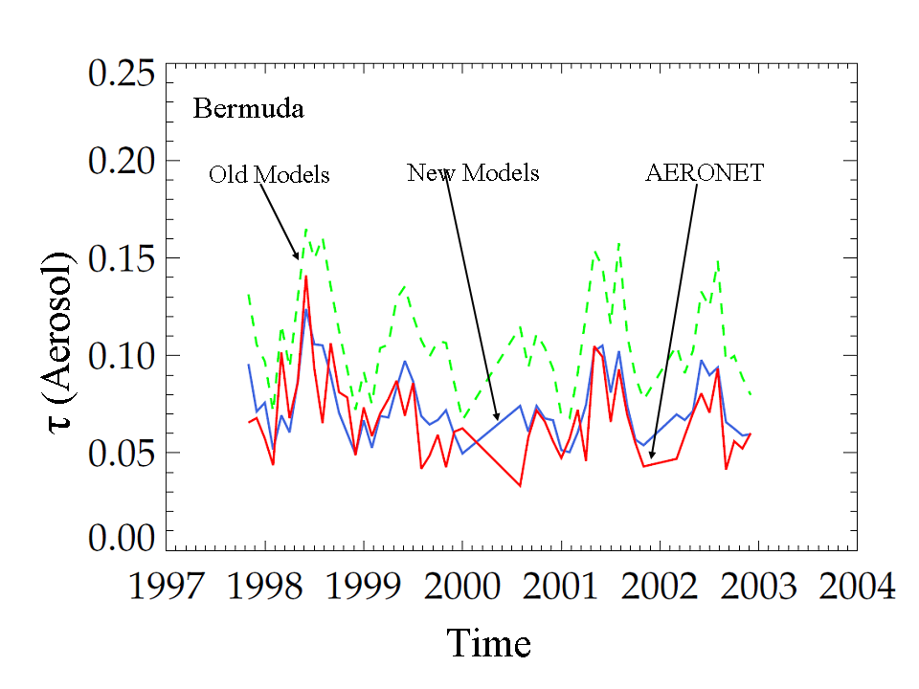
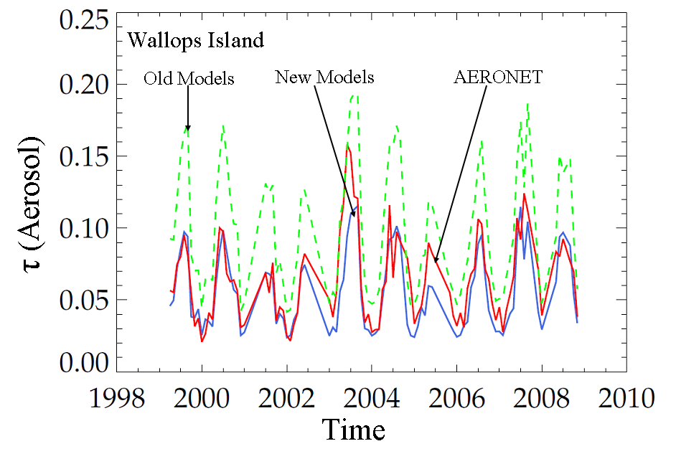
Comparison of τ (SeaWiFS vs. AERONET)
Bermuda
Wallops Island
Scatter Plot
Time Series
81% of the retrieval at Bermuda and 78% of the retrievals at Wallops Island fall within an uncertainty of ±0.02 in τ

Slide 25
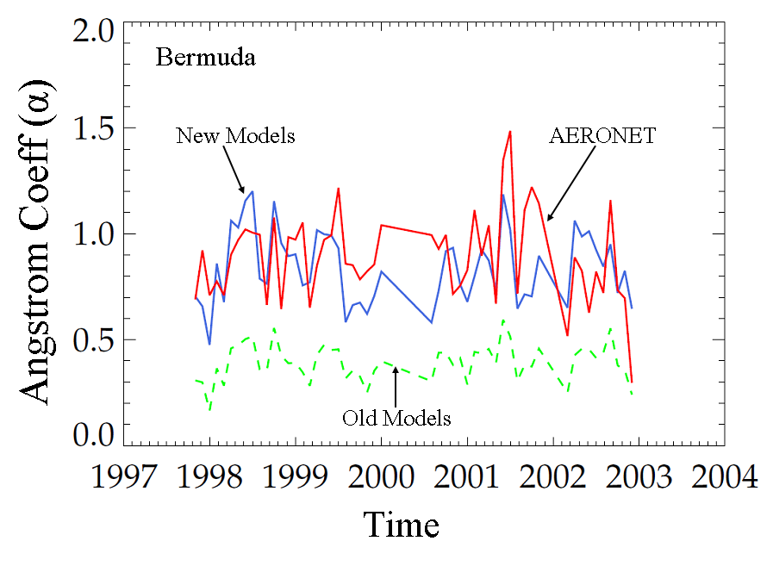
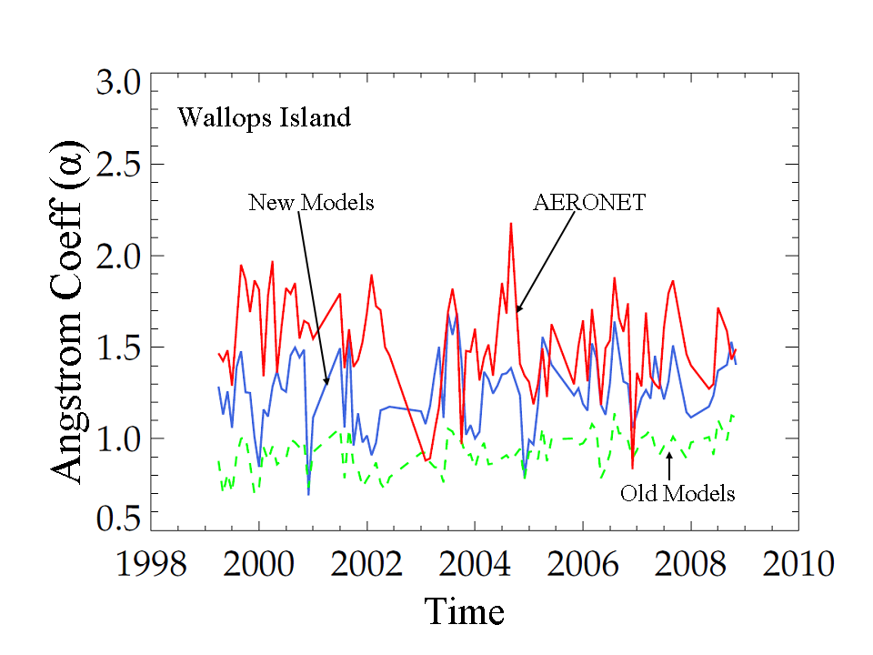
Comparison of α (SeaWiFS vs. AERONET)
Bermuda
Wallops Island
For new models, the Angstrom coeff. (α) shows better agreement over Bermuda than over Wallops Island
For old models, the α values are almost one-half of AERONET Values

Slide 26
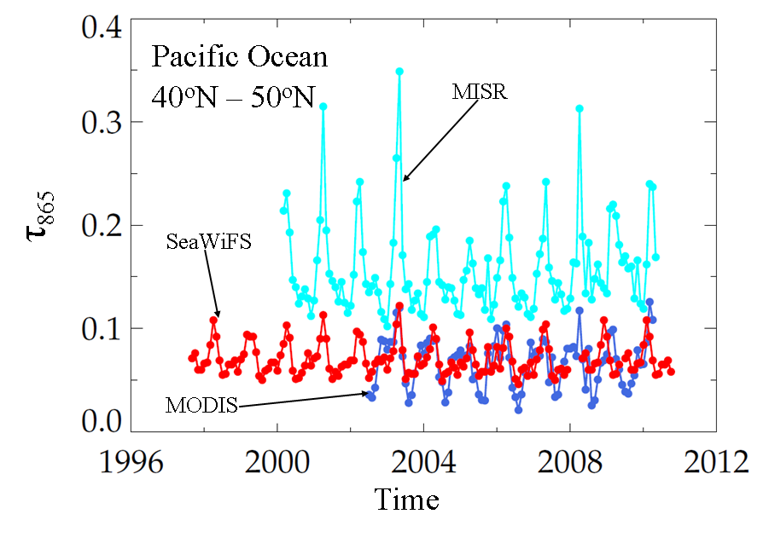
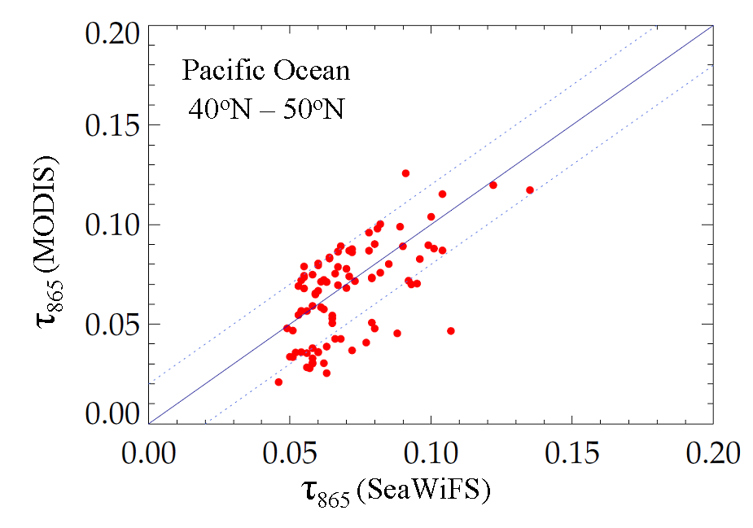
Comparison of τ₈₆₅
SeaWiFS vs. MODIS(atm) vs. MISR
Pacific Ocean (40ºN – 50ºN)
τ₈₆₅ from the SeaWiFS and MODIS sensors are very close (~ ±0.02)
The minimum values of τ₈₆₅ from the MISR sensor are higher than SeaWiFS & MODIS values by ~ 0.05

Slide 27
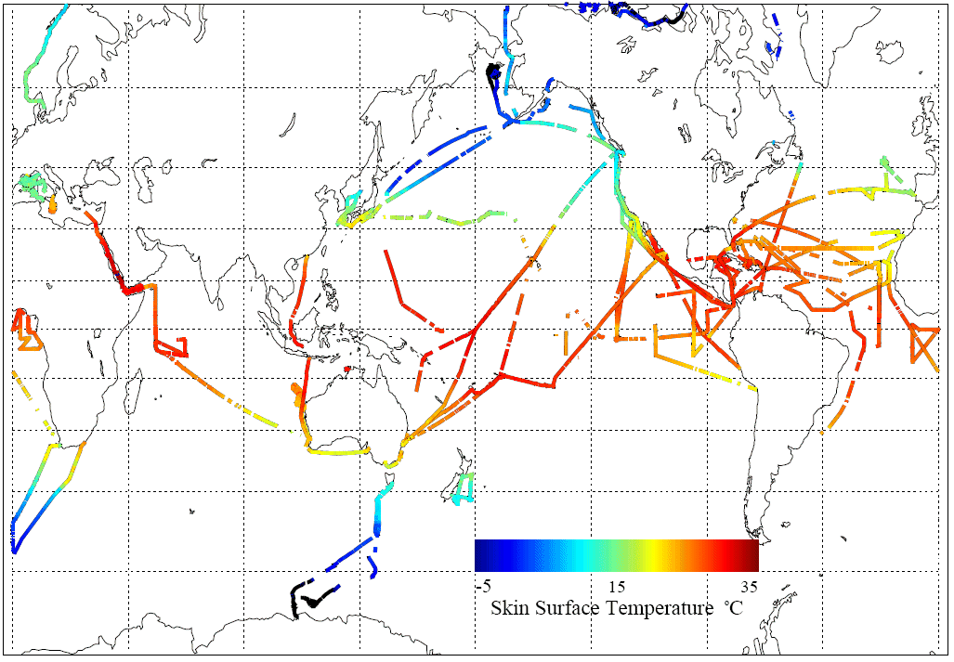
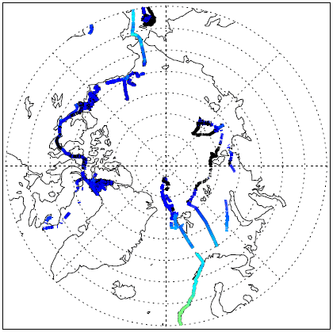
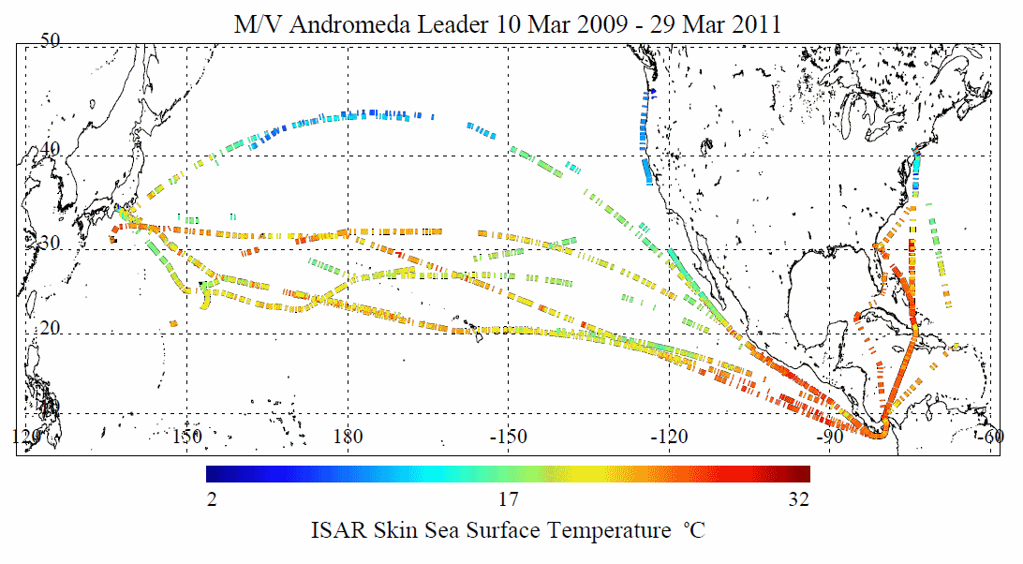

Minnett – Sea Surface Temperature algorithm refinement and validation though ship-based infrared spectroradiometry
Objective: Ensure that MODIS SSTs are part of the Climate Data Record
Approach:
Use shipboard FTIR spectroradiometers (M-AERI), and filter radiometers (ISAR) for independent validation of MODIS SST retrievals.
Ensure traceability of validation data to NIST reference standards.
Continue studies into improved atmospheric correction algorithms.
Continue studies of thermal skin layer of the ocean.
Continue studies of diurnal heating and cooling in the upper ocean.
Related activities:
  GHRSST Science Team
  NPP (VIIRS) Science Team
  SST Science Team
  AATSR Science Advisory Group
  HyspIRI Science Study Group
  EUMETSAT Mission Expert Team
M-AERI cruises
Notes:
continuing efforts torefine SST algorithm, reduce and estimate uncertainties
reprocessing expected this summer

Slide 28
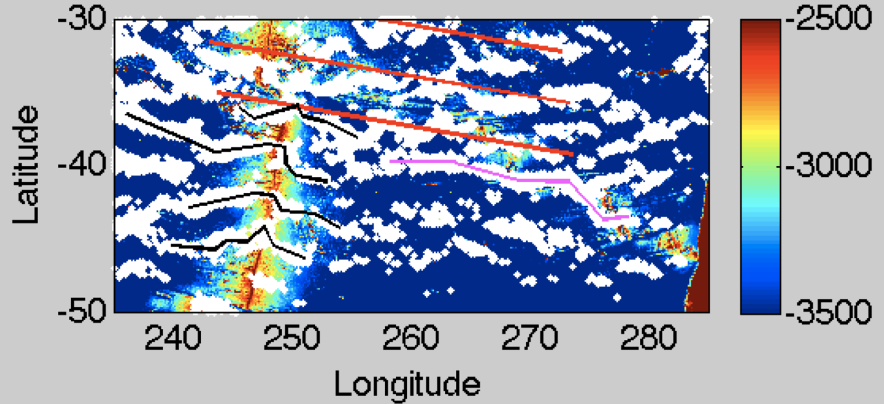
Topographic Control of Ocean Dynamics in the Subtropics
(Peter Cornillon and Lew Rothstein)
Objective: To better understand the topographic control of phenomena associated with the quasi-zonal structures observed in fields of mean dynamic ocean topography (Maximenko et al. (2008) and of sea surface temperature front probability (Obenour et al. (2010).
Colored background is bathymetry in meters. White dots are locations where SST front probability exceeds 18% in 2004-2005. Purple and black lines are digitized bands of front probability to aid the eye and red lines are the approximate location of structures seen in fields of filtered mean dynamic topography.
Notes:
low-level, persistent frontal boundaries, globally distributed. in some cases correlated with very deep sub-surface topography. first discovered using AMSR-E data. looking to use MODIS to increase resolution and try to understand this phenomenon

Slide 29
More Calibration Stuff

Slide 30
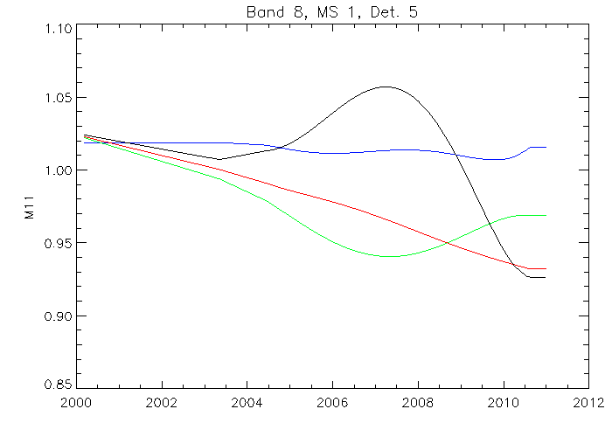
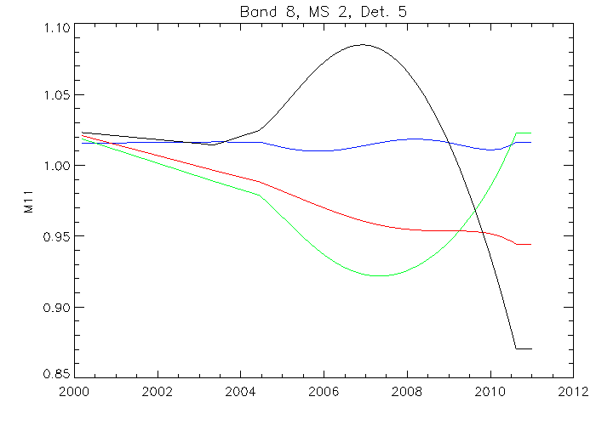
MODIS/Terra gain corrections as a function of time at different view angles, based on SeaWIFS nLw
412 nm, Mirror 1
412 nm, Mirror 2
+10%
-15%
2000
2012
Color coding: Frame/pixel 22 (beginning of scan, lunar),,
675 (nadir),, 989 (solar diffuser), 1250 (end of scan)
30
Gerhard Meister
Notes:
MCST option #2 using desert targets shows very similar results.

Slide 31
Deep-Blue Aerosol Collaboration
Jeong, M-J., N.C. Hsu, E.J. Kwiatkowska, B.A. Franz, G. Meister, C.E. Salustro (2011). Impacts of Cross-platform Vicarious Calibration on the Deep Blue Aerosol Retrievals for Moderate Resolution Imaging Spectroradiometer aboard Terra, T. Geo. Rem. Sens., accepted.

Slide 32
