Slide 1
NEO (NASA Earth Observations)
http://neo.sci.gsfc.nasa.gov/
&
NASA Earth Observatory
http://earthobservatory.nasa.gov/
Holli Riebeek
holli.riebeek@nasa.gov
Kevin Ward
kevin.ward@sigmaspace.com

Slide 2
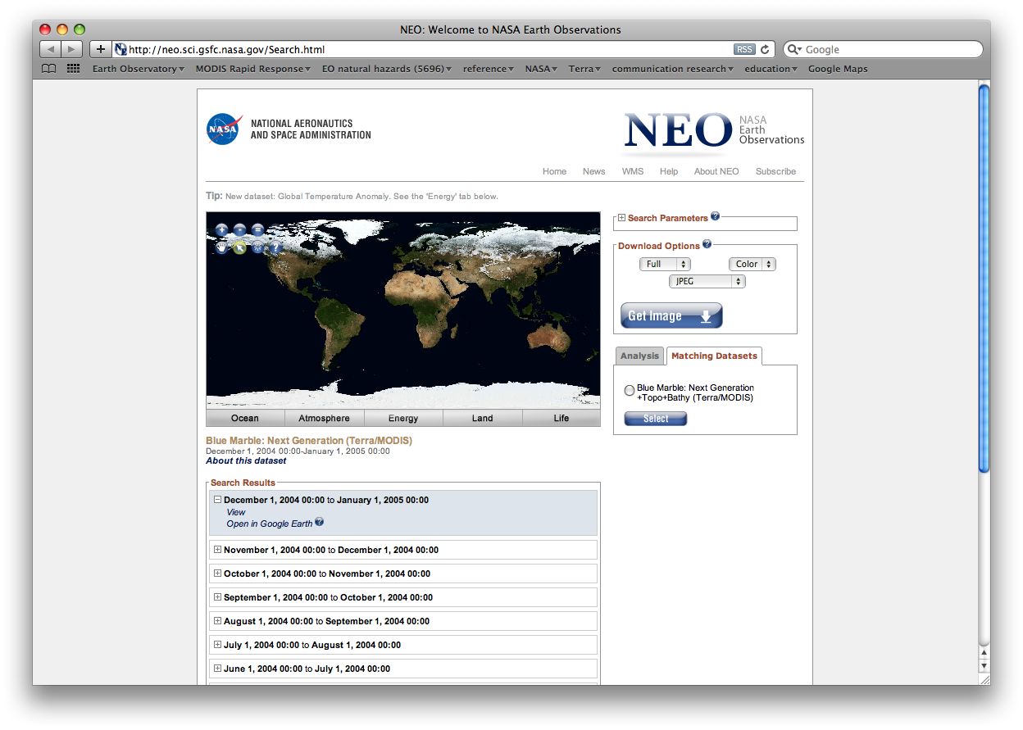

Slide 3
What is NEO?
A collection of global NASA satellite data imagery that can be easily accessed and utilized by a variety of users and applications
Address the needs of data users who do not posses the expertise or tools to handle raw data
Target Audiences
Formal & informal educators
Museums & Science Centers
Science communicators
Notes:
The search, retrieval, processing and visualization of NASA Earth science data requires many different experts using a wide range of tools and techniques. NEO’s goal is to eliminate these complexities for a user community that desires only quick and easy access to the images derived from those data.

Slide 4
Why come to NEO?
Images for publication/poster
Images for external application
e.g., Google Earth, WMS, planetarium
Perform basic analysis (education)
NEO holdings
50+ global datasets
Daily, weekly, and monthly composites
Most 0.1 degree (3600x1800)
Imagery produced by science teams, data processing facilities to NEO specification
MODIS groups, NSIDC, NOAA, NASA Langley, Goddard DISC
Notes:
0.1 degree = ~10km/pixel resolution; some datasets are only available in 0.25 degree resolution (1440x720)

Slide 5
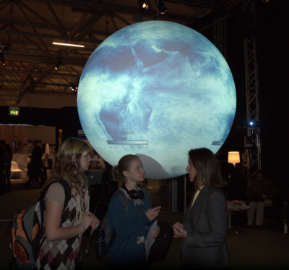
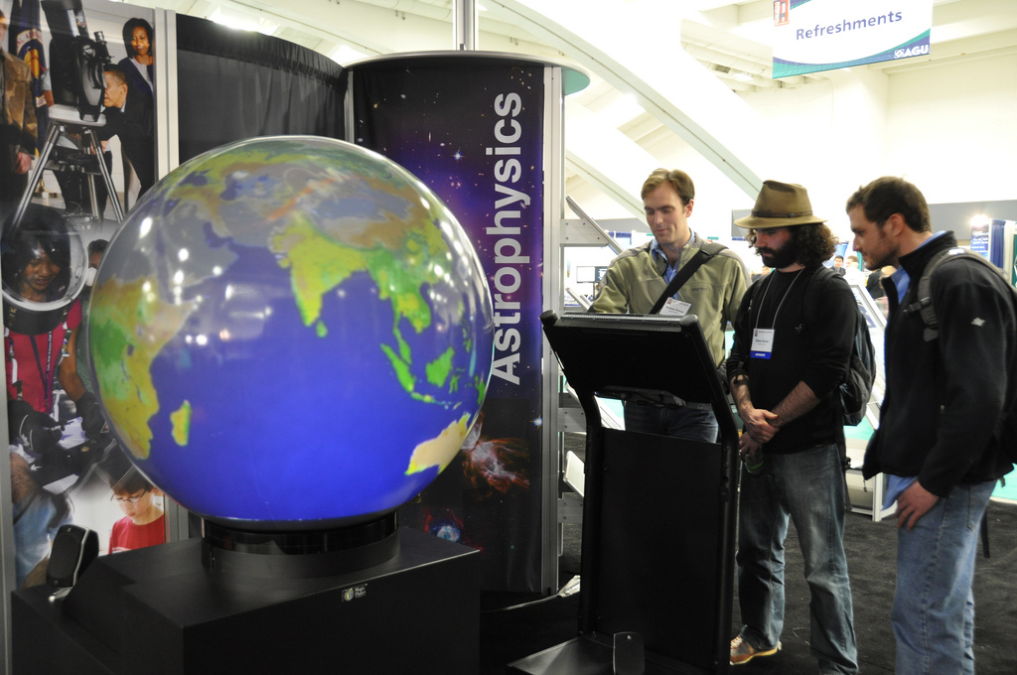
NEO development for 2010
Focus on supporting “spheres”
Science on a Sphere (53 installations, 12 this year)
Magic Planet, Global Microscope, etc.
best distribution point for NASA datasets to public
COP 15
Notes:
This year we are focusing on development of alternative “looks” for all of the datasets to further meet the needs of end-users who want more contextual content included on the images. One case where these looks will feature prominently is on spherical displays that are becoming more prominent in the informal education community. [NEO imagery on display on Science on a Sphere at COP15 (left) and on Dynamic Planet at NASA booth at AGU (right).]

Slide 6
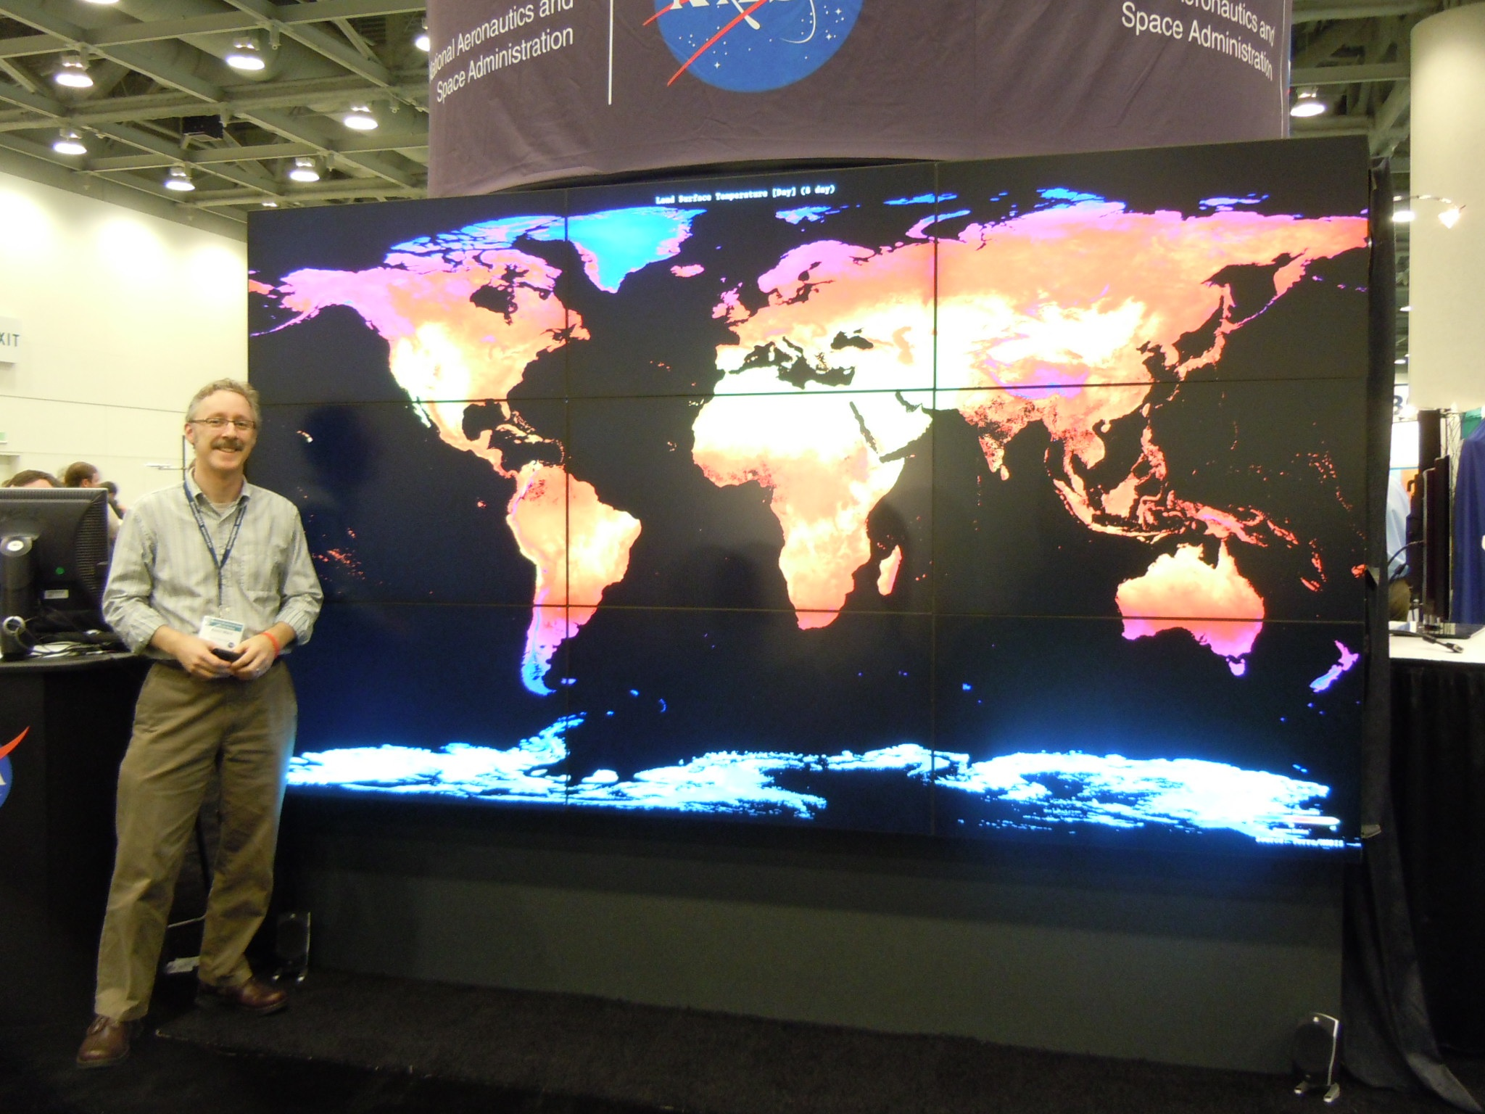
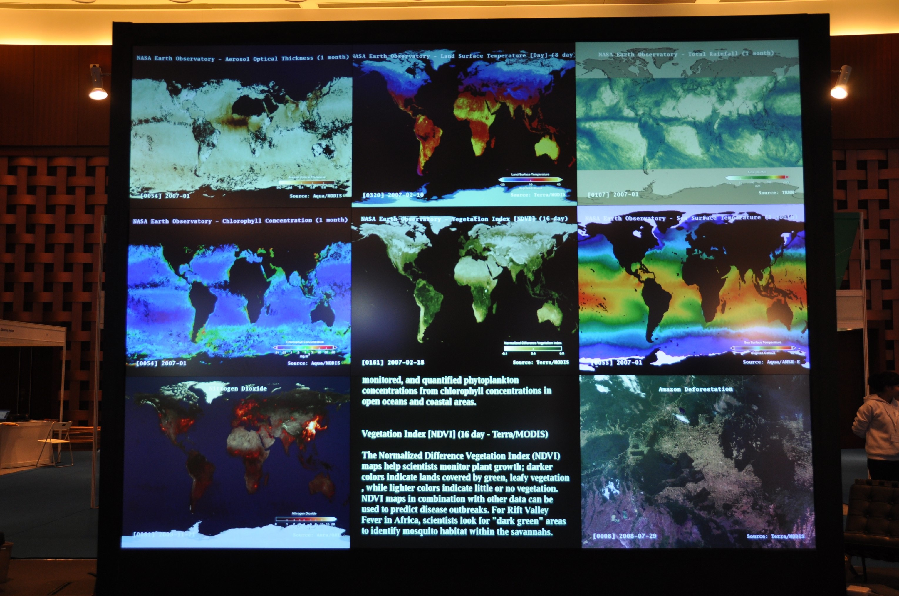
AGU
GEO-VII

Slide 7
NEO (NASA Earth Observations)
http://neo.sci.gsfc.nasa.gov/
For more information:
Kevin Ward
kevin.ward@sigmaspace.com

Slide 8
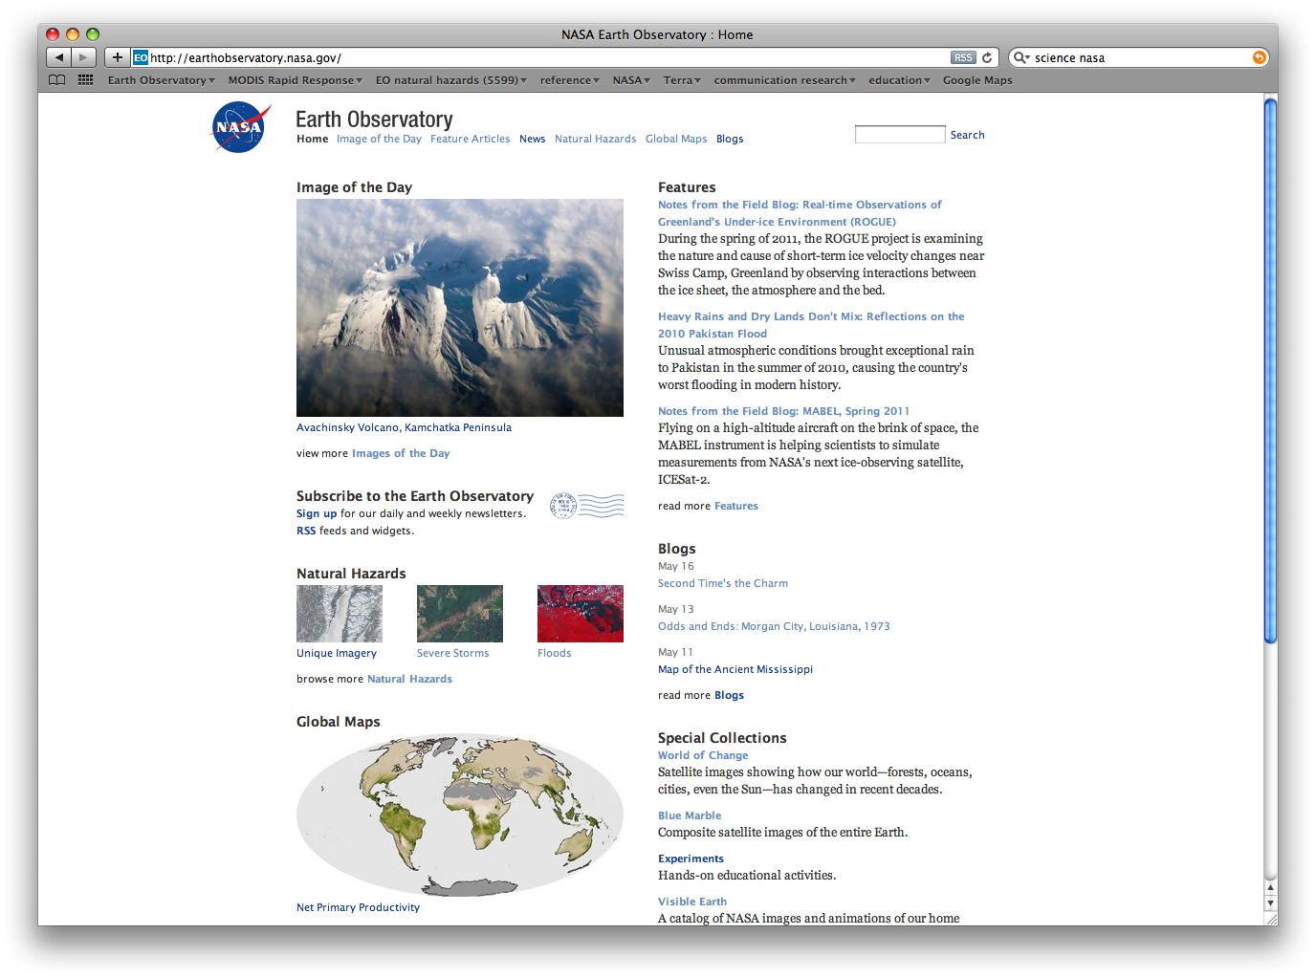

Slide 9
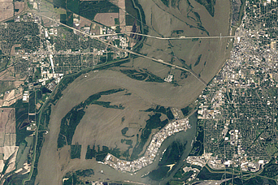
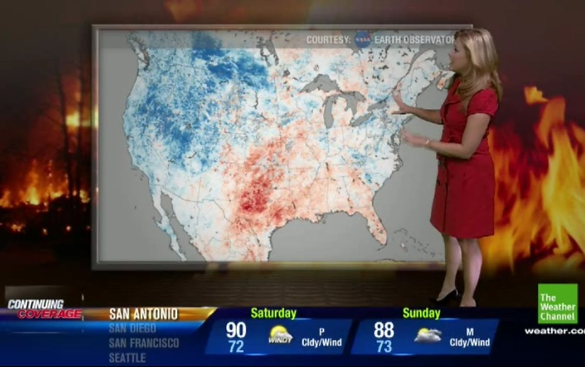
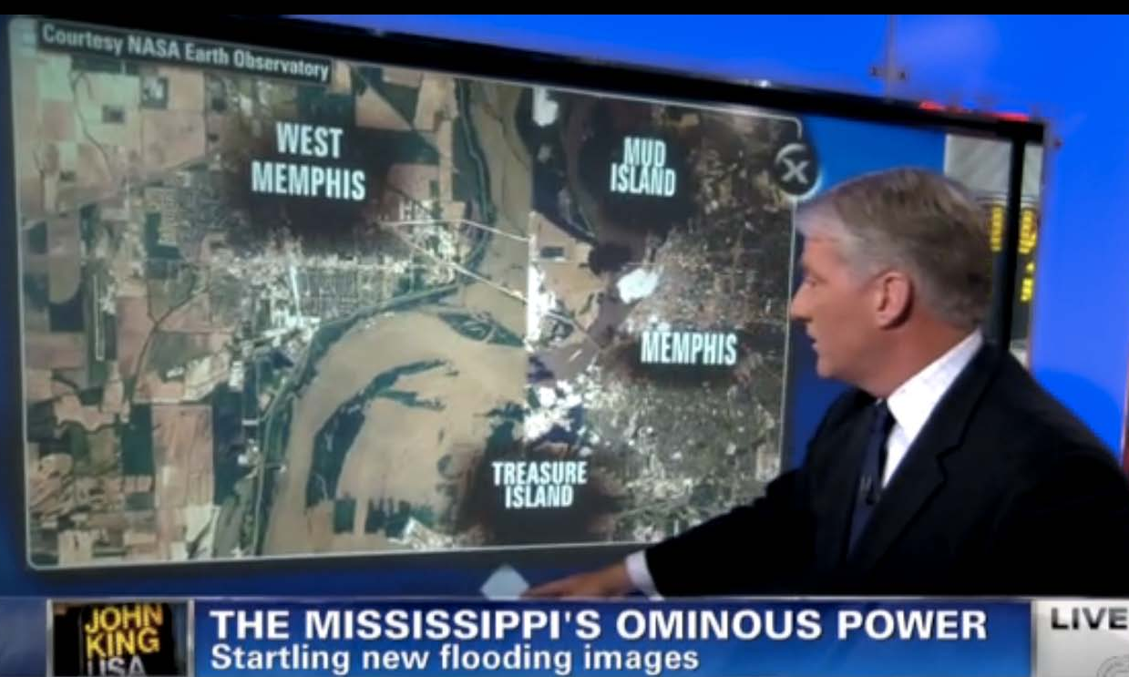
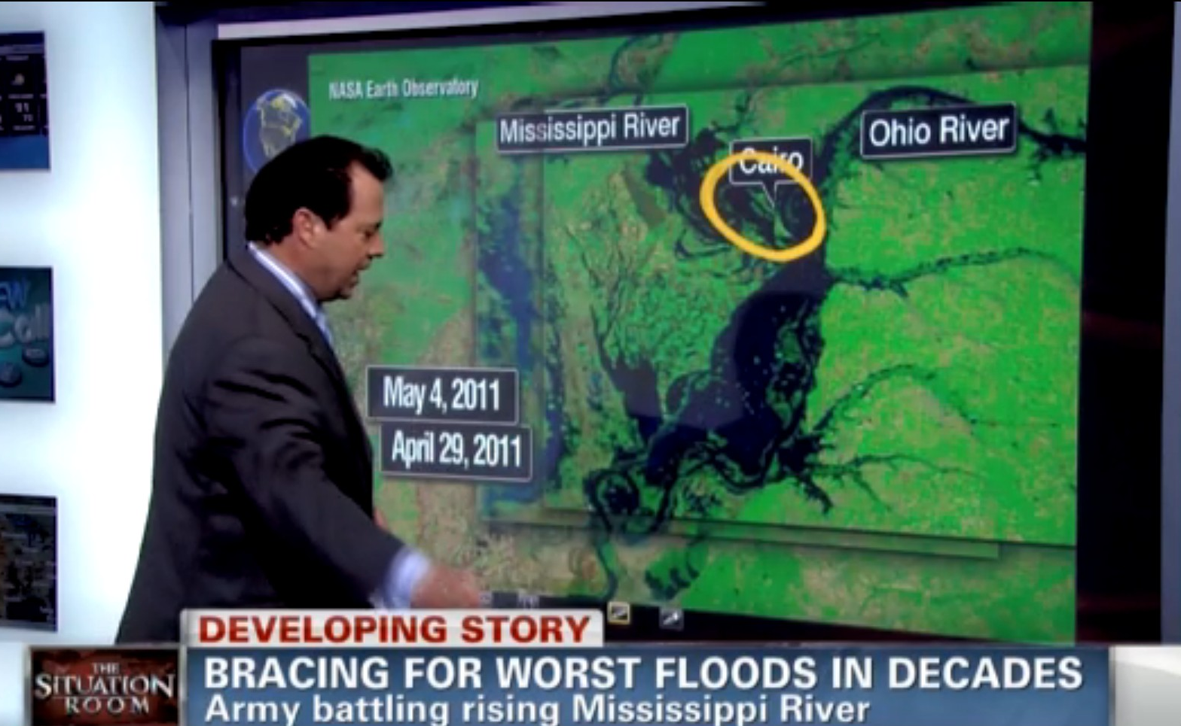
Earth Observatory Group: May 2011 At-a-glance
Most Popular Image
Team Highlights
Supported requests for flood imagery from a number of emergency response agencies (DHS/FEMA, U.S. Coast Guard, affected states) and media outlets; collaborated with the USGS and the EO-1 teams to obtain near-real time (and pre-flood where possible) imagery from the Landsat 5 and EO-1 satellites.
Kevin Ward was an invited panelist and presenter of NEO (NASA Earth Observations) at the Science on a Sphere Users Collaborative Network Workshop in Chicago, IL.
Rob Simmon presented and hosted a workshop on data visualization at the International Symposium on Remote Sensing of the Environment (ISRSE) in Sydney, Australia.
Holli Riebeek represented the Earth Observatory at the Goddard Open House.
Flooding in Memphis
Acquired May 10, 2011, this natural-color image shows flooded and conditions along the Mississippi River in Memphis, Tennessee.
http://tinyurl.com/663r3ol
In the Media
The Weather Channel
Temperature extremes related to TX wildfires
John King (CNN)
Mississippi River flooding
The Situation Room (CNN)
Mississippi /Ohio River flooding

Slide 10
Images featured on the EO in 2010
MODIS (both Terra & Aqua): 52%
EO-1/ALI: 14%
Landsats: 8%
ISS: 6%
all other sources: 20%

Slide 11
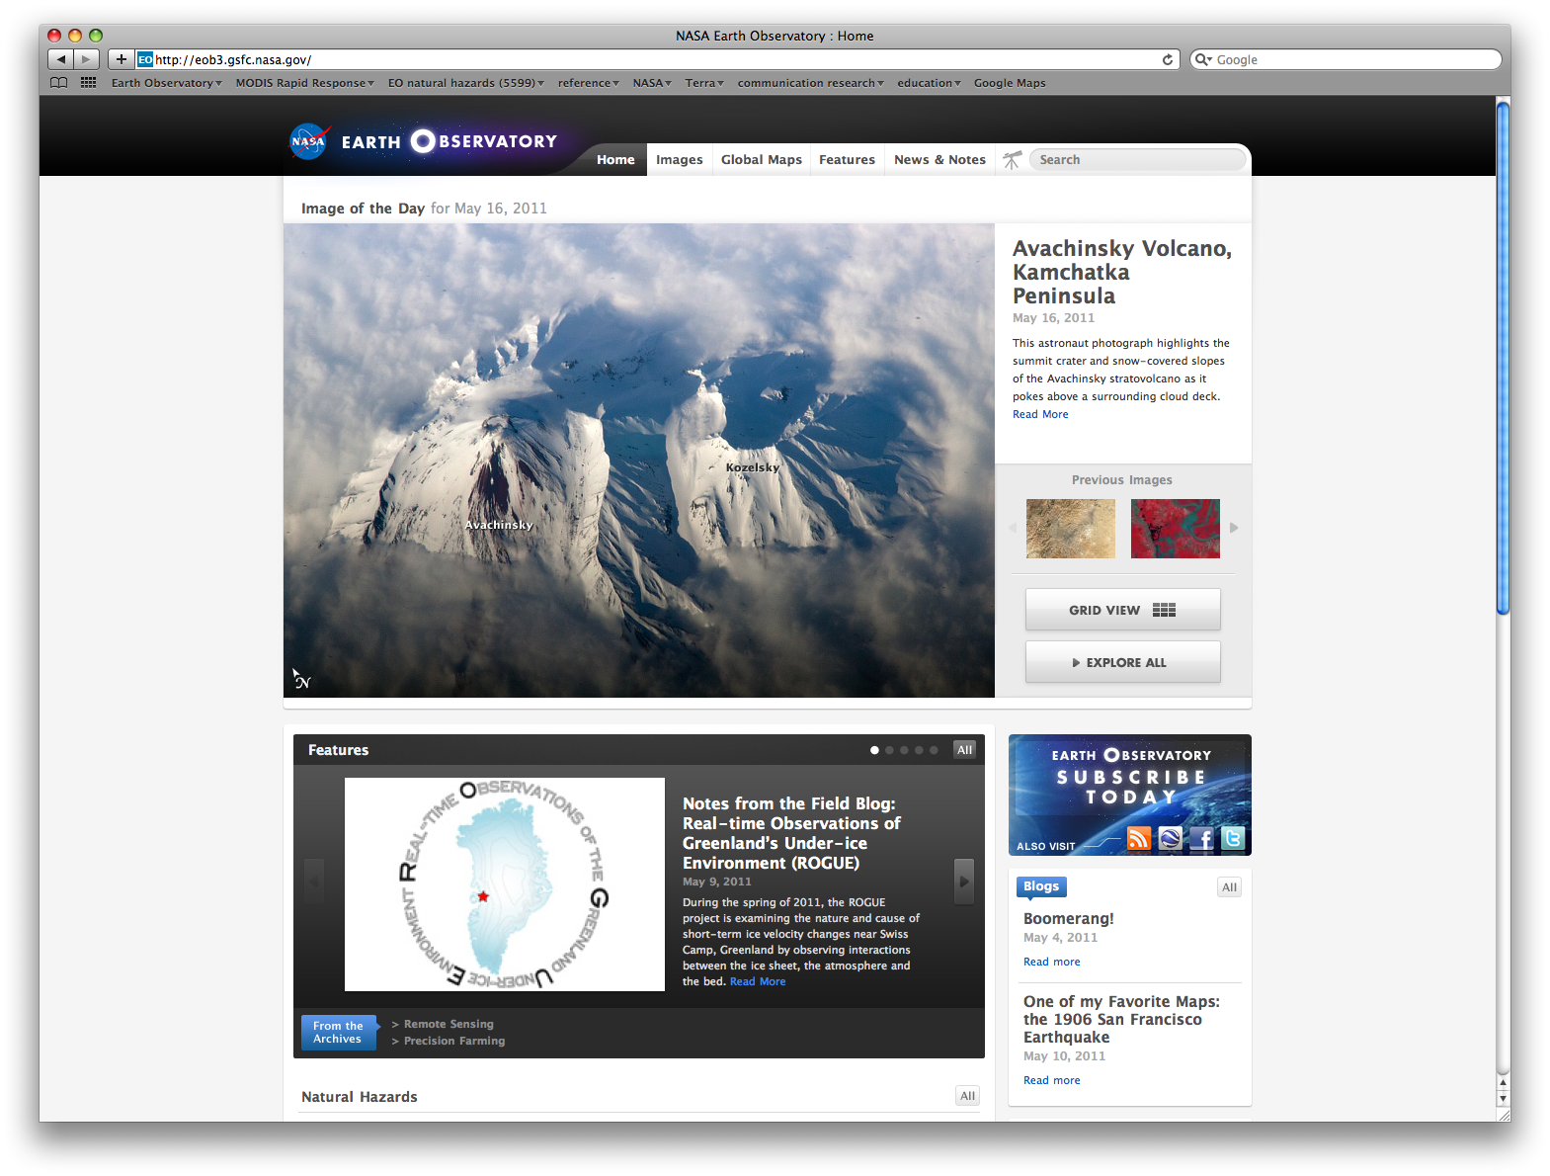

Slide 12
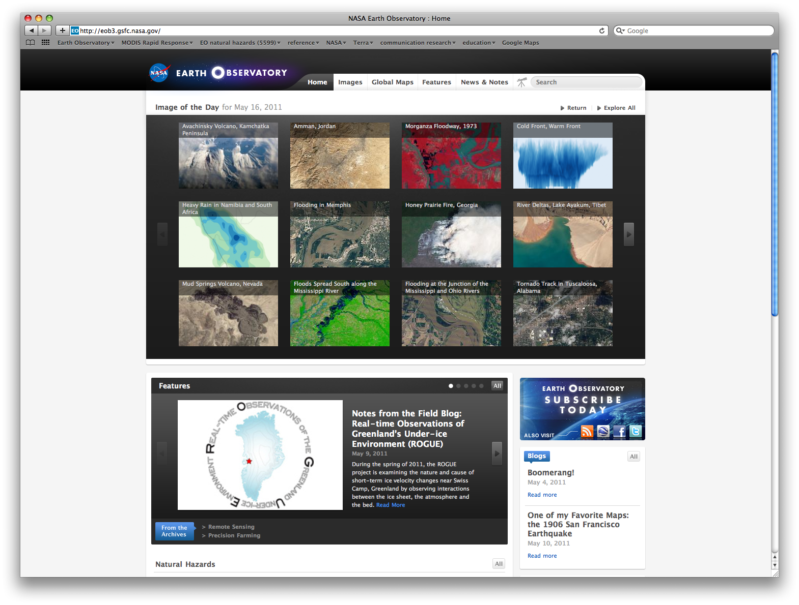

Slide 13
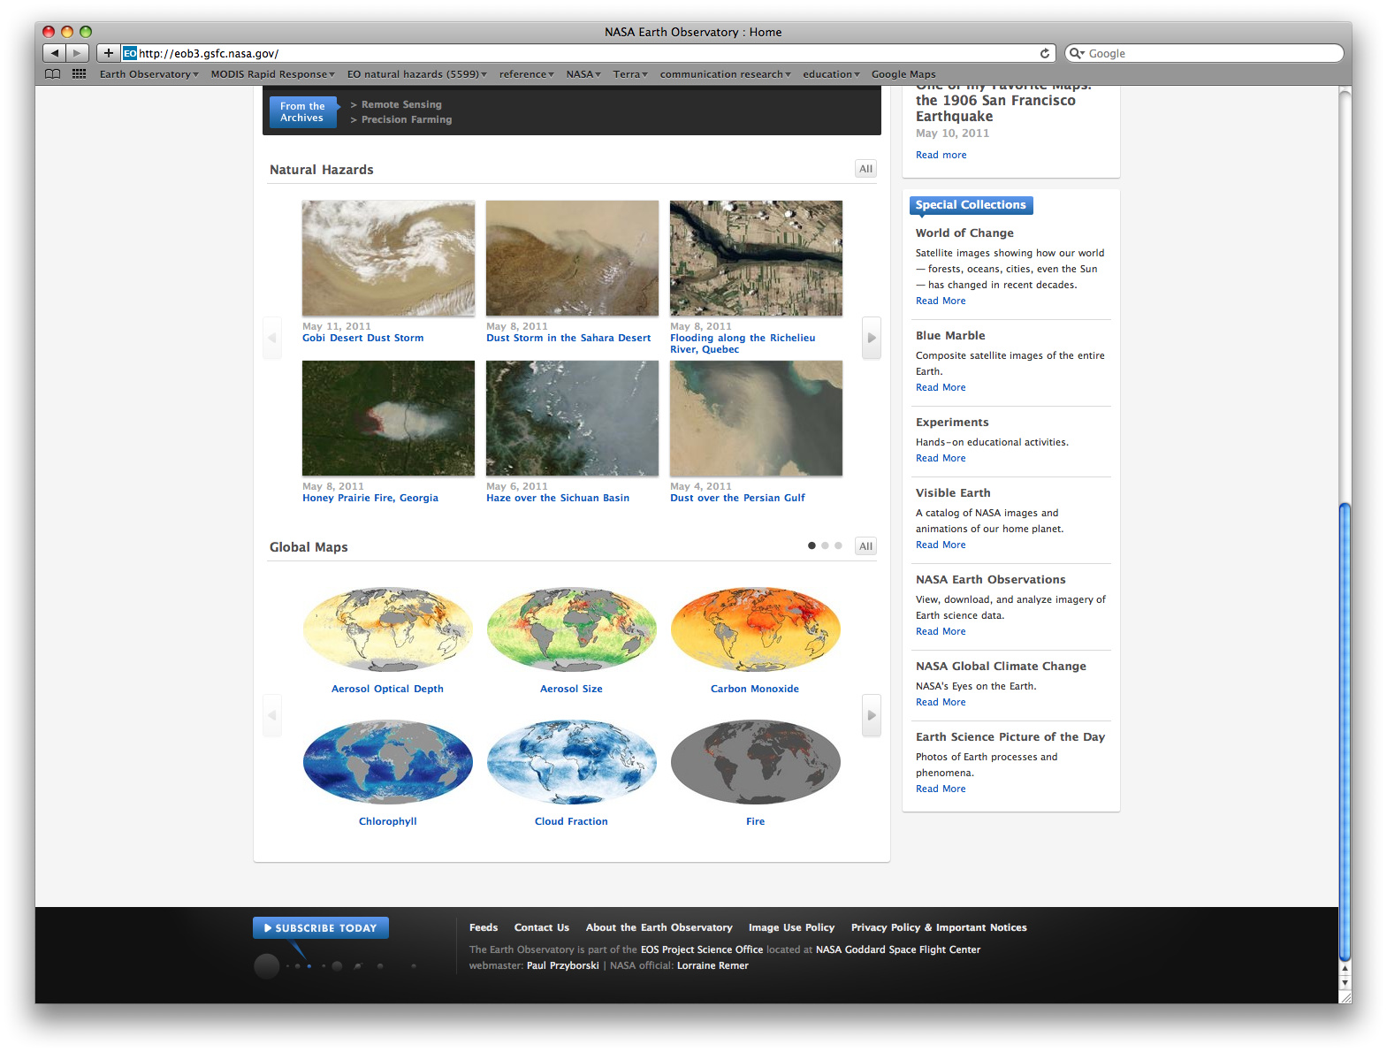

Slide 14
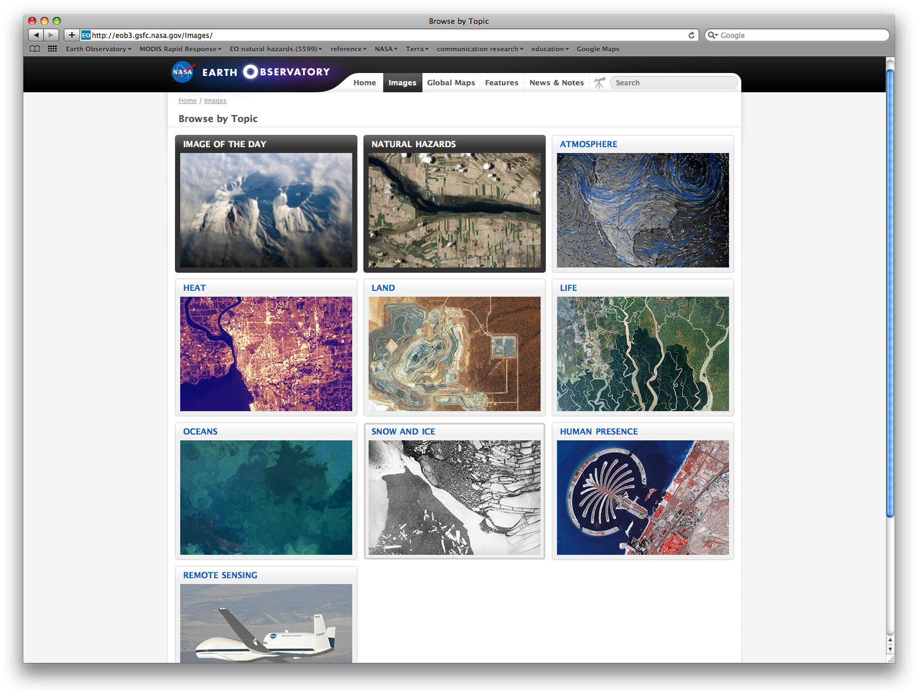

Slide 15
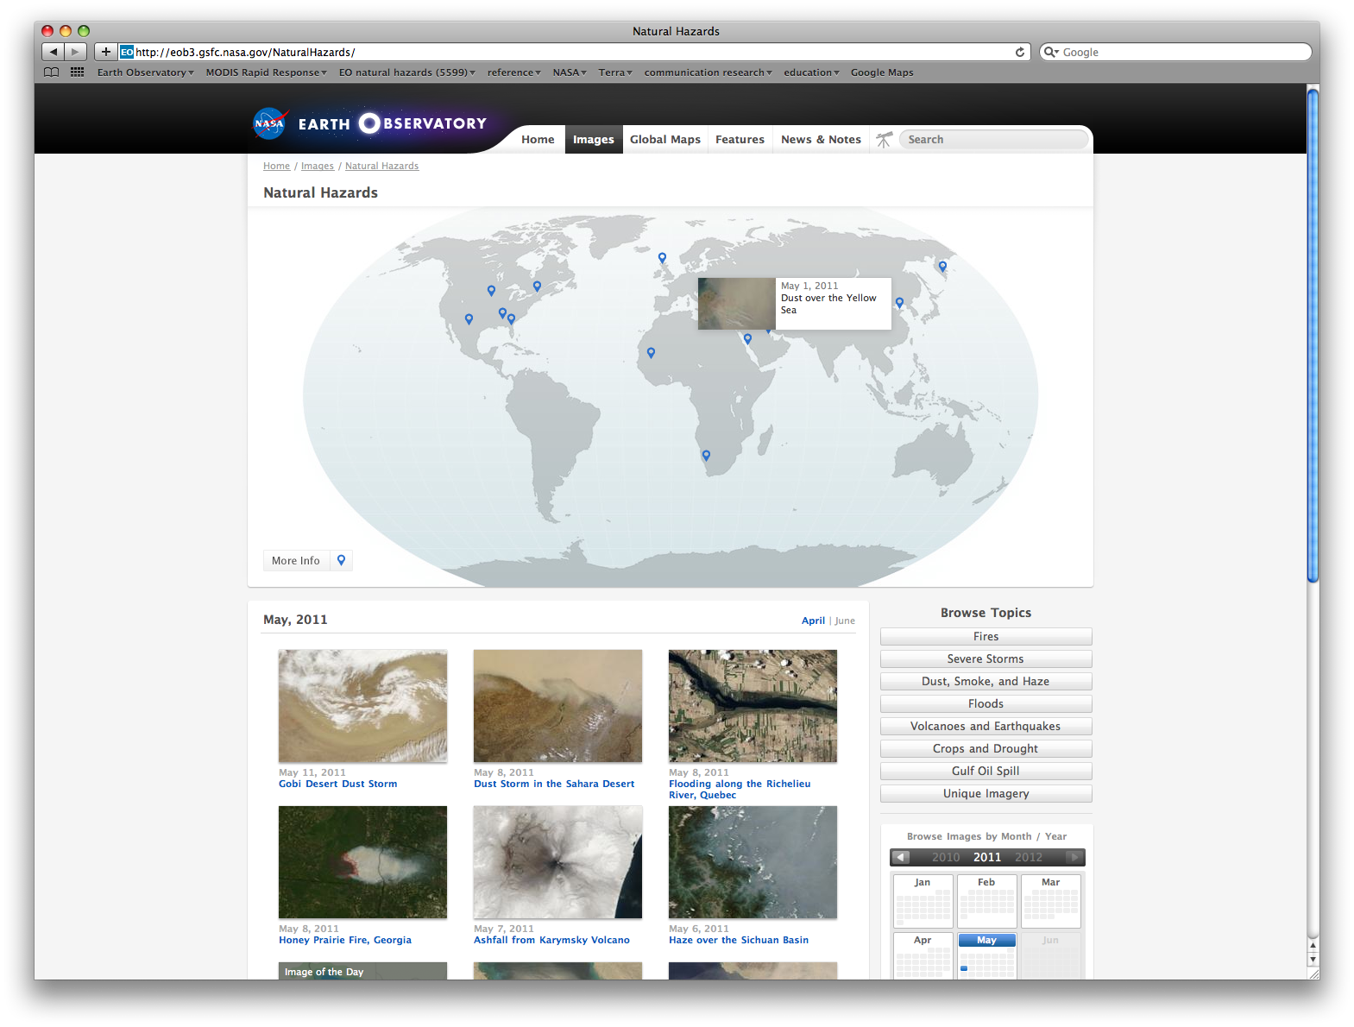

Slide 16
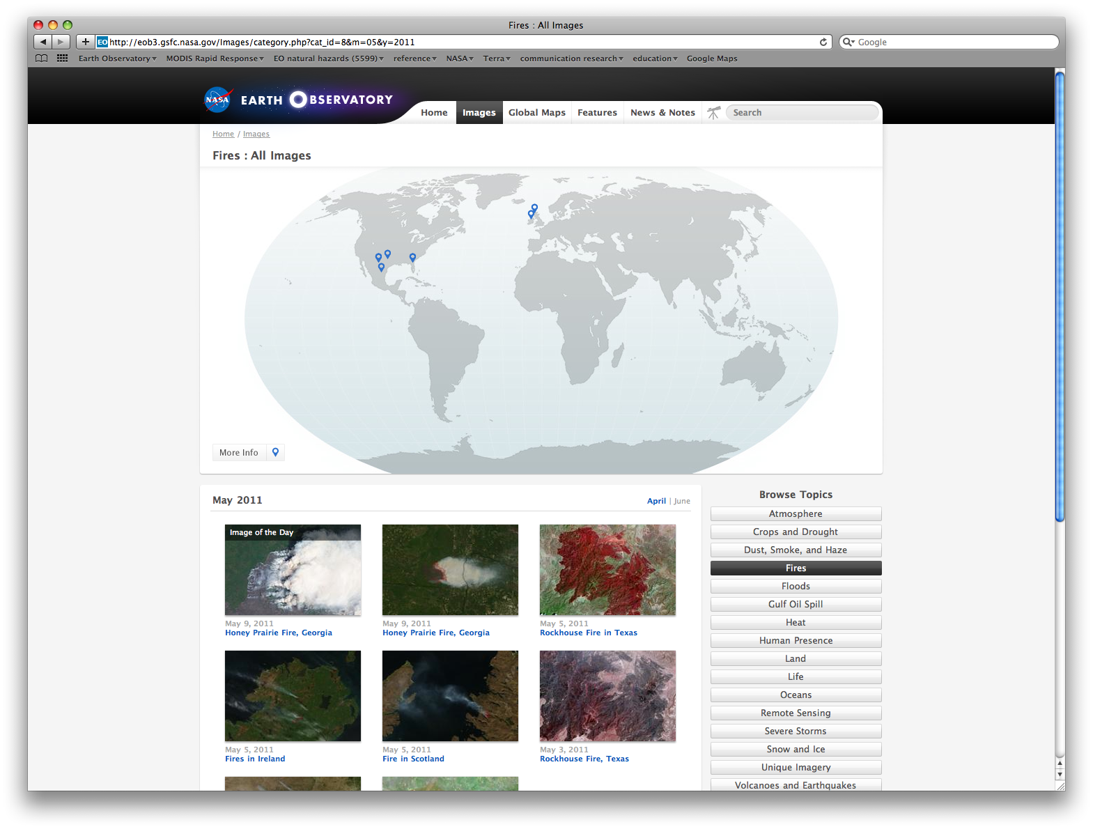

Slide 17
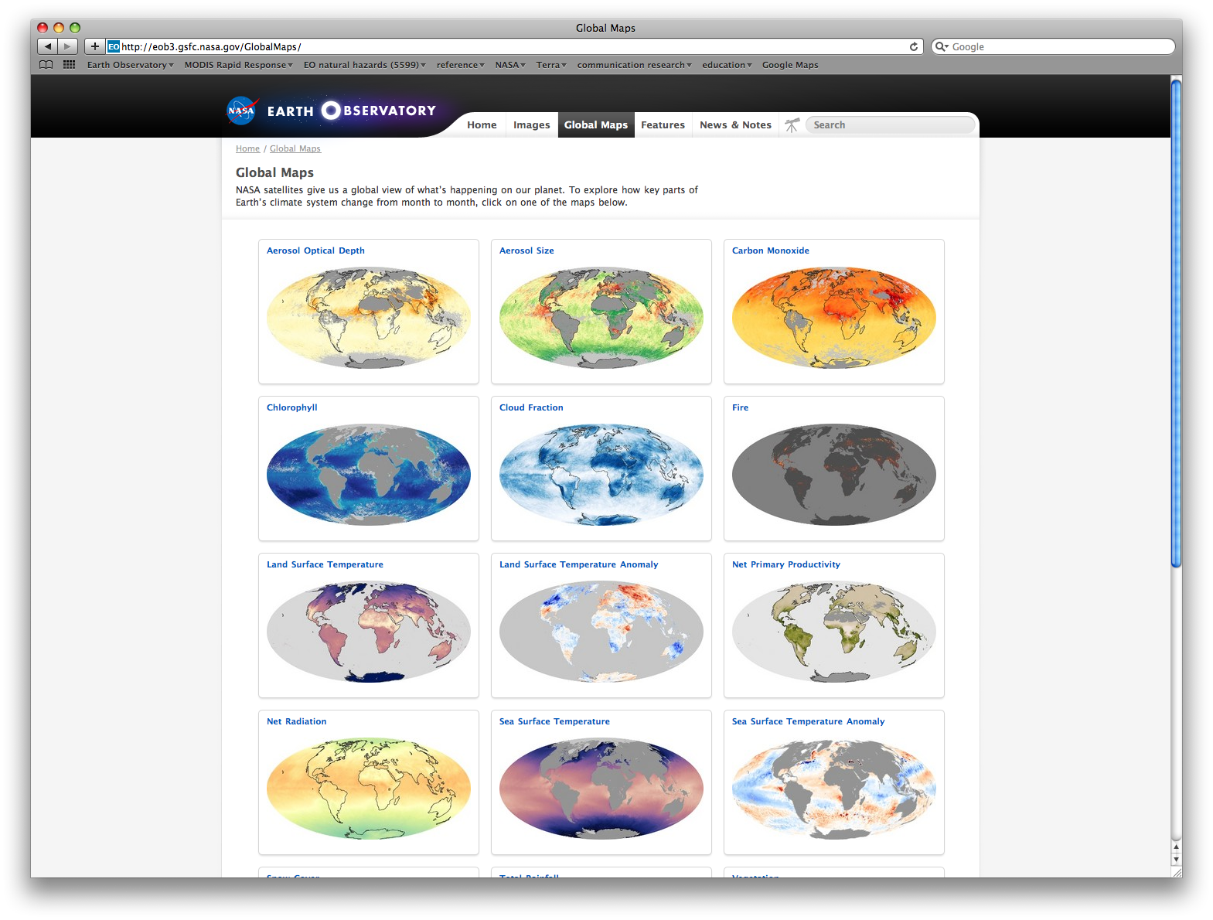

Slide 18
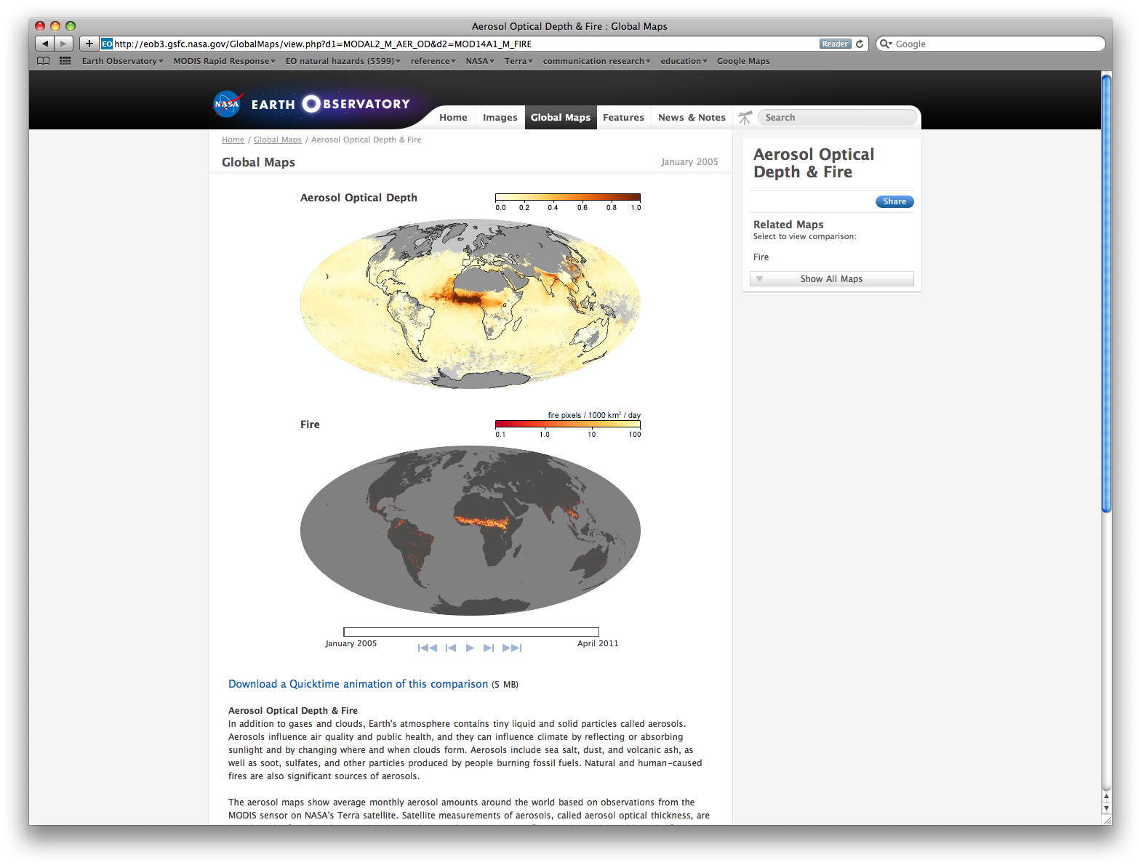

Slide 19
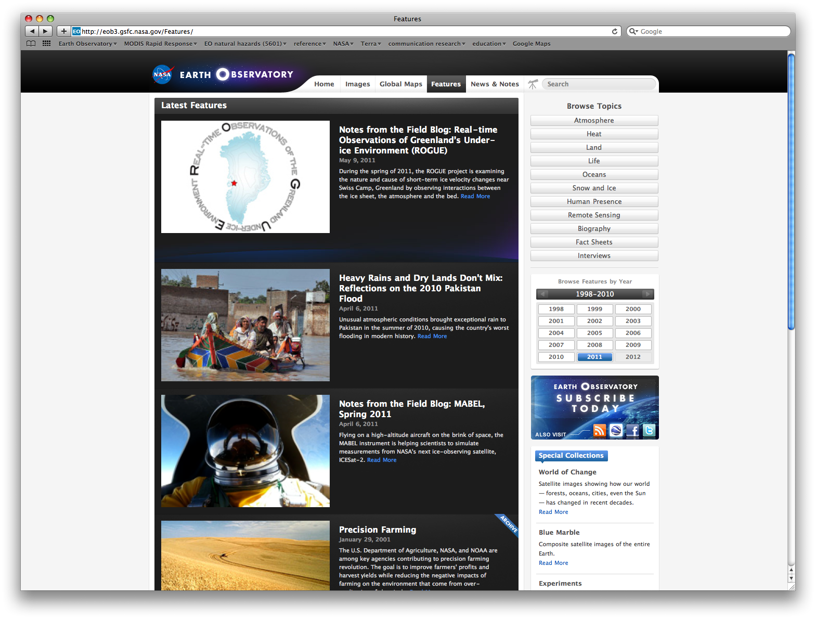

Slide 20
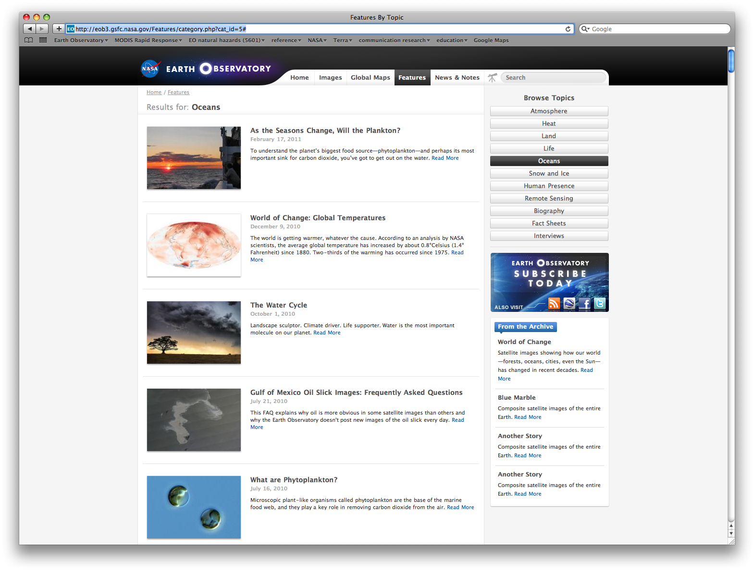

Slide 21
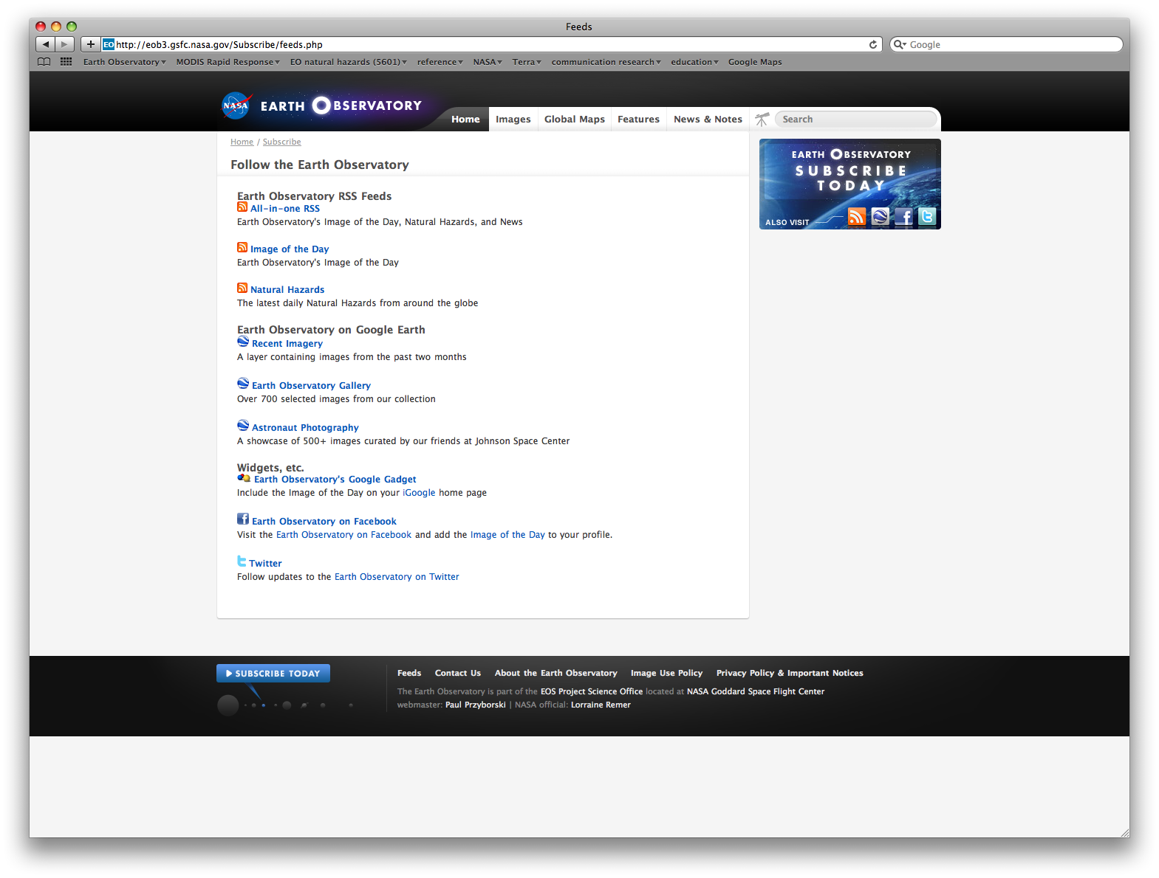

Slide 22
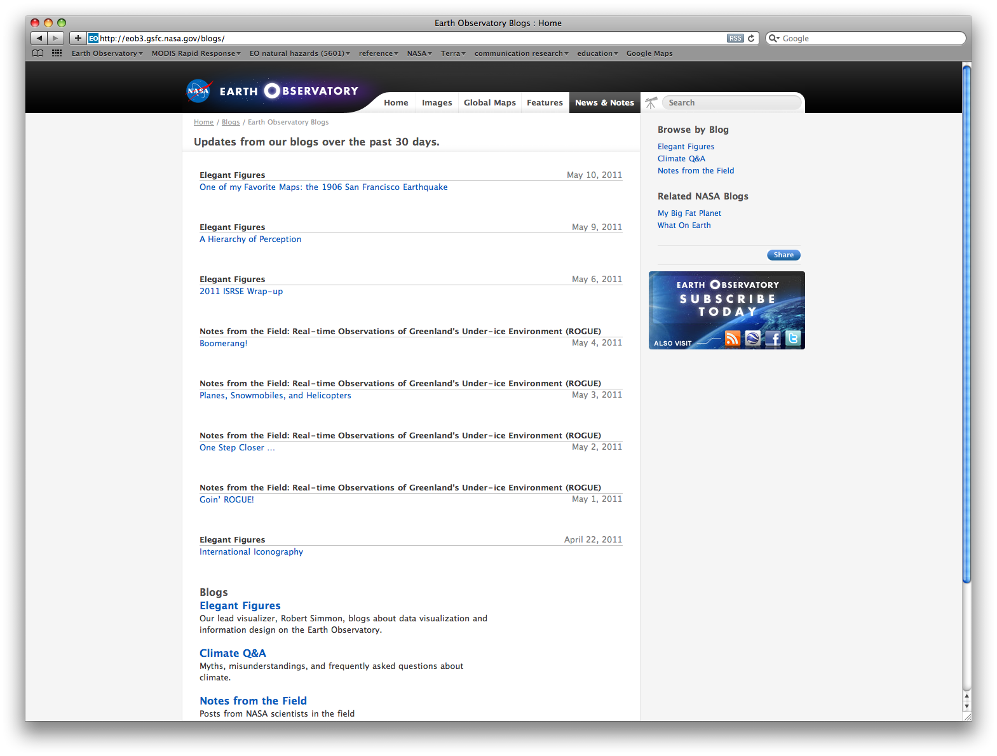

Slide 23
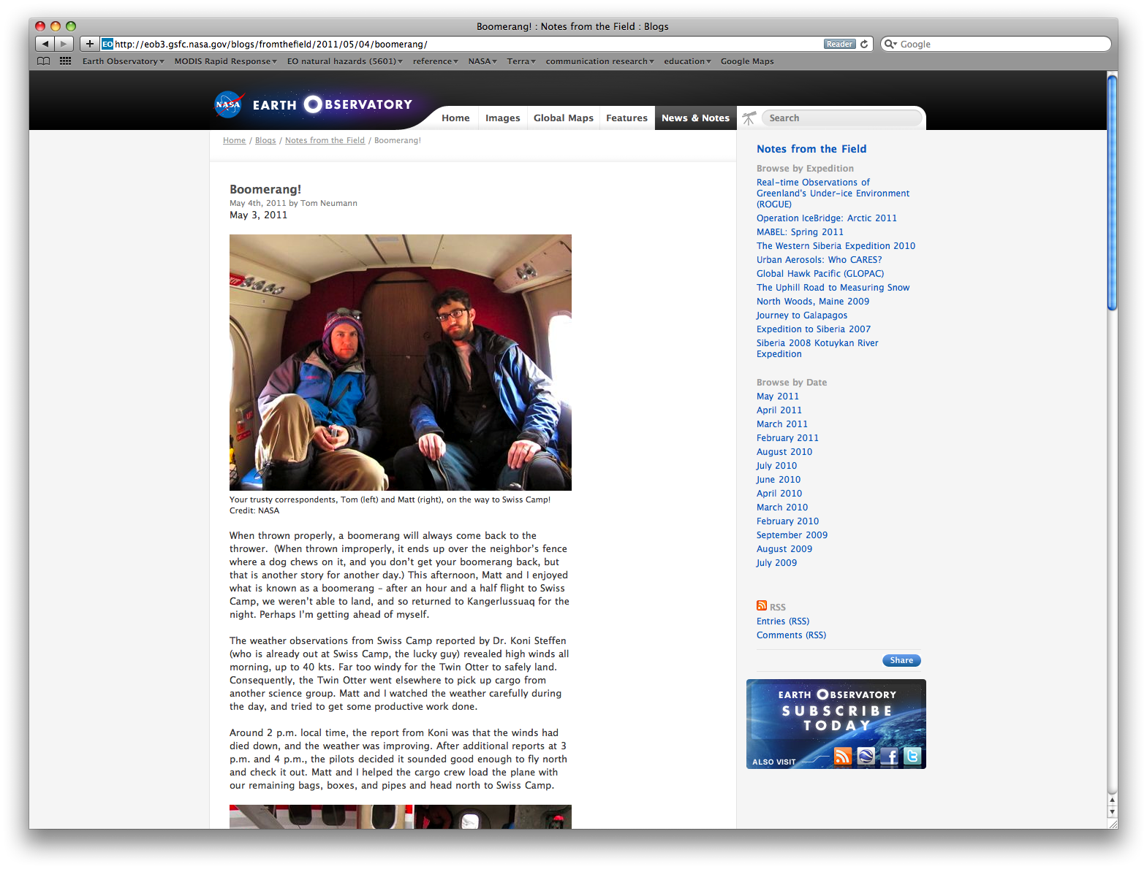

Slide 24
Contribute to the Earth Observatory
Blogs – Notes from the Field, Climate Q&A
Images – science highlights, images
Features – broad or significant research
Contact Mike Carlowicz at michael.j.carlowicz@nasa.gov

Slide 25
The Core Team
Kevin Ward - team leader, developer
Michael Carlowicz – editor
Rob Simmon - lead visualizer
Holli Riebeek – writer
Michon Scott – writer
Jesse Allen – visualizer
Paul Przyborski – system admin., developer

