Slide 1
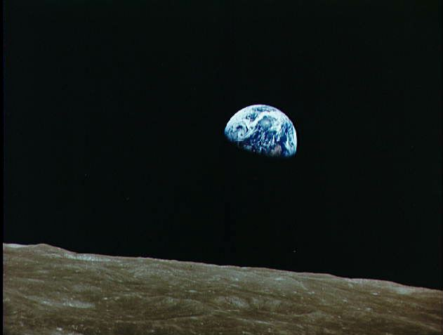
A New Role for Earth Science:
The Global Carbon Cops!
Steven W. Running
Numerical Terradynamic Simulation Group
College of Forestry and Conservation
University of Montana
MODIS SCIENCE TEAM MEETING
MaY 19, 2011

Slide 2
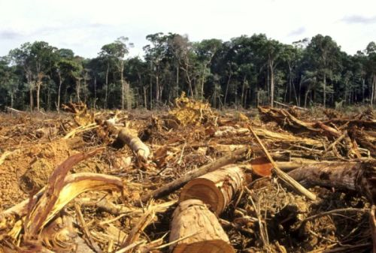
Fate of Anthropogenic CO₂ Emissions (2000-2009)
1.1±0.7 PgC y⁻¹
4.1±0.1 PgC y⁻¹
47%
+
2.4 PgC y⁻¹
27%
Calculated as the residual of
all other flux components
7.7±0.5 PgC y⁻¹
26%
2.3±0.4 PgC y⁻¹
Average of 5 models
Global Carbon Project 2010; Updated from Le Quéré et al. 2009, Nature Geoscience; Canadell et al. 2007, PNAS
Notes:
Residue is included in the land sink

Slide 3
Modelled Natural CO₂ Sinks
2
0
Land sink (PgCy⁻¹) 5 models
-2
-4
-6
1970
1980
2000
2010
1960
1990
2
0
Ocean sink (PgCy⁻¹) 4 models
-2
-4
-6
1970
1980
2000
2010
1960
1990
Time (y)
Updated from Le Quéré et al. 2009, Nature Geoscience
Notes:
Natural land and ocean CO2 sinks removed 57% of all CO2 emitted from human activities during the 1958-2009, each sink in roughly equal proportion. During this period, the size of the natural sinks has grown almost at the same pace as the growth in emissions, although year-to-year variability is large. There is the possibility, however, that the efficiency of the natural sinks is declining, an issue currently under intense debate in the scientific community. In 2009, the CO2 sinks increased slightly in repsonse to teh end of La Nina event that perturbed the global climate system from mid 2007 until early 2009.
The trend in the ocean sink is estimated by using an ensemble of 5 ocean-process models. The models were normalized to the observed mean land and ocean sinks for 1990-2000, estimated from a range of oceanic and atmospheric observations. Models were forced with meteorological data from the US national Centers for Environmental Prediction and atmospheric CO2 concentration. The land sink is calculated as the residual of the sum of all sources minus atmosphere+ocean sinks.

Slide 4
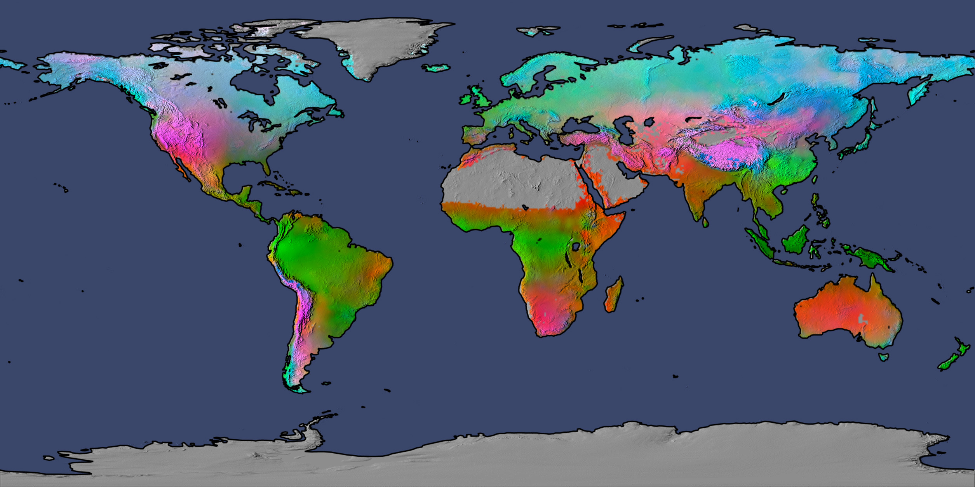
Potential climate limits to plant growth derived from long-term
monthly statistics of minimum temperature, cloud cover and rainfall.
Water = 40%, Temperature = 33%, Radiation = 27%
Nemani et al. 2003
Running et al 2004

Slide 5
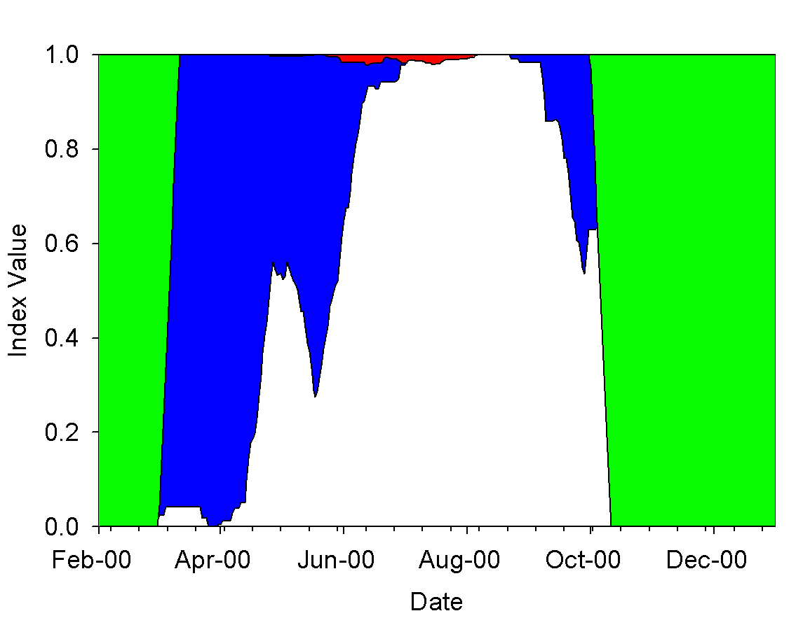
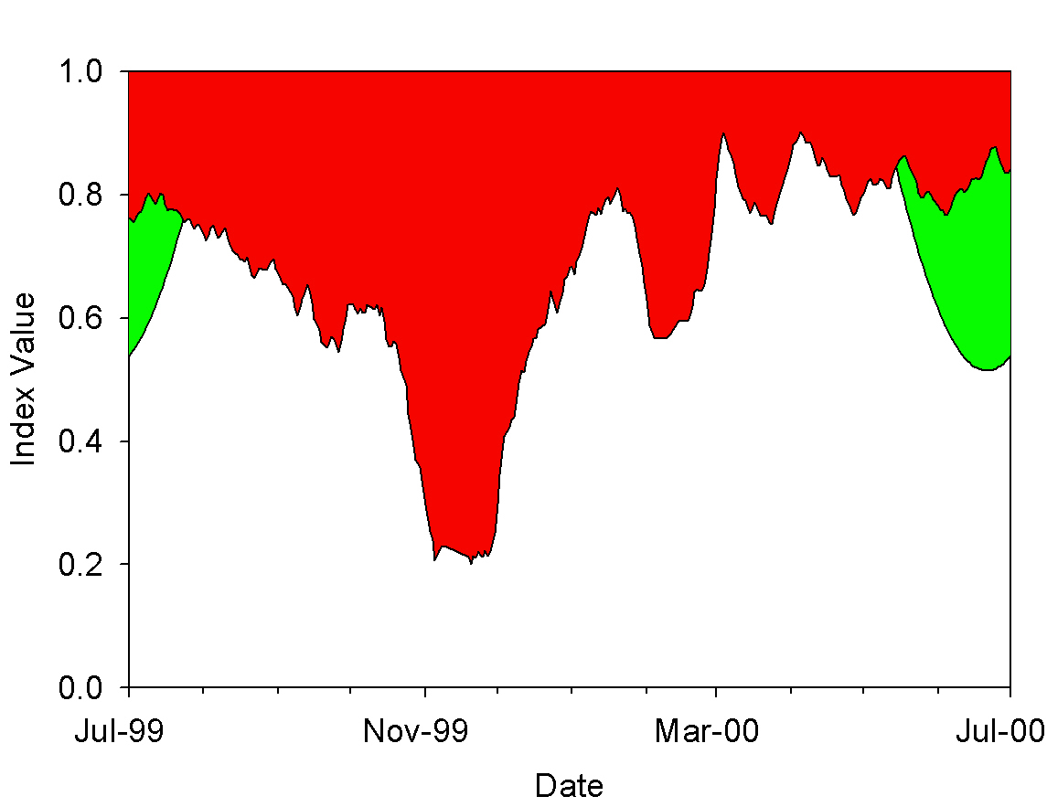
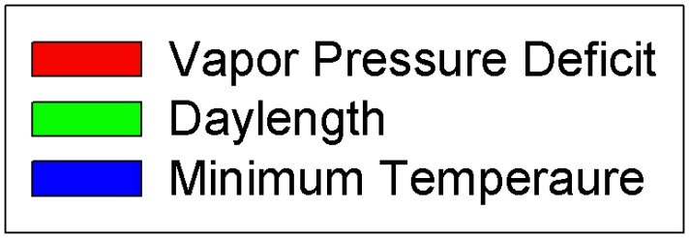
Seasonal Growing Season Constraints
Russia, Boreal
Africa, Savannah
Jolly, Nemani, Running. Global Change Biology 2005

Slide 6
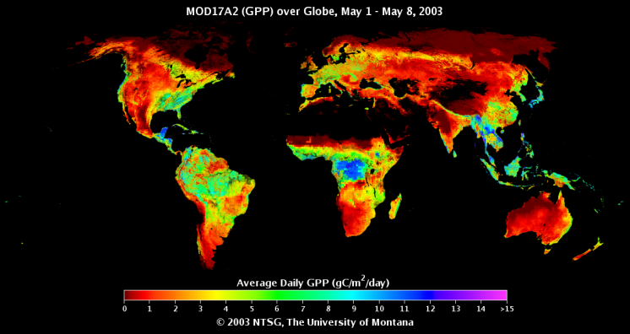
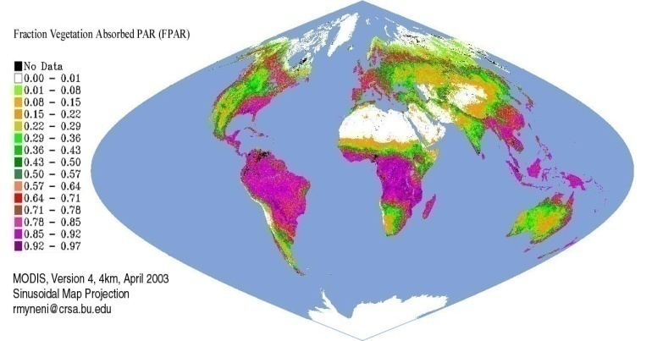
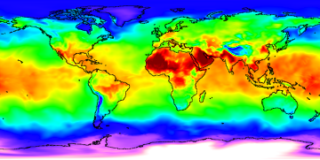
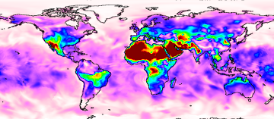
GPP = Light X Conversion Efficiency
GPP = f (PAR) x ε
Biome
Properties
Look-Up
Table (ε_{max} )
GPP
fPAR, PAR
Temperature
VPD

Slide 7
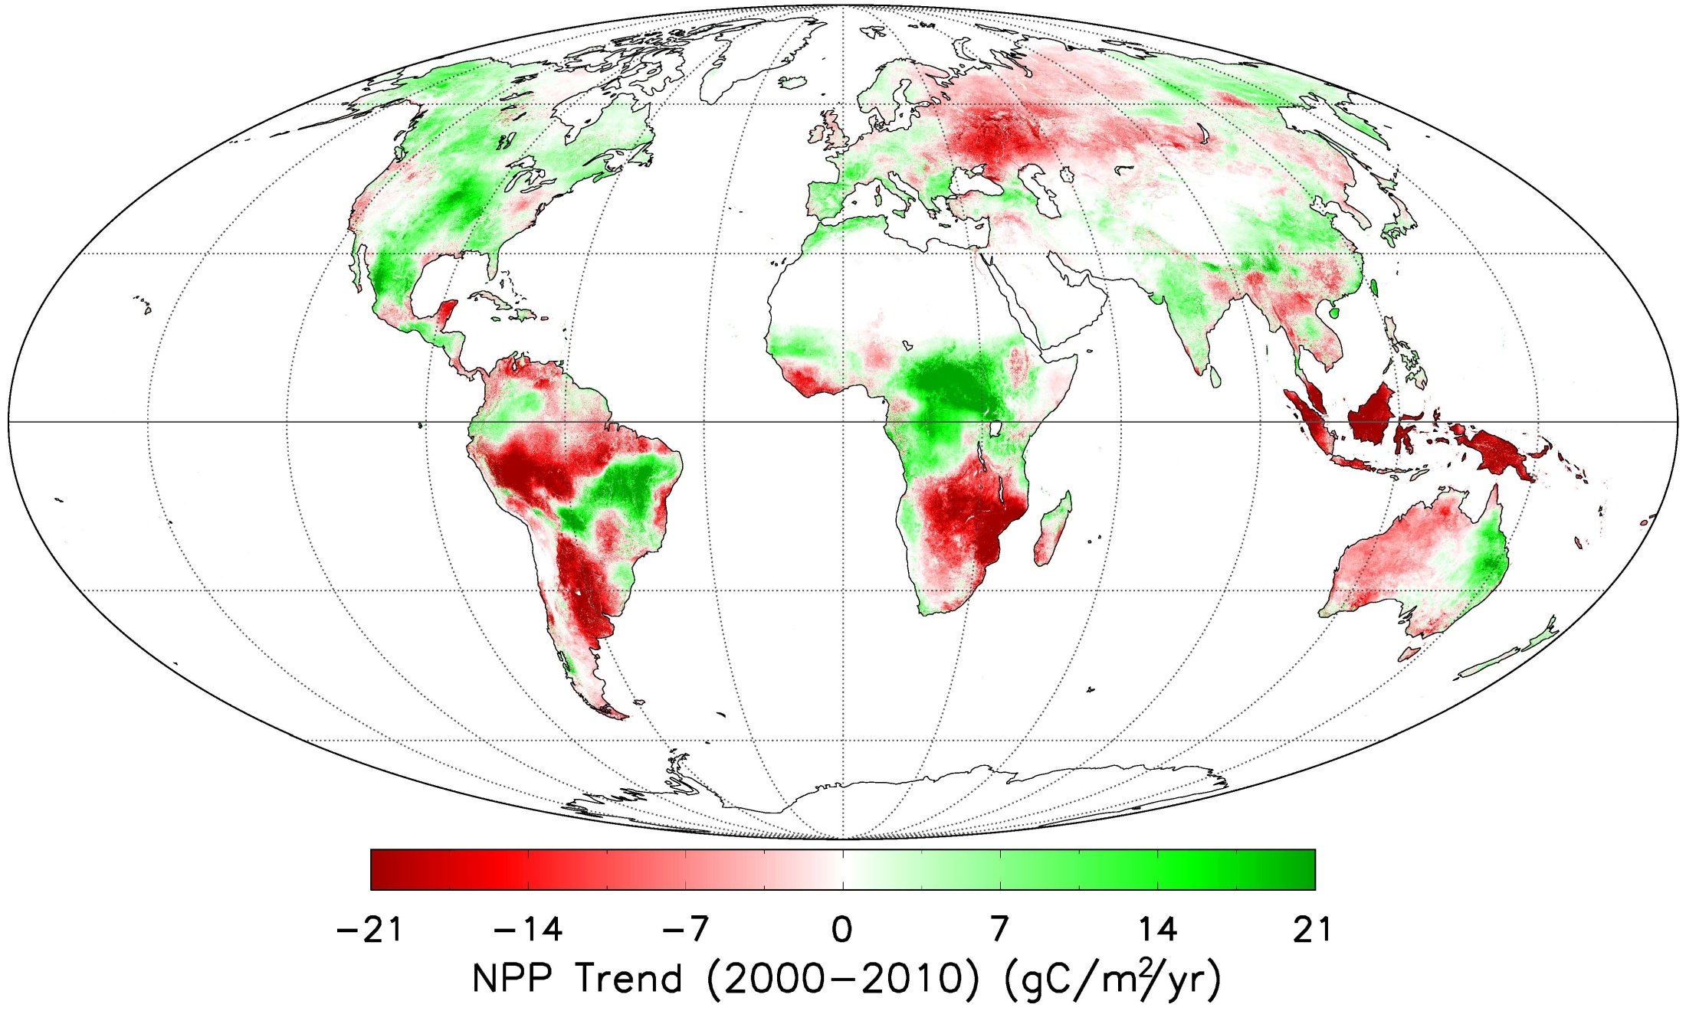
Net Primary Production trend (2000-2010)
Zhao & Running 2010, Science

Slide 8
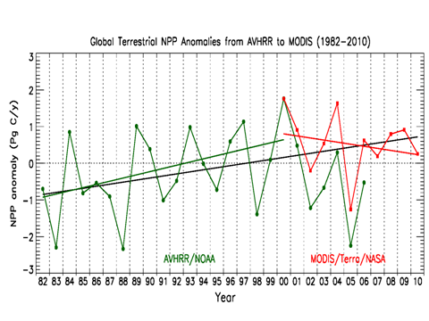
Global NPP Trend
From + in the 1980s-90s to a – in the 2000s

Slide 9
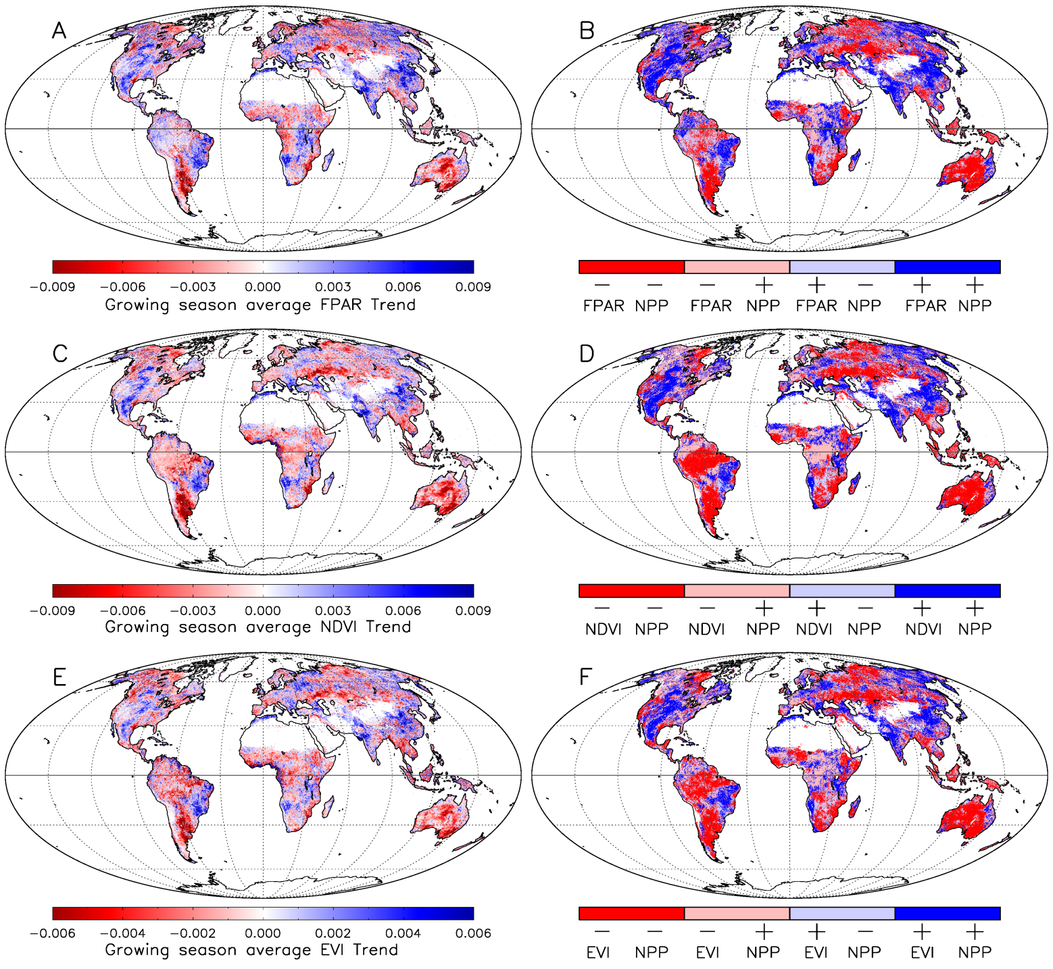
Consistency in changes between vegetation indices and NPP
FPAR
NDVI
EVI

Slide 10
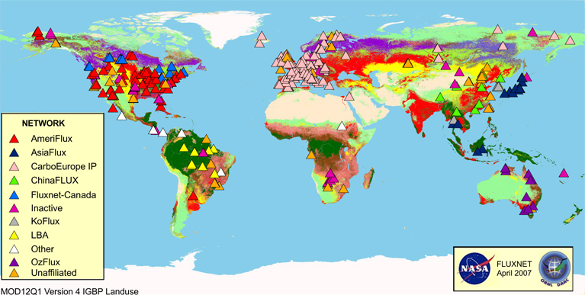
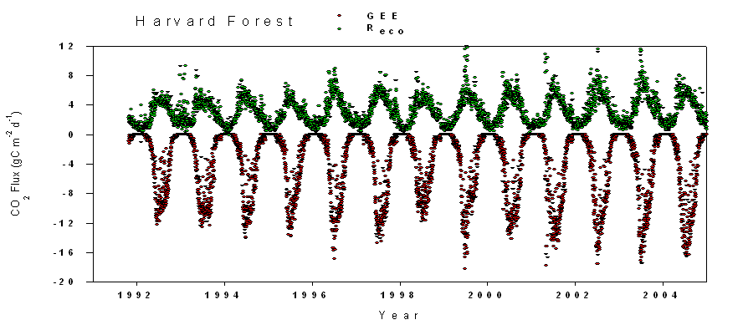

Slide 11
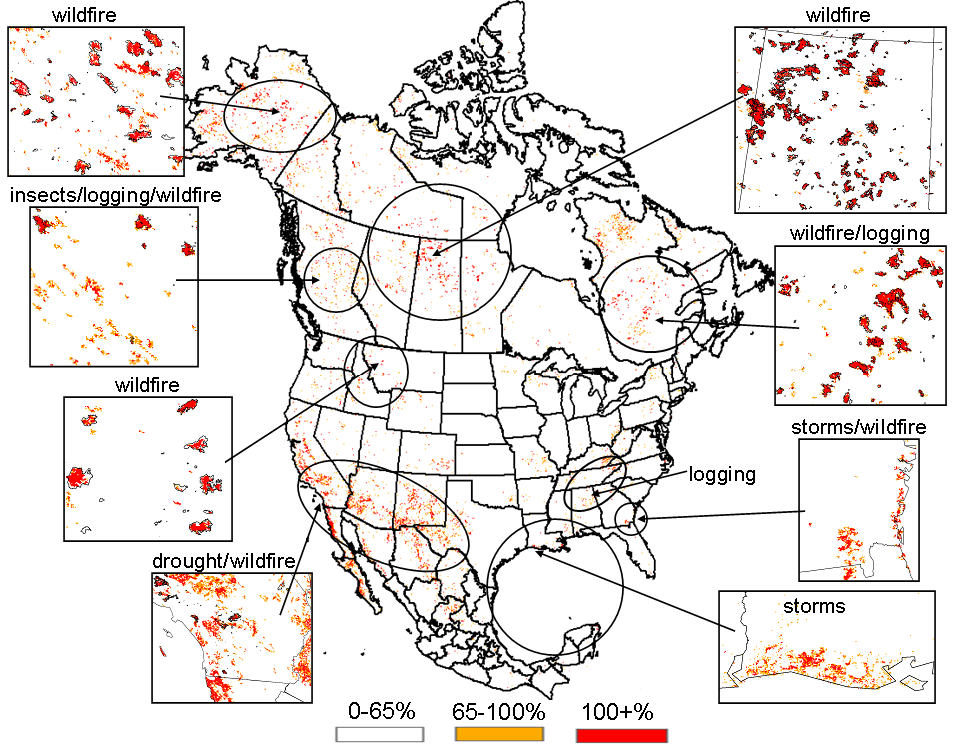
MODIS Annual Disturbance Index
Mildrexler et al 2007, 2009

Slide 12
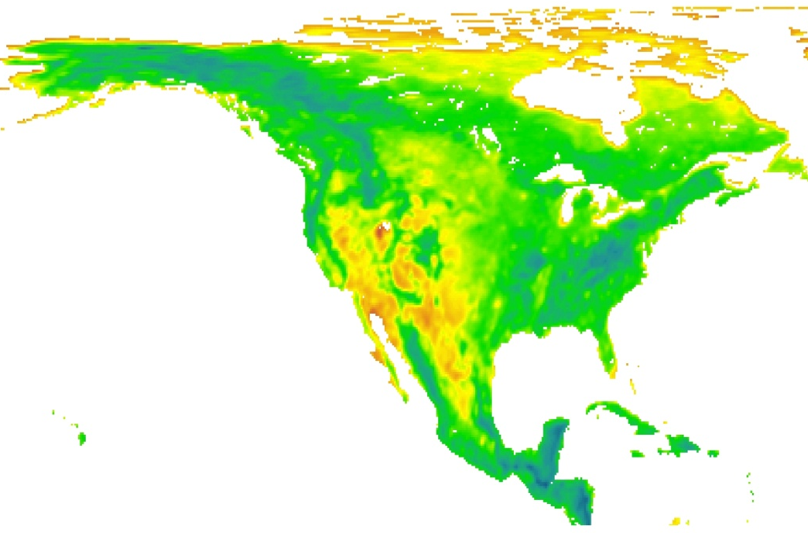
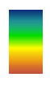
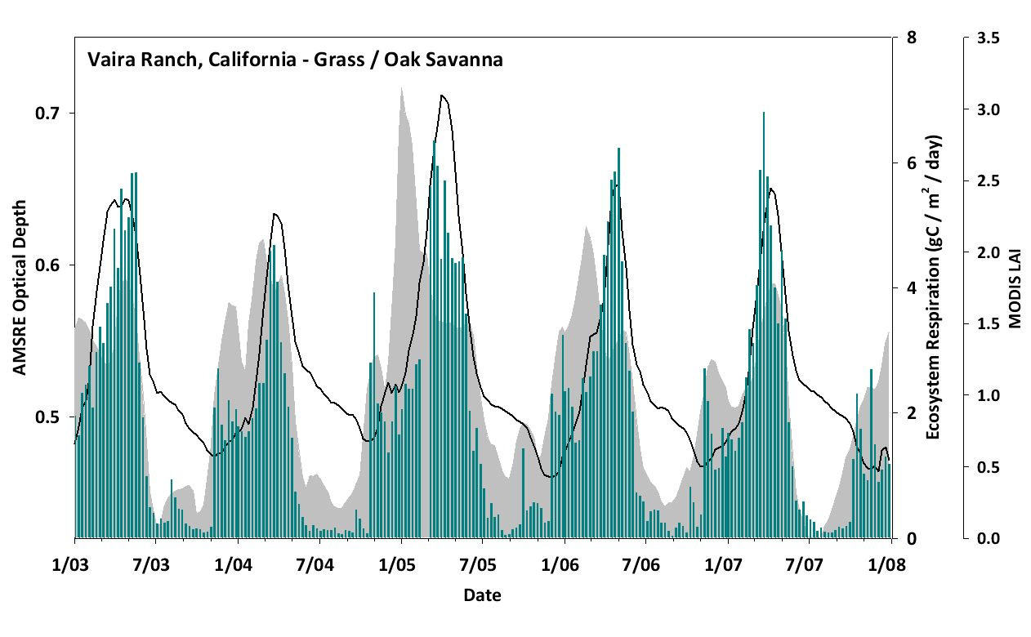
Monitoring Vegetation Phenology using AMSR-E Optical Depths: Comparison with MODIS LAI & Tower CO₂ fluxes
AMSR-E Optical Depth vs MODIS LAI
TIMESAT Start of Season
6 Ameriflux Towers 2004-2007
Vegetation Optical Depth Mean 2003-2008
High
Low
r² = 0.97
r² = 0.97
AMSR-E Optical Depth
MODIS 8 Day LAI
Ecosystem Respiration
Vegetation phenology assessment using AMSR-E optical depth retrievals. Seasonal changes in AMSR-E optical depths coincide with MODIS LAI derived start of the growing season (above) and seasonal shifts in ecosystem respiration from tower eddy covariance CO₂ measurements (left). The AMSR-E optical depths provide a unique measure of seasonal changes in canopy biomass that is less impacted by atmospheric contamination than optical-IR remote sensing, enabling near daily observations of vegetation conditions.
Notes:
At this semi-arid site (38.407 Lat, -120.951 Lon ) AMSR-E optical depth shows a double seasonal peak that was sensitive to early season vegetation changes (onset of grasses), that was not detected using MODIS LAI time series. The optical depth also compares favorably with tower measured seasonal shifts in ecosystem respiration and net ecosystem CO₂ exchange. The MODIS and AMSR-E results provide synergistic phenology information, including dynamic changes in both vegetation greenness and canopy biomass that are sensitive to seasonal changes in surface meteorology and land-atmosphere carbon exchange. We are working to combine these data to produce improved phenology measures optimized for a broad range of global atmospheric and environmental conditions.
12

Slide 13
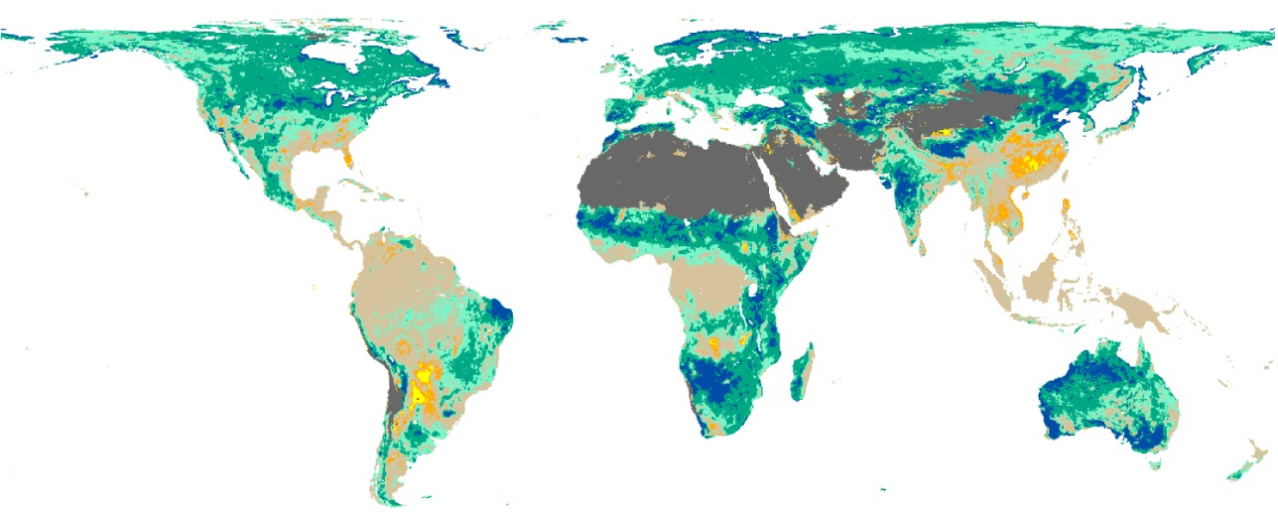
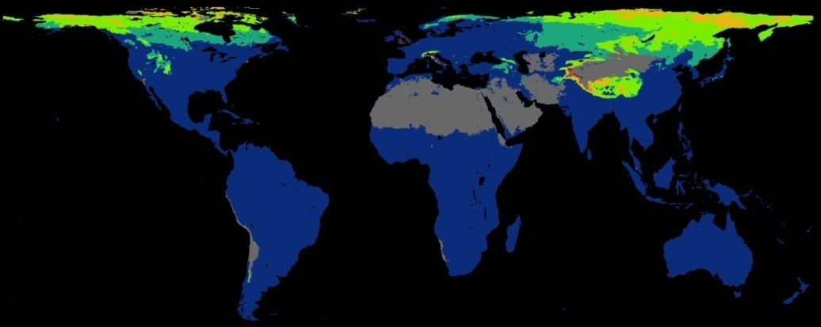
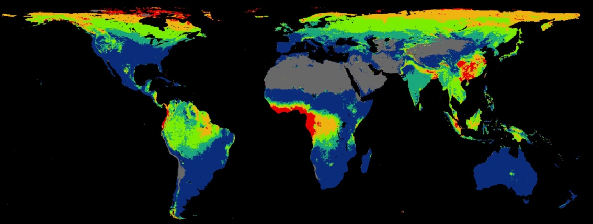
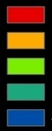
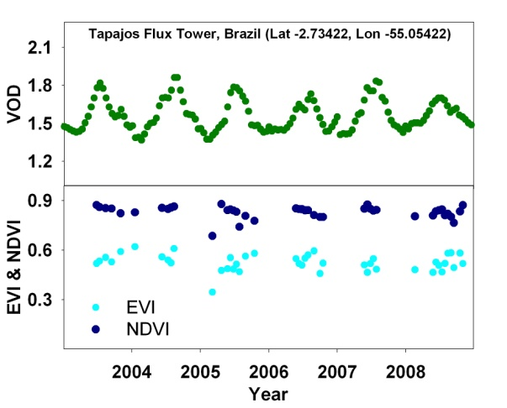
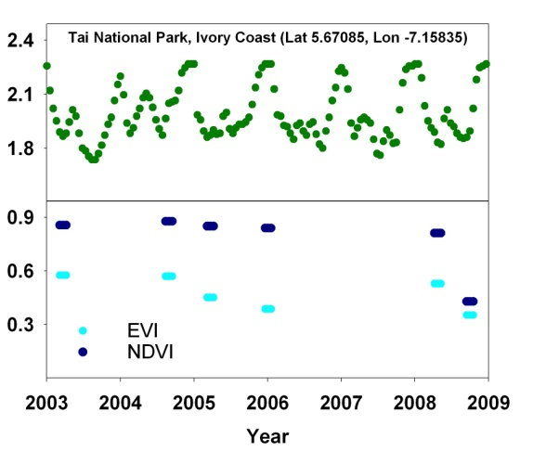
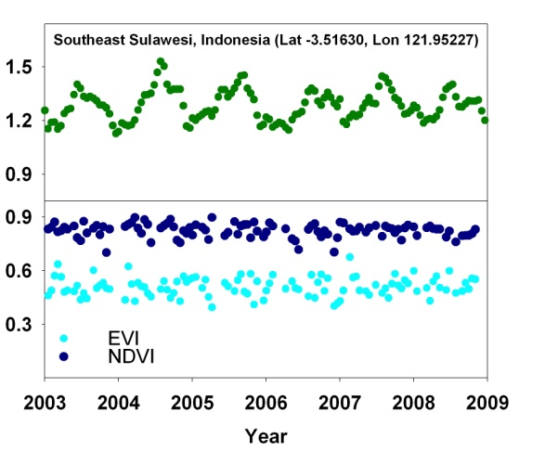
Global Phenology Monitoring using Vegetation Optical Depth (VOD) from AMSR-E
AMSR-E VOD (10.65GHz) is sensitive to vegetation canopy biomass & is well correlated with MODIS LAI, EVI & NDVI;
The VOD is largely unaffected by clouds & solar illumination, with potentially continuous global, daily monitoring;
The AMSR-E VOD provides a unique & complimentary phenology dataset.
R-value
MODIS LAI & AMSR-E VOD Correlation
8-Day Data
2003-2008
R-value
M.O. Jones et al. 2010. Rem Sens. Environ. 115
-1.0 -.75 -.5 -.25 .25 .5 .75 1.0
Highest QC Data Availability
AMSR-E
VOD
MODIS
EVI
Percent of Total
(2003-2008)
A
0 – 20%
21-40%
41-60%
61-80%
81-100%
B
C
IGBP Barren Land Cover Class
A
B
C
Notes:
We recently developed an algorithm for global retrieval of VOD from Aqua AMSR-E 10.65 GHz (X-band) brightness temperature time series across diverse land covers that requires minimal ancillary information and is sensitive to canopy biomass and vegetation water content.
The VOD signal shows negligible sensitivity to soil moisture variability, is largely independent of open water effects and varies with canopy density.
13

Slide 14
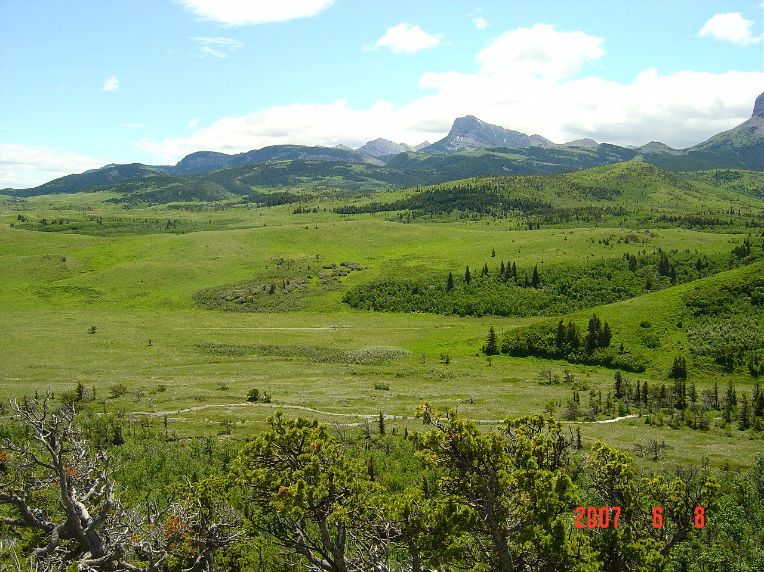
ARE WE REACHING A LIMIT IN
BIOSPHERIC PRODUCTIVITY?
OR
HAVE WE HIT PEAK NPP?

Slide 15
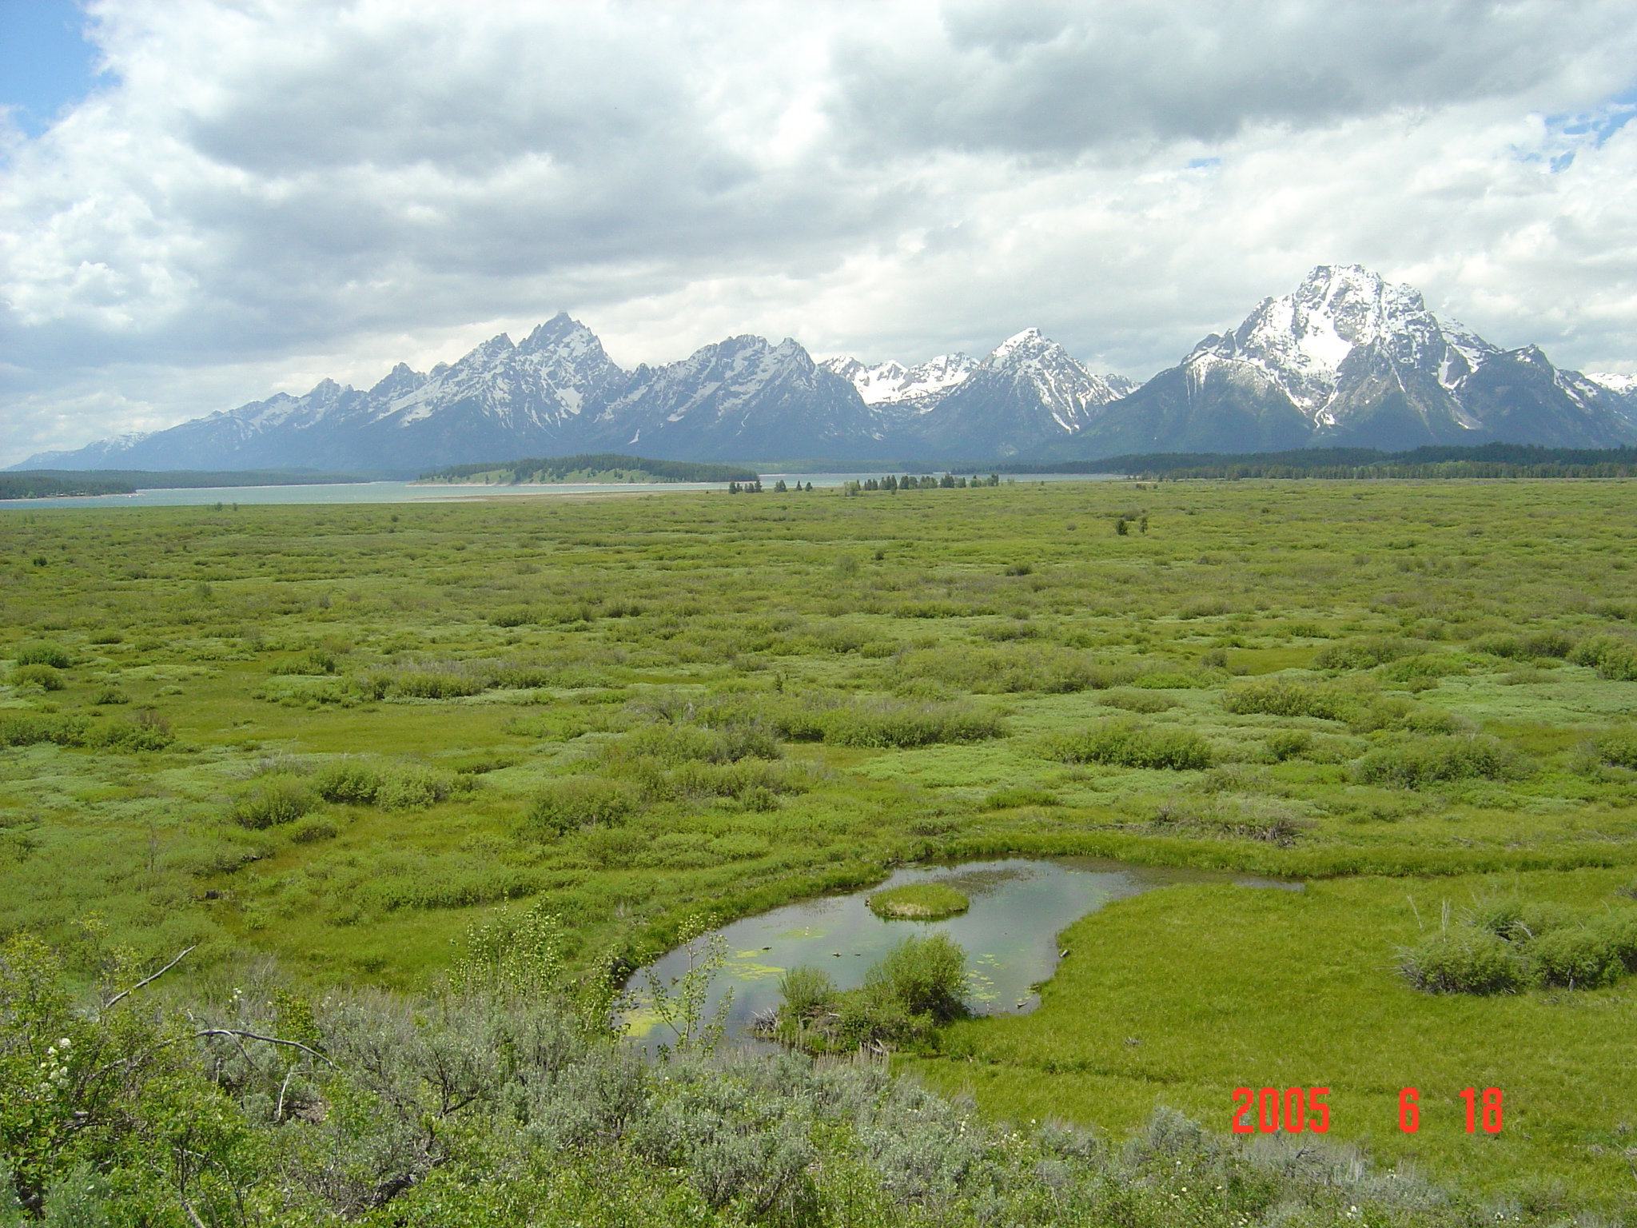
How will Biospheric Production meet a population increase of 40% and multiple new demands from
2011 - 2050?
Primary (Vegetation) Production is normally increased by:
- Engaging more land
- Irrigation/fertilization
- Genetic improvements

Slide 16
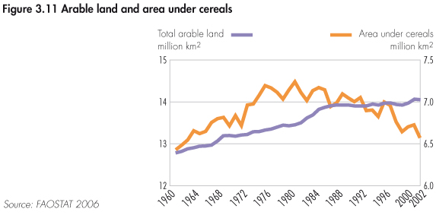
Land area is NOT increasing

Slide 17
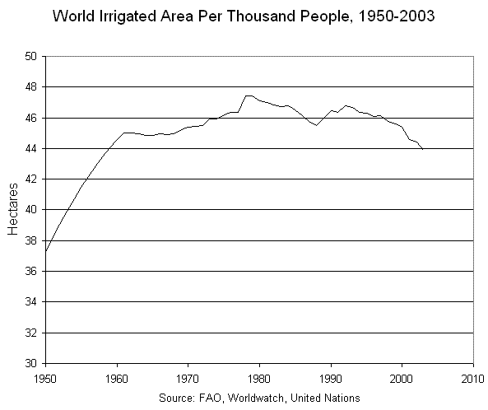
Irrigated Land Area is NOT Increasing
Lester Brown Plan 3.0, 2008

Slide 18
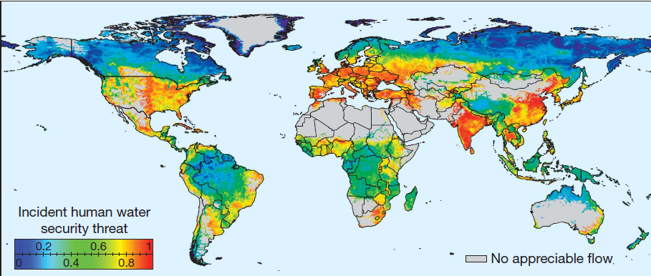
Global Water Availability Risk
Vorasmairty et al Nature 2010

Slide 19
Multi-Year Trend in Estimated Mean Annual ET and P-ET (1983-2006)
~73% of the global domain shows a positive ET trend;
BUT
~51% of the domain shows a negative water balance (P-ET) trend.
ET
P-ET
Notes:
19

Slide 20
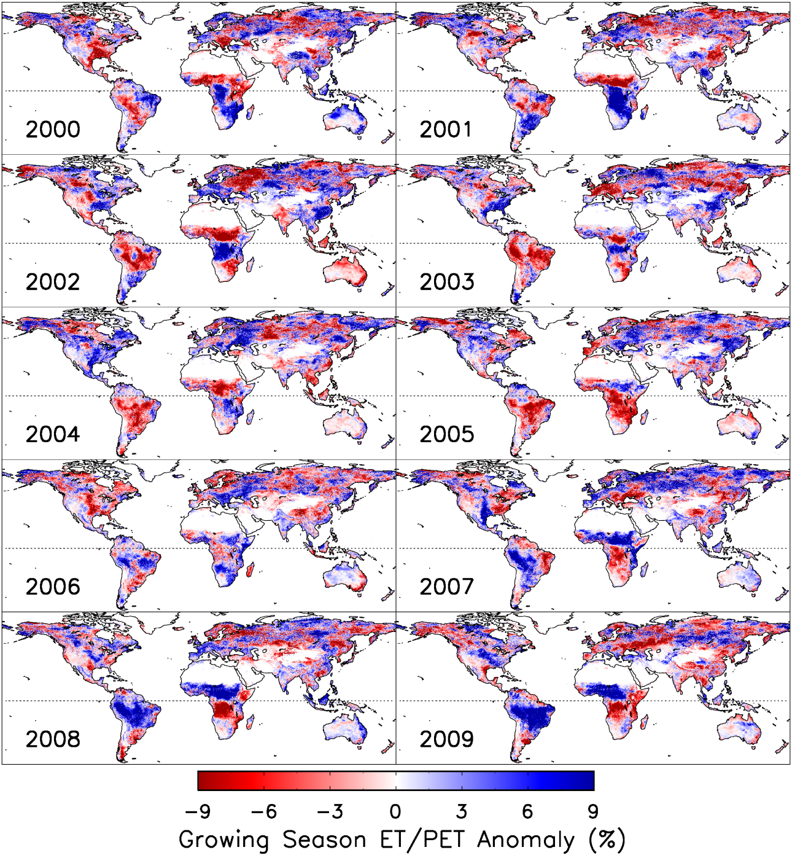
MODIS ET (MOD 16)

Slide 21
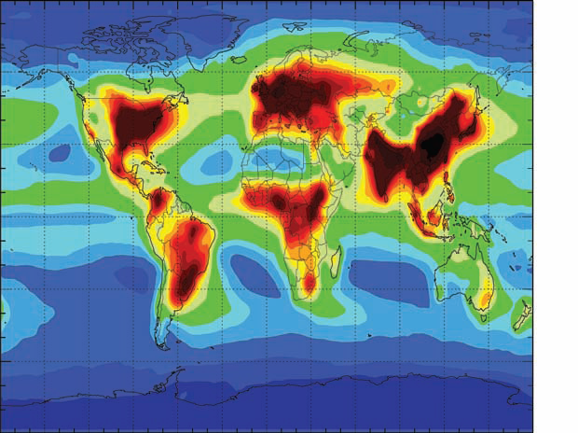
Nitrogen Loading is already damaging the biosphere
N Deposition rates ( 0 – 60kg/ha/yr )
Galloway et al Science 2008

Slide 22
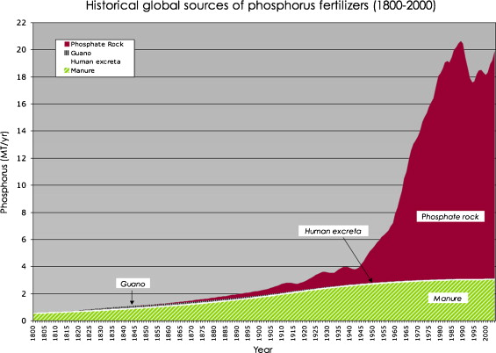
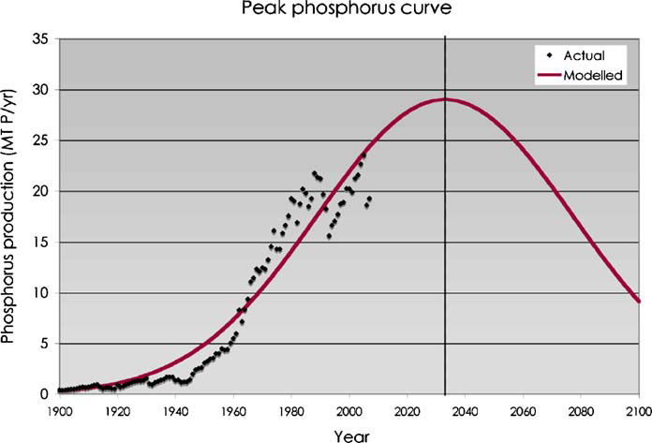
Future Phosphorus Limitations ?
Cordell et al 2009.
Global Env Change 19: 292-305

Slide 23
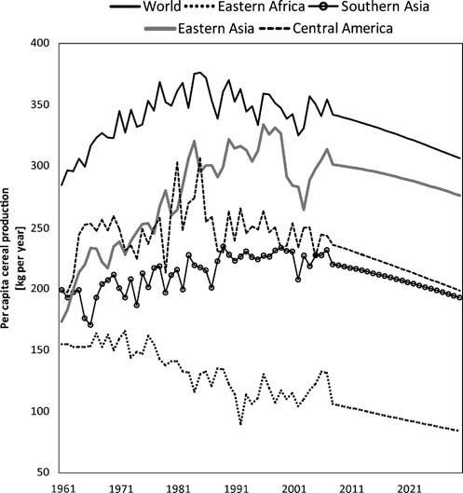
Per Capita Agricultural Production trends.
Global 14% Per capita reduction projected by 2030
Funk and Brown (2009)

Slide 24
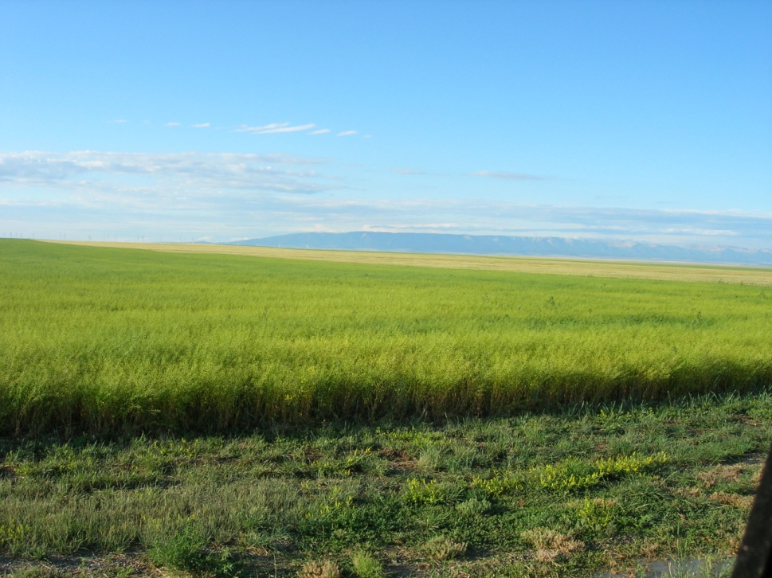
IS OUR CURRENT BIOSPHERIC CONSUMPTION OF NPP Sustainable*?
*Meeting needs and values of today’s generation, while preserving the planet’s life-support systems for the needs and values of future generations.

Slide 25
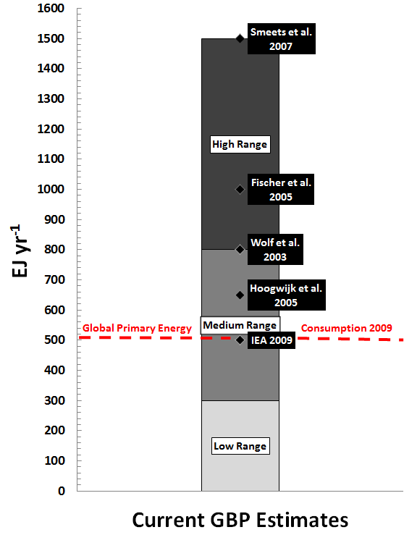
Current Global Bioenergy Potential Estimates
Current GBP estimates range up to 300% of global primary energy consumption 2009.
Bioenergy alone, adequate to fully replace fossil fuels?
Adapted from Dornburg et al. 2010

Slide 26
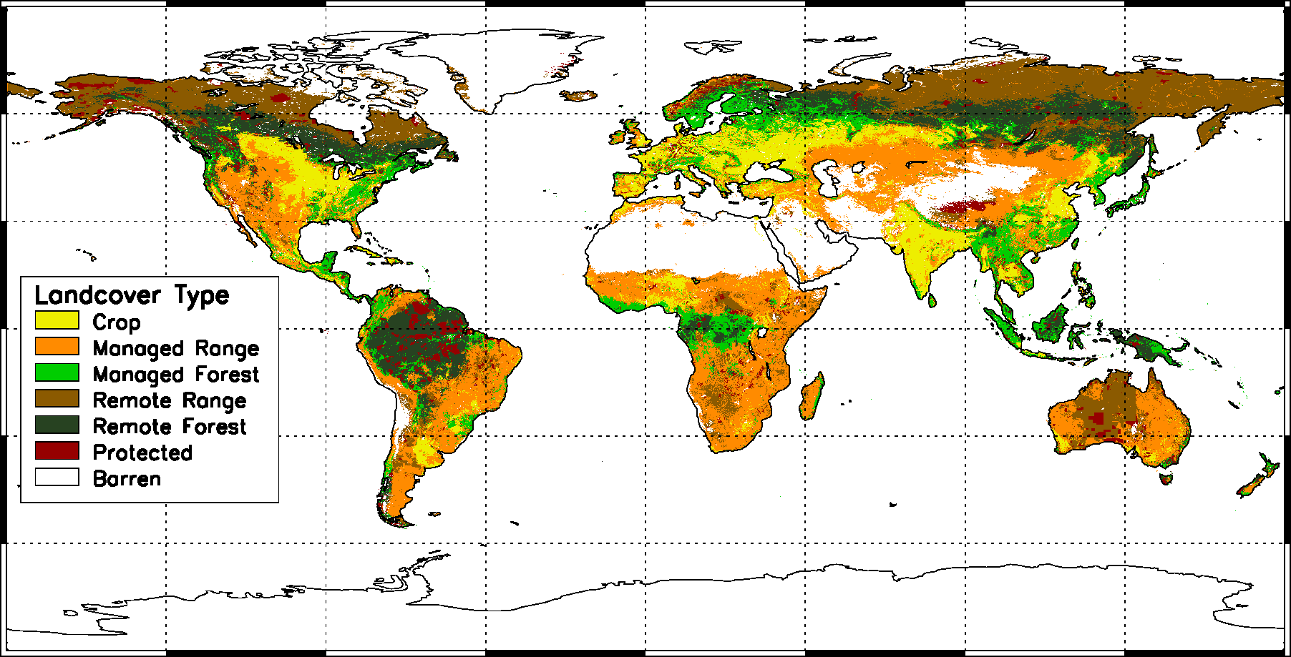
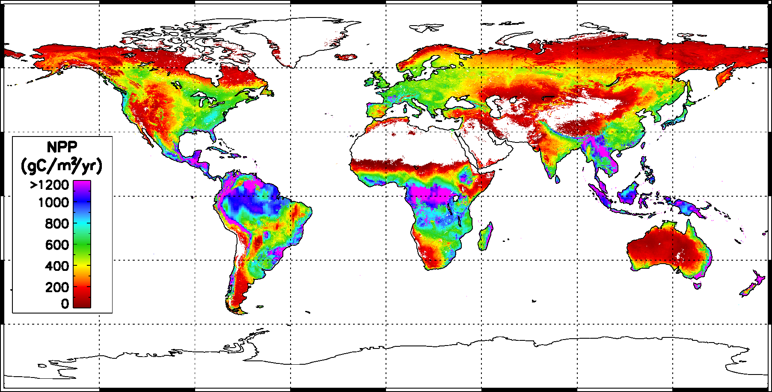
Methods
Global landcover:
MODIS NPP
MODIS LC
AGR2000
WDPA
GHF
Average global NPP (2000-2006) estimated from the MODIS GPP/NPP algorithm

Slide 27
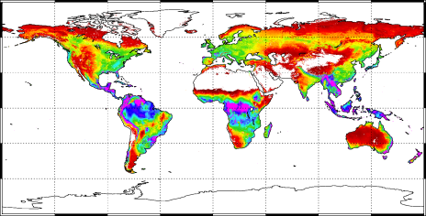
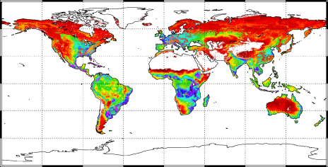
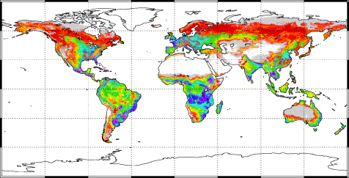
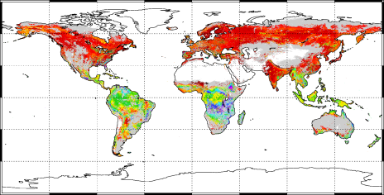
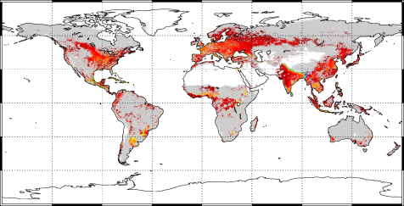
Scenario | Definition | Spatial
NPP | Total net primary production
GBP_{CAP} | Sustainable harvest of all aboveground NPP
GBP_{BIO} | GBP_{CAP} without low productivity areas
GBP_{AVAIL} | GBP_{BIO} without HANPP
GBP_{RES} | Sustainable harvest of current harvest residues only

Slide 28
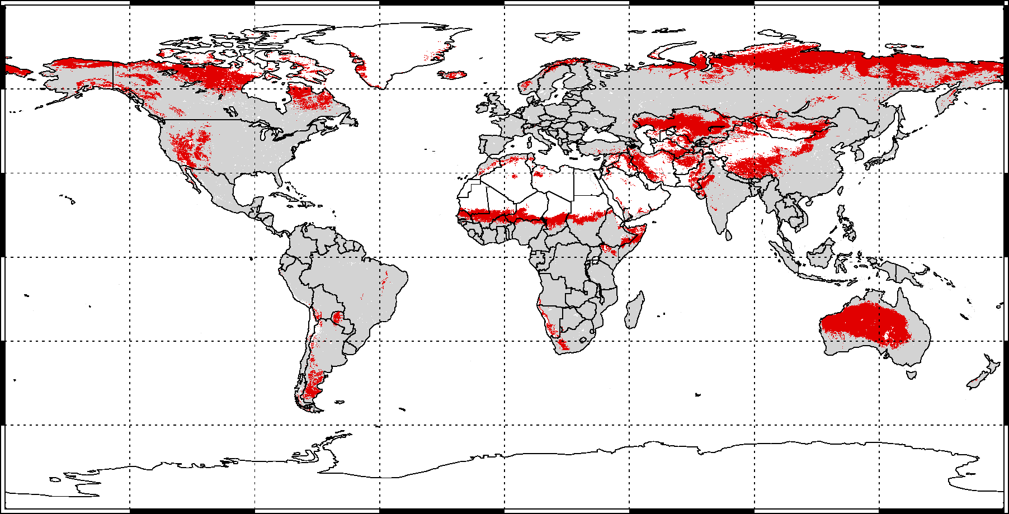
Low Productivity Areas
150 gC m⁻² yr⁻¹: threshold at which harvest energy requirements exceed potential bioenergy output

Slide 29
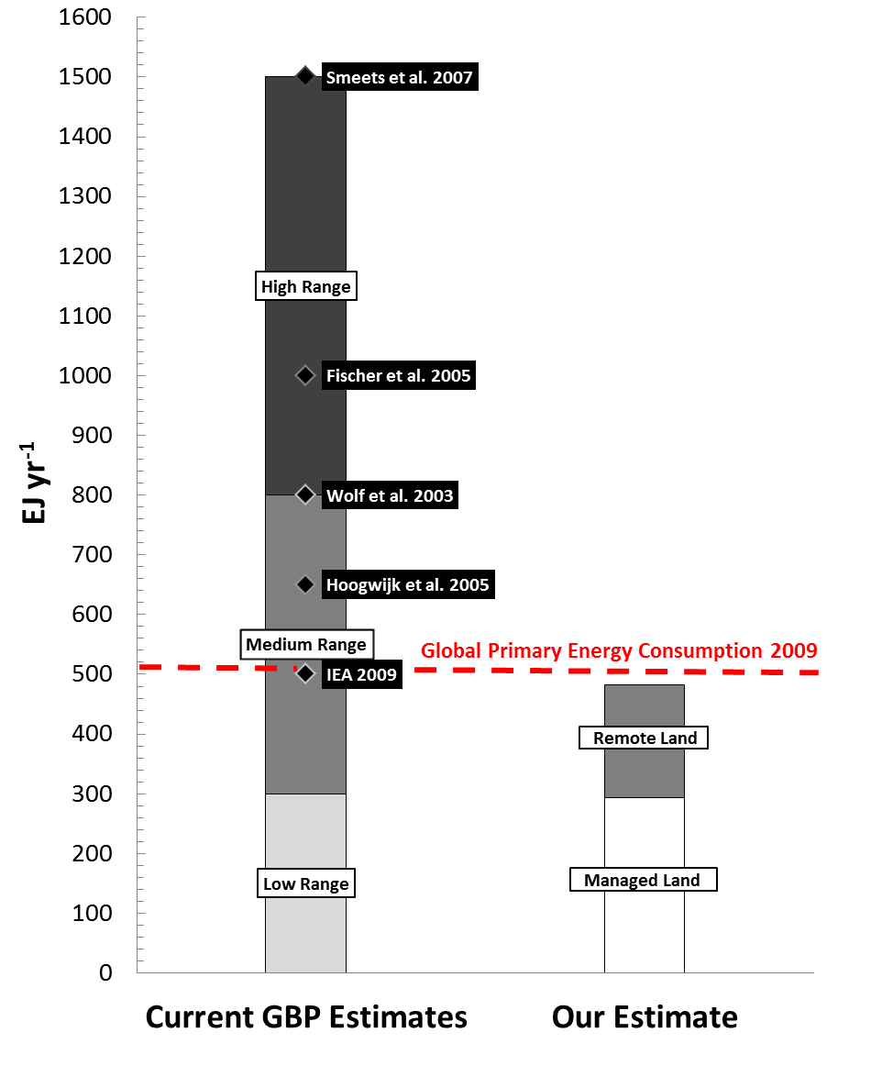
Current Global Bioenergy Potential Estimates
Achievable GBP:
  Managed Land:
  20-57% of GPEC09
  Remote Land:
  0-36% of GPEC09
We integrate current natural and human management factors, which are inherent in the MODIS NPP data

Slide 30
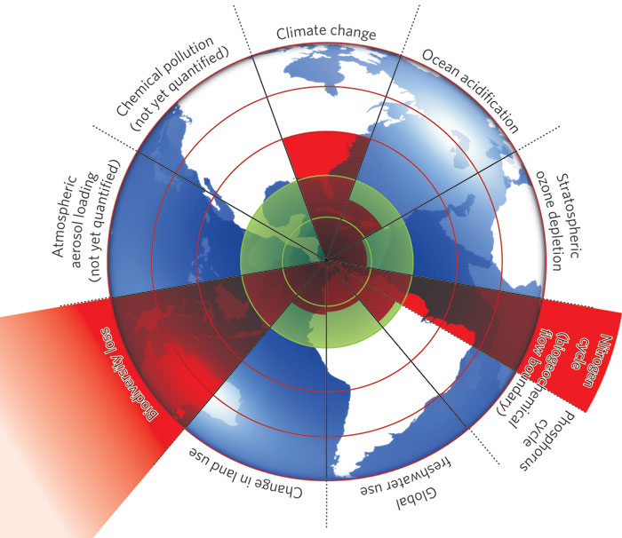
PLANETARY BOUNDARIES
Rockstrom et al. Nature 2009

Slide 31
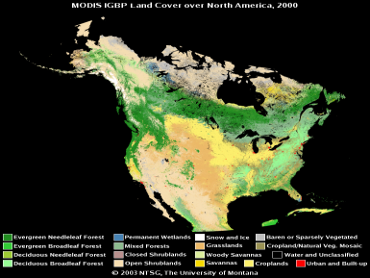
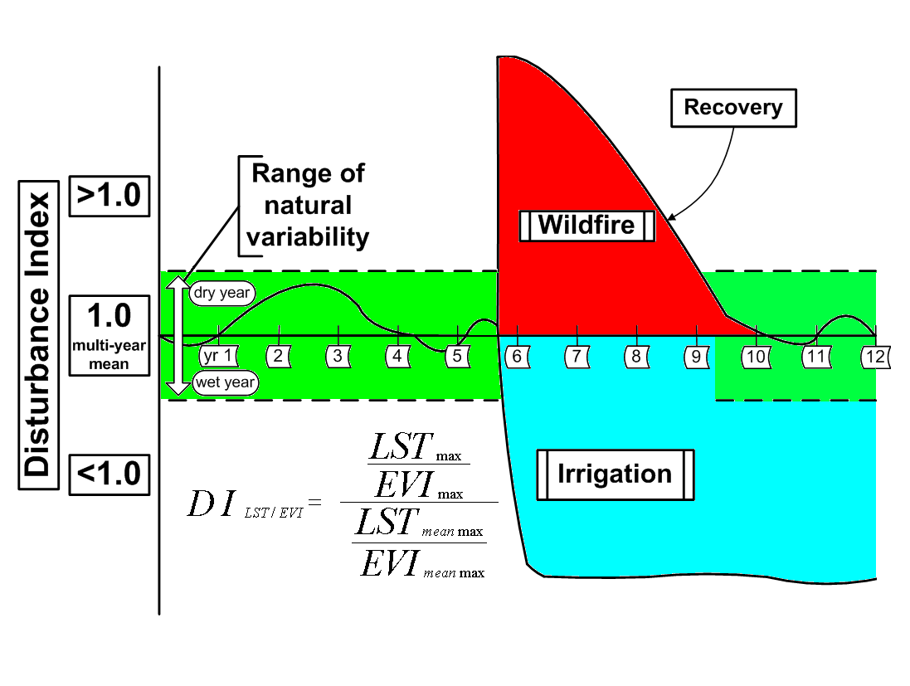







Terrestrial Carbon Monitor
State
Change
LANDCOVER
SATELLITE DATA
GROWING SEASON
PRIMARY PRODUCTION
GROUND DATA

