Slide 1

NPP Science: HQ Perspective on VIIRS
Diane E. Wickland
NPP Program Scientist
May 18, 2011

Slide 2
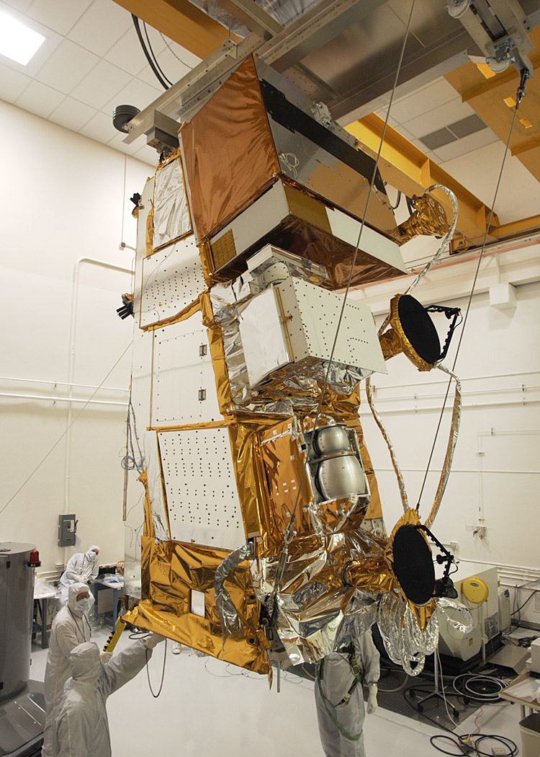
NPP Satellite - Nadir Deck View
Instruments lined up along cold facing panel
Nadir facing antennas
  T&C
  HRD
  SMD
CrIS and VIIRS cyro-radiators FOV to cold space on cold facing side
VIIRS
CrIS
ATMS and VIIRS EM heat pipe radiators mounted to cold facing panel
ATMS
OMPS

Slide 3
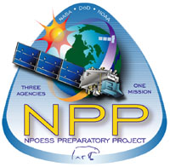
NPP is a NASA mission, but it is a little different . . .

Slide 4
NPOESS, JPSS, and NPP
NPP and NPOESS have a long, complicated history
The tri-agency NPOESS partnership (DOD, NOAA, NASA) has been dissolved
  “NPOESS” is no more
  The NOAA-NASA partnership continues under the Joint Polar Satellite System (JPSS) – afternoon platform series
  DOD is continuing alone -- early morning platform series
  NASA’s NPP mission has not changed its name – it is still the NPOESS Preparatory Project.
The roles and responsibilities of the NPP Science Team have not changed (at its core, the primary work remains EDR evaluation and related algorithm improvements for climate science!)

Slide 5
NPP Goals
The NPP mission has two major goals:
To provide a continuation of the EOS record of climate-quality observations after EOS Terra, Aqua, and Aura (i.e., it will extend key Earth system data records and/or climate data records of equal or better quality and uncertainty in comparison to those of the Terra, Aqua, and Aura sensors), and
To provide risk reduction for JPSS instruments, algorithms, ground data processing, archive, and distribution prior to the launch of the first JPSS spacecraft (but note that there are now plans to use NPP data operationally)

Slide 6
NPP Instruments
Five sensors will be flown on the NPP mission:
Visible Infrared Imaging Radiometer Suite (VIIRS)
Cross-track Infrared Sounder (CrIS)*
Advanced Technology Microwave Sounder (ATMS)*
Ozone Mapping and Profiler Suite (OMPS), and
Clouds and the Earth's Radiant Energy System (CERES)
* CrIS and ATMS together are referred to as CrIMSS

Slide 7
NPP PEATEs
As part of its Science Data Segment (SDS), NASA has developed several disciplinary Earth science Product Evaluation and Analysis Tool Elements (PEATEs) to support NPP Science Team members and the NPP Project staff in their evaluation of the EDRs
The PEATEs provide functions for the NPP Science Team and the NPP Instrument Calibration Support Element (NICSE) in support of their goals to evaluate SDR and EDR performance and to assess the suitability of operational EDRs for use in climate analyses.
The PEATEs also support development of improvements to the operational algorithms which generate SDR and EDR products.

Slide 8
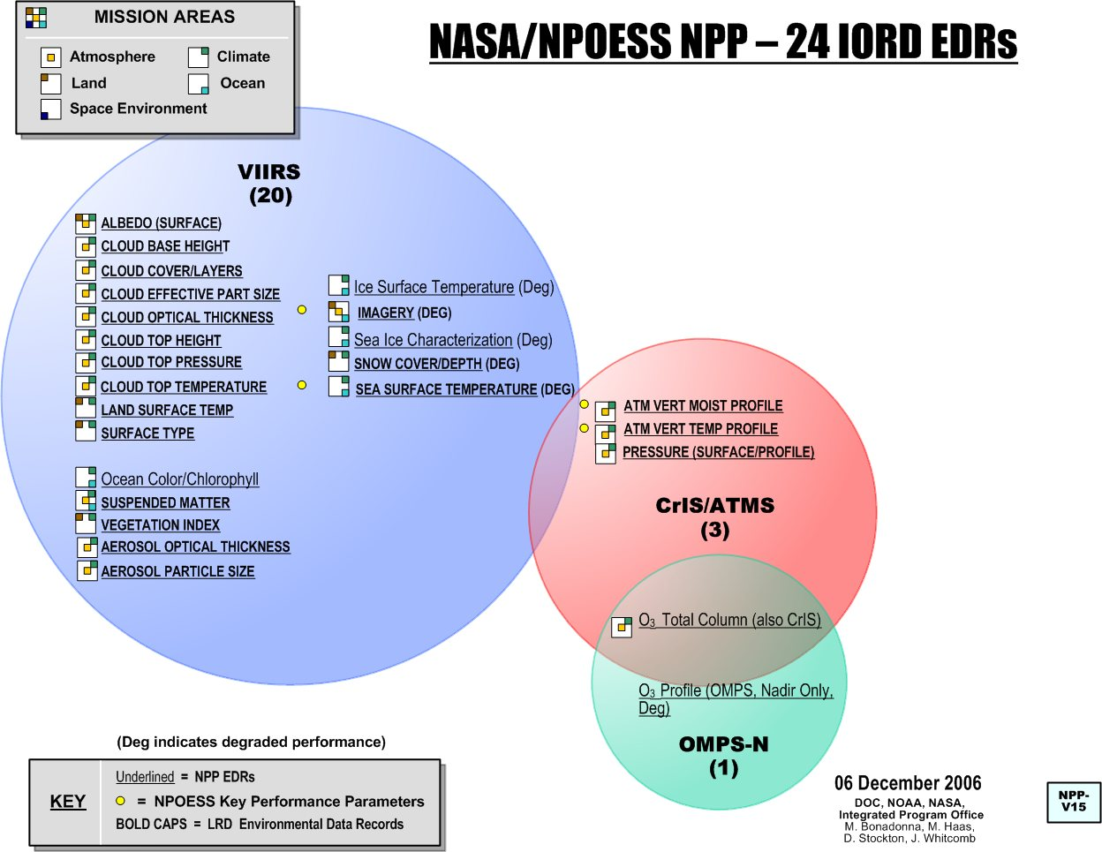
NPP / JPSS Data Products
Many IDPS algorithms have early (collection 3) EOS heritage. (EOS will be in Collection 6 by the time NPP data begins)
NASA Data Products:
CERES data products
OMPS Limb ozone profile

Slide 9
NPP Science Team for Climate Data Records

Slide 10
NPP Science Team Proposals Solicited (A.22 of ROSES-2010)
This solicitation requested proposals from members of the scientific community to participate in the NPP Science Team. NASA requested investigations for:
New and successor investigations to continue the evaluation of NPP/JPSS Environmental Data Records (EDRs), to demonstrate the suitability of these data sets for use as ESDRs and/or CDRs, and to develop and evaluate improvements to EDR algorithms that could make them more suitable as ESDRs or CDRs;
New investigations to develop scientific approaches for continuing key ESDRs begun by EOS that cannot be continued by NPP/JPSS due either to their omission from the initial plans for NPP/JPSS or to known performance limitations of the instruments currently in development; and
New investigations to develop and demonstrate innovative and practical applications of NPP data.

Slide 11
NPP Science Team - Key Statistics
Number of Proposals: Submitted Recommended Percentage
72 34 47%
Balance Across Types Recommended:
EDR Evaluation:
  a. EDR Evaluation and Improvement: 17
  b. Cal/Val: 5 ½
  c. New product using NPP data: 8 ½
Continuity product using non-NPP data: 0
Innovative and Practical Applications: 3

Slide 12
A.22: Recommended Balance Across Disciplines and Instruments
VIIRS: 26
ATMS: 2 ½
CrIS: 2 ½
OMPS: 3
CERES: 0 (not called for)
Land: 13
Ocean: 7
Atmosphere: 13

Slide 13
NPP Satellite Scheduled for Launch
Nadir facing antennas
  T&C
  HRD
  SMD
Launch Readiness Date: October 25, 2011
VIIRS
CrIS
ATMS
OMPS

Slide 14
End

Slide 15
NASA NPP Rationale
NPP will provide a bridge to ensure data continuity between the NASA EOS research satellites and the JPSS operational environmental satellite system.
  NPP is the first satellite mission to address the challenge of continuing a climate-quality time series of observations for a wide range of land, ocean, and atmospheric science data sets while simultaneously preparing to address operational requirements for meteorological observations.
  NPP builds on the tremendous success of NASA’s EOS program in providing time series data products that have proven invaluable for delivering a wealth of information on global change trends within the Earth system.
  NASA’s primary interest in NPP center on ensuring the continuity of high-quality, continuous, well-characterized, long time series measurements of sufficient quality to answer critical Earth system science, global change, and/or applied sciences questions .

Slide 16
NPOESS Preparatory Project Roles
Agency roles and responsibilities for NPP are as follows:
NASA provides the ATMS and CERES instruments, spacecraft, and launch services.
JPSS (formerly the IPO) provides the CrIS, VIIRS, and OMPS nadir instruments; Command Control and Communications Segment (C3S); and the Interface Data Processing Segment (IDPS).
NOAA provides the data Archive and Distribution Segment (ADS) and the OMPS limb capability

