Slide 1
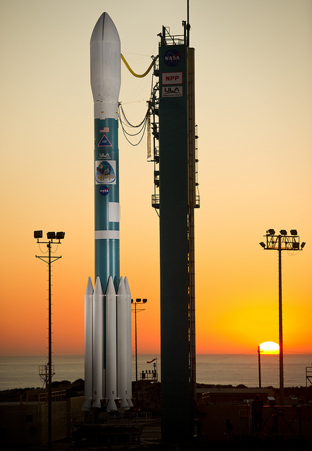
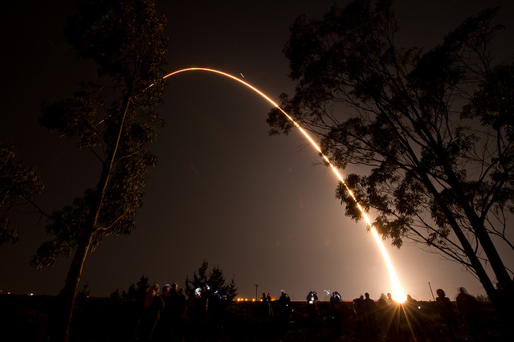
Suomi NPP Status
Jim Gleason NPP Project Scientist
May 7, 2012
Launch: Oct 28, 2011
1

Slide 2
Suomi NPP/VIIRS Instrument Status and Science Results”
Jim Gleason
NPP Project Scientist
JPSS VIIRS Operational Algorithm Team
VIIRS SDR
Changyoung Cao/NOAA/STAR
Frank DeLuccia/Aerospace
Jack Xiong/NASA
Robert Wolfe/NASA (Geo)
VIIRS EDR
Lead: Ivan Csiszar/NOAA/STAR
Clouds: A. Heidinger/NOAA/STAR
Ocean Color: W. Wang/NOAA/STAR
SST: S. Ignatov/NOAA/STAR
Imagery: D. Hilger/NOAA/STAR
Aerosol: I. Laszlo /NOAA/STAR
Land: I. Csiszar/NOAA/STAR
Cryo: J. Key/NOAA/STAR

Slide 3
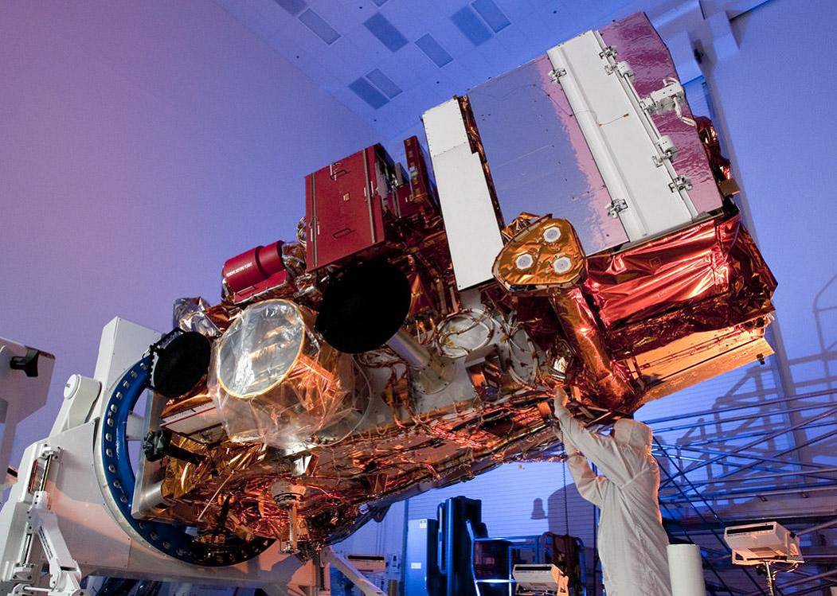
NPP with 5 instruments
13.2 ft long
8.5 ft wide
4,500 lbs
VIIRS
CrIS
ATMS
OMPS
CERES

Slide 4
NPP Status
Spacecraft in normal Mission Mode, all systems nominal
Ground System performance nominal with data flowing to NESDIS and AFWA Centrals and to CLASS archive
All Instruments are in normal operational mode
  ATMS SDR data declared provisional (ready for broader use)
  ATMS SDR/TDR to be used operationally by NOAA NCEP in Spring of 2012
  VIIRS, CrIS, OMPS SDRSs have reached beta status
    Public Access through NOAA CLASS
  Product Validation work ongoing.

Slide 5
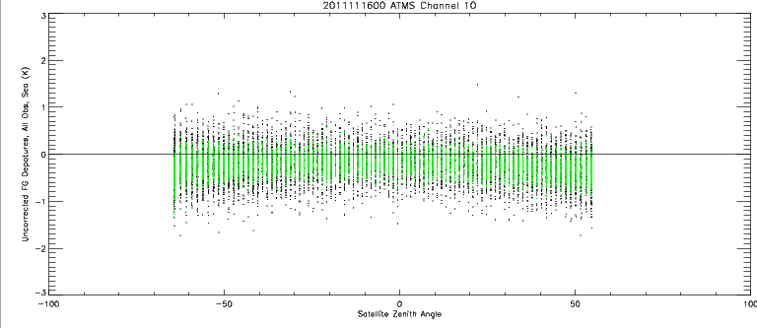
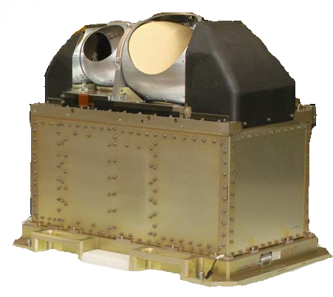
Advanced Technology Microwave Sounder
Northrop Grumman Electronic Systems
AMSU-A vs ATMS Stats
Departure; All Obs over Sea (K)
Description
Purpose: In conjunction with CrIS, global observations of temperature and moisture profiles at high temporal resolution (~ daily).
Approach: Scanning passive microwave radiometer
22 channels 23GHz - 183GHz
Swath width: 2300 km
ATMS SDR ready for Provisionally Release
ATMS data to be used by
NCEP Spring 2012
Satellite Zenith Angle (degrees)
ATMS has much better scan-dependent bias and (after re-mapping) noise levels are equivalent

Slide 6
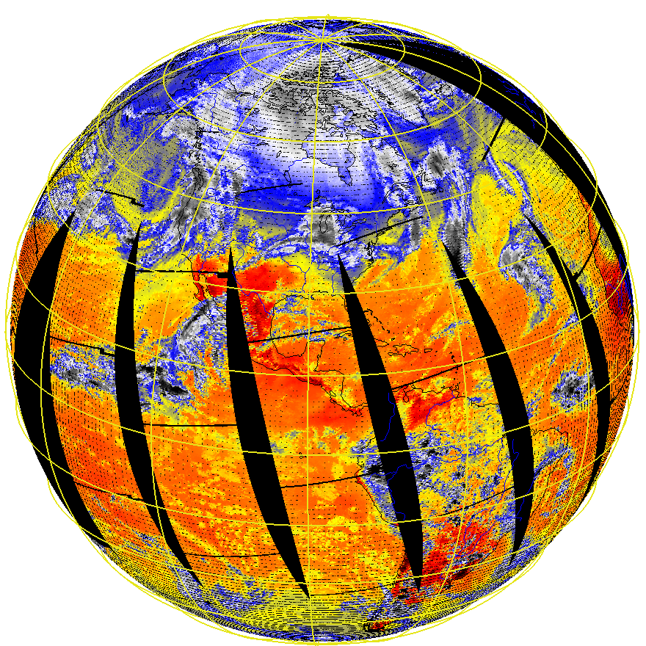
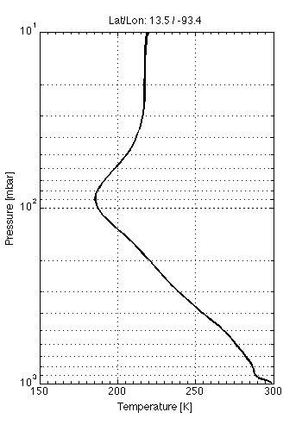
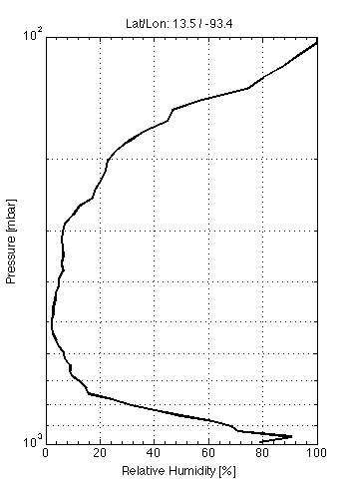
CrIS Data and Retreivals for 20 Jan 2012, t1910005
Single profiles
CrIS
Temperature
CrIS
Humidity
Notes:
On behalf of the NPP/JPSS NOAA Cal/Val team, the first global dataset from CrIS was produced on Jan 20, 2012. Attached are four figures. The first is imagery from a single CrIS channel out of more than the 3000 channels that CrIS can generate. Each channel is sensitive to a different part of the atmosphere as well as the surface. The channel shown in this figure is a “window” channel at 900 cm-1 wavenumber (or 11.1 microns) and is very sensitive to the Earth’s surface and clouds. The second figure in the lower left is the spectrum of the myriad of CrIS channels in temperature units. The spectrum is used to derive the vertical temperature and moisture (humidity) information needed by the National Weather Service to forecast weather, both calm and severe, up to 5 to 7 days in advance. The figures to the right show the first temperature and humidity soundings generated by CrIS using a research algorithm developed by Dr. Bill Smith Sr.. It is fitting that Bill provided the first sounding, since Bill was a long-time friend and colleague of Professor Vern Soumi. Bill started his career at NOAA in 1965 and is a pioneer in the profiling of the atmosphere from Earth remote sensing satellites and continues to remain very active in the sounding research community.

Slide 7
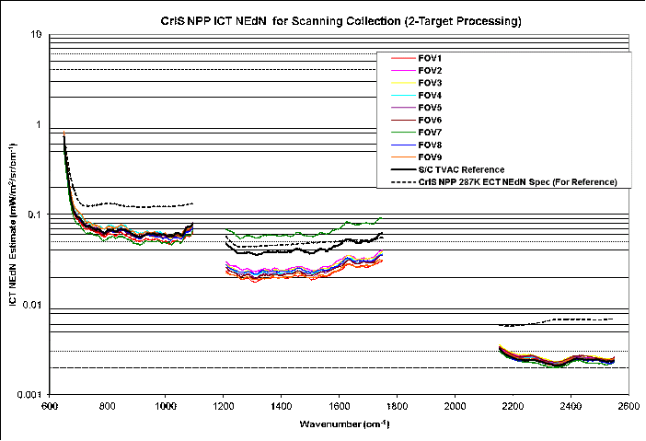
NPP CrIS Instrument Status
Exelis successfully performed Early CrIS instrument checkout and tuning from 1/28/12 to 2/21/12
Initial analysis shows that the instrument performance reaches and exceeds the pre-launch TVAC performance and specifications
Calibration coefficient table (Engineering Packet) version 32 was uploaded to CrIS instrument on 1/31/12, which includes update of some calibration coefficients determined from on-orbit data
Good Science RDR data started flowing from GRAVITE to the users on 1/20/12
Full spectral resolution data collection was performed successfully on 2/22/12 and 2/23/12
NEdN On-Orbit Data is Consistent with Ground Test Data (Black Lines); Much Better Than Spec Limits (Dashed Lines); Performance is Excellent. The relatively poor performance of MW FOV 7 (Middle green curve) was noted during ground testing and understood.

Slide 8
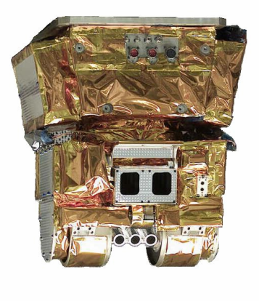
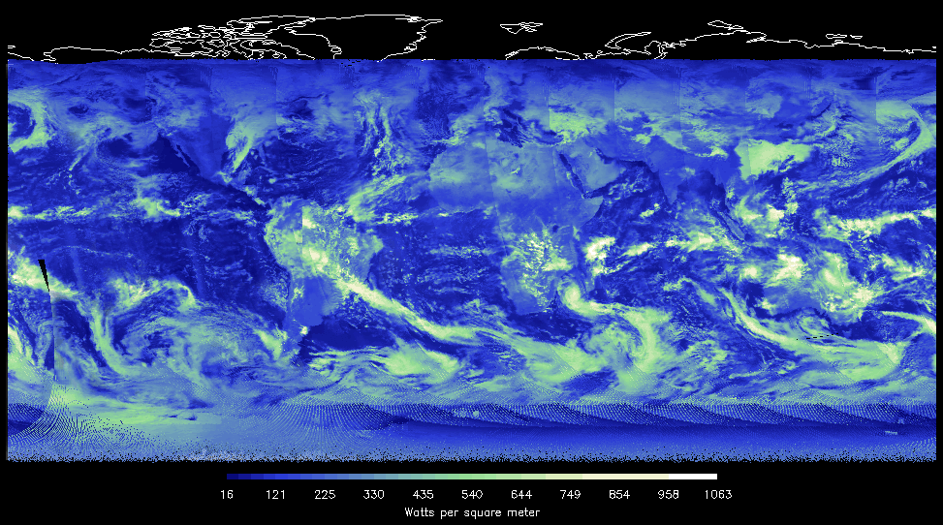
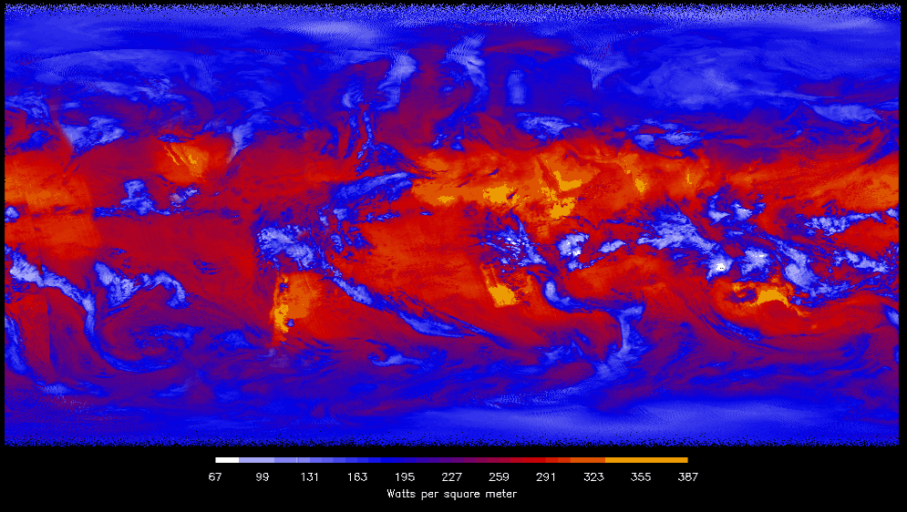
CERES Flight Model 5
Regular Operations: January 24, 2012
Reflected Solar Energy
CERES scanning radiometer measuring three spectral bands at TOA
  Total (0.3 to >50 μm)
  Shortwave (0.3 to 5.0 μm)
  Longwave Bandpass (8 to 12 μm)
Operations, Data Processing, Products, and Science are a continuation of experience developed on
  TRMM (1), EOS Terra (2), EOS Aqua (2)
Emitted Thermal Energy

Slide 9
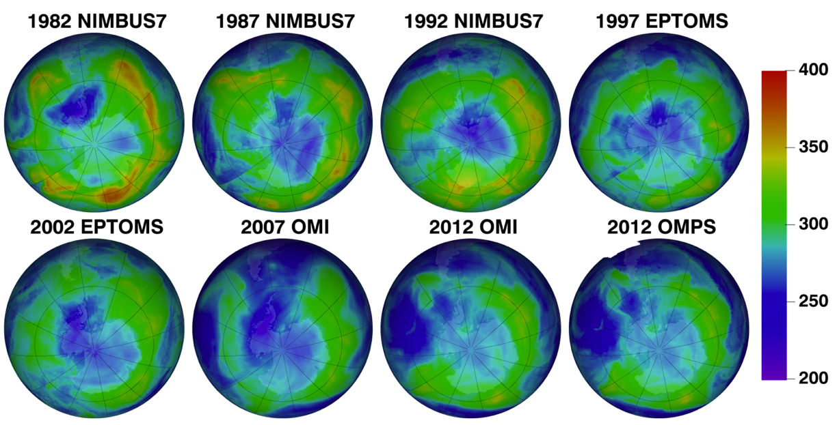

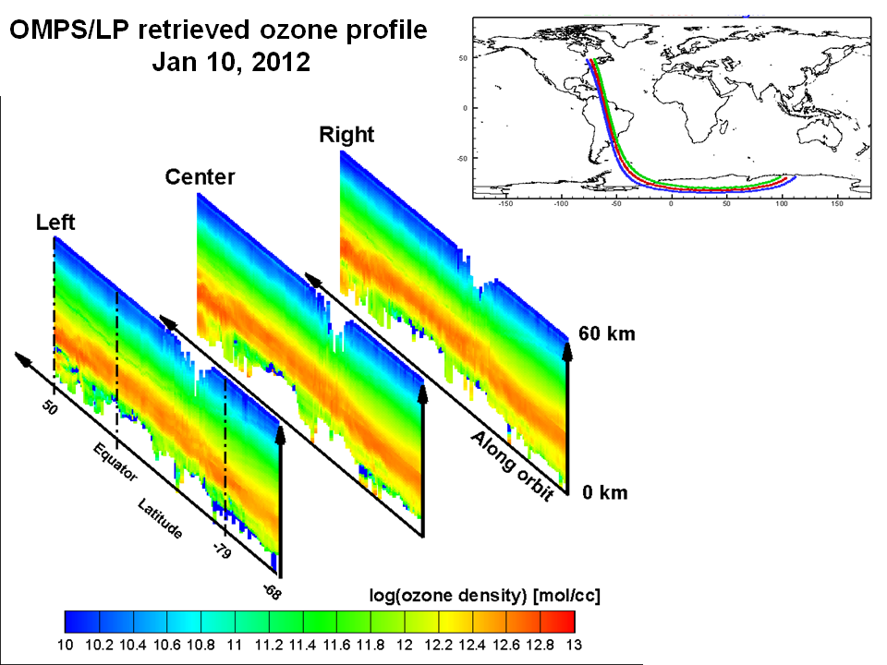
NPP Instrument Status: OMPS Nadir and Limb
Thirty Years of January 19th ozone

Slide 10
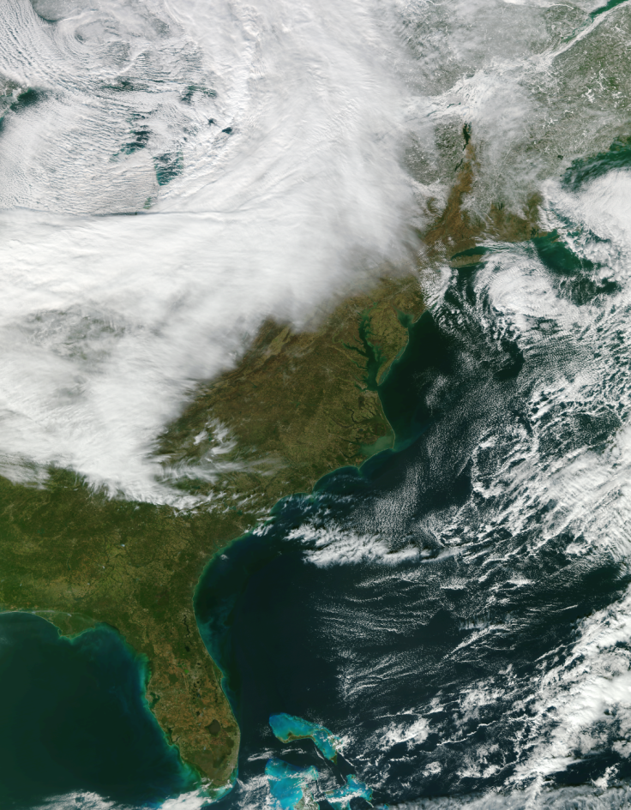
NPP Instrument Status: VIIRS SDR (1)
All band are producing excellent images with expected quality
All onboard calibrators (BB, SD, SDSM) are functioning normally, providing good quality data for SDR calibration
  Reflective Solar Band (RSB) LUT have been successfully updated on-orbit;
  VIIRS SDR Inter-comparisons show good agreement with Aqua/MODIS after the LUT updates
  Thermal Emissive Bands (TEB) response is stable, and consistent with pre-launch analysis

Slide 11
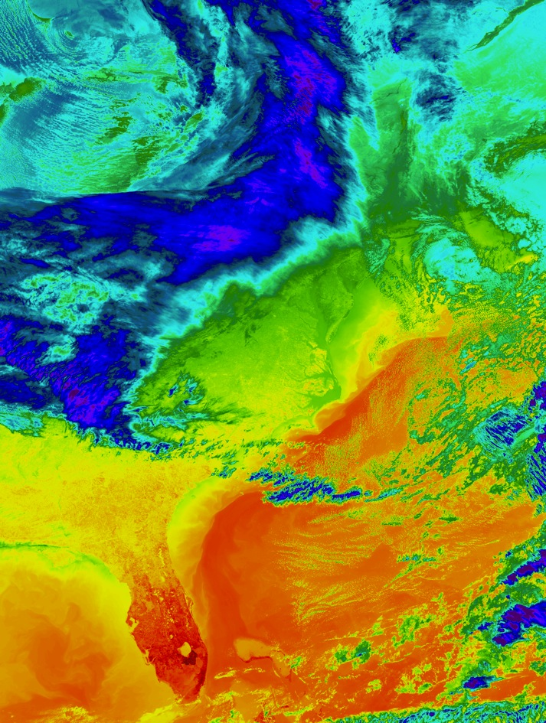
NPP Instrument Status: VIIRS SDR (2)
  Noise (NEdT) meets the sensor requirements for all detectors and all bands , consistent with pre-launch values;
  On-orbit calibration coefficients consistent with pre-launch values, except for M13 which is currently being updated
  Monitoring and trending shows all telemetry stable except the degradation in the NIR bands
  Geolocation LUT table was updated on 2/23, removed observed 1km offset
  An SDR Review meeting was held in April
  VIIRS SDR is in (de facto) beta status

Slide 12
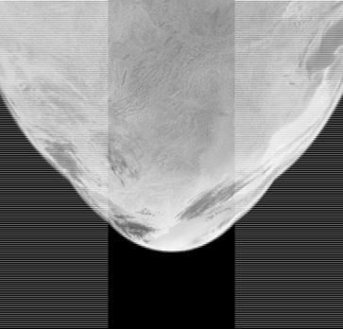
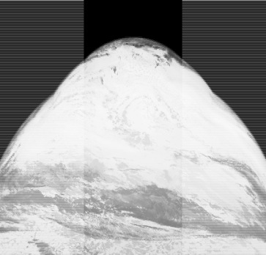

NPP Instrument Status: VIIRS Maneuvers
Images of Band I5 SDR Brightness Temperature
The following maneuvers have been performed successfully:
  Roll Lunar maneuver twice for RSB stability (1/4, 2/3)
  Yaw maneuver for SD and sun screen characterization (2/15-2/16)
  Pitch maneuver for TEB RVS characterization (2/20)
scan
scan
track
track
Pitch started at 18:15:34
Pitch ended at 18:59:19
Lunar Roll Maneuver
Response vs Scan Angle
M15 10.763 um
302K
M16 12.013 um
300K
VIIRS Readout Timing modified for Lunar Rolls
Sector Rotation tested Feb 22, 2012

Slide 13
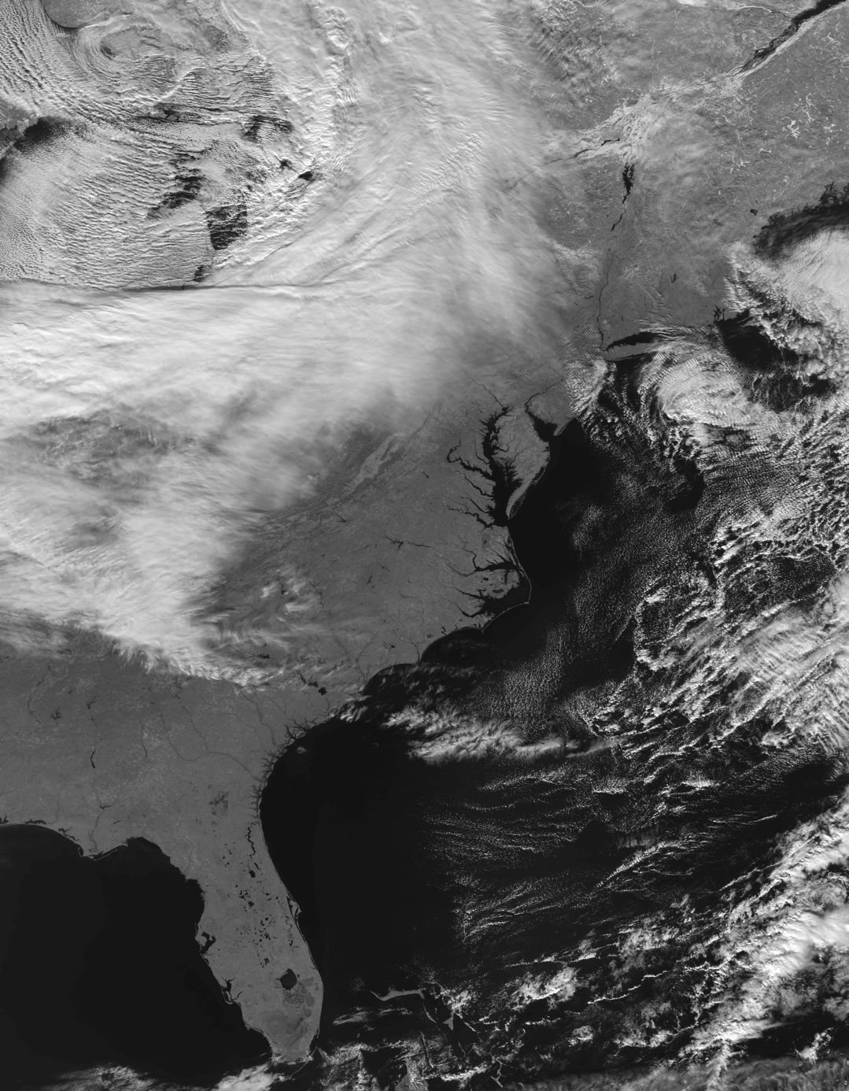
VIIRS M07 (0.865 microns) grey scaled
19 January 2012
VIIRS Data Anomaly
Degradation in M7/I2 observed after launch.
Smaller effect in M6 & M5.
Commissioning paused while anomaly was studied.
Degradation believed to be caused by an error in mirror coating process. An inadvertent layer of tungsten film was put on telescope mirrors.
Commissioning resumed Jan 18
Degradation is slowing, should level off.
No effect on VIIRS data products;
VIIRS SNR in M7 expected to be above spec.
Notes:
The chart shows a map of the Global biosphere, land and ocean using SeaWiFS data. These data are used to monitor biological productivity. Changes in these data sets can be related to changes in how carbon moves through and is stored in the climate system and how the biosphere may be reacting to a changing climate.

Slide 14
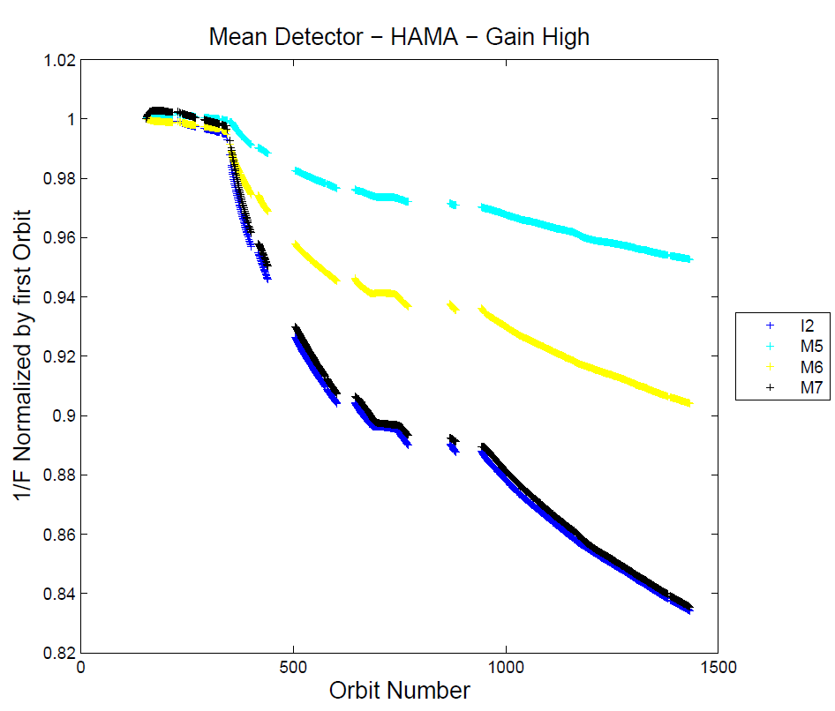
VIIRS Anomaly
Change in VIIRS Solar Data as a function orbit number
12/9 Test #1
Telescope stowed for 3 days
Jan 2 Test #4
Telescope stowed for 4 days
672 nm
Door
Opened, Nov21
12/19 Test #2
Telescope night only
746 nm
VIIRS 1394Anomaly
4 day Svalbard Line Outage –
Telescope rotating – slope looks unchanged
12/28 Test #3
Telescope stowed for 7 days
865 nm
F is conversion factor that compares the measured VIIRS solar data to the predicted value.
Data shows 1/F-factor. Should be 1 for new instrument.
Test periods used to diagnose VIIRS anomaly.
Data show anomaly depends on solar exposure; increases with light; stops in dark.
Notes:
On behalf of the NPP/JPSS NOAA Cal/Val team, the first global dataset from CrIS was produced on Jan 20, 2012. Attached are four figures. The first is imagery from a single CrIS channel out of more than the 3000 channels that CrIS can generate. Each channel is sensitive to a different part of the atmosphere as well as the surface. The channel shown in this figure is a “window” channel at 900 cm-1 wavenumber (or 11.1 microns) and is very sensitive to the Earth’s surface and clouds. The second figure in the lower left is the spectrum of the myriad of CrIS channels in temperature units. The spectrum is used to derive the vertical temperature and moisture (humidity) information needed by the National Weather Service to forecast weather, both calm and severe, up to 5 to 7 days in advance. The figures to the right show the first temperature and humidity soundings generated by CrIS using a research algorithm developed by Dr. Bill Smith Sr.. It is fitting that Bill provided the first sounding, since Bill was a long-time friend and colleague of Professor Vern Soumi. Bill started his career at NOAA in 1965 and is a pioneer in the profiling of the atmosphere from Earth remote sensing satellites and continues to remain very active in the sounding research community.

Slide 15
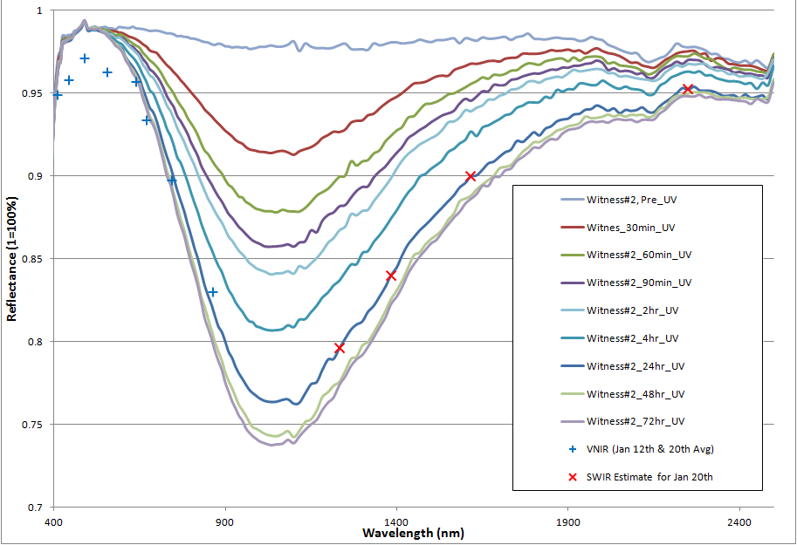
#2 Witness Mirror Degradation with
UV Exposure
VNIR Bands
SWIR Bands
M3
M2
M4
I1
M1
M11
M5
M10/I3
M6
M9
M7/I2
M8

Slide 16
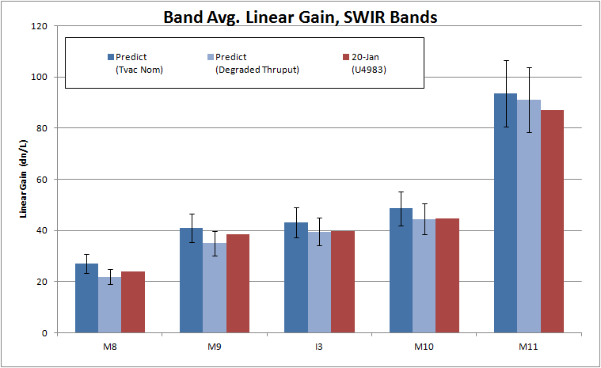
SWIR Turn-on shows
expected performance
Error Bars are +/-13% of predicted gain
  Original based sensor-TV, nominal plateau RC2 P2
  Degraded thruput reduces original by 24 hr UV exposure results for Witness#2

Slide 17
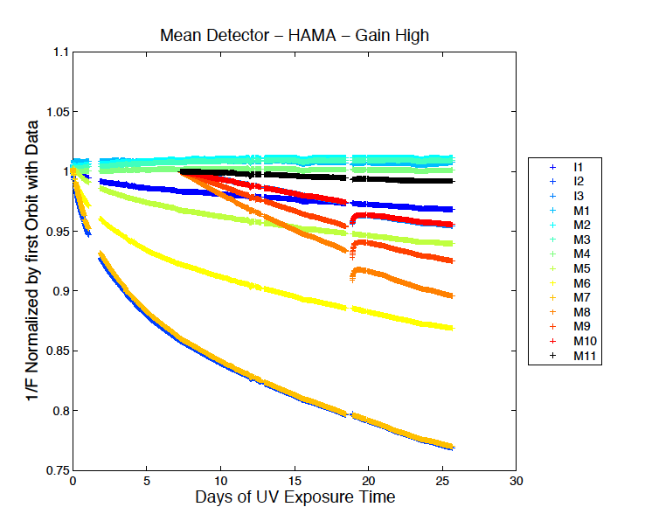
VIIRS Anomaly
Change in VIIRS Solar Data as a function of UV exposure
Anomaly depends on exposure to light, probably in the UltraViolet (UV) region.
Calculate amount of UV exposure in each orbit. Replot data, converting x-axis from orbit number to UV exposure time.
1 day UV exposure = 6.5 calendar days.
Data shows smooth dependence on UV exposure.
746 nm
865 nm
May 5, 2012
Notes:
On behalf of the NPP/JPSS NOAA Cal/Val team, the first global dataset from CrIS was produced on Jan 20, 2012. Attached are four figures. The first is imagery from a single CrIS channel out of more than the 3000 channels that CrIS can generate. Each channel is sensitive to a different part of the atmosphere as well as the surface. The channel shown in this figure is a “window” channel at 900 cm-1 wavenumber (or 11.1 microns) and is very sensitive to the Earth’s surface and clouds. The second figure in the lower left is the spectrum of the myriad of CrIS channels in temperature units. The spectrum is used to derive the vertical temperature and moisture (humidity) information needed by the National Weather Service to forecast weather, both calm and severe, up to 5 to 7 days in advance. The figures to the right show the first temperature and humidity soundings generated by CrIS using a research algorithm developed by Dr. Bill Smith Sr.. It is fitting that Bill provided the first sounding, since Bill was a long-time friend and colleague of Professor Vern Soumi. Bill started his career at NOAA in 1965 and is a pioneer in the profiling of the atmosphere from Earth remote sensing satellites and continues to remain very active in the sounding research community.

Slide 18
VIIRS Anomaly Conclusions
VIIRS M07 (0.865 microns) grey scaled
Tungsten Mirror contamination identified as root cause. Limited to VIIRS FM1 mirror.
Continuing to Monitor degradation
Putting in weekly LUT updates
Testing time-dependent predictive LUTs
Bandpass effect (RSRs) studies ongoing
VIIRS SNR in M7 expected to be above spec.
For M7/I2 865 nm High Gain SNR
SNR Margin
Specification 215
Raytheon 419 95%
Notes:
The chart shows a map of the Global biosphere, land and ocean using SeaWiFS data. These data are used to monitor biological productivity. Changes in these data sets can be related to changes in how carbon moves through and is stored in the climate system and how the biosphere may be reacting to a changing climate.

Slide 19

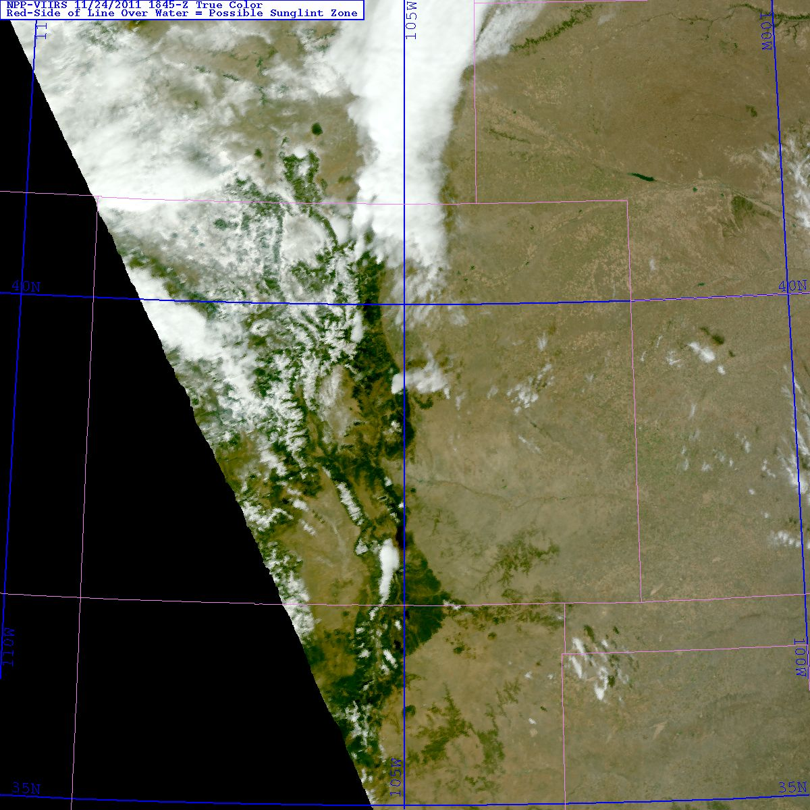
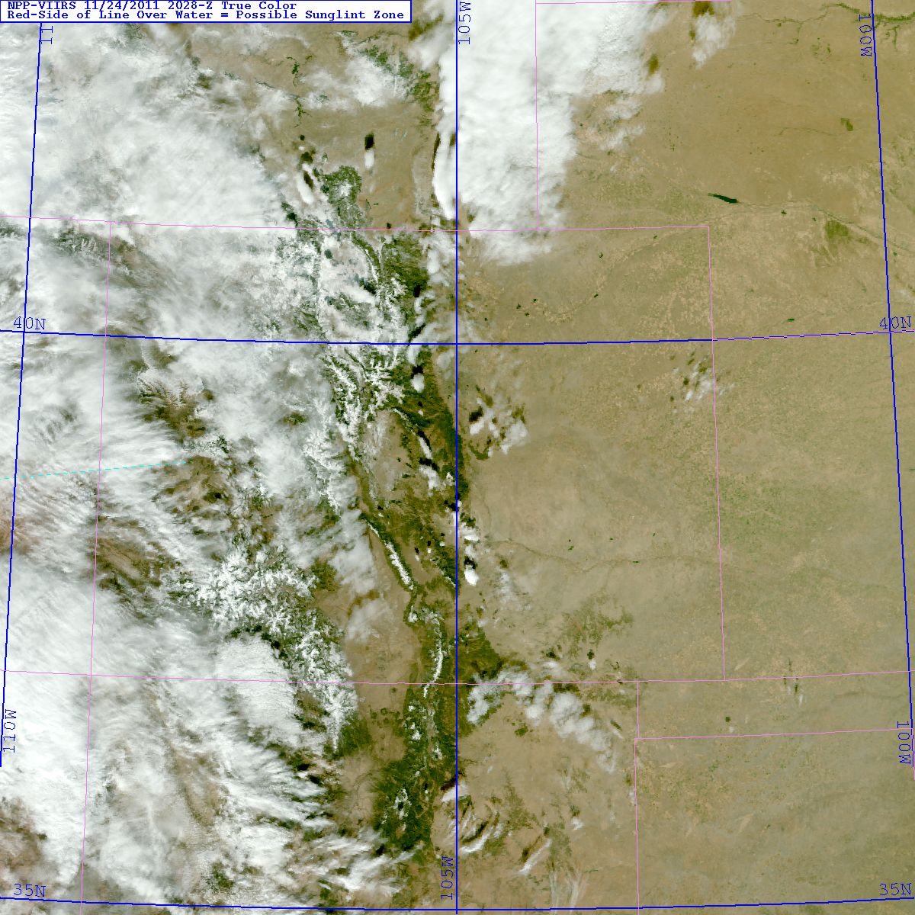
NPP VIIRS True Color Examples
Colorado
11.24.2011 1845 Z, Near Edge of Scan
11.24.2011 2028 UTC, Near Nadir
→ VIIRS maintains similar spatial resolution quality at edge of 3000 km swath
Notes:
All examples use VIIRS global data sets kindly provided by either the U. of Wisconsin (CIMSS) via the NOAA IDPS or via the GRAVITE team effort.
This effort is a joint collaboration between the Naval Research Laboratory (NRL) Marine Meteorology Division, Monterey, CA and Dr. Steve Miller at the Cooperative Institute for Research in the Atmosphere (CIRA), located at Colorado State University (CSU) in Ft. Collins, CO.
This project is funded by the National Oceanic and Atmospheric Administration (NOAA), Joint Polar Satellite System (JPSS), Dr. Mitch Goldberg, Program Manager.

Slide 20
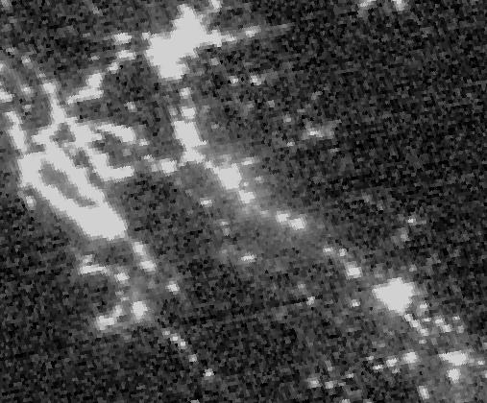
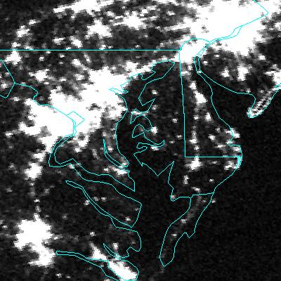

Resolution Improvements: OLS vs. DNB
740 m instantaneous geometric field of view (DNB) vs. ~5 km for the OLS results in dramatic spatial resolution improvements.
DNB Imagery courtesy of Steven Miller CIRA/CSU

Slide 21

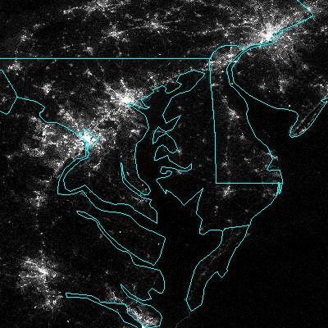
Resolution Improvements: OLS vs. DNB
740 m instantaneous geometric field of view (DNB) vs. ~5 km for the OLS results in dramatic spatial resolution improvements.
DNB Imagery courtesy of Steven Miller CIRA/CSU

Slide 22
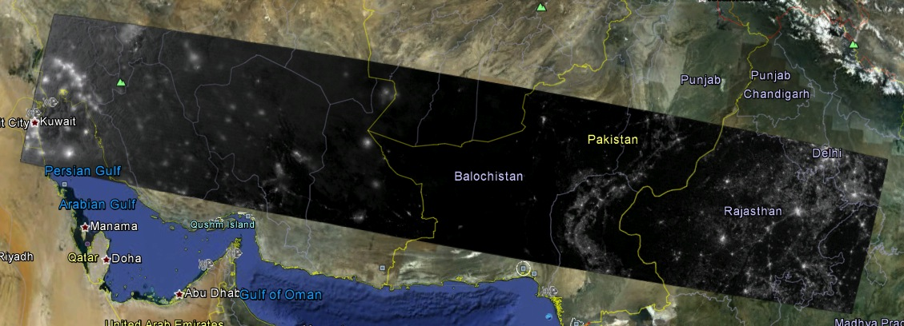
Night Time Scene – Pakistan/India Border
Sodium Vapor lamps along Pakistan/India border show geolocation error of ~5 km to the east with Ops Geolocation
  Rev 001 DNB Geo LUT used for Jan 31, 2012 granule
  Highlighted region shown in detail on next slide
d20120131_t2128288_e2129530
S. Weiss, NGAS

Slide 23
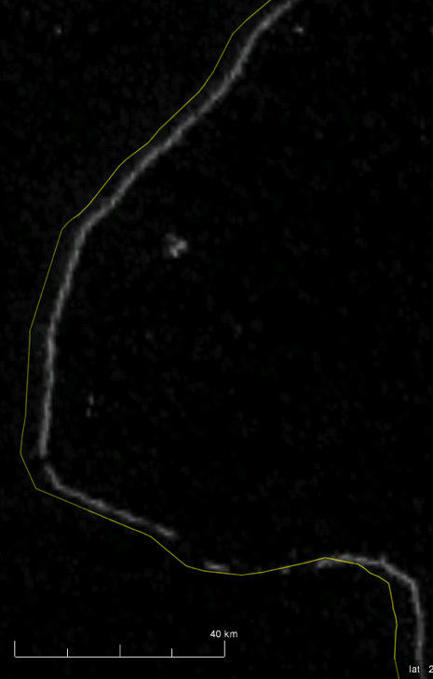
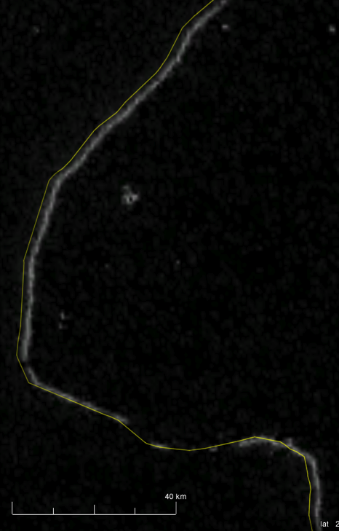
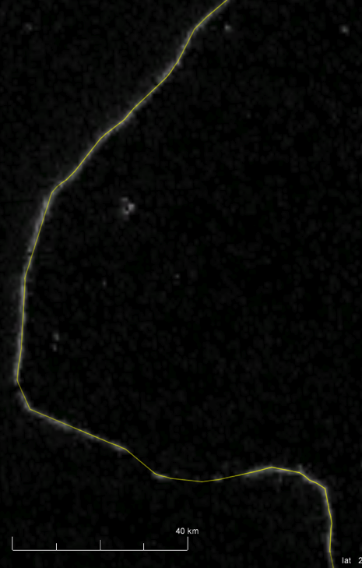
DNB Geolocation Improvement with LUT Revisions – Pakistan/India Border
DNB Geo LUT Rev 001
DNB Geo LUT Rev 002
NGAS DNB Geo LUT Rev 003
Google Earth Border
S. Weiss, NGAS
d20120131_t2128288_e2129530

Slide 24
Geolocation Trending
Error after
LUT update
(2/23/2012, doy 54)
 | Bias (m) | RMSE (m)
Track | -20 | 89
Scan | -9 | 64
Feb. 23, 2012 LUT update
41 days with average of
136 matchups/day
(minus 11 outliers/day)
375 m
Nadir equivalent units; Cross-correlation > 0.7;
Outliers are filtered (removed) based on daily 5, 4 and then 3 sigma test

Slide 25
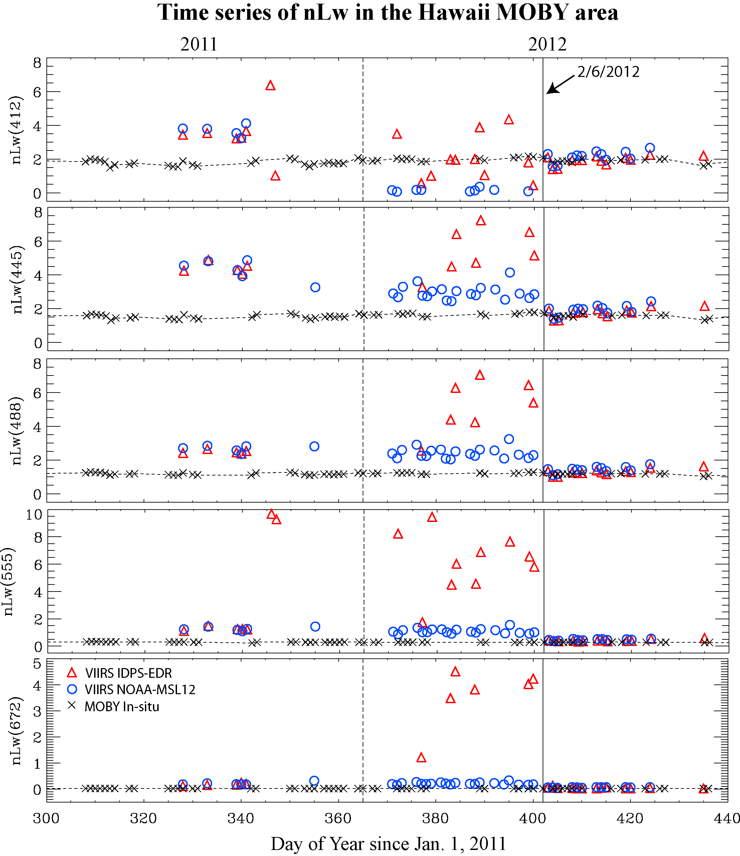
VIIRS vs. MOBY In Situ
412
443
486
555
671
VIIRS OC data compared with the MOBY in situ data, showing that SDR data since 2/6/2012 are good and reasonable, before that SDR date were poor/not reliable.
VIIRS ocean color products are good and reasonable from 2/6/2012.
Vicarious calibration is needed and will further improve ocean color products.
Data from M. Wang
MOBY PI: Ken Voss

Slide 26
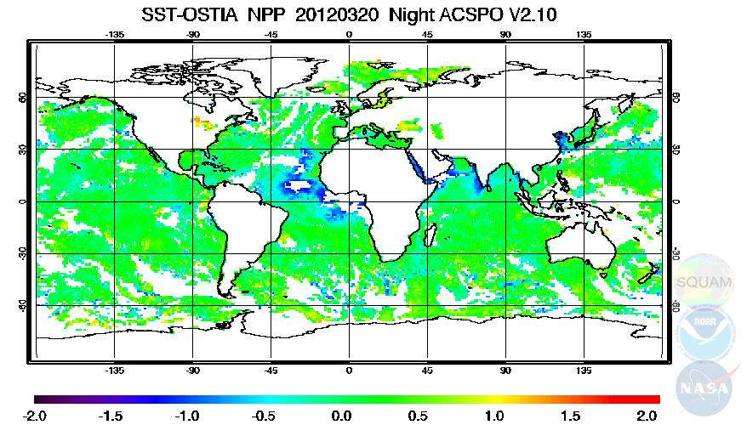
NIGHT: ACSPO minus OSTIA
‘Confidently Clear’ (No SST QFs are available in ACSPO)
Overall, deviation from reference flat & close to 0
Residual Cloud/Aerosol leakages in the Tropics
Advanced Clear-Sky Processor for Oceans Operational Sea Surface Temperature and Sea Ice Analysis

Slide 27
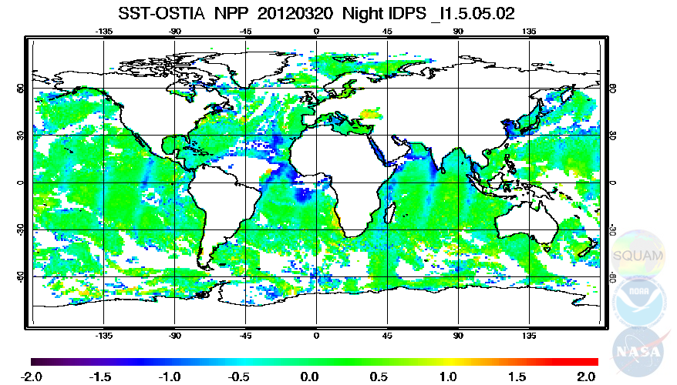
NIGHT: IDPS minus OSTIA
VCM = ‘Confidently clear’ (SST QFs are available but not used)
More Cloud leakages than in ACSPO (also in Hi Lat)
Some clear pixels screened out (e.g., Amazon basin)
“Limb Cooling” - Need recalculate SST coefficients

Slide 28
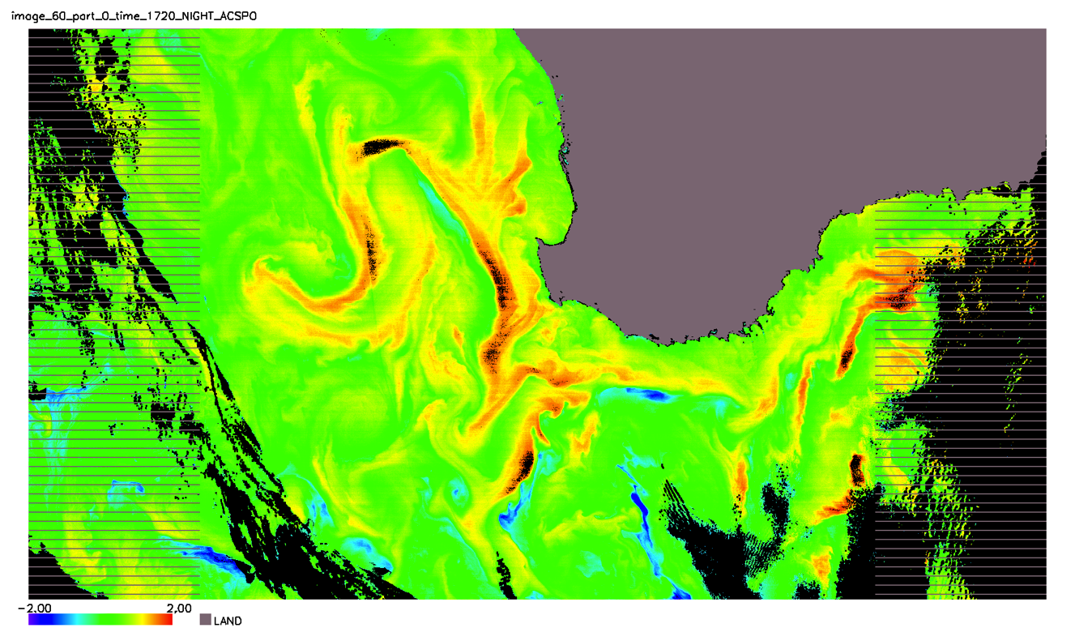
NIGHT: ACSPO “Confidently Clear” - Reynolds SST
Swath Projection: South-East Australia, 17 March 2012
1,000 Lines × 1,784 central FOVs (scan edges excluded to keep swath projection)
ACSPO shows a large cloud-free domain
0.25° Reference SST fails to capture high local dynamics
ACSPO screens out large warm deviations from Ref

Slide 29
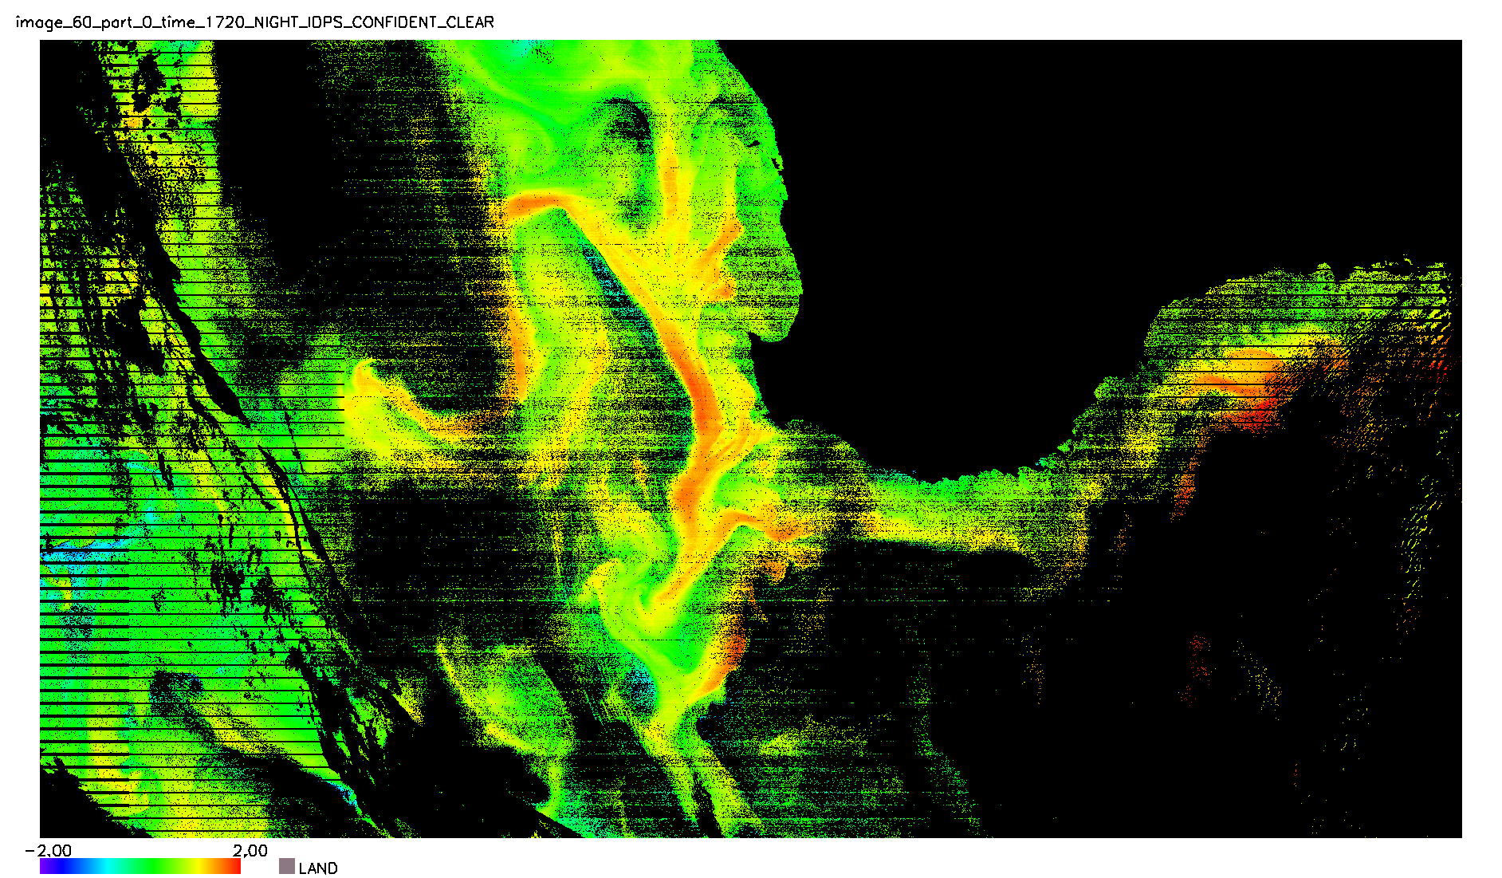
NIGHT: IDPS “Confidently Clear” - Reynolds SST
Swath Projection: South-East Australia, 17 March 2012
1,000 Lines × 1,784 central FOVs (scan edges excluded to keep swath projection)
IDPS VCM shows a much smaller cloud-free domain
“Salt-N-Pepper”, striping
..but preserves large warm deviations from Reference

Slide 30
Conclusions
Spacecraft in normal Mission Mode, all systems nominal
Ground System performance nominal with data flowing to NESDIS and AFWA Centrals and to CLASS archive
  Get VIIRS data from http://www.class.ngdc.noaa.gov/
  VIIRS SDRs available shortly (finishing README file)
  VIIRS Radiometry and Geolocation are good.
EDR Data Product Teams are busy.
  Tuning Cloud Mask
Contact JPSS EDR team leads for more details.

Slide 31

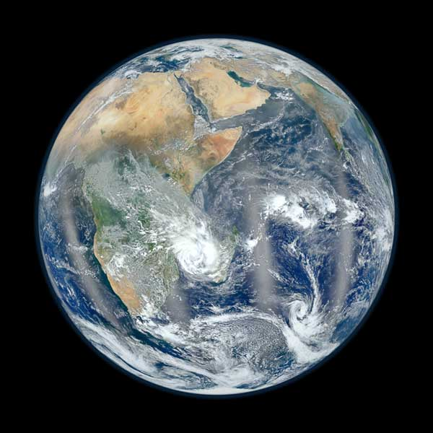
Questions?
Fishing boats

Slide 32
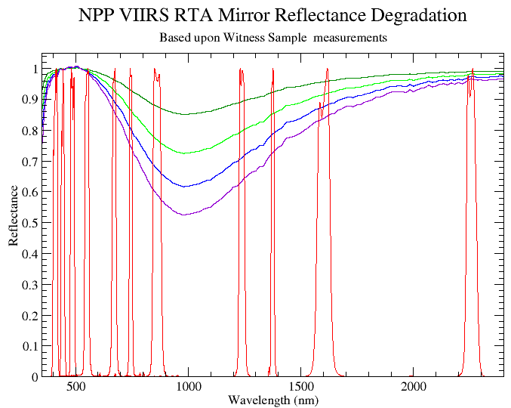
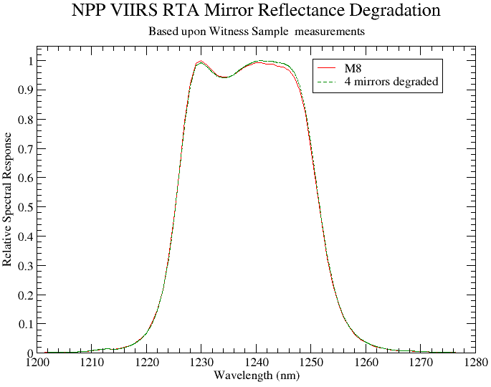
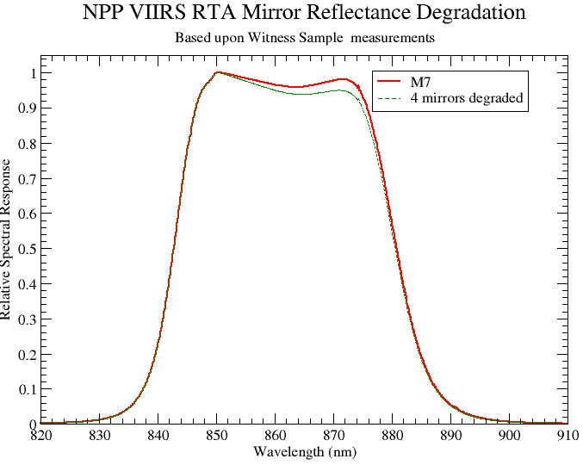
RTA Mirror Reflectance Degradation Anomaly
M7
M8
1 mirror
2 mirrors
Degradation in the reflectance of the 4 RTA mirrors modulates VisNIR and SWIR RSR. Using NG Oct 2011 band averaged RSR, initial review suggests that radiometric impact <0.5%.
3 mirrors
4 mirrors
Reflectance degradation estimated using RTA primary mirror “TWM” witness sample measurements extrapolated to 4 mirrors by power law

Slide 33
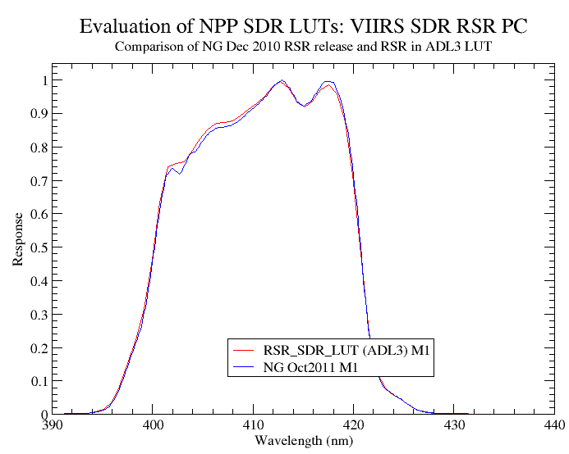
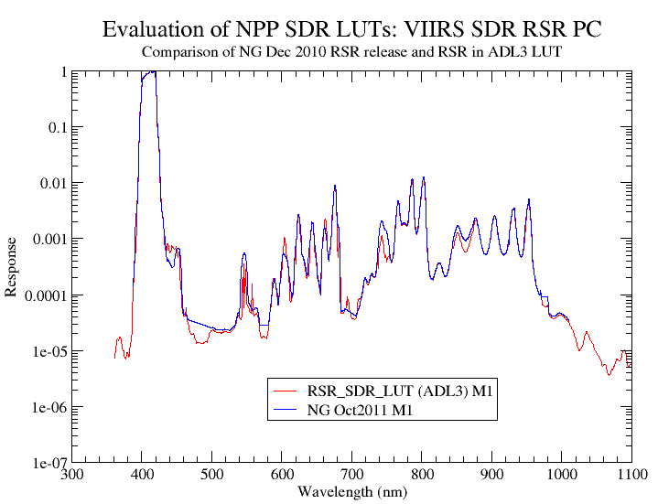
NPP VIIRS At-Launch VisNIR RSR based upon preliminary Spacecraft Level RSR
In Process: update at-launch RSR with NG Oct 2011 RSR release, which is based upon final Govt. Team Spacecraft Level RSR.

Slide 34
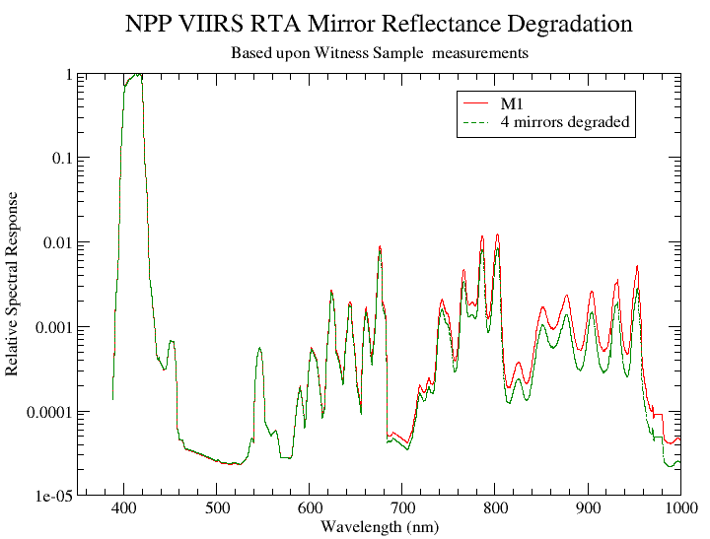
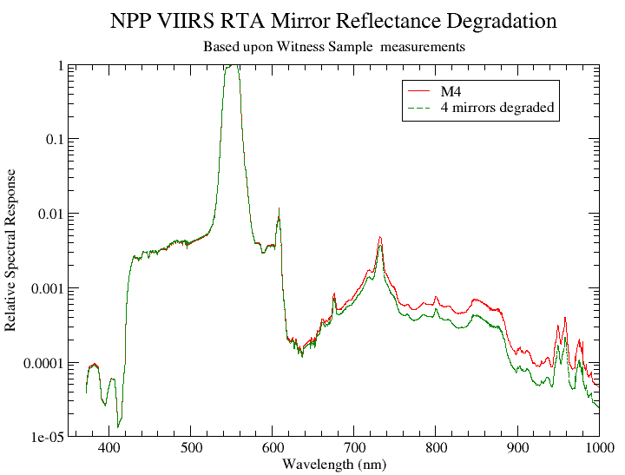
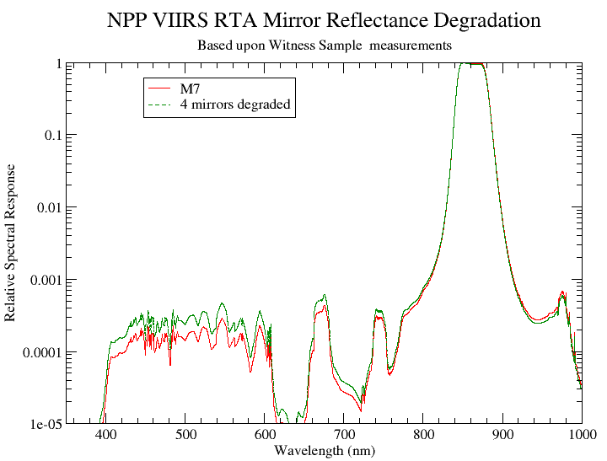
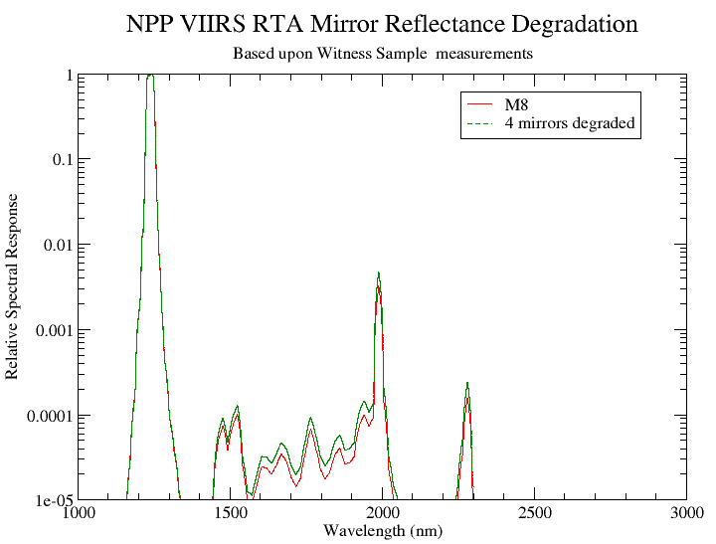

Slide 35
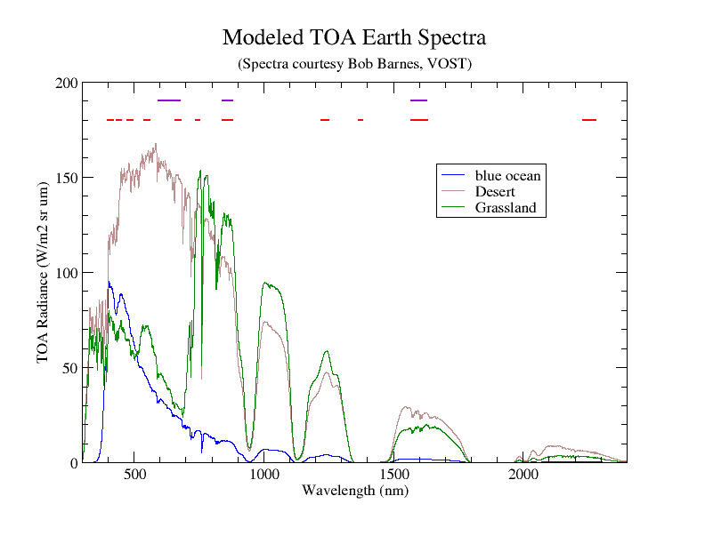
I bands
M bands

Slide 36
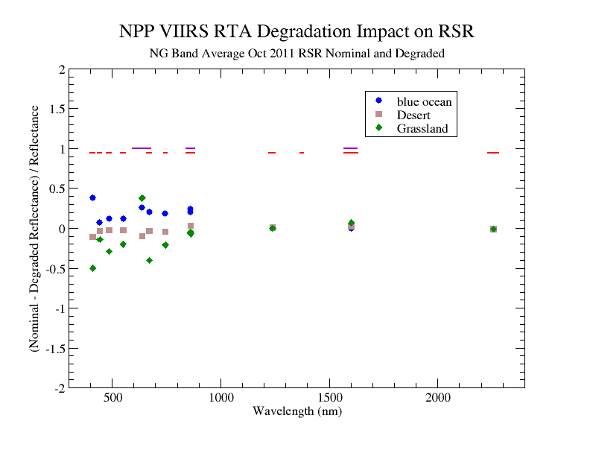
(Percent)
4 mirrors degraded
M bands
I bands

Slide 37
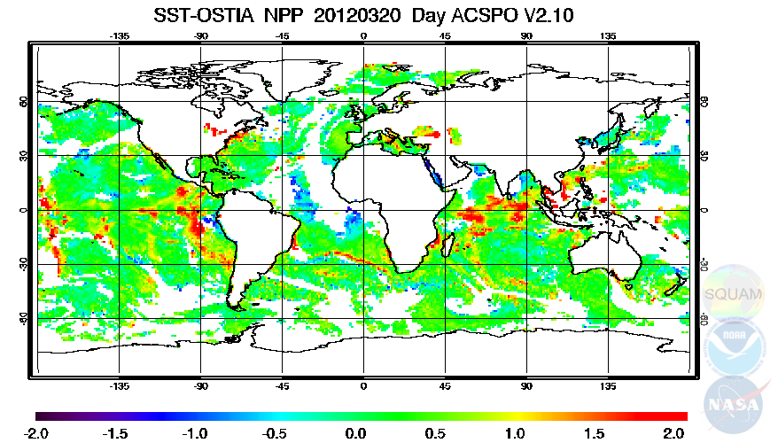
DAY: ACSPO minus OSTIA
‘Confidently Clear’ (No SST QFs are available in ACSPO)
Over most ocean, the ΔTs field is flat and close to ~0
Residual Cloud/Aerosol leakages seen in the Tropics
Daytime positive anomalies – e.g., diurnal warming

Slide 38

DAY: IDPS minus OSTIA
VCM = ‘Confidently clear’ (SST QFs are available but not used)
Larger “CC” domain than in ACSPO, but..
Very significant Cloud leakages, all over
Some Limb cooling - Need recalculate SST coefficients

Slide 39





Example: Feb. 28, 2012
MODIS-Aqua
MODIS-Aqua, VIIRS (APS & IDPS)
Satellite Comparison
Ocean features, retrieved nL_{W} and chlorophyll
have been shown to provide similar quality.
NPP- IDPS - VOCCO
NPP- NRL processing
MODIS

Slide 40









VIIRS products - Initial Evaluation
Feb 23, 2012 - Florida
VIIRS products compare with existing MODIS Products
IDPS VIIRS 412
IDPS VIIRS
MODIS vs IDPS –EDR’s
Feb 23 – 2012 – Florida
Comparison of APS and IDPS products ?
MODIS Chlorophyll
MODIS 412
VIIRS Algorithms
IDPS vs APS
IDPS -412
IDPS Chl
APS -412
APS -Chlorophyll
Government Processing
MODIS vs NPP APS
VIIRS NRL -412
VIIRS NRL -CHL
MODIS -412
MODIS Chl

Slide 41




Walton Smith Cruise
Feb 28 – March 2 , 2012
Station Locations
27th
1st
29th
2nd
28th
In situ Measurements
Above water measurement - ASD RRS,
In water measurement - HyperPro - Multicast
Waiting on the HPLC (Chlorophyll)
Ondrusek, Goode, Wood

Slide 42







MODIS
Florida
Keys
mg/m3
.01 .05 .3 1.6 8.4 45
MODIS NRL VIIRS IDPS VIIRS
Florida Florida Florida

Slide 43





MERIS
NPP –VIIRS
– NRL 7g
L2gen
Inter–satellite comparison:
Backscattering
Particle at 551
Example:
Feb 28 , 2012
IDPS
VOCCO
MODIS

Slide 44








VIIRS products - Initial Evaluation
2-28 , 2012 - Chesapeake Bay
MODIS vs IDPS –EDR’s
IDPS VIIRS 412
IDPS VIIRS
MODIS Chlorophyll
MODIS 412
2-28 , 2012 -
Chesapeake Bay
NPP - IDPS vs APS
IDPS -412
IDPS Chl
APS -412
APS -CHL
Government Processing
MODIS vs NPP APS
VIIRS NRL -412
VIIRS APS -CHL
MODIS -412
MODIS Chl

Slide 45

VIIRS M05/M04/M03 (red/green/blue)
VIIRS M15 (10.76 microns) color scaled from 225K to 325K
19 January 2012
Data processed at UW/SSEC as part of the NASA NPP Science Team

Slide 46
NPP Science
Backup Material

Slide 47


NPP VIIRS Pitch Maneuver on Feb 20, 2012, Orbit #1637
Images of Band I5 SDR Brightness Temperature
4 granules at the beginning
4 granules near the end
GMT 18:22:02 – 18:27:44
GMT 18:47:39 – 18:53:20
scan
scan
track
track
Pitch started at 18:15:34
Pitch ended at 18:59:19

Slide 48
Brightness temperature profiles of pitch maneuver observed deep space for M15, M16 (no TEB RVS correction is applied)
Real deep space signals
Real deep space signals raised to Ltyp

