Slide 1
MODIS Fire Product Collection 6 Improvements
Louis Giglio¹, Wilfrid Schroeder¹, Ivan Csiszar², Chris Justice¹
¹University of Maryland
²NOAA NESDIS

Slide 2
Collection 6 Algorithm Refinements
Processing extended to oceans and other large water bodies
Detect off-shore gas flaring
Reduce false alarms in Amazon caused by small forest clearings
Dynamically adjust potential fire thresholds
Detect smaller fires
Improved cloud mask
Assorted minor improvements

Slide 3
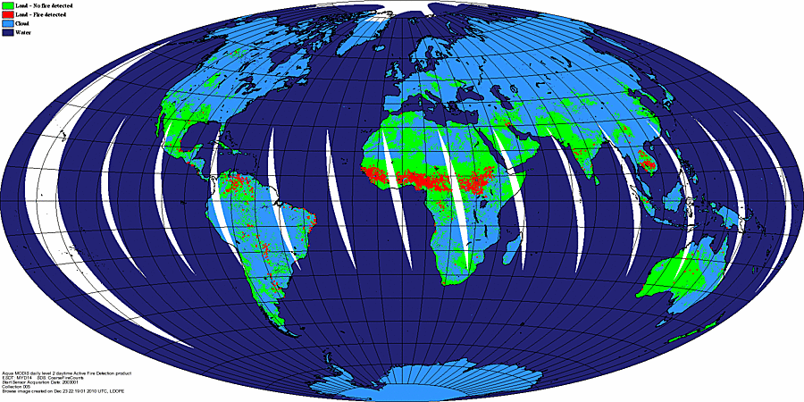
Collection 5

Slide 4
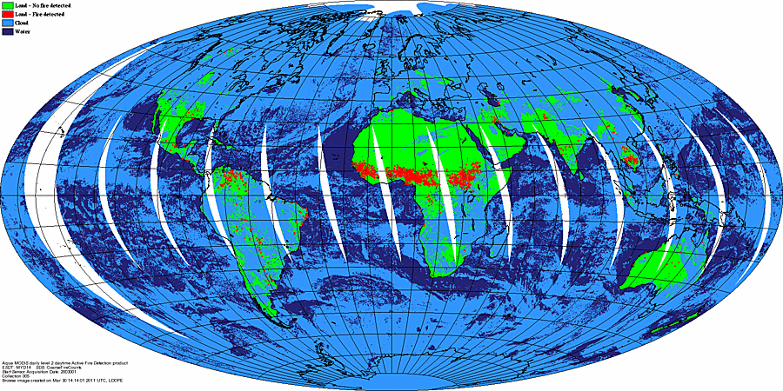
Collection 6

Slide 5
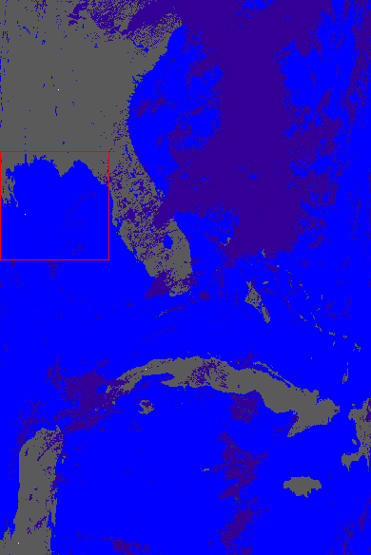
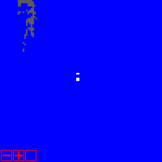
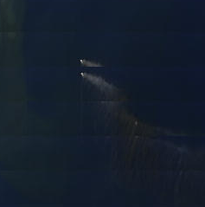
Deepwater Horizon Offshore Drilling Rig Fire
C6 Fire Mask
True Color
Terra MODIS 2010111 16:05 (21 April 2010)
Notes:
In figure of MODIS swath on left, grey represents clear land, blue represents water, and purple represents cloud. Pixels containing fires are shown in white (hard to see). Small image in upper right shows fire pixels associated with the Deepwater Horizon Offshore Drilling Rig. Small image in lower right is true color version showing smoke plumes (near edge of MODIS swath, hence the multiple views).

Slide 6
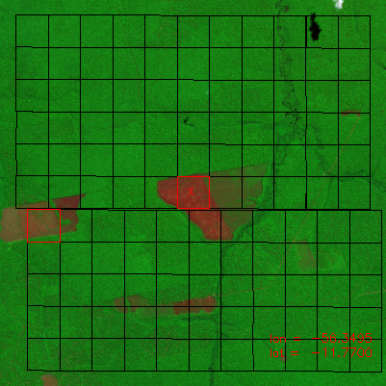
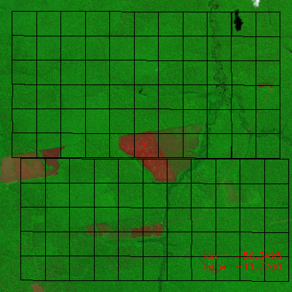
C6 Forest Clearing Rejection-Test
C5
C6
False color ASTER imagery superimposed with approximate edges of MODIS pixels (black grid). MODIS fire pixels are outlined in red.
Notes:
C5 false fire caused by forest clearing in left image is eliminated in C6.

Slide 7
C6 Dynamic Potential-Fire Thresholds
Detection algorithm uses various thresholds to quickly identify obvious non-fire pixels. These are known as “potential fire thresholds”.
Prior to Collection 6, fixed values were used for the potential fire thresholds, and these were applied globally. However, these thresholds really should vary with scan angle, location, land cover type, season, etc.
For Collection 6, the potential fire thresholds are set dynamically.

Slide 8
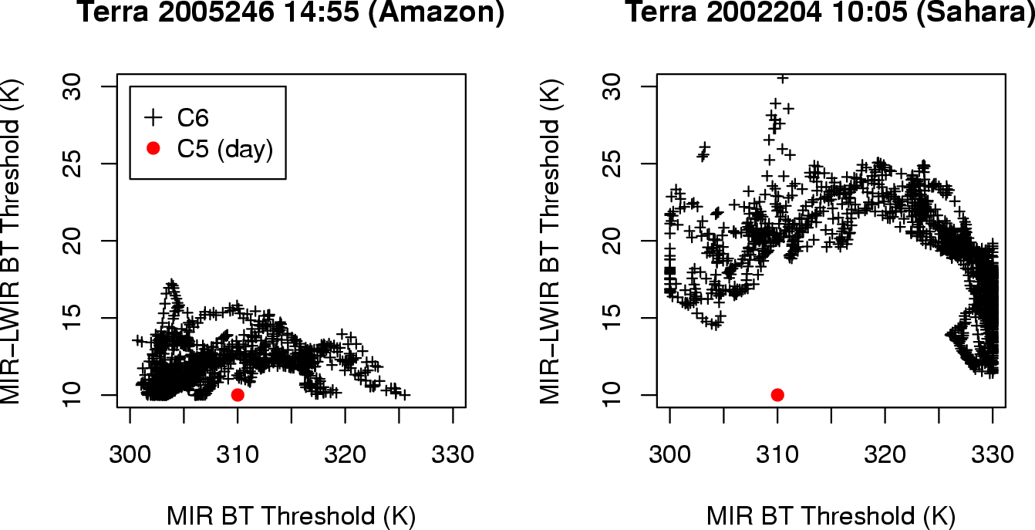
C6 Dynamic Potential-Fire Threshold Examples
Notes:
Red dots show fixed C5 thresholds for two different granules, one in the Amazon and another in the Sahara. Black crosses show the corresponding dynamic C6 thresholds.

Slide 9
Collection 6 Higher-Level Product Refinements
0.25° CMG product
New CMG product layers
fire persistence
Minor Level 3 product refinements

