Slide 1
Recent Results and Collection 6 Refinements for the Land Cover and Land Cover Dynamics Products
Mark Friedl, Damien Sulla-Menashe, Josh Gray, Eli Melaas,
Xioaman Huang, Curtis Woodcock
Department of Earth and Environment
Boston University

Slide 2

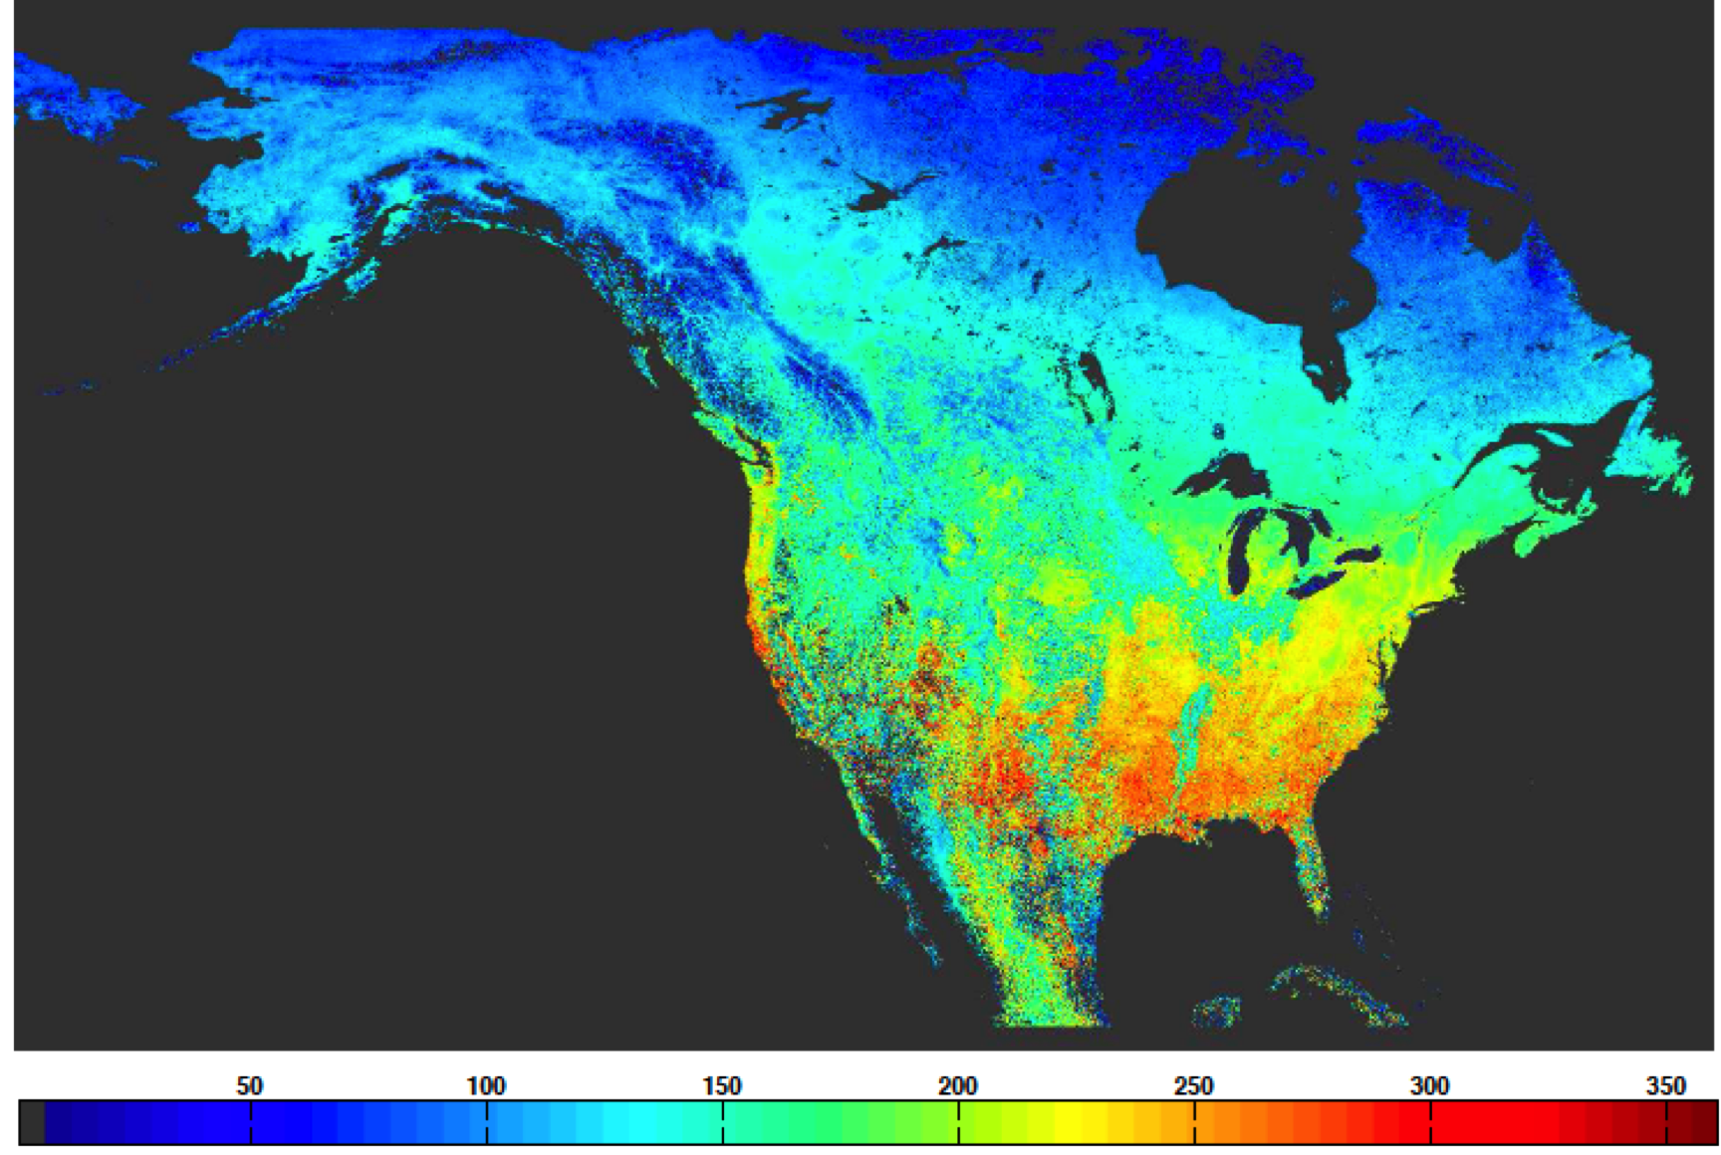
MCD12 Products
MCD12Q1 – Global Land Cover Type
MCD12Q2 – Global Land Cover Dynamics
North American land cover from MODIS
(MODIS Land Cover mage courtesy National Geographic)
North American growing season length
(Ganguly et al., RSE, 2010)

Slide 3
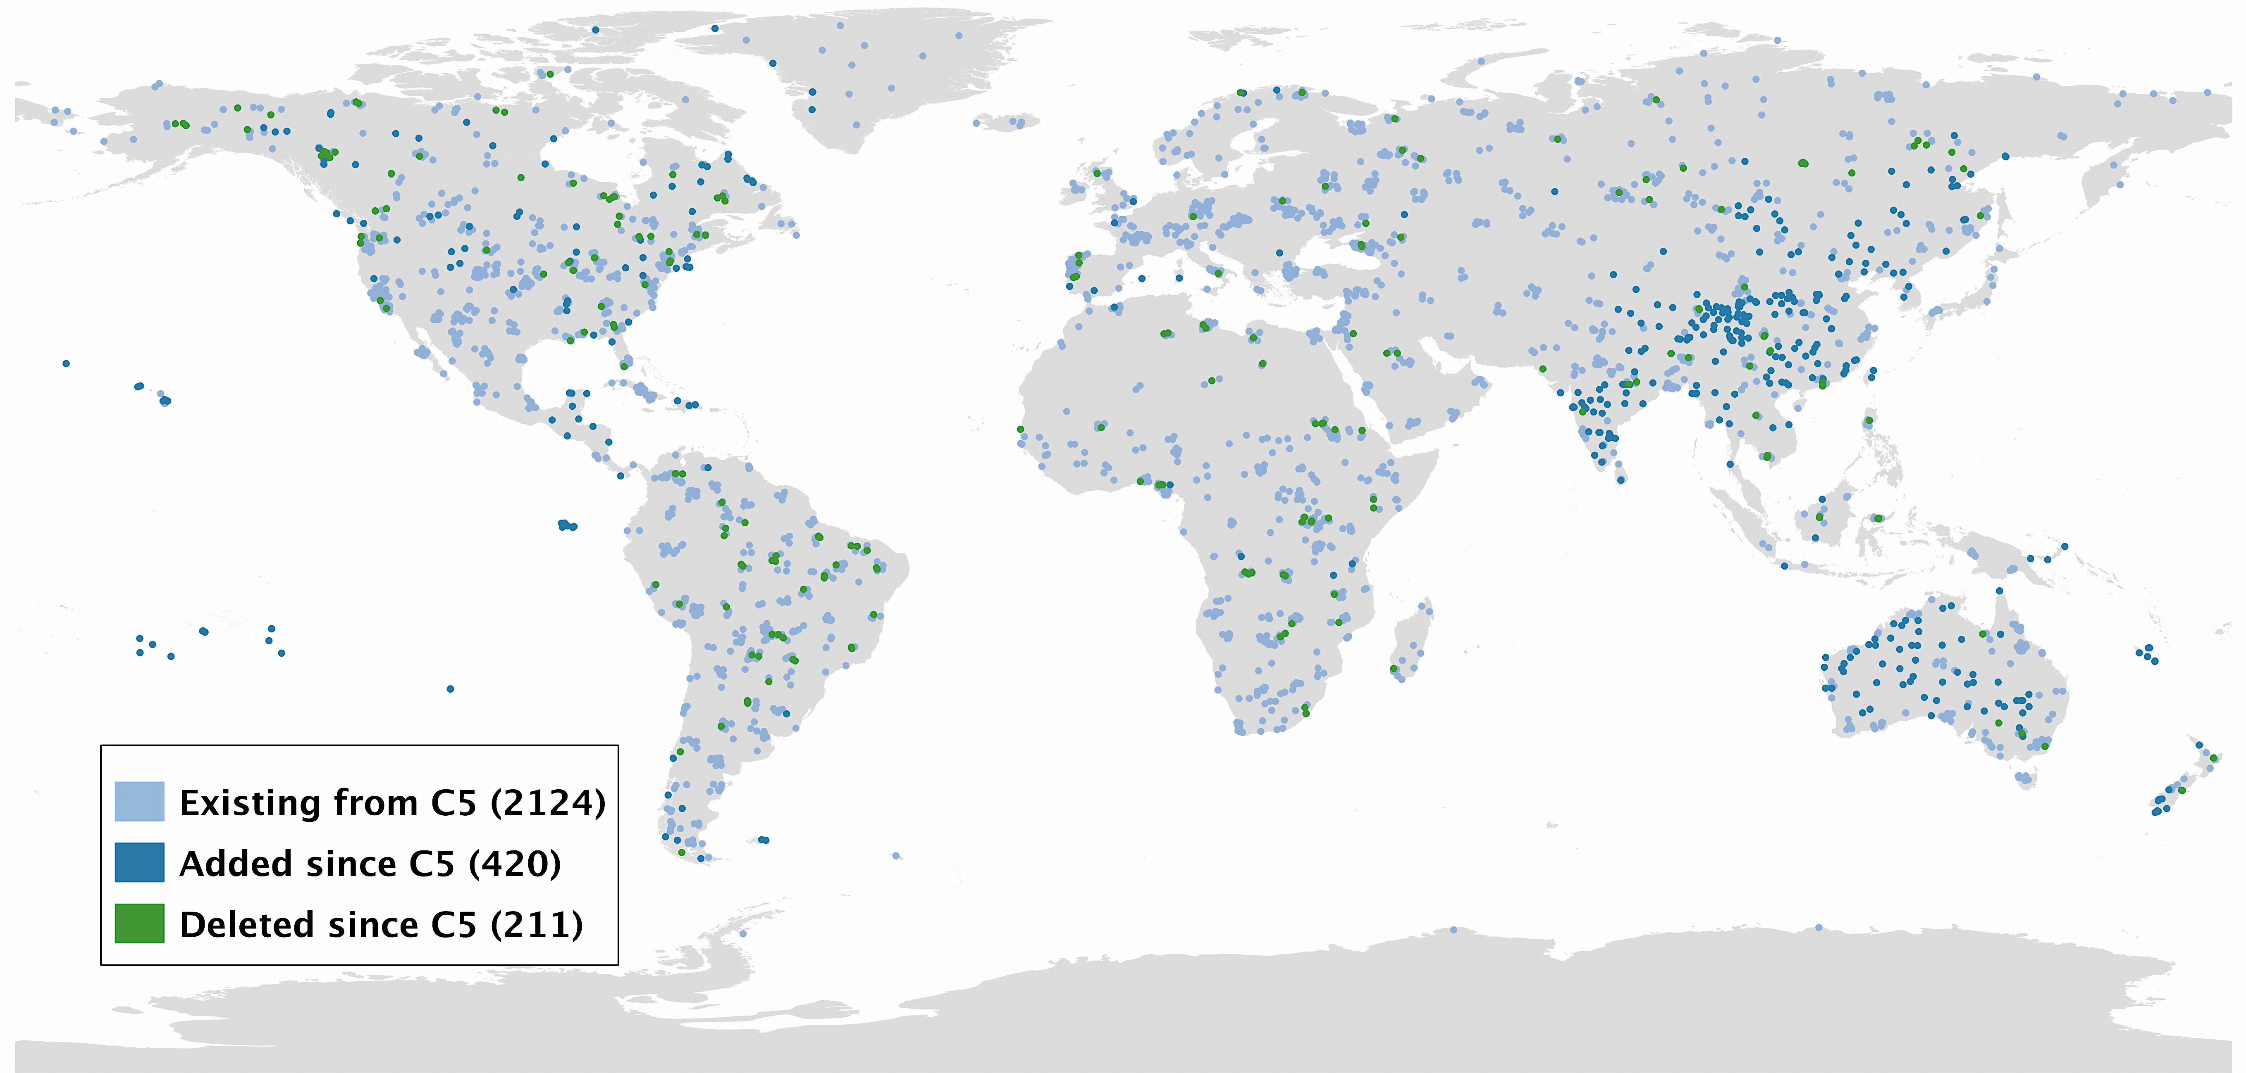
MCD12Q1 - Refinements
Training site database for supervised classification completely revised, augmented

Slide 4
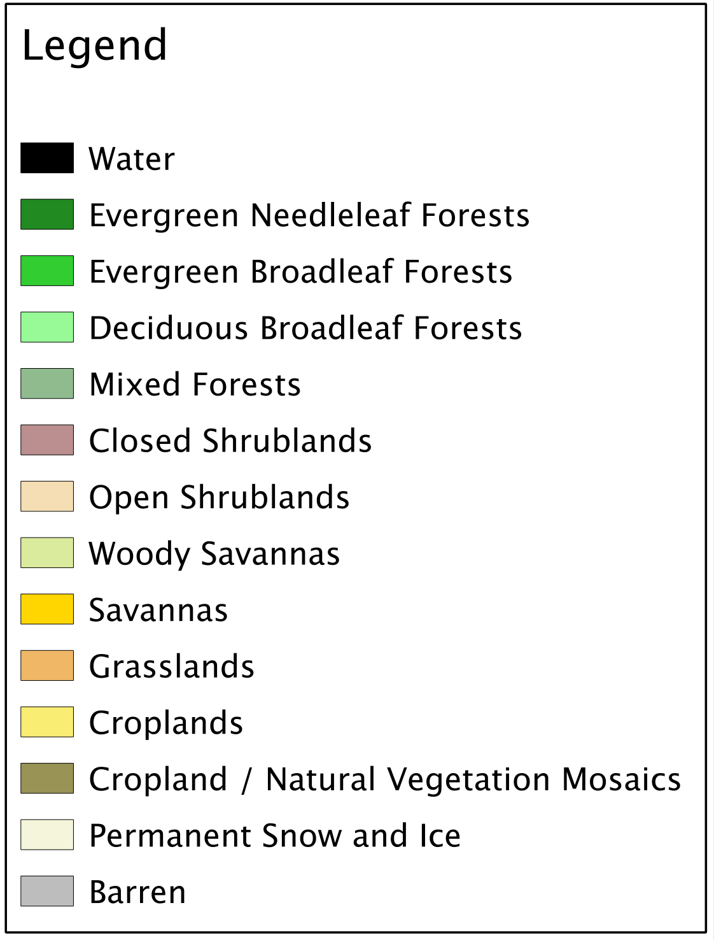
MCD12Q1 - Refinements
New LCCS Compliant Land Cover Layer
All Data
IGBP Legend
Vegetated and Nonvegetated Layer
Vegetated
Barren
Permanent Snow/Ice
Water
Tree and Ground Cover
Closed Tree Canopy
Moderate Tree Canopy
Sparse Tree Canopy
Dense Ground Cover
Sparse Ground Cover
Perennial and Annual Layer
Dense Shrub
Shrub /Herbaceous Mix
Dense Herbaceous
Sparse Shrub
Sparse Herbaceous
Leaf Type and Phenology Layer
Evergreen Needleleaf
Evergreen Broadleaf
Deciduous Needleleaf
Deciduous Broadleaf
Mixed

Slide 5
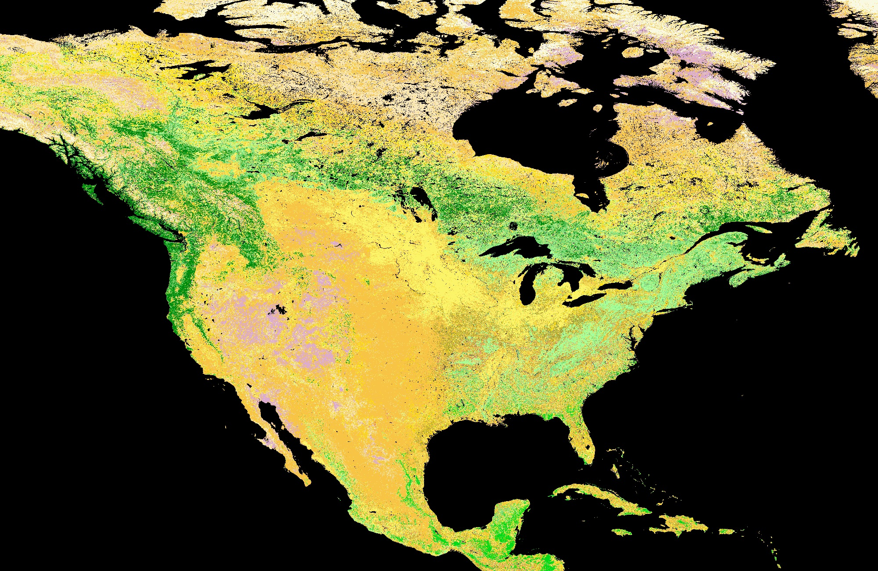
Preliminary C6 LCCS Product
North America

Slide 6
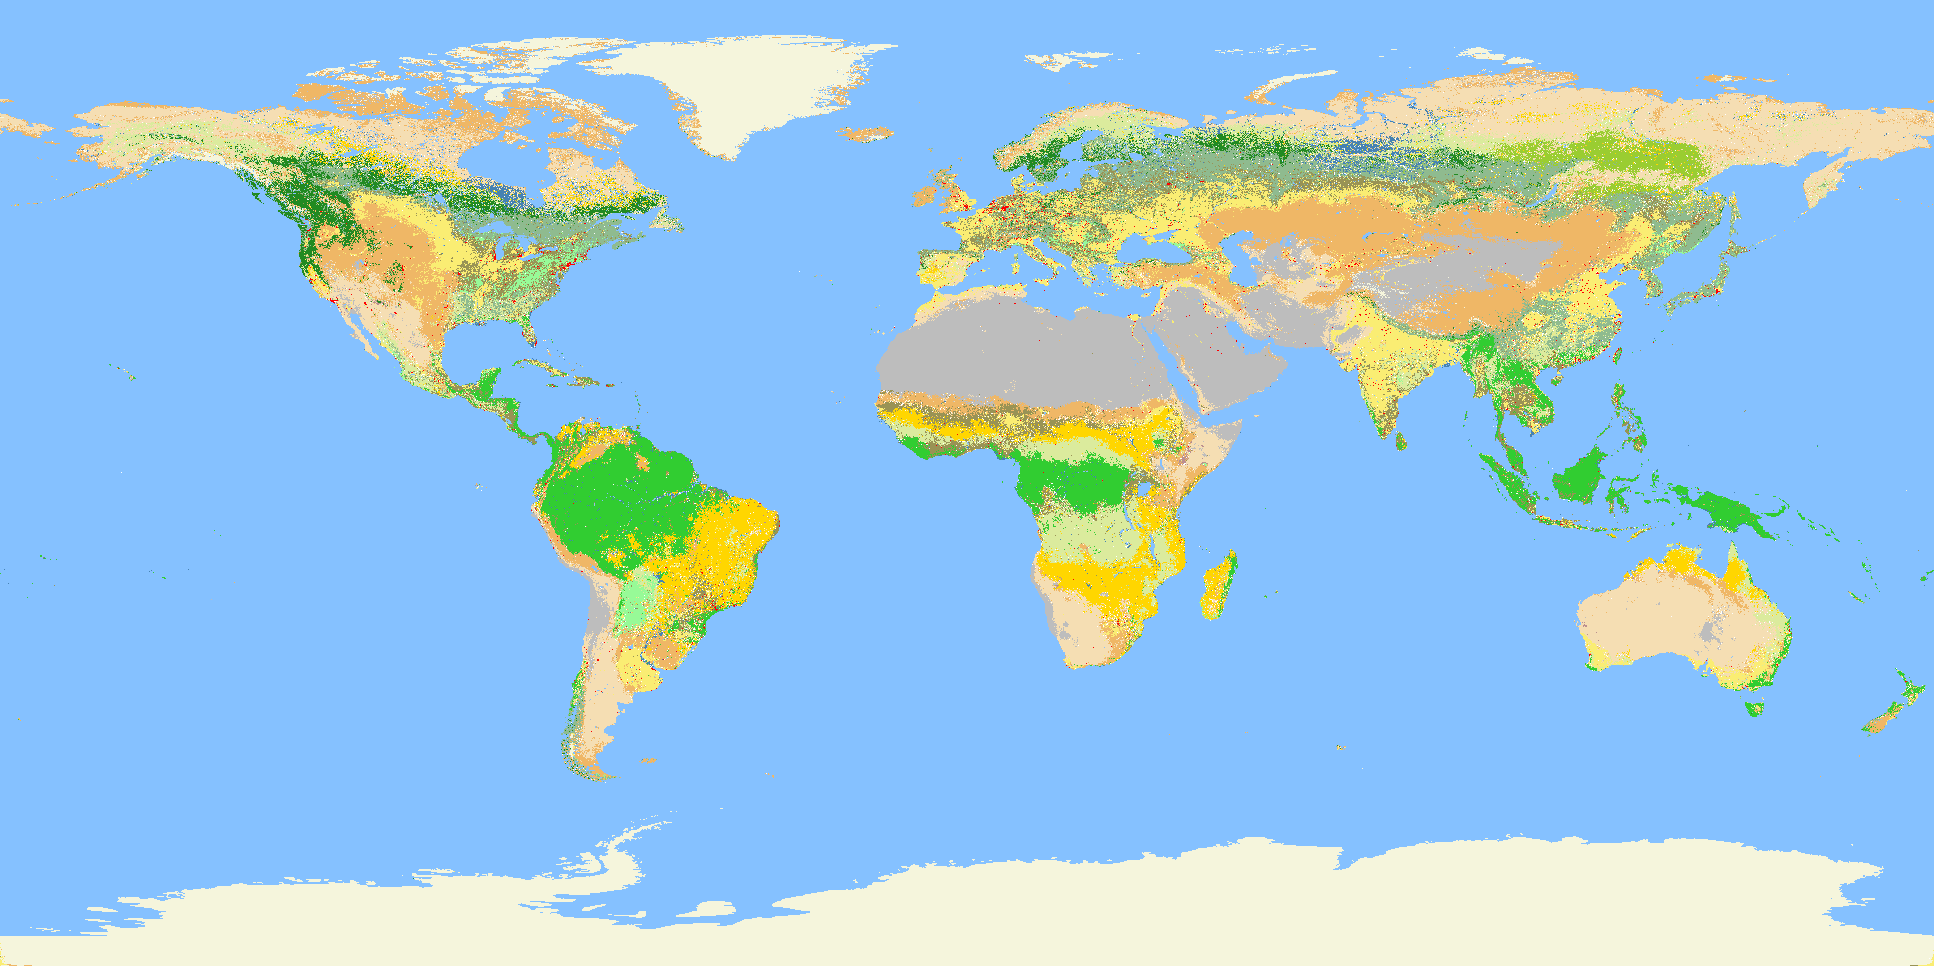
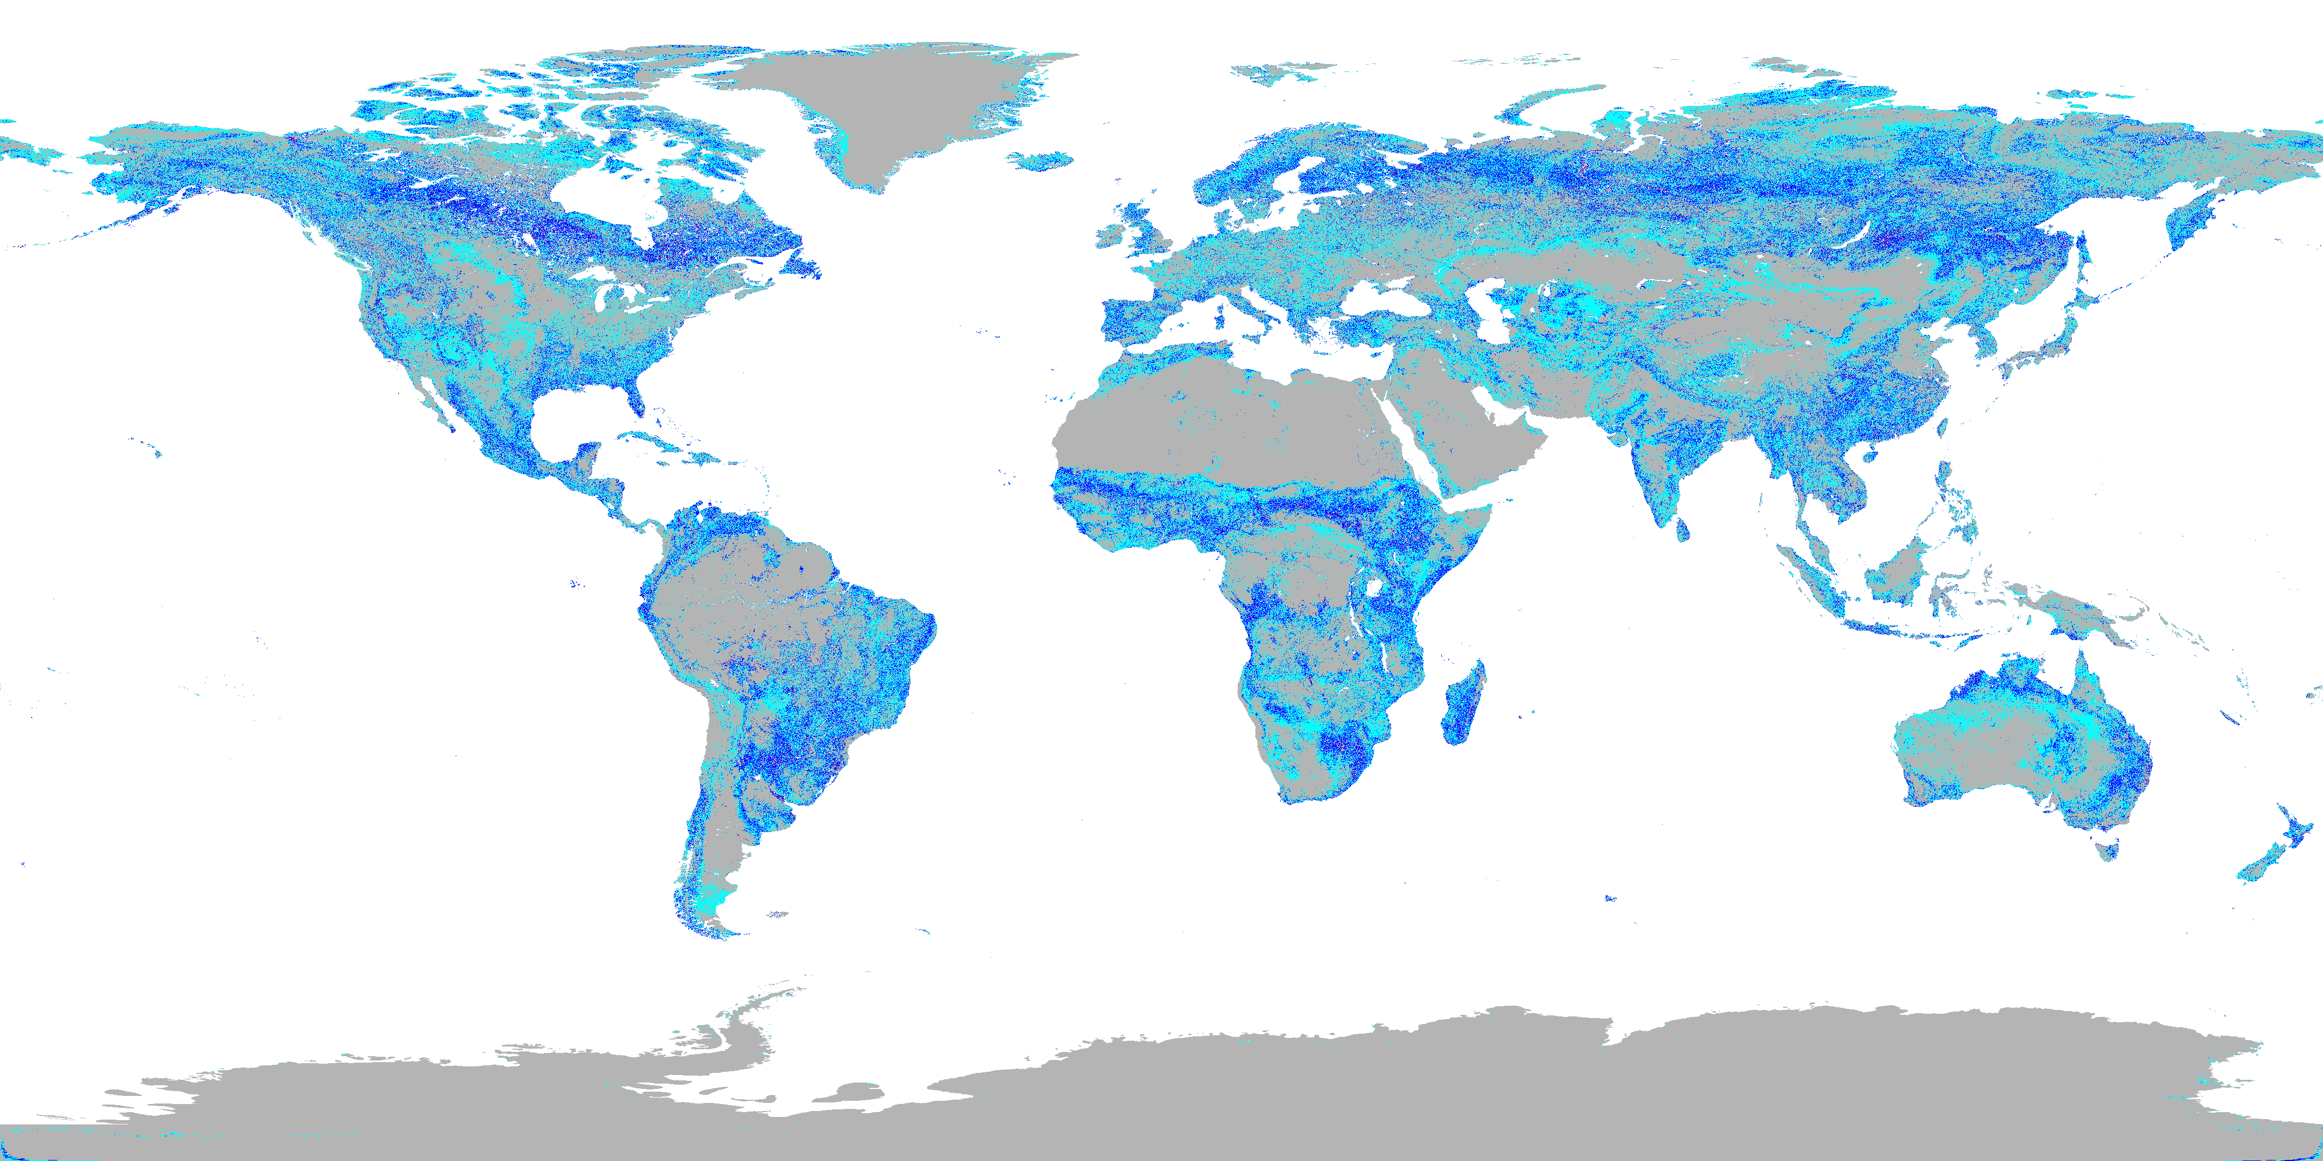
MCD12Q1 Refinements: Land Cover Change
Majority class from 11 years of MCD12Q1
Number of different class labels at each 500 m pixel
What is nature, magnitude of detectable change?

Slide 7
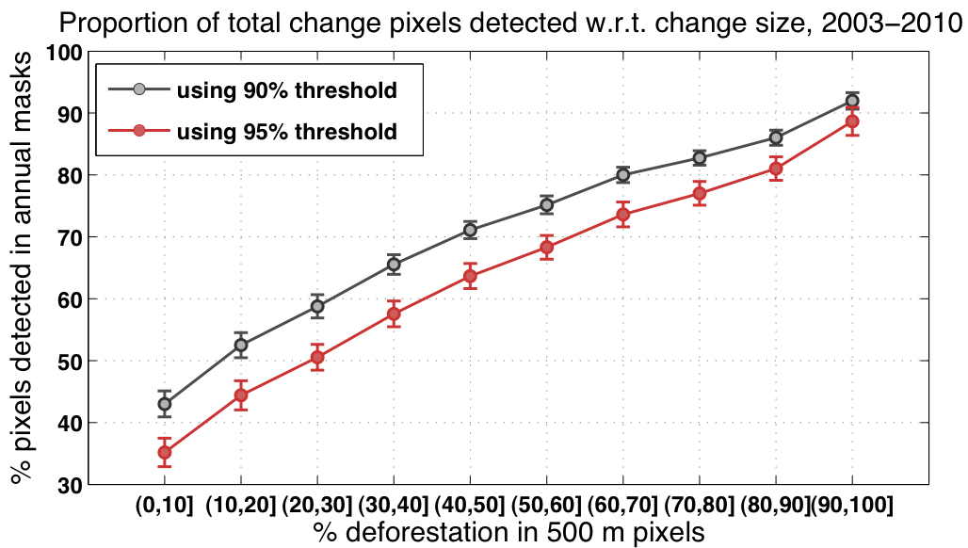
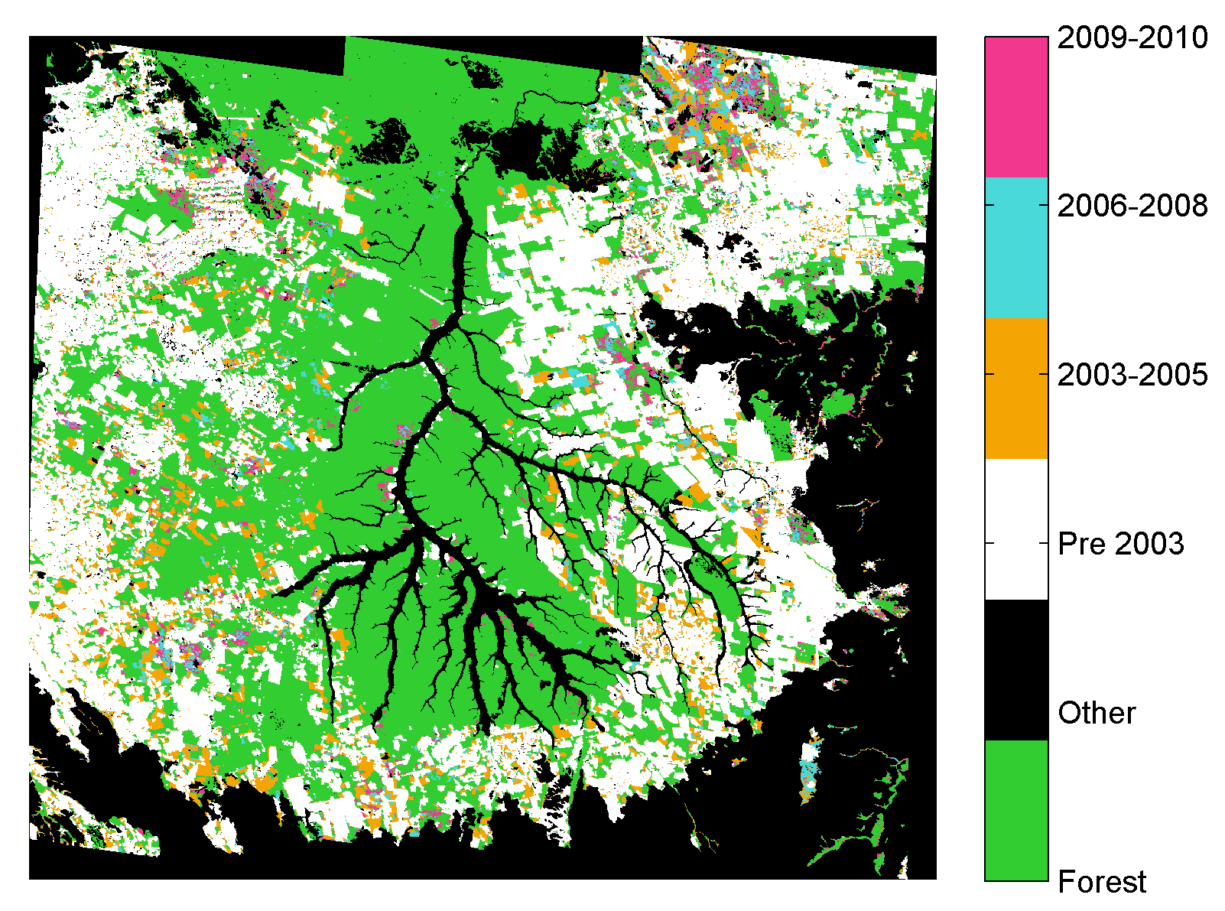
Signatures of LC Change in MODIS
Land Cover Conversion:
Pre-processing & feature extraction
Statistical metrics of change that exploit both spatial and temporal information
Huang et al., in prep

Slide 8
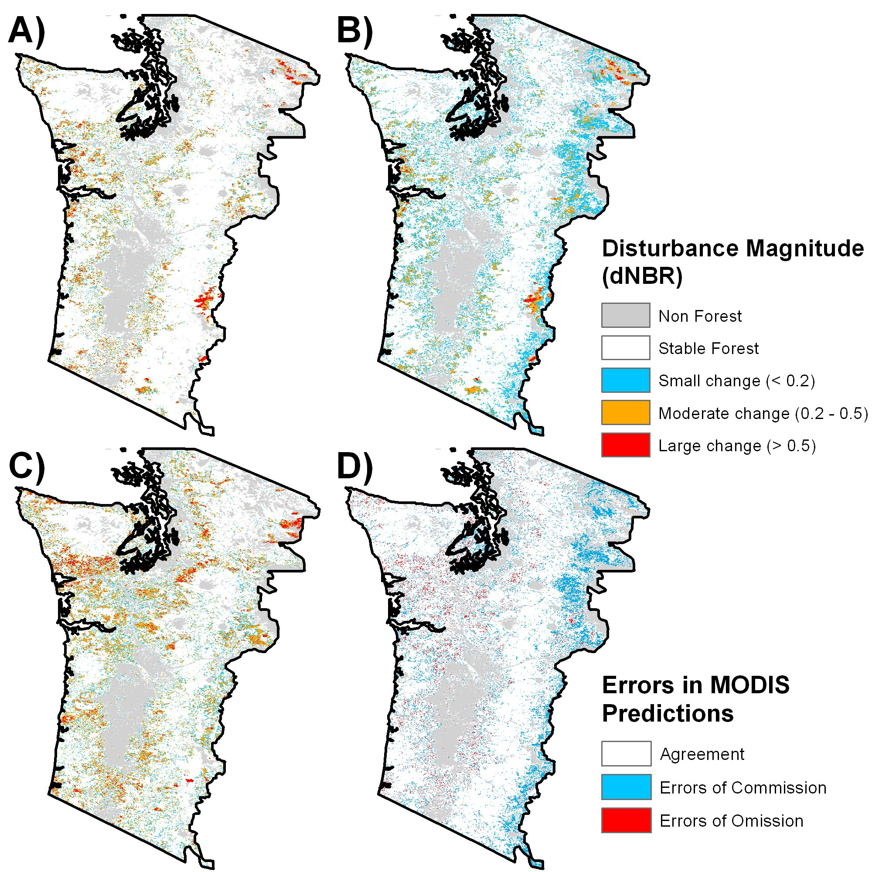
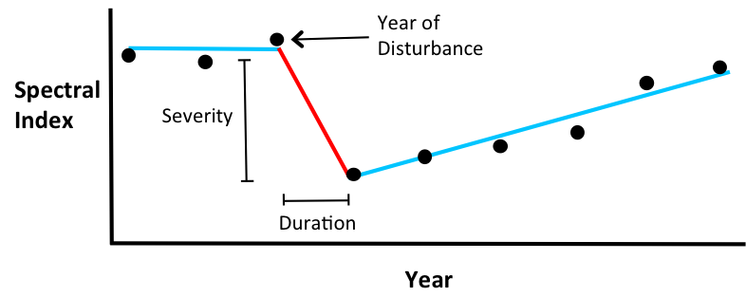
Signatures of LC Change in MODIS
Disturbance
How does area of land cover change affect detection of change?
How does land cover history (disturbance) affect detection of change?
How does noise in data affect detection of change?
Sulla-Menashe et al, in revision RSE

Slide 9
MCD12Q1 Summary
Improved training site database
  Provides improved basis for mapping
New LCCS-based classification
  Better framework for LC mapping
Land cover time series
  Explicit incorporation of change
  Explicit definition of nature, magnitude of changes

Slide 10
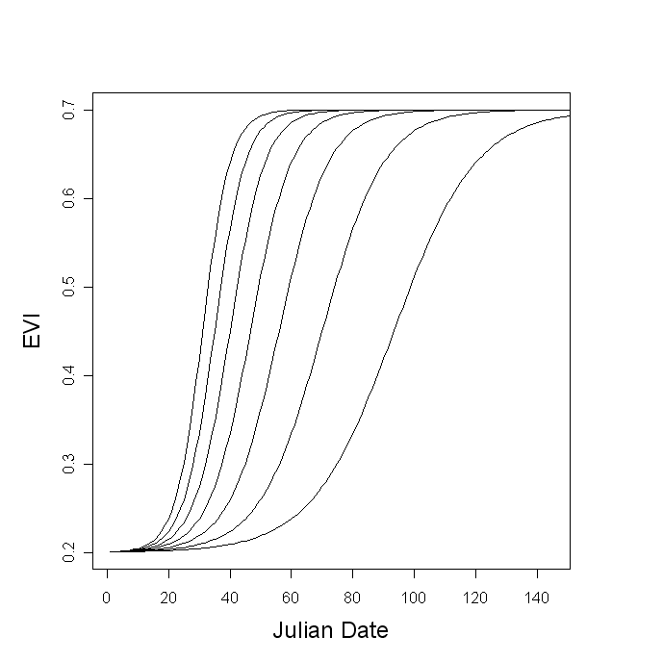
MCD12Q2 - Refinements
Bias reduction for asymmetric phenology using generalized logistic function.

Slide 11
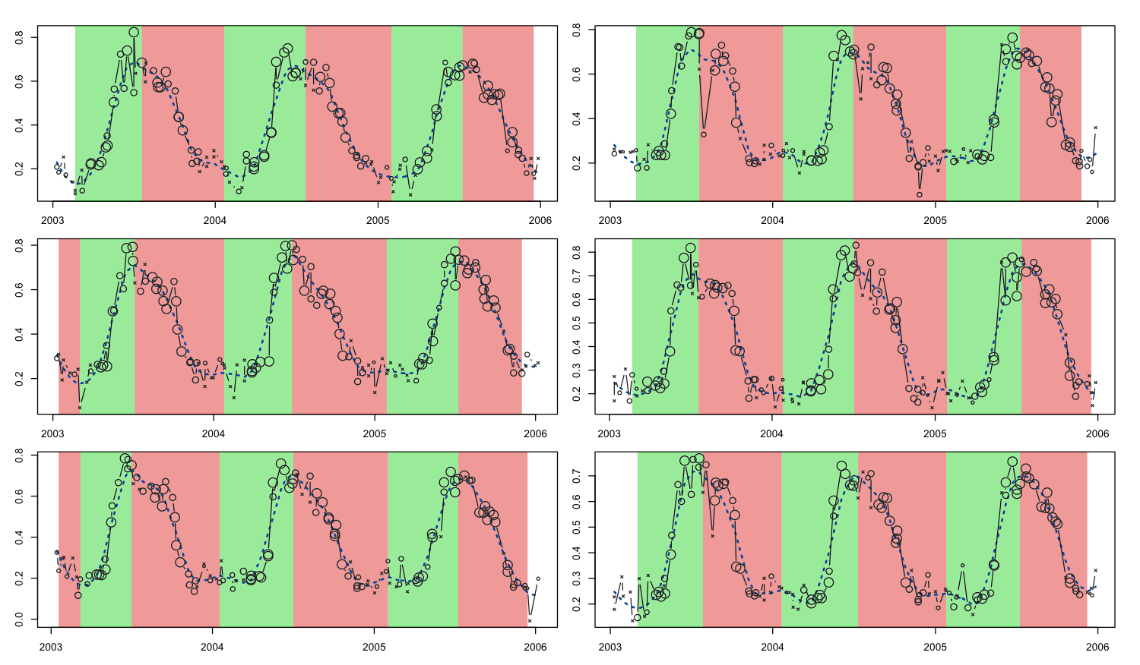
MCD12Q2 - Refinements
Smoothing & gap filling (snow, noise, missing data) via local regression

Slide 12
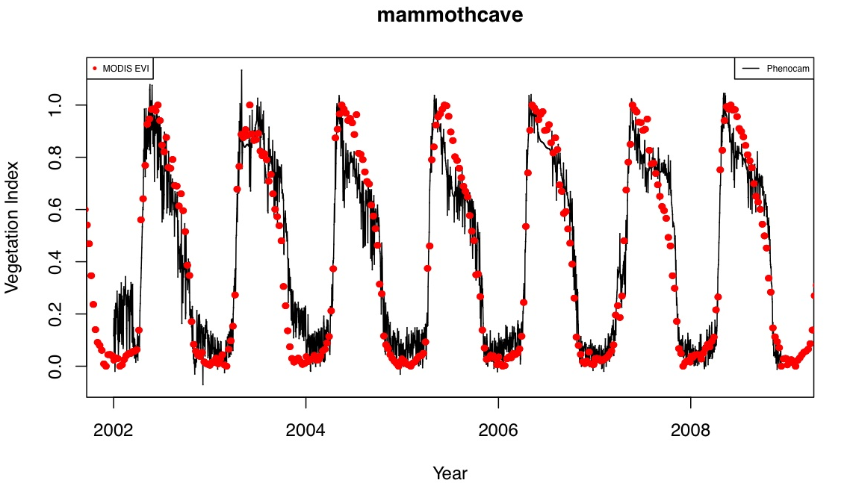
MCD12Q2 - Assessment
Comparison with Webcam data
G_{cc} time series from “Phenocams”
Using identical curvature change point methods to identify transitions
Across sites and across years
Hufkens et al, RSE, 2012
Klosterman et al, in prep

Slide 13
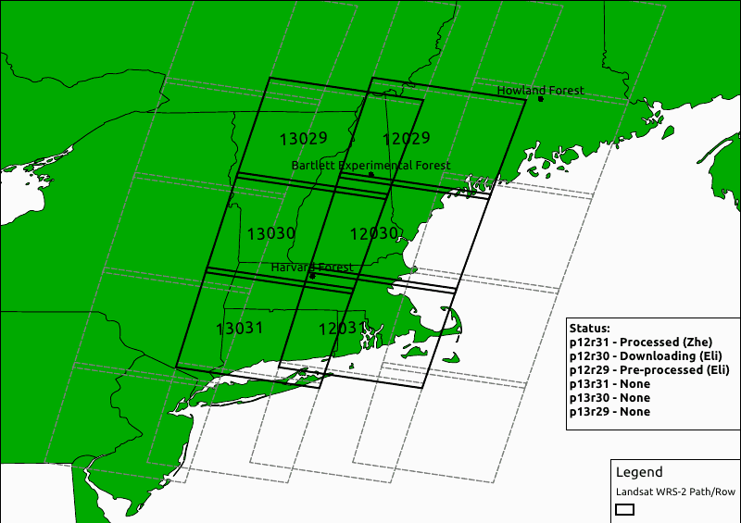
Start of Spring from MODIS vs Landsat
MCD12Q2 - Assessment

Slide 14
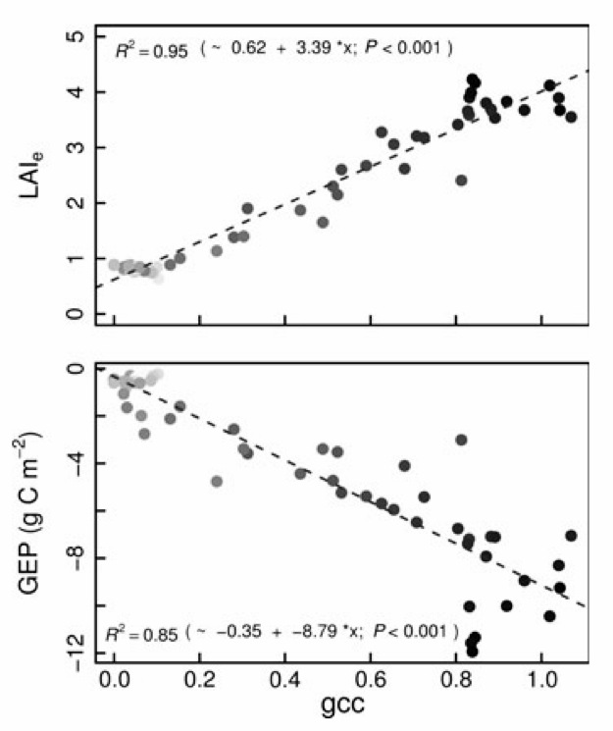
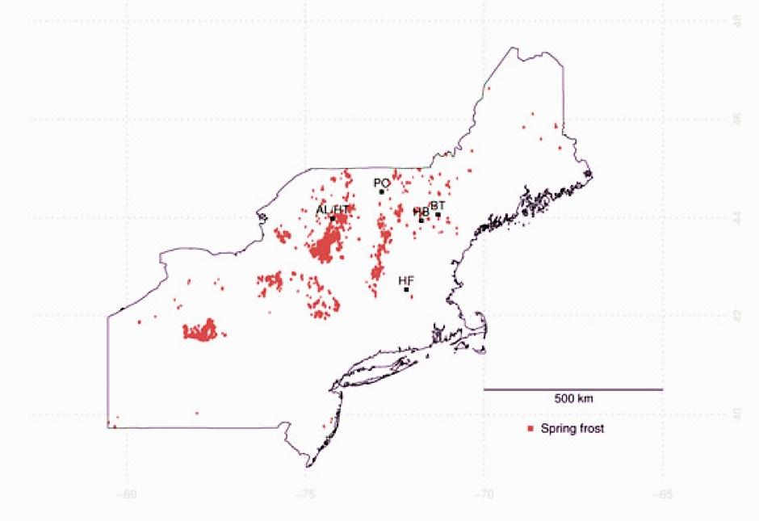
MCD12Q2 – New Science Results
Carbon cost associated with early spring and late spring frosts based on MODIS and flux data (Hufkens et al., GCB, 2012)

Slide 15
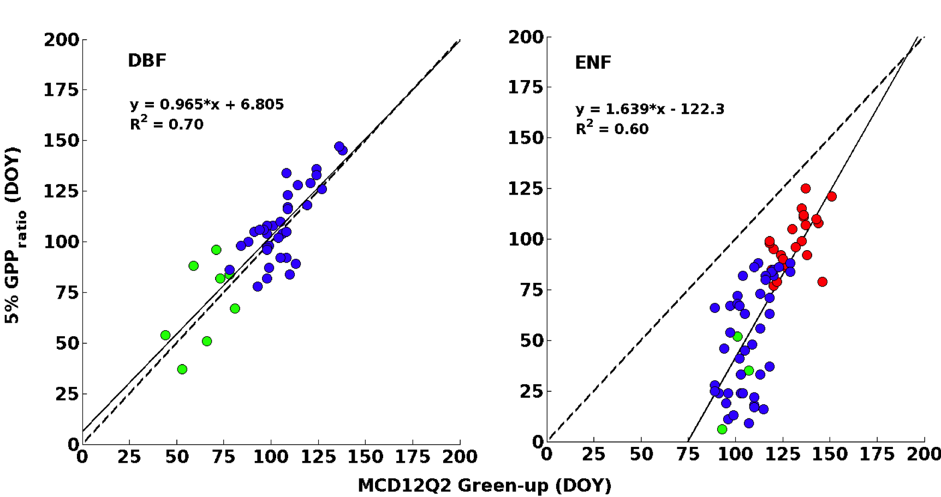
MCD12Q2 – New Science Results
Comparison of Photosynthetic Start of Spring from Eddy Covariance vs MCD12Q2 (Melaas et al., AFM, 2013)

Slide 16
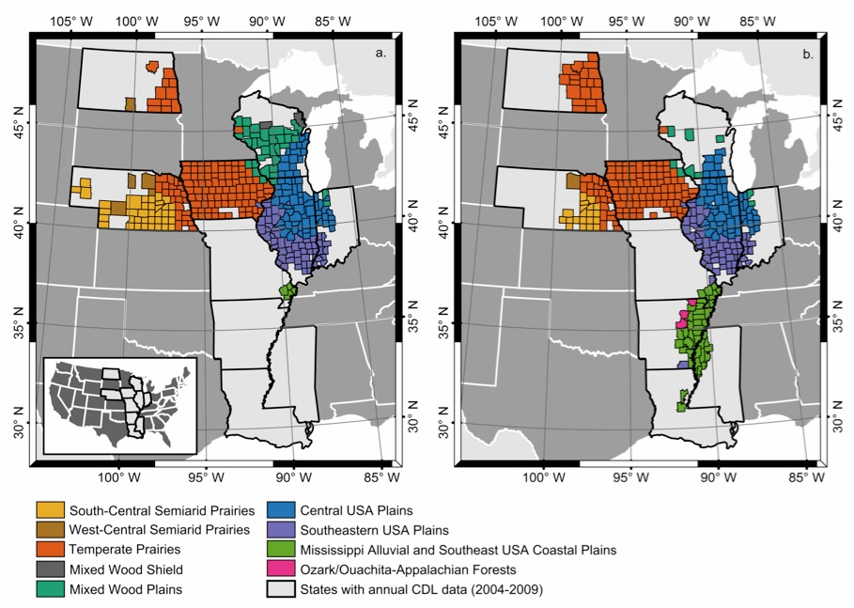
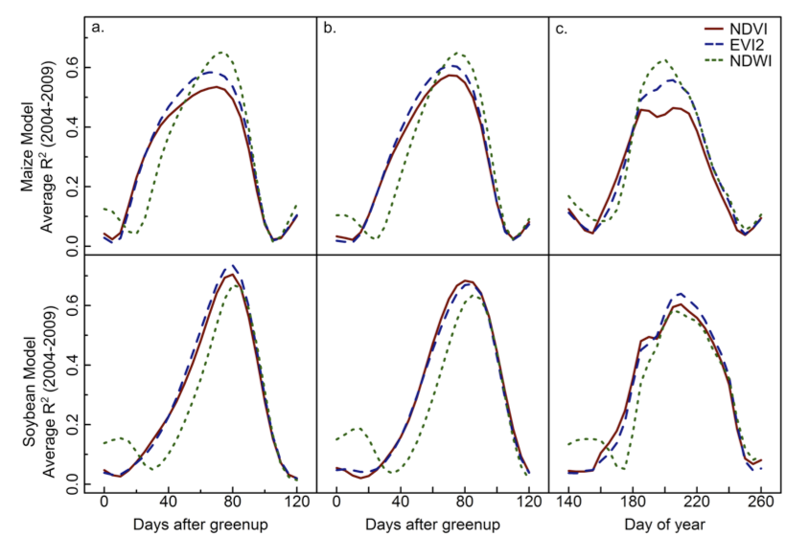
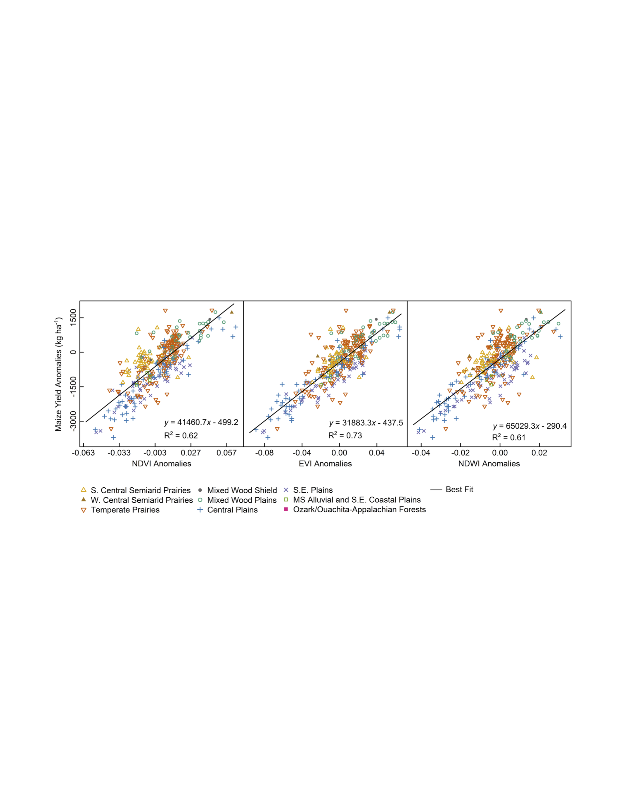
MCD12Q2 – New Science Results
Significant information in phenology related to crop yields. Upper left shows study region composed of major corn (left) and soybean (right) production counties in US. Upper right shows correlation between “phenologically-adjusted” vegetation indices and yield. Lower left plots yield 2005 anomalies versus predicted anomalies from MODIS.
Bolton and Friedl, AFM (2013)

Slide 17
MCD12Q2 - Summary
Revised functional model for phenology
  Reduces bias in product
Improved treatment for noise, missing data
  Reduces noise in product
Extensive assessment and validation
  Feeding back into algorithm revisions

Slide 18
Questions?

