Slide 1
MAIAC Update Alexei Lyapustin, GSFC, code 613 Yujie Wang, Sergei Korkin MODIS Science Team Meeting
April 16, 2013

Slide 2
MAIAC = Time Series + Spatial Analysis
Complete Physical Model of RT (Deterministic):
- Anisotropic surface;
- Retrieval of Spectral Regression Coefficient:
- Detection and accommodation of seasonal and rapid surface change;
- Storing “static” (surface) information;
- Synergy among WV, CM, aerosol and AC algorithms.
Explicit representation of BRF in RT:
Lyapustin, A., and Yu. Knyazikhin, Green’s function method in the radiative transfer problem. I: Homogeneous non-Lambertian surface, Appl. Optics, 40, 3495-3501, 2001.
Plan
Brief Overview of MAIAC
Algorithm Developments (Aerosol Type Discrimination and Cloud Filtering)
- RTLS BRF model

Slide 3
Learning and Retaining “Static” Information
MODIS, TOA RGB
NBRF
AOT
BRF

Slide 4
Multi-Angle Implementation of
Atmospheric Correction (MAIAC)
QB:Is Snow Detected?
4a. Retrieve Snow sub-pixel Fraction and Snow Grain Size
Queue of K days
New Granule
1. Grid L1B Data and Split in Tiles
2. LTP: Retrieve
Water Vapor
(NIR Algorithm)
3. QB, LTP: Cloud Mask (Covariance-Based Algorithm)
Is B7 BRF known?
No
Use MODIS Dark Target Algorithm
Yes
7. QP: Retrieve BRF and albedo in reflective bands.
Backup: Lambertian retrieval
6. LTP: Retrieve Fine Mode Fraction
5. LTP: Retrieve B3 AOT using known surface BRF, ρ_{B}=ρ₇b_{B}
4. QB: Retrieve Spectral Regression Coefficients in Blue band B3 (b_{B}).
MAIAC Products (1 km, gridded)
Atmosphere: Surface:
Cloud Mask; Parameters of RTLS BRF model;
Water Vapor; Surface Reflectance (BRF)/ Albedo;
AOT & aerosol type; Dynamic Land-Water-Snow Mask.

Slide 5
Cloud Mask
Left – MODIS TERRA RGB, 2003 (50×50km²), Right – MAIAC CM
Basis - covariance analysis (identifies stable pattern in the time series) & reference clear-sky image of surface
High covariance - CLEAR. Ephemeral clouds disturb the pattern and reduce covariance.
Algorithm maintains a dynamic clear-sky reference surface image in B1, B7, used as a comparison target in cloud masking.
Approach:
High_cov – search for clouds
Low_cov – search for clear-sky
CM Legend:
Blue (Clear), Red & Yellow (Cloudy).
GSFC, USA
Mongu, Zambia
Solar Village

Slide 6
Enhanced Cirrus Detection using WV
MOD35: R_{1.38} > 0.035, not used if H>2km
MAIAC: a) Threshold is f(WV): 0.01 (WV>1cm), and 0.035 (WV>0.3 cm)
b) Detect Clear Snow: cov(1.38,1.24)>High, cov(B1,refcm)>High
TOA
CM
BT
R26: 0-0.035
AOT
TOA
CM
BT
R26: 0-0.035
Georgia, USA
Niger, Africa

Slide 7
Spectral Regression Coefficient
GSFC,
2000,
DOY 84-93
Initial run using Levy et al., 2007
Second run after initialization
Queue of K days
In standard retrievals, AOT correlates with surface brightness (left).
SRC retrieval helps avoid surface artifacts (right).
SRC_{ij}
τ₁
τ₂
τ₃
N²
τ_{k}
Accumulate K>3 days and solve for N² SRC
TOA
CM
C5 AOT
TOA
CM
NBRF
BRF
SRC
AOT
Blue/Black-Underestimation
Green – Agree
Yellow/Red - Overestimation
Difference Image: MOD09-ASRVN (GSFC, 2005, day 264)
-0.02 0 0.02
TOA MOD09 ASRVN diff-Red diff-Green diff-Blue.

Slide 8
Aerosol Algorithm: Smoke Test
Lyapustin, A. et al., 2012: Discrimination of biomass burning smoke and clouds in MAIAC algorithm, ACP, 12, 9679–9686.
Phys. principles (~OMI): 1) n_{i} increases R→DB; 2) Multiple scattering, and absorption, increase R→DB, for absorbing aerosols.
TOA RGB CM AOT_{0.47} Angstrom SP (b) AP (0.7-0.91) Smoke Mask NBRF
DOY 253-254
500m
199, 500m

Slide 9
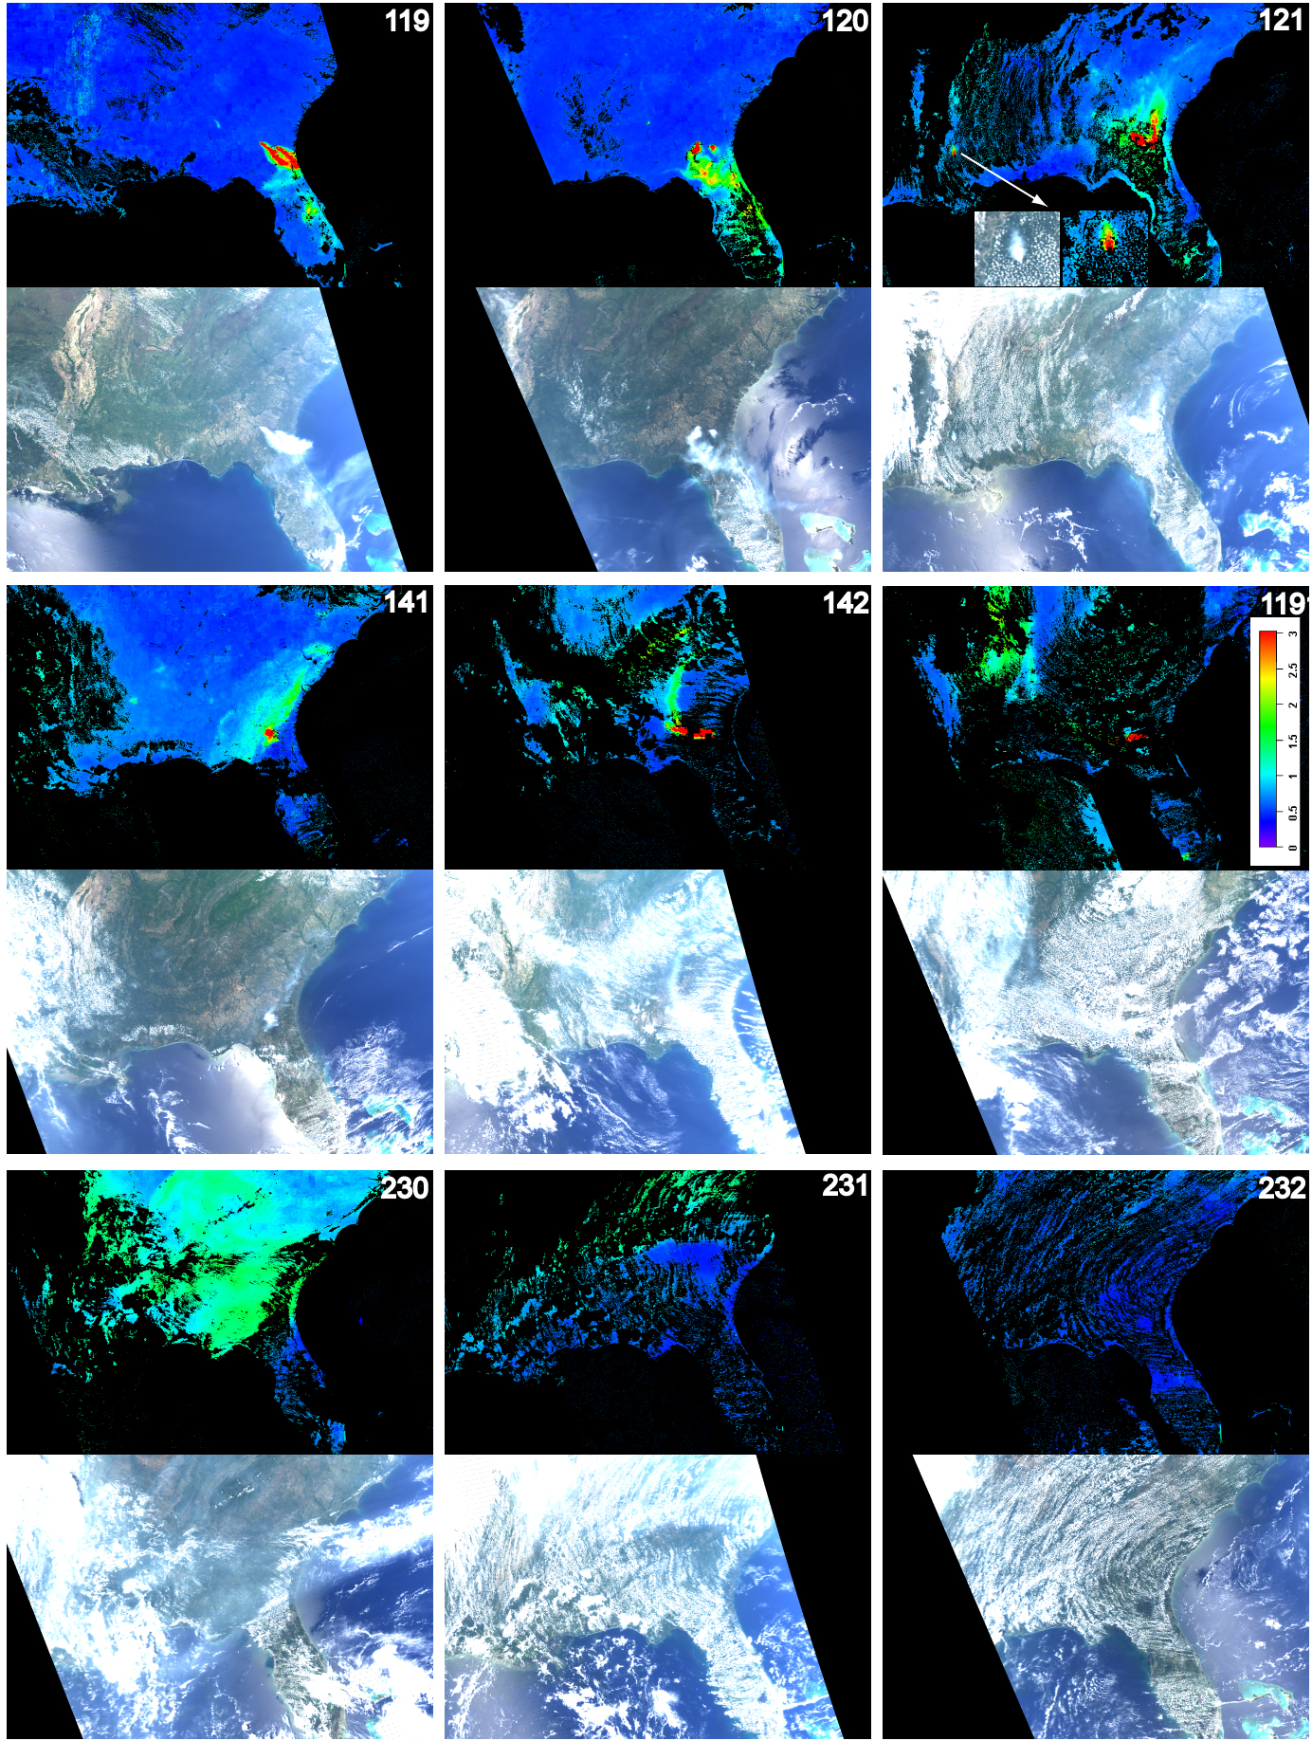
Georgia/Florida Fires of 2007

Slide 10
Removal of polluted air by weather system [Lyapustin et al., 2012, ACP].
TOA
CM
AOT
δ_{0.412}
δ_{0.47}
δ_{0.66}
δ_{2.13}
Backgr./Smoke/Dust
Model | Abs. | Size
Backgr. | No | Small
Smoke | Yes | Small
Dust | Yes | Large

Slide 11
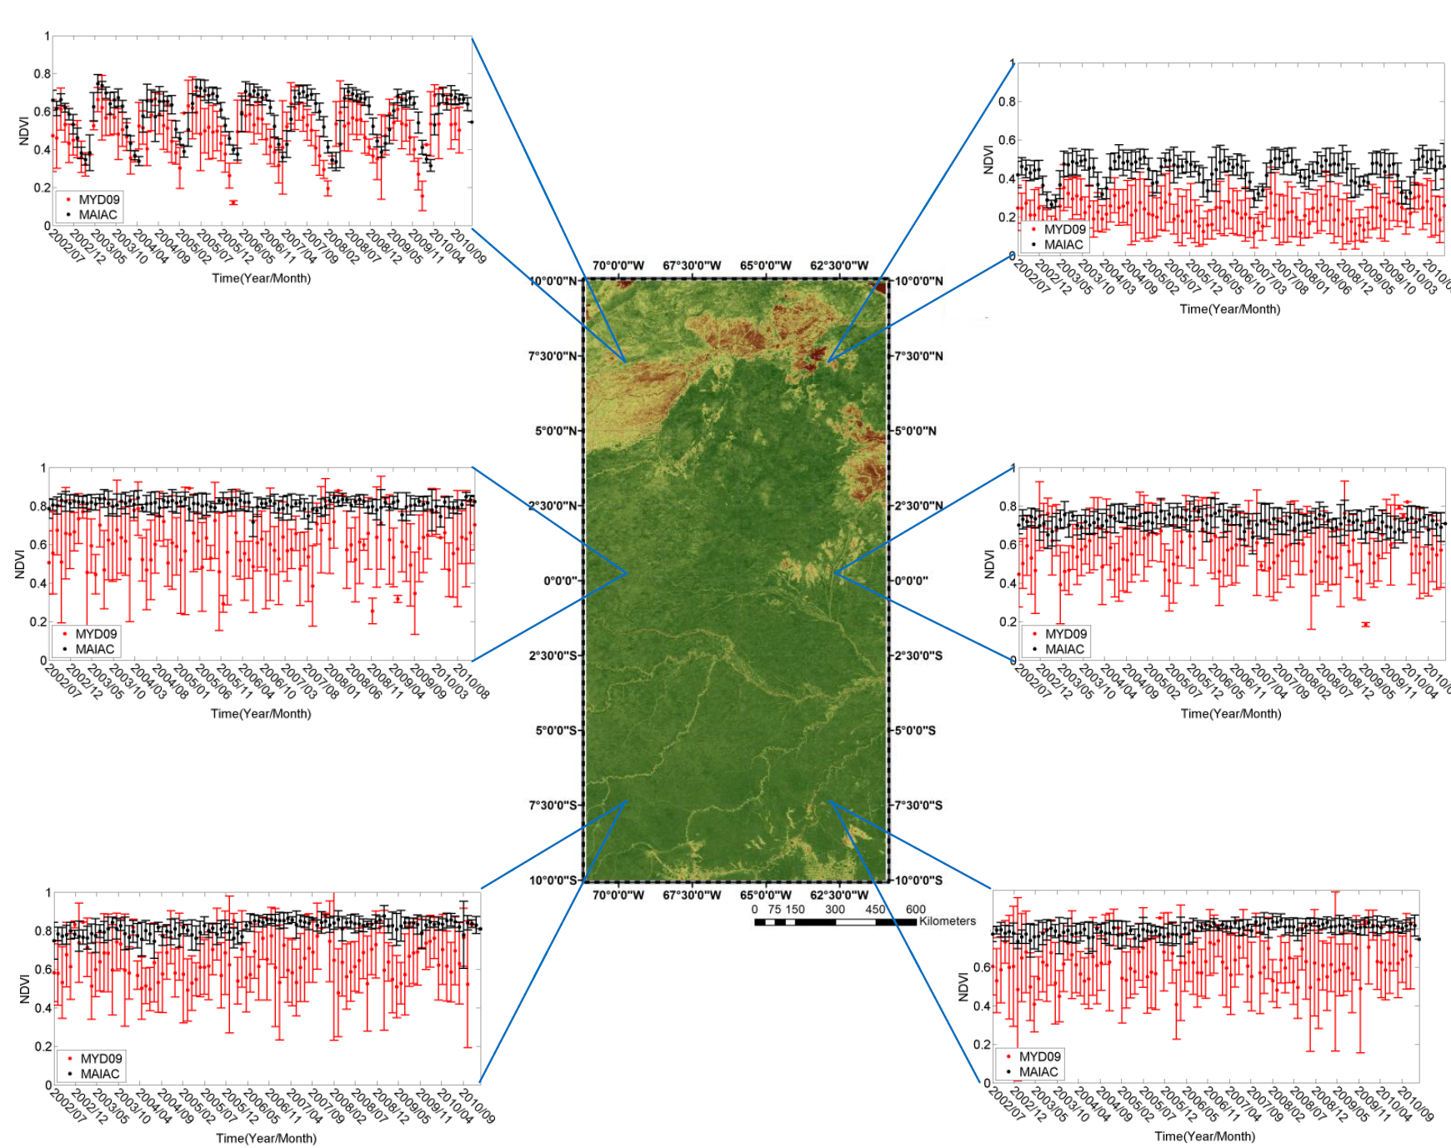
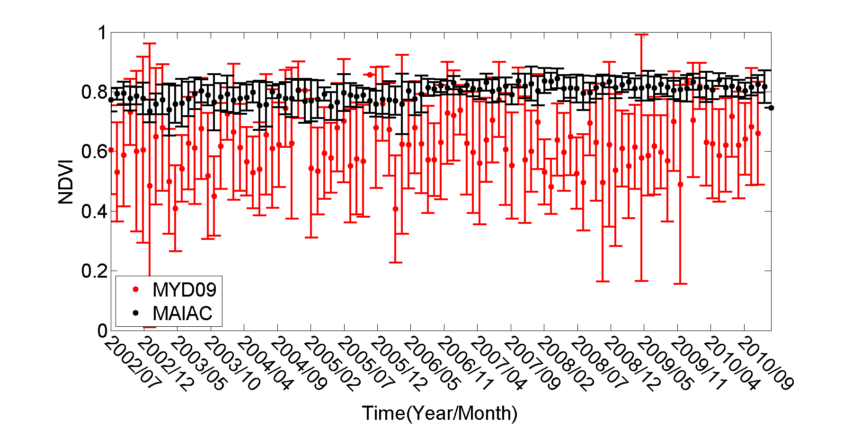
Amazonia: Comparison with MOD09

Slide 12
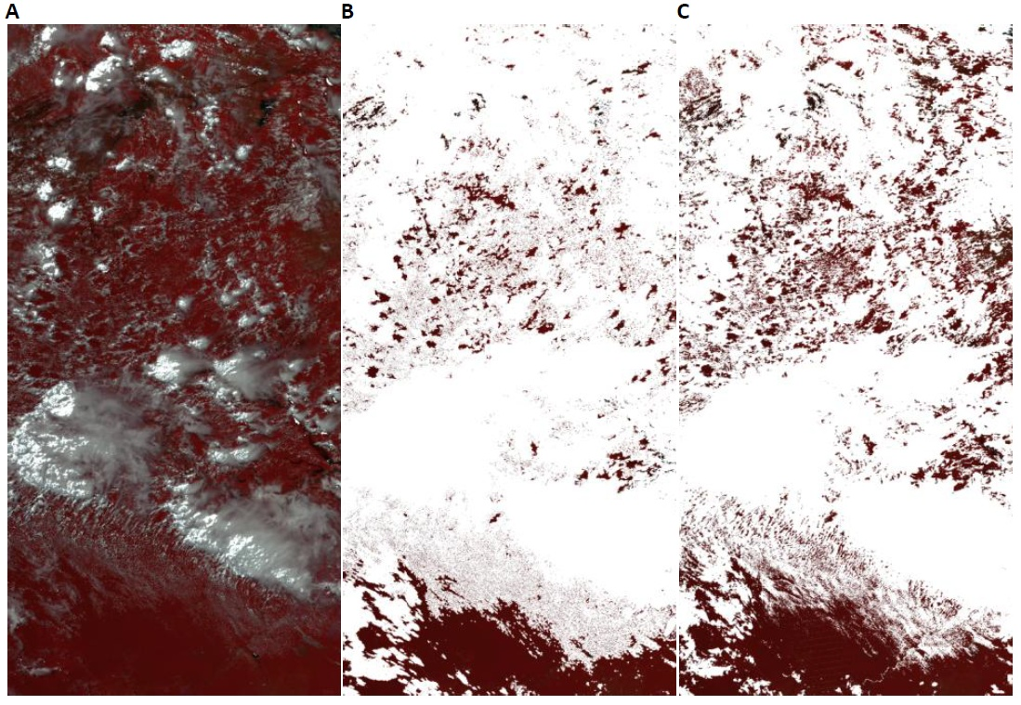
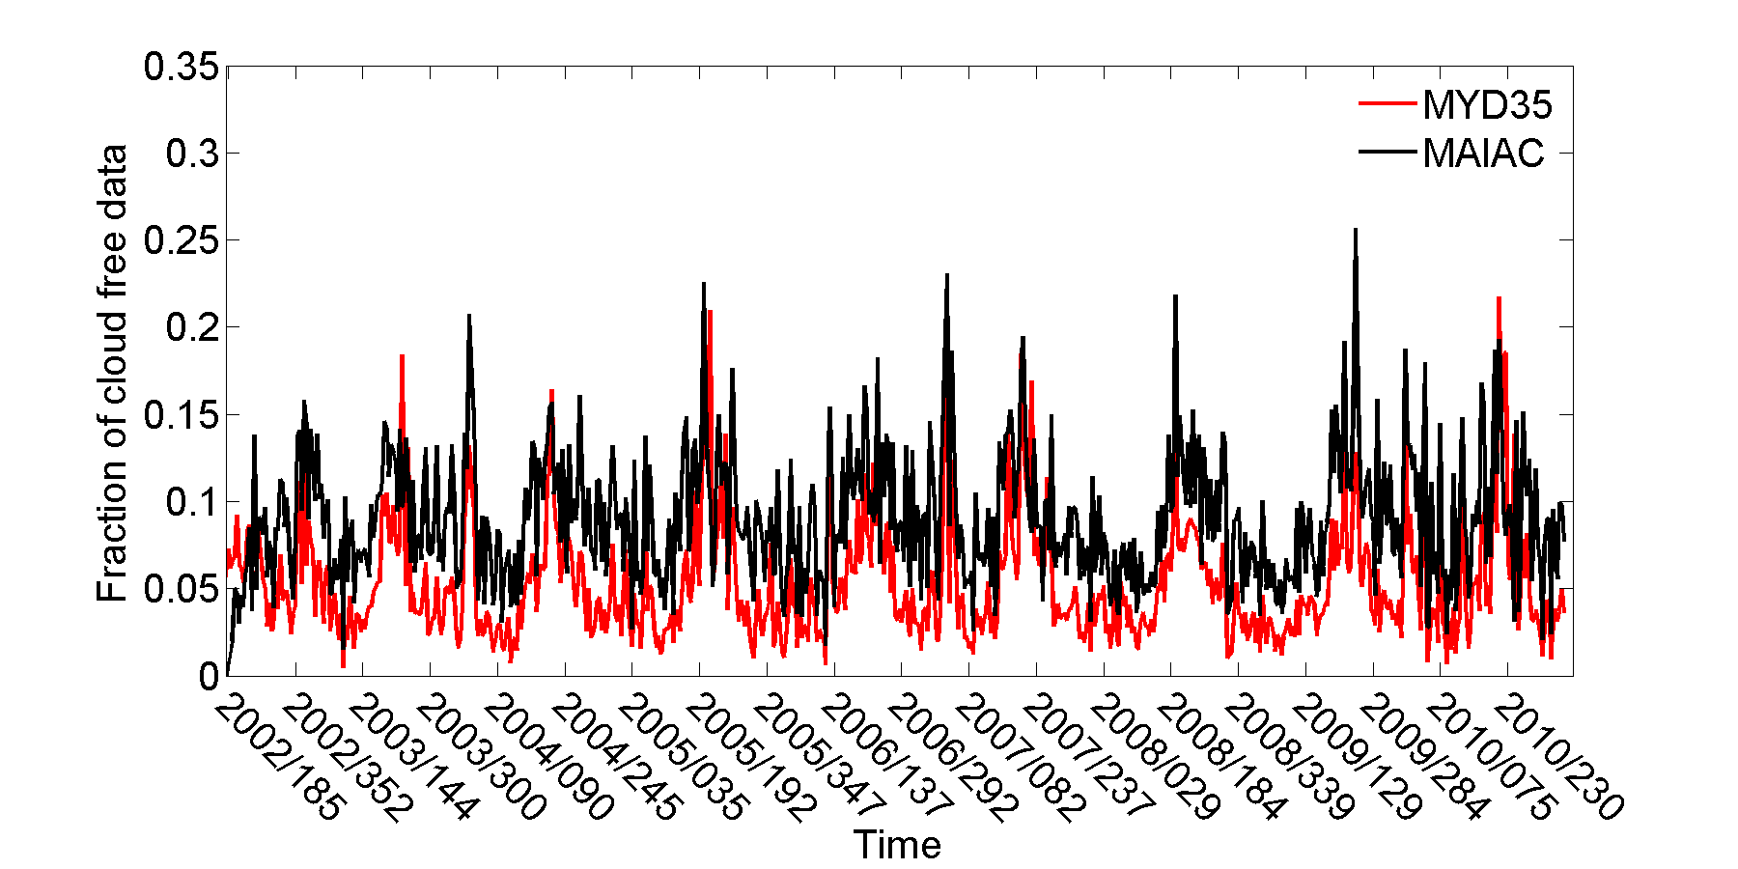
Cloud mask
MODIS TOA
MOD35 CM
MAIAC CM
Hilker, T., A. I. Lyapustin, C. J. Tucker, P. J. Sellers, F. G. Hall, Y. Wang, 2012: Remote Sensing of Tropical Ecosystems: Atmospheric Correction and Cloud Masking Matter. RSE, http://dx.doi.org/10.1016/j.rse.2012.08.035.
MAIAC Terra&Aqua Amazon dataset is available on the LAADS FTP site ftp://ladsweb.nascom.nasa.gov/MAIAC/

Slide 13
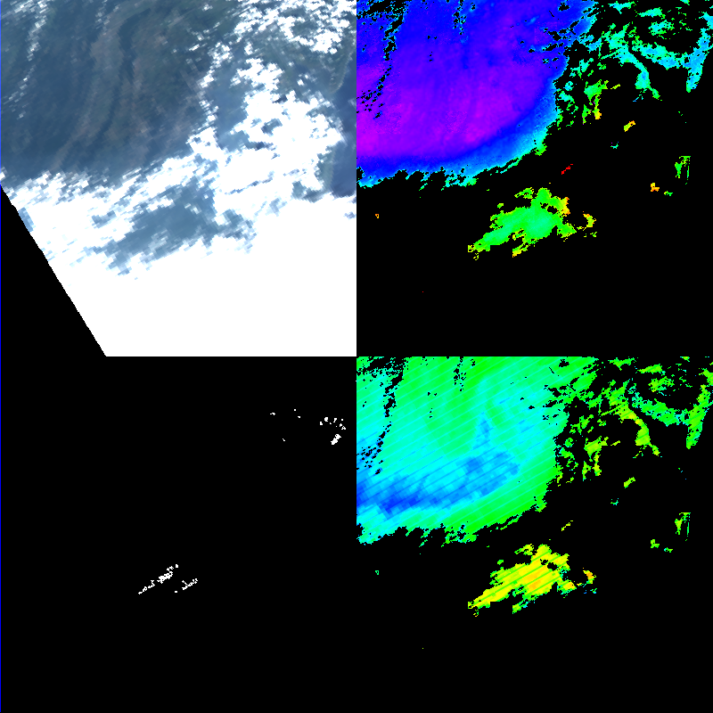
WV-AOT-Clouds …
TOA RGB
AOT_{0.47}
Aqua:
2011,
DOY 212,
17:30
Sub-grid WV variability
Column WV
0 1 2 3 4 5 cm

Slide 14
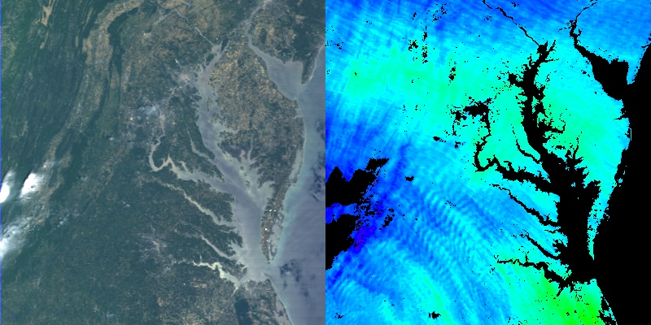
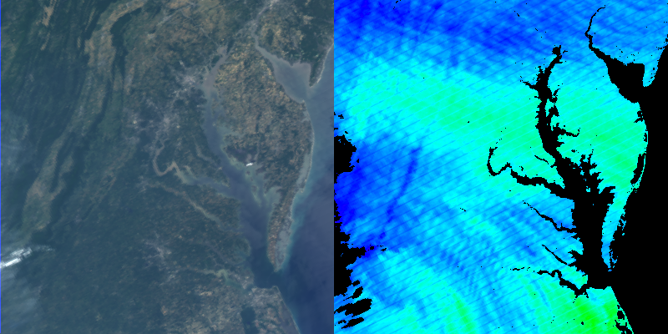
Mountain Waves in MODIS NIR WV
Terra, 2011: DOY 153
16:10
TOA RGB
Column WV
0 1 2 3 4 5 cm
Aqua:
DOY 153,
17:50
δ~3-5km

Slide 15
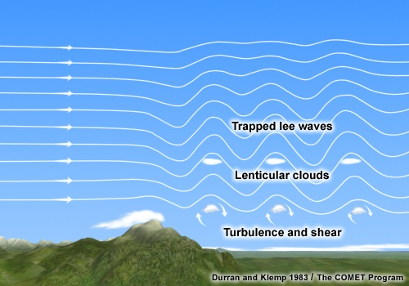
Mountain Waves in Water Vapor
RGB CM AOT CWV T11
Aqua: 2011
DOY 77
Aqua: 2011
DOY 79
MODIS Aqua WV BT (6.7μm), 12-28-04, from Uhlenbrock et al., Weather and forecasting, 22, 662-670, 2007.
CWV can provide wave period and drag (dissipation) distance. How can this information be used?

Slide 16
What is Bright Surface?
Sensitivity of measurements to AOT variations
AOT uncertainty relates to surface BRDF uncertainty:
Over land, uncertainty of
AE(Blue, Red) is defined by
the Red band retrieval:
TOA CM AOT_{0.47} Δτ (0-0.2) BRF
DOY
66
Balt.-Wash.
182,
2011
Δτ (0-1)
2002
237
238
Southern Israel

Slide 17
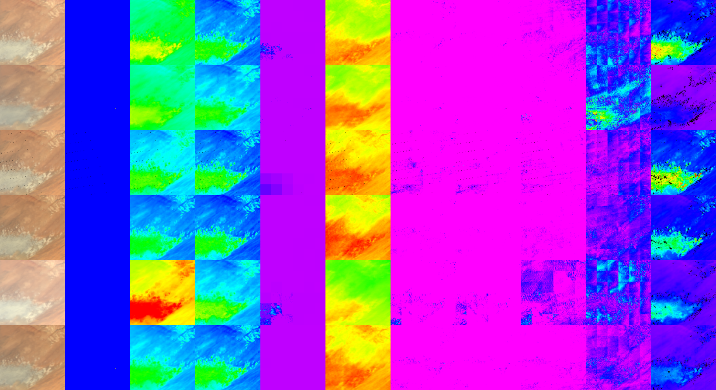
Bright-I: Surface Characterization
Analysis for 25×25 km² blocks (includes both magnitude and contrast)
Accept if
Cov>HIGH
& rmse<1
Example for Bodele Depression (150×150 km²: DOY 344-351, 2007)
TOA
CM
R_{0.412}
BRF_{0.412}
AOT
BT
δ_{0.47}
δ_{0.412}
δ_{0.66}
χ (0-4)
Δτ (0-0.5)
- AOT uncertainty

Slide 18
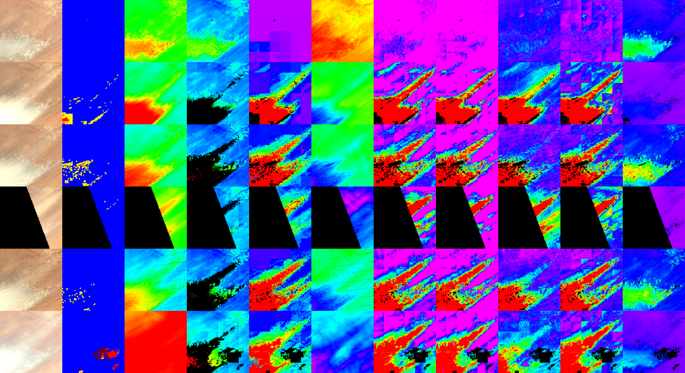
Bright-II: Aerosol Retrieval
Pixel Analysis
for every pixel with χ>0.5
… Bodele Depression (DOY 352-358, 2007 – Dust Storm)
TOA
CM
R_{0.412}
BRF_{0.412}
AOT
BT
δ_{0.47}
δ_{0.412}
δ_{0.66}
χ
Δτ (0-0.5)

Slide 19
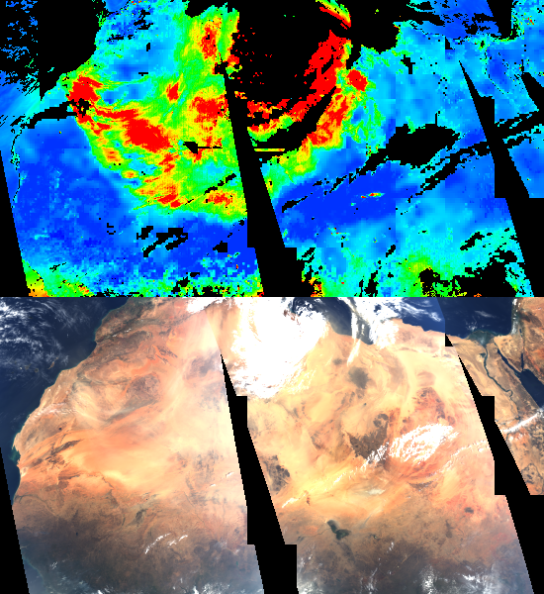
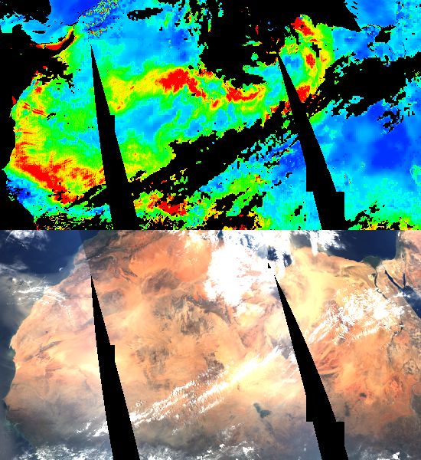
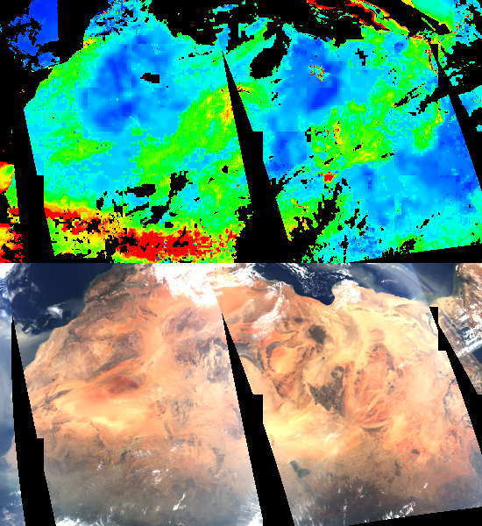
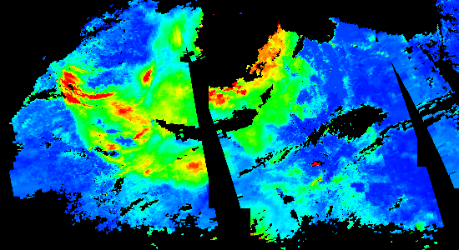
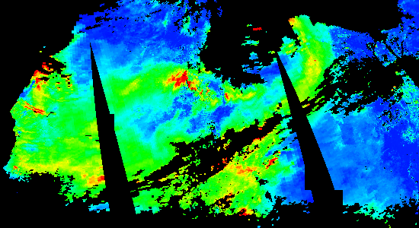
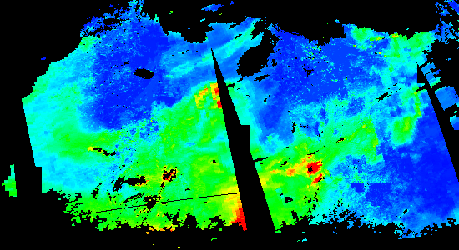
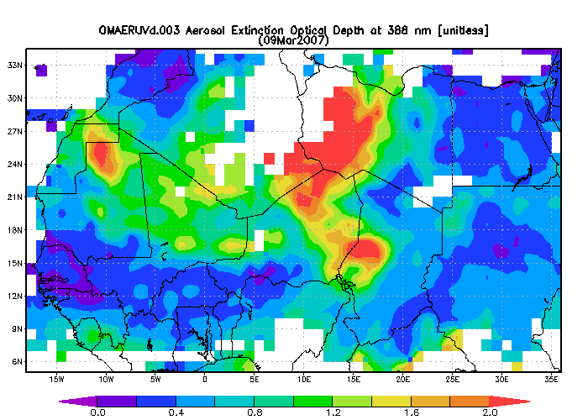
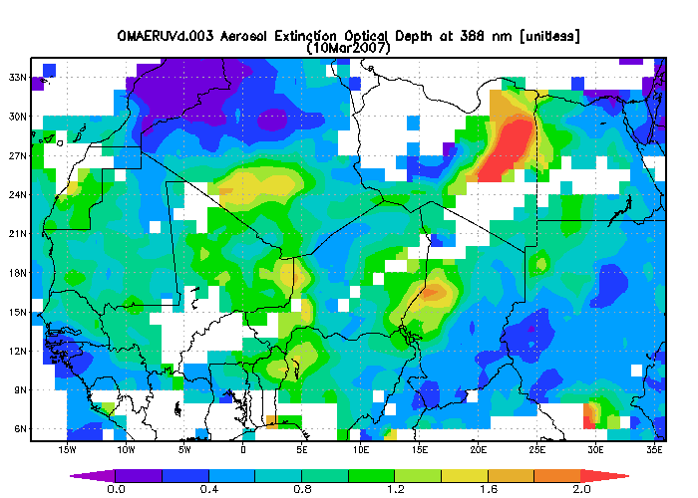
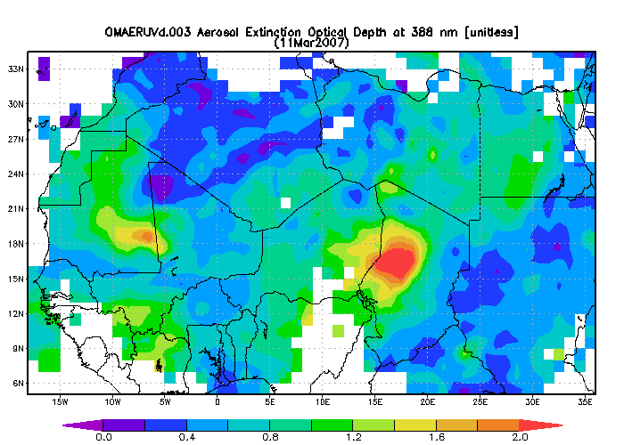
MAIAC
DB
OMI
DOY 68
- DOY 70
0 0.5 1.0 1.5 2.0

Slide 20
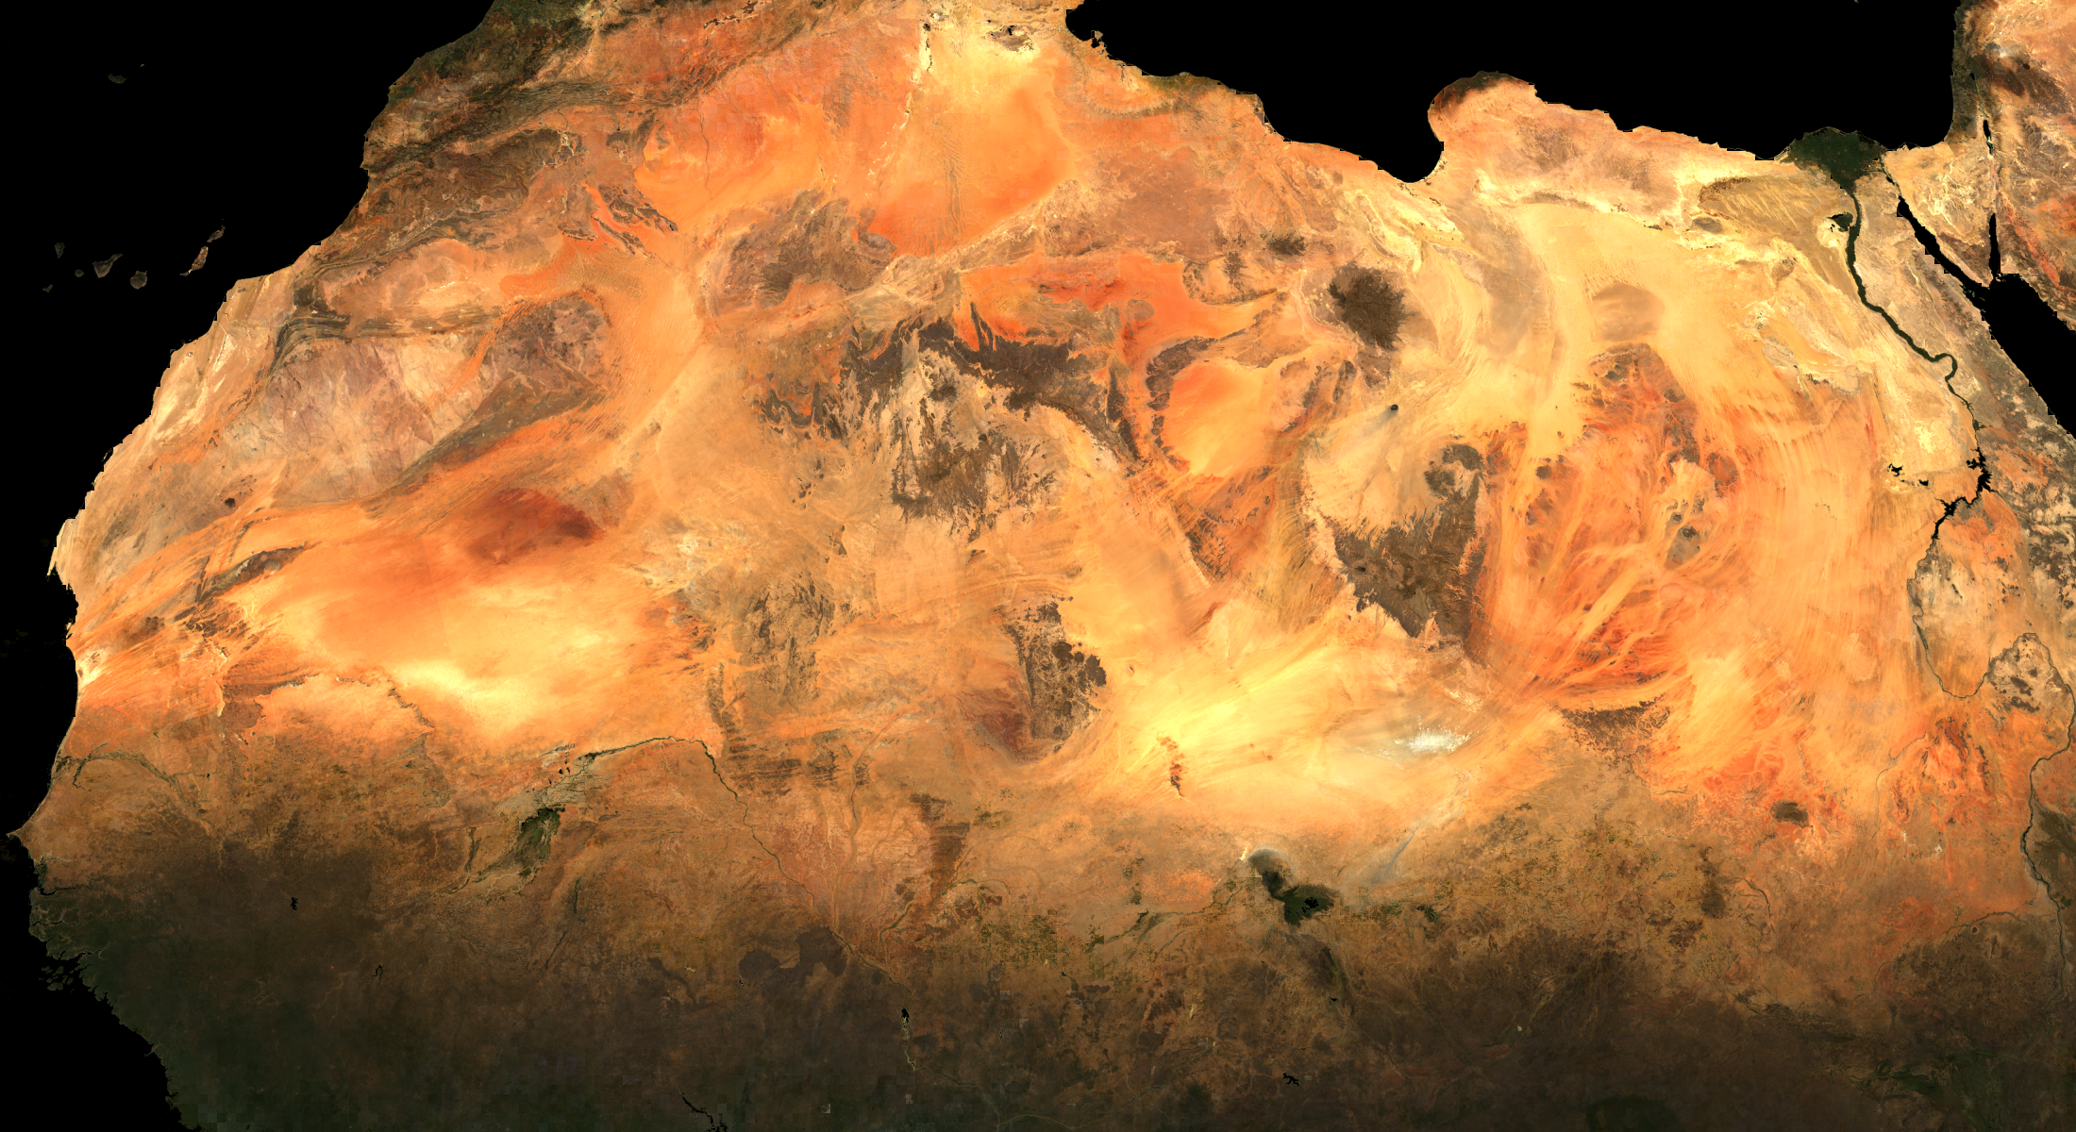
RGB NBRF, 5500×3000 km², 2007
MAIAC NBRF (SZA=45°, VZA=0°), end of 2007

