Slide 1
Albedo Trends Related to Land Cover Change and Disturbance: A Multisensor Approach
Jeff Masek, Yanmin Shuai (NASA GSFC)
Feng Gao (USDA ARS)
Chris Williams, Bardan Ghimire (Clark University)
Crystal Schaaf, Zhosen Wang (U. Mass, Boston)
Tao He (U. Maryland)
April 15, 2013

Slide 2
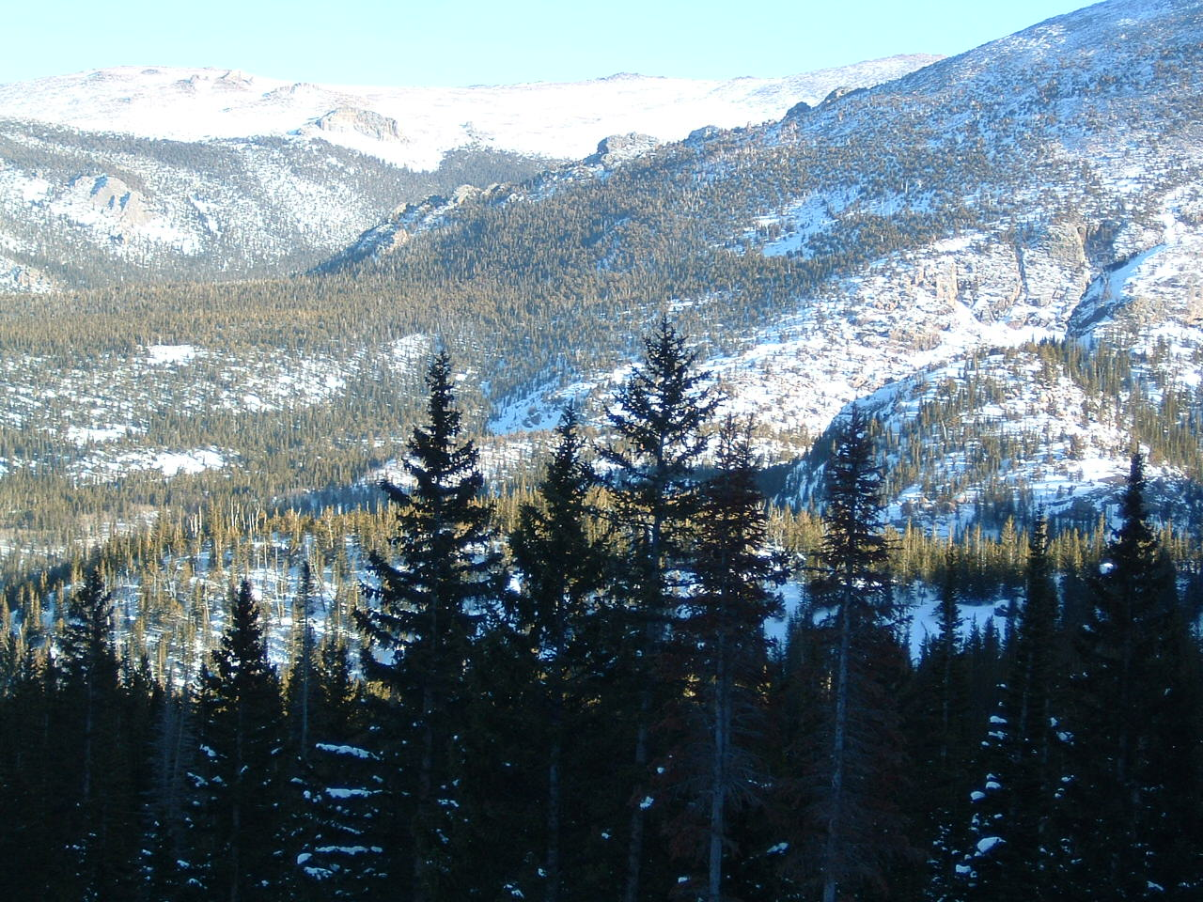
Replacing forest w/ short stature vegetation
=> increased albedo
=> net radiative cooling

Slide 3
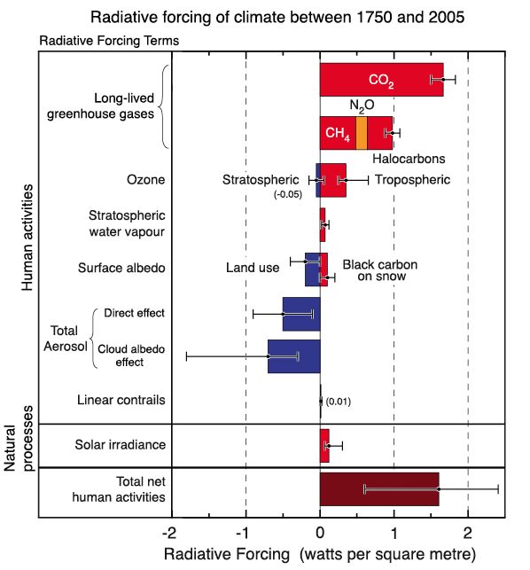
Global RF from Land Use Change (IPCC AR4)
~0.6 W/m² land use
Up to -0.5 W/m² land use
… but could be zero!
From IPCC AR4, Ch. 2

Slide 4
Improved Albedo via Multi-Sensor Fusion
Objective: improved estimates of albedo impacts of land use change and forest disturbance by fusing information from Landsat (spatial resolution) and MODIS (angular information)
❖ Global Scale: Improved Albedo vs. Land Cover LUT
- “pure”, geographically specific land cover samples
- recalculation of global land use RF since 1500
❖ Landscape Scale: How do disturbance & LC change affect regional albedo?
- 30m albedo by combining Landsat reflectance and MODIS BRDF
- application to long-term Landsat LC change maps

Slide 5
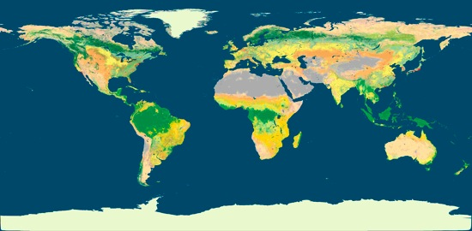
Improved Albedo-Land Cover LUT (Gao)
30m Landsat
VAR(ρ_{Landsat})
500m MODIS
Retrieve “pure” examples of MODIS albedo (MCD43A) for IGBP types (MCD12) by looking for 500m cells with low VAR(ρ_{Landsat})
Hierarchical approach: Inherit nearest example to provide example of every IGBP type at every location of globe
Separate albedo LUT for:
    albedo type {wsa, bsa} & spectral band {vis, nir, sw}
    climatologic date {1-46 8-day periods}
    snow covered & snow-free

Slide 6
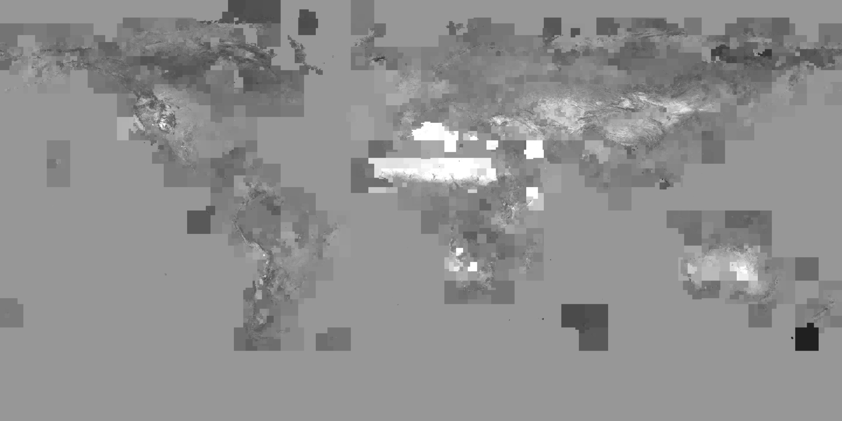
Grassland, Snow-free, Shortwave, WSA, 0.05°
(Albedo)
Global WSA = 0.178
0 0.1 0.2 0.3

Slide 7
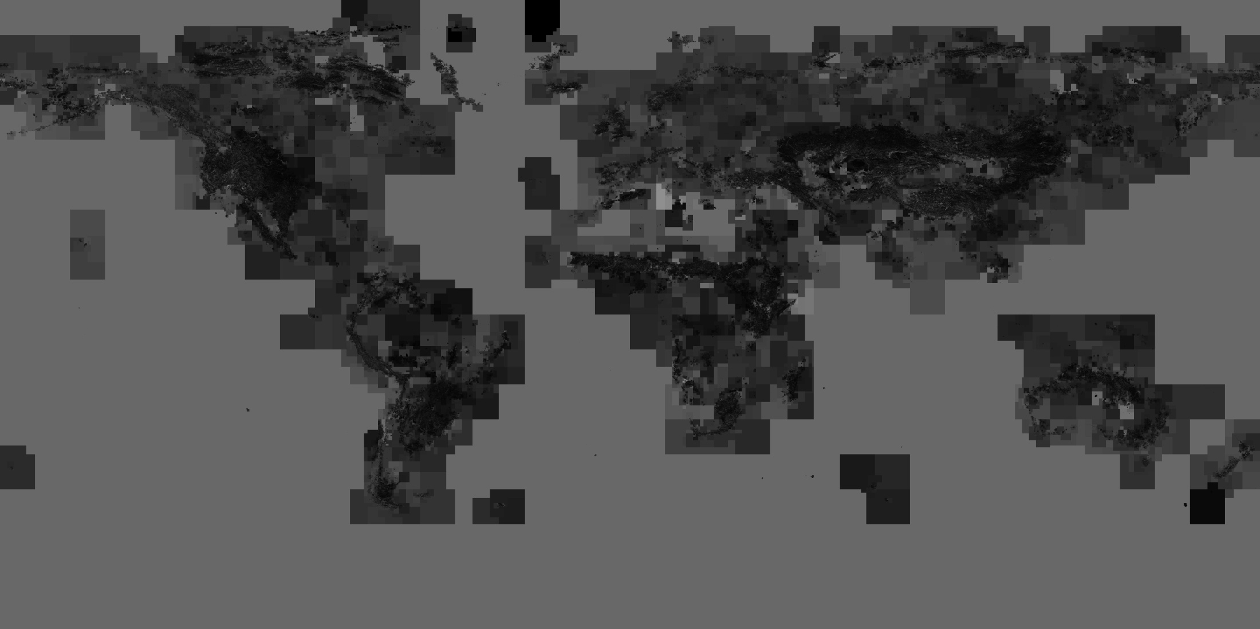
Grassland, Snow-free, Shortwave, Stdev of WSA, 0.05°
(uncertainty)
Global Standard Deviation of WSA = 0.041
0 0.05 0.1

Slide 8
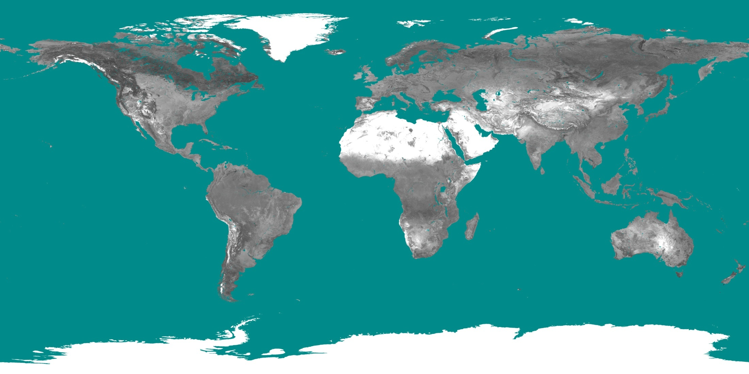
Modeled MODIS white-sky albedo from LUMs
in shortwave on August (2001-2010) at 0.05 degree
0 0.1 0.2 0.3
Notes:
Cyan represents fill value

Slide 9
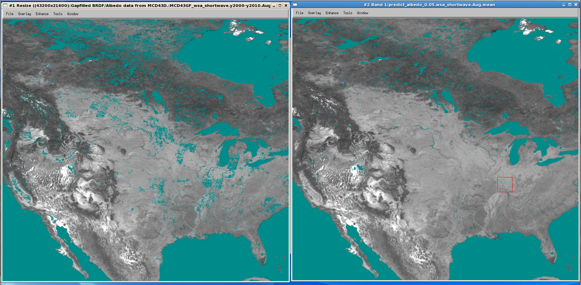
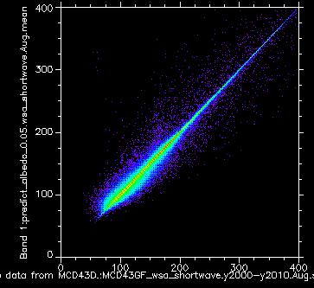
Climatology Albedo
Modeled Albedo
Modeled
Snow-free WSA
Shortwave
August
0.05 degree
Climatology

Slide 10
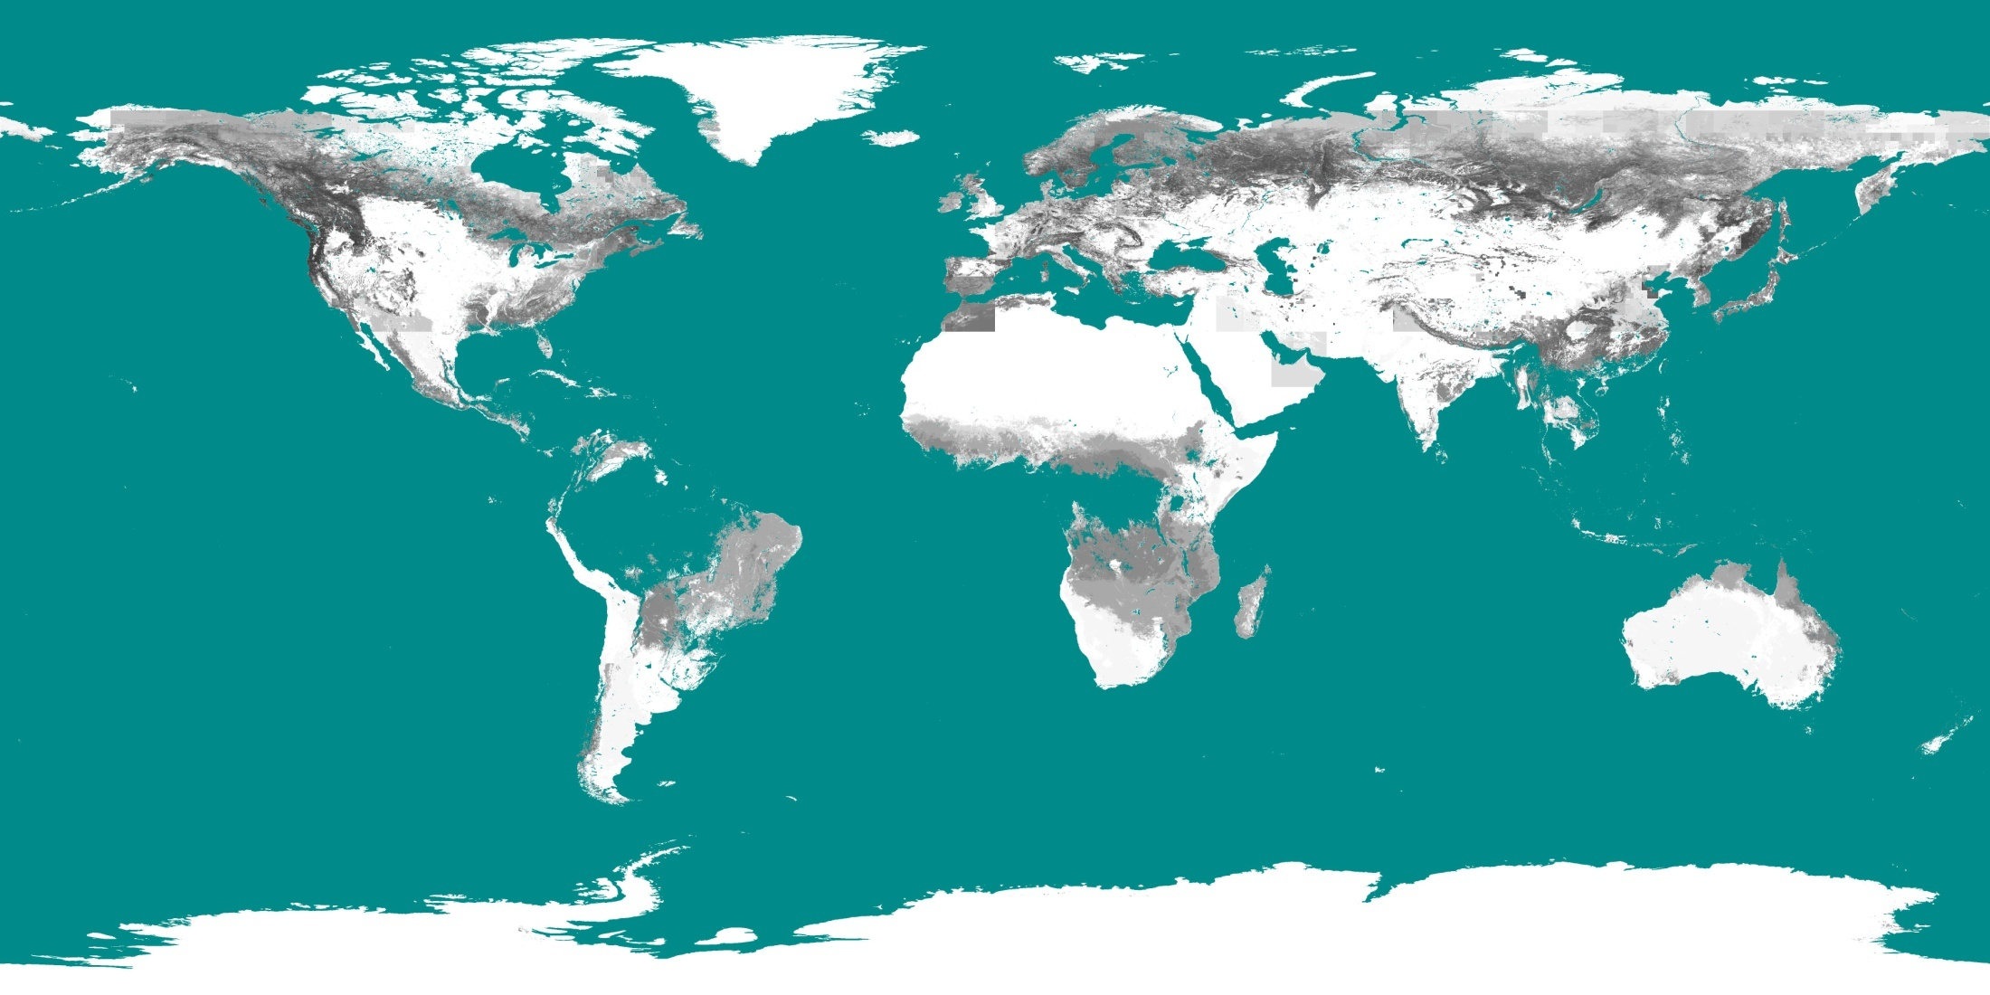
Modeled snow-covered shortwave white-sky albedo in January from LUMs
0 0.1 0.2 0.3 0.4 0.5
Notes:
Assume snow appear everywhere
tropical forests are missing since there is no snow covered albedo from LUMs for evergreen broadleaf forest ☺

Slide 11
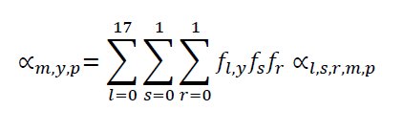

Global Albedo and Radiative Forcing
(Ghimire, Williams)
Compute blue-sky albedo for each month (m), year (y) and pixel (p) as:
f_{l,y} is fraction (f) of a given land-cover class (l) at year (y),
f_{s} is fraction of snow-covered (s=0) and snow free (s=1) (NCEP/NCAR reanalysis)
f_{r} is fraction of diffuse (r=0) and direct (r=1) radiation (NCEP/NCAR reanalysis)
Albedo maps from 1500 to 2005 are then converted into surface radiative forcing (F_{s}) using incoming solar radiation (I) from NOAA-CIRES Reanalysis as:

Slide 12
Global Land Cover History 1500-2005
Hurtt et al (2006) LU Harmonization cross-walked to IGBP land cover types

Slide 13
Global Albedo Change 1500-2005
(2005 – 1500) Global Δ surface SW albedo = 0.0012

Slide 14
Winter
Spring
Summer
Autumn
Spatial Patterns of Surface Albedo Change
Δ SW albedo (2005 – 1500)
Annual

Slide 15
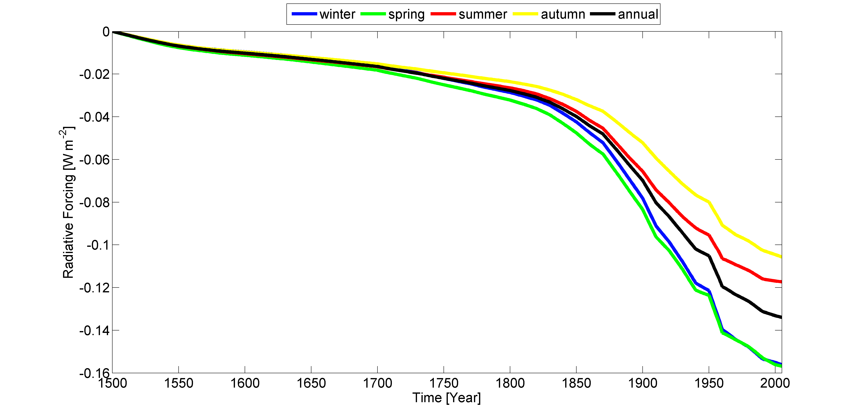
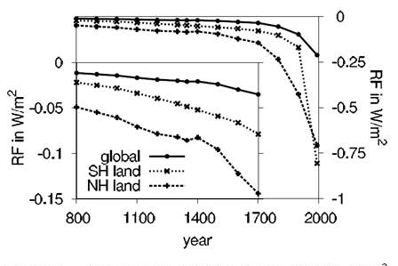
Global ALCC Radiative Forcing Change 1500-2005
(2005 – 1500) Global Δ RF surface = -0.13 W m⁻²
Pongratz, 2009, GRL

Slide 16
Recent Assessments of Global ALCC Forcing Since ~1700
This study: -0.12 W/m2 (-0.13 since 1500)
Pongratz (2009): -0.18 W/m2
Betts et al (2007): -0.18 W/m2
Brovkin et al (2006): -0.14 W/m2
IPCC AR4 (2007): -0.50 to -0.08 W/m2 (various data sets)

Slide 17
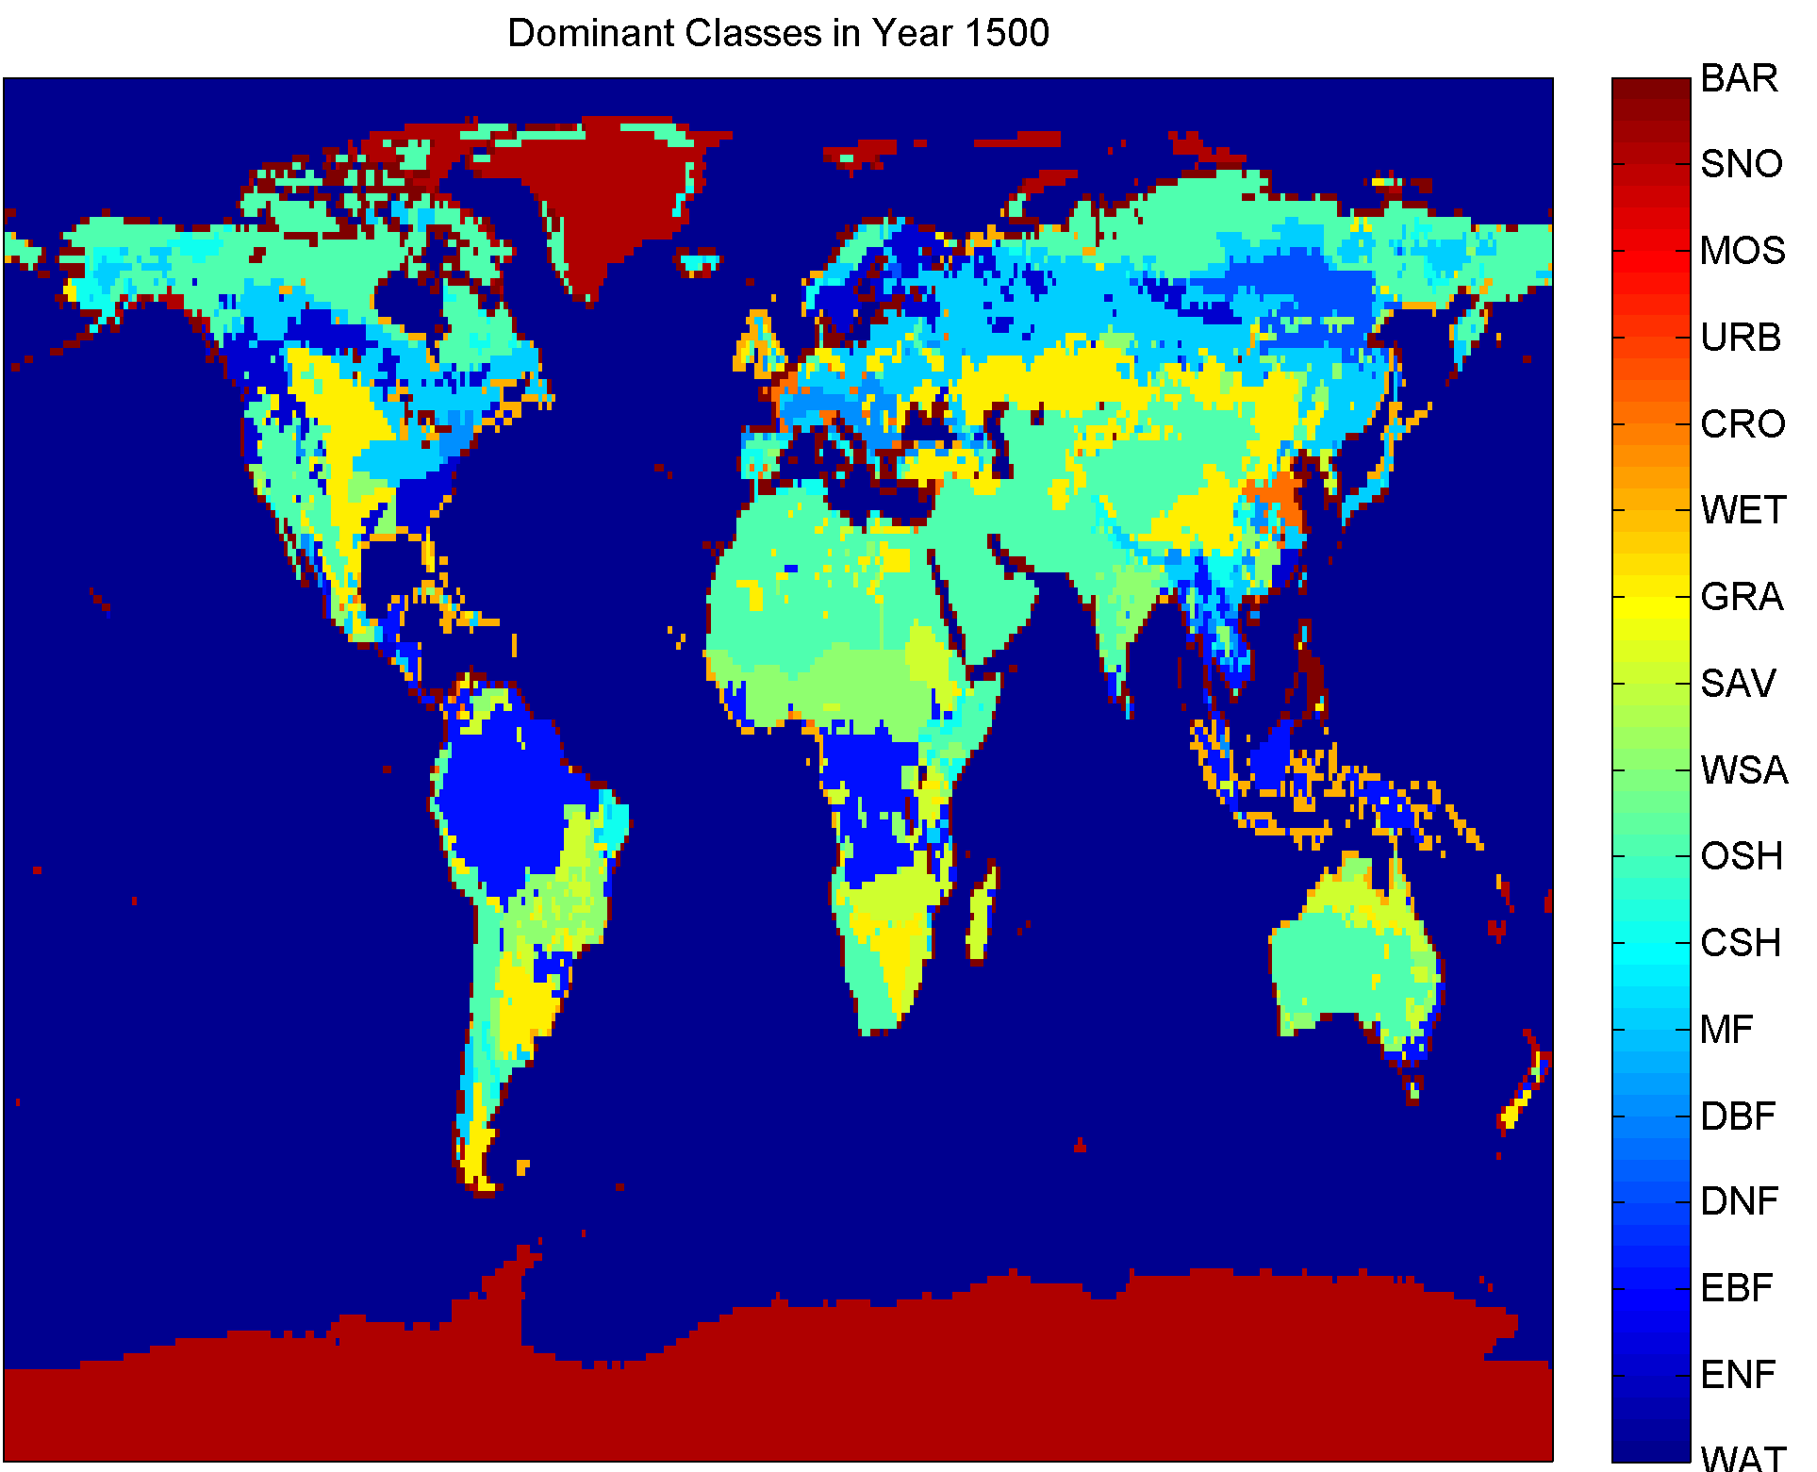
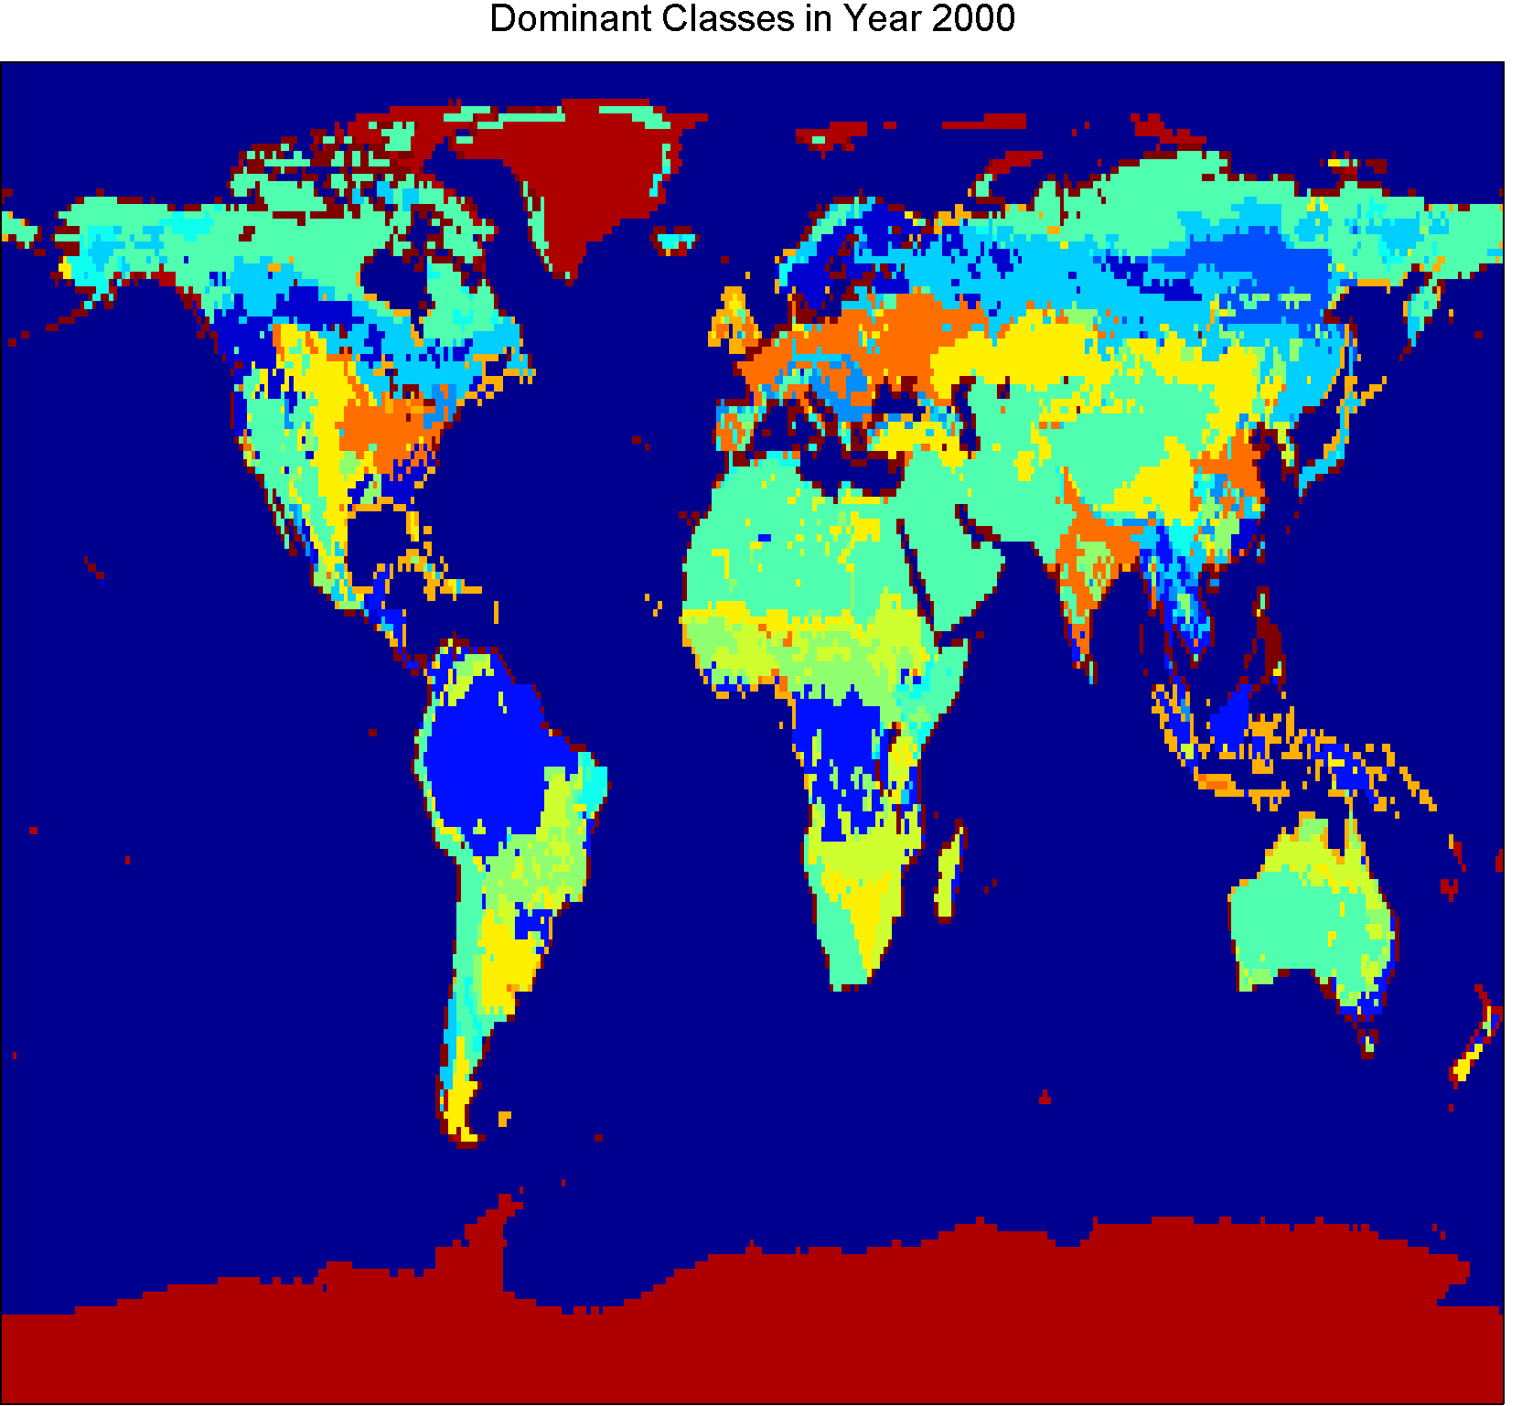
Regional Patterns: Africa
Open Shrubland
Woody Savanna
Grassland
Cropland

Slide 18
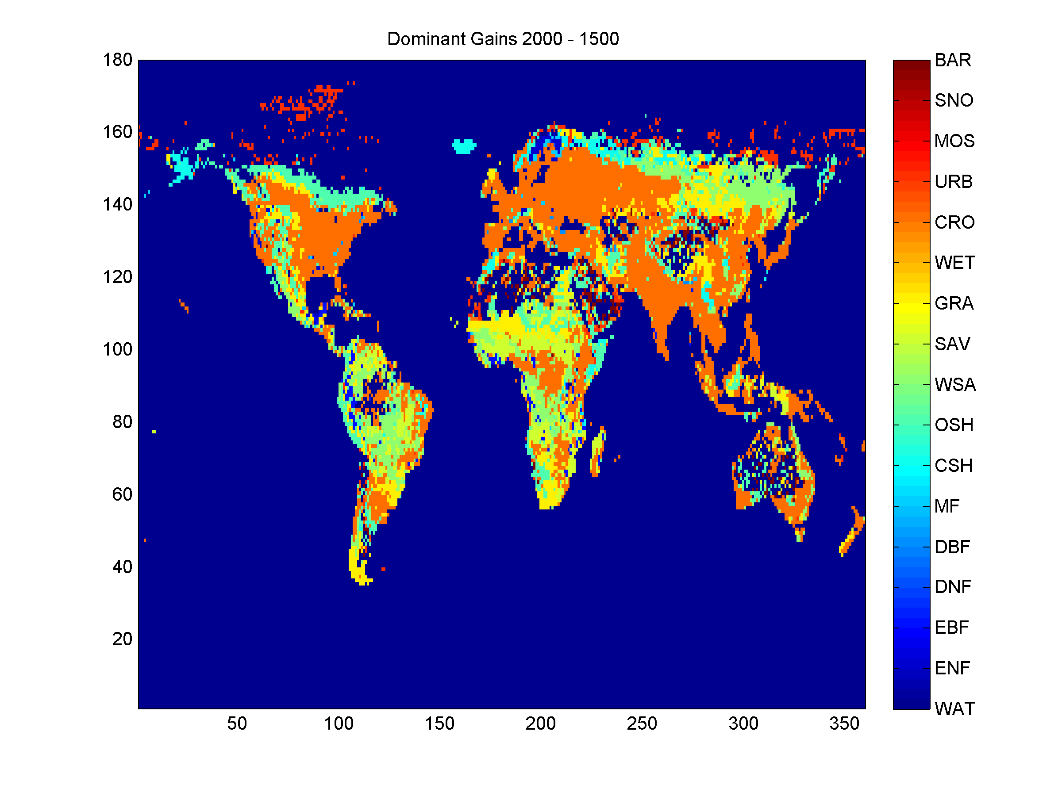
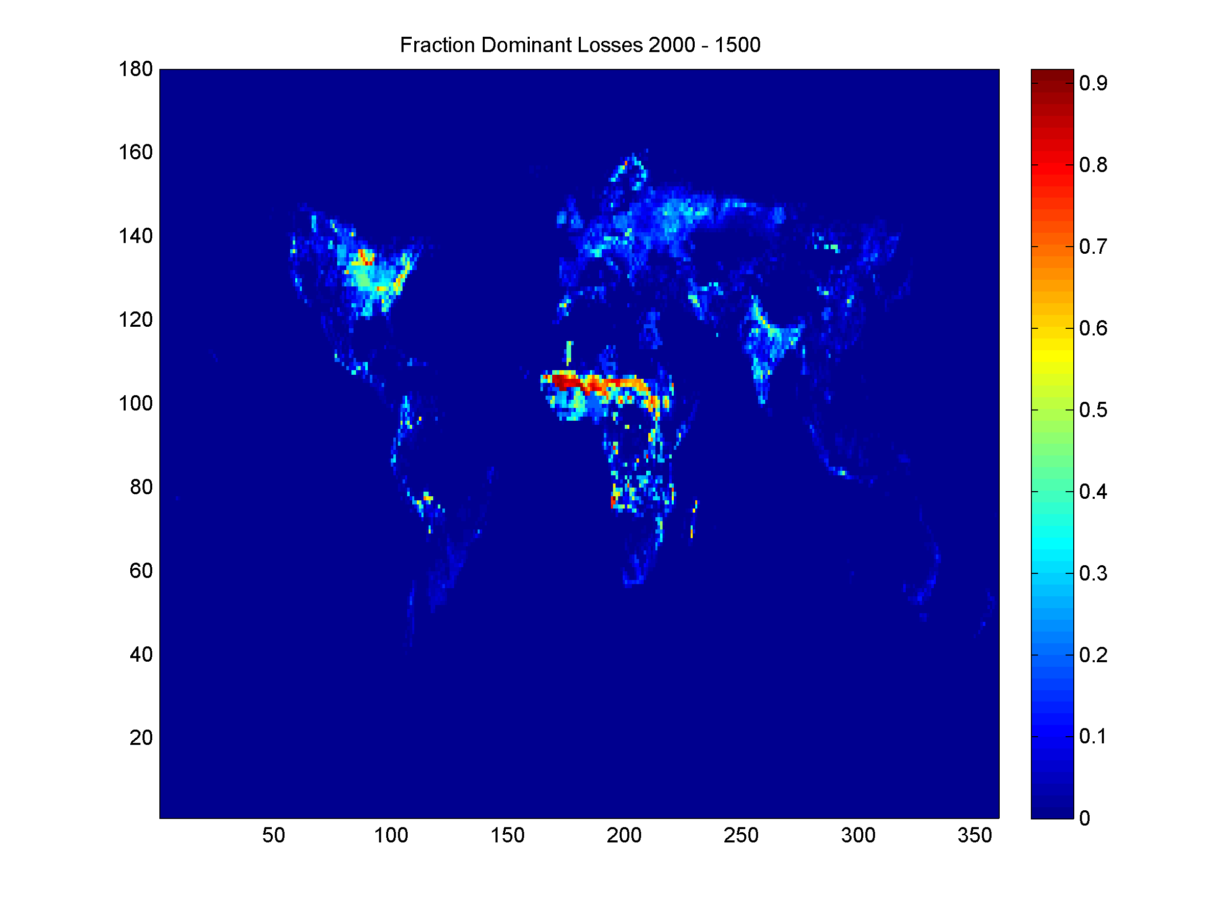
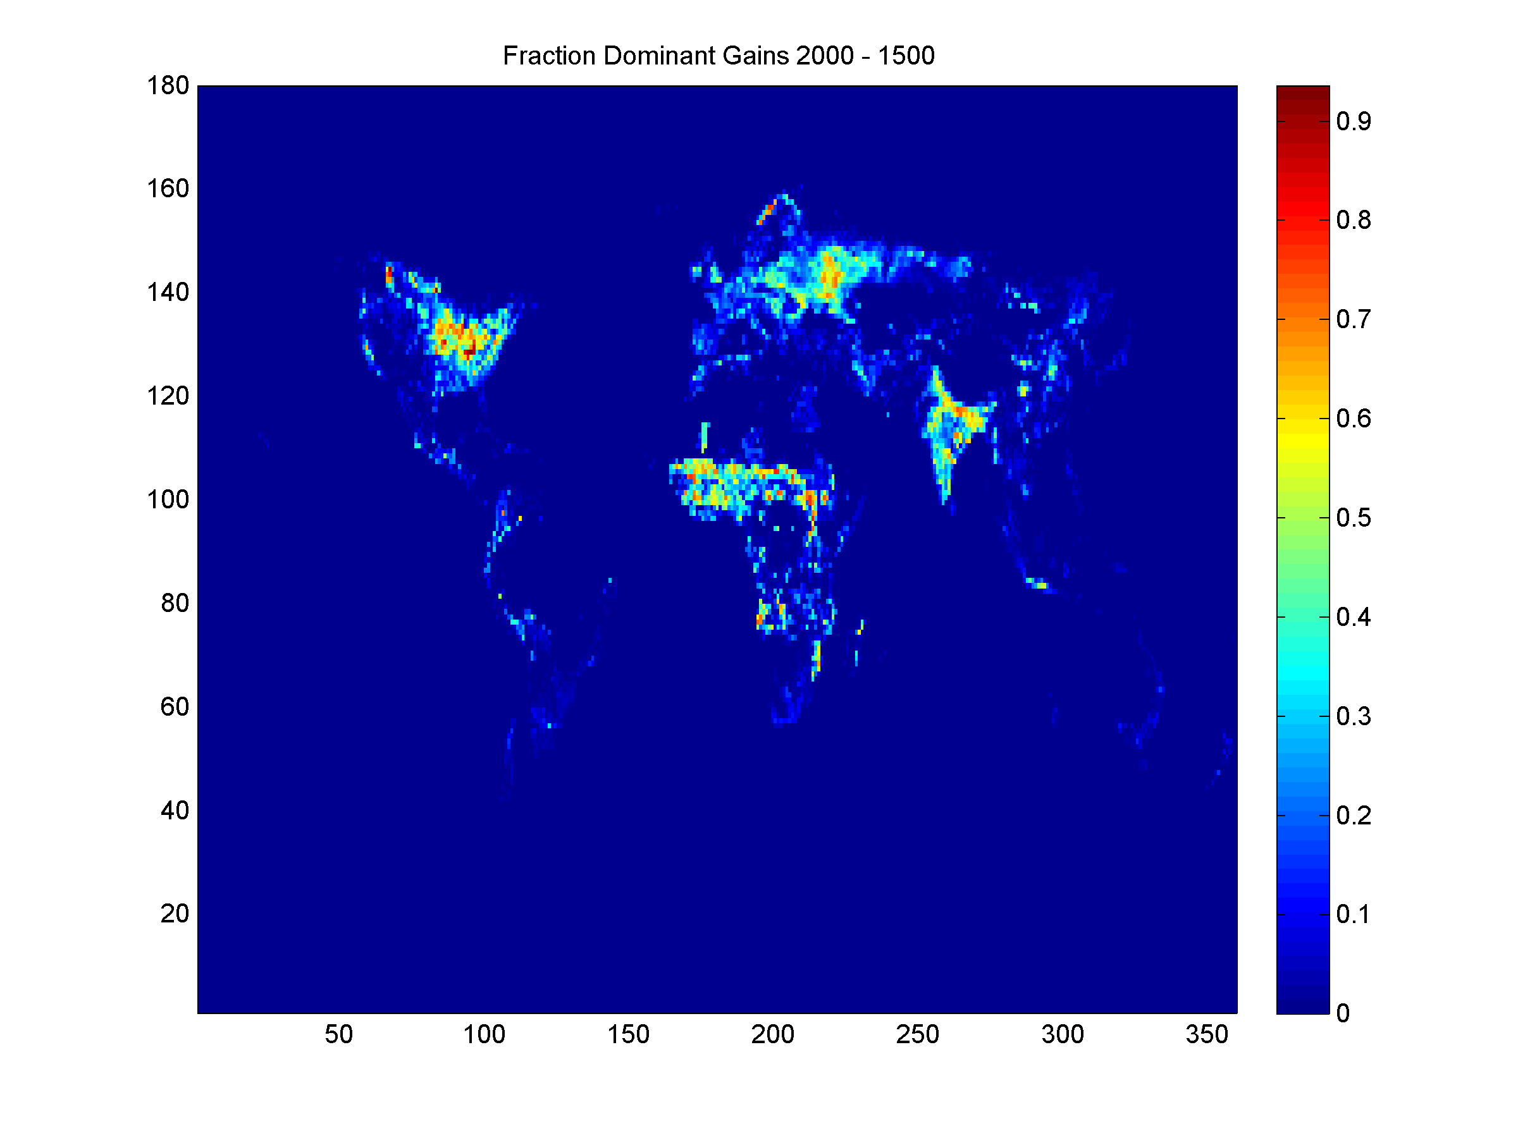
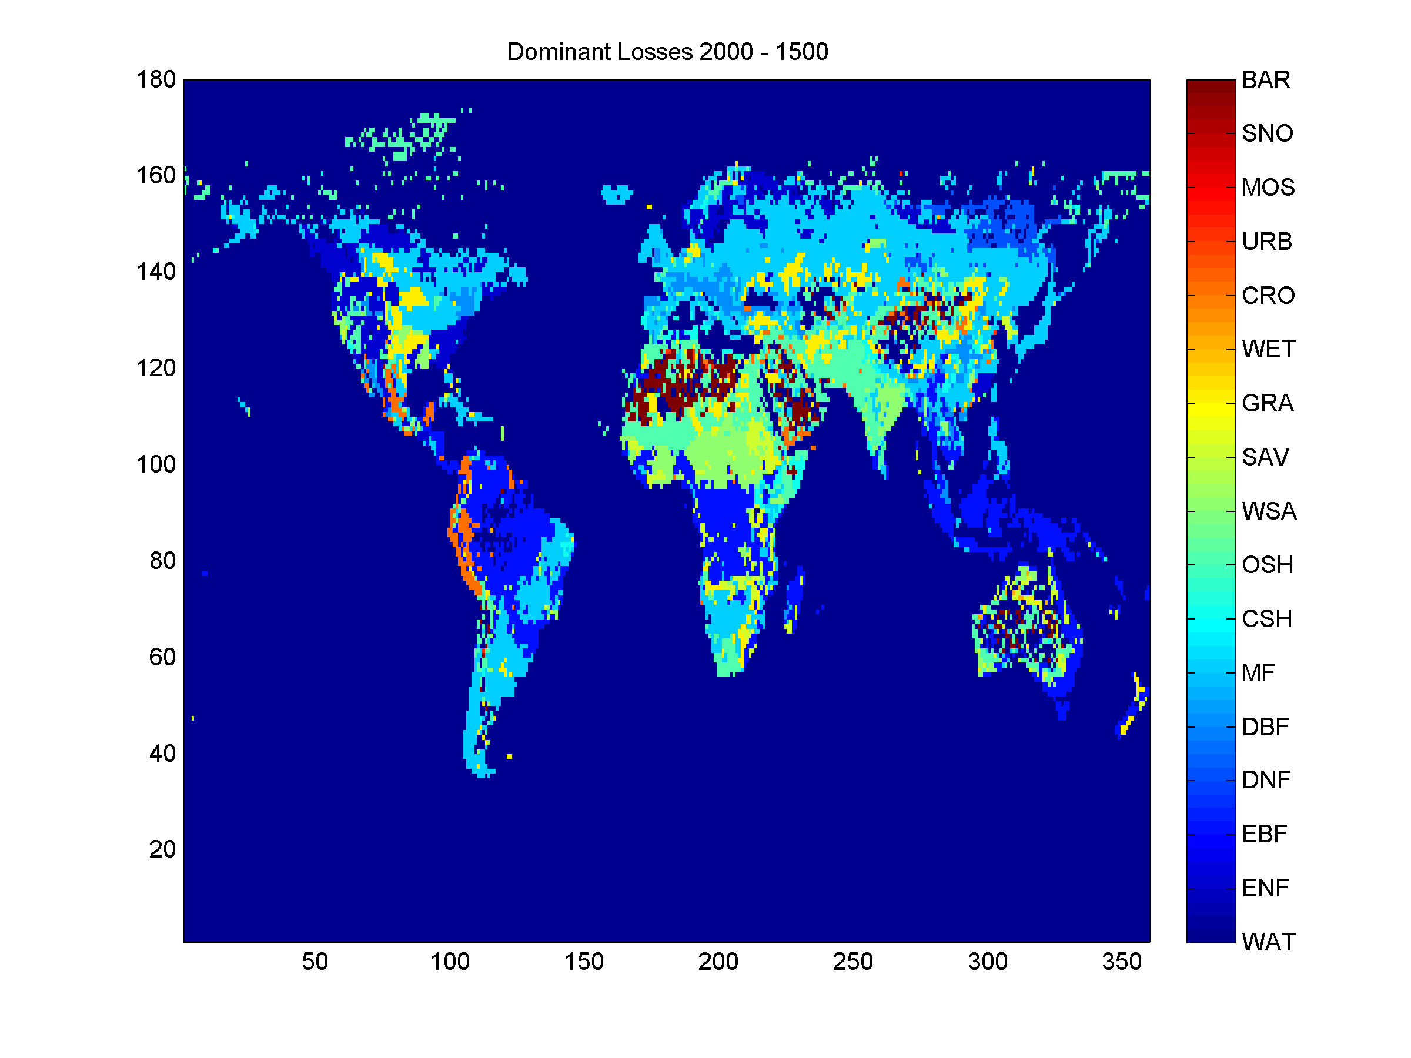
Fractional
Gain for Dominant Gained Biome
Fractional
Loss for Dominant Lost Biome
Change in Annual Average Outgoing Shortwave from the Surface
[W m⁻²]
warming
effect
Biome of Dominant Gain
Biome of Dominant Loss
cooling
effect

Slide 19
Fractional
Gain for Dominant Gained Biome
Fractional
Loss for Dominant Lost Biome
Change in Annual Average Outgoing Shortwave from the Surface
[W m⁻²]
GRA to OSH
OSH to GRA
warming
effect
OSH
to
GRA
Biome of Dominant Gain
Biome of Dominant Loss
WSA to
SAV or GRA
cooling
effect

Slide 20
Regional Patterns: North America

Slide 21
Fractional
Gain for Dominant Gained Biome
Fractional
Loss for Dominant Lost Biome
Change in Annual Average Outgoing Shortwave from the Surface
[W m⁻²]
warming
effect
Biome of Dominant Gain
Biome of Dominant Loss
cooling
effect

Slide 22
Fractional
Gain for Dominant Gained Biome
Fractional
Loss for Dominant Lost Biome
Change in Annual Average Outgoing Shortwave from the Surface
[W m⁻²]
warming
GRA, MF
to CRO
MF, DBF
to CRO
GRA, ENF
to
WSA
Biome of Dominant Gain
Biome of Dominant Loss
ENF
To
CRO
cooling

Slide 23
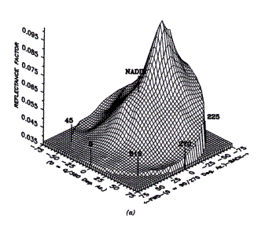
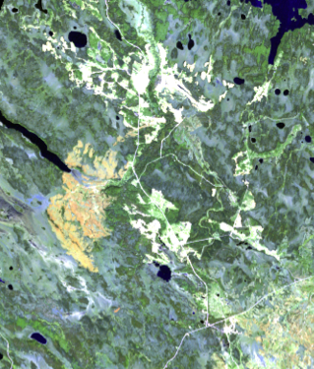
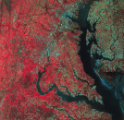
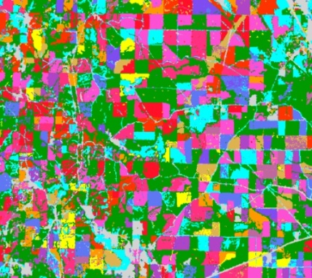
3. Landscape-Scale Albedo Evolution (Shuai)
How does disturbance and land cover change affect regional albedo?
Derive 30-meter albedo by combining:
- 30m Landsat nadir reflectance
- 500m MOD43 BRDF (Shuai et al., 2011)
+
Landsat nadir SR
MODIS BRDF
Generate per-pixel time series albedo using Landsat archive, and relate to forest disturbance type, severity

Slide 24
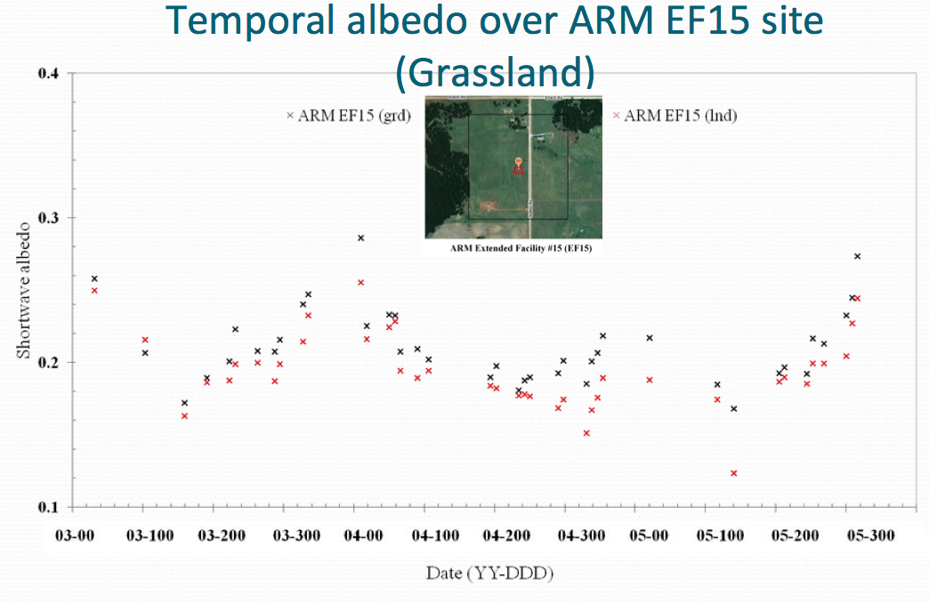

Slide 25
Clear Cut Harvest Example (Mid-Summer)
0.03-
0.08
0.13
0.18+
lndSR composite
R(b4):0.03-0.40
G(b3):0.00-0.06
B(b2):0.01-0.08
Black Sky Albedo
1985/200 | 1986/219 | 1988/241 | 1990/214 | 1991/201
1994/225 | 1995/212 | 1997/233 | 1998/220 | 1999/207
2001/220 | 2002/255 | 2003/202 | 2004/221 | 2005/207
2006/226 | 2009/234 | 2010/237 | 2011/224

Slide 26
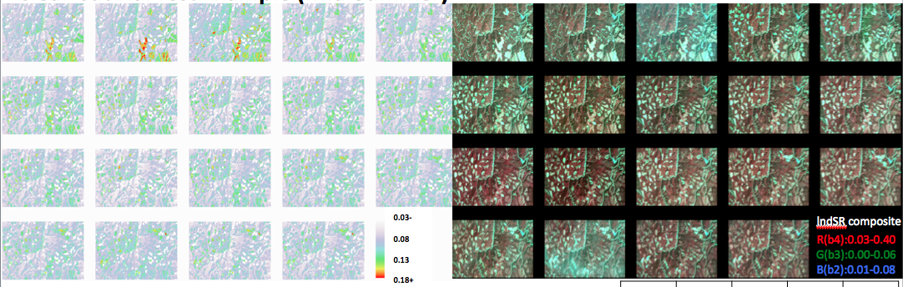
Clear Cut Harvest Example (Mid-Summer)
Black Sky Albedo
1985/200 | 1986/219 | 1988/241 | 1990/214 | 1991/201
1994/225 | 1995/212 | 1997/233 | 1998/220 | 1999/207
2001/220 | 2002/255 | 2003/202 | 2004/221 | 2005/207
2006/226 | 2009/234 | 2010/237 | 2011/224

Slide 27
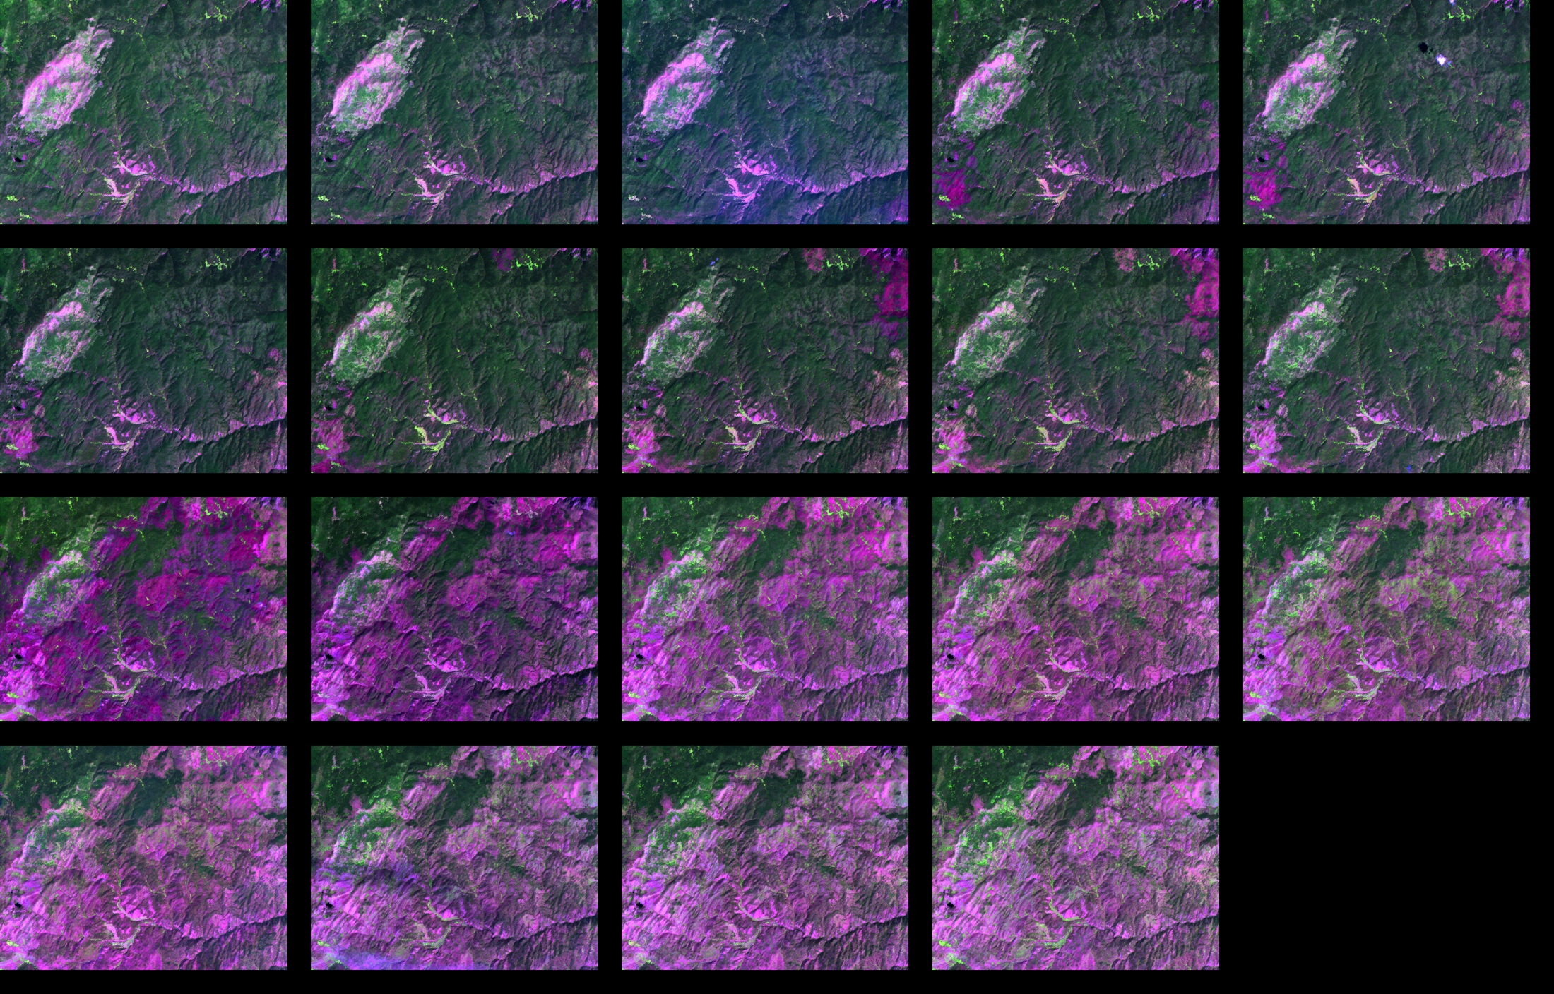
Burned Area Example (Mid-Summer)
lndSR composite
0.03
0.08
0.13
0.18+
R(b5):0.03-0.30
G(b4):0.03-0.40
B(b3):0.00-0.09
1985/200 | 1986/219 | 1988/241 | 1990/214 | 1991/201
1994/225 | 1995/212 | 1997/233 | 1998/220 | 1999/207
2001/220 | 2002/255 | 2003/202 | 2004/221 | 2005/207
2006/226 | 2009/234 | 2010/237 | 2011/224 | YYYY/DOY for each pic
Temporal White Sky Albedo (WSA) in the upper panel, with lndSR band5,4,3 composite in the upper-right panel and plots for individual forest disturbance in the lower graphic, show the evolution of WSA and surface reflectance (vegetation water content).

Slide 28
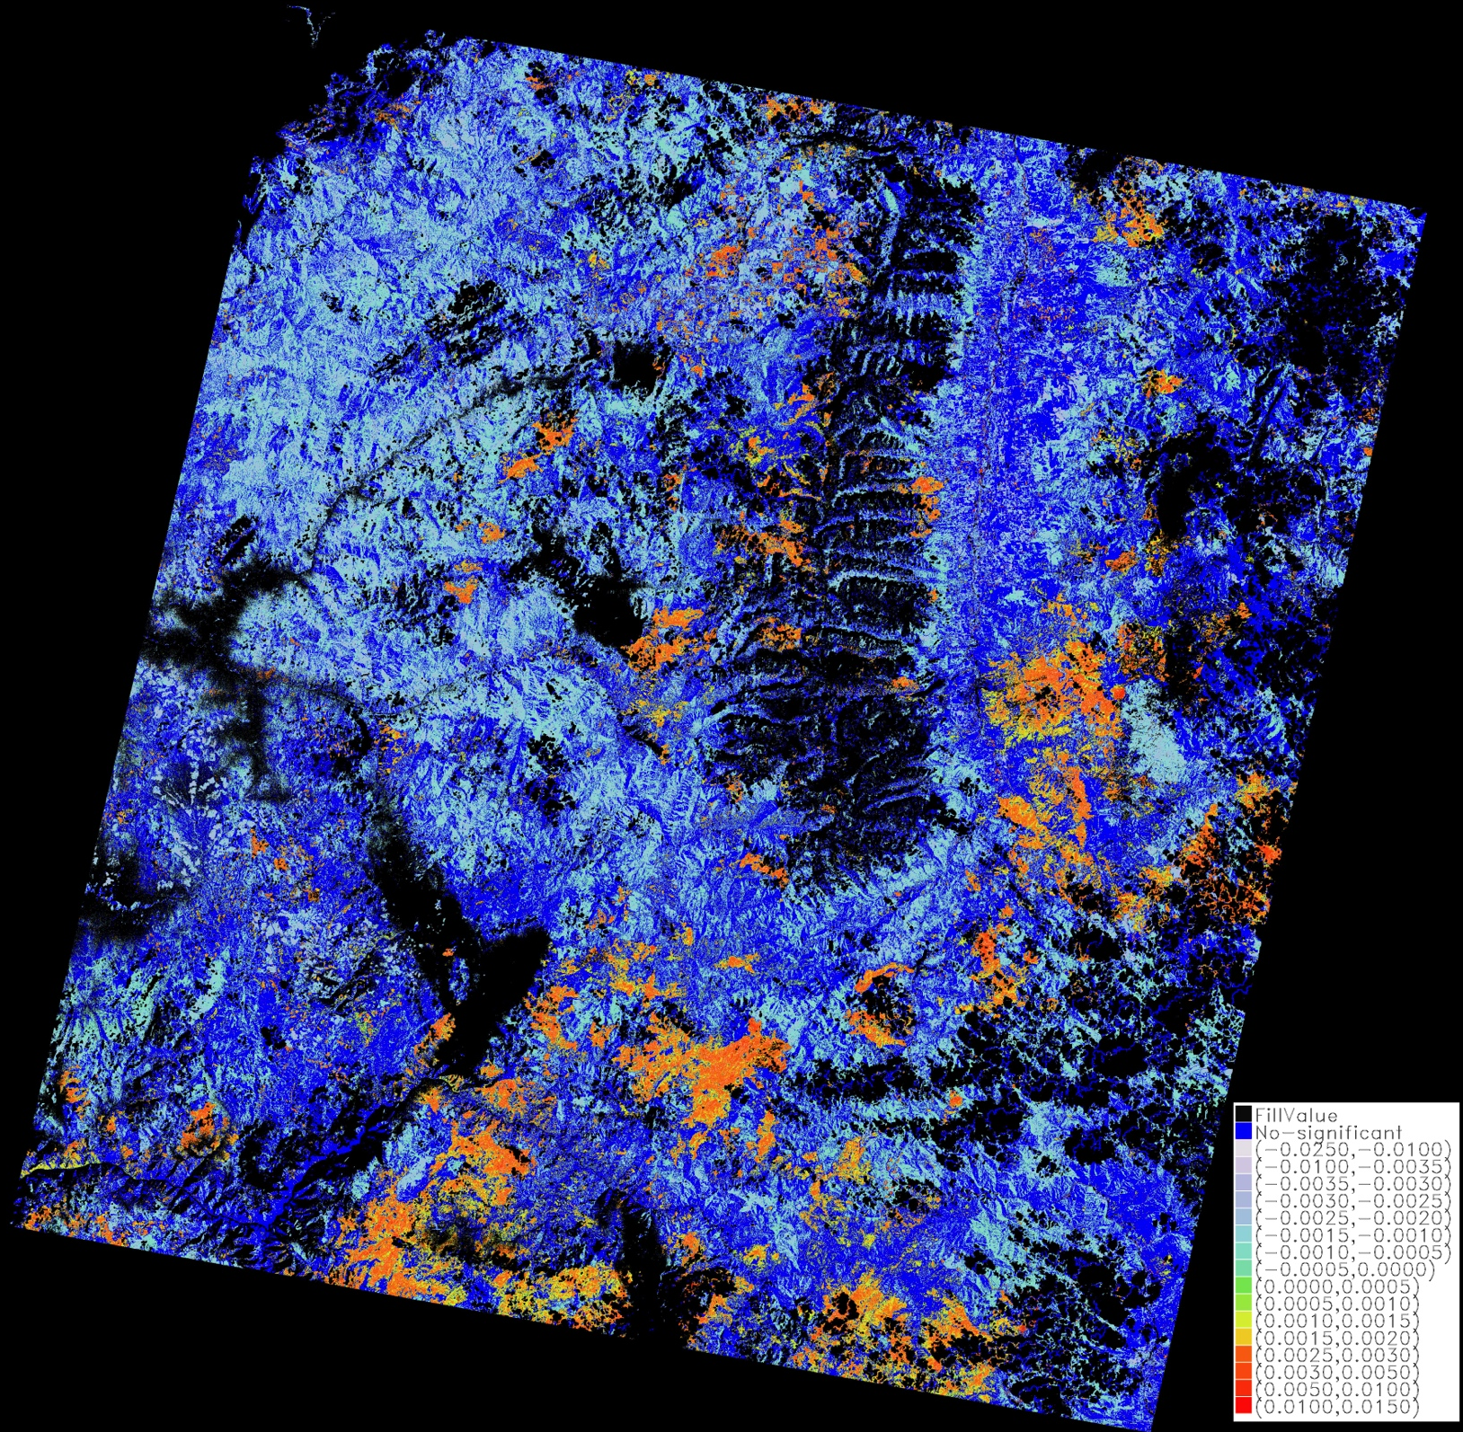
Significant summer albedo (WSA) trends, 1985-2011 based on temporal regression & T-test
No significant trend
Negative trend
Positive trend
For White Sky Albedo

Slide 29
Next Steps
Provide uncertainties for global albedo & RF trajectories
Extend to 2100 using IPCC RCP scenarios
Incorporate snow-covered albedo into landscape
analyses & provide annualized RF
Integrate albedo into USFS Forest Vegetation Simulator (FVS)

Slide 30
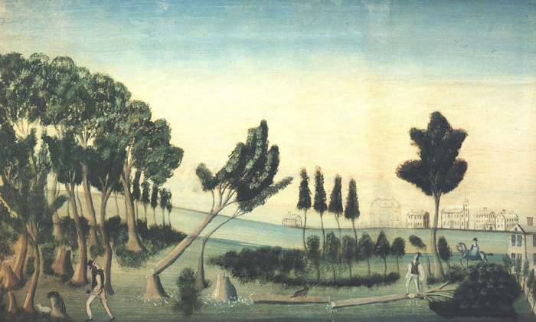
Thank You

Slide 31
Backup

Slide 32
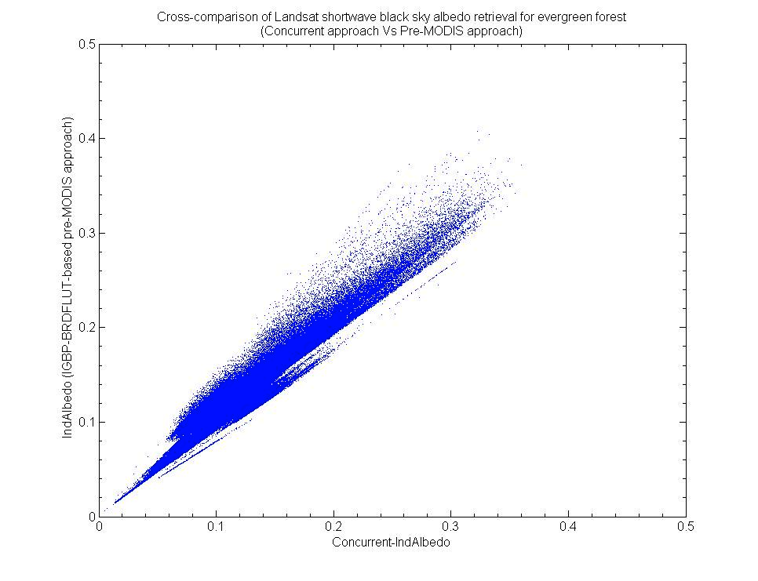
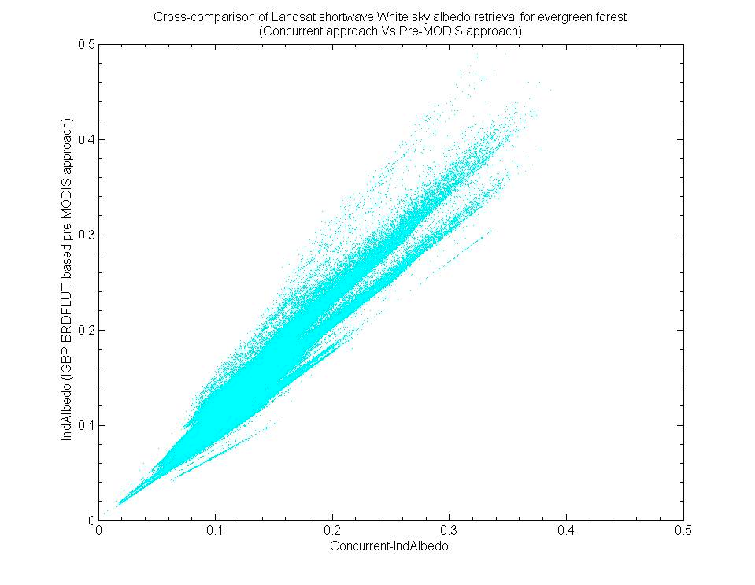
Comparison Between “Concurrent” and “BRDF LUT” Methods
(Montana, 5/10/2006)
BSA, Evergreen NL
WSA, Evergreen NL

Slide 33
Direct and diffuse incoming solar radiation for surface radiative forcing
  Determine albedo induced surface radiative forcing by overlaying (multiplying) direct and diffuse solar radiation maps with corresponding albedo change maps.
  NCEP/NCAR reanalysis 1 product for direct and diffuse solar radiation
  Same data source for forecast
  Also source for snow cover climatology

Slide 34
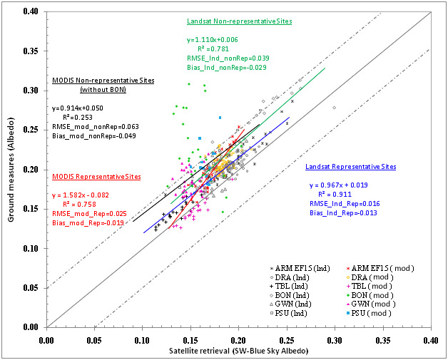
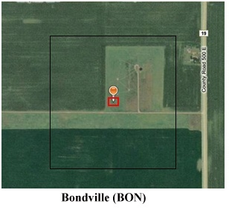
Comparison of Landsat and MODIS Albedo with In-Situ SURFAD

Slide 35
warming
Winter
Spring
Summer
Autumn
cooling
Spatial Patterns of Surface Radiative Forcing Change
Annual
Global Δ RF surface = -0.13 W m⁻²

Slide 36
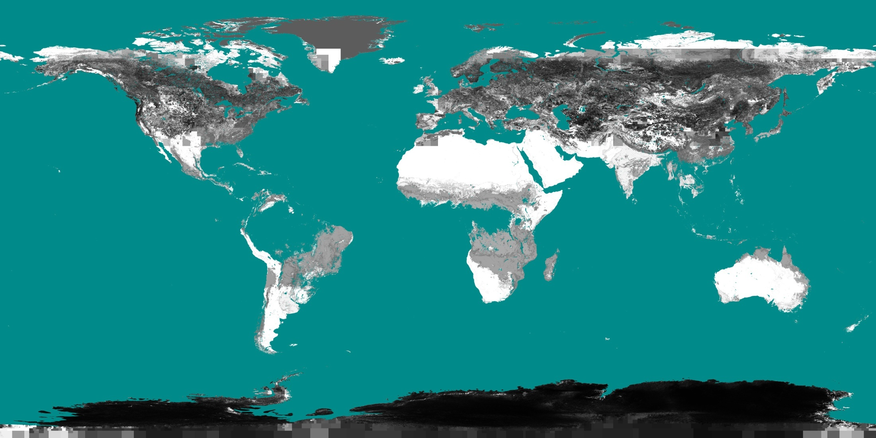
Uncertainty of the modeled snow-covered shortwave white-sky albedo in January from LUMs
0 0.05 0.1

Slide 37
Hierarchical Albedo LUT for IGBP Land Cover Types
1. Use Landsat global GLS2000 to identify homogenous land cover examples at MODIS 500m resolution
2. Extract MODIS albedo climatology for these homogenous examples
one globe
L=1
…
3. Propagate values to coarser scales to support modeling scenarios (ie. future landcover != current landcover)
5°
1°
L=i
0.5°
L=i+1
The albedo LUT is presented as:
ρ(i, j, L) where:
i = land cover type
j = geographic location (pixel)
L = resolution level
0.25°
…
0.05°
L=n
Notes:
When we compute albedo based on the
past, current or future land cover map,
we can use recursive approach starting
from fine resolution to coarse resolution
Until reaches the “one globe” end point
Like a ray (red) in figure.
ρ(i, j, L) = ρ(i, j, L) if exist
other wise
ρ(i, j, L) = ρ(i, j, L-1)
Until reach ρ(i, L=1) (*no variable j in first level)

Slide 38
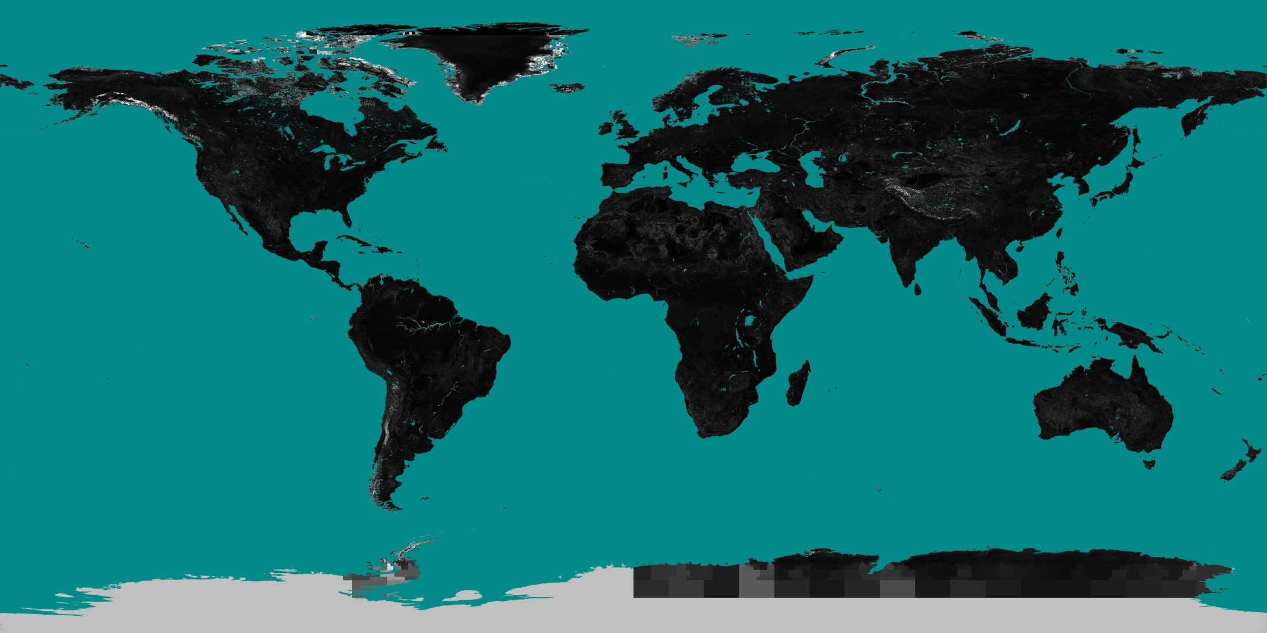
Uncertainty of the Modeled WSA from albedo LUMs
in shortwave on August (2001-2010) at 0.05 degree
0 0.05 0.1
Notes:
Uncertainties are larger for permanent snow.

Slide 39
Significant albedo (WSA) trends, 1985-2011 based on temporal regression & T-test
No significant trend
Negative trend
Positive trend
For White Sky Albedo

