Slide 1


MODIS Collection 6 BRDF/Albedo: Status and Updates
Zhuosen Wang¹, Crysal Schaaf¹, Miguel Román²
¹University of Massachusetts-Boston
²NASA Goddard Space Flight Center
April, 2013

Slide 2
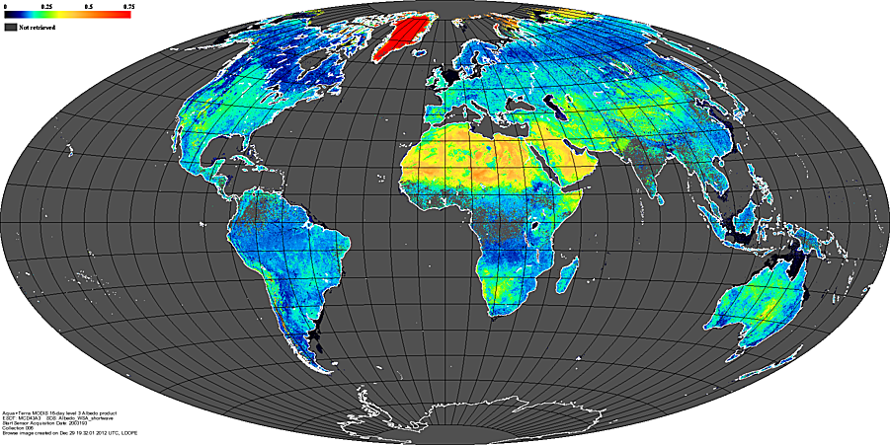
Outline
Collection 6 updates
Validation
NEON sites
Conclusion
MODIS Science Team Meeting, 2013

Slide 3
Updates: Eight Day -> Daily
Collection 5 eight day product
oldest Dynamic observation stream newest
day 1, day 2 ... day 9, … day 16, day xxx … day 24 , day 25 … day xxx+15 … … …
… …
Collection 6 daily product
oldest Dynamic observation stream newest
day 1, day 2 ... day 9, … day 16, day xxx … day 24 , day 25 … day xxx+15 … … …
…
… …
Observations weighted
Temporal, observation coverage, band quality
MODIS Science Team Meeting, 2013

Slide 4
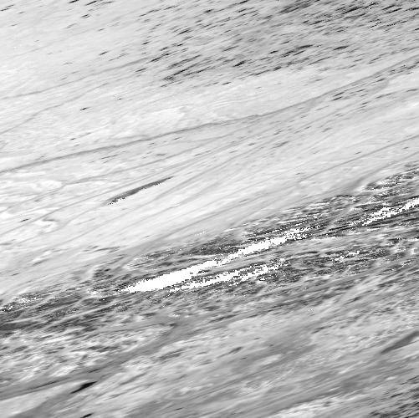
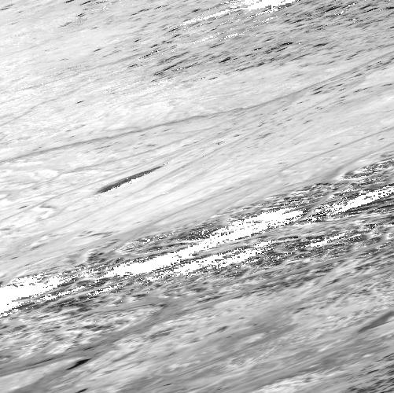
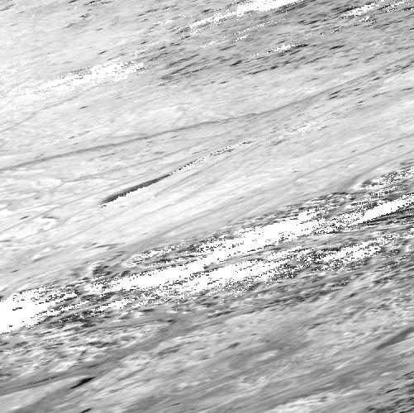
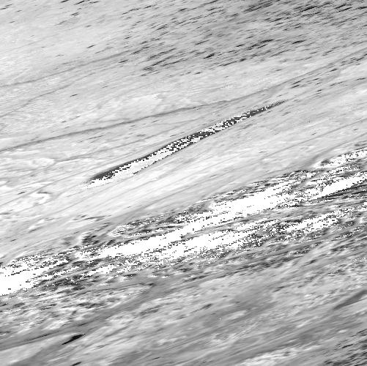
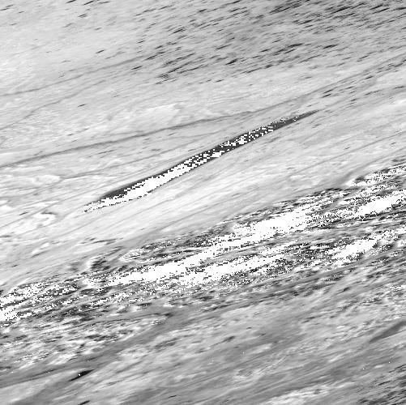
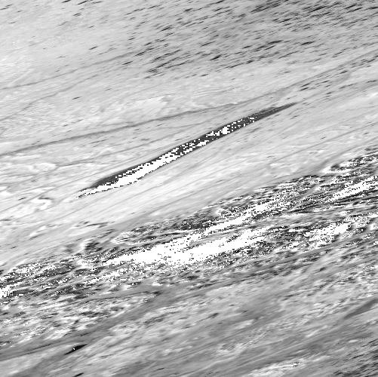
Updates: Capture Disturbance
2007245 shortwave WSA
2007248 shortwave WSA
2007251 shortwave WSA
2007254 shortwave WSA
2007257 shortwave WSA
2007259 shortwave WSA
Anaktuvuk River Fire location in 2007
MODIS Science Team Meeting, 2013

Slide 5
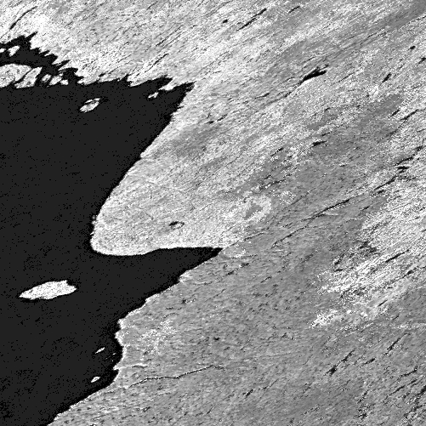
Updates: Magnitude Inversion
Back-up Database
Collection 5:
Land cover based
Collection 6:
Pixel based
Updated from the latest
full inversion
C6 backup database Fiso
MODIS Science Team Meeting, 2013

Slide 6
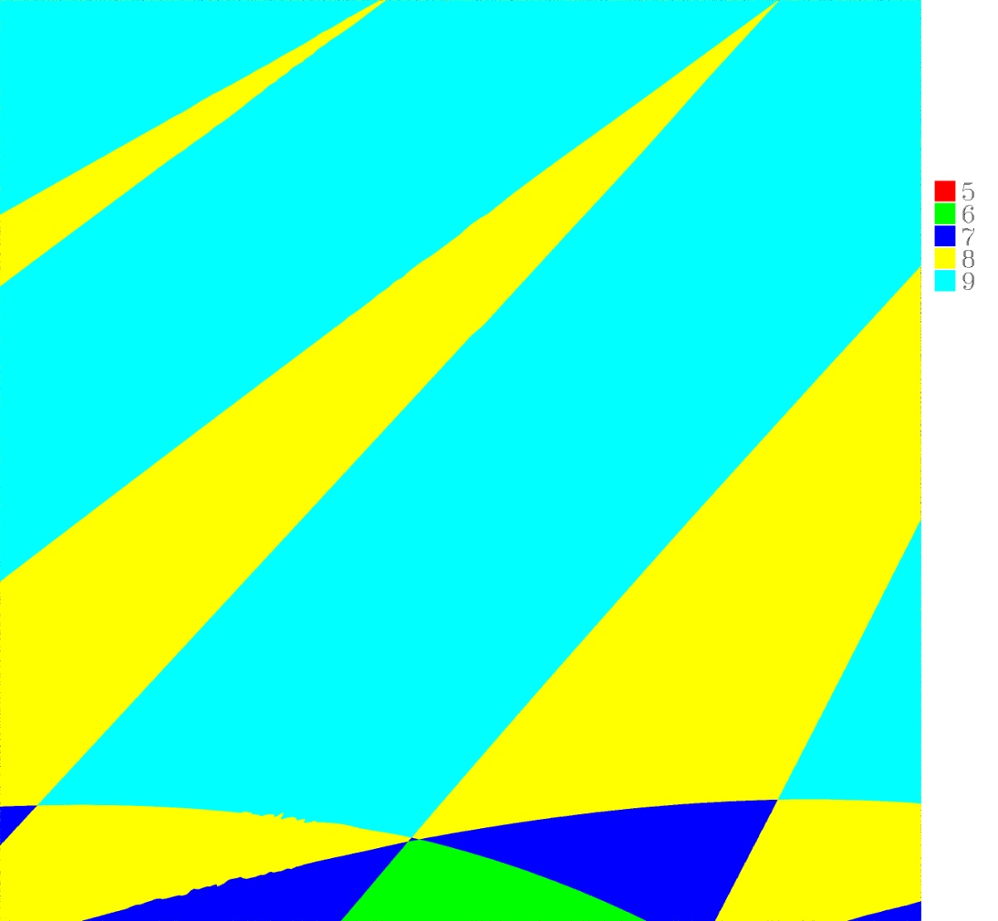
Updates: Number of input observations increased
Collection 5:
The first 4 layers
Collection 6:
All the available observations
Tile h16v01 Number of observations, DOY 240
MODIS Science Team Meeting, 2013

Slide 7
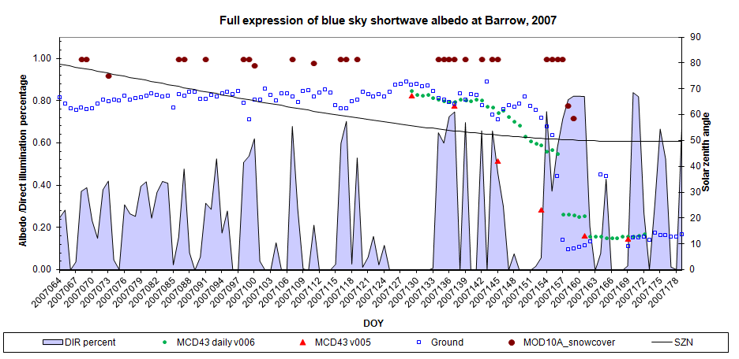
Updates: Snow status
Snow cover MOD10A1 product as input -- separate 100 % snow cover and partly snow cover
MODIS Science Team Meeting, 2013

Slide 8
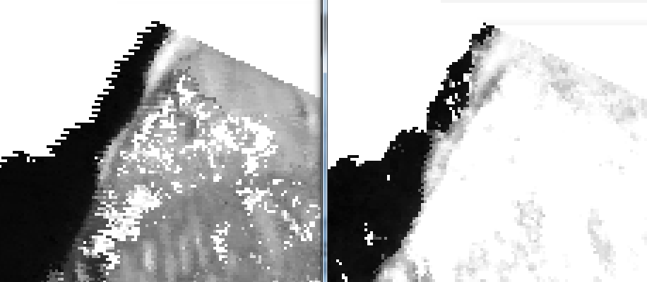
Updates: Snow /non snow status
Collection 5:
Majority snow/non snow status
Collection 6:
Current day snow/non snow status
Barrow C6 2007 SW WSA Barrow C5 2007 SW WSA
DOY 157 DOY 145 (input from 145 to 160)
Snowmelt
MODIS Science Team Meeting, 2013

Slide 9
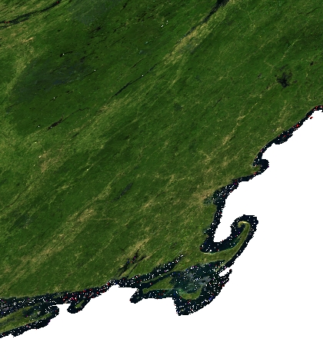
Updates: Climate Modeling Grid (CMG) Albedo
Collection 5:
Aggregated from 500 m albedo
Collection 6:
Redo the retrieval using all the clear sky observations within 1km grid for MCD43D.
MCD43B is discontinued.
H12v04 true color DOY 2011204
MODIS Science Team Meeting, 2013

Slide 10
Updates: Quality
Collection 5
Overall Quality
Snow status
Ancillary
Band Quality flag
Collection 6
Overall Quality
Snow status
Ancillary
Valid observations for each day
Quality flag Band 1
…
Quality flag Band 7
Uncertainty
MODIS Science Team Meeting, 2013

Slide 11
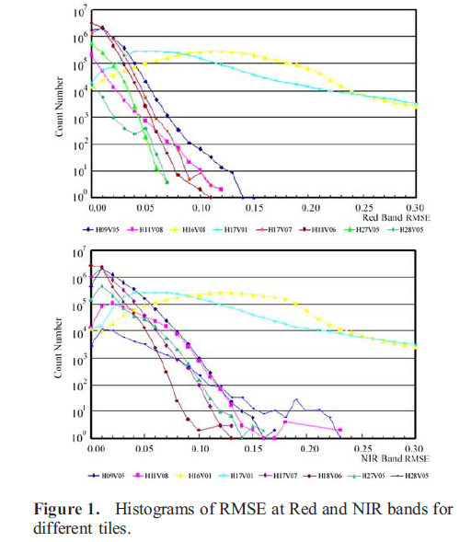
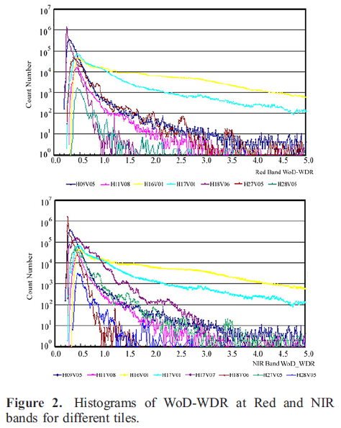
Updates: Adjust the Quality Threshold
Shuai et al., 2008 GRL
MODIS Science Team Meeting, 2013

Slide 12
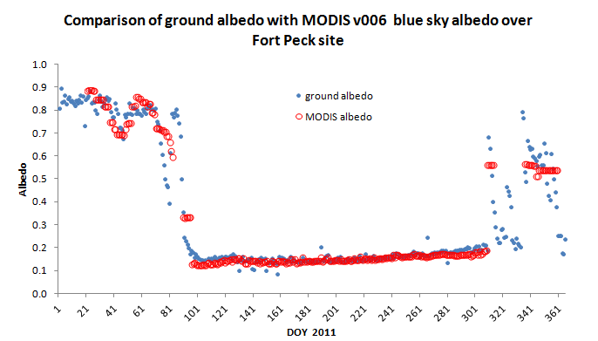
Validation: Compare with in situ measurements
MODIS Science Team Meeting, 2013

Slide 13
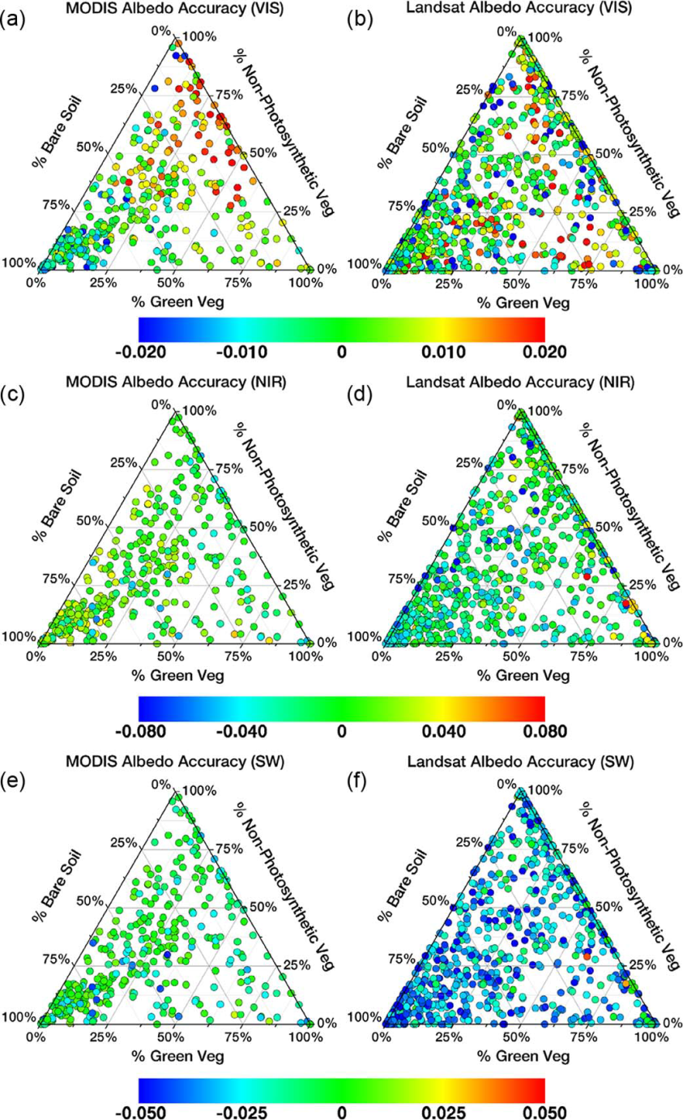
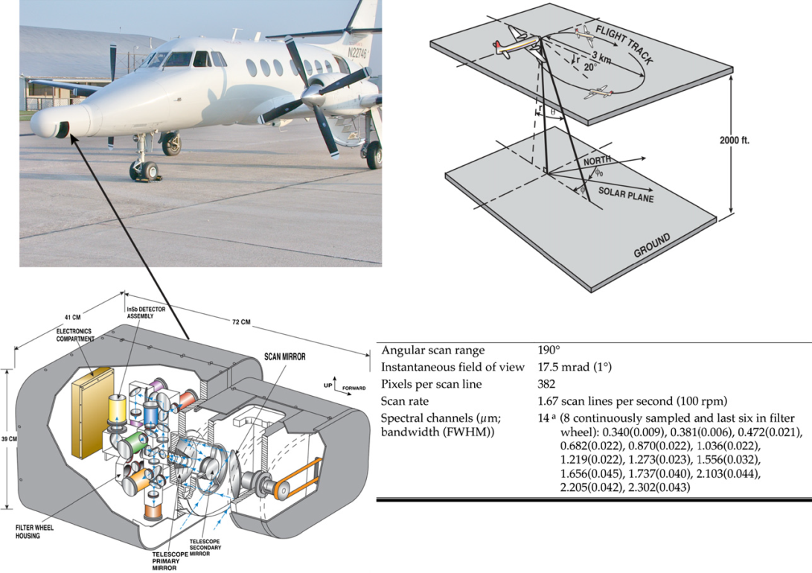
Validate MODIS/Landsat albedo using CAR data
In general, the satellite derived estimates met the accuracy requirements established for the high-quality MODIS operational albedos at 500 m (the greater of 0.02 units or ±10% of surface measured values).
Román et al., IEEE Transactions on Geoscience and Remote Sensing,2013
MODIS Science Team Meeting, 2013

Slide 14
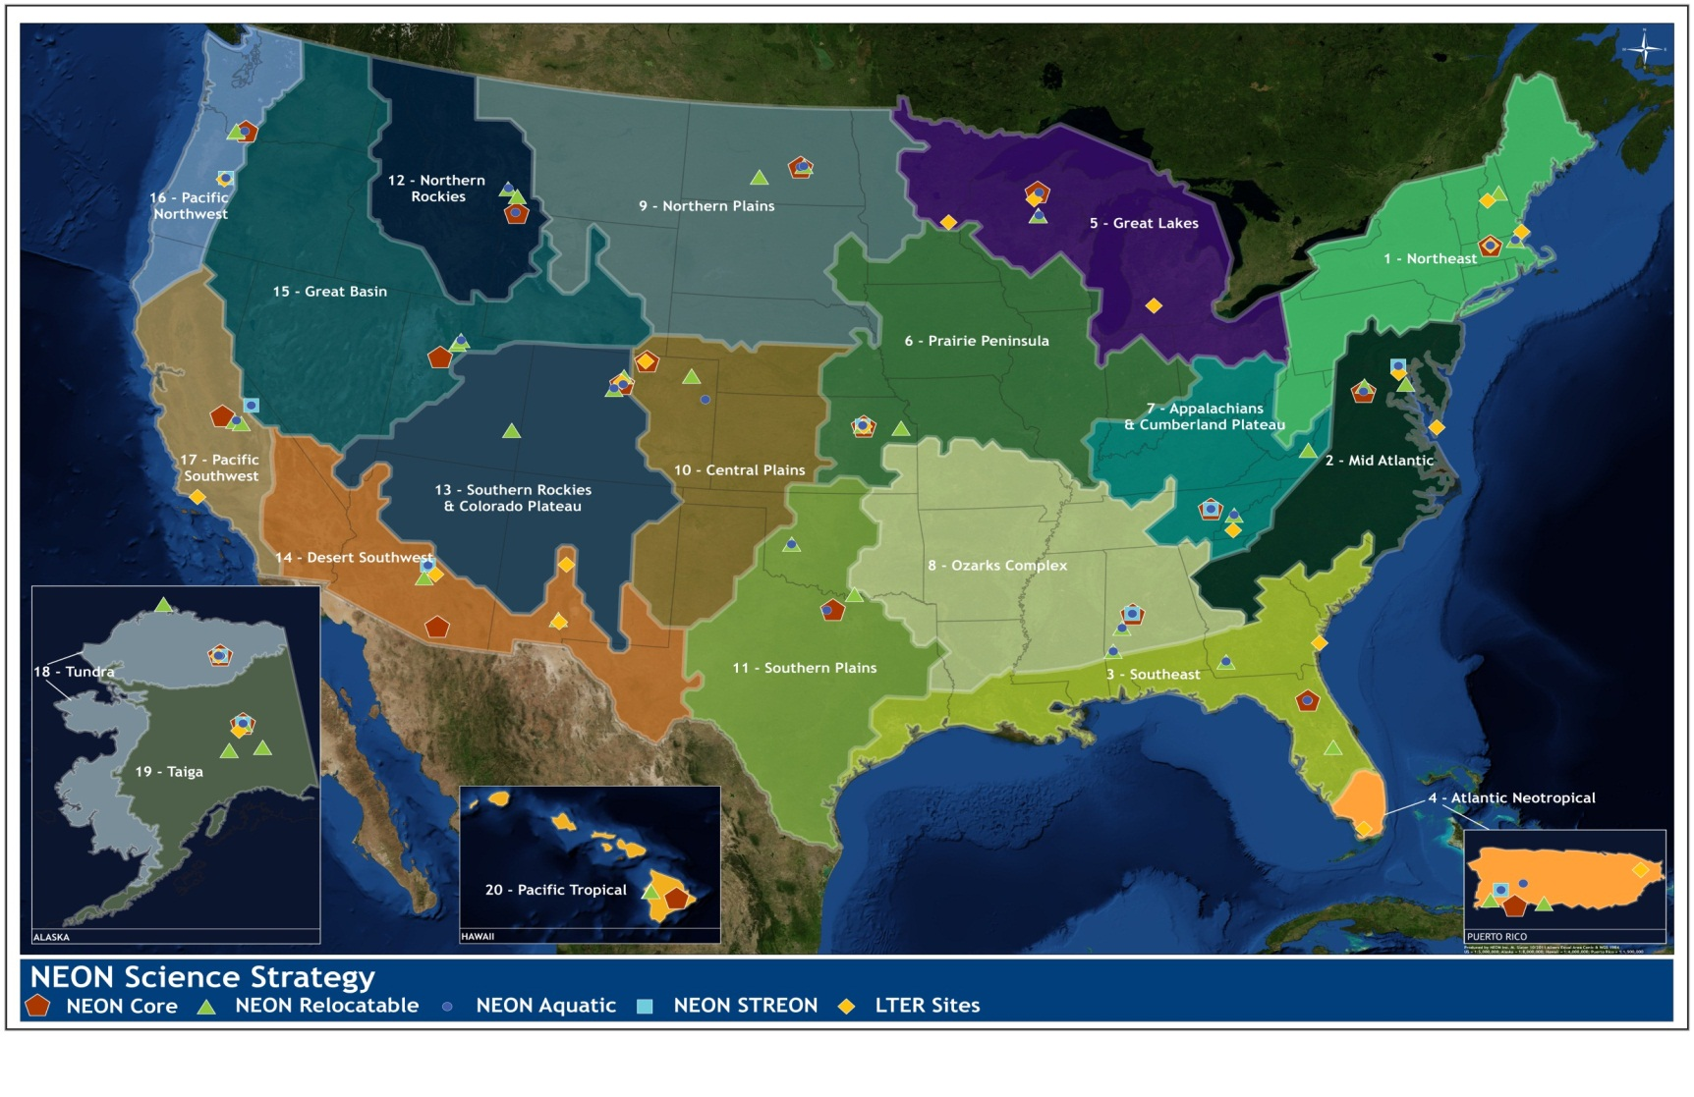
Evaluation at NEON sites: Location
NEON core sites location Courtesy of http://www.neoninc.org
Continue to expand our validation sites beyond Surfrad, BSRN, and Flux sites to include NEON sites.
MODIS Science Team Meeting, 2013

Slide 15
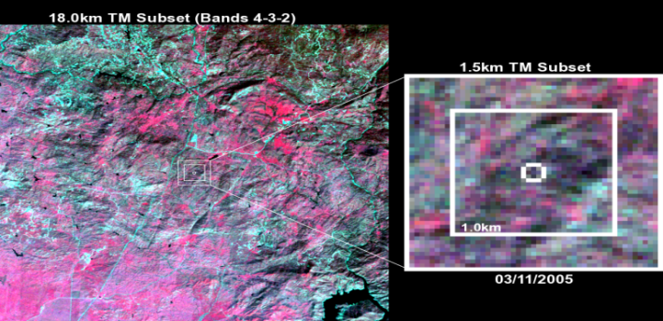
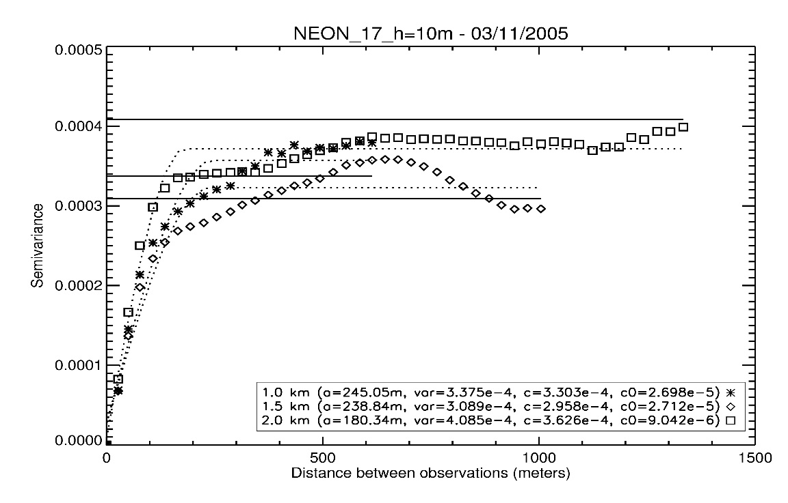
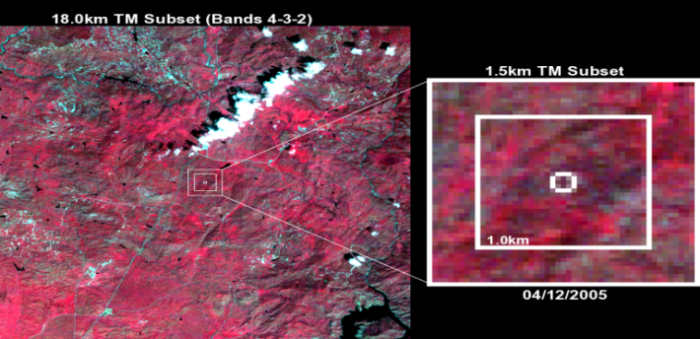
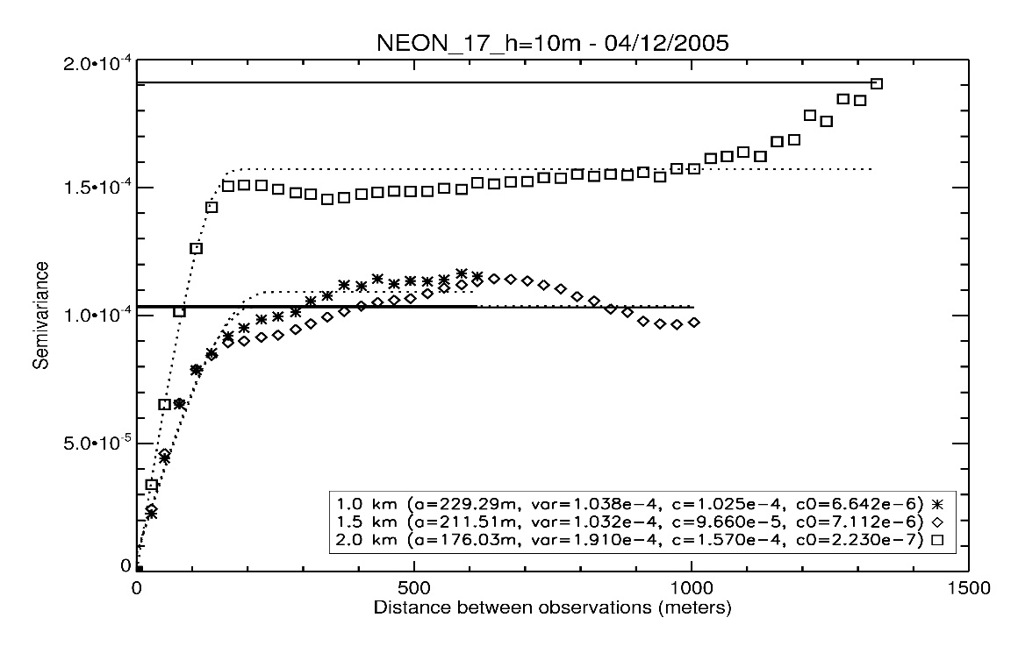
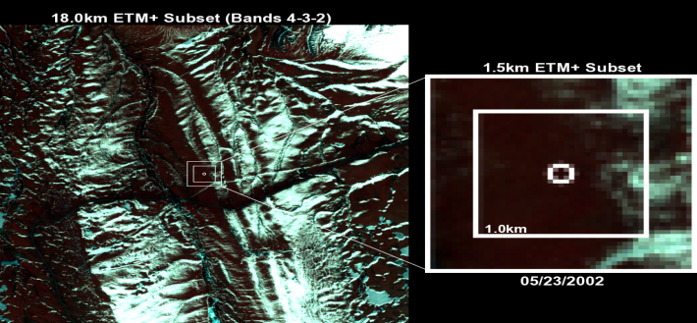
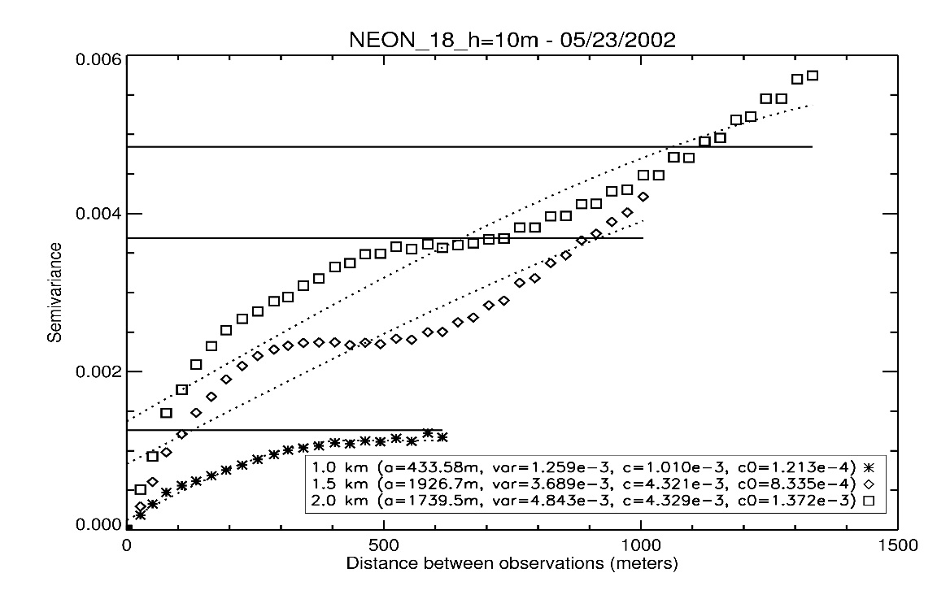
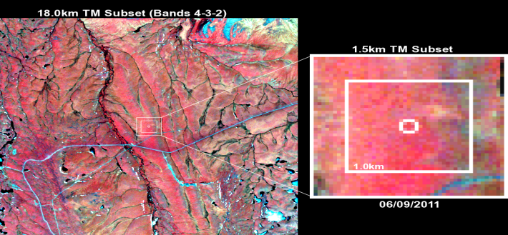
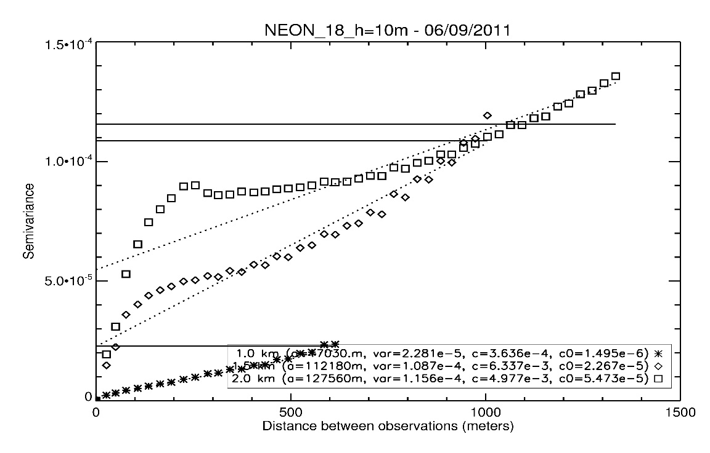
NEON sites: Spatial Representativeness
Domain 17:
San Joaquin Experimental Range
More representative site
Domain 17:
San Joaquin Experimental Range
More representative site
Domain 18:
Toolik Lake
Less representative site
Domain 18:
Toolik Lake
Less representative site
Xiaoyuan Yang
MODIS Science Team Meeting, 2013

Slide 16
NEON sites: Albedometer Height Analysis
10m (left), 20m (center) and 30m (right) albedometer heights are applied to each sites to evaluate the changing of R_{se} parameter with respect to 0.243.
MODIS Science Team Meeting, 2013

Slide 17
NEON sites: Fused MODIS and Landsat NBAR
MODIS Science Team Meeting, 2013

Slide 18
Conclusion
C6 daily BRDF/albedo product can now capture rapid land surface changes – snowmelt, fire etc.
More high quality output is produced because of the increase in the number of observations (especially over high latitude areas).
The MODIS albedos agree well with ground and airborne measurements.
The fusion of MODIS and Landsat produces vegetation index that track dynamic land surface characteristics with high temporal/spatial resolution.
MODIS Science Team Meeting, 2013

