Slide 1

Vegetation Continuous Fields
Evolution through multiple spatial and temporal resolutions
John R. Townshend¹, Charlene M. DiMiceli¹, Robert Sohlberg¹, Mark Carroll², Do-Hyung Kim¹
¹ University of Maryland, Department of Geographical Sciences, ² Sigma Space, NASA Goddard Space Flight Center
Notes:
Vegetation continuous fields products give the percent vegetation cover within each pixel. Typical layers are tree cover, non-tree vegetation, and bare ground.
The following slides give an overview of the development of global vegetation continuous fields over the past 20 years.

Slide 2


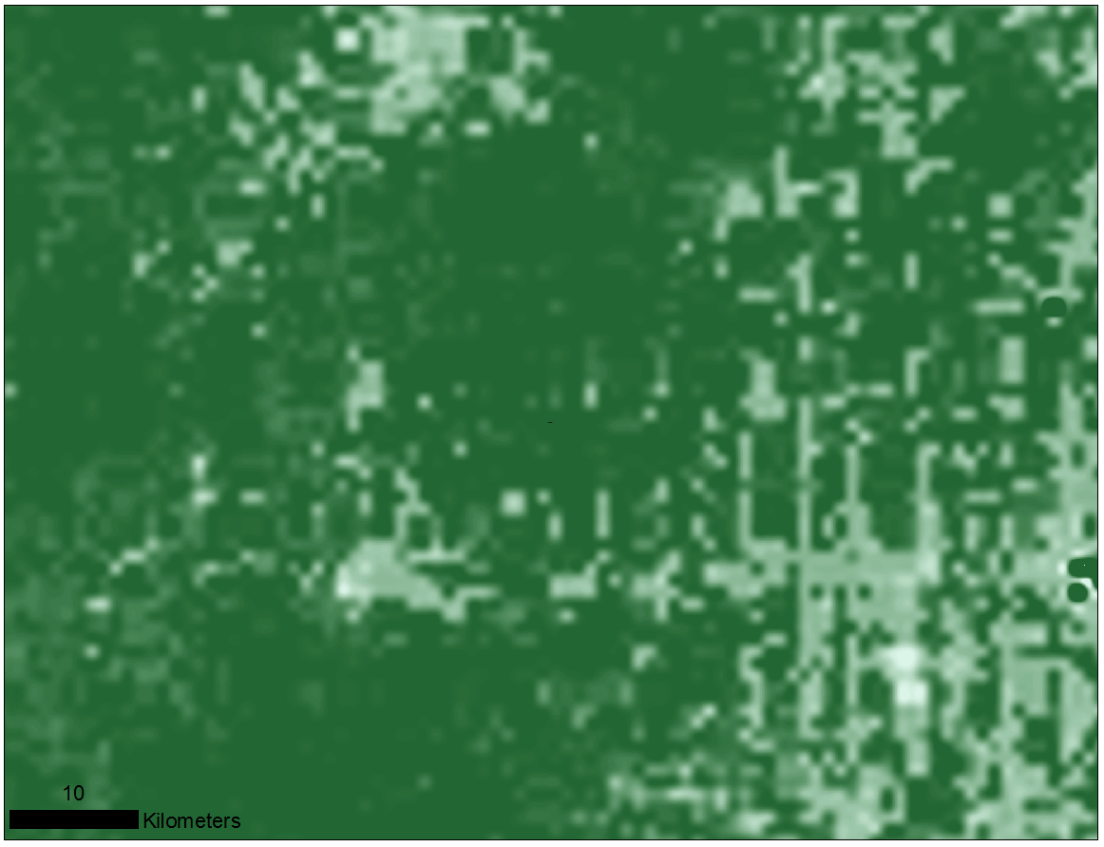
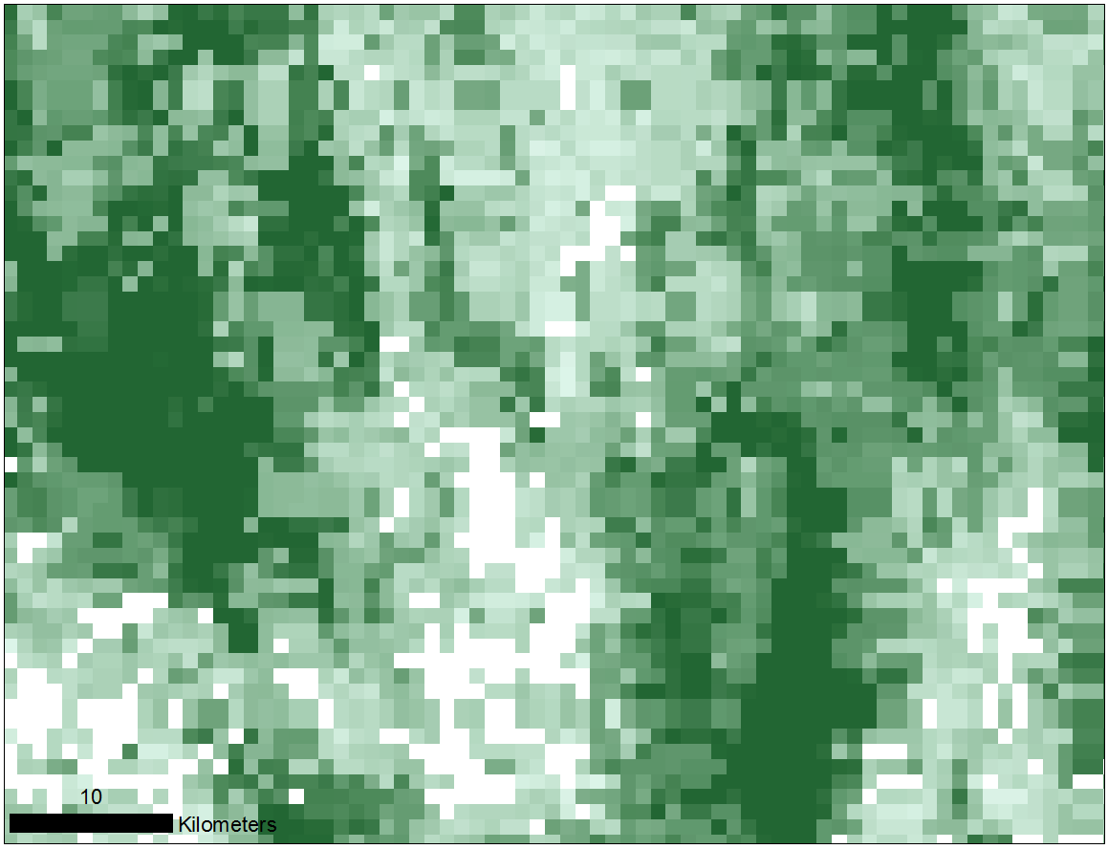
AVHRR VCF
Rondonia , Brazil
1 km resolution * Mixture model algorithm
Notes:
These slides show tree cover for two areas—Rondonia, Brazil and an area in the Congo.
After the development of regional products and an 8 km AVHRR VCF product, the University of Maryland published a 1 km AVHRR product covering the years from 1992 to 1993.

Slide 3
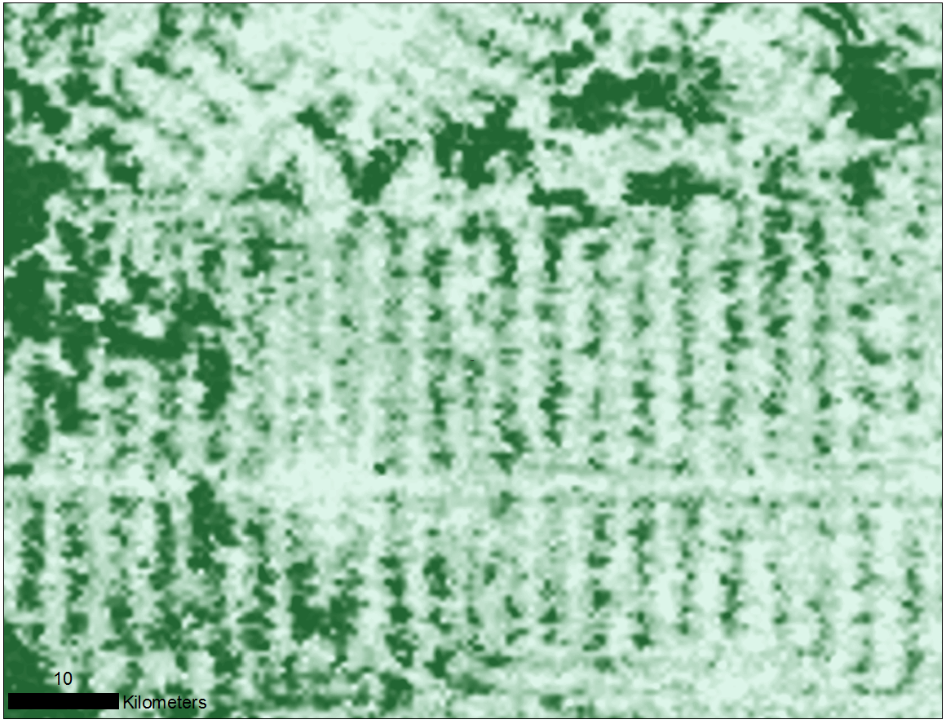
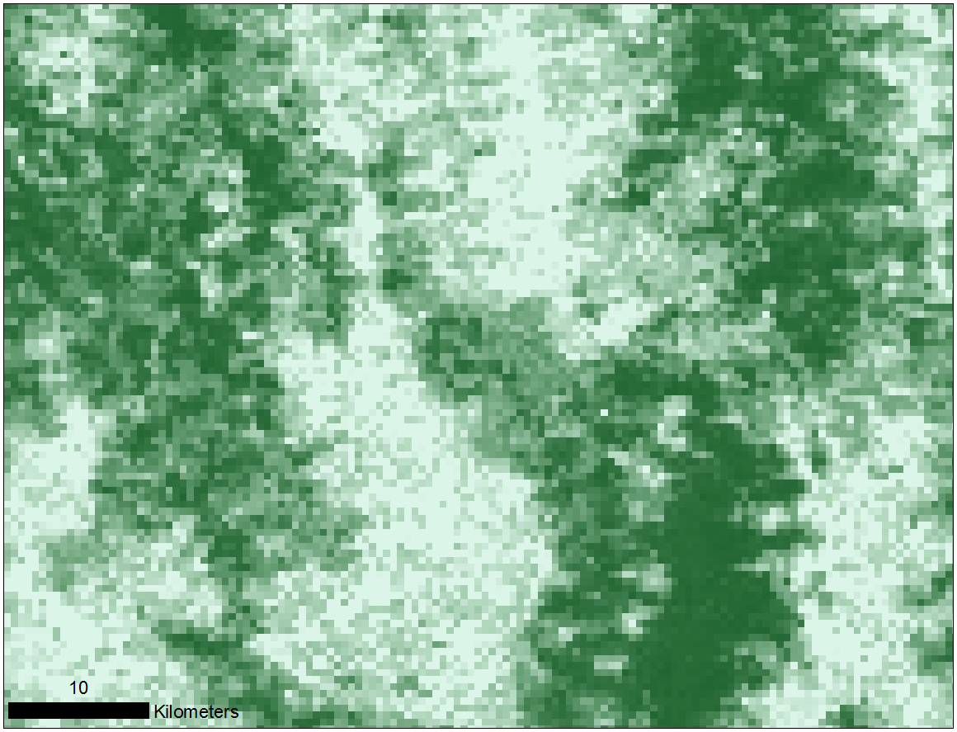
MODIS VCF C3
Rondonia , Brazil
500 m resolution * Regression tree algorithm
Increased training
Notes:
MODIS VCF products were significantly improved due to higher resolution and better instrument characteristics and processing. The C3 product was a single-year product for 2001.

Slide 4
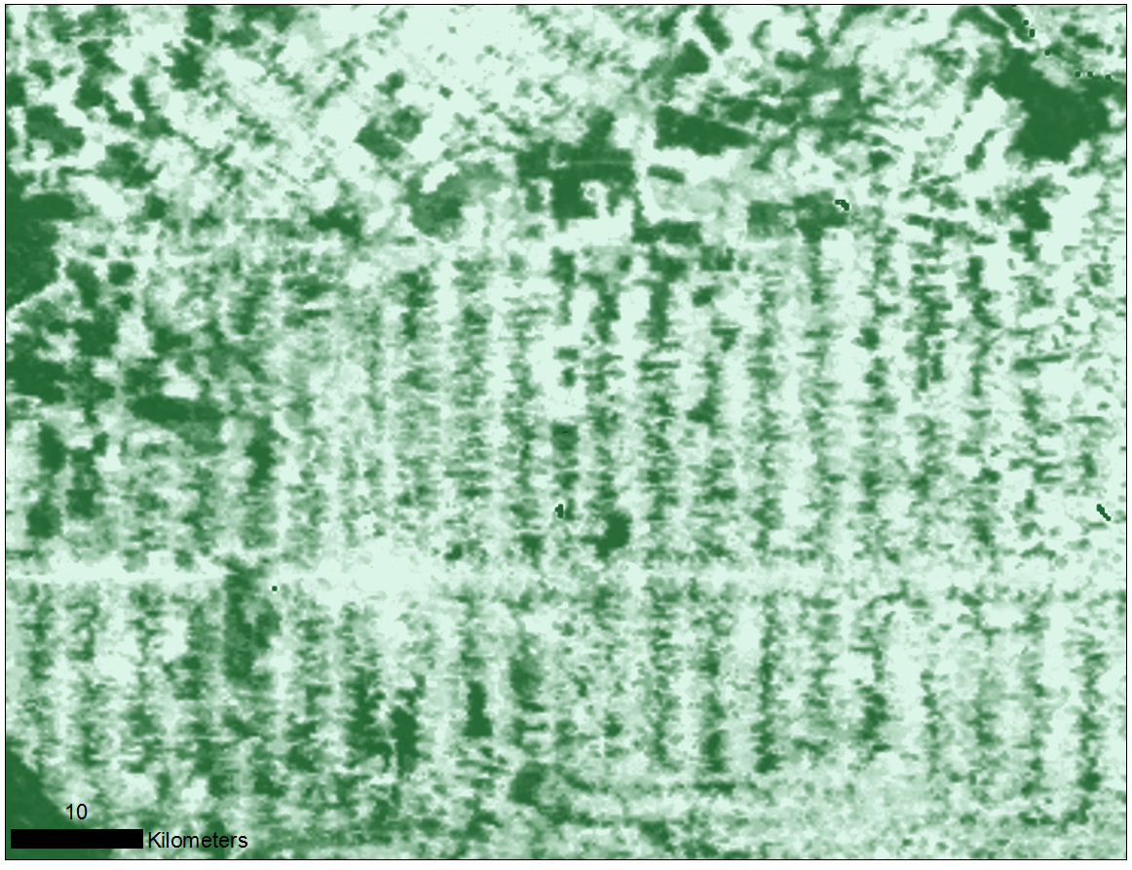
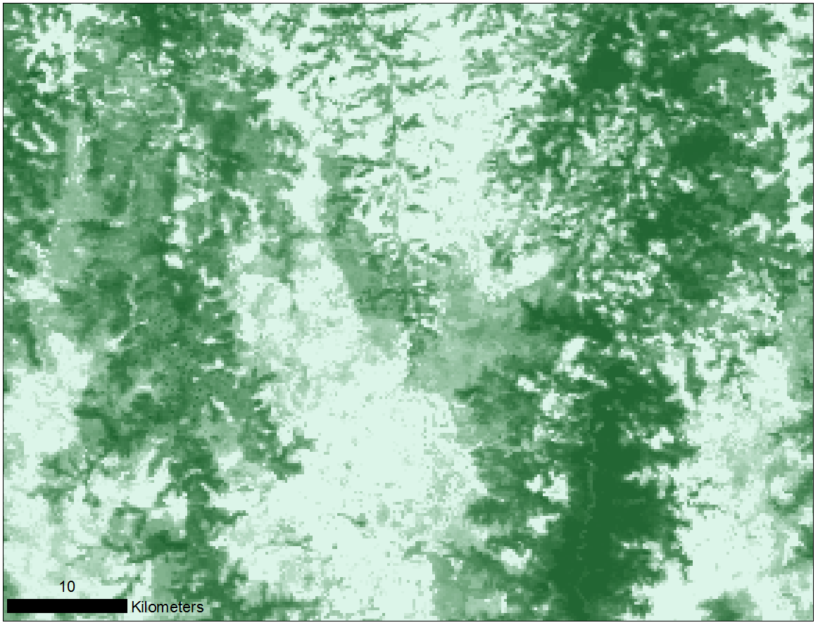
MODIS VCF C5
Rondonia , Brazil
250 m resolution * Bagged regression tree algorithm
Increased training * Annual * Fully automated
Notes:
First annual product.

Slide 5
Water Mask
MODIS C5 * 250 m resolution
Notes:
A greatly improved water mask was added to the MODIS C5 processing stream. This water map is being used separately as well for applications requiring accurate surface water characterization.

Slide 6

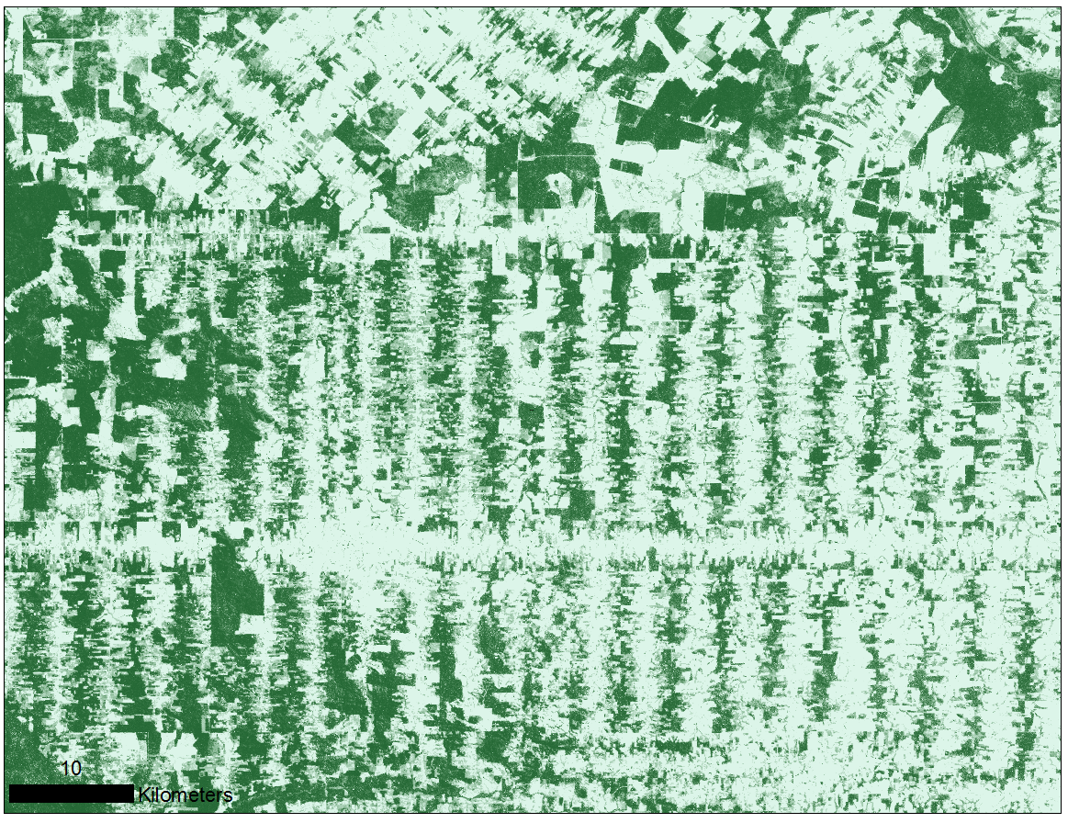
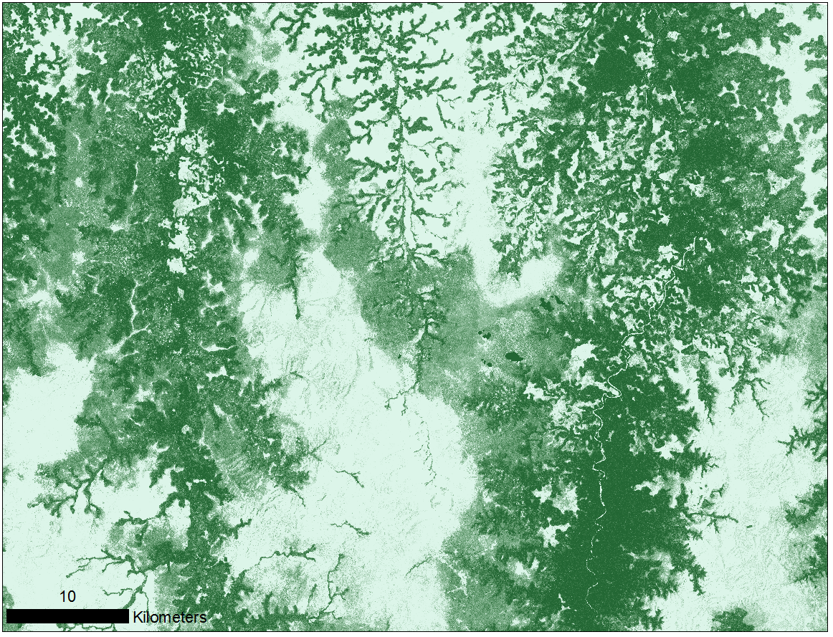
Landsat VCF
Rondonia , Brazil
30 m resolution * Regression tree algorithm
Training—MODIS VCF and high resolution data
Notes:
There are two products made by different groups at UMD; both teams arrived at a similar product as they pursued different research directions.

Slide 7
MEaSURES VCF 1982 - 2010
Rondonia, Brazil
1982
1990
1998
2010
30 year time series * Bagged regression tree algorithm
Expanded training * 1/20 degree resolution
Notes:
Coarser resolution, but long time series. Uses Eric Vermote’s Land Long-Term Data Record, a consistent multi-instrument record of surface reflectance, NDVI and brightness temperature. Additional tree cover layers will include evergreen, deciduous, broadleaf and evergreen. Water mask will be annual.

Slide 8
Vegetation Continuous Fields Products -- History
*
*
**
* http://www.landcover.org , ** http://earthenginepartners.appspot.com/science-2013-global-forest

Slide 9
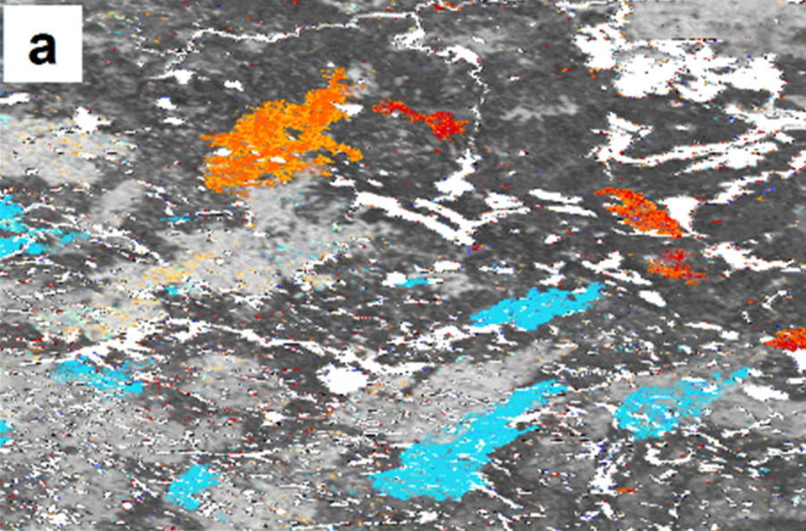
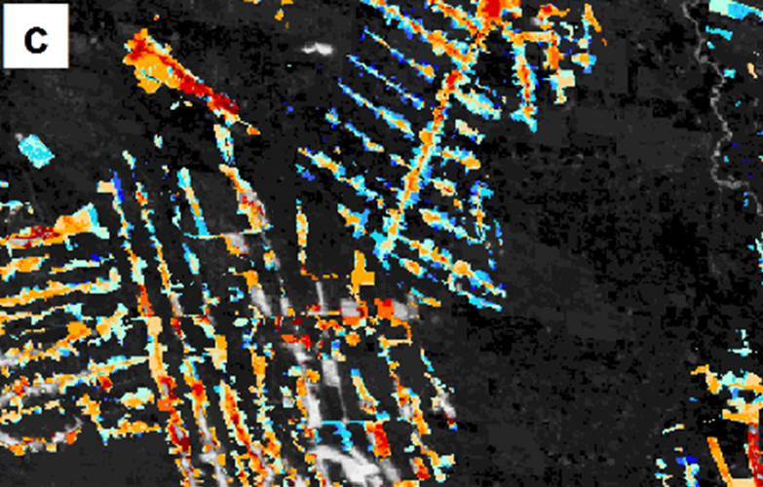
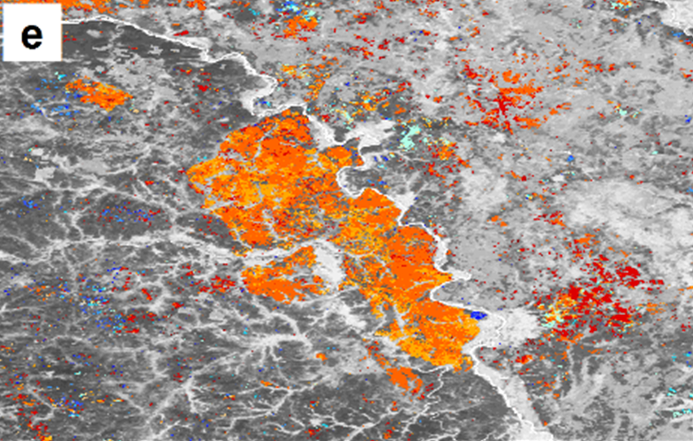
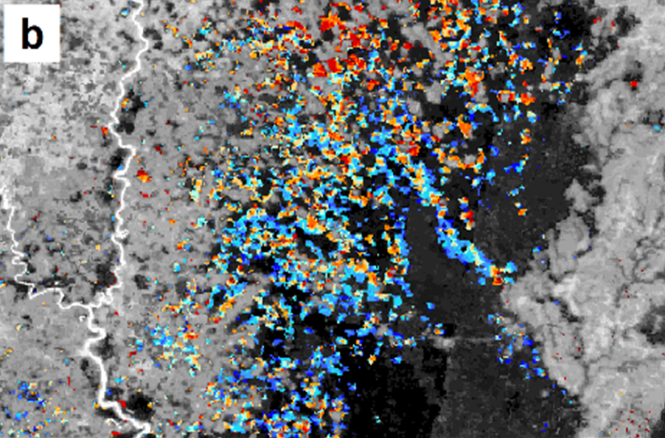
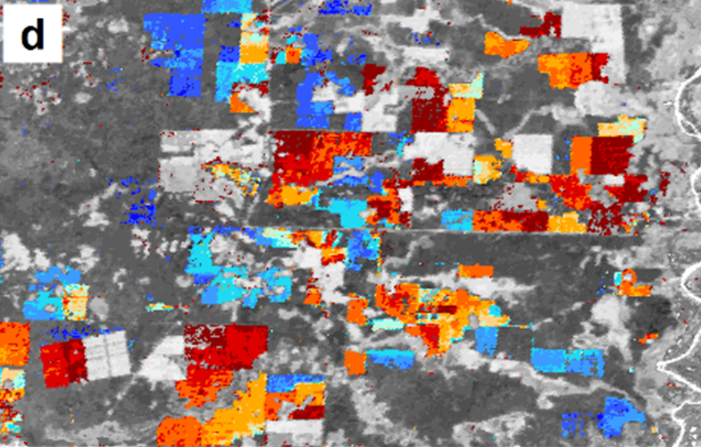
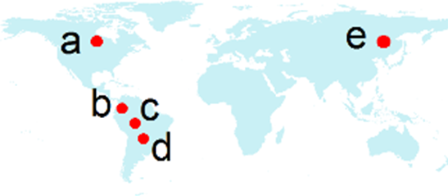
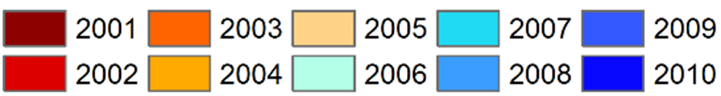
Forest Disturbance
Xiaopeng Song, 2014
Disturbance Year
Notes:
The most straightforward application of VCFs is in vegetation change detection. Here is an example of research done by Xiaopeng Song using MODIS and Landsat VCFs to detect deforestation. In these images the colors represent the year the disturbance occurred. Images are from Canada, three from South America and one from China.

Slide 10
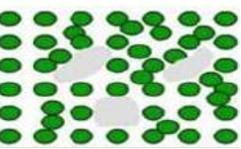
Why do we need both VCF and LAI products?
VCF | LAI
Horizontal vegetation structure (openness, gaps) | Vertical vegetation structure (number of layers)
Subpixel spatial resolution | 1 km spatial resolution
Annual | 16-day temporal resolution
Distinguishes tree, non-tree and bare ground fractional cover | Captures phenology
Notes:
Using VCF and LAI products together give a better characterization of the 3-D vegetation canopy.

Slide 11
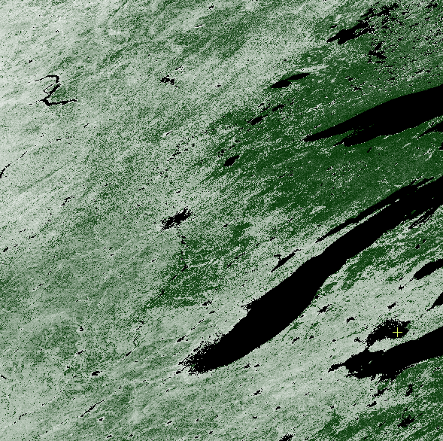
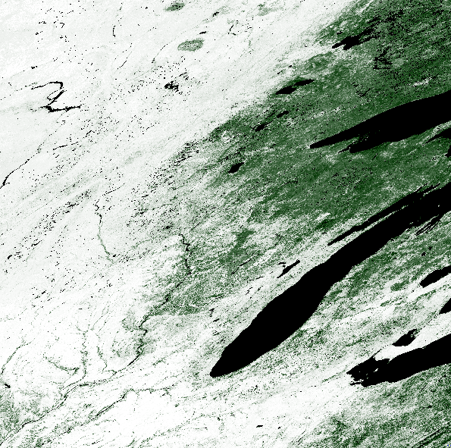
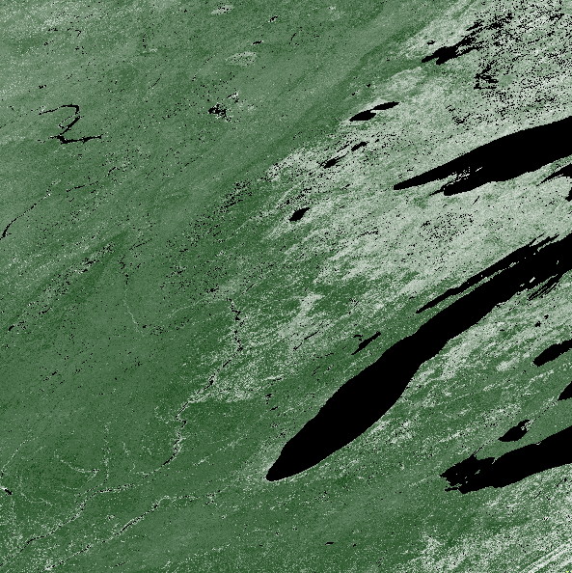
LAI and VCF
Maximum Annual LAI
MOD15A2--2010
VCF Tree Cover
MOD44B--2010
VCF Non-tree Vegetation
MOD44B--2010
Notes:
Here is an example of the ability of VCFs to distinguish between vegetation types. This is tile h11v04; you can identify the Great lakes on the right. The left-hand image shows the maximum annual LAI for 2010. We have used the maximum annual LAI in order to best correspond with the VCF layers which represent maximum vegetation cover for the year. The two images on the right show the vegetation divided into percent tree cover and percent non-tree vegetation. As you can see, the upper right is covered with forest; the remainder of the scene is cropland and mixed vegetation.

Slide 12
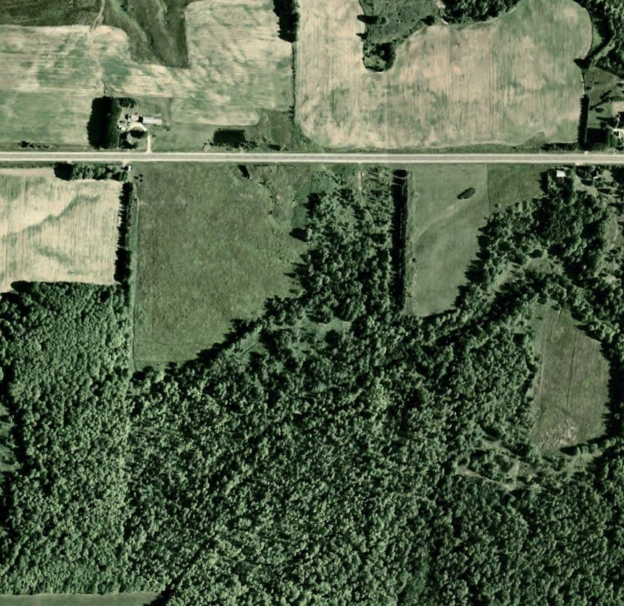
VCF vs LAI
1 km
 | VCF | maximum annual LAI (2010, MOD15A2)
Tree cover | 32% | 5.0
Non-Tree vegetation | 56%
Bare ground | 12%
USDA Farm Service Agency, Northern Michigan
Notes:
The next three slides show another comparison of VCF’s ability to characterize sub-pixel vegetation cover. The air-photo images are 1 km square, a single LAI pixel. Each of these pixels from 2010 has a maximum annual LAI of 5.0, but tree cover ranges from 32 to 64% with commensurate differences in the other vegetation layers.

Slide 13
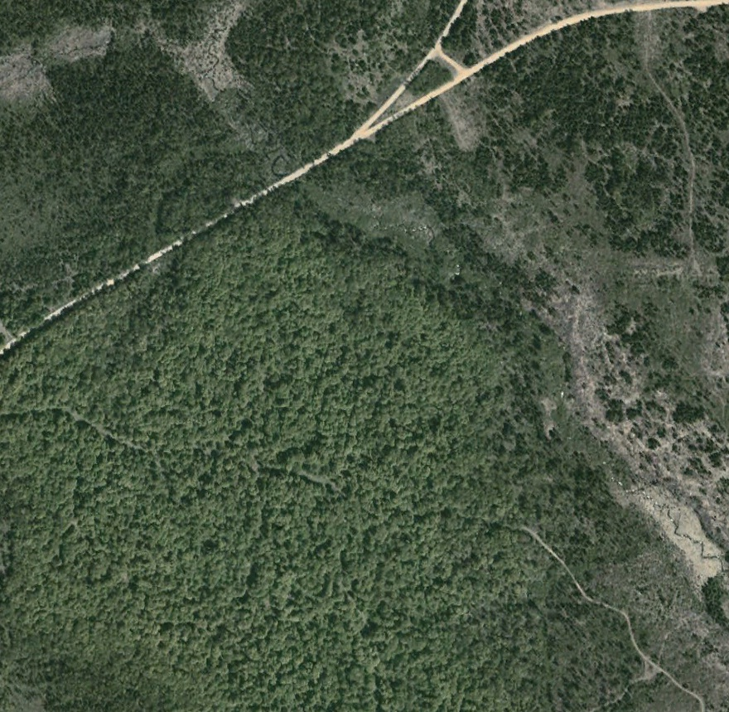
VCF vs LAI
1 km
 | VCF | maximum annual LAI (2010, MOD15A2)
Tree cover | 52% | 5.0
Non-Tree vegetation | 34%
Bare ground | 14%
USDA Farm Service Agency, Northern Michigan

Slide 14
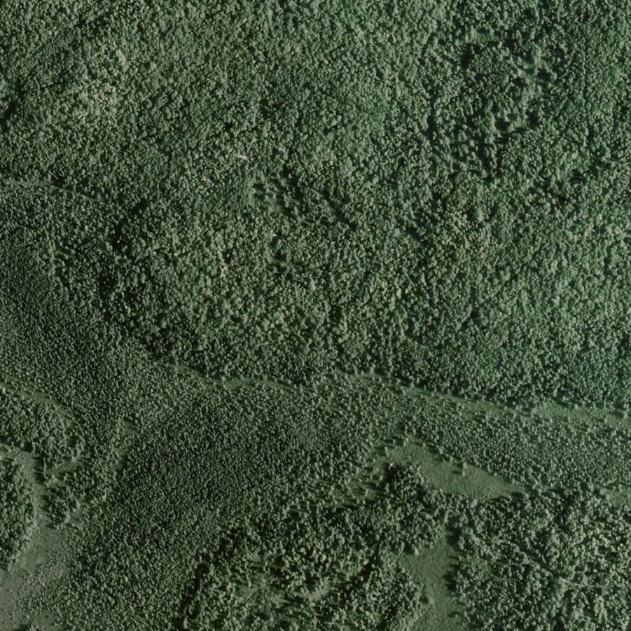
VCF vs LAI
1 km
 | VCF | Maximum annual LAI (2010, MOD15A2)
Tree cover | 64% | 5.0
Non-Tree vegetation | 30%
Bare ground | 6%
USDA Farm Service Agency, Northern Michigan

Slide 15
Future Plans
Further additions to training to improve difficult regions
Improved data mining models—Random Forest, Gradient Boosting
Testing on C6 data
Analysis of improvements with BRDF-corrected data
VIIRS
Updated error and uncertainty analysis
Notes:
Regions that need improvement: far north due to low light conditions, frequently cloudy tropical regions, sparse semi-arid woodland.
Improved models—bagging improved and smoothed our VCF results; we expect recent advances in data mining to further improve our products.
Testing on C6 data requires a full year.
Updated error and uncertainty analysis—we hope to take advantage of the NASA data buy high resolution data and the increasingly available Lidar data.

