Slide 1
Collection 6 MODIS Fire Products
Louis Giglio¹, Wilfrid Schroeder¹, Luigi Boschetti², David Roy³, Chris Justice¹
¹University of Maryland, ²University of Idaho, ³South Dakota State University
MODIS Science Team Meeting
April 2014

Slide 2
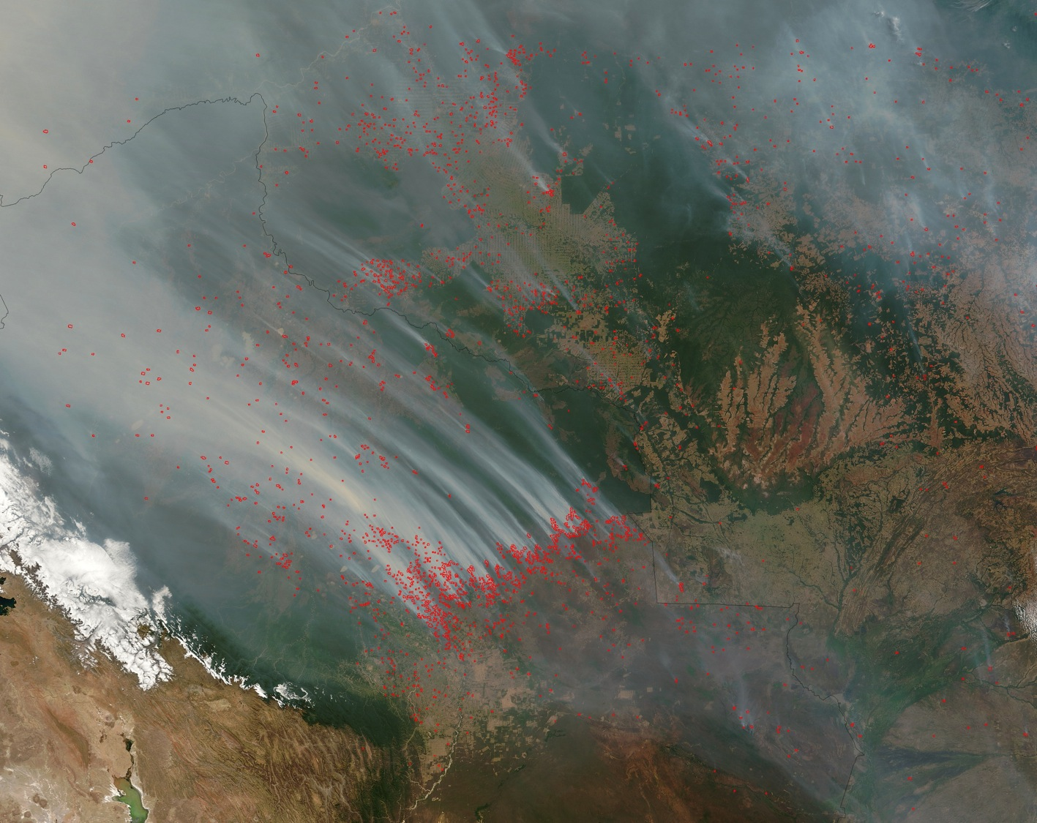
200 km
Deforestation Fires
Bolivia and Brazil, 13 Sep. 2004
Notes:
MODIS imagery of fires in Bolivia, 2004 day 257, 14:25. Picture credit: NASA Rapid Response System.

Slide 3
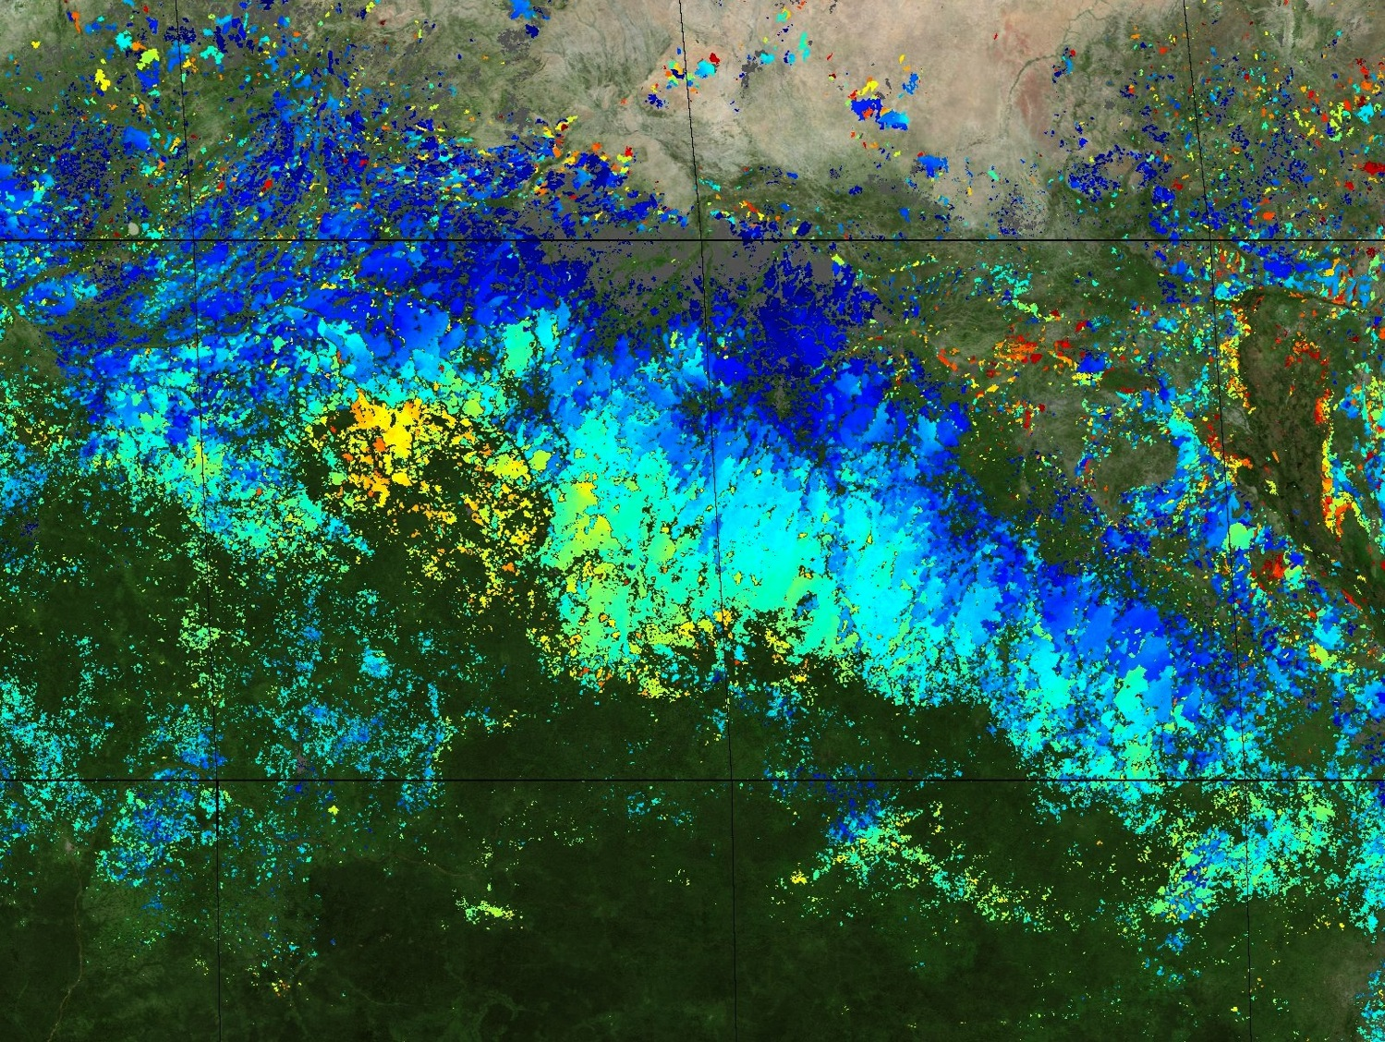
Burned Area in CAR and South Sudan
2004-2005 Fire Season
10°N
5°N
500 km
20°E
25°E
30°E
Notes:
MCD64A1 burned area, 2004-2005 fire season (September - April). Picture credit: Louis Giglio (University of Maryland).

Slide 4
MODIS Active Fire/Thermal Anomalies Products
MOD14/MYD14 | 1-km Swath L2
MOD14A1/MYD14A1 | 1-km Daily Composite L3
MOD14A2/MYD14A2 | 1-km 8-Day Composite L3
MOD14C8H/MYD14C8H | 0.5° 8-Day CMG
MOD14CMH/MYD14CMH | 0.5° Monthly CMG
MCD14ML | Monthly fire locations + attributes

Slide 5
Collection 6 Algorithm Refinements
Processing extended to oceans and other large water bodies
Detect off-shore gas flaring
Reduce false alarms in Amazon caused by small forest clearings
Dynamically adjust potential fire thresholds
Detect smaller fires
Improved cloud mask
Updated fire radiative power (FRP) retrieval

Slide 6
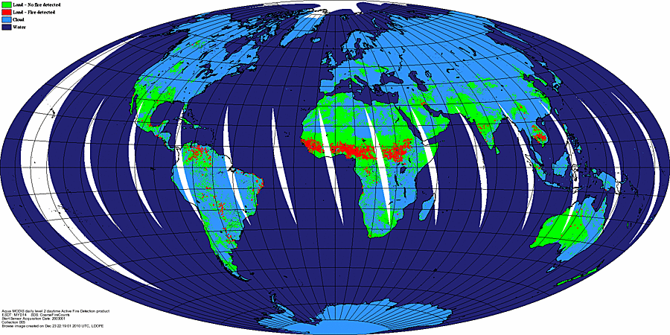
Collection 5

Slide 7
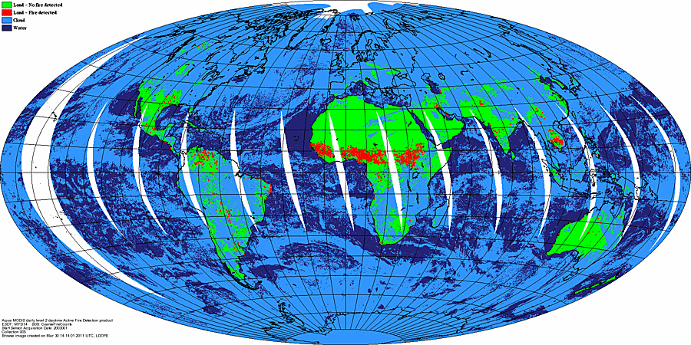
Collection 6

Slide 8
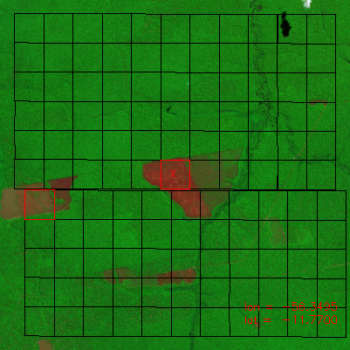
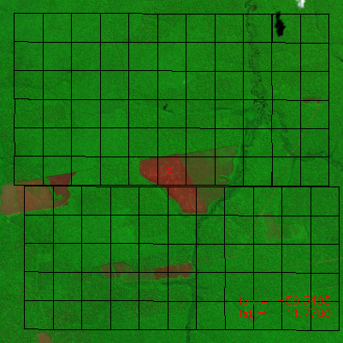
C6 Forest Clearing Rejection Test
C5
C6
False color ASTER imagery superimposed with approximate edges of MODIS pixels (black grid). MODIS fire pixels are outlined in red.
Notes:
C5 false fire caused by forest clearing in left image is eliminated in C6.

Slide 9
C6 Dynamic Potential Fire Thresholds
Detection algorithm uses various thresholds to quickly identify obvious non-fire pixels. These are known as “potential fire thresholds”.
Prior to Collection 6, fixed day/night values were used for the potential fire thresholds. However, these thresholds really should vary with scan angle, location, land cover type, season, etc.
For Collection 6, the potential fire thresholds are set dynamically.

Slide 10
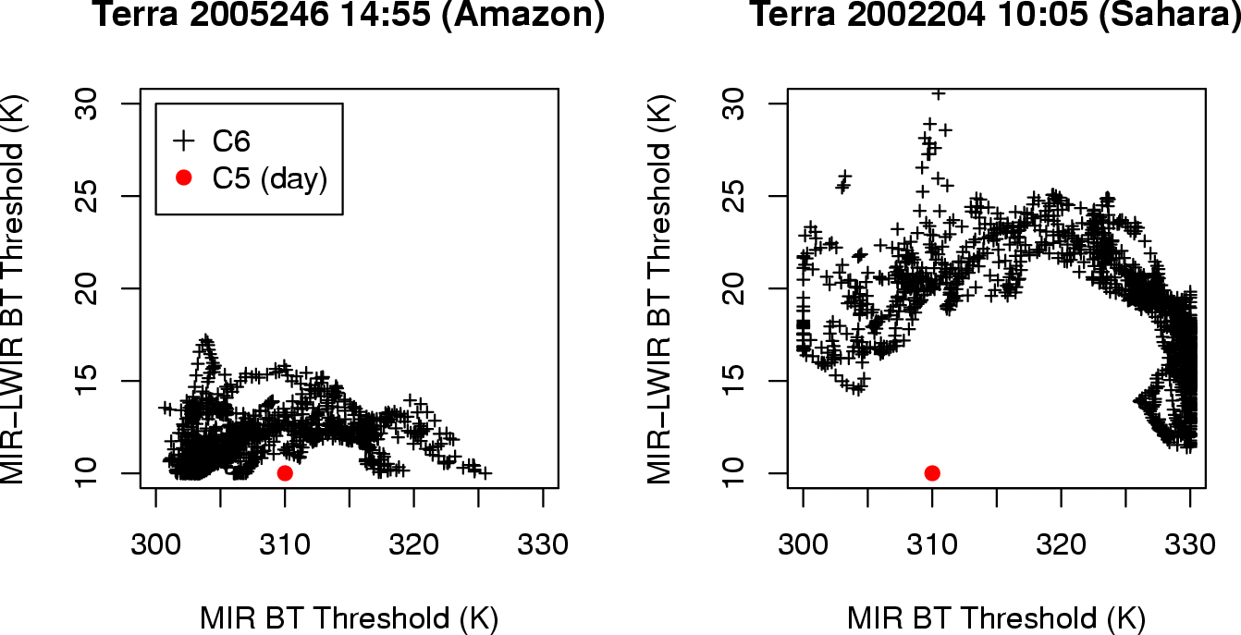
C6 Dynamic Potential Fire Threshold Examples
Notes:
Red dots show fixed C5 thresholds for two different granules, one in the Amazon and another in the Sahara. Black crosses show the corresponding dynamic C6 thresholds.

Slide 11
Collection 6 Higher Level Product Refinements
0.25° CMG product
New CMG product layers
fire persistence
Minor Level 3 product refinements

Slide 12
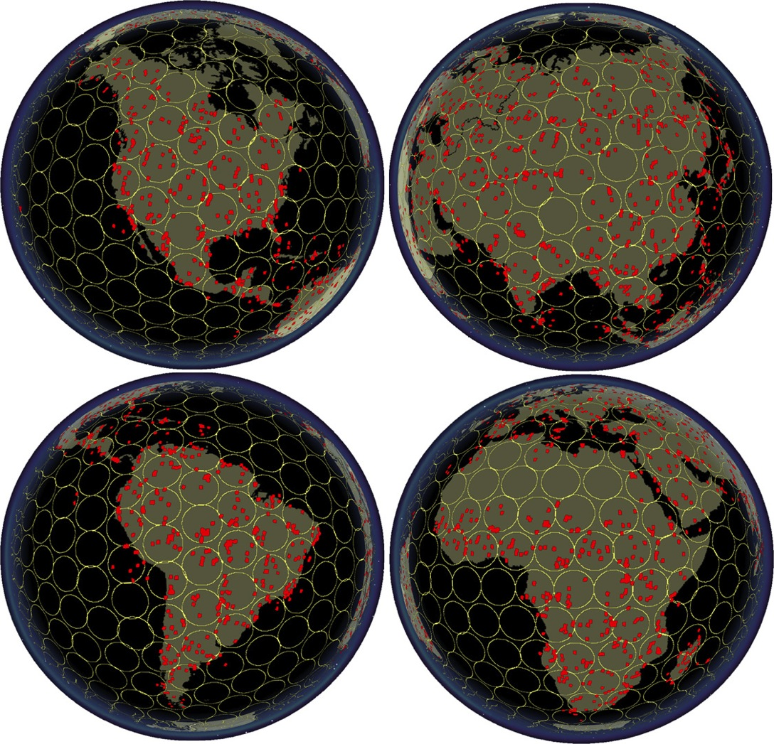
Validation
Use swath (L2) product
Compare Terra MODIS fire masks to 30-m ASTER fire masks
2500 ASTER scenes
Largely automated
C6 validation process can be initiated at any time

Slide 13
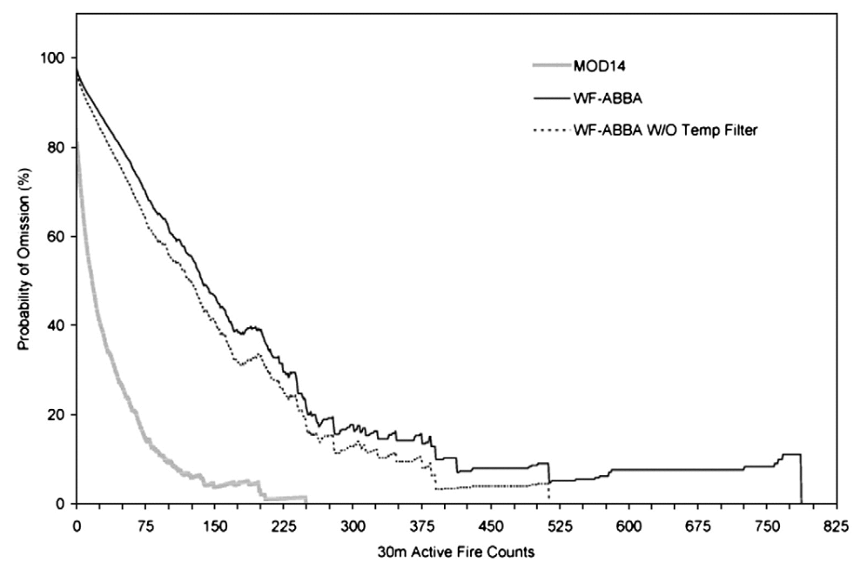
Example C5 Validation Results

Slide 14
Collection 6 Higher Level Product Refinements
0.25° CMG
New CMG product layers
fire persistence
Minor L3 product improvements
New type attribute in location product
Distinguish between static gas flares and other industrial sources, active volcanoes, and non-static vegetation fires

Slide 15
MODIS Burned Area Products
MCD45A1 | 500-m Monthly L3
MCD45A1-based GIS Products (SCF) | Shapefiles + 500-m GeoTIFF
MCD64A1 (SCF) | 500-m Monthly L3
For all products burning is mapped to the nearest day.

Slide 16
Algorithm/Product Characteristics
MCD45A1
MCD64A1
BRDF-based approach
500-m, daily
Uses no active fire data
Less noise-tolerant
Poorer mapping under cloudy conditions
Better mapping of cropland burning
VI time series approach
500-m, daily
Exploits active fire data
More noise-tolerant
Better mapping under cloudy conditions
Poorer mapping of cropland burning

Slide 17
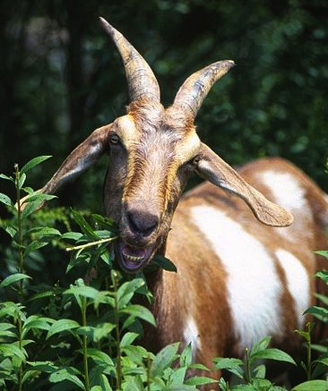
Merge features of the two different approaches to produce a better C6 product, i.e., a “Koala Goat”.
MCD45
MCD64
Wikimedia Commons
Notes:
Photo credits: Wikimedia Commons

Slide 18
Collection 6 Validation
Landsat imagery
CEOS burned area validation protocol

Slide 19
C6 Validation: Design Based Sampling
Stratified random sampling
Total population of the dataset: All Landsat pairs which respect the CEOS protocol requirements
Cloud free + within a set time period (~2 months)
Stratification
In space: sub-continental regions
In time: fire seasonality based on MODIS active fire detections

Slide 20
C6 Validation: Design Based Sampling
With Landsat 8 systematic acquisition sample is not merely a pair of scenes but rather the entire sequence over the year
Number of samples guided by the results of Stage 2 validation of C5.1

Slide 21
Characteristics of Stage 3 Sampling
Statistically robust sampling essential for proper characterization of presence/absence of fire
Current validation datasets are biased and are not suitable for detecting false positives
Need to validate temporal and spatial aspects separately
Image-pair interpretation widely tested and published in peer reviewed literature
Data availability is main limiting factor
With Landsat 8 data we can rigorously validate burned area for the first time in over 10 years

Slide 22
Thanks!

