Slide 1
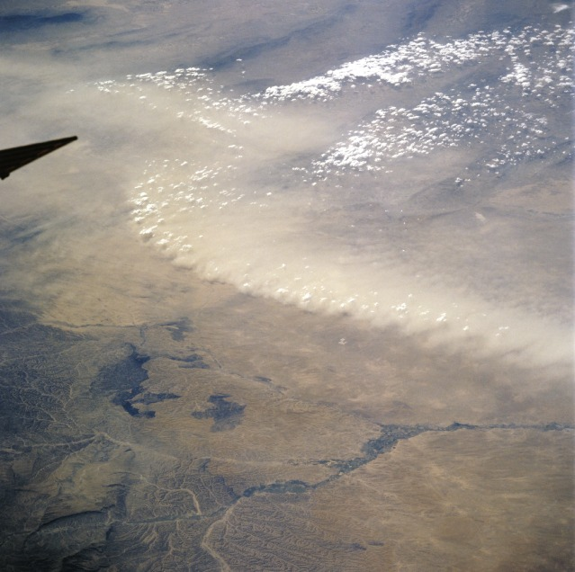
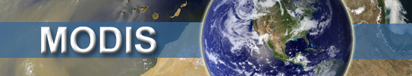
MODIS Dark Target products
Collection 6 and onward to Collection 7
Robert Levy (NASA-GSFC)
Shana Mattoo, Leigh Munchak, Richard Kleidman (SSAI @ NASA-GSFC)
Falguni Patadia (GESTAR/Morgan State Univ. @ NASA-GSFC)
Pawan Gupta (GESTAR/USRA @ NASA-GSFC)
Lorraine Remer (JCET-UMBC)
MODIS-STM-2014 Columbia MD: April 29, 2014

Slide 2
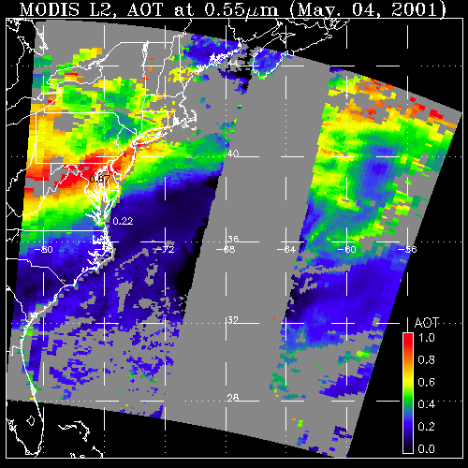
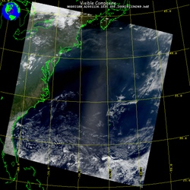
Aerosol retrieval from MODIS
What MODIS observes
Attributed to aerosol (AOD)
May 4, 2001; 13:25 UTC
Level 1 “reflectance”
May 4, 2001; 13:25 UTC
Level 2 “product”
LAND
OCEAN
GLINT
AOD
1.0
0.0
There are many different “algorithms” to retrieve aerosol from MODIS
Dark Target (“DT” ocean and land; Levy, Mattoo, Munchak, Remer, Tanré, Kaufman)
Deep Blue (“DB” desert and beyond; Hsu, Bettenhousen, Sayer,.. )
MAIAC (coupled with land surface everywhere; Lyapustin, Wang, Korkin,…)
Ocean color/atmospheric correction (McClain, Ahmad, …)
Etc (neural net, model assimilation, statistical, … )
Your own algorithm (many groups around the world)

Slide 3
Outline
Collection 6 (C6) in production
  Differences from C5 (Level 2)
  Some preliminary validation (for Aqua)
  Terra versus Aqua and calibration
  Level 3 protocol
  Higher resolution 3 KM product
Maintenance proposal accepted: Towards C7?
  Corrections of urban surfaces
  New Uncertainty products (per-pixel)
  Consistency between Terra and Aqua, and continuation onto VIIRS
Dark target web page

Slide 4
MODIS Collection 6: Introduction
Published in AMT
Levy, R. C., Mattoo, S., Munchak, L. A., Remer, L. A., Sayer, A. M., Patadia, F., and Hsu, N. C.: The Collection 6 MODIS aerosol products over land and ocean, Atmos. Meas. Tech., 6, 2989-3034, doi:10.5194/amt-6-2989-2013, 2013.
http://www.atmos-meas-tech.net/6/2989/2013/

Slide 5
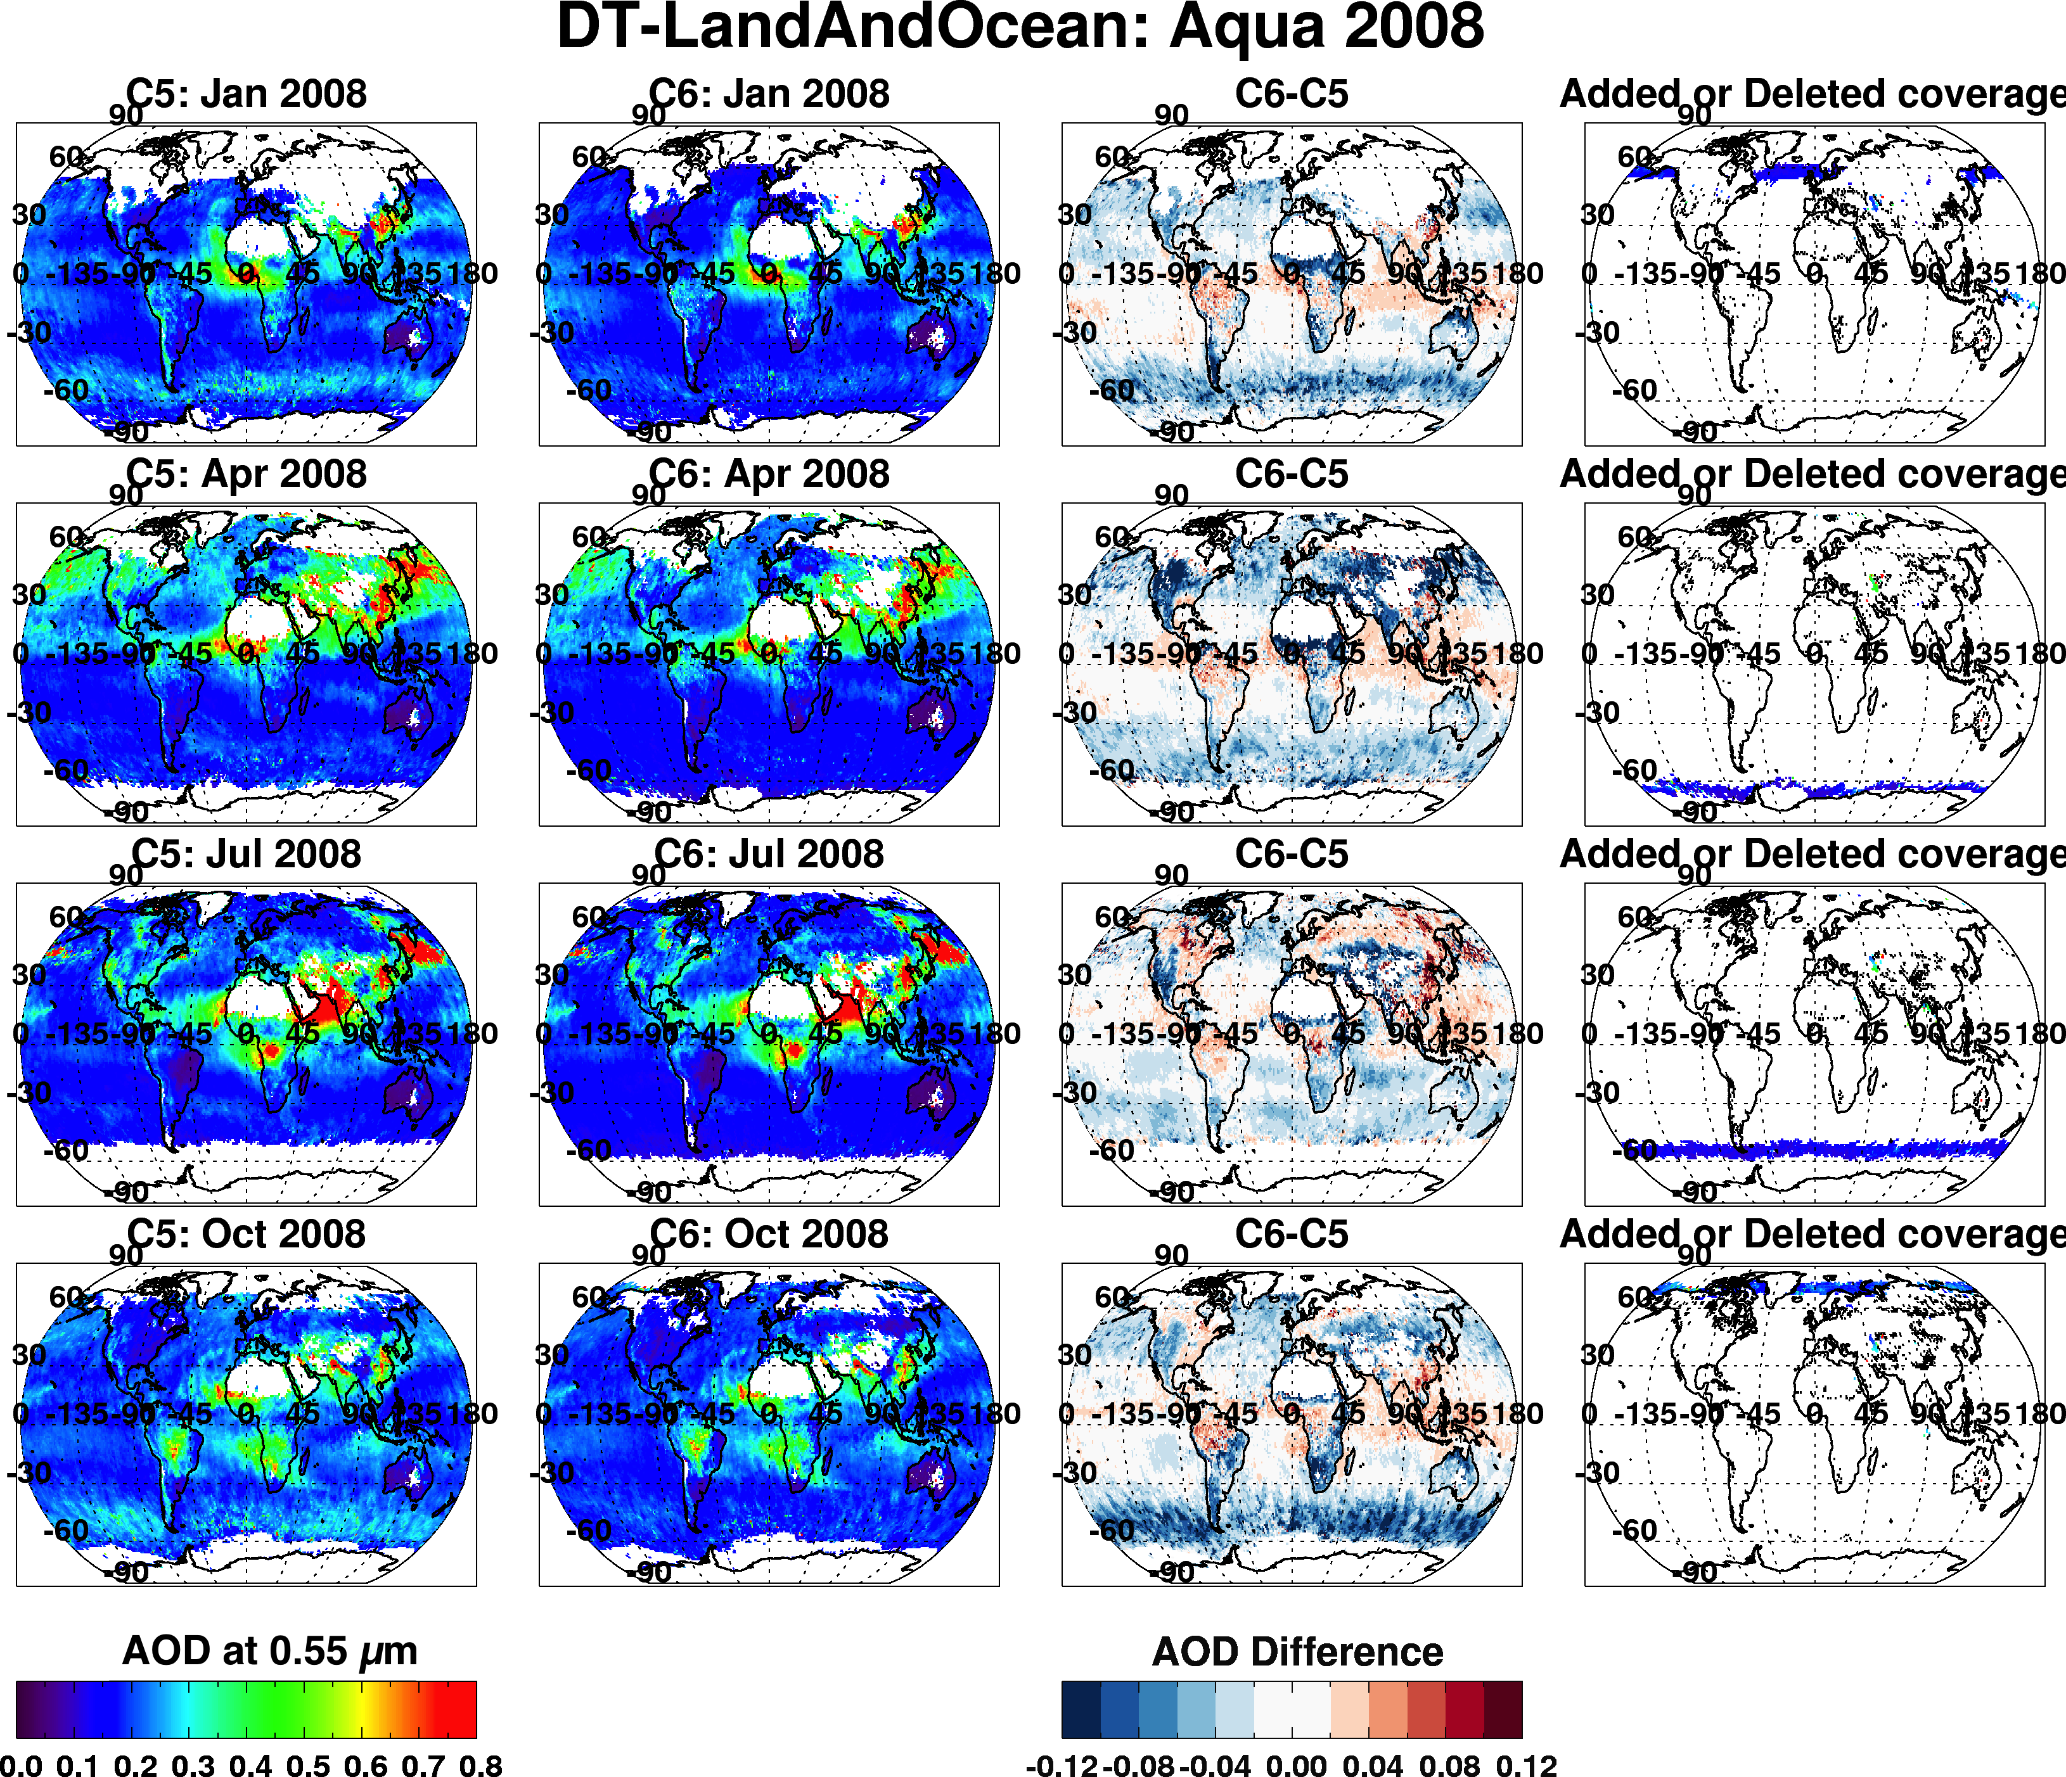
Overall changes (C6 vs C5): Aqua, 2008
Jan
Apr
Jul
Oct
0.0 0.8
-0.1 0.0 0.1

Slide 6
Aerosol over ocean

Slide 7
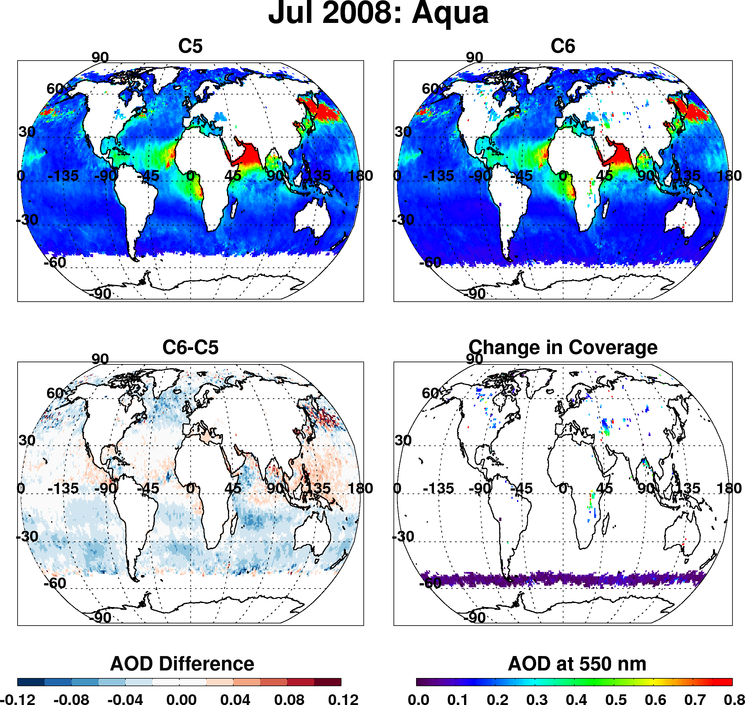
Dark target over ocean
Overall changes to products (Aqua, Jul 2008)
Overall decrease of AOD in mid-latitudes
Strong decrease in “roaring 40s” (even stronger in other months)
Overall increase in tropics
“New” coverage over inland lakes
Increase in coverage toward poles

Slide 8
Why the changes?

Slide 9
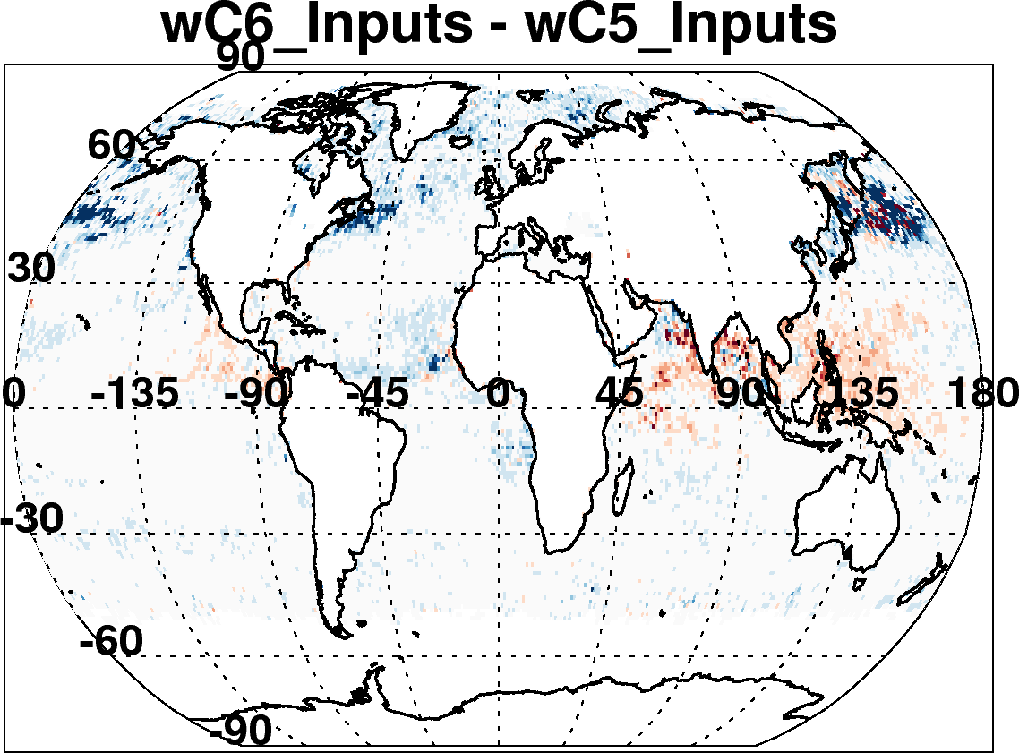
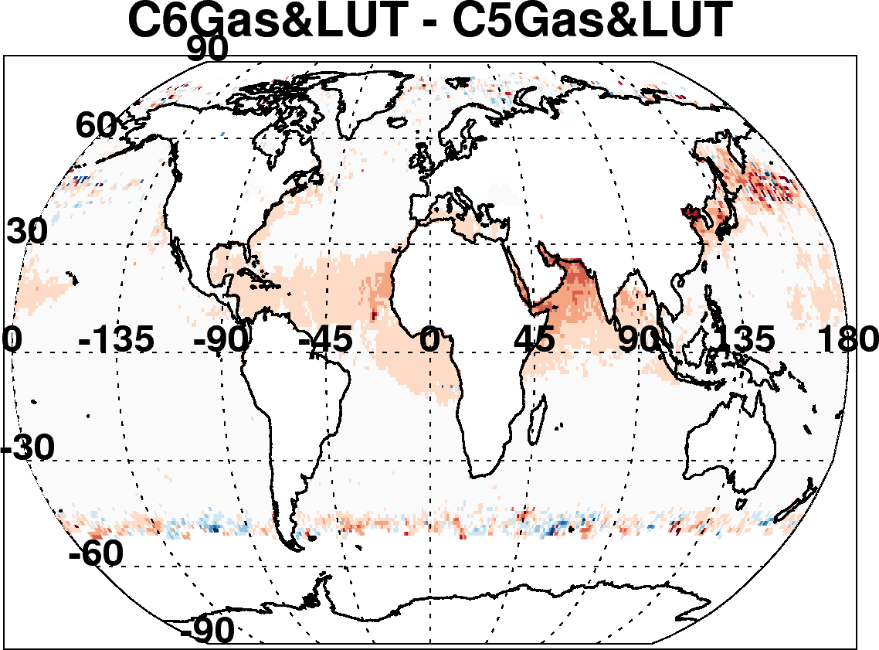
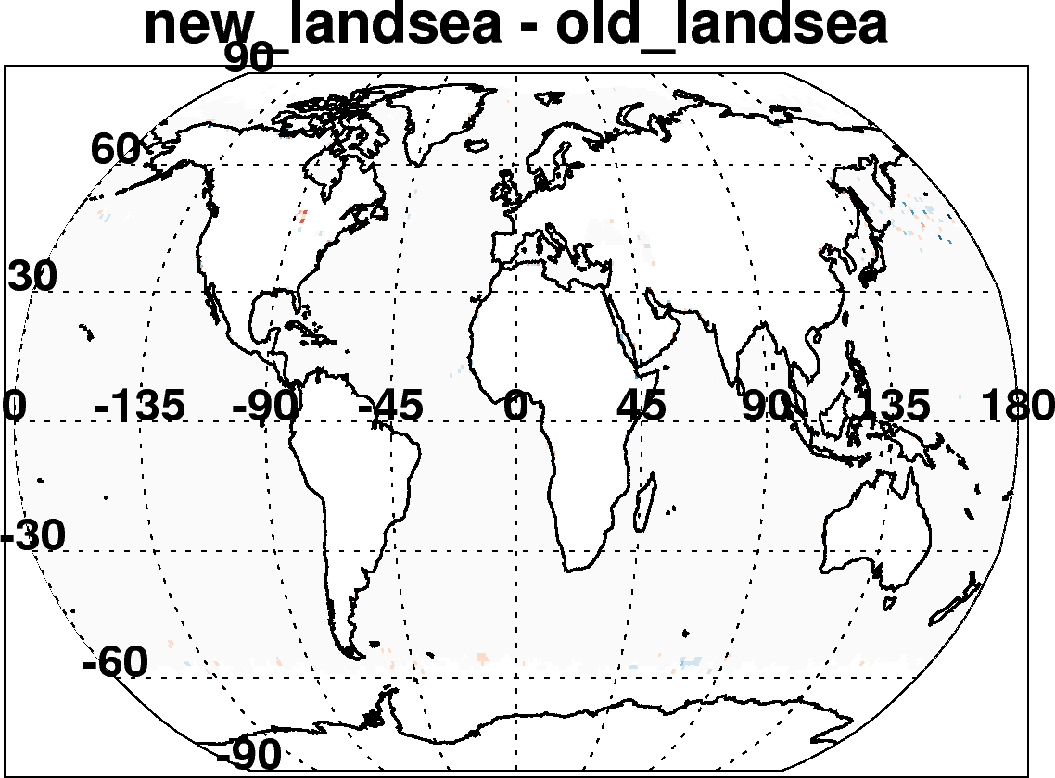
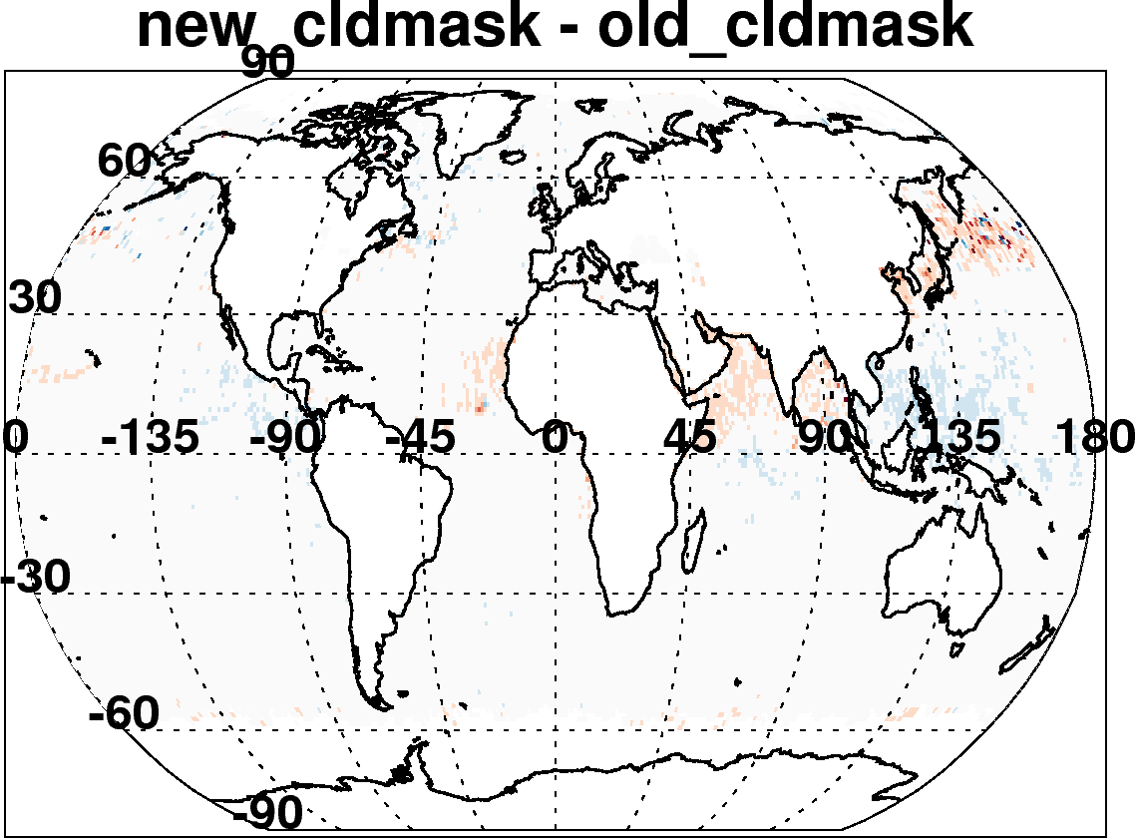
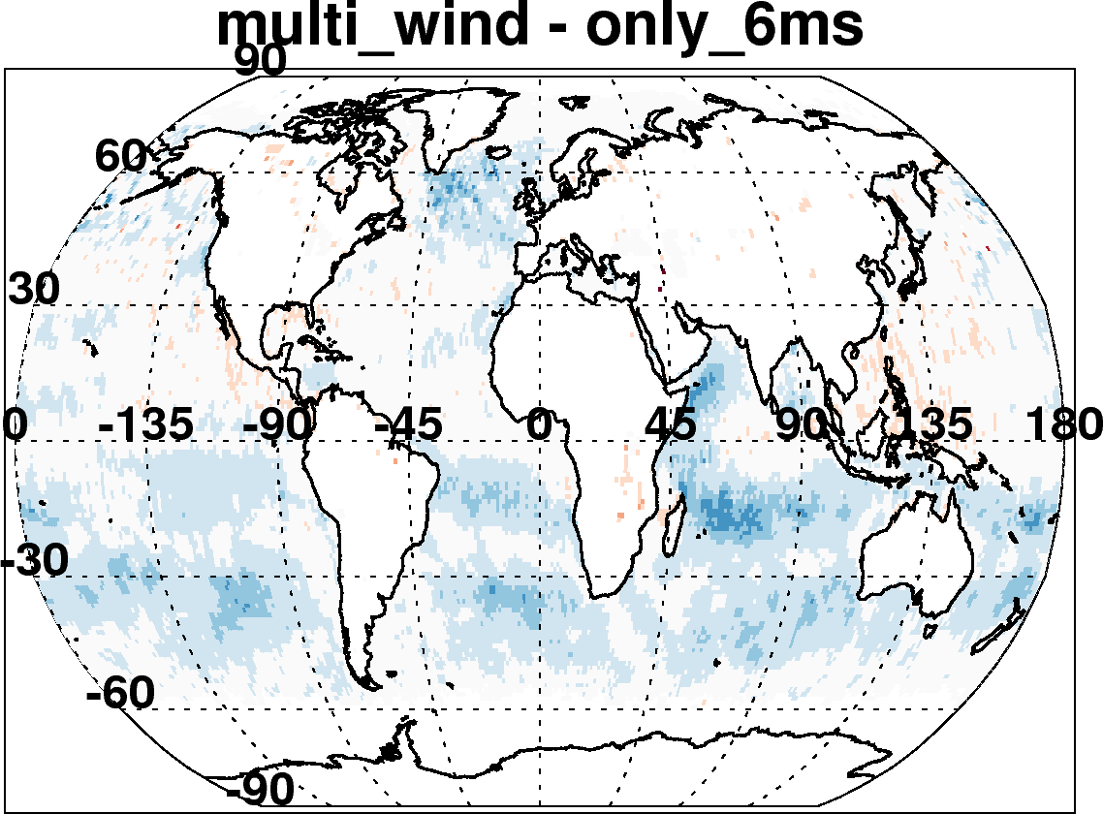

C6-C5 ocean: Due to many incremental changes
(Aqua, July 2008)
New reflectance, geo-location inputs, Wisconsin cloud mask
Updated radiative transfer
Re-define land and sea
Account for wind speed impact on surface
Improved cloud mask
Also changed “Quality Assurance” Filtering
Changed aerosol definitions of land and sea
Etc

Slide 10
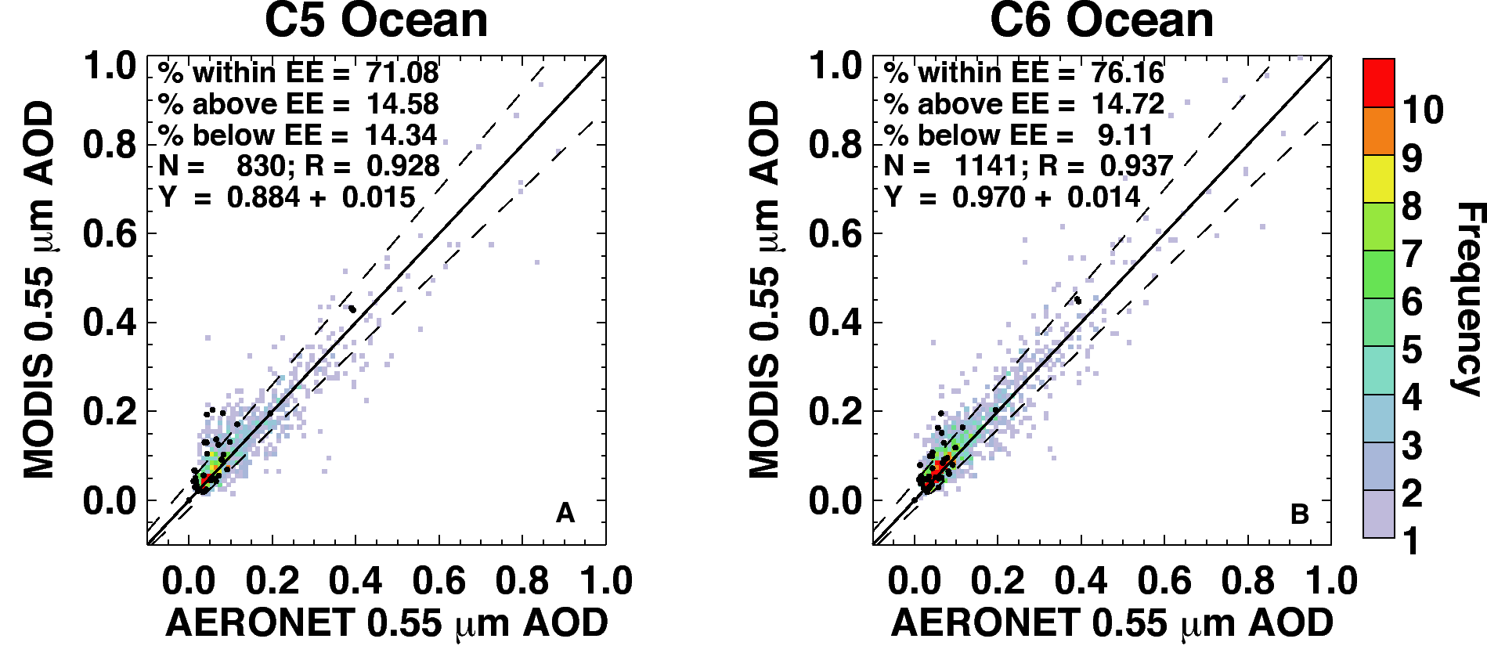
Comparison with AERONET and MAN
Aqua for 8 months (Jan + July, 2003, 2008 and 2010; Apr + Oct 2008).
Overall, not much change over ocean (slope, intercept, correlation)
But 30% more valid points to compare with (1141 versus 830).
AERONET are gray and colored, MAN are black dots

Slide 11
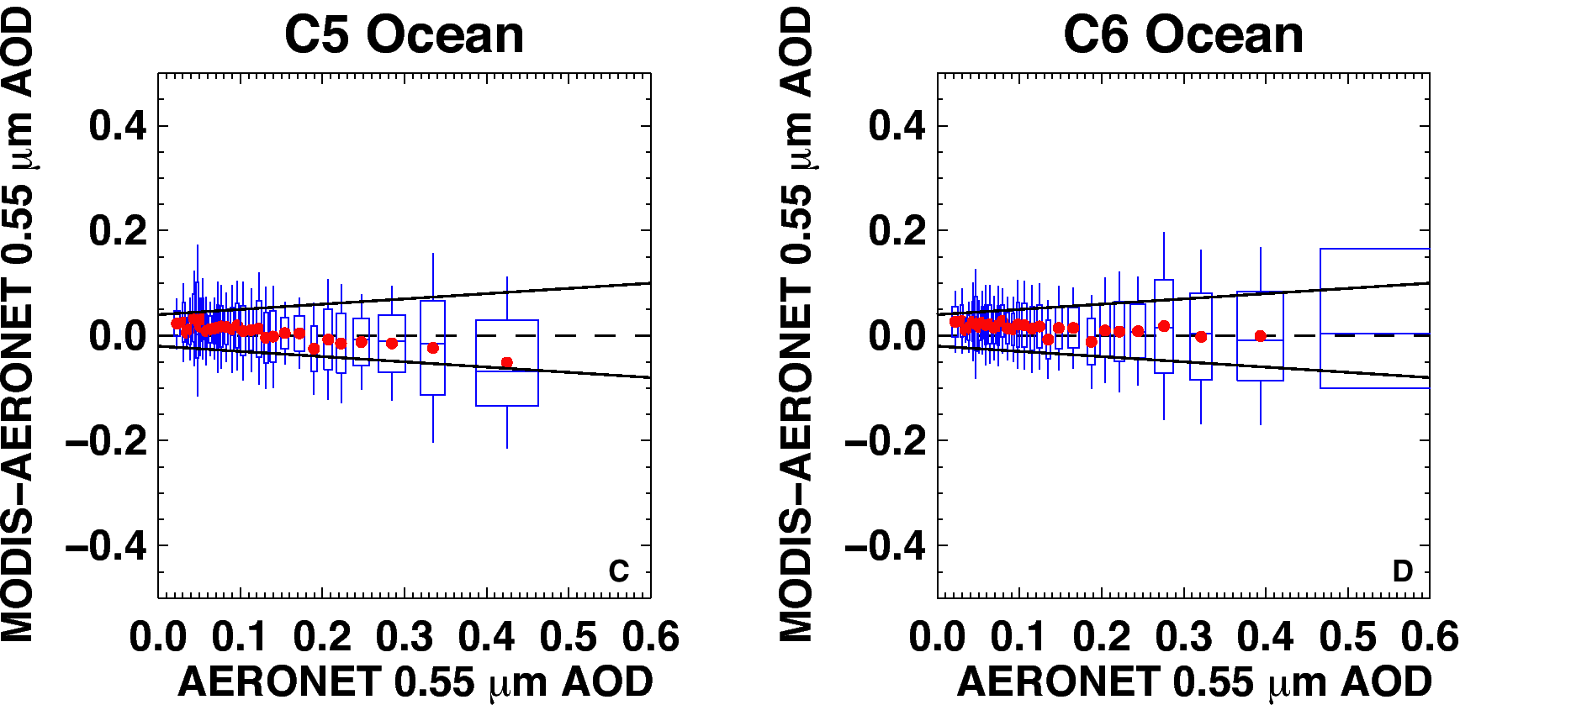
Better way to see MODIS improvement
MODIS error (MODIS–AERONET) versus AERONET; zero “error” is dashed line
Boxes represent middle 67% of each dataset, whiskers are middle 95% of MODIS-AERONET
Solid lines are “expected error” (EE) envelope; note asymmetry (new definition for C6).
Note that in C6, that the MODIS error is within EE for nearly all bins of AOD
C5 EE = ±(0.03 + 5%). C6 EE = (-0.02 – 10%), (+0.04 + 10%) )
Less overall “bias” in C6.
See updates (10 years of Aqua) on L. Munchak’s poster!

Slide 12
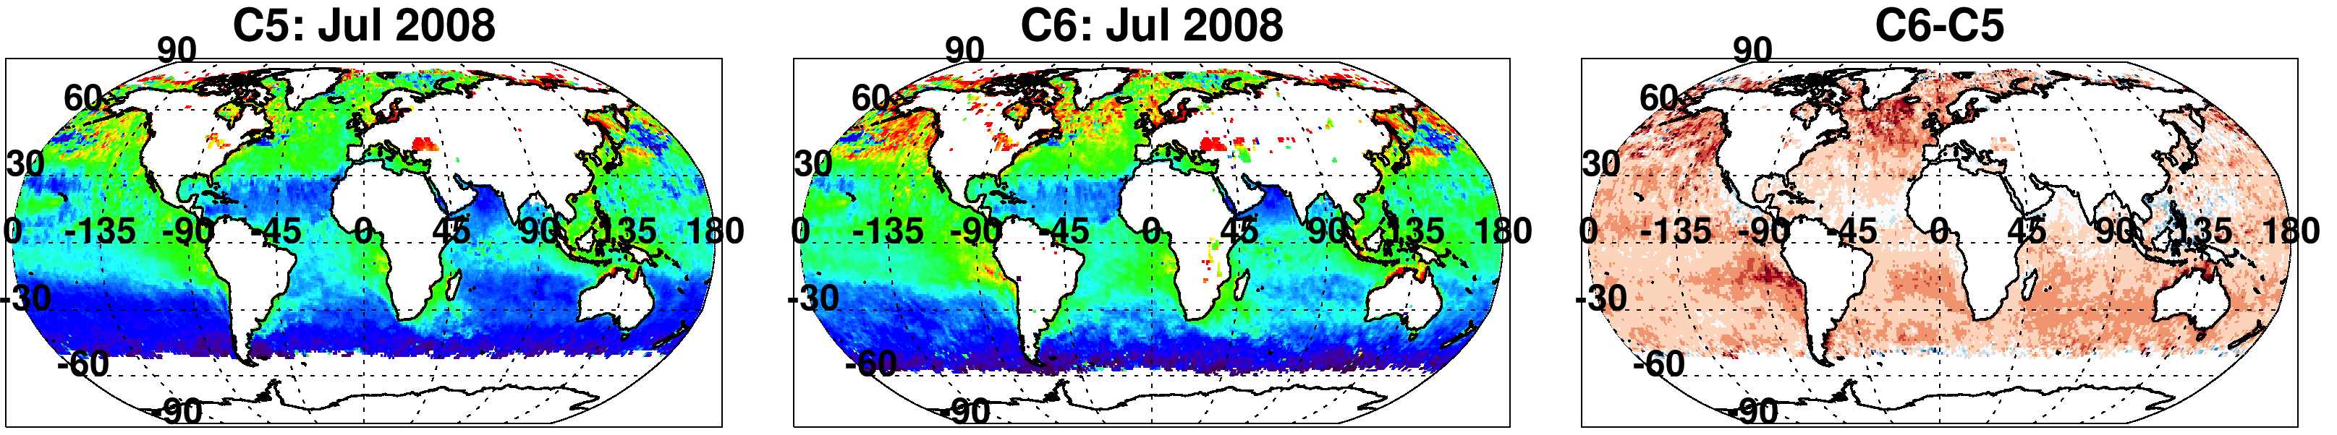
Impact on Ångström Exponent
-0.2 0.0 0.5 1.0 1.5 1.8
-0.6 -0.3 0.0 0.3 0.6
AE calculated from 0.55 vs 0.86 μm
Comparison is for Aqua
Overall increase of global AE (+0.18).

Slide 13
Reasonable validation of AE within ±0.4
MODIS “range” is less than AERONET
See L. Munchak’s poster!

Slide 14
Aerosol over land

Slide 15
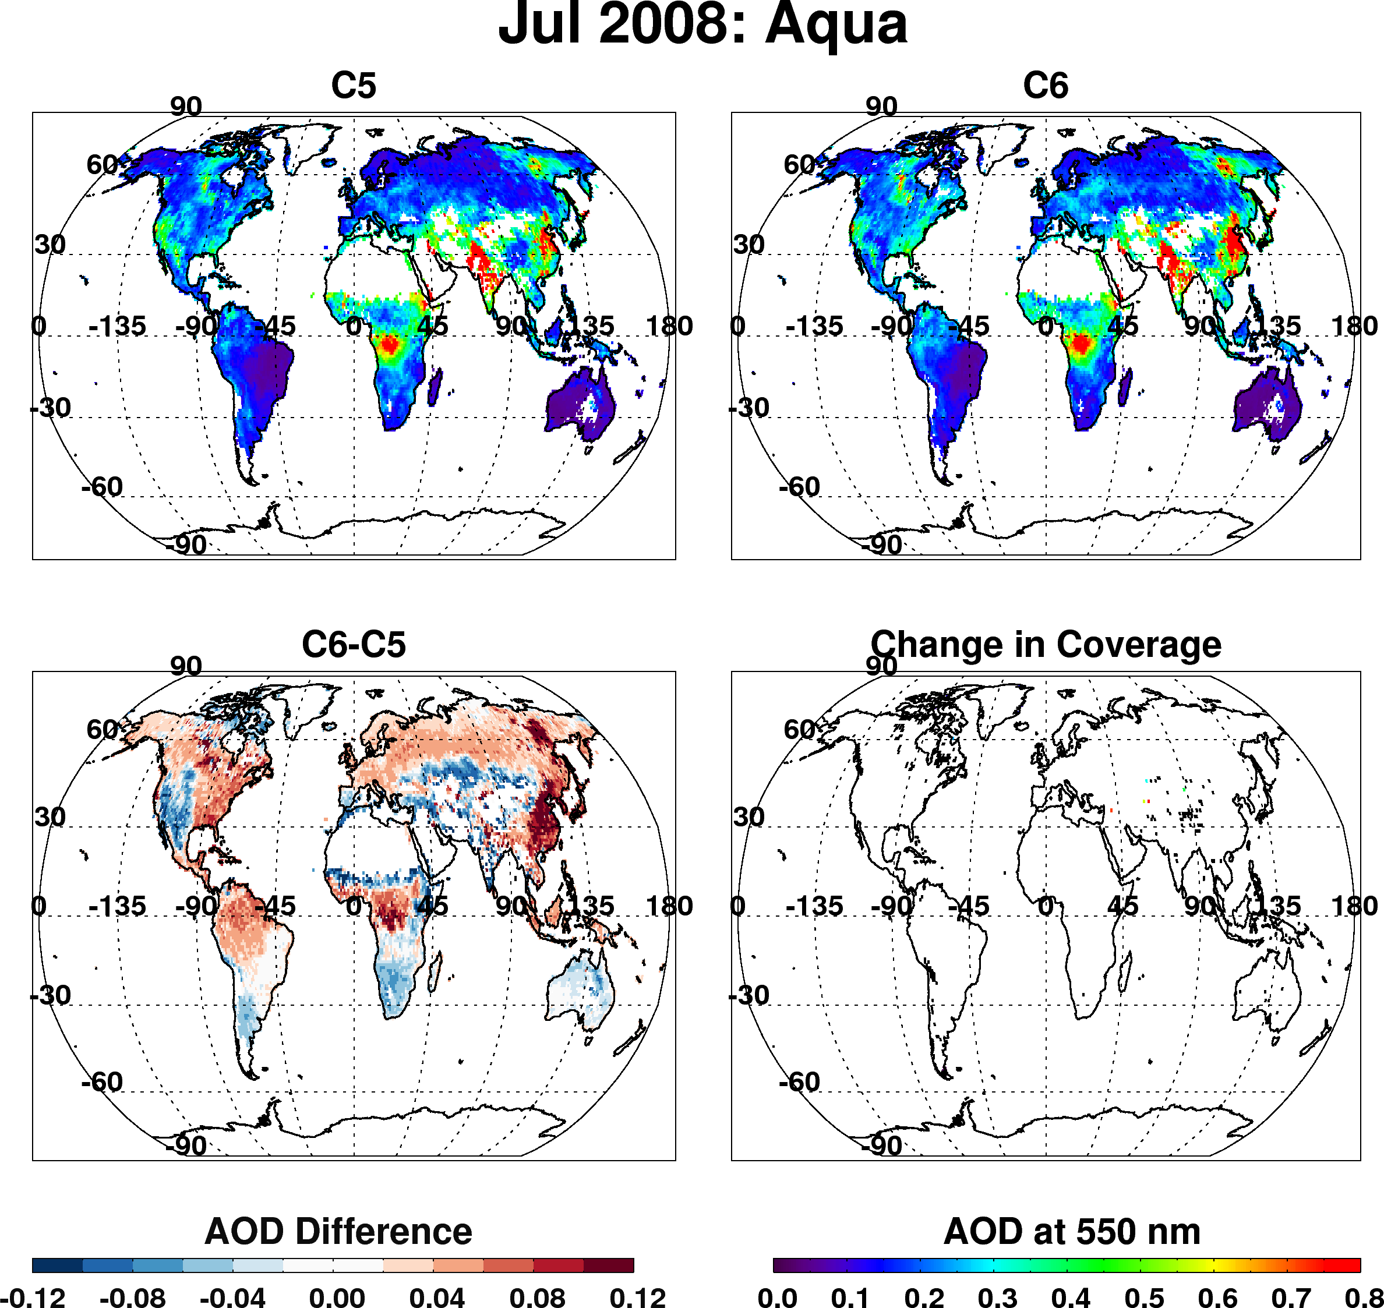
Dark target over land
Overall changes to products (Aqua, Jul 2008)
Overall decrease of AOD in semi-arid
Overall increase over vegetation
Strong increase over Eastern Asia
Slight change in coverage here and there

Slide 16
Why the changes?

Slide 17
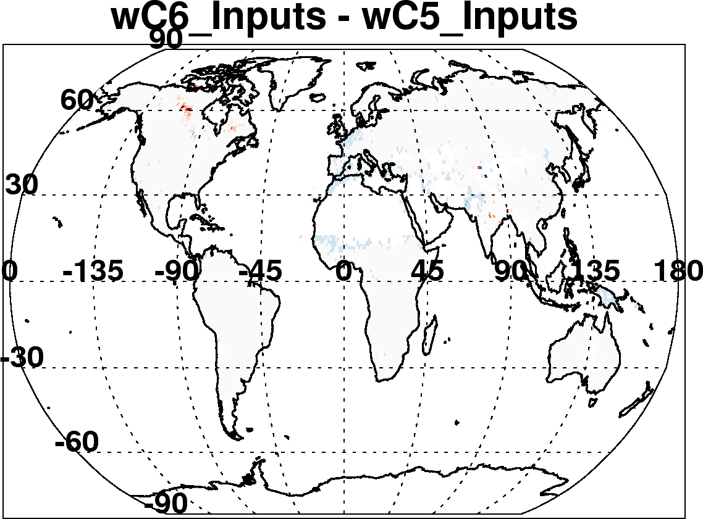
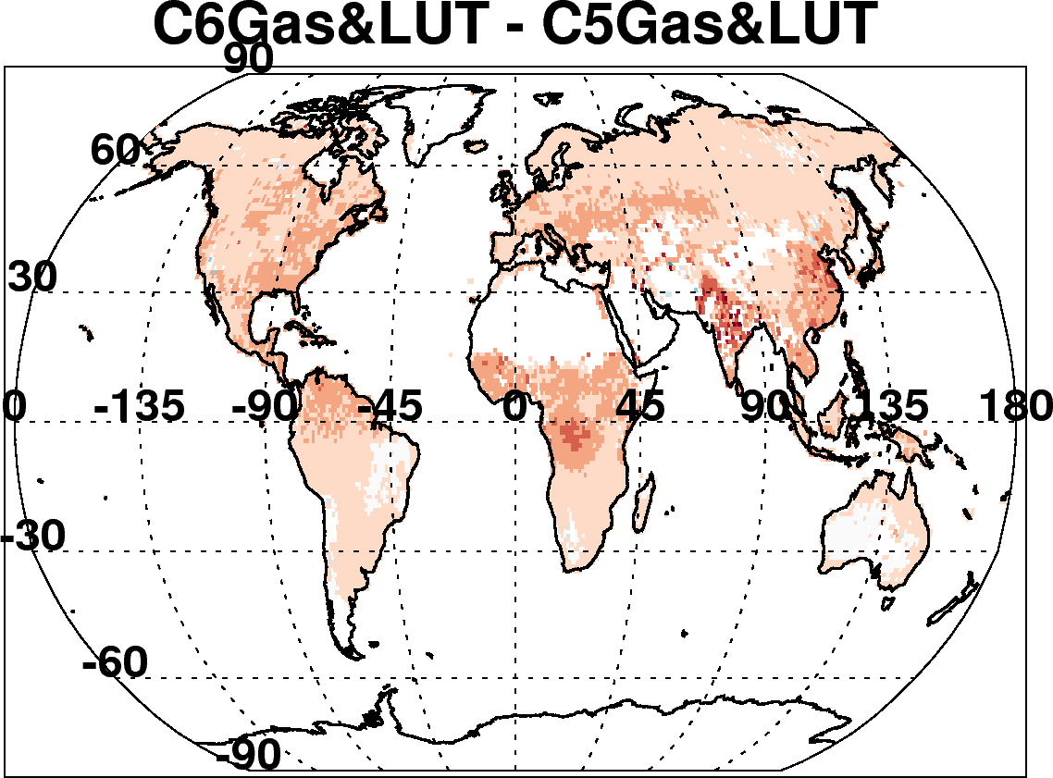
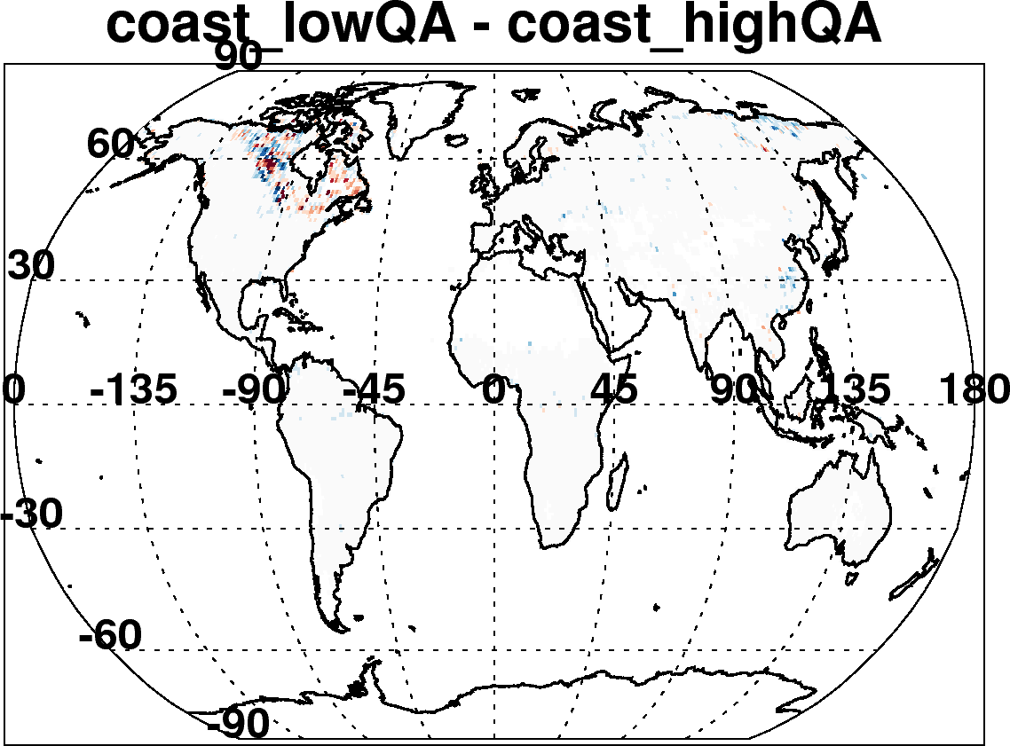
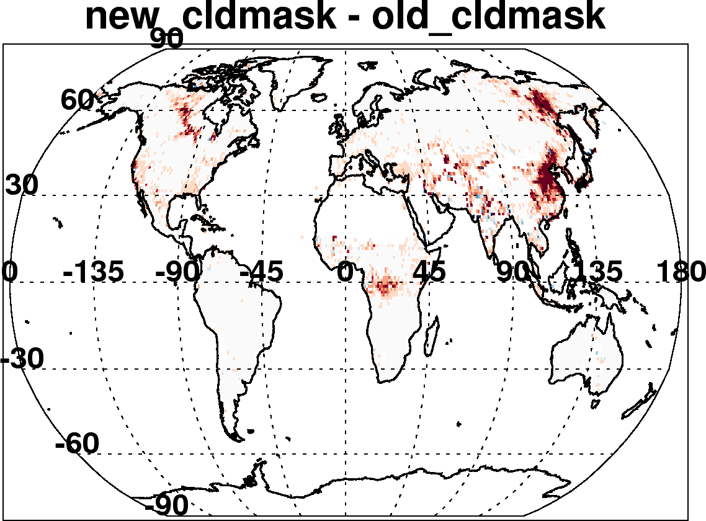
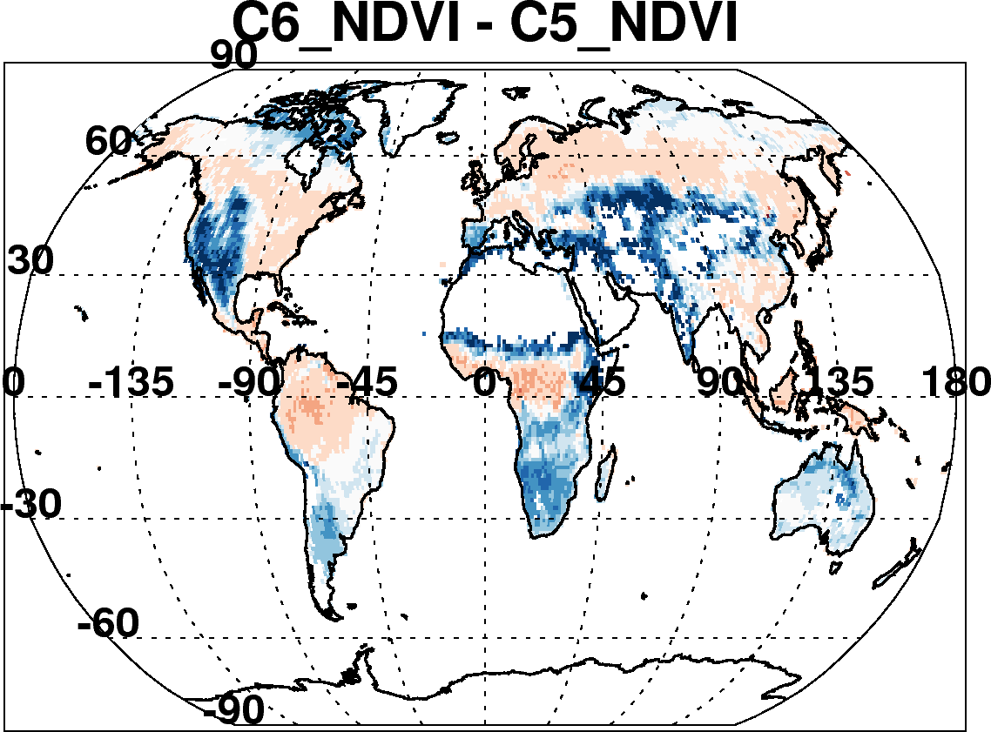
C6-C5 land: Due to many incremental changes
(Aqua, July 2008)
New reflectance and geo-location inputs
Updated radiative transfer
Re-define land and sea
Improved cloud mask to detect smoke
Fixed surface reflectance dependence on TOA NDVI
Also changed “Quality Assurance” Filtering
Changed aerosol definitions of land and sea
Etc
This was a major bug!

Slide 18
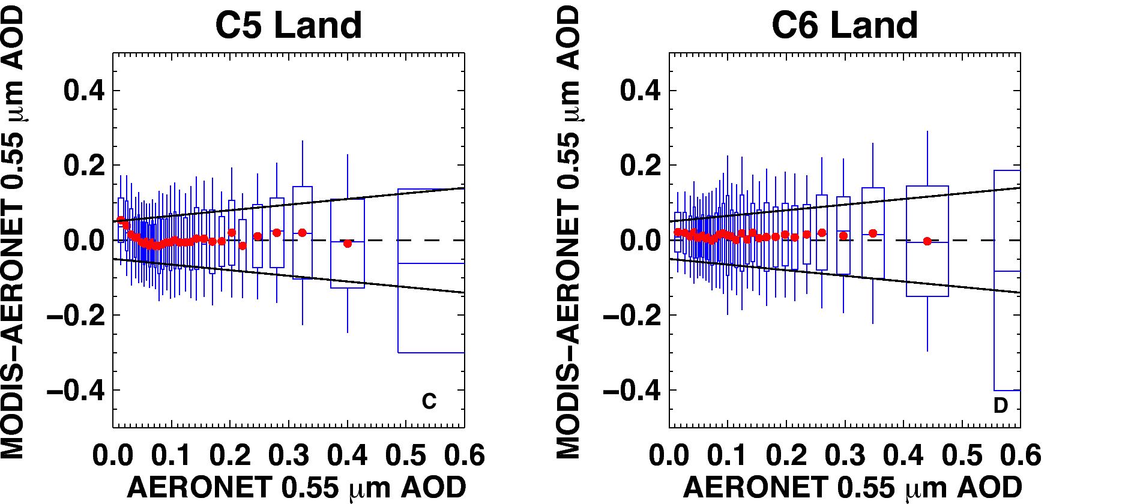
Preliminary comparison with AERONET
(8 months of Aqua data)
MODIS error (MODIS–AERONET) versus AERONET; zero “error” is dashed line
Boxes are middle 67% of dataset, whiskers are middle 95% of MODIS-AERONET
Solid lines are “expected error” (EE) envelope; no asymmetry
C6 MODIS error is within EE for nearly all bins of AOD (even at low values)
C5 EE = ±(0.05 + 15%)). Keep definition for C6.
See updates (10 years of Aqua) on L. Munchak’s poster!

Slide 19
Terra versus Aqua

Slide 20
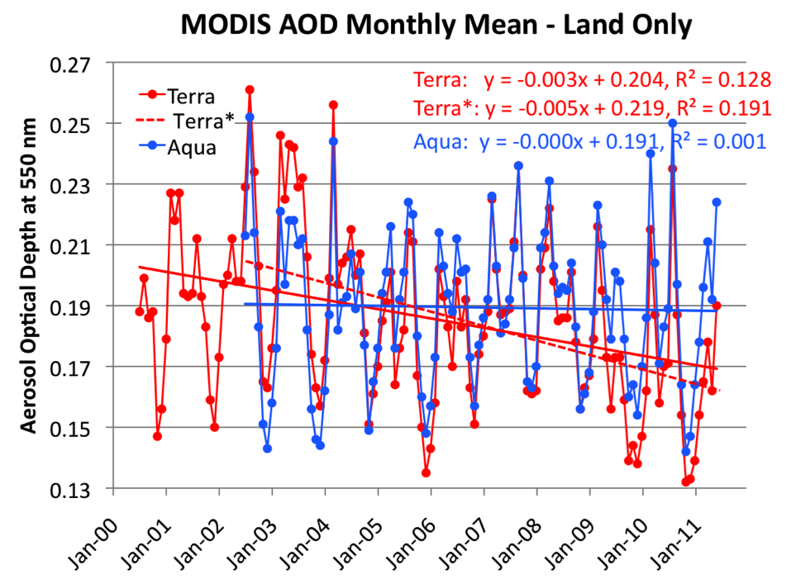
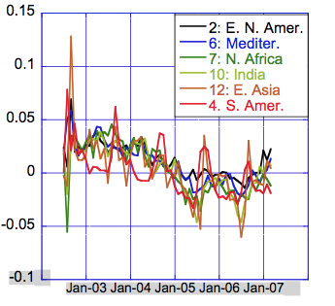
If we had used Collection 5
Over land, Terra decreases (-0.04/decade), Aqua constant
Terra / Aqua divergence is the same everywhere on the globe!
In NH, observations are 1.5 hours apart, while SH are 4.5 hours
So, probably not due to diurnal cycle of aerosol

Slide 21

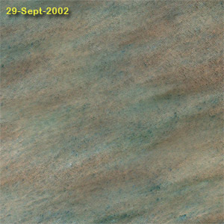
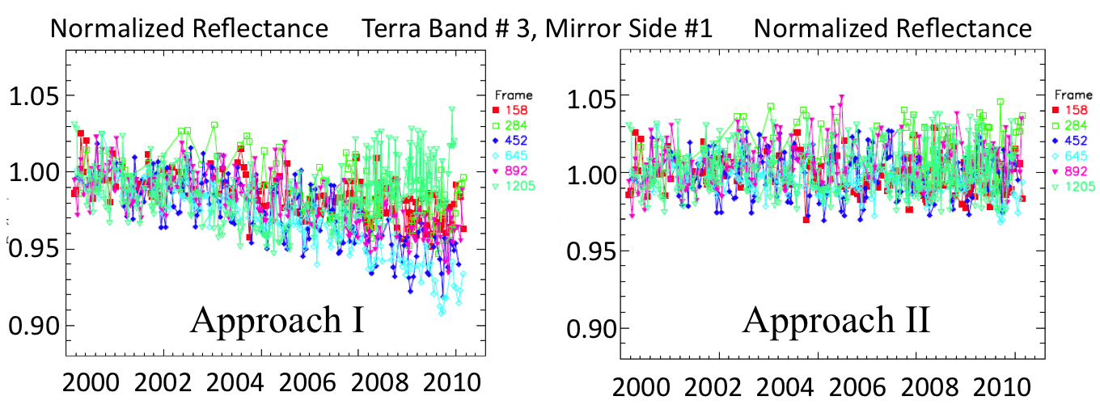
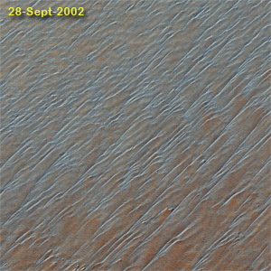
Why? MODIS reflectance over desert sites: C5
Collect clear-sky MODIS data over desert sites
Develop site-specific BRDF from first 3 years of mission
Over time, compare “observed” reflectance with BRDF modeled reflectance, for different view angles
Characterize and de-trend MODIS observations
Create a new L1B dataset for C6.
Observed Reflectance / BRDF Modeled
desert test sites
C5 reflectance
C6 reflectance
MCST (Sun, Xiong et al)
Notes:
21

Slide 22
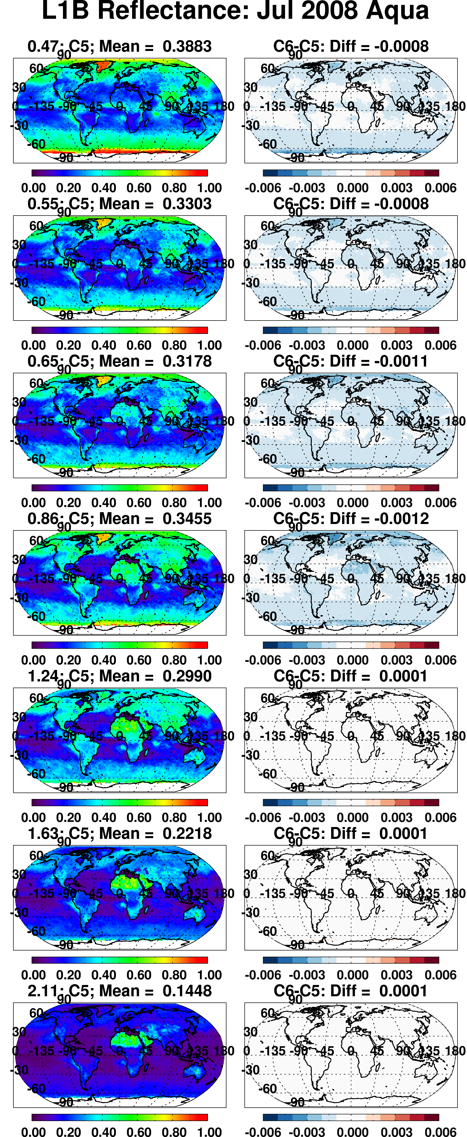
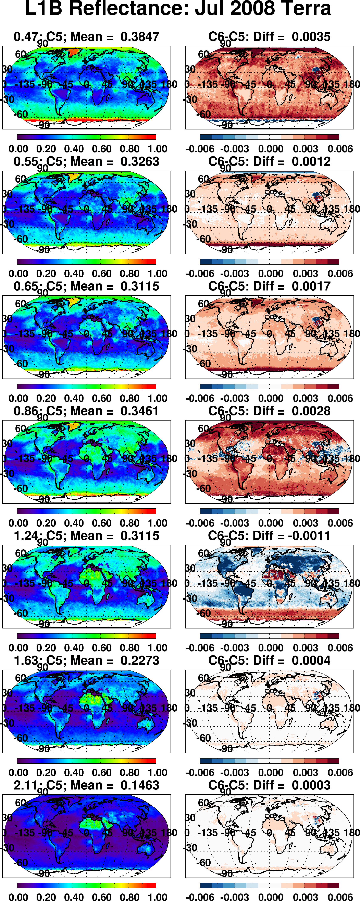


Impact to “observed” reflectance
“Global” Aqua changes in visible bands by -0.001 or less
“Global” Terra changes in visible bands by +0.002 or more
Overall Aqua changes are relatively stable, but Terra’s changes vary over time.
reflectance
Difference reflectance

Slide 23
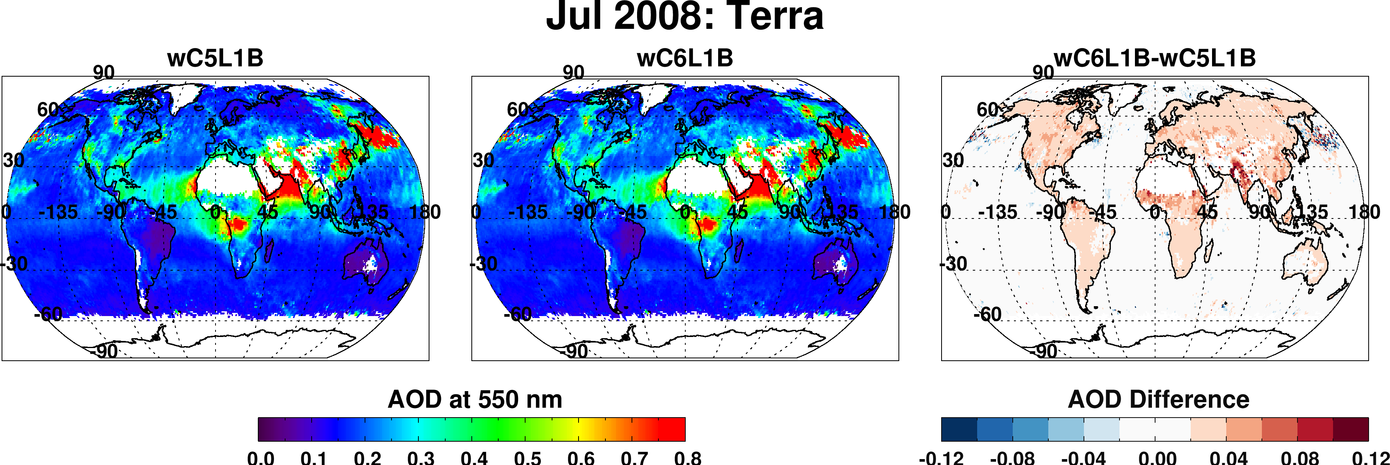
Impact of New Terra calibration
Big changes to blue and red bands
Biggest impacts over land
  Global increase by 0.02 (for this particular month). 10% of global mean!
Smaller impacts over ocean
  Global increase by 0.004 (for this particular month)

Slide 24
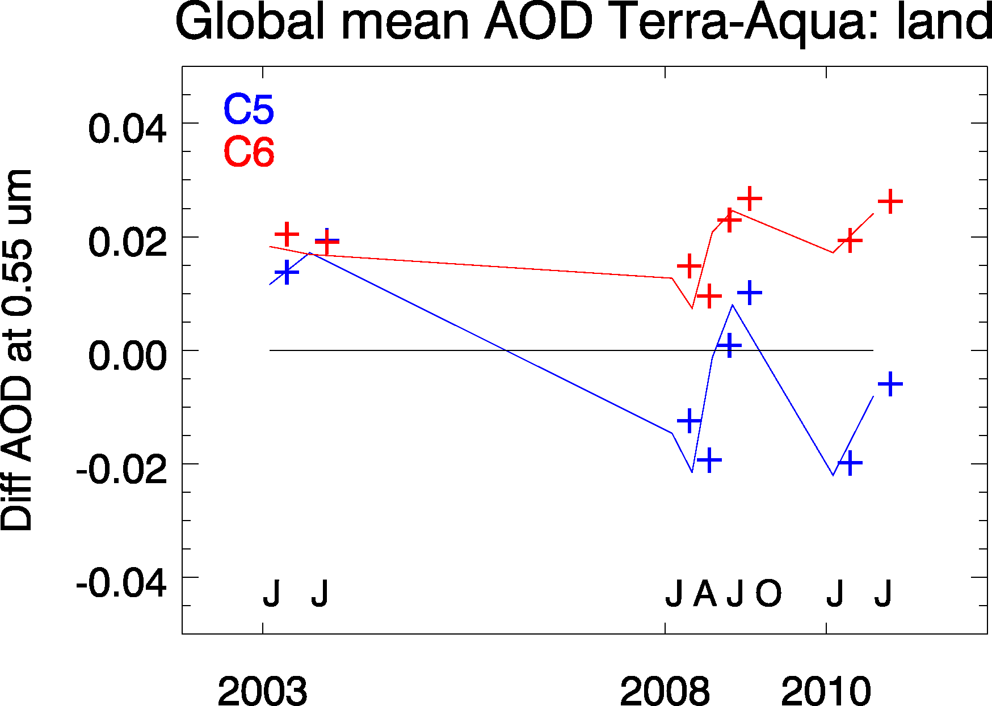
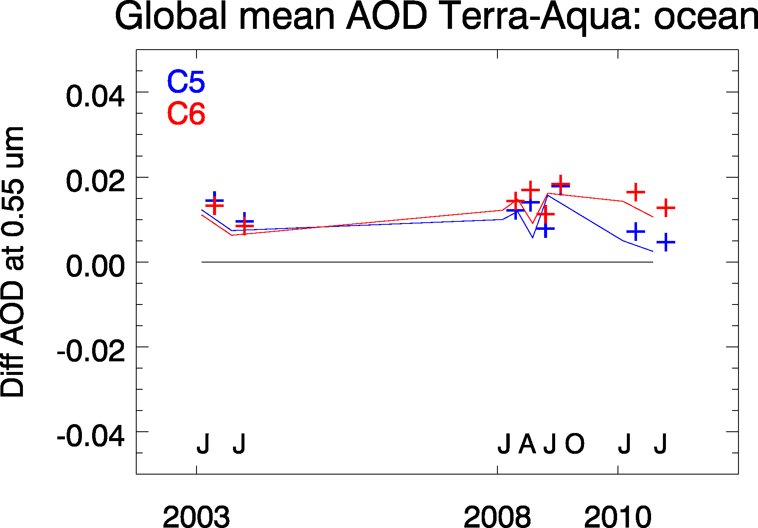
Impact of new calibration on trend of Terra-Aqua AOD
8 months processed with same dark-target aerosol algorithms
Terra now more “in sync” with Aqua time series
New calibration → Terra/Aqua divergence removed for C6!
(Terra-Aqua) offset remains 0.02 (land) and 0.015 (ocean)

Slide 25
What else for C6 Level 2?
Diagnostic SDSs (wind speed, integer QAC, topographic elevation, etc)
“Cloud mask”, “distance to nearest cloud”
Changes to SDS names

Slide 26
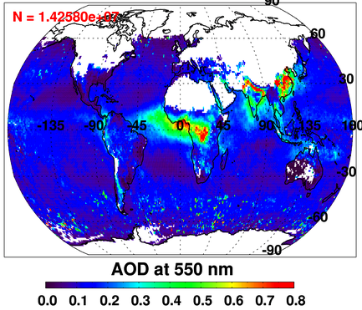
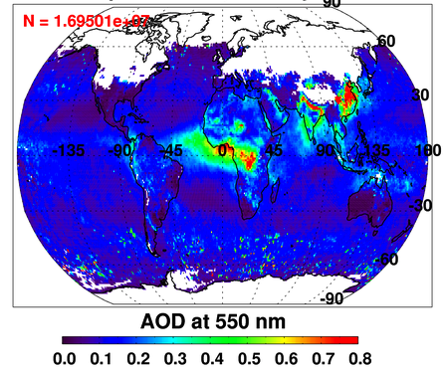
Deep Blue/Dark Target Merge:
Dark Target AOD
DeepDark AOD
Merging deep blue & dark target produces best global coverage
Deep blue is land-only; need dark target for oceans
Deep blue introduces coverage over Australian outback, Sahara desert
  and Arabian peninsula
Still no coverage over snow (see: most of Northern Hemisphere).
LOOKS REASONABLE, BUT NOT VALIDATED YET!!!!

Slide 27
Beyond MxD04_L2

Slide 28
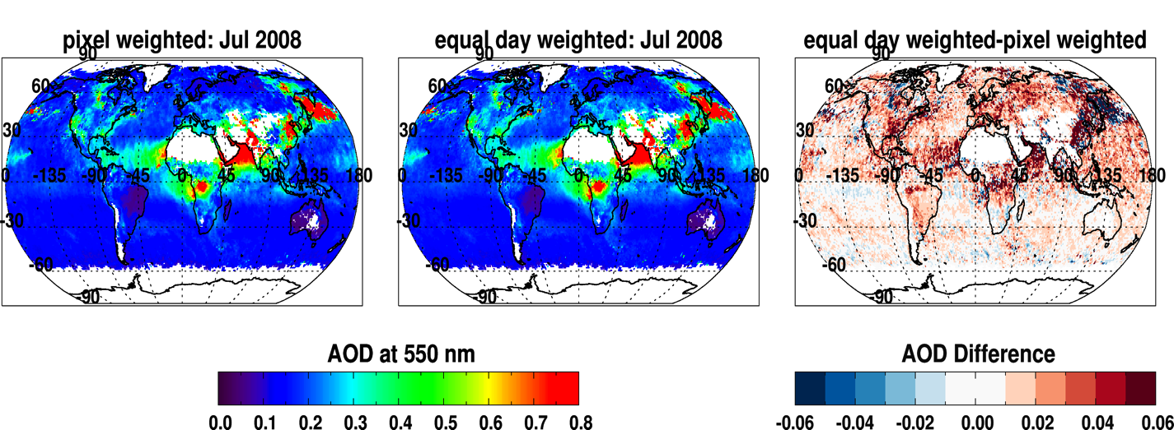
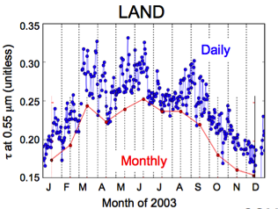
Changes to Level 3 (MxD08_M3)
C5
C6
C6-C5
In C5, averaging daily data did not look like monthly data (left, from Giovanni web application)
C5 monthly was “pixel weighted”. A day with 100 retrieved pixels was worth 10 times more than one with 10. It was clear-sky biased.
C6 monthly is “equal day” weighted. If at least five pixels in a day, than that day counts.
→ Increases monthly mean AOD over land, and ocean. Less clear sky biased?
C5

Slide 29
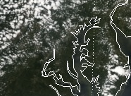
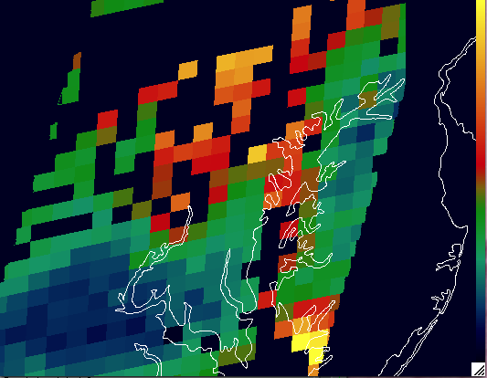
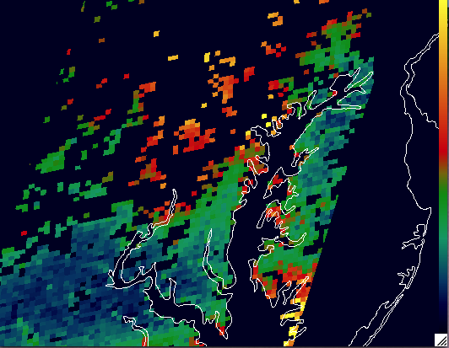
MxD04_3K (a new 3 km aerosol product)
Driven by air quality community,
Maybe also some applications to aerosol/clouds.
Currently Dark target only
Aqua: Day 209 2010
10 km
3 km
Munchak, L., R.C. Levy, S. Mattoo, L.A. Remer, B.N. Holben, J.S. Schafer, C.A. Hostetler, and R.A. Ferrare (2013). MODIS 3km Aerosol Product: applications over land in an urban/suburban region Atmos. Meas. Tech, 6, 1747-1759, doi:10.5194/amt-6-1747-2013
Remer, L., S. Mattoo, R.C. Levy, and L. Munchak (2013). MODIS 3km Aerosol Product: Algorithm and Global Perspective Atmos. Meas. Tech, 6, 1829-184, doi:10.5194/amt-6-1829-2013
J. M. Livingston, J. Redemann, et al, (2013). Comparison of MODIS 3-km and 10-km resolution aerosol optical depth retrievals over land with airborne Sunphotometer measurements during ARCTAS summer 2008, Atmos. Chem. Phys. Disc,

Slide 30
MxDATML2 product
From MxD06 (clouds) 5 km:
Latitude
Longitude
Cloud_Optical_Thickness
Cloud_Optical_Thickness_Uncertainty
Cloud_Optical_Thickness_PCL
Cloud_Optical_Thickness_16
Cloud_Optical_Thickness_16_PCL
Cloud_Optical_Thickness_37
Cloud_Optical_Thickness_37_PCL
Cloud_Optical_Thickness_Uncertainty_16
Cloud_Optical_Thickness_Uncertainty_37
Cloud_Effective_Radius
Cloud_Effective_Radius_Uncertainty
Cloud_Effective_Radius_PCL
Cloud_Effective_Radius_16
Cloud_Effective_Radius_16_PCL
Cloud_Effective_Radius_37
Cloud_Effective_Radius_37_PCL
Cloud_Effective_Radius_Uncertainty_16
Cloud_Effective_Radius_Uncertainty_37
Cloud_Water_Path
Cloud_Water_Path_Uncertainty
Cloud_Water_Path_PCL
Cloud_Water_Path_16
Cloud_Water_Path_16_PCL
Cloud_Water_Path_37
Cloud_Water_Path_37_PCL
Cloud_Water_Path_Uncertainty_16
Cloud_Water_Path_Uncertainty_37
Cloud_Optical_Thickness_1621
Cloud_Optical_Thickness_Uncertainty_1621
Cloud_Effective_Radius_1621
Cloud_Effective_Radius_Uncertainty_1621
Cloud_Water_Path_1621
Cloud_Water_Path_Uncertainty_1621
Cloud_Phase_Optical_Properties
Cloud_Quality_Assurance
Cirrus_Reflectance
Cloud_Top_Pressure
Cloud_Top_Temperature
Cloud_Top_Height
Cloud_Height_Method
Cloud_Top_Pressure_1km
Cloud_Top_Temperature_1km
Cloud_Top_Height_1km
Surface_Temperature_1km
OS_Top_Flag_1km
Infrared_obs_minus_calc
Cloud_Mask_SPI
Cloud_Multi_Layer_Flag
Cloud_Fraction
Cloud_Phase_Infrared
Cloud_Phase_Infrared_1km
From MxD04 (aerosol) 10 km:
Latitude_10km
Longitude_10km
Solar_Zenith_10km
Viewing_Zenith_10km
Relative_Azimuth_10km
Aerosol_Optical_Depth
Aerosol_Angstrom_Exponent_Ocean
Aerosol_Land_Sea_Flag
Aerosol_Cloud_Pixel_Distance_Land_Ocean
Aerosol_Cloud_Fraction_Ocean
Aerosol_Cloud_Fraction_Land
Aerosol_Land_Ocean_Quality_Flag
AOD_550_Dark_Target_Deep_Blue_Combined
AOD_550_Dark_Target_Deep_Blue_Combined_QA_Flag
AOD_550_Dark_Target_Deep_Blue_Combined_Algorithm_Flag
Deep_Blue_Aerosol_Optical_Depth_550_Land
Deep_Blue_Angstrom_Exponent_Land
Deep_Blue_Single_Scattering_Albedo_412_Land
Deep_Blue_Aerosol_Optical_Depth_550_Land_Best_Estimate
Deep_Blue_Aerosol_Optical_Depth_550_Land_QA_Flag
Deep_Blue_Aerosol_Optical_Depth_550_Land_Uncertainty
Aerosol_Quality_Assurance_Land
Aerosol_Quality_Assurance_Ocean
Combines the “best of” MxD04_L2 (10 km) aerosol, MxD06_L2 (5 km) cloud products, and other atmosphere prods
For joint analyses of aerosols and clouds (at granule level
From MxD05 (precip water) 10 km:
Precipitable_Water_Infrared_ClearSky Precipitable_Water_Near_Infrared_ClearSky
From MxD35 (Cloud Mask) 5 km:
Cloud_Mask
From MxD07 (Profiles) 5 km:
Total_Ozone
Lifted_Index
K_Index
Total_Totals_Index
Platnick, King, Hubanks,..

Slide 31
Towards collection 7
Accounting for bias over urban areas
Determining per-retrieval uncertainty
Residual calibration/polarization errors

Slide 32
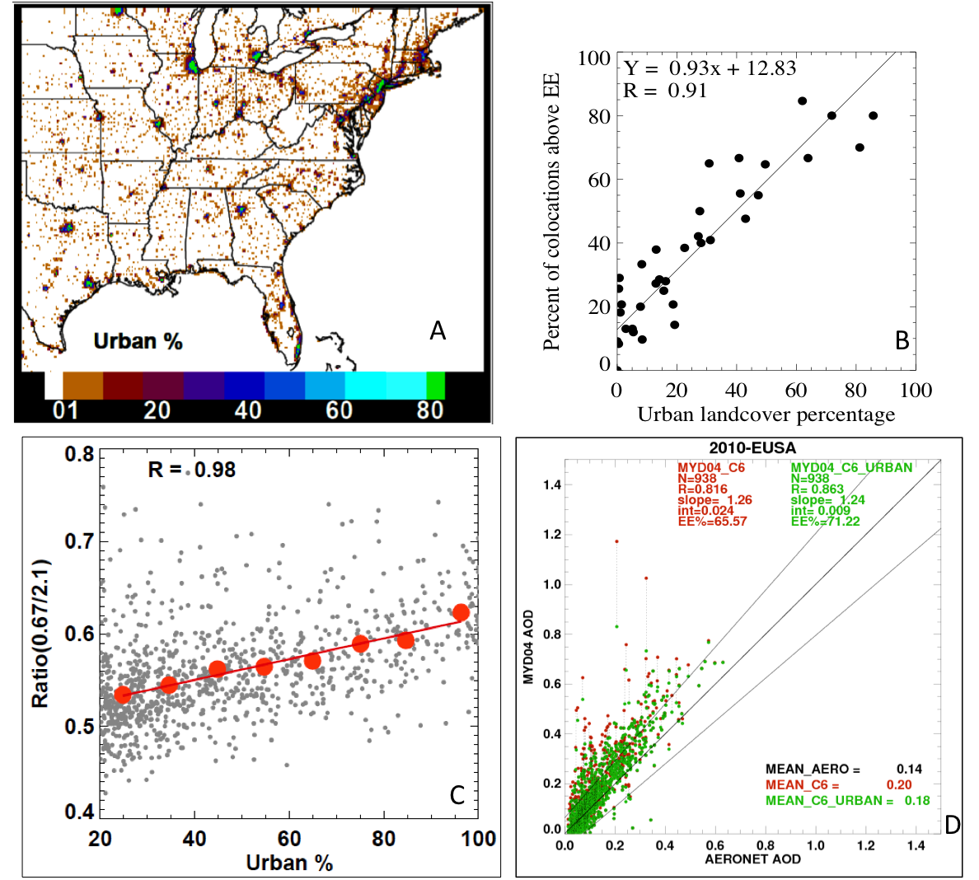
Accounting for Urban bias
More urban --> higher bias
Over MD/DC during DISCOVER-AQ
Looking at possible corrections
Applied to E-USA over 2010
Can we reduce artificial urban hotspots without impacting surrounding rural areas?

Slide 33
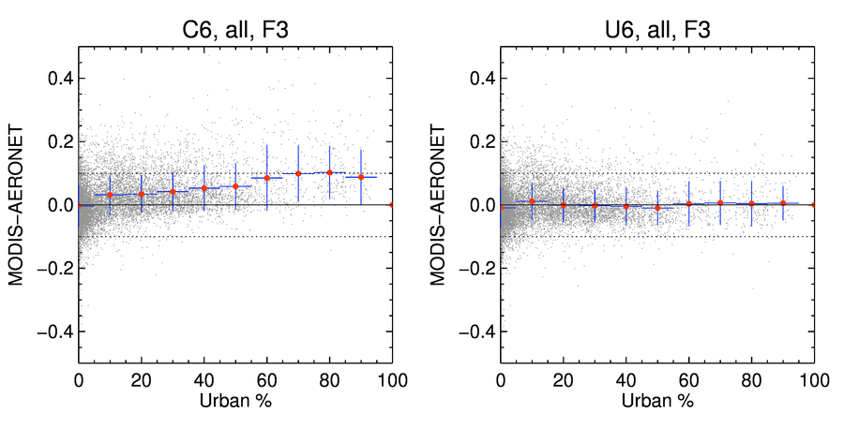
United States: 2002-2010 Aqua
C6 Retrieval
Retrieval using Urban fix
At least over the U.S, we can correct the positive urban bias.
See Pawan Gupta’s poster!

Slide 34
Characterizing uncertainty in Aerosol Optical Depth Retrieval
There are two broad error sources :
1. Measurement / Input Uncertainties
Calibration Uncertainty [1 – 2%]
Standard Deviation of reflectance in 10 x 10 km retrieval box [1 – 2%]
Uncertainty in the Ancillary data used for atmospheric correction [~3.5%]
Cloud contamination [ τ Bias of +0.04 (Terra) and +0.01 (Aqua), Hyer et al.,2011]
Snow contamination
2. Retrieval Assumptions
Surface reflectance
Aerosol models
See Falguni Patadia’s poster!

Slide 35
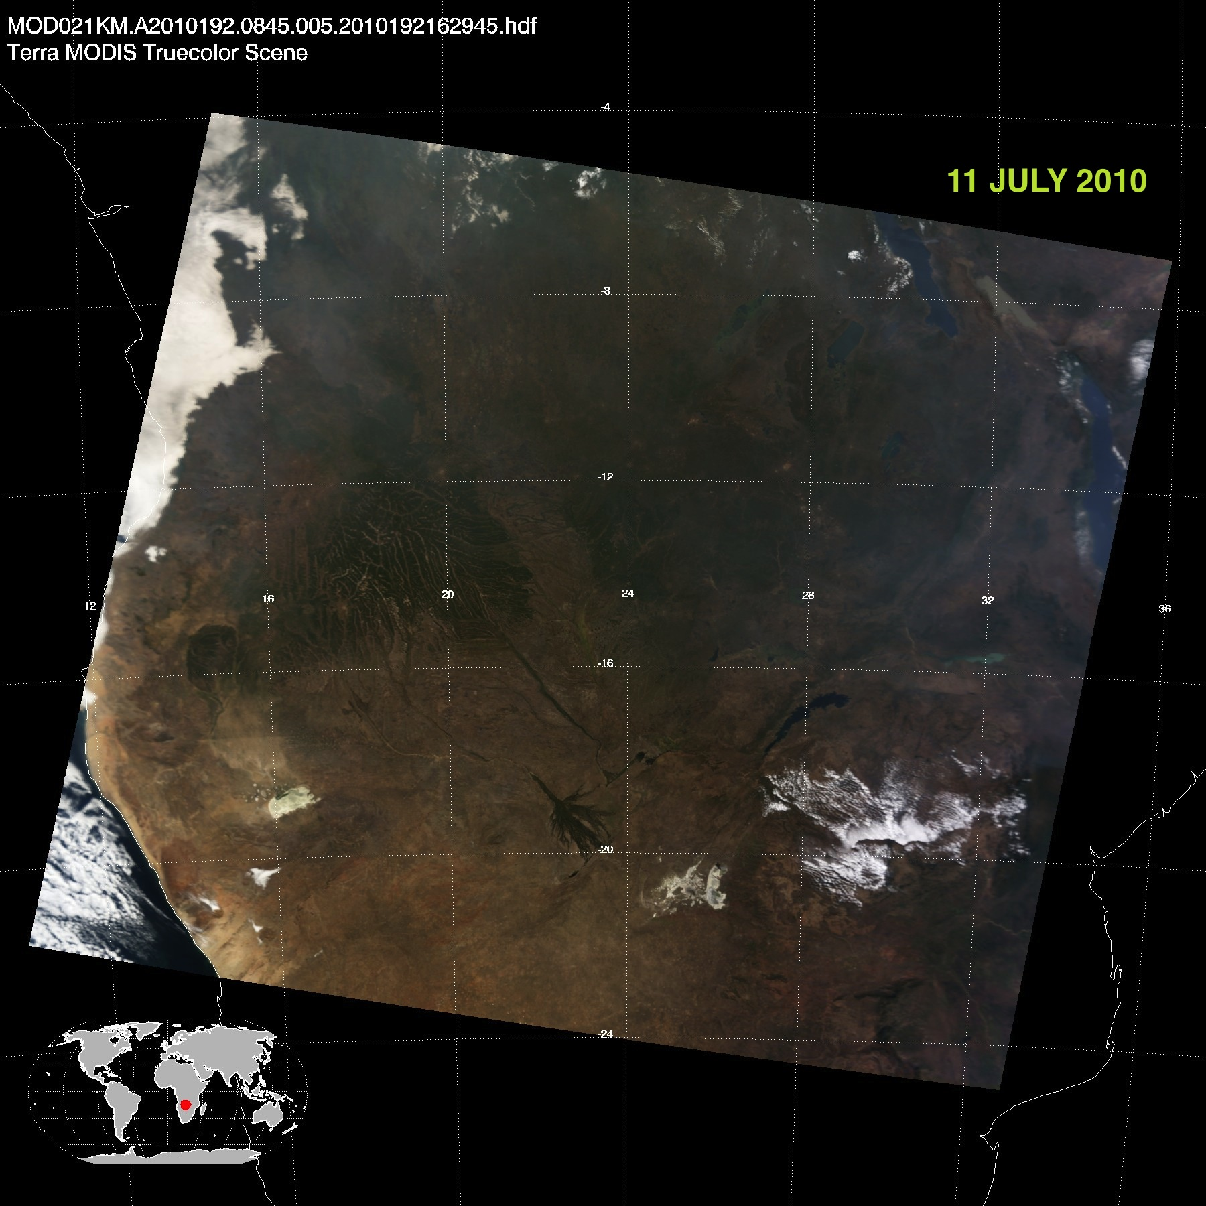
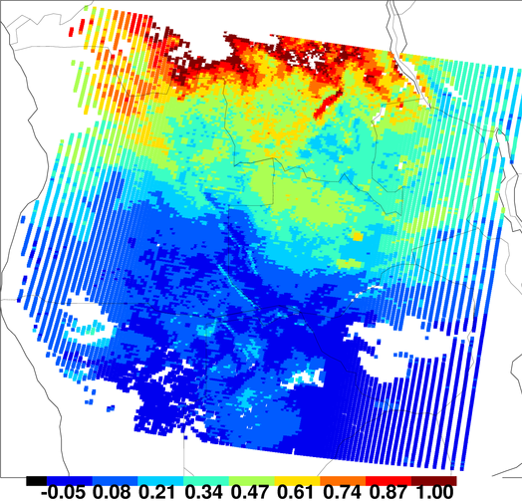
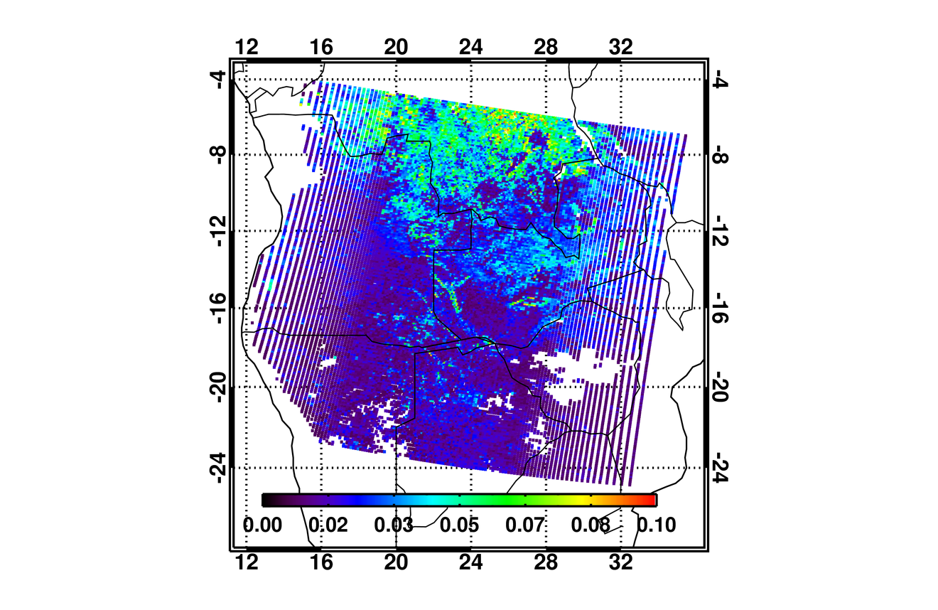
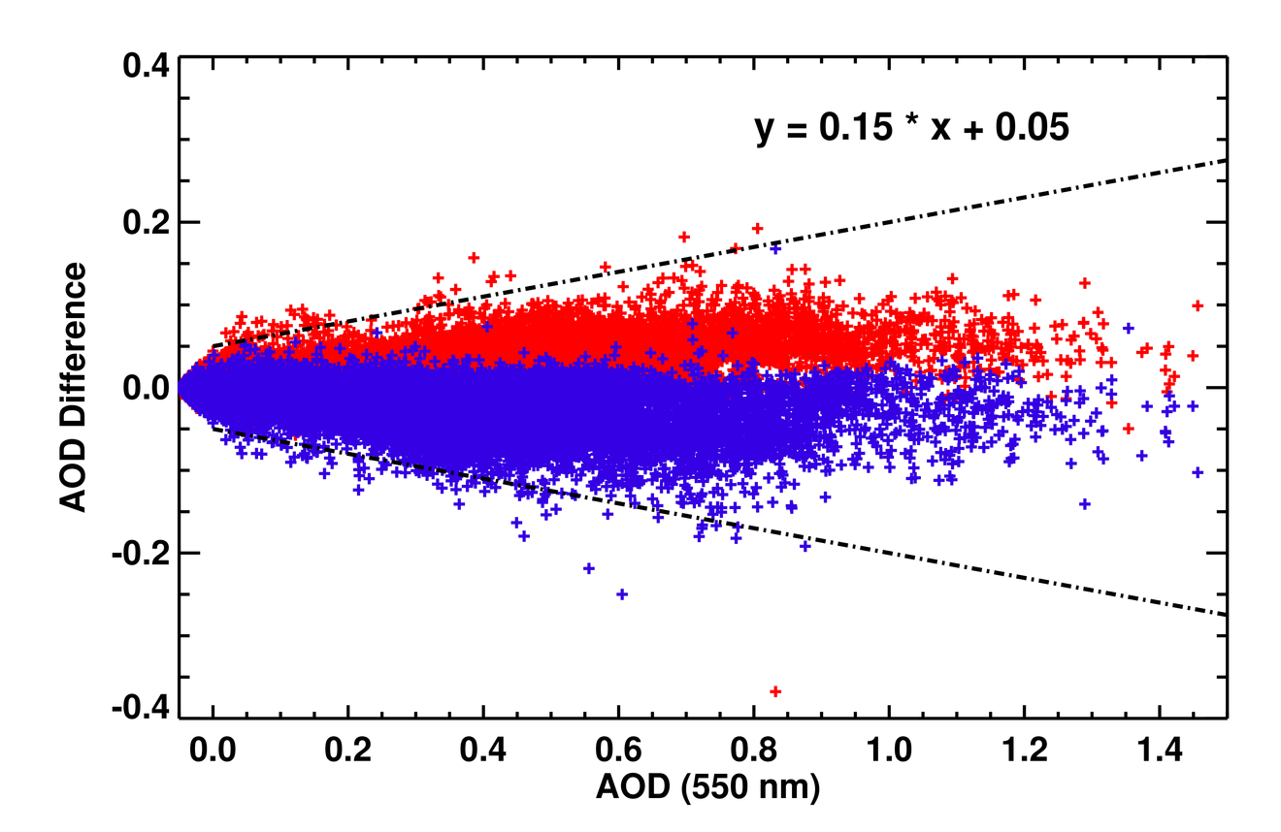
Example : Uncertainty in AOD retrieval from Reflectance Standard Deviation
MODIS L1B RGB Image over Central Africa
MODIS AOD (554 nm)
11 JULY 2010
AOD differences due to standard deviation of reflectance within 10 X 10 km box
Compared to EE envelope
0
1.0
Absolute Error in AOD
Absolute AOD Error Relative to AOD
0
0.1
See Falguni’s poster!

Slide 36
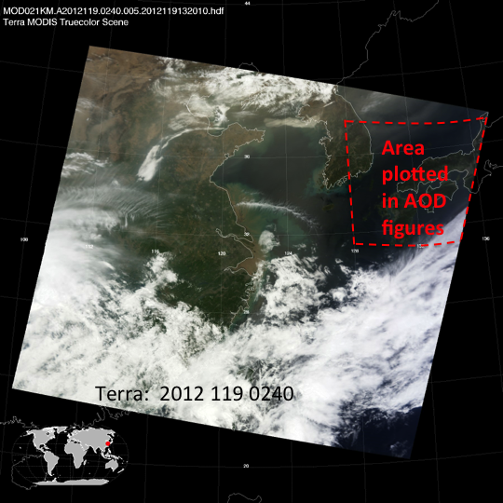
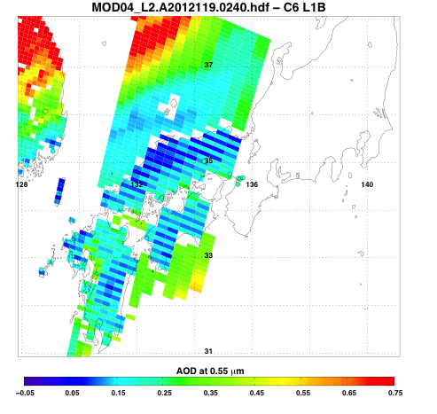
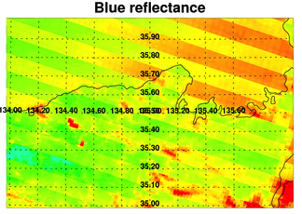
Residual calibration/polarization errors
Image over Japan
0.0 0.2 0.4 0.6 0.8
Hear Alexei Lyapustin’s talk!
Dealing with “striping” of 0.1 AOD in recent (post 2012) Terra data
Seems to be a mirror polarization sensitivity issue.

Slide 37
Dark-target aerosol retrieval:
Beyond MODIS

Slide 38
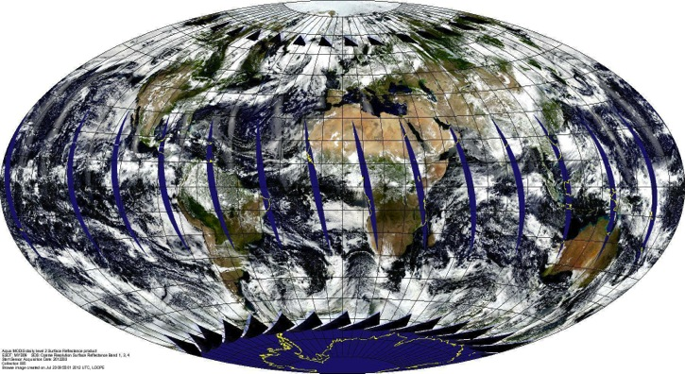
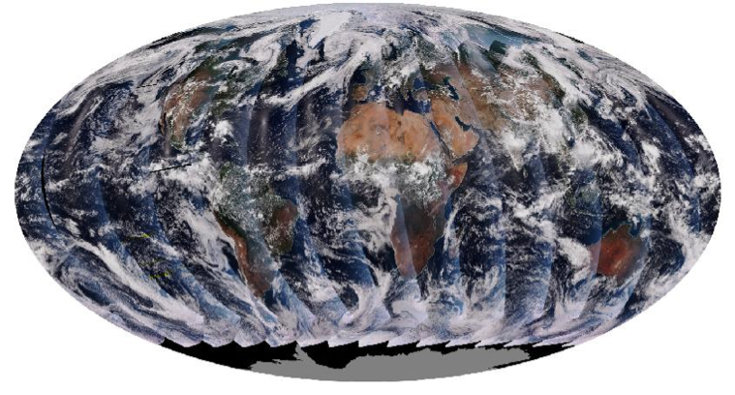
VIIRS versus MODIS
Orbit: 825 km (vs 705 km), sun-synchronous, over same point every 16 days
Equator crossing: 13:30 on Suomi-NPP, since 2012 (versus on Aqua since 2002)
Swath: 3050 km (vs 2030 km)
Spectral Range: 0.412-12.2μm (22 bands versus 36 bands)
Spatial Resolution: 375m (5 bands) 750m (17 bands): versus 250m/500m/1km
Wavelength bands (nm) used for DT aerosol retrieval: 482 (466), 551 (553) 671 (645), 861 (855), 2257 (2113) → differences in Rayleigh optical depth, surface optics, gas absorption.
Aerosol Retrieval: Created and maintained by scientists partnered with NOAA (NASA), with a strategy of maximizing environmental data record - EDR (climate data record – CDR)
ALSO: Different cloud masks, different aggregation techniques, different pixel selections.
Aqua (13:30 Local Time, Ascending)
Suomi-NPP (13:30 Local Time, Ascending);
Different instrument, resolution, sampling, cloud masking, algorithms, etc.
Will VIIRS “continue” the MODIS aerosol data record?

Slide 39
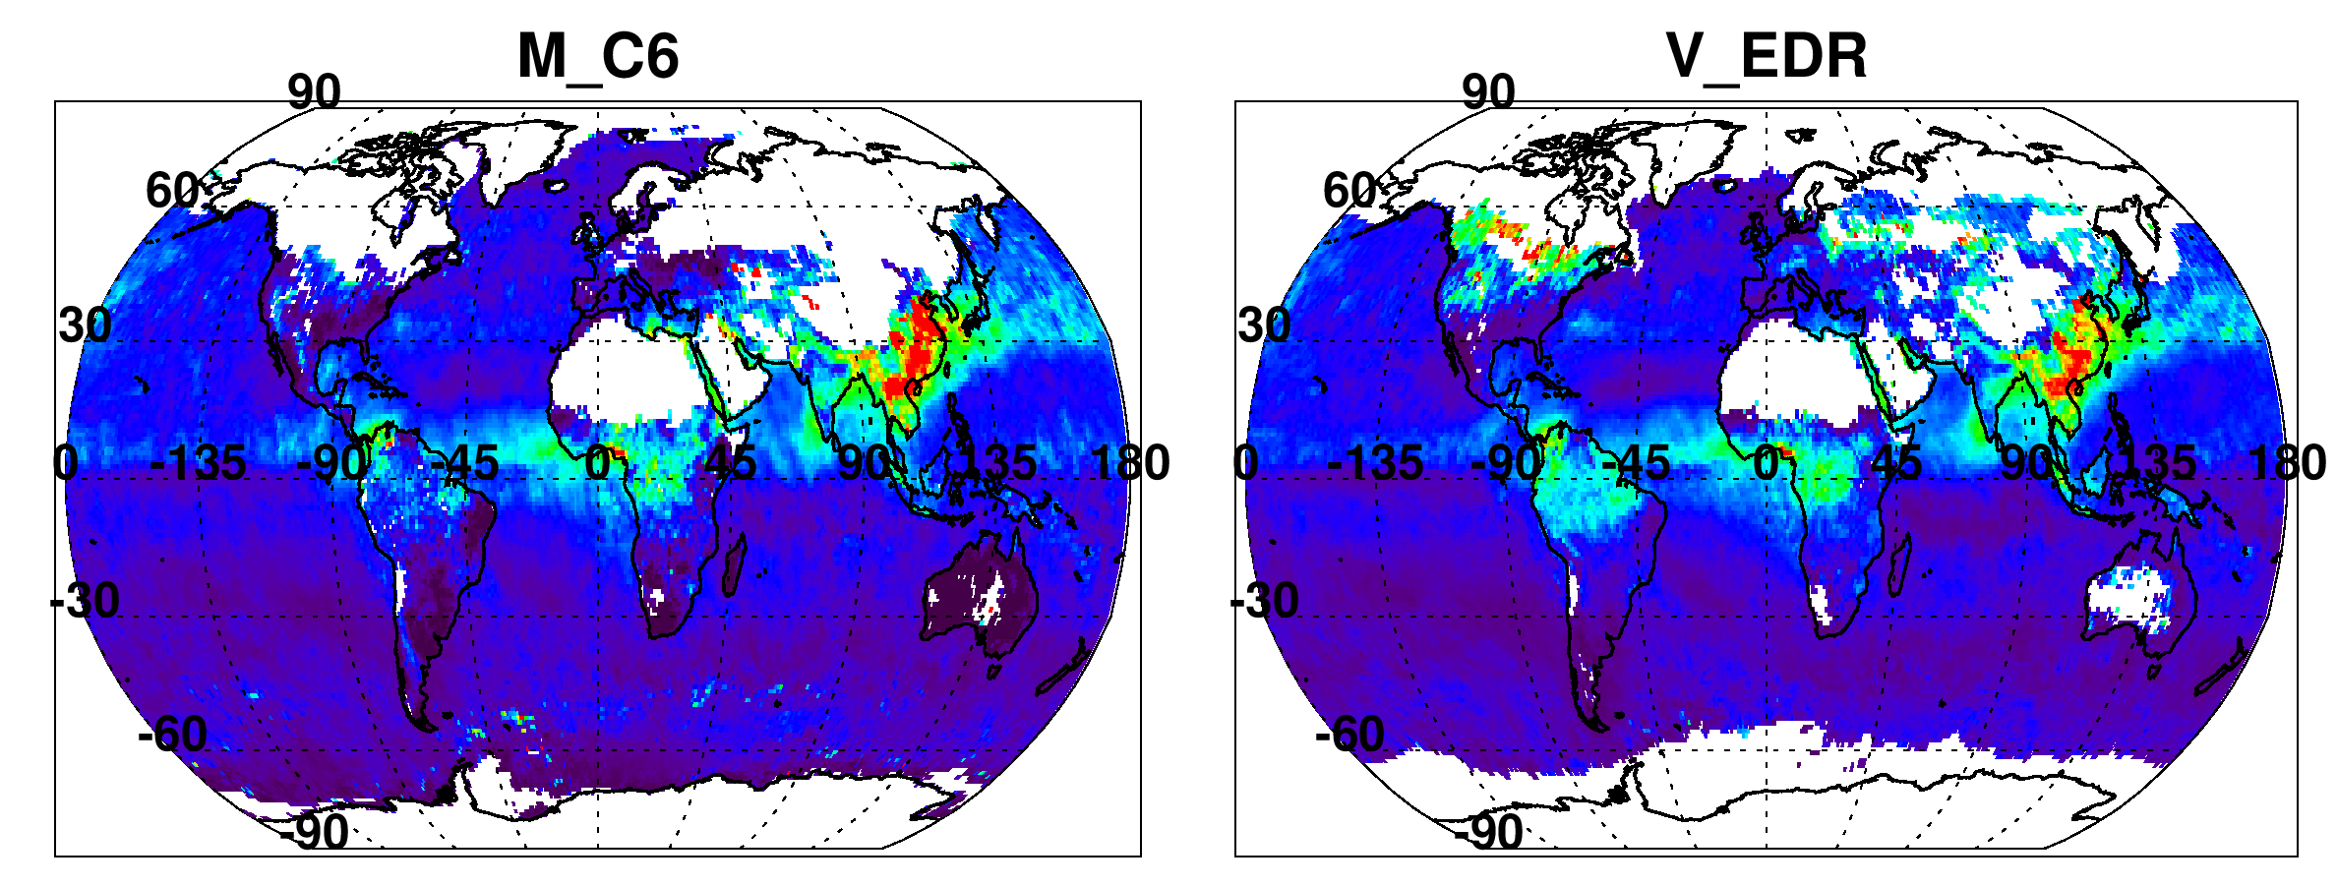


ONE RETRIEVAL ALGORITHM: Consistent Across Platforms
MODIS C6 product
NOAA-VIIRS product
Different snow thresholds?
Different SZA thresholds
MODIS-like on VIIRS
?
Still different, but much more similar over both land and ocean
We make VIIRS consistent with MODIS.
(we learned from Terra vs Aqua)

Slide 40
MODIS-like algorithm on ANY sensor!
For climate continuity
MODIS
VIIRS
MAS/E-MAS/AMS (Airborne spectrometers and historical experiment data)
International sensors
Future sensors (e.g. PACE / ACE) as a baseline for testing new ideas
Many details, but can be done!

Slide 41
Okay: summary time

Slide 42




Summary (C6)
There are many ways to retrieve aerosol properties from MODIS, and there is more than one set of algorithms/products
Dark-target algorithm/products updated for C6
Changes are “modest” but lead to significant changes in retrieved global aerosol
New products: DB/DT merge, MxD04_3K, etc
Documentation:
  Algorithm papers have been published
  ATBD in progress
  Website under development
C6 processing (Level 2) for Aqua almost finished. Terra begin soon? Level 3 soon?
Validation (vs AERONET, MAN, etc) in progress
Calibration/polarization/trending issues still being studied
MODIS RGB
MODIS Aerosol (06:35 UT)
MODIS RGB
MODIS Aerosol (06:35 UT)
The MODIS aerosol
cloud mask is more
conservative than
the VIIRS VCM.
The MODIS aerosol
cloud mask is more
conservative than
the VIIRS VCM.
VIIRS RGB
VIIRS Aerosol EDR
MODIS Algorithm, VIIRS Input
VIIRS RGB
VIIRS Aerosol EDR
MODIS Algorithm, VIIRS Input

Slide 43
Summary (Towards C7)
Corrections for urban surface bias
Development of “pixel level” uncertainty products
Calibration/polarization/trending issues still being studied
  Why is Terra offset from Aqua?
Development of generic dark-target algorithm to be used on VIIRS, airborne and other spectral remote sensing datasets. (a Super C7).
MODIS RGB
MODIS Aerosol (06:35 UT)
MODIS RGB
MODIS Aerosol (06:35 UT)
The MODIS aerosol
cloud mask is more
conservative than
the VIIRS VCM.
The MODIS aerosol
cloud mask is more
conservative than
the VIIRS VCM.
VIIRS RGB
VIIRS Aerosol EDR
MODIS Algorithm, VIIRS Input
VIIRS RGB
VIIRS Aerosol EDR
MODIS Algorithm, VIIRS Input

Slide 44


http://darktarget.gsfc.nasa.gov
Web site in development
Reference for all things “dark target”
  The algorithms and assumptions
  Examples
  Validation
  Primary publications
  Educational material
  FAQ
  Links to data access
  Considering a “forum”

