Slide 1
MODIS Sea-surface temperatures
Peter Minnett & BOB Evans
Rosenstiel School, University of Miami.
pminnett@rsmas.miami.edu

Slide 2
Summary
MODIS SSTs are stable and of good accuracy
New algorithmic enhancements to improve accuracy, especially towards edges of swaths
New V6 code delivered to OBPG and tested for next reprocessing cycle
New M-AERIs being deployed for skin SST validation
SI-calibration traceability leads to rigorous CDR generation
  But desired CDR accuracies not yet met

Slide 3
SST accuracy requirements
SST is an Essential Climate Variable (CEOS)
Required Errors and Uncertainties in SST for CDRs:
  Accuracy: better than 0.1K
  Stability: better than 0.04 K/decade
SST CDRs require traceability to SI-Standards
Difficulties are not only to achieve these, but to demonstrate whether they have been achieved
“Reference satellite sensor” – AATSR – terminated in April 2012 with failure of Envisat – focus on MODIS

Slide 4
Atmospheric correction algorithms
Collection 5:
SST = a₀ +a₁T₃₁ +a₂(T₃₁-T₃₂) T_{sfc} +a₃(sec(θ)-1)(T₃₁-T₃₂)
SST4 = a₀ +a₁T₂₂ +a₂(T₂₂-T₂₃) +a₃(sec(θ)-1)
6:
+ a₄(fn(mirror.side)) +a₅(θ) +a₆(θ)²
+ a₄(fn(mirror.side)) + a₅(θ) +a₆(θ)²
Quality flagging improved

Slide 5
Buoy matchups
Matchups between Aqua MODIS and drifters, after QA, for 2012. 79986 for day & night, but spatial distribution is uneven.
Buoy measurements are of a subsurface temperature.

Slide 6
Terra Modis sst residuals
MODIS TERRA – SST residual statistics for each quality level (day + night)
Quality | Min | Q1 | Median | Mean | Q3 | Max | RMS | SD | MAD
0 | -4.461 | -0.359 | -0.109 | -0.110 | 0.137 | 6.080 | 0.453 | 0.439 | 0.368
1 | -5.170 | -0.574 | -0.209 | -0.244 | 0.114 | 10.851 | 0.715 | 0.672 | 0.507
2 | -7.573 | -1.457 | -0.779 | -1.040 | -0.283 | 5.525 | 1.598 | 1.214 | 0.833
MODIS TERRA – SST4 residual statistics for each quality level (night only)
Quality | Min | Q1 | Median | Mean | Q3 | Max | RMS | SD | MAD
0 | -4.475 | -0.292 | -0.140 | -0.163 | -0.007 | 4.664 | 0.359 | 0.320 | 0.210
1 | -4.756 | -0.474 | -0.223 | -0.283 | -0.027 | 4.703 | 0.529 | 0.447 | 0.324
2 | -6.673 | -1.071 | -0.411 | -0.641 | -0.057 | 3.765 | 1.102 | 0.896 | 0.660
Expect mean error of -0.17K from skin effect

Slide 7
Aqua MODIS sst residuals
MODIS AQUA – SST residual statistics for each quality level (day + night)
Quality | Min | Q1 | Median | Mean | Q3 | Max | RMS | SD | MAD
0 | -4.546 | -0.362 | -0.131 | -0.139 | 0.093 | 13.024 | 0.460 | 0.438 | 0.338
1 | -5.882 | -0.565 | -0.208 | -0.255 | 0.087 | 10.948 | 0.701 | 0.652 | 0.477
2 | -7.231 | -1.584 | -0.851 | -1.111 | -0.323 | 8.764 | 1.639 | 1.202 | 0.885
MODIS AQUA – SST4 residual statistics for each quality level (night only)
Quality | Min | Q1 | Median | Mean | Q3 | Max | RMS | SD | MAD
0 | -4.394 | -0.312 | -0.152 | -0.183 | -0.013 | 3.961 | 0.385 | 0.339 | 0.219
1 | -5.178 | -0.597 | -0.292 | -0.381 | -0.074 | 3.473 | 0.640 | 0.514 | 0.372
2 | -7.684 | -1.871 | -1.041 | -1.235 | -0.348 | 4.111 | 1.703 | 1.172 | 1.101
Expect mean error of -0.17K from skin effect

Slide 8
Median of SST errors
Terra
Aqua
Collection 5 – red. Collection 6 - blue

Slide 9
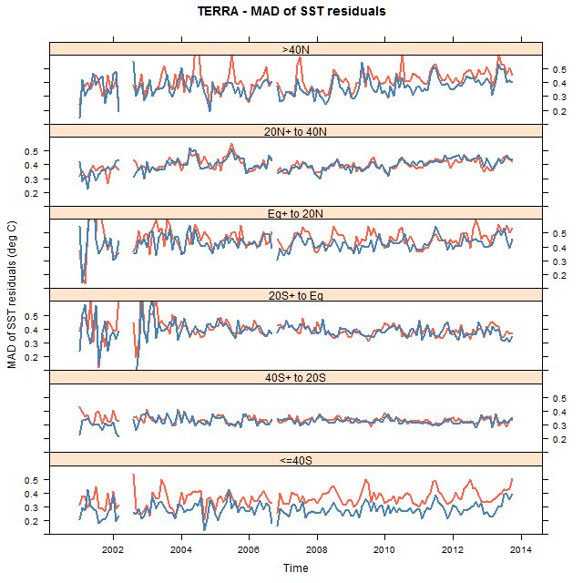
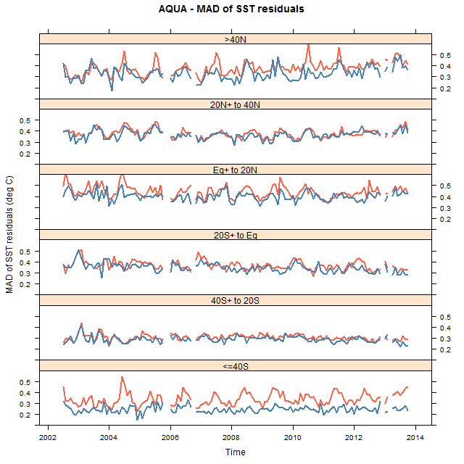
Mean Abs Diffs of SST errors
Terra
Aqua
Collection 5 – red. Collection 6 - blue

Slide 10
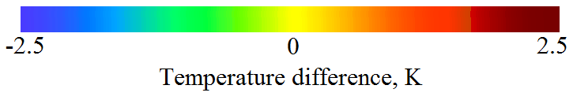
Comparison with other SSTs
Aqua MODIS SST vs Reynolds OI
Aqua MODIS SST vs WindSat SST

Slide 11
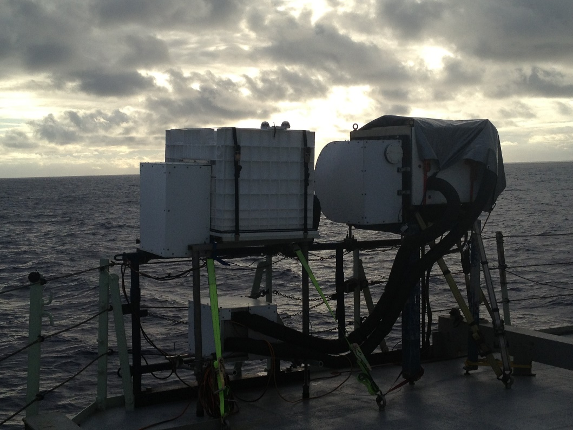
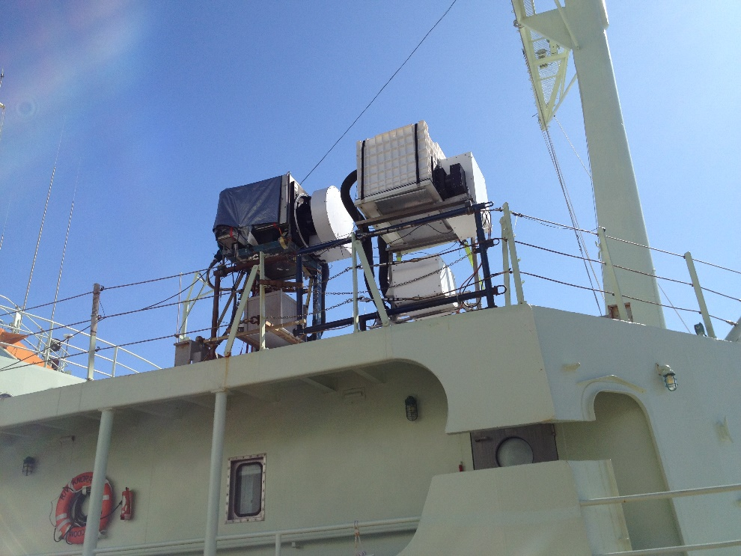
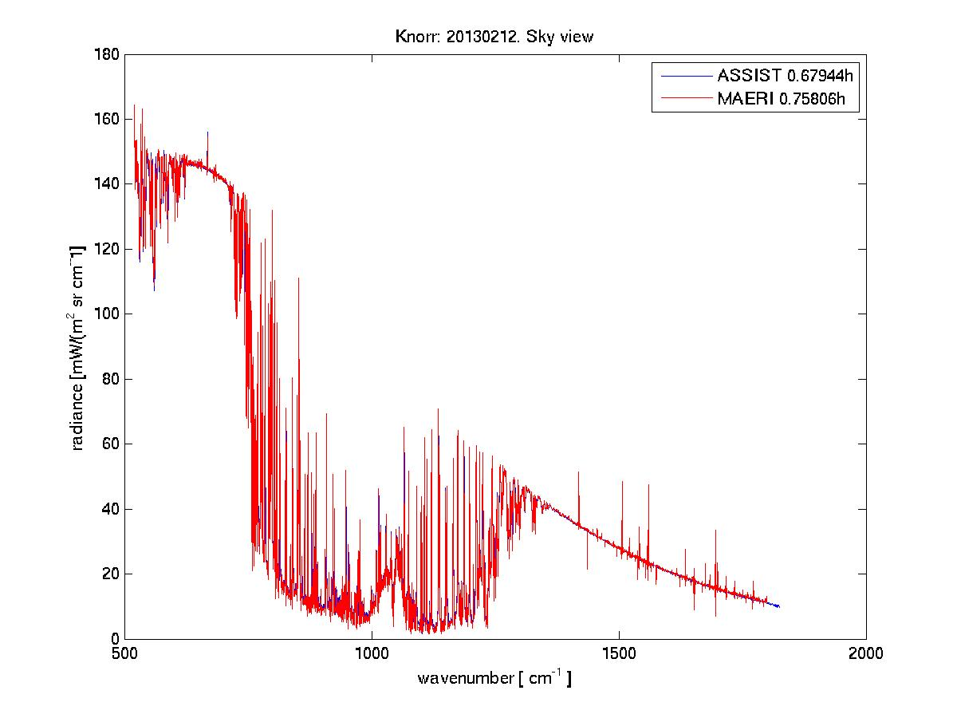
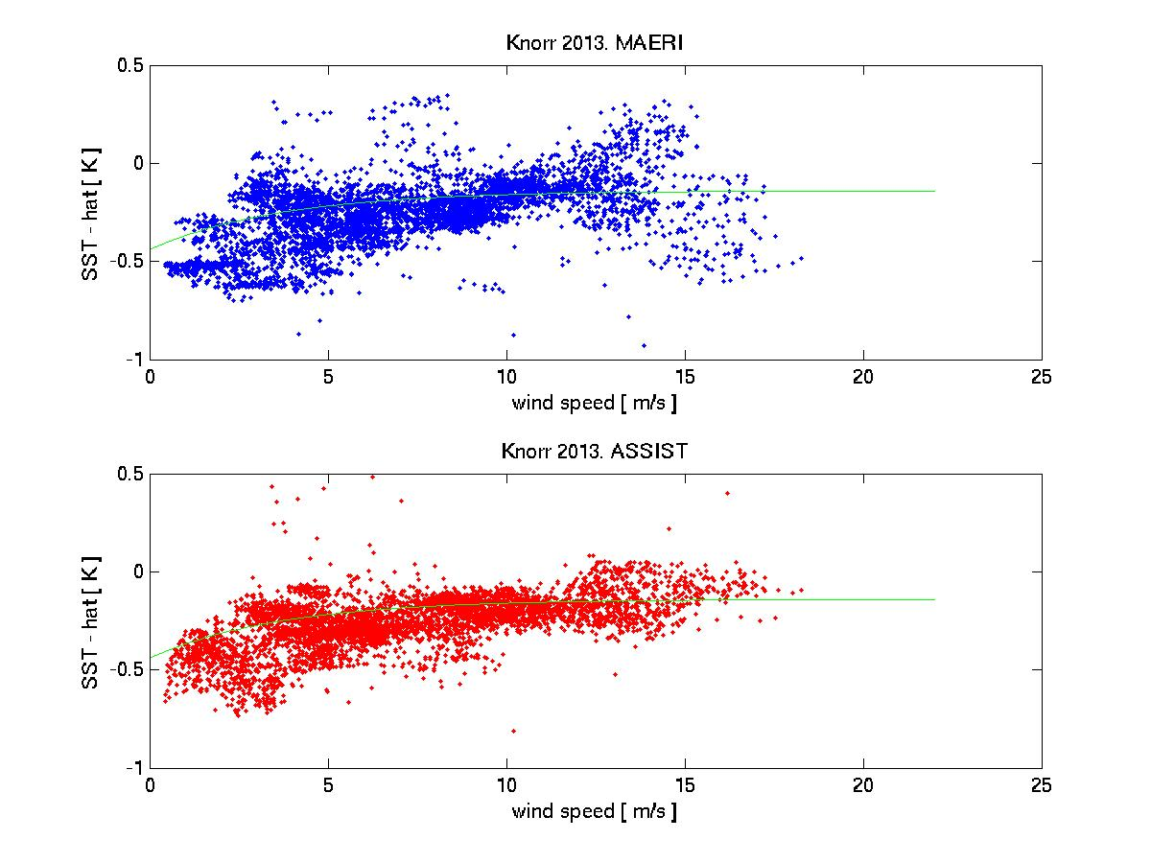
Radiometers at Sea
Mean difference between M-AERI SSTs =0.064K

Slide 12
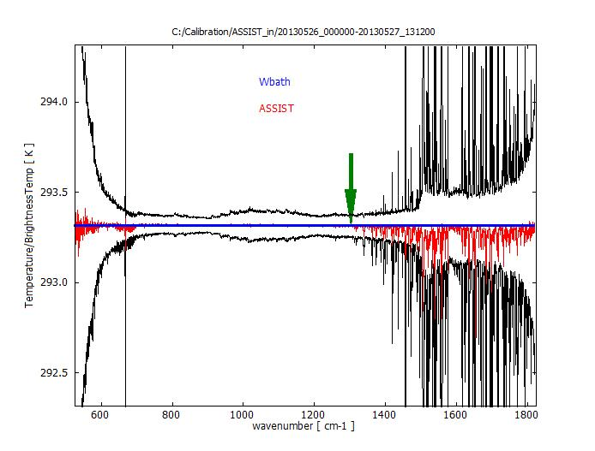
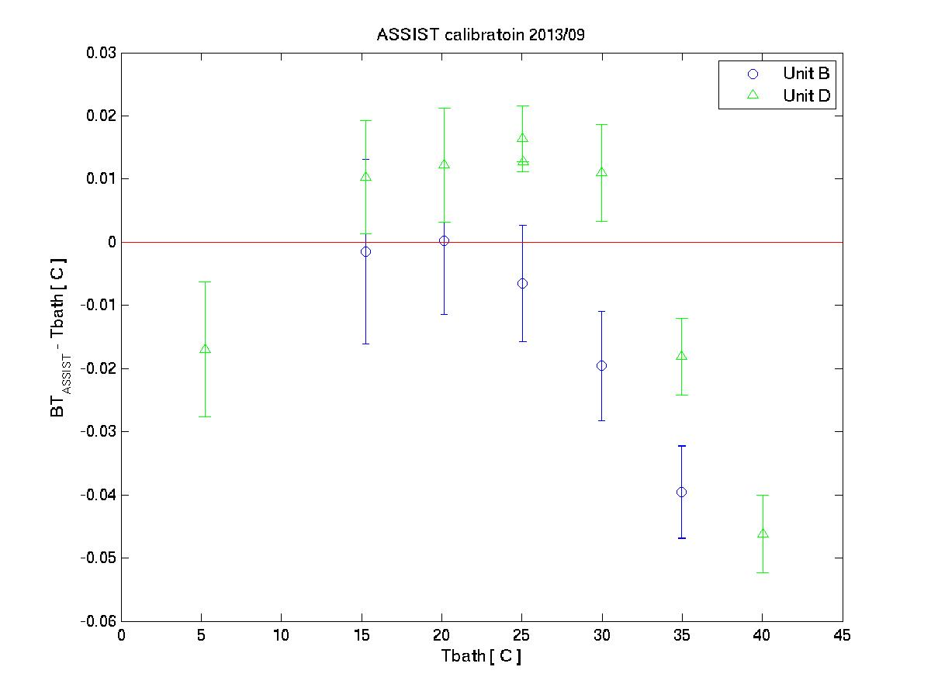
M-AERI Calibration

Slide 13
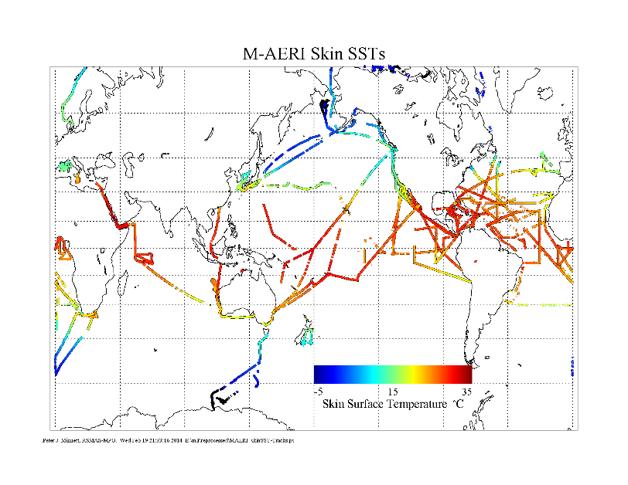
M-AERI deployments

Slide 14
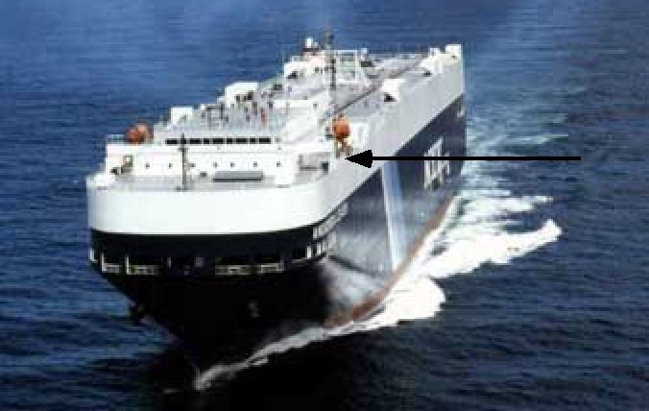
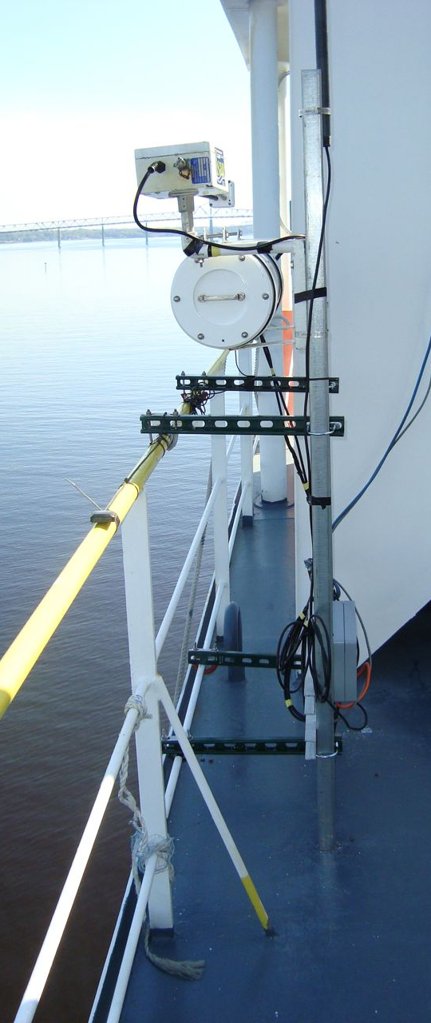
ISAR deployments

Slide 15
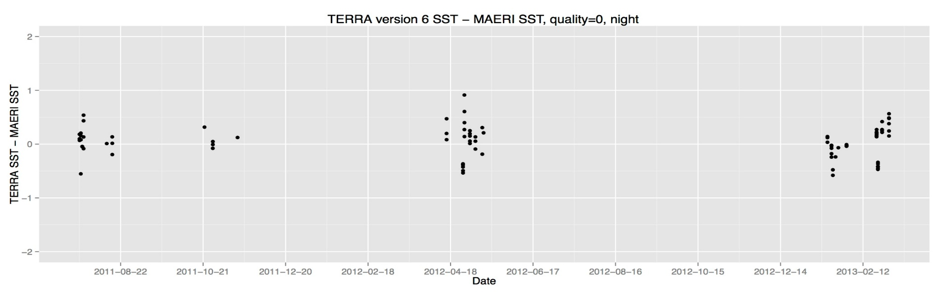
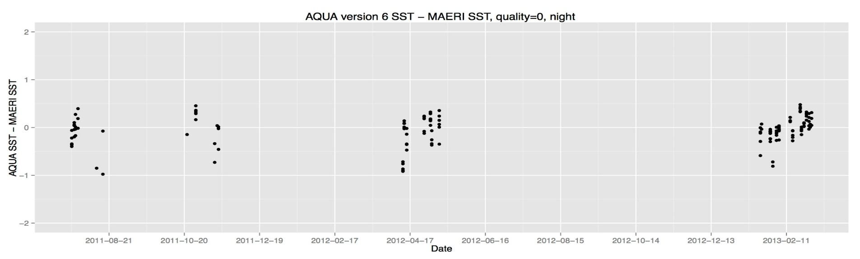
MODIs – M-AERI skin SSTs

Slide 16
Global Stats vs radiometers
MAERI | SST4 V6
 | mean | median | sd | mad | IQR | N
TERRA | 0.047 | 0.082 | 0.297 | 0.227 | 0.291 | 84
AQUA | -0.056 | -0.024 | 0.304 | 0.242 | 0.308 | 135
MAERI | SST night V6
 | mean | median | sd | mad | IQR | N
TERRA | -0.076 | -0.073 | 0.444 | 0.492 | 0.627 | 93
AQUA | -0.087 | -0.023 | 0.428 | 0.305 | 0.418 | 133
ISAR | SST4 V6
 | mean | median | sd | mad | IQR | N
TERRA | 0.110 | 0.085 | 0.618 | 0.289 | 0.388 | 662
AQUA | -0.017 | 0.016 | 0.373 | 0.270 | 0.414 | 369
ISAR | SST night V6
 | mean | median | sd | mad | IQR | N
TERRA | 0.003 | 0.044 | 0.716 | 0.525 | 0.727 | 798
AQUA | 0.059 | 0.066 | 0.495 | 0.384 | 0.521 | 355

Slide 17
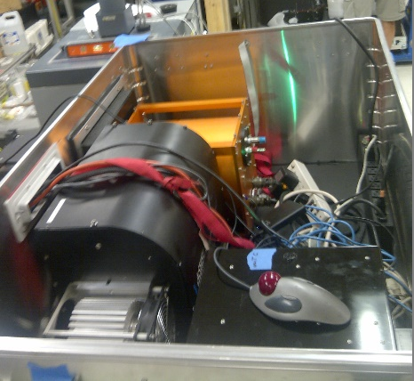
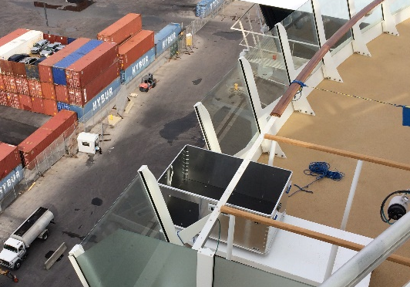
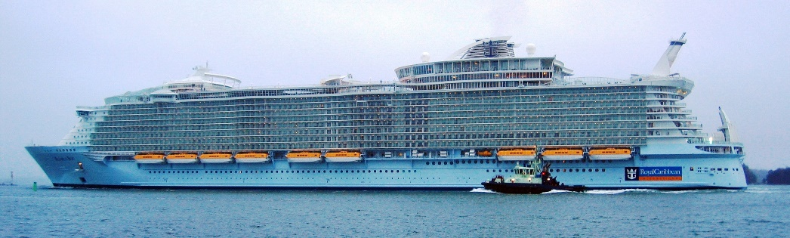
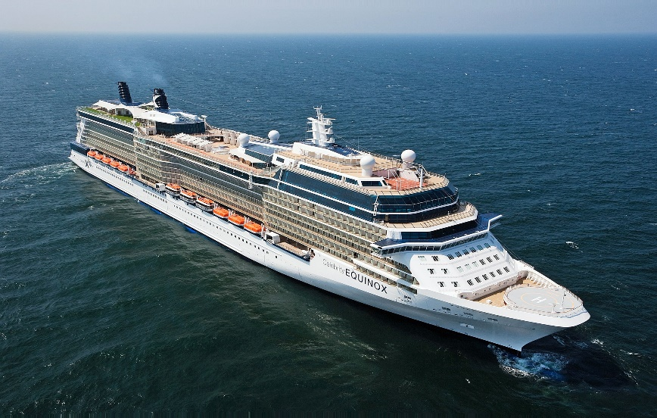
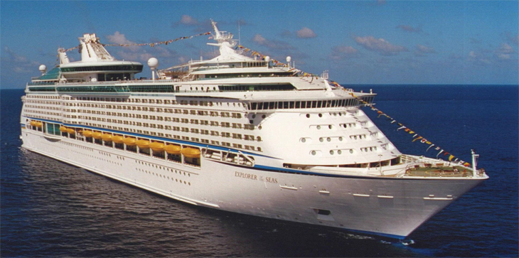
M-AERI Mk2
Three M-AERI Mk2s being deployed on RCCL cruise liners….

Slide 18
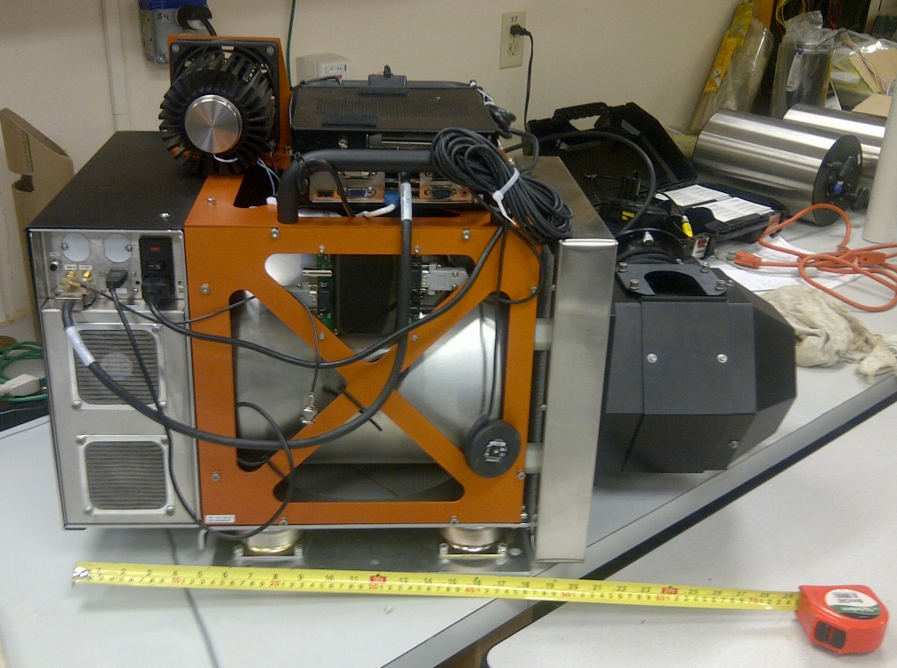
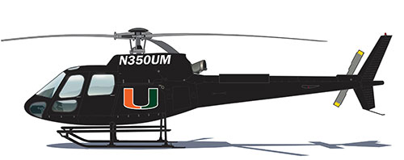
M-AERI Mk3
M-AERI Mk 3 small
enough to be helicopter mounted….

Slide 19
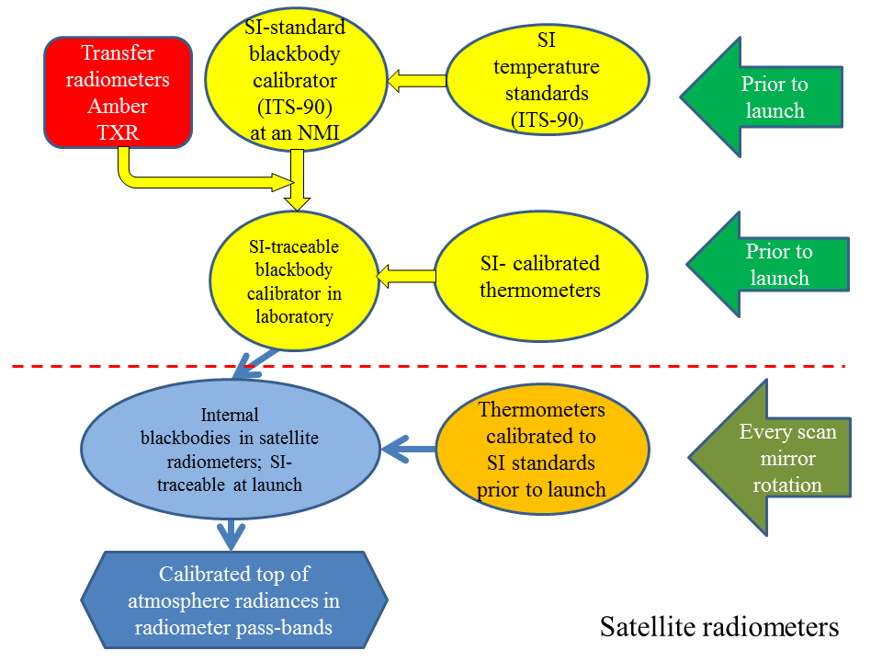
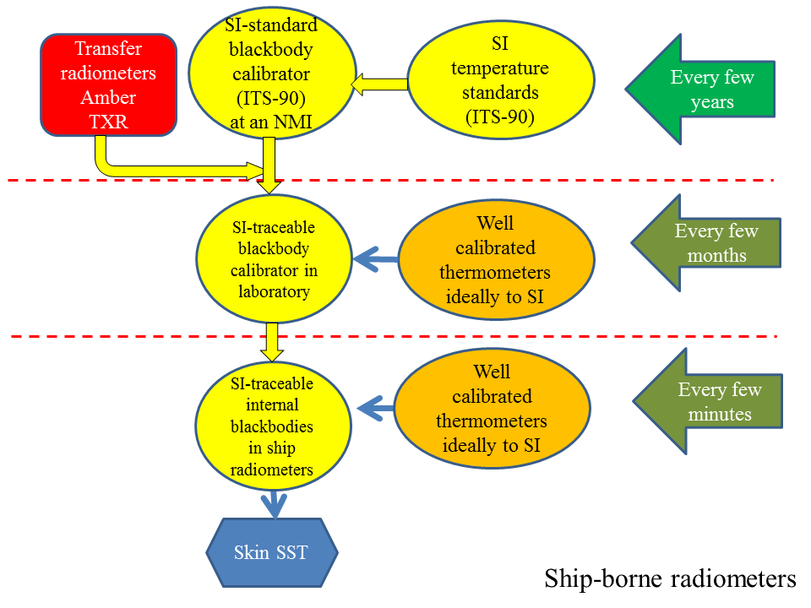
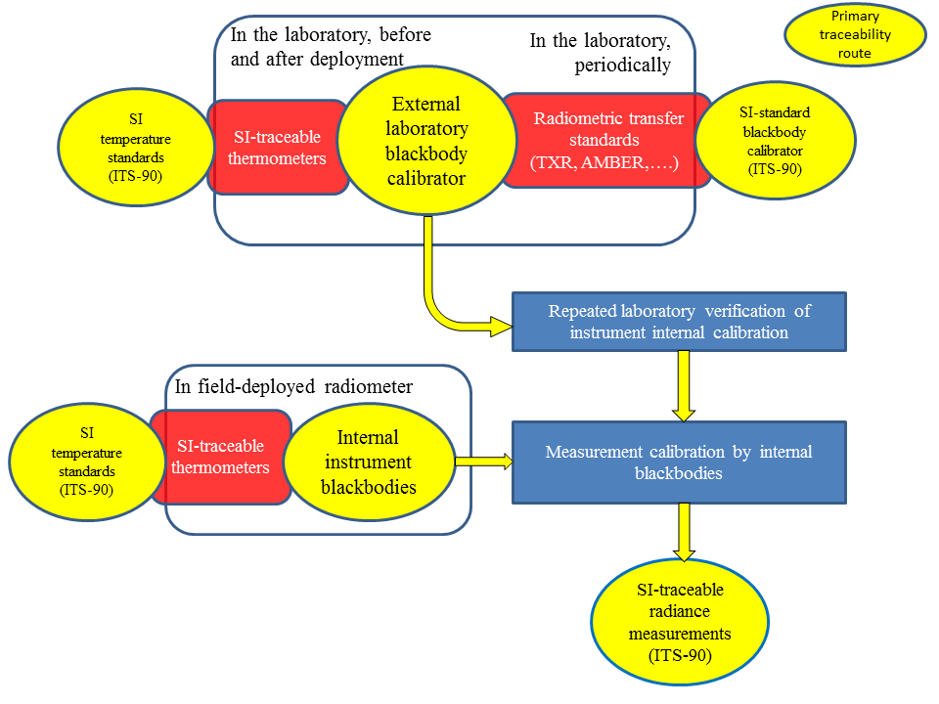
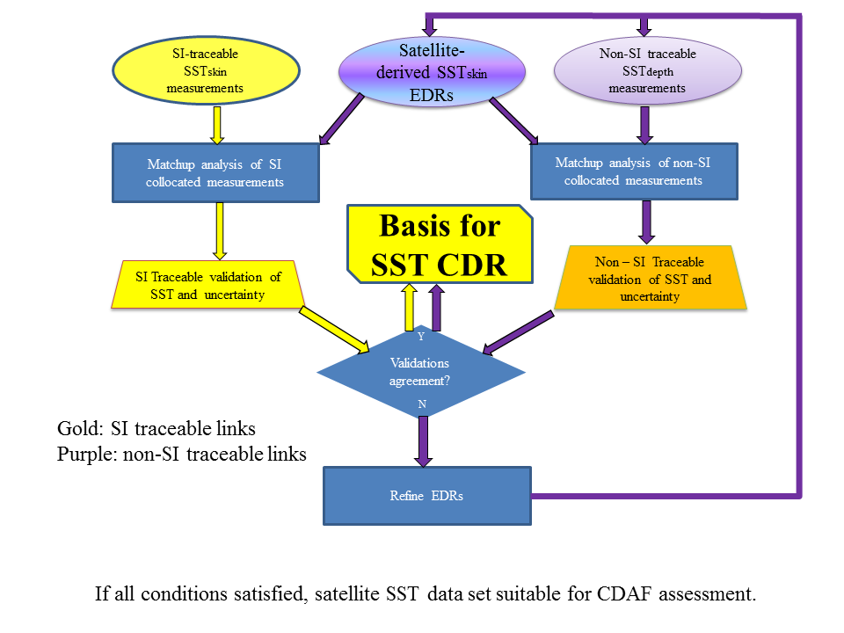
CDR generation

Slide 20
Looking forward
Minor improvements to algorithms
Forward solution – optimum estimation of skin SST
Evaluate sampling errors resulting from clouds
Better partitioning of sources of uncertainties to derive improved estimate of MODIS SST accuracies
Continue at-sea deployments……
Continue to grow MUDBs to demonstrate stability of MODIS SSTs…
Ensure MODIS and VIIRS SSTs are compatible and can contribute to the SST CDR
Not seek the 8th significant figure in SST

Slide 21
RSMAS SST TEam
Kay Kilpatrick
Gui Podesta
Miguel Izaguirre
Goshka Szczodrak
Liz Williams
Sue Walsh
Warner Baringer
Mike Reynolds – RMR Co, Seattle

Slide 22
Summary
MODIS SSTs are stable and of good accuracy
New algorithmic enhancements to improve accuracy, especially towards edges of swaths
New V6 code delivered to OBPG and tested for next reprocessing cycle
New M-AERIs being deployed for skin SST validation
SI-calibration traceability leads to rigorous CDR generation
  But desired CDR accuracies not yet met…….

