Slide 1
Seasonality of Amazon Forests Not A Sun-Sensor Illusion
Bi, Choi, Park, Knyazikhin & Myneni
Speaker: Ranga B. Myneni
Boston University
rmyneni@bu.edu
MODIS Science Team Meeting
April 29 to May 1, 2014
Columbia, MD
1

Slide 2
Motivation
Morton et al. (2014):
“Here we show that the apparent green up of Amazon forests in optical remote sensing data resulted from seasonal changes in near-infrared reflectance, an artefact of variations in sun-sensor geometry”
“Previous green-up studies with MODIS EVI or LAI data did not explicitly account for changing viewing and illumination conditions”
“Amazon forests maintain consistent canopy structure and greenness during the dry season”
2

Slide 3
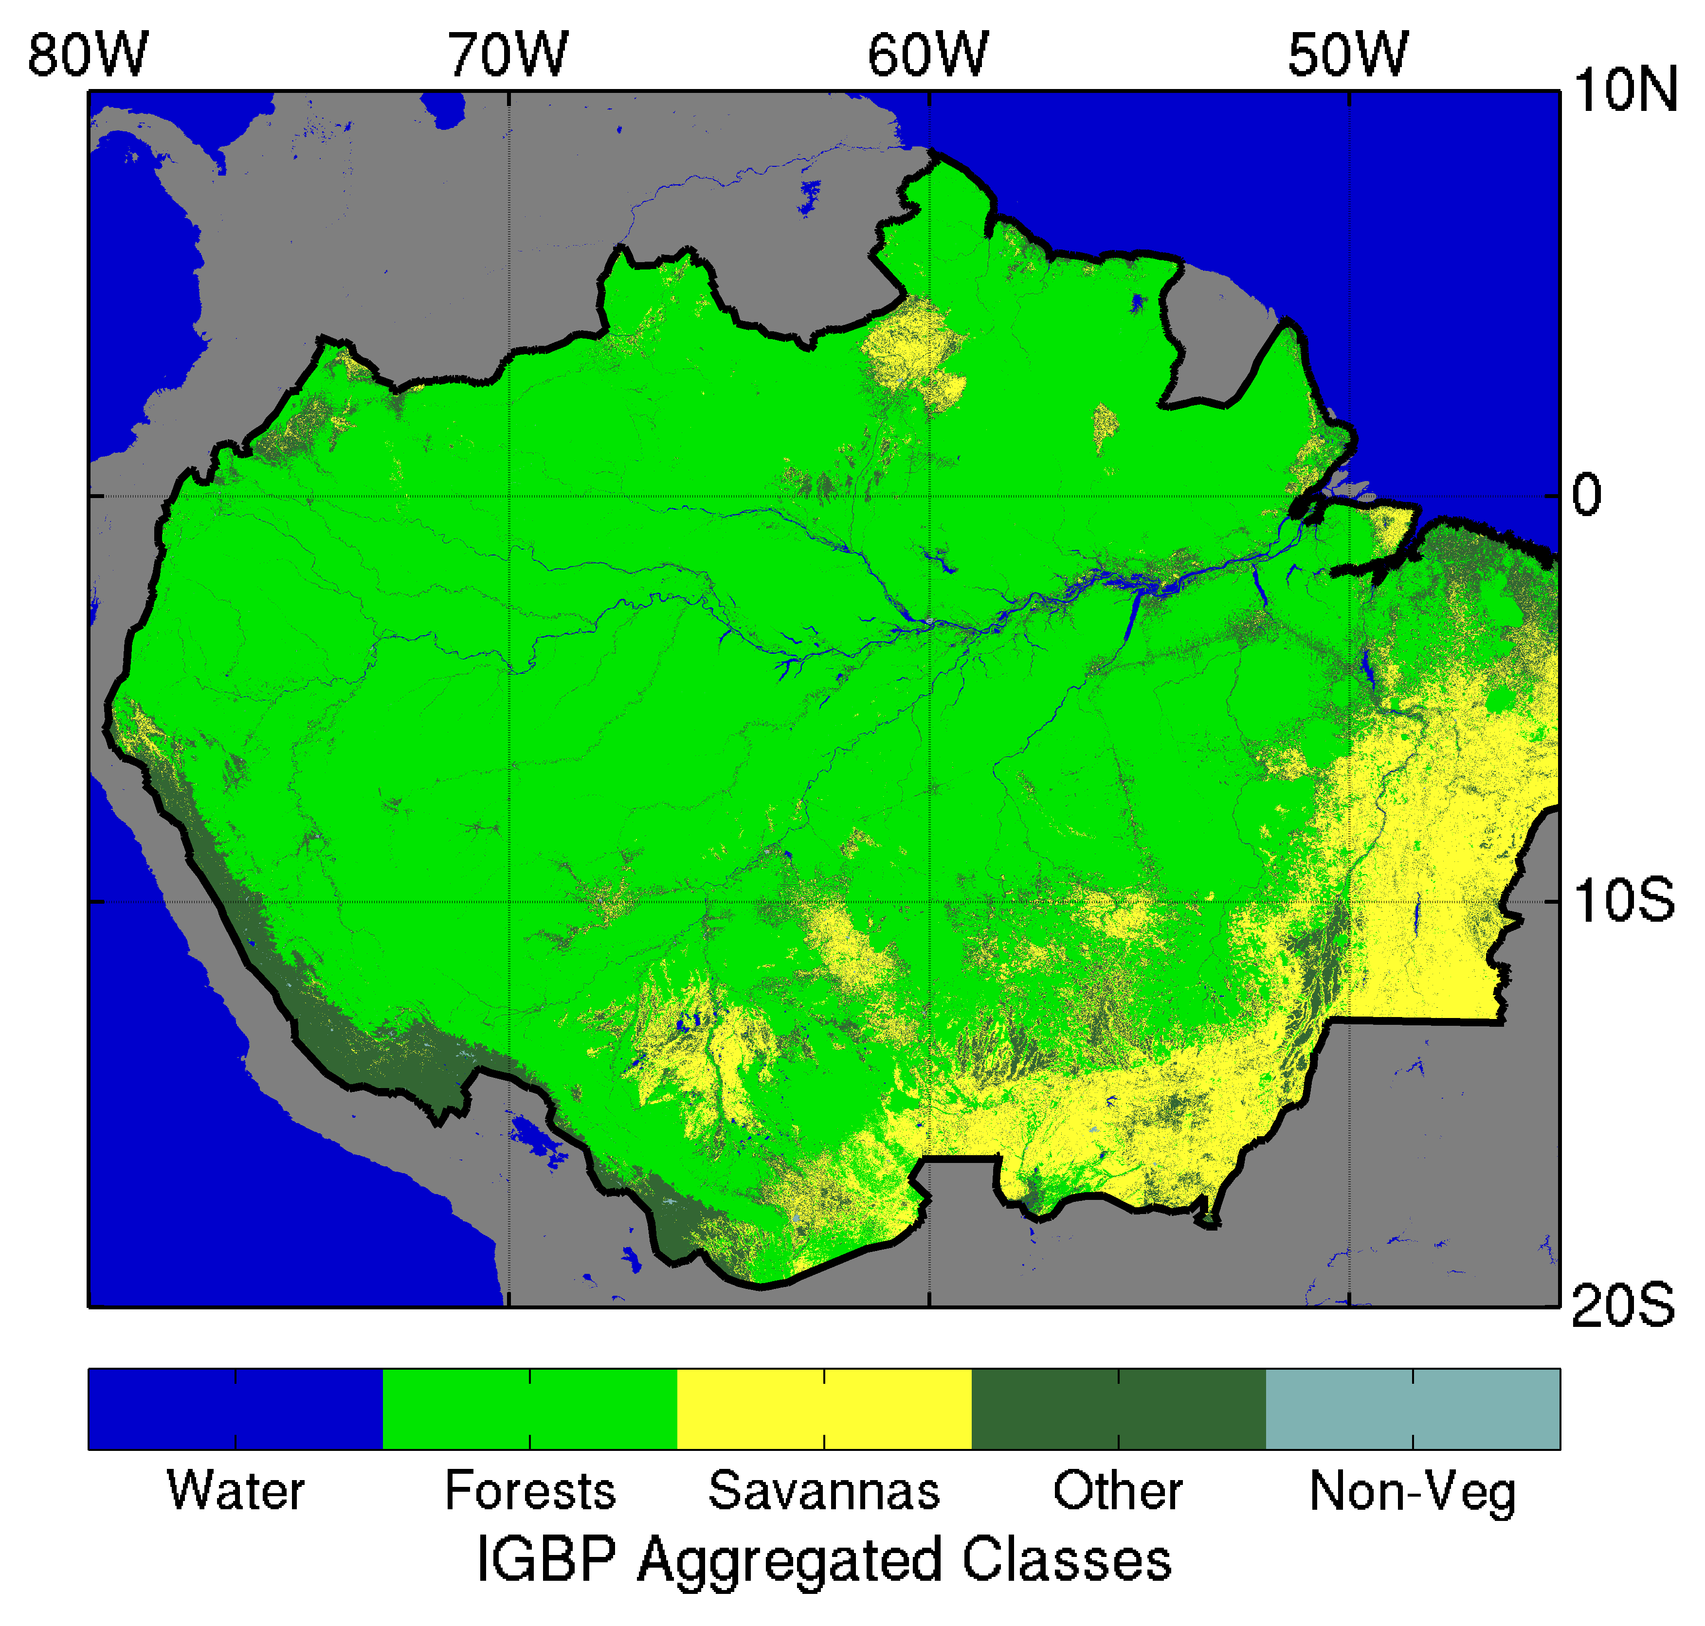
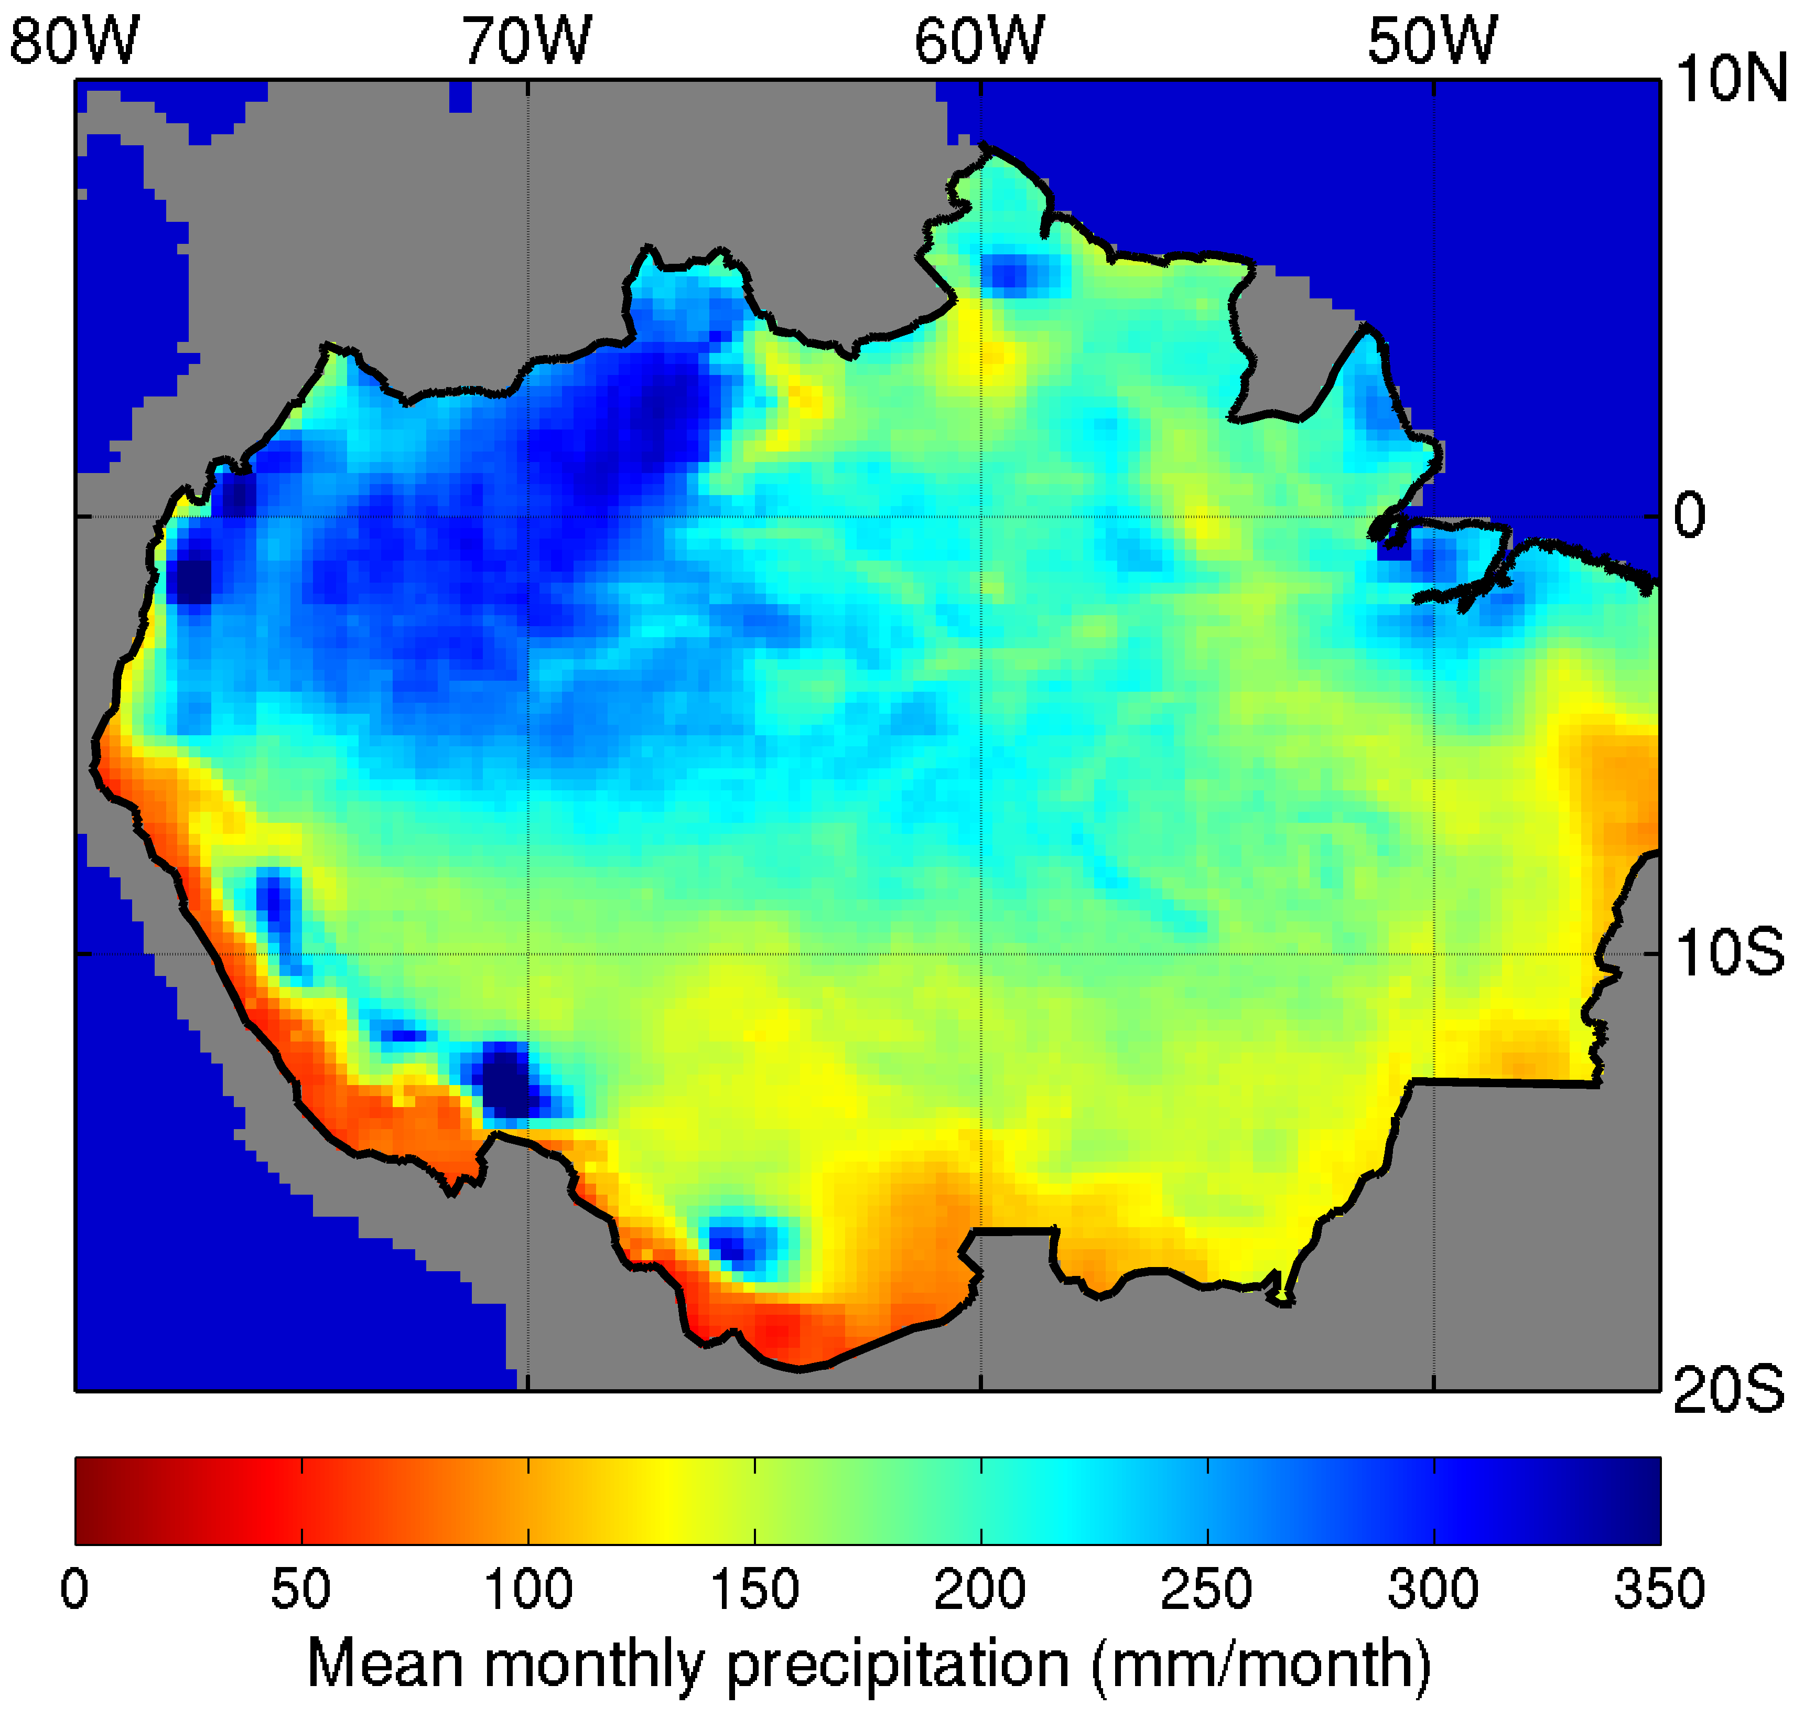
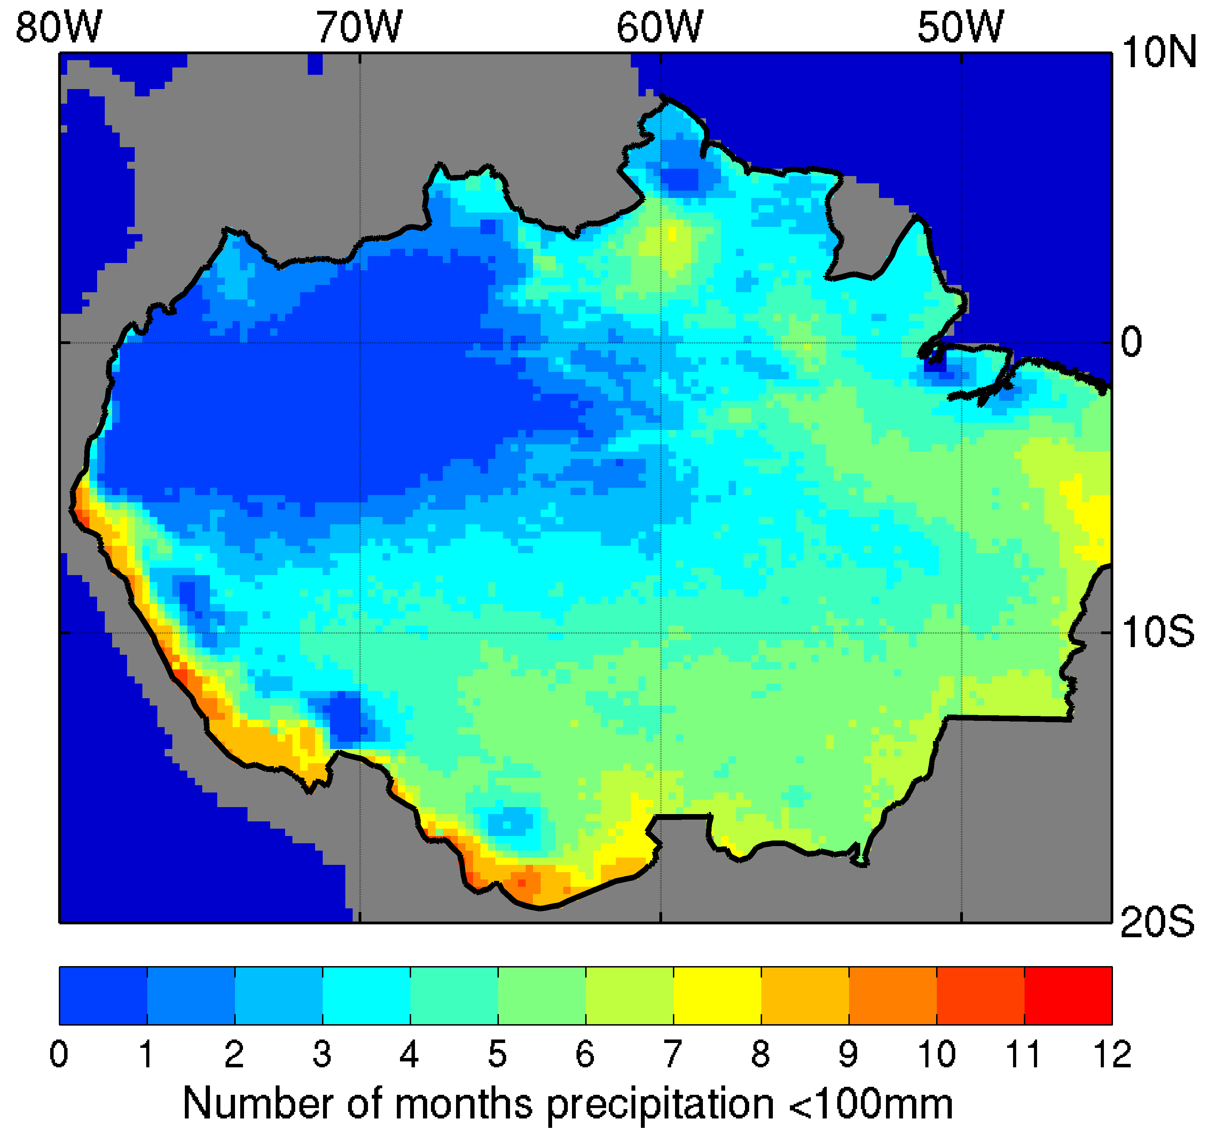
Study Area
Wet equatorial rainforests in a 1200 × 1200 km² area in the Amazon (MODIS Tile h11v09)
Average annual rainfall over 2000 mm (TRMM data 1998 to 2012, excluding 2005 and 2010)
Number of dry months (rainfall less than 100 mm) four or less
One of two tiles studied by Morton et al.
3

Slide 4
MODIS LAI Analysis
Terra MODIS Product from 7 Seasonal Cycles
(June 2000 to March 2008, excluding June 2005 to May 2006)
4

Slide 5
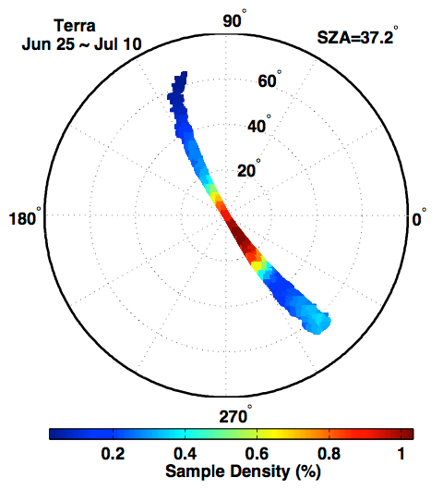
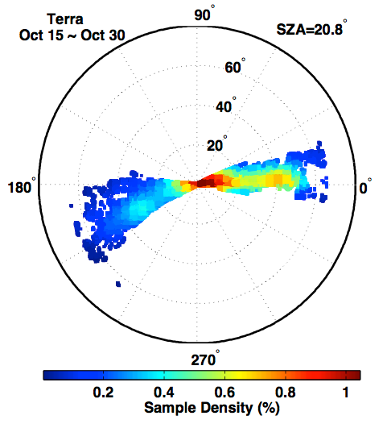
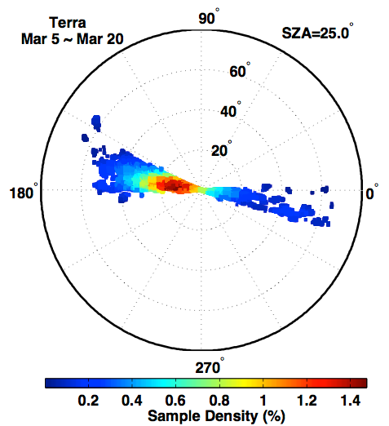
Seasonal Course of MODIS LAI Unrelated to Sun-Sensor Geometry
LAI seasonality does not track the progression of MODIS sampling
  off-principal plane in June
  near-principal plane in October
  off-principal plane in December
  near-principal plane in March
MODIS LAI algorithm explicitly accounts for sun-sensor geometry
LAI seasonality suggests net leaf flushing during the dry season and
net leaf abscission during the long wet season
5

Slide 6
Seasonal Course of MODIS LAI Unrelated to Sun-Sensor Geometry
LAI seasonality unrelated to seasonal course of solar zenith angle
LAI seasonality not influenced by view zenith angle variations as they do not vary
systematically through the seasonal cycle
6

Slide 7
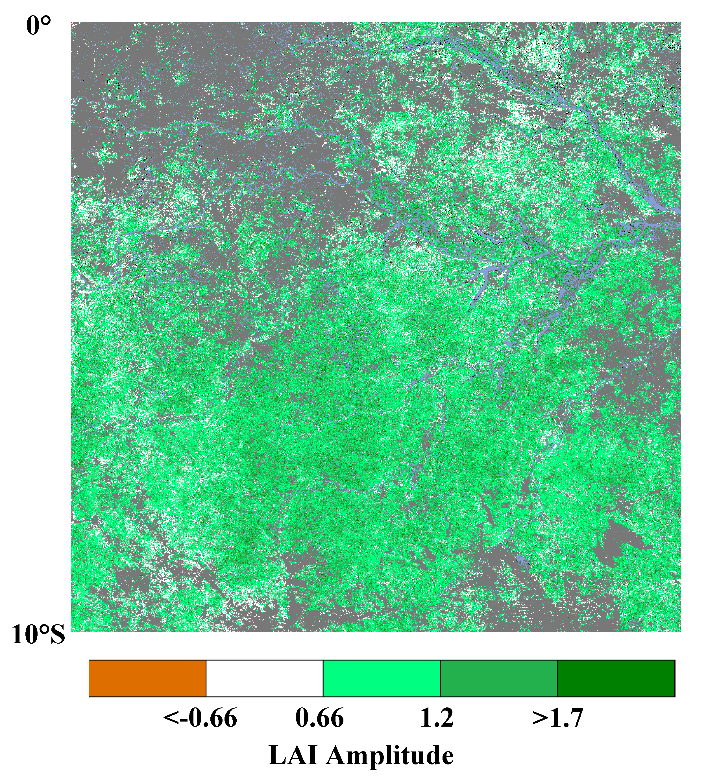
LAI Seasonal Amplitude
Significant LAI Seasonal Amplitude in nearly all pixels that consistently show dry season EVI greening
LAI Amplitude = (Sep to Nov Max LAI) – (May to Jun Min LAI)
White Pixels: LAI Amplitude less than |0.66|
White and Colored Pixels: Show EVI greening in at least 4 out of 7 seasonal cycles
EVI Greening: Oct EVI greater than Jun EVI
7

Slide 8
Conclusions: LAI Analysis
MODIS LAI data are derived by explicitly accounting for changing viewing and illumination conditions
Therefore, LAI data are free of sun-sensor geometry effects
LAI seasonal cycle shows distinct net leaf flushing during the dry season and net leaf abscission during the wet season
Wet equatorial Amazon forests do not maintain consistent canopy structure and greenness
8

Slide 9
MODIS EVI Analysis
Terra MODIS Product from 7 Seasonal Cycles
(June 2000 to March 2008, excluding June 2005 to May 2006)
Aqua MODIS Product from 4 Seasonal Cycles
(June 2003 to March 2008, excluding June 2005 to May 2006)
9

Slide 10
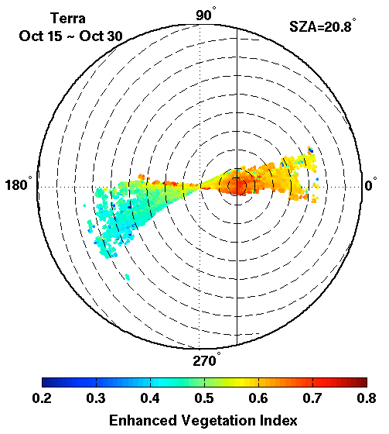
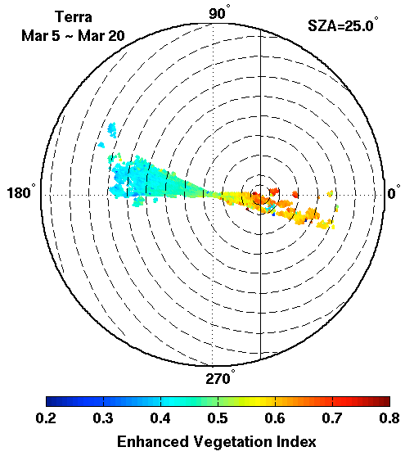
Net Leaf Abscission From Dry to Wet Season (MODIS)
Phase Angle: Angle between sensor view and solar directions
October EVI greater than March EVI at the same phase angle
True at all phase angles
October to March EVI decrease indicates net leaf abscission
Thus, there must be net leaf flushing during a 12-month cycle, else the result is a leaf-less forest
10

Slide 11
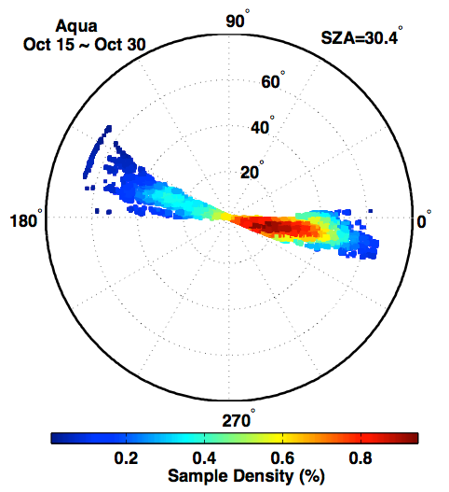
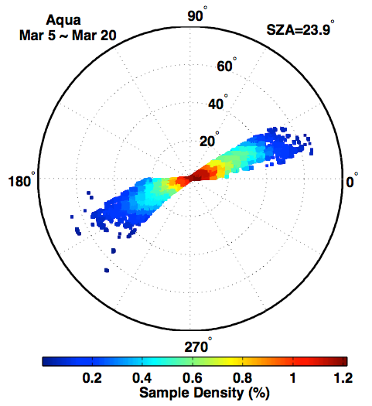
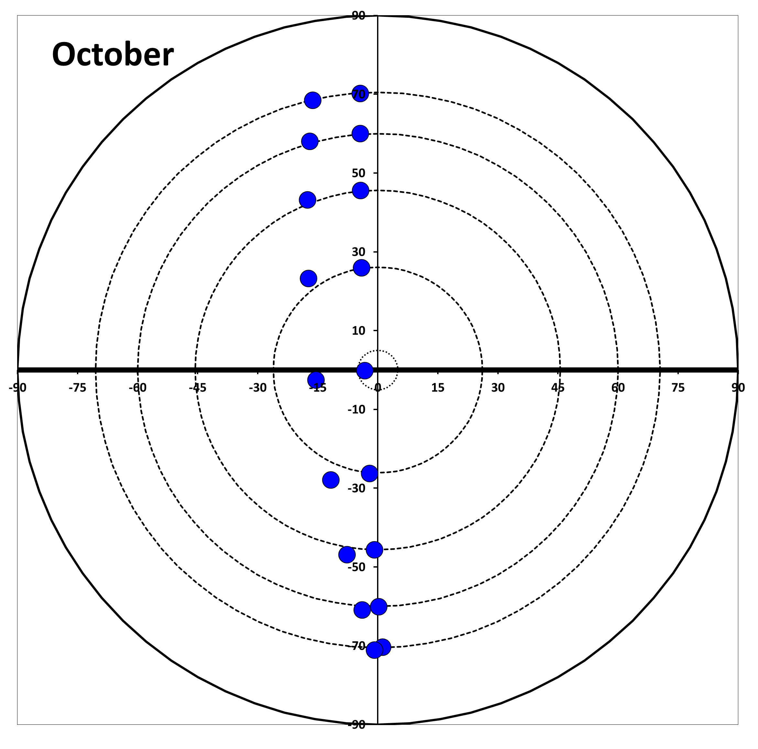
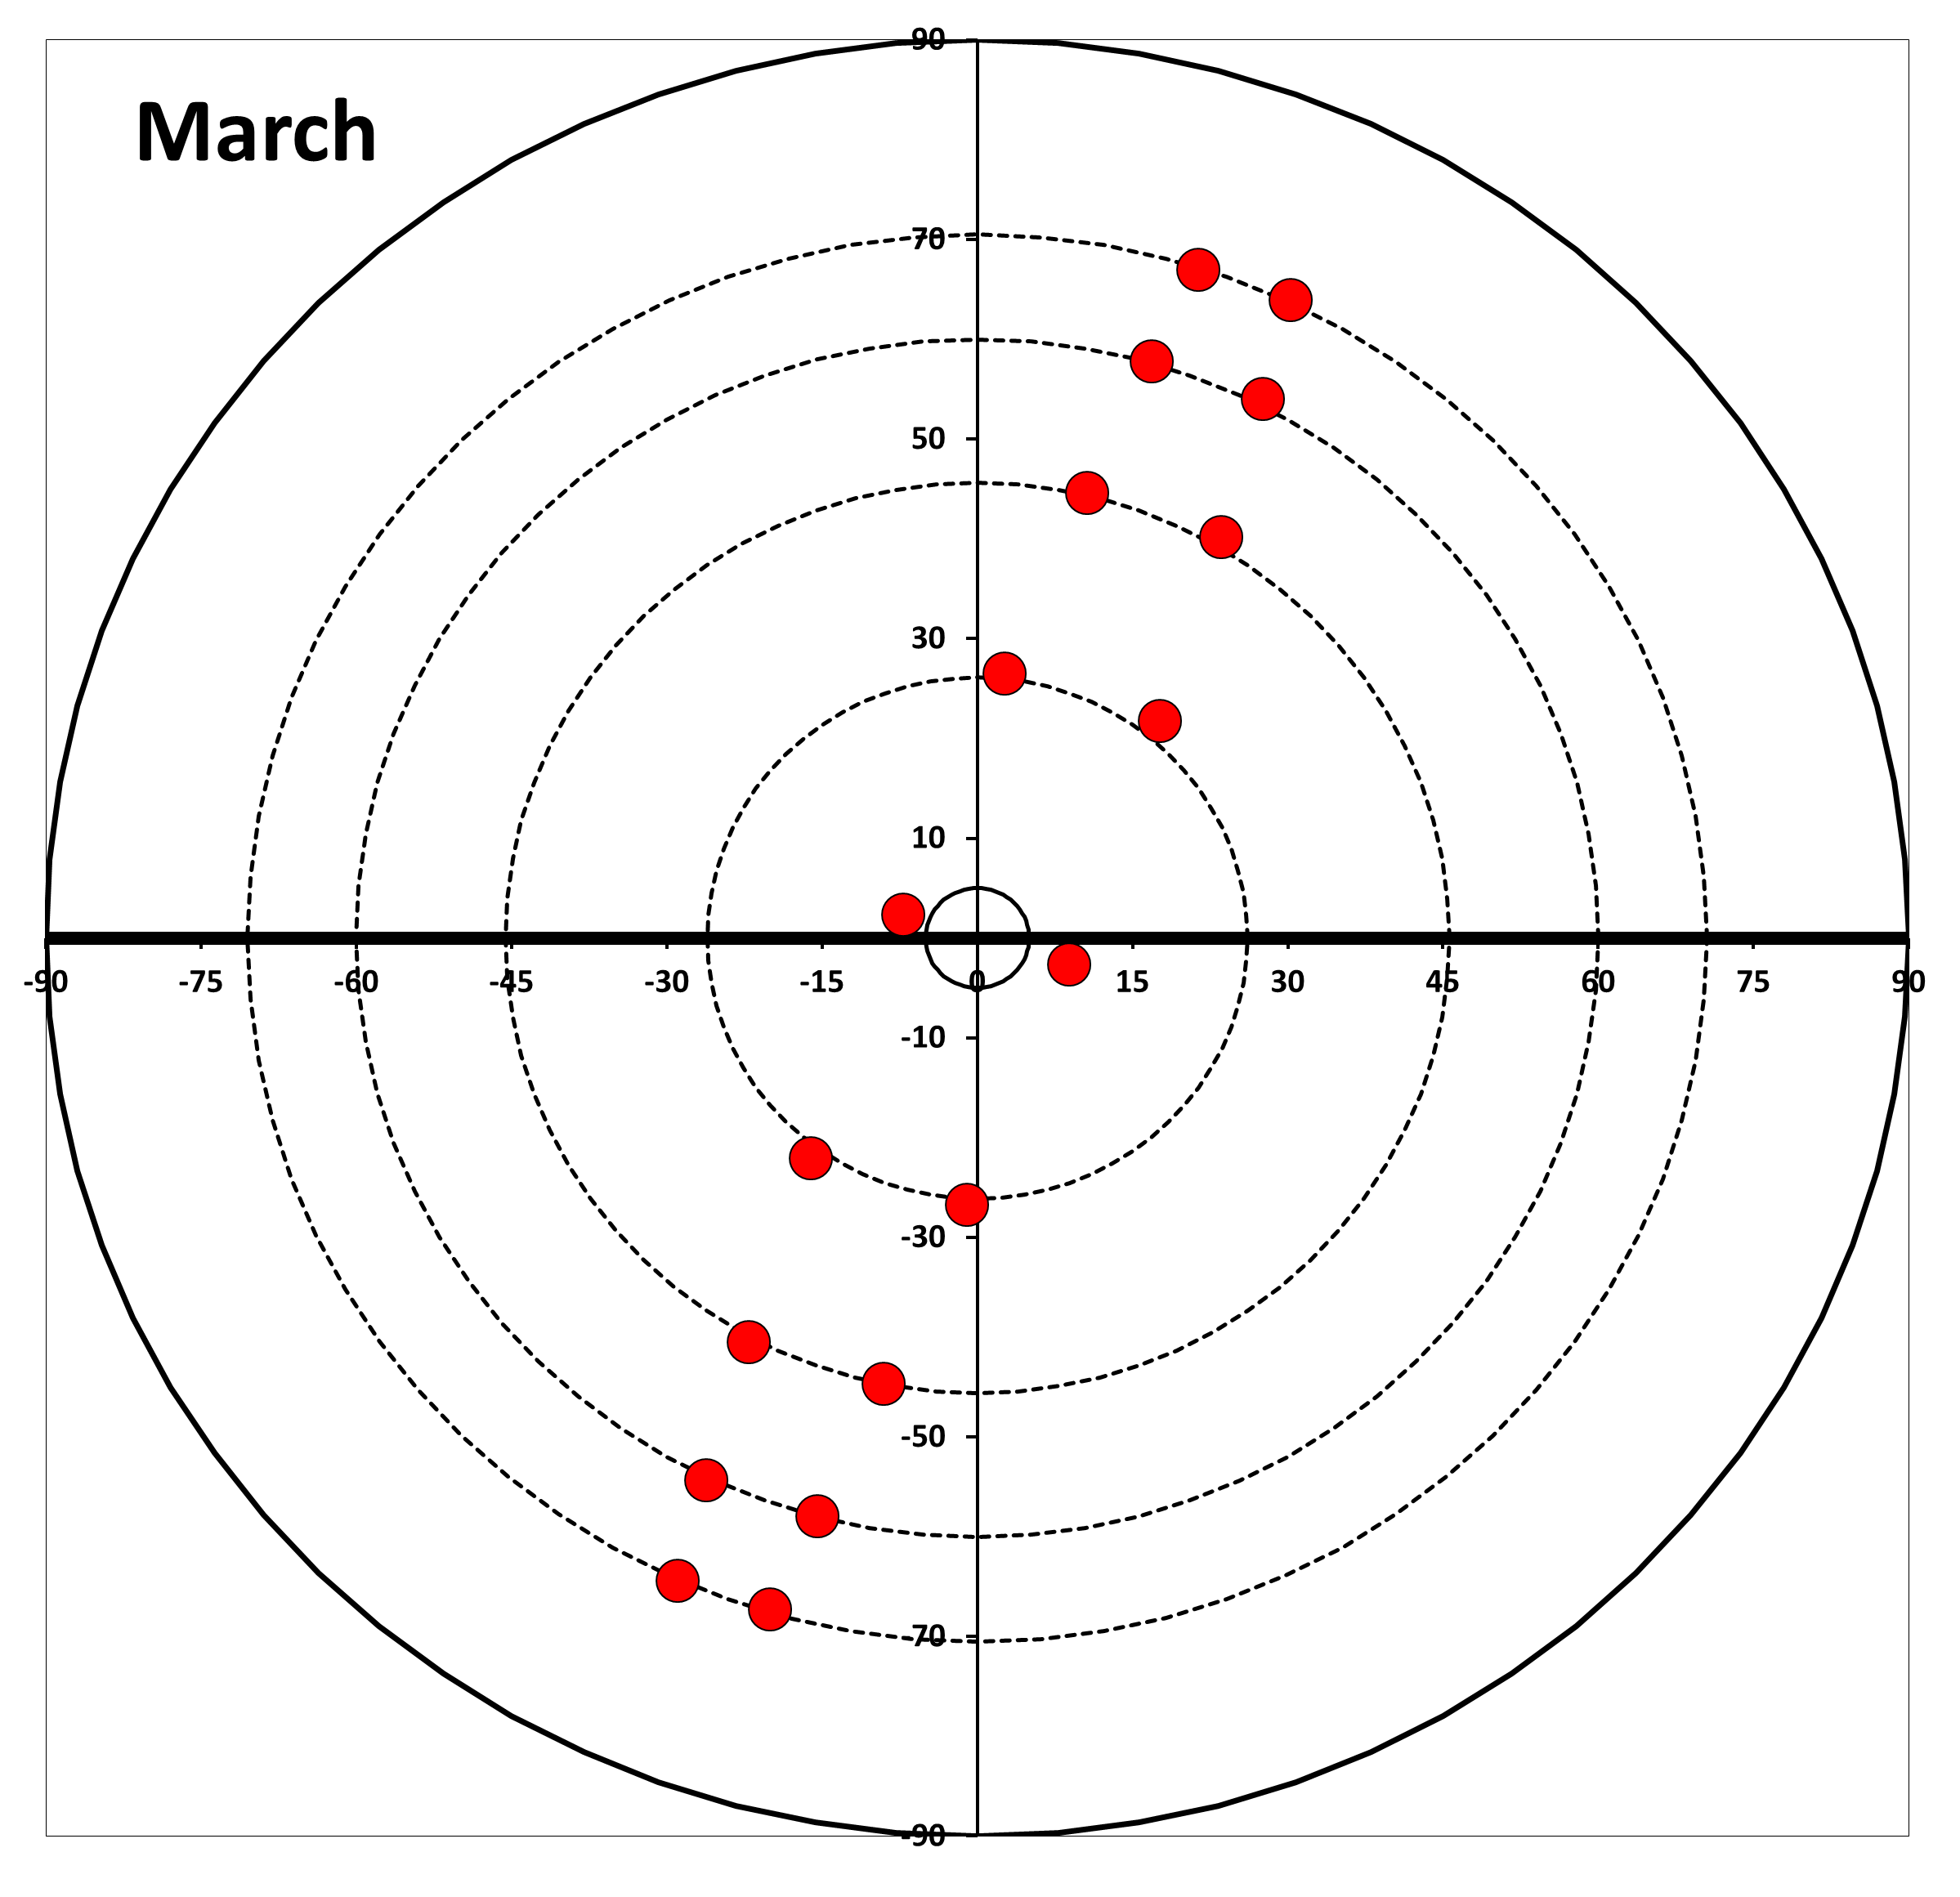
Net Leaf Abscission From Dry to Wet Season (MODIS vs. MISR)
MODIS
(example sampling)
T-MODIS Oct
T-MODIS Mar
A-MODIS Oct
A-MODIS Mar
MISR Oct
MISR Mar
MODIS and MISR data congruent
October EVI greater than March EVI
October to March EVI decrease indicates net leaf abscission
11

Slide 12
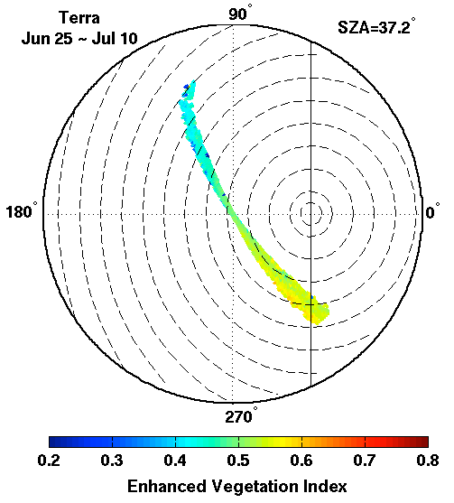
Net Leaf Flushing During the Dry Season
October EVI greater than June EVI at phase angles for which comparable observations exist
June to October EVI increase indicates net leaf flushing
Thus, there must be net leaf abscission during a 12-month cycle, else the result is infinite LAI
12

Slide 13
Conclusions: EVI Analysis
Dry season greening and wet season browning are not artefacts of changing sun-sensor geometry
Amazon forests do not maintain consistent canopy structure and greenness
13

Slide 14
Multi-Sensor & Multi-Product Analysis
14

Slide 15
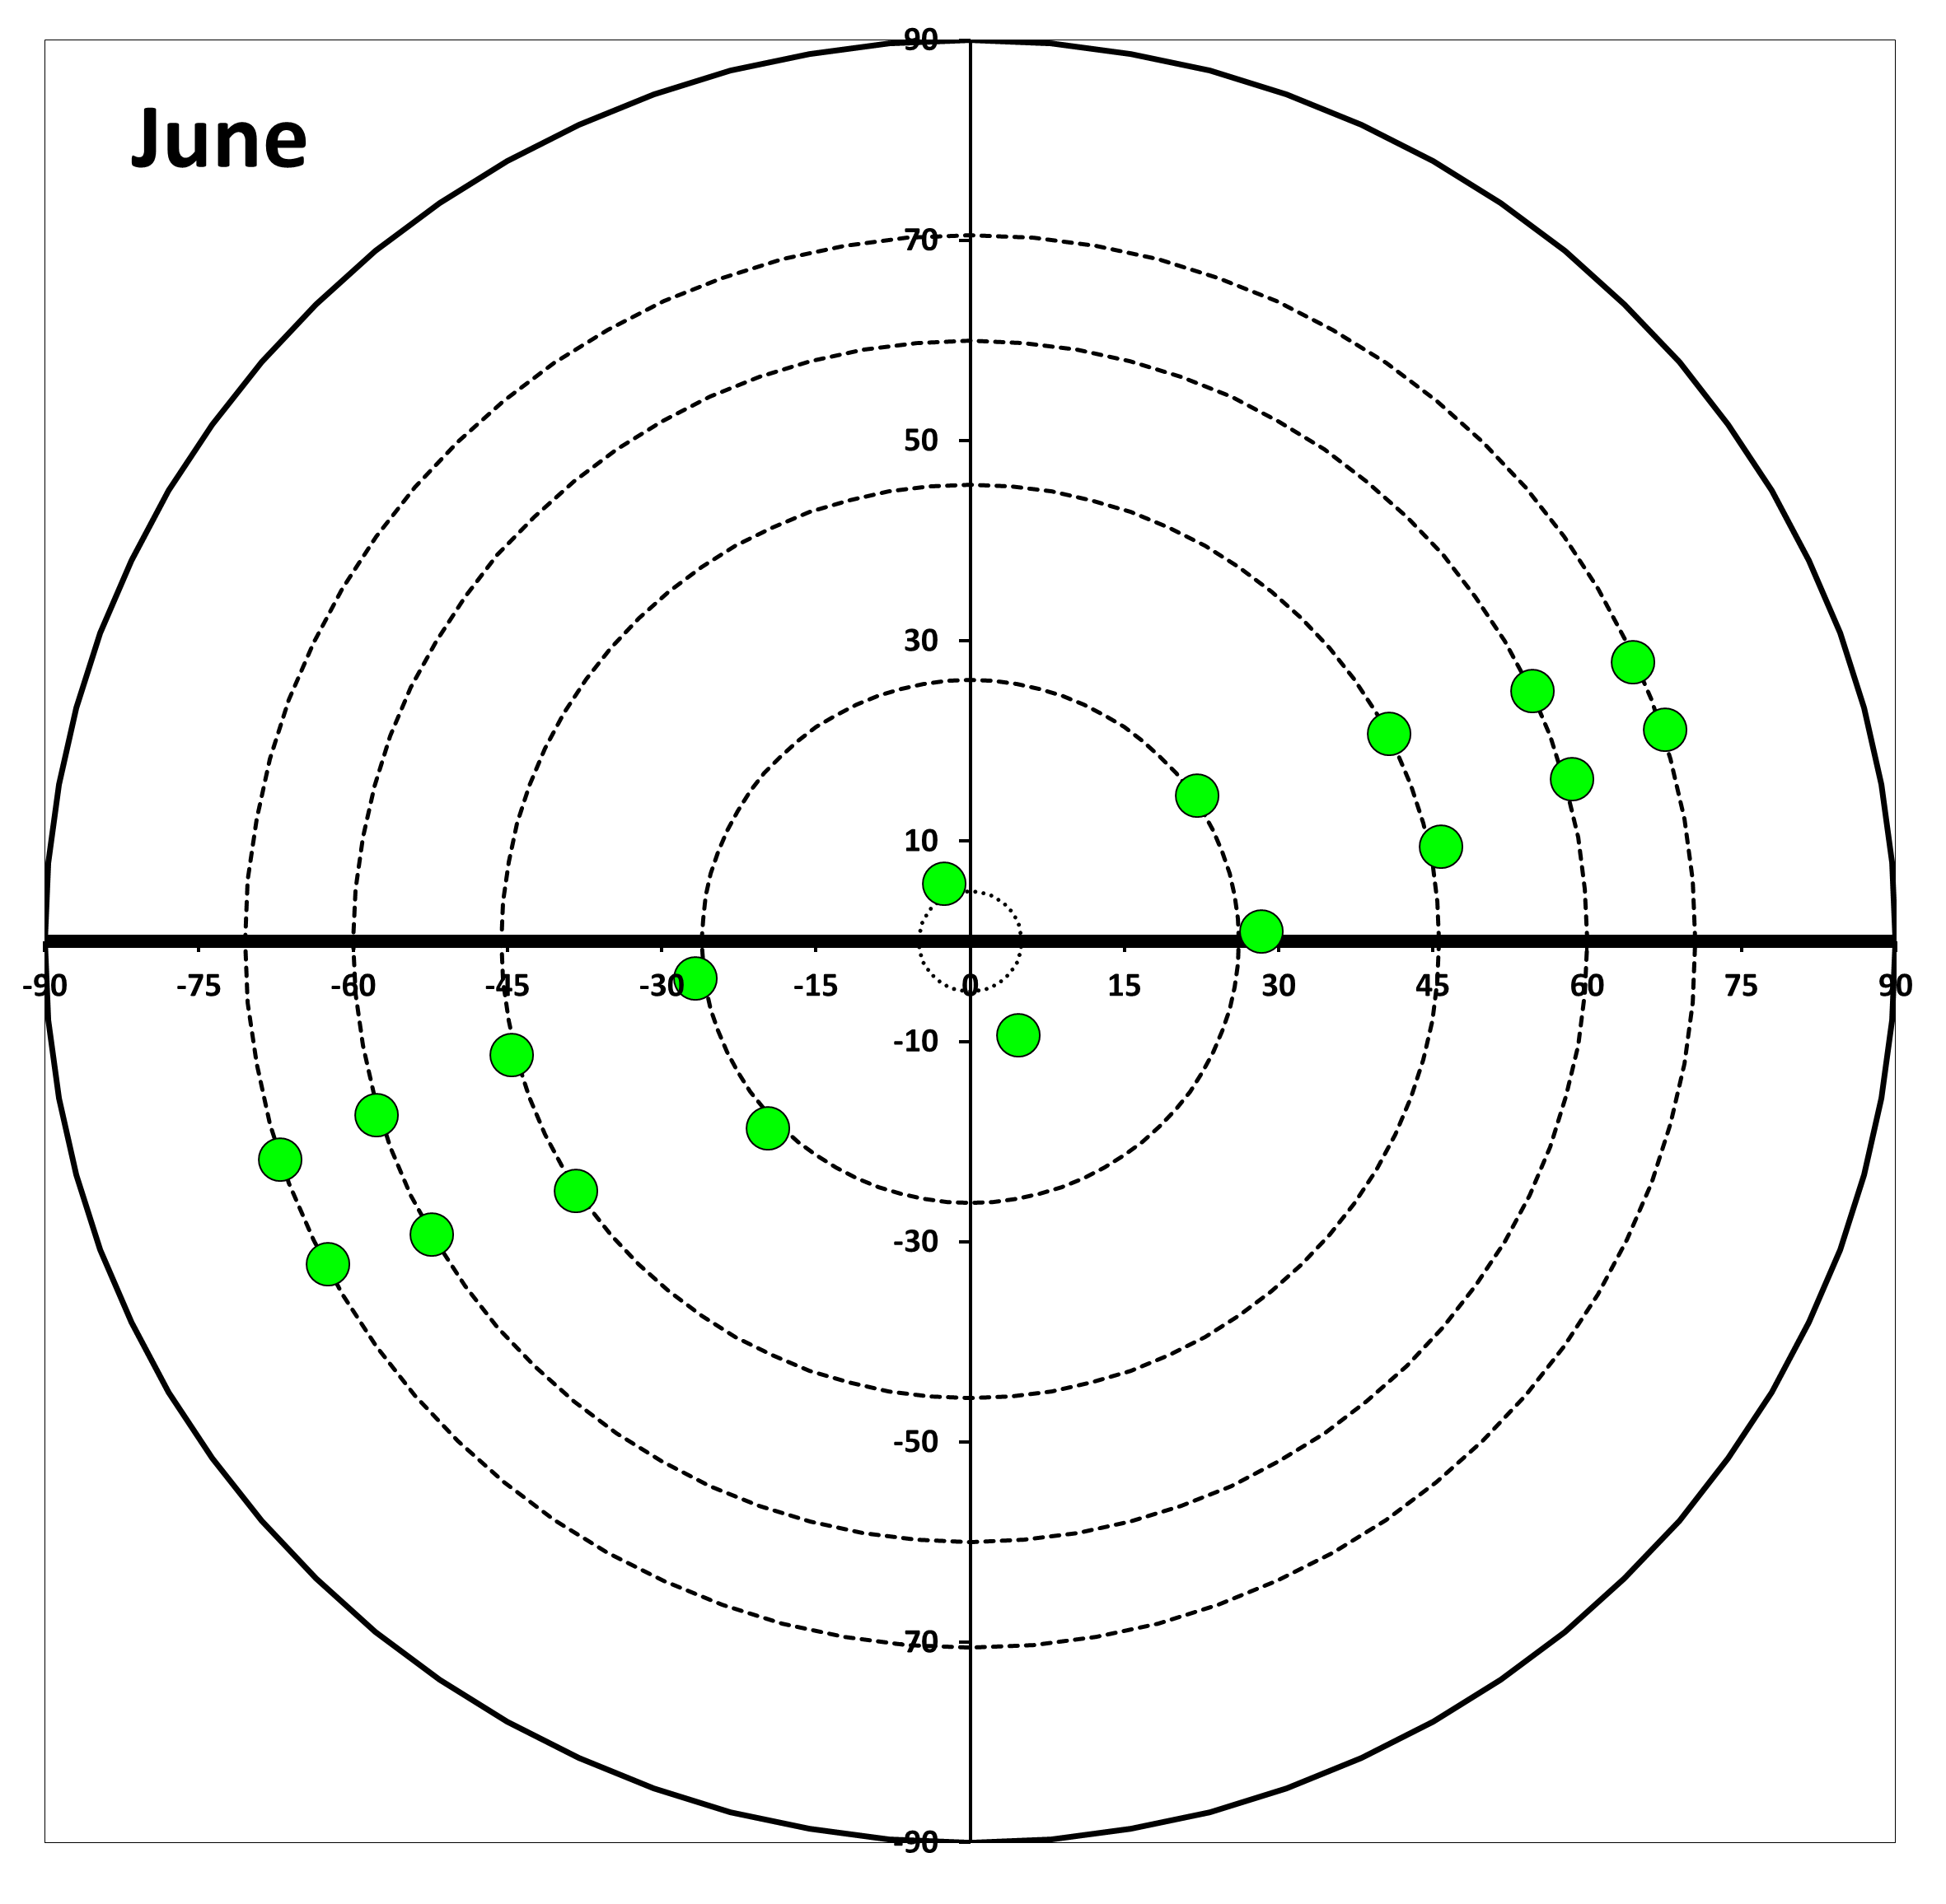
Dry Season Greening
MODIS
MISR
(example sampling)
Evidence for dry season greening:
  Terra & Aqua MODIS EVI (MAIAC) – Courtesy of A. Lyapustin
  Terra MISR Near-infrared reflectance
  Terra MODIS LAI (divided by 10)
These data are free of sun-sensor geometry effects
Note that MODIS and MISR sensors have opposite sampling in these months
If MODIS sampling results in artificial greening, MISR sampling should result in artificial browning
But, in both cases we see greening
15

Slide 16
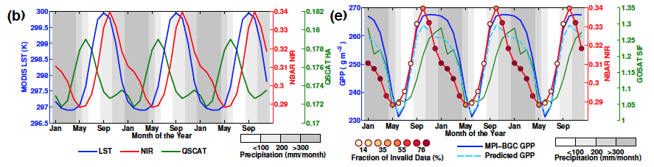
Seasonality in Wet Equatorial Amazon Forests
Figure courtesy of Xu and Saatchi
Seasonality evidenced from multiple data types, sensors and platforms:
  Terra MODIS Land Surface Temperature (LST)
  Terra MODIS NBAR Near-Infrared Reflectance
  QSCAT Backscatter
  GOSAT Sun-Induced Chlorophyll Fluorescence
  Gross Primary Production upscaled from global network of flux towers
Results from this comprehensive analysis concordant with those presented here
16

Slide 17
Conclusions: Multi-Sensor & Multi-Product Analysis
Various products/data from different instruments consistently show seasonality in wet equatorial Amazon forests*
*Vegetation Optical Depth (VOD) from AMSR (Courtesy of Jones, Kimball & Nemani)
17

Slide 18
GLAS Lidar Analysis
18

Slide 19
GLAS Metrics vs. MODIS LAI: Amazon Forests
June: 2005 and 2006
October: 2004 and 2007
By Campaign (no averaging over years)
All GLAS data over Amazon Rainforests
LAI 1km pixels with > 3 Lidar shots
Two Metrics
  WCRH (Centroid)
  Apparent Reflectance (NIR)
No relationship between GLAS Metrics and MODIS LAI
19

Slide 20
GLAS Metrics vs. MODIS LAI: Deciduous Forests
GLAS Centroid saturates beyond LAI of 3
GLAS Apparent NIR Reflectance insensitive to LAI
20

Slide 21
Relationship Between GLAS Metrics: Amazon Forests
Increase in Centroid does not correspond to increased reflectance
Increase in reflectance does not correspond to increased Centroid
21

Slide 22
Conclusions: GLAS Lidar Analysis
GLAS metrics not suitable for determining LAI changes of Amazon forests due to saturation
These forests maintain LAI greater than 5 during the entire seasonal cycle and exhibit a seasonal LAI variation of about 1
The old adage “absence of evidence is not evidence of absence” applies here
22

Slide 23
Overall Conclusions
Wet equatorial Amazon forests do not maintain consistent structure and greenness
They exhibit a distinct light driven seasonal cycle
23

