Slide 1
Collection 6 Status
1. Atmosphere Team
L3 Atmosphere Team Product (MOD/MYD08) +
Joint L2 Product (MOD/MYDATML2) +
browse imagery, etc.
2. Cloud Optical Properties
part of MOD/MYD06 product +
MYD02 Band 1/2 1km re-registration
MOD06: S. Platnick, G. Wind, N. Amarasinghe, B. Marchant, J. Riedi, G. T. Arnold, K. Meyer, M. D. King, Z. Zhang, C. Wang, R. Holz, S. A. Ackerman, P. Yang, B. Baum, …
MODATML2: G. Britzolakis, S. Platnick, B. Ridgway
MOD08: P. Hubanks, S. Platnick, B. Ridgway
MYD02 1km re-registration: R. Wolfe, R. Bennartz, S. Platnick
with thanks to MODAPS & the Atmosphere PEATE at U. Wisconsin-Madison
MOD06, MOD08, etc.: Platnick et al., MODIS STM, 29 April 2014

Slide 2

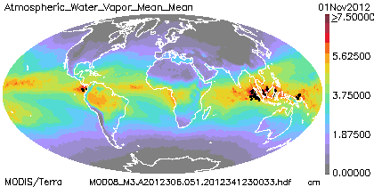
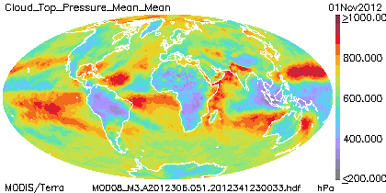
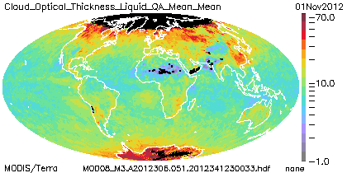
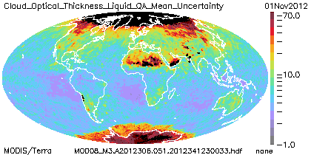
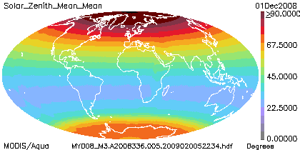
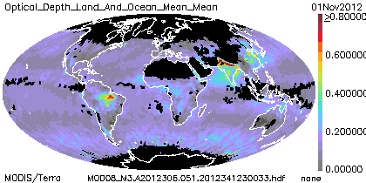
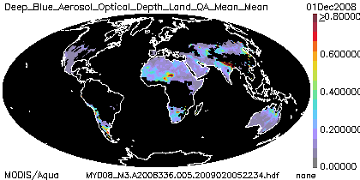
1. Atmosphere Team
MOD06, MOD08, etc.: Platnick et al., MODIS STM, 29 April 2014

Slide 3
Atmosphere Team C6 Status
  Aqua L2 reprocessing started in Dec 2013
    MYD04/06 and updated MYD35/05/07 with re-aggregated L1 1km
    Reprocessing status: competed through ~ Oct. 2013 (as of 28 Apr)
    Forward processing status: started on Jan. 1, 2014 but being re-done due to ancillary production rule problem for cloud optical products
Terra L2 reprocessing status
  Updated MCST Terra band 5 (1.24 µm) de-trending code ready for delivery to MODAPS
  MOD04 Deep Blue: mid-May for next (final?) science test delivery
Aqua/Terra L3 (MOD08_D3, _E3, _M3)
  All SDS code updates other than MOD06 completed and tested. Testing of MOD06 Optical Properties and Cloud-Top code this week.
  Change in ‘Definition of Day’ algorithm implemented/tested
  Updated browse imagery and UI (Starry Monoharan)
Webinar series (lead: Rich Kleidman)
MOD06, MOD08, etc.: Platnick et al., MODIS STM, 29 April 2014

Slide 4
MOD08 Collection 6 Change Highlights
Notable SDS Change Summary
  Aerosols (MOD04): Addition of 2D aerosol histograms, SDS deletions and renaming, non-pixel count multiday weightings.
  Cloud-top (MOD06): Addition of cloud-top stats by restricted Sensor ZA limits. Addition of surface type fraction. Improved bin resolution for calculation of means vs. pressure height (high, middle, low). Cloud-top height SDSs.
  Cloud optical properties (MOD06): Addition of cloud optical property SDSs (e.g., 1.6 & 3.7 µm-derived parameters), removal of QA SDSs.
Definition of Day
  UTC definition results in daytime discontinuities in (sub)tropics.
  Inconsistent with other instrument team approaches. Can impact daily gridded comparisons but makes little difference to monthly analysis.
MOD06, MOD08, etc.: Platnick et al., MODIS STM, 29 April 2014
Notes:
Aerosol: 3x joint histos (ex., AOD vs. angst. exp1; AOD vs. angst. Exp1; AOD vs. small mode ratio)
CT: sfc type = snow, gilnt, desert, …
COP: PCL stats added

Slide 5
MOD08 C6 SDS Change Summary
Product | SDSs Added/Modified | SDSs Renamed | SDSs Deleted
Aerosol: Dark Target | 19 | 10 | 24
Aerosol: Deep Blue | 8 | – | –
Cloud-Top Properties | 60 | – | –
Cloud Optical Properties | 54 | 10 | numerous (incl. all QA-weighted)
Solar/View Geometry Stats | 12 | – | –
Item | No. Lines of Code
Common Data Language (CDL) File Specifications | 120,000 (+70%)
C, F90, F77 code | 180,000 (+34%)
Ancillary files (process control, packing lists, etc.) | 8,000 (+16%)
Comments | 21,000 (+7%)
L3 C6 code metrics and changes relative to C5.
Each SDS changed needs to be implemented in 4 files (tile, daily, 8-day, & monthly).
MOD06, MOD08, etc.: Platnick et al., MODIS STM, 29 April 2014
Notes:
153 SDSs added – to 4 files (tile, daily, …) - many 1D or 2D histograms. The # lines of code on right => need an automated way to build up our filespec text files.
CTP: 30 of the SDSs added are 1D or 2D histograms
COP: PCL stats added
Each change in a file involves ~15-30 lines of code in the flle-spec

Slide 6
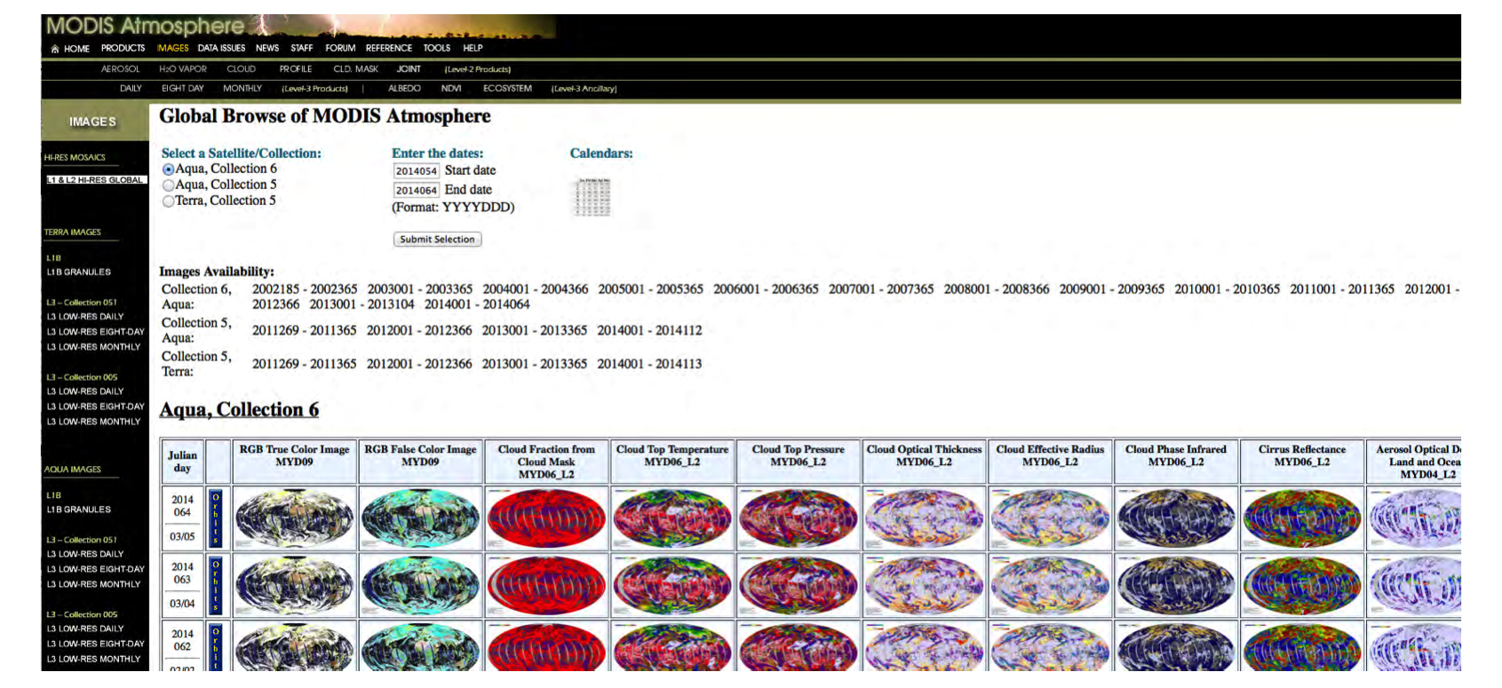
MOD08 Collection 6 Browse Imagery
http://modis-atmos.gsfc.nasa.gov/IMAGES
L2 browse
(Min Feng)
L3 browse
(S. Monoharan,
B. Ridgway)

Slide 7
MOD08 Collection 6 Documentation
http://modis-atmos.gsfc.nasa.gov/products_C006update.html
MOD06, MOD08, etc.: Platnick et al., MODIS STM, 29 April 2014

Slide 8
Webinar Series Draft Schedule (July–Sept 2014)
Goal: Educate user community on the MODIS atmosphere products in conjunction with the release of C6 via weekly webinar sessions.
Session/Topic:
MODIS C6 overview, web resources, etc.: Platnick, Xiong
MOD04 Dark Target: Levy
MOD04 Deep Blue: Sayer
MOD04 Overview/Combined DB-DT and 3 km product: Levy, Sayer
MOD35 Cloud Mask: Ackerman
MOD06 Cloud-Top/Optical properties: Ackerman, Platnick
MOD06 Optical Properties: Platnick
MOD08 Atmosphere Team L3 products: Hubanks, Ridgway, Platnick
Data Acquisition LAADS, LANCE, WorldView, MIRADOR, ECHO–REVERB: TBD
Giovanni – Aerosols Express: Chris Lynnes
MODIS Atmo Educational Materials and Resources: Kleidman
MOD06, MOD08, etc.: Platnick et al., MODIS STM, 29 April 2014
Notes:
Near Real Time Data Products (LANCE) and WorldView/GIBS: [TBD]

Slide 9
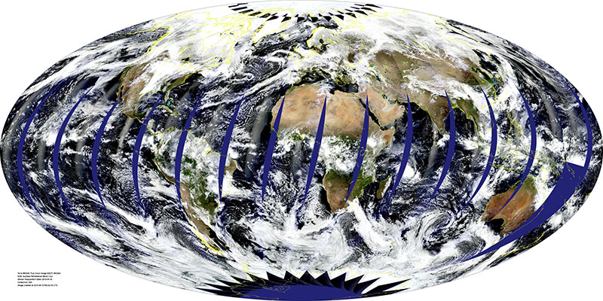
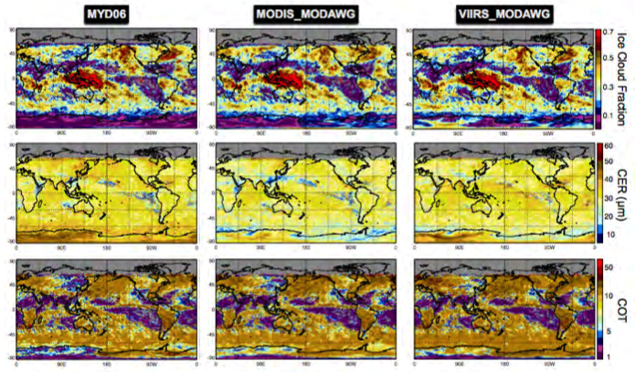
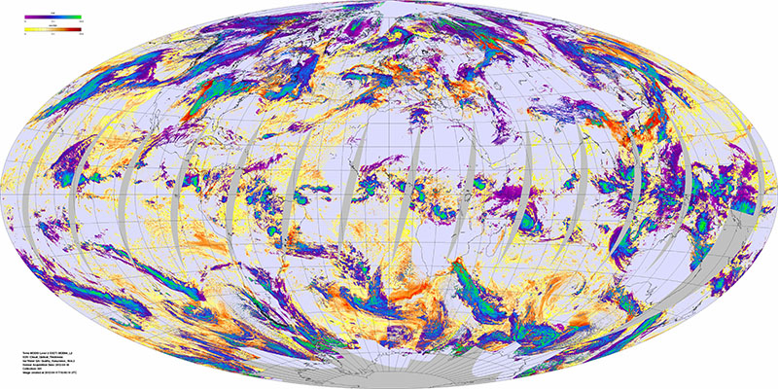
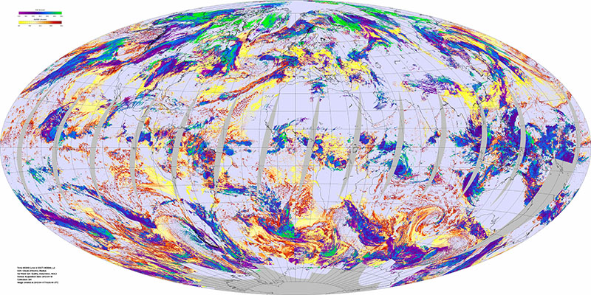
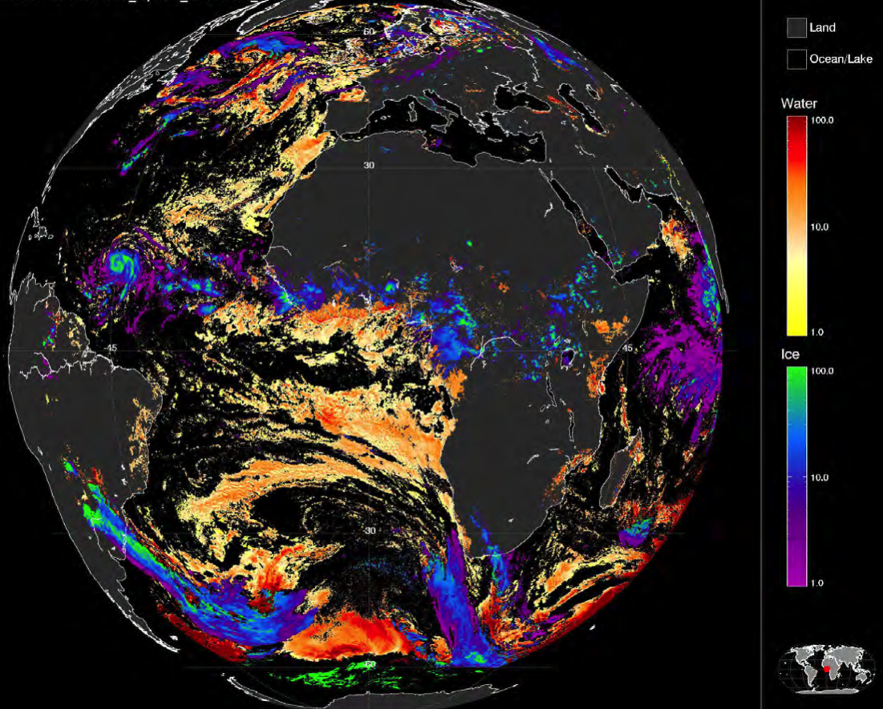
2. Level-2 Cloud Optical Properties (MOD/MYD06)
+ “Chimaera” multi-sensor retrieval package
MODIS
common VIIRS/MODIS algorithm
eMAS
SEVIRI
MOD06, MOD08, etc.: Platnick et al., MODIS STM, 29 April 2014

Slide 10
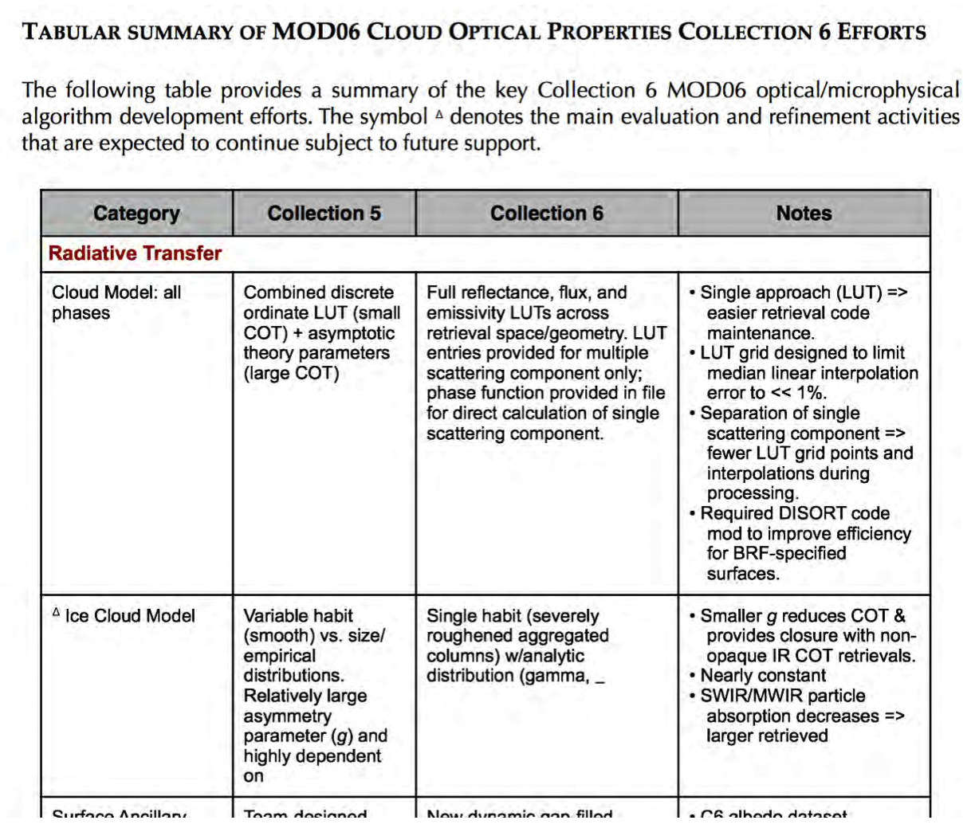
MOD06 Collection 6 Change Highlights
(see poster by Wind et al.)
Radiative transfer models and related ancillary datasets
Algorithm
  Retrieval Science (e.g., retrieval phase)
  QA assignment/filtering (e.g., partly cloudy FOVs)
  Pixel-level uncertainties
modis-atmos.gsfc.nasa.gov/_docs/C6MOD06OPExecSum.pdf
MOD06, MOD08, etc.: Platnick et al., MODIS STM, 29 April 2014

Slide 11
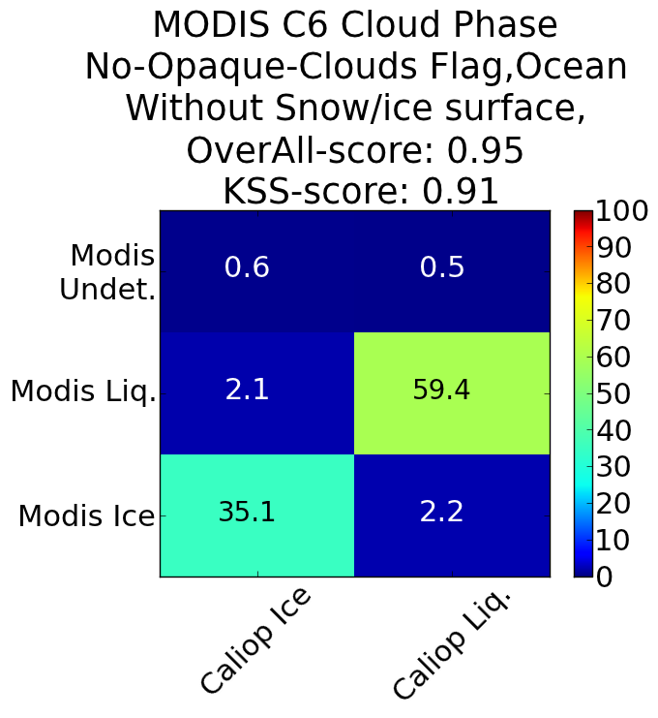
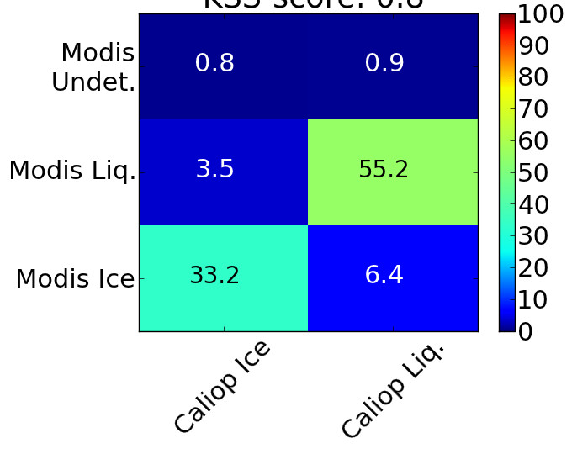
MOD06 C6 Change Highlight: Retrieval Phase
(see poster by Marchant et al.)
Combined IR and SWIR/VNIR tests (reflectance ratio tests replaced with separate ice and liquid water retrievals). CALIOP, POLDER validation.
MODIS vs. CALIOP: Ocean Scenes Only, CSR=0, Jan. 2008
MODIS C6
Hit rate = 0.95
KSS score = 0.91
MODIS C5
Hit rate = 0.88
KSS score = 0.80
MOD06, MOD08, etc.: Platnick et al., MODIS STM, 29 April 2014
Notes:
Values are normalized so that the sum over each matrix is100%.
Hanssen-Kuiper Skill Score (KSS) : The score has a range of -1 to +1, with 0 representing no skill. Also: HSS =/= Hit – False Positive (FAR) with proper normalization for just those 4 entries.

Slide 12
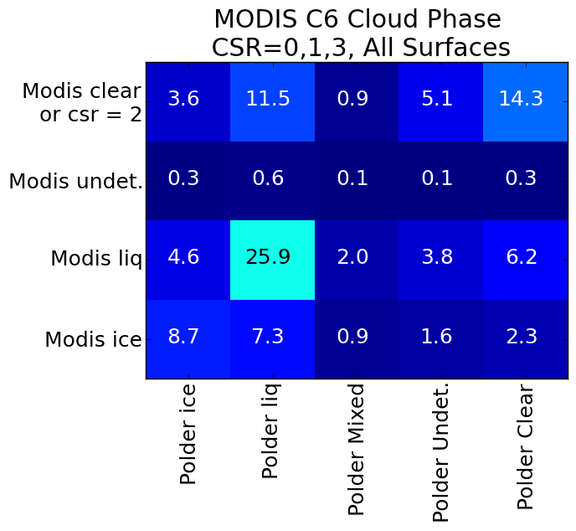
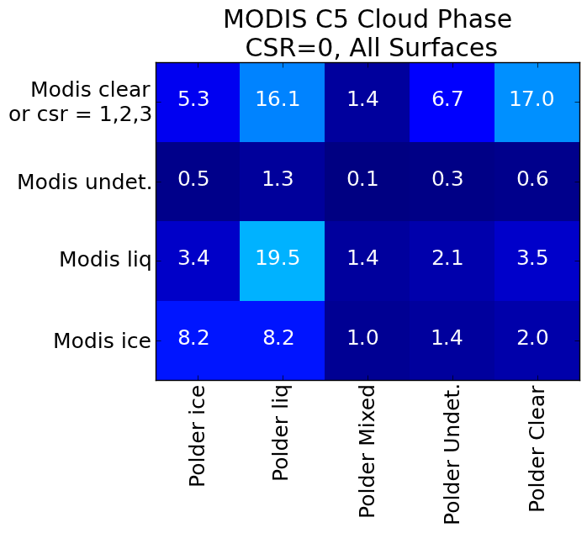
MOD06 C6 Change Highlight: Retrieval Phase
MODIS vs. POLDER: All Scenes, Jan. 2008
MODIS C6
MODIS C5
MODIS C6 (CSR=0,1,3)
Hit rate = 0.73
MODIS C5 (CSR=0)
Hit rate = 0.67
MOD06, MOD08, etc.: Platnick et al., MODIS STM, 29 April 2014
Notes:
Hit rate: ignored POLDER mixed and undet. => exact calc as for CALIOP
Unlike CALIOP, POLDER has undetermined and mixed categories. Also much larger spatial resolution than MODIS needed to filter our POLDER FOVs that have heterogeneous phase according to MODIS. Also, unlike CALIOP comparisons, these comparisons are done over the common POLDER/MODIS swath, so a more complete range of view angles.
Hit Rate calc doesn’t include ‘clear’ sky comparisons

Slide 13
MOD06 C6 Change Highlight: Retrieval Phase
MODIS vs. CALIOP: July 2008, CSR=0
Surface | Ocean |  | Land |  | Desert & snow/ice
CALIOP cloud opacity | Thin | Opaque | Thin | Opaque | Thin | Opaque
C6 retrieval phase | 0.85 0.72 | 0.95 0.92 | 0.79 0.65 | 0.93 0.88 | 0.77 0.62 | 0.88 0.77
C5 retrieval phase | 0.73 0.62 | 0.89 0.87 | 0.65 0.51 | 0.89 0.82 | 0.56 0.53 | 0.62 0.72
C6 IR phase | 0.85 0.73 | 0.82 0.81 | 0.69 0.68 | 0.76 0.89 | 0.43 0.70 | 0.44 0.83
Hit Rate KSS
MOD06, MOD08, etc.: Platnick et al., MODIS STM, 29 April 2014
Notes:
Unlike CALIOP, POLDER has undetermined and mixed categories. Also much larger spatial resolution than MODIS needed to filter our POLDER FOVs that have heterogeneous phase according to MODIS. Also, unlike CALIOP comparisons, these comparisons are done over the common POLDER/MODIS swath, so a more complete range of view angles.
Hit Rate calc doesn’t include ‘clear’ sky comparisons

Slide 14
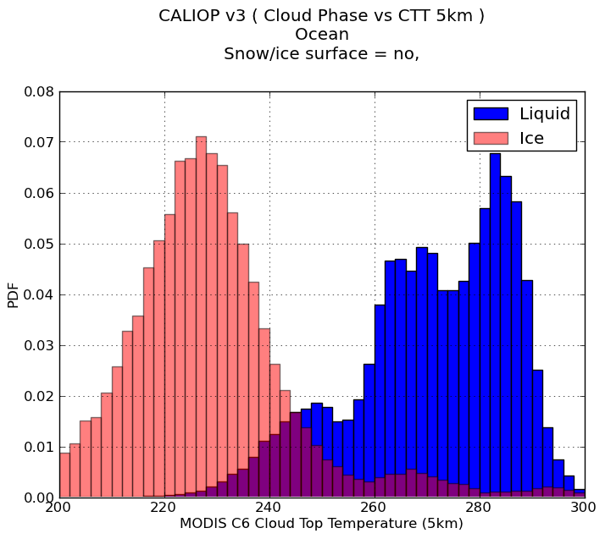
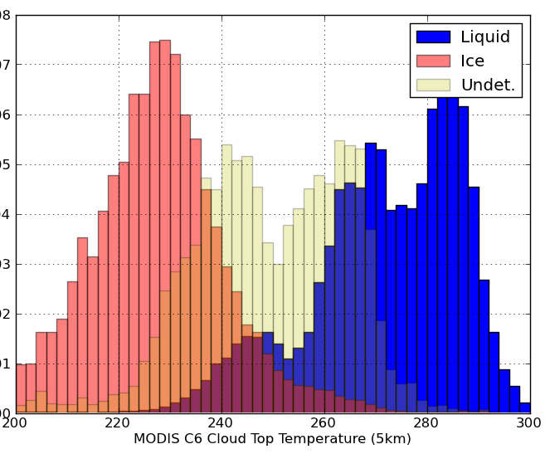
MOD06 C6 Change Highlight: Retrieval Phase
Phase vs. CTT over non-ice ocean, Jan. 2008,
filtered by CALIOP single phase in the column
CALIOP v3 Phase
MOD06 C6 Phase, CSR=0
63%
37%
63%
36%
1%
PDF
MYD06 C6 CTT (5km)
MYD06 C6 CTT (5km)
MOD06, MOD08, etc.: Platnick et al., MODIS STM, 29 April 2014
Notes:
Each ‘color’ is normalized to unity separately

Slide 15
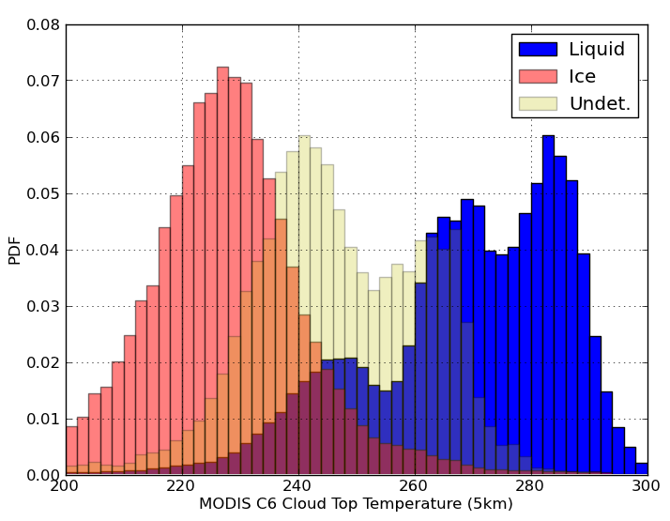
MOD06 C6 Change Highlight: Retrieval Phase
Phase vs. CTT over non-ice ocean, Jan. 2008,
filtered by CALIOP single phase in the column (LHS only)
CALIOP v3 Phase
MOD06 C6 Phase, CSR=0
MYD06 C6 CTT (5km)
MYD06 C6 CTT (5km)
MOD06, MOD08, etc.: Platnick et al., MODIS STM, 29 April 2014
Notes:
Each ‘color’ is normalized to unity separately

Slide 16
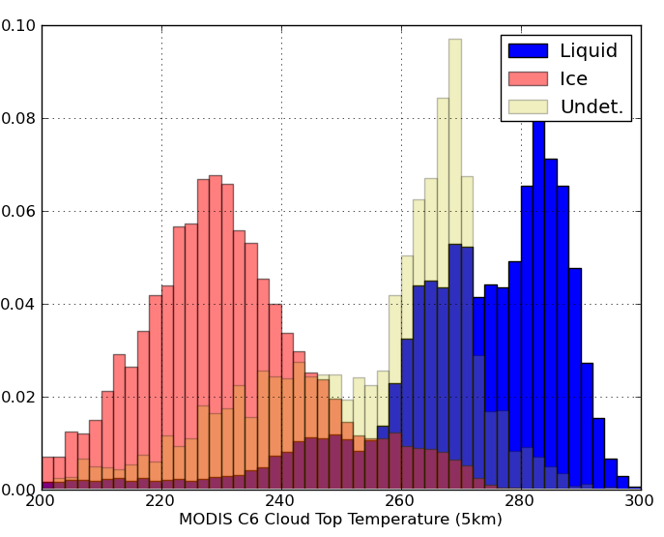
MOD06 C6 Change Highlight: Retrieval Phase
Phase vs. CTT over non-ice ocean, Jan. 2008,
filtered by CALIOP single phase in the column
CALIOP v3 Phase
MOD06 C5 Phase
63%
37%
2%
39%
59%
PDF
MYD06 C6 CTT (5km)
MYD06 C6 CTT (5km)
MOD06, MOD08, etc.: Platnick et al., MODIS STM, 29 April 2014

Slide 17
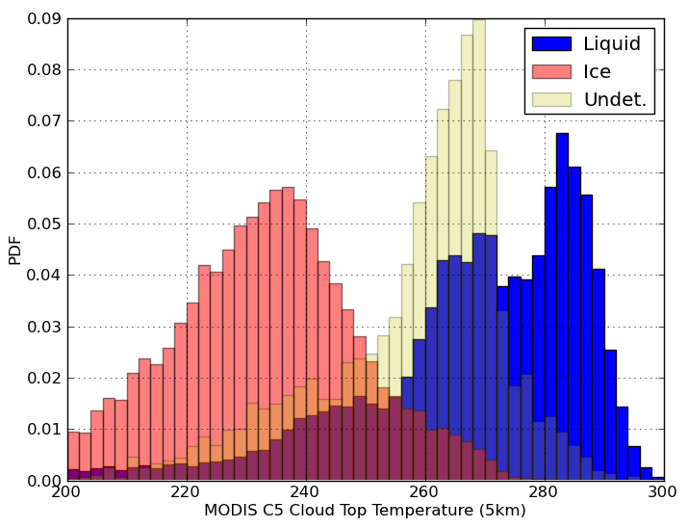
MOD06 C6 Change Highlight: Retrieval Phase
Phase vs. CTT over non-ice ocean, Jan. 2008,
filtered by CALIOP single phase in the column (LHS only)
CALIOP v3 Phase
MOD06 C5 Phase
MYD06 C6 CTT (5km)
MYD06 C6 CTT (5km)
MOD06, MOD08, etc.: Platnick et al., MODIS STM, 29 April 2014

Slide 18
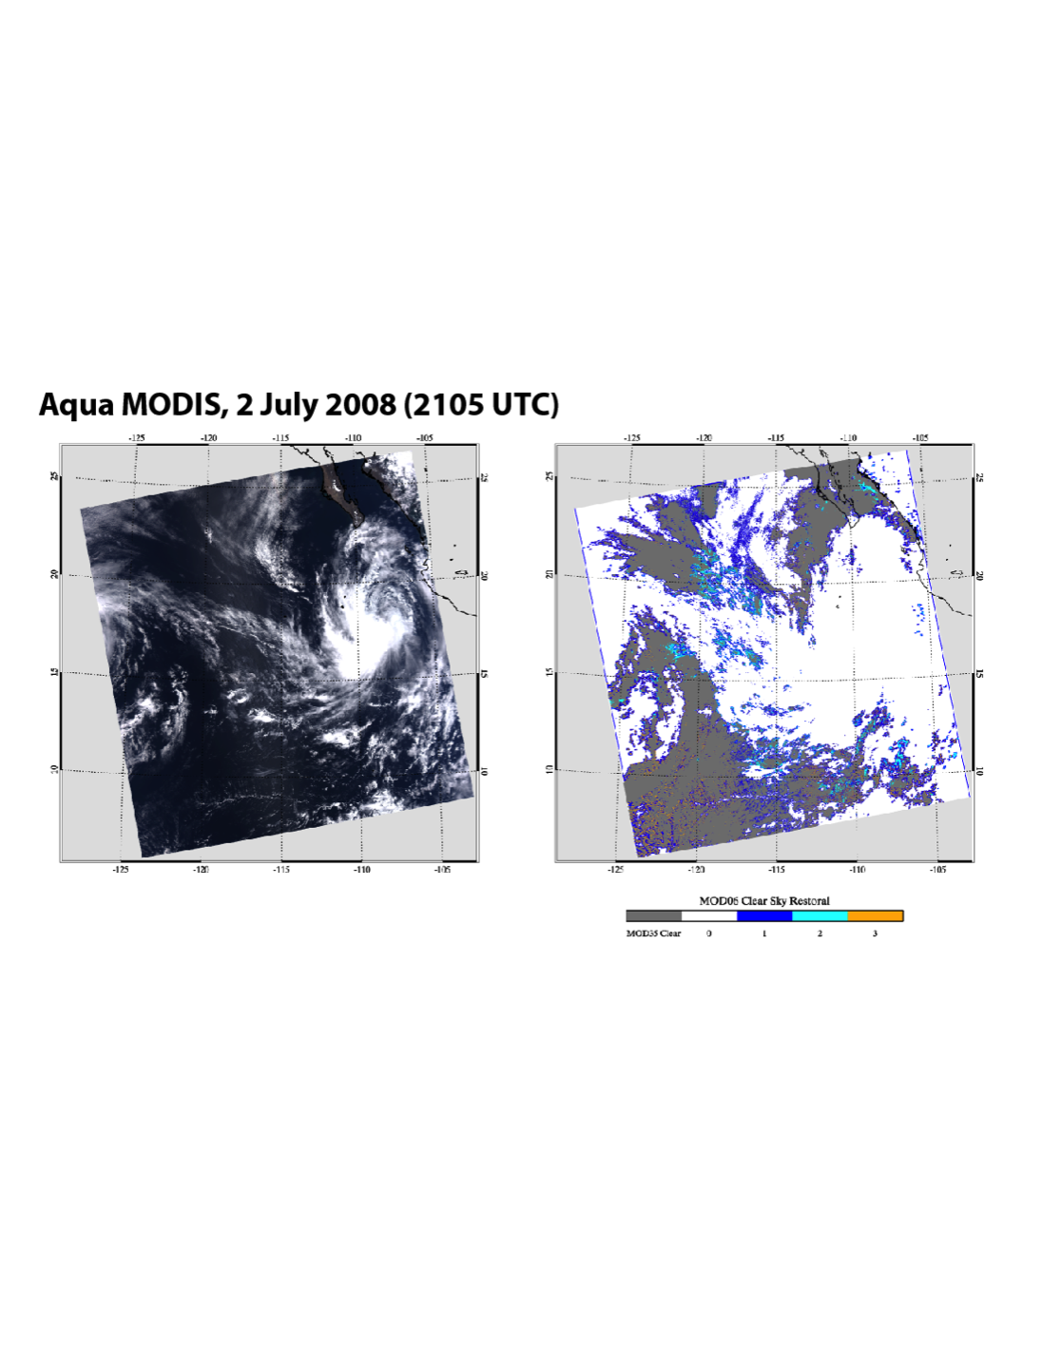
MOD06 C6 Change Highlight: “Partly Cloudy” (PCL) FOVs
(see poster by Meyer et al.)
Attempt retrievals on pixels expected to be partly cloudy (Clear Sky Restoral algorithm). Provide solution space metrics on failed retrievals.
Aqua MODIS, 2 July 2008 (2105 UTC)
Clear Sky Restoral Flags
MOD35
clear
MOD35
cloudy
1
2
3
“Partly
Cloudy”
MOD06, MOD08, etc.: Platnick et al., MODIS STM, 29 April 2014

Slide 19
MOD06 C6 Change Highlight: “Partly Cloudy” (PCL) Pixels
(see poster by Meyer et al.)
Attempt retrievals on pixels expected to be partly cloudy (Clear Sky Restoral algorithm). Provide solution space metrics on failed retrievals.
Aqua MODIS, 2 July 2008
Clear Sky Restoral Flags
MOD35
clear
MOD35
cloudy
1
2
3
“Partly
Cloudy”
MOD06, MOD08, etc.: Platnick et al., MODIS STM, 29 April 2014

Slide 20
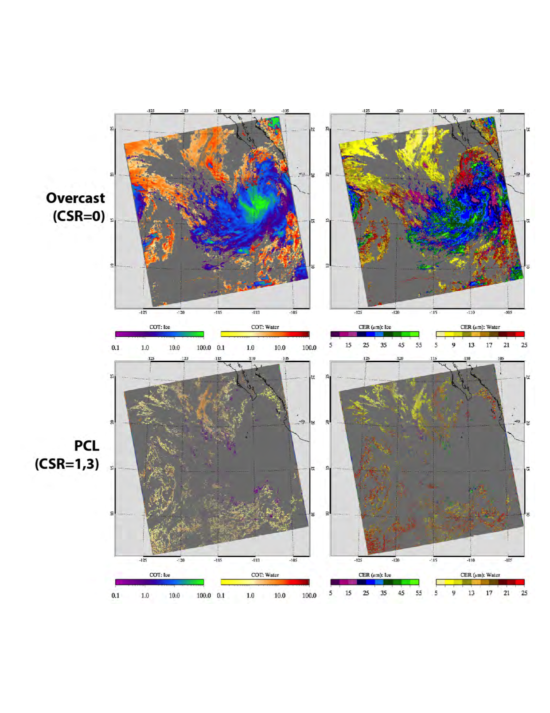
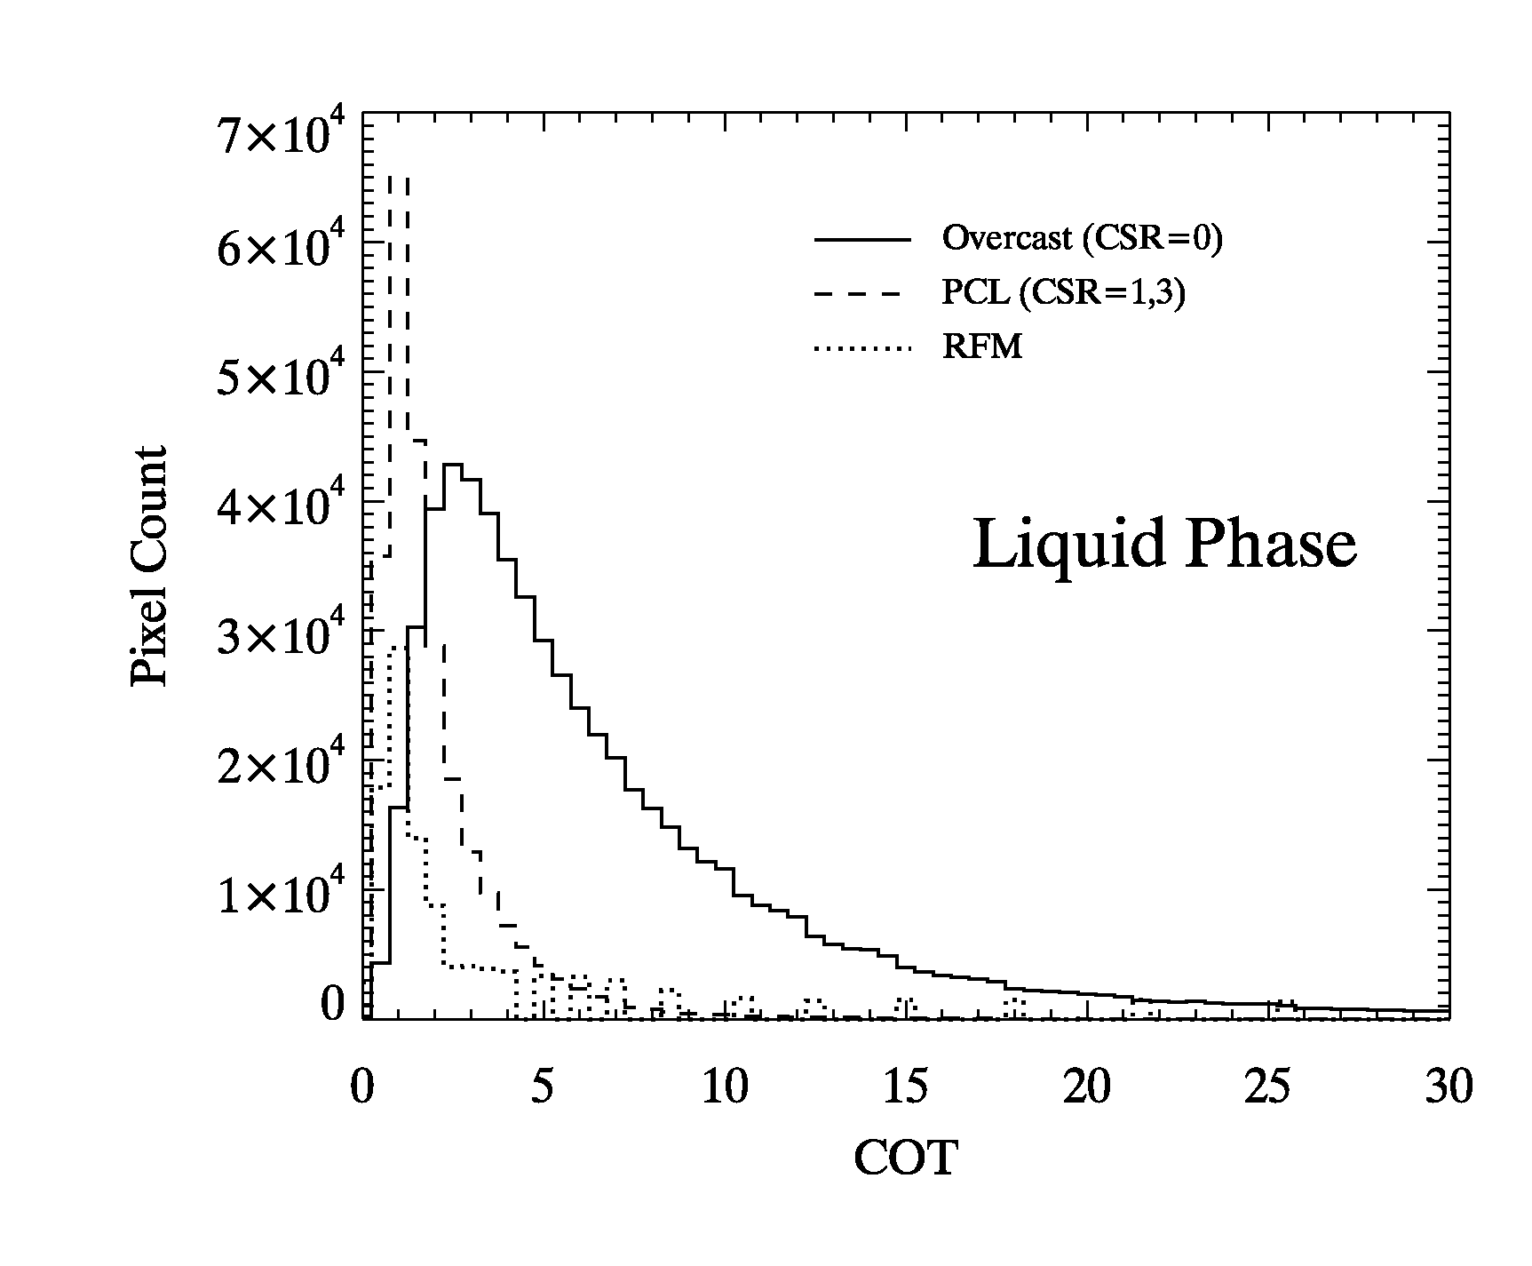
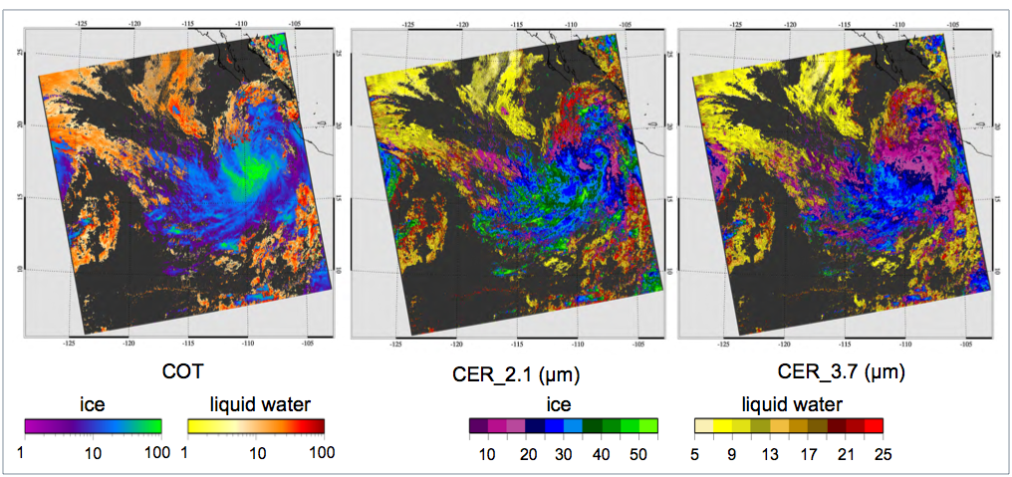
MOD06 C6 Change Highlight: “Partly Cloudy” (PCL) Pixels
Optical Thickness
Eff. Radius (2.1µm)
Overcast
(CSR=0)
PCL
“overcast” pixels
PCL
(CSR=1,3)
from Retrieval Failure Metric SDS
µm
MOD06, MOD08, etc.: Platnick et al., MODIS STM, 29 April 2014

Slide 21
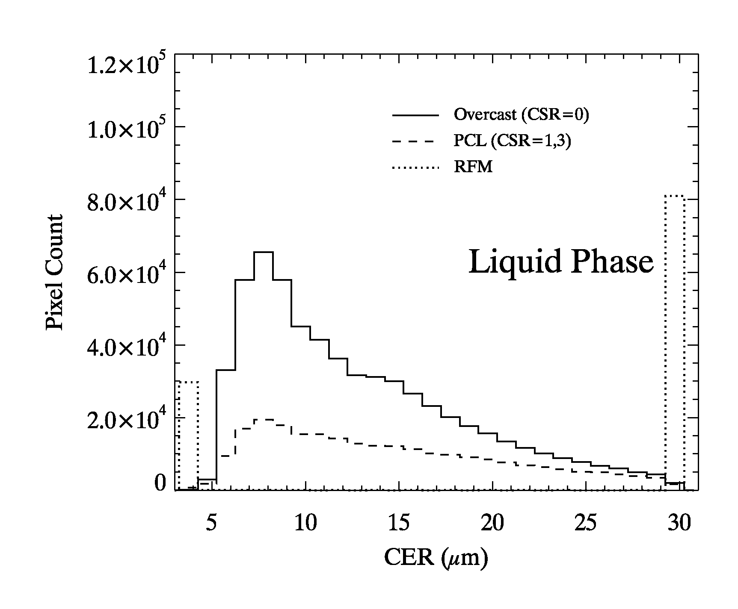
MOD06 C6 Change Highlight: “Partly Cloudy” (PCL) Pixels
Optical Thickness
Eff. Radius (2.1µm)
Overcast
(CSR=0)
“overcast” pixels
PCL
PCL
(CSR=1,3)
Retrieval
Failure Metric SDS
µm
MOD06, MOD08, etc.: Platnick et al., MODIS STM, 29 April 2014

Slide 22
Overcast Pixels
PCL
Aqua MODIS Liquid Clouds April 2005 Monthly L3
Cloud Retrieval Fraction
COT
MOD06, MOD08, etc.: Platnick et al., MODIS STM, 29 April 2014

Slide 23
Overcast Pixels
PCL
Aqua MODIS Liquid Clouds April 2005 Monthly L3
Cloud Retrieval Fraction
CER 1.6µm
CER 2.1µm
CER 3.7µm

Slide 24
