Slide 1
Terra: Aging Spacecraft and Considerations of Maintaining Mean Local Time vs. Maintaining Altitude and Allowing MLT to Drift
K. Thome, T. Heyd, D. Mantziaras, J. Hendrickson, A. Kelly
NASA/GSFC

Slide 2
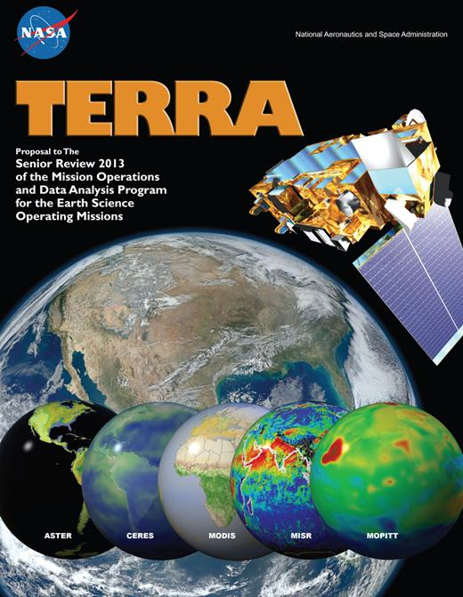
Response to the 2013 Senior Review
Terra Mission Team
(GSFC)
Project Scientist (P.S.) – Kurtis J. Thome
Deputy P.S. - Si-Chee Tsay
Deputy P.S. for Data - Robert E. Wolfe
ESMO Project Manager – Wynn Watson
Instrument PIs & Team Leaders (T.L.)
ASTER: Japan T.L. : H. Tsu
US T.L. : Michael Abrams (JPL)
CERES: P.I. - Norman Loeb (LaRC)
MISR: P.I. - David Diner (JPL)
MODIS: T.L. - Michael King (UC/LASP)
MOPITT : Canada P.I. - James Drummond
(Dalhousie University)
US P.I. - John Gille (NCAR)

Slide 3
Terra status
Terra and its five sensors remain very healthy 14+ years into its mission
Terra spacecraft can support full science operation
All instruments, except ASTER’s SWIR bands, being fully operational
Terra is expected to be functional through 2020 based on predicted battery performance and available fuel
  No other life-limiting subsystem-specific issues
  Result of well-built and engineered system
Success of Terra also due to a collaborative effort between
  Science teams
  Algorithm developers
  Instrument teams
  Flight Operations Team

Slide 4
AM Constellation Overview
Terra is part of the AM (or Morning) Constellation consisting of 4 satellites
Landsat-7, launched in April 1999
Terra launched in December 1999
EO-1 and SAC-C added in November 2000
SAC-C no longer in constellation and EO-1 drifting

Slide 5
AM Constellation
16-day, 705 km orbit with descending morning crossing time
Morning constellation not as populated or in close formation as the A-Train
  For instance, Landsat 5 and Landsat-8) considered to be in morning constellation due to the orbit similarities
  Landsat 5 is no longer operational
  Landsat 8 is eight days out of phase with M-train
  Landsat 7 will likely start orbit lowering prior to Terra
All factors may give Terra more flexibility for end-of-life options

Slide 6
Orbit maintenance tutorial
Participating in a constellation requires periodic orbital maneuvers to maintain Terra’s orbit
Science requirements for Terra also define orbital parameters
Key orbital parameters from a constellation and science standpoint are
  Orbital altitude (apogee and perigee)
  Mean local time (MLT) of crossing
Orbital maneuvers used to maintain a safe orbit are
  Drag makeup maneuver (DMU)
  Inclination adjust maneuver (IAM)
  Risk mitigation maneuver (RMM) or debris avoidance maneuver (DAM)

Slide 7
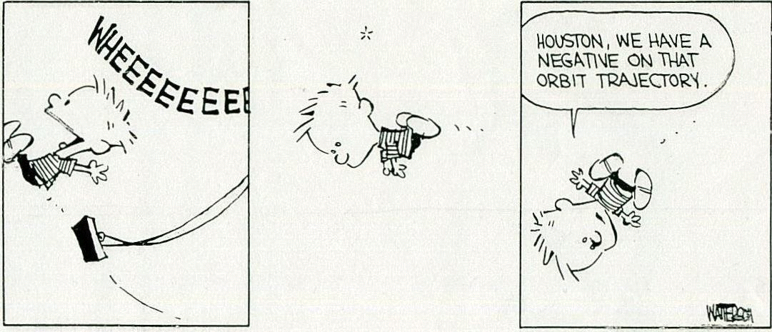
Orbit maintenance tutorial
Fuel is often a life-limiting factor for long-life platforms
Amount of maneuvering fuel is a trade between platform weight at launch and expected platform life
Accurate orbit insertion by launch vehicle increases fuel on platform for maneuvering
One can view fuel limitations as a good thing since it indicates platform is performing beyond its design life

Slide 8
Maneuvers maintain ground track

Slide 9
Maneuvers maintain crossing time (MLT)
Operational Range 10:29 to 10:31
Mission Requirement 10:15 to 10:45

Slide 10
Terra fuel usage
Terra’s fuel is used for orbit maintenance, debris avoidance, and constellation exit
Current estimates show ~100 kg remaining
  Approx. 40 kg is needed for constellation exit (given current constraints)
  Leaves 60 kg of usable fuel for maneuvers
Each inclination adjust maneuver (IAM) burns ~4 kg
Each drag makeup maneuver (DMU) ~0.4 kg
Need to determine how to use the remaining fuel to maximize benefits for the science community

Slide 11
Terra fuel usage
Fuel usage by Terra as a function of time since launch
Inclination maneuvers to change to 10:30 MLT
Fuel to Exit Constellation
Unusable Fuel

Slide 12
Terra is using its fuel
Flight Operations Team needs inputs from Terra scientists as to how to use remaining fuel
Goal is to optimize length of mission while keeping the risk to morning and afternoon constellations low
Science trades are effectively related to
  Maintain crossing time (MLT) – implies changes in orbit altitude
  Maintain orbital altitude – implies changes in MLT
More complicated and detailed than this but this is the basic concept
Terra project science office is seeking input to help guide the Flight Operations Team’s recommendation to the Mission Operations Working Group
Final recommendation goes to NASA HQ for approval

Slide 13
Example impact to Terra data from changing MLT
Some impacts from changing MLT affects all Terra instruments equally
Long-term data records are impacted by changes in MLT
Earlier crossing time means larger solar zenith angle (sun closer to the horizon) and less solar heating
  Lower signal levels in reflective bands
  Lower temperatures
  Leads to lower signal to noise ratio
Cloud probabilities decrease
  Clear-sky science energy studies easier
  Lower impact of clouds on surface products

Slide 14
Impact to Terra data from changing orbit
Changing orbital altitude also has platform-wide science impacts
Long-term data records will include changes in spatial coverage
New geometric processing algorithms may need to be developed
  Effects from scan rates and integration times
  Parallax corrections
Lowering altitude to move out of constellation will
  Decrease spatial coverage (swath width)
  Improve spatial resolution
  May cause gaps in spatial sampling

Slide 15
Terra Project plans for evaluating MLT question
Terra Project Science Office is working closely with Instrument and Flight Operations Teams
Poll the Instrument teams as to preferred approaches
  FOT will provide a list of possible scenarios (large number)
  Instrument teams will help reduce the number of possible scenarios to evaluate
  Detailed analysis of this smaller number of scenarios by FOT
  Instrument teams will help select preferred methods
  FOT presents these preferred methods to MOWG
Go through a few examples to illustrate

Slide 16
Fuel usage scenarios – starting assumptions
Predictions of fuel usage depends on the goals of the science community
5 kg of propellant will remain in the propulsion lines as unusable
Maneuver lengths and timing limitations to ensure platform health force use of less efficient apogee burns
Terra’s exit constraints follow the Afternoon Constellation Operations Coordination Plan
  Apogee of exiting spacecraft must be at least 2 km below minimum perigee of current constellation members
  Terra’s apogee must be below 692 km

Slide 17
Baseline option
Continue current operations until constellation exit fuel reserve is reached
Estimated to be early 2017 when we would stop performing inclination maneuvers
MLT drifts outside of 10:29 operational range in late 2017 and continues drifting until 10:15 Mission Requirement
Maneuvers to exit the constellation to lower Terra’s altitude below 692 km
MLT drift rate will reverse and stay within requirements limits until early 2022
  Orbital altitude will degrade and MLT will change until platform de-orbits
  Terra will not maintain its WRS-2 ground track

Slide 18
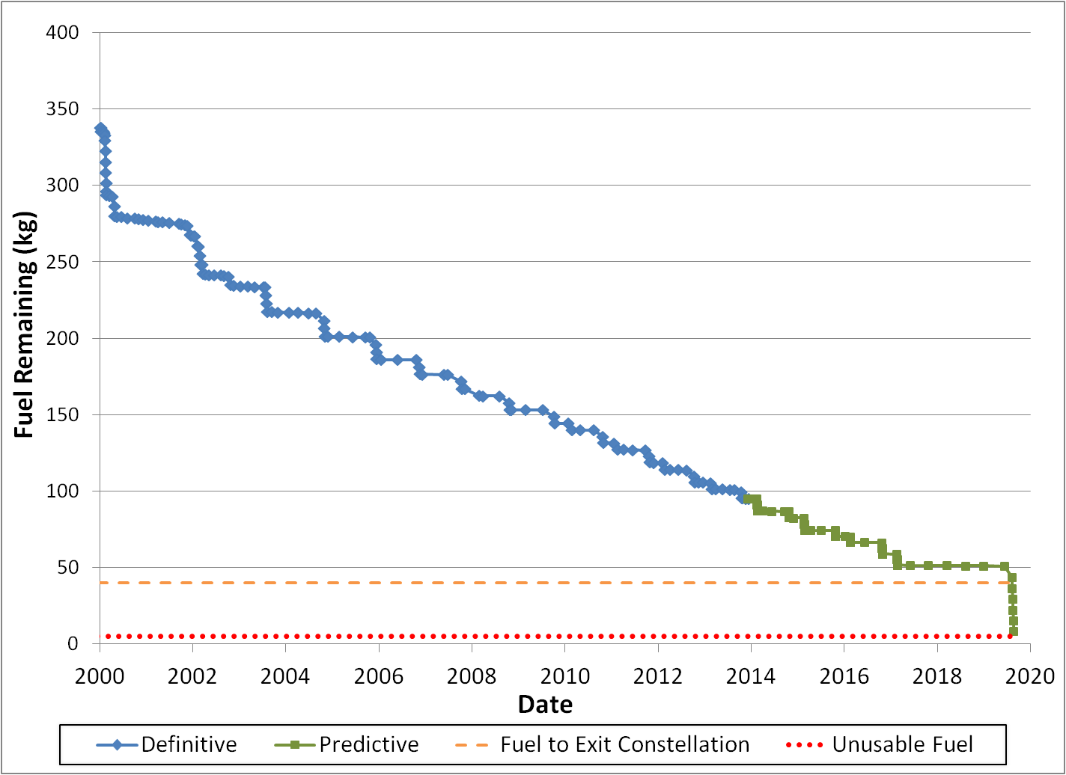
Baseline scenario fuel usage prediction
Based on predicted fuel usage and solar activity, Terra has enough fuel to support science requirements until 2019 and possibly beyond
Fuel used
Predicted fuel usage
End of IAMs
Fuel needed to Exit Constellation
Unusable Fuel
Constellation exit burn

Slide 19
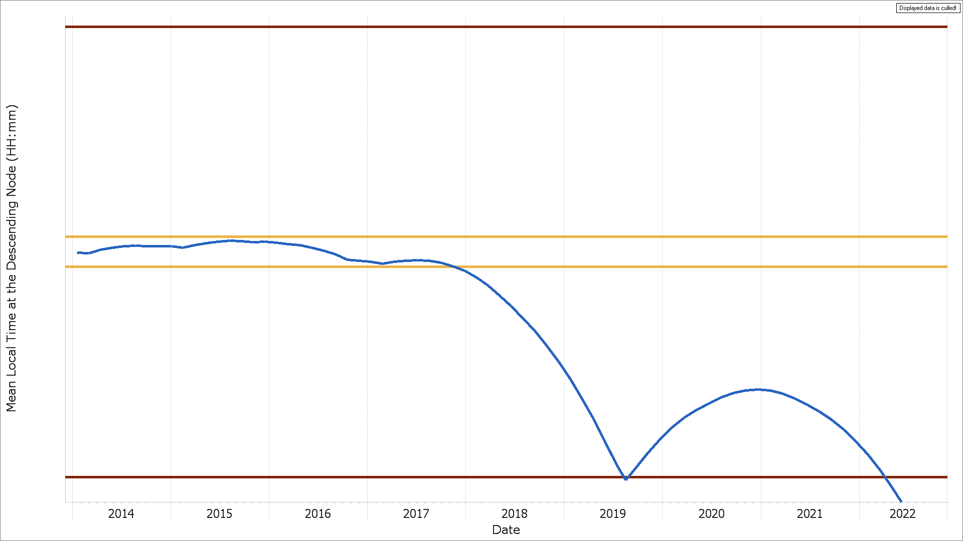
Baseline scenario MLT prediction
10:45
Mission Requirement
Final IAM
Feb 2017
MLT < 10:29
November 2017
10:31
10:29
Operational Range
MLT < 10:15
April 2022
MLT < 10:15
& Constellation Exit
August 2019
Mission Requirement
10:15

Slide 20
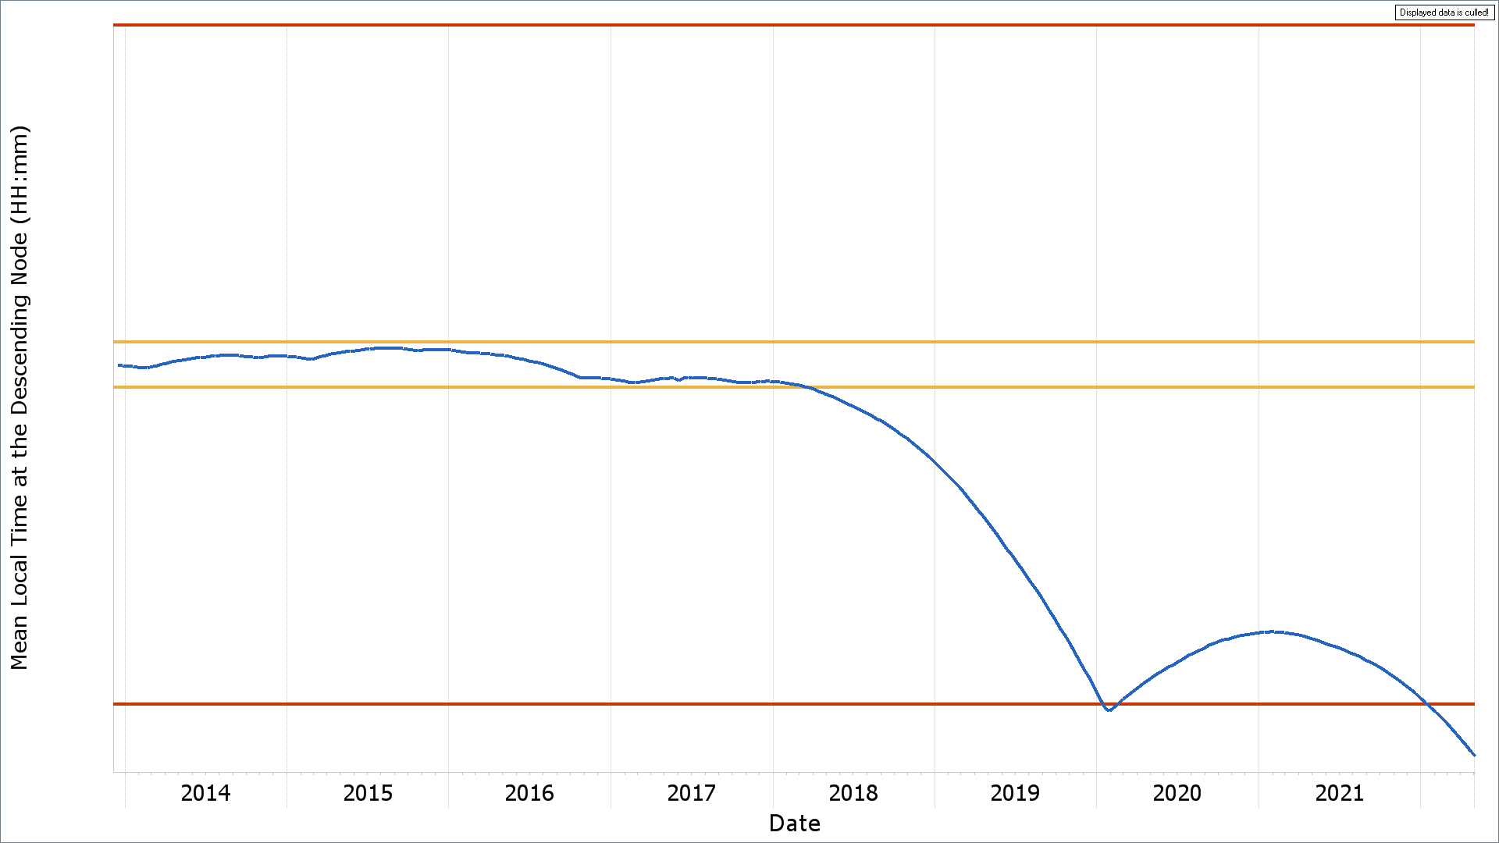
Modified baseline scenario
Additional inclination maneuvers added in the Fall of 2017
10:45
Mission Requirement
Final Inclination Adjust Maneuver Oct 2017
MLT < 10:29 March 2018
10:31
10:29
Operational Range
MLT < 10:15
January 2022
MLT ≈ 10:15
@ Constellation Exit
January 2020
Mission Requirement
10:15

Slide 21
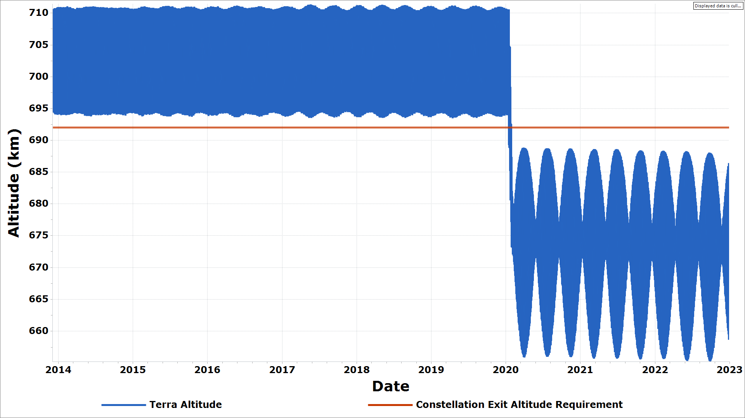
Modified Baseline scenario altitude predictions
Constellation exit
692 km requirement
Constellation Exit
January 2020
After constellation exit, Terra will have 689 km maximum altitude and 656 km minimum altitude
Orbit slowly degrades over the next 30+ years until reentry

Slide 22
Altitude impacts
As Terra’s orbit decays, instrument swaths and spatial resolution will continually decrease
Instrument | Current |  | Post-constellation exit
 | Spatial Resolution (km) | Cross Track Swath (km) | Spatial Resolution (km) | Cross Track Swath (km)
MISR | 0.275, 0.550, or 1.1 | 380 | 0.263, 0.526, or 1.05 | 364
MODIS | 0.250 (day) and 1 (night) | 2330 | 0.239 (day) and 0.96 (night) | 2233
MOPPIT | 22 (horizontal) | 616 | 21.07 (horizontal) | 590
ASTER* | 0.015 (VNIR - horizontal) and 0.09 (TIR) | 60 (VNIR and TIR) | 0.014 (VNIR - horizontal) and 0.086 (TIR) | 57.5 (VNIR and TIR)
CERES | 20 | NA | 19.1 | NA

Slide 23
Too many scenarios to evaluate in detail
Maximize time in operational MLT range (10:29 to 10:31)
  Orbit lowering maneuvers to maintain MLT
Maximize time in required MLT range (10:15 to 10:45)
  Exit constellation prior to starting MLT drift
  Lower orbit below constellation exit criteria
Maximize time at current altitude of 705km
  Maintain altitude with DMUs but no more IAMs
  Drift MLT past 10:15 to ~10:02 then lower orbit
Maximize mission life to greatest extent possible
Exit constellation by lowering perigee or apogee only
Exit constellation sooner to regain MLT time
Seek Relaxation in constellation requirement from 692 km to 694 km
Stop all maneuvers (DMU & IAM) and allow orbit to slowly degrade

Slide 24
Next scenario to be examined
Input from Instrument Team Leads has already led to the first refinement in scenario studies
Relief on 692 km apogee limit means
  Less fuel needed to exit constellation
    2 maneuvers (8 kg fuel) rather than 10 maneuvers (40 kg fuel)
    Leaves more fuel for other maneuvers
  Achieve science for a longer period
Relaxation of constellation exit criteria would delay the date of last IAM and constellation exit burns
  Ground track and altitude could be maintained until a later date
  Risk to constellation is higher

Slide 25
Scenario studies and time line
Early estimates of constellation requirement relaxation show ground track maintained until 2023
Detailed study underway to evaluate this
Still dependent on approval from Constellation Group
  Need science input on what alternate studies to evaluate
  Evaluations will take place over summer
Finalize Terra Project Science Office’s recommendation to FOT in early fall
FOT will present preferred scenarios to the Mission Operations Working Group meeting in October

