Slide 1
Very Brief GEOS-5 Overview
Arlindo da Silva
Arlindo.dasilva@nasa.gov
Global Modeling and Assimilation Office, NASA/GSFC
MODIS Science Team Meeting
Sheraton Silver Spring
21 May 2015

Slide 2
GEOS-5
Earth System Model
Components coupling via the Earth System Model Framework (ESMF)
Aerosol and chemistry radiatively coupled to GCM
Applications:
Seasonal forecasts
Weather and aerosol NRT forecasts
Reanalysis
Observing System Simulation Experiments (OSSEs)

Slide 3
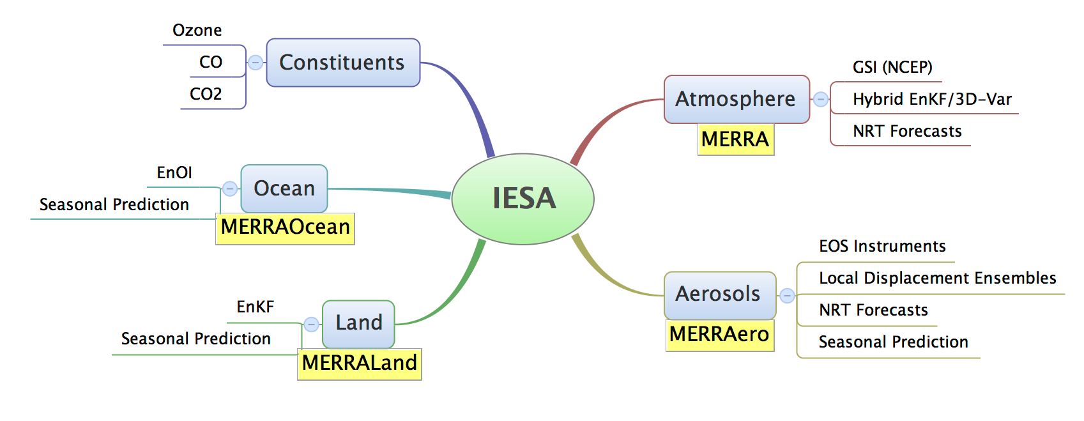
GEOS-5 Data Assimilation

Slide 4
GEOS-5 Model Configuration for NRT Data Products
Global, 72 Levels, top at 0.01 hPa

Slide 5
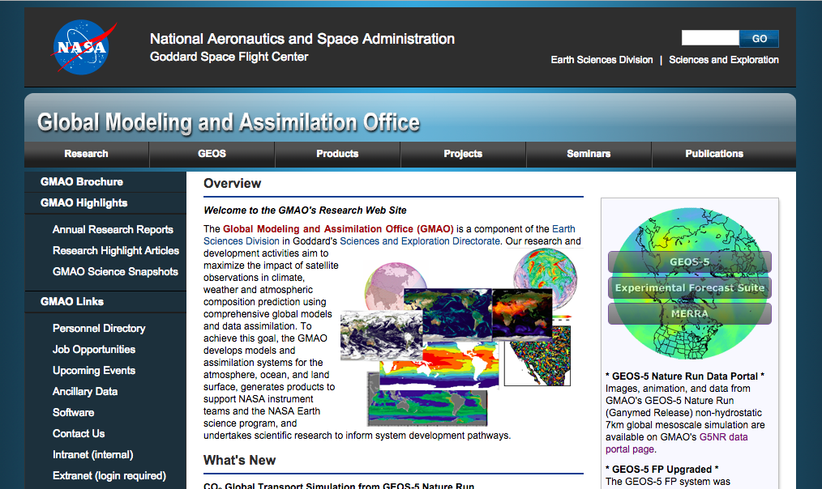
http://gmap.gsfc.nasa.gov
CLICK HERE

Slide 6
GMAO Products
GMAO generates GEOS-5 data products in near real time or reanalysis modes in support of diverse user communities. Starting in February 2013, GEOS-5 forward processing is conducted in two separate streams. These are called (1) Forward Processing (FP) and (2) Forward Processing for Instrument Teams (FP-IT).
The FP stream generates forecasts as well as assimilation products using the most current system approved for near-real-time production. FP products are primarily used for real time support for NASA field campaigns, support for NASA science, GEOS system evaluation, and interaction with other data assimilation centers. The FP system is updated as the GEOS system improves and is transitioned to production status.
The FP-IT stream generates only assimilation products. FP-IT processing uses a "semi-frozen" GEOS-5 system to ensure long-term continuity and reproducibility. FP-IT products serve primarily the NASA EOS Instrument Teams who require stable products over a long period of time. Reprocessing of historical periods using the FP-IT system is conducted as needed in coordination with Instrument Teams.

Slide 7
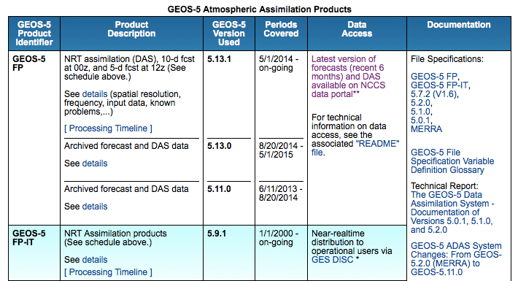
http://gmap.gsfc.nasa.gov/products

Slide 8
Summary of GEOS-5 Reanalysis Activities
Name | Nominal Resolution | Period | Aerosol Data | Available
MERRA-1 | 50 km | 1979-present | NONE | now
MERRAero | 50 km | 2002-present | MODIS C5 | now
FP for Inst. Teams | 50 km | 1997- | MODIS C5 | In progress
NCA | 25 km | 2010-11 | MODIS C5, MISR | Now
MERRA-2 | 50 km | 1979-present | AVHRR, MODIS C5, MISR,AERONET | Summer 2015
MERRA-2 Dynamical Downscaling | 12.5 km | 2000-2015 | AVHRR, MODIS C5/C6, MISR, AERONET | Q4 2015

Slide 9
Summary
GMAO generates GEOS-5 data products in near real time or reanalysis modes in support of diverse user communities:
GEOS-5 FP-IT is the semi-frozen NRT system used for supporting several instrument teams
Every time the FP-IT is upgraded, all data is reprocessed for the EOS period as to produce a consistent data product
MERRA-1 and MERRA-2 reanalyses c0ver the satellite ERA (1980-present).

