Slide 1
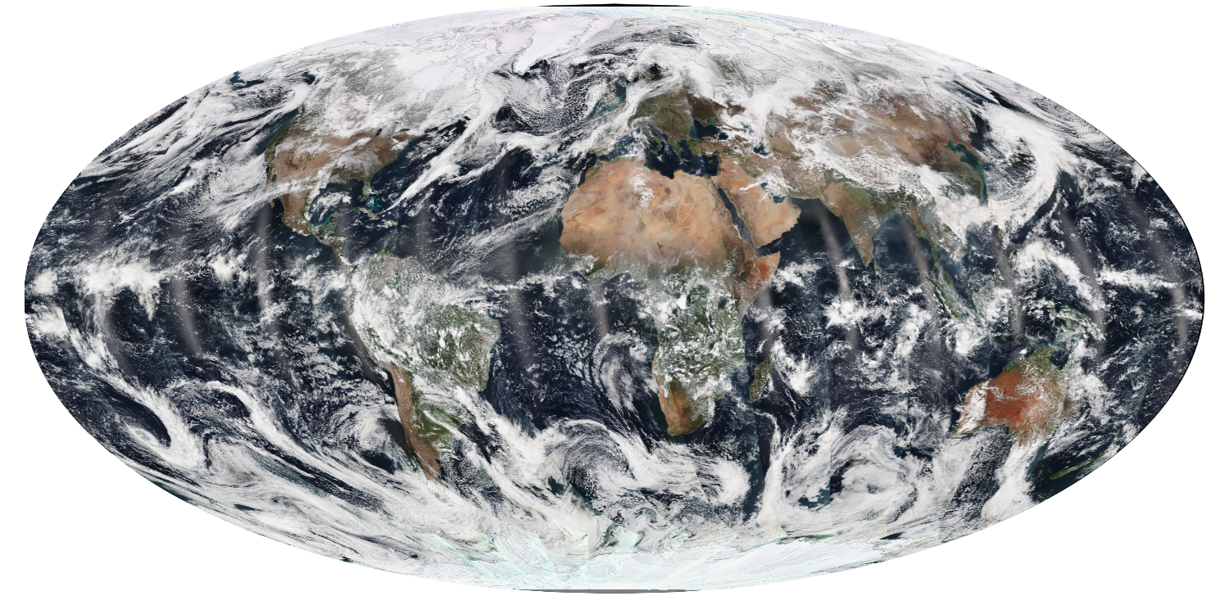

Suomi NPP Atmosphere SIPS
Liam Gumley (PI), Bob Holz, Steve Ackerman (Co-Is)
VIIRS True Color 2014/03/21
Space Science and Engineering Center
University of Wisconsin-Madison

Slide 2
What is a SIPS?
SIPS = Science Investigator-led Processing System
The SIPS creates NASA SNPP science products using software developed by the Suomi NPP Science Team, and delivers the products to a NASA DAAC for archive and distribution.
Atmosphere SIPS: UW-SSEC / Liam Gumley
Land SIPS: GSFC / Ed Masuoka
Ocean SIPS: GSFC / Gene Feldman
Ozone SIPS: GSFC / Ed Masuoka
Sounder SIPS: JPL / Steve Friedman
Notes:
The SIPS are a continuation of the PEATEs established by NASA. With the SIPS, we are moving from product evaluation and alternative algorithm testing to climate data record production (to continue the NASA climate record of EOS).

Slide 3
SNPP Atmosphere Discipline
1. Bryan Baum: UW-SSEC (Atmosphere Discipline Lead)
Continuity of Cloud Top Pressure and Cloud Infrared Thermodynamic Phase by Combining CrIS and VIIRS Measurements
2. Eva Borbas: UW-SSEC
Continuation of EOS Clear Sky Infrared Total Precipitable Water Vapor Product Using a Combination of VIIRS and CrIMSS Measurements
3. Bo-Cai Gao: Naval Research Laboratory
Continuation of Standard Cirrus Reflectance Product from the EOS Terra and Aqua MODIS to Suomi NPP VIIRS
4. Christopher Elvidge: NOAA-NESDIS NGDC
VIIRS Nighttime Lights
5. Christina Hsu: Goddard Space Flight Center
Extending Long-Term Aerosol Data Records from MODIS to VIIRS: Data Continuity and Enhancements to the E-Deep Blue Algorithm
6. Robert Levy: Goddard Space Flight Center
A Consistent Dark-Target Aerosol Data Record, Created from MODIS, VIIRS and Beyond
7. Steven Platnick: Goddard Space Flight Center
Development of VIIRS L2 Cloud and L3 Gridded Atmosphere Team Products for NASA Research and EOS Data Record Continuity
8. Jun Wang: University of Nebraska - Lincoln
Evaluate and Enhance Suomi NPP Products for Air Quality and Public Health Applications
Notes:
Three cloud investigations, three aerosol investigations, and one water vapor investigation. Bo-Cai Gao and Eva Borbas are new team members (both were members of the MODIS Science Team).

Slide 4
SIPS Responsibilities (from AO)
Atmosphere SIPS will:
Be responsible for processing, reprocessing, and general assessment of Suomi NPP VIIRS Atmosphere products.
Process Level 0 data to Level 1, Level 2, and global gridded Level 3 atmosphere products using scientific algorithm software from the Suomi NPP Atmosphere Discipline Group.
Deliver all data products along with scientific algorithm software, associated metadata, and documentation to LAADS.
Acquire near-real-time algorithms for selected products and process and deliver these products within three hours for distribution through the LANCE system.

Slide 5
SIPS Management
Suomi NPP SIPS are managed by the ESDIS Project (Code 423) at NASA GSFC.
ESDIS Project will coordinate, negotiate, and manage the SIPS activities through appropriate acquisition methods, including the use of contracts and cooperative agreements.
Point of contact is Alfreda Hall, ESDIS SNPP Manager.

Slide 6
SIPS Tasks (from SSEC proposal)
The Atmosphere SIPS will:
Assist the SNPP Science Team with integrating and testing the product generation software in the SIPS environment,
Implement the product generation software in SIPS operations,
Create VIIRS Level 1B data in global forward stream mode,
Create VIIRS Level 2 and 3 atmosphere products in global forward stream mode (“near real-time” in 3 hours and “best product” in 48 hours),
Reprocess historical VIIRS atmosphere products when directed by the SNPP Science Team,
Provide assessment capabilities for VIIRS atmosphere products,
Deliver products, software, browse imagery, ancillary data, and metadata to NASA LAADS for archive and distribution.
Notes:
The Atmosphere SIPS builds on the resources, experience, and tools developed for the Atmosphere PEATE. The same management team and technical teams are in place. Philosophy will be very similar to the PEATE, with the biggest change being that the SIPS is responsible for global processing of products for NASA. Note that products created by the Atmosphere SIPS will go to the GSFC LAADS for archive and distribution (like the MODIS Atmosphere products). However the Atmosphere PEATE will continue to make L0, L1B, L2, and L3 products available to collaborators.

Slide 7
VIIRS Level 0 and 1B Products
VIIRS stored mission data will be delivered to the Atmosphere SIPS by NASA EDOS (via Land SIPS) in a NASA-defined Level 0 format.
VIIRS Level 1A, Geolocation, and Level 1B data will be created by the Atmosphere SIPS using a NASA version of geolocation and calibration algorithms and software.
Atmosphere SIPS may use different LUTs or corrections in its’ version of the L1B processing.
Level 1B and geolocation files will be 6-minute granules in netCDF4 format.
Atmosphere SIPS will fuse Level 1B sounder with imager data (CrIS/VIIRS, AIR/MODIS) for several of the ST investigations (e.g., to provide 13 micron channels at VIIRS resolution).
Notes:
NASA is moving away from the RDRs, SDRs, and EDRs created by the IDPS. NASA EDOS will be responsible for delivering Level 0 stored mission data to each of the SIPS. NASA HQ directed the VIIRS PEATES to form a team to design and create NASA software and formats for the L1B data. The team (led by the Ocean, Land, and Atmosphere PEATE and VCST leads) is already working on this effort. The Atmosphere SIPS will always create VIIRS L1B data onsite.

Slide 8
NASA Level 1 Software
NASA directed the VIIRS SIPS to come up with a plan to create a NASA version of Level 1 software and file formats for VIIRS, CrIS, ATMS, OMPS using Level 0 data supplied by EDOS.
Goal is to be independent of IDPS data, processing, and software
VIIRS Ocean, Land, and Atmosphere PEATEs and VCST are developing the VIIRS Level 1 software
Fred Patt (Ocean SIPS) is project leader. Liam Gumley is lead for Atmosphere.

Slide 9
NASA Level 1 Software Objectives
Modular, well-documented, efficient, robust portable software, owned and maintained by NASA.
Straightforward implementation of instrument calibration equations and support for calibration updates.
Data product formats developed and maintained by NASA. Level 1B and Geolocation will be the standard final products.
Level 1A data product will be generated as part of the processing stream.
Separate executables for Level 1A, Geolocation and Level 1B.
Reasonable granule length (e.g., 6 minutes) chosen by NASA.
Reduce number of Level 1B data files (i.e., eliminate separate files for each VIIRS band).

Slide 10
NASA Level 1 Further Objectives
Product formats compatible with both netCDF4 and HDF5
  Serve the largest possible user community
Modular calibration and geolocation software
  Run standalone or link with existing software
Rapid-prototyping development methodology
  Schedule and resource constraints
Re-use existing software where possible
Compliance with metadata standards (ISO, CF)

Slide 11
NASA Level 1 Software Responsibilities
Ocean SIPS
  L0-to-1A and OBC file processing software
  I/O routines for other teams
  Data product formats
  Calibration ATBD support
Geolocation Team (Land SIPS)
  Geolocation ATBD updates
  L1A-to-Geolocation processing software
VCST
  Calibration ATBD updates
  L1A-to-L1B processing software
Land SIPS
  Data product formats
  Software development and testing support
Atmosphere SIPS
  Data product formats
  Software development and testing support

Slide 12
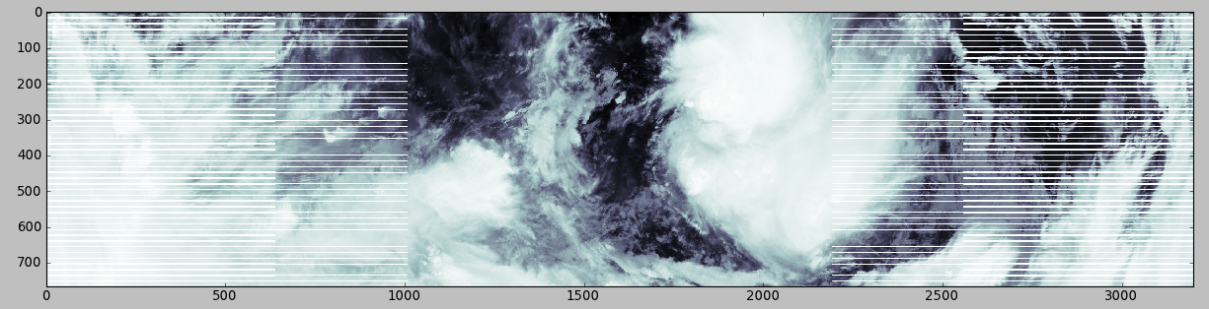
VIIRS M15 SDR granule from IDPS
Granule is 86 seconds long (48 earth scans)
Nadir resolution is 750 meters
Dimensions are 3200x768 pixels
Note bowtie deletion zones

Slide 13
VIIRS vs. MODIS 5-min granules
Atmosphere PEATE
VIIRS M7 2012/06/03 18:45 (left) and Aqua MODIS band 2 2012/06/03 18:40 (right) in Intermediate File Format created by the Atmosphere PEATE for the SNPP Science Team.
Note that VIIRS Bowtie-Pixel restore is a downstream option at the Atmosphere SIPS.

Slide 14
SIPS Intermediate File Format (IFF)
Atmosphere PEATE developed a consistent file format for MODIS and VIIRS L1B data to simplify the creation of reader software (e.g., same variable names and attributes for MODIS and VIIRS).
MODIS and VIIRS IFF files can be created in 6-minute granules.
VIIRS bowtie-deleted pixels can be restored if needed.
VIIRS Land/Water mask consistent with MODIS C6 can be included.
HDF4 or netCDF4 format can be created.
IFF simplifies the transition from IDPS SDR format to NASA L1B format. The science software does not need to change if it reads IFF.

Slide 15
VIIRS Level 2 Products
The Atmosphere SIPS will create VIIRS Level 2 products using software developed and owned by the investigators on the Science Team.
Software will be transitioned to operations using the same process that was used by the Atmosphere PEATE (build and test on a server provided by the SIPS).
Level 2 products will be created operationally in forward stream and near real-time processing modes.
Level 2 products for the duration of the SNPP mission will be reprocessed when directed by the Science Team.
Level 2 products will be created in a non-public processing mode for algorithm and software development and testing.

Slide 16
Level 2 Software Development
Science Team members are responsible for developing and testing their Level 2 product generation software.
There are no particular requirements on how the software is implemented (e.g., C, C++, FORTRAN, Python are all ok), but it must run on the SIPS Linux development server. If you decide to use Matlab or IDL, let’s talk.
The SIPS provides a 64-bit Linux development and test server if you don’t have one.
Product format is TBD by the Atmosphere Discipline, however netCDF4 or HDF5 are recommended.
Product metadata will conform to NASA standards. The SIPS may be able to help with this item.
The Science Team owns the product generation software. The SIPS will not rewrite or recompile it. The SIPS just runs it reliably and efficiently.

Slide 17
VIIRS Level 2 Product Examples
Monthly means of Aerosol Optical Depth for July 2012 from
^{MODIS Dark} ^{Target,} VIIRS Deep Blue, and VIIRS IDPS algorithms (Hsu 2013).
Christina Hsu

Slide 18
VIIRS Level 3 Products
Level 3 products will be created by the Atmosphere SIPS using algorithms and/or software created by the Science Team.
The Science Team will decide how to filter and grid the Level 2 data to create Level 3 products.
If requested, the Atmosphere SIPS could implement the Level 3 gridding software for consistency and efficiency.
Atmosphere PEATE
SNPP VIIRS CHIMERA and Aqua MODIS C6
Water Cloud Optical Thickness Level 3 products for Jan. 2014

Slide 19
Proposed Workflow for Level 3 Gridding

Slide 20
Current ST Support Activities
Providing ST members access to SIPS development, test, and data resources
  ‘thunder’ development server access (new server coming soon!)
  IFF test data creation
  algorithm integration in SIPS environment
  rapid reprocessing
  creating prototype Level 3 products
  automated matchups and comparisons with CALIOP
Participating in EDOS Level 0 data flow interface tests (contact, day in the life, week in the life)
Participating in VIIRS Level 1B software development/test
UW/SSEC and UMBC are leading CrIS Level 1B development

Slide 21
Continuing PEATE Activities
Ingesting IDPS VIIRS, CrIS, and ATMS RDRs via SD3E (continue until EDOS transition is complete)
Ingesting IDPS VIIRS, CrIS, and ATMS SDRs via SD3E (will cease by end of 2015)
Creating quicklooks for Level 1, Level 2, and Level 3
Creating prototype Level 2 atmosphere products in test mode for ST
Providing IDPS and SIPS products and quicklooks to ST members and collaborators
Providing product evaluation for ST members (e.g., MODIS/VIIRS and VIIRS/CALIPSO comparisons)

Slide 22
Product Evaluation
Atmosphere PEATE
Global distribution of Cloud Top Height differences between VIIRS IDPS and CALIPSO products created by the Atmosphere PEATE for the SNPP Science Team cloud product assessment report

Slide 23
SIPS Infrastructure
The Atmosphere SIPS utilizes the infrastructure built by the Atmosphere PEATE including:
> 1200 CPU cores for data processing with 4 GB RAM per core (can expand to use > 8000 cores on UW campus);
> 2 PB of formatted data storage;
Private switched Gigabit Ethernet network between all processing and storage servers;
10 Gbps network interfaces from data ingest and distribution servers to the UW-Madison campus backbone, supporting sustained data ingest rates of greater than 1 Gbps;
Dedicated servers for SNPP Science Team members to develop and test algorithms;
Secure in-house data center with in-row cooling, UPS power, and routine backups.

Slide 24
SIPS Archived Data
VIIRS, CrIS, and ATMS RDRs for SNPP mission
VIIRS, CrIS, and ATMS SDRs for SNPP mission (until NASA Level 1B is available)
Aqua MODIS C6 Level 1B since 2010
Aqua MODIS C6 Level 2 atmosphere products for Aqua mission
AIRS Level 1B for Aqua mission
IASI Level 1B for Metop-A and Metop-B missions
CALIOP Level 1 and Level 2 for CALIPSO mission

Slide 25
SIPS Ancillary Data
GDAS analysis (1.0 degree grid) [GRIB1 and GRIB2]
GFS 3/6/9/12-Hour Forecast (1.0 degree grid) [GRIB1]
GFS 12-Hour Forecast (0.5 degree grid) [GRIB2]
NSIDC Near Real-Time Global Ice and Snow Extent [HDF4]
NCEP Daily Sea Ice Concentration [GRIB1]
Total Ozone Analysis using SBUV/2 and TOVS (TOAST) [GRIB1]
Reynolds OISST (8 day)
Canadian Meteorological Centre (CMC) GHRSST [netCDF4]
UK Met Office Sea Surface Temperature and Sea Ice Analysis
Other datasets can be ingested as stored as needed.

Slide 26
SIPS Software Delivery Process
Science Team members are responsible for delivering their product generation software to a SIPS development and test server.
Science Team members must build and test their software on the SIPS development and test server. The SIPS will ensure the required compilers (e.g., GNU, PGI, Intel) and libraries (e.g., HDF5, netCDF4) are installed.
Science Team members must supply a complete test case for their software delivery, including compiled binaries, static LUTs, ancillary data, production rules, input satellite data, output products, logfiles, and driver scripts.
The SIPS will replicate the results of the test case using the compiled binaries, scripts, and data included in the delivery, and iterate with the ST member as needed.
When the SIPS is able to replicate the test case to the satisfaction of the ST member and the SIPS, the software delivery is complete.

Slide 27
SIPS Software Integration
The SIPS will integrate the ST-delivered software in the SIPS processing environment.
The compiled binaries and LUTs delivered by the ST member on the dev/test server will be used in production: the SIPS will not recompile or modify the software to run in production. The ST member will always own the software that runs in production.
The SIPS will create a global test dataset (e.g., one month) and provide the products files for the ST member to evaluate.
When the ST member approves the results of the global test, the software moves into production mode (if ready) or test mode. The Atmosphere Discipline will notify the SIPS when a new “collection” or “version” of the products are ready for production.
Data created in production mode (forward stream or reprocessing) are delivered to LAADS for archive and distribution.
Data created in test mode are made available to the ST member and their collaborators only (they will not be delivered to LAADS).

Slide 28
Product Generation by SIPS
Atmosphere SIPS processing will be separated into four separate modes, all operating simultaneously:
Forward Stream Processing Mode: create the best possible global VIIRS L1B and Atmosphere L2/L3 products using the highest fidelity input data sources (requires 24-48 hour delay). Atmosphere L2/L3 products are delivered to LAADS.
Near Real-Time Processing Mode: create low latency global VIIRS L1B and Atmosphere L2 products (< 3 hours). Atmosphere L2 products are delivered to LANCE.
Historical Reprocessing Mode: create the best possible VIIRS L1B and Atmosphere L2/L3 products for the entire SNPP mission record (< 2 weeks to process entire mission). Atmosphere L2/L3 products are delivered to LAADS.
Experimental Reprocessing and Evaluation Mode: create global VIIRS Level 1B and Atmosphere L2/L3 test products and global collocated inter-comparison products for review and evaluation by the SNPP Science Team. Products are delivered to Science Team only.

Slide 29
Product Distribution by SIPS
The SIPS will provide data search and download for all products to SNPP Science Team members and their collaborators.
For all datasets other than test mode products, there are no restrictions on who can download data from the SIPS.
However the SIPS is not a DAAC. Data requests from the science community at large and the public should go to LAADS.

Slide 30
Items Delivered by SIPS to LAADS
Standard data products and ancillary data used to generate the products with no period of exclusive access.
Scientific algorithm software source code and static data (coefficients, LUTs). No end-user support is required.
Algorithm Theoretical Basis Document (ATBD) documentation as well as spatial, temporal, and product metadata associated with the standard products.
Browse products associated with standard products.

Slide 31
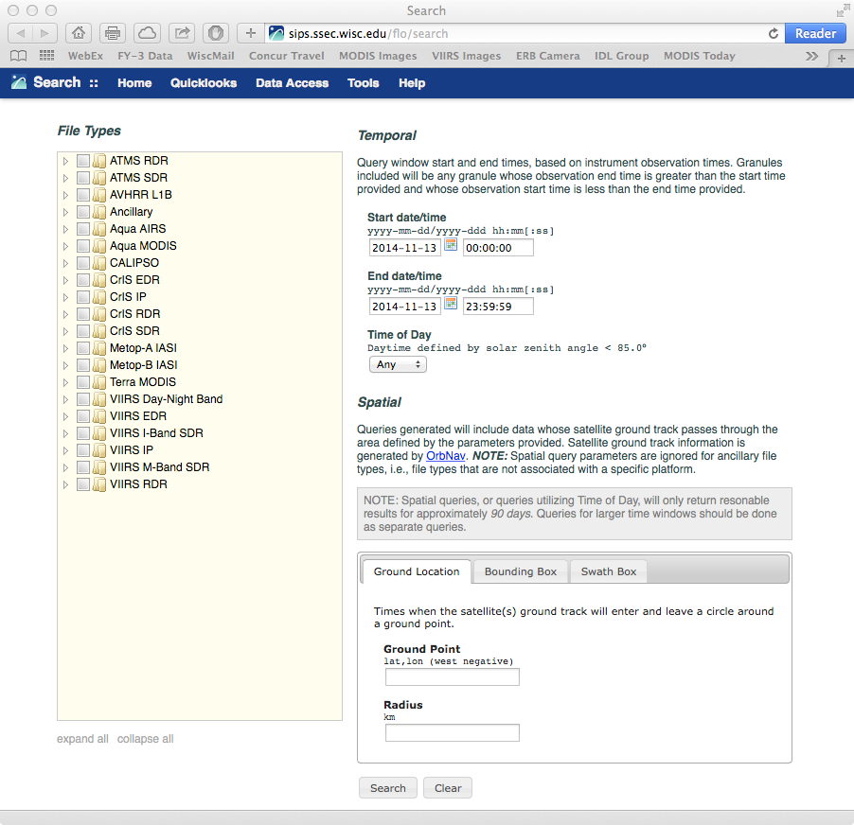
SIPS Website
SIPS website: http://sips.ssec.wisc.edu/
Data search and download (try the API!)
Browse imagery
Documentation
Orbit tools
Orbit tracks

Slide 32
Near Term Activities
In the next 12 months, the SIPS plans to
Continue to work with ST to test VIIRS Atmosphere Level 2 and 3 product generation software;
Start creating Level 2 and 3 standard data products in forward stream, real-time, and reprocessing modes;
Transition from using IDPS SDR data to NASA Level 1B data and software.

Slide 33
Atmosphere SIPS Schedule
FY 2014
Atmosphere SIPS Kickoff Meeting with new SNPP Science Team Members,
Work with VIIRS Level 1B Working Group team to develop, test, and evaluate new Level 1B software, products, formats, and metadata,
Create prototype Atmosphere Level 2 products from VIIRS and MODIS for entire SNPP mission,
Meet with LAADS and LANCE to discuss details for product deliveries and metadata.
FY 2015
Work with SNPP Science Team to define new aerosol and cloud product formats and metadata,
Integrate and test Version 1 of NASA VIIRS Level 1 product generation software,
Integrate and test Version 1 of SNPP Science Team atmosphere product generation software,
Work with SNPP Science Team to evaluate, assess, and validate products from the NASA VIIRS Atmosphere Level 2 algorithms,
Commence production of NASA VIIRS Level 1B and Atmosphere Level 2 products in Forward Stream and Near Real-Time processing modes,
Create Version 1 of NASA VIIRS Atmosphere Level 2 and Level 3 products for the entire SNPP mission,
Deliver NASA VIIRS Atmosphere Level 2 and Level 3 products to LAADS and to LANCE.

Slide 34
END
Liam.Gumley@ssec.wisc.edu
+1 608 265 5358

