Slide 1
The Coupling of Convection, Large-Scale Atmospheric Dynamics, and Sea-Surface Temperature Hot Spots as Characterized by MODIS, TRMM, and ECMWF-Interim Reanalysis Data
TERRA/AQUA PI: Terry Kubar (UCLA/JIFRESSE)
Co-I: Ali Behrangi (JPL)
Collaborator: Graeme Stephens (JPL)
MODIS Science Team Meeting – Atmosphere Team Breakout Session
20 May 2015

Slide 2
Overarching Motivations
•Understanding ocean-atmosphere interactions over the tropics is paramount to understanding tropical climate and even climate sensitivity
•Observed has been the relatively narrow SST range over which deep convection occurs, with the onset between 26-28˚C, peak convective activity between 29.5˚C-30˚ [e.g. Waliser and Graham 1993; Kubar et al. (2011); Behrangi and Kubar (2012)], and drop-off beyond these SSTs, the latter related to the formation of SST hot spots (Waliser 1996)
•While Waliser (1996) characterized composites of monthly large-scale circulation, cloud fields, and ocean profile temperatures the month(s) before, during and after hot spots (defined as monthly 10⁶km² regions in which monthly SSTs>29.75˚C), less focus was placed on individual hot spot events and the relationships between hot spot intensity, size, and its interplay with large-scale forcing and convective strength.
•We have the advantage of high-temporal resolution multi-sensor satellite data (e.g. MODIS and TRMM) as well as co-located reanalysis data (ERA-Interim), to characterize the horizontal, vertical and temporal evolution of different cloud types, large-scale dynamics/thermodynamics, and precipitation as they relate to hot spots from various time scales (e.g. synoptic to interannual)

Slide 3
Specific Objectives
•Characterize relationships between SSTs, different convective cloud types from MODIS, and large-scale dynamics from ECMWF reanalysis (ERA-Interim)
•Using the Aqua MODIS joint L3 histograms, partition MODIS ice cloud types as a function of visible optical depth τ as thin cirrus, anvil, and convective core clouds
•Cirrus clouds have 0<τ<5, anvil clouds 5<τ<30, and convective core clouds τ>30 – thus cirrus clouds have a TOA warming effect, and anvil and convective core clouds a net TOA cooling effect (based on Kubar et al. 2007)
•Perform time-series analyses in domain-averaged 20˚longitude x10˚latitude boxes, and construct latitudinally-averaged Hovmoller diagrams (between 0-10˚S) to quantify the importance of SST hot spot formation on the spawning of deep convection via relationships with upward motion and low-level convergence
•Examine synoptic variability of SSTs, vertical cloud profiles, and large-scale dynamics and moisture profiles vertical profiles over favorable hot spot selection regions
•Investigate the occurrence of a “predator-prey” type of relationship involving convection (predator) and prey (hot spots)

Slide 4
Ice Cloud Fraction, ω₅₀₀, and Rain Rates vs SSTs
Total Ice Cloud Fraction and ω₅₀₀ both peak at SSTs ~ 30˚, a slightly higher SST than Waliser and Graham’s (1993) analysis
Cirrus clouds peak over warmer SSTs and may be a positive feedback with SSTs
TRMM rain rates peak at 30˚C, but then drop off more quickly than cloud fraction, since optically thinner clouds occur over higher SSTs and rain less

Slide 5
Climatology of SST Hot Spots, Clouds, and Large-Scale Circulation in 20˚lon x 10˚lat boxes
•Box between 160˚-180˚ and ~0˚-10˚S generally has just under a 2 month-duration with SSTs>30˚C
•Cirrus cloud fraction generally slightly larger with greater areal coverage than anvil clouds
•Generally easterly low-level winds throughout tropics, except near zero mean u-winds over the warm pool, where winds can be easterly or westerly (e.g. during westerly wind bursts)

Slide 6
Time Series of ω₅₀₀ and Anvil Clouds and SSTs over West & East Selection Regions
160˚-180˚, 0-10˚S (Black: SSTs)
180˚-200˚, 0-10˚S (Black: SSTs)
Black Dots: Hot spots
Red: ω₅₀₀
Red: ω₅₀₀
Red: Anvil CF
Red: Anvil CF
•Both ω₅₀₀ and Anvil CF clouds peak in intensity/coverage just following (~15 days to ~1 month) after peak SST hot spot, usually at the end of each calendar year
•Moderate El Nino late 2009/10 marked by strongest hot spot of the record, with strongest upward motion and largest anvil cloud coverage just after SST peak

Slide 7
Time Series of Convective Core CF, Rain Rates, and SSTs over West & East Selection Regions
Red: Convective Core CF
Red: Rain Rates
•Pulses of convective core cloud fraction (e.g. CF>0.1) and corresponding heavy rain rates during the decay stage of hot spots
•Lots of shorter-term convective and precipitation variability as well
•Greatest convective core cloud fraction (top) and rain rates (bottom) just after the SST hot spot peak in late 2009/early 2010
•Other pulses of convective core cloud fraction/rain follow high SSTs (whether or not fully-fledged hot spots)

Slide 8
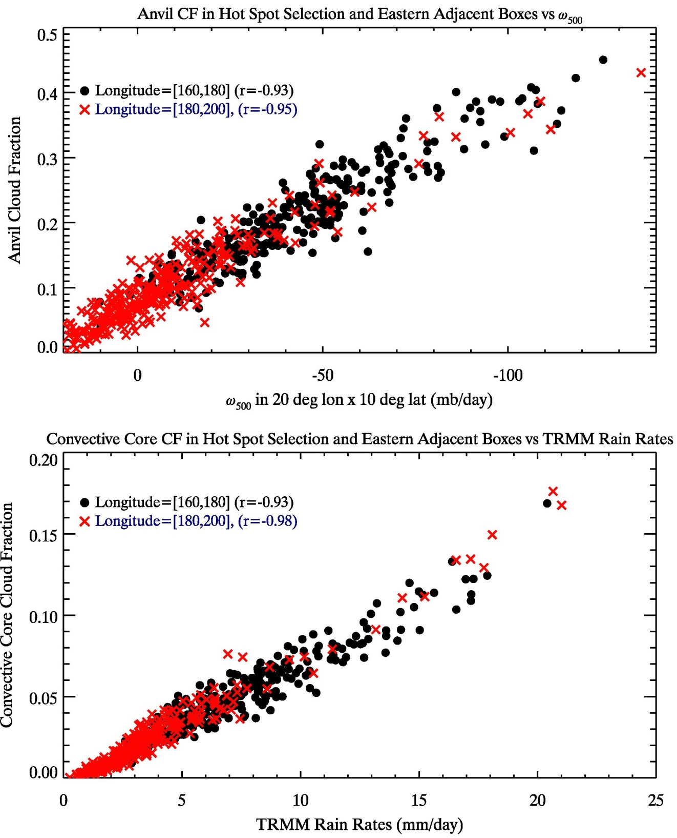
Summary of Cloud, ω, and Rain Rate Relationships over Primary Hot Spot Region [160˚,180˚] and Eastern Adjacent Regions
•In both west and east 20˚x10˚ boxes, anvil CF and ω₅₀₀ are tightly correlated with each other, as are convective core cloud fraction and TRMM rain rates
•The latter finding is consistent with Kubar et al. (2007) (“Radiative and convective driving of tropical high clouds), but that study used MODIS and AMSR-E and examined regions in the north Pacific ITCZ

Slide 9
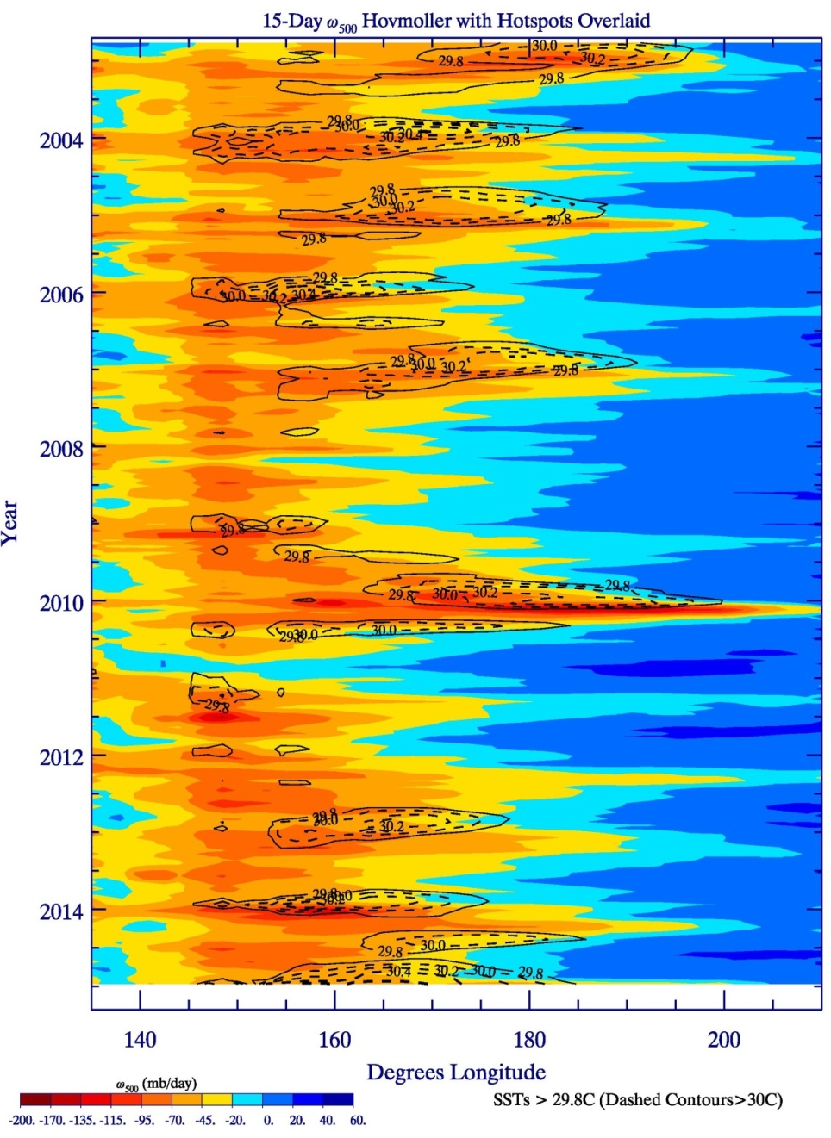
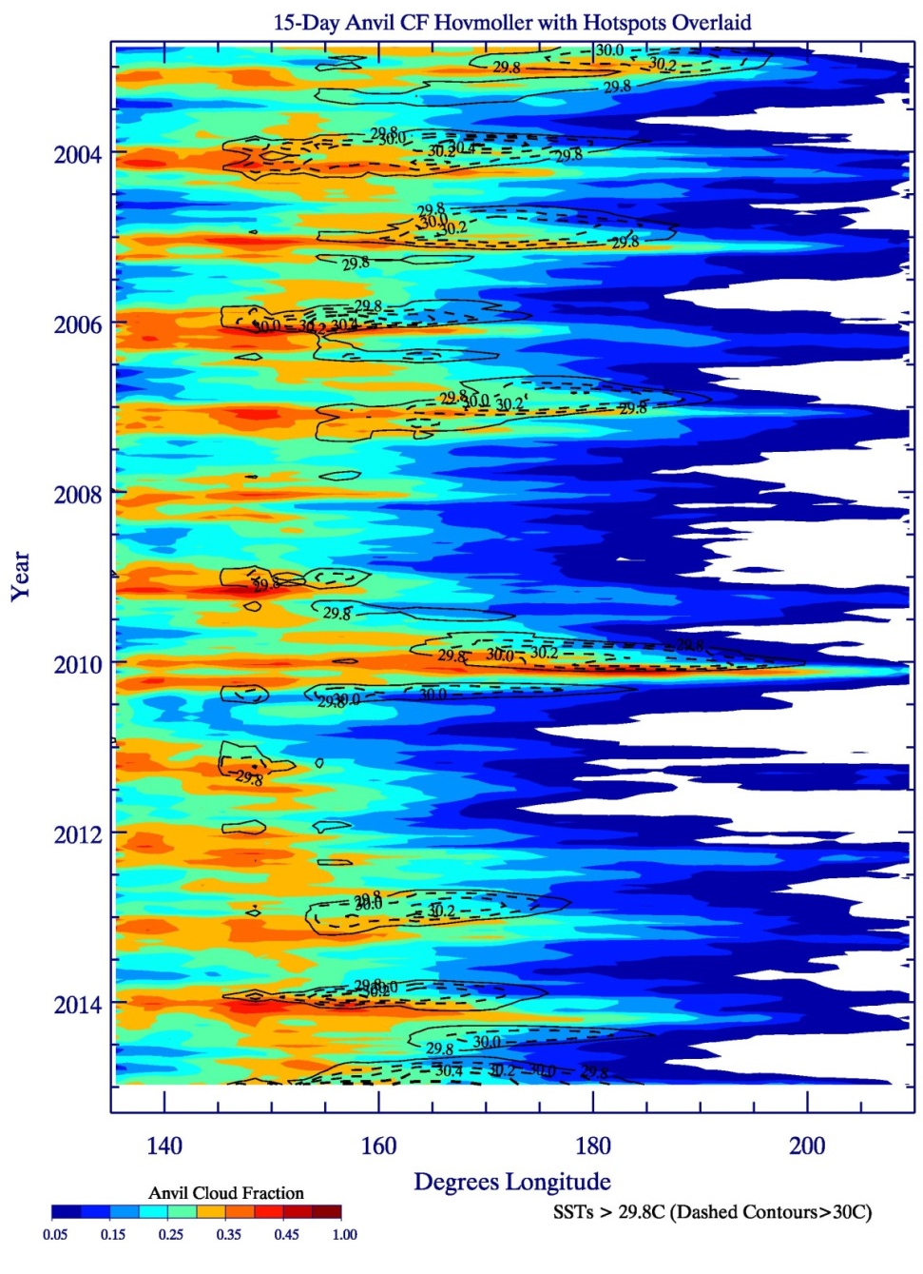
15-Day Hovmoller Diagrams over entire record (2002-2015) of ω₅₀₀ Anvil CF with Hotspots Superimposed (Dashed Contours: SSTs>30˚; Solid: SSTs=29.8˚
•La Ninas (late 2007-2008 and late 2010-2011) – small or no hot spots
Moderate El Nino (late 2009/10): eastward propagation of large and strong hot spots, with large area of strong upward motion and widespread anvil CF

Slide 10
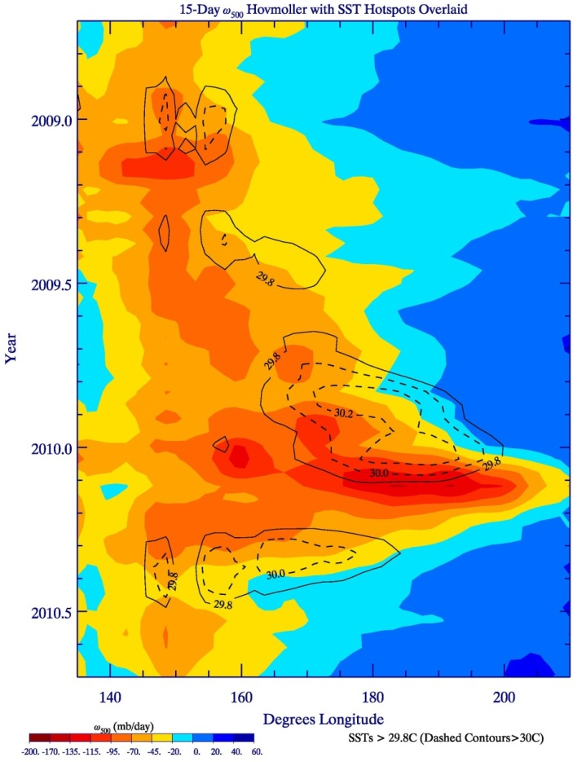
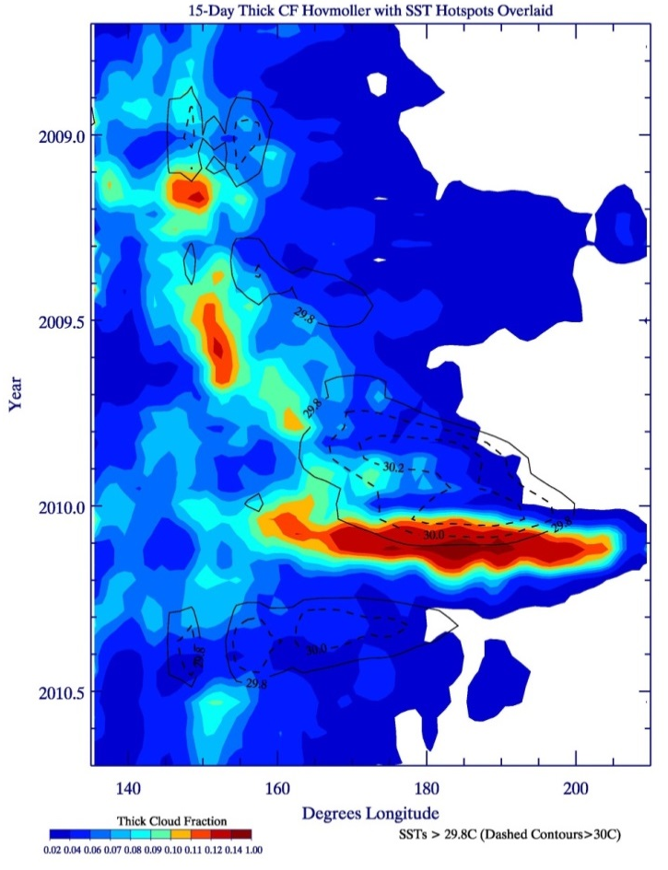
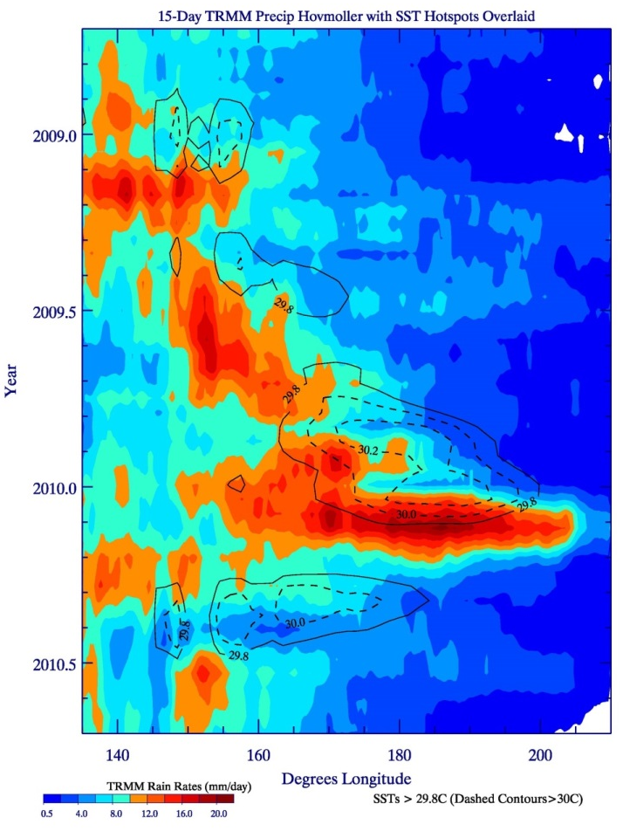
“Zoomed-In” Hovmoller Diagrams during 2008-2010
With Hot Spots Superimposed (Dashed Contours: SSTs>30˚; Solid: SSTs=29.8˚)
ω₅₀₀ (late 2008-late 2010)
MODIS Convective Core CF
TRMM Rain Rates
•Moderate El Nino during late 2009-early 2010; eastward-propagating hot spot with SSTs well above 30.2˚ for a few months → strong upward motion, significant and organized convection, and intense precipitation between 160˚-200˚ during the hotspot decay stage

Slide 11
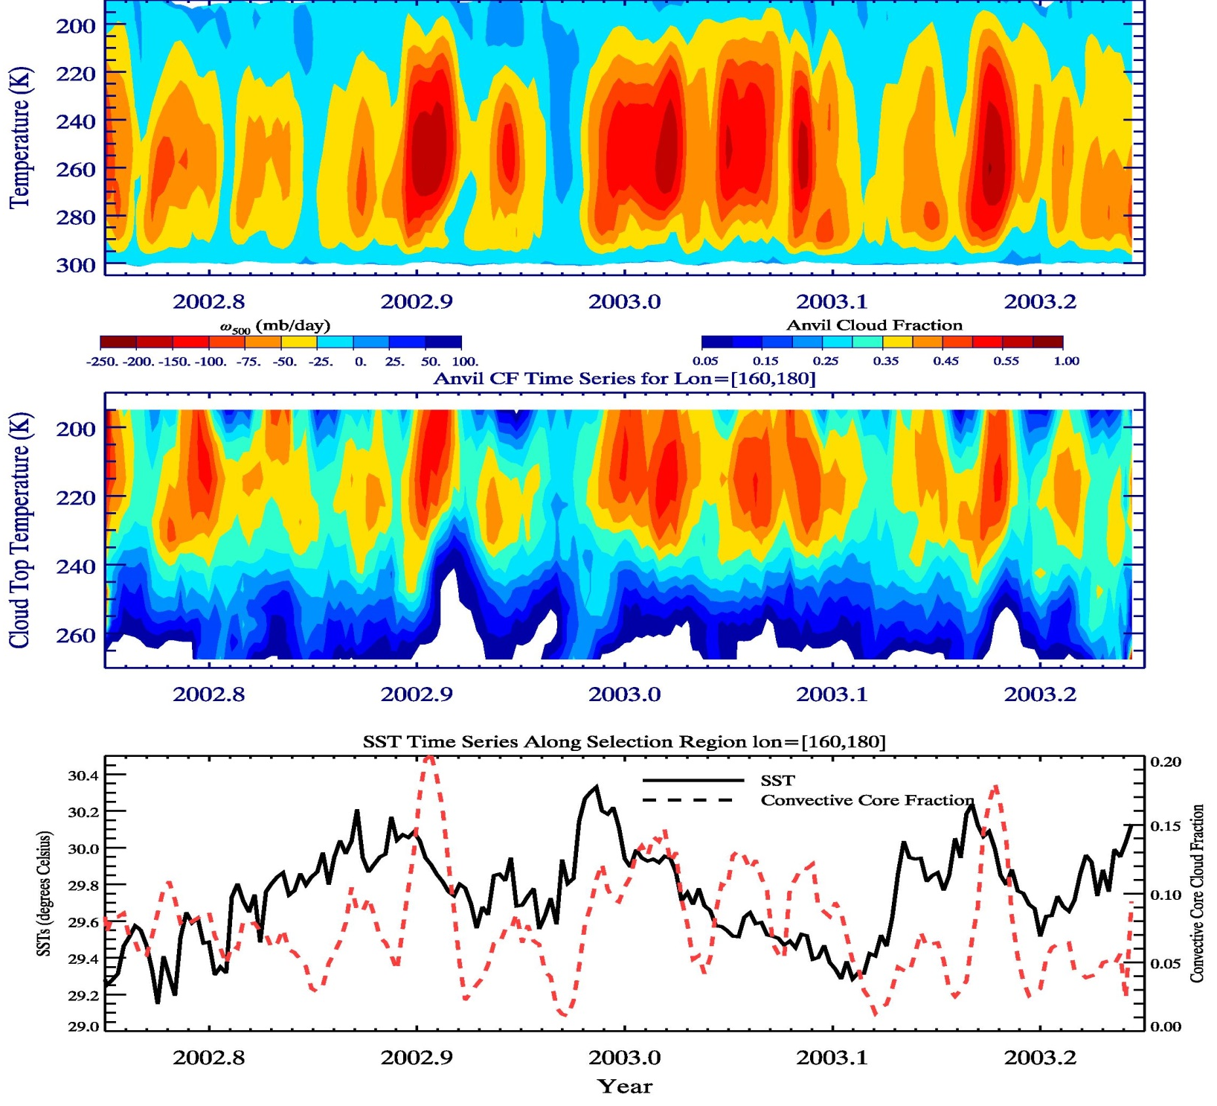
Zoomed in Vertical Profiles for Primary Hot Spot Region (1)
•While significant synoptic-to-submonthly variability exists of upward motion/
convection,
more
sustained and organized deep ascent follows hot spots
•Shallow to deep
transition of
convection
with time
ω
Strong upward motion following hot spot peak
CF Anvil
Sustained period of anvil clouds
Convective Core Follows SST Hotspots with a fairly quick response time (days to weeks)

Slide 12
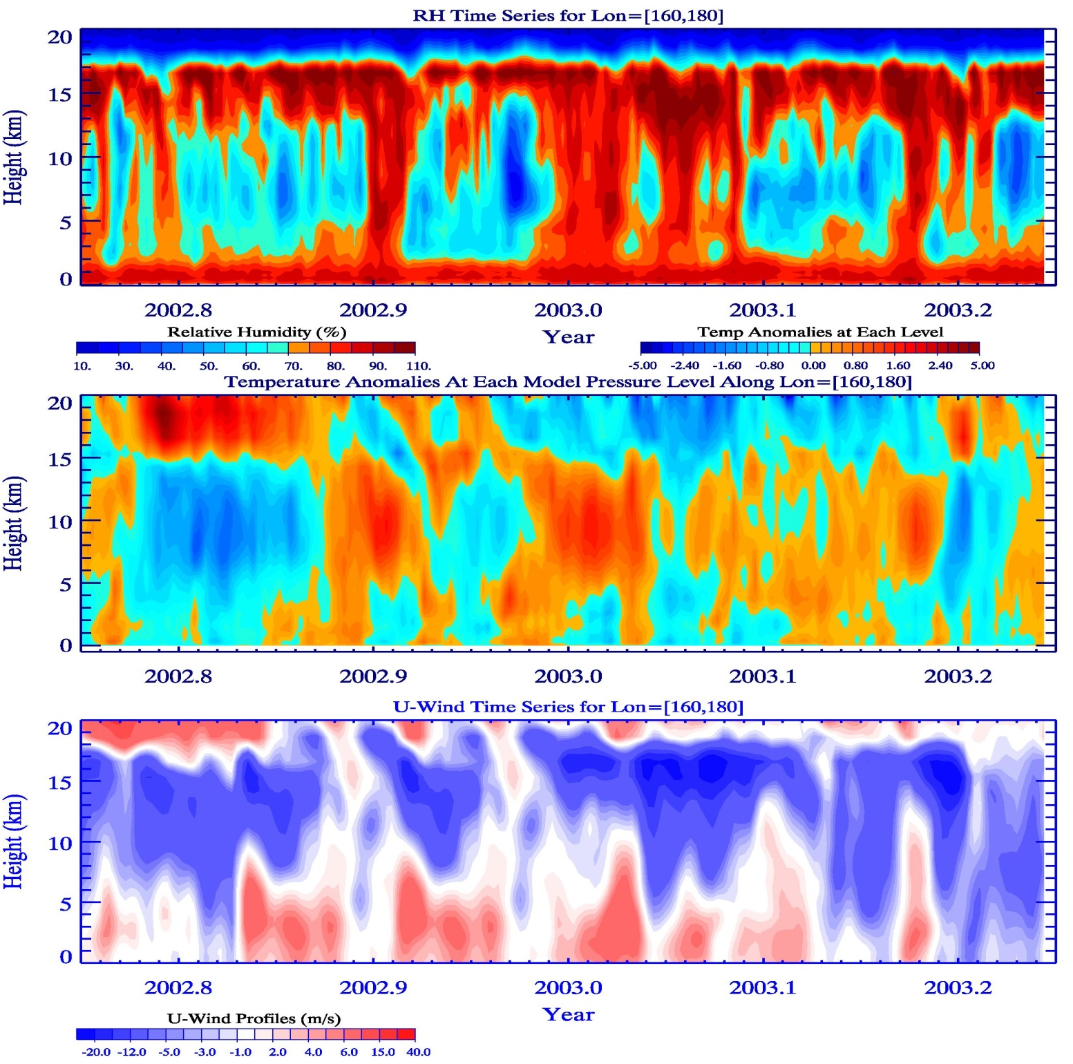
Zoomed in Vertical Profiles for Primary Hot Spot Region (2)
•Low-level moistening preceding deep convection, during/after hot spot peak
•Dry mid/upper troposphere (except near tropopause) prior to SST hot spots
RH
T’
Unstable
Transfer of Heat from Ocean to Atmosphere
U-Winds
Pulses of lower-level westerly winds in association with hot spots; they are associated with low-level convergence (not shown)

Slide 13
Feedbacks and “Predator-Prey” System of SSTs/Dynamics/Clouds
SSTs
SSTs
ω₅₀₀
Anvil + convective CF
Top: Both strong ascent and anvil/convective core clouds increase strongly following hot spot event, with 15-30 day response time
Lower Right: Convective Core CF and Rain Rates follow a counterclockwise loop – after hot spot peak, convection utilizes, or “preys” on hot spots
until hot spot is depleted, after which convection draws down and SSTs eventually rise again

Slide 14
Quick Summary
•Strong ascent, anvil and convective cloud fraction, and high rain rates are observed in the western and central South Pacific (0-10˚S) just after maximum SSTs associated with hot spots
•In some cases, the strength/duration of the hot spots coincides with the subsequent intensity of convection and precipitation
•Three independent datasets (MODIS, TRMM and ERA-Interim) are consistent with each other in illustrating these relationships, with anvil clouds and ω₅₀₀ very strongly linked to each other, as well as convective core cloud fraction and rain rates
•Hot spots generally move east to west, except during El Nino, when hot spots are larger, more widespread, and longer-lasting
•The predator-prey relationship between SST and convection is an intuitive concept that illustrates the strongly coupled nature of ocean-atmosphere system

