Slide 1


Differences in penetration depth for MODIS and RSP/VIIRS spectral ice cloud effective particle size retrievals
bastiaan.vandiedenhoven@nasa.gov
Bastiaan van Diedenhoven
- Columbia University-
-NASA GISS-

Slide 2
SWIR bands and absorption

Slide 3

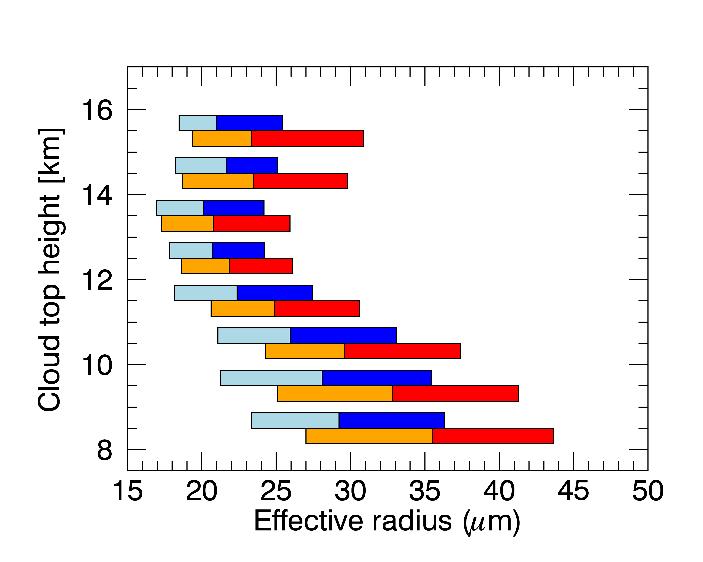
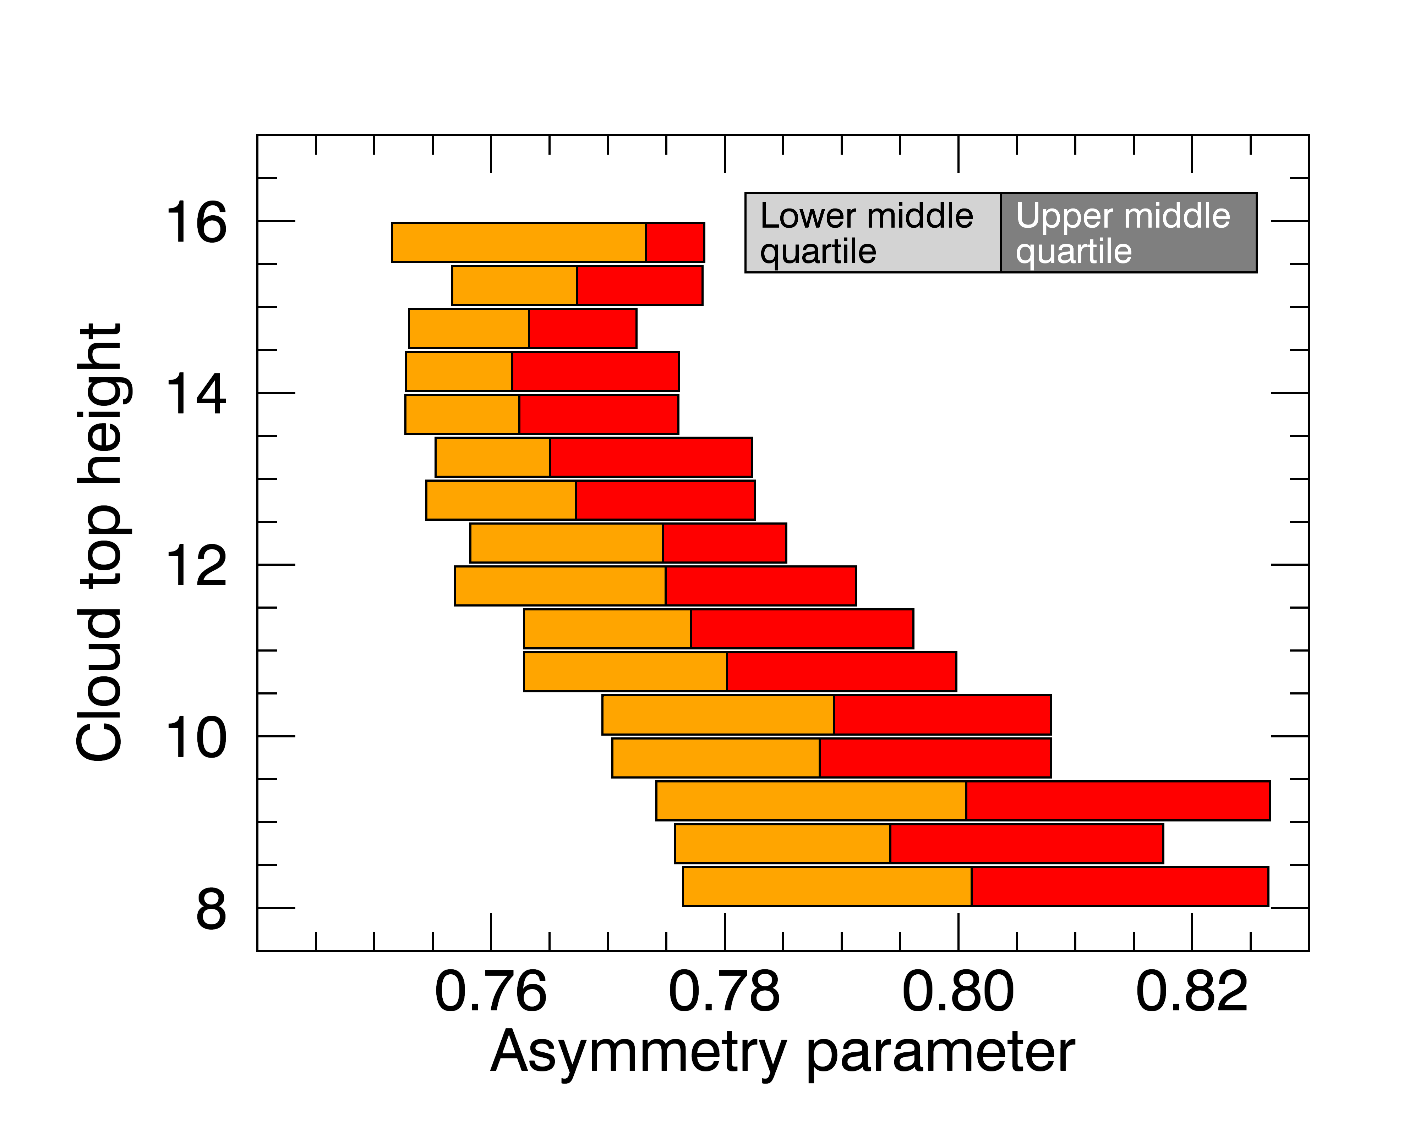
RSP data from the SEAC⁴RS campaign
Using 2.25 μm channel
Convective clouds only
COT>5 only
Using 1.59 μm channel

Slide 4
RSP data from the SEAC⁴RS campaign
Using 2.25 μm channel
Convective clouds only
COT>5 only
Using 1.59 μm channel
~Level of neutral buoyancy

Slide 5
Vertical weighting functions
75% of reflected light
Defined as in Platnick (2000)
Homogeneous layers

Slide 6
Vertical weighting functions:
Larger particle size
75% of reflected light
Defined as in Platnick (2000)
Homogeneous layers

Slide 7
Vertical weighting functions:
Larger asymmetry parameter
75% of reflected light
Defined as in Platnick (2000)
Homogeneous layers

Slide 8
Vertical weighting functions:
Higher sun
75% of reflected light
Defined as in Platnick (2000)
Homogeneous layers

Slide 9
RSP data from the SEAC⁴RS campaign
Convective clouds only
COT>5 only
2.25 micron channel sees (optically) deeper into cloud
Using 2.25 μm channel
Using 1.59 μm channel

Slide 10
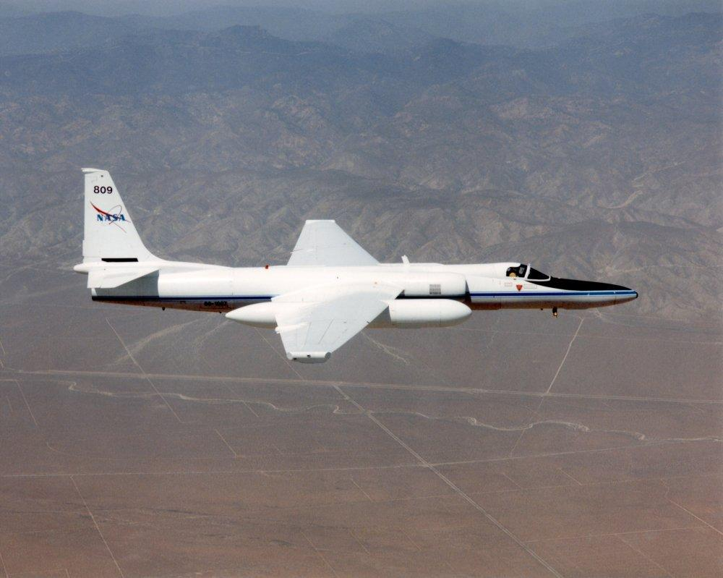
Optical depth -> physical depth
Dense cloud top
Diffuse cloud top

Slide 11
Probing cloud top ‘diffuseness’ with lidar
Dense cloud top
Diffuse cloud top
Lidar Penetration depth:
H(τ=0.1)-H(τ=3)

Slide 12
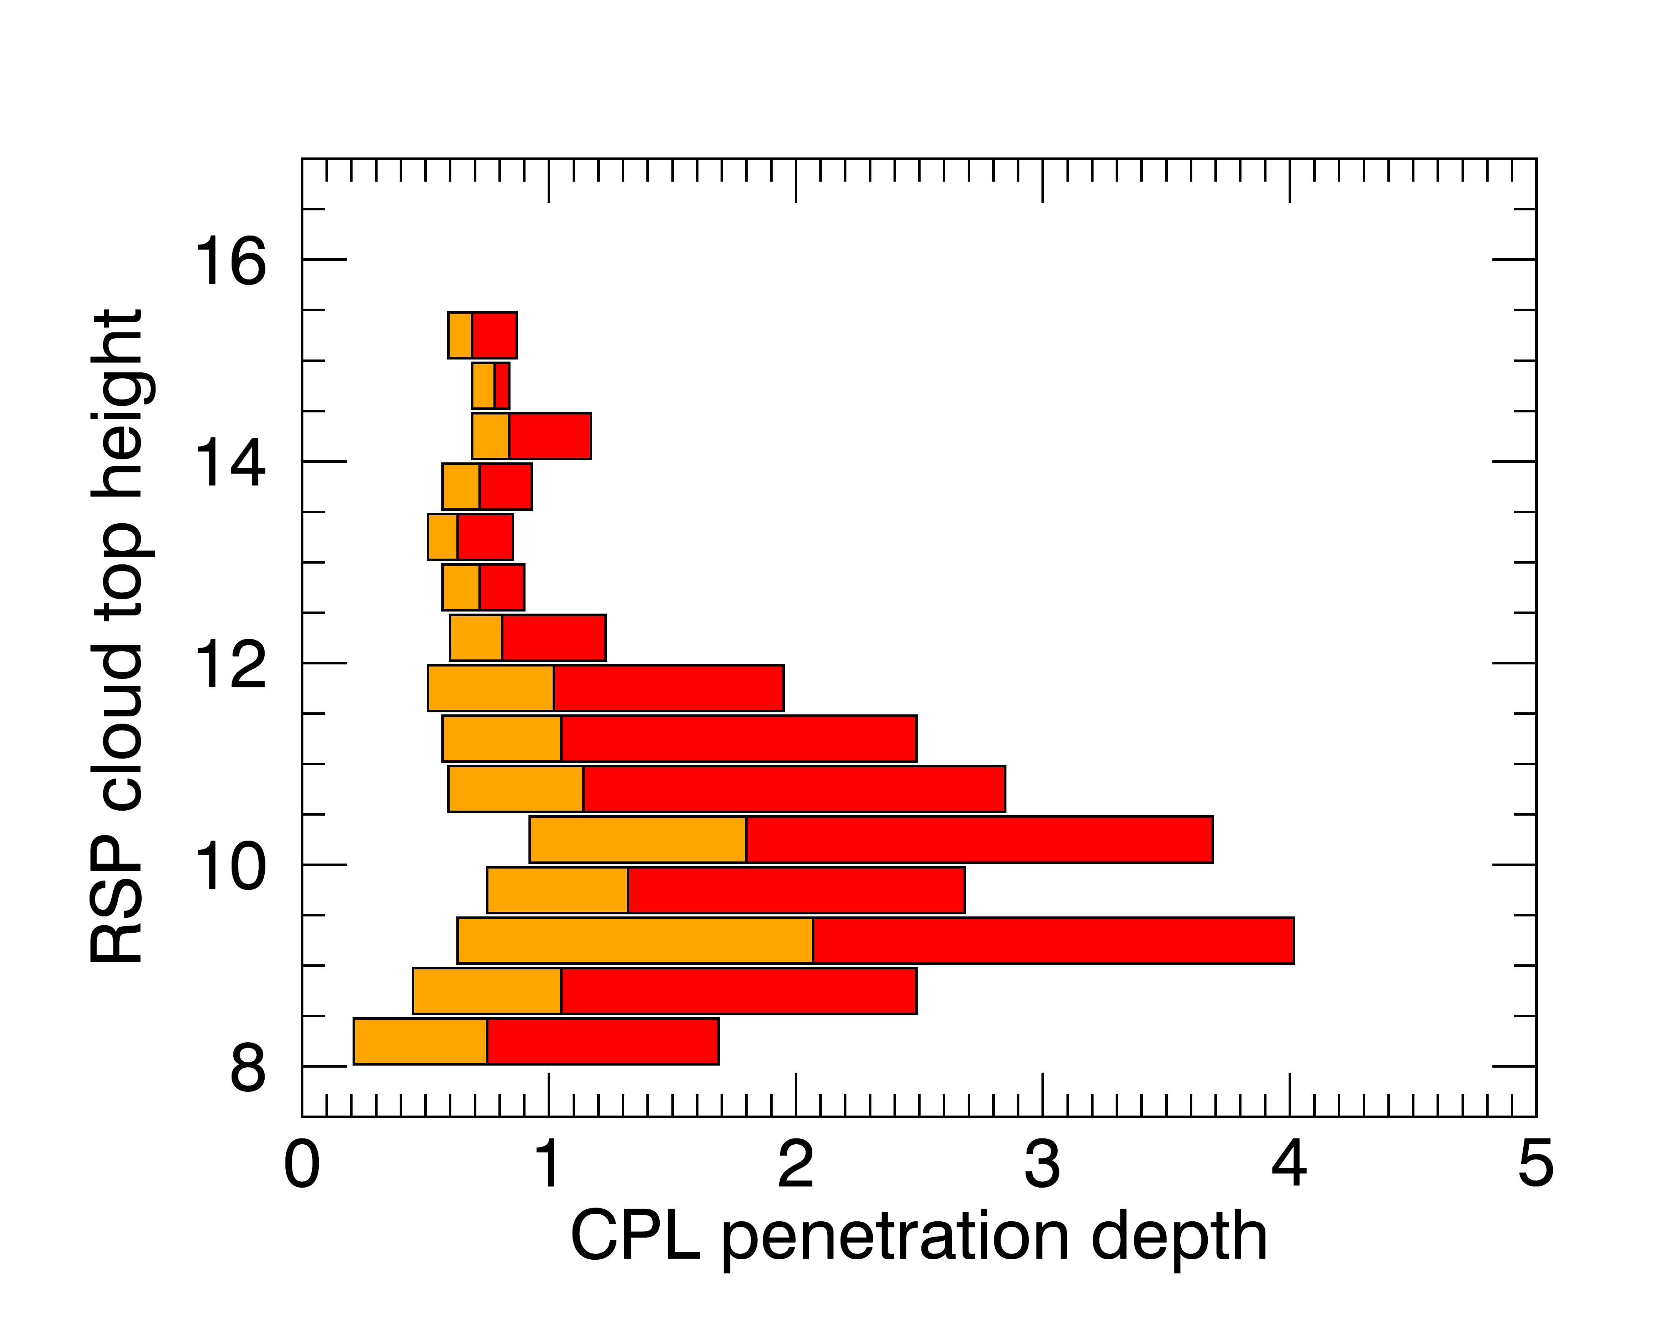
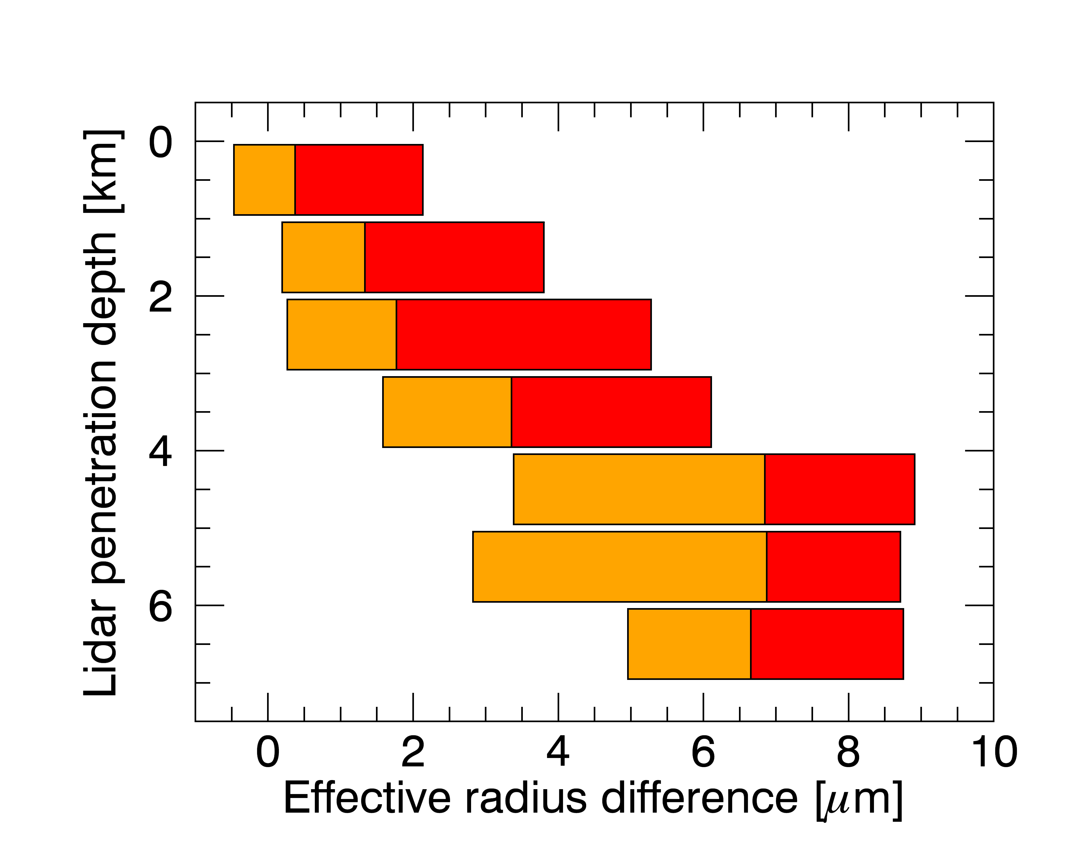
Difference between SWIR band retrievals depends on ‘diffuseness’ of top
Difference in size from two channels increases with ‘Diffuseness’ of top
~Level of neutral buoyancy
Lidar Penetration depth:
H(τ=0.1)-H(τ=3)

Slide 13
Difference between SWIR band retrievals
Lidar Penetration depth:
H(τ=0.1)-H(τ=3)
Using 2.25 μm channel
Using 1.59 μm channel
Difference between SWIR band retrievals depends on ‘diffuseness’ of top

Slide 14
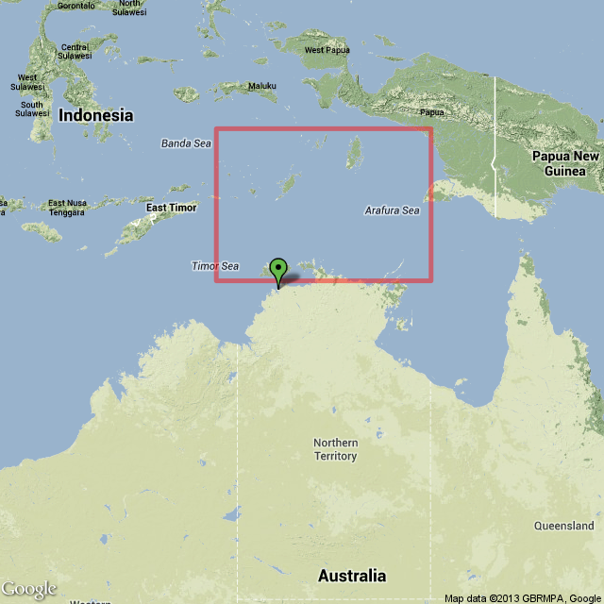
MODIS+POLDER retrievals at TWP
Vertical variation of effective radius and asymmetry parameter varies
From van Diedenhoven et al., JGR, 2014
16 Jan.-20 Feb. 2006
COT>5

Slide 15
Conclusions
MODIS vs VIIRS will depend on cloud top structure.
MODIS vs VIIRS will depend on g (higher in warm clouds)
MODIS vs VIIRS will depend on geometry
Smallest differences expected for dense, cold convective cloud tops clouds near LNB

Slide 16
Suggestion
Use two (or more) SWIR bands to retrieve
  Effective radius at specific level (e.g., OD=1)
  Linear slope of effective radius w.r.t. optical depth
Benefits:
  Comparison between sensors more straightforward
  Easier to use for model evaluation
  Paring with lidar allows estimate of slope w.r.t. to physical height/temperature
  Can also be applied to liquid clouds?

Slide 17
SWIR bands and absorption

