Slide 1
MODIS Collection 6 Ice Model Assessments with POLDER and CALIPSO
Ping Yang, Souichiro Hioki, Jiachen Ding
Department of Atmospheric Sciences
Texas A&M University
In collaboration with
Steven Platnick, Michael King
Kerry Meyer, Nandana Amarasinghe, and Chenxi Wang
Bryan Baum, Robert Holz

Slide 2
Ice Refractive Index
32 µm

Slide 3
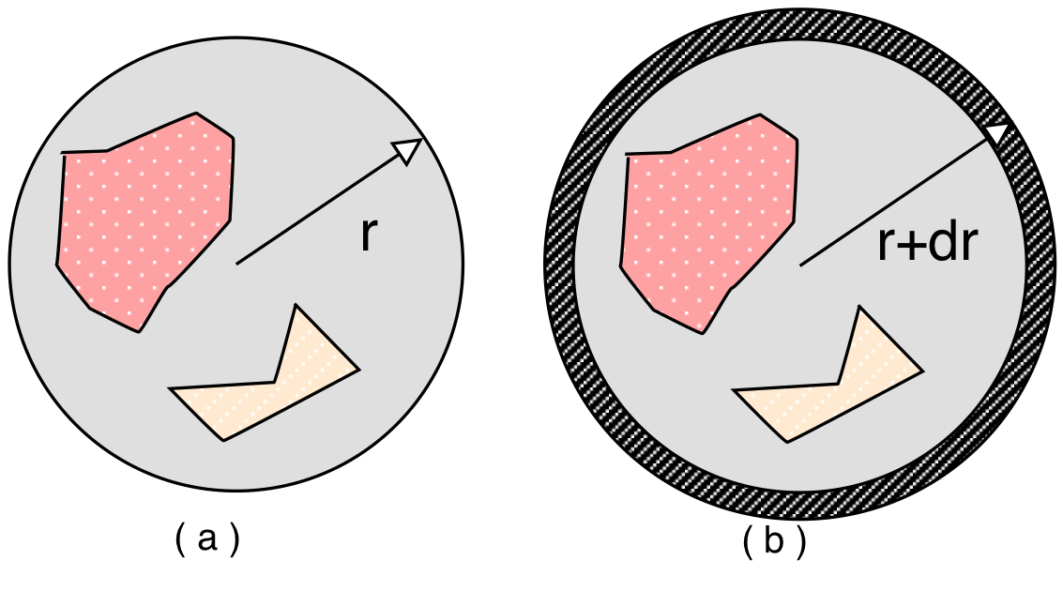
Novel Invariant Imbedding T-Matrix Method
Johnson (1988); Bi, Yang, Kattawar, and Mishchenko (2013), Bi and Yang (2014)

Slide 4
What is a nonspherical particle?
A nonspherical particle is a certain distribution of
the refractive index within a spatial domain of interest.
A nonspherical particle = an inhomogeneous sphere
= a multi-layered sphere
Note that the T-matrix corresponding to r=0 is zero.

Slide 5
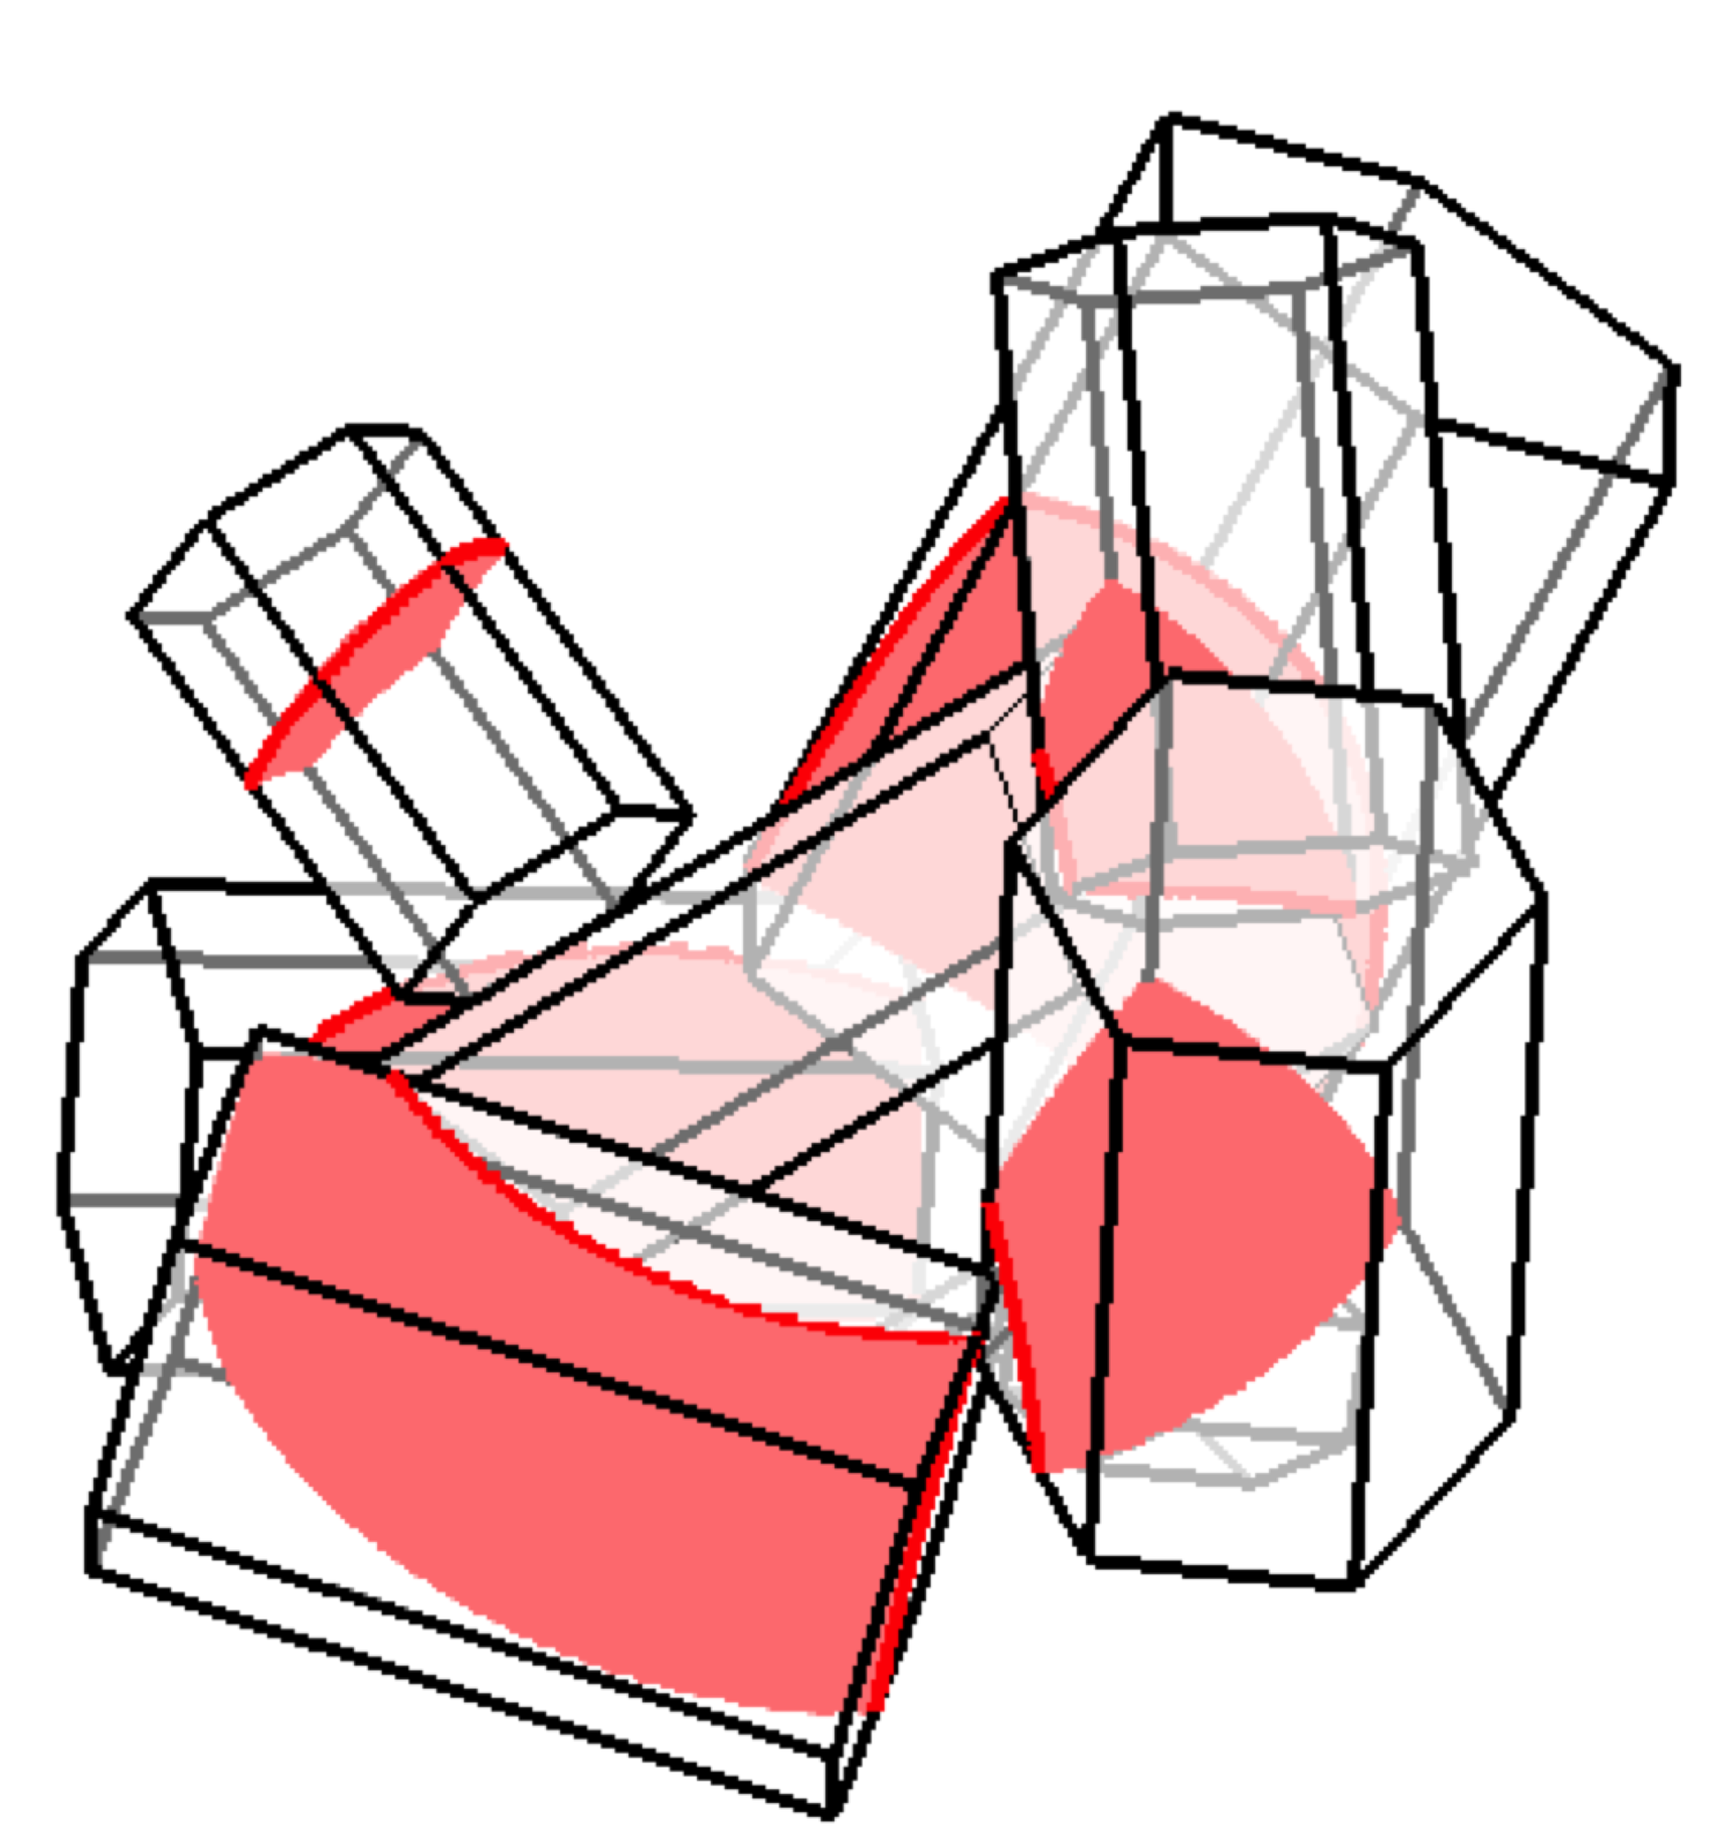
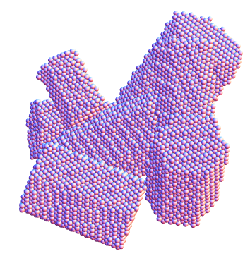
Comparison between II-TM and ADDA (Bi and Yang, 2014)
m=1.3078+i1.67x10⁻⁸
KD=65
T-matrix
DDA
In the Discrete-dipole-approximation(DDA )simulation, 1056 orientations with 128 scattering planes are set to achieve the randomness. ADDA is a public DDA software developed by Yurkin and Hoekstra.

Slide 6
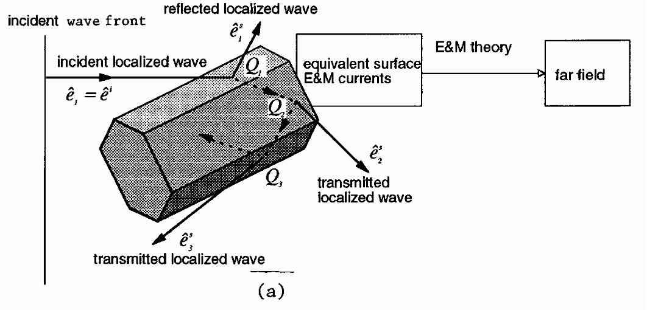

Yang and Liou (1996)

Slide 7
MODIS C5 (Baum et al. 2005) and MODIS C6 (Platnick et al. 2014) Ice Models

Slide 8
G. L. Stephens, S.-C. Tsay, P. W. Stackhouse Jr., and P. J. Flatau, 1990: The relevance of the microphysical and radiative properties of cirrus clouds to climate and climatic feedback. J. Atmos. Sci., 47, 1742–1754.
“The asymmetry parameter had to be adjusted from the broadband Mie value of g=0.87 for the size distribution chosen to a lower value of g=0.7 in order to bring the observations and theory into broad agreement.”
“Cirrus clouds characterized by g=0.87 warmed approximately twice as much as cirrus clouds modeled with g=0.7.”

Slide 9
Consistency of spectral retrievals
MODIS operational retrieval algorithm (Nakajima and King, 1990)
Infrared techniques: 8.5 µm, 11 µm, and 12 µm (e.g., Wang et al. 2011)
The cloud property retrievals based on the two techniques should be consistent.

Slide 10
Scatter plots of MODIS observed TOA BTs and BTD (8.5-11mm) vs. simulated BTs and BTD by using the optimal t and D_{eff} (after Wang et al. 2011).

Slide 11
Spectral Consistency: MODIS C5 versus MODIS C6

Slide 12
Ranges of POLDER Observations
(5%-95% quantile)

Slide 13
Polarimetric property consistency: POLDER observations (color contour) versus simulations (lines) with D_{e}=60 µm

Slide 14
Enhanced backscatter for roughened particles (Zhou and Yang 2015):
where 0.3< R<0.7
and δ_{c}=2πD(π-θ)/λ.

Slide 15
Comparison of Integrated Attenuated Backscatter-Optical Depth relations of MODIS C5 and MODIS C6 model ice particles in different latitudinal areas

Slide 16
Conclusions
  With the newly developed MODIS C6 ice cloud optical property model, improvements have been achieved from several perspectives:
    Spectral consistency in cloud property retrieval (VIS/NIR vs IR)
    Polarimetric property consistency: POLDER observations vs simulations
    Consistency in a combination of passive (MODIS) and active (CALIPSO) observations.
  MODIS C6 ice cloud optical property model has been extended to the generation of ice cloud properties in the Community Radiative Transfer Model (CRTM)
  Will apply the MODIS C6 model to RT models in GCMs (e.g., CESM).

