Slide 1
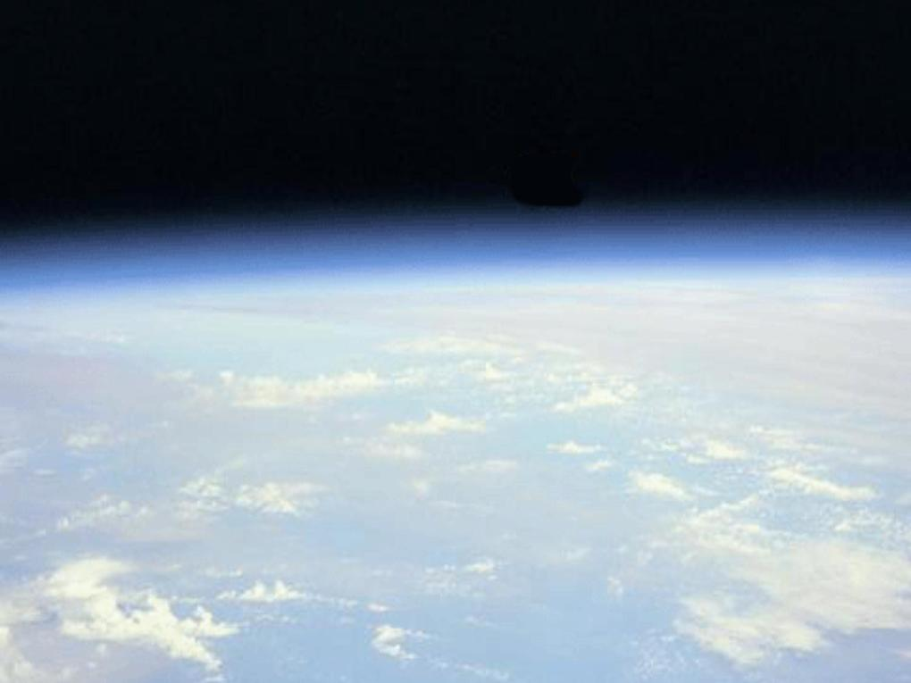
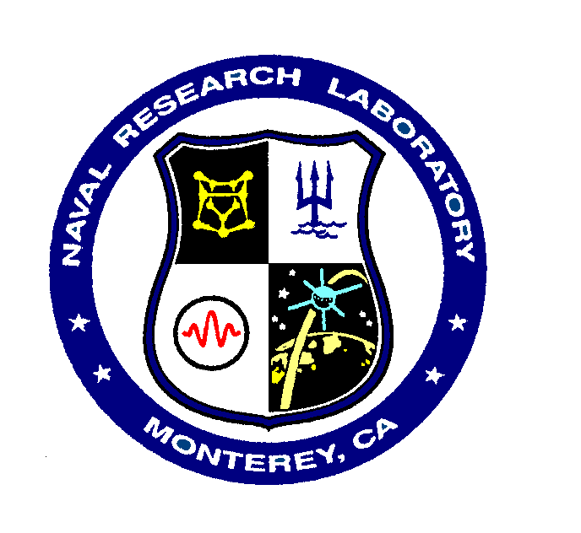

Issues impacting the study of long-term aerosol forcing trends
Jianglong Zhang¹, Jeffrey S. Reid², James R. Campbell², Edward J. Hyer², Travis D. Toth, Matthew Christensen¹, and Xiaodong Zhang³
¹ University of North Dakota, Dept. of Atmospheric Sciences
² Naval Research Laboratory, Marine Meteorology Division
³ University of North Dakota, Dept. of Earth System Science

Slide 2
Goals and Objectives in the
First Research Year
Objectives of Year 1:
Expand the investigation of aerosol trends to the vertical coordinate.
Study temporal variation of above-cloud aerosol events
Further explore the Southern Oceans aerosol anomaly, through studying of subsurface oceanic bubbles
Develop trend-quality aerosol products
Explore use of nighttime aerosol retrievals jointly with VIIRS
Goal: Examine decadal trends in Terra and Aqua’s AOT and radiative forcing products from MODIS and CERES by accounting for uncertainties and biases in the next generation of aerosol products.

Slide 3
Area 1: For regions with significant AOT trends, identify the sources of the trends in the vertical -
Is there a consistent story?
Collocated MODIS and CALIOP (2006-2013)
Day 0-0.5 km
Night 0-0.5 km
MODIS
Day 0.5-1 km
Night 0.5-1 km
Day 1-2 km
Night 1-2 km
CALIOP
Day >2 km
Night >2 km
0
0.2
0.4
-0.1
0
0.1
Mean AOT
(550 nm)
Temporal variation
ω AOT/yr
0
0.05
0.1
Spatial distributions of layer AOT in vertical
Toth et al., 2015 (submitted)

Slide 4
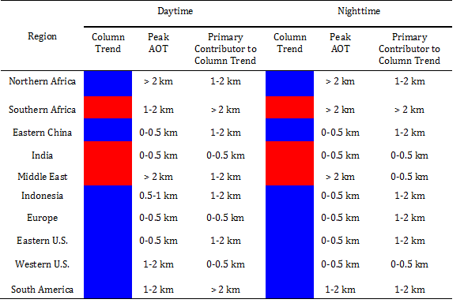
Aerosol Profile Variability (CALIOP only)
Toth et al., 2015 (submitted)

Slide 5
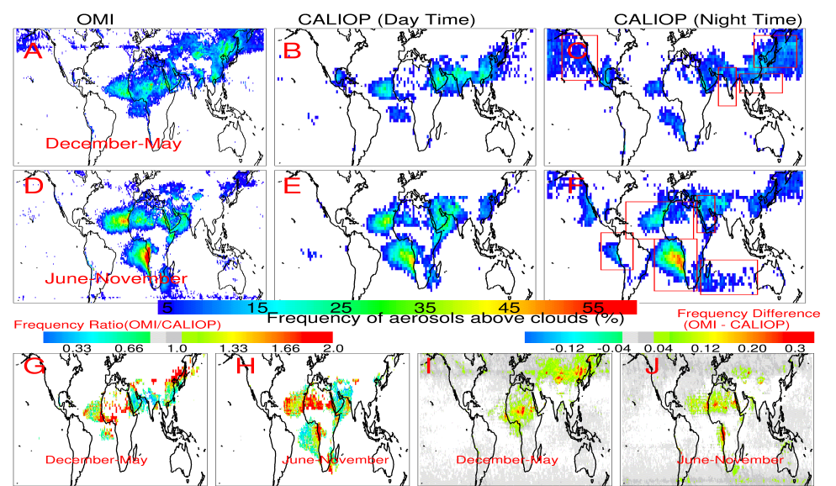
Area 2: Investigate the climatology of aerosol above cloud aerosol events
Alfaro-Contreras et al., 2015, submitted

Slide 6
Area 2: Investigate Aerosol Climatology for
Above-Cloud Aerosol Events
Alfaro-Contreras et al., 2015, submitted

Slide 7
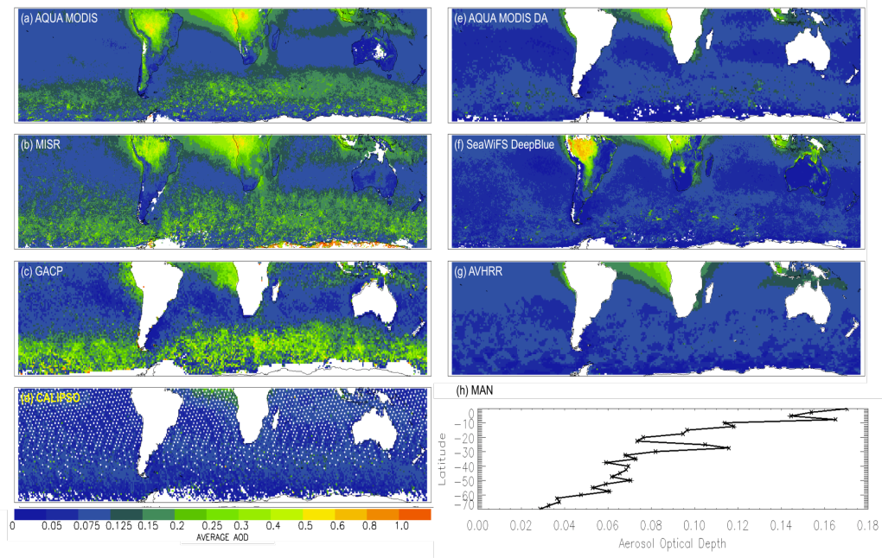
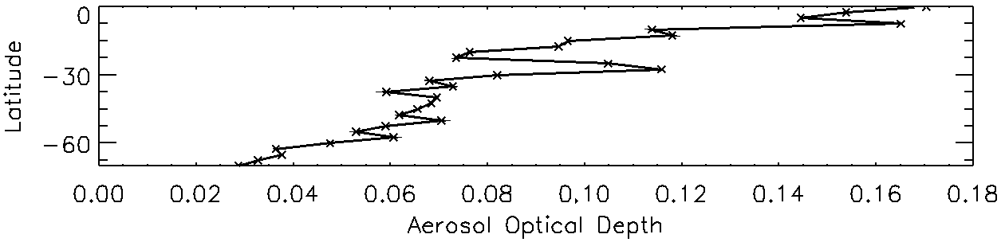
Area 3: Bubble Investigation of
the Enhanced Southern Ocean Aerosol Anomaly (ESOA)
C5 Aqua MODIS DT
2006
C5 Aqua MODIS DA
MISR
SeaWiFS DB
GACP
AVHRR
CALIOP
MAN
AOT
Toth et al., 2013
AOT

Slide 8

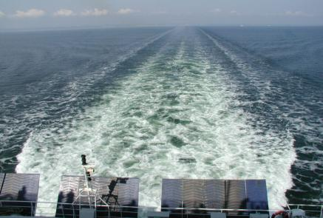
ESOA can’t be fully explained by cloud contamination…
Sub-surface bubble contribution?
Whitecaps are simply air bubbles on the surface. However, they have significantly different lifetime: minutes to hours for subsurface bubbles vs seconds for whitecaps (e.g. Johnson and Cooke, 1981).
Radiative Transfer Models (RTMs):
6S atmospheric RTM.
HydroLight oceanic RTM.
Ocean bubble data:
Ocean bubble phase function is adopted from Zhang et al. (2002).
Ocean bubble concentrations are obtained from Zhang (2001) and Zhang and Lewis (2002), denoted default bubble concentration.
Subsurface bubbles
Christensen et al., 2015, accepted
http://upload.wikimedia.org/wikipedia/commons/a/ab/Wake_%28Kilwater%29_behind_a_ferry.jpg

Slide 9
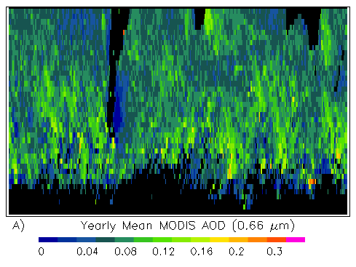
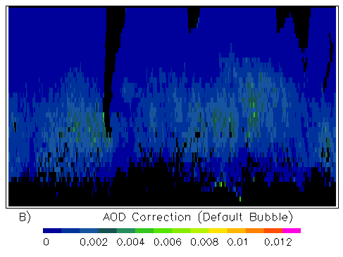
Can’t be fully explained by cloud contamination…
Sub-surface bubbles?
Yearly mean MODIS AOD
AOD Correction (default bubble)
Subsurface bubbles are not the cause of ESOA
Subsurface bubbles may not be important for AOT, but it has been show its importance for TOA energy and ocean color retrievals
The difference in surface reflectance (ΔR/π) with and without consideration of oceanic bubbles are plotted as functions of wavelength and near-surface wind speed
Christensen et al., 2015, accepted

Slide 10
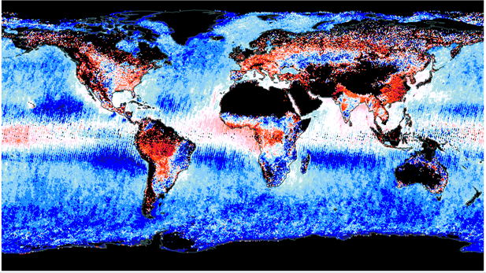
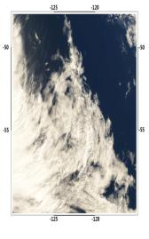
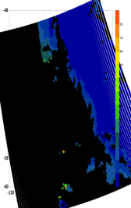
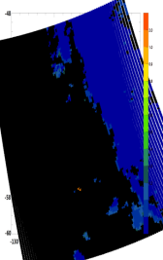
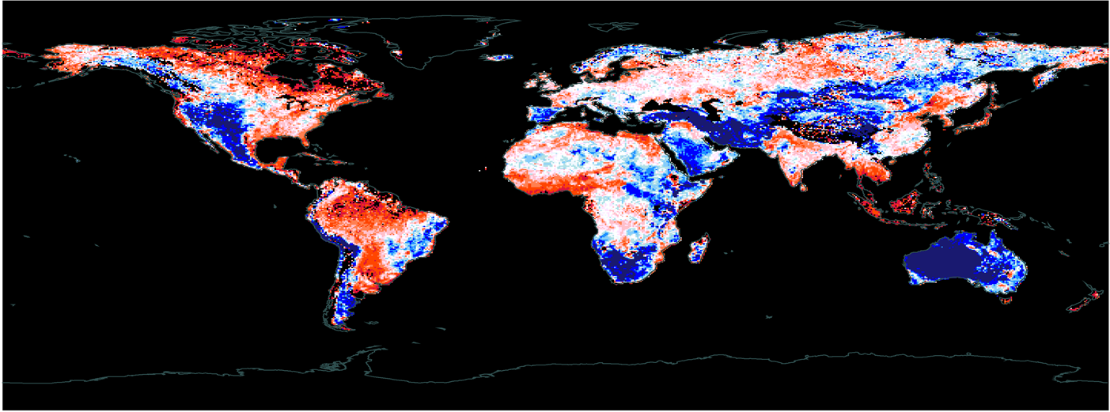
Area 4: Working Toward Trend-Quality MODIS Aerosol Data though Rigorous QA
2005-2007
Our Quality-Assured C5 MODIS aerosol products are accessible through the GODAE server
Terra C6 just completed! Working towards constructing trend-quality C6 MODIS aerosol products (DT+DB) following Shi et al., 2011; 2014
DT/MISR AOD
C5
C6
DB/MISR AOD
2007-01-03 48-60◦ S, 115-130◦ W (DT)
0.4 0.6 0.7 0.8 0.9 1.11 1.25 1.66

Slide 11
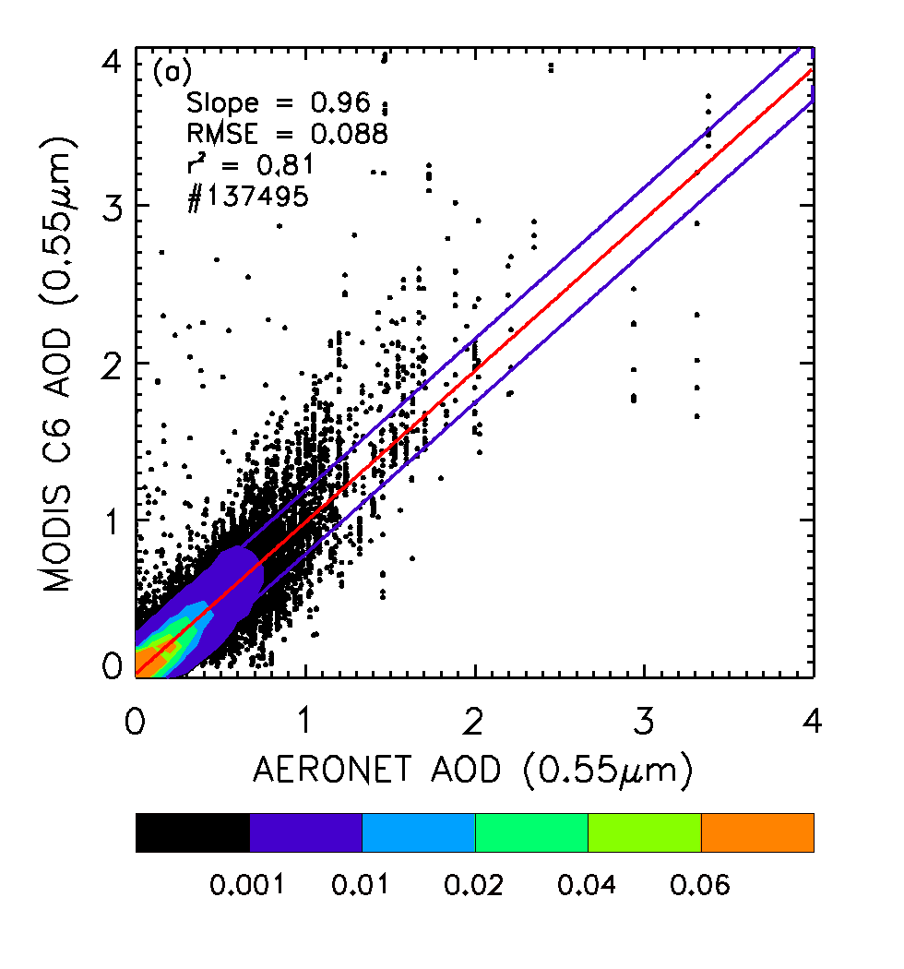
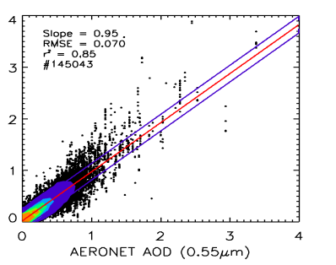
Area 4: Working Toward Trend-Quality QA MODIS aerosol data (cont…)
  Validated using AERONET data, cloud contamination, as well as biases related to aerosol microphysical properties and near-ocean surface wind speeds are reduced when comparing with C5 MODIS DT over-ocean aerosol products.
  The ESOA feature is also greatly reduced in the c6 MODIS aerosol products.
  Our study suggests that cloud contamination still exists and is observable in the C6 dataset.
  By applying data screening and empirical correction steps similar as used in constructing the C5 version of the DA-quality product, our preliminary results show a further reduction of uncertainties in AOD by 17%, and the outliers by 20%.
C6-DT
QAed

Slide 12
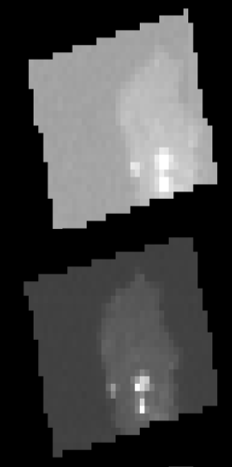
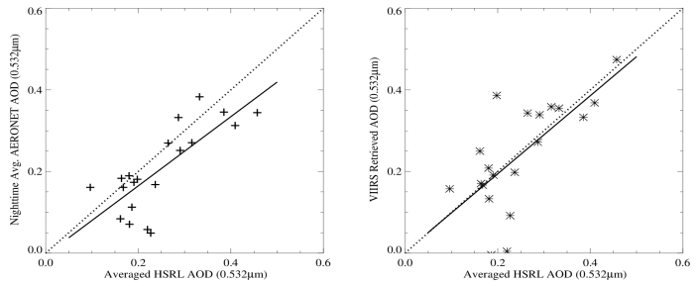
Area 5: Nighttime Aerosol Retrievals are Limited. Can VIIRS Fill the Observational Gap?
  Reliable nighttime measurements of aerosol optical properties, such as optical depth (τ,) are needed for both climate studies and aerosol modeling efforts (e.g., Zhang et al. 2003, 2008).
Recently-launched Visible/Infrared Imager/Radiometer Suite (VIIRS) includes a calibrated Day/Night Band (DNB) that can be used to observe nocturnal anthropogenic sources of radiation (e.g., city lights).
This study presents a new method that uses the statistical variance of pixels within a given artificial light source.
See the poster section for details
Cape Verde, clear versus dusty skies
Clear
Dusty
VIIRS DNB and AERONET AOD vs. HSRL AOD (Huntsville)
0.4
0.4
AERONET AOD (0.532 µm)
VIIRS AOD (0.532 µm)
0.2
0.2
0.0
0.2
0.4
0.6
0.0
0.2
0.4
0.6
Theodore et al., 2015, submitted
HSRL AOD (0.532 µm)

Slide 13
Conclusions and Plans for Year 2
The significant positive daytime regional AOT trends over India and the Middle East are contributed to the most from the near-surface (0-0.5km) and an elevated layer (1-2km), respectively. Positive temporal variation is also observed from the two regions for above-cloud AOT.
While working on understanding uncertainties in C5 and C6 MODIS aerosol products, we have evaluated the impacts of subsurface bubbles on the ESOA phenomenon. This study suggests that submerged bubbles are not the primary cause for ESOA. That being said, submerged bubbles have been shown their importance for TOA energy and ocean color retrievals.
For the coming year, emphasis will be given to:
Development of trend-grade aerosol datasets (DT+DB).
Start looking at MAIAC data
Although not shown, we have been working towards aerosol forcing trend analysis through a multi-sensor based approach (including MODIS and CERES).

Slide 16
Collocated Collection 6 Aqua MODIS/CALIOP Analysis
Toth et al., 2015 (submitted)

