Slide 1
MODIS Land C6 Schedule and Status
Sadashiva Devadiga^{1,2}, Ye Gang^{1,2} and Edward Masuoka¹
¹NASA GSFC
²Science Systems and Applications Inc.
MODIS/VIIRS Science Team Meeting
May 19-22, 2015

Slide 2
Forward Processing Status
Forward processing is typically 1-2 days behind real time
  C5 L1B, C5 Land, C4.1 LST (C4 LST algorithm with C5 L1 input), C51 Land Cover, BA, VCF, and C55 GPP/NPP (improved and gap filled product generated at the SCF)
  C51 Atmosphere
  C6 L1B and C6 Atmosphere
  Processing of maneuver days could be delayed because of the need for an offline processing to facilitate review of data by LDOPE for geolocation error from loss of pointing accuracy.
Land (except for snow and sea-ice) and Atmosphere products available from LAADS archive.
C5/C5.1/C4.1 processing to be continued for a year after completion of the C6 land and atmosphere reprocessing.
Products from C5 processing are expected to be available from DAAC for a year after completion of the C6 land reprocessing.
NRT processing (C5 Land and C51 Atmosphere) is completed typically 2 hours after acquisition of data.

Slide 3
C6 L1B Reprocessing Status
L1 (MxD02), Geolocation (MxD03) and L1B (MxD02QKM, MxD02HKM, MxD021KM)
  C6 reprocessing of Aqua and Terra completed in 2012.
  Forward processing of Terra and Aqua L1B started in 2012 and is currently at the leading edge.
  Terra L1B reprocessed in August 2014 to address trending in Band 5.
  C6 Products have been available to public since late 2012 from LAADS.
  MCST continues to derive and deliver forward LUT updates for the two processing streams as needed.
  MCST delivered new C6 LUT for Aqua with change to RVS-based correction for bands 1-4 to correct for the trending observed in the C6 L1B. Expected to be put in operation in the C6 forward processing, with approval from the science teams.
  Terra and Aqua L1B process with code change to correctly identify the sector rotation period put in forward processing in May 2015.

Slide 4
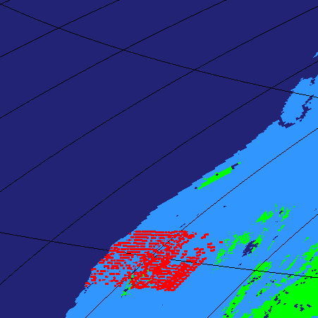
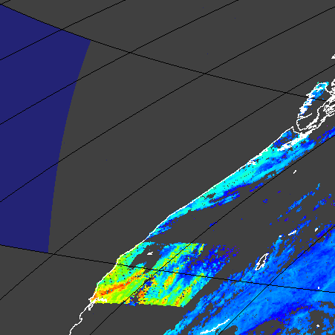
C6 L1B Reprocessing Status
Incorrect Recording of sector Rotation during Lunar events
Global Browse of Terra Active Fire and LST from day 2014345
Lunar Maneuver: 2014-12-31 20:25:00 - 22:22:17

Slide 5
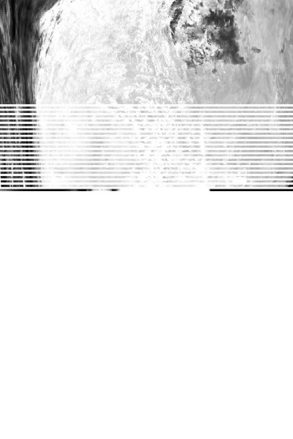
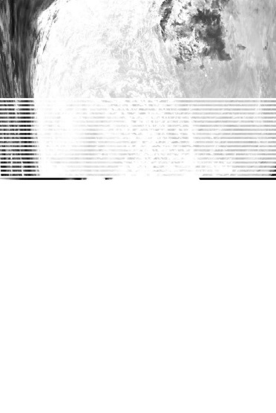
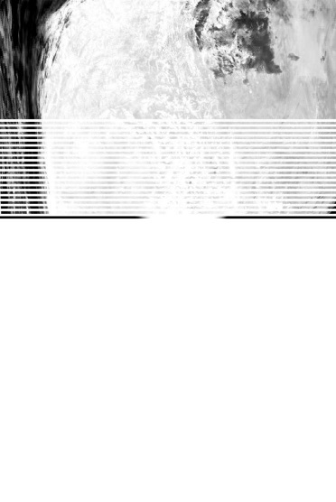
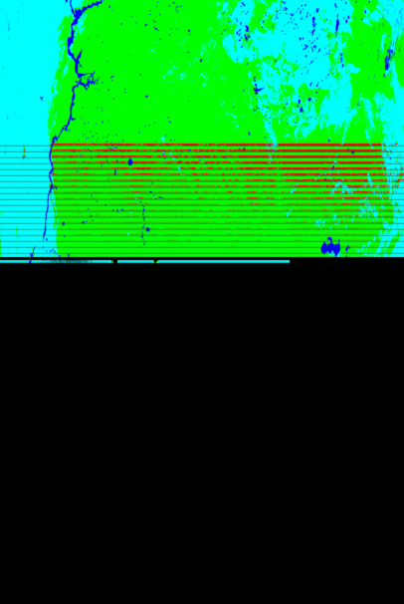



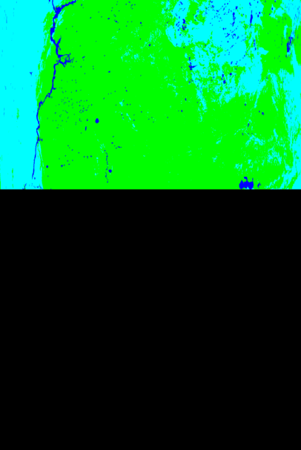
C6 L1B Reprocessing Status
Incorrect Recording of sector Rotation during Lunar Events
Granule MYD021KM.A2008343.2235 acquired during the Lunar Roll Maneuver of Aqua MODIS on 2008-12-08 (21:30:00 22:36:57 22:43:43 23:58:20)
Band 20
Band 22
Band 29
MOD14

Slide 6
C6 L1B Reprocessing Status
Aqua C6 Reflectance Trends from current LUT
nadir
326
1205
MCST, MSWG Telecon 02/04/2015

Slide 7
C6 L1B Reprocessing Status
Aqua C6 Reflectance Trends from new LUT
nadir
326
1205
MCST, MSWG Telecon 02/04/2015

Slide 8
C6 Land Reprocessing Plan
Land Reprocessing run in two tiers with 1st tier of reprocessing currently in progress.
  1st Tier of reprocessing includes – suite of LSR (MxD09), Fire(MxD14), sea-ice(MxD29), LST(MxD11), VI(MxD13), LAI/FPAR (MxD15), GPP/PSNnet (MxD17) and BRDF/Albedo (MCD43)
  Second tier of products include – Snow (MxD10), MAIAC (MOD19), Simon’s LST (MOD21), Evapotranspiration (MOD16), Burned Area (MCD64A1), VCF (MOD44B), LC (MCD12Q1 and MCD12Q2).
  C6 reprocessing used
    New improved Land Water Mask
    Multi-year land cover product using three years of MODIS observation. Multi-year land cover product available for years 2001, 2004, 2007, and 2010.
    Polarization corrected L1B – applied to Aqua and Terra MODIS C6 L1B
  C5 forward processing is expected to continue for a year after completion of the C6 reprocessing and data products from both version will be available to public during this period

Slide 9
C6 Land Reprocessing Status
Polarization Correction of L1B
C6 Surface Reflectance used Polarization Corrected L1B(MxD02PCQKM, MxD02PCHKM, MxD021KM)
  Terra MODIS products impacted by increasing polarization sensitivity since launch – visible artifact in products since 2007.
  Correction applied to TOA radiances and is not part of the L1B calibration.
  Polarization Corrected L1B generated from post processing of the operational C6 L1B products, both Aqua and Terra (PGE 128).
  Polarization Corrected L1B is an intermediate product used as input by the surface reflectance in C6 Land reprocessing. Identical format as C6 L1B.
The Polarization Correction process corrects bands 1, 2, 3, 4, 8, 9 and 10
  Detrending applied to Terra and Aqua bands 1, 2, 3, 4, and 8
  Gain adjustments applied to Terra bands 1, 2, 3, 4, and 8
  Polarization correction applied to bands 3, 8, 9 and 10. Terra used time varying coefficients. Aqua used fixed pre-launch coefficients.
  For Terra bands 8, 9 and 10 used time varying polarization coefficients since 2000-065. For Terra band 3 used time varying coefficients from day 2002193 and onwards. For days prior to 2002193 band 3 used fixed coefficients from July 2002.

Slide 10
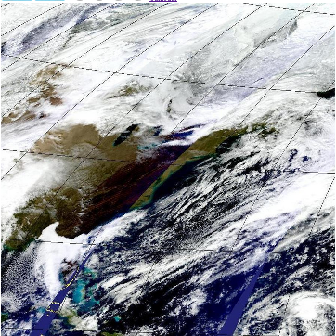
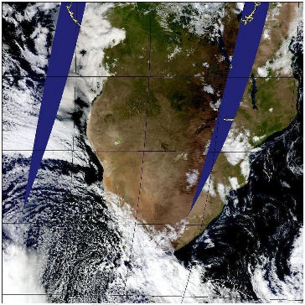
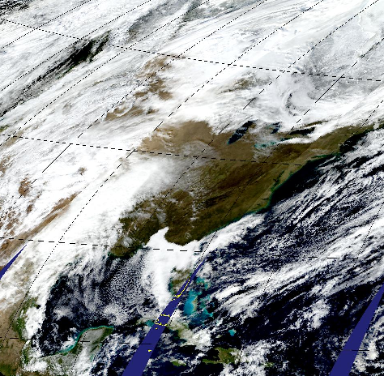
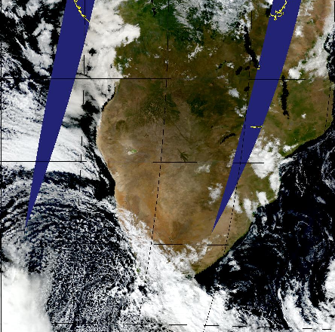
C6 Land Reprocessing Status
Surface Reflectance: L1B vs PC L1B
North America
2012349
South Africa
2009193

Slide 11
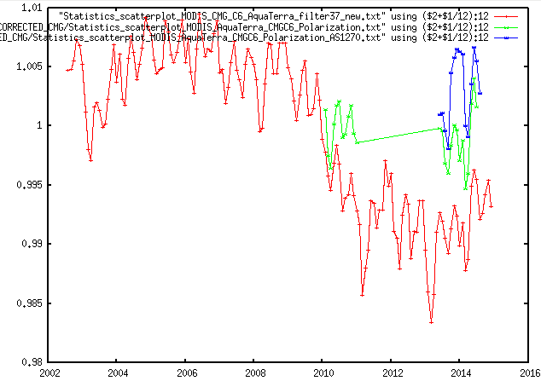
C6 Land Reprocessing Status
Surface Reflectance: L1B vs PC L1B
Ratio of Terra and Aqua mean SR CMG over BELMANIP Sites
Test data from years: 2010, May 2013 – June 2014
Eric Vermote, GSFC Code 619

Slide 12
C6 Land Reprocessing Status
Tier 1 Processing
  Products include suite of LSR (MxD09), Fire(MxD14), sea-ice(MxD29), LST(MxD11), VI(MxD13), LAI/FPAR (MxD15), GPP/PSNnet (MxD17) and BRDF/Albedo (MCD43)
  Used C51 snow (C5 snow algorithm run with C6 L1B and Cloud Mask) as input to LST and BRDF/Albedo
Reprocessing started in February 2015, with the beginning of Terra mission. Currently processing Terra and Aqua.
Processing Stream1 on mtvs7
  Generates Surface Reflectance, Active Fire, VI, LAI-FPAR and Sea-ice
  At ~70x rate processing completed through data day 2007224.
  Re-reprocessing of period 2000055 – 2003192 started on May 15, 2015 with Polarization correction applied to the L1B from this period
  VI to be reprocessed from beginning through 2007224 – issues with QA and reliability datasets, use of new CMG database for use in CMG products.
Processing stream 2 on mtvs1
  Generates BRDF/Albedo and LST.
  At ~15x rate processing completed through data day 2002050
  Re-reprocessing of BRDF-Albedo started on April 9, 2015 – error in handling of dead detectors, algorithm change to process based on individual band QA.

Slide 13
C6 Land Reprocessing Status
Tier 2 Processing
  Products include Snow (MxD10), MAIAC (MCD19), Simon’s LST (MxD21), Evapotranspiration (MxD16), Burned Area (MCD64A1), VCF (MOD44B), LC (MCD12Q1 and MCD12Q2).
  C6 algorithm development and Science Testing is in progress – at least one or more revisions of the algorithms has been received, baselined and tested at MODAPS.
  Land Cover process to be migrated to MODAPS.
  These products do not have interdependency. Reprocessing of the product will begin upon approval of the algorithm by the PI.
  MODAPS will have dedicated resources for science testing of the products in tier2 block and for the Tier2 reprocessing.

Slide 14
C6 Land Reprocessing Timeline
Public release of Teir1 Land Products
Expected completion of Land Reprocessing
C5 Land Processing and C4.1 LST
C6 Atmos Reproc - Terra
C6 Atmosphere Forward Processing -Terra
C6 Atmosphere Forward Processing - Aqua
C6 Land Reprocessing
Re-reprocessing
2000055-2003192
C6 Land Reprocessing
C6 Land Forward processing
Delivery and Testing for products in Tier 2
Feb
2015
Mar
Apr
May
June
July
Aug
Dec
2015
Mar
2016
Mar
2017
Reprocesseing stopped at 2007224
Reprocesseing resume at 2007224

Slide 15
Near Real Time Processing for LANCE MODIS – C5/C6
Products are being generated within 2 hours of data acquisition for most L2 products. Latency varies for L3 products.
Current production uses NRT variation of operational C5 PGEs in production at MODAPS.
C6 PGEs have been baselined for NRT and are currently being run in the NRT test system (NRT3). Expected to be operational soon after release of C6 operational products to the public.
C6 PGEs could be run in parallel with C5 version for 1 year to allow applications users time to transition – additional resources may be needed to meet the latency requirement and the needed redundancy (nrt1 and nrt2)

Slide 16
Global Image Browse System
GIBS project generates, archives and distributes browse images of products from many different instruments to meet the requirements of its clients
  Not supposed to be used in scientific research.
  An example client World View https://earthdata.nasa.gov/labs/worldview/ needs high quality multi-resolution browse images to improve the browsing capability in data ordering.
  GIBS has identified the initial MODIS Land and Atmosphere layers, and will consult with science team/DAACs for more layers.
MODAPS will generate the global and granule browse images for GIBS
  Metadata to be included to facilitate archive and search
  Final product list, map projection type, color LUT are finalized.
  Browse generation processes at MODAPS and GIBS using C6 data products as input are currently being tested.
  Science Team review and feedback are solicited. The first test run of MODIS C6 Land product imagery is available at: http://goo.gl/oSQ5Wk . Imagery available for most days between July 7th and October 3rd 2003.

Slide 17
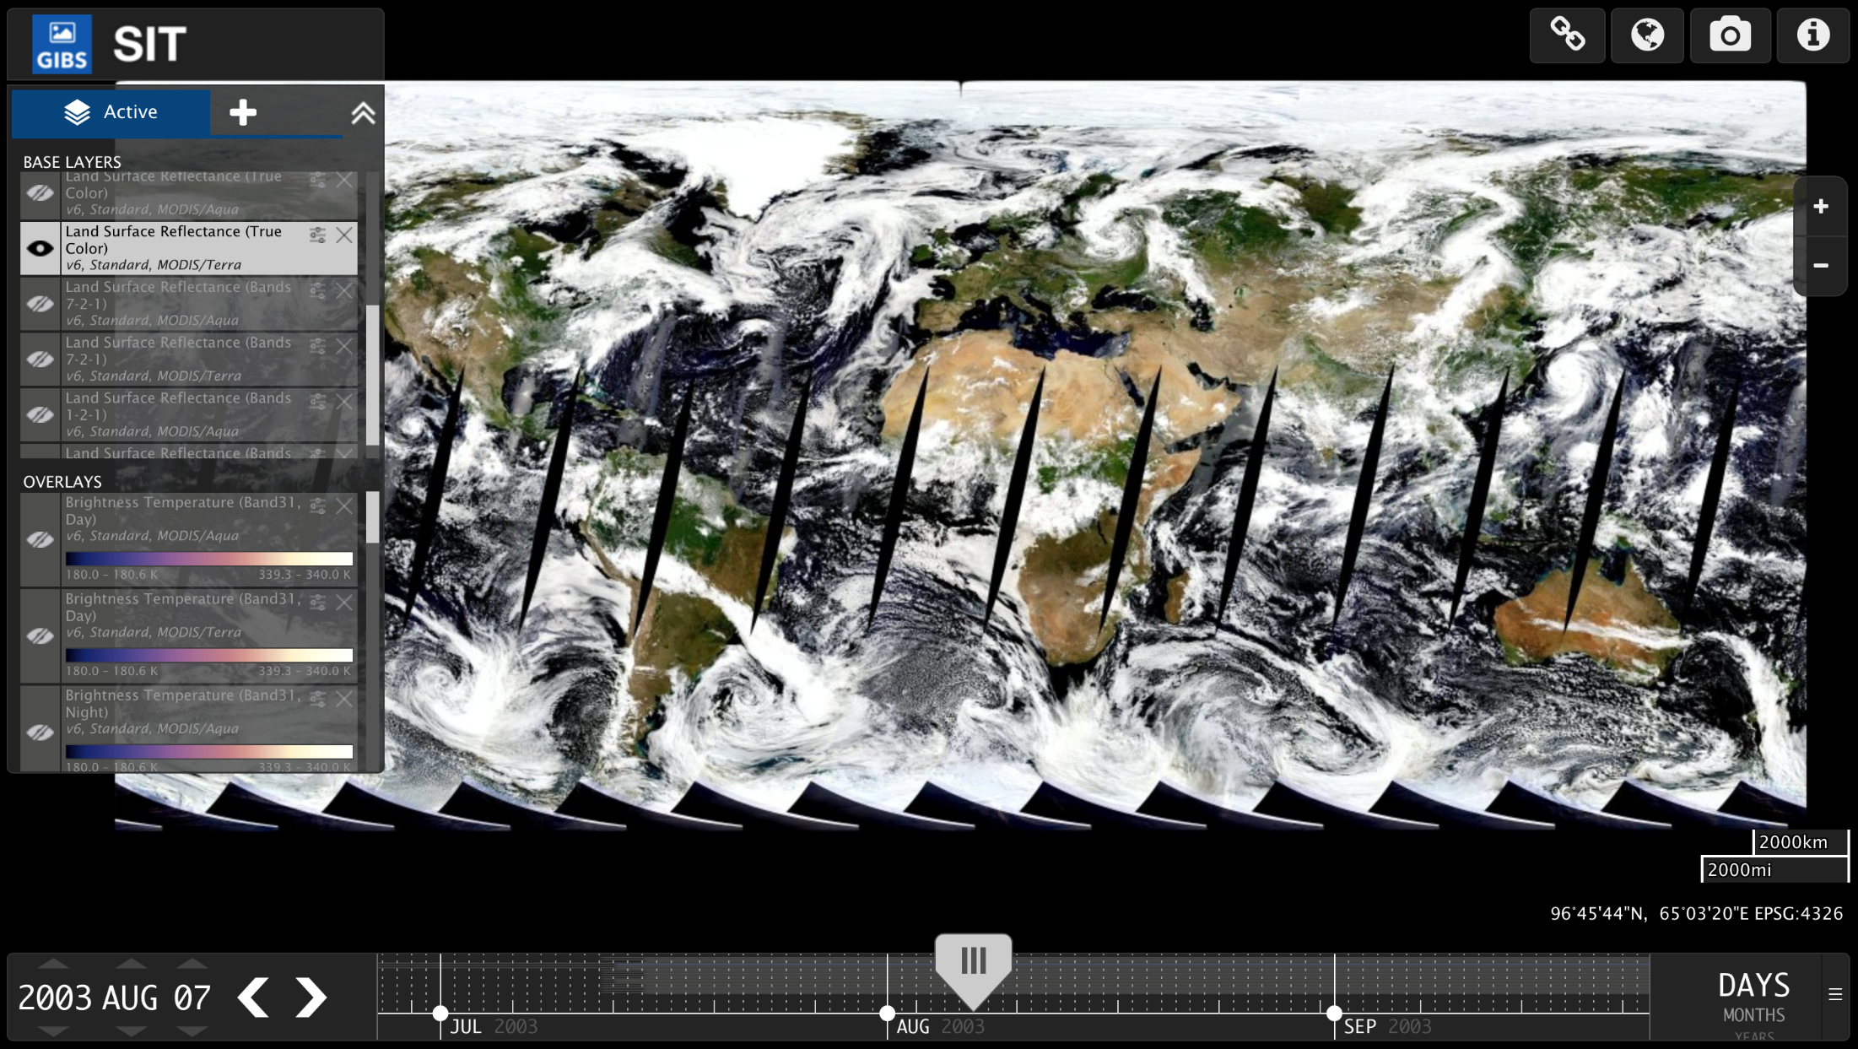
Global Image Browse System
Test Version: GIBS imagery from C6 Land Processing

Slide 18
Conclusion
Teir1 of C6 Land Reprocessing is progressing.
Development and testing of Teir2 block of products is in progress. Reprocessing of products will begin as final algorithms become available.
MODAPS is resourced to run Teir1 and Teir2 streams in parallel.
C6 Land reprocessing is expected to finish ~March 2016
C5 forward processing expected to continue for an additional year after completion of C6 reprocessing.
C6 Land data could be available to public in Aug 2015.
Science teams are required to update the User Guides for the C6 products
NRT system getting ready to use the C6 variation of the PGEs.
C6 Products will be used to generate the Land Imagery for the GIBS.

