Slide 1
EOS Terra Spacecraft Status
MODIS Science Team Meeting
May 21, 2015
Jason Hendrickson, Terra Flight Systems Manager
(301) 614-5754
Jason.T.Hendrickson@nasa.gov

Slide 2
Spacecraft status
Section 1

Slide 3
Spacecraft Status Summary
1 – ASTER SWIR is no longer providing usable science data. No further recovery attempts planned. SWIR data processing turned OFF 8/21/13. No impact to MODIS
2 – Hex Bay Battery (BBAT) cell #50 failed and multiple BBAT heater control groups failed on 10/13/09. No impact to MODIS
4 – ASTER TIR CPHTS reservoir line temperature fluctuations (6 occurrences in 2015, 33 occurrences in 2014). No impact to MODIS
  3 – A PWA Failure occurred in the MODIS Buffer on 10/14/14 in PWA-57, the PWA was removed from the Buffer on 10/15/14.
  4 – A Science Formatter Equipment Side A (SFE-A) Anomaly occurred on 5/24/14 (Data Loss 00:05:52), on 04/10/15 (Loss : 05:20), on 04/14/15 (Loss : 03:31), on 04/24/15 (Loss : 04:50). There were 3 SFE anomalies in 2 weeks in April 2015, this happened previously in 2009.
  5 – MISR Halt Anomaly occurred on 7/8/14 and was a SEU resulting on MISR no longer outputting data and the FOT running a Red Limit Response to power MISR OFF. MISR was successfully returned to Normal Operations 8/1/14. No Impact to MODIS
  7 – ACE-B Sensor Select Anomaly occurred on 7/5/14, new TMON immediately responded and returned the ACE-B to the correct configuration. No Impact to MODIS
  8 – MODIS SFE Data Corruption occurred on 10/26/14 at 01:35:30 requiring the MODIS interface card on the SFE to be reset. This anomaly was not detectable in telemetry and relied on EDOS data processing to detect. The MODIS Data corruption was successfully recovered after ~17:53:57.
  9 – ASTER Skipped EDU on DOY 075. No Impact to MODIS

Slide 4
Highlights in Last Year
(Maneuvers)
  Propulsive Maneuvers
  DMU #85 executed on 09/24/14
  IAM #39 executed on 10/29/14
  DMU #86 executed on 11/13/14
  DMU #87 executed on 12/12/14
  DMU #88/DAM #8 executed on 12/31/14
  DMU #89 executed on 02/04/15
  IAM #40 executed for 02/19/15
  IAM #41 executed for 02/25/15
  DMU #90 executed on 03/04/15
  DMU #91 executed on 04/22/15
  Calibration Maneuvers
  MODIS Roll #140 executed on 06/17/14
  MODIS Roll #141 executed on 07/16/14
  MODIS Roll #142 executed on 08/14/14
  MODIS Roll #143 executed on 09/12/14
  MODIS Roll #144 executed on 10/12/14
  MODIS Roll #145 executed on 11/11/14
  MODIS Roll #146 executed on 12/11/14
  MODIS Roll #147 executed on 01/10/15
  MODIS Roll #148 executed on 02/09/15
  MODIS Roll #149 executed on 03/10/15
  MODIS Roll #150 executed on 04/08/15
  MODIS Roll #151 executed on 05/08/15

Slide 5
Mission Highlights
(MODIS Data Corruption/SFE Anomaly)
  SFE Interface card error resulted in MODIS Data Corruption (SSR and DB)
  On 10/26/14 the Flight Operations Team (FOT) was notified by EDOS that they were having issues processing MODIS data
  Issue is not detectable in telemetry (No changes seen in SFE or MODIS telemetry)
  Issue only identifiable by EDOS in data processing
    Was initially being worked as a data processing issue by EDOS not Data Quality delaying FOT response
  Issue was resolved by disabling and re-enabling the associated interface card on the SFE without affecting data flows for other instruments
    Resulted in ~17:53:57 of MODIS Data Loss
  Previous occurrence
  Anomaly had previously occurred in 2012 and was recovered similarly
  Both Data Corruption issues only affected MODIS data, however it is conceivable that a future reoccurrence could affect other interfaces and other instruments

Slide 6
Mission Highlights
(SFE Anomaly)
  SFE Interface card error required SFE Reset
  Historical issue, automatically recovered by TMON 16 on occurrence
    Normally occurs 1-2 times per year
  Recent SFE occurrences
    04/10/15 (DOY 100) @ 11:48:16z; MODIS Data Loss 05:20
    04/14/15 (DOY 104) @ 01:48:47z; MODIS Data Loss 05:31
    04/24/15 (DOY 114) @ 13:19:24z; MODIS Data Loss 04:50
    3 occurrences in 2 weeks rare (has occurred before in 2009)
  Previous occurrence
  Anomaly had previously occurred in 2012 and was recovered similarly
  Both Data Corruption issues only affected MODIS data, however it is conceivable that a future reoccurrence could affect other interfaces and other instruments

Slide 7
Anomaly Trending
Science Formatter Equipment Upset Trend

Slide 8
Mission Highlights
(PWA Failures)
A PWA Failure (PWA – 57; Superset 112 and 113) was seen in the MODIS Buffer on 10/14/14
  Resulted in loss of 1 Superset (SS) for MODIS (33 SS -> 32 SS)
    Each PWA failure results in 2 SS failing but Trash Buffer SS was reallocated to MODIS to minimize capacity Loss
  First PWA failure in MODIS Buffer since transitioning MODIS to Data Module Unit (DMU)-2 in 2007
    DMU-2 (3 PWA Failures) appears less susceptible to PWA failures than DMU-1 (7 PWA Failures)
It is believed a SSR/DMU Reset will recover the failed PWAs
  SSR reset early in mission due to an SSR Halt recovered the one PWA (PWA-16) that had failed at that point
  The recovered PWA has been operational
An additional PWA Failure in MODIS would result in a 6.25% reduction in Buffer Capacity (Current ~90% Buffer Full -> ~96%)
MODIS should consider options in case of additional PWA Failures
  Accept reduced SSR Capacity (May result in additional data losses)
  Reallocate DMU-2 SSR Supersets to MODIS (Would need to be coordinated with MISR)
  Consider SSR/DMU Reset to recover failed PWAs (Would need approval from other IOTs and NASA HQ)

Slide 9
Science Data Capture Statistics
  Month Days Tbits Capture Reason for Data Loss
May 2014 31 36.99 99.98% SFE-A Anomaly
June 2014 30 38.36 99.99% Incorrect Lockup Replay
July 2014 31 34.63 83.57% MISR Anomaly
August 2014 31 39.27 100.0% N/A
September 2014 30 38.60 99.87% MODIS/MISR Buffers Disabled
October 2014 31 32.92 98.45% PWA & SFE-A Anomalies / Missed LUR
November 2014 30 36.49 99.99% MDA2 Bite during PB
December 2014 31 38.44 100.0% N/A
January 2015 31 39.49 99.94% Incorrect LUR / Negative Acq
February 2015 28 35.88 100.0% N/A
March 2015 31 36.38 100.0%* AST Skipped EDU (150 CADUs lost)
April 2015 30 35.26 99.92% SFEA anomaly X 3 / Incorrect LUR

Slide 10
Terra Collision Avoidance Activities
High Interest Events (HIEs)
Year | Jan | Feb | Mar | Apr | May | Jun | Jul | Aug | Sep | Oct | Nov | Dec | Total
2014 (T1-T4) | 1 | 2 | 3 | 1 | 1 | 2 | 1 | 1 | 2 | 1 | 4 | 5 | 24
Tier 3 | 0 | 2 | 1 | 1 | 0 | 1 | 0 | 0 | 1 | 0 | 1 | 2 | 9
Tier 4 | 0 | 2 | 1 | 0 | 0 | 0 | 1 | 0 | 0 | 0 | 1 | 1 | 6
2015 (T1-T4) | 5 | 2 | 4 | 5 |  |  |  |  |  |  |  |  | 16
Tier 3 | 2 | 0 | 0 | 1 |  |  |  |  |  |  |  |  | 3
Tier 4 | 1 | 0 | 0 | 0 |  |  |  |  |  |  |  |  | 1
CARA Defines the 4 Tiers as: T1 – Notify (email/phone), T2 – Conduct Briefing, T3 – Plan Maneuver, T4 – Execute Maneuver
2005: 4 HIEs – 1 Risk Mitigation Maneuver (RMM ) performed on 10/21/2005: Terra vs. 14222 CA on 10/23
2006: 1 HIE – 1 maneuver waived off due to CA. Maneuver originally planned for 01/12/2006: Terra vs. 1716 CA on 1/12@ 17:46z
2007: 4 HIEs – 1 RMM performed on 06/22/2007: Terra vs. 31410 CA on 6/23
2008: 2 HIEs – 1 RMM planned and waived off: Terra vs. 82832 CA on 10/28/2008 @ 06:17z
2009: 2 HIEs – No RMMs planned or performed
2010: 5 HIEs – 1 RMM performed on 01/22/2010: Terra vs. 34700 CA on 1/23 @ 20:46z
2011: 20 HIEs – 2 RMM planned and waived off: (1) Terra vs. 26181 CA on 3/28/2011 @ 12:14z (2) Terra vs. 30440 Repeating CA 05/07-09/2011
2012: 19 HIEs – 1 maneuver waived off due to CA. Maneuver originally planned for 05/31/2012: Terra vs. 37789 CA on 6/1 @ 22:49z
2013: 17 HIEs – 7 that required significant action
2014: 24 HIEs – 6 that required DAM execution or nominal maneuver waive-off and replan
2015 thru present: 16 High Interest Events (HIEs) – 3 that required DAM execution or nominal maneuver waive-off and replanning
  12/31/2014: CAs vs. 35925 TCA Thu 01/01 at 08:02:55 GMT – RED HIE, repeating CAs (10) DAM #9 planned and executed (T4)
  01/02/2015: CAs vs. 87161 TCA Sun 01/04 at 18:26:50 GMT – RED HIE, repeating CAs (8+), DAMs planned, not actionable (T3)
  01/11/2015: CAs vs. 80767 TCAs 01/14 and 01/15 – Repeating CAs (16), DAMs planned, no viable maneuver, suspended planning (T3)

Slide 11
EPS Performance
Bus Load: Nominal
  Average bus load: 2314 Watts average housekeeping current: 11.91 A; Total instrument current: 7.171 A
Battery Performance: Nominal with exception of anomalous BBAT condition
  BBAT cell # 50 failed following IAM #24 on October 13 (DOY 286) 2009
  BBAT heater control electronics (HCE) anomaly occurred following IAM #24 on October 13 (DOY 286) 2009
    At least 4 of 9 BBAT heater groups are no longer being controlled
    Heater control setpoints changed for controllable heater groups to reduce the thermal gradient
  PBAT Charge/Discharge Ratio was reduced from 105% to 104% on April 25, 2013 to extend PBAT life
  PBAT BPC Channel A Disabled January 14, 2014; increases BBAT cold temperatures due to increased discharge
  Reduced BBAT Heater 1-3 Setpoints May 19-23, 2014; for further reduction of thermal gradient
  Reduced BBAT Heater 6 Setpoint June 10, 2014
Battery Temperatures: Nominal with exception of anomalous BBAT data
Battery Voltages (BBAT)
  Minimum battery voltages at 65.99 Volts
Solar Array
  Last offset adjustment performed on April 17th 2015
NO IMPACT TO SCIENCE

Slide 12
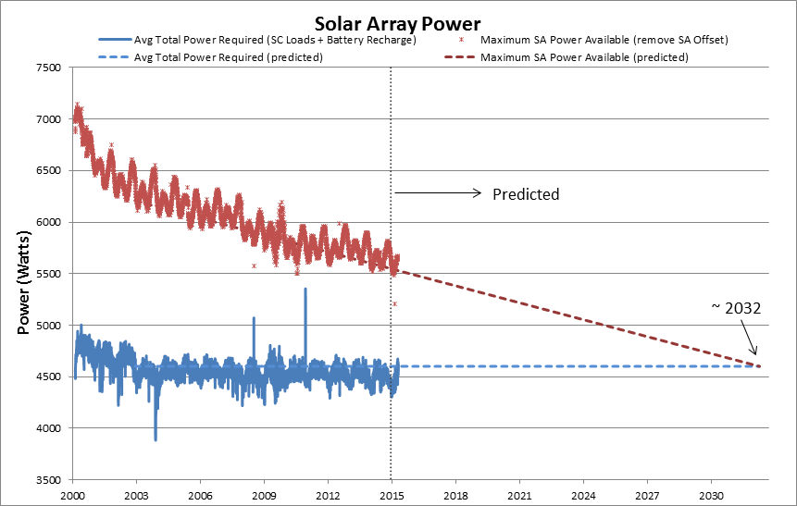
EPS Life Expectancy

Slide 13
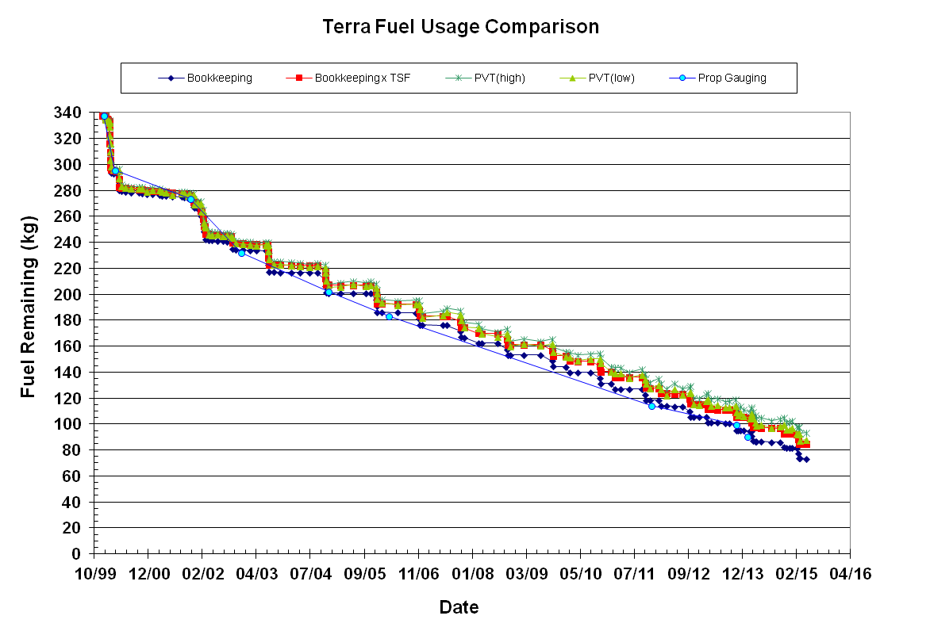
Fuel Remaining (with MLT drift)
Based on predicted fuel usage, Terra has enough fuel to support science requirements until 2020 (Baseline) and possibly beyond (~2022)
Will be discussed in more detail during Constellation Exit presentation
Baseline Fuel Reserve = 45kgs
Proposed Fuel Reserve = 12kgs

Slide 14
Future Plans
Upcoming Activities
MODIS Roll #151 | May 08, 2015
MISR Bi-Monthly Calibration | May 20, 2015
Master DMU RTCS and CERES DMU RTCSs | Late May 2015
Leap Second # 36 | June 30, 2015
Onboard Lock Up Replay Automation | 3Q2015
Ground Based Automation Implementation | 3Q2015
Activity log PB and SA adjusts, improve SSR automation via FSW | 3Q2015
Update Drag Scale Factor | 4Q2015
Leap Second # 36 | June 30, 2015
HGA Model/Keyhole Unwind; MMS Dev - HGA Gimbal motor sun exposure model | 3Q2015

Slide 15
Life Limiting Components
Subsystem | Component | Design | Current | Capability | Comments
EPS | Solar Array | 24 Shunts | 23 Shunts | 96% | Degradation is minimal. Fully capable of supporting mission through 2020 unless future failures occur.
 | Batteries | 108 Cells | 107 Cells | 99% | BBAT cell #50 failed on 10/15/09.
 | Batteries | 36 Heater Controls | 28 Heater Controls | 77% | BBAT heater control failed on 4 of 9 heater groups on primary, redundant, and survival. Battery cell charging/discharging and the remaining heater groups are preventing cells from freezing. PBAT heater control performance is nominal. Improved HCE TMON contingency response.
TCS | MOPITTCPHTS | 2 | 2 | Full | Performance is nominal
 | SWIR CPHTS | 2 | 2 | Full | Performance is nominal
 | TIR CPHTS | 2 | 2 | Full | Random temperature fluctuations. Performance within requirements.
SCC | SCC | 2 | 2 | Full | Performance is nominal
COMM | HGA | 2 | 2 | Full | MDA BITE failures occur 2-3/week due to SEU. Recoverable
 | X-Band | 2 | 1 | 75% | DAS Modulator 1 failed (50%). Solid State Power Amplifier redundancy still available (100%).
 | CTIU | 2 | 2 | Full | Performance is nominal
 | OMNI | 2 | 2 | Full | Performance is nominal
CDH | MO | 2 | 2 | Full | Drift rate changes have occurred since 10/3/10. Performance is within requirements.
 | SFE | 2 | 2 | Full | SFE SEU occur 1-2/year. Recoverable
 | SSR | 59 PWA | 49 PWA | 83.1% | Recycle of DMU likely to recover all PWAs
GNC | IRU | 3 | 3 | Full | Performance is nominal. 2 for 3 redundancy
 | TAM | 2 | 2 | Full | Performance is nominal
 | SSST | 2 | 2 | Full | Minor loss of sensitivity in SSSTs, Bias patch uplinked to account for sensitivity loss
 | CSS | 2 | 2 | Full | Performance is nominal
 | ESA | 2 | 2 | Full | Performance is nominal
 | FSS | 1 | 1 | Full | Performance is nominal. Not currently used
 | RWA | 4 | 4 | Full | Performance is nominal. 3 for 4 redundancy
 | MTR | 3 | 3 | Full | Performance is nominal
Prop | REAs | 16 | 16 | Full | Performance is nominal
Instruments | ASTER - SWIR | 2 | 2 | 0% | Cooler is unable to maintain detector temperature. Science Data is unusable (Fully Saturated) and is no longer being recorded. Still collecting and monitoring Engineering data.
 | ASTER - TIR | 2 | 2 | Full | Performance is nominal
 | ASTER - VNIR | 2 | 2 | Full | Performance is nominal
 | CERES - Aft | 1 | 1 | Full | Performance is nominal
 | CERES - Fore | 1 | 1 | Full | Performance is nominal
 | MISR | 2 | 2 | Full | Performance is nominal
 | MODIS | 2 | 1 | 50% | Power Supply #2 failed, Formatter A degraded, cross-strapped. All Science is nominal.
 | MOPITT | 2 | 1 | 50% | Displacer B and Chopper Motor failed. Loss of redundancy only. All Science is nominal.
Critical S/C Subsystem components still have full redundancy

Slide 16
Summary
  Terra remains very healthy 15+ years into the mission
    Electrical Power Subsystem performance has been stabilized following 2009 anomaly
    Fuel Remaining to continue operations to 2020 and beyond
  Data Capture percentages continue at ~100%
  Collision Avoidance events are increasing in frequency
  FOT continues to monitor all trends/anomalies
  FOT continues to come up with new ideas/process improvements to maximize mission life and efficiency

Slide 17
Terra Constellation Exit Proposal
Jason Hendrickson & Dimitrios Mantziaras

Slide 18
Constellation Exit Proposal
Baseline Plan
  Constellation Exit Original Definition : Lower orbit Apogee 2 km below lowest Perigee of constellation envelope (692 km Altitude)
  Requires 45 kg of Fuel held in reserve
  Exit Constellation: Jan. 2020
Proposed Plan (Pending Waivers and Approvals from NASA HQ)
  Constellation Exit According to Revised Definition : Lower orbit 4 km below constellation envelope
    New Apogee will be above constellation perigee
    Ensures safe distance from constellation because argument of Perigee and eccentricity of lowered orbit will remain in sync (frozen orbit) with constellation for an extended period as orbit decays
  Requires 12 kg of Fuel held in reserve
  Exit Constellation: Aug. 2022

Slide 19
Proposed Constellation Exit Plan
Long Term Terra Orbit After Constellation Exit
Constellation Orbit
Terra orbit after constellation exit
  Monthly snapshots 2022-2030 (one orbit per month)
  Colors become lighter as time progresses
Over eight years the orbit eccentricity remains fairly consistent
No interaction with the Constellation orbit envelope over time
Notes:
Call out highlighted curves

Slide 20
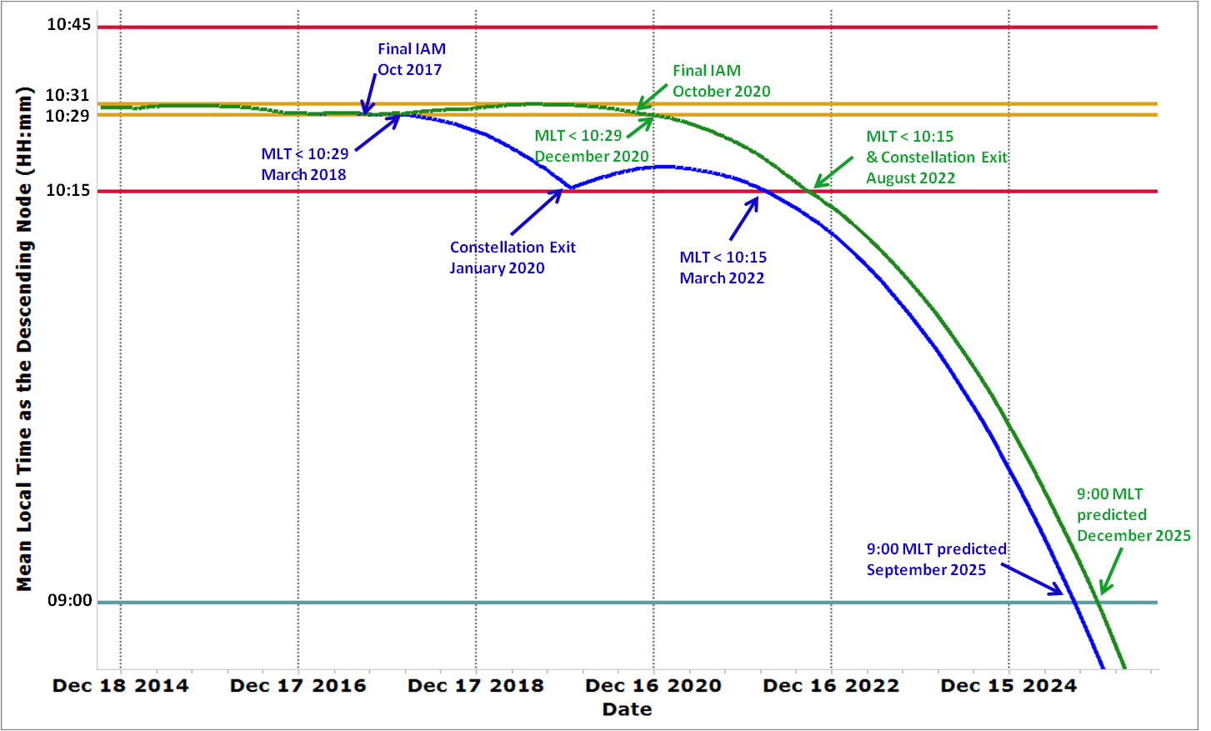
Baseline vs. Proposed Constellation Exit Plan
Mean Local Time Prediction
Difference in overall mission lifetime between baseline and proposed plan is 5 months
Difference in science collection is additional ~3years at tight MLT and current altitude

Slide 21
Life After Constellation Exit
Terra intends to continue operations and science data collection after Constellation Exit
  Presumes continued NASA funding and continued health of platform
  Overall Mission Lifetime limited to once MLT drifts to 09:00
FOT Operations
  The Terra FOT will continue to maintain the Terra platform after constellation exit until it is deemed necessary by NASA to decommission Terra
  Continued Maintenance will include Debris Avoidance Maneuvers as needed, using remaining fuel, to avoid orbital debris
Science Data Collection
  Instruments will continue to be able to collect data after Constellation Exit
  Data processing and Science Analysis will need to updated to take into account lower orbit and drifting MLT

Slide 22
Terra Conclusions
Terra Spacecraft Hardware continues to be healthy after 15+ years on orbit
  2009 Battery Cell 50 and Heater Group Failures have stabilized
  Solar Array Degradation rate indicates it should continue to meet Terra power needs past 2030
Terra still has sufficient propellant to continue to meet Science Requirements for 5-7 years and beyond
  Baseline
    Current Operations : March 2018
    Science Requirements : January 2020
  Pending approval:
    Current Operations : December 2020
    Science Requirements : August 2022

Slide 23
Backup slides

Slide 24
Acronyms
ATC Automated Time Commands
BBAT Hex Bay Battery
BPC Battery Power Conditioner
C/D Charge/Discharge
CA Conjunction Avoidance Activity
CPHTS Capillary Pumped Heat Transfer System
DAM Debris Avoidance Maneuver
DAS Direct Access System
DCU Data Control Unit
DMU Drag Make-Up
EDU Engineering Data Unit
ESA Earth Sensor Assembly
FOT Flight Operations Team
FSW Flight Software
HCE Heater Control Electronics
HIE High Interest Event
IAM Inclination Adjust Maneuver
IOT Instrument Operations Team
LM Lockheed Martin
  MLT Mean Local Time
MO Master Oscillator
PBAT Power Equipment Module Battery
RMM Risk Mitigation Maneuver
RTCS Relative Time Command Sequence
S/C Spacecraft
SA Solar Array
SCC Spacecraft Control Computer
SEU Single Event Upset
SFE Science Formatter Equipment
SSR Solid State Recorder
TMONs Telemetry Monitors
WRS World Reference System

Slide 25
EPS Process Improvements
New Solar Array Operations
  Since 2013, to reduce stress on the battery and streamline DMU execution, the Terra Solar Array (SA) has been managed to maximize charging while avoiding plume impingement danger regions by using more flexible SA parking locations and SA rotation rates
Raised average BBAT Cell temperatures by disabling BPC Channel
  Successfully executed Jan. 14, 2014
  Raised average BBAT cells temperatures by 1 degree (2 degrees for coldest cell)
    This improves our contingency posture in the event of a load shedding incident and reduces the thermal gradient of BBAT (reduces uneven wear)
Implemented improved response to HCE Anomaly
  In 2009 a Single Event Upset (SEU) on the Heater Control Electronics (HCE) disabled heaters on BBAT and PBAT
  A telemetry monitor (TMON) was developed and successfully uplinked Feb. 20, 2014 to immediately recover from the anomaly and ensure the heaters are re-enabled
Lowered BBAT Heater Set Points
  From 5/19/14 to 6/10/14 the FOT reduced the set points for BBAT heaters 1, 2, 3, and 6 by 1ºC
  This reduced the BBAT thermal gradient by 0.5 – 0.75ºC, reducing uneven wear on BBAT cells

Slide 26
EOS Aqua Spacecraft Status
MODIS Science Team Meeting
May 21, 2015
Beneé Durham, Aqua Flight Systems Manager
(301) 614-5018
Benee.L.Durham@nasa.gov

Slide 27

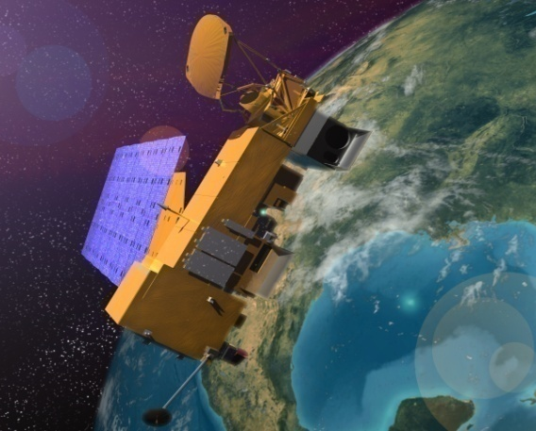
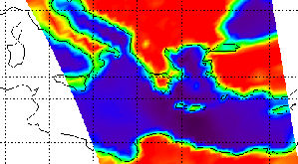
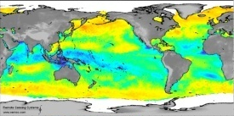
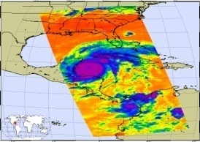
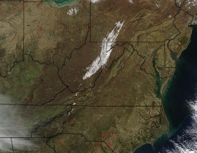
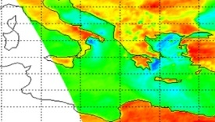
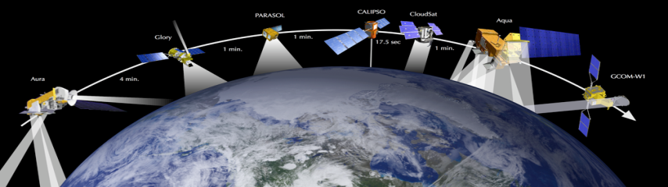
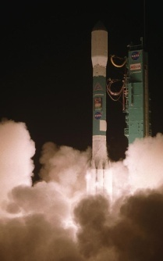
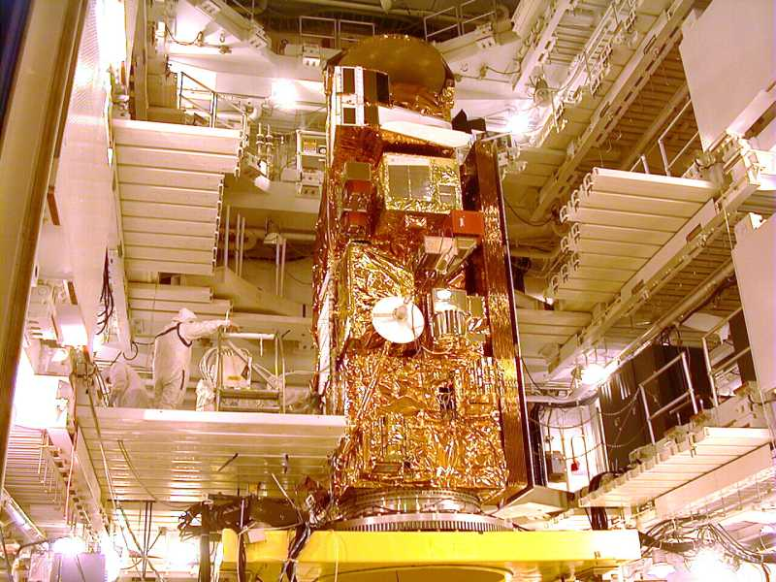
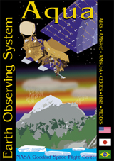
EOS-Aqua Overview / Objective
Aqua Features
Launch Date: May 4TH, 2002 (Delta II, 7920-10L, VAFB)
Orbit: 705 km, sun-synch. polar, 98.2º Inc., 1:30PM MLT asc. node
Instrument Payload:
  AIRS - Atmospheric Infrared Sounder (USA/JPL)
  AMSR-E - Advanced Microwave Sounding Radiometer – (JAPAN/JAXA)
  AMSU- Advanced Microwave Sounding Unit (USA/JPL)
  CERES - Clouds & the Earth's Radiant Energy System (USA/Langley)
  HSB - Humidity Sounder for Brazil (Brazil/IPNE)
  MODIS - Moderate Resolution Imaging Spectroradiometer (USA/GSFC)
Project Management: Earth Science Mission Operations (ESMO)
Spacecraft Flight Operations: Contracted by GSFC to Honeywell / ASRC/ AIMM/GATS and supported by NASA TDRSS and EPGN
Instrument Operations and Science Data processing: Performed at respective Instrument Locations where developed
Mission Duration: Completed 6-year Prime Mission (completed May 2008). Extended Operation began in May 2008.
CERES
AMSU-A
AMSR-E
HSB
AIRS
MODIS
Science
Aqua emphasizes observations of the Earth’s Water Cycle, including evaporation, water vapor in the atmosphere, clouds, precipitation, soil moisture, sea ice, land ice, and snow cover. Additional variables also being measured by Aqua include radiative energy fluxes, aerosols, vegetation cover on the land, phytoplankton and dissolved organic matter in the oceans, and air, land, and water temperatures.
Aqua leads the Afternoon Constellation (A-Train) to maximize coincident Science with Calipso, CloudSat, Parasol & Aura.
Notes:
27
17

Slide 28
Aqua Spacecraft Component Status

