Slide 1






Change in Our MIDST: Detection and Analysis of Land Surface Dynamics in North and South America Using Multiple Sensor Data Streams
Geoffrey M. Henebry
Xiaoyang Zhang
Baojuan Zheng
Lan Nguyen
Geospatial Sciences Center of Excellence
South Dakota State University
firstname.lastname@sdstate.edu
Kirsten M. de Beurs
Braden Owsley
Dept. of Geography & Environmental Sustainability
University of Oklahoma
kdebeurs@ou.edu
braden.owsley@ou.edu
John S. Kimball
Flathead Lake Biological Station
The University of Montana
john.kimball@umontana.edu
Christopher Small
Lamont-Doherty Earth Observatory
Columbia University
csmall@columbia.edu
MODIS/VIIRS Science Team Meeting 21 MAY 2015
NNX14AJ32G

Slide 2
Our science question is broad:
Where in the western hemisphere is the vegetated land surface changing significantly during the past 15+ years in response to direct human impacts?
Broad scope of the Western Hemisphere:
North, Central, and South America plus the 4 islands in the Caribbean Sea >9000 km²—Cuba, Hispaniola, Jamaica, Puerto Rico.
Special focus on (1) megacities and major conurbations and (2) cerrado region of Brazil.

Slide 3
Multiple Indicators Detecting Significant Trends → MIDST
We are building an innovative system to use multiple sensor datastreams to
quantify and localize change,
characterize environmental processes, and
examine the function of land surface change.
    The process of change analysis is a sequence of tasks:
    detection of changes,
    quantification of changes,
    assessment of changes,
    attribution of changes, and
    projection of the potential consequences of changes.
Multiple Indicators Detecting Significant Trends → MIDST
We are building an innovative system to use multiple sensor datastreams to
quantify and localize change,
characterize environmental processes, and
examine the function of land surface change.
    The process of change analysis is a sequence of tasks:
    detection of changes,
    quantification of changes,
    assessment of changes,
    attribution of changes, and
    projection of the potential consequences of changes.
MIDST will implement solutions to the first three “detection” tasks and produce georeferenced polygons of significant trends from datastreams.
MIDST will then evaluate plausible links of candidate drivers to polygons with one or more significant trends.

Slide 4
trend. Dictionary.com. Dictionary.com Unabridged. Random House, Inc. http://dictionary.reference.com/browse/trend (accessed: December 08, 2014).
What do we mean by “trend”?
As a noun:
1. The general course or prevailing tendency; drift: trends in the teaching of foreign languages; the trend of events.
2. style or vogue: the new trend in women's apparel.
3. the general direction followed by a road, river, coastline, or the like.
As a verb (used without object):
4. to have a general tendency, as events, conditions, etc.
5. to tend to take a particular direction; extend in some direction indicated.
6. to emerge as a popular trend; be currently popular: trending topics on the Internet; words that have trended this year.
7. to veer or turn off in a specified direction, as a river, mountain range, etc.: The river trends toward the southeast.

Slide 5
trend. Dictionary.com. Dictionary.com Unabridged. Random House, Inc. http://dictionary.reference.com/browse/trend (accessed: December 08, 2014).
tend. Dictionary.com. Dictionary.com Unabridged. Random House, Inc. http://dictionary.reference.com/browse/tend (accessed: December 08, 2014).
trend
Word origin: before 1000; Middle English trenden to turn, roll, Old English trendan;
akin to Old English trinde ball, Dutch trent circumference, Swedish trind round.
tend
Word origin: 1300-50; Middle English tenden < Middle French tendre < Latin tendere
to stretch, extend, proceed
At root, the French-Latin tend implies directionality.
At root, the Anglo-Saxon trend does not imply directionality.

Slide 6
Technical indication of a temporal trend:
Measurements over a specified period that, taken as a whole, indicate a prevalence toward different values at the extremities of the period.
A temporal trend indicates change through time.
A temporal trend is assessed looking backward in time.
Statistical significance of the trend is a function of
the duration of the measurement period,
the temporal density of the measurements,
the variation in the time series of values, and
the user’s criteria for significance.
Seasonal Kendall (SK) trend test corrected for first-order autocorrelation: non-parametric statistical analysis generating exact significance values [de Beurs & Henebry 2004 GRSL, 2005 IJRS].

Slide 7
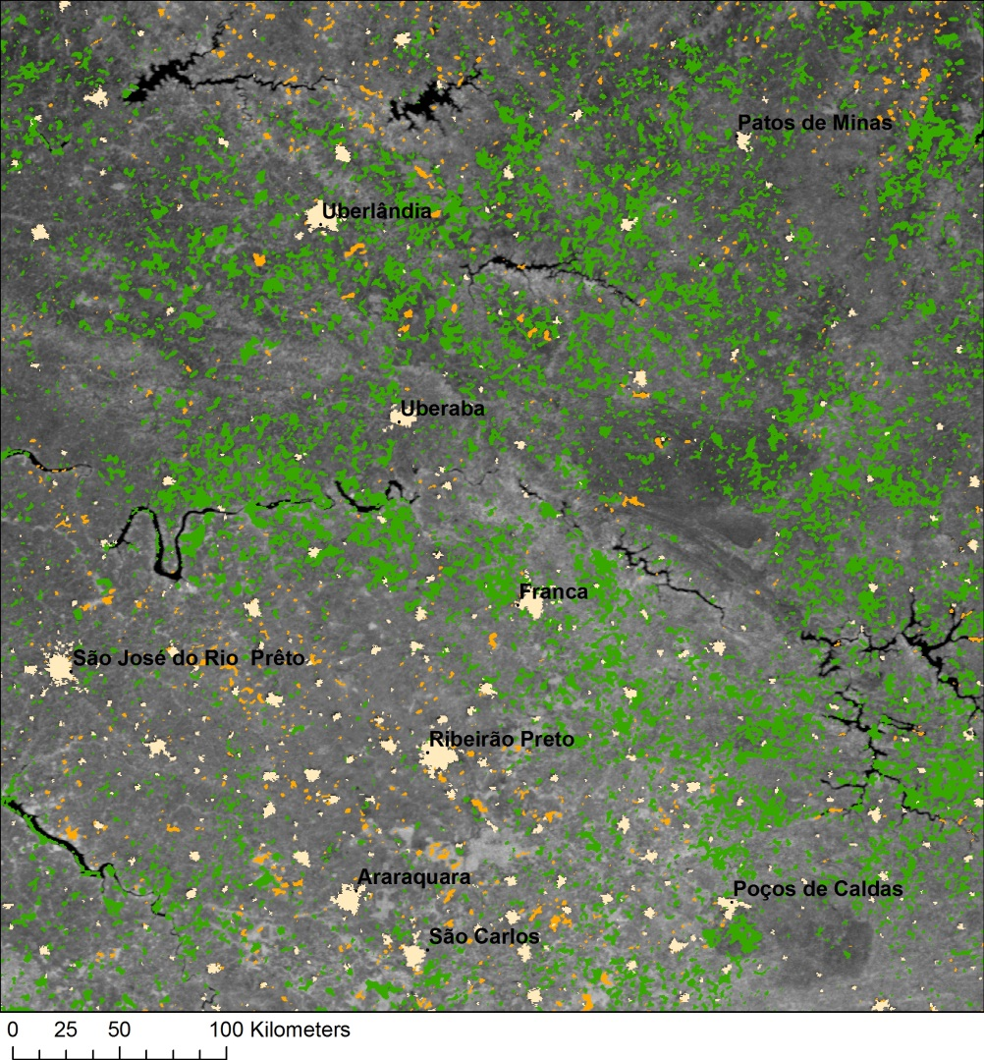
Significant changes in northern São Paulo and western Minas Gerais states in Brazil from 2001-2012 as revealed by 46 MODIS NBAR NDVI 8-day composites at 500m. Significance classes are overlaid on the average NDVI.
Bright green indicates significant positive trends at p<0.01. Bright orange indicates significant negative trends at p<0.01.
Application of a 3x3 median filter highlights the larger hotspots of significant change.
Tan areas have been screened for low NDVI and low seasonality, corresponding to cities, towns, and settlements.

Slide 8
MIDST is running SK analyses on key gridded L3 environmental variables from multiple sensors on NASA’s Terra and Aqua satellites:
MODIS: albedo, land surface temperature, land cover, land cover dynamics (land surface phenology), aerosol optical depth, evapotranspiration, snow cover, burned area, LAI/fPAR, GPP, and NDVI, EVI, and tasseled cap factors from NBAR.
AMSR-E + AMSR2: surface air temperature, soil moisture, precipitable water vapor, fractional open water, vegetation optical depth.
AIRS: temperature, water vapor, relative humidity, carbon monoxide at multiple pressure levels, and height, pressure, temperature of the tropopause.
CERES: shortwave, longwave, and net radiative fluxes at surface for clear sky and total sky, shortwave, longwave, and net radiative fluxes and albedo at top of atmosphere for clear sky and total sky.
MOPITT: retrieved carbon monoxide (CO) total column, retrieved CO mixing ratio profile at multiple pressure levels.
and more!
500 m, 1000 m, 0.05°,
8-day & monthly
25 km, 8-day & monthly
1.0°, monthly
1.0°, monthly
1.0°, monthly

Slide 9
To make biogeophysical sense of multiple trends, we will interpret (or constrain) them with reference to idealized surface radiation budget and surface energy balance to reduce the candidates for proximate causes of the changes.
R_{n} = SW_{down}*(1-α) + LW_{down} – LW_{up}
R_{n} = G + SH + LE
Consider the following environmental changes with urban expansion within an agricultural matrix:
  Increases in albedo, sensible heat flux, land surface temperature, air temperature, impervious surface area, boundary layer height, roughness length, aerosol optical depth, and carbon monoxide concentration;
  Decreases in vegetation indices, LAI/fPAR, GPP, latent heat flux, evapotranspiration, and surface moisture.

Slide 10
MIDST will evaluate detected significant changes in the vegetated land surface against 12 scenarios capturing most common land cover changes:
urbanization
conversion to/from crops
onset of drought
recovery from drought
fire
recovery from fire
intensification of row crop agriculture
intensification of grazing
plant pests & diseases
extreme weather events including flooding, hail, and wind
forest harvesting
geological natural hazards including volcanoes, earthquakes, and landslides

Slide 11
Detected Change = ƒ(EV1, EV2, EV3,… EVn)
MIDST will use four different but complementary statistical modeling approaches to link change polygons with candidate drivers:
  Regularized Generalized Canonical Correlation Analysis (RGCCA v1.0)
  Generalized, Unbiased, Interaction Detection and Estimation (GUIDE v15.0)
  LOgistic regression Trees with Unbiased Selection (LOTUS v2.3)
  Probabilistic Mixture Modeling of Land Surface Phenologies (PMM-LSP)
Training using known changes: increases in impervious surface area, areas of burns or floods or droughts, areas of changing crop type or management, etc.

Slide 12
Let’s look at trends from MOPITT & AIRS time series
Carbon monoxide (CO) results from incomplete combustion from mobile and stationary sources in urban areas—indicator of urban metabolism—from wildfires in remote areas—indicator of disturbance—from agricultural prescribed burning— indicator of land management or crop type —and chemical interactions with hydroxyl (OH) radical.
CO lifetime in boundary layer is a few weeks to a couple of months.
AIRS CO channels are more sensitive in upper and mid troposphere (300–600 hPa). MOPITT TIR retrievals are sensitive in mid troposphere and in lower troposphere, when sufficient thermal contrast between surface and lower atmosphere exists.
Deeter et al. 2007. Sensitivity of MOPITT observations to carbon monoxide in the lower troposphere. JGRA doi: 10.1029/2007jd008929
Warner et al. 2007. A comparison of satellite tropospheric carbon monoxide measurements from AIRS and MOPITT during INTEX-A. JGRA. doi: 10.1029/2006jd007925.
Worden et al. 2013. Decadal record of satellite carbon monoxide observations. ACP doi: 10.5194/acp-13-837-2013.

Slide 13
Comparable low levels of CO over remote areas
MOPITT:
Average annual CO above 5 remote (non-MSA) areas in CONUS
AIRS:
Average annual CO above 5 remote (non-MSA) areas in CONUS
Zheng et al. in prep

Slide 14
Discrepancy between sensors where surface CO is high
MOPITT: Average annual CO above the 10 largest MSAs in CONUS
AIRS:
Average annual CO above the 10 largest MSAs in CONUS
Zheng et al. in prep

Slide 15
1
2
3
4
5
Significant decreases in CO at surface in each of the 10 largest MSAs during the EOS era
Zheng et al. in prep

Slide 16
6
7
8
9
10
Significant decreases in CO at surface in each of the 10 largest MSAs during the EOS era
Zheng et al. in prep

Slide 17
To conclude I want to show you the preliminary MIDST web interface, which currently hosts eight variables derived from MODIS at 0.05° for 2000-2014:
MCD43C4 8-day Nadir BRDF-Adjusted Reflectance (NBAR) calculated [1] NDVI, [2] EVI, Tasseled Cap [3] Greenness, [4] Brightness & [5] Wetness
MOD11C2 8-day Land Surface Temperature for [6] Day & [7] Night
MOD16A2 [8] Monthly Evapotranspiration
http://tethys.dges.ou.edu/GlobalChange/
Significant (p<0.01) positive changes appear in blue.
Significant (p<0.01) negative changes appear in orange.

