Slide 1
Remote Sensing of Ecosystem Productivity Using MODIS
Fred Huemmrich, UMBC/GSFC
John Gamon, University of Alberta

Slide 2
Study Goals
We want to develop methods to use optical signals to estimate ecosystem carbon exchange
Examine the relationships between ecosystem production (GEP) and spectral reflectance
We have some physical understanding of the nature of these relationships but we do not have a good physical model relating leaf/canopy biochemistry, photosynthetic processes, and spectral reflectance
Use data from existing flux towers to empirically examine relationships for different vegetation types over multiple years
Define an algorithm for a potential MODIS product

Slide 3
Light Use Efficiency (LUE) Model
G = ε fAPAR Qin = ε  APAR
G is gross ecosystem production (GEP)
Qin is the incoming photosynthetically active radiation (PAR)
fAPAR is the fraction of PAR absorbed by green vegetation
APAR is the PAR absorbed by vegetation or fAPAR Qin,
ε is the light use efficiency (LUE)
In MOD17 ε is calculated based on meteorological conditions and vegetation type
ε  = f(Tair) g(VPD) ε*
ε* is the maximum LUE for the vegetation type
Can we determine GEP using only optical inputs?

Slide 4
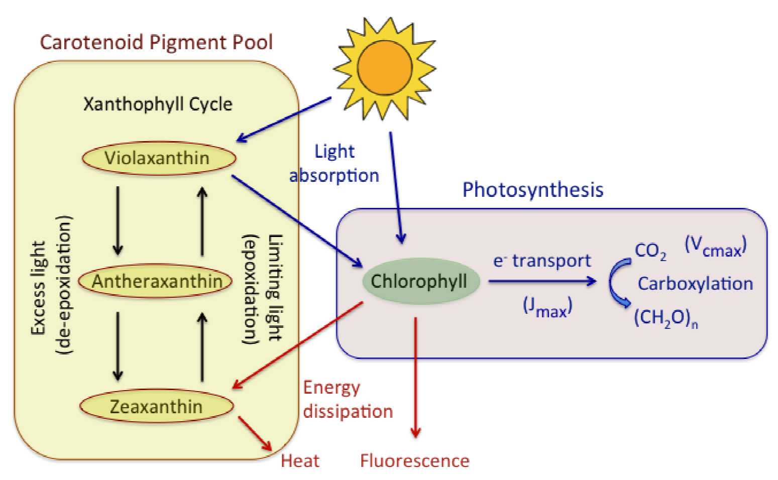
Photosynthetic Energy Pathways
Radiation absorbed by a leaf can go to: productive photosynthesis (blue text and arrows), energy dissipation (red text and arrows), regulatory processes associated with the xanthophyll cycle (black text and arrows), and carotenoid and chlorophyll pigment pools, all of which can be assessed with optical sampling
Gamon 2015
Notes:
Energy flows - energy to photosynthetic processes, excess energy must be dumped to prevent damage to photosynthetic machinery
Fluorescence; Photoprotective carotenoid pigments - non photochemical quenching -xanthophyll cycle
Distribution of absorbed radiation within a leaf, showing processes of productive photosynthesis (blue text and arrows), energy dissipation (red text and arrows), regulatory processes associated with the xanthophyll cycle (black text and arrows within box on left), and carotenoid and chlorophyll pigment pools, all of which can be assessed with optical sampling

Slide 5
Optical Signals
Leaf biochemistry responds to stresses over varying time scales
• Short term stress responses change relative amounts of Xanthophyll cycle pigments in leaves
• There are also longer term changes in the relative amounts of photosynthetic and photoprotective pigments (Chlorophylls and Carotenoids) in leaves
These biochemical changes produce detectable changes in leaf optical properties - we are trying to relate them to carbon fluxes
Using these optical signals as model inputs has an important effect on the interpretation of the model
• We go from trying to predict vegetation response to environmental variables (temperature and humidity)
• To an approach where we are observing the plant’s responses to environmental conditions
- even if we don’t know exactly what those environmental forcings are

Slide 6
Optical Signals
Shifts in pigments affects the spectral region around 531 nm (MODIS band 11)
• The Photochemical Reflectance Index (PRI) is the normalized difference of reflectances at 531 nm and a reference band at 570 nm (which we don’t have on MODIS)
- it was developed to detect Xanthophyll pigments
• PRI is also affected by the overall size of the the Chlorophyll and Carotenoid pools in leaves
- we are calling the index for this the Chlorophyll-Carotenoid Index (CCI), the normalized difference of bands 11 and 1 (red band)

Slide 7
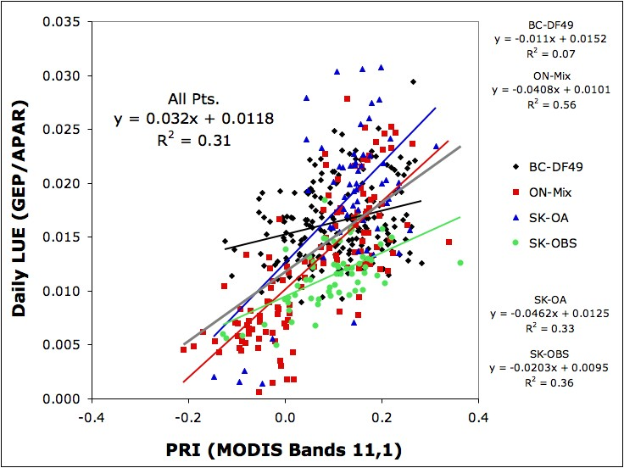
MODIS CCI and LUE
Look at four different Canadian flux tower sites
• Summertime observations only, little change in LAI or NDVI
• LUE from flux tower data
CCI calculated using MODIS bands 11 (an ocean band) and 1 (red band)
Different relationship for each forest type, consistent across years
CCI (MODIS Bands 11,1)
BC-DF49 = British Columbia, Douglas fir site; ON-Mix = Ontario, mixed forest;
SK-OA = Saskatchewan, Old Aspen; SK-OBS = Saskatchewan, Old Black Spruce
Notes:
Get different relationships for each forest type

Slide 8
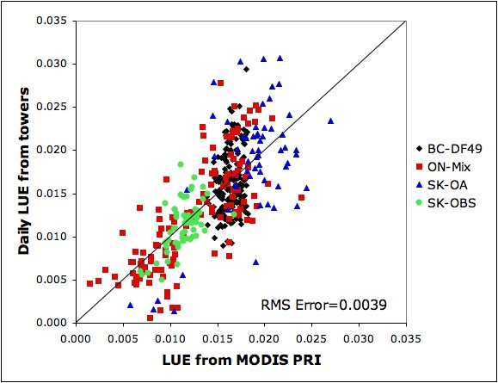
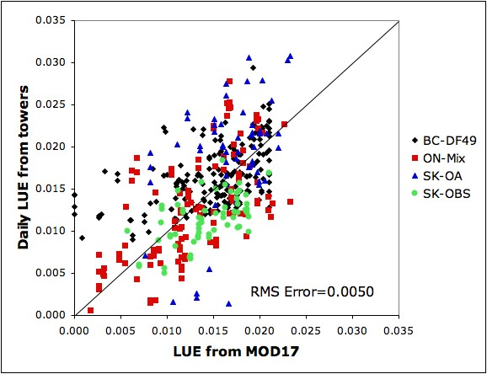
LUE Uncertainties
Comparing LUE from CCI to LUE from MOD17 algorithm
- For these sites CCI does a better job than the existing MODIS GPP model (MOD17) using the tower meteorological observations
From MODIS observations
Modeled using Met Data
BC-DF49 = British Columbia, Douglas fir site; ON-Mix = Ontario, mixed forest;
SK-OA = Saskatchewan, Old Aspen; SK-OBS = Saskatchewan, Old Black Spruce
Notes:
8
Conclusions
Although not designed for this purpose, MODIS PRI can measure ecosystem LUE.
There are different relationships between PRI and LUE for different forest types, and the relationships are consistent over multiple years.
LUE from MODIS PRI may be more accurate than the modeling approach used by MOD17
MODIS PRI provides a direct observation of vegetation stress responses,
MODIS can map LUE variations with more spatial detail than using meteorological data to model LUE,
We recommend MODIS PRI be used to monitor ecosystem LUE.

Slide 9
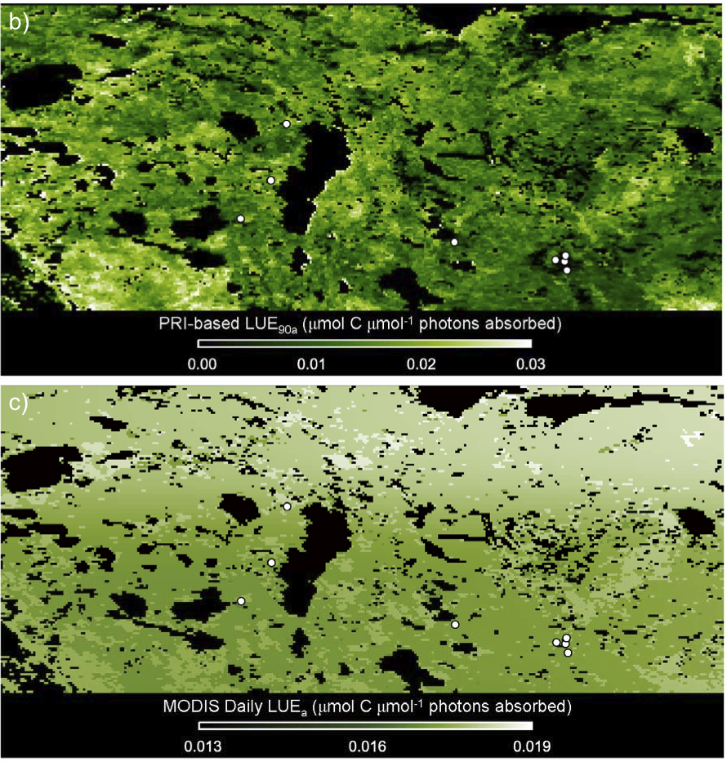
Optical Approaches and Landscape Heterogeneity
Upper figure: LUE from MODIS reflectances
Lower figure:
LUE estimated using meteorological inputs in MOD17 model
From Drolet et al. 2008

Slide 10
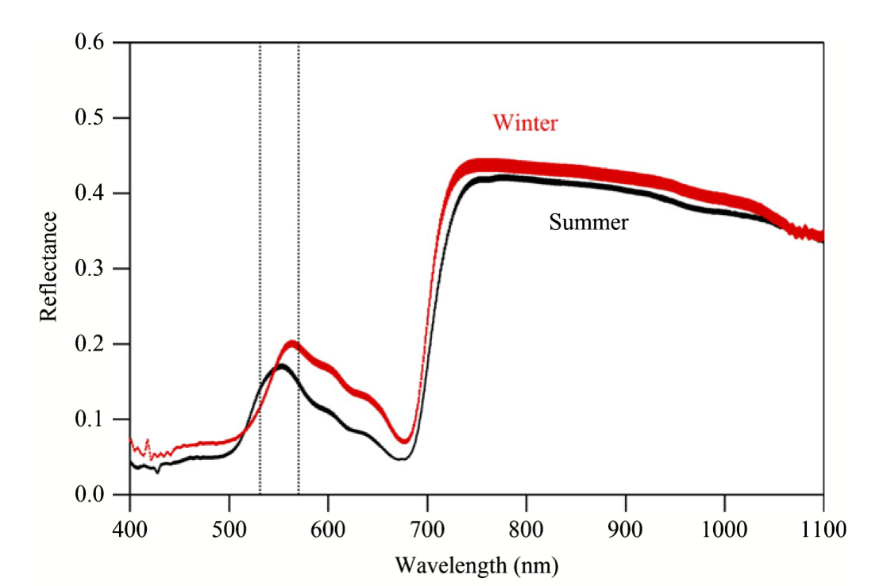
Boreal Conifer Needle Reflectance
MODIS bands 11 and 1 can detect seasonal change in needle reflectance
Band 11
Band 1
570 nm
Band 12
Leaf spectra of Pinus contorta showing the seasonal changes between summer- (black line) and winter-adapted (red line) leaves. Vertical lines indicate bands used for Chlorophyll:Carotenoid Indices (CCIs), including MODIS bands 1 (645 nm, a terrestrial band), 11 (531 nm, an ocean band), and 12 (551 nm, an ocean band), and the standard PRI reference band (570 nm, unavailable from MODIS).
Wong and Gamon 2015

Slide 11
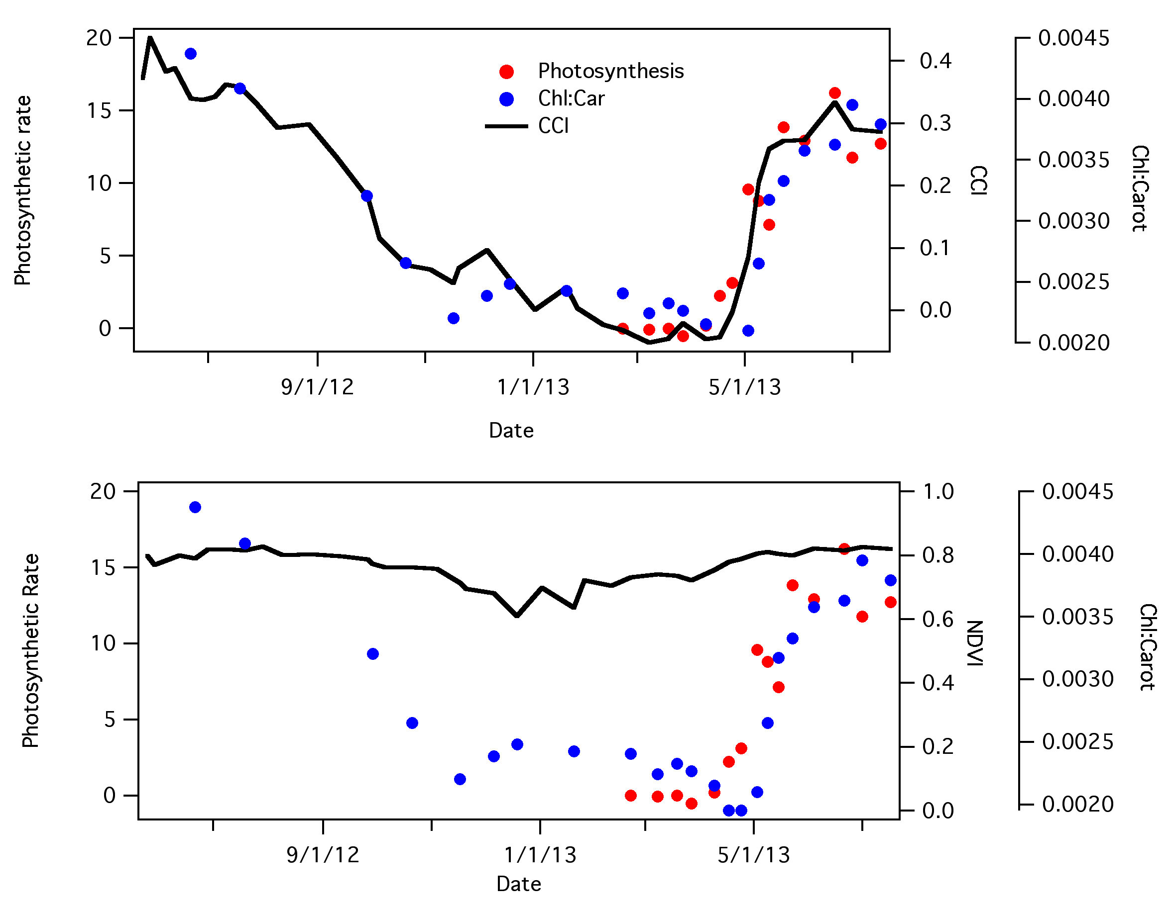
Seasonal Change in Boreal Conifer Needles
Time trends for Pinus contorta leaves exposed to a boreal climate
Red points - needle photosynthesis
Blue points - chlorophyll:carotenoid ratio
Black line:
Chlorophyll-Carotenoid Index
Black line: NDVI
Wong and Gamon 2015
Notes:
Explain that CCI and MODIS PRI are the same thing, but we decided we needed to change the name

Slide 12
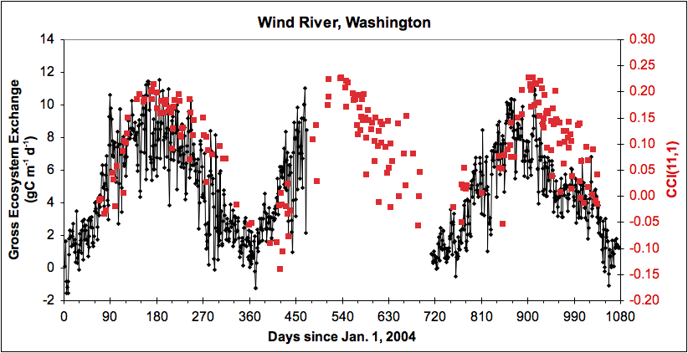
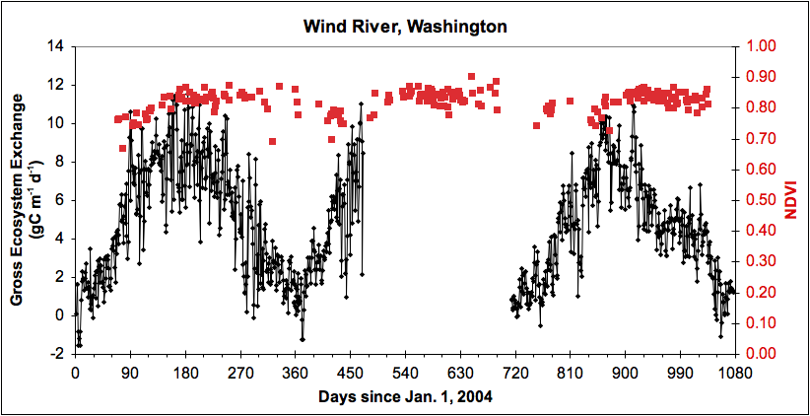
Seasonal Change in Evergreen Conifer Stands
Wind River, WA
CCI from Aqua MODIS
NDVI from Aqua MODIS
Black lines: Daily GEP from flux tower
Flux data from Fluxnet Synthesis
Notes:
for evergreen conifers CCI tracks GEP seasonality, While NDVI does not.

Slide 13
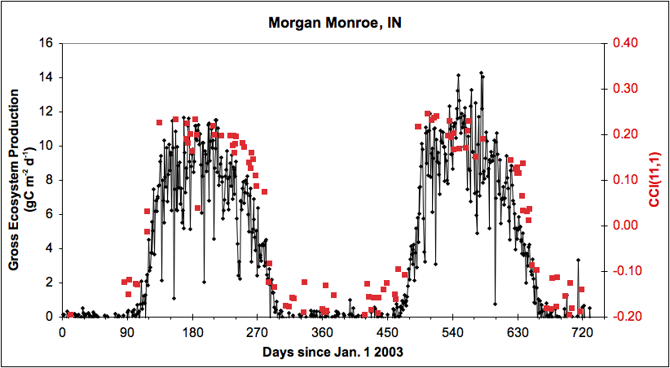
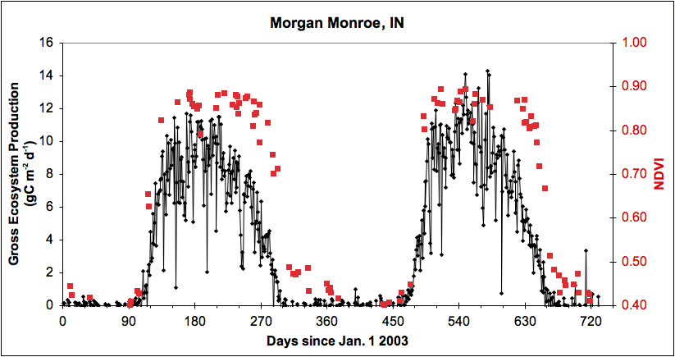
Seasonal Change in Deciduous Forest Stands
Morgan Monroe, IN
CCI from Aqua MODIS
NDVI from Aqua MODIS
Black lines: Daily GEP from flux tower
Flux data from Fluxnet Synthesis
Notes:
In deciduous forests, both NDVI and CCI describe greenup, but NDVI remains flat through growing season, while CCI tracks late summer drop off and senescence

Slide 14
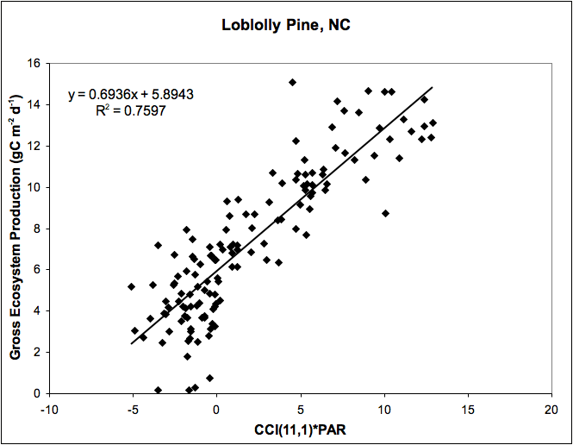
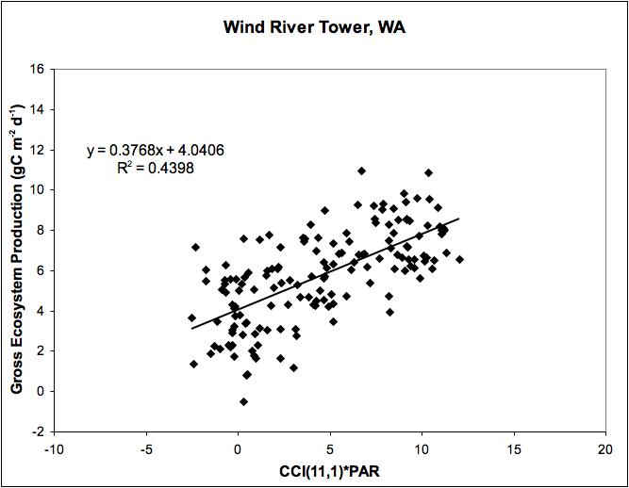
MODIS CCI and Gross Ecosystem Production (Conifers)
Notes:
Note axes are the same in all plots, note differences in slopes and variability around regression lines

Slide 15
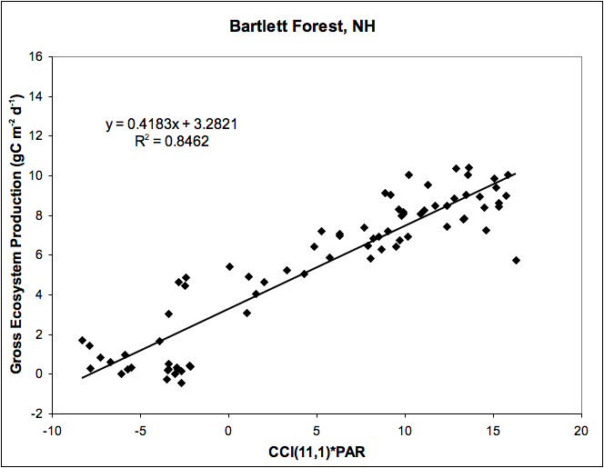
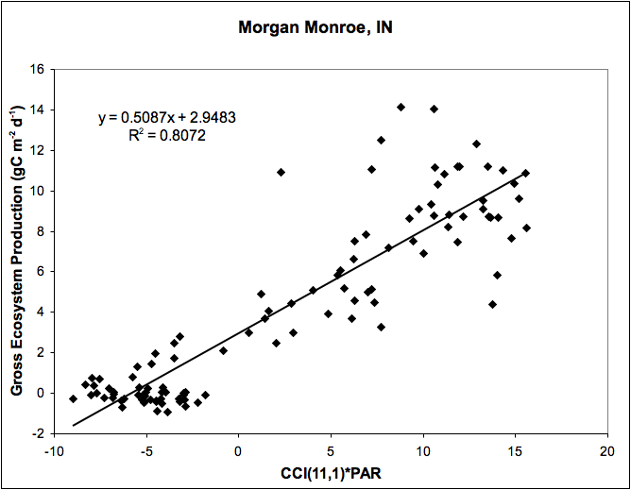
MODIS CCI and Gross Ecosystem Production (Deciduous)
Notes:
Note axes are the same in all plots, note similarity in slopes

Slide 16
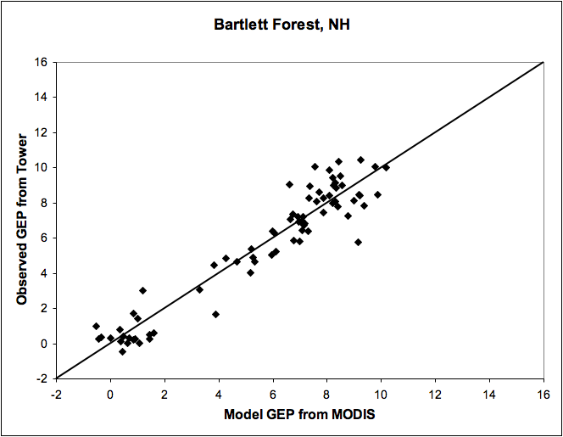
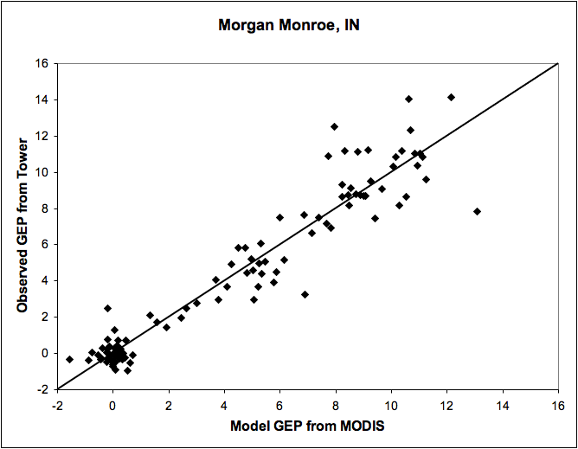
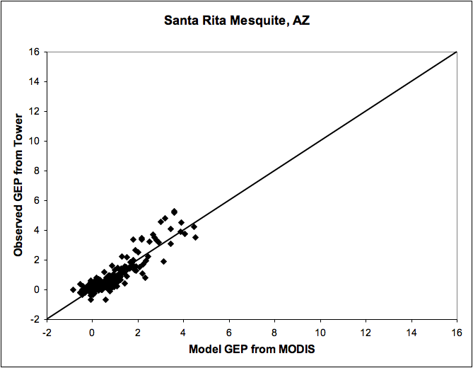
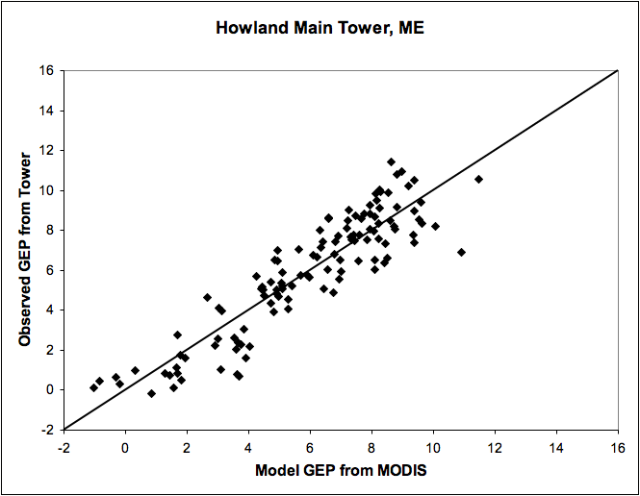
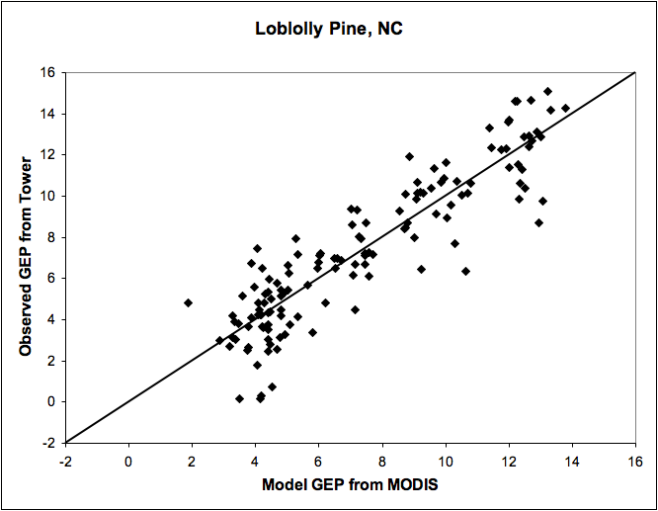
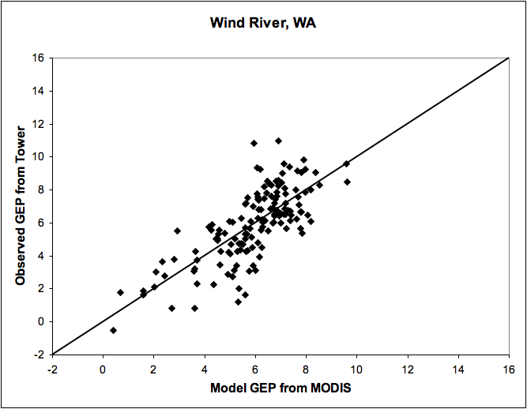
Multiple Linear Regressions of MODIS Band Reflectances
• Separate regression calculated for each site
• Used bands 1-12, except band 6
Notes:
Site based multiple regressions do a good job of describing daily GEP. Can we group sites to generalize without significant degrading results?

Slide 17
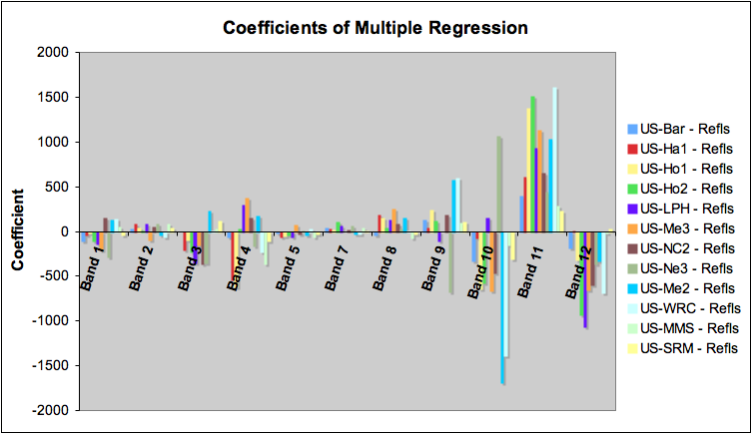
Multiple Linear Regressions of MODIS Band Reflectances
Coefficient weights suggest that the ocean bands 10 (498-493 nm),11(526-536 mn), 12 (546-556 nm) contain significant information on GEP for multiple sites
Notes:
Coefficients from multiple site based multiple regressions. Note the importance of ocean bands 10, 11, 12 in the coefficient weightings.

Slide 18
Conclusions
Although not designed for this purpose, MODIS reflectances combining land and ocean bands may be able to derive GEP
Optical signals from MODIS may give a direct observation of vegetation biochemistry
A change from trying to predict responses to observing responses to environmental conditions
Providing more spatial detail in GEP than modeling approaches
Can provide an independent estimate of fluxes
There are different relationships for different vegetation types
Need to understand variability for GEP algorithm development
Could be used to define vegetation functional types (biodiversity)

Slide 19
Future Work
Evaluate MODIS data for more flux tower sites
Convergence of new Fluxnet synthesis data and MODIS C6 data becoming available
Define processing algorithms for future MODIS products
Effects of view and sun angles
How do relationships differ for different vegetation types?
How do relationships change with season?
What are the effects of spatial heterogeneity on relationships?
What are the expected errors in retrievals?

