Slide 1


LP DAAC Status
MODIS/VIIRS Science Team Meeting
May 20, 2015
Dave Meyer, USGS
LP DAAC Project Scientist
Tom Maiersperger, SGT, Inc.
LP DAAC Science Lead

Slide 2
LP DAAC status, V06 & VIIRS
Status
  MODIS metrics
  Web site update
  Schedule/product delivery
    Coordinate V06+VIIRS ingest
New capabilities
  Earth Data Search Client
  New Services
  Outreach/communications
    Collection 6 land products workshop
  Digital Object Identifiers for MODIS V06

Slide 3
LP DAAC MODIS Distribution – historical

Slide 4
MODIS Distribution (Volume)

Slide 5
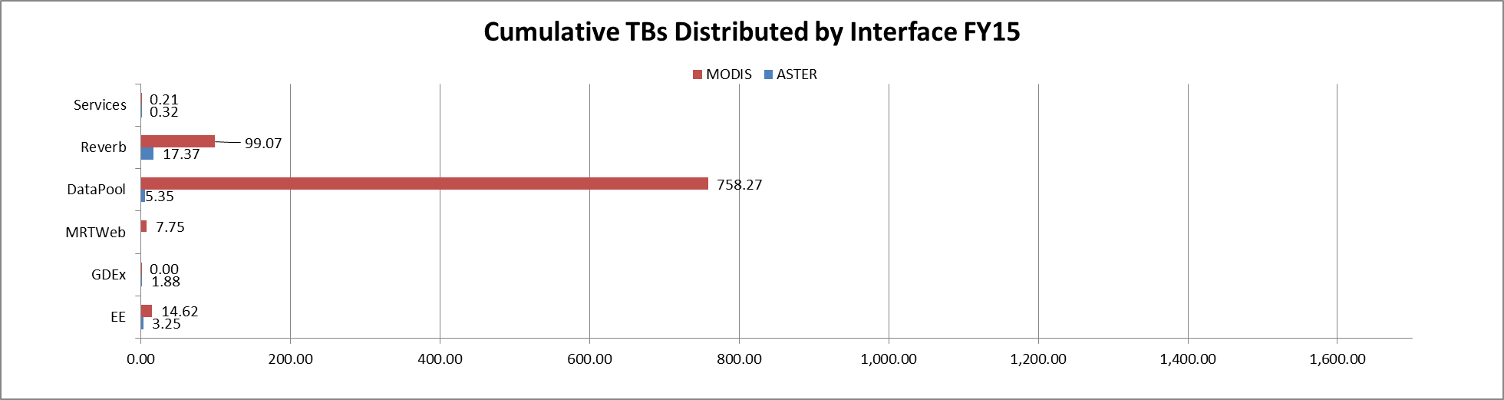
LP DAAC distribution by access point – FY2015
Notes:
This chart displays TBs distributed rather than files because EarthExplorer does not report the number of files downloaded.

Slide 6
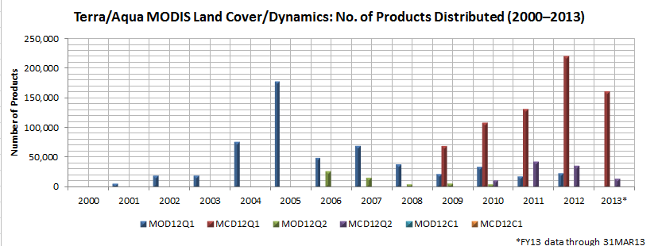
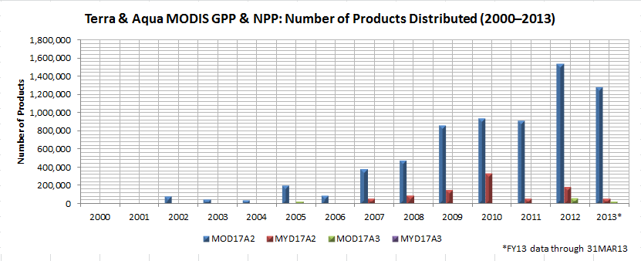
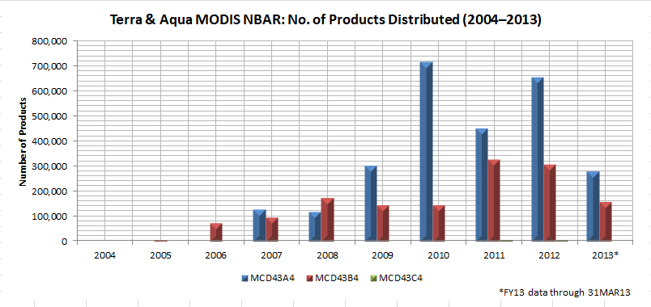
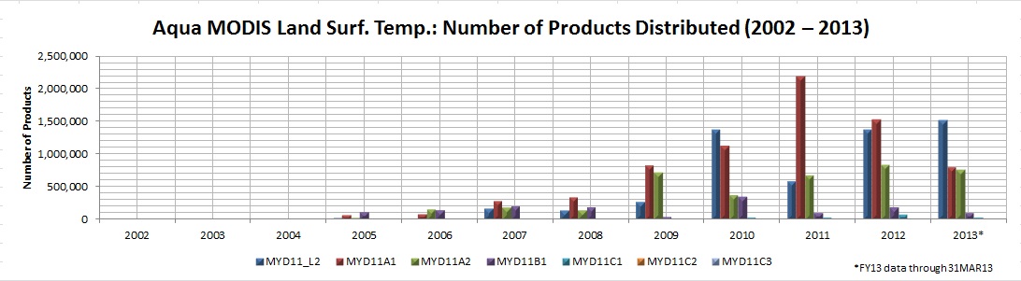
Metrics Data
Product-by-product charts are appended to this presentation
We can provide additional metrics upon request

Slide 7
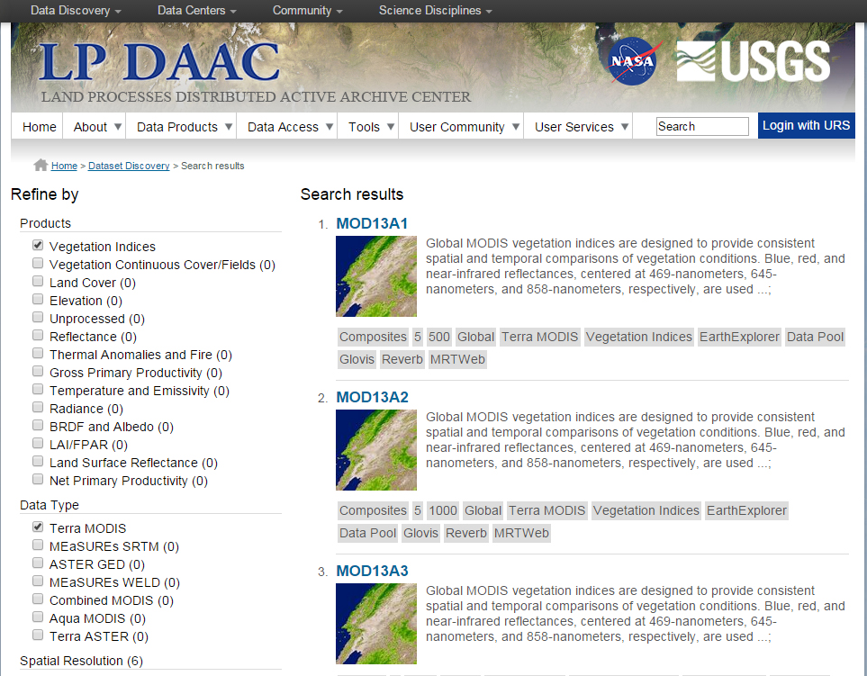
Website Redesign
Faceted Search

Slide 8
Preparing the archive for V06+VIIRS
V06 delayed public release until fall
  LP DAAC agreed to maintain both V05 and V06 for 1-2 years
Nominally, first VIIRS products arrive this summer (!!!)
Archive must be scaled to accommodate this load (plus additional products such as MEasUREs, new ASTER products, etc.)
Info we (LP DAAC) have:
  V06 product delivery scheduled, product descriptions
    Assuming appropriate documentation (ATBD’s, user guides, etc.) are found in the “usual” places.
We need:
  Accurate descriptions of VIIRS products and delivery schedule
    Currently estimating archive size based on comparable LandPEATE products

Slide 9
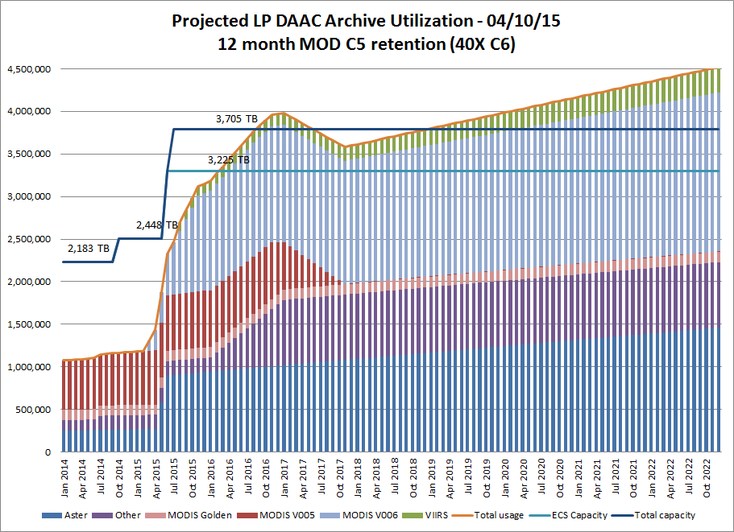

Slide 10
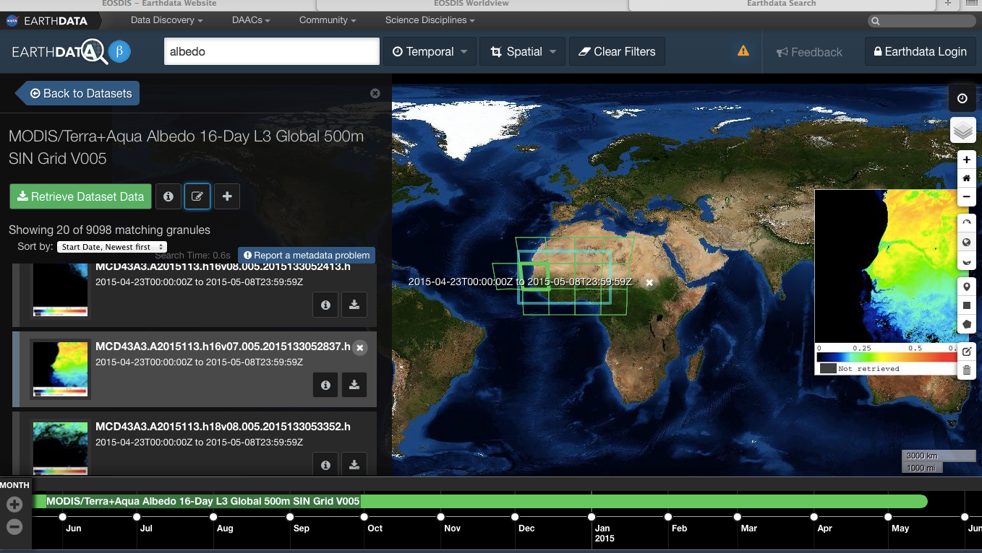
NASA Earth Data Search Client (beta)

Slide 11
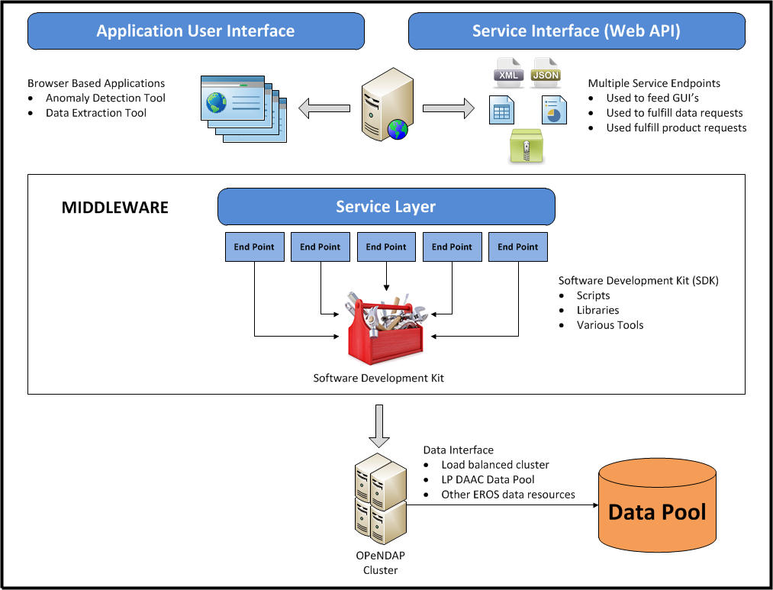
LP DAAC Services Concepts

Slide 12
LP DAAC Data Access: OpenDAP vs. Data Pool
LP DAAC data is available through the LP DAAC Data Pool
  Data files can be downloaded through HTTP links:
    http://e4ftl01.cr.usgs.gov/MOLT/MOD09Q1.005/2015.01.09/MOD09Q1.A2015009.h11v04.005.2015027222534.hdf
    The entire granule is downloaded through the link.
OPeNDAP services allow users to request only the portion of the data files they are interested in:
    http://opendap.cr.usgs.gov/opendap/hyrax/MOD09Q1.005/h11v04.ncml.ascii?sur_refl_b01[683:1:683][2000:1:2010][2000:1:2010]
    “request one pixel from MOD09Q1 from a specific tile, date and location for band 1, and return the result as an ASCII file”
    Can be built into scripts to perform manipulations on the result
Information is extracted directly from the archive without downloading large amounts of data.

Slide 13
Middleware application: sample selection
Demonstration Python application performed at the pixel level:
“Extract time series of EVI and LST from 10 flux tower locations from the beginning of Terra Mission through the current date”
  Data are located in 7 different MODIS Level 3 tiles
    MOD11A2.005, 8-day LST (686 date values)
    MOD13A3.005, monthly EVI (180 date values)
    7 * (686 + 180) = 6,062 granules (212 GB)
  Process through sample selector 1 hour, 10 minutes
    Downloaded ASCII file is 409 KB (7 orders of magnitude less!)

Slide 14
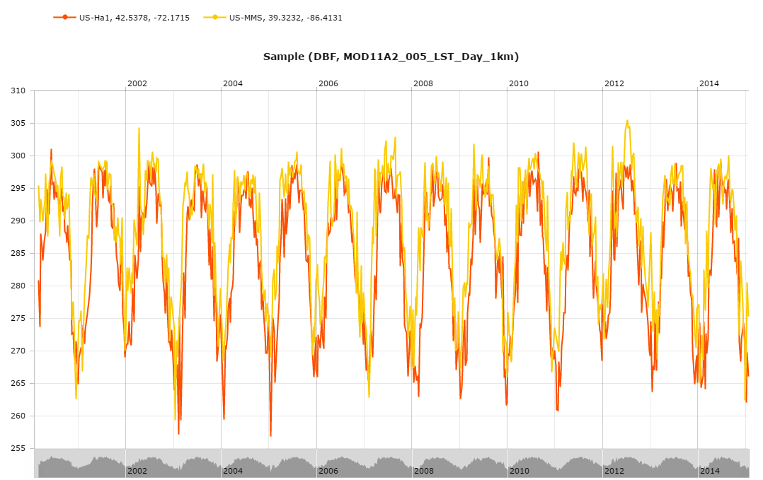
Sample selection: plot LST at two sites

Slide 15
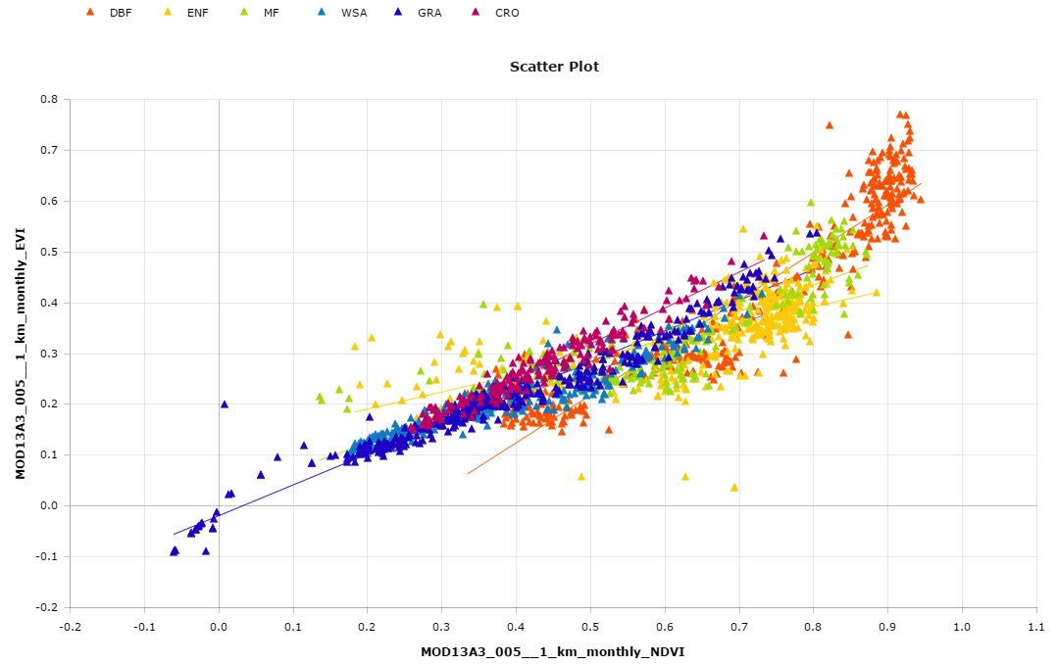
Sample selection: Compare NDVI, EVI at 7 sites

Slide 16
OpenDAP Accessibility
Many different tools can be used to access OPeNDAP Datasets
  R
  Python
  Panoply
  Working with ESRI for access via ArcGIS platforms.
Currently in use by:
  USGS Center for Integrated Data Analytics (D. Blodgett*)
  NASA Federated Giovanni (C. Lynnes*)
  NSF Earthcube (“BCube” brokered URLs, SJ. Khalsa)
    *(funded through NASA ACCESS)
Higher level interfaces in testing by UWG (and others)

Slide 17
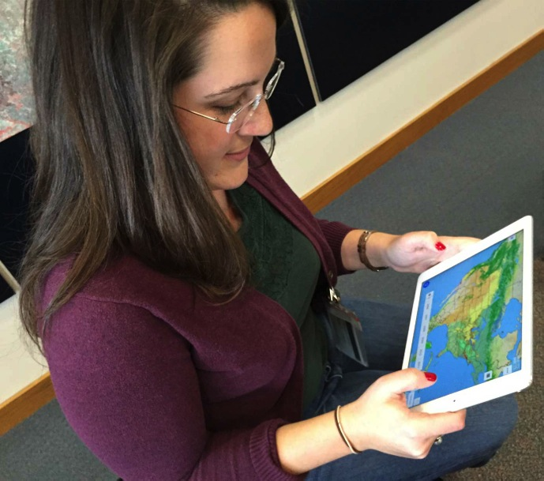
Landcast mobile app
Enables mobile users to easily explore and visualize LP DAAC land data collections
  Geared towards general users, educators, application community
  Currently iOS (Android planned)
  Demo previewed at AGU 2014
Datasets for visualization will include
  MODIS: NDVI, LST, VCF, among others
  ASTER GDEM
Unique functionality will include animating time series, sharing images via email and social media, saving images
Response to request from NASA to explore mobile applications

Slide 18
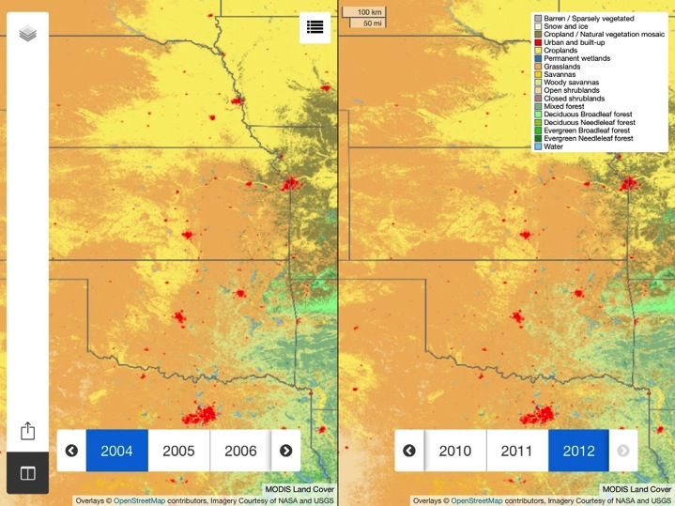
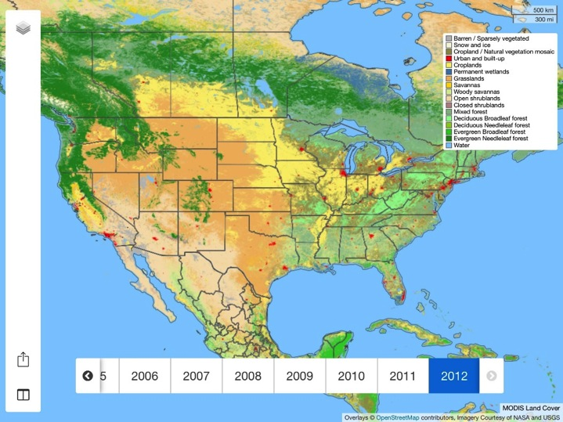
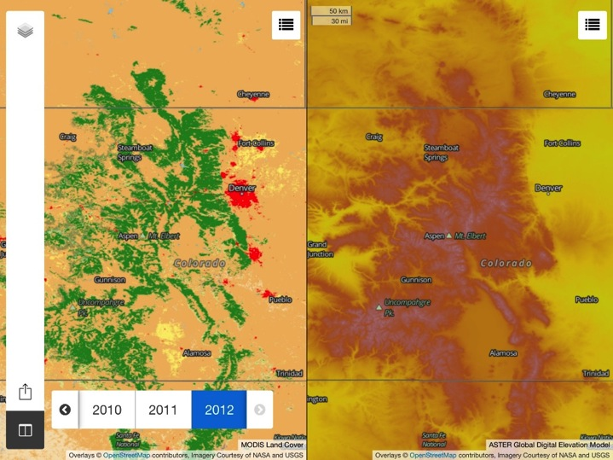

Slide 19
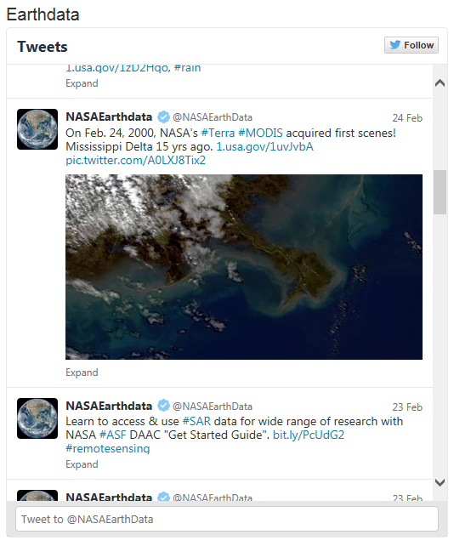
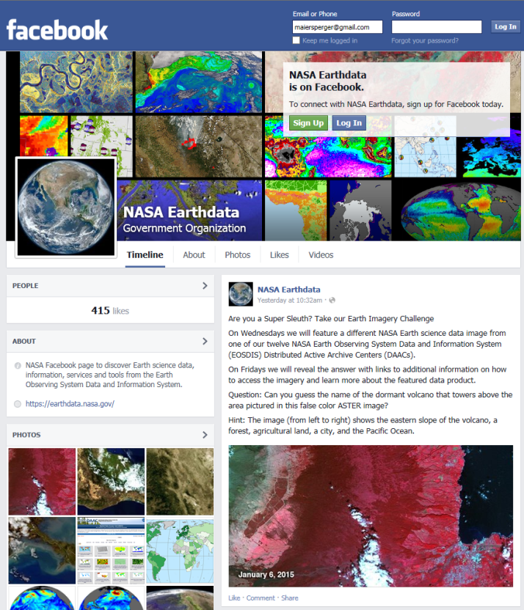
Outreach and Communication: Social Media

Slide 20
Twitter as a tool to direct users to LP DAAC web site
Web-Enabled #Landsat data used to map permafrost in Alaska Yukon River Basin. bit.ly/1sKciZn , @NASA_Landsat pic.twitter.com/3cAvZcYPkb (from Dec 2014)
  29,325 Impressions (how many people saw this tweet?)
  573 Engagements (how many interactions/clicks within this tweet – bitlink, hashtags, avatar, followed, favorite, etc.)
Developing metric to determine increase in web site visits due to social media referrals.

Slide 21
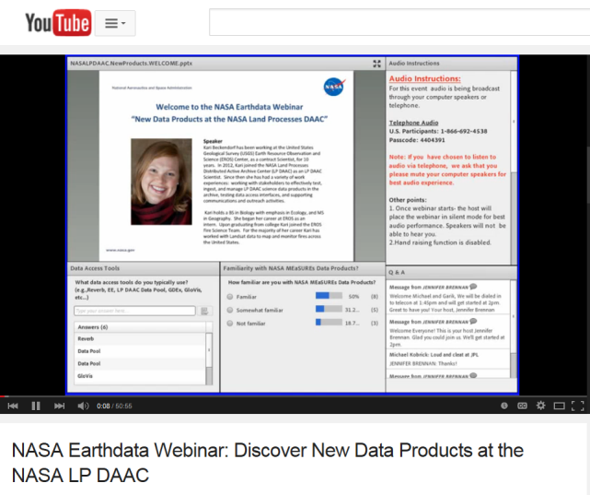
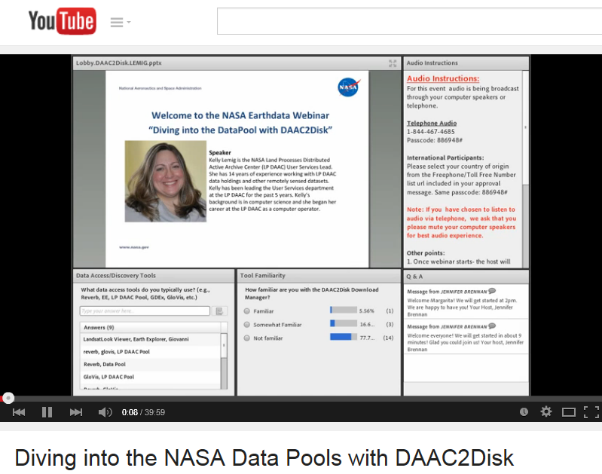
Outreach and Communication: Webinars

Slide 22
MODIS C6 Land Products Workshop
Collection 6 land products workshop:
  LP DAAC uses Earthdata Webinar platform for delivery to remote participants
    Extends reach and reduces travel costs for participants
  Interview videos with product PI’s
    Incorporate videos into webinars
    Publish to Youtube
    Schedule interviews with interested PI’s at target “meetings of opportunity”
    Who’s interested?

Slide 23
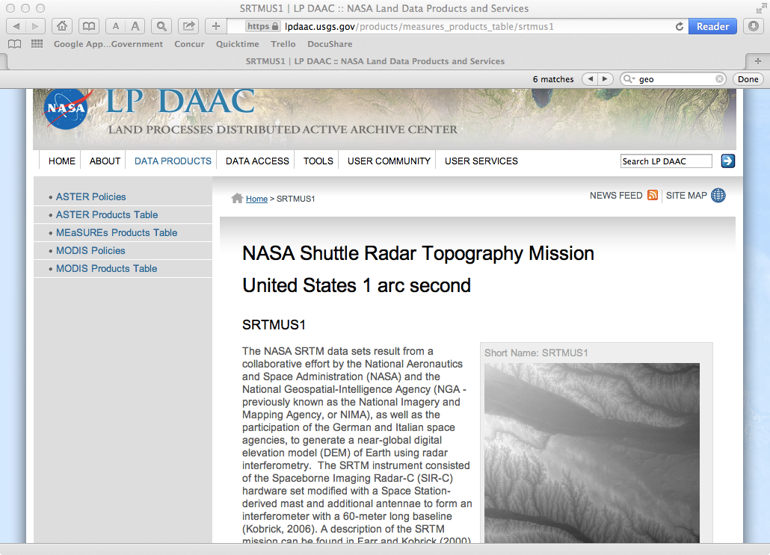
DOI Example – MEaSUREs SRTM V.03 (con’t)
Citation example:
URL above resolves to SRTMUS1 “landing page”:
Kobrick, M. and Crippen, R (2013) NASA Shuttle Radar Topography Mission United States 1 arc second Global Digital Elevation Model (HDF-EOS),
doi:10.5067/MEaSUREs/SRTM/SRTMUS1.003. [online] Available from:
http:/dx.doi.org/10.5067/MEaSUREs/SRTM/SRTMUS1.003
Include a citation generator so a user can select their desired citation style (APA, MLA, Chicago, etc) to be displayed on the screen.

Slide 24
MODIS V06 Digital Object Identifier Citation
Increasingly, journals are requiring DATA citations (i.e. – DOI’s that link to data landing pages, which are NOT the same as journal pub citations!)
  Connect publications to their underlying data
  Give credit for producing and curating data sets
  Facilitate data and science transparency and reproducibility
  Track the products that derive from data
ESDIS requests “creator” (algorithm developer/product generator) and “distributor” (“publisher”). Recommended format:
  Running, S.W., Q. Mu, M. Zhao. 2016. MODIS Aqua Net Evapotranspiration 8-Day L4 Global 1km SIN Grid. Ver. 6. [indicate subset used]. Sioux Falls, South Dakota, USA: Land Processes Distributed Active Archive Center. http://dx.doi.org/10.5067/MODIS/MYD16A2.006
ORNL & LPDAAC to work with PIs & SIPS to suggest citations
  Citation for both PI team + SIPS (MODAPS) as “creators”

Slide 25
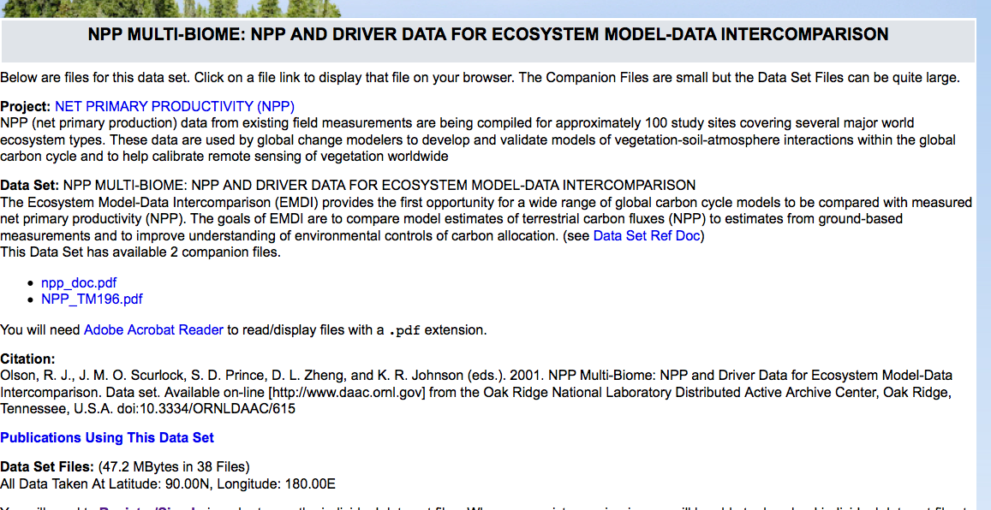
Showing potential users where data have been cited

Slide 26
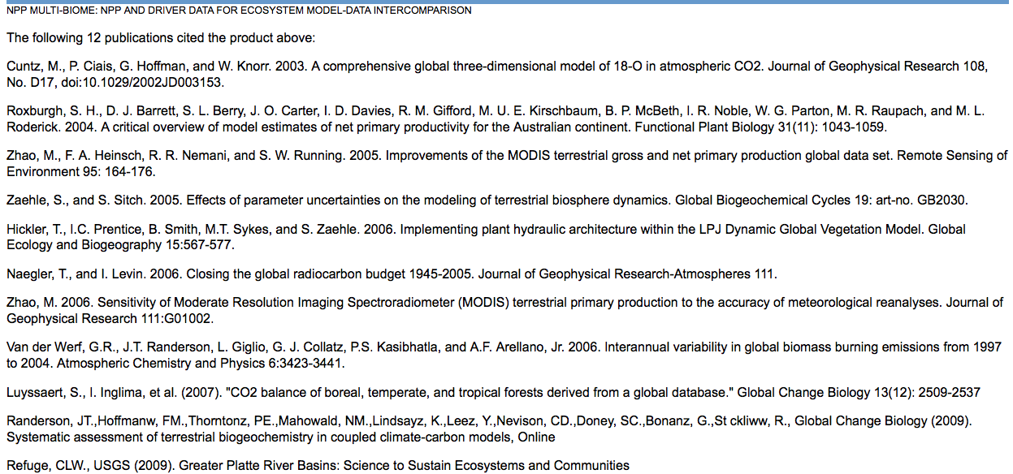
Showing potential users where data have been cited

Slide 27
Questions?

Slide 28
Product-specific metrics

Slide 29
LP DAAC Distribution – last 18 months

Slide 30
MOD09 – Land Surface Reflectance

Slide 31
MYD09 – Land Surface Reflectance

Slide 32
MOD11 – Land Surface Temperature

Slide 33
MYD11 – Land Surface Temperature

Slide 34
MCD43x3 - Albedo

Slide 35
MCD43 – Albedo/BRDF Parameters

Slide 36
MOD43x4 - NBAR

Slide 37
MOD13 – Vegetation Indices

Slide 38
MYD13 – Vegetation Indices

Slide 39
MCD15 – LAI/fPAR

Slide 40
MOD/MYD17 - GPP

Slide 41
MOD/MYD14 – Thermal Anomalies/Fire

Slide 42
MxD12 – Land Cover Type/Dynamics

Slide 43
MOD44B – Veg. Cont. Fields/Water Mask

Slide 44
MCD45 – Burned Area

