Slide 1
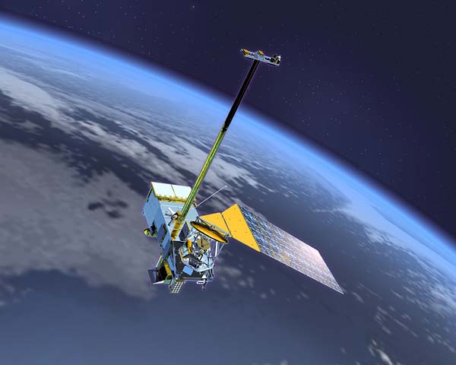
NOAA/NCDC Surface Reflectance Climate Data Record Initiative
Eric Vermote^{(a)}, Chris Justice^{(b)}, Martin Claverie^{(b,a)}, Ivan Csiszar^{(c)}, Dave Meyer^{(d)},Ranga Myneni^{(e)}, Frederic Baret^{(f)}, Ed Masuoka^{(a)} , Robert Wolfe^{(a)} and Sadashiva Devadiga^{(g,a)}
^{(a)}NASA/GSFC, Terrestrial Information Systems Branch, Code 619
^{(b)}Department of Geography / University of Maryland at College Park
^{(c)}NOAA/NESDIS/STAR
^{(d)}USGS/EROS Data Center
^{(e)} Dept of Geography and Environment, Boston University
^{(f)} INRA/ Avignon, France
^{(g)} SSAI
Contact: 301 6145413 eric.f.vermote@nasa.gov
MODIS/VIIRS Science Team Meeting, May 18 – May 22, 2015, Silver Spring, MD

Slide 2

Land Climate Data Record: Multi instrument/Multi sensor Science Quality Data Records used to quantify trends and changes
81
82
83
84
85
86
87
88
89
90
91
92
93
94
95
96
97
98
99
00
01
02
03
04
05
06
07
08
09
10
11
12
13
14
15
AVHRR
N07
N09
N11
N09
N14
N16
N18
VEGETATION
Terra
MODIS
Aqua
  AVHRR (GAC) 1982-1999 + 2001 (2003)-present
  MODIS (MO(Y)D09 CMG) 2000-present
  VIIRS 2011 – 2025
  SPOT VEGETATION 1999-2000
NPP
VIIRS
JPSS
  Emphasis on data consistency – characterization rather than degrading/smoothing the data

Slide 3
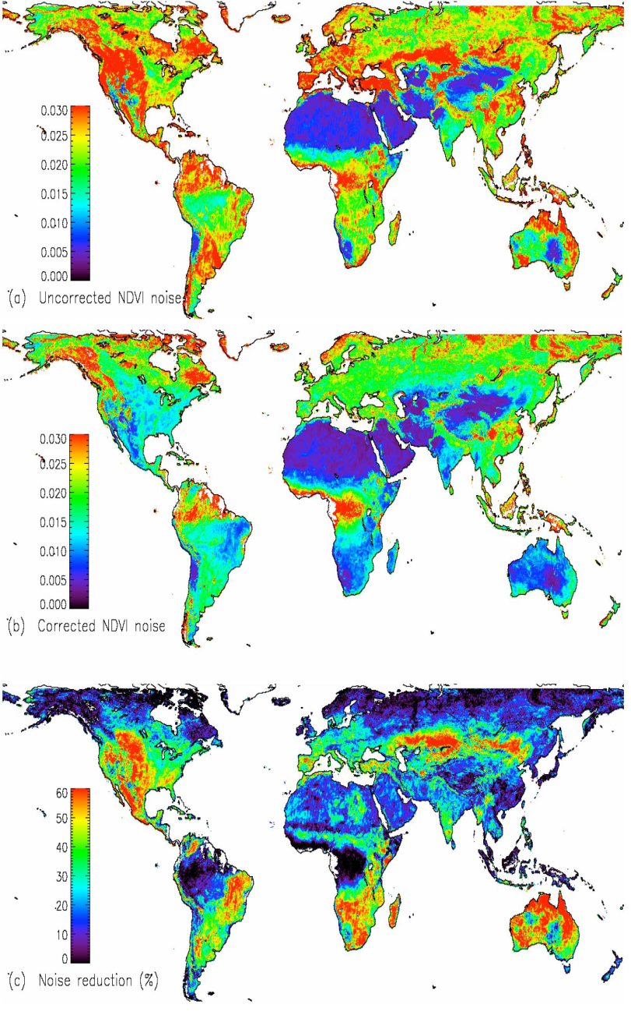
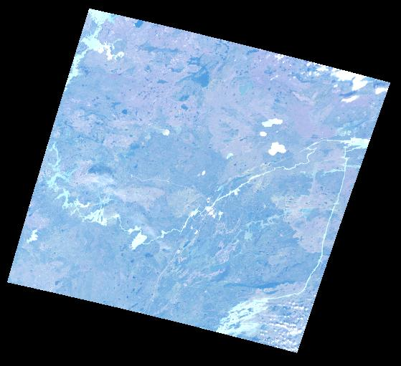
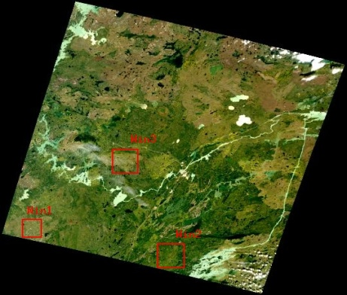
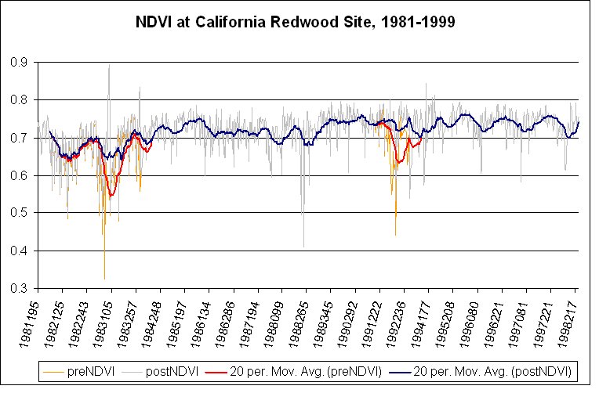
Land Climate Data Record
Needs to address calibration, atmospheric/BRDF correction issues
ATMOSPHERIC
CORRECTION
BRDF CORRECTION
CALIBRATION
Degradation in channel 1
(from Ocean observations)
Channel1/Channel2 ratio
(from Clouds observations)
El Chichon
Pinatubo

Slide 4
Data products
CDR(s) | Period of Record and Temporal Resolution | Spatial Resolution & Projection Used (if applicable) | Update Frequency | Data file distinction criteria | Inputs | Uncertainty Estimates | Collateral Products
Surface reflectance (Red,NIR) NDVI | 1981-present daily | Linear Latitude Longitude (0.05deg) | daily | One file for each day and each CDR: Surface reflectance, NDVI | AVHRRGAC data | Reflectance (Red 0.02; NIR 0.03) NDVI (0.07) 3x3 average Reflectance (Red 0.01; NIR 0.015) NDVI (0.03) | LAI/FPAR

Slide 5
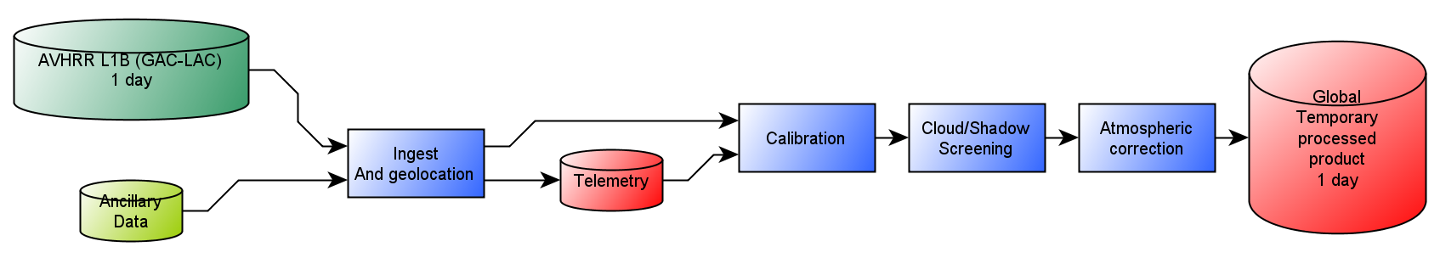
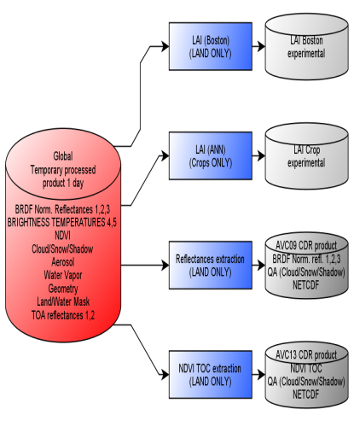
Production Approach
Overview

Slide 6
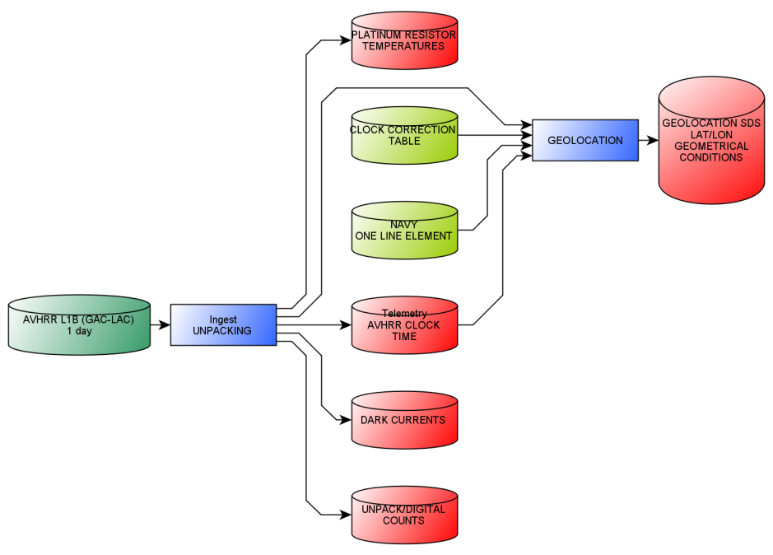
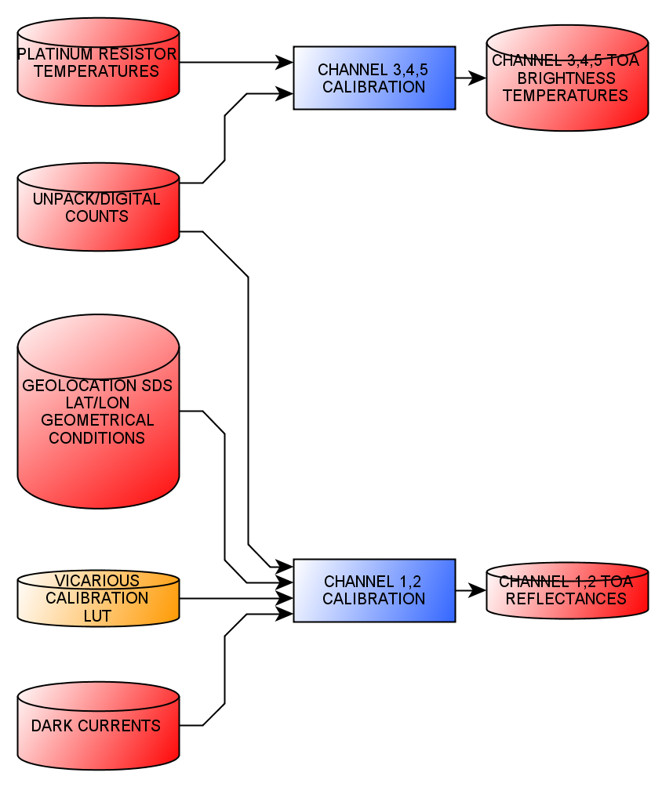
Production details
Geolocation
Calibration
95th AMS Annual meeting, Phoenix Arizona, January 4-8 2015

Slide 7
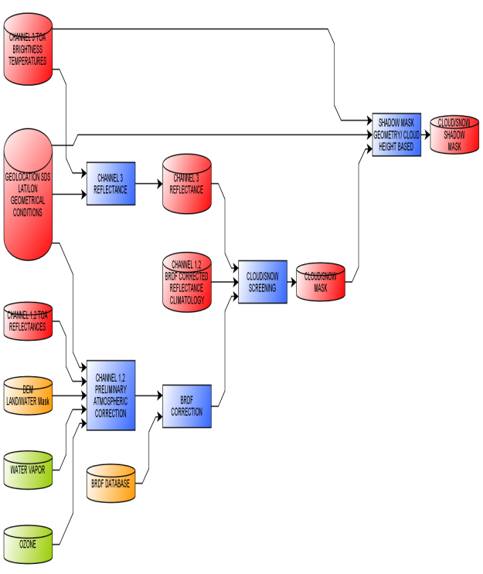
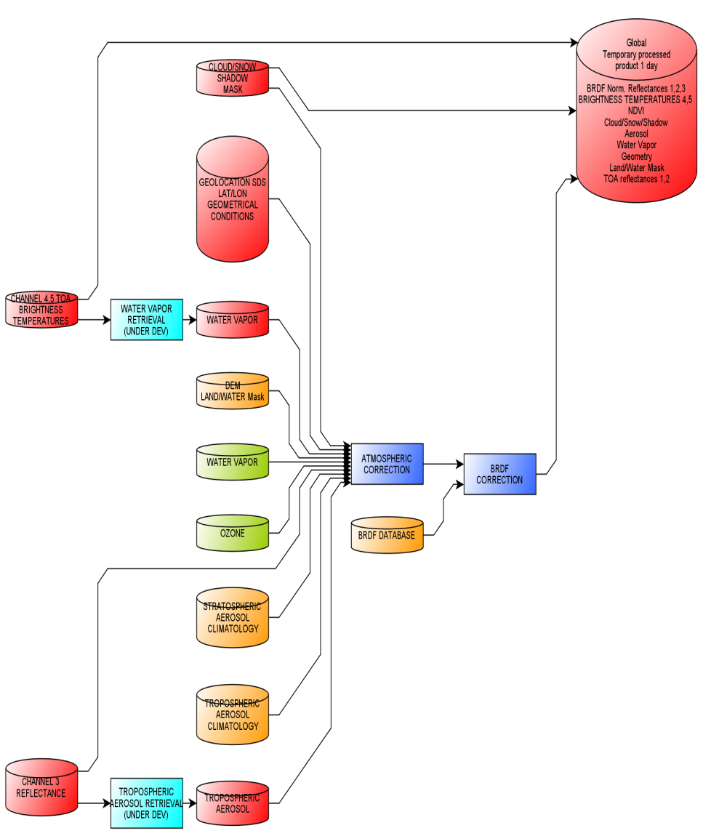
Production details (cont.)
Cloud/Shadow screening
Atmospheric/BRDF correction
95th AMS Annual meeting, Phoenix Arizona, January 4-8 2015

Slide 8
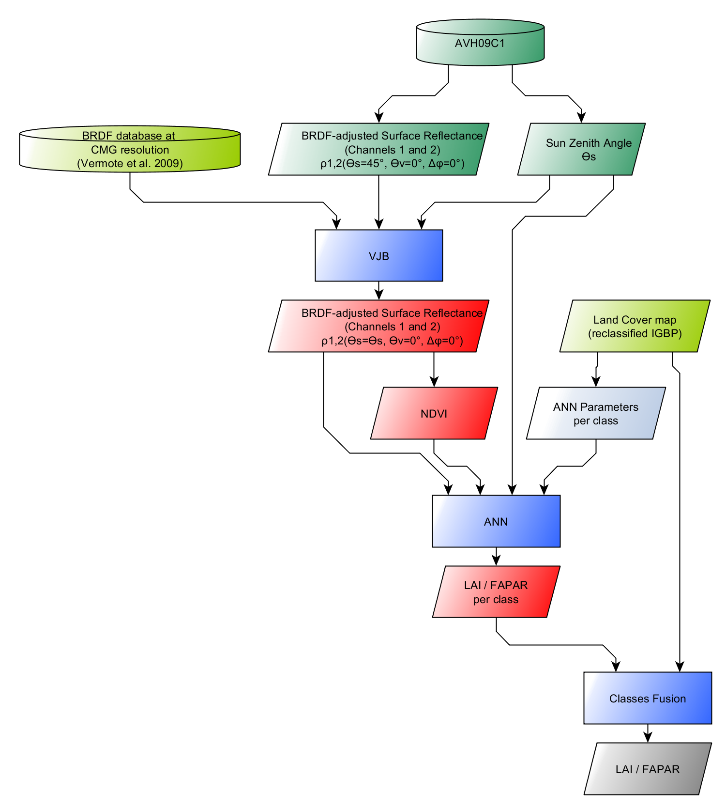
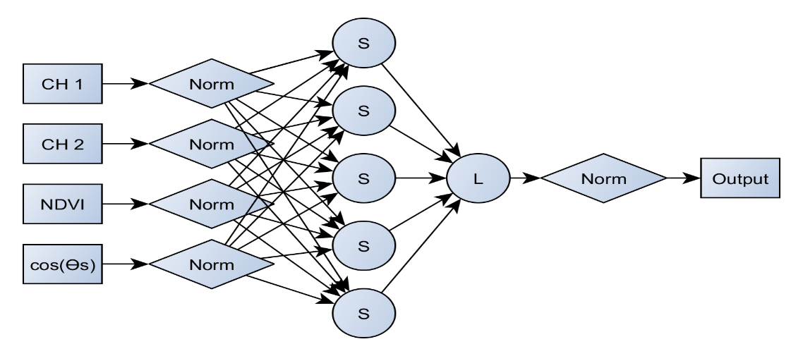
LAI/FAPAR Algorithm basis
The algorithm is based on a per-class neural network trained using AVHRR SR and MODIS LAI/FAPAR.

Slide 9
Validation & Quality Assurance

Slide 10
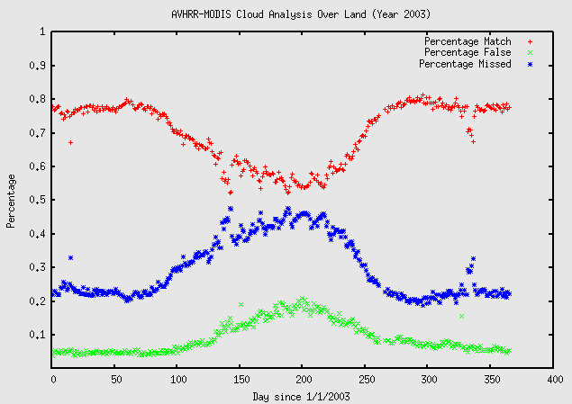
Assessing CLAVR using MODIS shows the need of an improved cloud mask
Evaluation of the global performance of the CLAVR Algorithm reported as percentage. Overall CLAVR identified only 2/3 of the cloud flagged by MODIS (red points), and labeled about 1/3 of the observation flagged as clear by MODIS as cloudy (blue points).

Slide 11
Independent validation of MODIS internal cloud mask

Slide 12
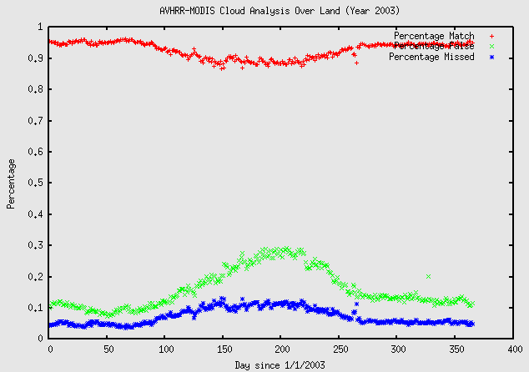
New improved cloud mask for AVHRR
Evaluation of the global performance of the LTDR cloud mask Algorithm reported as percentage.

Slide 13
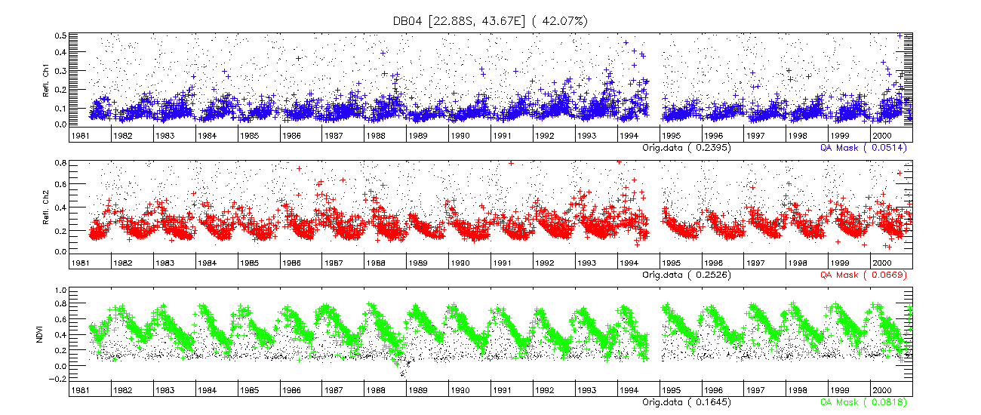
AVHRR Time series CLAVR mask

Slide 14
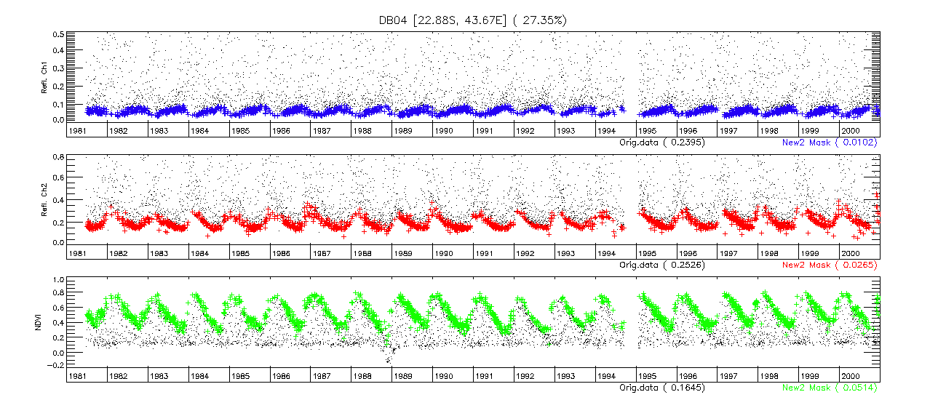
AVHRR Time series LTDR cloud mask

Slide 15
Methodology for evaluating the performance of surface reflectance product (generic)
Subsets of Level 1B data processed using the standard surface reflectance algorithm
comparison
Reference data set
Atmospherically corrected TOA reflectances derived from Level 1B subsets
AERONET measurements
(τ_{aer}, H₂O, particle distribution
Refractive indices,sphericityeri)
Vector 6S

Slide 16
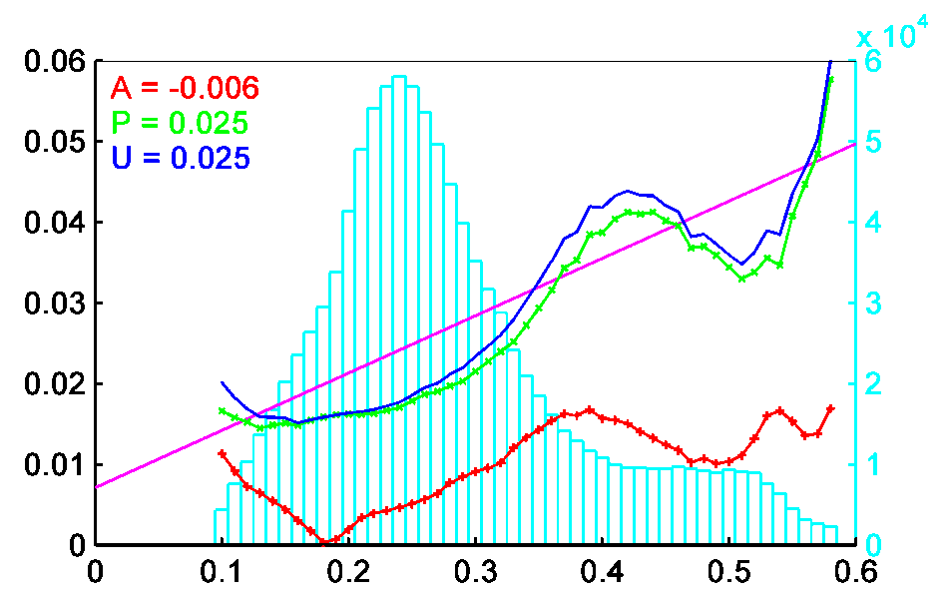
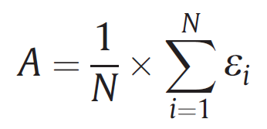
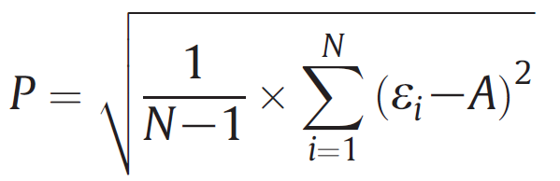
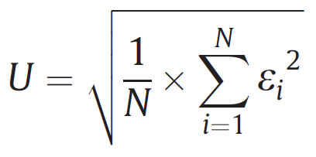
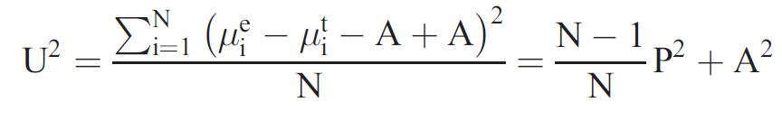
Validation Metrics
Accuracy (A) = the bias
Precision (P) = the repeatability
Uncertainty (U) = the actual statistical deviation
S
A, P, U, S
Number of Occurrences
SR references
Specification (S) = Uncertainty requirement
From Vermote and Kotchenova, 2008

Slide 17
MODIS SR validated over AERONET sites

Slide 18
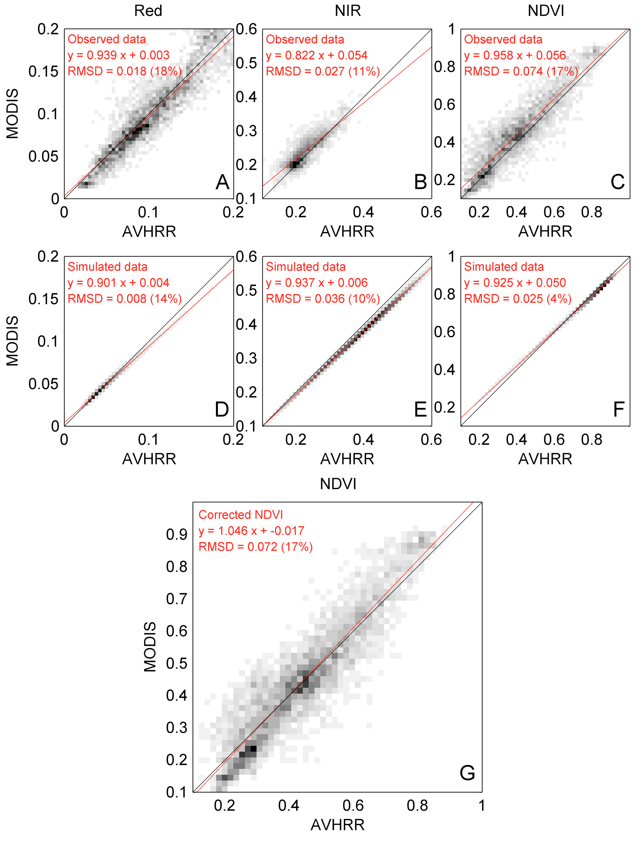
Using Direct comparison with MODIS Aqua for validation
Comparison of MODIS Aqua and NOAA16 AVHRR data, A (Red) ,B (NIR) ,C (NDVI) are observed over AERONET sites for 2003-2004, D (Red), E(NIR), F(NDVI) are simulated using a vegetation model that account for spectral difference between MODIS and AVHRR bands. G shows over the AERONET sites MODIS NDVI versus corrected AVHRR NDVI computed from spectrally adjusted AVHRR surface reflectance.

Slide 19
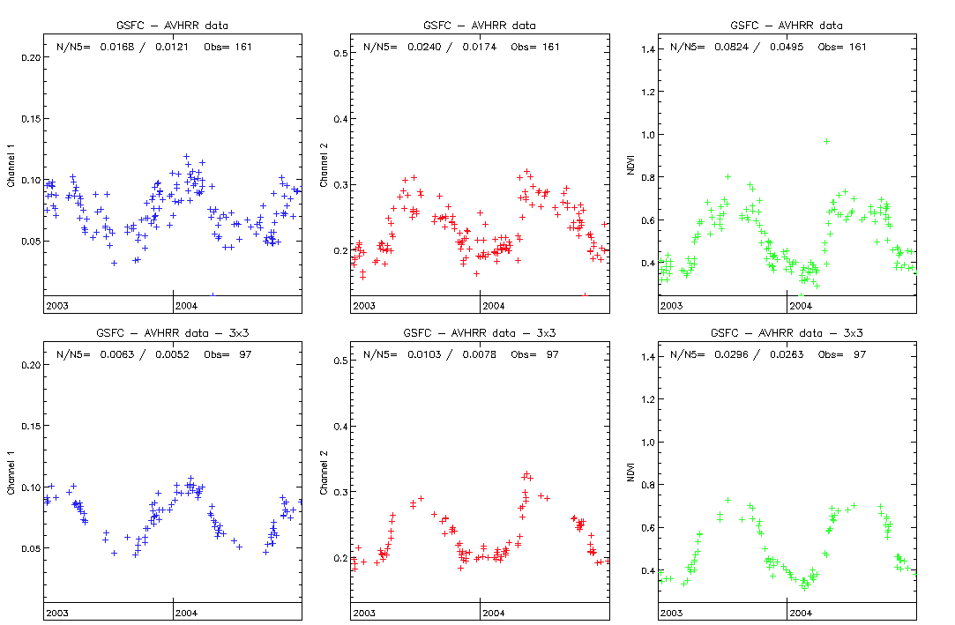
Analysis of the AVHRR reflectance and NDVI time series reveal an issue with GAC sampling

Slide 20
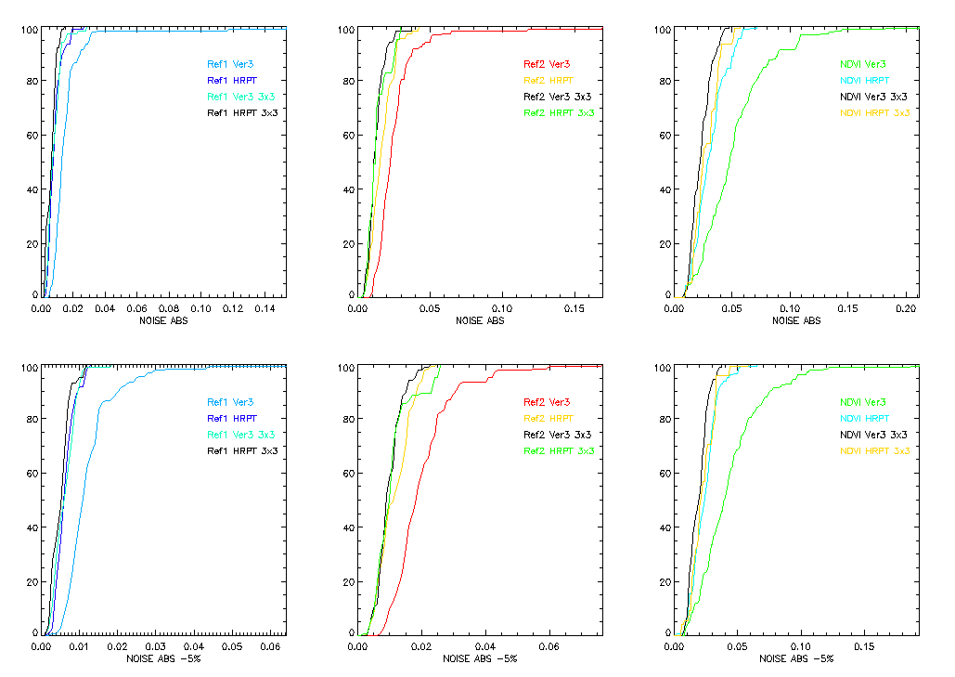
Analysis of the GAC artifact over AERONET SITES

Slide 21
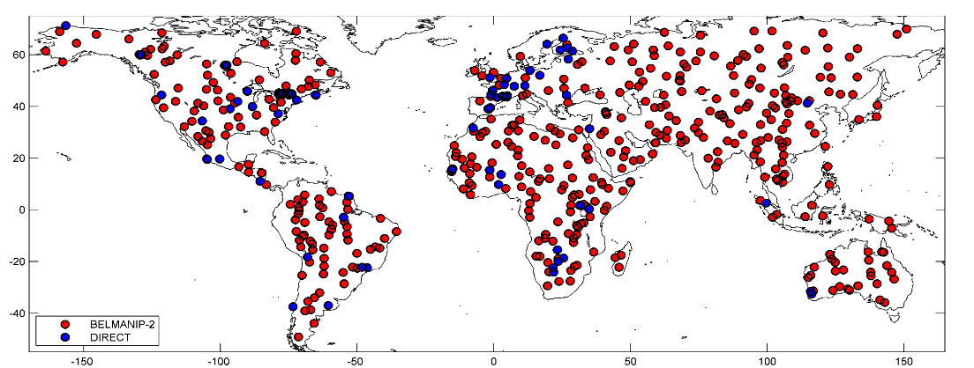
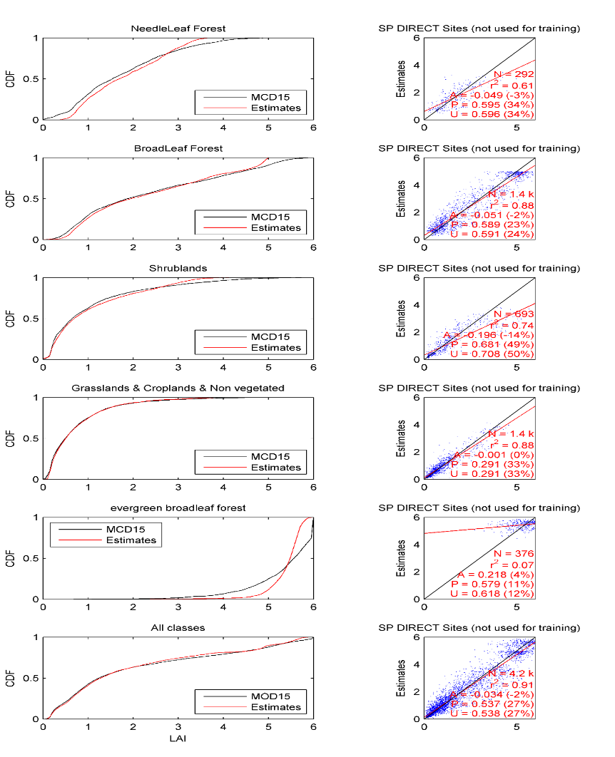
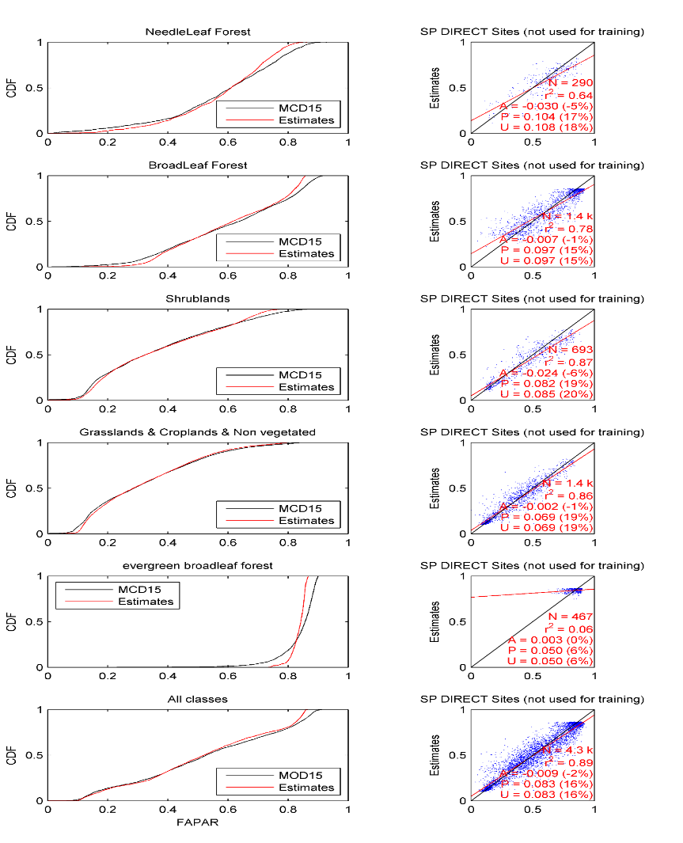
LAI Calibration procedure
We used the BELMANIP-2 sites network to calibrate the LAI/FAPAR ANN and the DIRECT in situ measurement to assess the uncertainty of the retrievals.
LAI
FAPAR

Slide 22
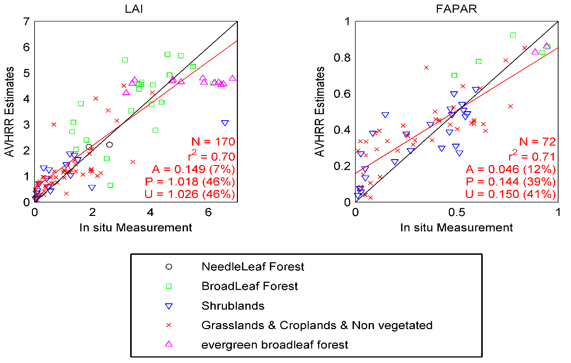
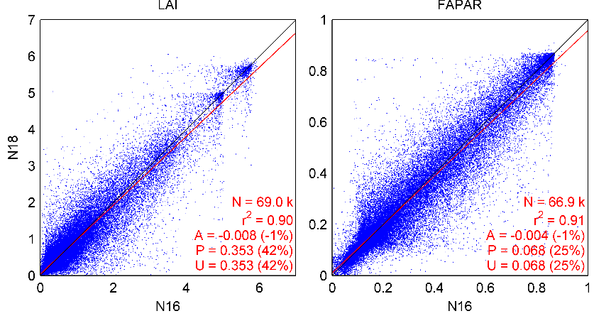
Validation/Evaluation Results
In situ validation: we extrapolated DIRECT measurement (1km footprint) to 0.05degree using MODIS LAI/products
Class | LAI |  |  | FAPAR
 | bias | RMSE | N | bias | RMSE | N
NeedleLeaf Forest | -0.04 | 0.31 | 2 |  |  | 0
BroadLeaf Forest | 0.39 | 1.18 | 22 | 0.07 | 0.15 | 5
Shrublands | 0.02 | 0.93 | 20 | 0.04 | 0.13 | 25
Grasslands & Croplands & Non vegetated | 0.11 | 0.69 | 51 | 0.05 | 0.16 | 40
evergreen broadleaf forest | -0.81 | 1.53 | 14 | -0.07 | 0.07 | 2
All | 0.13 | 1.05 | 171 | 0.05 | 0.15 | 72
Product evaluation: inter-comparison of NOAA-16 vs NOAA-18 outputs

Slide 23
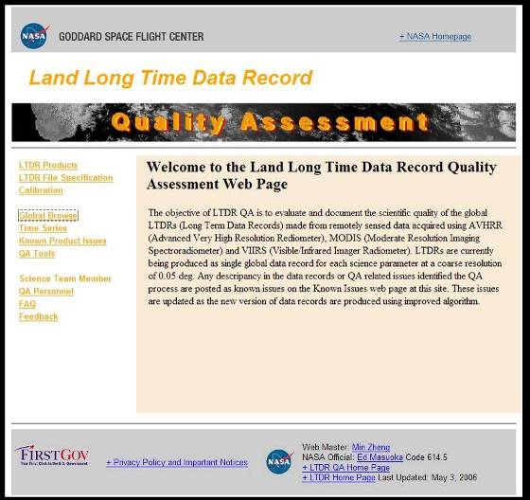
Operational Quality Assurance

Slide 24
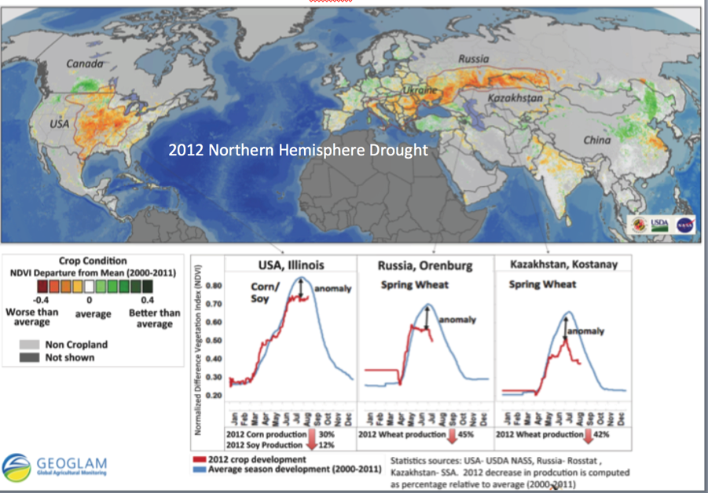
MODIS NDVI Anomaly July 30th 2012
Assessment of the impact of the 2012 Northern Hemisphere Drought from the MODIS Climate Modeling Grid daily NDVI data. The anomaly image shows the cropland NDVI departure from the average (2000-2011) on July 30th 2012, highlighting hotspots of crops under stress during the 2012 droughts that affected the United States and the Black Sea region. The time-series curves below compare the daily development of croplands in 2012 (red) to average (2000-2011) in 3 important crop growing regions: Illinois, USA; Orenburg Oblast, Russia; Kostanay Oblast, Kazakhstan. The crop development through the season depicted by NDVI shows consistent negative anomalies with regard to a ten year average, with highest discrepancies during the crops peak development period. In 2012 crops in the US, southern Europe and the Black Sea region suffered from prolonged high temperatures and lack of moisture, which resulted in significantly reduced production. This information was available one month prior to harvest and several months before the release of official statistics.

Slide 25
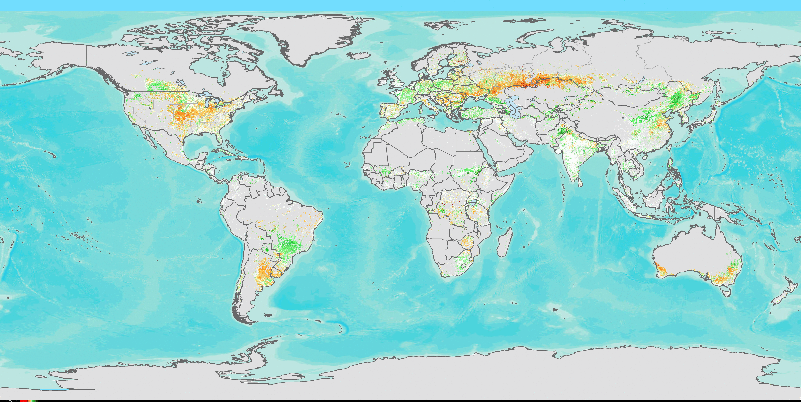
Prototype VIIRS NDVI Anomaly, July 30th 2012
A VIIRS NDVI anomaly (prototype) image computed for the same date (July, 30th 2012) as the MODIS NDVI anomaly shown in the previous slide, generated from data produced at the GSFC Land PEATE.

Slide 26
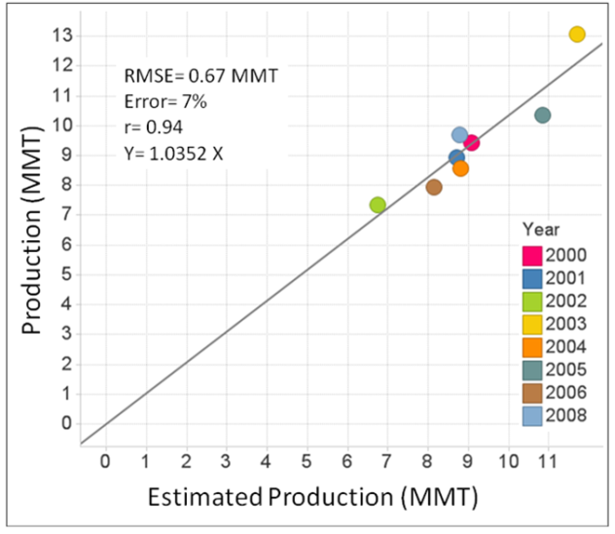
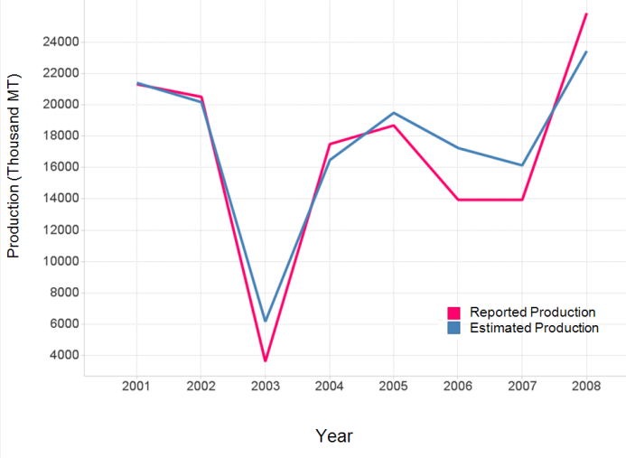
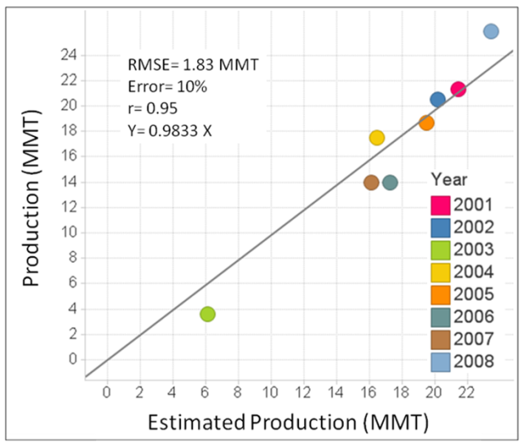
Application to Agriculture: Yield/Production prediction
Kansas: Wheat
Ukraine: Wheat
Becker-Reshef, I., E. Vermote, M. Lindeman, and C. Justice (2010a), A generalized regression-based model for forecasting winter wheat yields in Kansas and Ukraine using MODIS data, Remote Sensing of Environment, 114(6), 1312-1323.

Slide 27
Improving timeliness of winter wheat production forecast in United States of America, Ukraine and China using MODIS data and NCAR Growing Degree Day
Remote Sensing of the environment, 161,131-148 (2015)
B. Franch^{1,2}, E. F. Vermote², I. Becker-Reshef,¹ M. Claverie^{1,2}, J. Huang¹, J. Zhang¹, and J.A. Sobrino³
¹ Department of Geographical Sciences, University of Maryland, College Park MD 20742, United States
² NASA Goddard Space Flight Center, Code 619, 8800 Greenbelt Road, Greenbelt, MD 20771, USA
³ Global Change Unit, Image Processing Laboratory (UCG-IPL). Parque Cientifico, Universitat de Valencia, Spain
Daily accumulated Growing Degree day
(GDD)
Daily BRDF-corrected NDVI adjusted (ANDVI)
Wheat mask
Inputs
ANDVI, GDD climatology
Median ANDVI at the peak and at GDD of the day of forecast
(median based on 2000 to 2012 data )
ANDVI, GDD
Adjusted NDVI and accumulated GDD for the day of the forecast
Mpct
% Wheat in each Administrative Unit (AU)
Simulated adjusted peak NDVI (~ANDVI_{peak})
Becker-Reshef et al. (2010) method

Slide 28
Results for major producers
USA
Ukraine
China
The results show that the earliest time winter wheat production can be forecasted within an error of 10% is roughly one and a half month prior to the average date of the peak, that is two months and a half month prior to the harvest

Slide 29
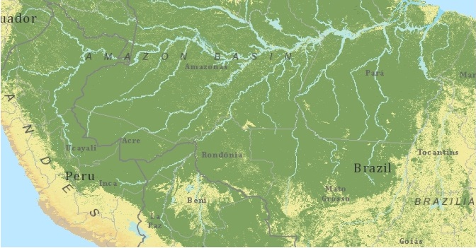

funded MEASURES-2013 proposal entitled "Vegetation Continuous Fields ESDR for the AVHRR and MODIS Records: 1981 - Present", PI: Robert Sohlberg (UMD).
Percent tree cover, Amazon Basin, 1990--Land LTDR AVHRR data

Slide 30
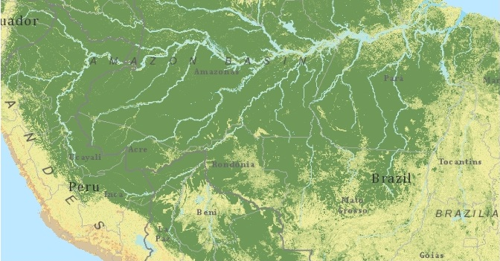
Percent tree cover, Amazon Basin, 2000—MODIS CMG data

Slide 31
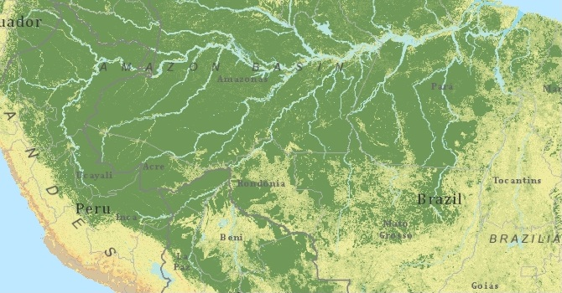
Percent tree cover, Amazon Basin, 2010--MODIS CMG data

