Slide 1
New physically based sea surface temperature retrievals for NPP VIIRS
Andy Harris, Prabhat Koner
CICS, ESSIC, University of Maryland
Notes:
Add the “title” of the product or service to the cover slide.
Add the project lead(s) name, office, and the date slides are submitted.
If this product/service development is stopping at the pre-operational phase, change the word “Operational” to “Pre-Operational”.

Slide 2
Activities
Data
  VIIRS & MODIS L1B
  VIIRS & MODIS GHRSST SST
  NCEP GFS
  Aerosol climatology (CMIP5)
Working with matchups
  Time-space matches with in situ
  iQUAM data (drifting & moored buoys)
  Allows quantitative assessment of algorithm adjustments
Channel selection
  Check observed BTs against output from CRTM
  For now, only use channels which agree “well”
    Ad hoc bias correction risks corrupting signal, or distorting physical model
    Best to identify and fix issues at source
    Experiments with GOES indicate bias correction can degrade retrieval

Slide 3
Physical Retrieval
Reduces the problem to a local linearization
  Dependent on ancillary data (NWP) for an initial guess
  More compute-intensive than regression – not an issue nowadays
    Especially with fast RTM (e.g. CRTM)
Widely used for satellite sounding
  More channels, generally fewer (larger) footprints
Start with a simple reduced state vector
  x = [SST, TCWV]^{T}
  N.B. Implicitly assumes NWP profile shape is more or less correct
Selection of an appropriate inverse method
  Ensure that satellite measurements are contributing to signal
  Avoid excessive error propagation from measurement space to parameter space
    If problem is ill-conditioned

Slide 4
History of Inverse Model
Forward model:
Simple Inverse: (measurement error)
Legendre (1805) Least Squares:
MTLS:
OEM:

Slide 5
Uncertainty Estimation
Physical retrieval
Normal LSQ Eqn: Δx = (K^{T}K)⁻¹K^{T}Δy [= GΔy]
MTLS modifies gain: G’ = (K^{T}K + λI)⁻¹K^{T}
Regularization strength: λ = (2 log(κ)/||Δy||)σ²_{end}
(σ²_{end} = lowest singular value of [K Δy])
Total Error
||e|| = ||(MRM – I)Δx|| + ||G’||⟨||(Δy - KΔx)||⟩
N.B. Includes TCWV as well as SST

Slide 6
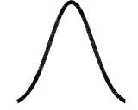
“Optimized” OE
[S_{e}], S_{a} =
Perform experiment – insert “true” SST error into S_{a}⁻¹
  Can only be done when truth is known, e.g. with matchup data
0
σ² is an overestimate…
…or an underestimate
0

Slide 7
DFS/DFR and Retrieval error
Retrieval error of OEM higher than LS
More than 75% OEM retrievals are degraded w.r.t. a priori error
DFR of MTLS is high when a priori error is high
The retrieval error of OEM is good when a priori SST is perfectly known, but DFS of OEM is much lower than for MTLS

Slide 8
Improved cloud detection
Use a combination of spectral differences and RT
  Envelope of physically reasonable clear-sky conditions
Spatial coherence (3×3)
Also check consistency of single-channel retrievals
Flag excessive TCWV adjustment & large MTLS error
Almost as many as GHRSST QL3+, but with greatly reduced leakage

Slide 9
VIIRS Initial Results
Data are ordered according to MTLS error
  Reliable guide for regression as well as MTLS
  Trend of initial guess error is expected

Slide 10
MODIS Initial Results
Note improvement from discarding MTLS error “last bin”
  Irrespective, MTLS is quite tolerant of cloud scheme
Recalculated SST4 coefficients produce quite good results

Slide 11
Status & Plans
“Initial cut” MTLS shows promise with VIIRS
  Well-calibrated instrument, with reliable* fast RTM available
  Error calculation useful quality indicator
  MODIS offers more possibilities
Cloud detection can be aided by RTM
  “Single-channel” retrieval consistency, MTLS error calculation
Plans
  Take advantage of SIPS!
    Liaise w/ RSMAS on matchups
  Take advantage of differing length scales to reduce atmospheric noise
  Perhaps combine with sounder for more local atmospheric information
  Refine fast RTM, iteration
  Tropospheric aerosols…

Slide 12
Backup slides

Slide 13
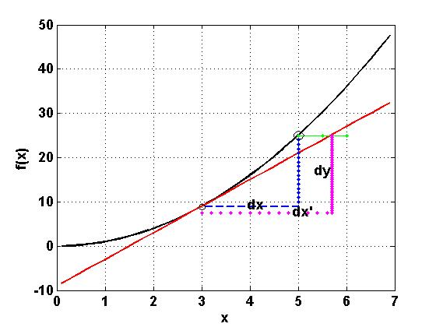
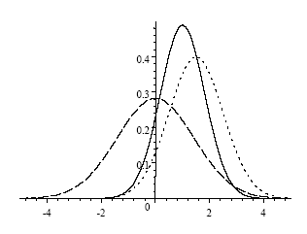
Deterministic & Stochastic
Determinitic | Stochastic/Probabilistic
MTLS/RTLS/Tikhonov: Single pixel measurement error Lengendre (1805) Least Squares: Last 30~40 years: MTLS: Total Error: | OEM: A set of measurement Low confidence for pixel retrieval Chi-Square test: Regression: A set of measurement Historical heritage in SST retrieval using Window channels. Coefficient Vector/matrix: C Main concerns: Correlation & Causation
A posteriori
observation
A priori
Notes:
You need to have a good explanation for the point you’re trying to make for δX ≤ κ δE
Also need to explain why correlation & causation are problems for OEM but not MTLS

Slide 14
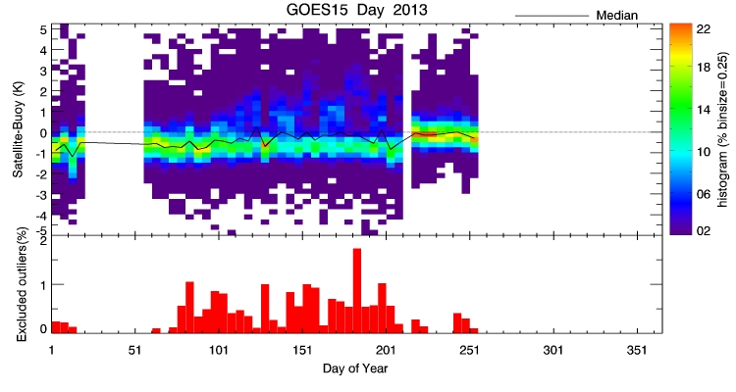
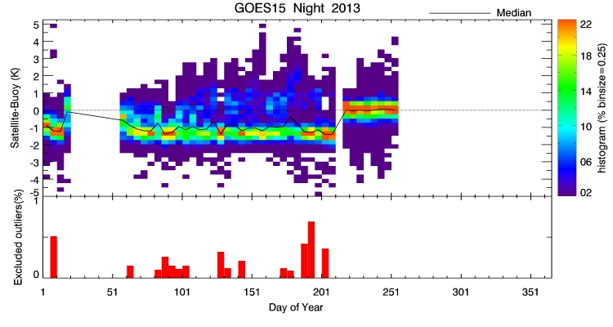
Recent update to Geo-SST
Physical retrieval based on Modified Total Least Squares
Improved bias and scatter cf. previous regression-based SST retrieval
GOES-15
Daytime
Nighttime

Slide 15
How sensitive is retrieved SST to true SST?
If SST changes by 1 K, does retrieved SST change by 1 K?
CRTM provides tangent-linear derivatives
Response of NLSST algorithm to a change in true SST is…
Merchant, C.J., A.R. Harris, H. Roquet and P. Le Borgne, Retrieval characteristics of non-linear sea surface temperature from the Advanced Very High Resolution Radiometer, Geophys. Res. Lett., 36, L17604, 2009

Slide 16
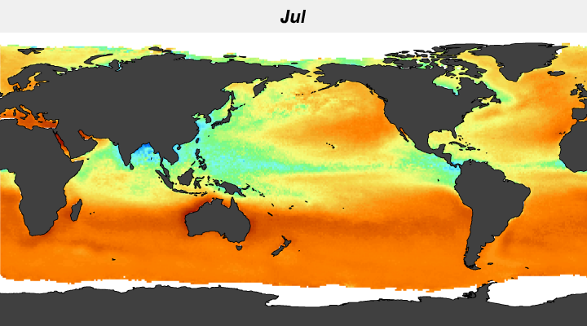
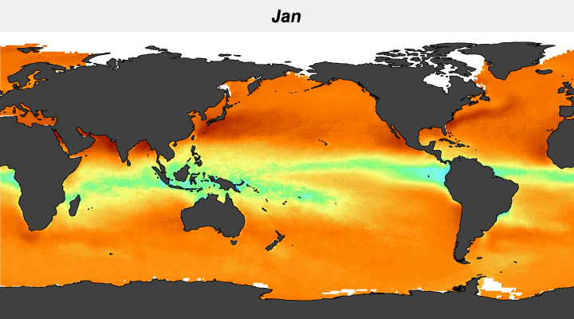

Sensitivity to true SST
Sensitivity often <1 and changes with season

Slide 17
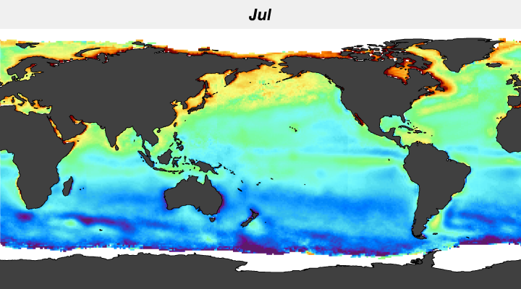
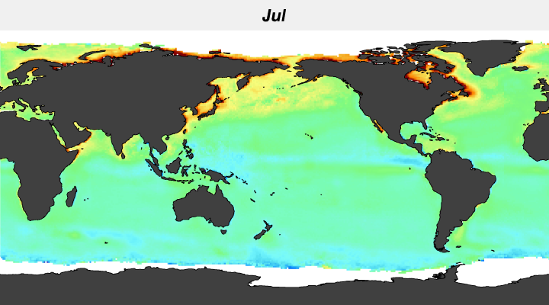


Sensitivity to true SST
Air – Sea Temperature Difference

Slide 18
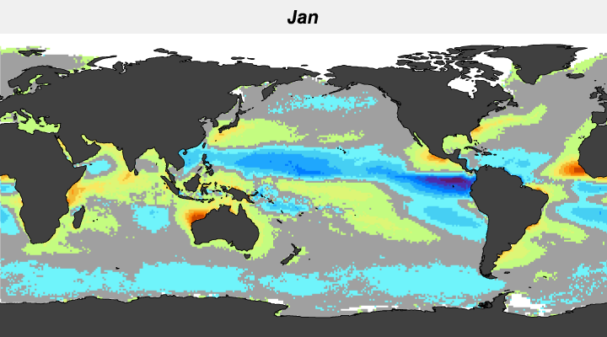
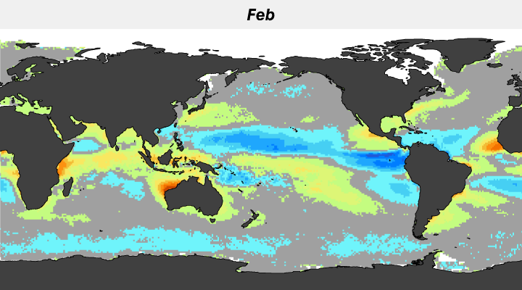
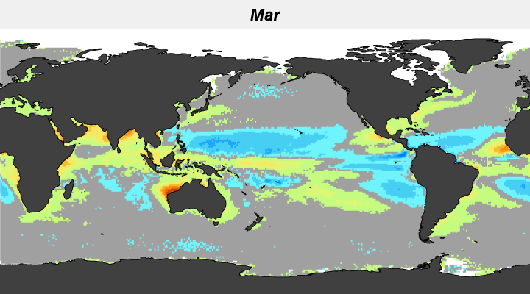
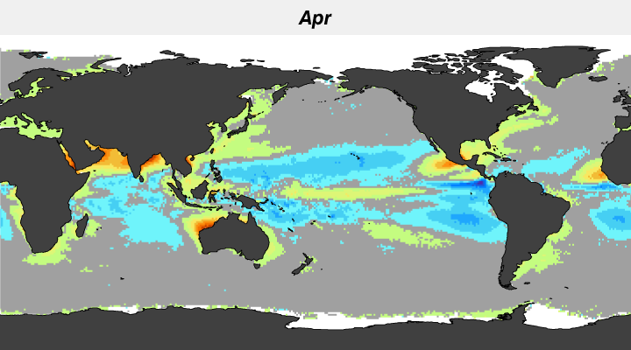
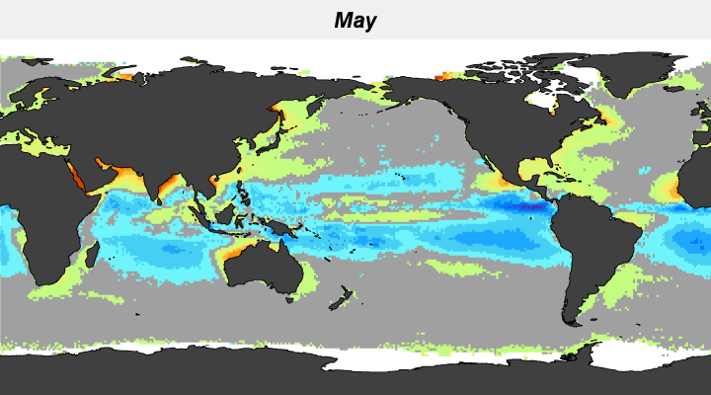
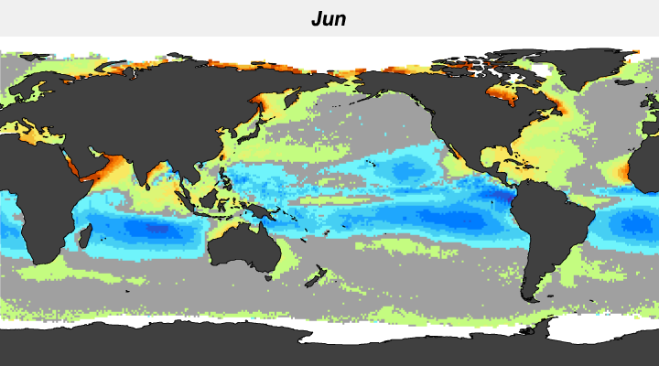
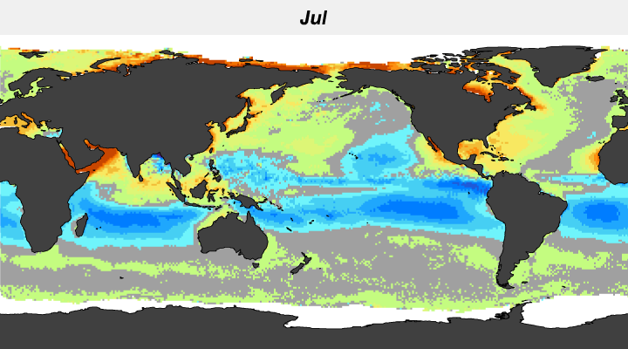
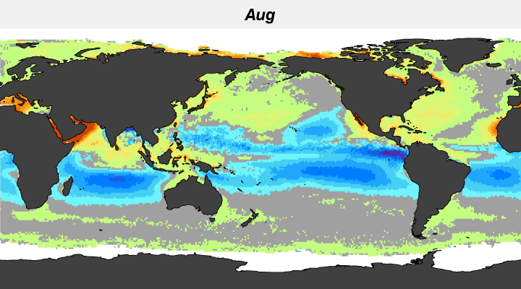
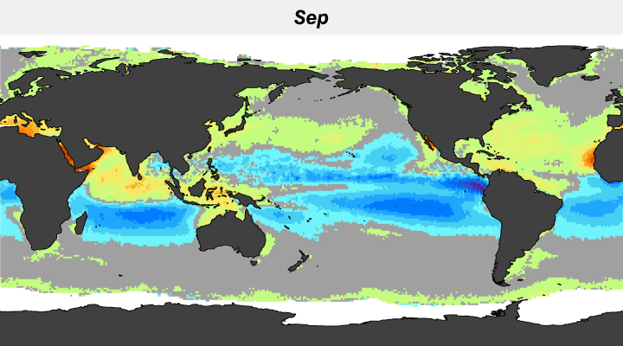
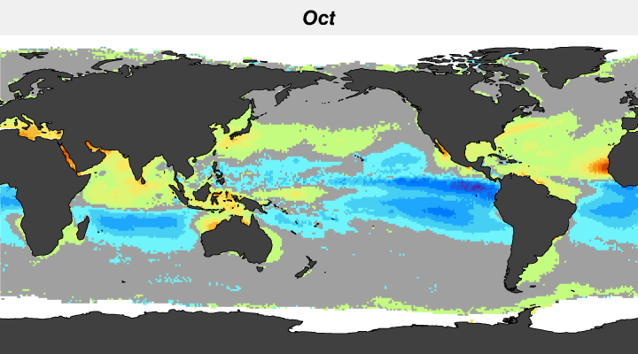
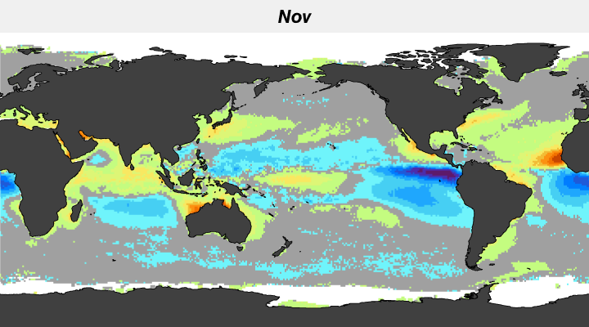
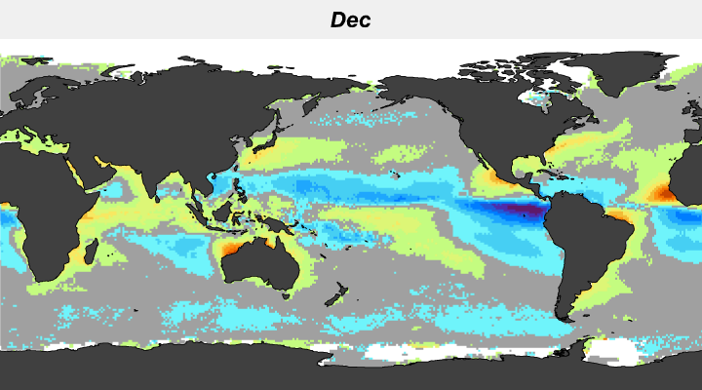
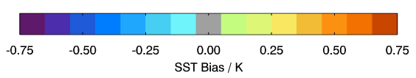
Seasonal Geographic Distribution
of Bias

Slide 19
Characteristics of different cloud detections
The data coverage of new cloud (NC) 50% more than OSPO
# cloud free pixels for high SZA is sparse – maybe OSPO & OSI-SAF regression form are not working for this regime
There is no physical meaning from RT for a regression variable of SSTg multiplied with (T11-T12).
Notes:
Why the different color scales for OSPO & NC? Can they be the same?
Phrases like “no physical meaning” are provocative, so have a good explanation for what you mean (or soften the language)

