Slide 1
Satellite Ocean Color Products: What should be produced?
ZhongPing Lee, Bryan Franz, Norman Kuring, Sean Baily
raise questions, rather to provide definite answers

Slide 2
How do we determine what OC products to (“should”) be generated at NASA?
or
Does it matter if we produce 10’s of products from ~6 bands of measurements, as now processors are fast and data storage device is cheap?

Slide 3
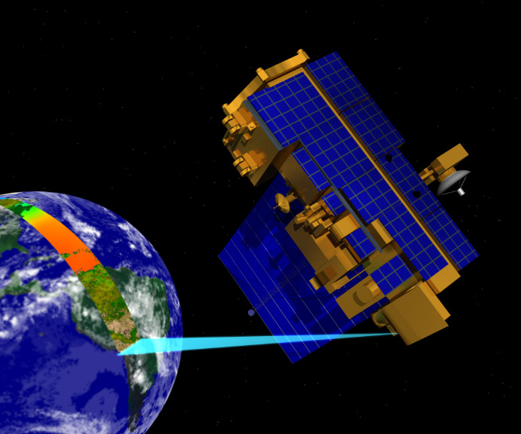
MODIS/VIIRS/…
“Toy”, to server citizens/people
Notes:
Our toy,

Slide 4
To meet demand or address scientific questions:
S1: What are there and how much?
S2: How do they contribute/affect BGC processes?
NASA: “Everything” – Chl/PIC/POC/DOC/phyto. species …
NOAA (Pers. Comm.): Chl/phyto. bloom/information for shelf-habitat and sanctuaries/clarity(IOPs, Kd)/glint image; information for fisheries/oil detection
EPA (Pers. Comm.): Chl (in particular for nearshore and inland waters)/pollutants
Navy (Pers. Comm.): Chl/SPM/visibility
Climate-change researchers: Everything/anomalies
Citizens: clarity/pollution/seafood …
Notes:
Navy: How the constituents affect opt-electical system? How the constituents affect visibility?
Citizens: How clean/clear the water is? Is it safe to use?

Slide 5
What are produced now (“standard” products):
Level-2 OC Product
Name and Algorithm Reference
R_{rs}(λ)
Ångstrom
AOT
Chlorophyll a
K_{d}(490)
POC
PIC
CDOM_index
PAR
iPAR
nFLH
Spectral water-leaving reflectance and derived aerosol optical properties
λ = 412, 443, 469, 488, 531, 547, 555, 645, 667, 678
Phytoplankton chlorophyll concentration
Marine diffuse attenuation at 490nm
Particulate organic carbon concentration
Particulate inorganic carbon concentration
Colored dissolved organic matter index
Daily mean photosynthetically available radiation
Instantaneous photosynthetically available radiation
Chlorophyll fluorescence line height

Slide 6
Evaluation Products
Products | Algorithm
Chl, a_{dg}(443), b_{bp}(443) | Maritorena (GSM)
IOPs (a(443), a_{ph}(443), a_{dg}(443), b_{bp}(443)) | Lee (QAA)
K_{d}(412),K_{d}(443),K_{d}(490) | Lee
Zeu | Lee
Zeu | Morel
K_{PAR} | Morel
Produced at Level-3 only (from daily binned Rrs)

Slide 7
Planned Changes to OC Standard Product Suite
Level-2 OC Product
Name and/or Algorithm Updates/Changes
R_{rs}(λ)
Ångstrom
AOT
Chlorophyll a
K_{d}(490)
POC
PIC
CDOM_index
PAR
iPAR
nFLH
calibration updates, ancillary data updates, improved land/water masking, terrain height, other minor fixes
λ = 412, 443, 469, 488, 531, 547, 555, 645, 667, 678
new algorithm (Hu et al. 2012)
coefficient update
no change
updated algorithm and LUT
remove product (redundant with new IOP suite)
consolidated algorithm, minor fixes
no change
flagging changes (allow negatives)
12. IOPs
suite of inherent optical property products (Werdell et al. 2013)
Notes:
It appears we have everything

Slide 8
Expanded Product Suite - IOPs
proposed IOP product suite
a(λ) total absorption at all visible wavelengths
b_{b}(λ) total backscatter at all visible wavelengths
a_{ph}(λ) phytoplankton absorption at all vis. wavelengths
a_{dg}(443) absorption due to colored-detritus at 443nm
S_{dg} exponential spectral slope for a_{dg}
b_{bp}(443) particle backscattering at 443nm
S_{bp} power-law spectral slope for b_{bp}
uncertainties uncertainties in a_{dg}, a_{ph}, b_{bp} at 443nm
rationale
provides total a and b_{b} for input to IOP-based derived product algorithms (e.g., Lee et al. spectral K_{d}, euphotic depth)
provides sufficient information to compute full spectral component absorption and scattering coefficients and uncertainties
  VIIRS λ = 410, 443, 486, 551, 671
  MODIS λ = 412, 443, 469, 488, 531, 547, 555, 645, 667, 678
Notes:
I added aph() … sure bb()??

Slide 9
It appears we have everything, then what is the problem …
An AOP product is the same as a phyto. pigment product …
If two products have a correlation coefficient as 1.0, should we produce these two “independent” products?
Notes:
POC is also by Rrs ratio, but likely POC is highly correlated with Chl, at least for the open ocean

Slide 10
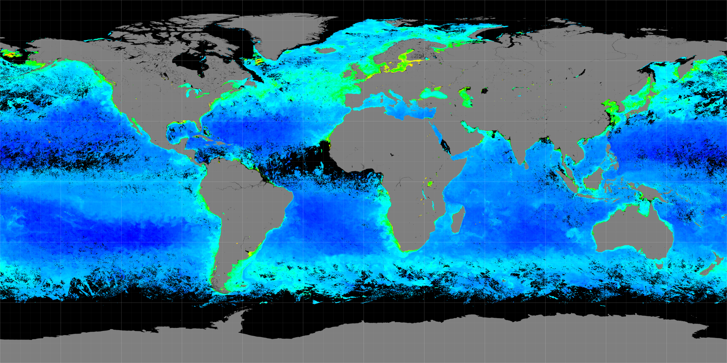
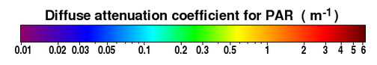
K_{d}(PAR)
Again, no independent information regarding the ocean system

Slide 11
K_{d}(PAR) is fundamentally vague …

Slide 12
Many optical properties (a, b_{b}, K_{d}) are spectral,
Q1: Do we generate products at one or all bands?
TA1: Rule of thumb – try our best to produce products with spectrally (spatially) independent information
Planed IOP suite:
a(λ) total absorption at all visible wavelengths
a_{ph}(λ) phytoplankton absorption at all visible wavelengths
GIOP:
Actually only two independent products: M_{ph} and M_{dg}
TA1b: Generate a(λ) and a_{ph}(λ) without assumptions regarding their spectral shapes/dependences.
Notes:
Did we cheat or deceive people? Not intentionally, and did inform the users, but they like the way …
The way of “packaging” matters

Slide 13
Q2: How to promote the use of more robust products?
Statistics on downloading OC products (Apr. 6 – May 6, 2015)
 |  | L3 BIN Files |  |  |  | L3 SMI Files
 | IP | Daily | 8 Day | Monthly | Other | Daily | 8 Day | Monthly | Other
PAR | 208 | 5821 | 3677 | 6144 | 246 | 3622 | 9388 | 9902 | 104
Chl | 1445 | 15263 | 5734 | 9299 | 453 | 398638 | 49554 | 96981 | 10453
Kd490 | 94 | 74 | 21 | 218 | 10 | 4338 | 1056 | 4159 | 123
PIC | 66 | 44 | 30 | 248 | 4 | 2802 | 146 | 2197 | 350
POC | 74 | 151 | 48 | 615 | 5 | 26627 | 194 | 1169 | 105
IOP | 6 | 0 | 0 | 1 | 0 | 1101 | 128 | 4 | 0
TA2: Name IOP products as something more familiar with endusers; Or
No longer generate “fake” Chl or POC products, “force” users to do the conversion.

Slide 14
Stop producing K_{d}(PAR)
K_{d}(PAR) [m⁻¹]
K_{d}(USR) [m⁻¹]
PAR_{d}(z)/PAR(0⁻)
USR_{d}(z)/USR(0⁻)
(Lee et al 2013)
PAR: 400-700 nm
USR: 400-560 nm

Slide 15
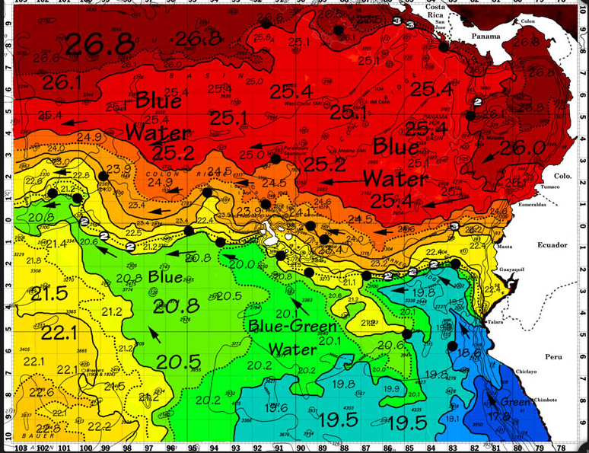
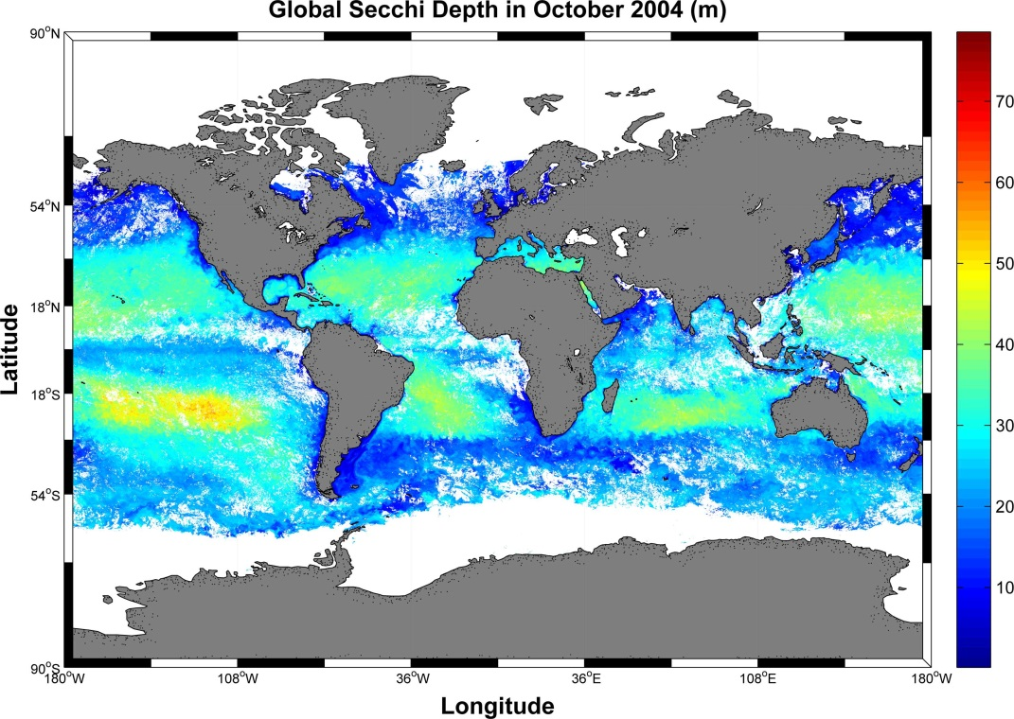
Q3: How to maximize the value provided by OC satellites?
Should NASA also generate some products for all citizens?
TA4: Produce water-quality classes (Good, So-so, Bad)
Or easy-to-understand products
See the front?
See your toe?

Slide 16
Q4: How to achieve consistent OC products across satellites? multiple sets of algorithms??
TA5: Separate the wavelength conversion and product retrieval into two independent modules, then one set of algorithms for all satellites
Q5: Should we provide smaller number but more robust products or more but less robust products? e.g., oil, floating algae, SPM, phyto. bloom, pCO2, salinity, …
TA6: ???

Slide 17
Questions/discussions …

Slide 18
Current VIIRS OC Standard Product Suite
Level-2 OC Product
Algorithm Reference
R_{rs}(λ)
Ångstrom
AOT
Chlorophyll a
K_{d}(490)
POC
PIC
PAR
Spectral water-leaving reflectance and derived aerosol optical properties
λ = 410, 443, 486, 551, 671
Phytoplankton chlorophyll concentration
Marine diffuse attenuation at 490nm
Particulate organic carbon concentration
Particulate inorganic carbon concentration
Daily mean photosynthetically available radiation
12. IOPs
suite of additional inherent optical property products (Werdell et al. 2013)

Slide 19
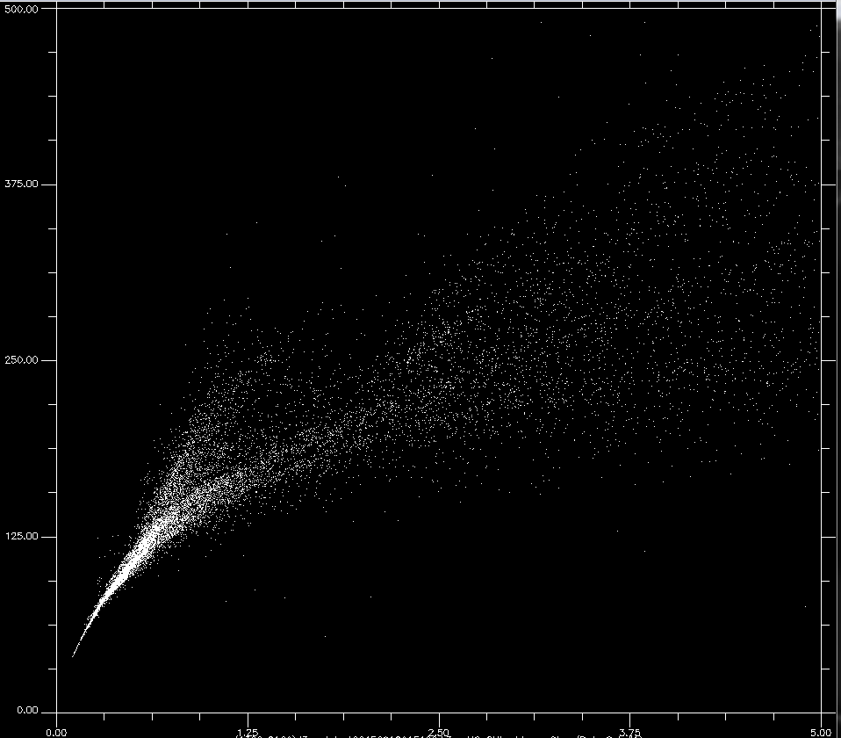
POC
Chl

