Slide 1
Calibration Adjustments for the MODIS Aqua 2015 Ocean Color Reprocessing
Gerhard Meister, NASA Code 616
OBPG (Ocean Biology Processing Group)
5/18/2015
MODIS/VIIRS Science Team, Calibration Breakout
Silver Springs, MD,
May 2015
1
1
Notes:
1
1
1
1
monitoring harmful blooms from space gives coastal communities ability to take precautionary measures
fishing bans
beach closures
image shows true color (top) and chlorophyll (bottom) views of bloom in mouth of Mississippi
similar information was used to monitor a red tide bloom off coast of Texas last fall

Slide 2
Background:
The upcoming MODISA Ocean Color reprocessing (R2014.0) is mainly about a new data format (HDF5) for the L2 files, ancillary data, algorithm updates
We used new fits for the whole time series (avoids uncertainty from predictions during regular processing)
MCST provided complete refit of RSB LUT (now V6.1.33.8_OC2)
OBPG redid xcal analysis (now axc38d) of MODISA to itself
MODIS Aqua does not show strong changes in polarization sensitivity -> polarization correction still prelaunch, xcal adjustments only for gains
2
2
Notes:
2
2
2
2

Slide 3
Xcal: MODISA ‘true’ TOA radiance
air
aerosol
whitecap
glint
water
gas
L_{t}(λ) = [ L_{r}(λ) + Lª(λ) + tL_{f}(λ) + TL_{g}(λ) + t_{d}(λ)L^{w}(λ) ] · t_{g}(λ)
from MODISA L^{w}(λ) 6-day mean
(7 days excluding central day,
only frames 300-1050)
from MODISA NIR
assumes MCST NIR band characterization
L(λ) = radiance at wavelength λ
t (λ) = transmission at wavelength λ
Xcal to itself: small impact on temporal trending, potentially large impact on scan angle depencence

Slide 4
Crosscalibration coefficients:
L_{m}/M₁₁ = L_{t}
M₁₁= a₀+a₁*f+a₂*f² +a₃*f³ +a₄*f⁴
L_{m}: measured TOA radiance (MODISA)
L_{t}: true TOA radiance (from MODISA L3)
f: frame number (0-1353)
M₁₁: gain correction, depends on band, MS, detector. Total of 2*10*5 = 100 polynomial coefficients (a_{(i)}) per band per day. ~2-3 million matchups per day.
4
Notes:
4
4
4

Slide 5
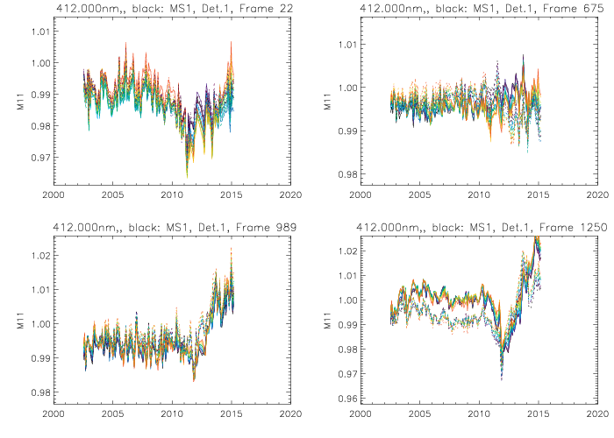
M₁₁ at 412nm for 4 different scan angles:
Beg. of scan
(lunar)
Nadir
Solar Diffuser
End of scan
Colors: detectors 1-10
Solid (dashed) lines: mirror side 1 (2)
5
Notes:
5
5
5

Slide 6
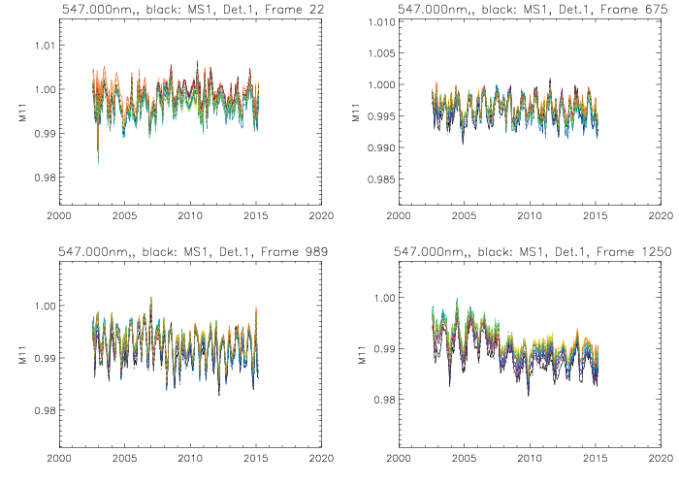
M₁₁ at 547nm for 4 different scan angles:
Beg. of scan
(lunar)
Nadir
Solar Diffuser
End of scan
Colors: detectors 1-10
Solid (dashed) lines: mirror side 1 (2)
6
Notes:
6
6
6

Slide 7
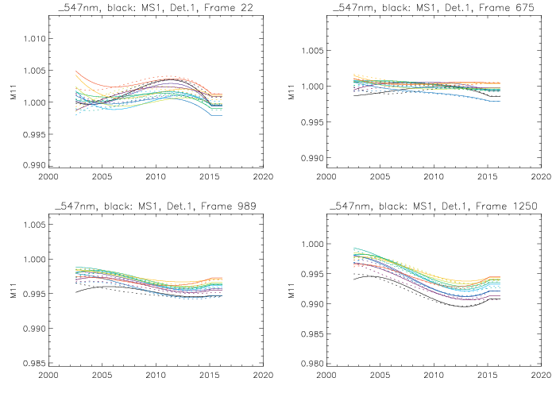
M₁₁ at 547nm after temporal fit:
Beg. of scan
(lunar)
Nadir
Solar Diffuser
End of scan
Colors: detectors 1-10
Solid (dashed) lines: mirror side 1 (2)
7
Notes:
7
7
7

Slide 8
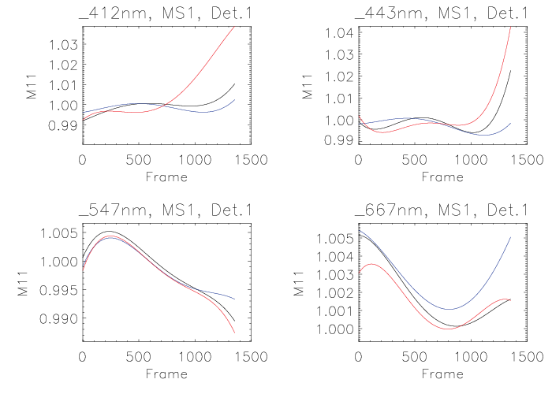
M11 scan angle dependence:
Average (black), BOM (blue), EOM (red)

Slide 9
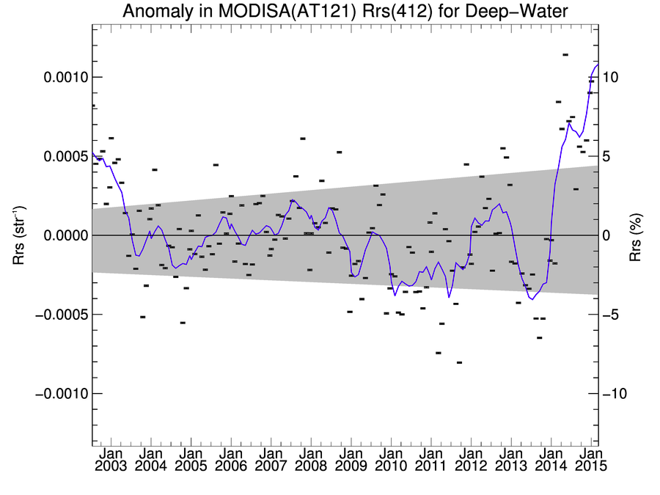
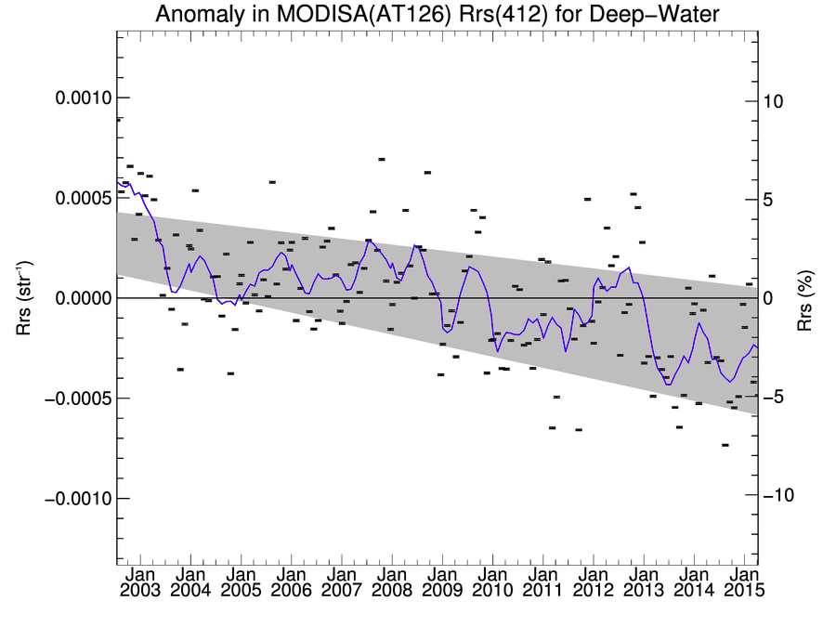
Temporal anomaly: 412nm Rrs
~5% downward trend in reproc. over 13 years
Operational end of mission artifacts due to not updating neither MCST LUT nor xcal
Operational:
Reprocessing:

Slide 10
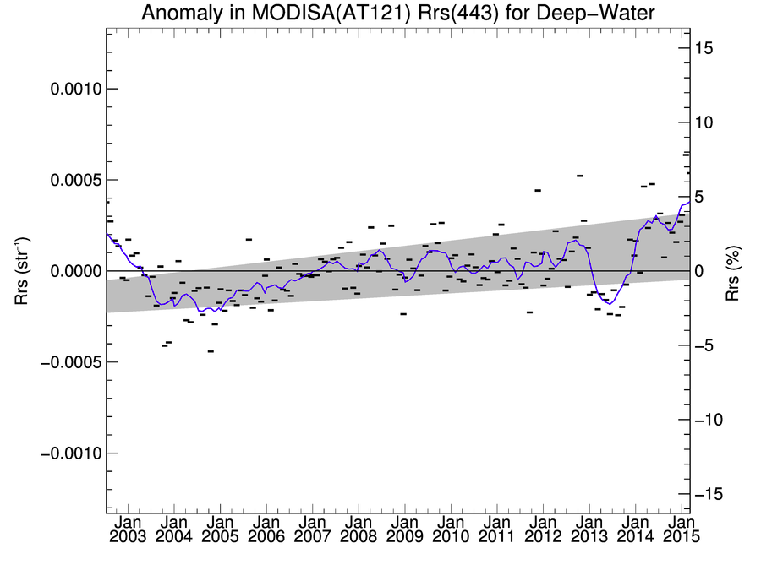
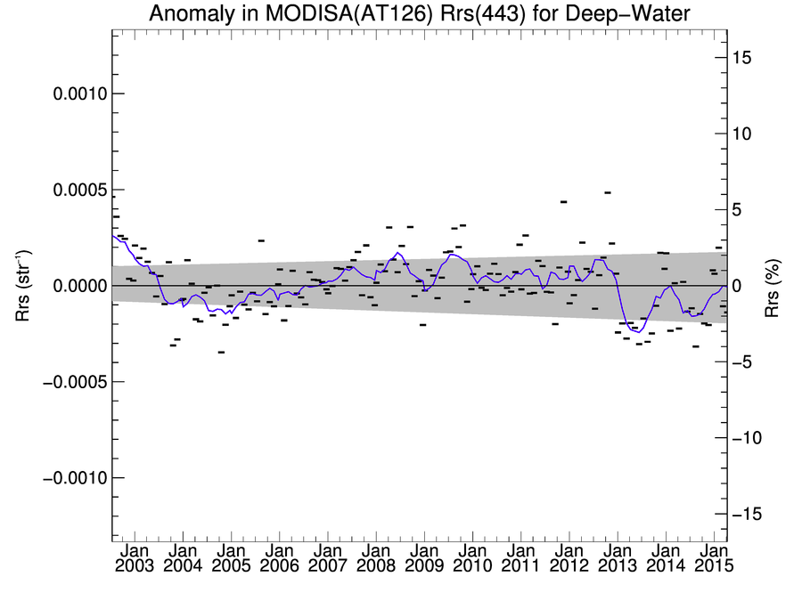
Temporal anomaly: 443nm Rrs
No apparent trend in reproc. over 13 years, higher variability at end and beginning
Operational end of mission artifacts due to not updating neither MCST LUT nor xcal
Operational:
Reprocessing:

Slide 11
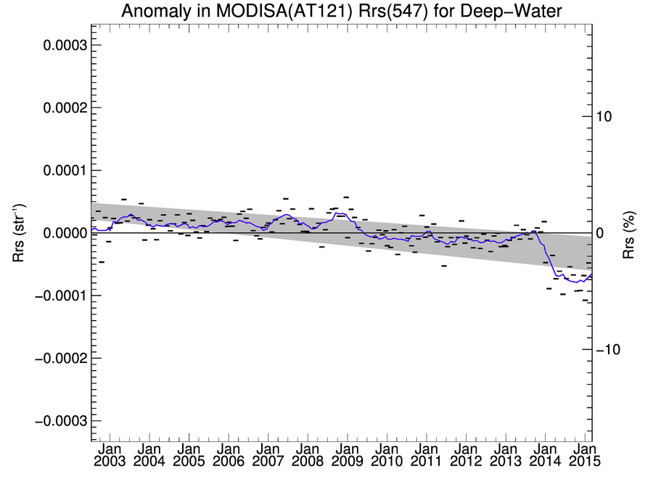
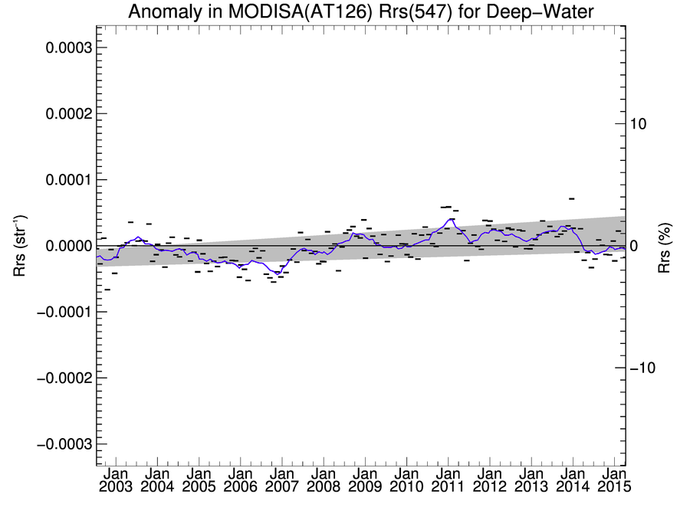
Temporal anomaly: 547nm Rrs
Slight upward trend in reproc., stronger in olig., less in meso. and eutr.
Operational end of mission artifacts due to not updating neither MCST LUT nor xcal
Operational:
Reprocessing:

Slide 12
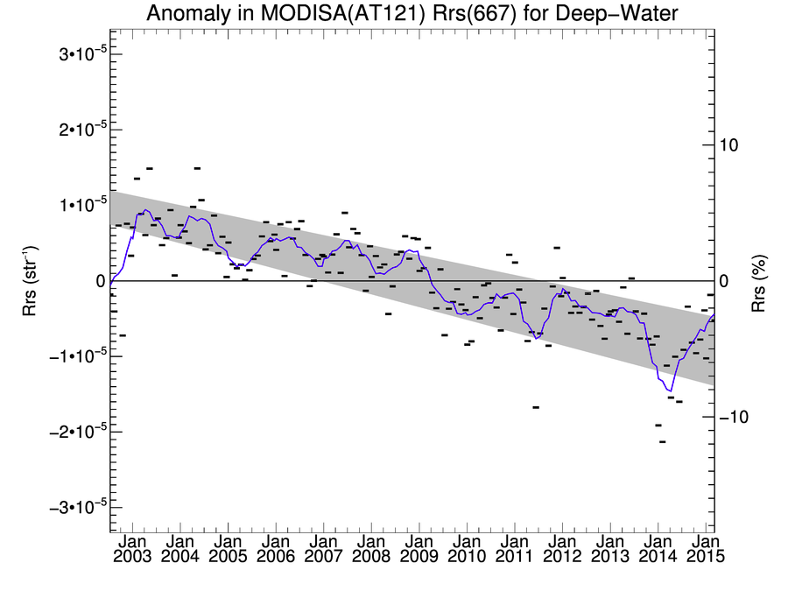
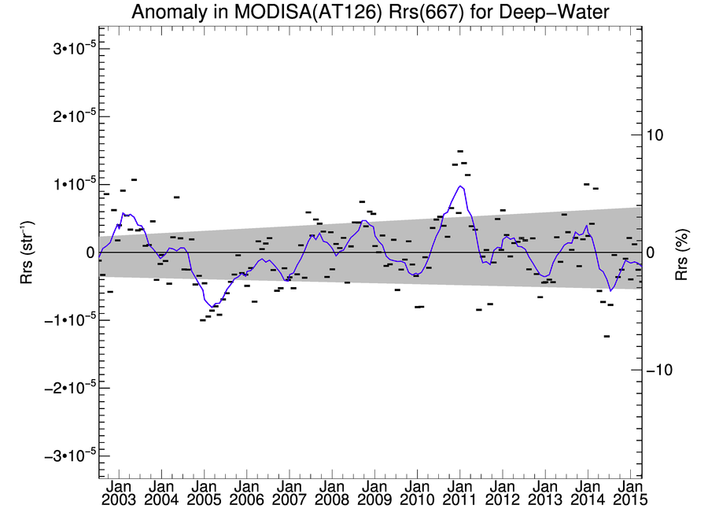
Temporal anomaly: 667nm Rrs
No apparent trend in reproc., same for 678nm
Operational had a clear downward trend (about 10%), same for 678nm
Operational:
Reprocessing:

Slide 13
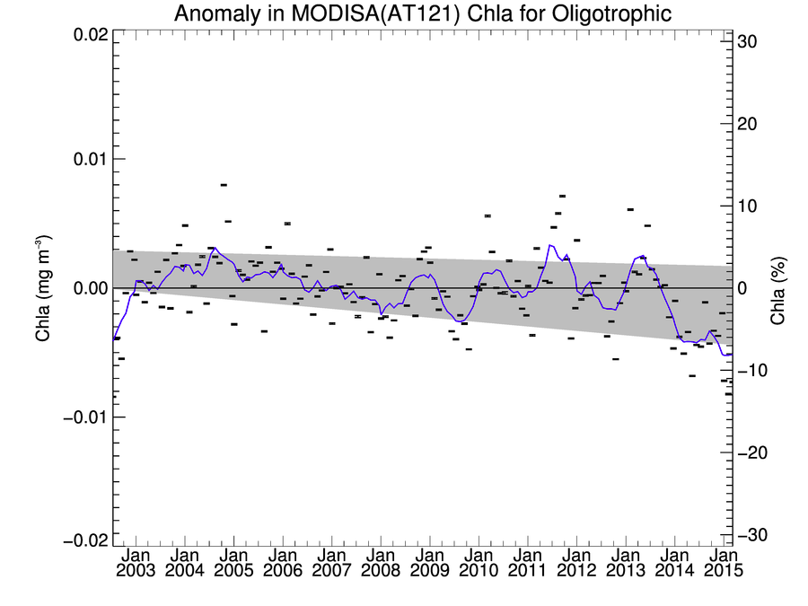
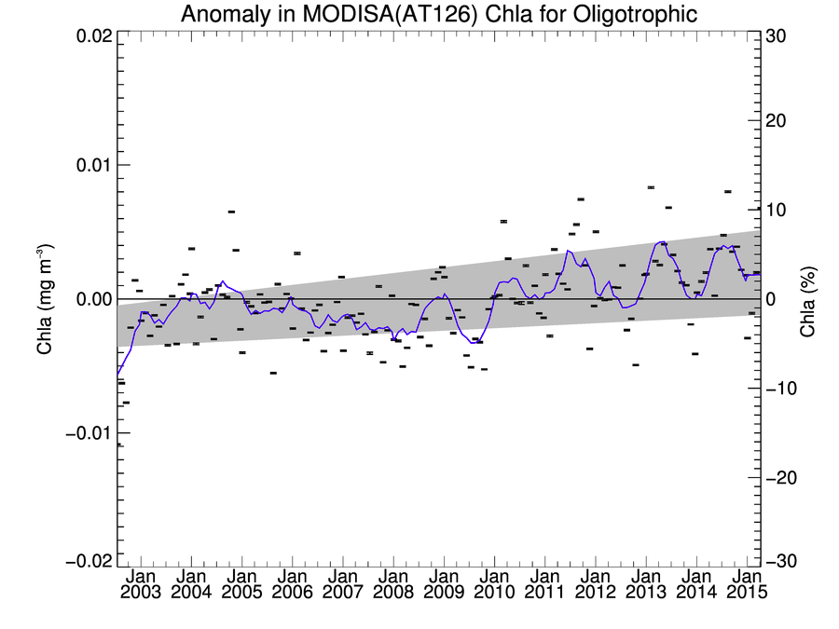
Temporal anomaly: Chl-a, oligotrpohic
Chlorophyll-a in oligotrophic water is ~10% higher in 2014 for reprocessing
Operational:
Reprocessing:

Slide 14
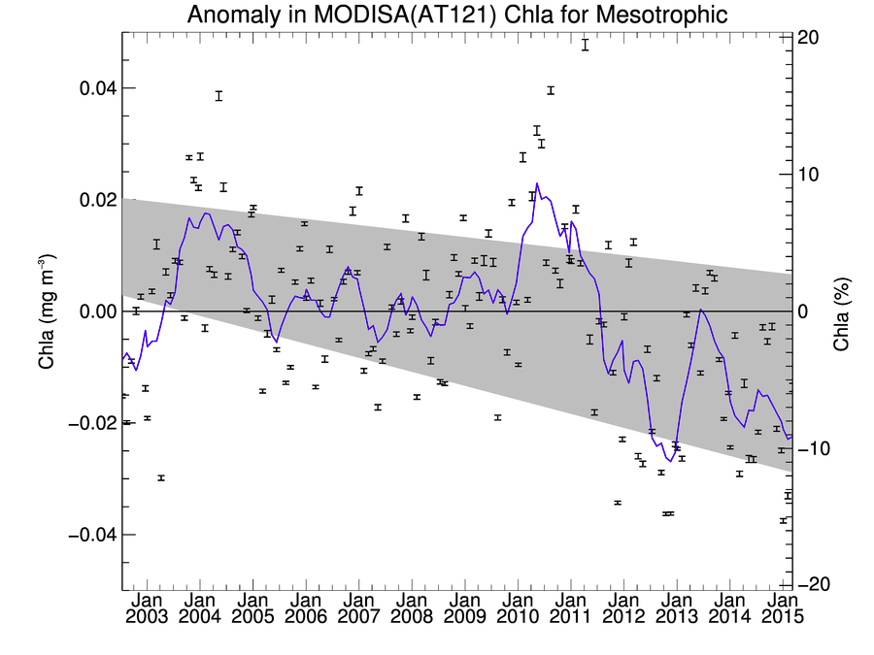
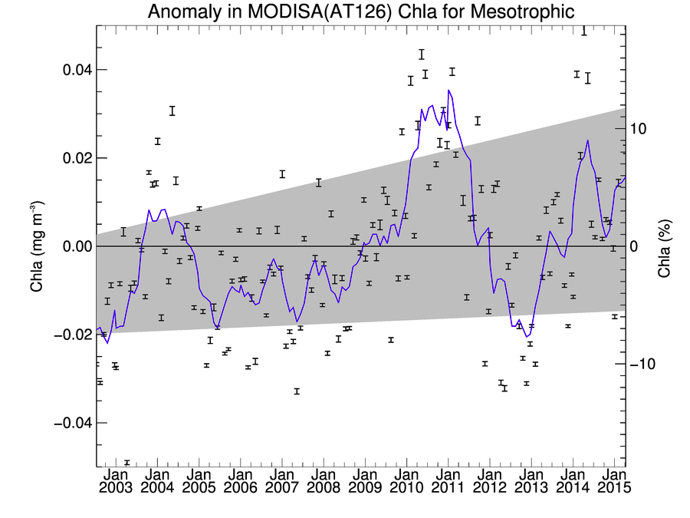
Temporal anomaly: Chl-a, mesotrpohic
Chlorophyll-a in mesotrophic water is ~15% higher in 2014 for reprocessing
Operational:
Reprocessing:

Slide 15
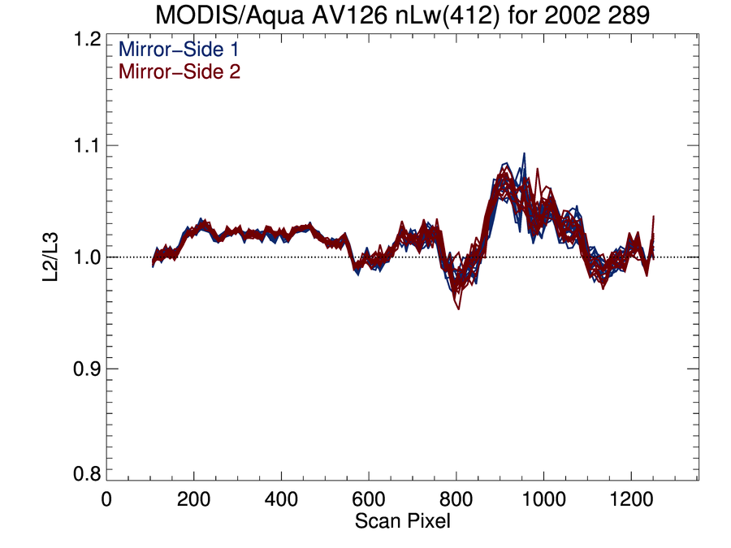
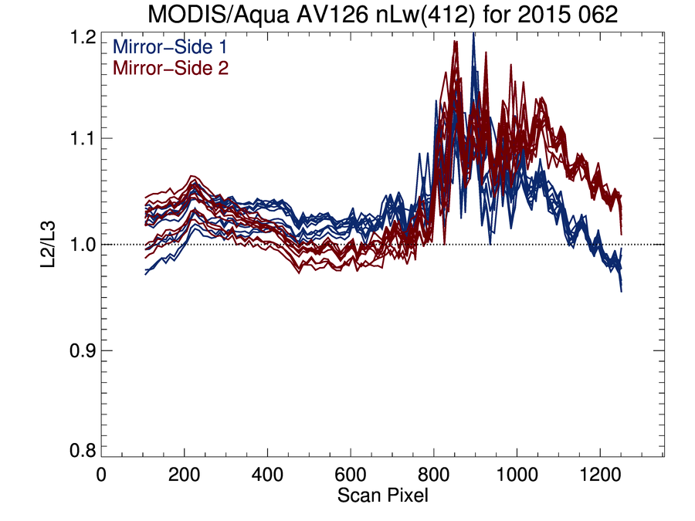
Scan angle dependence of 412nm nLw (reproc.):
Increased variation around frame 900 (glint region)
Increased striping and overall variability towards end of mission
Early mission:
Late mission:

Slide 16
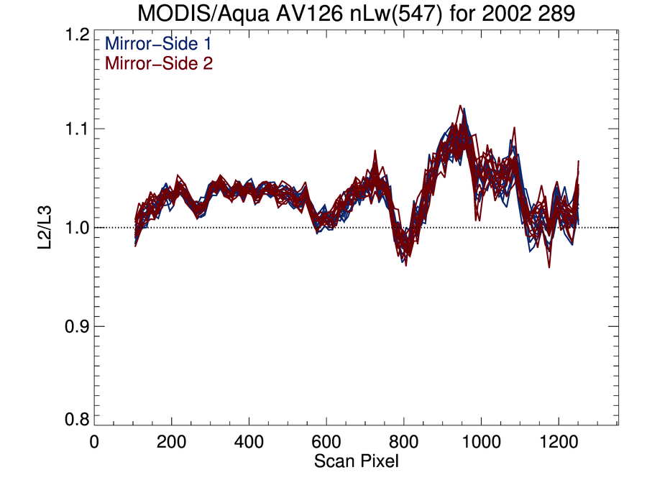
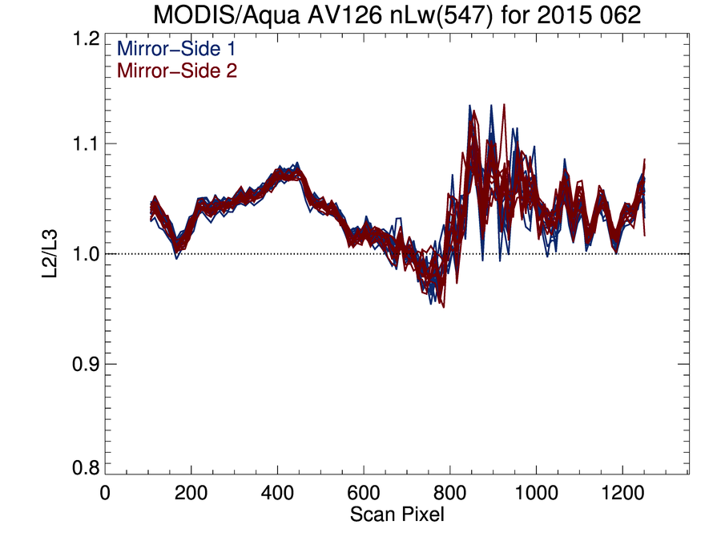
Scan angle dependence of 547nm nLw (reproc.):
Increased variation around frame 900 (glint region)
No (global average) striping, not much degradation with time
Early mission:
Late mission:

Slide 17
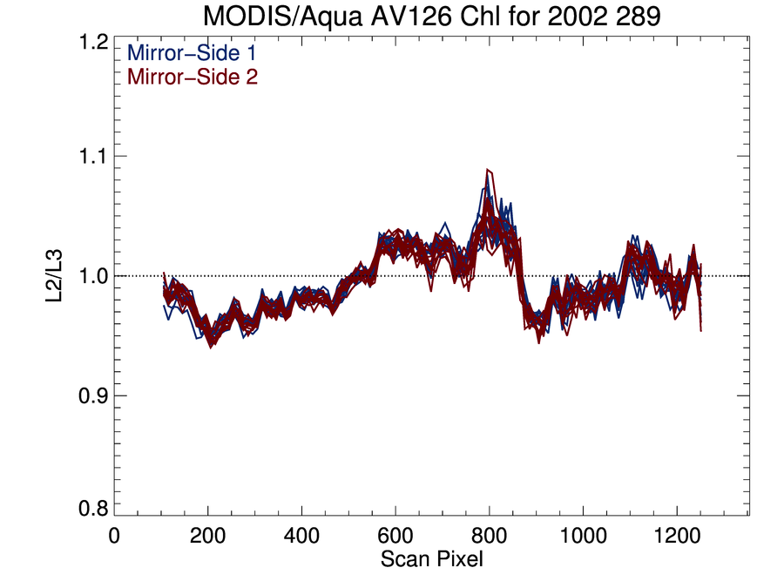
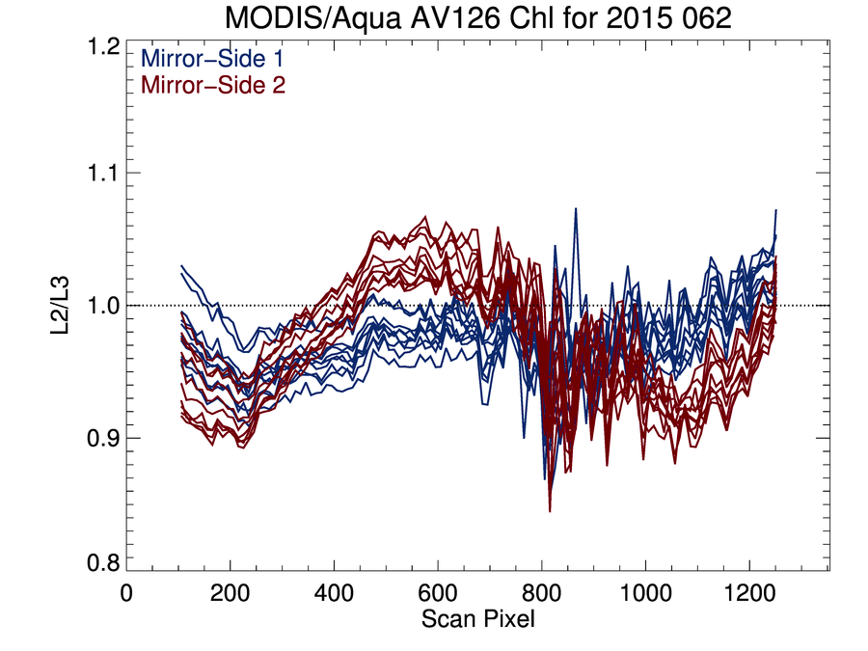
Scan angle dependence of chl-a (reproc.):
Increased variation around frame 900 (glint region)
Striping and scan angle dependence increase towards end of mission
Early mission:
Late mission:

Slide 18
Summary:
Reprocessing improves the most recent time period, but variability in blue bands remains
Overall improvement for long term trend of red bands, but 412nm long term trend still questionable
Chlorophyll-a ~10-15% higher in 2014 after reprocessing
Using MODIS Aqua results, MODIS Terra will be crosscalibrated in the next few months (SeaWiFS and MERIS first). Switch to new data format will be made soon without recalibration. Time series may be discontinuous e.g. due to new ancillary data until new crosscalibration is applied.
18
18
Notes:
18
18
18
18

Slide 19
Backup slides:

Slide 20
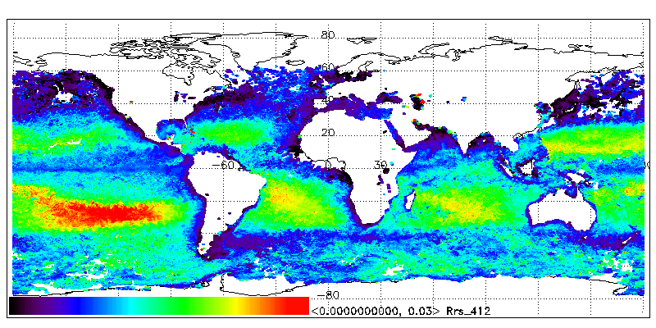
Xcal approach (Step 1): input ‘true’ L3 (15 days) Rrs
MODIS Aqua: 412nm Rrs (remote sensing reflectance)
20
Notes:
20
20
20

Slide 21
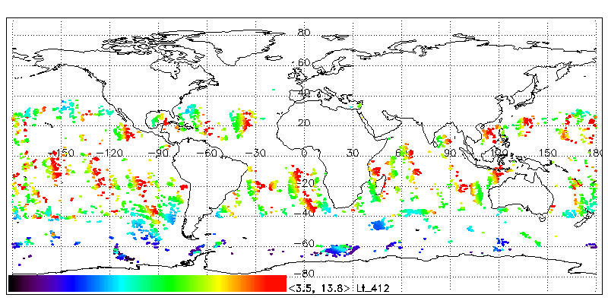
Xcal approach (Step 2): input MODIS Lm
MODIS Terra TOA radiance from one day, screened for chlorophyll, AOT, straylight, etc.
21
Notes:
21
21
21

Slide 22
Xcal approach (Step 3): vicarious Lt (from ‘true’ L3)
L_{t}(λ) = [ L_{r}(λ) + Lª(λ) + tL_{f}(λ) + TL_{g}(λ) + t_{d}(λ)L^{w}(λ) ] · t_{g}(λ)
22
Notes:
22
22
22

Slide 23
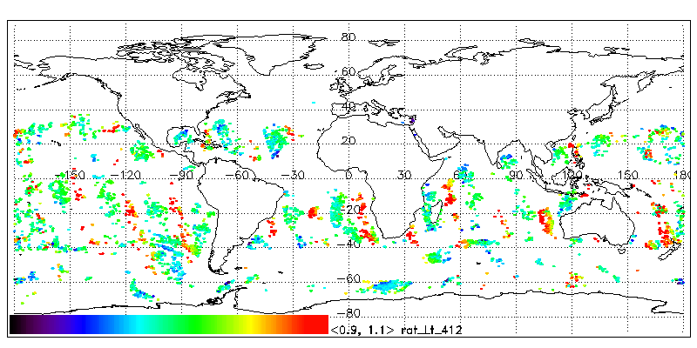
Xcal approach (Step 4): Ratio Lm/vLt
L_{m}/M₁₁ = L_{t} + m₁₂*Q + m₁₃*U
23
Notes:
23
23
23

