Slide 1
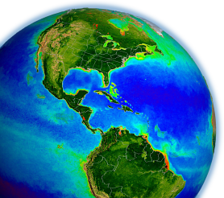
SeaWiFS Calibration Update
Fred Patt
a story of less than one digital count
MODIS/VIIRS ST Meeting
Silver Spring, MD, May 2015

Slide 2
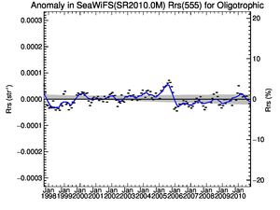
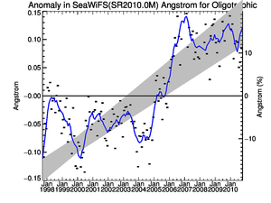
The Problem
The SeaWiFS radiometry has shown remarkable overall stability over the mission (1997 – 2010).
The temporal response has been based on the lunar calibration.
There have been persistent artifacts in multiple parameters near the 2005 – 2006 transition in the data from the last reprocessing (2010). Past efforts to determine and correct the cause of this were unsuccessful.
The OBPG took a fresh look at the problem in 2014.

Slide 3
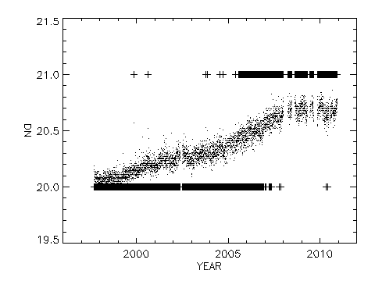
The Cause
The SeaWiFS Dark Restore value is provided as a single sample per band and scan during Earth observation.
The calibration processing implemented the dark restore processing as the median of all of the samples in a granule for each band.
Examination of the dark restore counts over the mission showed that the values changed by less than one count in all bands.
The median value changed by one count in some bands and none in others.
Band 8 Mean and Median Dark Count

Slide 4
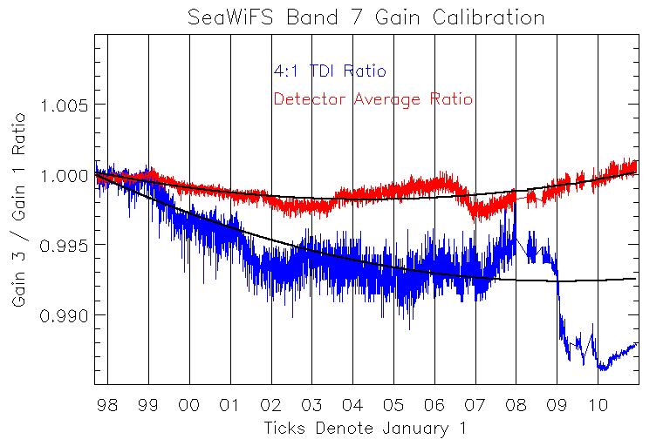
Band 7 Gain 3 Drift Correction Update
For Band 7, the lunar calibration gain (3) has shown a mission-long drift relative to the Earth view gain (1).
Following the re-analysis of the dark restore, the Band 7 gain 3 drift was also re-analyzed using the average of the individual detector measurements.

Slide 5
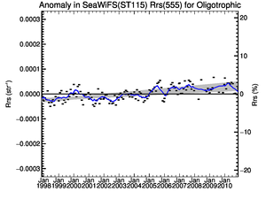
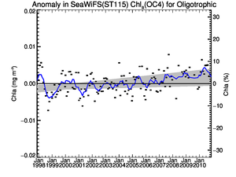
Updated SeaWiFS Calibration
The dark restore based on the intergain calibration (IGC) data analysis was incorporated into the calibration processing as a set of look-up tables.
The lunar calibration data were re-analyzed using the dark restore LUTS.
The Band 7 Gain 3 correction was updated using a quadratic fit to the re-analyzed gain ratio.

Slide 6
questions?

