Slide 1
MODIS Clear-sky Infrared Total Precipitable Water Vapor Product and its continuity with VIIRS and CrIS
E. Eva Borbas, Zhenglong Li and W. Paul Menzel
Cooperative Institute for Meteorological Satellite Studies
Space Science and Engineering Center
University of Wisconsin-Madison

Slide 2
Outline
The TPW retrieval algorithm
MODIS vs VIIRS TPW Products
Terra/MODIS calibration issue
Aqua/MODIS data record / trends
HIRS TPW data record
Conclusion
Future Plans

Slide 3
Algorithm Discussion
Clear radiance exiting the atmosphere for a MODIS IR band with
wavelength λ:
p_{sfc}
I_{λ} = ε_{λ}^{sfc} B_{λ}(T_{sfc}) τ_{λ}(p_{sfc}) - ∫ B_{λ}(T(p)) [ dτ_{λ}(p) / dp ] dp .
o
I_{λ} is measured by MODIS for λ = 4.4 - 14.2μm (I₂₅, I₂₇, … I₃₆)
I_{λ} can be considered a nonlinear function of the atmospheric properties including T, q, ozone, surface pressure, skin temperature, and emissivity.
We can infer a statistical regression relationship using calculated radiances from a global set of radiosonde profiles and surface data.
Relationship is inverted to retrieve atmospheric properties from observed MODIS radiances.

Slide 4
Algorithm Discussion
Global Training Dataset (SeeBor V5.0): data set drawn from NOAA-88, TIGR-3, ozonesondes, ECMWF analyses, desert radiosondes containing 15000+ global radiosonde profiles of temperature, moisture, and ozone used for training data set. The surface characteristics is assigned by using the UW Baseline Fit Global Land Surface Emissivity Databasehttp://www.cimss.ssec.wisc.edu/iremis/).
RT model: Radiance calculations for each training profile are made using a 101 pressure layer transmittance model (CRTM). Instrument noise is added to calculated spectral band radiances.
In the regression retrieval algorithm, viewing angle, land/ocean and Brightness Temperature classifications were applied to build a better relationship for different atmospheric situations.
Uncertainty: MOD07 TPW within 2 (4) mm rms for dry (wet) retrievals wrt Microwave Water Vapor Radiometer (at SGP Cart site)
Notes:
.

Slide 5
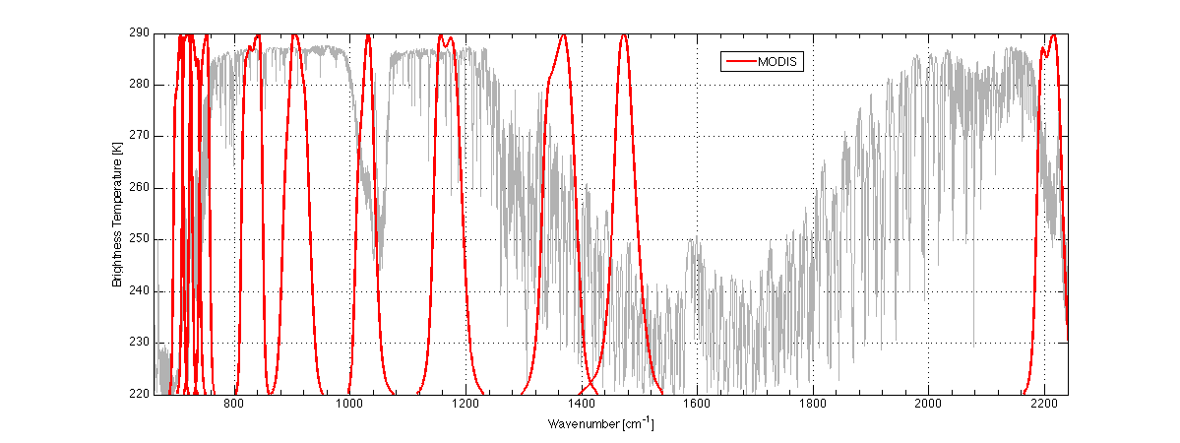
Spectral Response Functions of Aqua/MODIS TIR bands used by the TPW algorithm

Slide 6
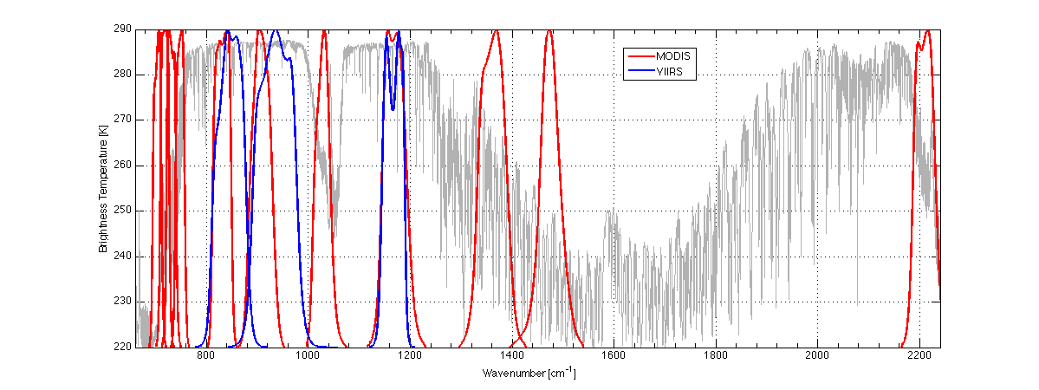
Spectral Response Functions of Aqua/MODIS TIR and VIIRS bands used by the TPW algorithm
M16
M15
M14

Slide 7
Comparison of the MODIS and the VIIRS TPW Products
Characteristics | MODIS (MOD07) | VIIRS (+CrIS)
Spectral Bands | IR only using CO2, H2O and IRW bands; between 4.5 and 14.5 μm (11 bands) | Band M14, M15, M16 TPW derived from CrIS/ATMS
Spatial Resolution | 5km : 5x5 1km average | 5km: 7x7 750m average
Spatial Coverage | Global (clear sky) | Global (clear sky)
Cloud Mask | MOD35 Cloud Mask | MVCM (750m)
Ancillary Data | GDAS (1⁰x1⁰ res) | CFSR(0.5⁰x0.5⁰ res)
Time periods | Morning (SZA <= 85⁰ and Local Time Before Noon) Afternoon (SZA <= 85⁰ and Local Time After Noon) Evening (SZA > 85⁰ and Local Time Before Midnight) Night (SZA > 85⁰ and Local Time After Midnight)
Outputs | Total Precipitable Water (TPW) Hi and Low Integrated WV Skin Temperature Temperature, Mixing Ratio Profile Total Ozone Stability indices (LI, K, TT) | TPW Skin Temperature
Time Coverage | 2000- | 2012-

Slide 8
10.15.2014
AM
MYD07
VIIRS-only
Single Pixel

Slide 9
10.15.2014
AM
MYD07
VIIRS-only
Single Pixel

Slide 10
10.15.2014
AM
MYD07
VIIRS-only
5km

Slide 11
TPW fields for a selected Granule at 8:40 UTC, Oct 15, 2014
AIRS L2
CFSR
CrIS CSPP Dual Regression
Retrievals
MYD07 RTVL
NUCAPS
VIIRS Single Pixel

Slide 12
TPW fields for a selected Granule at 8:40 UTC, Oct 15, 2014
VIIRS Single Pixel
MYD07
VIIRS 7x7 + new BT classification

Slide 13
TPW fields for a selected Granule at 8:40 UTC, Oct 15, 2014
VIIRS Single Pixel
MYD07
VIIRS 7x7 + new BT classification

Slide 14
TPW fields for a selected Granule at 8:40 UTC, Oct 15, 2014
VIIRS Single Pixel
MYD07
VIIRS 7x7 + new BT classification

Slide 15
10.15.2014
CrIS CSPP
Dual Regression
AM
PM

Slide 16
10.15.2014
CrIS+ATMS
NUCAPS
AM
PM

Slide 17
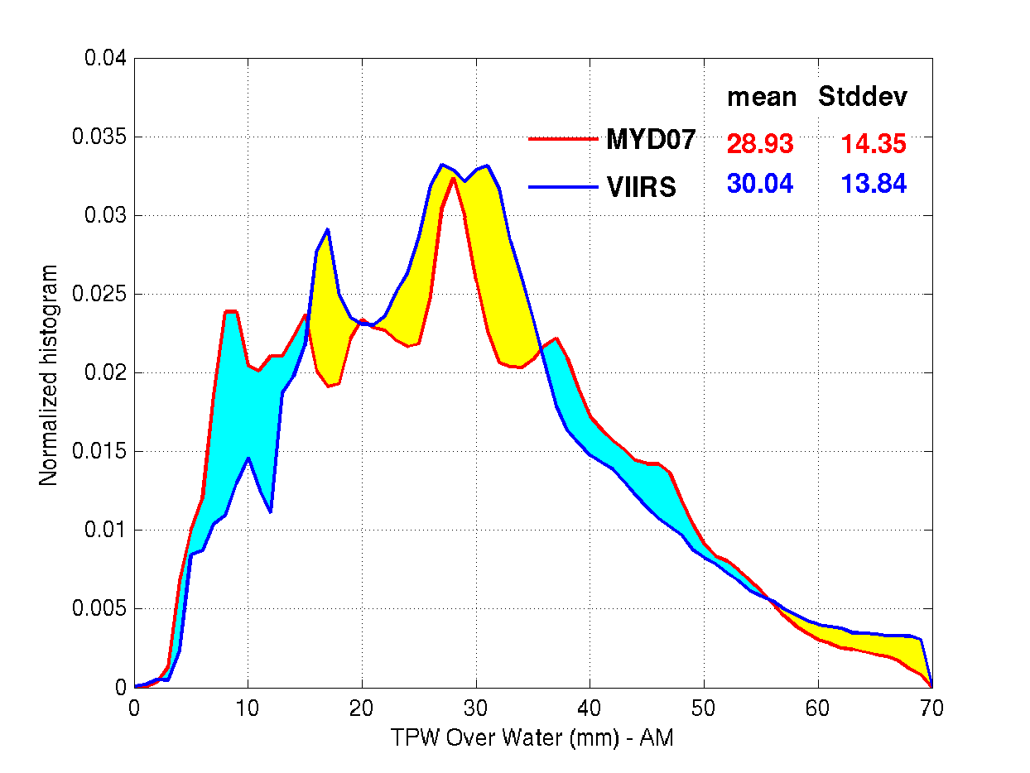
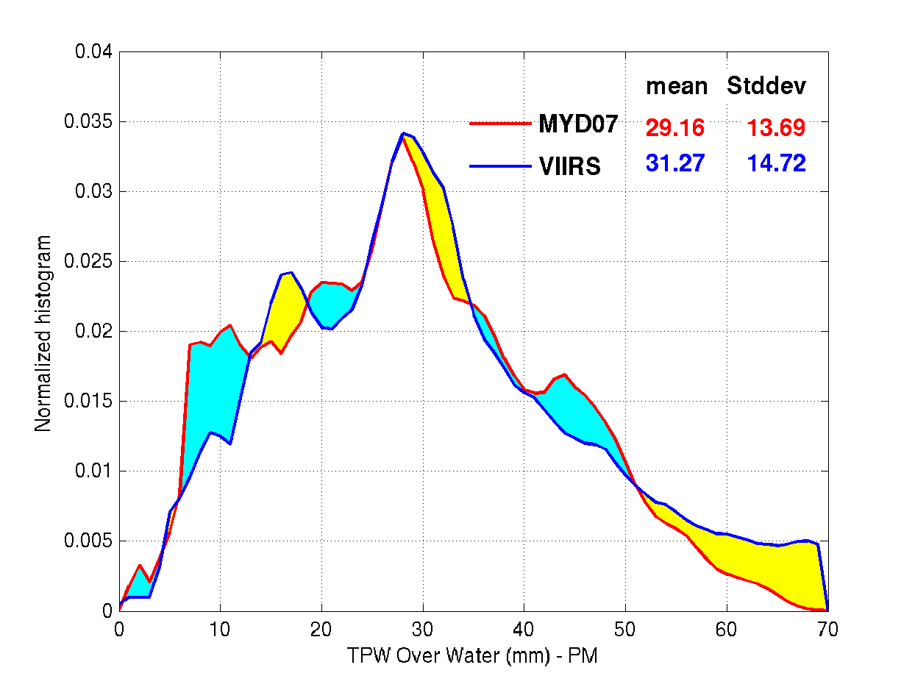
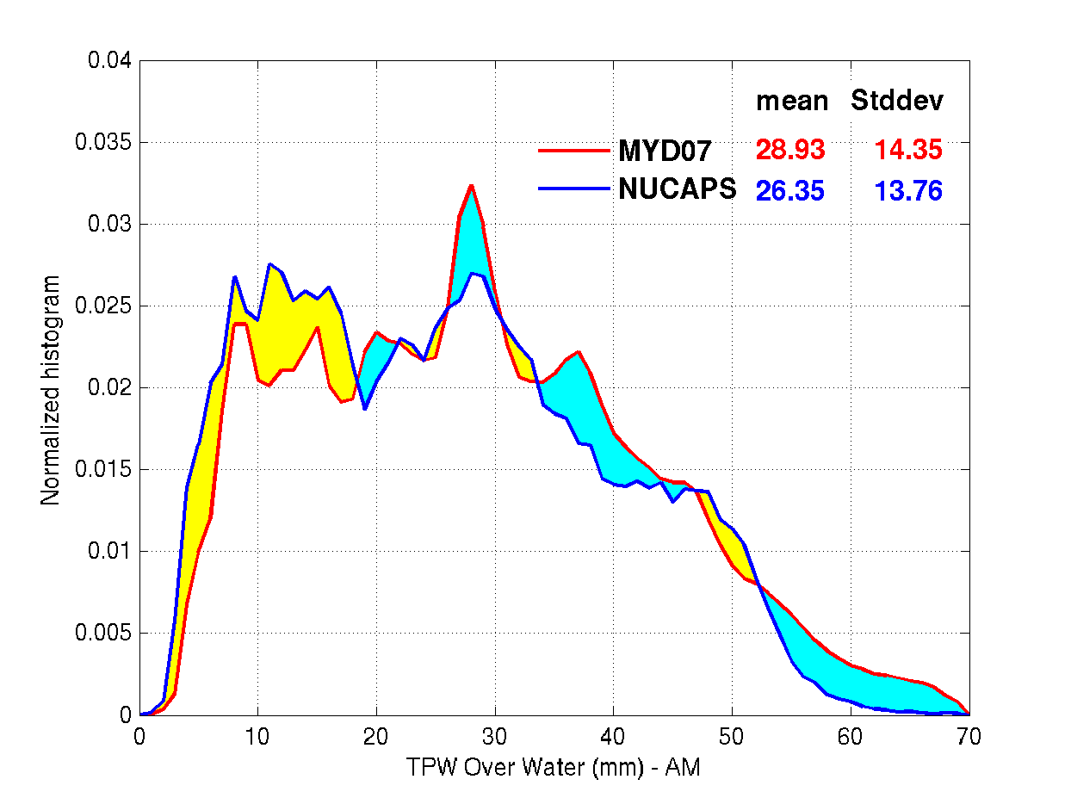
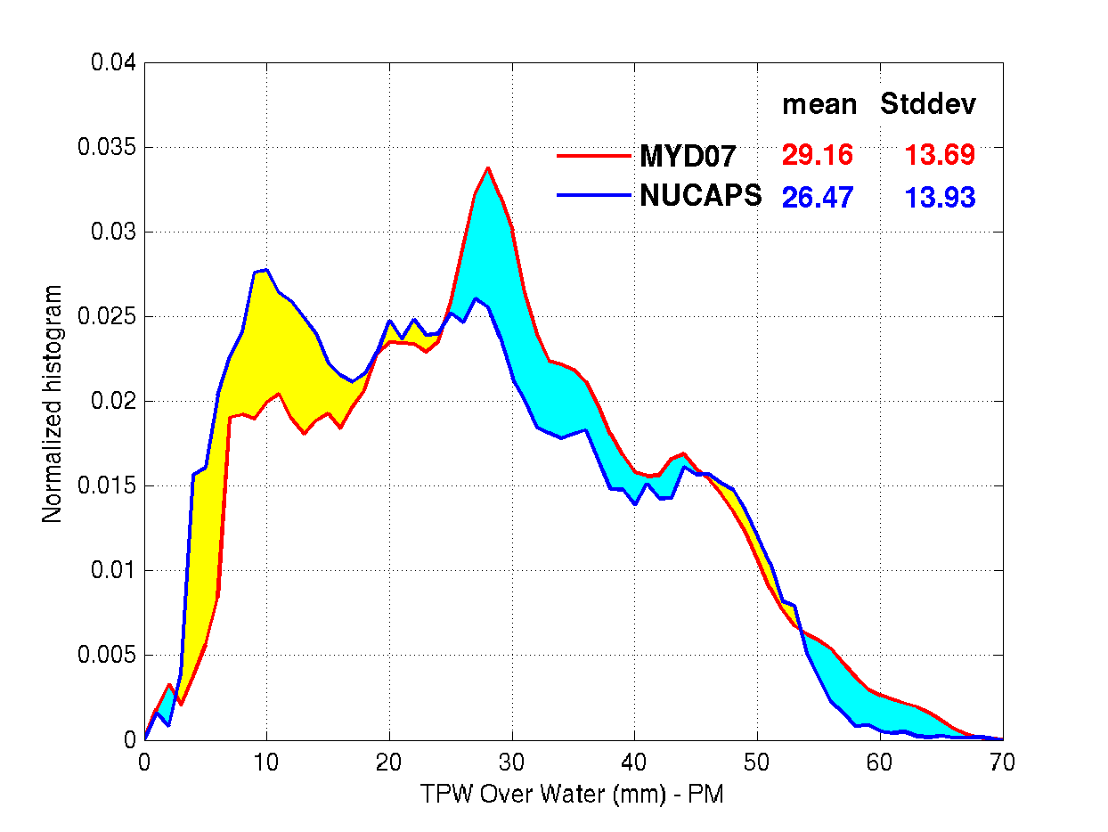
Normalized histogram of MYD07 vs VIIRS (5km) and NUCAPS TPW on Oct 14, 2014 over Water
VIIRS
VIIRS
More pixels
Less pixels
NUCAPS
NUCAPS

Slide 18
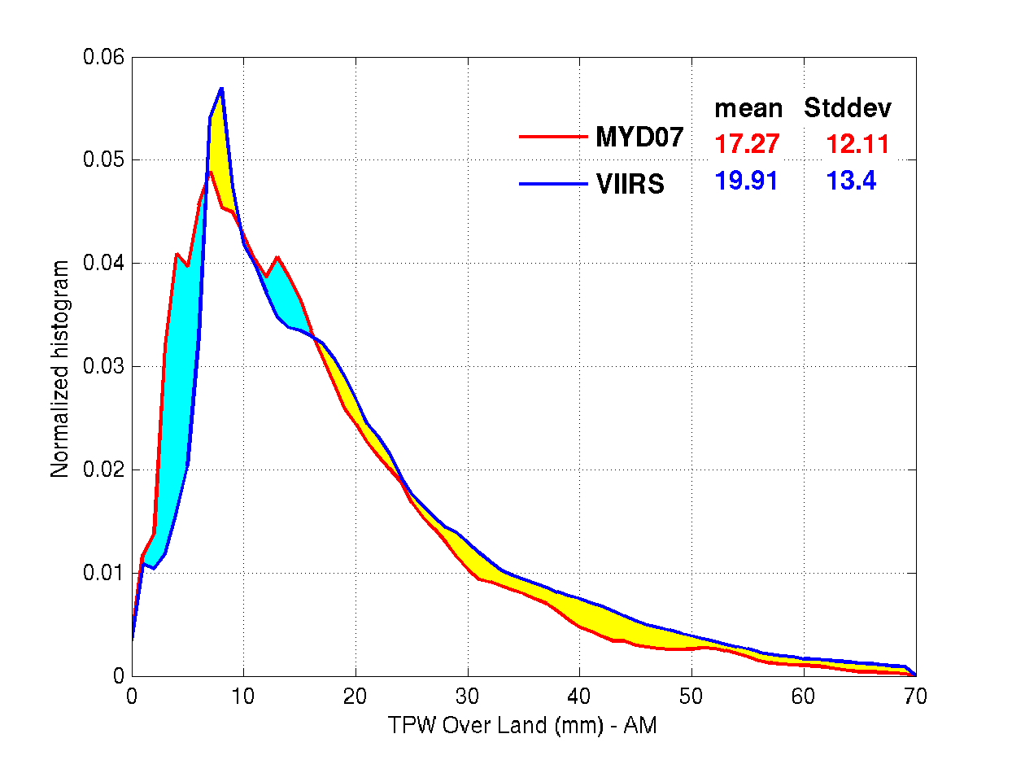
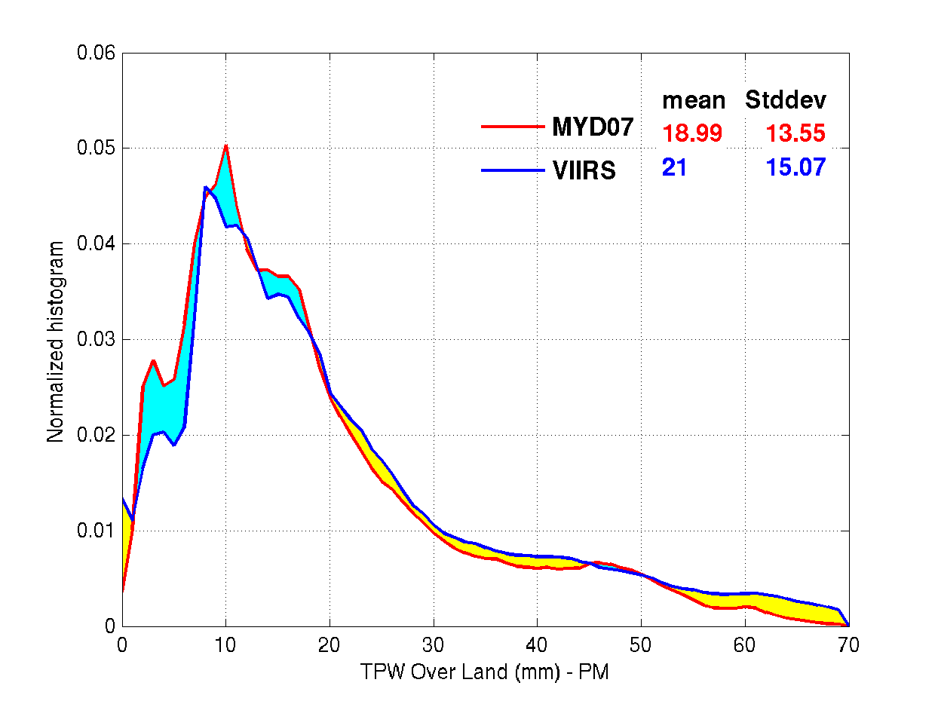
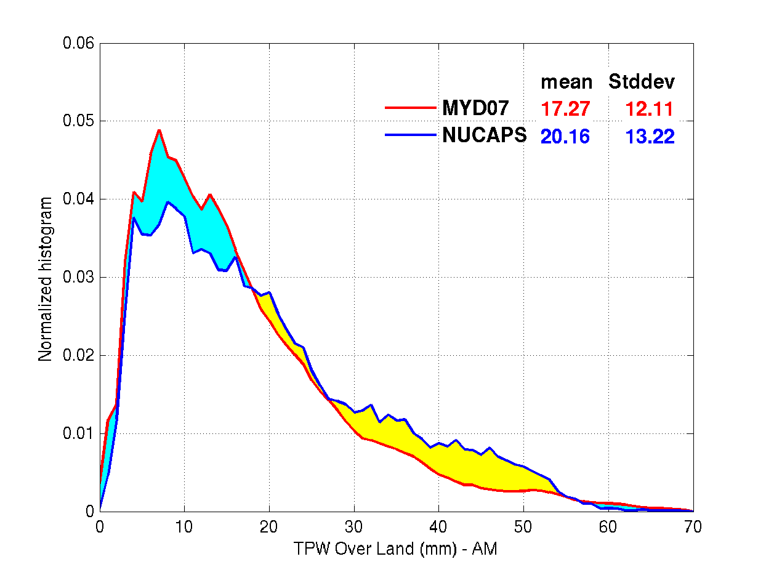
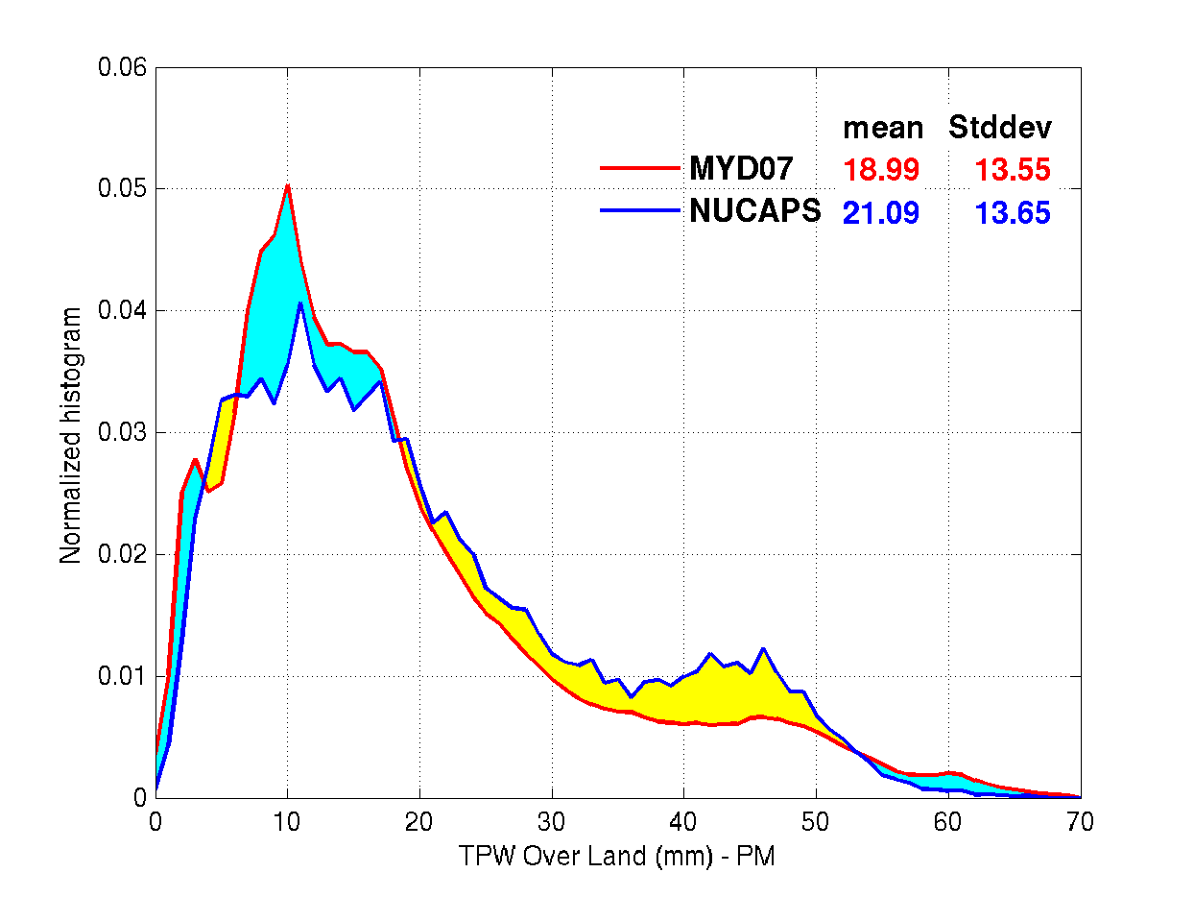
Normalized histogram of MYD07 vs VIIRS (5km) and NUCAPS TPW on Oct 14, 2014 over Land
VIIRS
VIIRS
More pixels
Less pixels
NUCAPS
NUCAPS

Slide 19
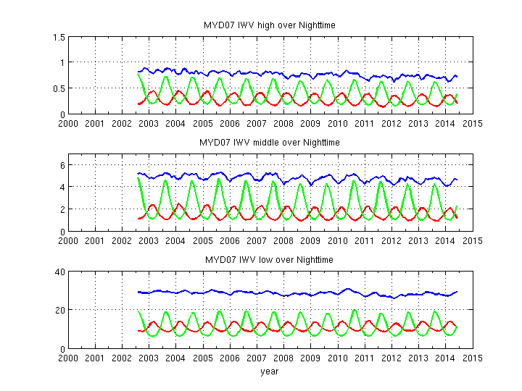
Time series of the Aqua MOD07 high, middle and low layer monthly mean integrated water vapor (IWV) for the mid-latitude North (30N to 60N), mid-latitude South ((30S-60S) and tropical latitude (30S to 30N) bands at nighttime
High IW
High IWV
MODIS 30-60 S Latitude
MODIS 30-60 N Latitude
MODIS -30 - +30 Latitude
Middle IW
Middle IWV
Low IW
Low IWV

Slide 20
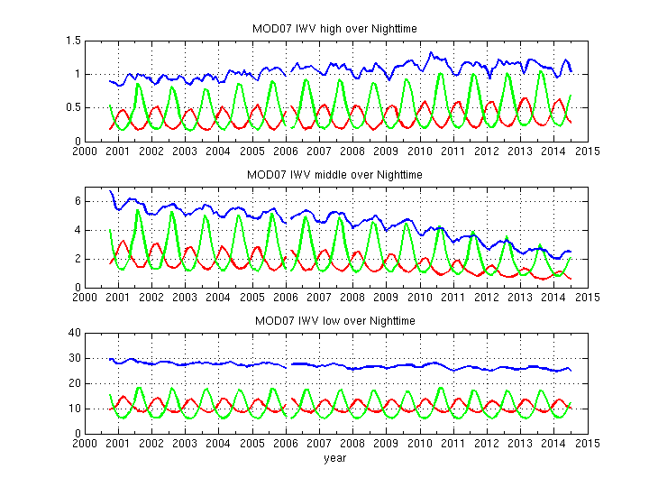
Time series of the Terra MYD07 high, middle and low layer monthly mean integrated water vapor (IWV) for the mid-latitude North (30N to 60N), mid-latitude South ((30S-60S) and tropical latitude (30S to 30N) bands at nighttime
High IW
High IWV
MODIS 30-60 S Latitude
MODIS 30-60 N Latitude
MODIS -30 - +30 Latitude
Middle IWV
Middle IW
Low IW
Low IWV

Slide 21
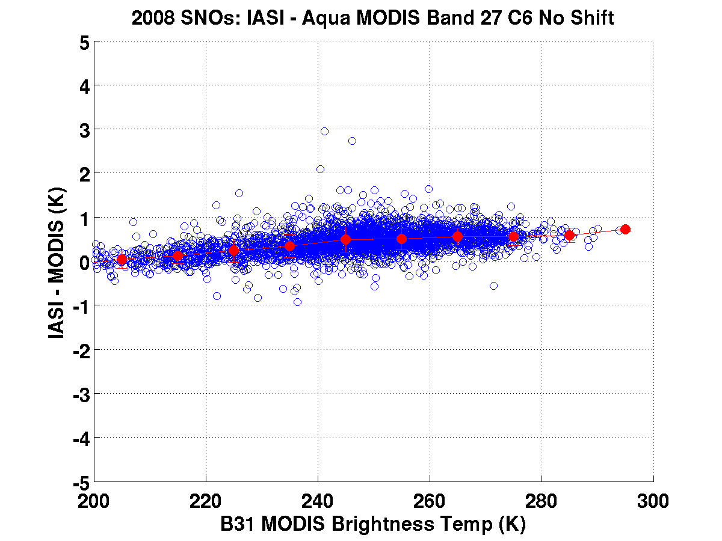
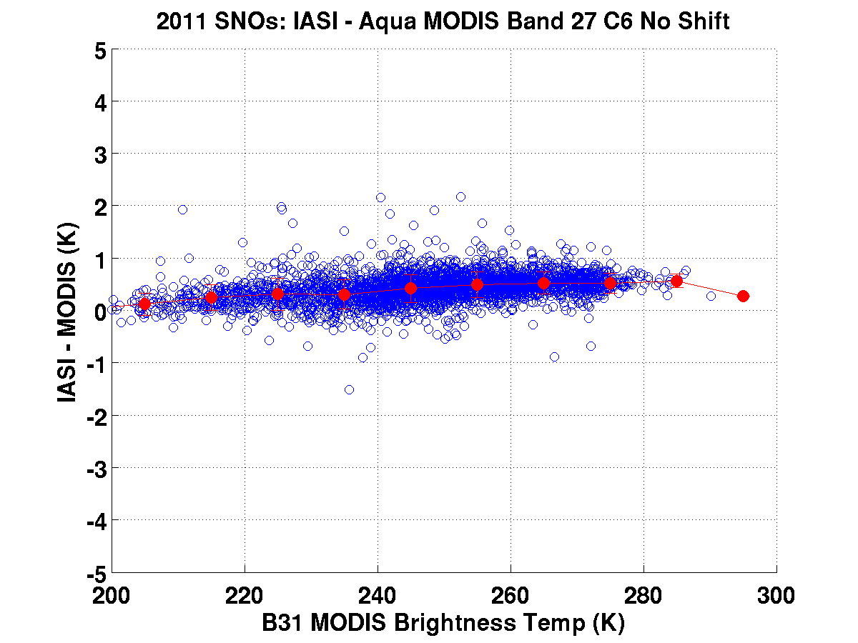
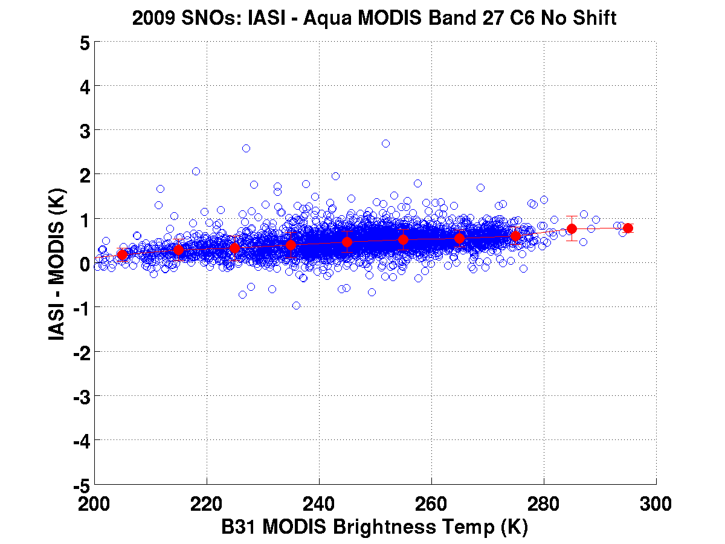
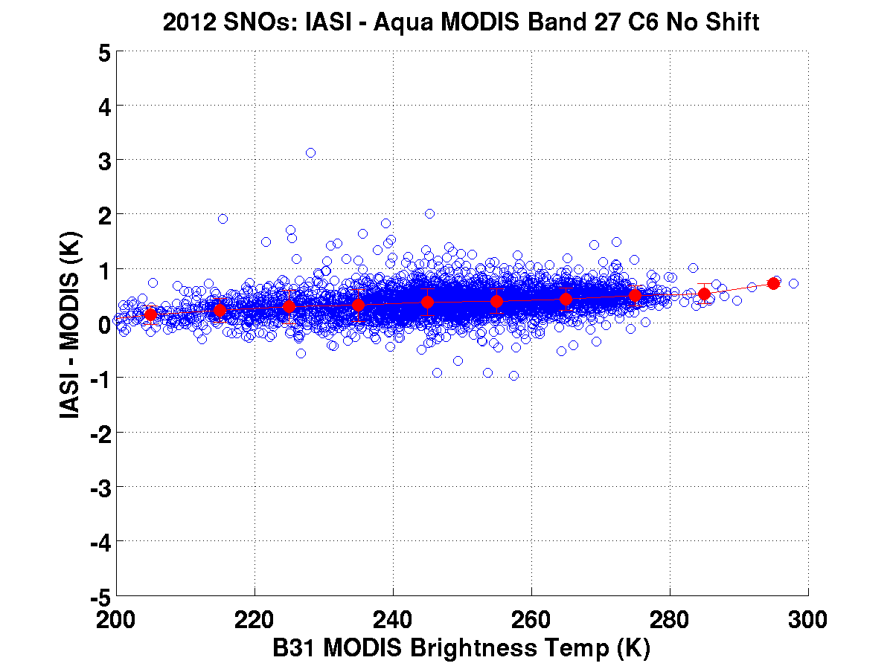
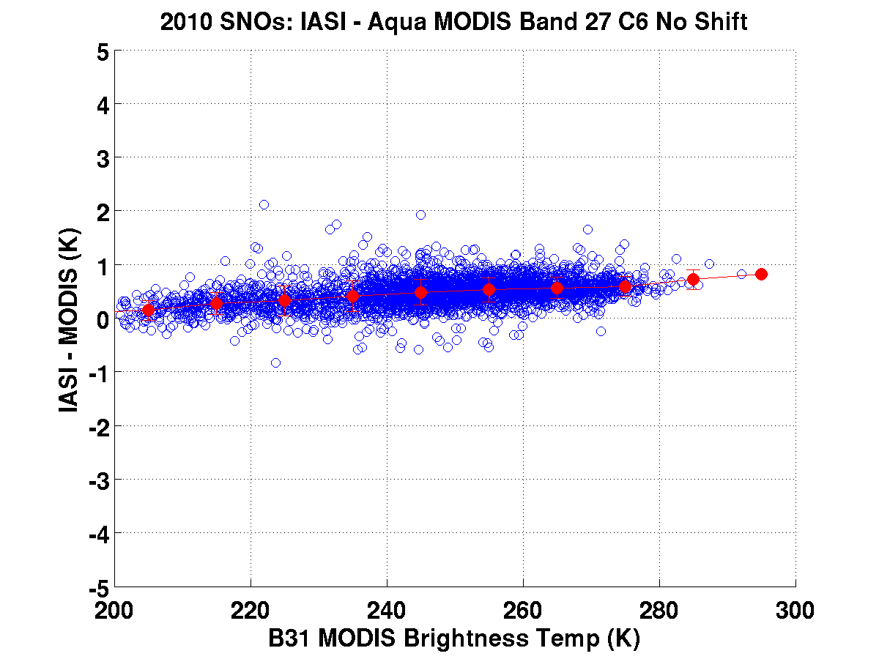
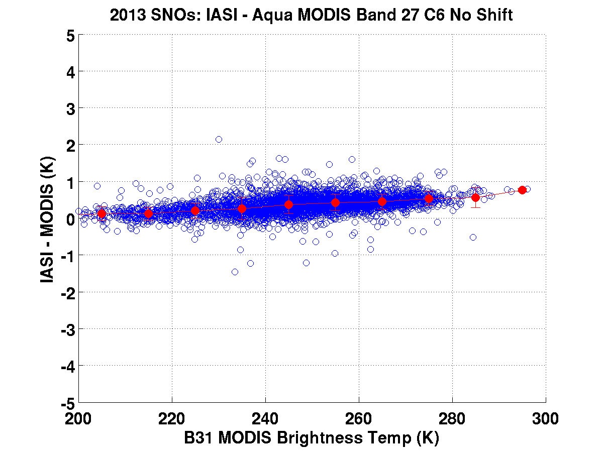
2008
2011
A
q
u
a
B
2
7
2009
2012
2010
2013

Slide 22
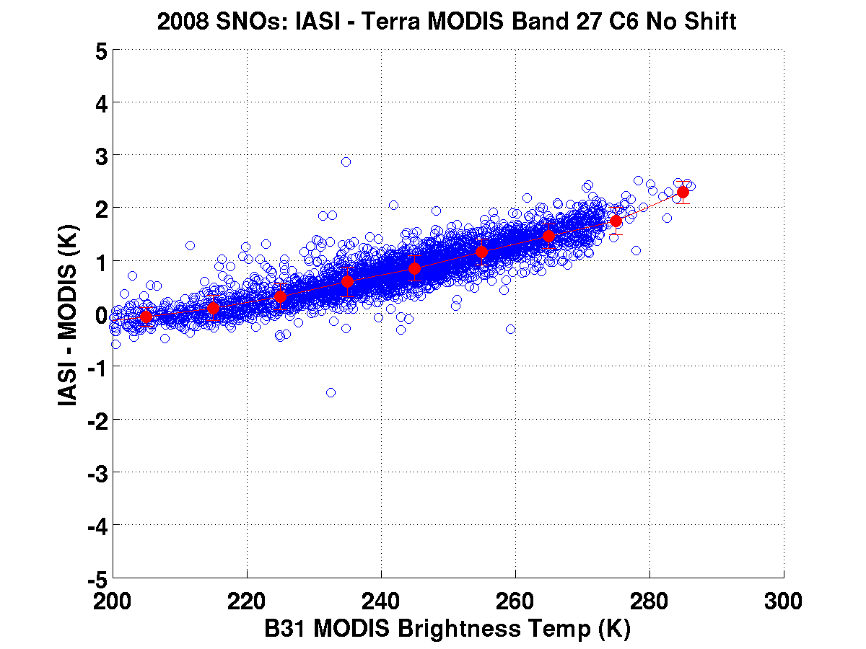
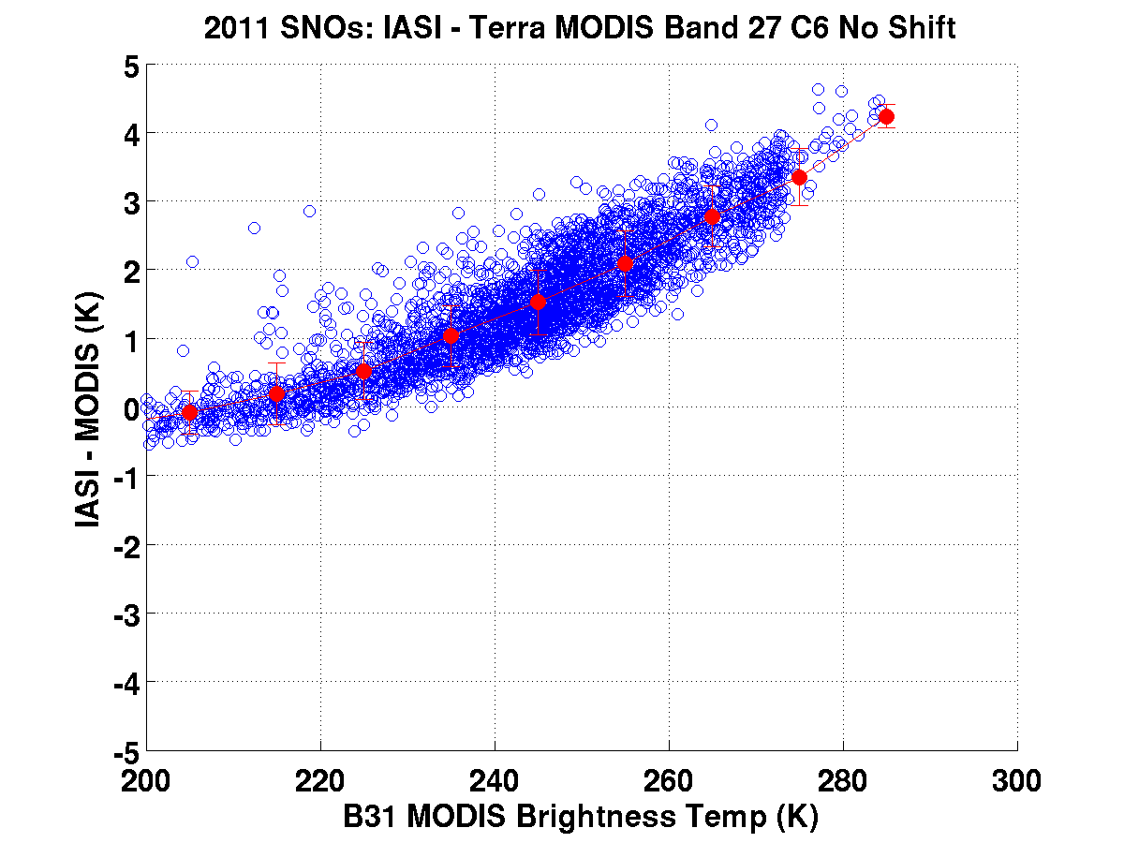
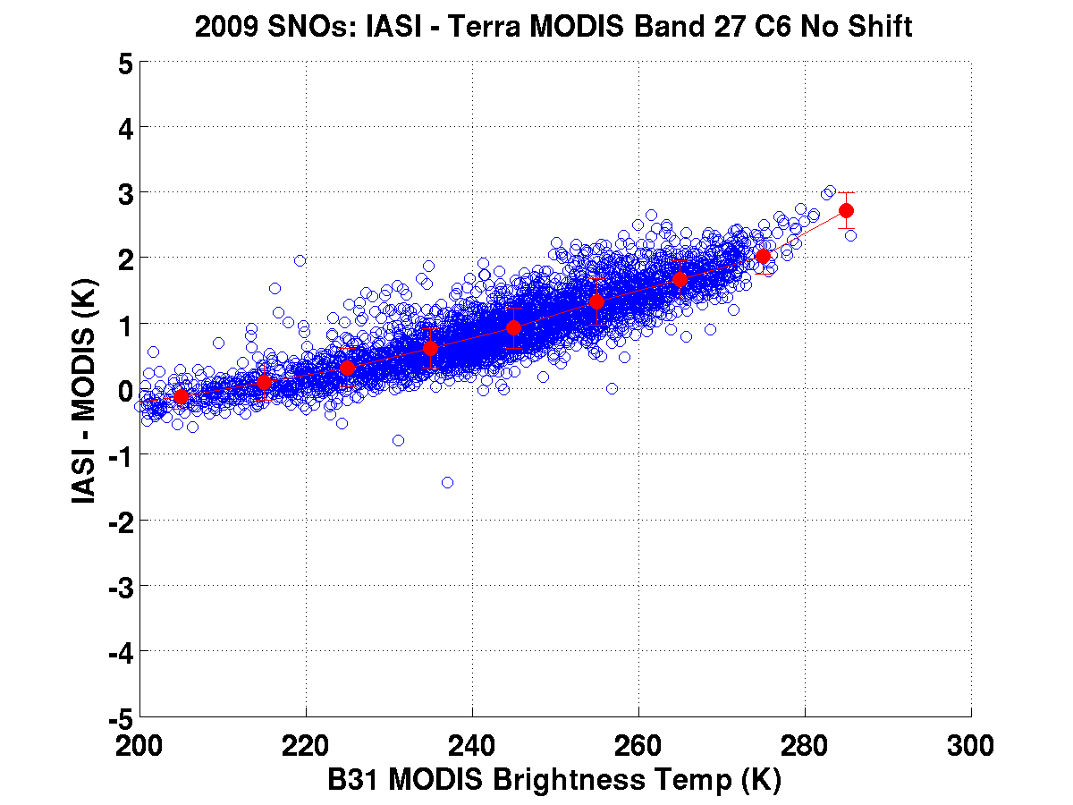
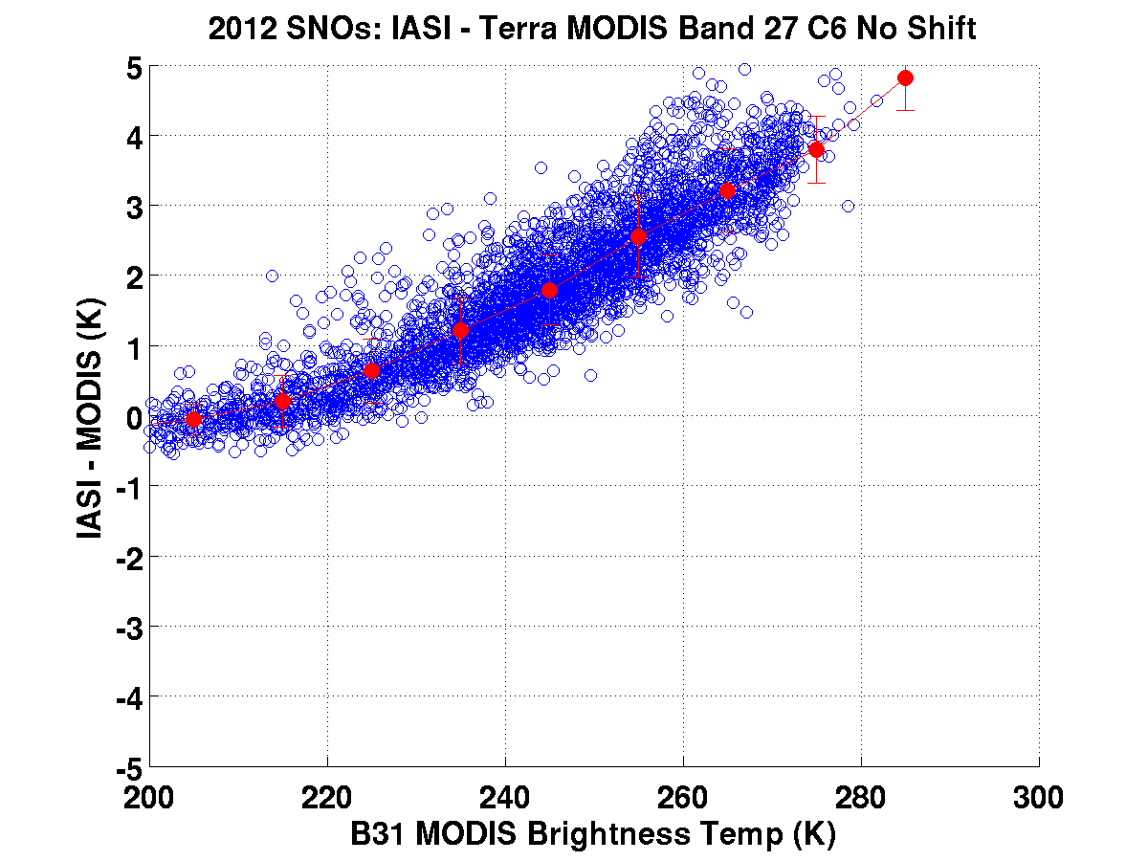
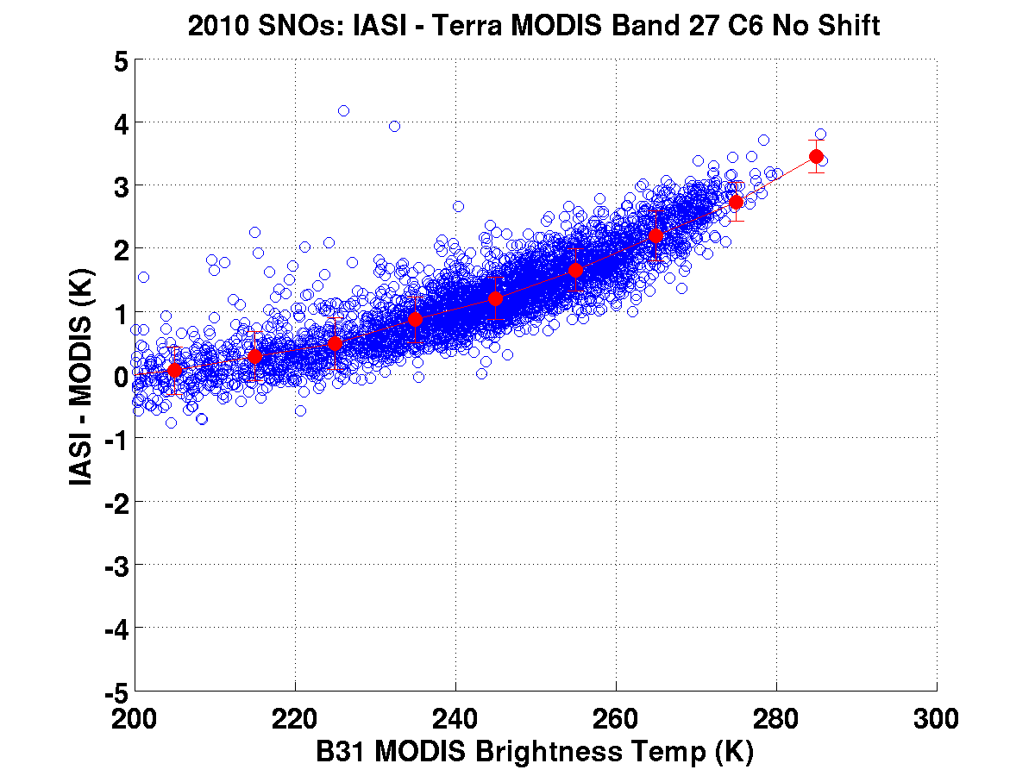
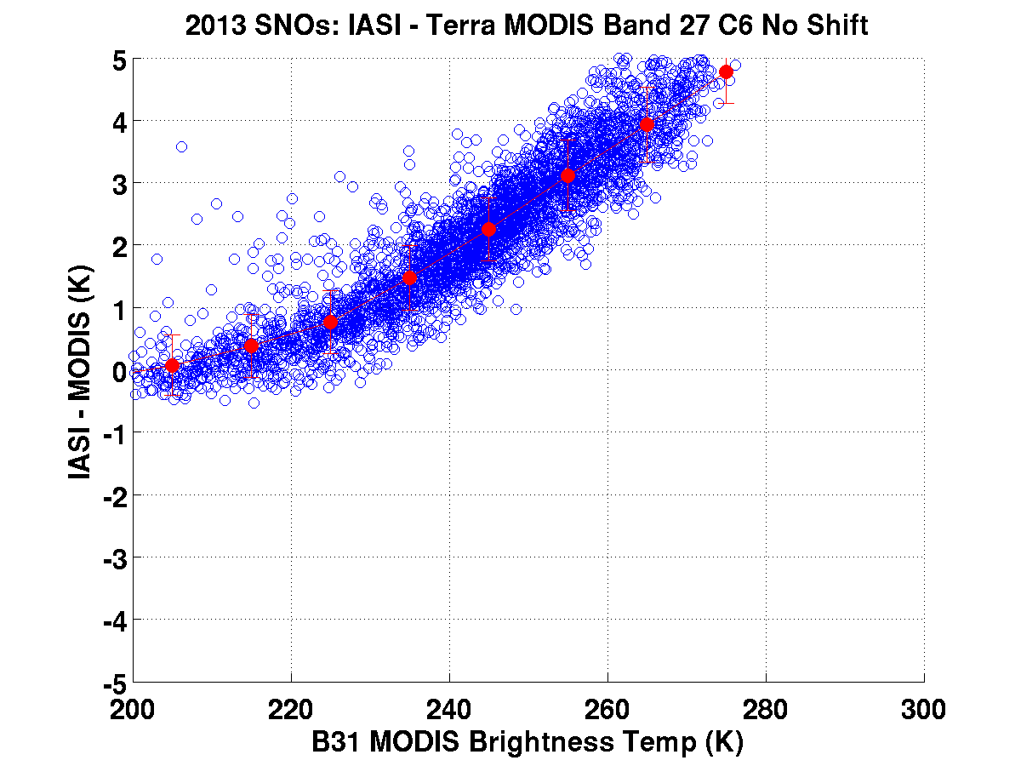
2008
2011
T
e
r
r
a
B
2
7
2009
2012
2010
2013

Slide 23
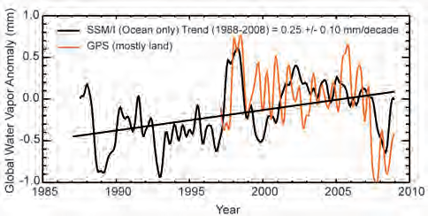
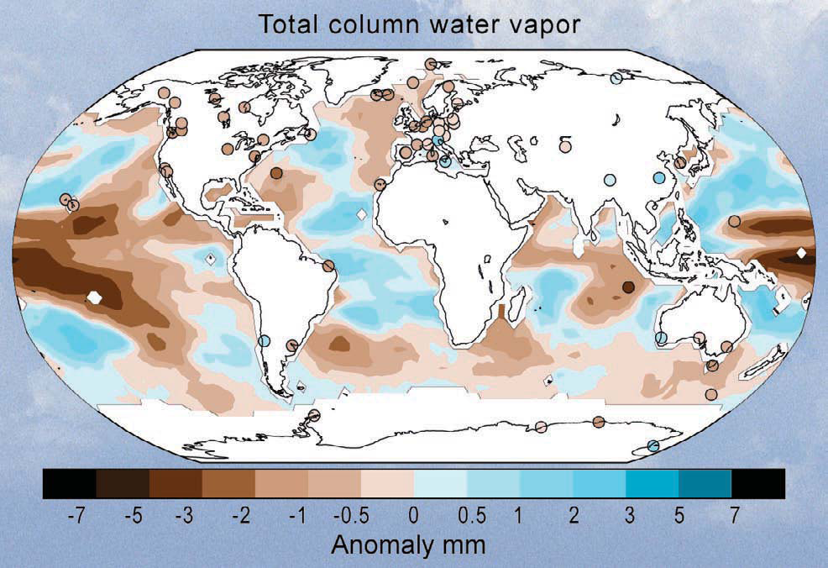
(Peterson et al 2009)
(Peterson et al 2009)
2008 La Nina Water Vapor 10 yr Anomaly

Slide 24
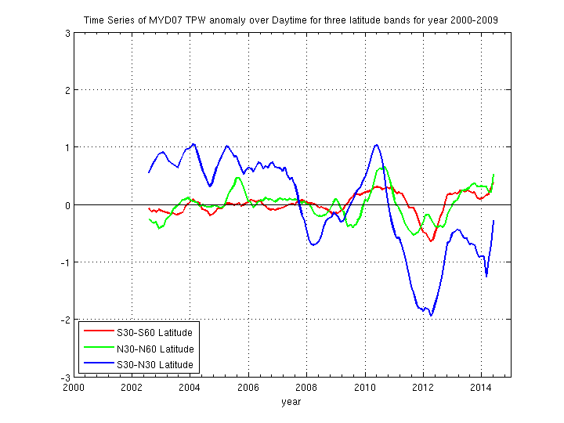
(Peterson et al 2009)
MYD07 TPW
La Ninas
Moderate 2007-2008
Strong 2010-2011
(Peterson et al 2009)
2008 La Nina Water Vapor 10 yr Anomaly

Slide 25
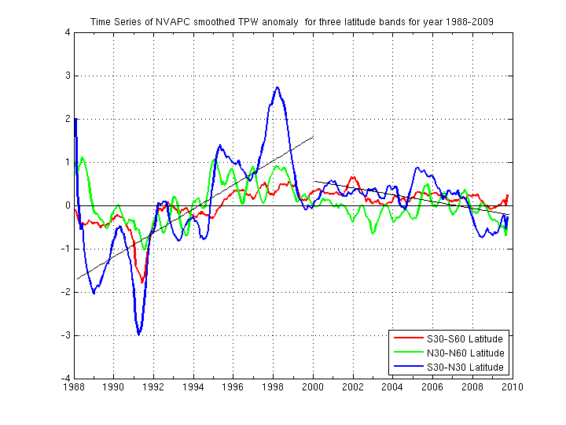
NVAP and MYD07 TPW trends
NVAP-Climate
MYD07
El Nino
Mod 2009-2010
La Ninas
Moderate 2007-2008
Strong 2010-2011

Slide 26
MYD07 TPW 12y anomaly
2009-2010
Moderate El Nino
2010-2011
Strong La Nina

Slide 27
GOAL: Processing HIRS, MODIS, and VIIRS+ with the same algorithm will create a TPW record that can reveal trends over more than 4 decades
1990
2000
2010
HIRS Northern Mid latitude (30N-60N)
Afternoon
N11 N14 N16 N18 N19
1980
?
Aqua/MODIS Northern Mid latitude
Daytime
S-NPP/VIIRS Northern Mid latitude

Slide 28
Time series of HIRS TPW for Northern Mid-latitudes 1989 - 2015
HIRS/2
HIRS/3
HIRS/4
night
N11 N14 N16 N18 N19
morning
N12 N15 N17 MetA
afternoon
N11 N14 N16 N18 N19
evening
N12 N15 N17 MetA

Slide 29
Conclusions (MODIS and HIRS trends)
Seasonal MODIS, HIRS and NVAP TPW cycle is strongest in northern mid-lats and weakest in tropics
Aqua MODIS and NVAP (& HIRS –see on poster) water vapor trends are in good agreement; Terra MODIS water vapor is out of family due to Ch 27 cross-talk calibration drift
TPW does not show significant diurnal changes
TPW decrease in 2008 and 2012 is evident in Aqua MODIS, N15 & N17 HIRS and NVAP-Climate data record. Those agree with the La-Nina events at the Tropic.
Increase in tropical TPW in 2015 is suggested

Slide 30
Conclusions (VIIRS TPW)
VIIRS split window enables 750 m resolution TPW maps with moderate ability to depict moisture gradients – very wet and very dry conditions are not captured very well
VIIRS TPW over land requires careful attention to the surface emissivity, sea/land and BT classifications, and clear determination
NUCAPS show moisture gradients at 50 km resolution even in the presence of non-precipitating clouds
VIIRS + NUCAPS shows promise for continuing the moisture records established by HIRS and MODIS

Slide 31
Plans for VIIRS + NUCAPS TPW Products
Check sea-land and BT training data distributions
Increase the viewing angle categories
Supplement VIIRS split window with NUCAPS to better capture very dry and wet conditions
Plans for MODIS TPW Products
Characterize Terra B27 crosstalk and reprocess if possible
Plans for HIRS TPW Products
Recalibrate split window bands against IASI and reprocess complete record

Slide 32
The End

Slide 33
MODIS spectral shifts applied
Aqua
Terra
Band 27: +4.0 cm-1
Band 28: +2.0 cm-1
Band 30: +1.0 cm-1
Band 34: +0.8 cm-1
Band 35: +0.8 cm-1
Band 36: +1.0 cm-1
Band 27: +5.0 cm-1
Band 28: +2.0 cm-1
Band 30: +0.0 cm-1
Band 34: +0.8 cm-1
Band 35: +0.8 cm-1
Band 36: +1.0 cm-1
H2O
H2O
O3
CO2
CO2
CO2
Based on AIRS/IASI-MODIS Brightness Temperature differences
over a selected year 2009.
(Tobin et al, 2006, Quinn et al, 2010)

