Slide 1
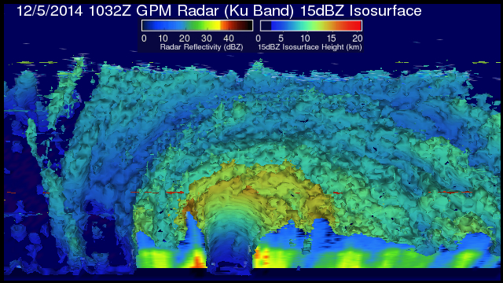
ESD: FY16 President’s Budget Request Overview and Program Status
19 May 2015

Slide 2
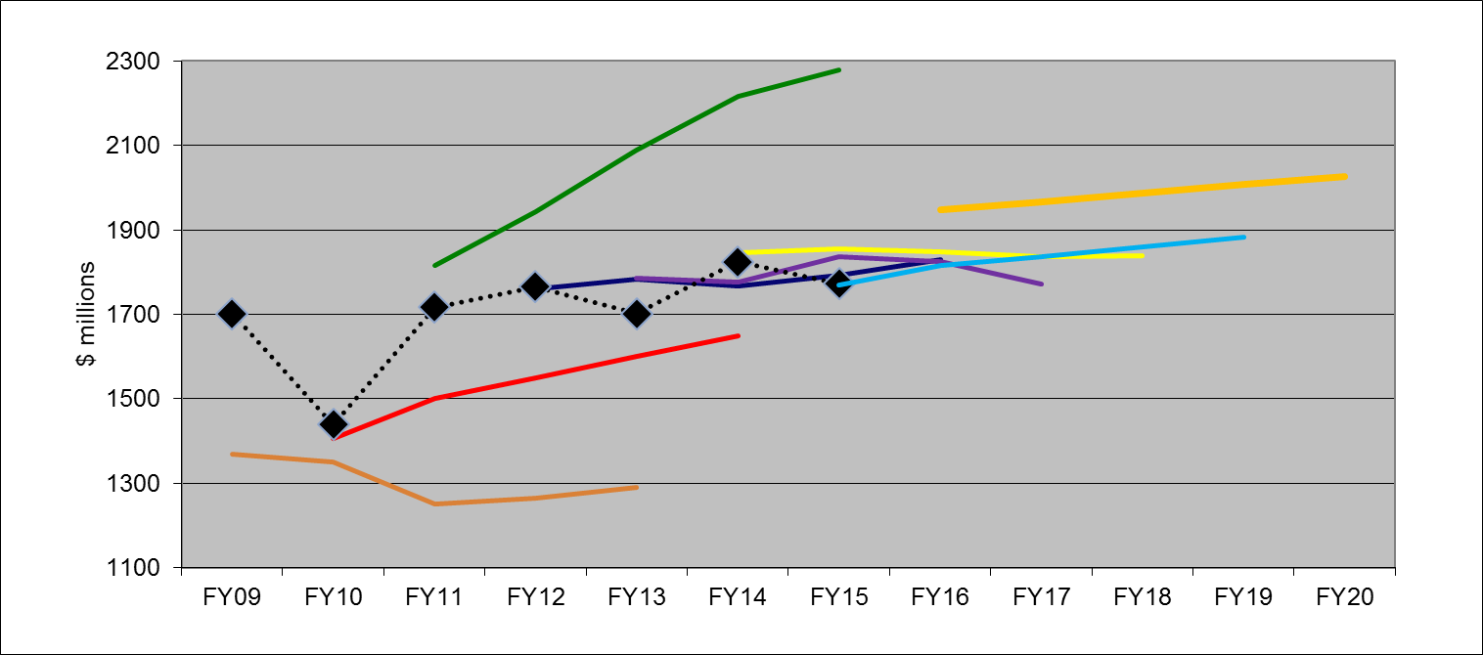
Earth Science Budget:
FY16 Request/FY15 Appropriation
FY11 request
FY16 request
FY14 request
FY12 request
Appropriation
FY15 request
FY13 request
FY10 request
FY09 request
(previous Admin)

Slide 3
OVERALL SUMMARY (1 of 3)
Freilich
  ESD budget increases significantly in President’s budget request
  NASA now has mandate for additional long-term measurements for the nation:
    Altimetry after Jason-3
    Solar Irradiance, Ozone Profile, Earth Radiation Budget all starting in FY16
  Sustainable Land Imaging Program (w/USGS; NASA funds flight hardware):
    TIR-FFD (2019)
    Upgraded Landsat-9 (2023)
    Focused technology development to inform designs of Landsat-10+
  Continued development and launch of: SAGE-III/ISS, ECOSTRESS/ISS, GEDI/ISS, CYGNSS, TEMPO, GRACE-FO, ICESat-2, SWOT, NISAR, PACE
  Continue Venture Class on schedule with full funding
  OCO-3 completion and flight to ISS in late 2017
  CLARREO Technology Demonstration instruments on ISS - development and flight in late 2019 (2 instruments, Reflected Solar/HySICS and IR Pathfinder)
 | FY15 | FY16 | FY17 | FY18 | FY19 | FY20
FY16 | 1.730 | 1.894 | 1.913 | 1.932 | 1.952 | 1.971
FY15 |  | 1.762 | 1.784 | 1.805 | 1.829 | ---

Slide 4
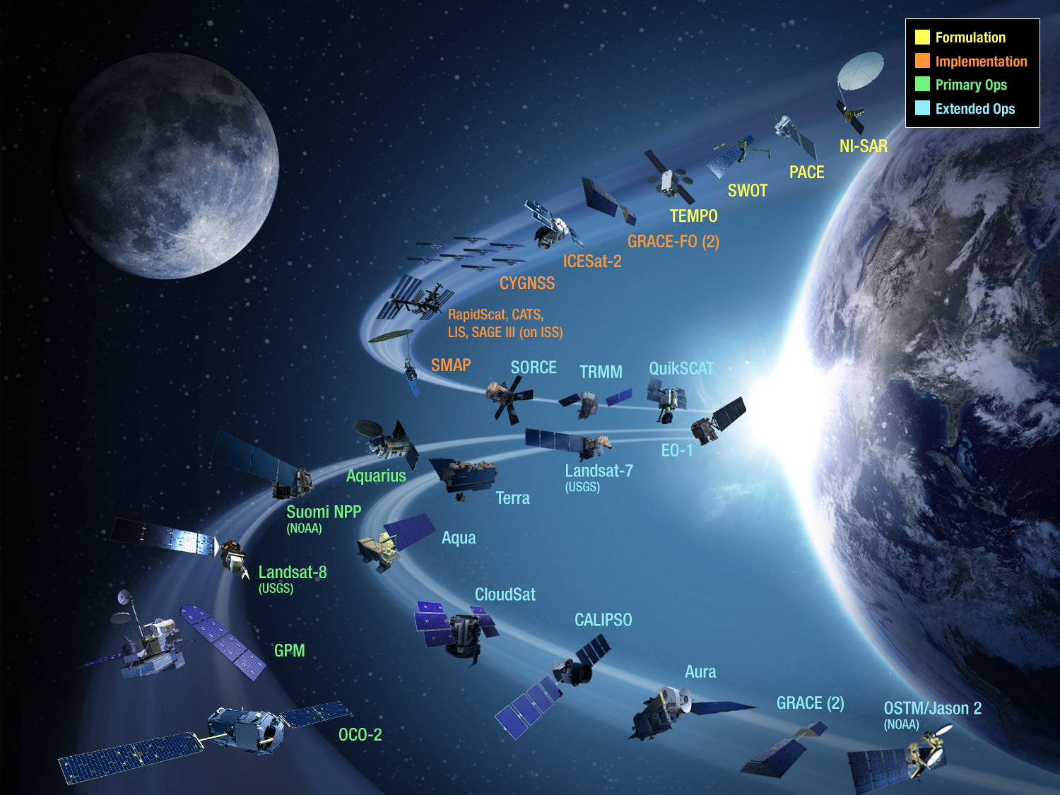

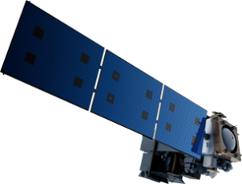
JPSS-2 (NOAA)
SLI-TBD
Formulation in 2015
RBI
OMPS-Limb
[[TSIS-2]]
[[Future Altimetry]]
RapidScat, CATS,
SMAP
[[TCTE]]

Slide 5
ED 2015 Senior Review Mission Set
Mission Completed
*
Mission Completed
Mission Completed
EO-1
Mission Completed

Slide 6

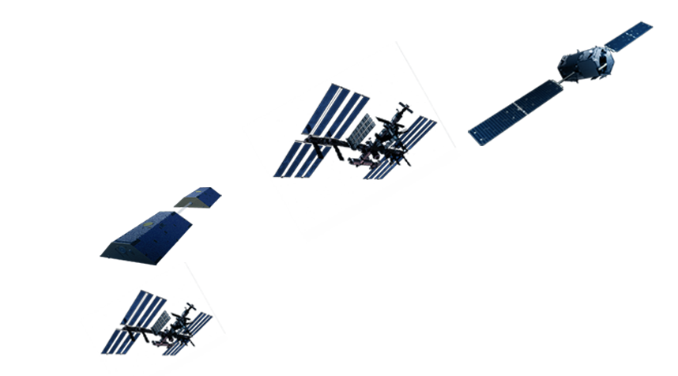
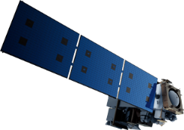
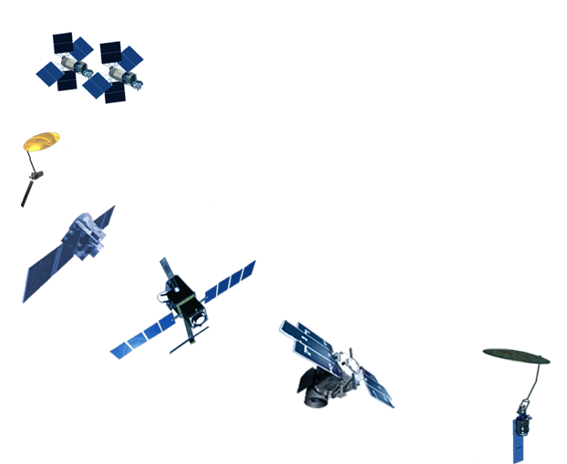

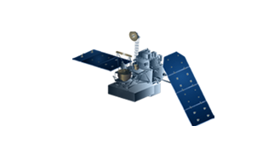
3 ESD-developed EO missions launched since 2/2014
2 ISS-developed EO instruments launched (2014, 2015)
11+ more ESD EO launches before 2022
✔
OCO-2
7/2014
SAGE-III
(on ISS)
mid-CY2016
JPSS-2 (NOAA)
Grace-FO
Aug 2017
RBI
OMPS-Limb
TSIS-1
[[TSIS-2]]
[[Future Altimetry]]
✔
✔
RapidSCAT, CATS
(on ISS) CY2014/15
LIS
(on ISS) 2016
SLI-TIR-FFD, L9
Formulation in 2015
(
CLARREO*
2019 for Pathfinders/ISS
✔
NI-SAR
2021
GEDI/ISS
ECOSTRESS/ISS
EVI-3
2022
EVM-2
2021
EVI-2
2020
PACE
CY2022
GPM
2/2014
TEMPO
EVI-1,
CY2018 LRD
SWOT
CY2020
CYGNSS
EVM-1,
Oct 2016 LRD
ICESat-2
June 2018
✔
SMAP
Jan 2015

Slide 7
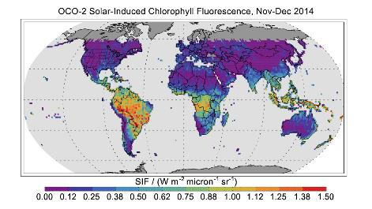
OCO-2 Level 2 Product Status
OCO-2 Level 2 products (global column CO₂ (XCO2)) were released through GSFC DAAC at the end of March.
The March 30th release also included solar-induced fluorescence (SIF) and updated L1b files. The L1b updates correcting known deficiencies including instrument artifacts (e.g. solar cosmic rays and a minor “clocking” of slit to FPA).
A forward data stream arrived at the DAAC on March 30th, and backward processing at ~3x began shortly after. Forward data begins with March 19th. Backwards processing will extend to 9/6/14.
The OCO-2 Science Team meeting was held Feb. 24 – 26th, 2015 in Pasadena. A broad cross section of the science team participated (118 in person, another 10 or so via webex).
The image to the right shows a sample of the OCO-2 solar-induced fluorescence retrievals using both nadir and glint observations from 21 Nov to 29 Dec.
The Northern Hemisphere fall Is evident in the lack of plant activity and therefore solar-induced fluorescence.
Spring plant activity is evident in the high solar induced fluorescence values over South America, sub-Saharan Africa, and Indonesia.
Month by month time series are consistent with the changing seasons.

Slide 8
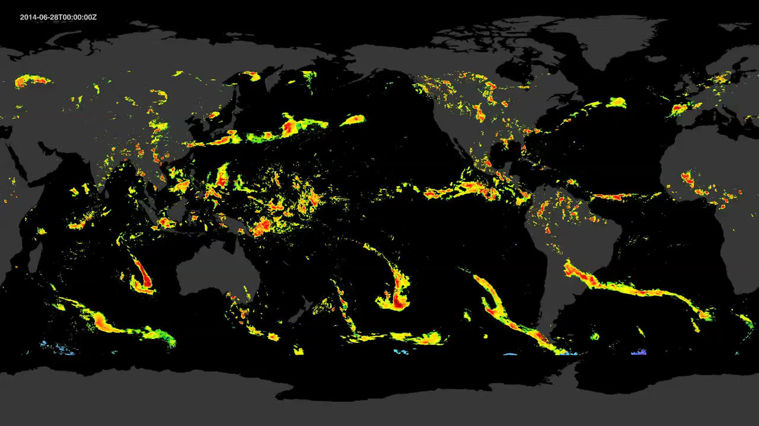


Multi-Satellite Precipitation Data (30 min, 10km by 10km)
IMERG: Integrated Multi-satellitE Retrievals for GPM

Slide 9
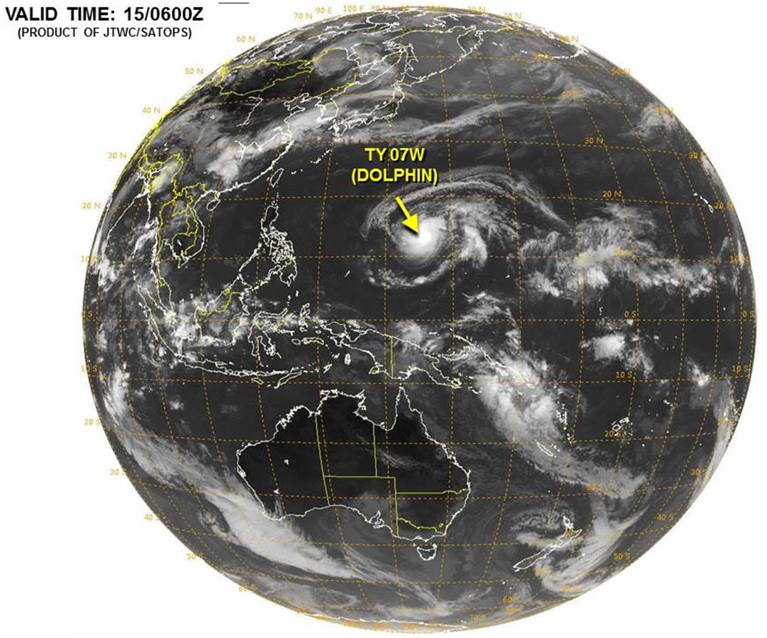
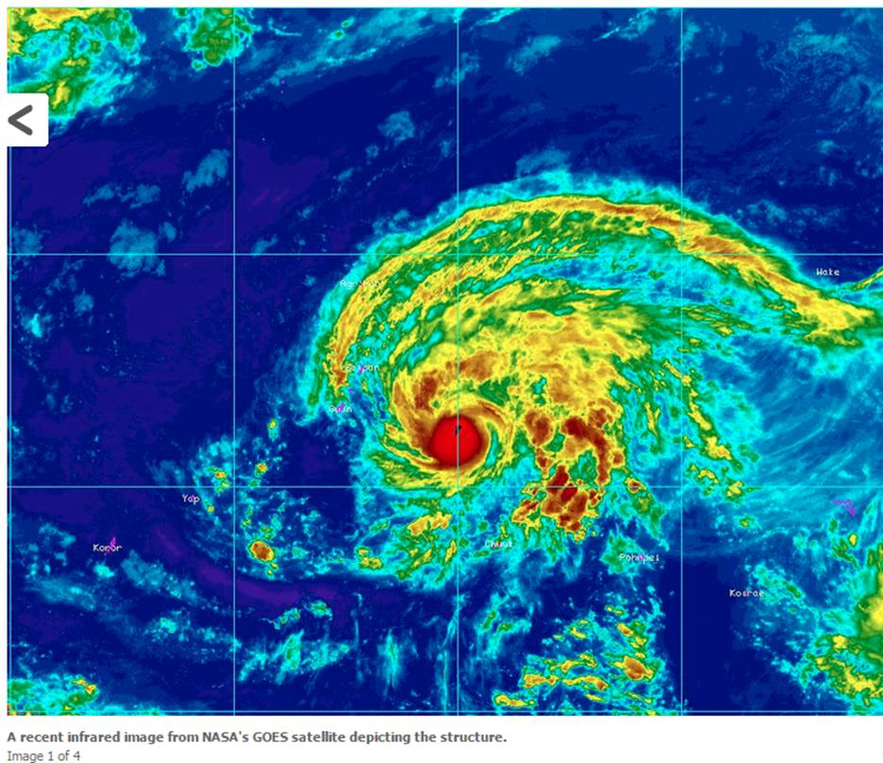
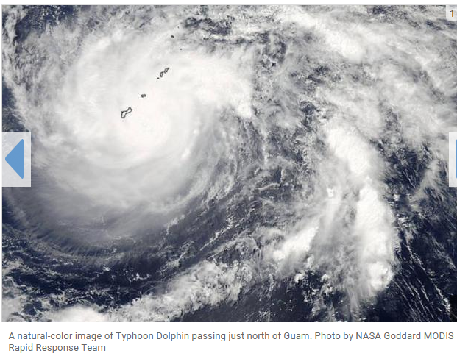
Typhoon Dolphin
HAGATNA, Guam, May 15 (UPI) -- NASA's MODIS instrument recently captured Typhoon Dolphin hovering just north of Guam.
The storm passed across the Northern Marianas on Friday, sustaining winds of 109 miles per hour.

Slide 10
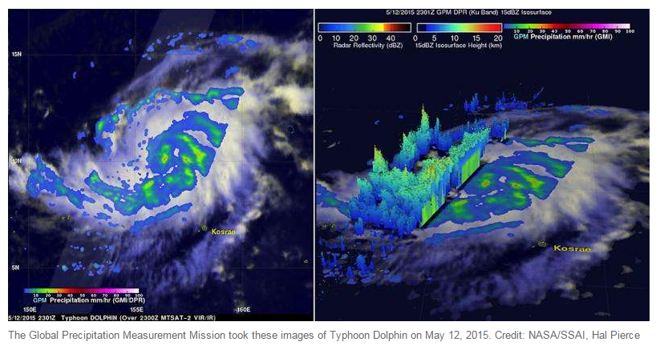
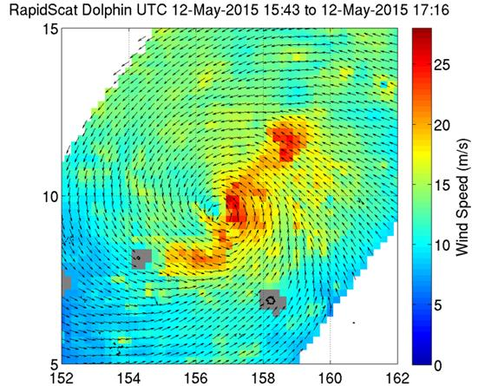
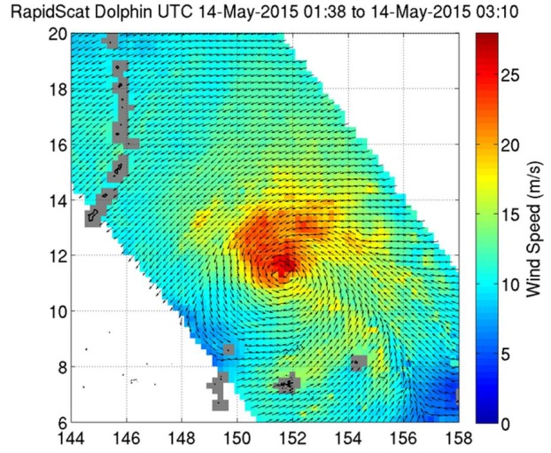
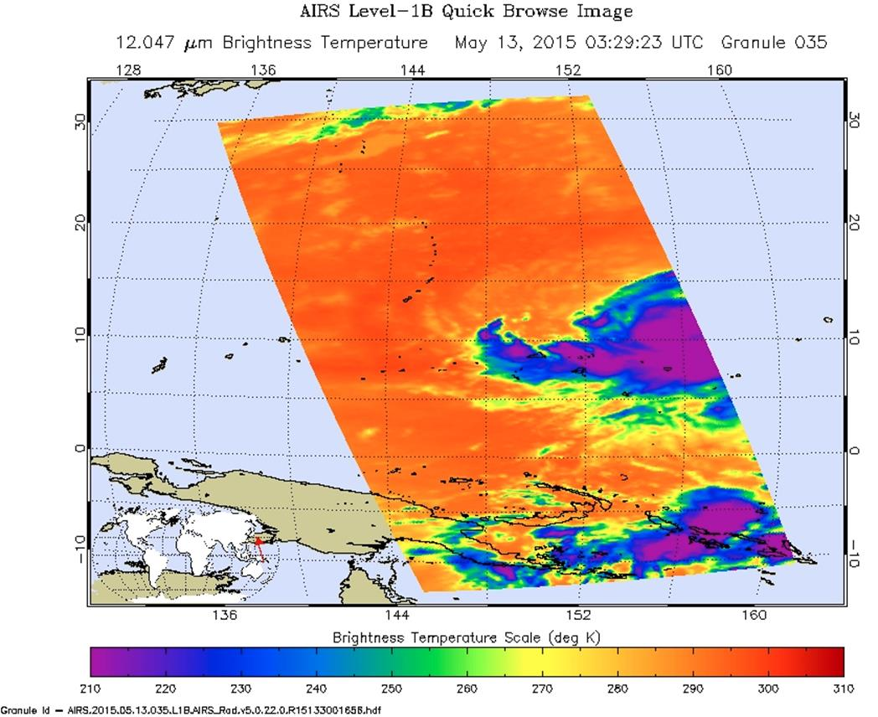
GPM / RAPIDSCAT / AIRS
RapidScat instrument on the International Space Station captured this image of Typhoon Dolphin on May 12, 2015 showing a very well-established spiral pattern in the storm
The RapidScat image taken on May 14, 2015 shows a very tight spiral of winds in the center which shows a very organized storm eye.
AIRS instrument image of Dolphin from May 13, 2015
Notes:
- RapidScat instrument on the International Space Station captured this image of Typhoon Dolphin on May 12, 2015 showing a very well-established spiral pattern in the storm. Credit: NASA JPL, Doug Tyler
Read more at: http://phys.org/news/2015-05-gpm-airs-rapidscat-view-typhoon.html#jCp
- The RapidScat image taken on May 14, 2015 shows a very tight spiral of winds in the center which shows a very organized storm eye. Credit: NASA JPL, Doug Tyler
Read more at: http://phys.org/news/2015-05-typhoon-dolphin-guam.html#jCp
- AIRS instrument image of Dolphin from May 13, 2015. Credit: NASA JPL/Ed Olsen

Slide 11
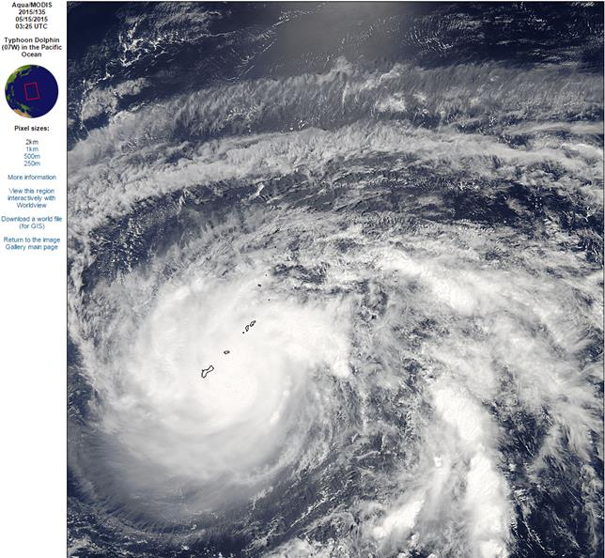
AQUA/MODIS
2015/135
05/15/2015
03:25 UTC

Slide 12
Update 5/17/2015
Typhoon Dolphin is beginning to weaken and is now the equivalent of a Category 4 hurricane, as of Sunday morning mainland U.S. time. Dolphin reached its peak intensity as a Category 5 super typhoon on Saturday with top winds estimated to be 160 mph.
Dolphin is now making its anticipated right turn, now moving northward instead of west-northwest.
Dolphin will eventually round the western edge of a subtropical high-pressure system and begin to meet the mid-latitude upper-atmospheric westerlies. This will accelerate the typhoon toward the northeast, with steady weakening.
While the typhoon will curve well east of the Japanese mainland, Dolphin may take a close swipe at Iwo To (Iwo Jima) on Tuesday, local time. Iwo Jima, famous for its role in World War II, is currently uninhabited except for military personnel.
Dolphin's eye passed through the Rota Channel between Guam and Rota Island early Friday evening, local time, delivering the typhoon's strongest winds in the eyewall to both locations.
Andersen Air Force Base on the northeast side of Guam clocked a peak wind gust of 106 mph just before 7 p.m. local time on Friday. Guam is 14 hours ahead of U.S. EDT. Just before 8 p.m. local time, Andersen AFB was reporting peak sustained winds of 84 mph in the southern eyewall of the typhoon.
Rota Island, about 45 miles northeast of Guam, was hit by the northern eyewall of Dolphin. Storm chasers Jim Edds and James Reynolds are located there and sending reports. With a population of about 2,500, many of Rota's buildings are made of concrete.

Slide 13
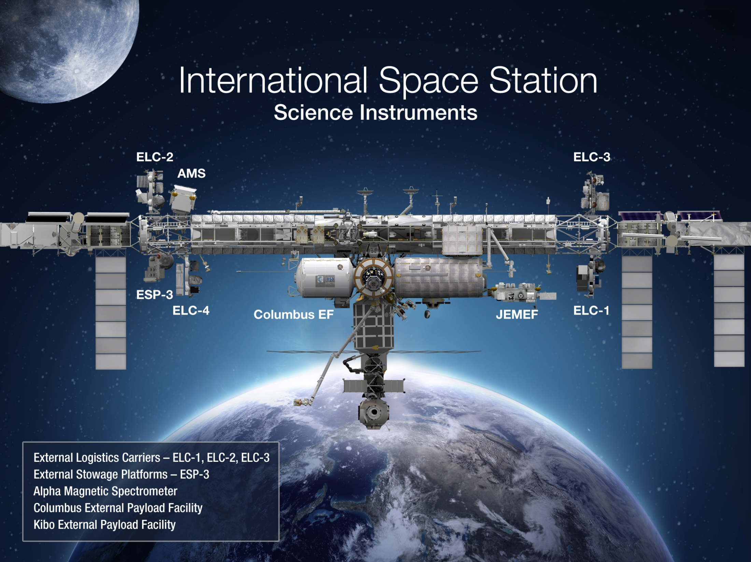
Earth
LIS (2016)
SAGE III (CY2016)
ISERV (2012-2015)
CATS (2015-)
HICO (2009-2014)
GEDI (2020)
ECOSTRESS (2020)
RapidSCAT (2014-)
CLARREO Pathfinders (CY2019)

Slide 14
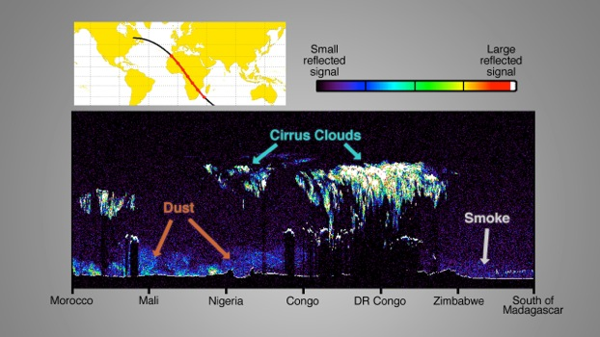
Early CATS Image
The CATS image shows a profile of particles in the atmosphere over a swath of Africa, from 30 degrees North to 30 degrees South, as the space station flew over it in the early morning of Feb. 11.
Notes:
Data from CATS will be used to derive properties of cloud/aerosol layers at three wavelengths (355, 532, 1064 nm) including:
layer height
layer thickness
backscatter
optical depth
extinction
depolarization-based discrimination of particle type
The CATS payload is designed to provide a combination of long-term operational science, in-space technology demonstration, and technology risk reduction for future Earth Science missions. CATS is not a "business as usual" project - it is specifically intended to demonstrate a low-cost, streamlined approach to developing ISS science payloads.
Primary design considerations for the Cloud-Aerosol Transport System include:
Make the system as eye-safe as possible.
Use solid state photon-counting detectors.
Leverage existing instrument designs and use commercial parts where possible.
Fit within mass, volume, and power constraints of the JEM-EF.
In recent years there have been significant advances in the approach to lidar design. A now-proven approach to lidar design is to use a high PRF laser, multiple kHz rather than 10's of Hz, at low pulse energies. Ground based systems of this type, the MicroPulse Lidar, have been in use since the early 90's. The airborne Cloud Physics Lidar has been used since 2000. The advantages of the high PRF design with low per-pulse energy permits use of solid-state photon-counting detectors. A basic requirement of the high PRF approach is a narrow field of view (along with narrowband filtering) to minimize solar background noise. The narrow FOV minimizes multiple scattered signals.
The overall instrument design is driven by the desire to use photon-counting detection. The system transmits three wavelengths (1064, 532, and 355 nm) simultaneously and collinear. Return signal collected by the telescope is separated by use of dichroics. The return signals are further separated into polarization components.
The laser units are provided by Fibertek, Inc., as is the avionics/communications package. Mechanical design services are provided by Design Interface, Inc. The Fabry-Perot interferometer in the HSRL receiver was provided by Michigan Aerospace Corporation.

Slide 15
Venture Class Selections/Solicitations
Most recent Selection
EVS-1: CARVE, ATTREX, DISCOVER-AQ, AirMOSS, HS-3
EVM-1: CYGNSS (2016 LRD)
EVI-1: TEMPO (2017 Instrument Delivery)
EVI-2: GEDI, ECOSTRESS (2019 Inst. Del.)
EVS-2: AtoM, NAAMS, OMG, ORACLES, ACT-America
Notes:
TJF 3/27/15: removed second page number.

Slide 16
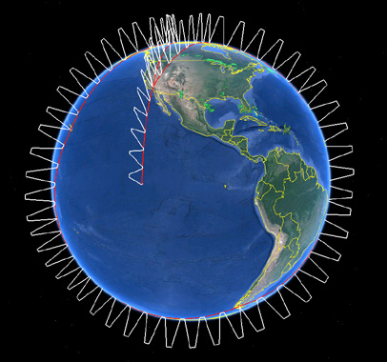
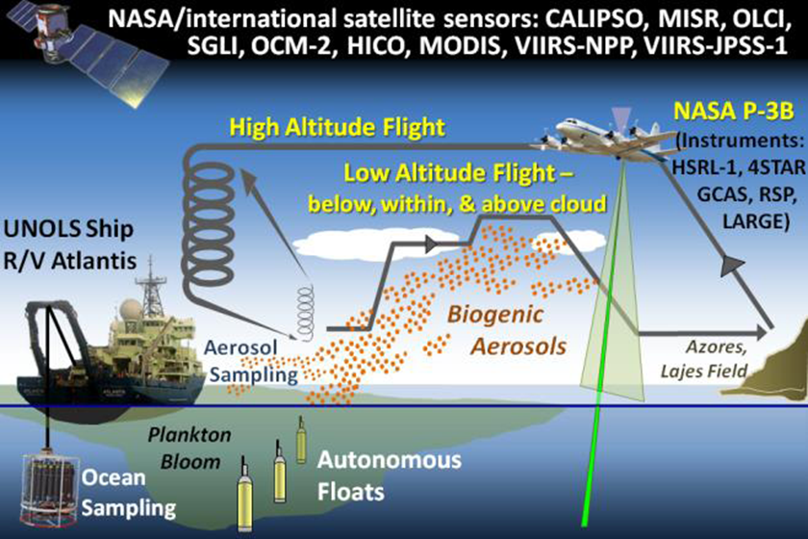
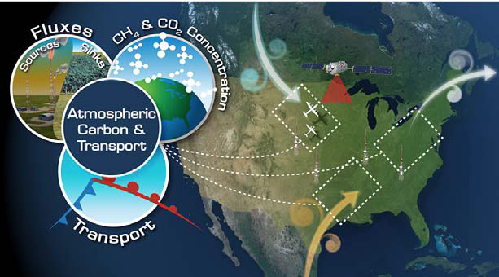
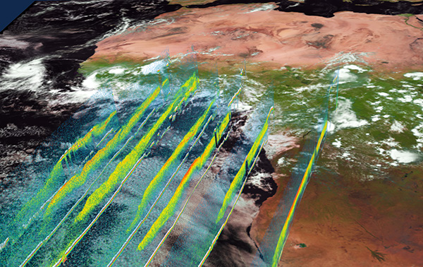
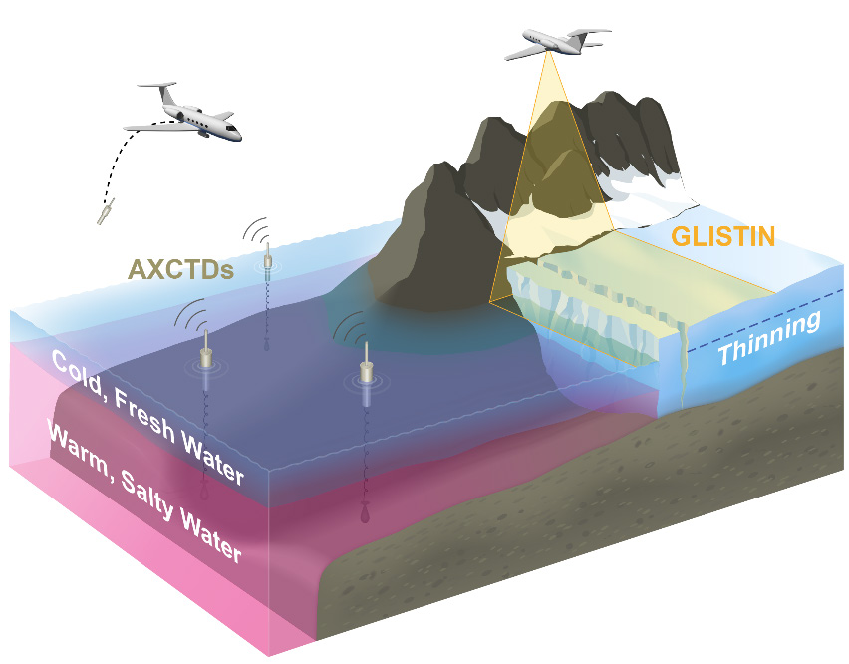
Earth Venture Suborbital-2 (EV-2) Investigations
Atmospheric Tomography Experiment (ATom) – Harvard University (Steve Wofsy)
  This investigation will study the impact of human-produced air pollution on certain greenhouse gases. Airborne instruments will look at how atmospheric chemistry is transformed by various air pollutants and at the impact on methane and ozone which affect climate. Flights aboard NASA’s DC-8 will originate from the Armstrong Flight Research Center in Palmdale, California, fly north to the western Arctic, south to the South Pacific, east to the Atlantic, north to Greenland, and return to California across central North America.
North Atlantic Aerosols and Marine Ecosystems Study (NAAMES) – Oregon State U. (Mike Behrenfeld)
This investigation will improve predictions of how ocean ecosystems would change with ocean warming. The mission will study the annual life cycle of phytoplankton and the impact small airborne particles derived from marine organisms have on climate in the North Atlantic. The large annual phytoplankton bloom in this region may influence the Earth’s energy budget. Research flights by NASA’s C-130 aircraft from Wallops Flight Facility, Virginia, will be coordinated with a University-National Oceanographic Laboratory System (UNOLS) research vessel.
Atmospheric Carbon and Transport – America – Penn State University (Kenneth Davis)
This investigation will quantify the sources of regional carbon dioxide, methane and other gases, and document how weather systems transport these gases in the atmosphere. The research goal is to improve identification and predictions of carbon dioxide and methane sources and sinks using spaceborne, airborne and ground-based data over the eastern United States. Research flights will use NASA’s C-130 from Wallops and the UC-12 from Langley Research Center in Hampton, Virginia.
ObseRvations of Aerosols Above Clouds and Their IntEractionS (ORACLES) – ARC (Jens Redemann)
  ORACLES will probe how smoke particles from massive biomass burning in Africa influences cloud cover over the Atlantic. Particles from this seasonal burning that are lofted into the mid-troposphere and transported westward over the southeast Atlantic interact with permanent stratocumulus “climate radiators,” which are critical to the regional and global climate system. NASA aircraft, including a Wallops P-3 and an Armstrong ER-2, will be used to conduct the investigation flying out of Walvis Bay, Namibia.
Oceans Melting Greenland (OMG) – JPL (Josh Willis)
The objective of OMG is to investigate the role of warmer saltier Atlantic subsurface waters in Greenland glacier melting. The study will help pave the way for improved estimates of future sea level rise by observing changes in glacier melting where ice contacts seawater. Measurements of the ocean bottom as well as seawater properties around Greenland will be taken from ships and the air using several aircraft including a NASA S-3 from Glenn Research Center in Cleveland, Ohio, and Gulfstream III from Armstrong.

Slide 17
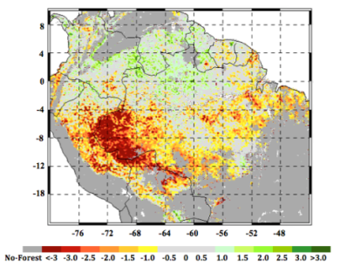
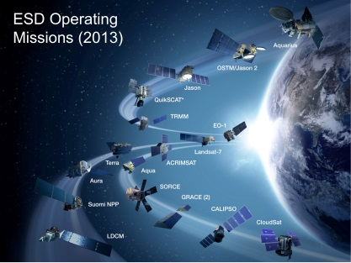
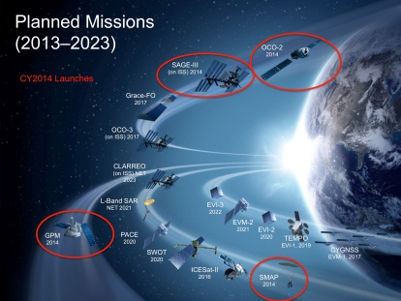
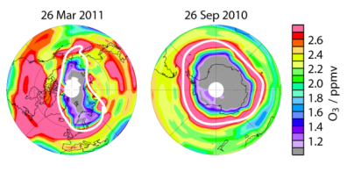
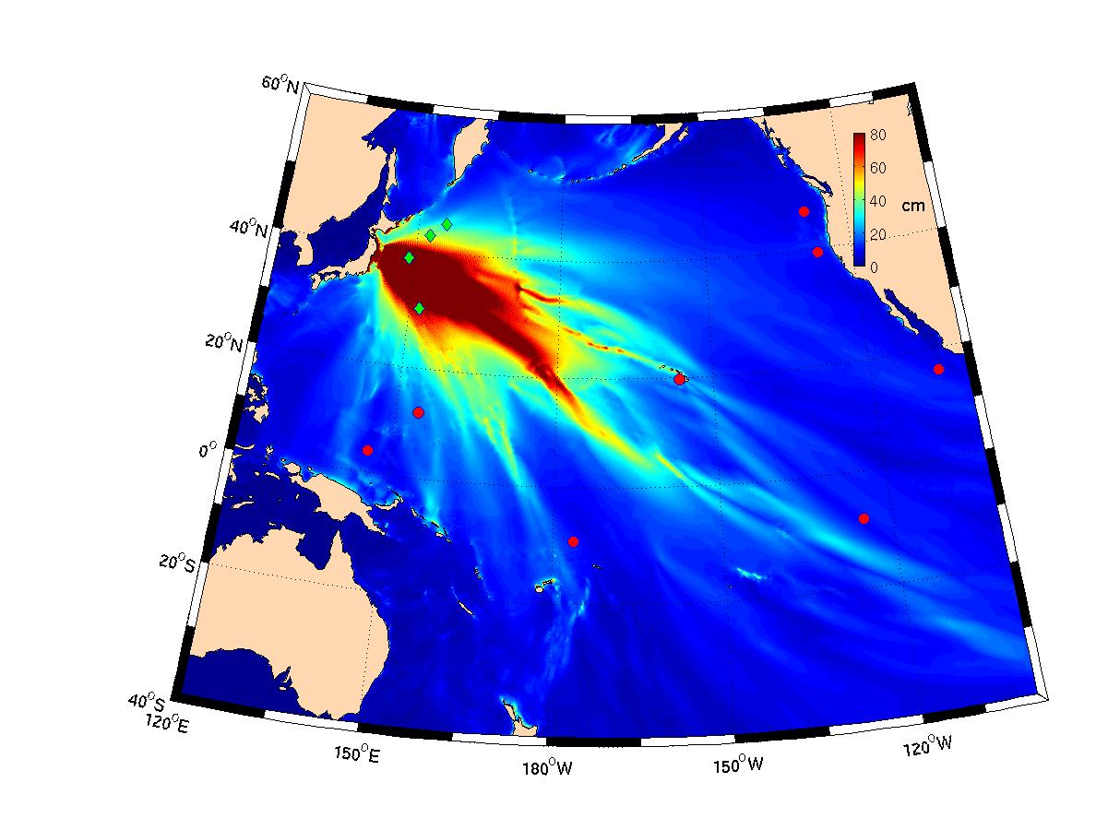
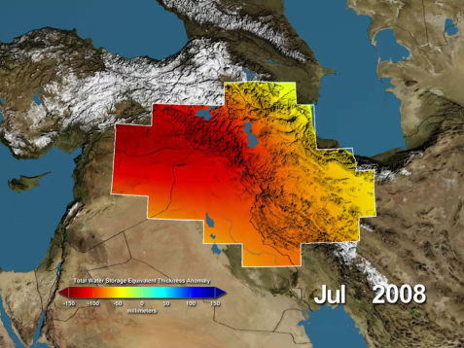
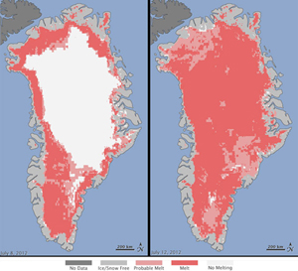
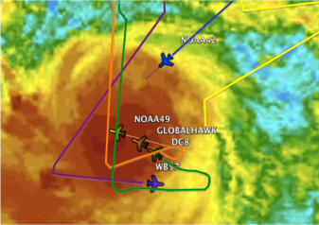
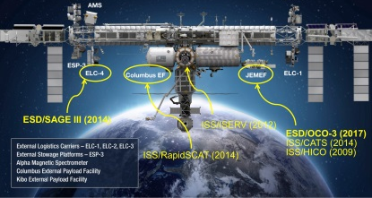

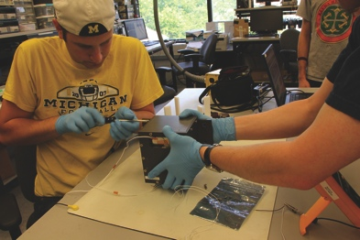
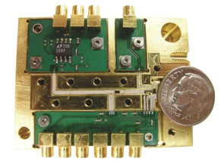
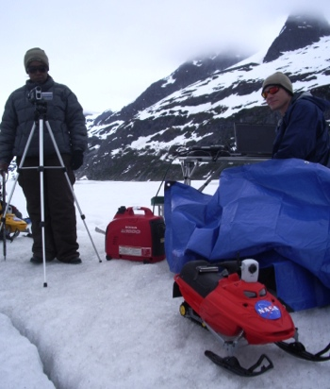

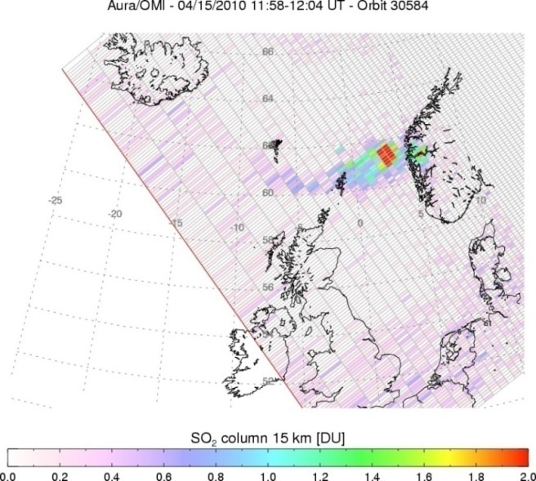
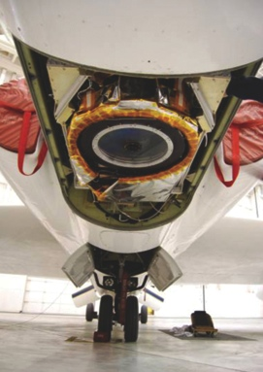
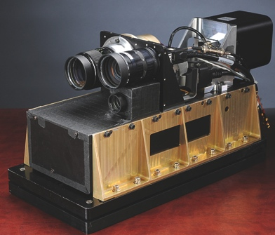



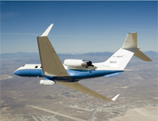
NASA’s Earth Science Division
Research
Flight
Applied Sciences
Technology
Notes:
17

Slide 18
OVERALL SUMMARY (2 of 3)
Freilich
  Earth Science Research
    Includes funding to improve understanding of coupled North Atlantic-Arctic
    system
    Includes additional funding for research to understand linkages between
    oceans and climate
    Funds CDI, BEDI/GCIS, CRT/Citizen Science
  Applied Sciences
    Will be used to accelerate ramp-up of Water and Food Security initiatives
 | FY15 | FY16 | FY17 | FY18 | FY19 | FY20
FY16 | 399 | 432 | 417 | 425 | 418 | 414
FY15 |  | 424 | 400 | 390 | 392 | ---
 | FY15 | FY16 | FY17 | FY18 | FY19 | FY20
FY16 | 40.4 | 47.6 | 48.7 | 48.4 | 47.6 | 48.8
FY15 |  | 38.0 | 38.7 | 39.8 | 39.8 | ---
Notes:
TJF 3/27/15: Revised bullets under Earth Science Research to reflect changes discussed with Freilich for the ASAC charts

Slide 19
OVERALL SUMMARY (3 of 3)
Freilich
  Earth Science Technology Office
    Increase for the InVEST program (~ $5M/year additional)
 | FY15 | FY16 | FY17 | FY18 | FY19 | FY20
FY16 | 59.7 | 60.7 | 62.1 | 61.5 | 61.2 | 62.7
FY15 |  | 54.5 | 55.6 | 55.5 | 55.6 | ---

Slide 21
Long-term Measurement Mandate Missions
Freilich
  Precision Altimetry following the launch of Jason-3
    FY16-20 budget supports NASA contributions to Jason-CS
      LV, radiometer, laser retroreflector; etc. NASA funding for mission ops and data analysis; 2020 launch
    Continued development of SWOT (2020 launch)
  Solar Irradiance
    TSIS-2 and beyond transferred to NASA in FY14
    FY16-20 budget supports completion of TSIS-1 and flight on ISS, LRD August 2017
      Recognizes NOAA FY15 appropriation for TSIS-1
  Earth Radiation Balance (RBI instrument)
    RBI continues to be developed by NASA for flight on JPSS-2
Notes:
TJF 3/27/15: Changed TSIS-2 to FY14 (consistent with discussion with Peg Luce and the Babin QFR [QFR-Babin-Transfer of Missions to NASA-SMD-Cleared-150313-CLEAN] cleared by SMD on 3/13/15

Slide 22
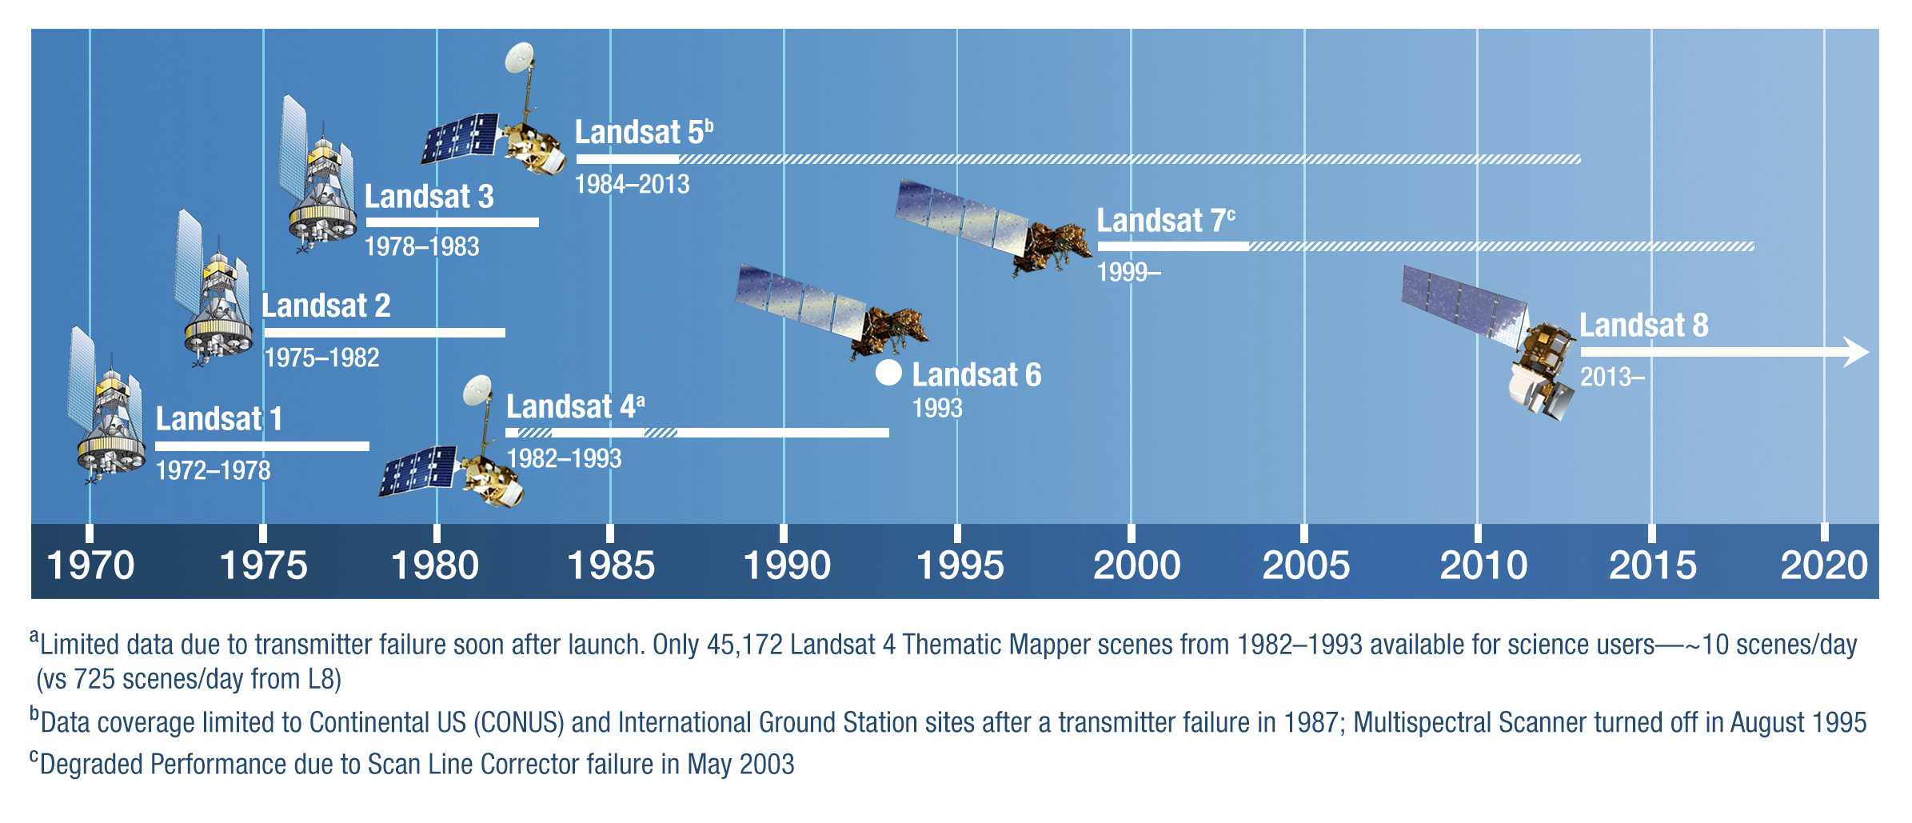
Landsat History
The Landsat program began as the Earth Resources Technology Satellites Program in 1966, with Landsat 1 (ERTS) launched in July 1972
NASA built and launched Landsats 1-5 and Landsats 7-8
Thermal band added for Landsats 3 and beyond
After launch, Landsat operations are transferred from NASA to USGS, and USGS collects, archives, processes, and distributes the image data via the internet at no cost to users
Landsat 8 began as a data purchase and became known as the Landsat Data Continuity Mission (LDCM)
  Although the thermal bands were originally not incorporated in the mission, they were added back into the Observatory’s capabilities following strong support from a variety of stakeholders

Slide 23
SLI in FY16 President’s Budget Submit
A multi-component program, with the essential investments in technology and observational innovation to ensure a world class, sustainable, and responsible land imaging program through 2035:
  TIR-FF (Class D Thermal Infrared Free Flyer) to launch ASAP (no later than 2019) and to fly in constellation with a reflective band imager like OLI on L-8
    Low-cost mitigation against an early loss of the Landsat 8 Class C TIRS, while demonstrating feasibility of constellation flying for land imaging
  Landsat 9 (Class B upgraded rebuild of Landsat 8) to launch in 2023
    Low programmatic risk implementation of a proven system with upgrades to bring the
    whole system to Class B
  Land Imaging Technology and Systems Innovation
    Hardware, operations and data management/processing investments to
    reduce risk in next generation missions.
  Landsat 10
    Mission definition to be informed by the Technology investments, leading to key mission configuration/architecture decisions by the end of the decade
NASA Budget for | FY 2014 | FY 2015 | FY 2016 | FY 2017 | FY 2018 | FY 2019 | FY 2020
Sustainable Land Imaging | $30,000 | $64,100 | $78,900 | $134,600 | $174,400 | $179,900 | $147,300

Slide 24
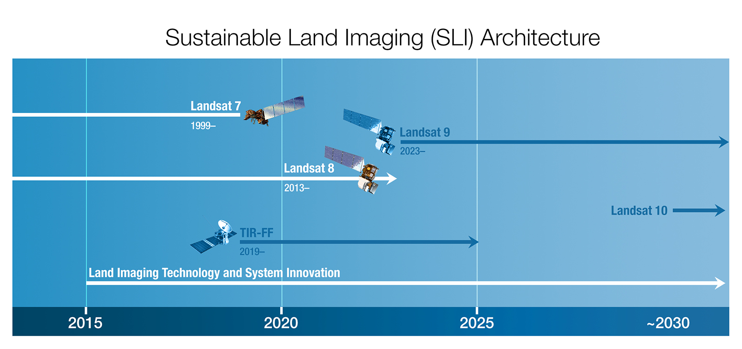
Landsat Future

Slide 25
Thermal IR Free Flyer, TIR-FF
The primary objective is to provide an alternate source of thermal IR imagery by 2019 - specifically in advance of the TIR channels provided on Landsat 9 (2023 launch date).
  Thermal IR measurements provide unique, precise information on water use (primarily for crop irrigation) and urban heating
  Studies have indicated that the TIR measurements are at the greatest risk of continuity because (1) the L8 TIRS has only a 3-year design life; (2) stray light and hardware issues have already degraded the reliability and performance of the L8 TIRS; and (3) the EU Sentinel satellites do not include thermal channels
  TIR-FF will fly in constellation with another land imaging satellite, likely Landsat 8 or Sentinel-2
The TIR-FF development is assigned to NASA/GSFC for implementation
  Small satellite
  Simple instrumentation
  Dedicated small launch vehicle
TIR-FF will follow a Class D implementation to ensure rapid development, with a
launch targeted for 2019
Notes:
The least stringent of the L7 and L8 performance requirements to provide ET measurements

Slide 26
Landsat 9
The Landsat 9 mission: a near-repeat build of the LDCM/Landsat 8 system, upgraded to full Class B, to launch in 2023.
  Ensures the baseline Landsat data record is continued into the late 2020s with minimal programmatic and technical risk
  The ground system is fully defined, needing incremental additions only
Rebuild based on the successful Landsat 8 observatory, with specific modifications:
  The Landsat 9 TIRS instrument would be upgraded to full Class B configuration (5-year design life; in-house NASA/GSFC build)
  Spacecraft competed and modified as required to accommodate upgraded TIRS
  Commercial management/oversight practices explored for cost savings at acceptable risk

Slide 27
Technology and Systems Innovation
Persistent investment in technology and observational innovation is essential for a world class, sustainable, and responsible land imaging program.
The Plan includes a budget for technology and systems innovation that rises to ~5% of the total SLI budget line.
At the component/technology level examples of specific investigations include:
  Focal plane technology to support wide swath, moderate resolution imagery for multispectral and hyperspectral instruments; Underway
  Hyperspectral thermal measurements; Underway
At the system level, examples of specific technical investigations include:
  Instrument miniaturization approaches to meet program observing objectives with smaller, less expensive satellites; Underway
  Integrated instrument approaches combining VISNIR and TIR channels
At the programmatic level, examples of specific investigations include:
  Commercial and hybrid commercial/governmental procurement and management approaches; Underway
  Integration of multiple data sets from an open array of satellite observations to create a seamless land imaging archive for the user, including TIR-FF + Landsat 8 or + Sentinel 2 Underway with ROSES (NASA’s competitive research program) solicitation/selections
Near-term work will inform the Landsat 10 configuration decision (L10 development to start in early 2020’s)

Slide 28
Land Imaging in FY15 Senate Approps Report
Senate FY 2015 Report:
Landsat Data Continuity.—The Committee provides $68,100,000, $4,000,000 above the request, for a land imaging mission successor to Landsat 8. With Landsat 7 at risk for ending its mission life as early as 2017, the Committee is deeply troubled at the potential loss of 8-day continuous terrestrial coverage now provided through the Landsat satellite series. The Committee does not concur with various administration efforts to develop alternative ‘‘out of the box’’ approaches to this data collection—whether they are dependent on commercial or international partners. Given the constraints in Federal funding, and the absence of credible alternatives to a conventional land imaging mission that ensures Landsat data continuity, NASA should proceed with an acquisition in fiscal year 2015 for a mission to launch a follow on to Landsat 8 by not later than 2020 that does not exceed a cost cap of $650,000,000, inclusive of all launch vehicle costs. Such a mission shall maximize the utilization of non-recurring engineering efforts from Landsat 8 to maintain a relatively low level of project risk. In addition, as a follow on to Landsat 8, program reserves shall be limited to not more than 10 percent for the duration of the mission’s development and all hardware contracts should be firm fixed price and reflect steep discounts over the price paid for comparable components for Landsat 8. The Committee notes that the notional land imaging fiscal year 2016 budget is now more than $100,000,000 below what is needed for a 2020 launch. Hence, the Committee expects the 2016 budget to reflect resources necessary to meet that launch date.

Slide 29
Land Imaging in FY15 Appropriation
FY 2015 Appropriations Explanatory Statement
The agreement supports Senate direction on Landsat Data Continuity, but provides the requested amount of $64,100,000 and clarifies Senate direction on development parameters. Instead of a firm cost cap boundary, the mission shall:
cost substantially less than Landsat-8;
provide the same data quality as Landsat-8 so as to not require an overhaul
of associated ground systems; and
provide no degradation or gap in data including the 8-day continuous
terrestrial coverage.
The agreement does not endorse any efforts to develop alternative approaches to this data acquisition that would increase risk of a coverage gap and not meet the needs of the Landsat user community.

Slide 30
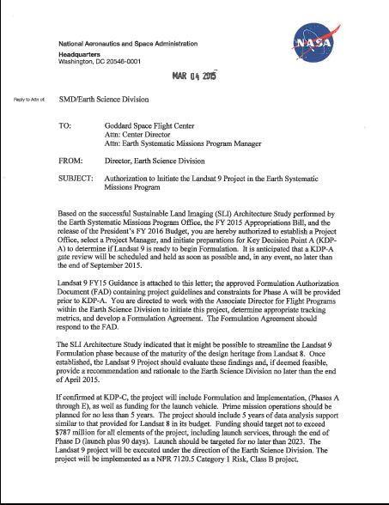
Sustainable Land Imaging: Landsat 9
Landsat 9
Project Authorization Letter

Slide 31
Pre-Aerosol, Cloud, and ocean Ecosystem (PACE) Mission
Pre-Aerosol, Cloud, and ocean Ecosystem (PACE) is an ocean color, aerosol, and cloud mission identified in the 2010 report “Responding to the Challenge of Climate and Environmental Change: NASA’s Plan for a Climate-Centric Architecture for Earth Observations and Applications from Space Science”.
Science Objectives
Primary: Understand and quantify global biogeochemical cycling and ecosystem function in response to anthropogenic and natural environmental variability and change: ocean color sensor
Secondary: Understand and resolve/quantify the role of aerosols and clouds in physical climate (the largest uncertainty): polarimeter
Extend key Earth system data records on global ocean ecology, biogeochemistry, clouds, and aerosols (expanded ocean color sensor similar to MODIS)
Risk | 8705.4 Payload Risk Class C
Launch | 2022/2023, budget and profile driven
Orbit | 97° inclination; ~650 km altitude; sun synchronous
Duration | 3 years
Payload | Ocean color instrument; potential for a polarimeter
LCC | $805M Cost Cap
Notes:
17
TJF 3/27/15: colored title text as white, so it would be visible; resized and re-located chart title

Slide 32
PACE Cost Cap
Cap is $805M and includes the following:
  Project team at GSFC (to include PM, SE, & SMA functions)
  Spacecraft bus
  Launch vehicle
  Instrument payload
  3 years of mission operations
  Project-held UFE
  Data processing/analysis to be performed by GSFC’s Ocean Biology Processing Group (OBPG)
  Mission Science
    Calibration/validation (hardware and conducting cal/val)
    Science team support (development phase and post launch)

