Slide 1
Active Fire and Burned Area Products:
Extending MODIS to VIIRS
Wilfrid Schroeder & Louis Giglio
Department of Geographical Sciences
University of Maryland – College Park
Active Fire Co-investigators/Collaborators:
Ivan Csiszar, Patricia Oliva, William Walsh, Evan Ellicott,
Patrick Coronado, Kelvin Brentzel, Brad Quayle

Slide 2
VIIRS Active Fire Background
Baseline 750 m product builds on MODIS C6 Fire and Thermal Anomalies (MOD14/MYD14) algorithm
  Provides fire mask, fire radiative power retrievals, plus additional metadata
    Mimics MOD14/MYD14 science data format & nomenclature
  Currently implemented/maintained at Land SIPS (NPP_VAFIRE_L2D)
  Currently implemented/maintained in IPOPP serving the DB community
  Latest algorithm being ported to NESDIS in order to replace operational version in IDPS (based on outdated Collection 4 version)
New 375 m product based on similar MOD14/MYD14 architecture
  Provides fire mask, limited fire retrievals (frequent saturation), plus additional metadata
    Resembles MOD14/MYD14 science data format & nomenclature
  Currently running at the USDA Remote Sensing Applications Center (RSAC), and in fire monitoring systems in South Africa and Brazil
  Being ported to IPOPP
  To be ported to Land SIPS

Slide 3
Collection 5 -> 6 Improvements
Omission Errors
Commission Errors
C5
C5
C6
C6

Slide 4
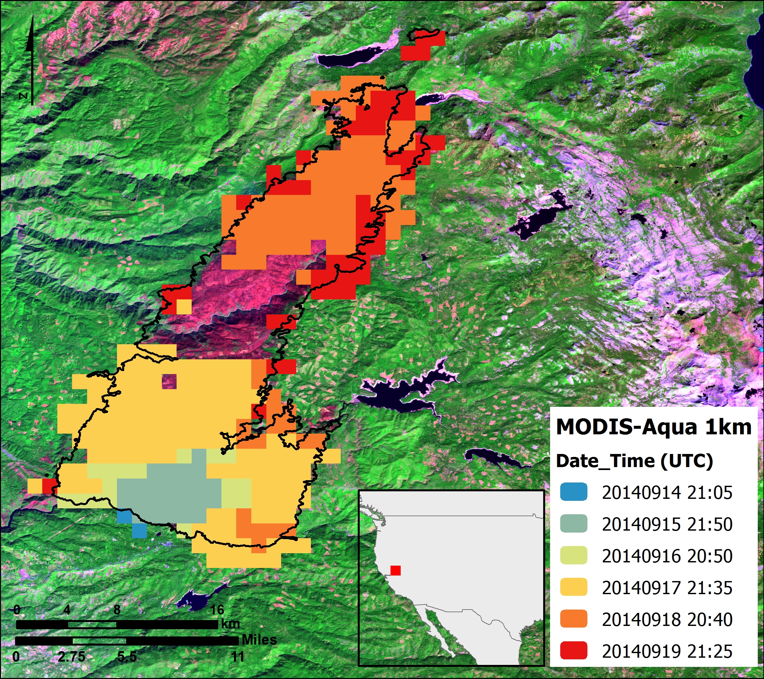
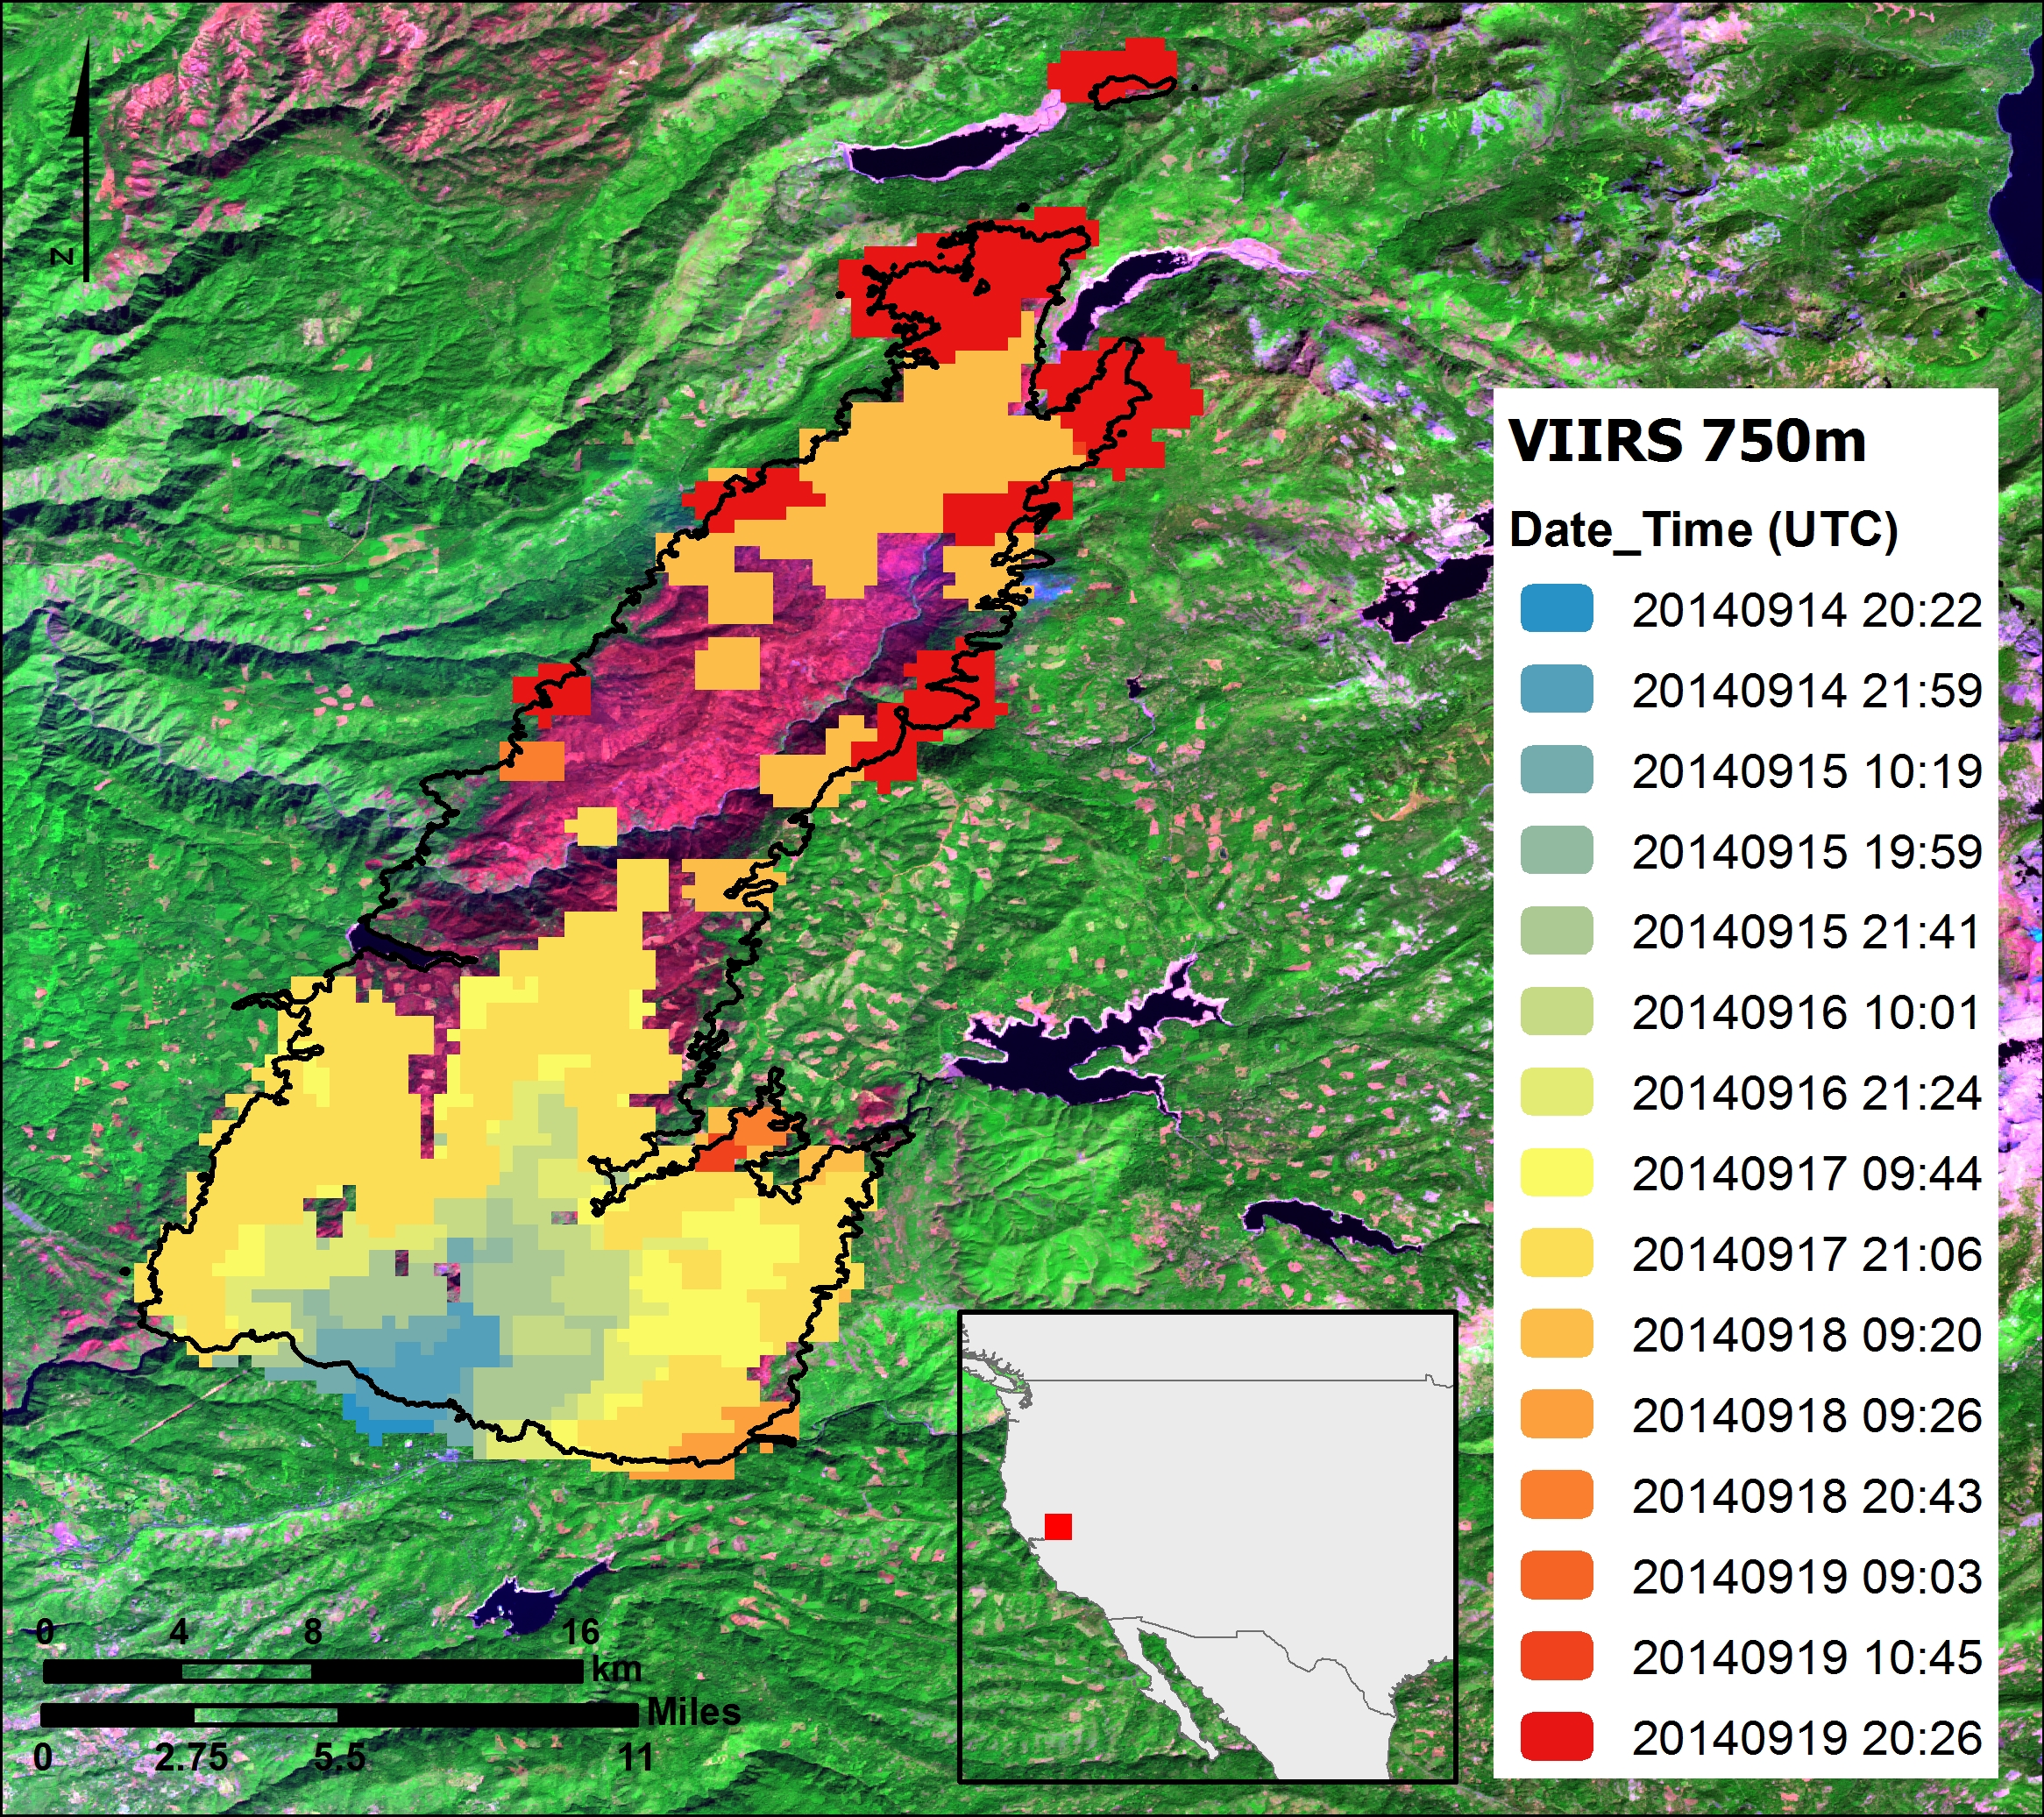
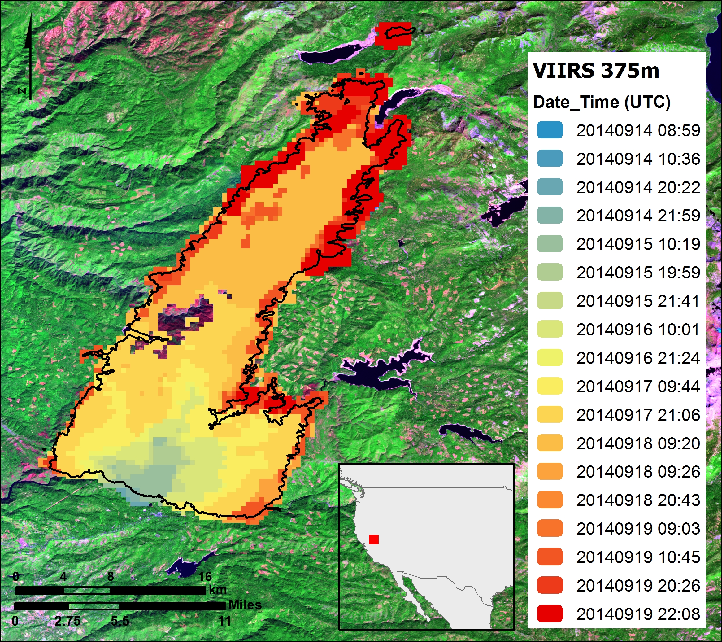
MODIS 1 km × VIIRS 750 m × VIIRS 375 m
Active Fire Data Inter-comparison
King Fire, California (September 2014)
Aqua/MODIS 1 km
NPP/VIIRS 750 m
NPP/VIIRS 375 m

Slide 5
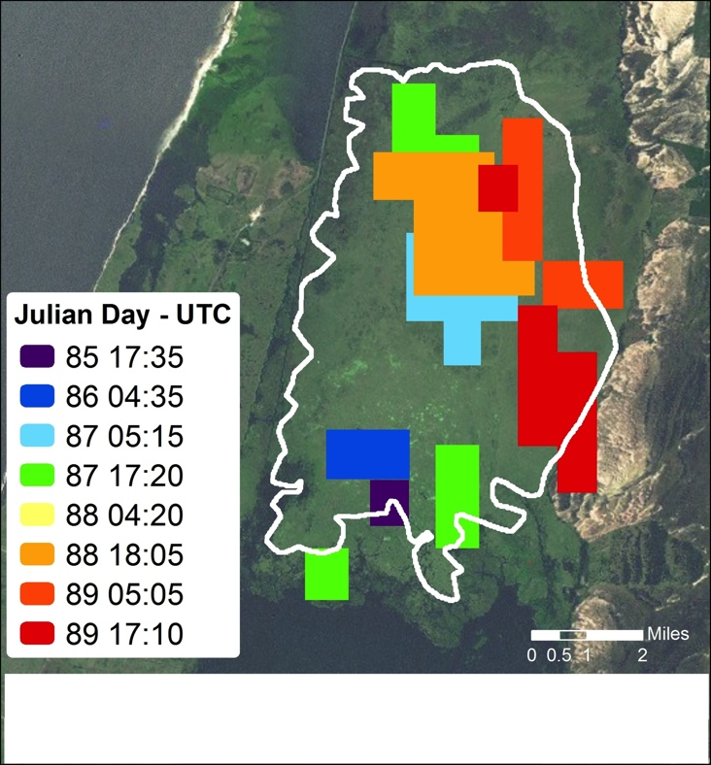
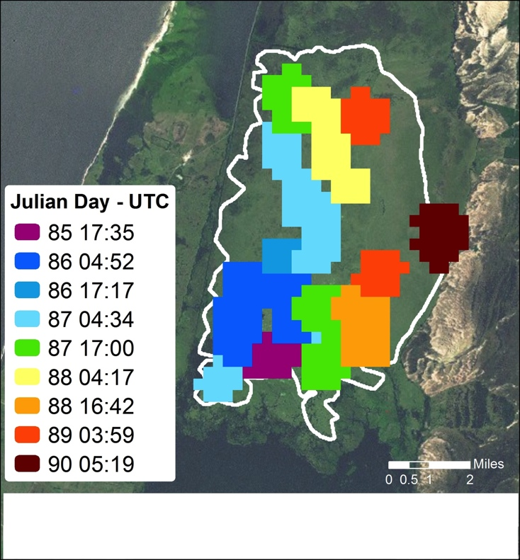
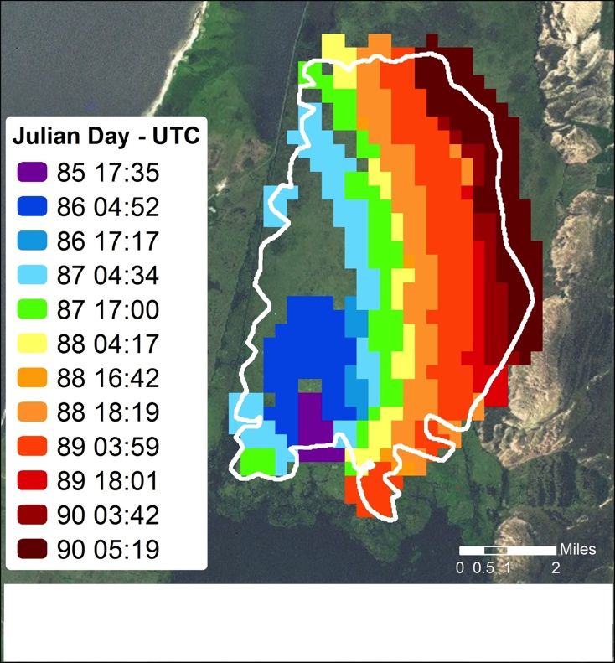
MODIS 1 km × VIIRS 750 m × VIIRS 375 m
Active Fire Data Inter-comparison
Taim Ecological Reserve, Southern Brazil (March 2013)
Aqua/MODIS 1 km
NPP/VIIRS 750 m
NPP/VIIRS 375 m

Slide 6
MODIS-VIIRS Fire Data Continuity:
Important SRF Differences
Standard atmospheric transmittance and
mid-infrared channel spectral response functions for
VIIRS 375m (I04), VIIRS 750m (M13), and MODIS 1km (B21/22)
CO₂

Slide 7
Active Fire Data Status
Several Level 1 data quality issues affecting input files, in particular dual-gain M13 channel, were addressed since launch
  Data aggregation in brightness temperature domain leading to cold bias and consequent omission errors
  Data anomalies (bad quality flags, missing/corrupted scans, lunar calibration maneuvers) resulting in bands of spurious fire pixels
Outstanding issues continue to be addressed
Incorrect radiance to brightness temperature calculation at/near saturation
  Mx8.9 appeared to have addressed the problem, although initial inspection still indicate potential inconsistency in channel I04
Though greatly reduced, outstanding dual-gain channel data anomalies originate from same calibration error
  Use of nearby scans to fill-in missing calibration data
  Affecting both regular stream and DB data
Flagging of saturated pixels during data aggregation for single gain channels
  Problem cannot be solved for NPP and J1 due to flight software/hardware architecture
  Problem unlikely to be solved for J2 (flight software/hardware already built using same architecture)
    Alternative transmission of full un-aggregated data proposed

Slide 8
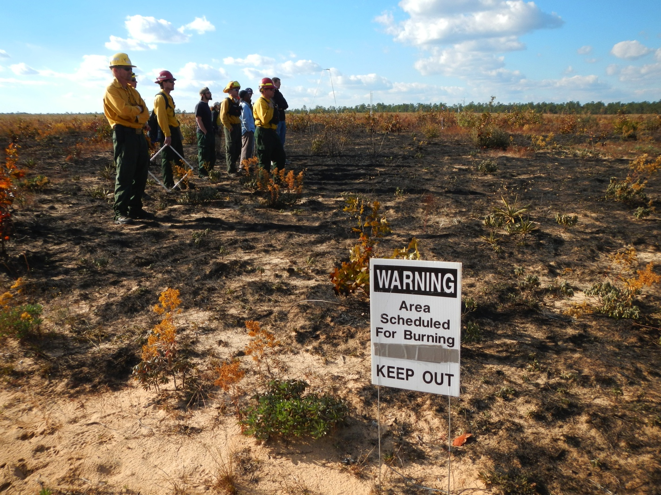
Active Fire Data Validation
Use of Landsat-class data to validate VIIRS is not an option due to prohibitively large time separation between same-day acquisitions
  We won’t match the MODIS validation status for VIIRS ( ≤ stage 2)
Use of prescribed fires (easy/accessible)
Coincident ground, airborne, spaceborne data acquisitions
Community-organized (reduce spending, maximize output)

Slide 9
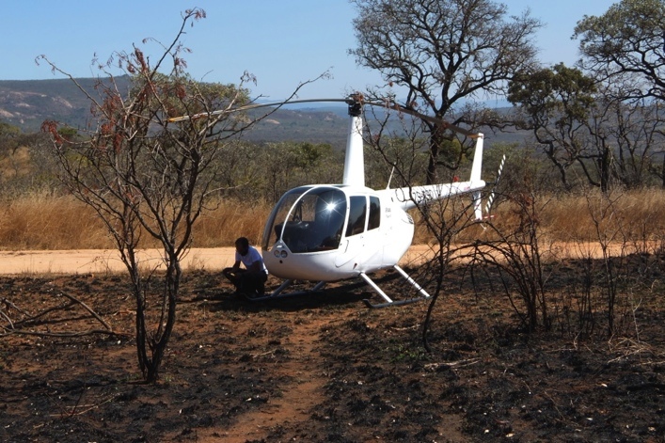
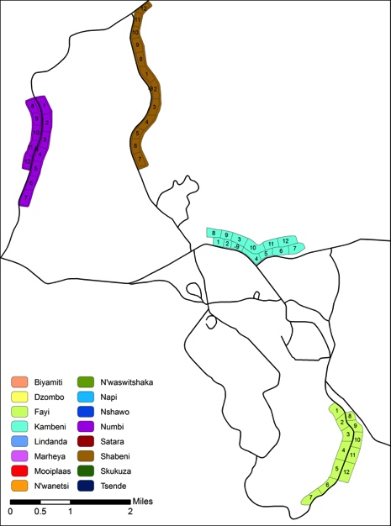
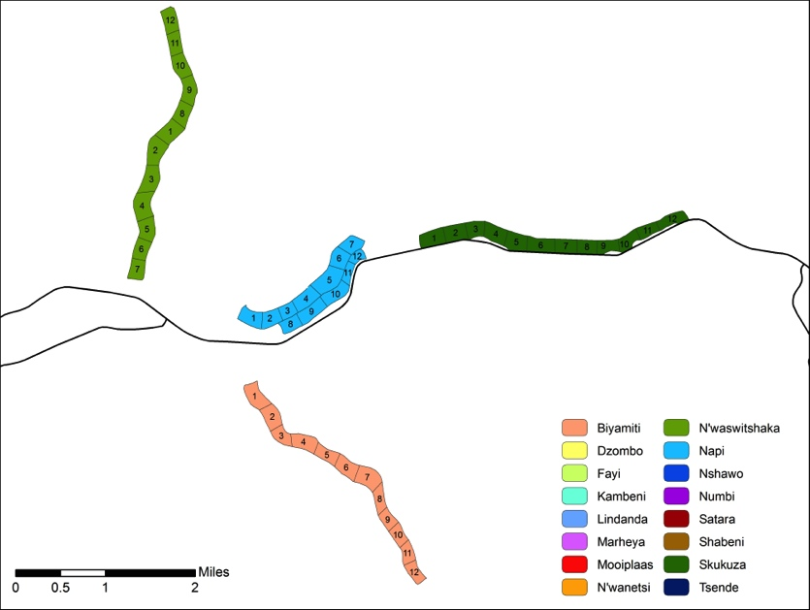
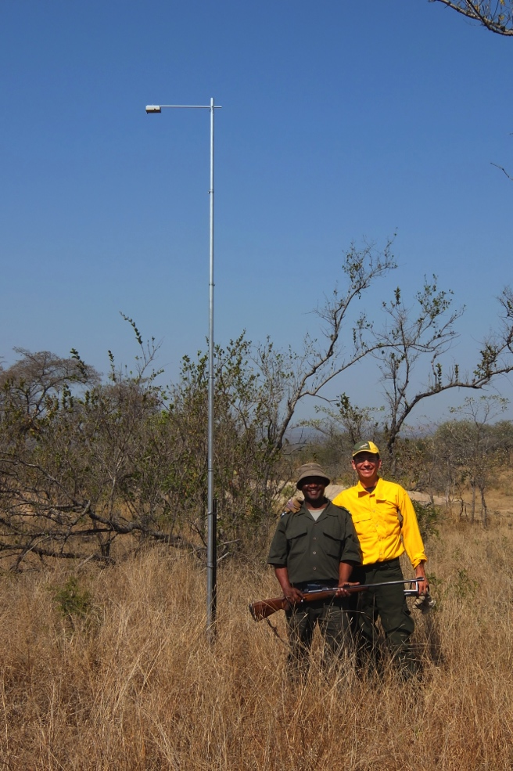
Experimental Fires in Kruger National Park/South Africa
August 2014
Several plots averaging 7 ha in area
300m
300m
NIR
MIR

Slide 10
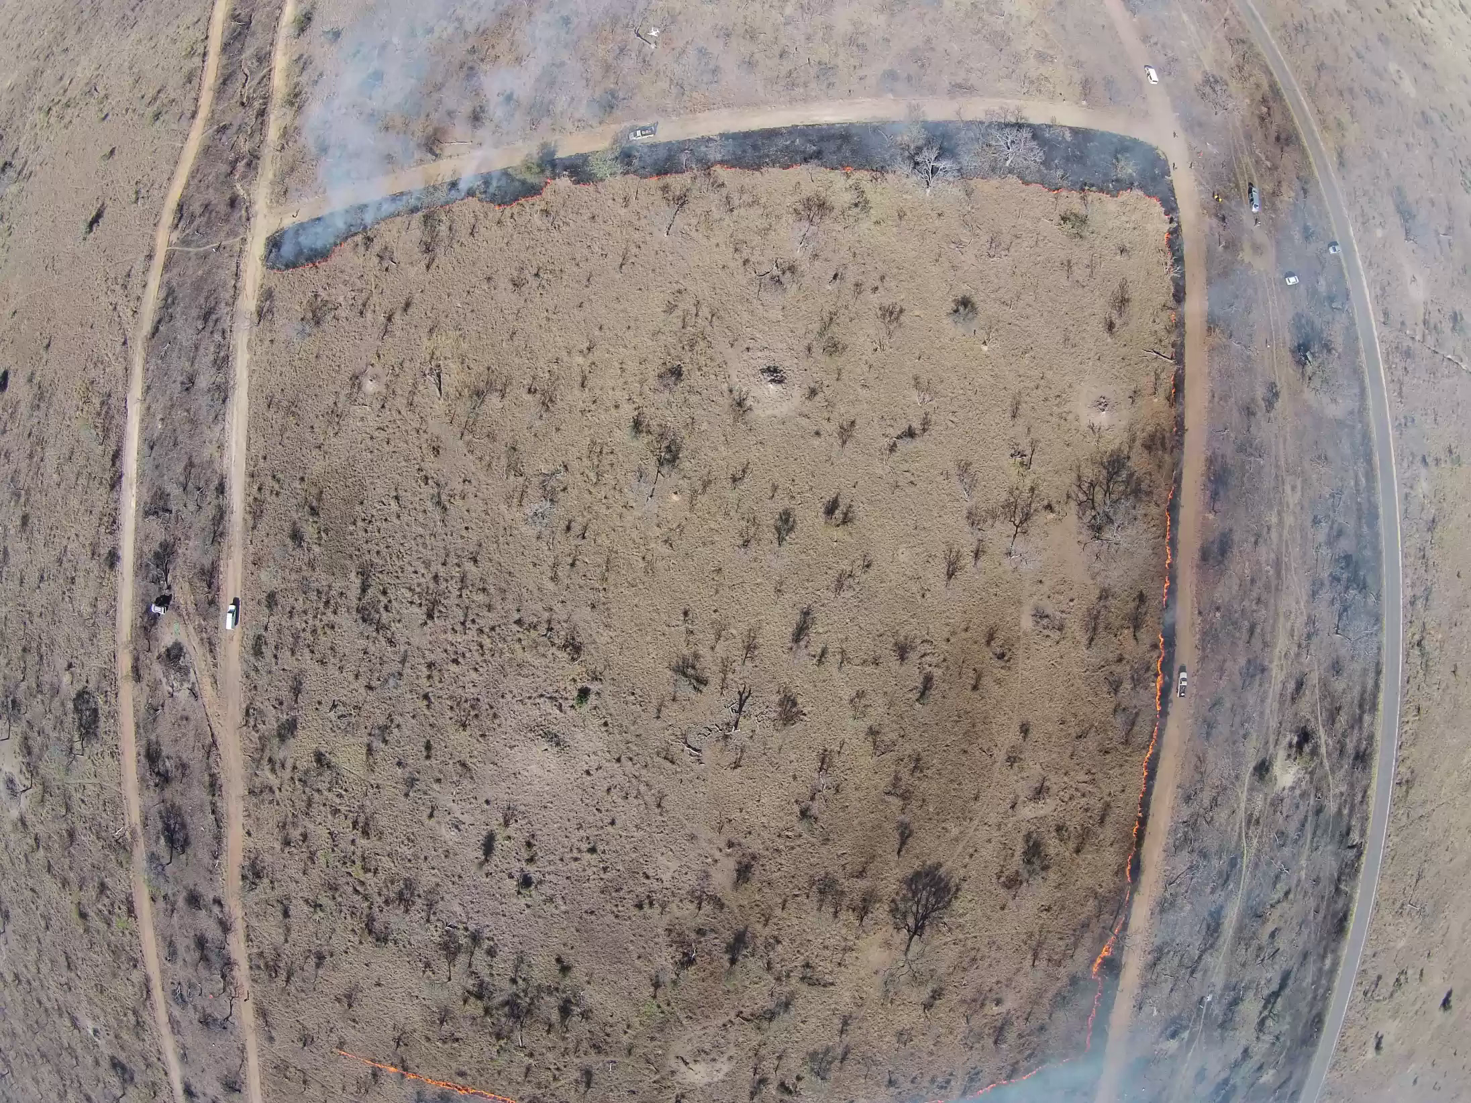
Kruger National Park,
26 Aug 2014
Lon: 31.442º E
Lat: 25.099º S
4ha plot
5min duration

Slide 11
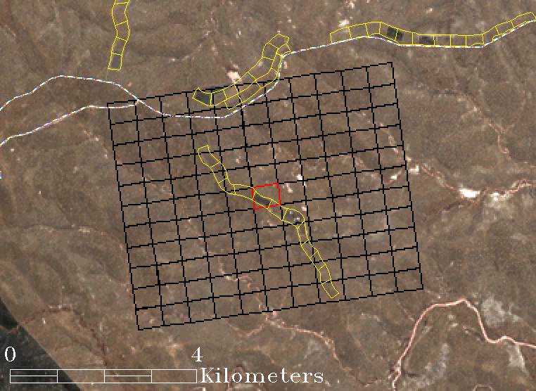
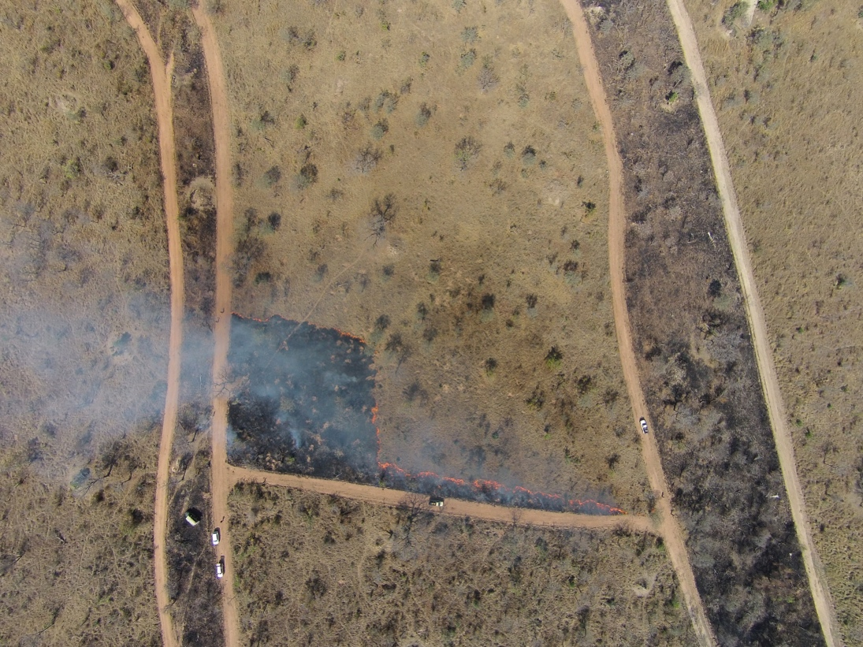
Landsat-8
Kruger National Park
19 August 2014
Lat: 25.131º S
Lon: 31.411ºW
N
N
View from
remote- controlled helicopter
Subset of VIIRS 375 m pixel grid (fire detection in red)
Surface-leaving FRP (VIIRS): 4.4±0.2MW
@ 13:24:26 h local time
Ground Radiometers
Length of active (back) fire front at time of VIIRS overpass: 200 m

Slide 12
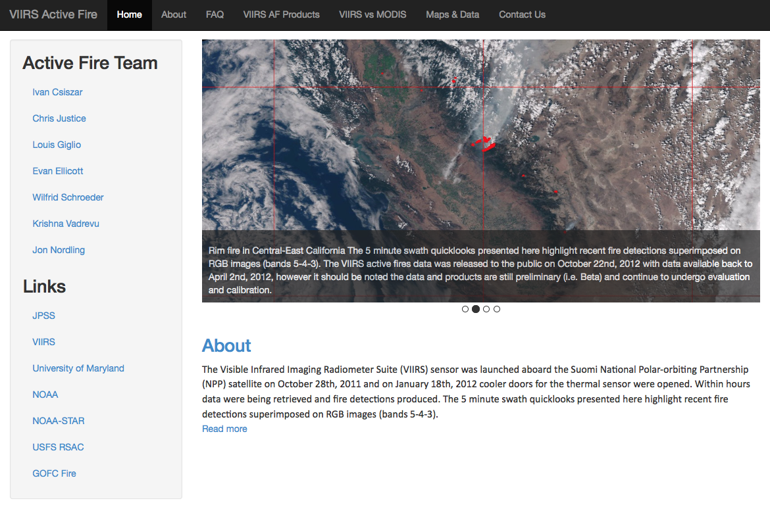
VIIRS Active Fire – University of Maryland
http://viirsfire.geog.umd.edu/

Slide 13
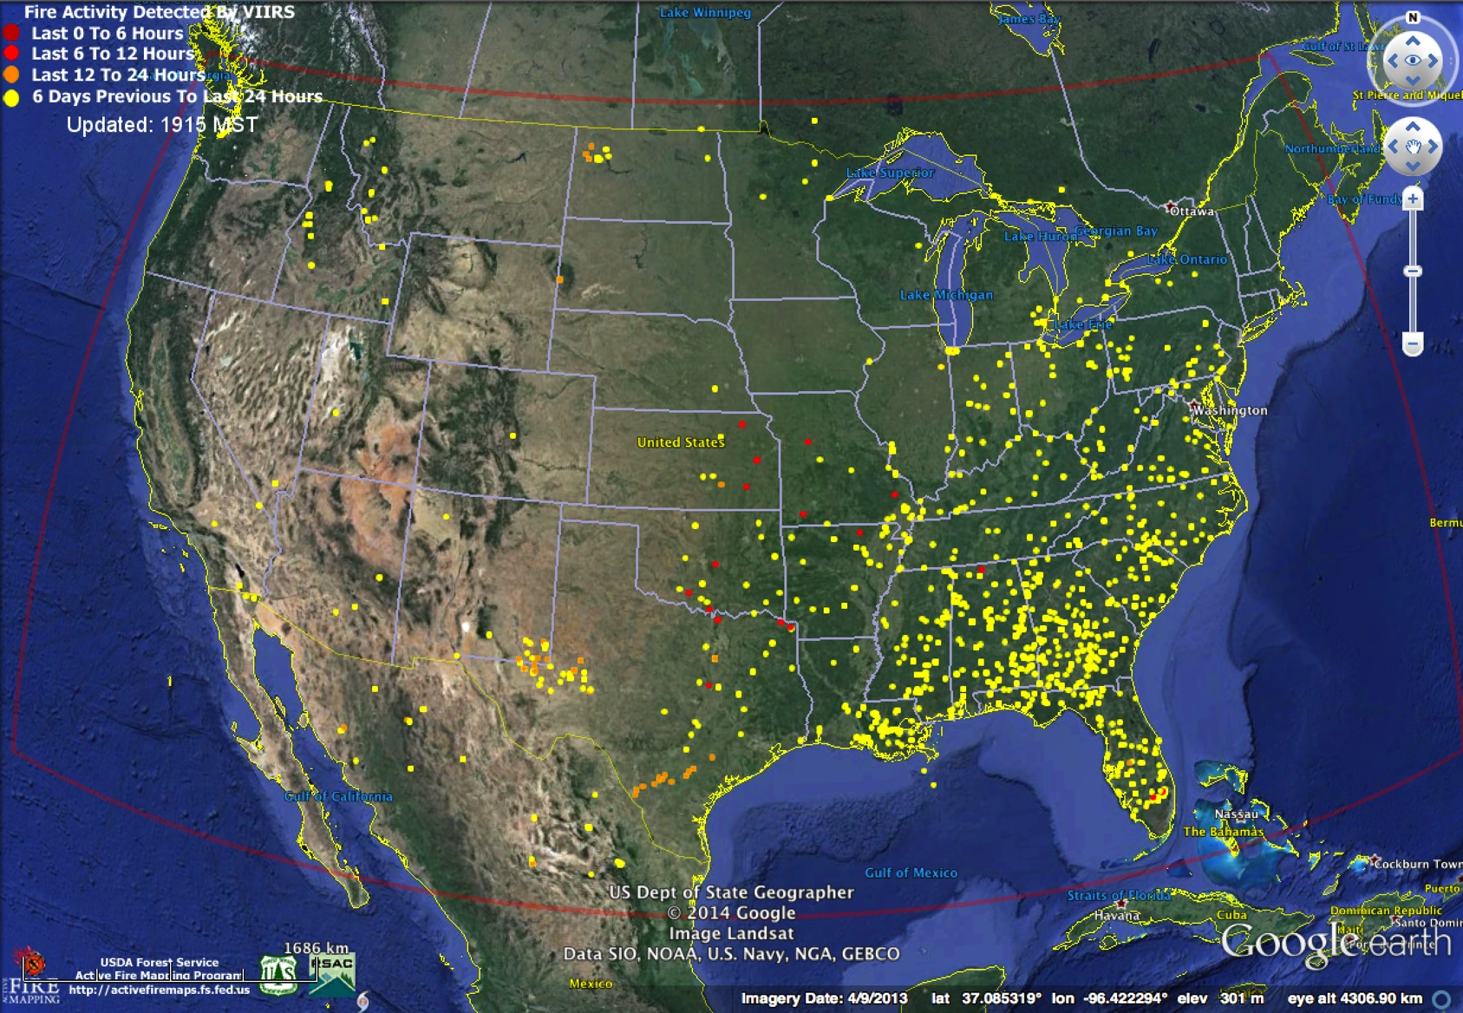
VIIRS 375 m NRT Fire Data Implemented for North America USDA-Remote Sensing Applications Center
http://activefiremaps.fs.fed.us/

Slide 14
Conclusions
VIIRS active fire products on track
  Both algorithms (375 m and 750 m) successfully implemented
  Fire user community already benefiting from VIIRS data
  Inter-comparison with MODIS fire product and initial validation results indicating good overall performance
  Provisions added to MODIS (C6) and VIIRS active fire product files in order to facilitate atmospheric correction of fire retrievals
  Latest science algorithm ported to NESDIS
Future work
  Continue monitoring of/responding to outstanding issues affecting Level 1 input data
  Implement tuning of 750 m fire algorithm
  Further develop/promote 375 m fire algorithm, continue investigation of hybrid algorithm
  Begin implementation of Level 3 product
  Expand validation analyses
    Using drones over relatively small (< 10 ha) fires
    Using field data to verify data simulation techniques

Slide 15
A Global Burned Area Data Record: Extending MODIS to VIIRS
Louis Giglio¹, Luigi Boschetti², David Roy³, Krishna Vadrevu¹, Chris Justice¹
¹University of Maryland, ²University of Idaho, ³South Dakota State University
MODIS/VIIRS Science Team Meeting
May 2015

Slide 16
MODIS Burned Area Products
MCD45A1 | 500-m Monthly L3
MCD45A1-based GIS Products (SCF) | Shapefiles + 500-m GeoTIFF
MCD64A1 (SCF) | 500-m Monthly L3
For all products burning is mapped to the nearest day.

Slide 17
Algorithm/Product Characteristics
MCD45A1
MCD64A1
Predictive BRDF model
500-m, daily
Uses no active fire data
Less noise-tolerant
Poorer mapping under cloudy conditions
Better mapping of cropland burning
Supervised classifier
500-m, daily
Exploits active fire data
More noise-tolerant
Better mapping under cloudy conditions
Poorer mapping of cropland burning

Slide 18

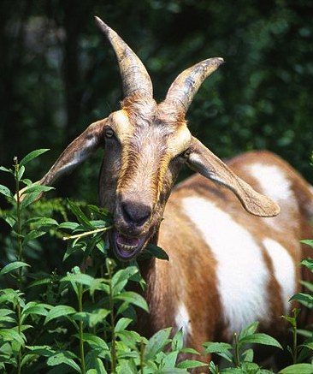
Merge features of the two different approaches to produce a better C6 product, i.e., a “Koala Goat”.
MCD45
MCD64
Wikimedia Commons
Notes:
Photo credits: Wikimedia Commons

Slide 19

Merge features of the two different approaches to produce a better C6 product, i.e., a “Koala Goat”.
MCD45
MCD64
Wikimedia Commons
Notes:
Photo credits: Wikimedia Commons

Slide 20
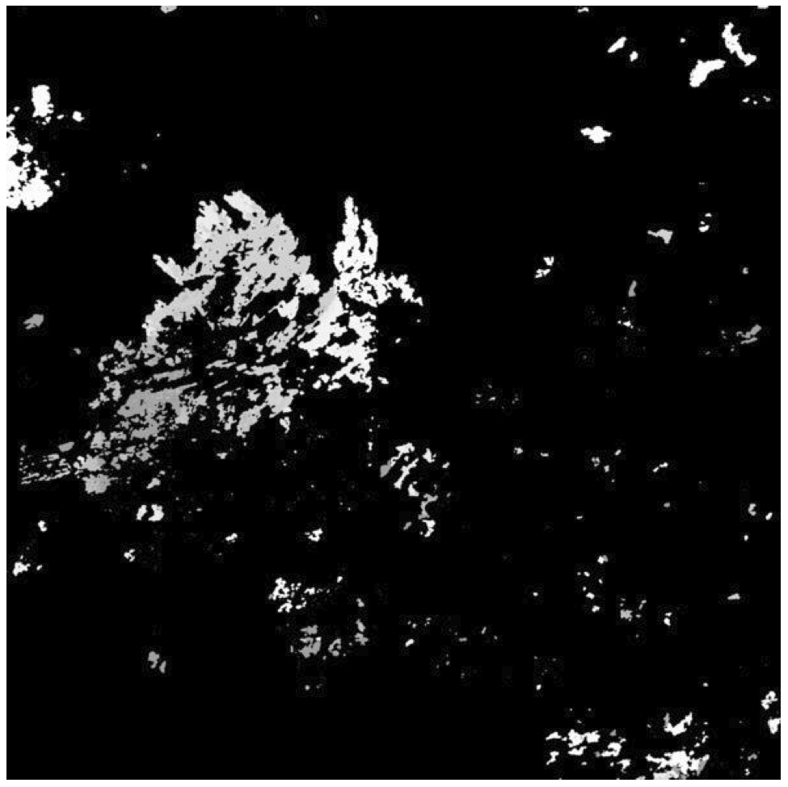
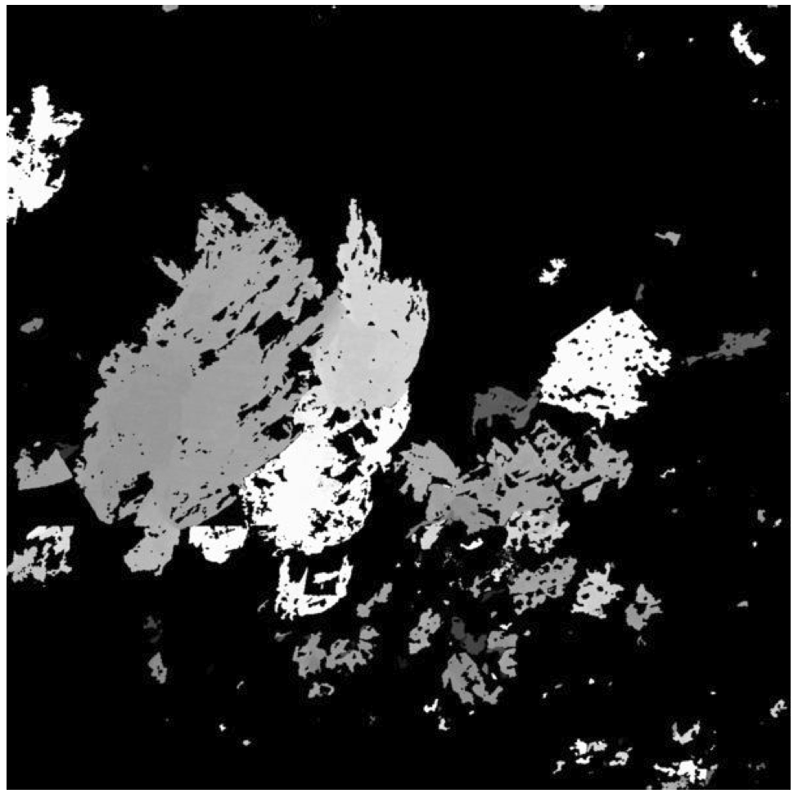
Large burn in Botswana, Aug.-Sep. 2008
~ 100 km
C5.1 MCD45
C5.1 MCD64

Slide 21
MCD64A1 C6 Changes (So Far)
More smaller burns detected
  5%-10% increase in total burned area
  30%-100% increase in agricultural burned area

Slide 22
VIIRS Burned Area Product
Level 3: Monthly 10° × 10° tiles (sinusoidal projection); burns mapped on a daily basis
  500-m spatial resolution for consistency with C6 MCD64A1 burned area product
  Compromise between M- and I-band spatial resolution
Additional QA and temporal uncertainty layers
0.25° CMG
Shapefiles and GeoTIFF files produced at SCF

Slide 23
VIIRS Burned Area Product
Will use VIIRS bands M5, M7, M8, and M11
  Alternate 375-m I-bands will be considered
VIIRS MCD64A1 prototyped with daily, 1-km NPP_DSRFIP_L3 surface reflectance product from Land SIPS as placeholder

Slide 24
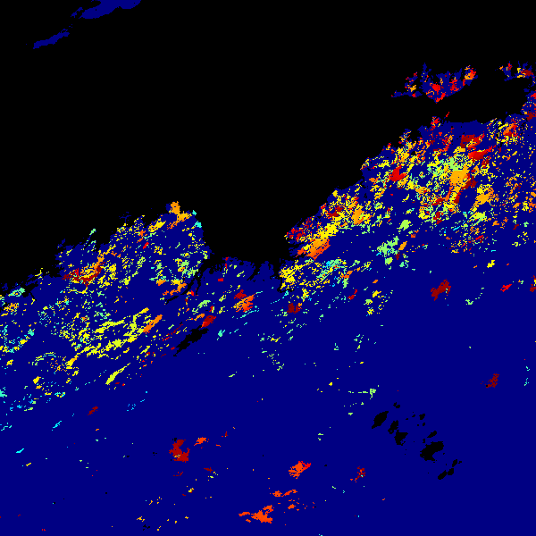
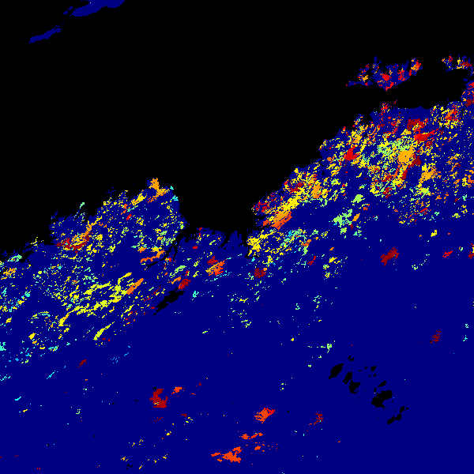
MCD64A1 Burn Date
Australia (h30v10), 1 March – 31 August 2014
MODIS
VIIRS

