Slide 1
A Deterministic Inverse Method for SST Retrieval from VIIRS:
Early Results
Andy Harris, Prabhat Koner
CICS, ESSIC, University of Maryland
Notes:
Add the “title” of the product or service to the cover slide.
Add the project lead(s) name, office, and the date slides are submitted.
If this product/service development is stopping at the pre-operational phase, change the word “Operational” to “Pre-Operational”.

Slide 2
Motivation
Previous generation SST algorithms are regression-based
  E.g. MCSST, NLSST (Pathfinder)
  Usually employed direct regression of radiances against in situ SSTs
  Ameliorates issues with instrument calibration/characterization
Some success for RT-based regression
  Primary example (A)ATSR series
  Well-calibrated and characterized radiometer
  Dual-view permitted robust retrieval, but fairly narrow swath
Regression-based algorithms could result in regional/seasonal biases
  Attempt to characterize global retrieval conditions with only a few coefficients
  Causes bias if local atmospheric conditions are different from the ensemble mean for the training data

Slide 3
Simulated Pathfinder Retrieval Errors
ERA-40 “matchup” subset
Pathfinder matchups
Lat, lon, time, view angle
ERA-40 data
Atmospheric profiles
SSTs
CRTM
Simulated matchup BTs
CRTM
No Aerosols & ERA-40 data filtered for cloud fraction
Simulated global BTs
SST Retrieval coefficients
Simulated Pathfinder SSTs (+ ERA-40 SSTs)
N.B. Bias is Pathfinder SST – ERA-40 SST
Notes:
Pathfinder algorithm training procedure is followed, i.e. 5-month rolling-regression with max weight on central month.
NLSST algorithm is partitioned by 11 um – 12 um BT difference (as per Pathfinder). Full month of cloud-free ERA-40 data are randomly sampled in view angle. Cloud-free makes use of grid points <50% cloud cover and RH values within the profile above 95% are reset to 95%.

Slide 4
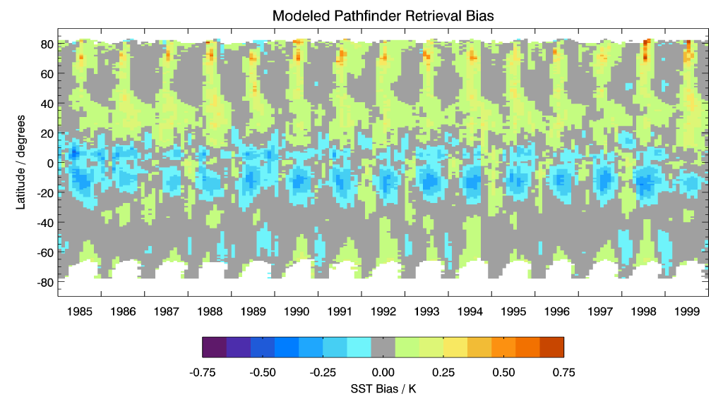
Modeled Pathfinder Bias 1985 – 1999
What happens when we include volcanic aerosol?

Slide 5
Simulated Pathfinder Retrieval Errors
ERA-40 “matchup” subset
Pathfinder matchups
Lat, lon, time, view angle
ERA-40 data
Atmospheric profiles
SSTs
CRTM
Simulated matchup BTs
CRTM
Insert volcanic aerosol optical depths
Simulated global BTs
SST Retrieval coefficients
Insert volcanic aerosol optical depths
Simulated Pathfinder SSTs (+ ERA-40 SSTs)
N.B. Bias is Pathfinder SST – ERA-40 SST
Notes:
Pathfinder algorithm training procedure is followed, i.e. 5-month rolling-regression with max weight on central month.
NLSST algorithm is partitioned by 11 um – 12 um BT difference (as per Pathfinder). Full month of cloud-free ERA-40 data are randomly sampled in view angle. Cloud-free makes use of grid points <50% cloud cover and RH values within the profile above 95% are reset to 95%.

Slide 6
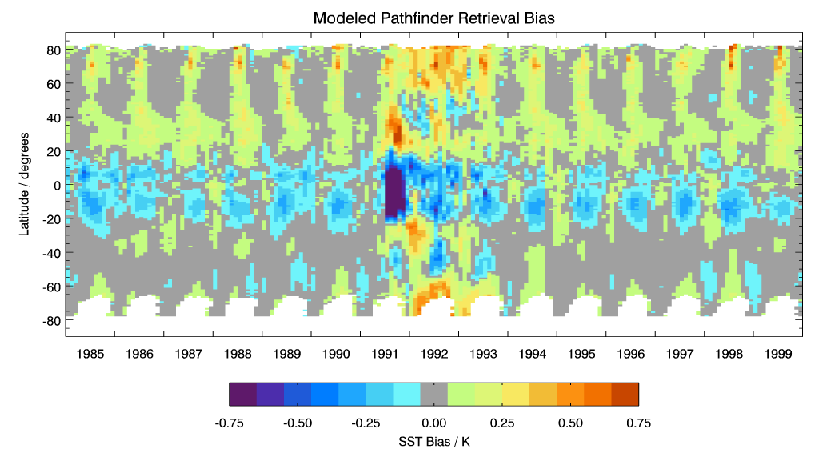
Include Pinatubo in
RTM radiances
Negative bias is reduced, but positive biases are propagated N & S
Split-window based algorithm has no skill in compensating for aerosol

Slide 7
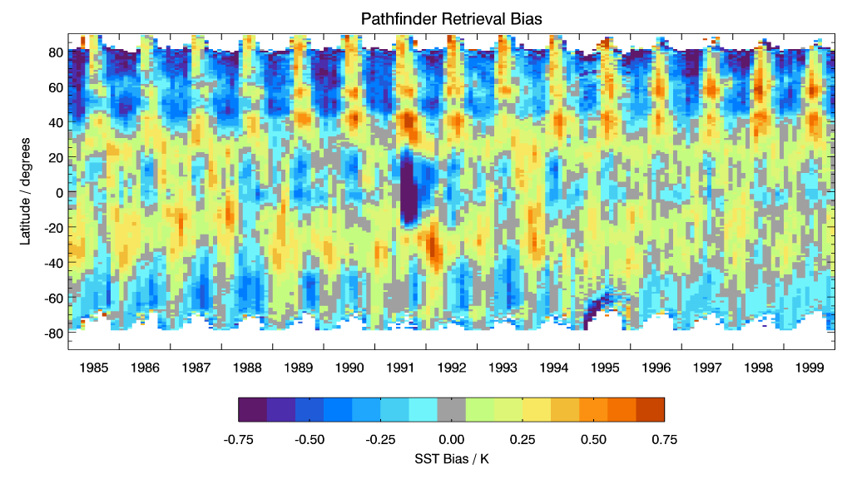
Pathfinder V5 – Daily OI ¼ °
Common features w.r.t. biases induced by Pinatubo aerosol
Actual seasonal variability is greater than predicted by modeling

Slide 8
Physical Retrieval
Reduces the problem to a local linearization
  Dependent on ancillary data (NWP) for an initial guess
  More compute-intensive than regression – not an issue nowadays
    Especially with fast RTM (e.g. CRTM)
Widely used for satellite sounding
  More channels, generally fewer (larger) footprints
Start with a simple reduced state vector
  x = [SST, TCWV]^{T}
  N.B. Implicitly assumes NWP profile shape is more or less correct
Selection of an appropriate inverse method
  Ensure that satellite measurements are contributing to signal
  Avoid excessive error propagation from measurement space to parameter space
    If problem is ill-conditioned

Slide 9
History of Inverse Model
Forward model:
Simple Inverse: (measurement error)
Legendre (1805) Least Squares:
MTLS:
OEM:

Slide 10
Uncertainty Estimation
Physical retrieval
Normal LSQ Eqn: Δx = (K^{T}K)⁻¹K^{T}Δy [= GΔy]
MTLS modifies gain: G’ = (K^{T}K + λI)⁻¹K^{T}
Regularization strength: λ = (2 log(κ)/||Δy||)σ²_{end}
(σ²_{end} = lowest singular value of [K Δy])
Total Error
||e|| = ||(MRM – I)Δx|| + ||G’||⟨||(Δy - KΔx)||⟩
N.B. Includes TCWV as well as SST

Slide 11
DFS/DFR and Retrieval error
Retrieval error of OEM higher than LS
More than 75% OEM retrievals are degraded w.r.t. a priori error
DFR of MTLS is high when a priori error is high

Slide 12
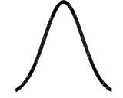
“Optimized” OE
[S_{e}], S_{a} =
Perform experiment – insert “true” SST error into S_{a}⁻¹
  Can only be done when truth is known, e.g. with matchup data
0
σ² is an overestimate…
…or an underestimate
0

Slide 13
DFS/DFR and Retrieval error
Retrieval error of OEM higher than LS
More than 75% OEM retrievals are degraded w.r.t. a priori error
DFR of MTLS is high when a priori error is high
The retrieval error of OEM is good when a priori SST is perfectly known, but DFS of OEM is much lower than for MTLS

Slide 14
Improved cloud detection
Use a combination of spectral differences and RT
  Envelope of physically reasonable clear-sky conditions
Spatial coherence (3×3)
Also check consistency of single-channel retrievals
Flag excessive TCWV adjustment & large MTLS error
Almost as many as GHRSST QL3+, but with greatly reduced leakage

Slide 15
VIIRS Initial Results
Data are ordered according to MTLS error
  Reliable guide for regression as well as MTLS
  Trend of initial guess error is expected

Slide 16
MODIS Initial Results
Note improvement from discarding MTLS error “last bin”
  Irrespective, MTLS is quite tolerant of cloud scheme
Recalculated SST4 coefficients produce quite good results

Slide 17
Things to consider
It seems “obvious” that a sensitivity of 1 is desirable
  E.g. if there is diurnal warming of 5 K, it will be observed in the data, and strong upwellings will be accurately observed, etc.
However, there is a penalty to be paid
  Ill-conditioned problem ➔ noise propagates from measurement space to parameter space
  Compromise is usually struck (e.g. minimum least squares result for training data in a regression algorithm)
Regression algorithms may have sensitivity <1 for large regions
  E.g. daytime algorithms in the tropics (diurnal warming!)
  Causes bias if local atmospheric conditions are different from the ensemble mean for the training data

Slide 18
Things to consider cont’d
Physical retrieval methods locally linearizes the retrieval
  Ameliorate regional bias issues
Physical retrievals still ill-conditioned
  Least-Squares generally considered to have unacceptable noise
Optimal Estimation can have sensitivity ~1
  Requires somewhat inflated SST error covariance
  Leads to relatively poor noise performance
  Using “true” SST error greatly improves retrieval accuracy
  However, SST sensitivity is substantially reduced
MTLS algorithm adjusts its sensitivity
  Sensitivity <1 when initial guess is close to truth
  Sensitivity ➔ 1 when initial guess is far from truth
  Retrieval accuracy approaches “optimized” OEM
  May still be an issue for fine structure

Slide 19
Summary
MTLS seems applicable to VIIRS
  Well-calibrated instrument, with reliable fast RTM available
  Error calculation useful quality indicator
MODIS offers even more possibilities
  “Sounding” channels permit inclusion of basic profile shape information in the state vector
  See Prabhat’s presentation at the Oceans Breakout
Cloud detection can be aided by RTM
  “Single-channel” retrieval consistency, MTLS error calculation
Options for improvement
  Close to validation limit for conventional in situ
  Take advantage of differing length scales to reduce atmospheric noise
  Perhaps combine with sounder for more local atmospheric information
  Refine fast RTM, iteration
  Tropospheric aerosols…

Slide 20
Backup slides

Slide 21
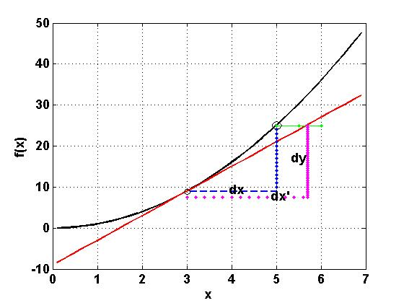
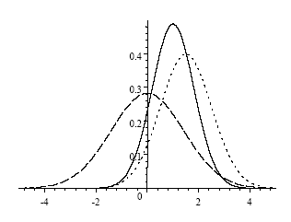
Deterministic & Stochastic
Determinitic | Stochastic/Probabilistic
MTLS/RTLS/Tikhonov: Single pixel measurement error Lengendre (1805) Least Squares: Last 30~40 years: MTLS: Total Error: | OEM: A set of measurement Low confidence for pixel retrieval Chi-Square test: Regression: A set of measurement Historical heritage in SST retrieval using Window channels. Coefficient Vector/matrix: C Main concerns: Correlation & Causation
A posteriori
observation
A priori
Notes:
You need to have a good explanation for the point you’re trying to make for δX ≤ κ δE
Also need to explain why correlation & causation are problems for OEM but not MTLS

Slide 22
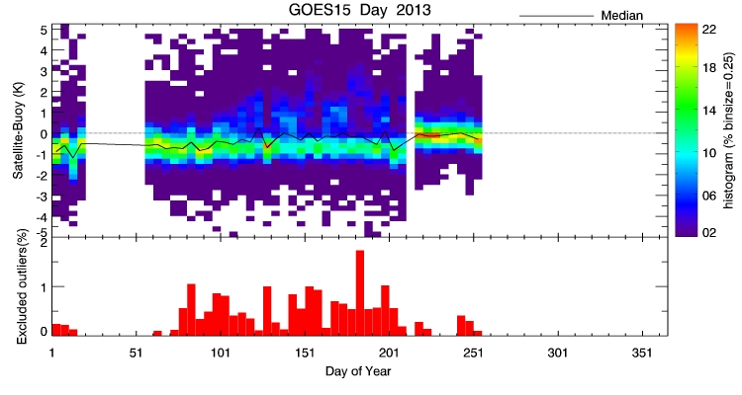
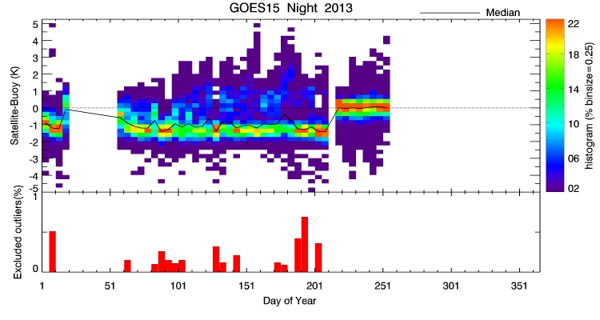
Recent update to Geo-SST
Physical retrieval based on Modified Total Least Squares
Improved bias and scatter cf. previous regression-based SST retrieval
GOES-15
Daytime
Nighttime

Slide 23
How sensitive is retrieved SST to true SST?
If SST changes by 1 K, does retrieved SST change by 1 K?
CRTM provides tangent-linear derivatives
Response of NLSST algorithm to a change in true SST is…
Merchant, C.J., A.R. Harris, H. Roquet and P. Le Borgne, Retrieval characteristics of non-linear sea surface temperature from the Advanced Very High Resolution Radiometer, Geophys. Res. Lett., 36, L17604, 2009

Slide 24
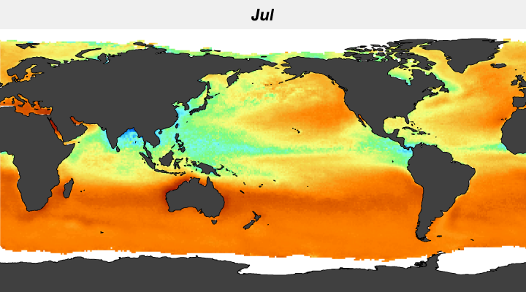
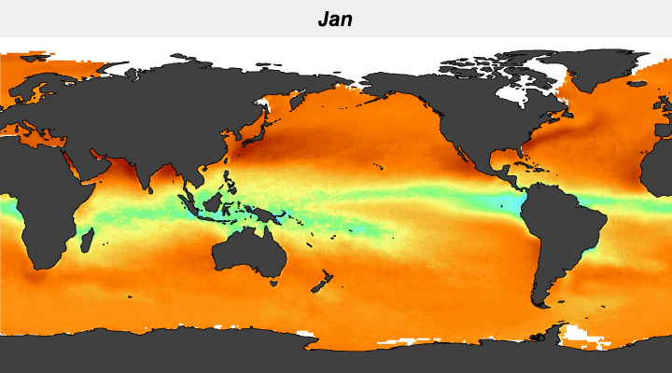

Sensitivity to true SST
Sensitivity often <1 and changes with season

Slide 25
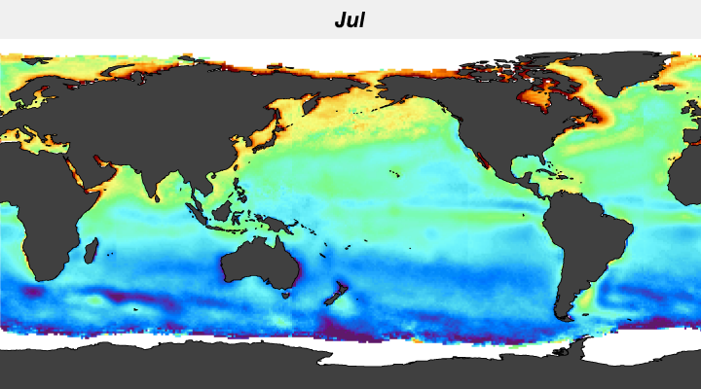
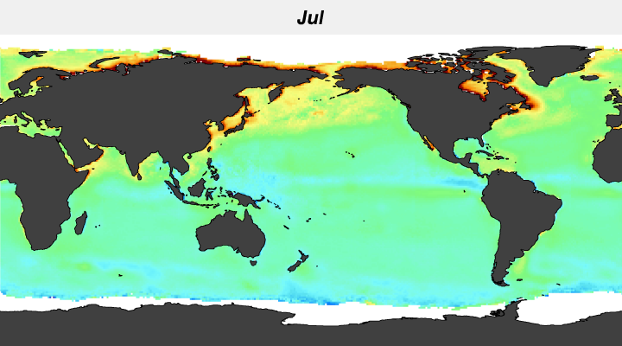


Sensitivity to true SST
Air – Sea Temperature Difference

Slide 26
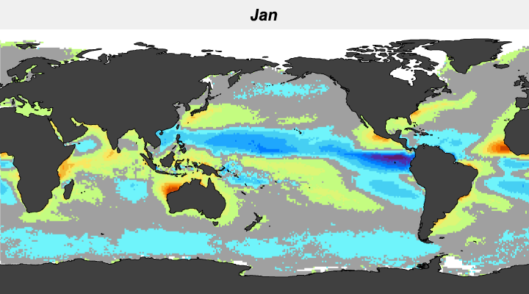
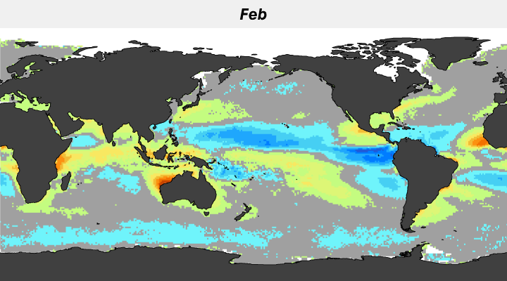
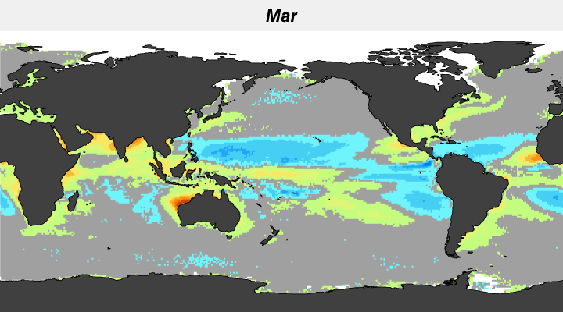
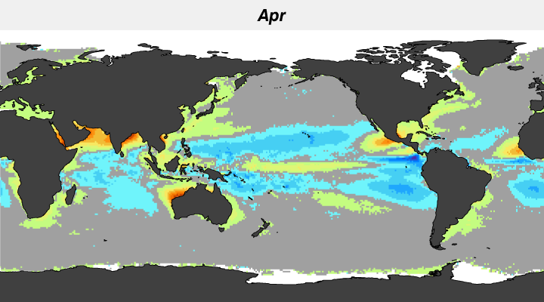
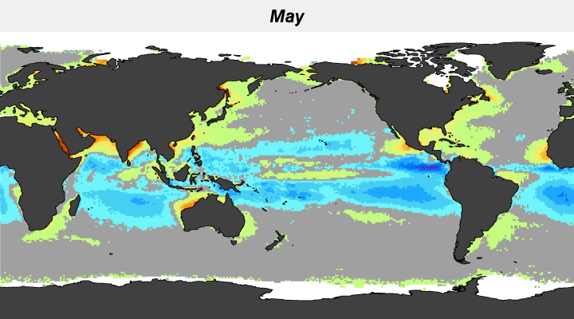
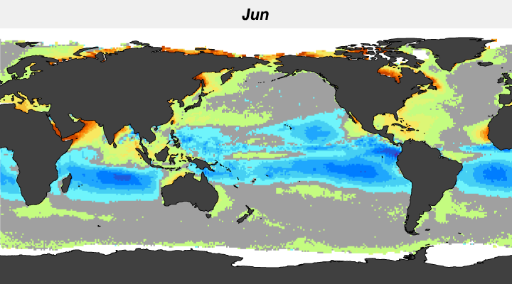
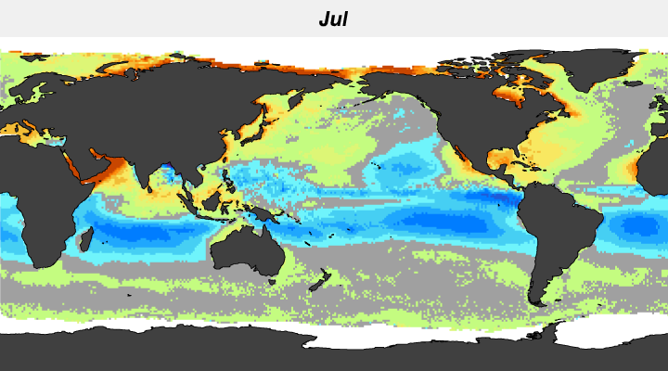
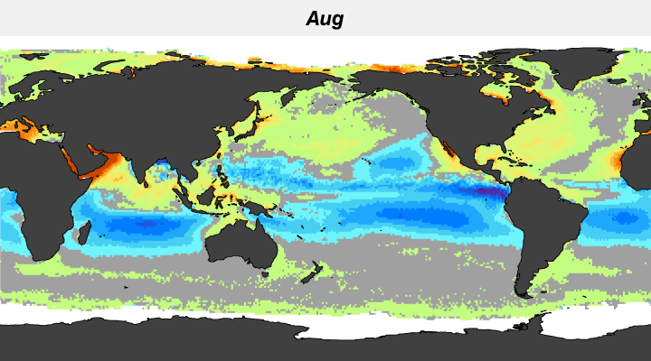
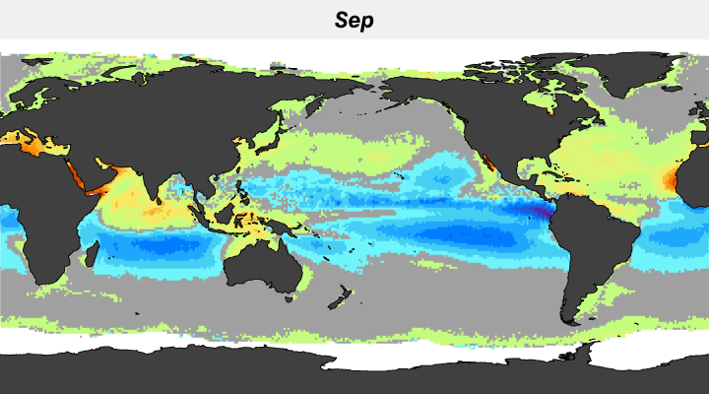
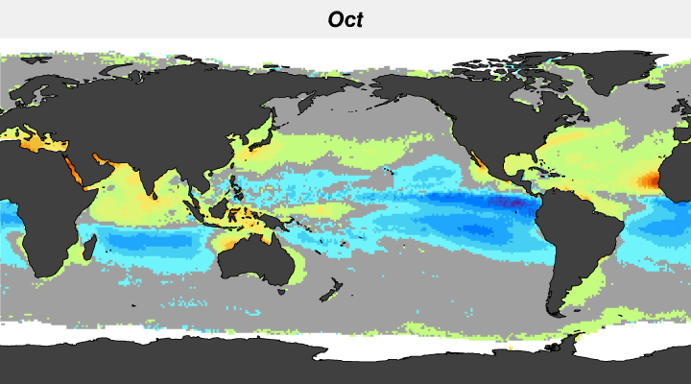
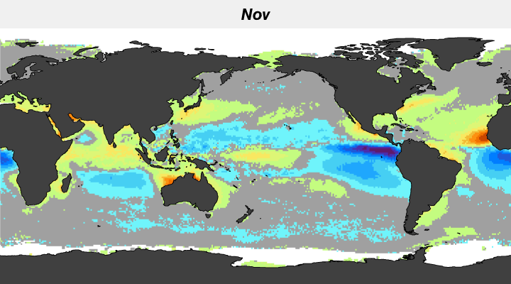
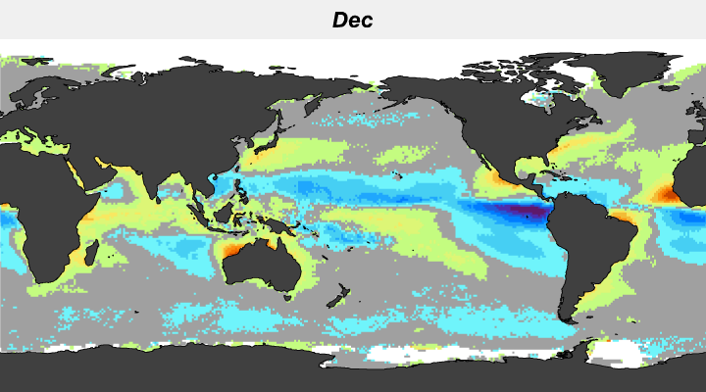
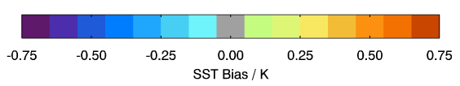
Seasonal Geographic Distribution
of Bias

Slide 27
Characteristics of different cloud detections
The data coverage of new cloud (NC) 50% more than OSPO
# cloud free pixels for high SZA is sparse – maybe OSPO & OSI-SAF regression form are not working for this regime
There is no physical meaning from RT for a regression variable of SSTg multiplied with (T11-T12).
Notes:
Why the different color scales for OSPO & NC? Can they be the same?
Phrases like “no physical meaning” are provocative, so have a good explanation for what you mean (or soften the language)

