Slide 1

Update on
Algorithm MAIAC
Alexei Lyapustin (GSFC-613)
Yujie Wang (UMBC)
Sergey Korkin (USRA)
May 20, 2015

Slide 2
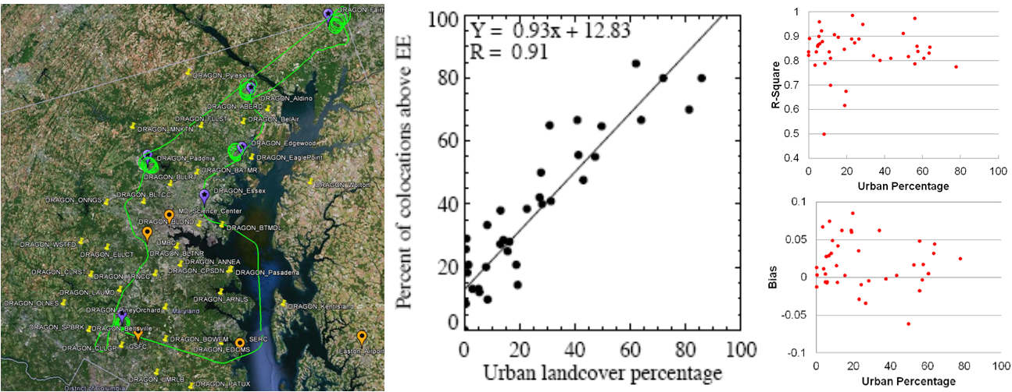
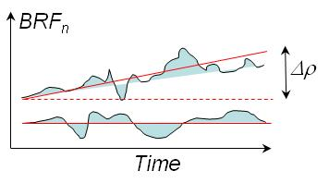
MAIAC: Building a Complete Physical Model of Atmosphere-Surface (RT)
DT MAIAC
- Anisotropic surface;
- SRC Retrieval
- Detection of seasonal and rapid change:
- Dynamic LWS classification;
- Adaptive and learning system:
Aerosol Type Discrimination;
Synergy among WV, CM, aerosol and AC;
(global aerosol retrievals; low urban bias)
BRF
BRF_{n}
NIR
RGB
(store and dynamically update clear-sky TOA reflectance; spectral BRDF; spatial variability metrics; brightness temperature and contrasts @1km)

Slide 3
Current Status
MAIAC is at MODAPS;
MAIAC MODIS reprocessing expected to start this summer;
MAIAC MODIS for North America, South America, Africa (±10°), and Europe for 2000-mid-2014 is available at NASA NCCS ftp:
ftp://maiac@dataportal.nccs.nasa.gov/DataRelease/
(if asked for password, press Enter);
- Continuous science development: CM, snow detection and characterization, aerosol typing; specific developments for tropics.

Slide 4
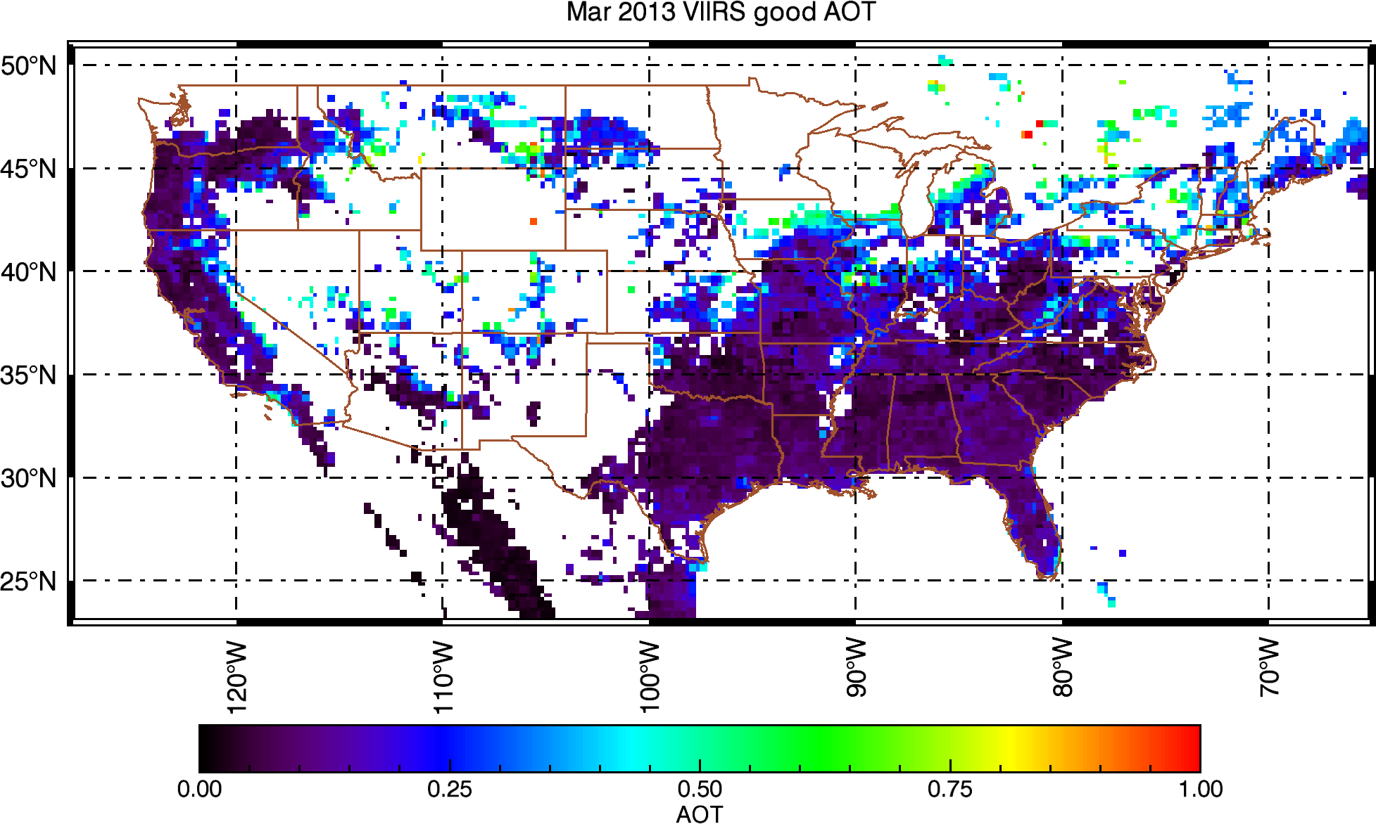
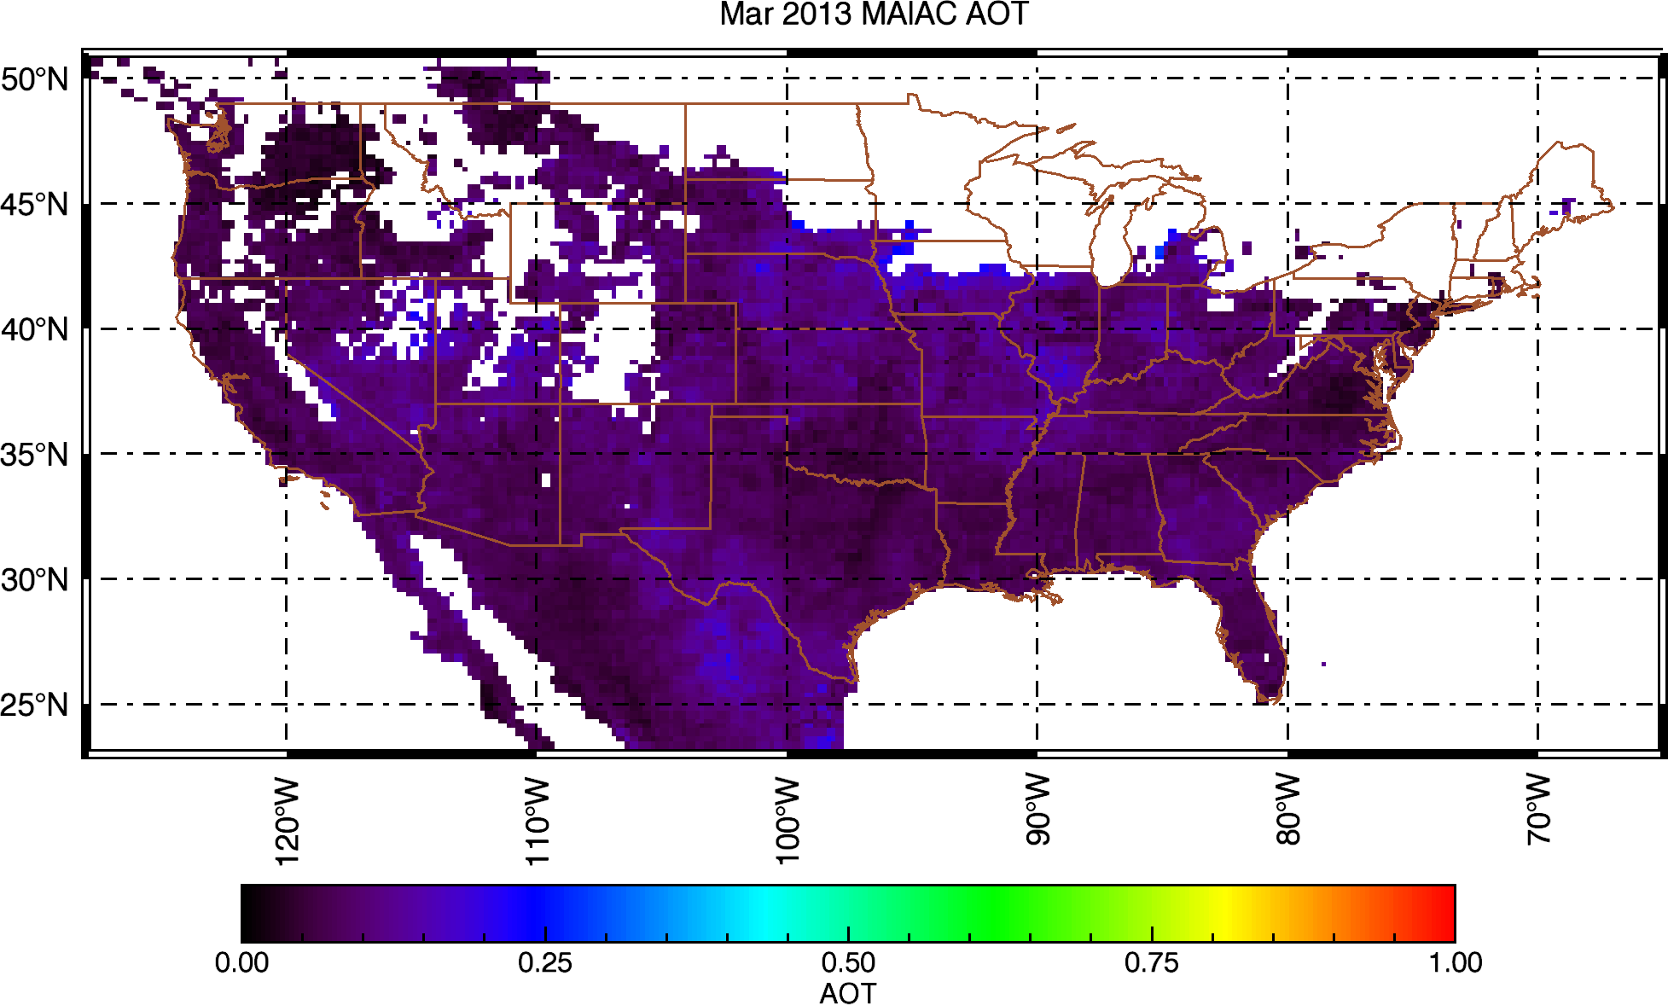
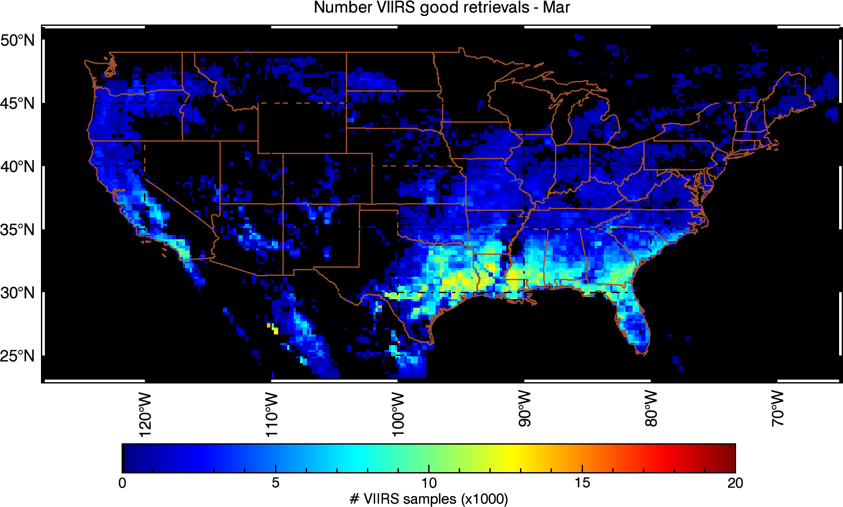
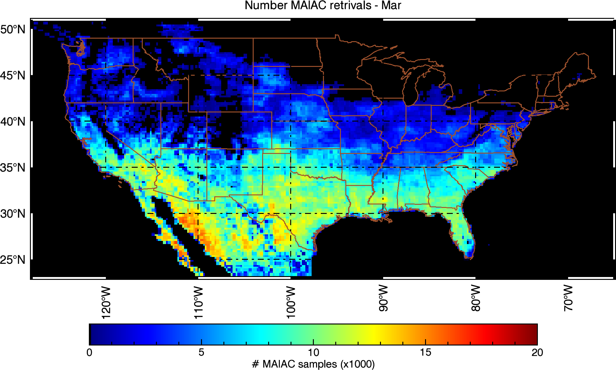
VIIRS AOT IP vs MODIS MAIAC (25km)
(S. Kondragunta, S. Superczynski (NOAA), study for NASA GeoCAPE project)

Slide 5
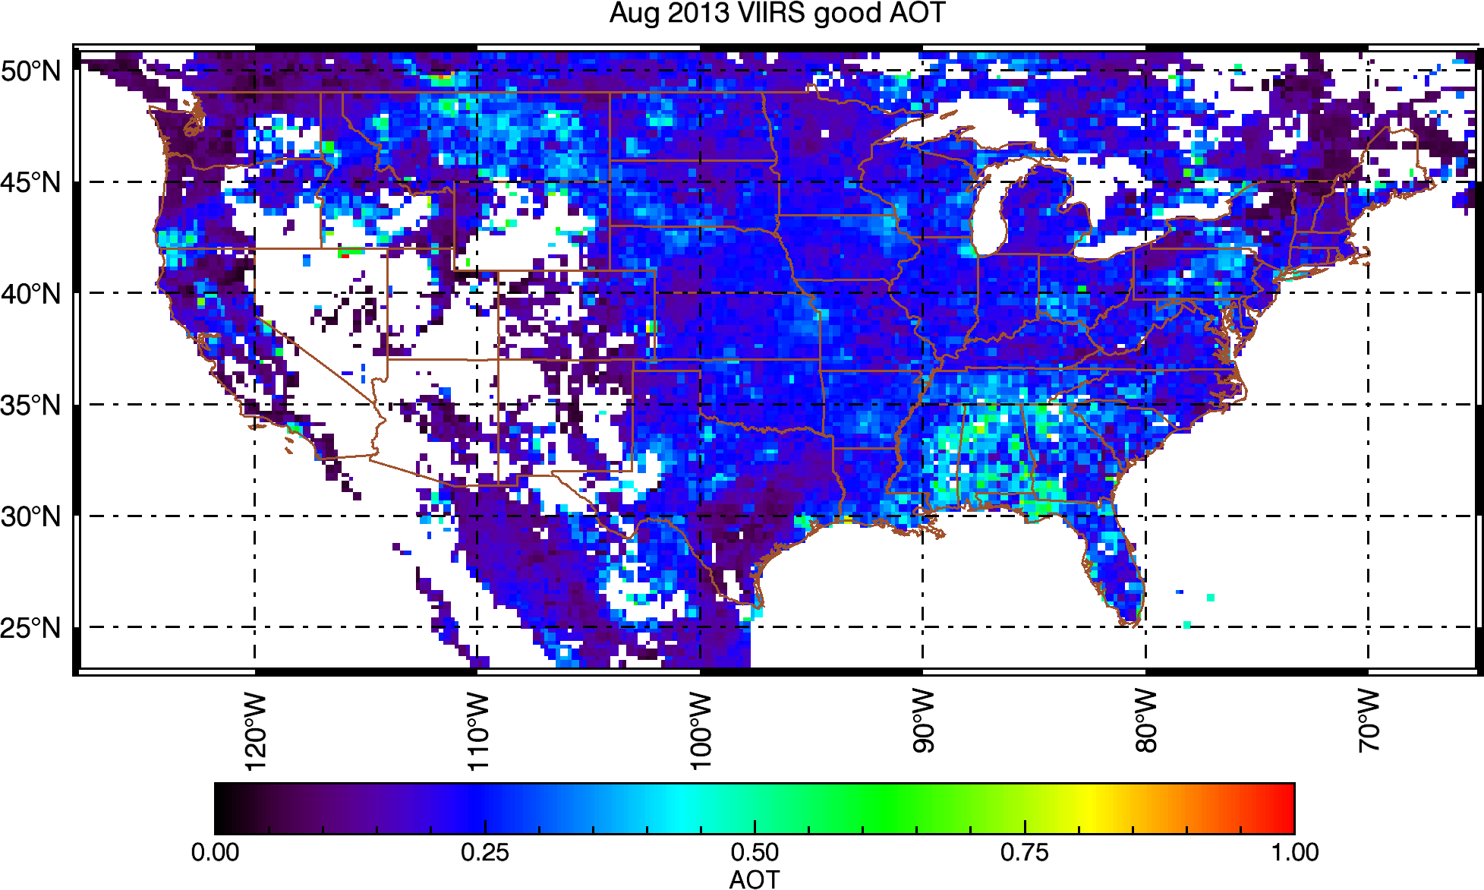
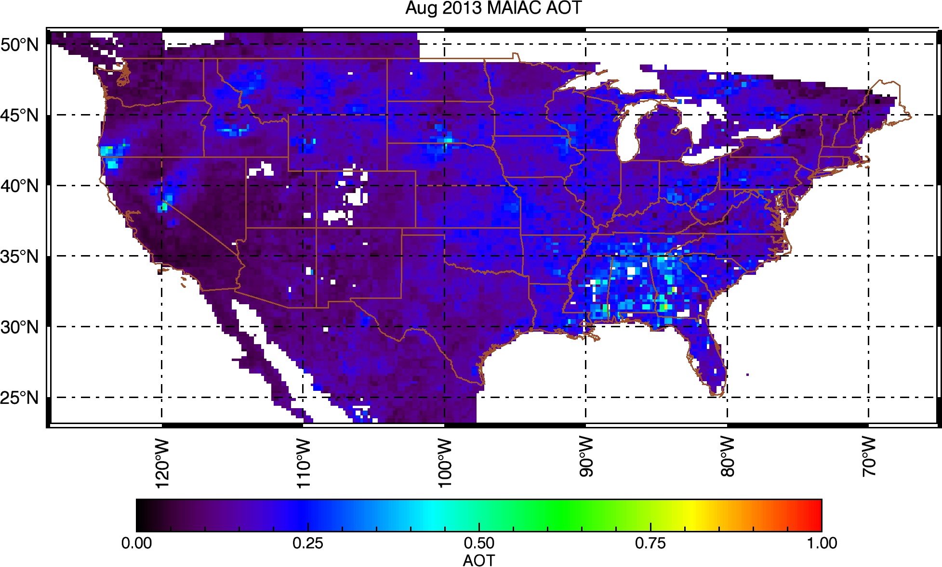
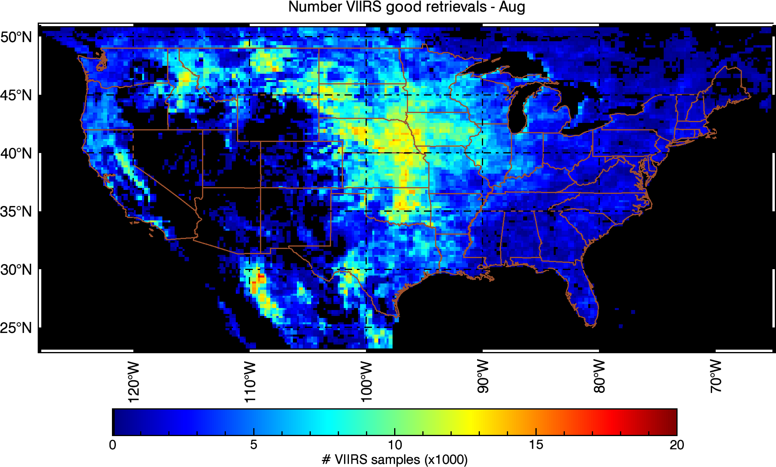
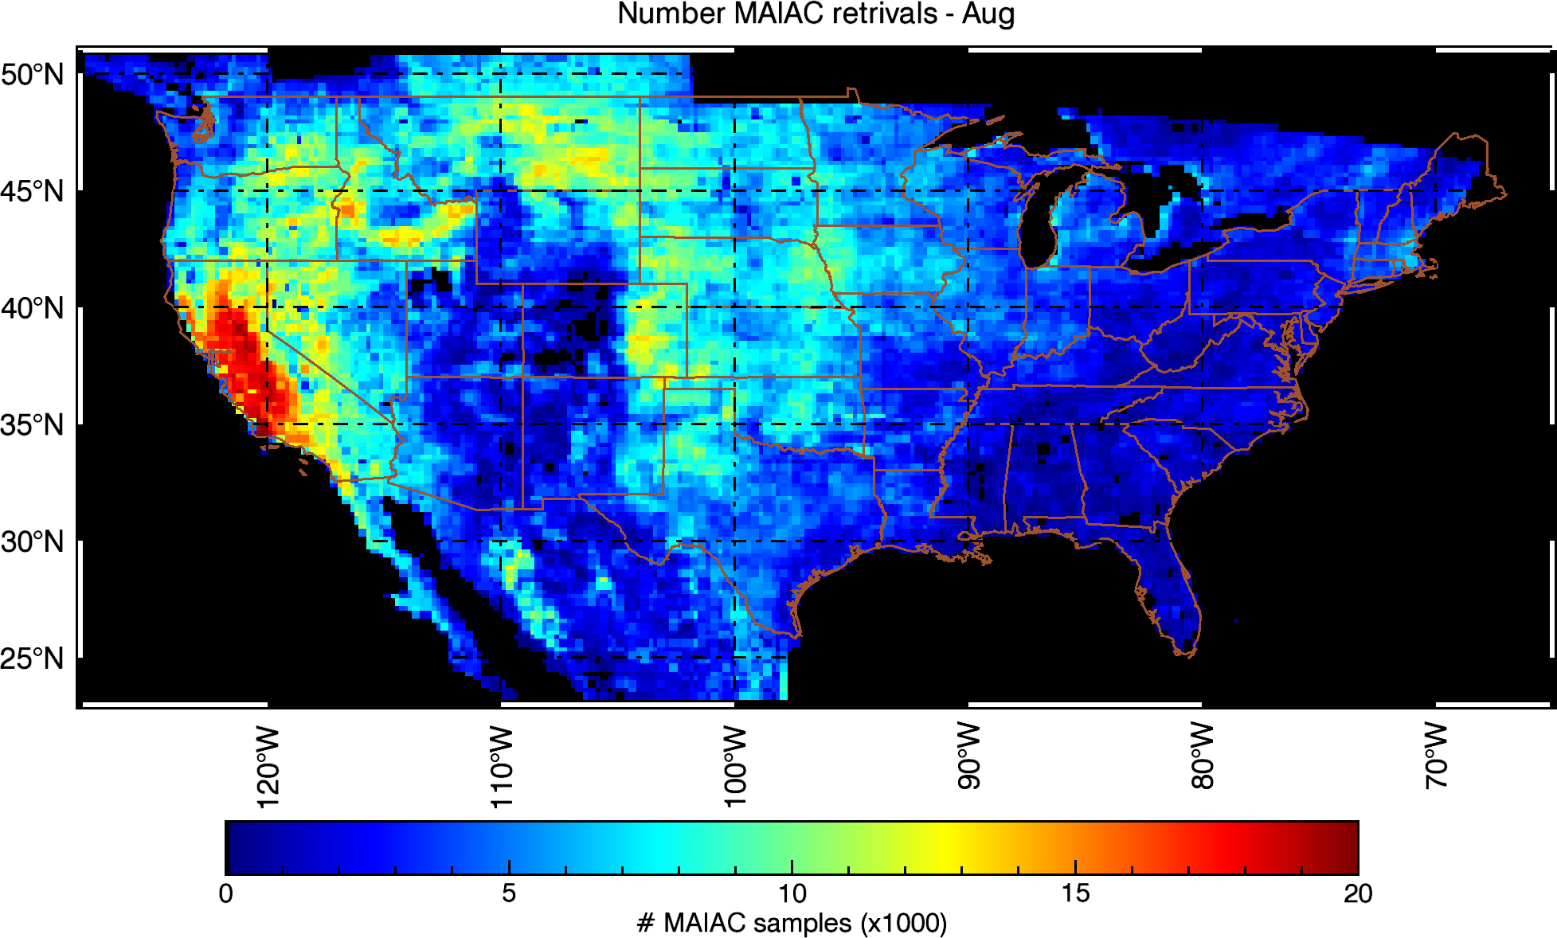
VIIRS AOT IP vs MODIS MAIAC (25km)
(S. Kondragunta, S. Superczynski (NOAA), study for NASA GeoCAPE project)

Slide 6
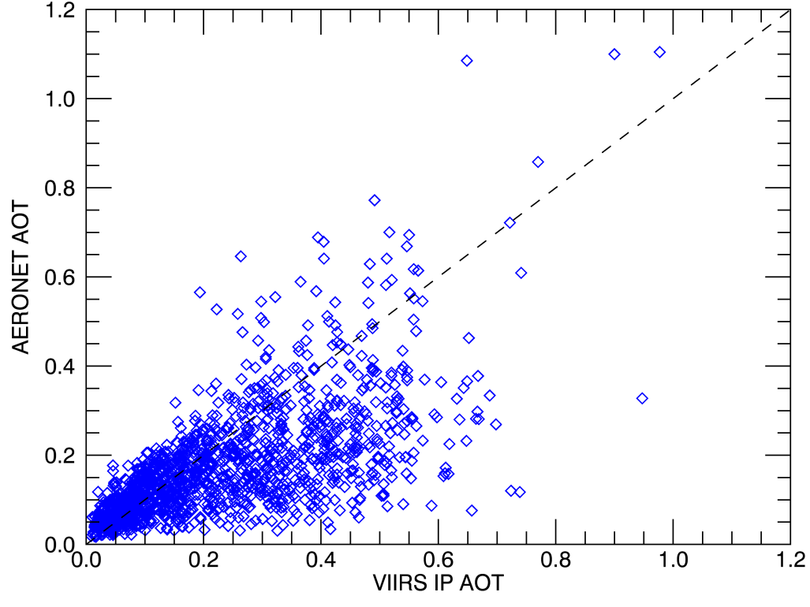
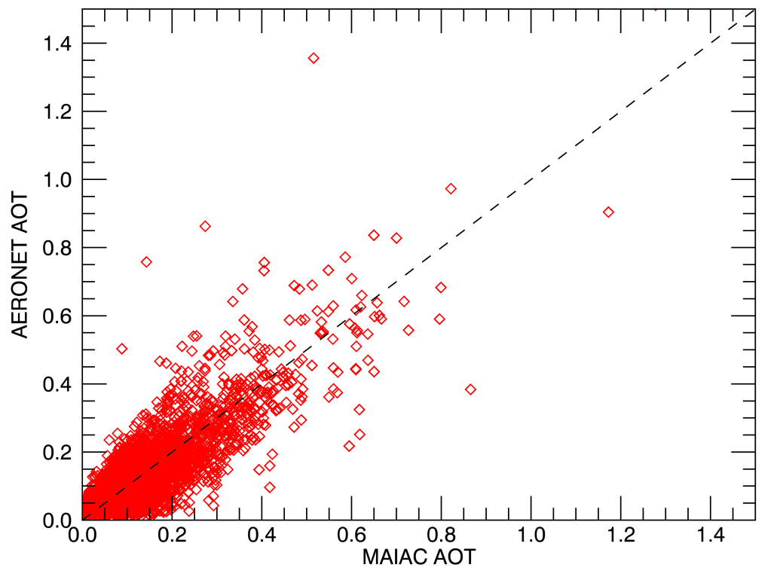
VIIRS AOT IP vs MODIS MAIAC (25km)
(S. Kondragunta, S. Superczynski (NOAA), study for NASA GeoCAPE project)
AERONET Comparisons

Slide 7
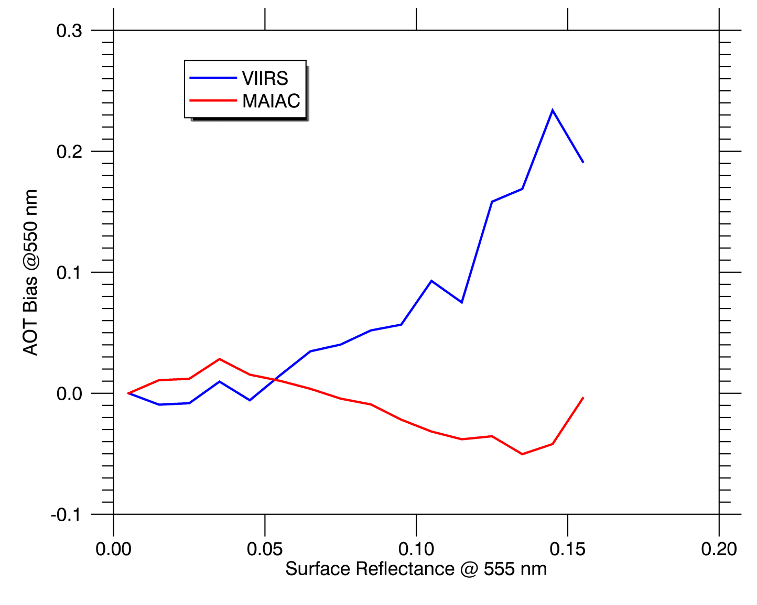
VIIRS AOT IP vs MODIS MAIAC (25km)
(S. Kondragunta, S. Superczynski (NOAA), study for NASA GeoCAPE project)
Bias vs. Surface Reflectance
- MAIAC and VIIRS comparable at sfc. reflectances below 0.05
- Similar slope (opposite sign) from 0.05 - 0.1, then VIIRS bias increases dramatically.

Slide 8
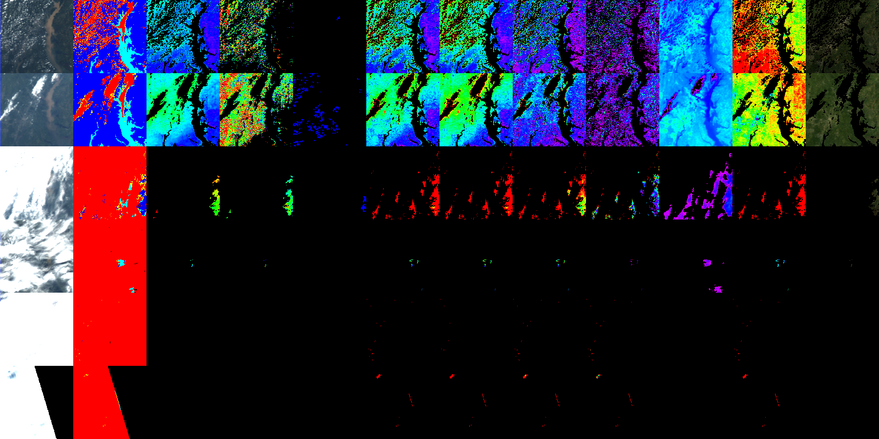
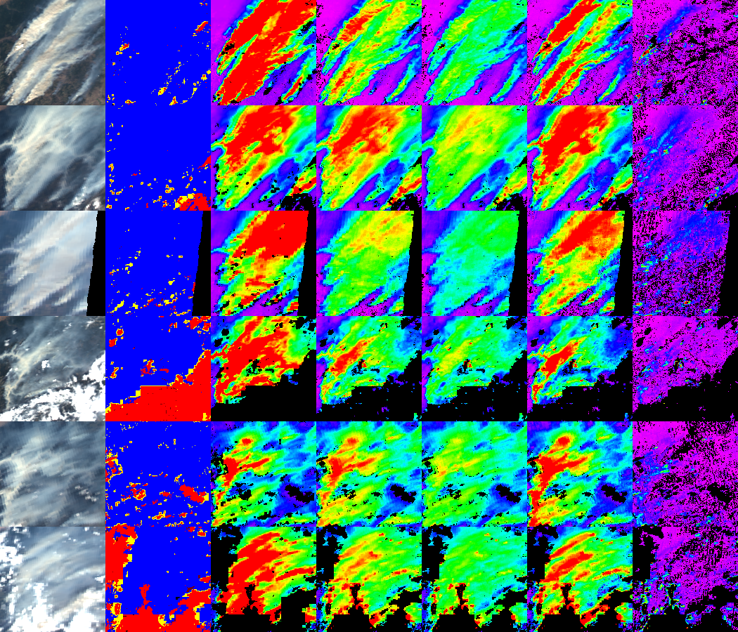

Aerosol Type Discrimination (Smoke/Dust)
Lyapustin, A. et al., 2012: Discrimination of biomass burning smoke and clouds in MAIAC algorithm, ACP, 12, 9679–9686.
Phys. principles (~OMI) – enhanced shortwave
absorption (Red →Blue →DB)
n_{i} increases R→DB for OC (smoke) and dust;
Multiple scattering, for absorbing aerosols.
R^{A,TOA}
background
smoke
- proxy of aerosol
reflectance
0.45
0.65
λ
TOA
CM
AOT
δ_{0.412}
δ_{0.47}
δ_{0.66}
δ_{2.13}
Backgr./Smoke/Dust
Model | Abs. | Size
Backgr. | No | Small
Smoke | Yes | Small
Dust | Yes | Large

Slide 9
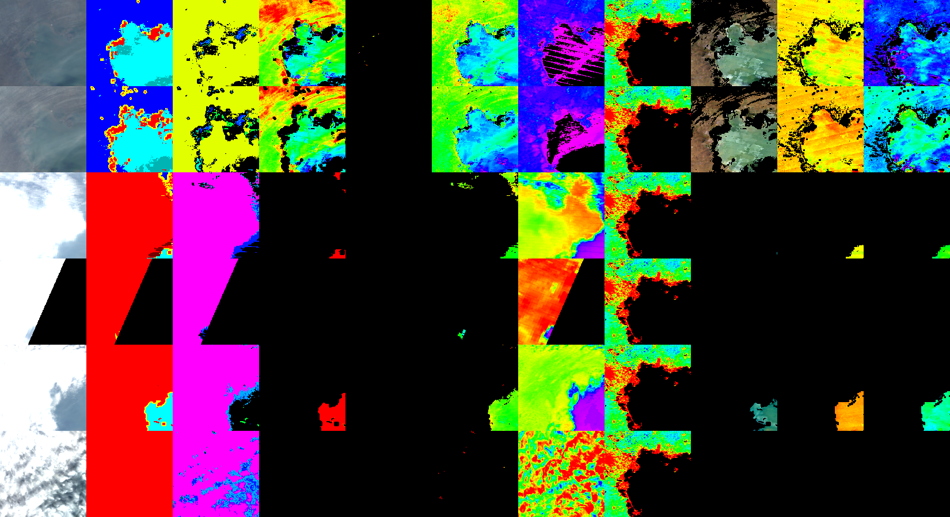
Aerosol @1km: China
July 2013
Beijing (AOT~2.5)
AOT
November 2011
Detected “smoke”
(fine mode, absorbing)

Slide 10
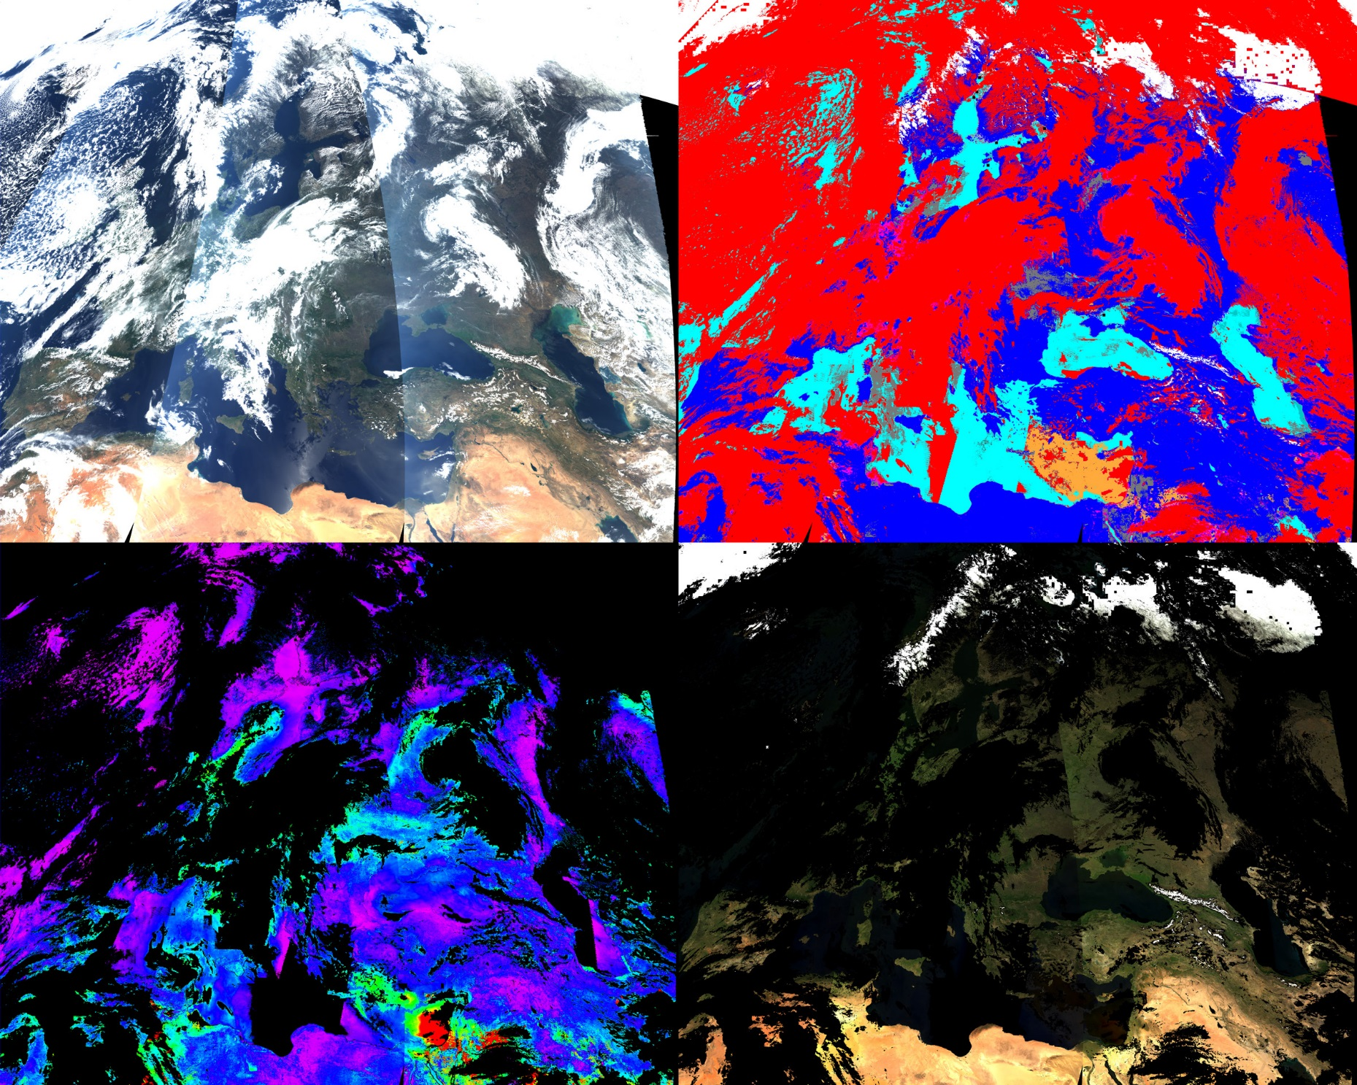
Europe-North Africa: Aerosol Types

Slide 11

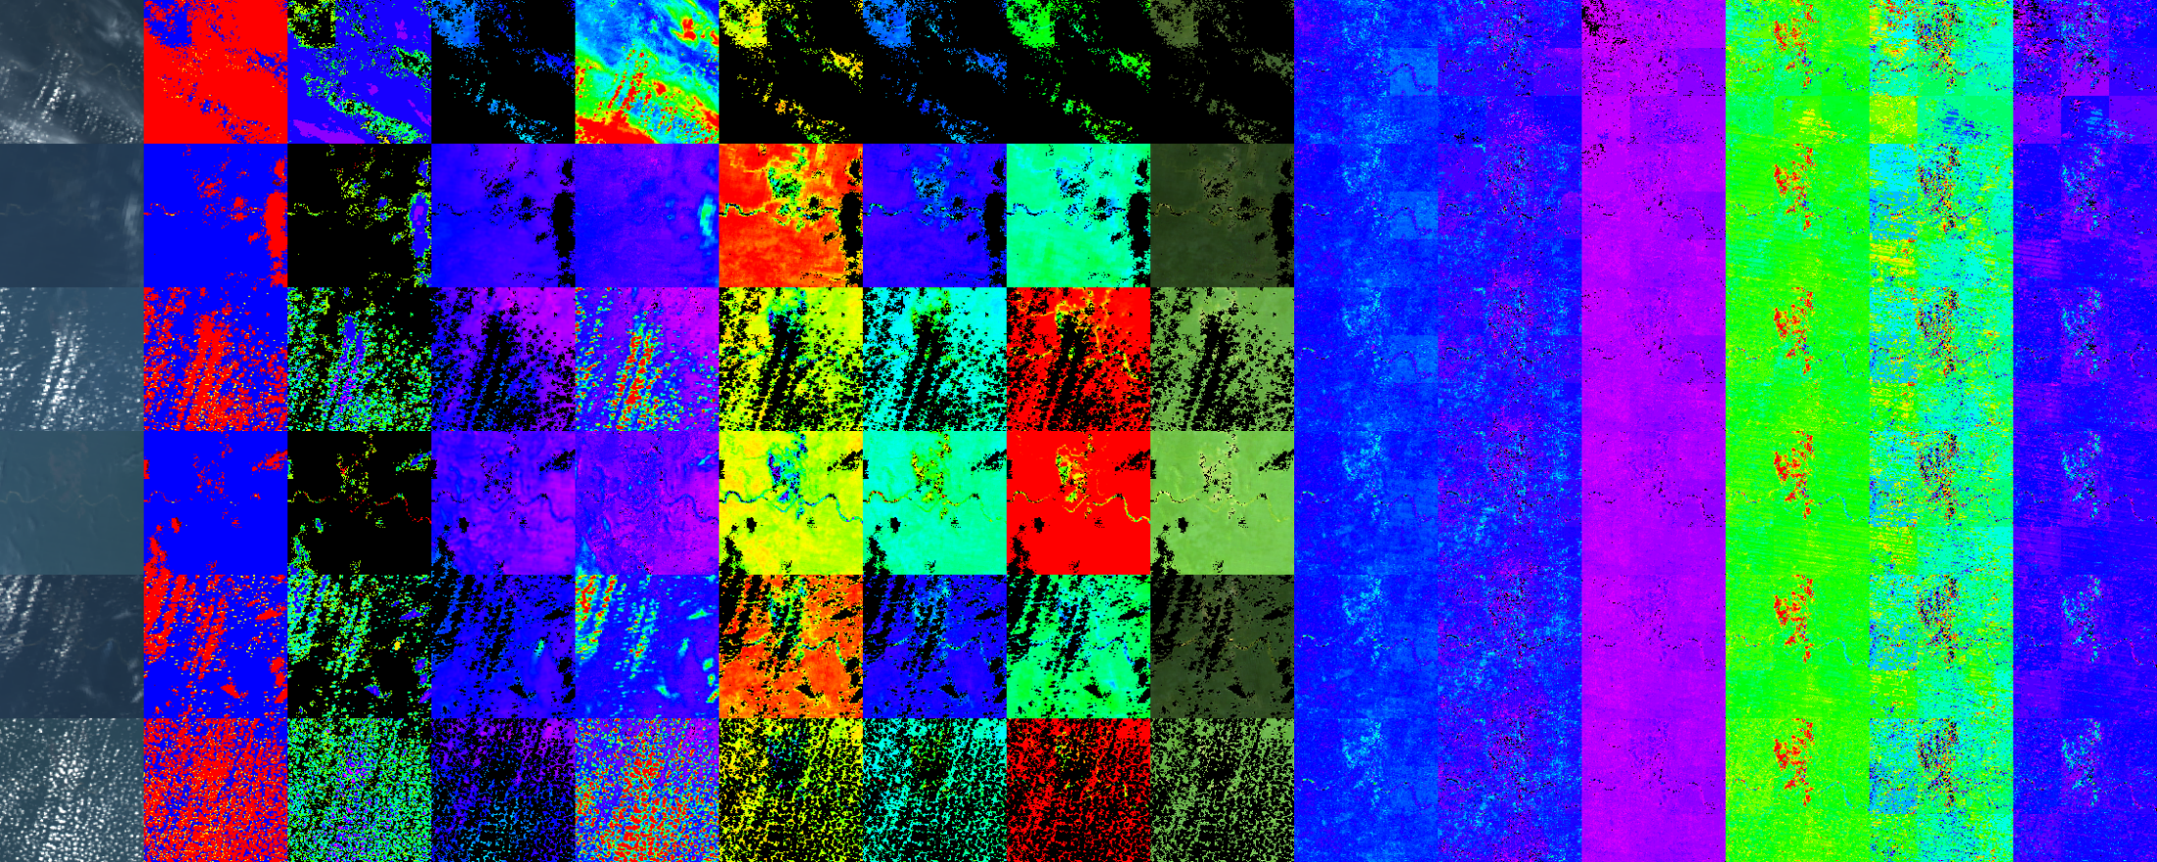
Recent Developments
Morton et al. (Nature, 2014): BRDF retrieval in Amazon doesn’t happen often
Equatorial Amazon, 150km: Rare 3-day period of low cloud cover
(BRDF variation >> spatial variation)
Meso-scale (50km) RTLS retrieval
Select high NDVI (>0.75) pixels;
Get average ρ_{0.66} for 20-50th percentile (N>20); filter residual clouds (~0.005) and shadows;
If sufficient angular sampling during 10 days (Terra+Aqua), then RTLS inversion;
Joint inversion of RGB and 2.1μm channels for more robust retrieval;
Get pixel’s BRDF by scaling using single good observation
BRDF shape update every 1-2 weeks to track geometry and phenology changes
TOA CM AOT NDVI ρ_{0.66} ρ_{0.87} ρ_{RGB}
0.84-0.9 0.02-0.04 0.25-0.35

Slide 12
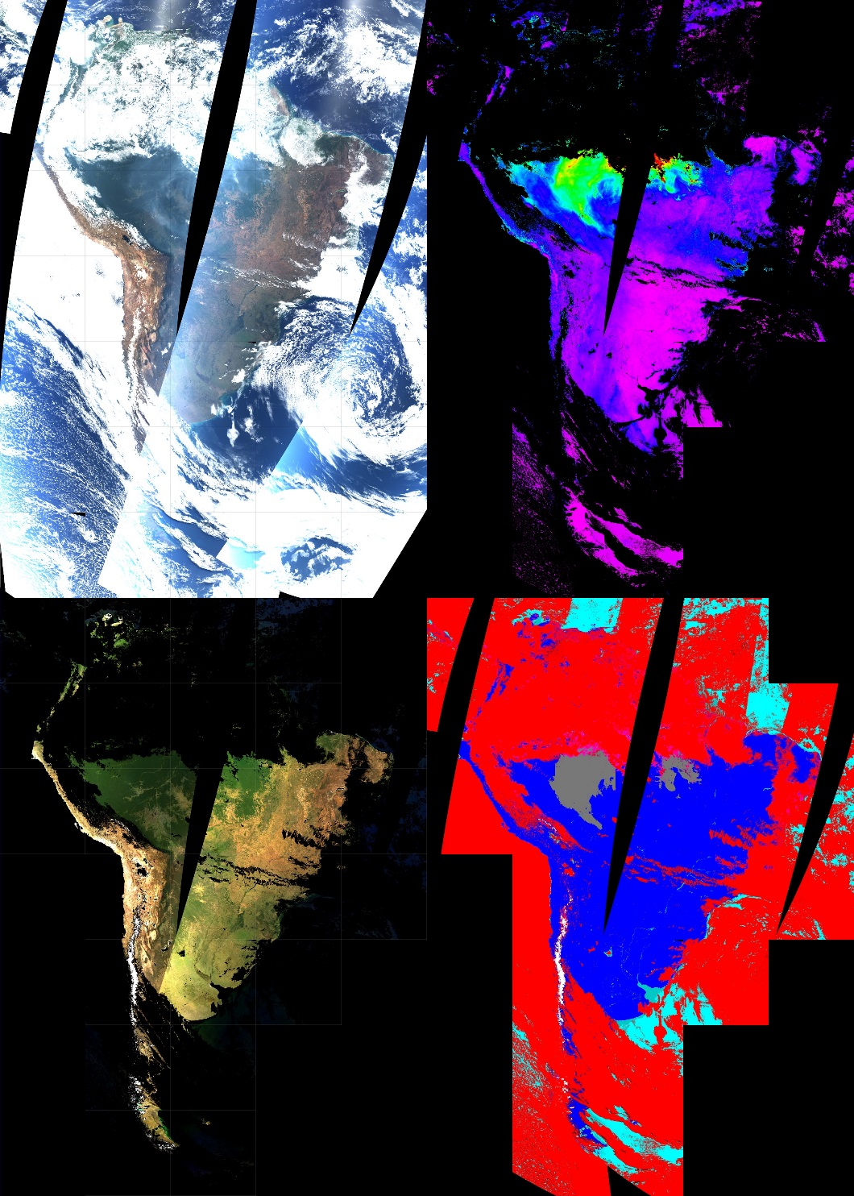
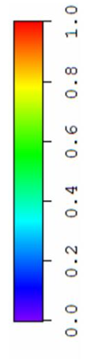
Dry Season and Biomass Burning
230
AOT
Clearing of Amazon forests for agricultural development.
As timber dries, biomass burning begins.
CM
RGB BRF
CM Legend
Clear Land
Clear Water
Detected Smoke
Clouds
Cloud Shadows
223 - 2003

Slide 13
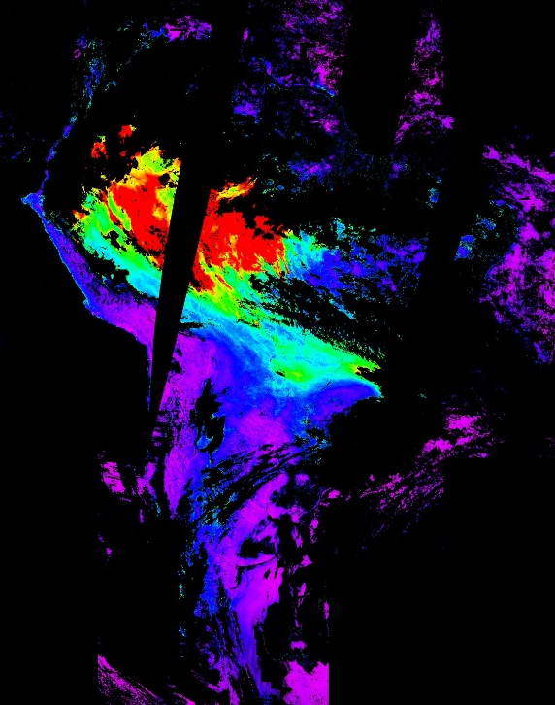
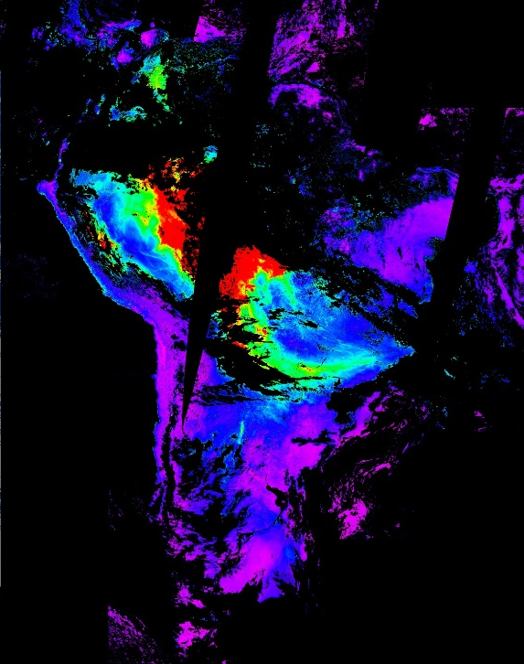
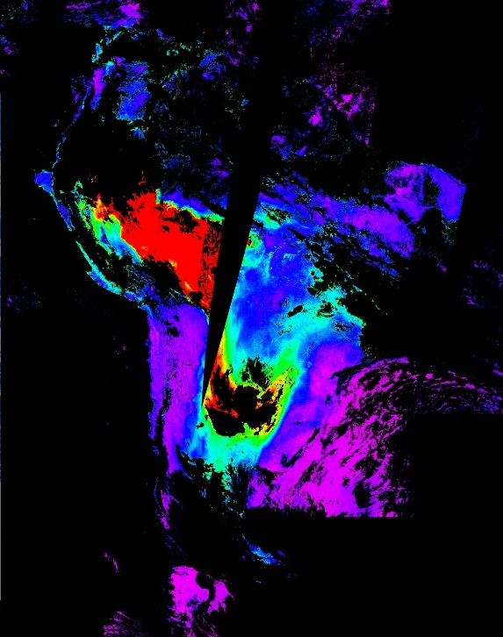
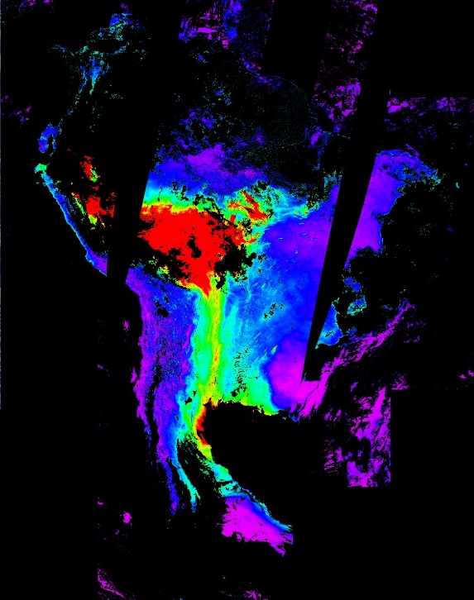
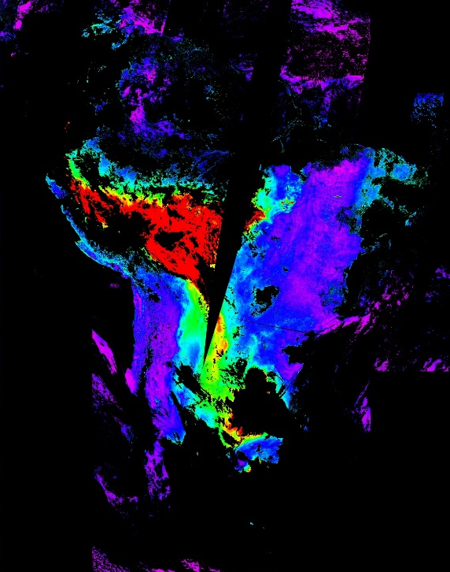
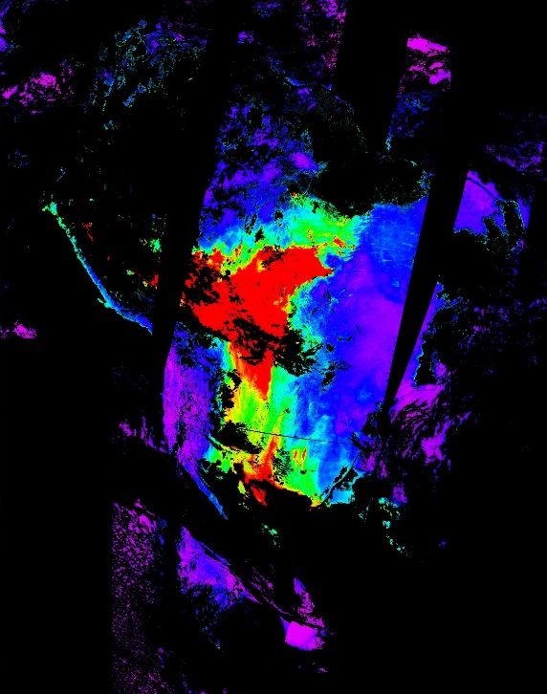
… Biomass Burning (2003)
242
244
246
247
248
249

Slide 14
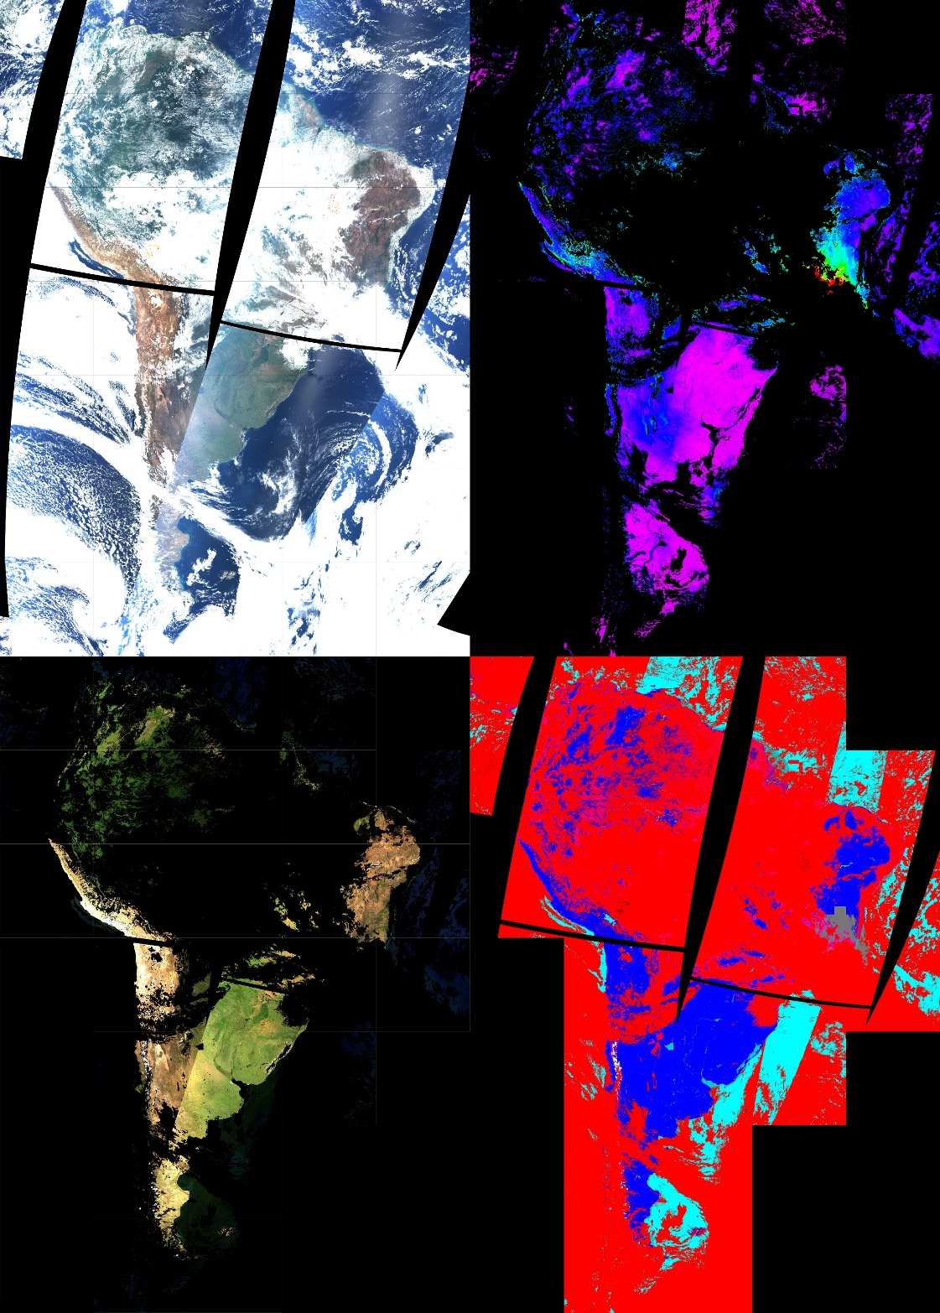
Quality of Atmospheric Correction
CM Legend
Clear Land
Clear Water
Detected Smoke
Clouds
Cloud Shadows
296 - 2003

Slide 15
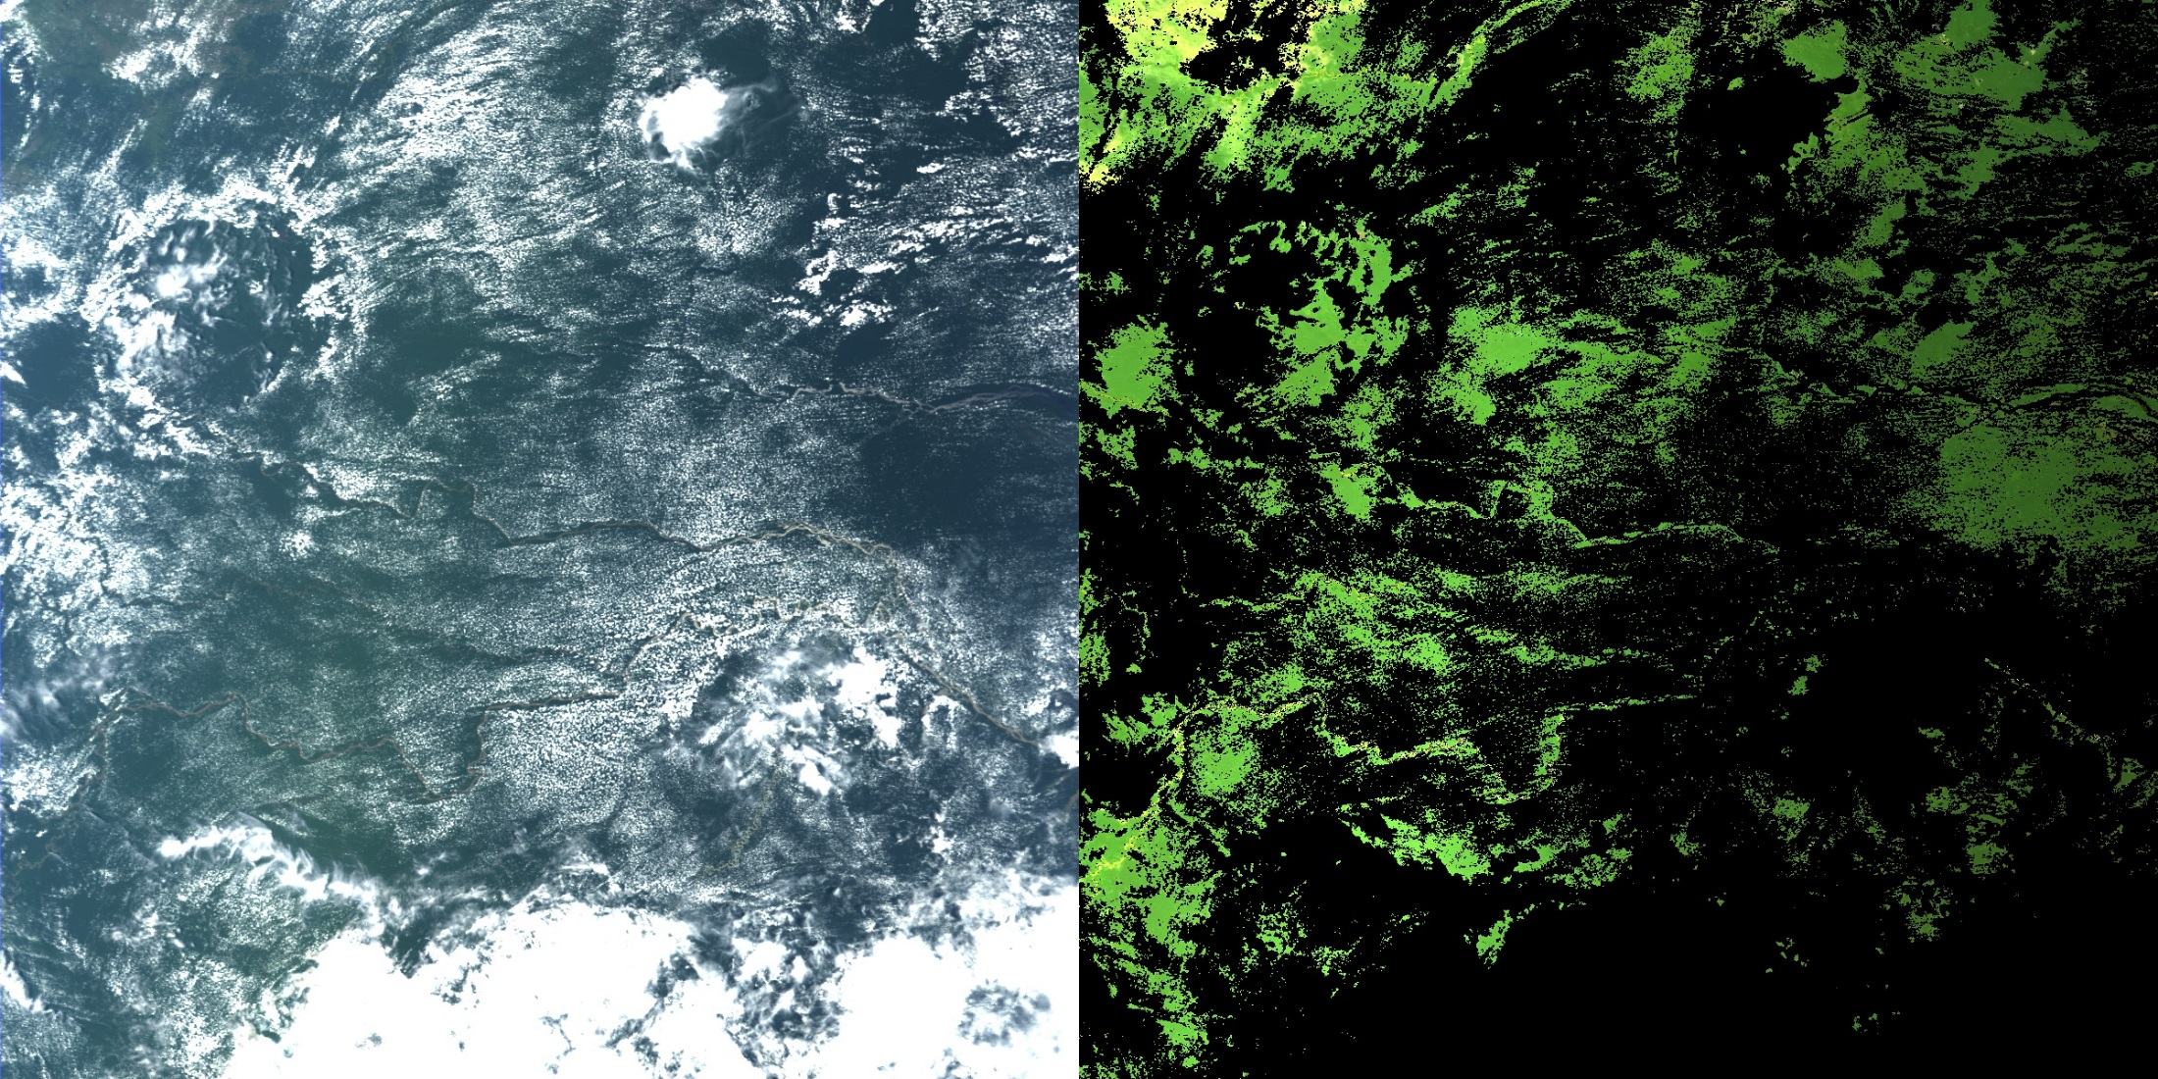
Quality of Atmospheric Correction …
TOA RGB
BRF RGB
1200 km
Decreasing brightness – moving from backscattering towards forward scattering

Slide 16
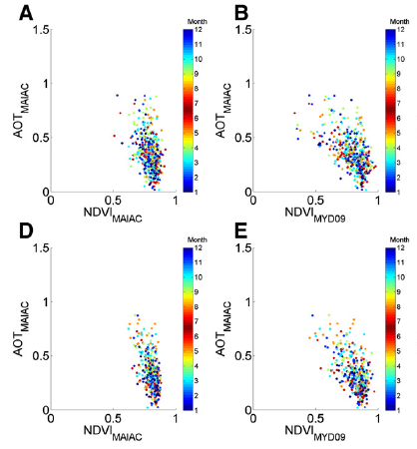
Aerosol Effect on NDVI
(from Hilker et al., 2012)
Northern area
(7°30′ N, 70° W)
Southern area
(7°30′ S, 70° W)
Smoke aerosol model (more absorption at 0.47μm) gives larger AOT resulting in lower BRF_{0.67}.

