Slide 1
MODIS/VIIRS
Sea-Surface Temperatures
Peter J Minnett, Kay Kilpatrick, Elizabeth Williams,
Sue Walsh & Bob Evans
Rosenstiel School of Marine & Atmospheric Science
University of Miami

Slide 2
Algorithm continuity – MODIS to VIIRS
The ROSES objective is to demonstrate compatibility between MODIS (Terra and Aqua) SST retrievals and those of S-NPP VIIRS to lead to the production of a Consistent Data Record, and then to a Climate Data Record.
Consistency can be achieved by using, over multiple missions, comparable cloud-screening and atmospheric correction algorithms, and using same approaches to estimate errors and uncertainties.

Slide 3
C(onsistent)DRs to
C(limate)DRs
Temperature Climate Data Records are more demanding, requiring traceabilty of calibration history to SI standards, and this requires ship-board radiometers with calibration referenced to NIST, or NPL, standards.
SST accuracy requirements are very stringent: absolute accuracy of 0.1K, and decadal stability of 0.04K
(Ohring, G., Wielicki, B., Spencer, R., Emery, B., & Datla, R., 2005. Satellite Instrument Calibration for Measuring Global Climate Change: Report of a Workshop. Bulletin of the American Meteorological Society, 86, 1303-1313)

Slide 4
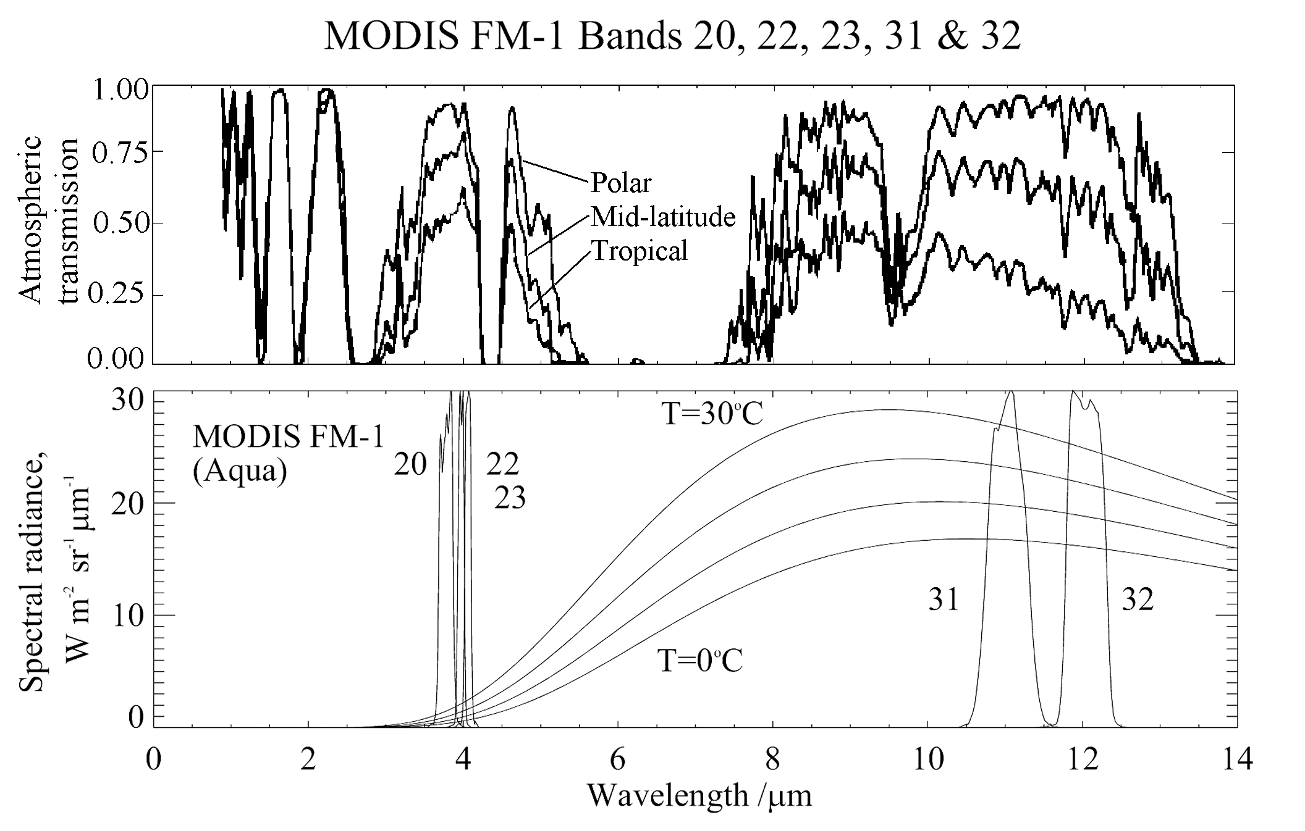
Atmospheric transmissivity in the infrared
Spectral dependence of the atmospheric transmission for wavelengths of electro-magnetic radiation from about 1 to 14 µm, for three characteristic atmospheres (above), and (below) the black-body emission for temperatures of 0, 10, 20 and 30ºC, and the relative spectral response functions of the bands MODIS (Flight Model 1) on Aqua used to derive SST.

Slide 5
NLSST Retrieval Equation
Non-Linear SST algorithm (day and night, cloud and aerosol free):
SST = c₁+c₂ * T₁₁+ c₃ * (T₁₁-T₁₂) *T_{sfc}+c₄ * (sec (θ)-1 )* (T₁₁-T₁₂)
where T_{n} are brightness temperatures measured in the channels at n μm wavelength, T_{sfc} is a ‘climatological’ estimate of the SST in the area, and θ is the satellite zenith angle. For MODIS, T₁₁ from Band 31, T₁₂ from Band 32.
c_{i} are coefficients, not necessarily constant. There are uncertainties associated with their derivation – both for rte and matchups.
Applicable to cloud-free conditions only; residual effects from cloud screening and aerosol radiances add uncertainties….
(Walton et al, (1998). The development and operational application of nonlinear algorithms for the measurement of sea surface temperatures with the NOAA polar-orbiting environmental satellites. Journal of Geophysical Research 103 27,999-28,012.)

Slide 6
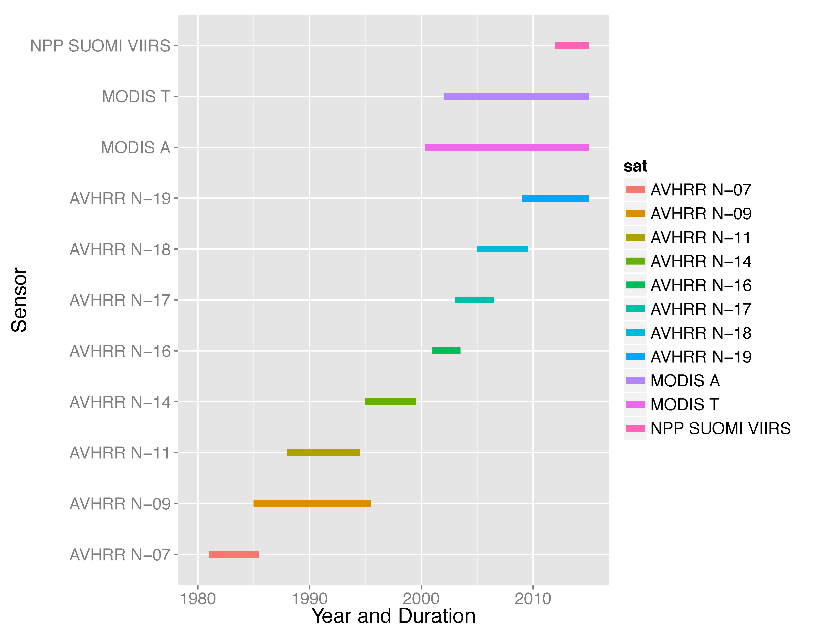
Time Series of Satellites

Slide 7
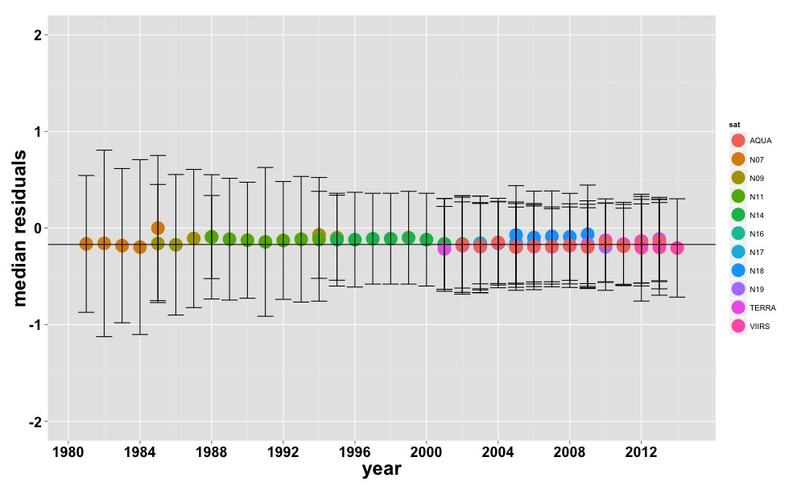
Consistent Data Record
All sensors
accuracy IQR 0.063
accuracy stability 0.215
MODIS + VIIRS
accuracy IQR 0.036
accuracy stability 0.101

Slide 8
MODIS SST4
Measurements in mid-IR atmospheric transmission window have potential to provide better SSTs
SST4 = c₁+ c₂ * T_{3.9} + c₃ * (T_{3.9}−T_{4.0}) +
c₄ * (sec(θ)−1)
But can only be used confidently at night, due to reflection of solar radiation at the sea surface, and scattering from the atmosphere.

Slide 9
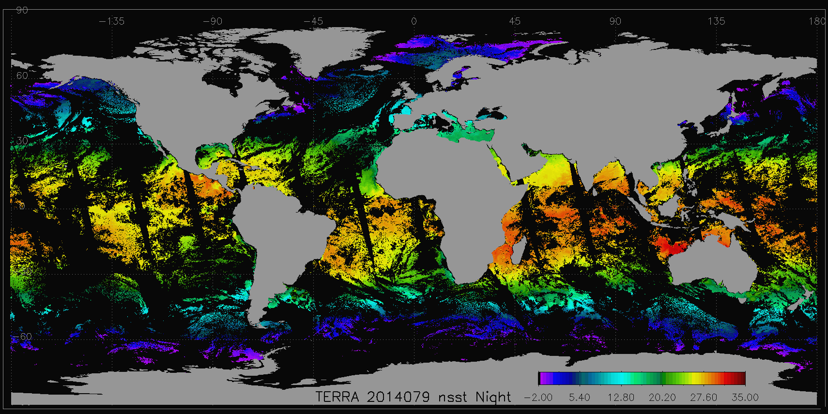
Terra MODIS night SST

Slide 10
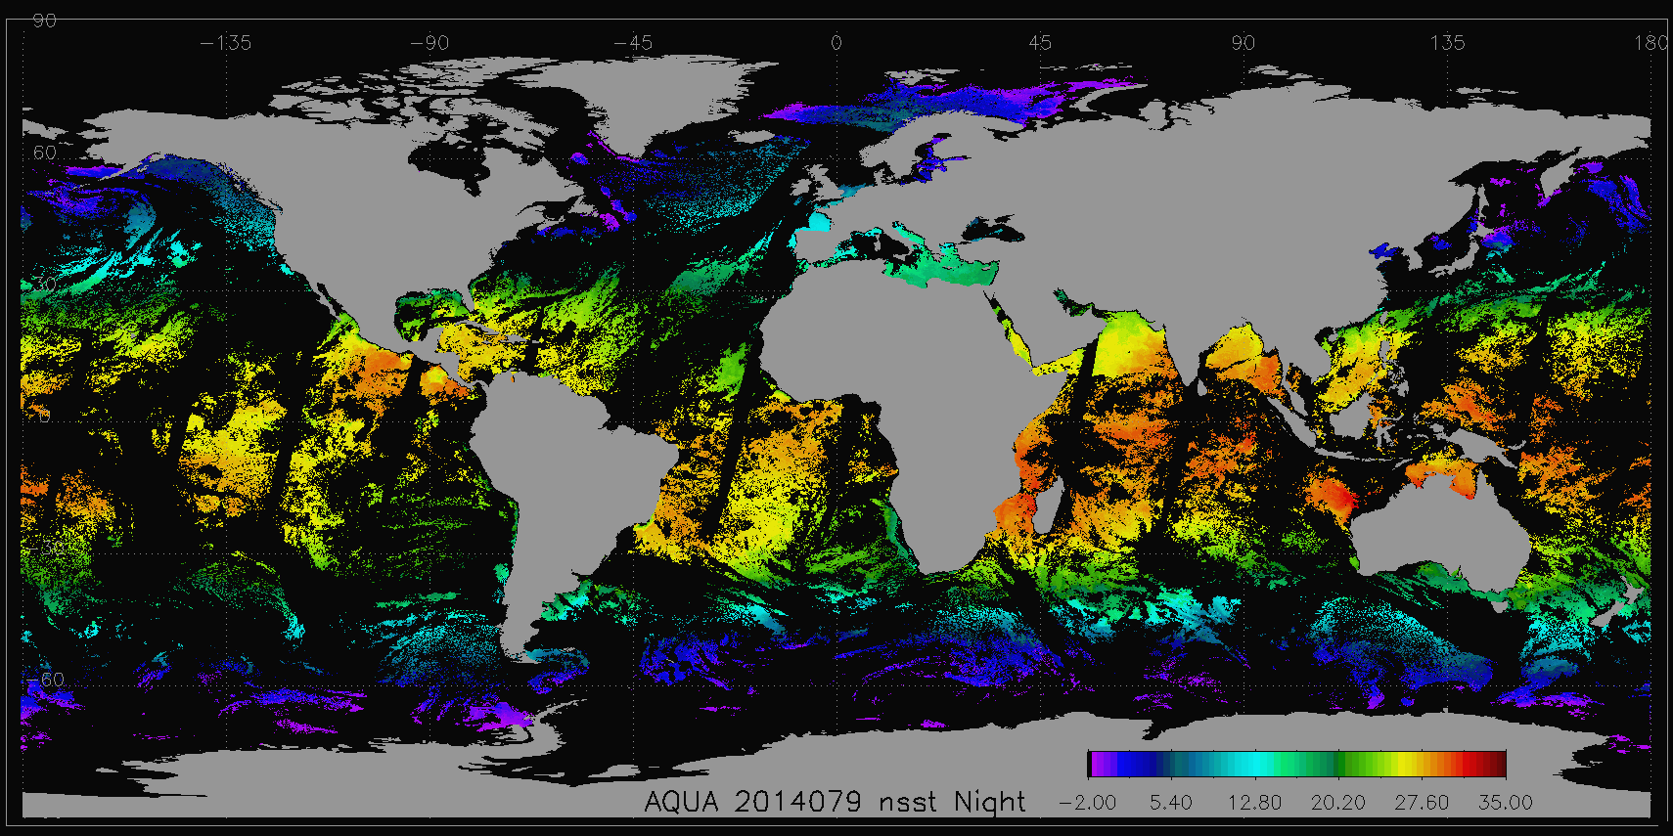
Aqua MODIS night SST

Slide 11
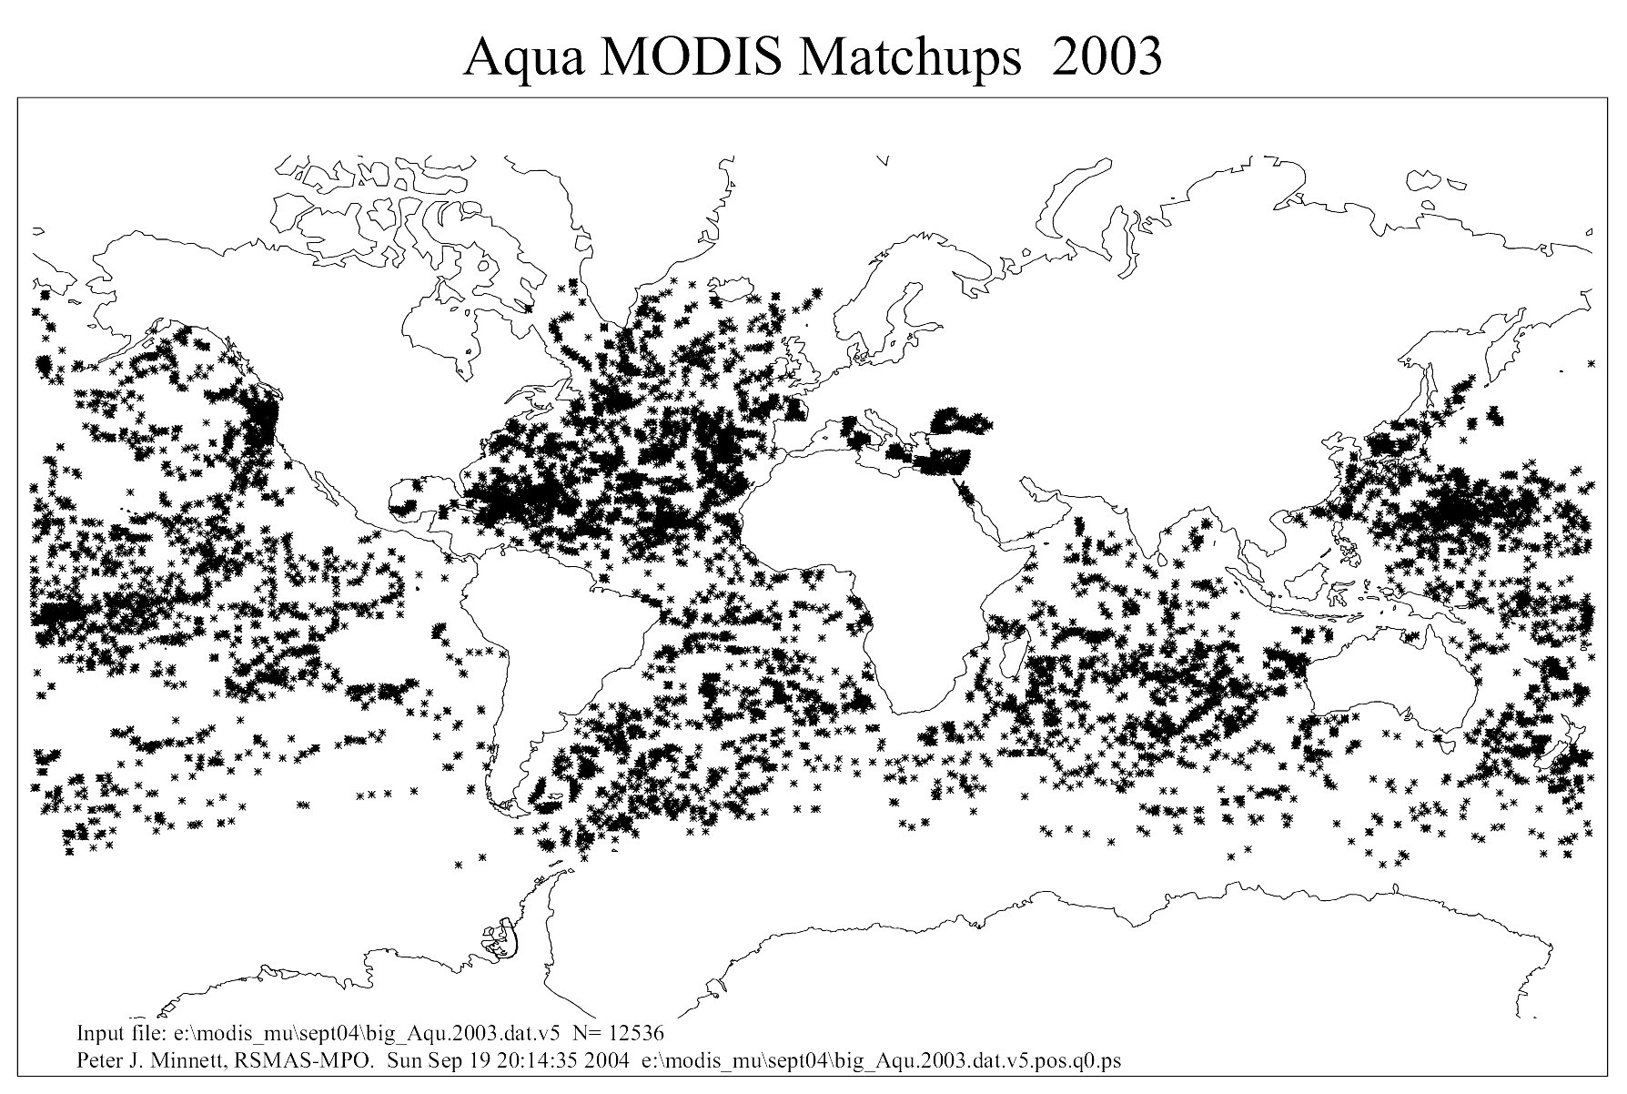
Validation with buoys
C5 Aqua MODIS ql=0 matchup with buoys. 2003. N=12536.

Slide 12
C5 MODIS median errors
From Kilpatrick et al., 2015. A decade of sea surface temperature from MODIS. Remote Sensing of Environment, 165, 27-41

Slide 13
C5 MODIS uncertainties
From Kilpatrick et al., 2015. A decade of sea surface temperature from MODIS. Remote Sensing of Environment, 165, 27-41

Slide 14
Aqua MODIS SST C6 - night

Slide 15
GSFC Matchups C6 2015 reprocessing
Sensor | quality | mean | median | SD | RSD | Count
Residuals MODIS SST – buoy SST
TERRA SST | ql 0 | -0.171 | -0.155 | 0.445 | 0.353 | 428,374
TERRA SST | ql 1 | -0.451 | -0.405 | 0.659 | 0.533 | 154,228
AQUA SST | ql 0 | -0.121 | -0.141 | 0.477 | 0.346 | 307,558
AQUA SST | ql 1 | -0.265 | -0.19 | 0.752 | 0.468 | 164,949
TERRA SST4 | ql 0 | -0.166 | -0.145 | 0.331 | 0.209 | 427,768
TERRA SST4 | ql 1 | -0.419 | -0.385 | 0.632 | 0.523 | 139,254
AQUA SST4 | ql 0 | -0.210 | -0.18 | 0.448 | 0.331 | 420671
AQUA SST4 | ql 1 | -0.489 | -0.405 | 0.677 | 0.515 | 223929

Slide 16
Continuity to VIIRS
After C. Moeller, J. McIntire, T. Schwarting, et al., VIIRS F1 “best” relative spectral response
characterization by the government team, in: J.J. Butler, X. Xiong, X. Gu (Eds.), SPIE 8153,
Earth Observing Systems XVI, 81530K, San Diego, California, USA. September 13, 2011.
http://dx.doi.org/10.1117/12.894552.

Slide 17
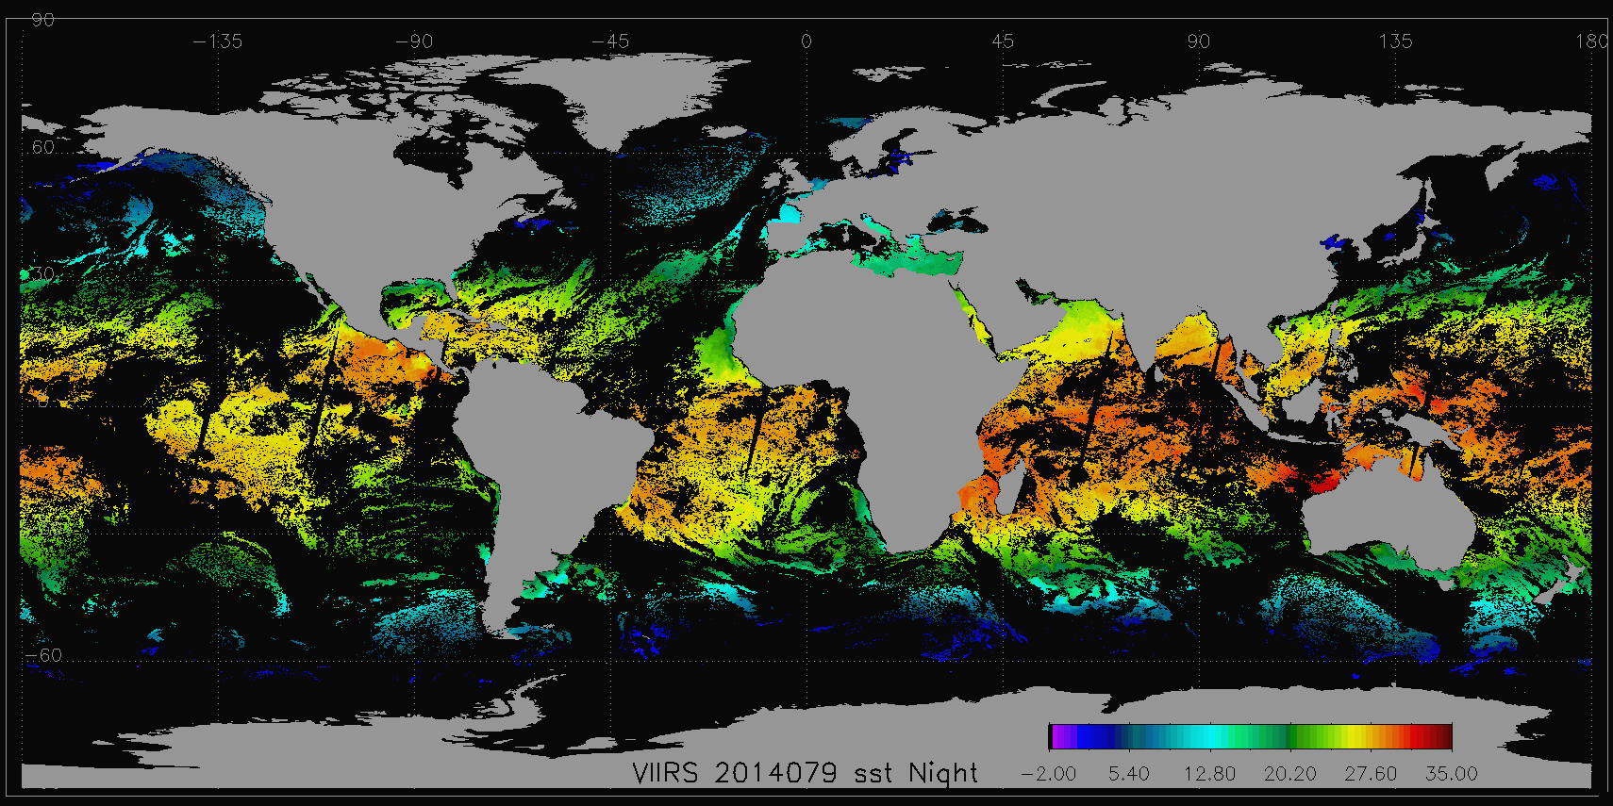
S-NPP VIIRS night SST

Slide 18
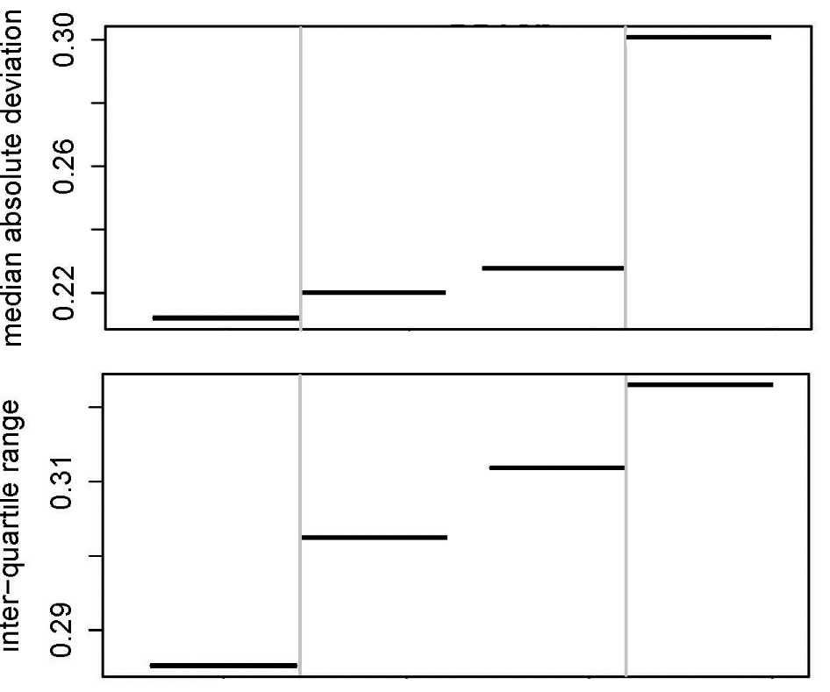
Effects of VIIRS pixel aggregation
Aggregation transitions
3 to 2 2 to 1

Slide 19
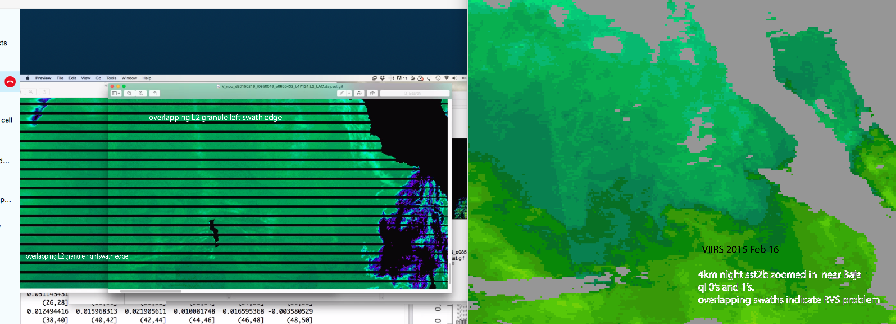
VIIRS RVS issue at 10-12µm?

Slide 20
SST uncertainties as f(satellite zenith angle). QL=0
1º
0º
VIIRS 2band SST – buoy subsurface T
-1º
-55º
0º
55º

Slide 21
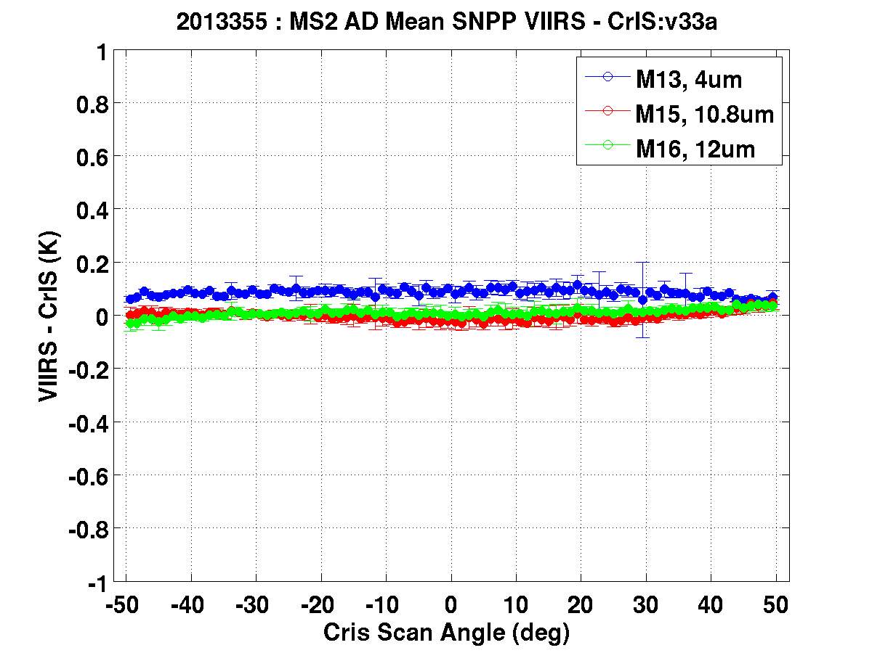
VIIRS vs CrIS
Provided by Chris Moeller

Slide 22
SST uncertainties as f(satellite zenith angle). QL=0,1
VIIRS 2band SST – buoy subsurface T

Slide 23
SST uncertainties as f(satellite zenith angle). QL=0,1
VIIRS 2band SST – buoy subsurface T

Slide 24
Algorithm innovations
Objective to extend retrievals towards edge of VIIRS & MODIS swaths
SST _{sat} = a₀ +
a₁T₁₁ +
a₂(T₁₁-T₁₂)T_{sfc} +
a₃(sec(θ)-1)(T_{11μm}-T_{12μm}) +
a₄(mirror.side) +
a₅(θ) +
a₆(θ²)

Slide 25
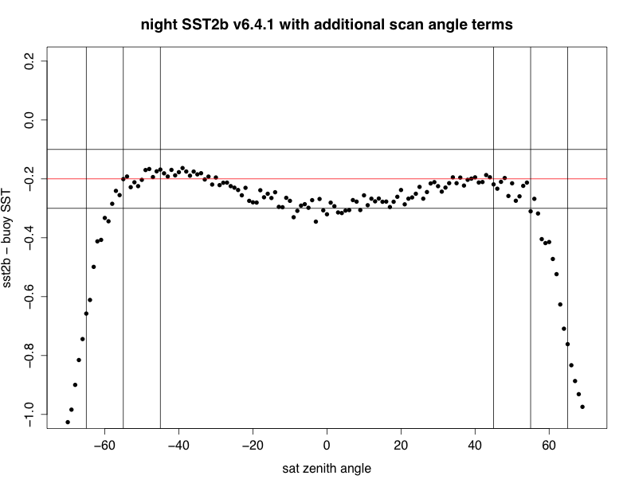
AVHRR
AVHRR
MODIS
MODIS
AVHRR
VIIRS
MODIS
MODIS
VIIRS
VIIRS
AVHRR
VIIRS
VIIRS 2band SST – buoy subsurface T

Slide 26
MODIS
AVHRR
VIIRS
AVHRR
MODIS
VIIRS
VIIRS 2band SST – buoy subsurface T

Slide 27
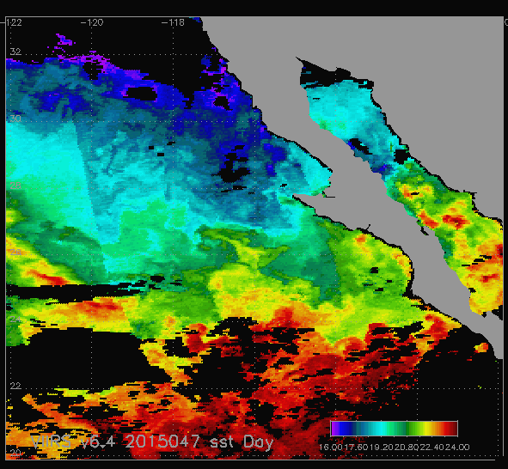
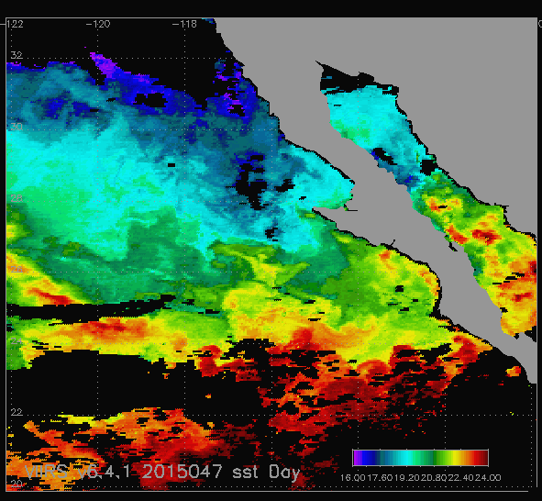

VIIRS Day SST Feb 16 2015
Before scan angle correction
4km map image
After scan angle correction

Slide 28
MODIS
AVHRR
VIIRS
AVHRR
MODIS
VIIRS
VIIRS 2band SST – buoy subsurface T

Slide 29
MODIS
AVHRR
VIIRS
AVHRR
MODIS
VIIRS

Slide 30
VIIRS SST stability

Slide 31
And so to Climate Data Records… using shipboard radiometry.
Groups deploying filter radiometers on ships:
Werenfrid Wimmer, University of Southampton, UK
Tim Nightingale, Rutherford Appleton Laboratory, UK
Lei Guan, Ocean University, Qingdao, China
Helen Beggs, Bureau of Meteorology, Australia
Carol Anne Clayson, WHOI, USA
Jacob Høyer, Danish Meteorology Institute, Denmark
Simon Hook, JPL, USA (on moorings)

Slide 32
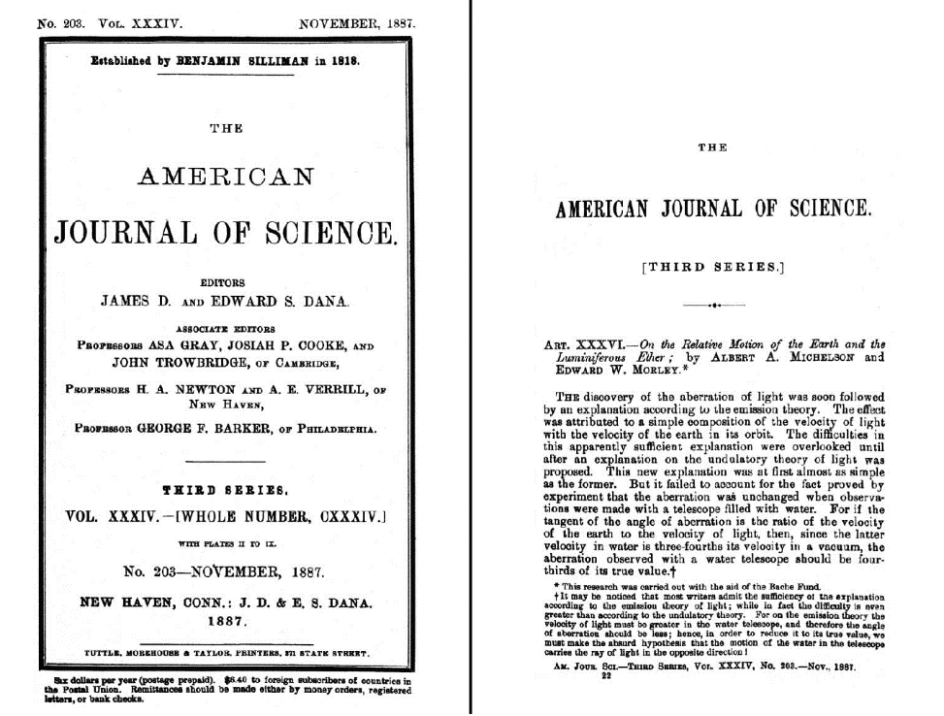
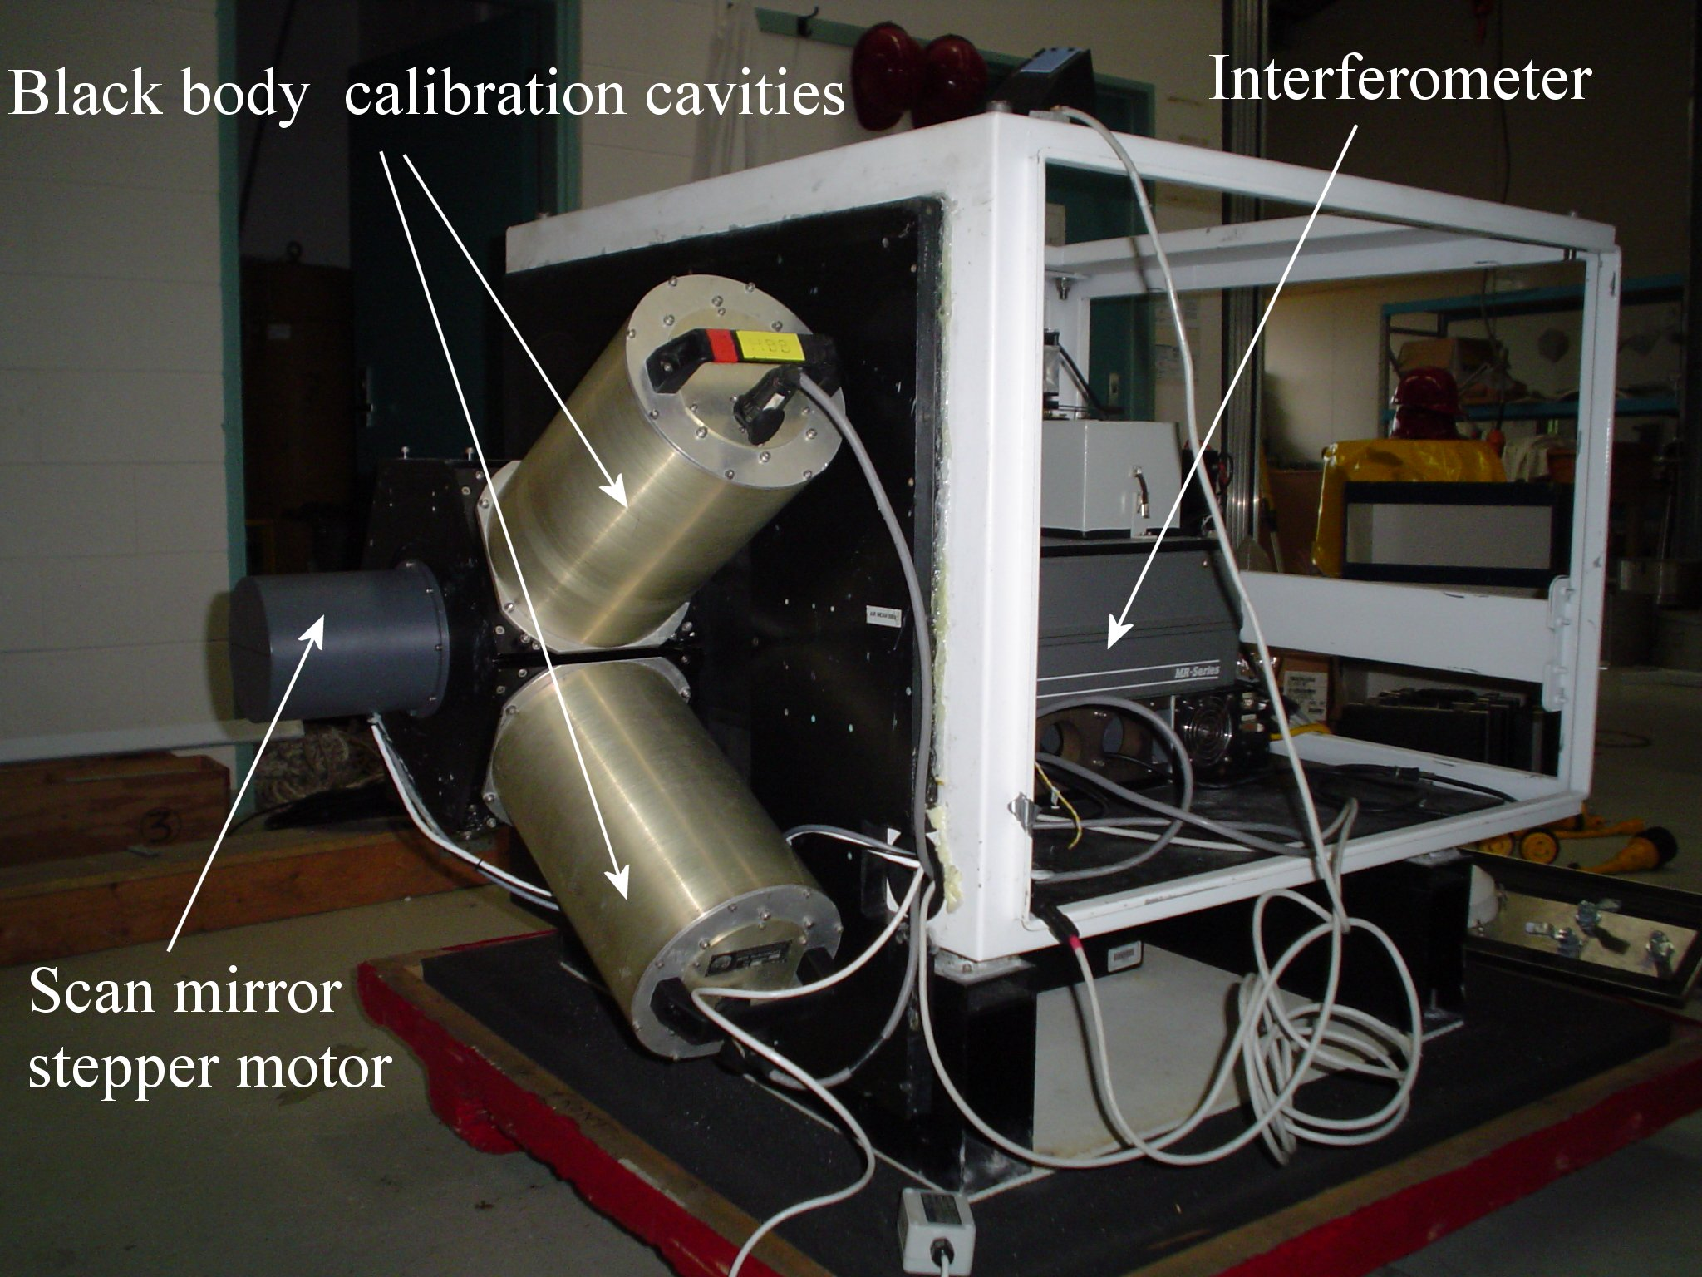
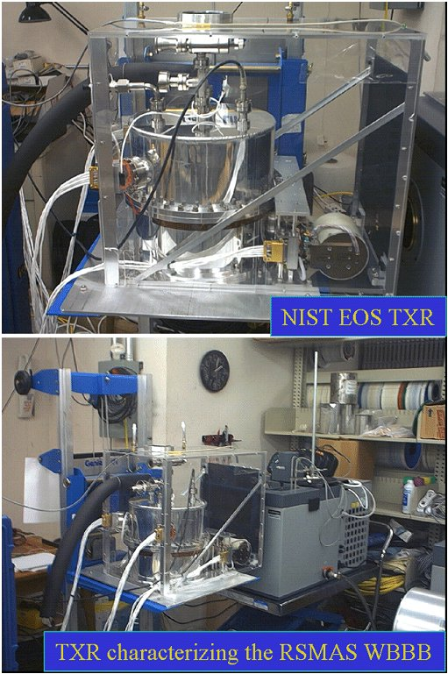
Marine-Atmospheric Emitted Radiance Interferometer
M-AERI is a very well-calibrated and stable sea-going Fourier Transform Infrared Interferometer.
At sea calibration by two internal blackbody cavities with thermometers with NIST-traceable calibration.
Calibration sequence before and after each cycle of ocean and atmospheric measurements.
Calibration before and after deployments using NIST-designed water-bath blackbody calibration target at RSMAS. Uses NIST-traceable thermometers at mK accuracy.
Periodic radiometric characterization of RSMAS water-bath blackbody calibration target by NIST TXR.

Slide 33
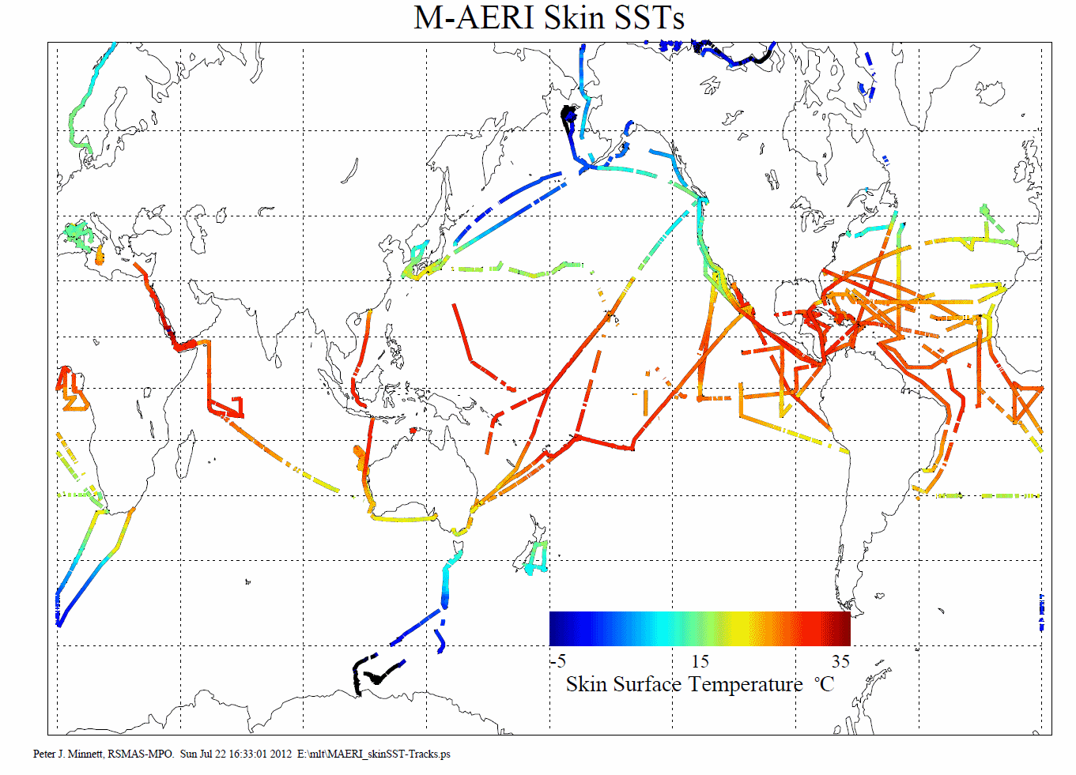
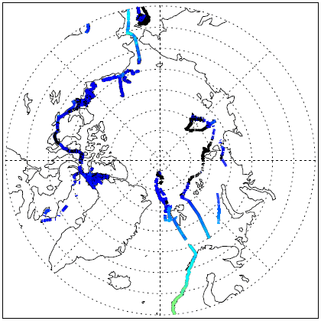
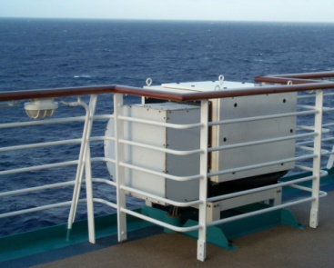
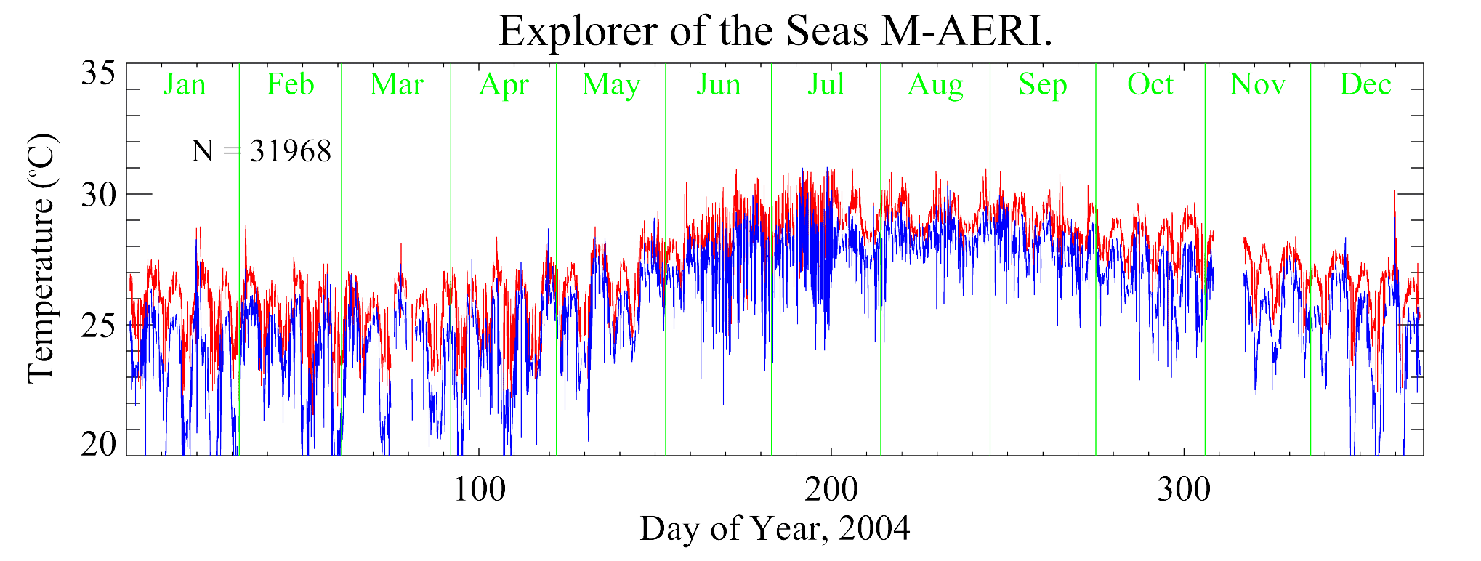
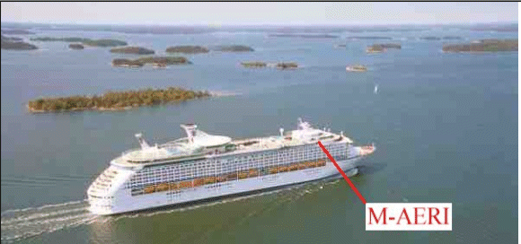
M-AERI Deployments
Skin SST (red) and near-surface air temperature (blue) measurement for 2004.

Slide 34
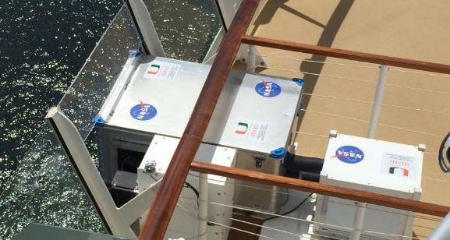
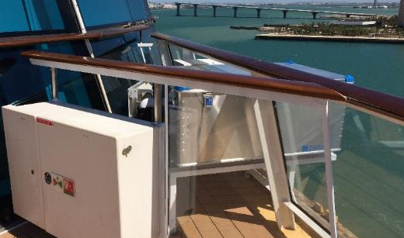
Current VOS deployments
Collaboration with Royal Caribbean Cruise Lines
Allure of the Seas
Celebrity Equinox
Celebrity Equinox
3rd ship being negotiated

Slide 35
Summary
Both MODIS’s are very stable.
  Algorithm developments are improving accuracy
VIIRS is a very “clean sensor”
  SSTs are of good quality
  Recent evidence of a possible rvs (HAM) issue
Methodology for generating SST Climate Data Records is understood…. (we think).
(Minnett, P.J., & Corlett, G.K. (2012). A pathway to generating Climate Data Records of sea-surface temperature from satellite measurements. Deep Sea Research Part II: Topical Studies in Oceanography, 77–80, 44-51)

Slide 36
Data availability
MODIS (C5) SSTs from NASA OBPG at GSFC website:
http://oceancolor.gsfc.nasa.gov/
MODIS (C5) SSTs in GHRSST L2P format from the NASA PO.DAAC at JPL:
https://podaac.jpl.nasa.gov/dataset/JPL-L2P-MODIS_A
https://podaac.jpl.nasa.gov/dataset/JPL-L2P-MODIS_T

Slide 37
Acknowledgements
Funding, primarily from NASA, MODIS project and then Physical Oceanography program. Also from NOAA/NESDIS/STAR.
Support of OBPG at NASA GSFC.
Support of MCST & VCST.
Input from many students and colleagues.

Slide 38
Thank you.

