Slide 1


Leaf Area Index (LAI) and Fraction of Photosynthetically Active Radiation (FPAR): Updates on MODIS and VIIRS
MODIS/VIIRS Science Team Meeting
Taejin Park, Ranga B. Myneni,
Yuri Knyazikhin, Kai Yan, Chi Chen ,
Sungho Choi, Bin Yang, Jian Bi
Department of Earth & Environment
Boston University
Notes:
Good morning. This is Taejin Park who is I’m going to talk

Slide 2
Table of Content
Overview of MODIS & VIIRS LAI/FPAR
Update on MODIS LAI/FPAR
Update on VIIRS LAI/FPAR
Summary and Future plan

Slide 3

Overview of MODIS & VIIRS LAI/FPAR
Status of MODIS LAI/FPAR Product
  Collection 3: November 2000 – December 2002 / OBSOLETE!
  Collection 4: March 2000 – December 2006 / OBSOLETE!
  Collection 5: February 2000 – Present
    MO(Y)D15A2: Terra (Aqua) 8 day composite LAI/FPAR 1km
    MCD15A2: Terra-Aqua combined 8 day composite LAI/FPAR 1km
    MCD15A3: Terra-Aqua combined 4 day composite LAI/FPAR 1km
  Collection 6: Reprocessing and Ready to be Released
    MO(Y)D15A2H, MCD15A2H, MCD15A3H: Same with C5 but all for 500m
Status of VIIRS LAI/FPAR Product
  Collection 1.1: January 2012 – Present (Private Archive)
    D8LFPAR1_L3D: 8 day composite LAI/FPAR 1km (Moderate Band)
    D8LFPARH_L3D: 8 day composite LAI/FPAR 500m (Image Band)

Slide 4
Update on MODIS LAI/FPAR − C5 vs. C6
Changes in Collection 6 LAI/FPAR
  L2G–lite surface reflectance at 500m resolution as (MOD09GA) input in place of reflectance at 1km resolution (MODAGAGG)
  New multi-year land cover product at 500m resolution in place of the 1km resolution static land cover product
  Uses the C5 science algorithm and LUT
C5 vs C6 Comparison Tests
  MODIS C5: MOD15A2 (1km)
  MODIS C6: MOD15A2H (500m)
  Test Period: Jan 1st 2003 (DOY: 001) – Dec 31st 2003(DOY:365)
  Test Coverage: Global Scale

Slide 5
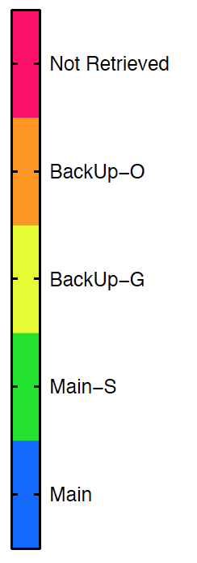
Update on MODIS LAI/FPAR − C5 vs. C6
Spatial Coverage (Retrieval Index)
  Proportion of Main algorithm execution => Proxy of retrieval quality
  C6 shows slightly improved spatial coverage for most biomes
  Especially, 17% increase in biome 5
  Overall, comparable spatial coverage with C5 product
Main: Main algorithm was executed
Main-S: Main algorithm was executed. Saturation
BackUp-G: View/sun zenith angle too low. Backup retrievals
BackUp-O: Main algorithm fails. Backup retrievals
Not Retrieved: not executed because BRF is not available

Slide 6
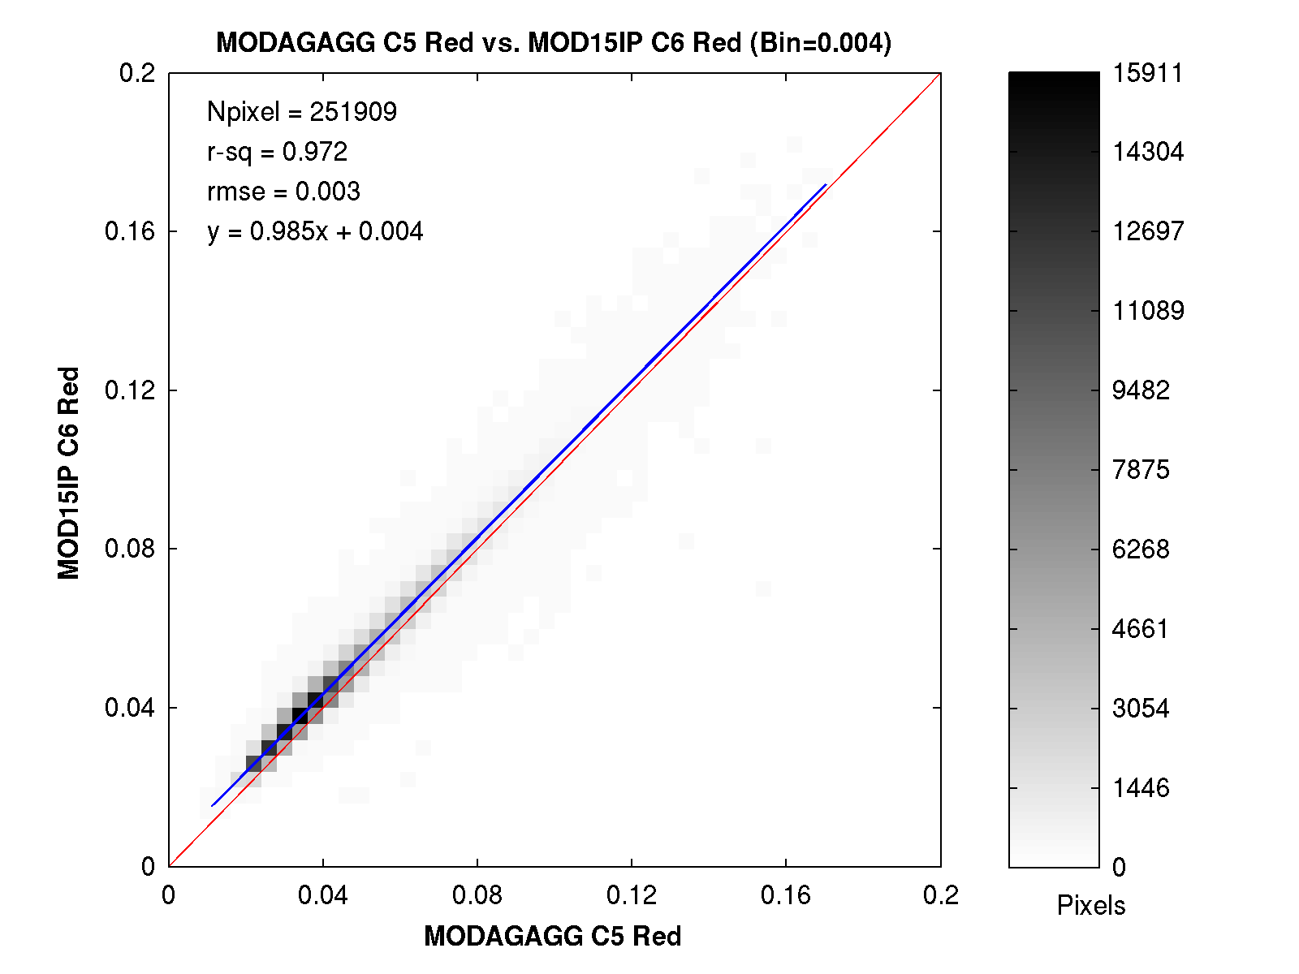
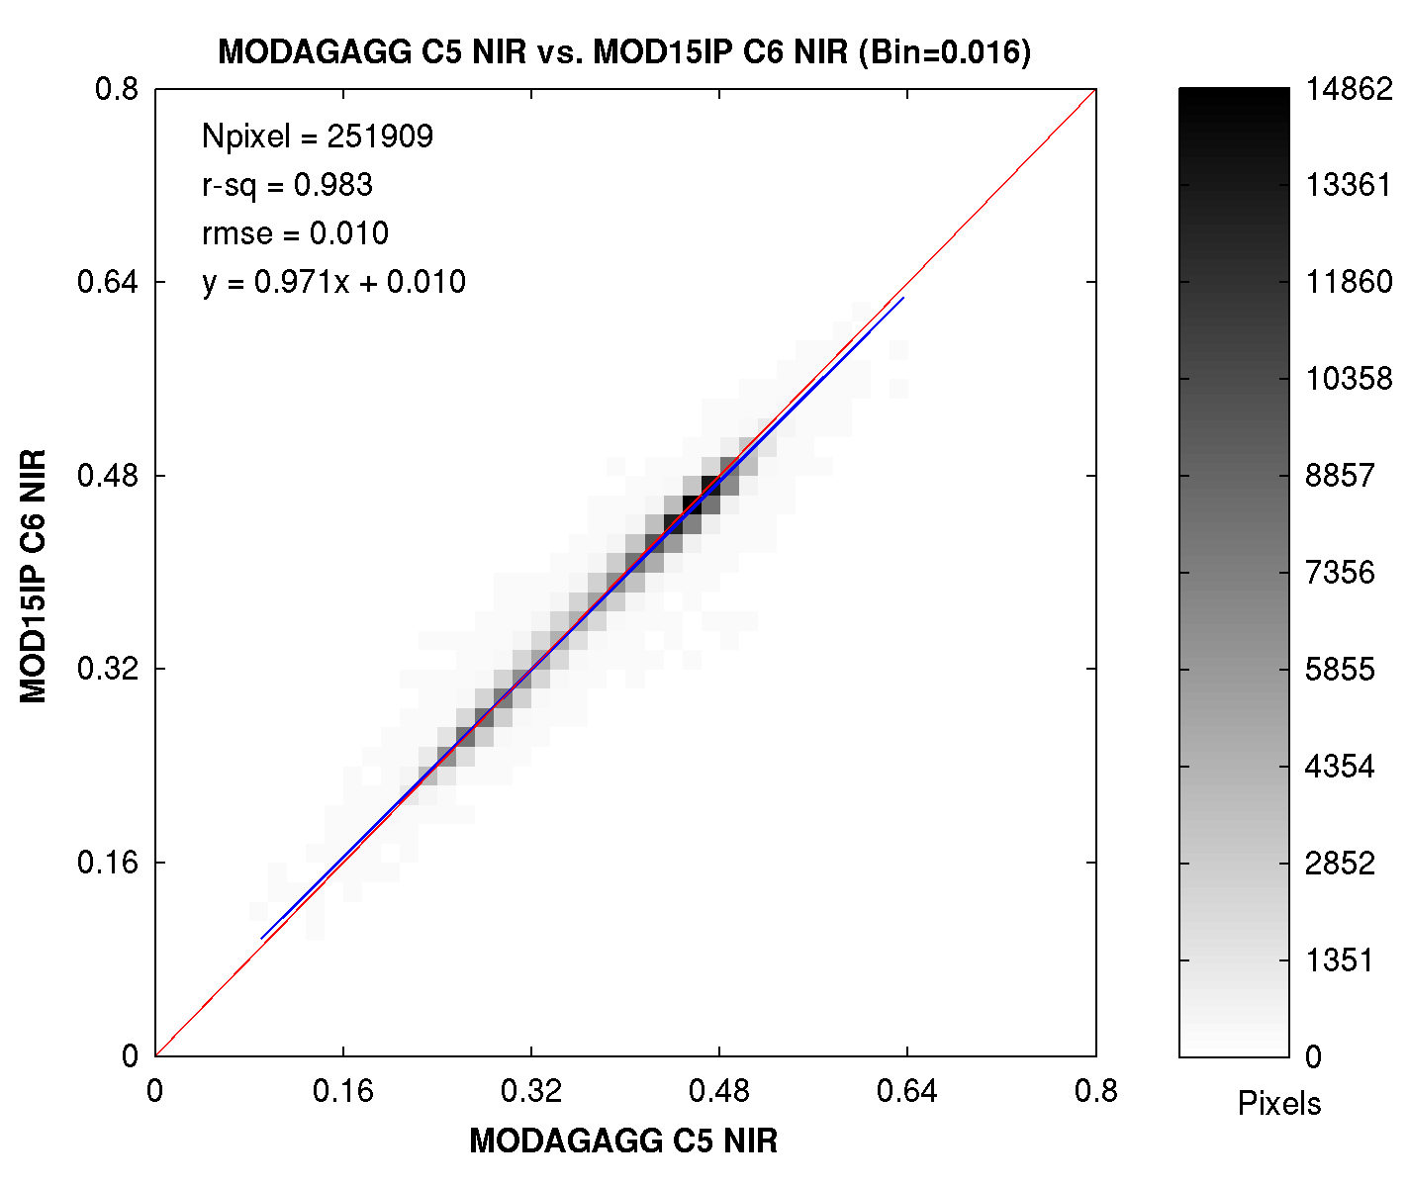
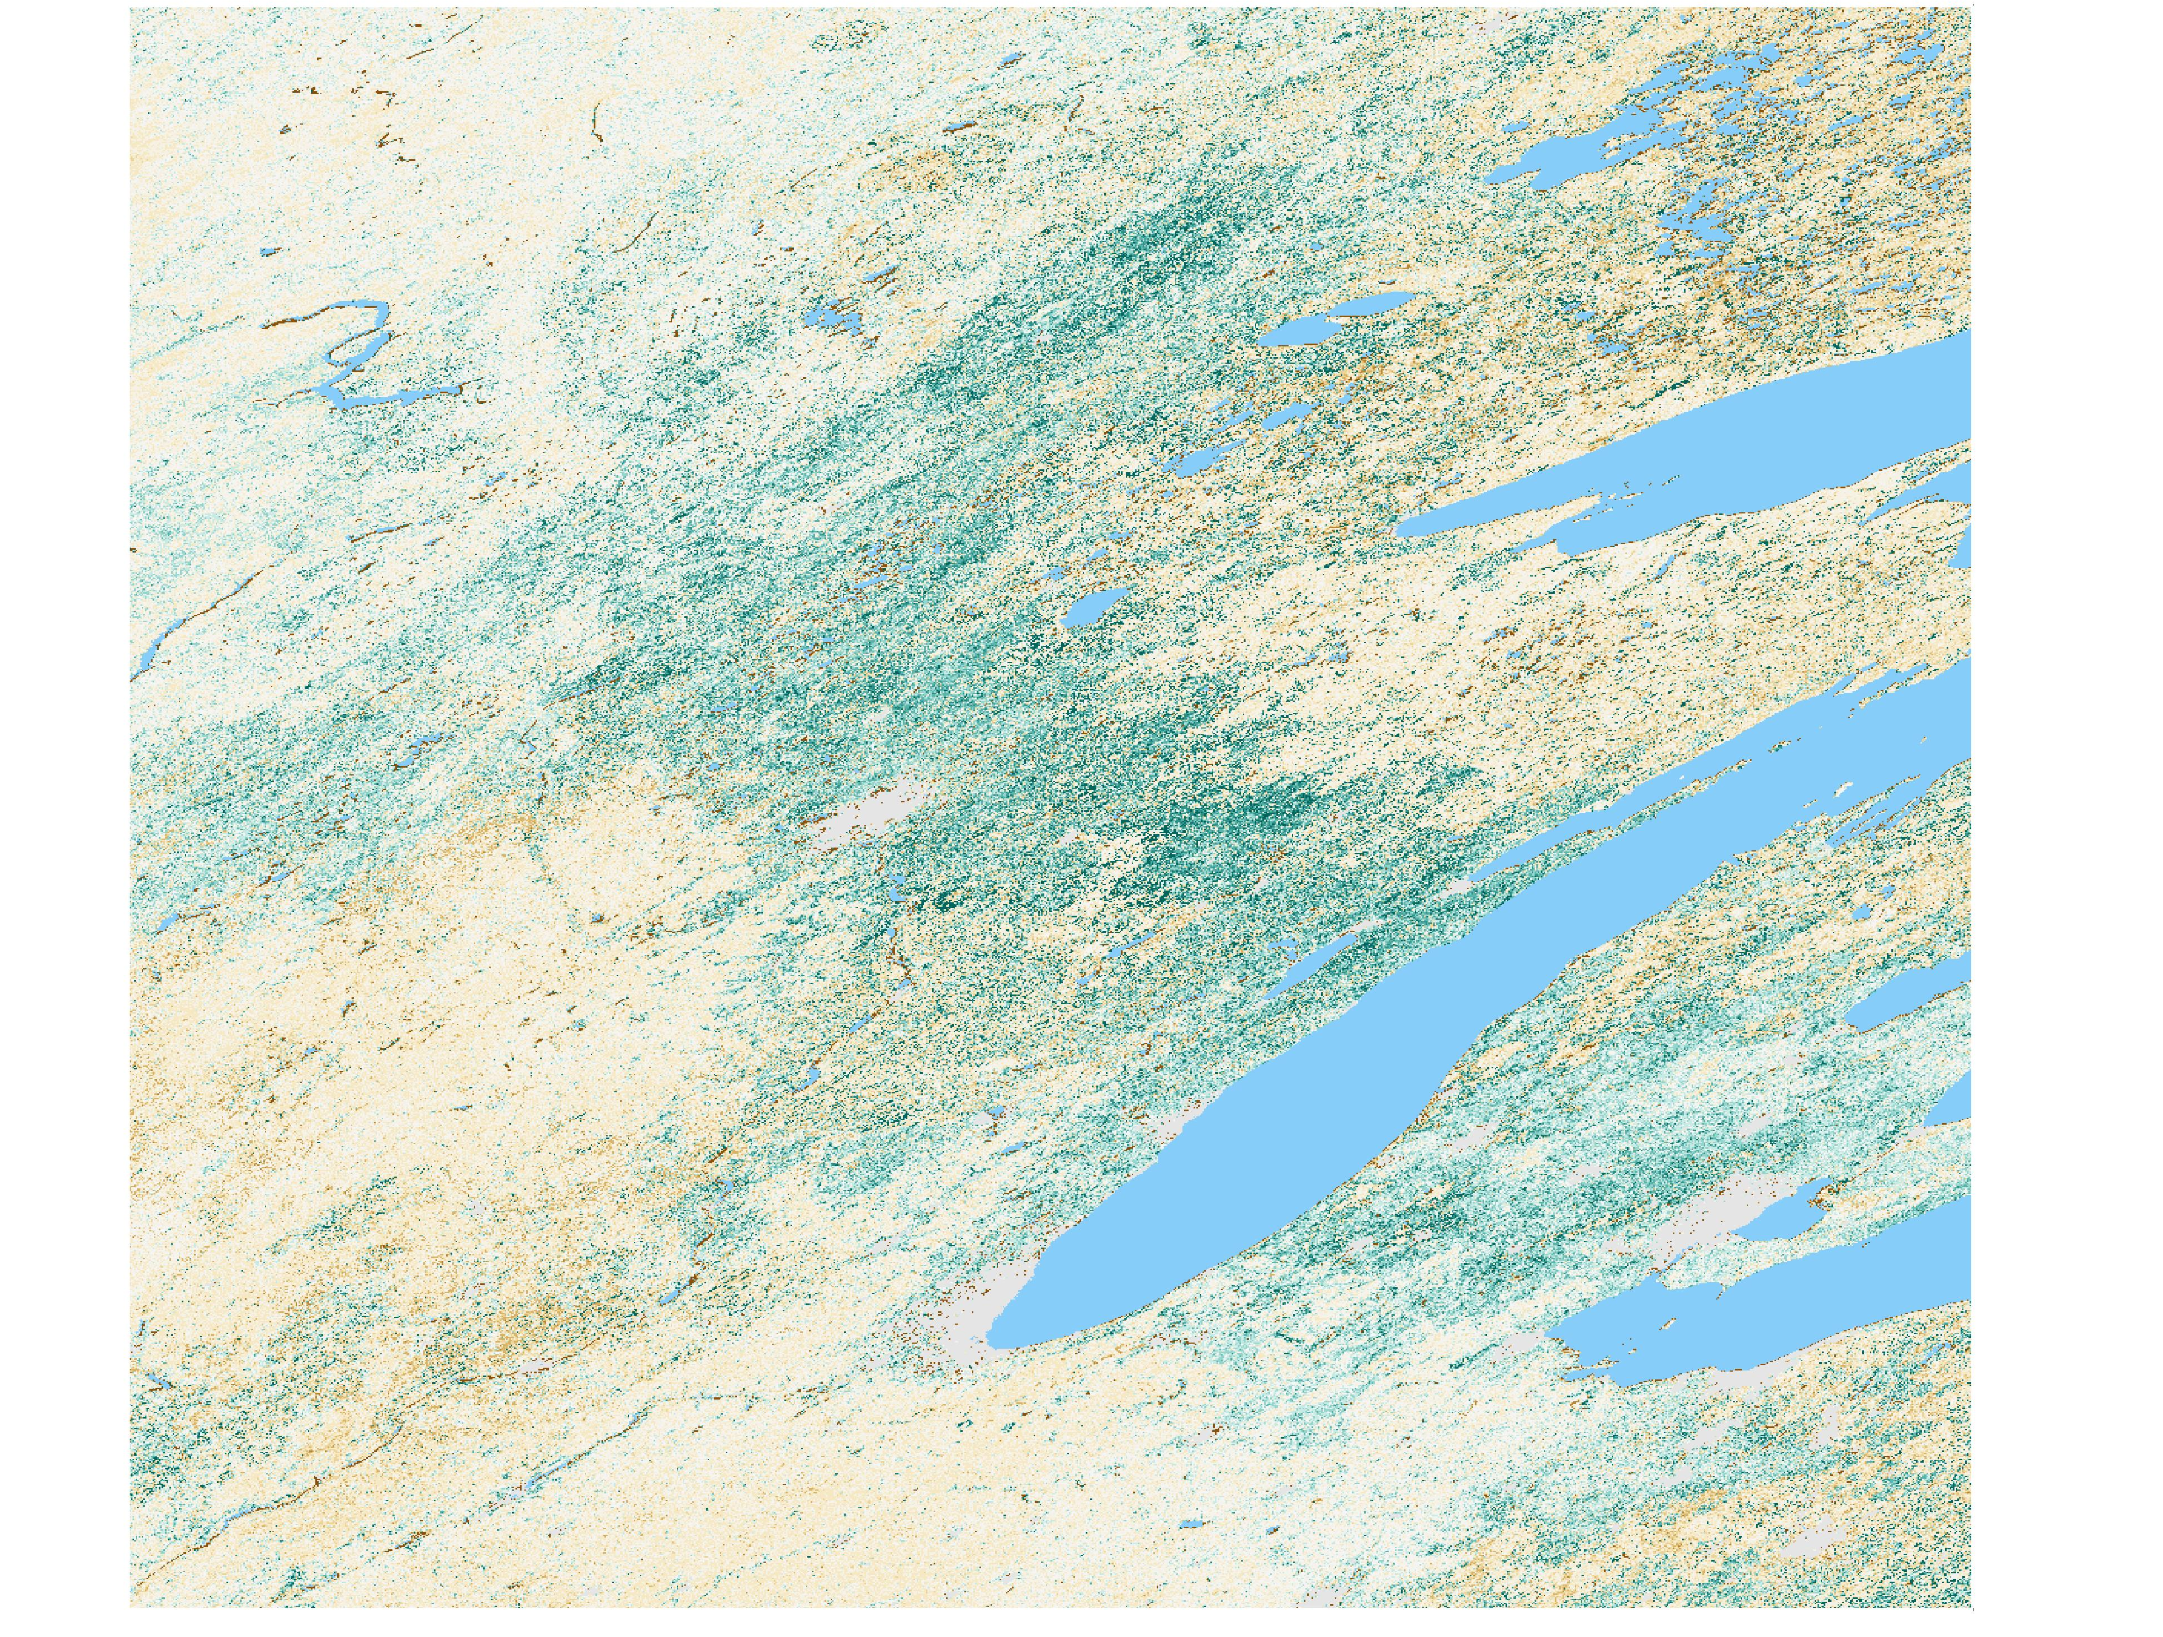
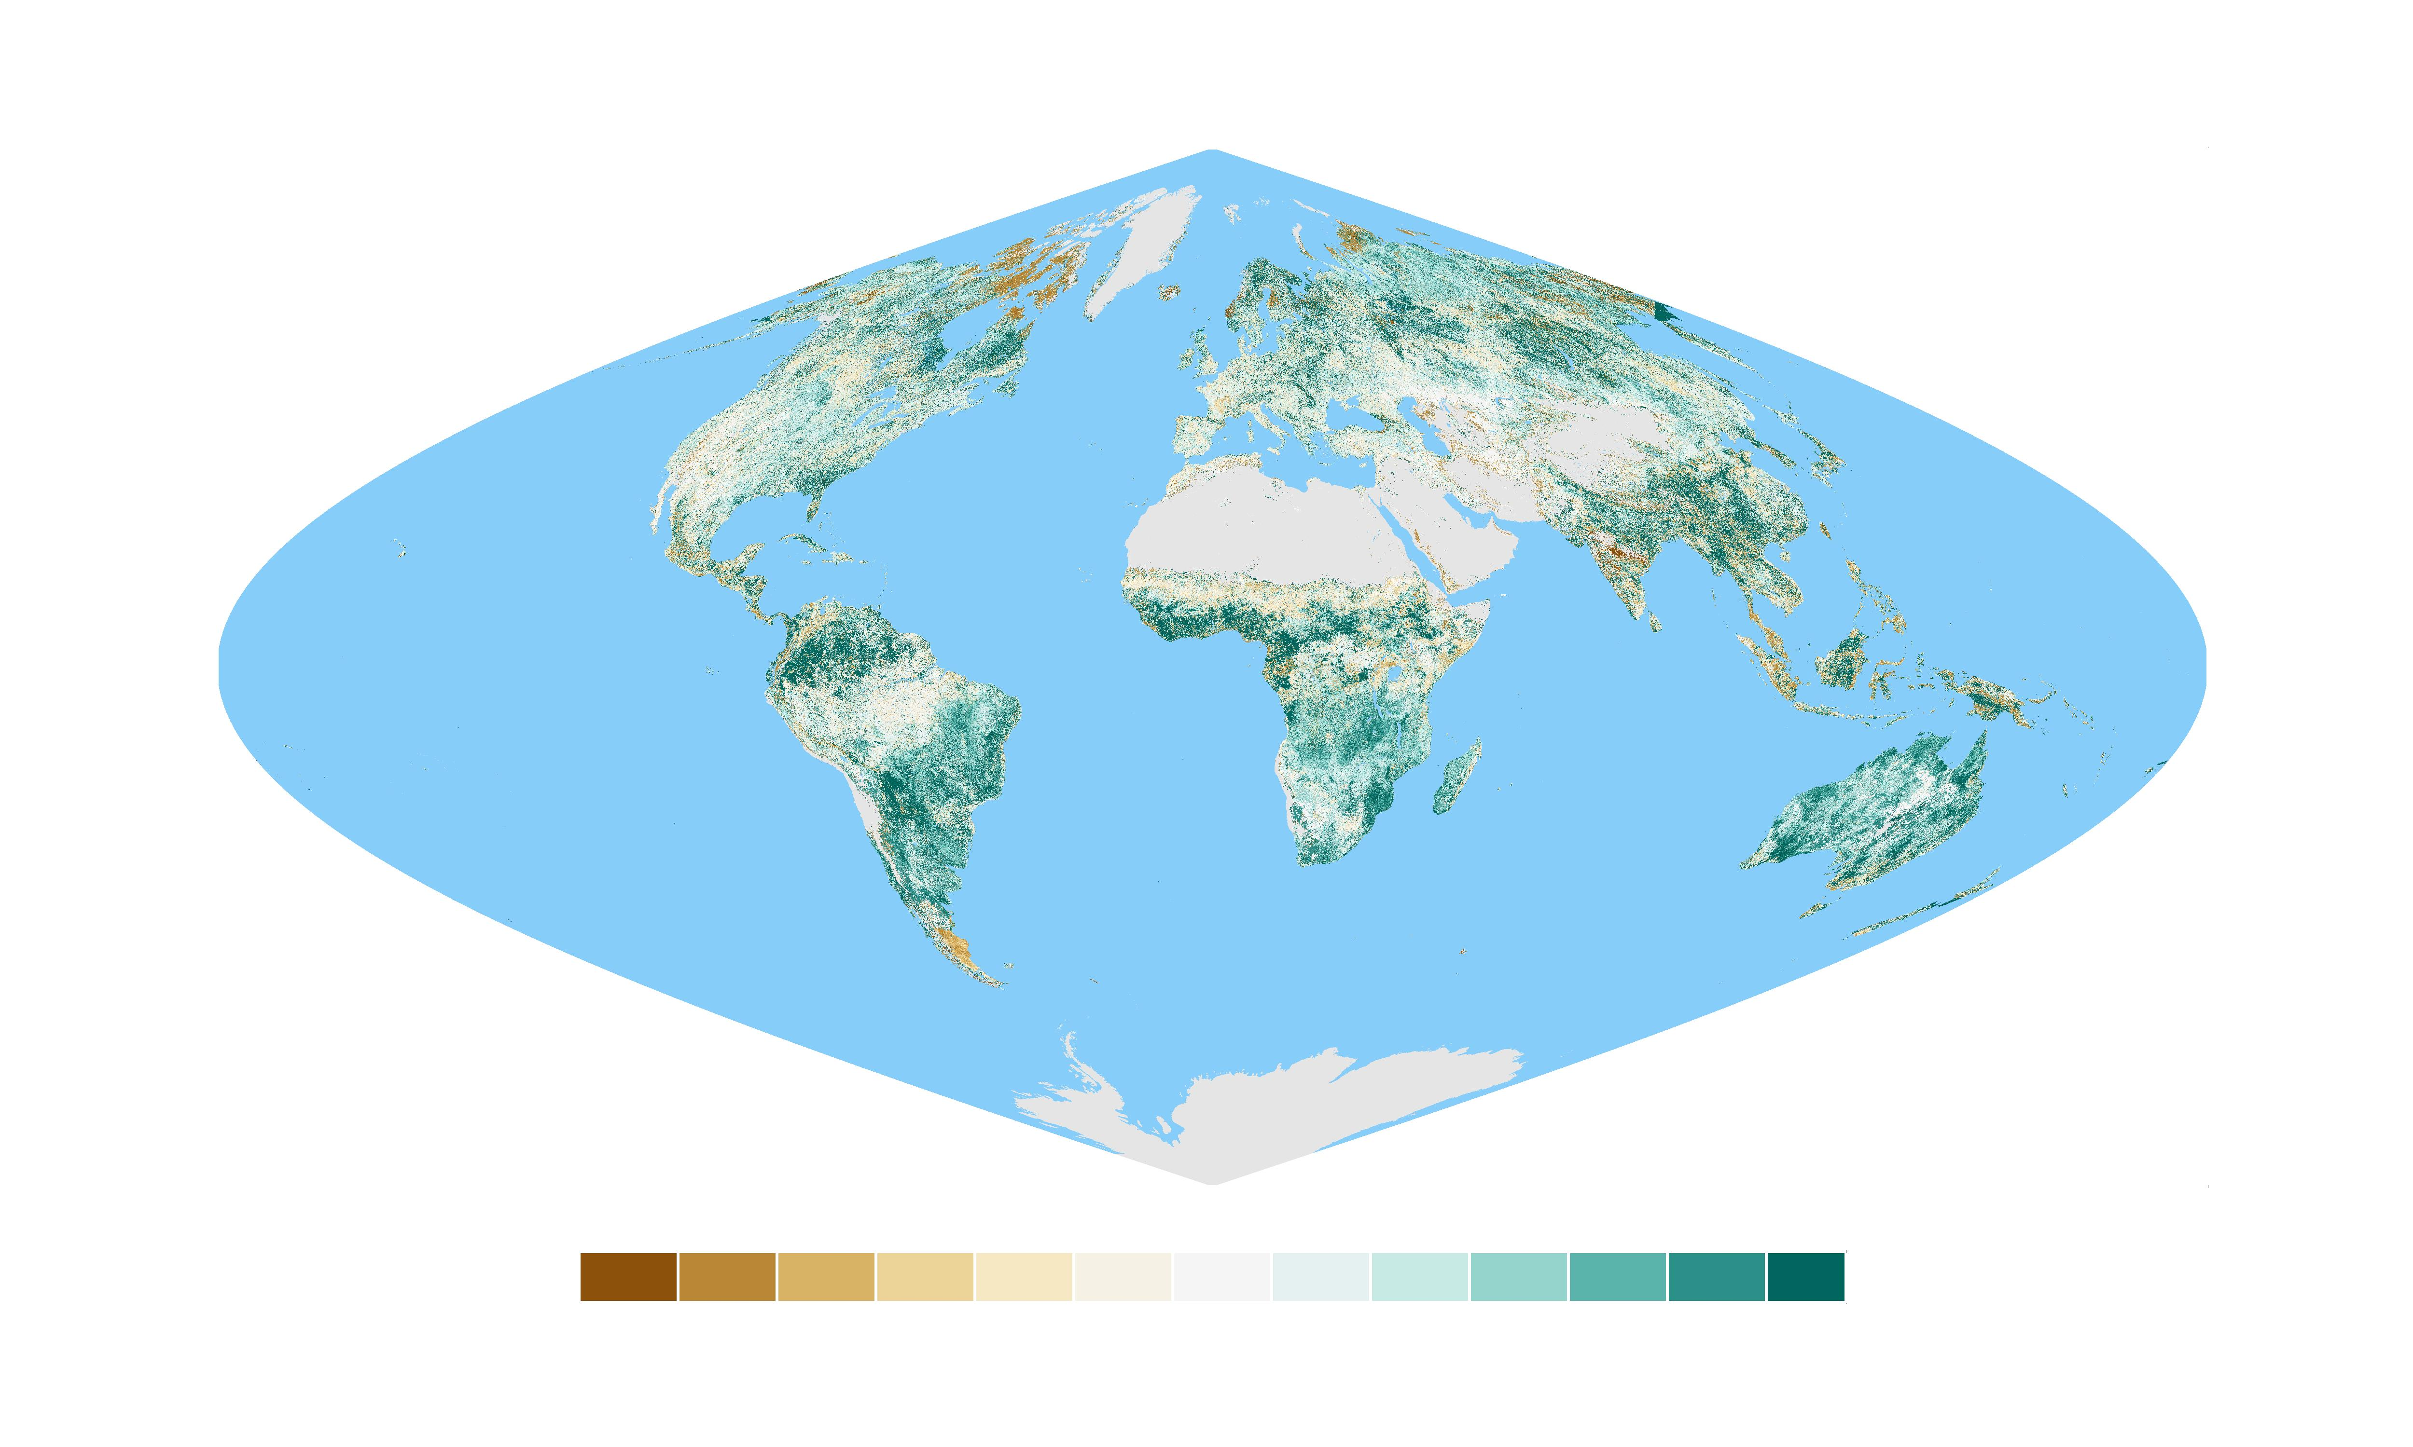
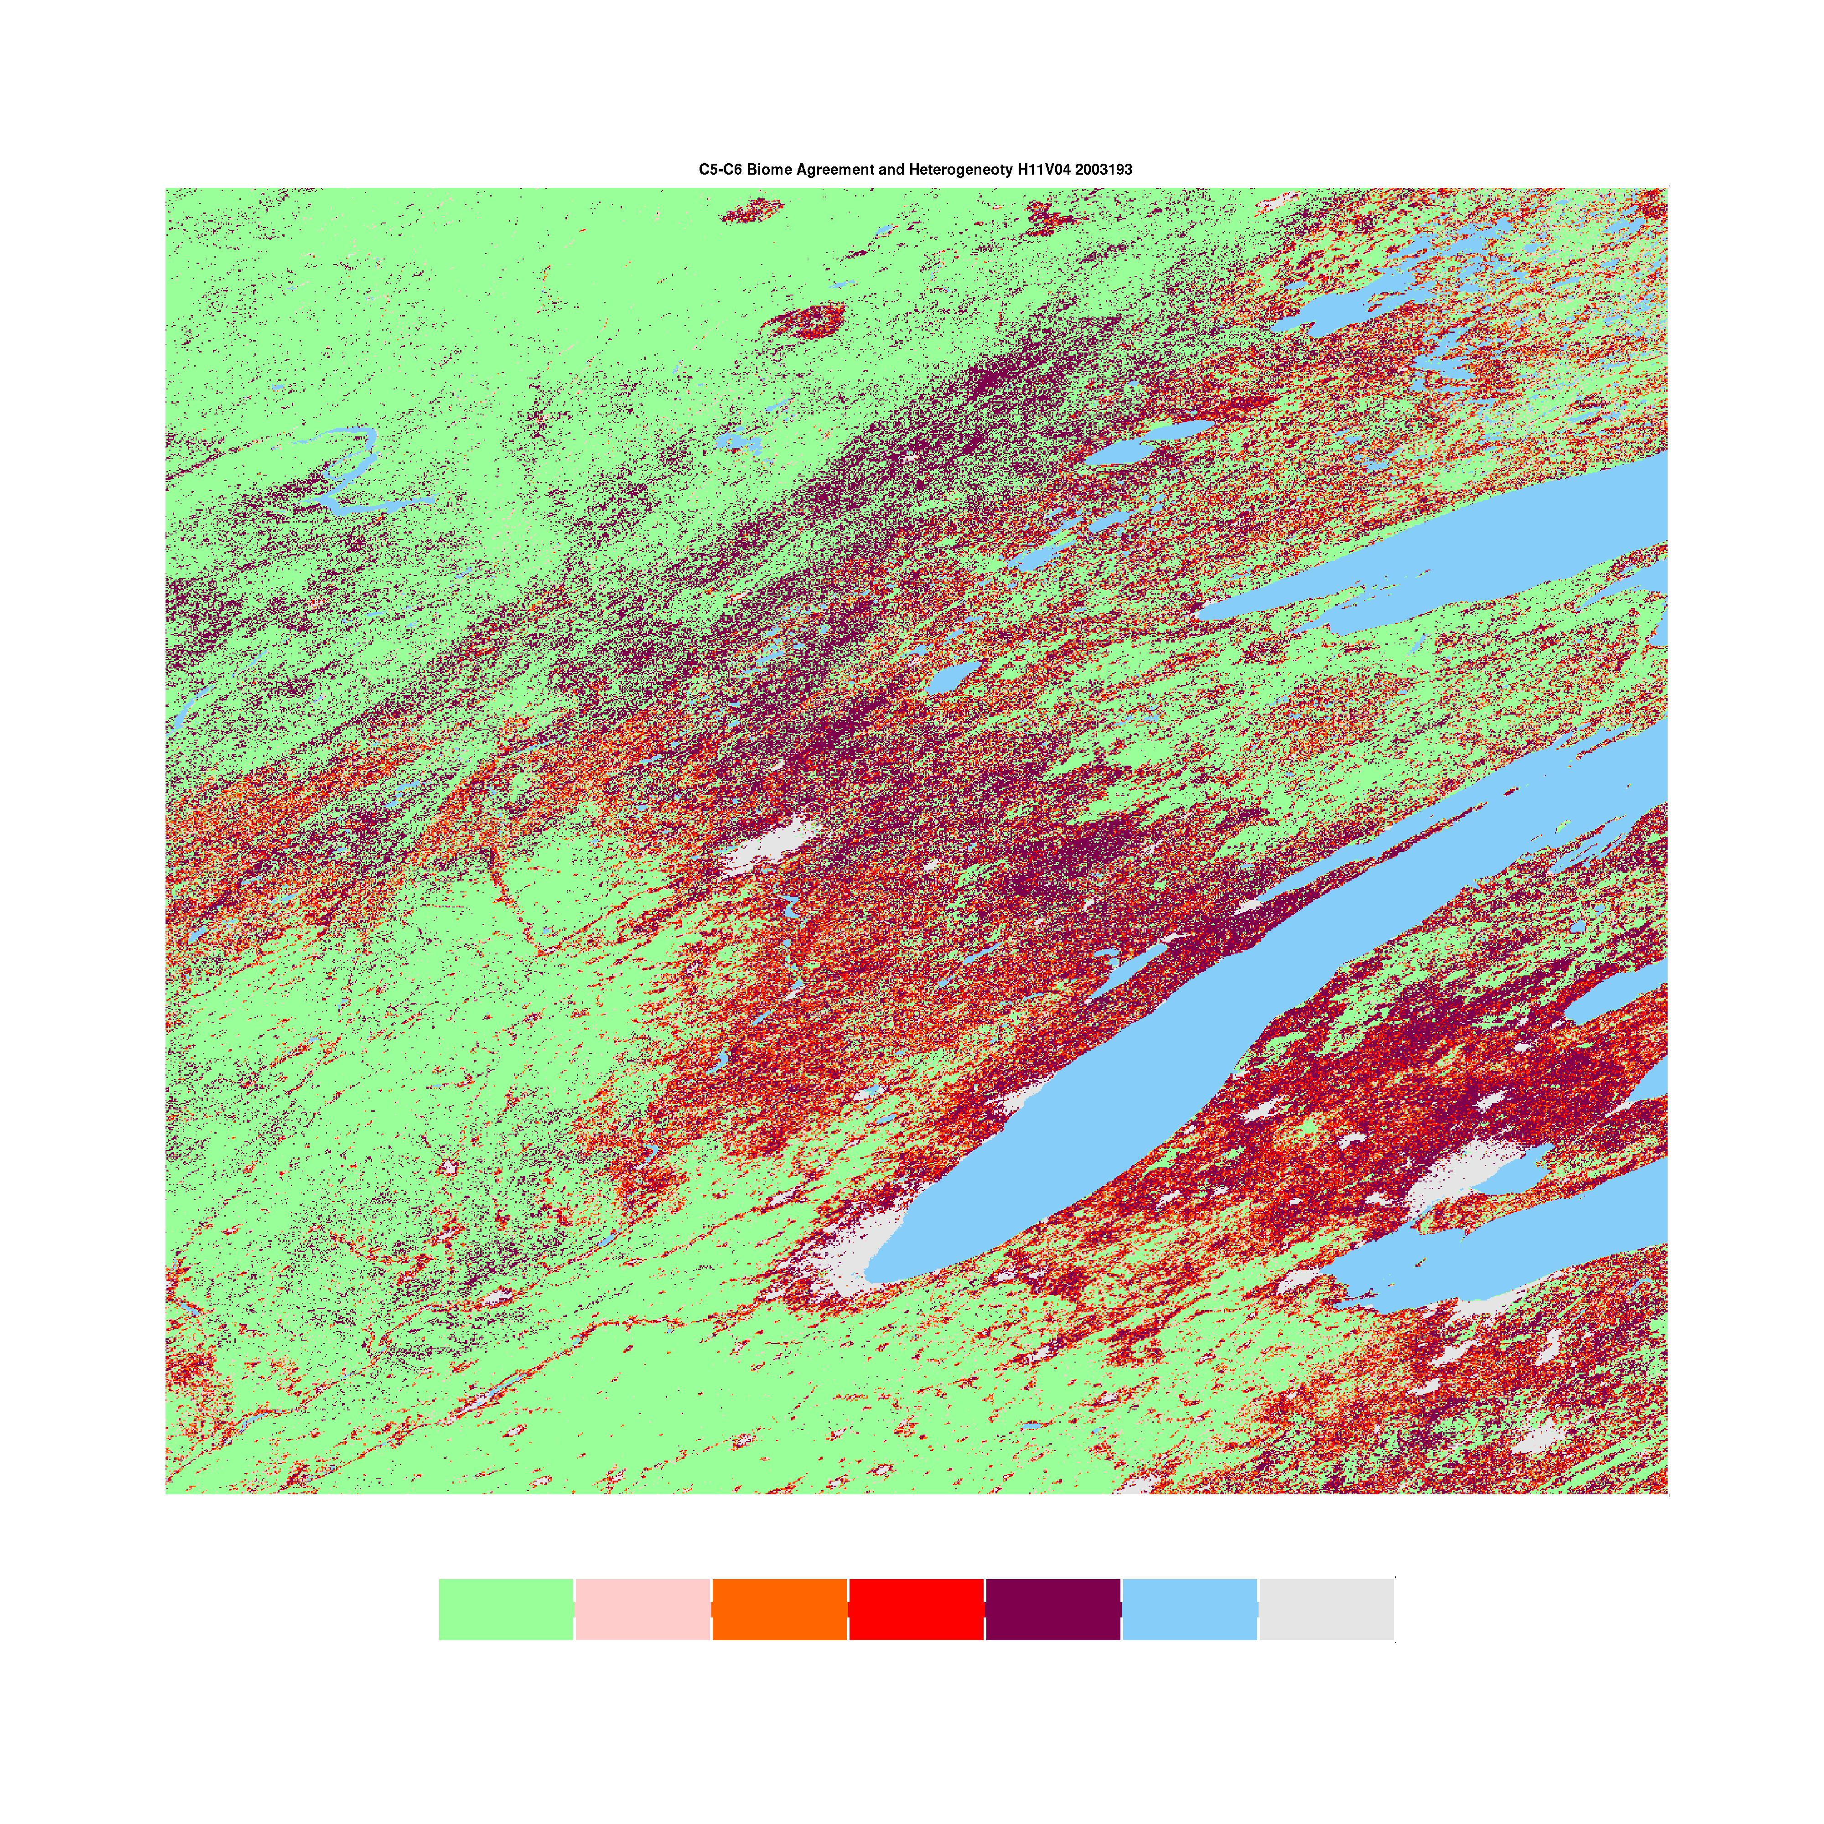
Update on MODIS LAI/FPAR − C5 vs. C6
Possible inconsistency due to changes in input
  Positive bias (0.0035 or 9%) in red band induces negative bias in LAI/FPAR
  LAI/FPAR C5 and C6 input biome maps disagree by about 30%
[H11V04 2003193]
Relative Difference (%)
-80
-60
-40
-20
-5.0
5.0
20
40
60
80
100
-100
[Biome Type Input change between C5 and C6 Product]
Disagree=0
Disagree=1
(unit: % wrt Global Land Area)
Disagree=2
Disagree=3
Disagree=4

Slide 7
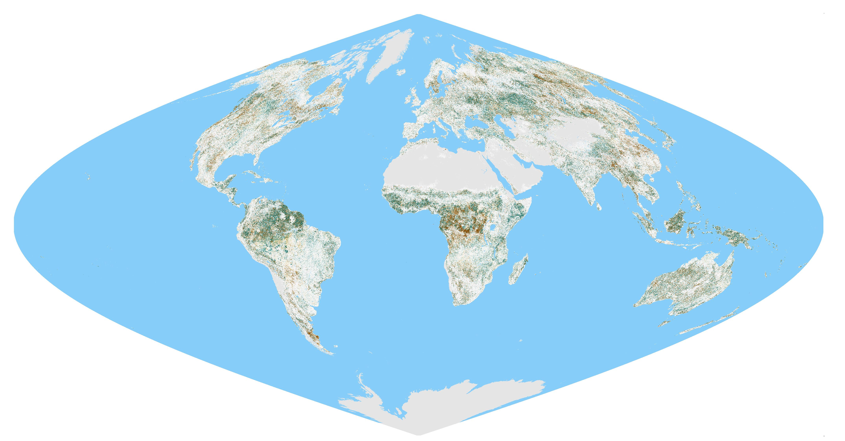
Update on MODIS LAI/FPAR − C5 vs. C6
Consistency between C5 and C6 (LAI)
  C6 underestimates C5 LAI
  For the same biome input, C6 produces global LAI within C5±0.29
  Biome type disagreement worsens the consistency (C5±0.39)
[Year=2003, DOY=193]
LAI
Relative Difference (%)
-14.0
-15.0
-12.5
-10.5
-8.0
-5.0
5.0
8.0
10.5
12.5
14.0
15.0

Slide 8
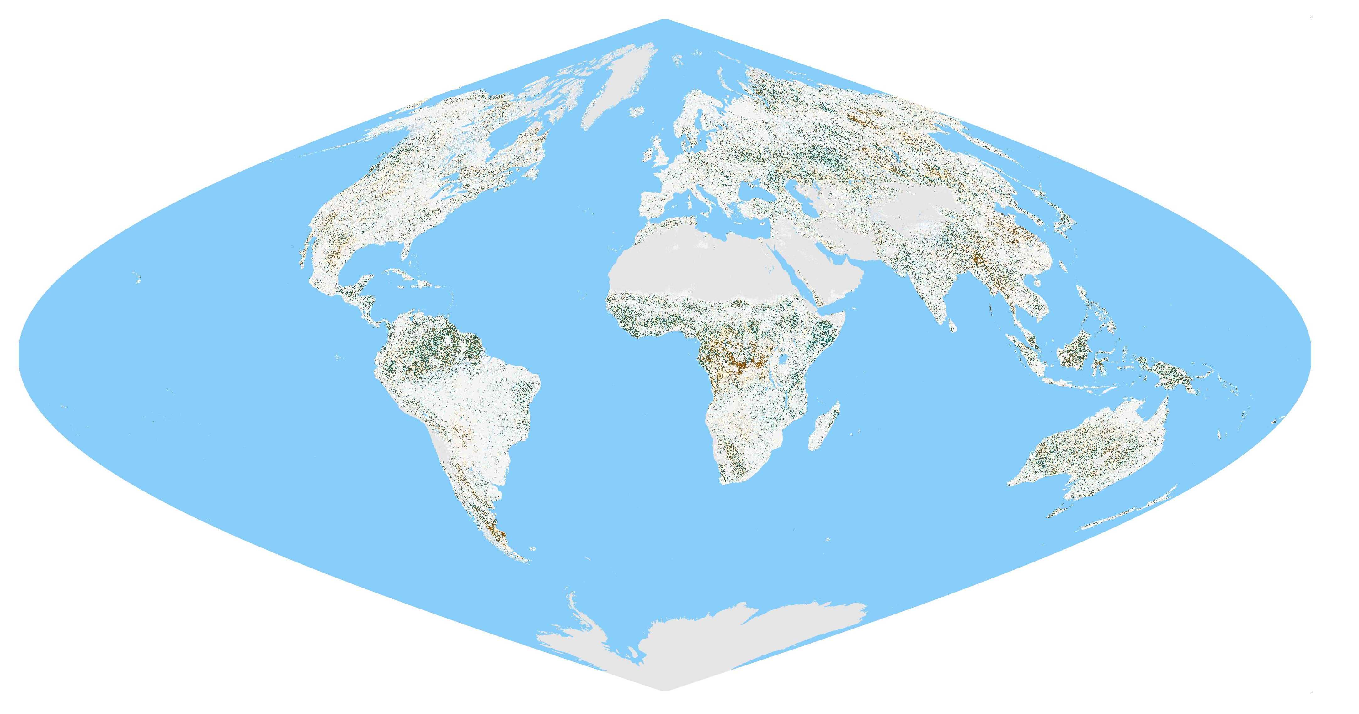
Update on MODIS LAI/FPAR − C5 vs. C6
Consistency between C5 and C6 (FPAR)
  C6 underestimates C5 FPAR
  For the same biome input, C6 produces global FPAR within C5±0.051
  Biome type disagreement worsens the consistency (C5±0.066)
[Year=2003, DOY=193]
FPAR
Relative Difference (%)
-14.0
-15.0
-12.5
-10.5
-8.0
-5.0
5.0
8.0
10.5
12.5
14.0
15.0

Slide 9
Update on MODIS LAI/FPAR − C5 vs. C6
Validation of MODIS LAI Product
  LAIs & effective LAIs from DIRECT field data set
  C5: RMSE_{LAI}=0.85, RMSE_{effLAI}=0.78, RMSE_{LAIall}=0.81
  C6: RMSE_{LAI}=0.69, RMSE_{effLAI}=0.77, RMSE_{LAIall}=0.74
  C6 shows better agreement with field data compared to C5
B8
B8
B7
B7
B6
B6
B5
B5
MODIS C5 LAI
MODIS C6 LAI
B4
B4
B3
B3
B2
B2
B1
B1
Field LAI (45 LAI and 82 effective LAI)
Field LAI (45 LAI and 82 effective LAI)

Slide 10
Update on MODIS LAI/FPAR − C5 vs. C6
Validation of MODIS FPAR product
  Both C5 and C6 shows overestimation in lower FPAR
  C6 (RMSE=0.15) shows a better agreement than C5 (RMSE=0.16)
  Demand for higher FPAR and woody-biome samples
  Demand for FPAR validation protocol (e.g., understory)
B8
B8
B7
B7
B6
B6
B5
B5
MODIS C5 FPAR
MODIS C6 FPAR
B4
B4
B3
B3
B2
B2
B1
B1
Field LAI (45 FPAR)
Field LAI (45 FPAR)

Slide 11
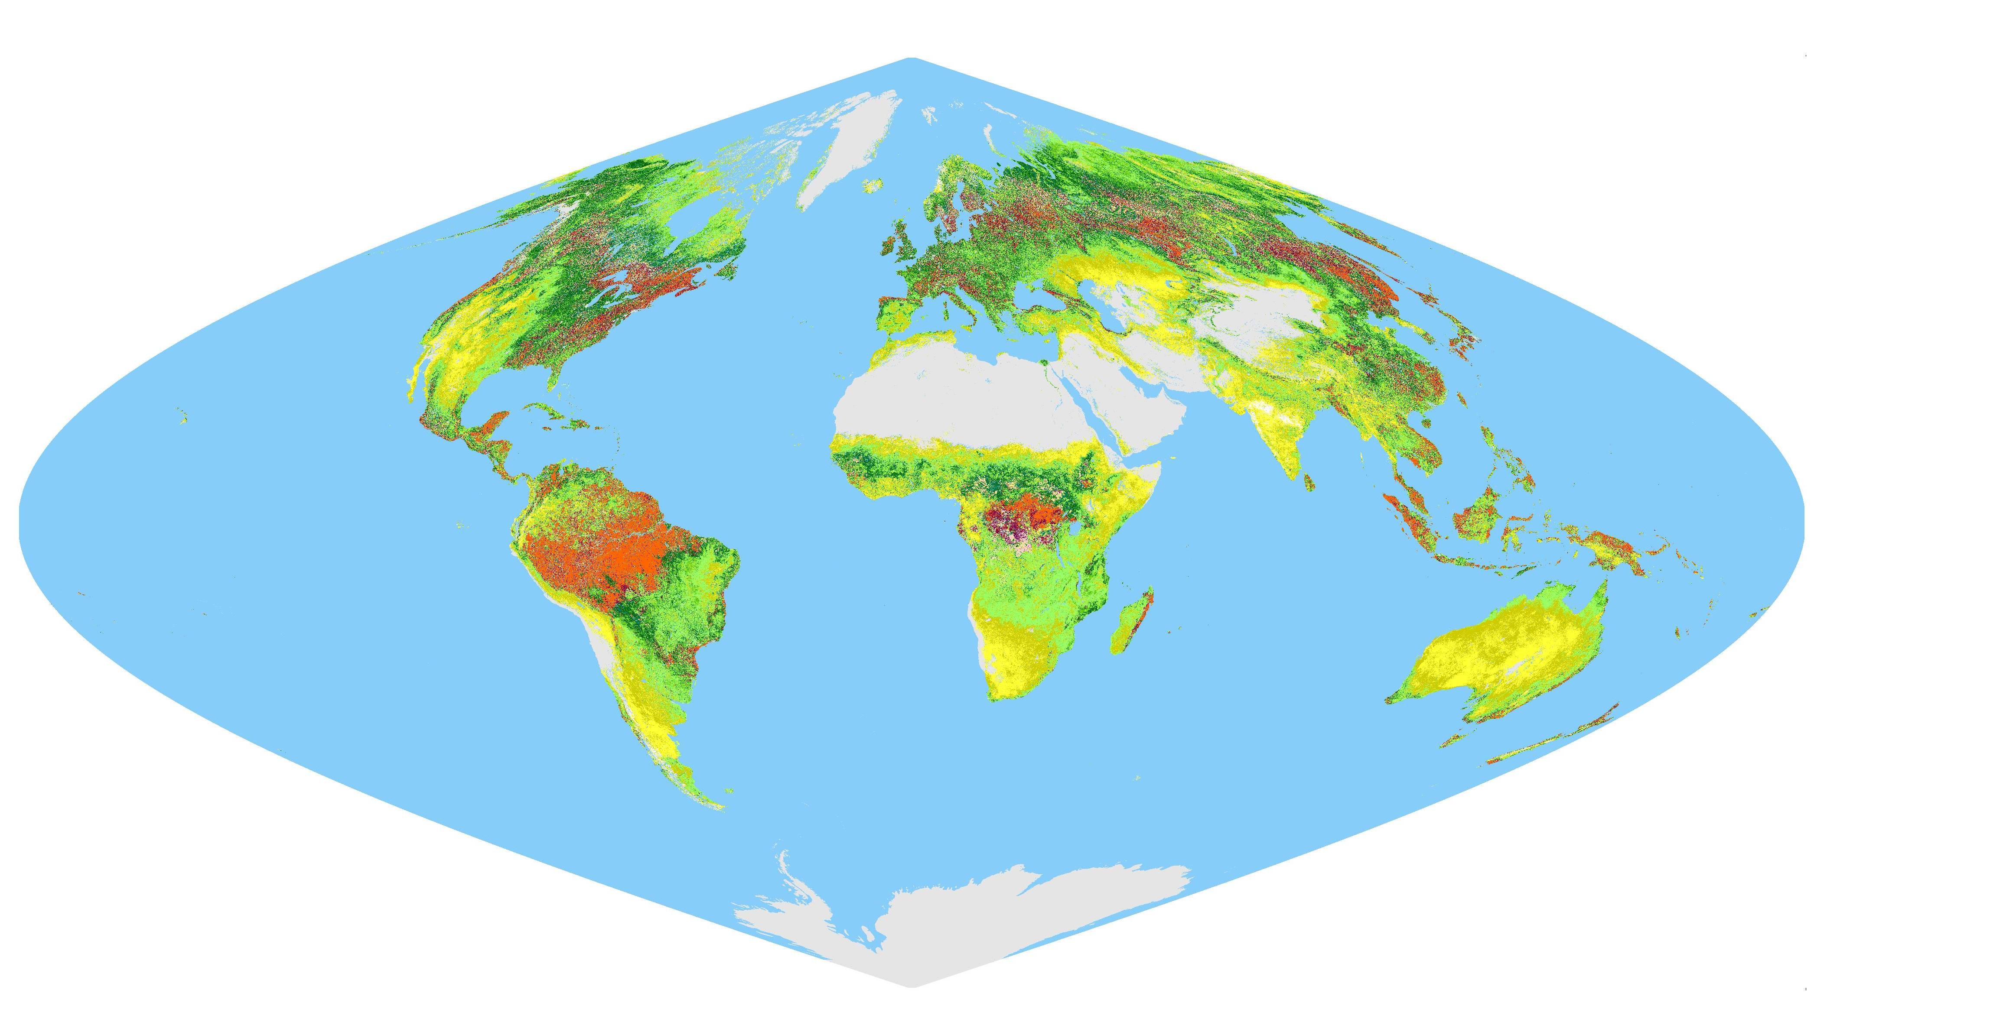
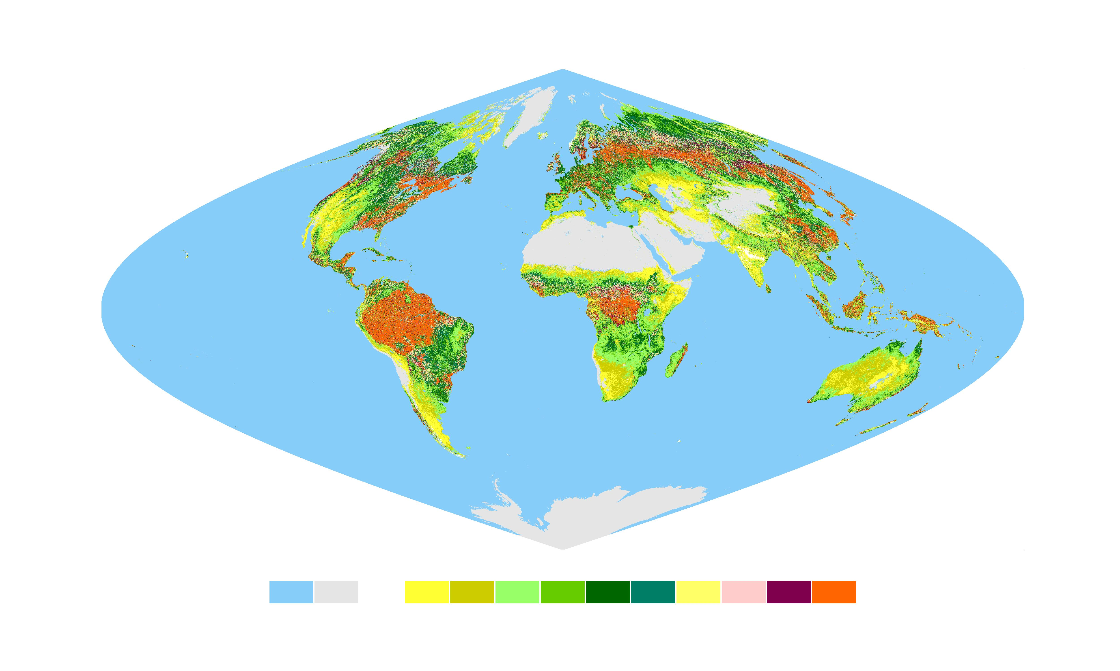
Update on VIIRS LAI/FPAR − MODIS vs. VIIRS
Comparison between MODIS C5 and VIIRS C1.1 (MODIS LUT)
  MODIS C5: MOD15A2 (1km)
  VIIRS C1.1: D8LFPAR1_L3D (1km)
  Test Period: Jan 1st 2013 (DOY: 001) – Dec 31st 2013(DOY:365)
  Test Coverage: Global Scale
  Spatial coverage and spatiotemporal pattern resemble with MODIS C5
[Year=2013, DOY=193]
MODIS C5 LAI
VIIRS C1.1 LAI
Leaf Area Index (LAI)
Water
0.0
0.1
0.3
0.5
1.2
1.6
2.1
2.8
3.4
4.4
5.4
7.0
Non-Veg
Main: Main algorithm was executed
Main-S: Main algorithm was executed. Saturation
BackUp-G: View/sun zenith angle too low. Backup retrievals
BackUp-O: Main algorithm fails. Backup retrievals
Not Retrieved: not executed because BRF is not available

Slide 12
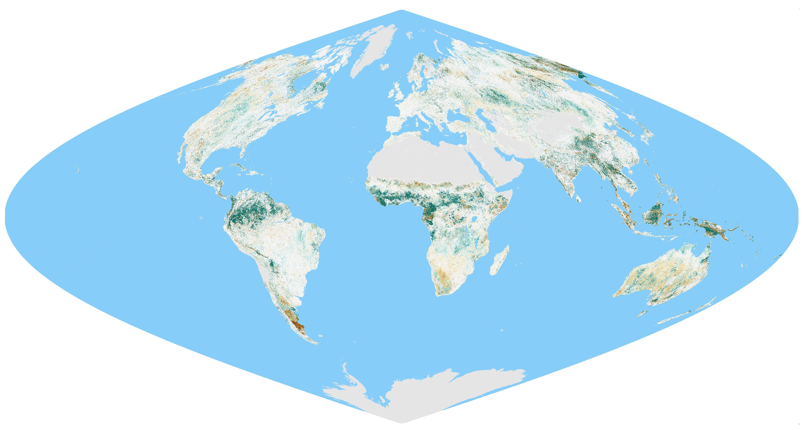
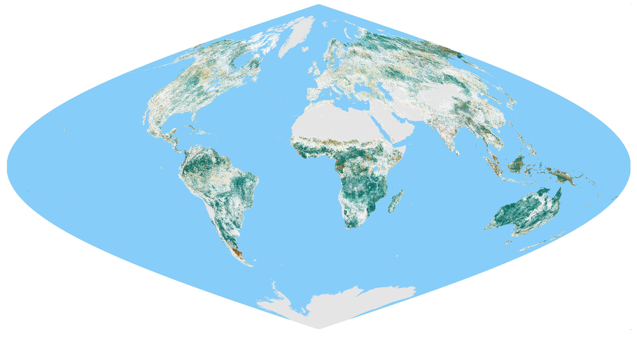
Update on VIIRS LAI/FPAR − MODIS vs. VIIRS
Comparison between MODIS C5 and VIIRS C1.1 (MODIS LUT)
  VIIRS overestimates C5 LAI & FPAR
  VIIRS produces global LAI within MODIS C5±1.81
  VIIRS produces global FPAR within MODIS C5±0.207
  Adjustments for VIIRS spectral band composition are needed
FPAR
Relative Difference (%)
LAI
-5.0
10
20
40
50
-40
-30
-20
-10
5.0
30
-50
[Year = 2013 DOY = 193]

Slide 13
Update on VIIRS LAI/FPAR − MODIS vs. VIIRS
Comparison between VIIRS C1.1 (MODIS LUT) and field data
  Larger overestimations are observed for both FPAR & LAI
  FPAR: RMSE=0.21 (+0.70, C5 RMSE = 0.14)
  LAI: RMSE_{LAI}=1.35 (+0.58, C5 RMSE_{LAI}=0.77)
  Caveat: Temporal mismatch between VIIRS and field measurements
B8
B8
B7
B7
B6
B6
VIIRS C1.1 FPAR
B5
B5
VIIRS C1.1 LAI
B4
B4
B3
B3
B2
B2
B1
B1
Field FPAR (38 FPAR)
Field LAI (55 LAI and 80 effective LAI)

Slide 14
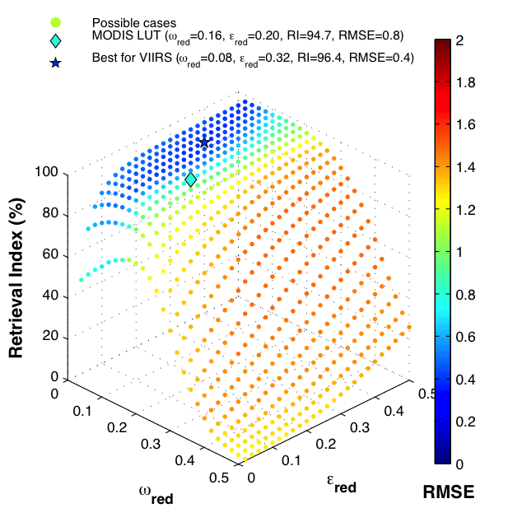
Update on VIIRS LAI/FPAR − MODIS vs. VIIRS
LUT adjustment for VIIRS spectral band composition
  Single scattering albedo and uncertainties in Red BRF (<->flatten NIR)
  Maximizing retrieval index & Minimizing RMSE
  Biome2: 0.4 RMSE & 1.7% RI improved (overestimation remedied)
  Potential for MODIS-like LAI/FPAR production from VIIRS
MODIS-VIIRS LAI

Slide 15
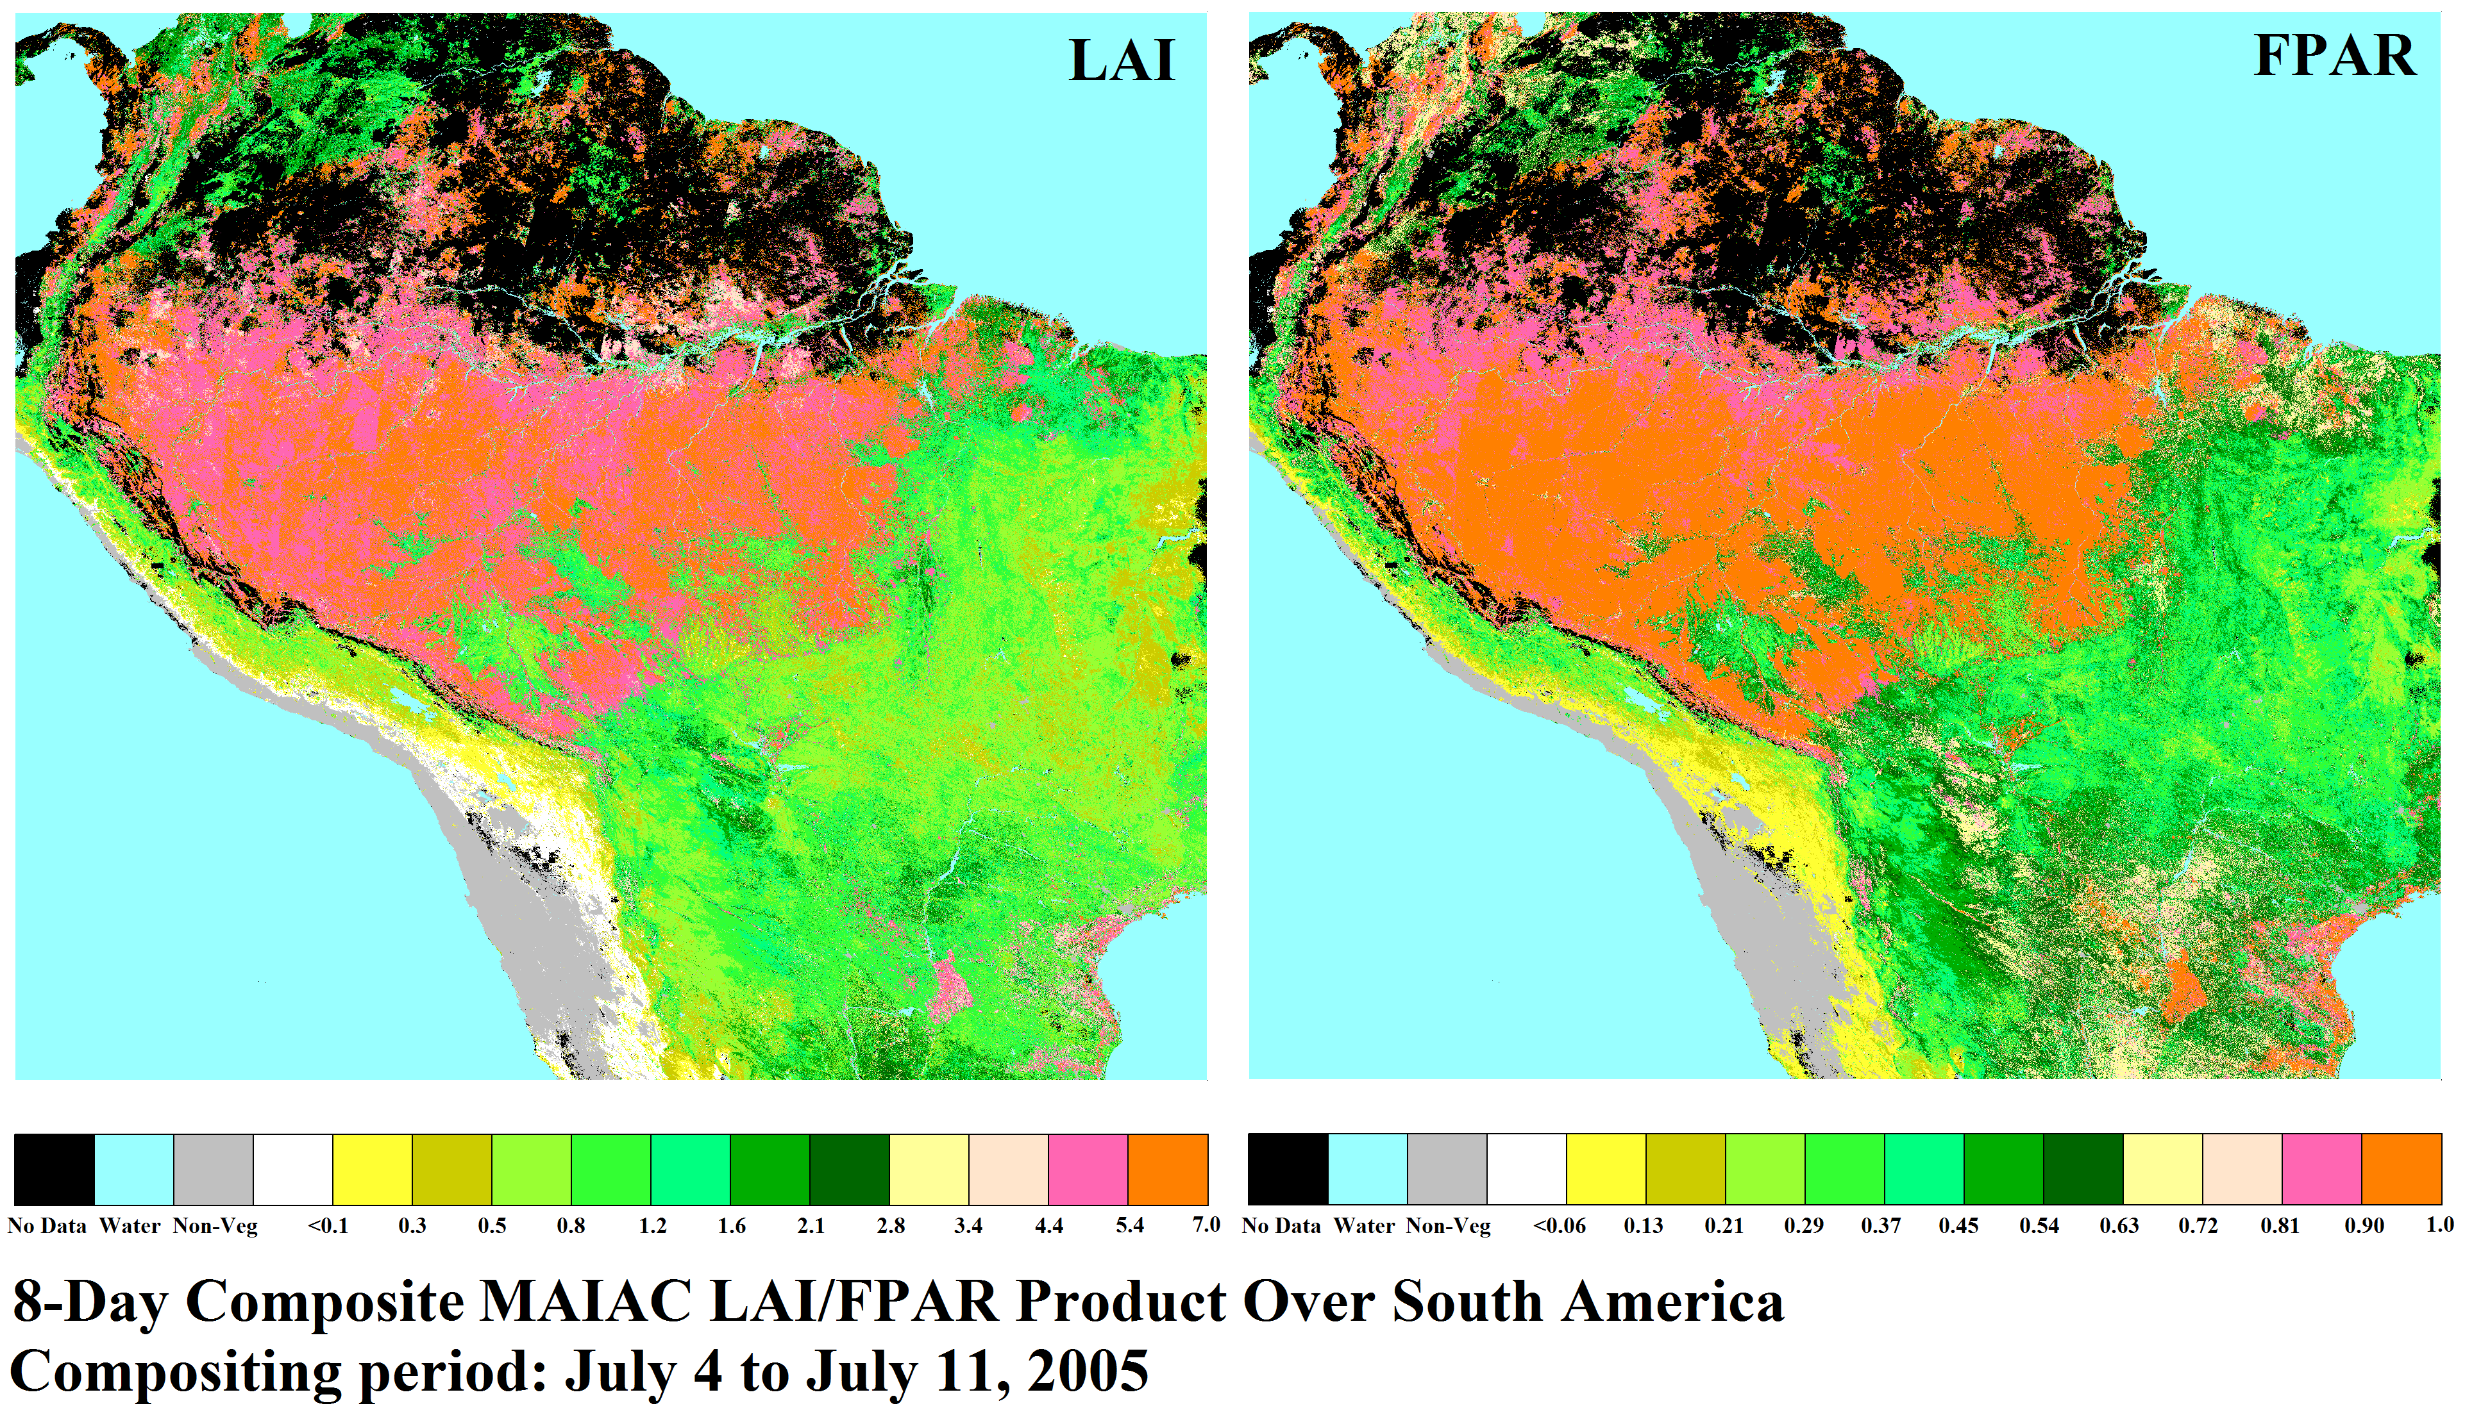
Implementation of Algorithm
MAIAC LAI/FPAR Prototype
  Implement MODIS scientific algorithm into MAIAC BRFs
  Progressing on MAIAC specific LUT adjustment
[MAIAC LAI/FPAR Prototype]

Slide 16
Future plan & Summary
Summary
  C6 produces global LAI within C5±0.29 and FPAR within C5±0.051
  C6 agrees better with in-situ LAI (RMSE_{LAI}=0.69) and FPAR (RMSE=0.15)
  VIIRS based on MODIS LUT produces global LAI within C5±1.81 and FPAR within C5±0.207
  VIIRS tends to overestimate both LAI (RMSE_{LAI}=1.35) & FPAR (RMSE=0.21)
  Potential for MODIS-like global LAI/FPAR product from VIIRS
Further plan
  Input uncertainty and sensitivity assessment
  VIIRS LUT adjustment and Delivery
  Update field observations for both MODIS &VIIRS Missions (e.g., ImagineS)
  VIIRS evaluation and validation

Slide 17
Thank You

