Slide 1
Power of Story
Compelling Data + Story + Telling
Every presenter has the potential to be great; every presentation is high stakes; and every audience deserves the absolute best.

Slide 2
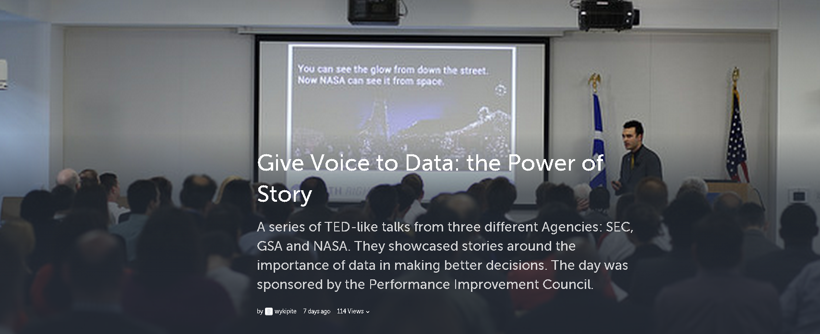

Engage Thru Story
Engage Thru Story
Performance
Improvement
Council
Performance
Improvement
Council

Slide 3





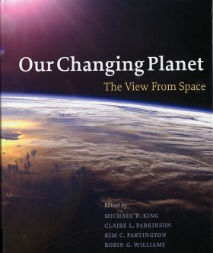

Earth System Science
Land
Ocean
Atmosphere
Ice
Changing Planet

Slide 4
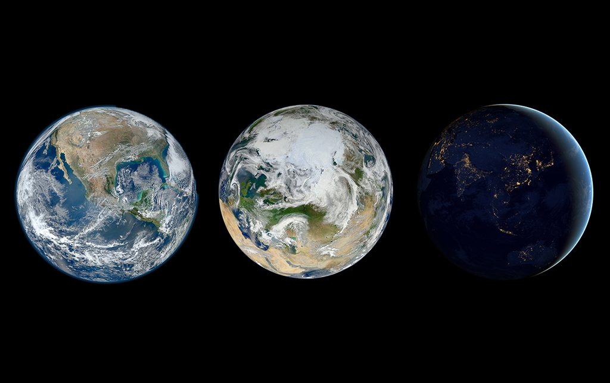

Slide 5
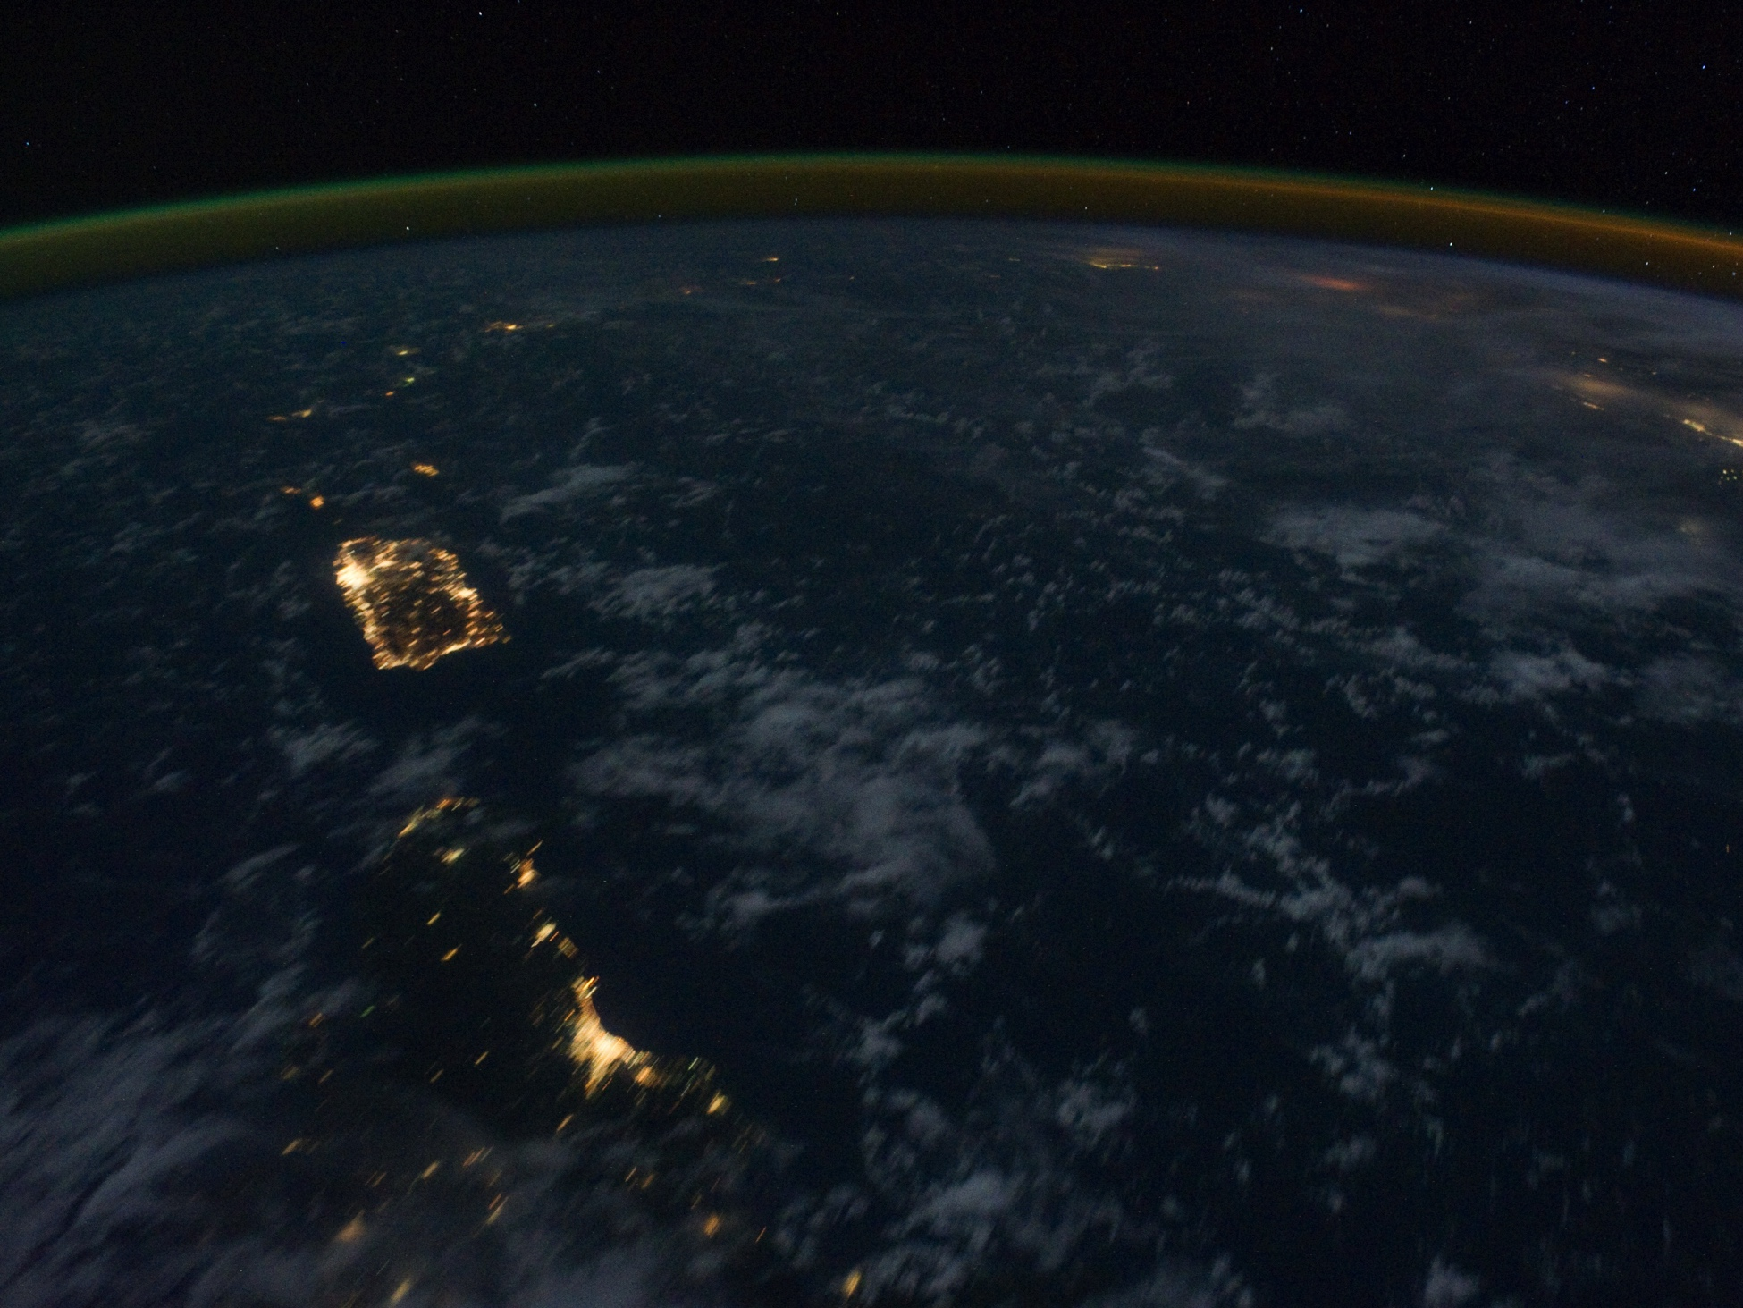
What makes a community meaningfully similar or different is not just its landscape, but also its people.

Slide 6

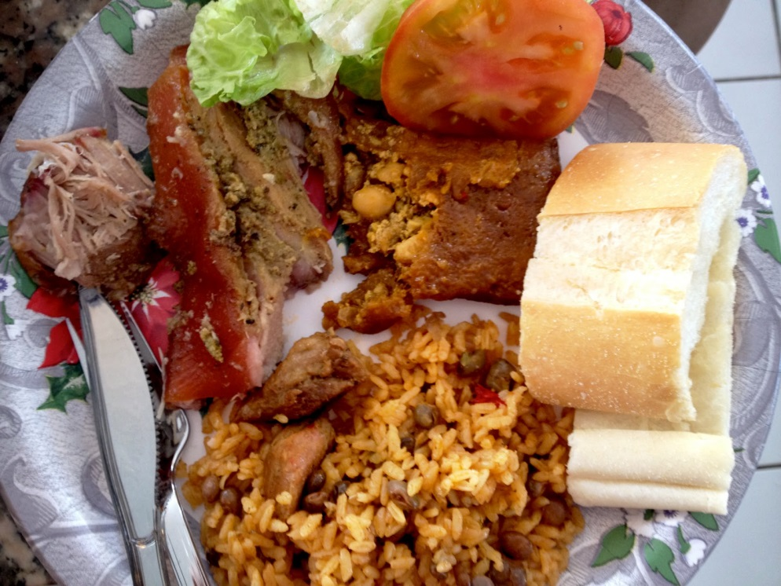
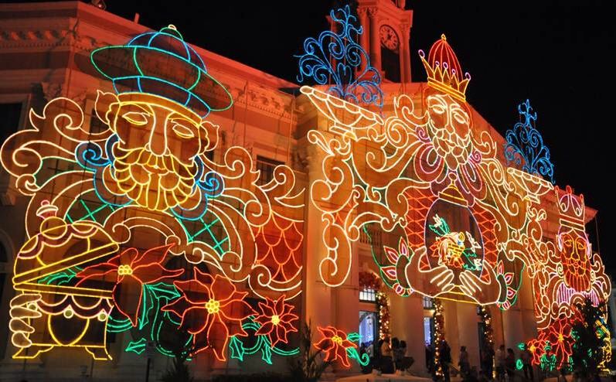
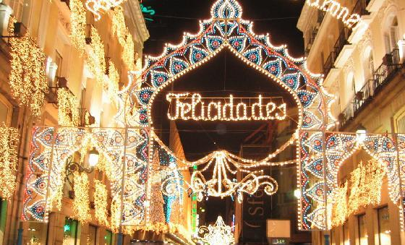
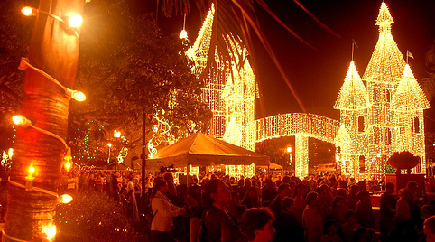
Holiday Season in Puerto Rico

Slide 7
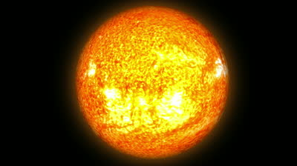
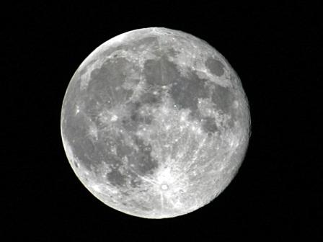
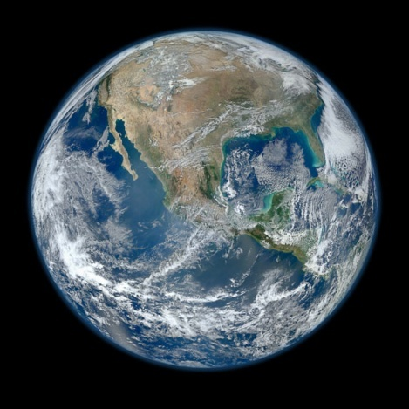
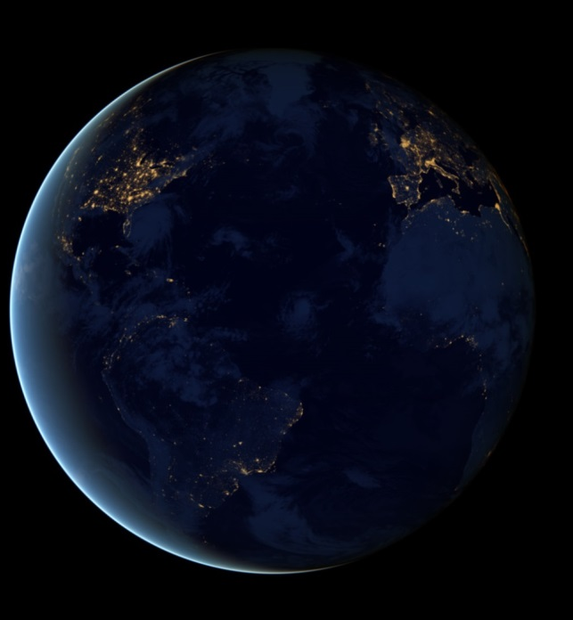
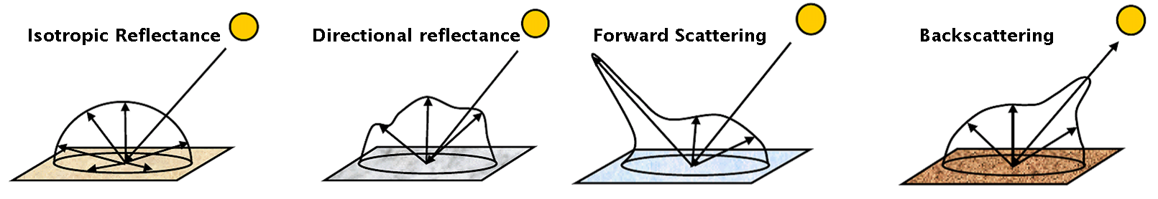
The Solution: Combine daytime and nighttime measurements…
…with well-established physical principles.

Slide 8
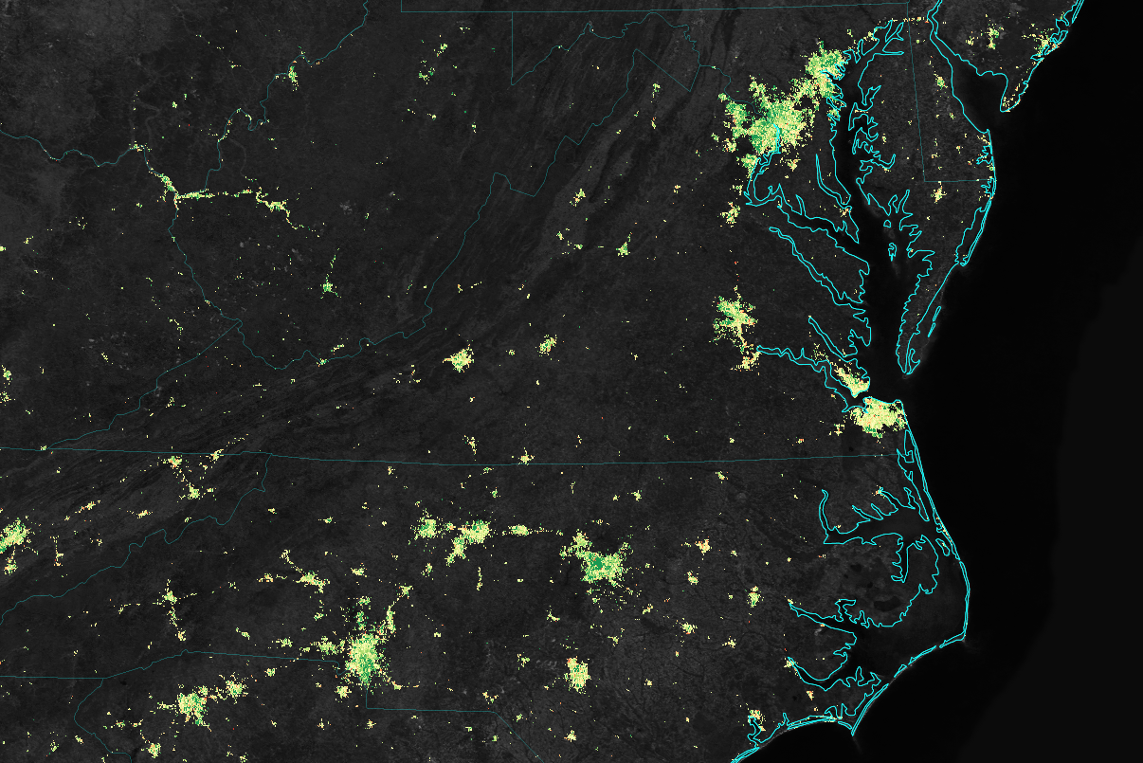

Baltimore – Washington
Metro Area
Richmond
Portsmouth
Greensboro
Raleigh
Charlotte
Greenville
Holiday Lighting
less equal more

Slide 9
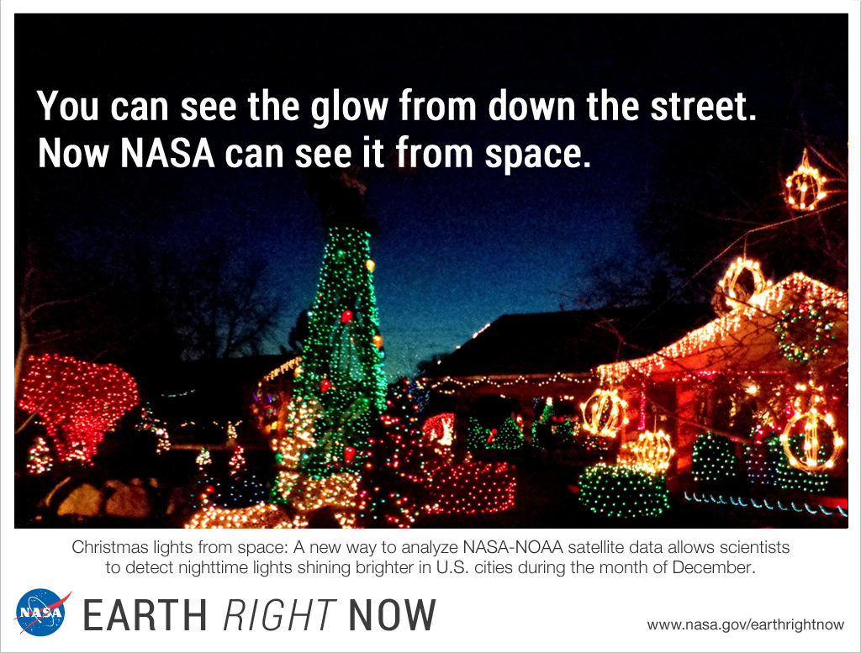

Slide 10
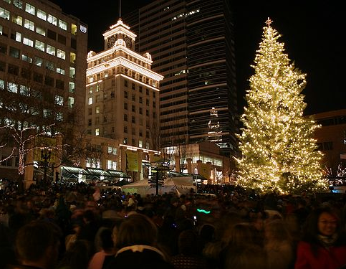
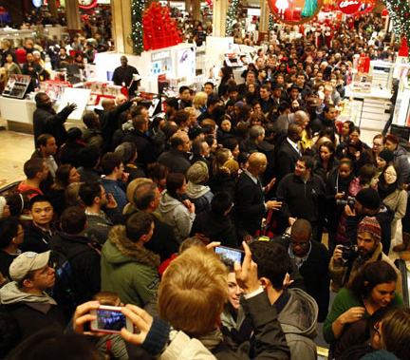
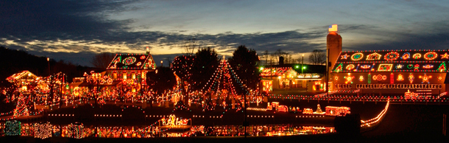

Slide 11

Holiday Season in Puerto Rico
Large-to-Medium
sized cities
More Nighttime Lights
Small towns
Magnitude of lighting demand
More People

Slide 12
Holiday Season in Puerto Rico
Large suburbs & exurban areas
Cultural Centers
Central urban districts
More Christmas Lights
Magnitude of holiday lighting demand
Countryside towns
More People

Slide 13
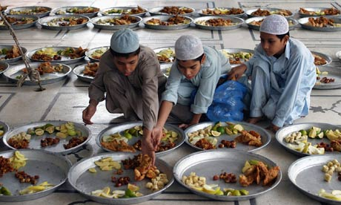
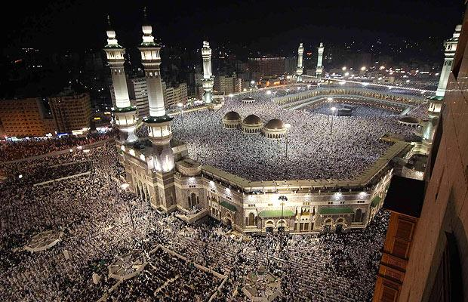
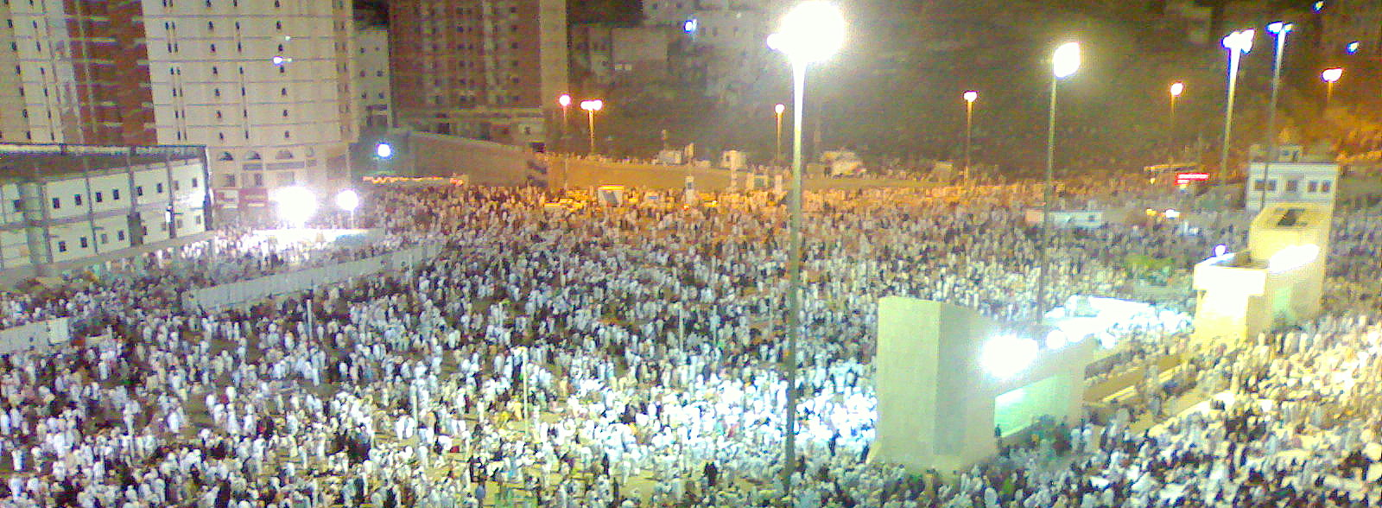
The Holy Month of Ramadan

Slide 14
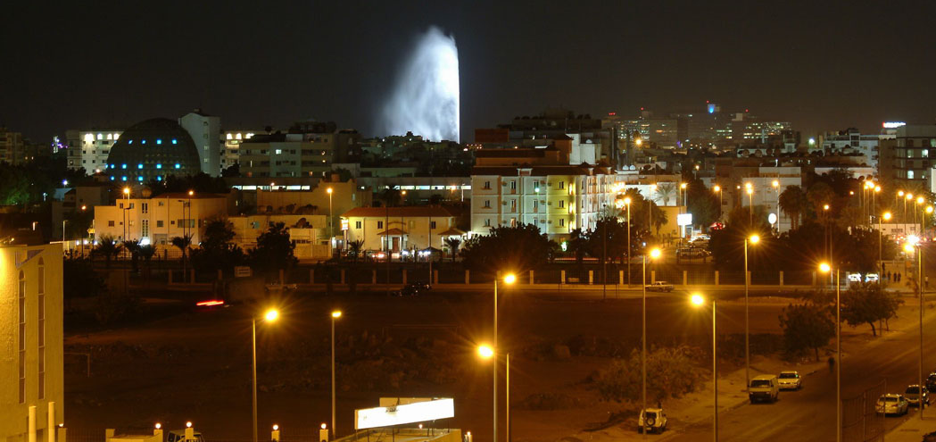
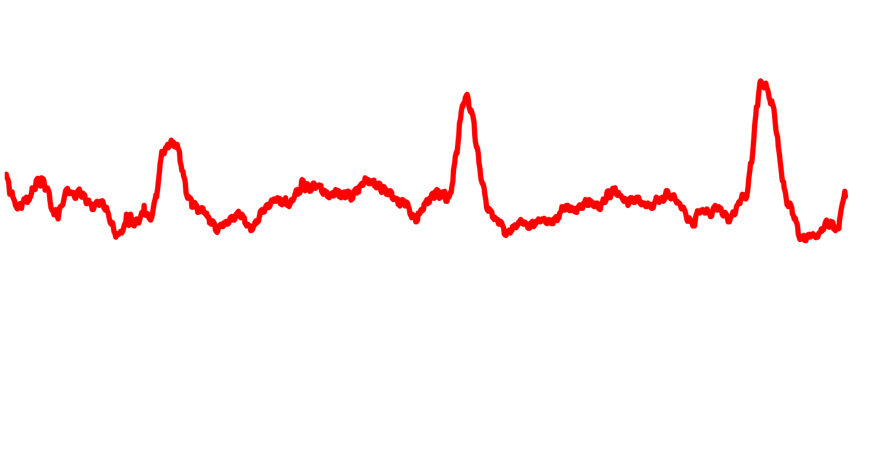
Jeddah, Saudi Arabia
2012 2013 2014

Slide 15
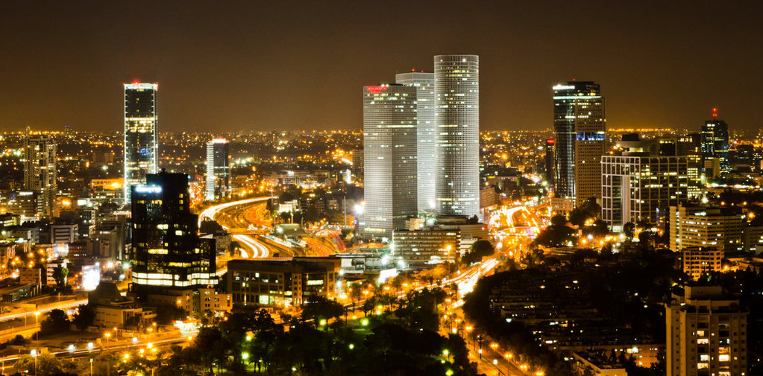

Tel Aviv, Israel
2012 2013 2014

Slide 16

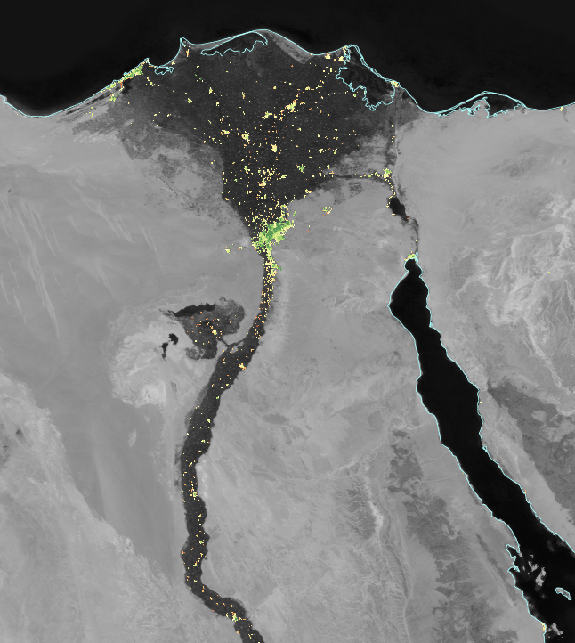
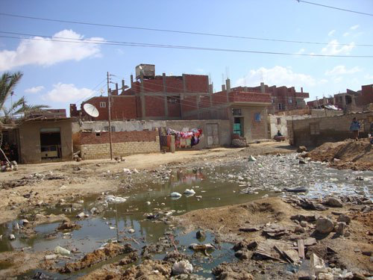
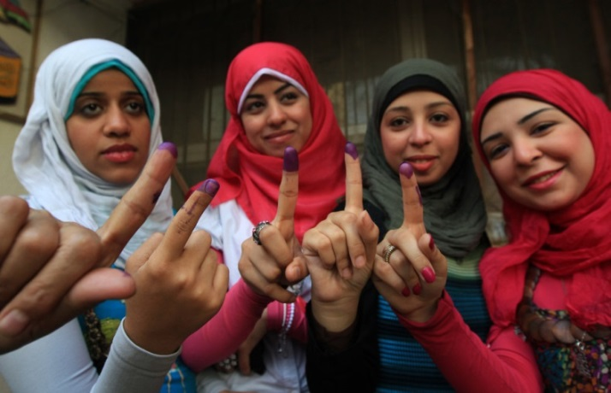
Cairo

Slide 17
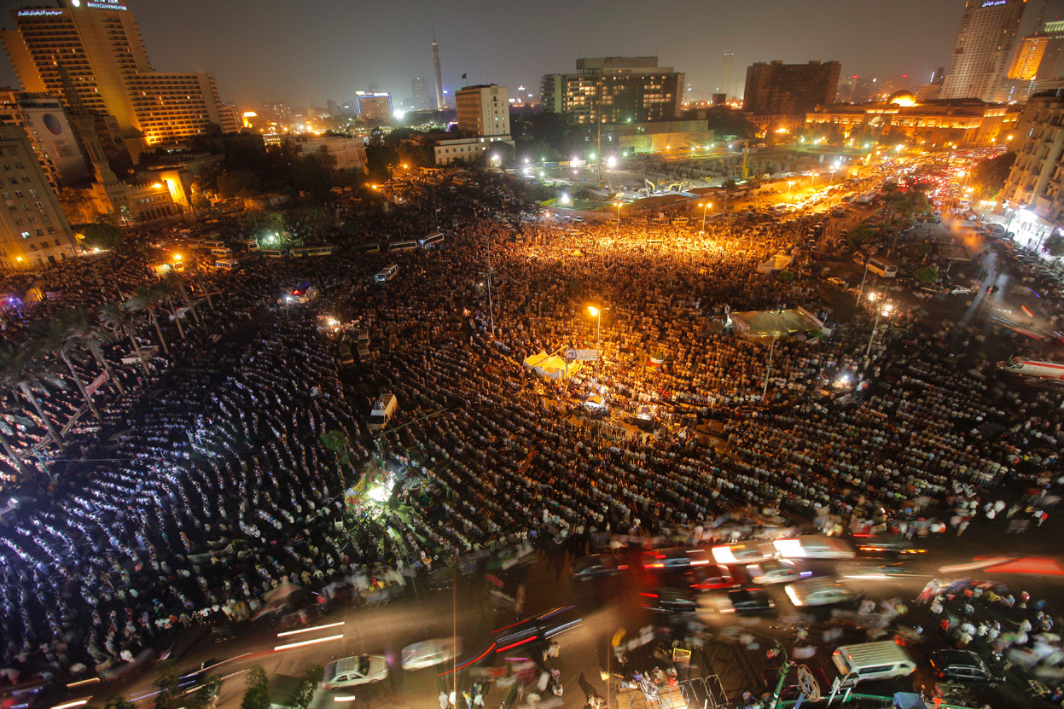
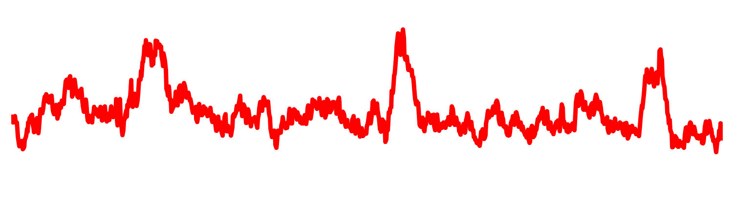
Cairo, Egypt
2012 2013 2014

Slide 18
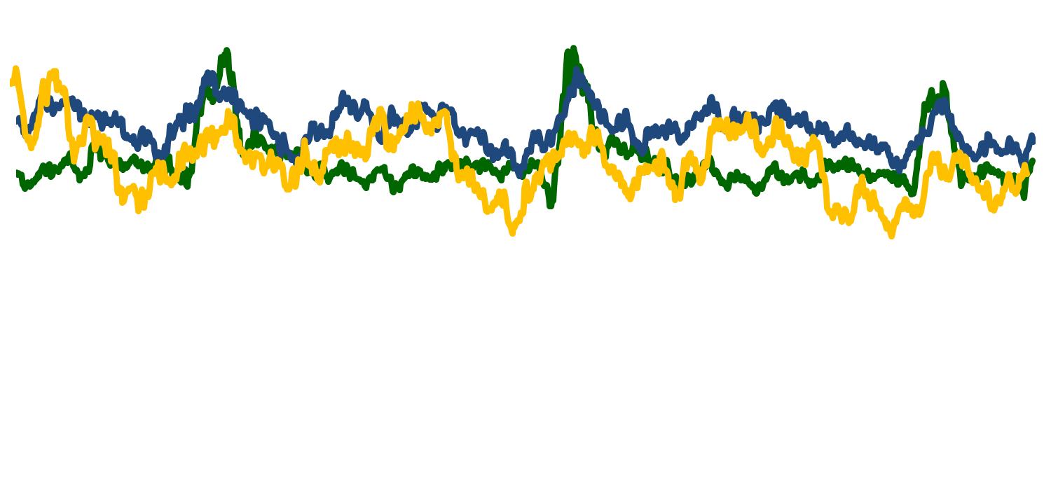
Cairo District, Sharqiya District, and Assiut District

Slide 19
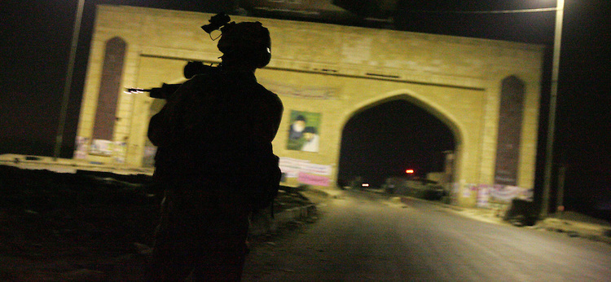
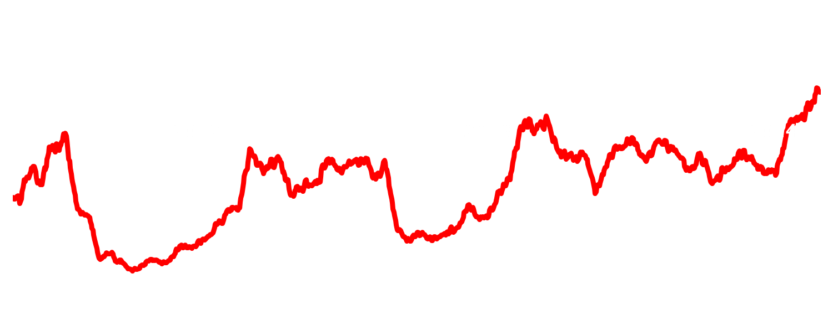
Basrah, Iraq

Slide 20
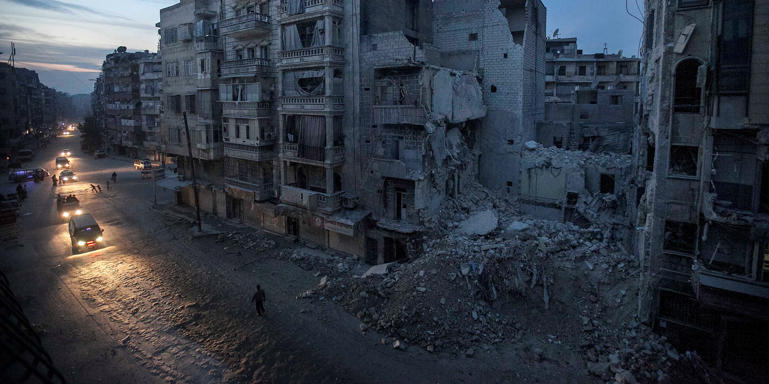
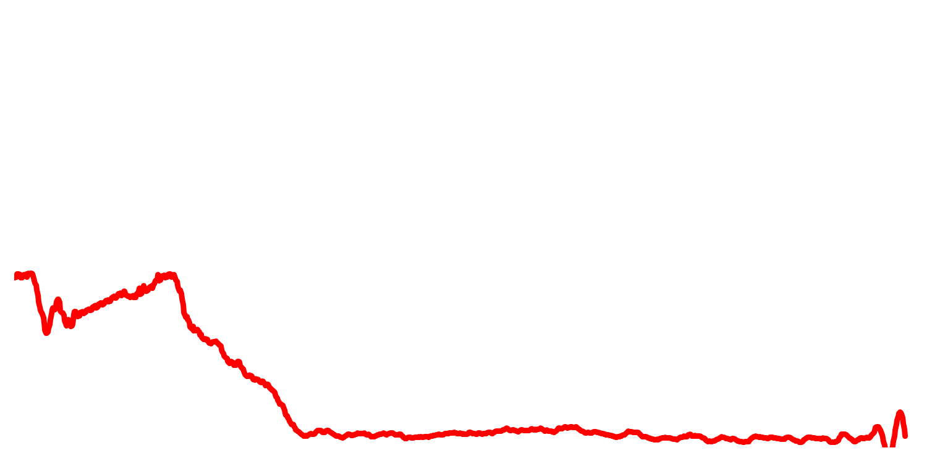
Aleppo, Syria

Slide 21
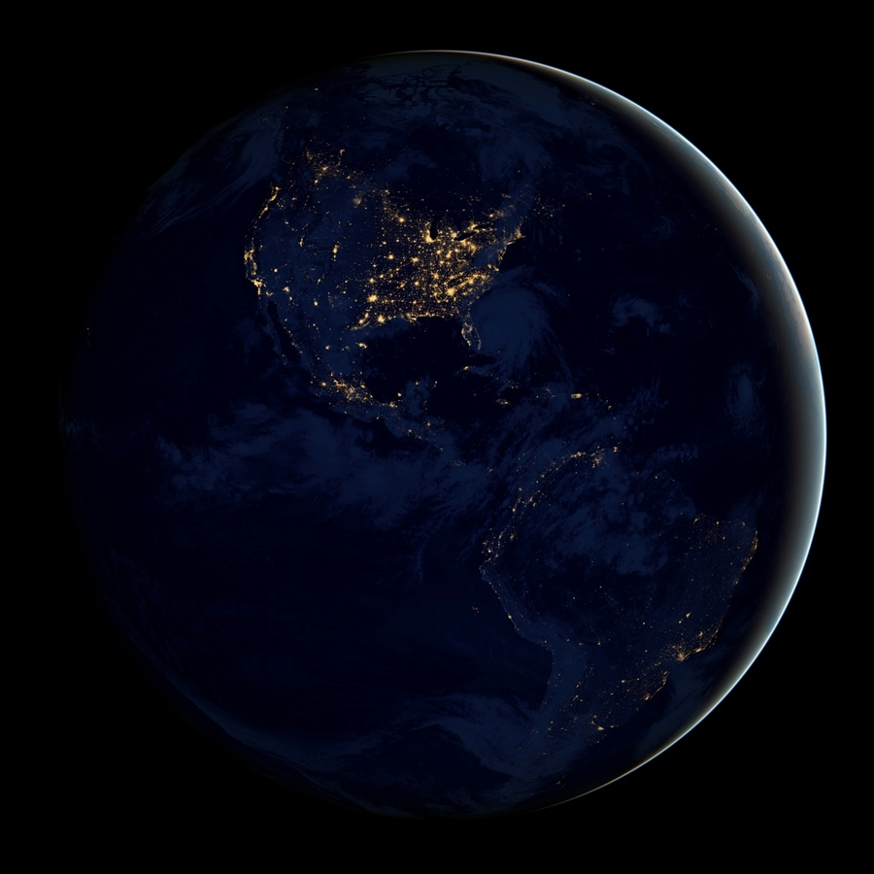
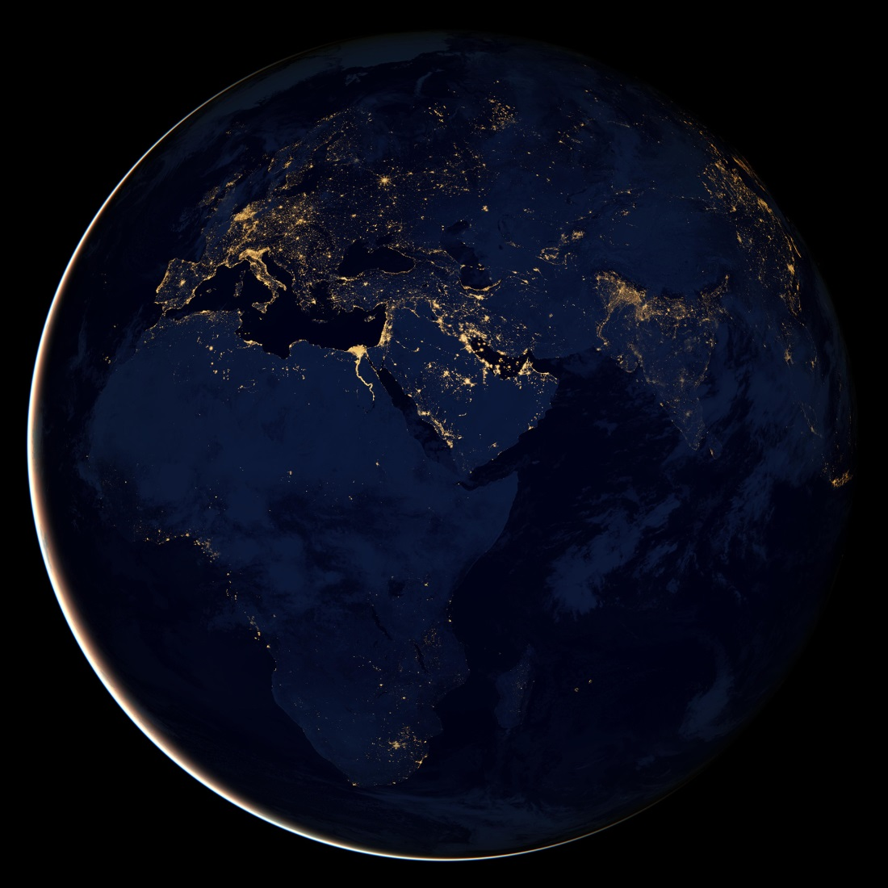


Pres
Why is it important ?

Slide 22
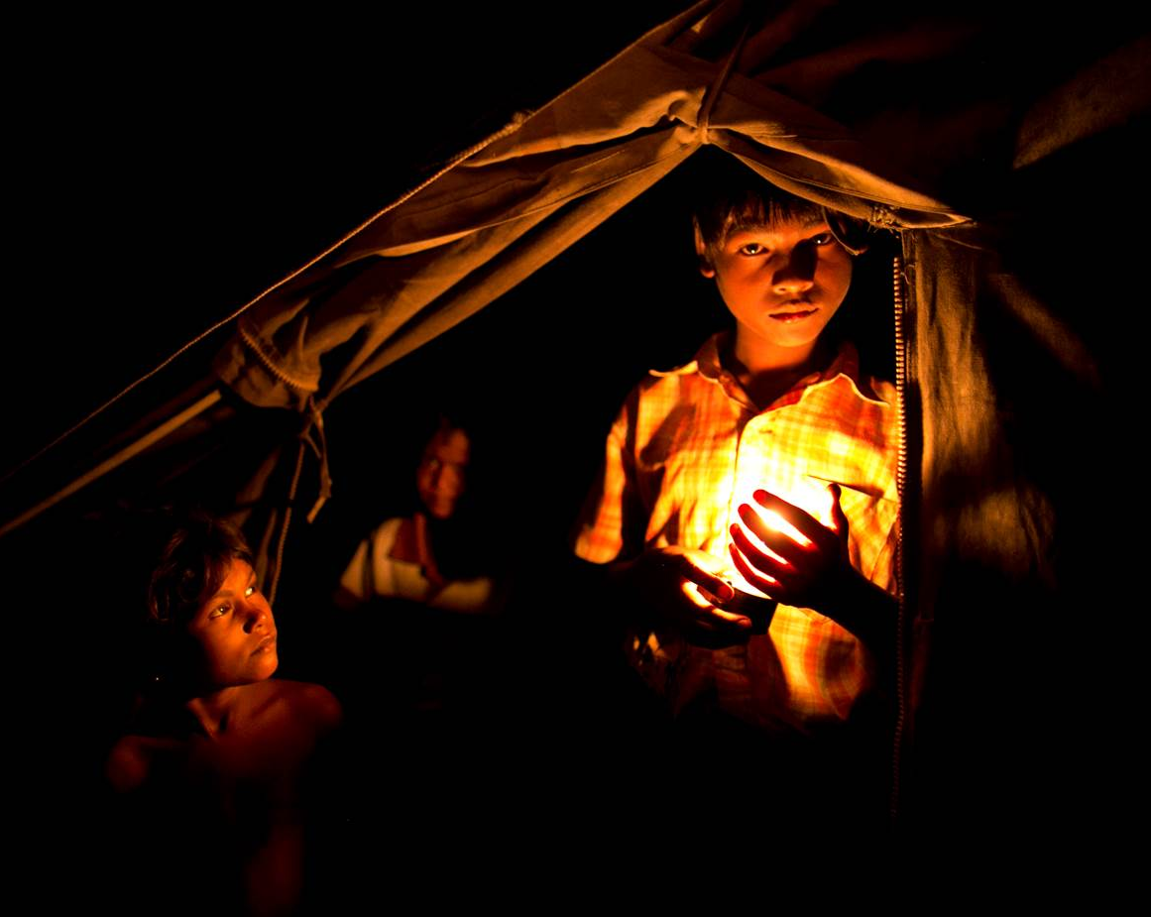
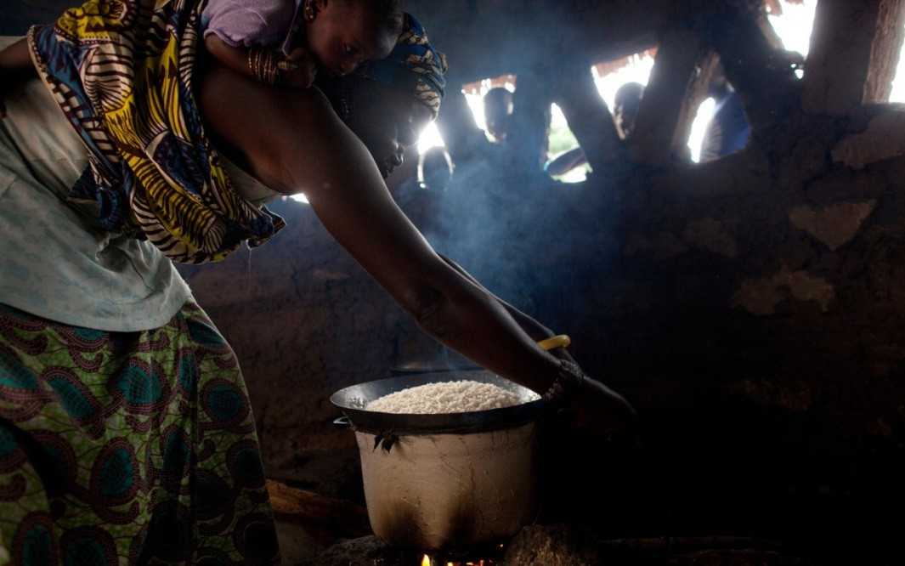
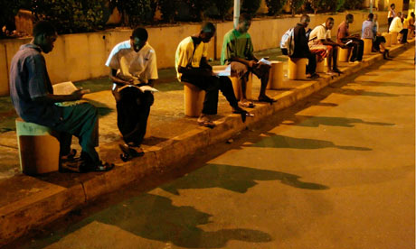
Sustainable energy for all.

Slide 23

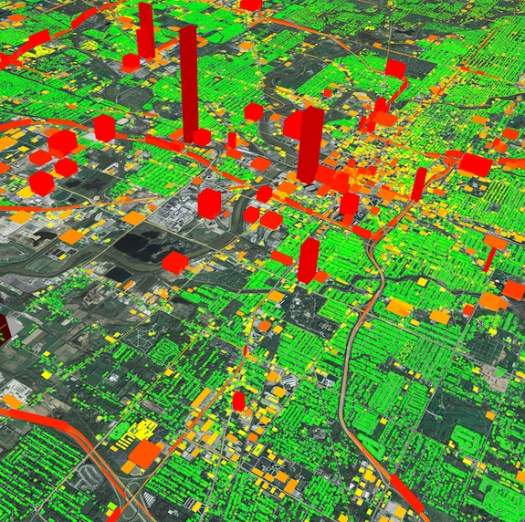
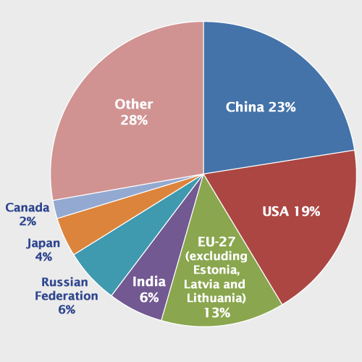
Individual
Neighborhood
Global

Slide 24
Thanks to NASA’s SIF Fund. For more info:
Román and Stokes (2015). Holidays in lights: Tracking cultural patterns in demand for energy services. AGU Earth's Future Journal [Accepted].
+ Innovative research that made ours possible:
Miller and Turner (2009), A Dynamic Lunar Spectral Irradiance Data Set for VIIRS DNB Nighttime Environmental Applications, IEEE-TGRS.
Zhang et al., (2013), The Vegetation Adjusted NTL Urban Index: A new approach to reduce saturation and increase variation in nighttime luminosity, RSE.
Johnson, et al., (2013), Preliminary investigations toward nighttime aerosol optical depth retrievals from the VIIRS DNB, AMTD.
Walther, et al., (2013), The Expected Performance of Cloud Optical and Microphysical Properties derived from Suomi NPP VIIRS DNB Lunar Reflectance, JGR-Atmospheres.
Cao and Bai (2014), Quantitative Analysis of VIIRS DNB Nightlight Point Source for Light Power Estimation and Stability Monitoring, Remote Sensing.

Slide 25
