Slide 1

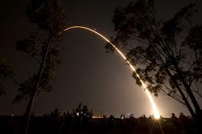



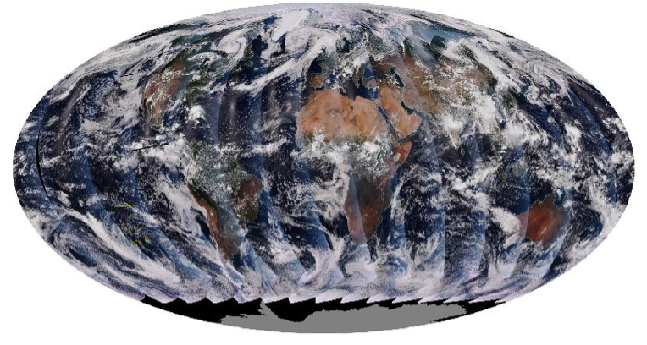


Will ensemble approach improve surface PM2.5 estimate from space?
Jun Wang
Yun Yue, Xiaoguang Xu
Yang Liu
Robert Levy
James J. Szykman
In collaboration with
Suomi-NPP launch
28 Oct. 2011
Lina Balluz
Chaoyang Li
VIIRS,13:30 Local Time
14.1 revs/day
Robert Holz

Slide 2
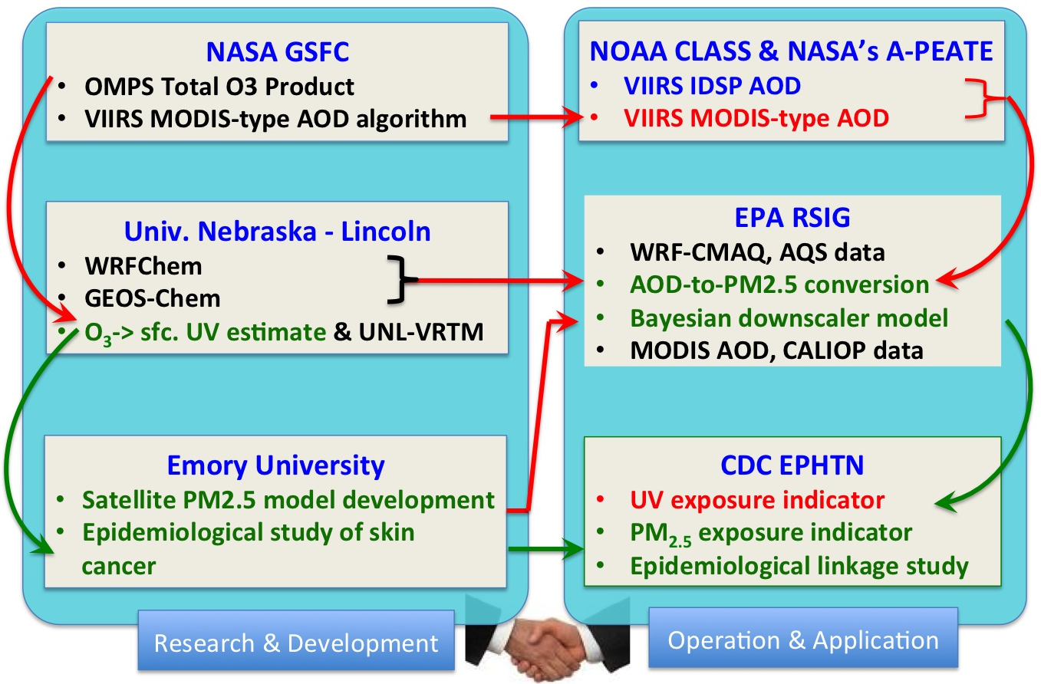
Work/Data Flow & Approaches
Black: datasets & model already in place; green: existing model capability and data flow that will be improved; red: the data and data flow will be created

Slide 3
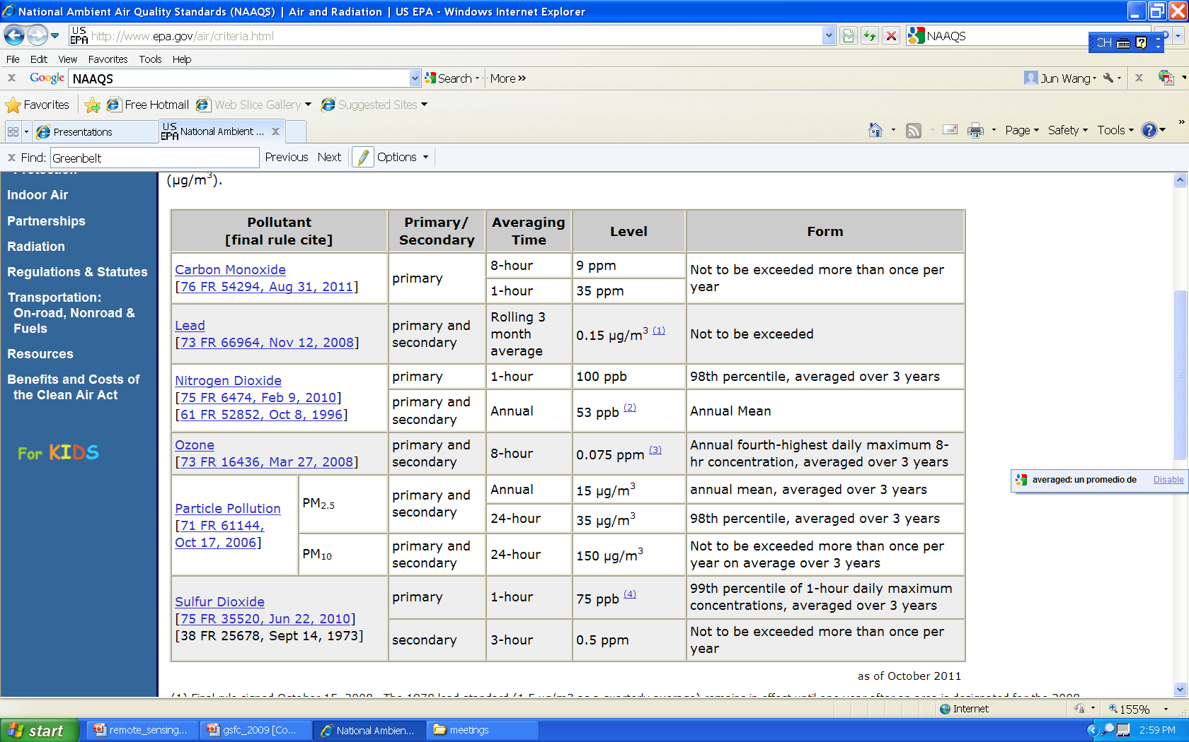
National Ambient Air Quality Standards
NAAQS as of Oct. 2011
12 μg/m³,
FR, 15 Jan. 2013
Notes:
Final rule signed October 15, 2008. The 1978 lead standard (1.5 µg/m3 as a quarterly average) remains in effect until one year after an area is designated for the 2008 standard, except that in areas designated nonattainment for the 1978, the 1978 standard remains in effect until implementation plans to attain or maintain the 2008 standard are approved.
(2) The official level of the annual NO2 standard is 0.053 ppm, equal to 53 ppb, which is shown here for the purpose of clearer comparison to the 1-hour standard.
(3) Final rule signed March 12, 2008. The 1997 ozone standard (0.08 ppm, annual fourth-highest daily maximum 8-hour concentration, averaged over 3 years) and related implementation rules remain in place. In 1997, EPA revoked the 1-hour ozone standard (0.12 ppm, not to be exceeded more than once per year) in all areas, although some areas have continued obligations under that standard (“anti-backsliding”). The 1-hour ozone standard is attained when the expected number of days per calendar year with maximum hourly average concentrations above 0.12 ppm is less than or equal to 1.
(4) Final rule signed June 2, 2010. The 1971 annual and 24-hour SO2 standards were revoked in that same rulemaking. However, these standards remain in effect until one year after an area is designated for the 2010 standard, except in areas designated nonattainment for the 1971 standards, where the 1971 standards remain in effect until implementation plans to attain or maintain the 2010 standard are approved.

Slide 4
Existing PM_{2.5} ground monitoring in continental U.S.
20 June 2013
21 June 2013
Blue: ~1000 stations using Federal Reference Method (FRM) as part of Air Quality System (AQS). Measure daily PM2.5 at daily, every 3rd or 6th day frequency.
Red: ~600 stations using a variety of techniques to provide continuous (hourly resolution) PM2.5 mass, in support of the AIRNow program.
Still, many areas remain unmonitored.

Slide 5
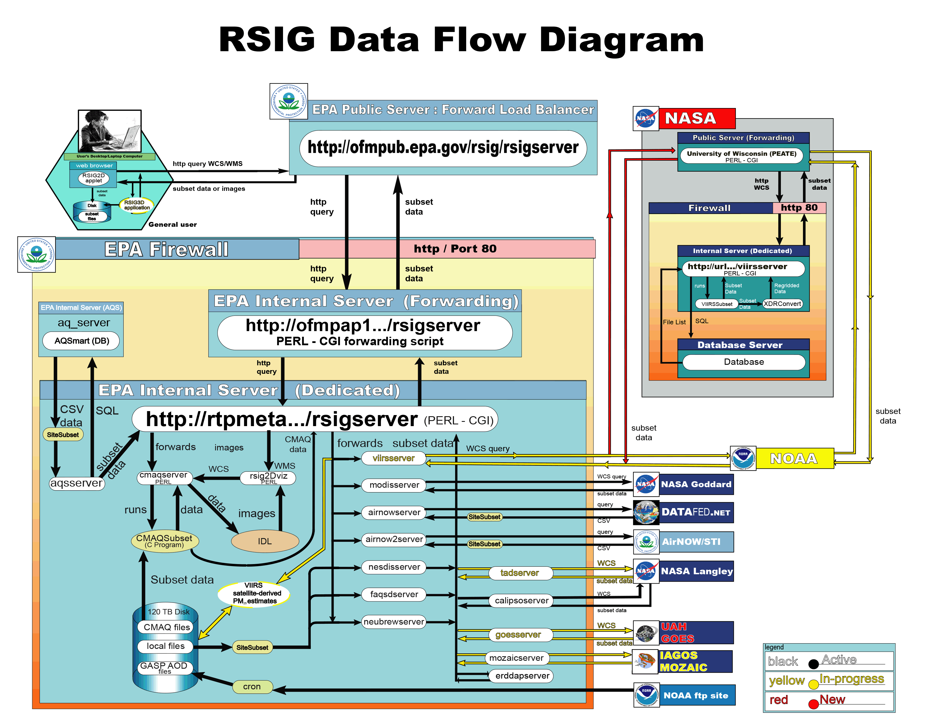
Use of EPA Remote Sensing Information Gateway to deliver VIIRS AOD/PM_{2.5} data products
Current satellite WCS:
  MODIS C6 (10 km, 3 km, DB)
  CALIOP, GASP (GOES AOD)
  Prototype NOAA-VIIRS
Establish OGC compliant Web Coverage Service (WCS ) between PEATE and RSIG to add NASA- VIIRS data (This project).
GEOS-Chem scaling factors used to create a daily Look-Up-Table (LUT) of the spatial varying relation of AOD and PM_{2.5} (van Donkelaar et. al., 2012, ES&T) .
Prototype use of AOD-to-PM2.5 scaling factors via regional models (WRF-CMAQ & WRF-CHEM) and explore ensemble type approach (This project).
http://ofmpub.epa.gov/rsig/rsigserver?index.html

Slide 6
Atmospheric Environment, 1984.
Retrieval algorithm
Aerosol Information
Satellite data
Notes:
Fraser et al, 1984 perhaps is among the first to illustrate steps and demonstrate their concepts with real data.

Slide 7
Atmospheric loading of particulate sulfur
(gm⁻²) on 31 July 1980.
Derived from GOES visible reflectance are
Aerosol optical thickness (AOT)/depth (AOD)
Columnar amount of sulfur
7/31/1980

Slide 8
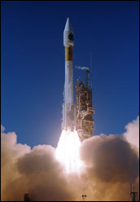
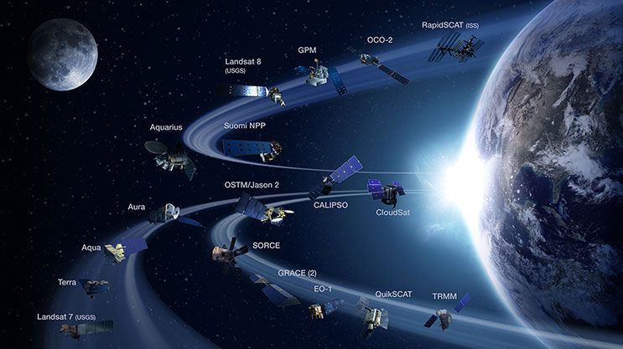
NASA Earth Observation System
18 Dec. 1999
Updated Jan. 2015
Notes:
GOES is a meteorological satellite that is not designed to measure aerosols. Today, we have more advanced research satellites that what we had 30 years ago. In US, These satellite form together as part of NASA’s Earth Observation. The flagship of this system is Terra satellite, lauched in 1999, and carries 5 sensors. Two of which are MODIS and MISR.

Slide 9
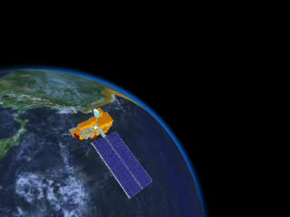
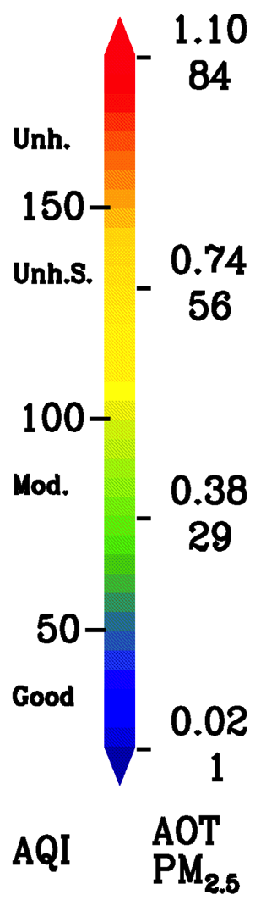
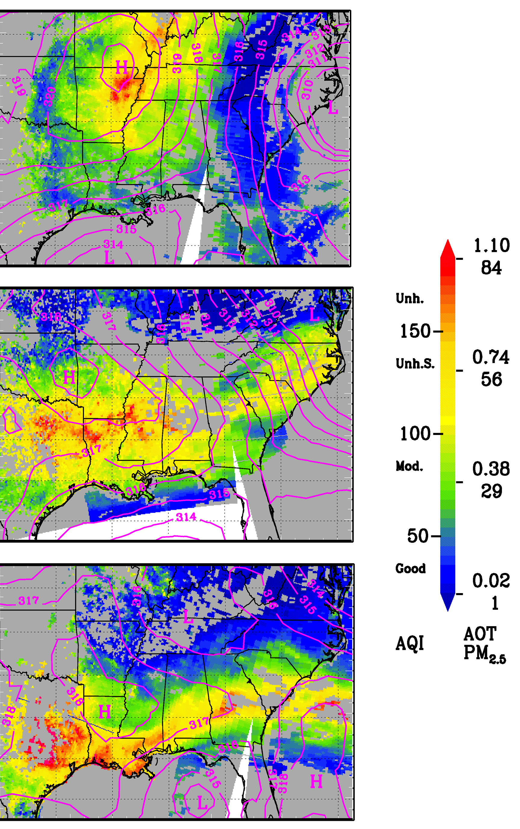
Satellite Remote Sensing of Aerosol Transport
09/10/02
09/10/02
09/11/02
09/11/02
09/12/02
09/11/02
MODIS Aerosol Optical Thickness &
700mb Geopotential Height
PM2.5 = A*AOD + B
Wang & Christopher, 2003;
Notes:
Ground-based measurements of air quality is limited in spatial converge. Satellite remote sensing provides a unique tool to monitor air quality in large scales. Shown in this slide is a demontration of using MODIS aerosol products in conjunction with 700mb synoptic to track and forecast the haze layer over the southeaster U.S. during 9-12 Sep 2002.
Reference:
Wang, J., and S.A. Christopher, Intercomparison between satellite-derived aerosol optical thickness and PM2.5 mass: Implications for air quality studies, Geophys. Res. Lett., 30, 2095, doi:10.1029/2003GL018174, 2003.
More details.
On 10 Sep 2002, the haze layer is controlled by high pressure system over the central US, and its center is over the Arkansas and Missouri As the high pressure system is expected to move southward; we also expect that the haze layer will affect the air quality over the southern states on the 11-12 Sep 2002, which is consistent with the what see on the next day.

Slide 10
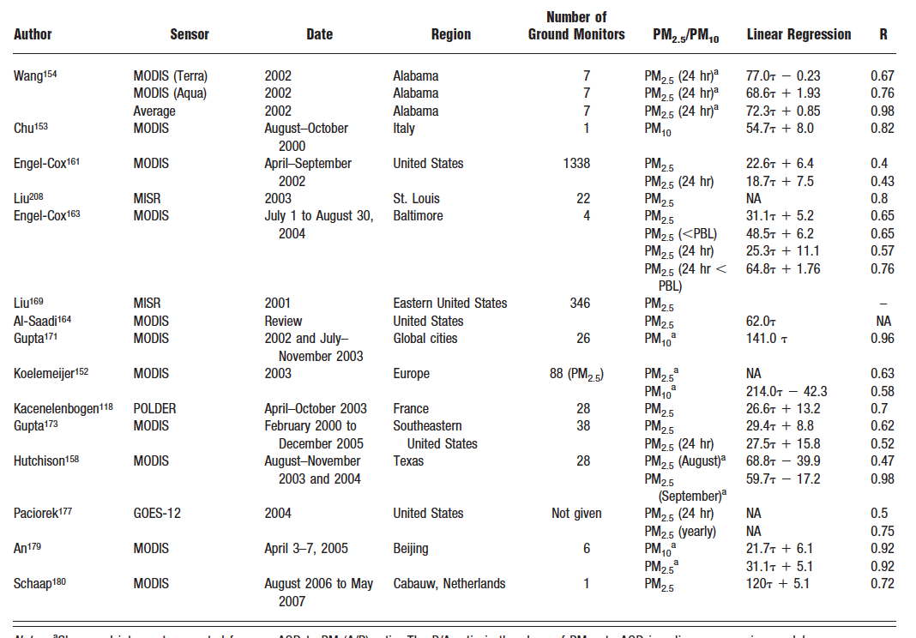
Past studies on AOD vs. surface PM concentration
(from Hoff and Christopher, 2009, JAWMA)
2003
2009
multivariate regression, Kriging, neutral network, etc…
Notes:
Quantiative measurement of aerosols from space only stareted a decade agao. Usually, satellite observed refeltance will first go through a cloud screen process before they are input the retrieval agorithm to drive aerosol optical thickenss. This satellite derived aerosol optical thickness are then compared to aerosol optical thckness from chemsitry transport mode to derive the particulate matter concentration through a scaling method. However, because of the incosistenece of aerosol optical proeprties between retrieval and chemistry transport model, the final product from the models after using satellite AOT will not be able to reproduce the satellite-observed refletance.

Slide 11
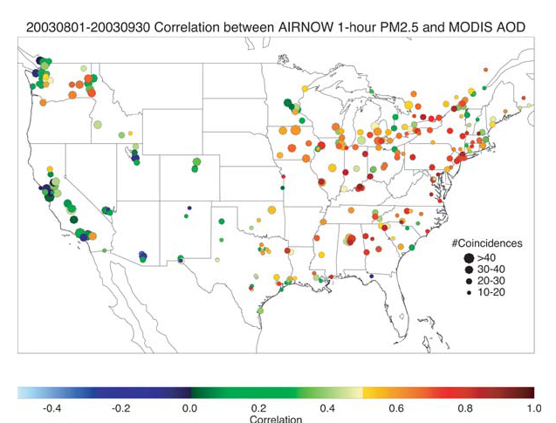

AOD vs. surface PM is non-linear
~200 sites over continental U.S.
CTM has been used to provide ancillary information needed to derive surface PM_{2.5} from AOD.
(Liu et al., 2004; Wang et al., 2010; van Donkelaar et al., 2010).
PM vs AOT linear correlation coefficient
Engel-Cox et al., 2004, JAWMA.
Notes:
Quantiative measurement of aerosols from space only stareted a decade agao. Usually, satellite observed refeltance will first go through a cloud screen process before they are input the retrieval agorithm to drive aerosol optical thickenss. This satellite derived aerosol optical thickness are then compared to aerosol optical thckness from chemsitry transport mode to derive the particulate matter concentration through a scaling method. However, because of the incosistenece of aerosol optical proeprties between retrieval and chemistry transport model, the final product from the models after using satellite AOT will not be able to reproduce the satellite-observed refletance.

Slide 12
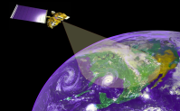


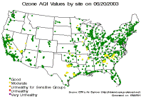


Challenges & Strategies
Challenges:
  Vertical distribution, particle size distribution, aerosol composition, sampling bias
  Cloudy conditions
Strategies:
  Ensemble modeling using WRF-Chem, WRF-CMAQ, and GEOS-Chem
  Spatial & statistical modeling
Satellites
Models
aircraft, ships,
sondes, lidars
Surface sites

Slide 13
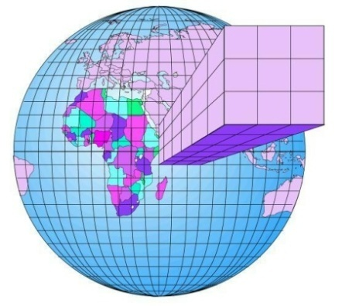

Direct Use of Reflectance to constrain CTM Model
UNL-VRTM
surface reflectance
algorithm (this work)
Reflectance
ρ_{GEOS-chem} & Jacobian ∂ρ/ ∂τ
GEOS-chem
Harvard
Source, Sinks
Chemical reactions
MOD04
MYD04
Reflectance
ρ_{MODIS}
Levy et al.
(2007)
MODIS/Terra
MODIS/Aqua
Keep same dark cloud-free pixels as MOD04.
τ = τ + ∂ρ/∂ τ × Δρ
ρ _{MODIS} =
ρ_{GEOS-chem} ?
scale the aerosol mass
Wang et al., 2010, RSE.
AOT(τ) and 3D aerosol mass
Notes:
Here, we like to illustrate this new concept using GEOS-chem model and MODIS standard aerosol product. We simulate the refletance and its jacobian to optical thickness at the TOA based upon the VLIDORT radative transfer model and GEOS-chem simulated aerosol field. This simulated refletances are then compared with the MODIS-observed refleance saved in the MODIS standard aerosol product to retrieve aerosol optical thickness. We done this interatively until the model and measured refltance machines. We then output the aerosol optical thickness and particulate matter concentration.
One difficulty in implementing this is to know the surface refletance simultanenously during the retrieval.

Slide 14
Results for April 2008 over China
Wang et al., 2010
This work
Model + MODIS Ref.
Model only
Model + MODIS product
Notes:
Here, we like to illustrate this new concept using GEOS-chem model and MODIS standard aerosol product. We simulate the refletance and its jacobian to optical thickness at the TOA based upon the VLIDORT radative transfer model and GEOS-chem simulated aerosol field. This simulated refletances are then compared with the MODIS-observed refleance saved in the MODIS standard aerosol product to retrieve aerosol optical thickness. We done this interatively until the model and measured refltance machines. We then output the aerosol optical thickness and particulate matter concentration.
One difficulty in implementing this is to know the surface refletance simultanenously during the retrieval.

Slide 15
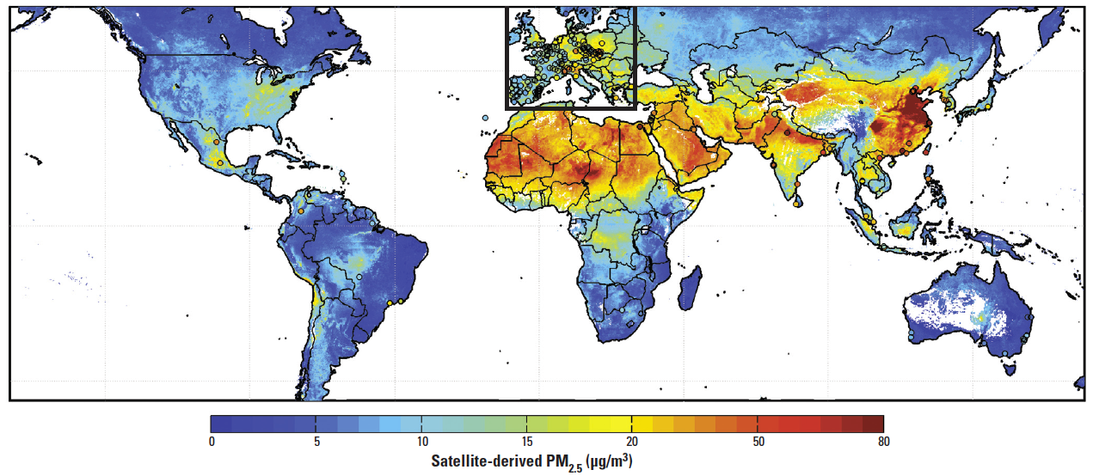
Surface PM_{2.5} climatology
PM_{2.5} averaged during 1/1/2001 – 12/31/2006, 10x10 km²
MODIS & MISR AOD + a CTM (GEOS-Chem)
van Donkelaar et al. 2010
Notes:
Quantiative measurement of aerosols from space only stareted a decade agao. Usually, satellite observed refeltance will first go through a cloud screen process before they are input the retrieval agorithm to drive aerosol optical thickenss. This satellite derived aerosol optical thickness are then compared to aerosol optical thckness from chemsitry transport mode to derive the particulate matter concentration through a scaling method. However, because of the incosistenece of aerosol optical proeprties between retrieval and chemistry transport model, the final product from the models after using satellite AOT will not be able to reproduce the satellite-observed refletance.

Slide 16
An ensemble approach multiple AOD products + multiple models
Hypothesis:
  each satellite AOD product has its unique strengths and weaknesses, and a combination of them can yield a better AOD product than any individual product
Questions:
  if the climatology of PM_{2.5}-AOD ratio can be better represented by the ensemble mean of multi-models (instead of one model, GEOS-Chem, that is currently used);
  if the combination of AOD from different sensors and algorithms together with PM_{2.5}-AOD ratio from (a) can yield the best estimate of PM_{2.5} than from each individual source of AOD, and
  the cost-and-benefits of using hindcast to estimate surface PM_{2.5} from AOD.

Slide 17
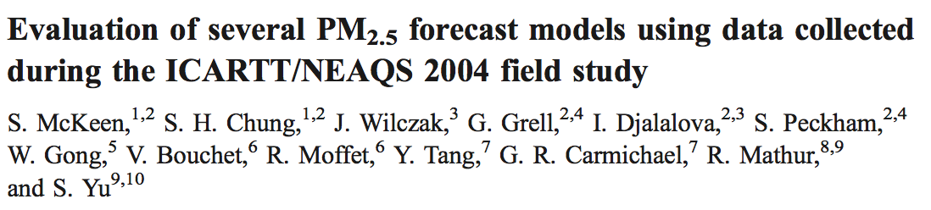
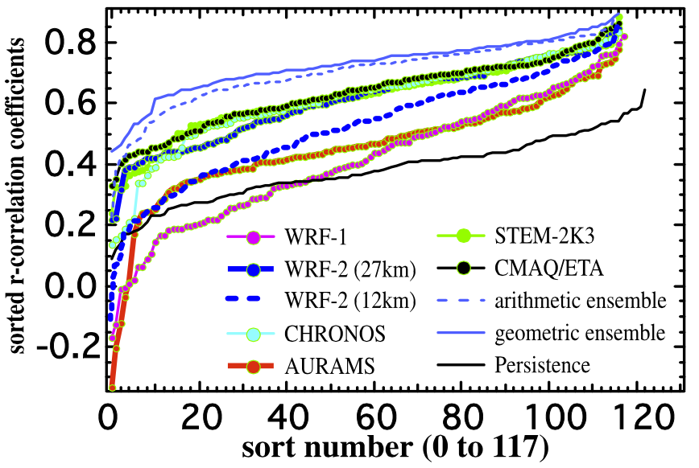
JGR, 2007.
The ensemble PM_{2.5} forecast, created by combining six separate forecasts with equal weighting, is also evaluated and shown to yield the best possible forecast in terms of the statistical measures considered.

Slide 18
Focusing on June 2012

Slide 19
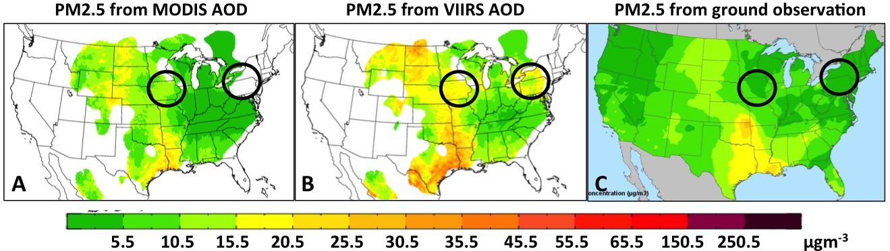
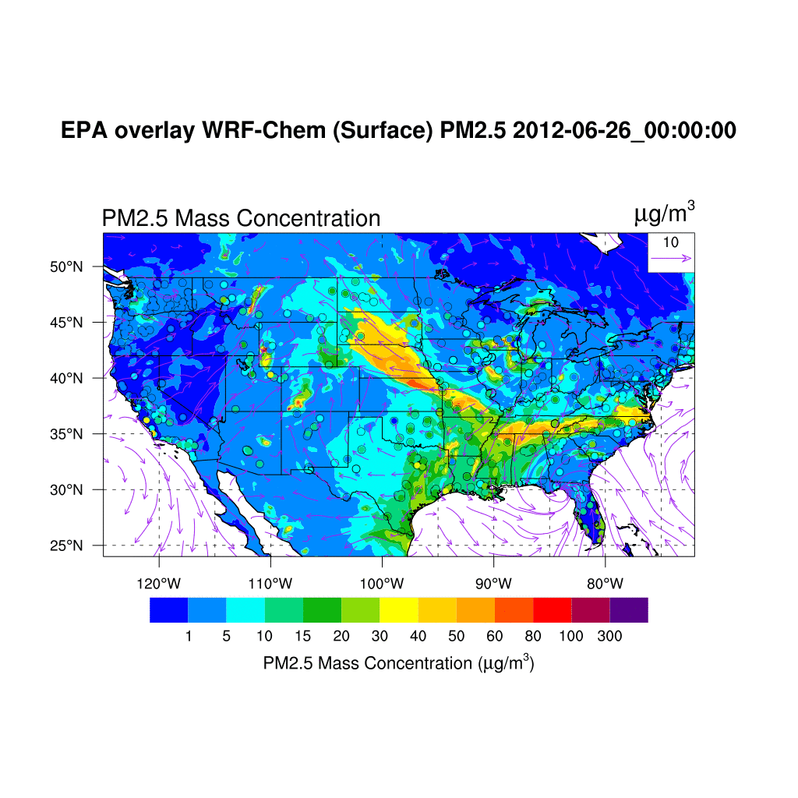
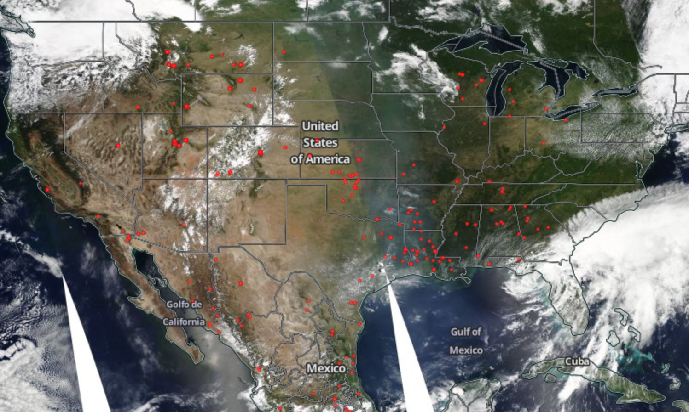
A case study
6/26/2012

Slide 20
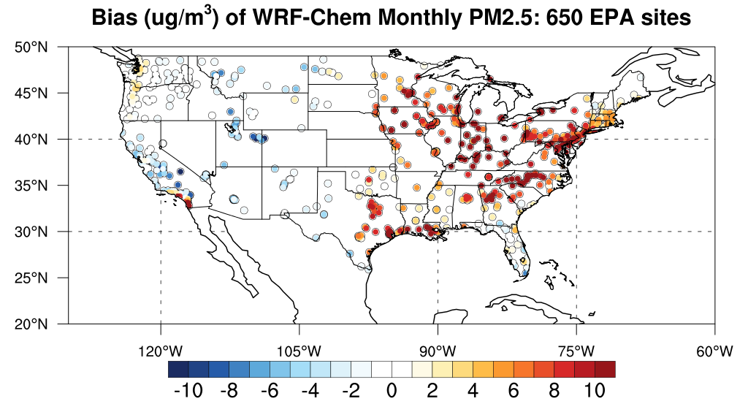
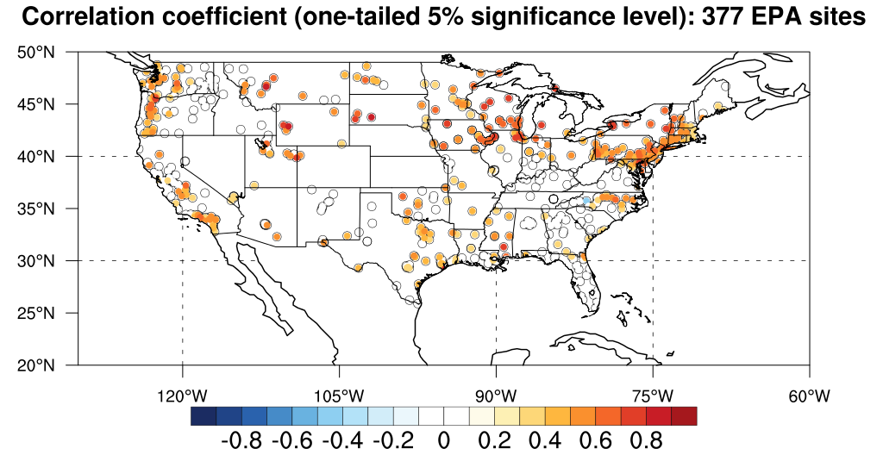
WRF-Chem
GEOS-Chem
bias
R
It appears that WRF-Chem does a better job in simulating surface PM2.5 over Texas, albeit its large positive bias over eastern part of U.S.

Slide 21
R
R after applying MODIS AOD

Slide 22
Applying MODIS AOD
|b2| - |b1|
MODIS-type VIIRS AOD leads to significant overestimation
Applying MODIS-type VIIRS AOD

Slide 23
Distribution of sorted relative bias and correlation coefficient for each station
Applying
VIIRS
ABS (relative bias %)
Applying
MODIS
Correlation R

Slide 24
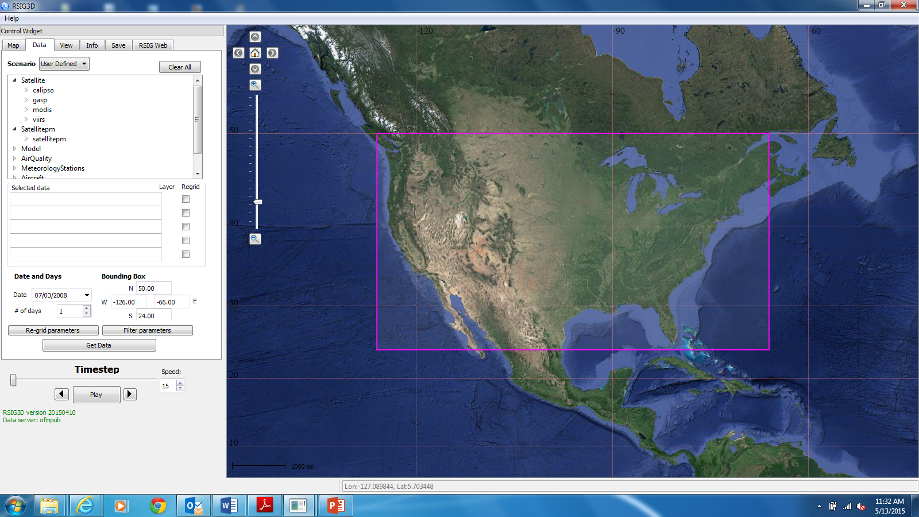
Use of EPA Remote Sensing Information Gateway
to delivery NASA-VIIRS AOD/PM_{2.5} data products
User Interface for New RSIG 3-Dimensional application.
Delivers data/products to user via web coverage services.
Beta testing to begin summer 2015.

Slide 25
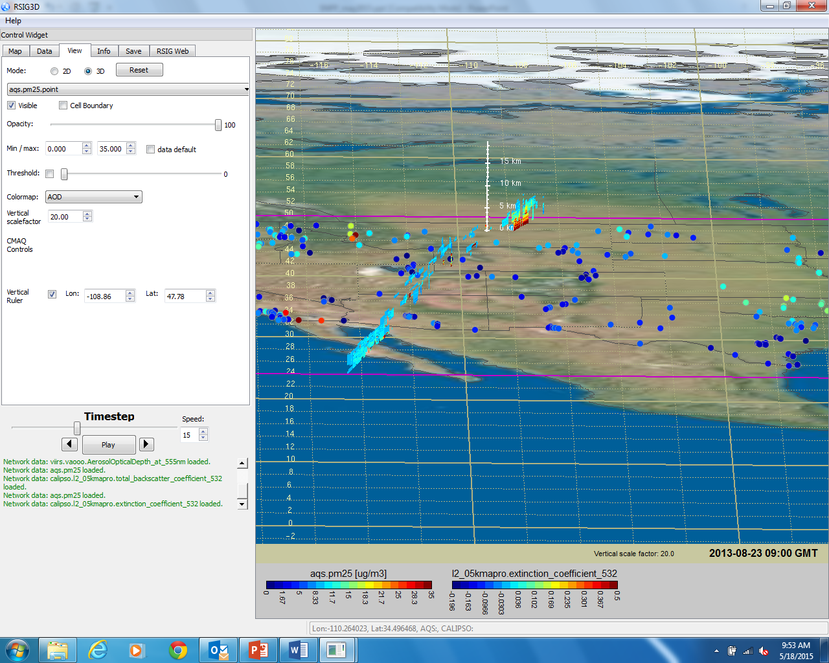
Early morning CALIOP overpass shows extremely high extinction (532 nm) in the lowest 2 km associated with smoke from the RIM fire (Aug 2013).

Slide 26
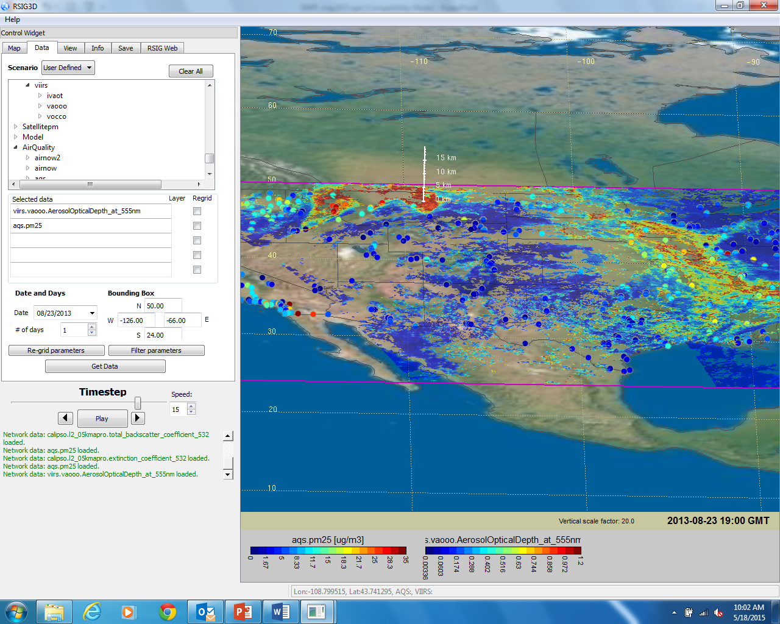
VIIRS AOD (NOAA-EDR) captures high AOT covering most of MT and moving into the Dakotas, both areas associated with sparse surface PM_{2.5} monitoring coverage.

Slide 27

Thank you !

Slide 28
Applying MODIS AOD reduces biases in GEOS-Chem PM_{2.5}
b1
|b2| - |b1|
b2

