Slide 1
VIIRS Nighttime Lights Development Update
Kimberly Baugh
Earth Observation Group (EOG)
CIRES - University of Colorado, USA
NOAA National Centers for Environmental Information (NCEI), USA
Kim.Baugh@noaa.gov
Chris Elvidge - NOAA NCEI, USA
Mikhail Zhizhin - CIRES - University of Colorado, USA
Feng Chi Hsu - CIRES - University of Colorado, USA
Tilottama Ghosh – CIRES – University of Colorado, USA

Slide 2
Nighttime Lights Composites
What are they?
A nighttime lights composite is made to serve as a baseline of persistent light sources.
Composites are made as an average of the highest quality nighttime lights imagery over desired time period – usually monthly or annually.
“Stable Lights” composites have ephemeral light sources and non-light (background) areas are removed from a composite.
EOG group is producing current monthly cloud-free/no-moon DNB nighttime lights composites and is doing algorithm development to turn these in to Stable Lights composites.

Slide 3
Nighttime Lights Composites
Processing Steps
Flag input DNB data so only the “highest quality” nighttime data gets averaged into a composite. Currently defined as:
Cloud-free (using the VIIRS cloud-mask (VCM) product)
Nighttime with solar zenith angles greater than 101
Not affected by moonlight (lunar illuminance < 0.0005 lux)
Middle of swath (DNB has increased noise at edge of scan)
Free of lights from lightning
Free of “lights” from South Atlantic Anomaly
Create annual average DNB composite products and histograms of individual observations
Use annual histograms to remove DNB outliers (ephemeral lights and other sensor noise
Identify and remove background (non-light) areas
Create TOA and atmospherically-corrected DNB composites

Slide 4
Nighttime Lights Composites
(Monthly DNB Products)
Monthly DNB nighttime lights composites are available online
Globe is cut into 6 tiles to reduce individual file sizes
These products still contain ephemeral lights and non-lights (background).
http://www.ngdc.noaa.gov/eog/viirs/download_monthly.html

Slide 5
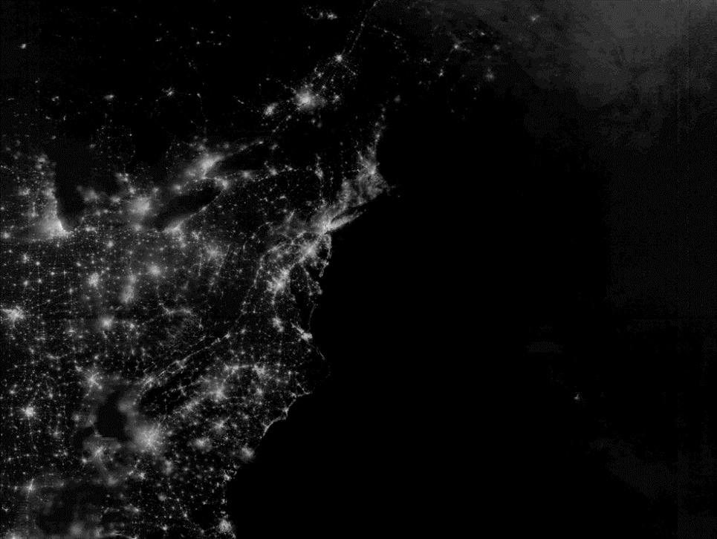
DNB Stray Light
Northrup Grumman algorithm was implemented at the IDPS in August 2013.
Does a good job of mitigating stray light effects for visual interpretation.
Some issues for algorithm development within the stray light corrected region:
Can under/over-correct, especially at transition into stray light and in Southern hemisphere
Variance of data across scan is altered
Correction quality is dependent on time from correction lookup table generation
Stray light corrected regions are identified and processed separately

Slide 6
DNB Ephemeral Light Removal
Approach:
Create histograms of DNB radiances using an extended time series (annual)
Use histograms to identify and remove outliers
Similar to algorithm developed for DMSP-OLS Stable Lights
Advantages: This algorithm removes ANY outliers, including fires, boats, unfiltered-SAA, crosstalk, …
Disadvantages: Persistent flares and volcanic activity can remain. Method requires long time-series of data.

Slide 7
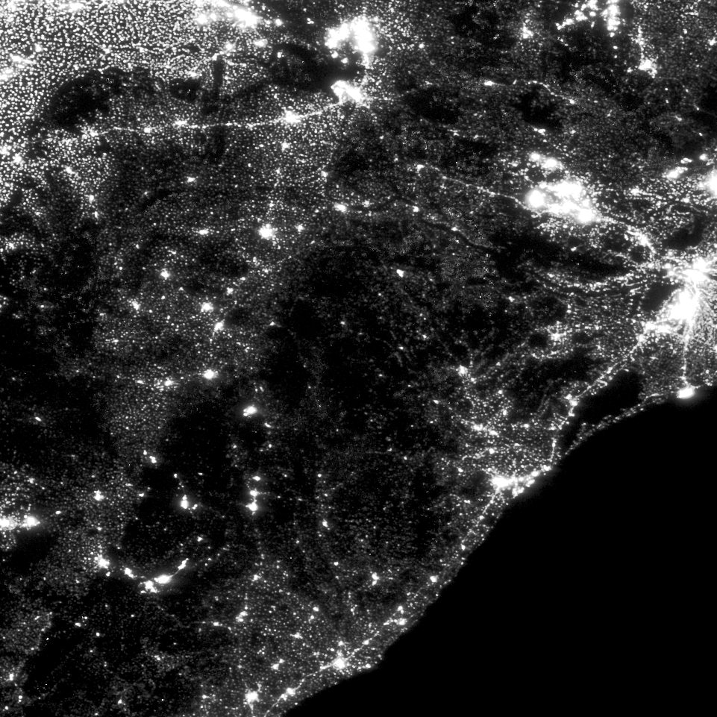
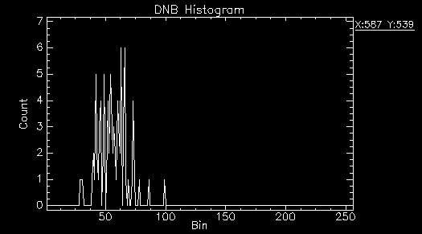
DNB Ephemeral Lights: Outlier Removal
Odisha, India 2014 DNB Composite
Histograms are made for each grid cell in composite
DNB radiance values are placed in discrete bins based on log transform. Bin=floor(100*(log(1E9*Rad+1.5))
Example histogram of small village

Slide 8
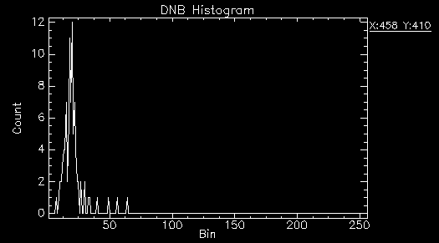
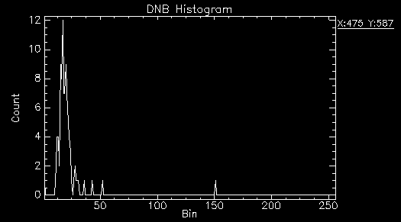
DNB Ephemeral Lights: Outlier Removal
Example histograms of grid cells containing fires

Slide 9
DNB Ephemeral Lights: Outlier Removal
Algorithm:
Compute standard deviation of observations
Remove highest observation
Re-compute standard devation
Repeat steps 2-3 if difference in standard deviations > threshold
Re-compute average of remaining observations
Outlier removal algorithm removed top 4 observations:

Slide 10
DNB Ephemeral Lights: Before Outlier Removal
Toggle with next slide
Notice how regions with fire activity return to background radiance levels after outlier removal

Slide 11
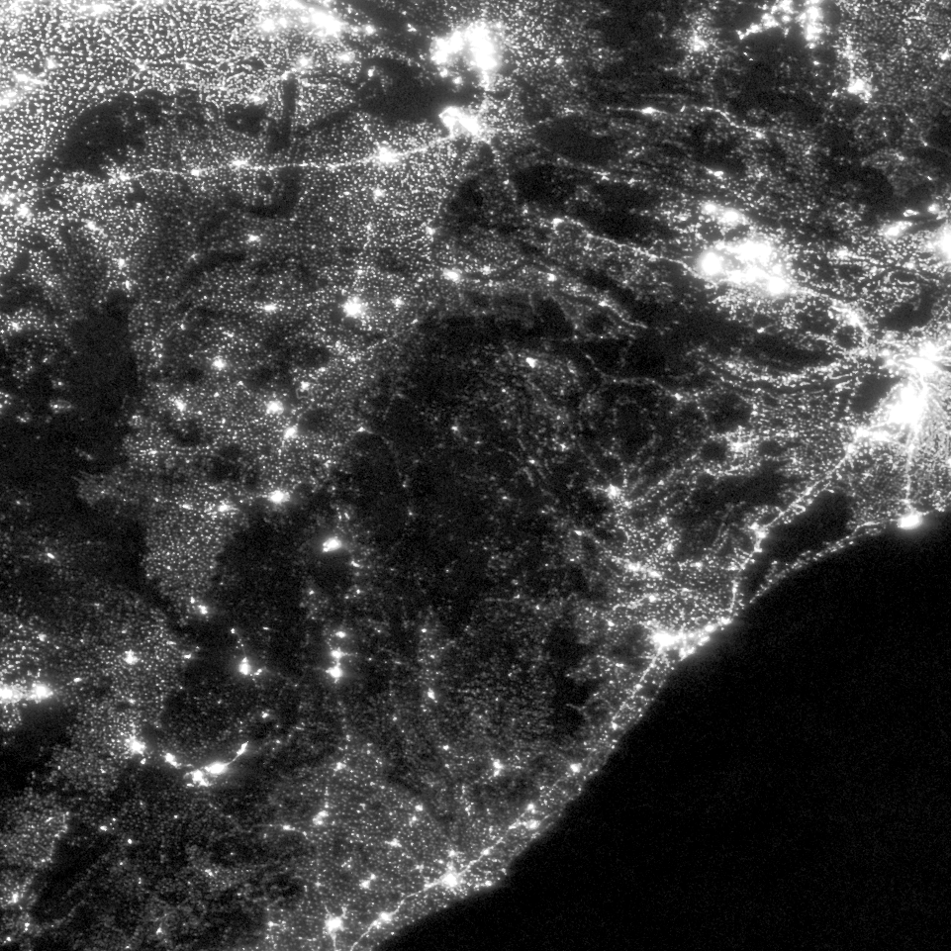
DNB Ephemeral Lights: After Outlier Removal
Toggle with previous slide
Notice how regions with fire activity return to background radiance levels after outlier removal

Slide 12
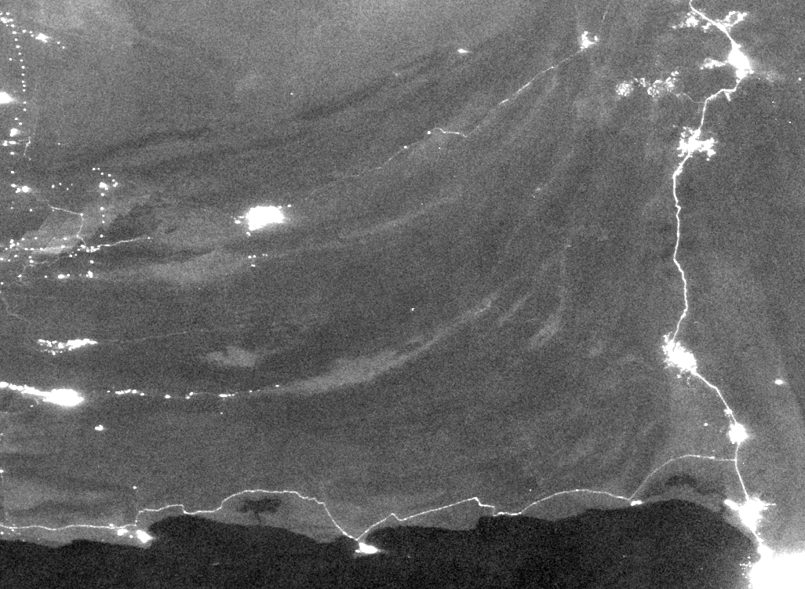
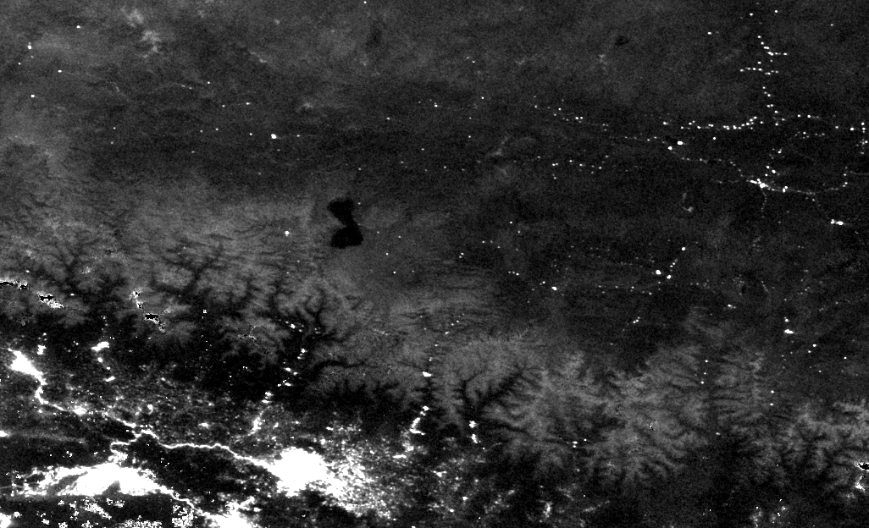
DNB Background Removal
The DNB’s detection limits are low enough, that even without moonlight present, nocturnal airglow can light up terrain and high albedo surfaces, making it challenging to separate dim lights from high albedo surfaces.
2014 DNB Composite over Southern Pakistan – some road features have lower average radiance values than no-light areas with high albedo
2014 DNB Composite over Himalayas – snow-covered peaks have higher average radiances than some of the villages

Slide 13
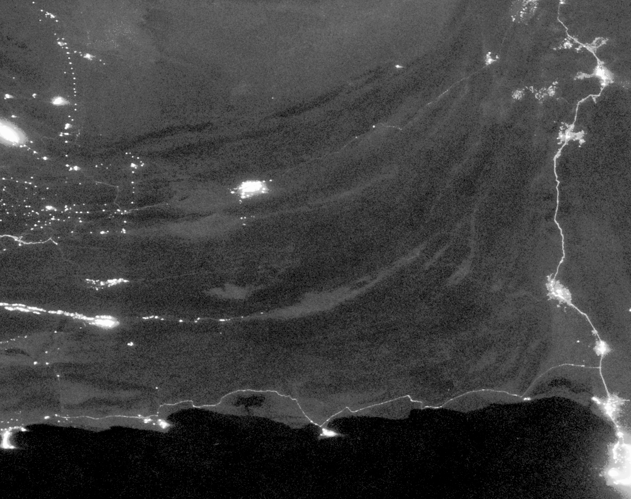
DNB Background Removal
2014 DNB Composite with outliers removed
First derivative – areas close to zero are background (gray)
2014 DNB Composite with background masked using deriv image
Radiance values of terrain surfaces can equal radiances of dim lights, but the values vary more slowly spatially than dim lights
First derivative, or gradient images of DNB composites lend well to thresholding to bring out nighttime lights
Initial testing shows most nighttime lights from cities/villages are retained, dim roads can get fragmented.

Slide 14
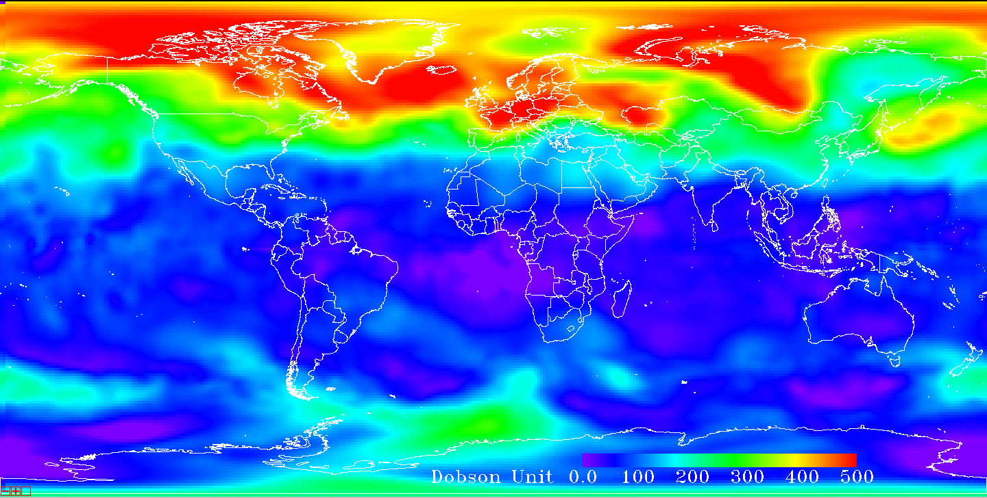
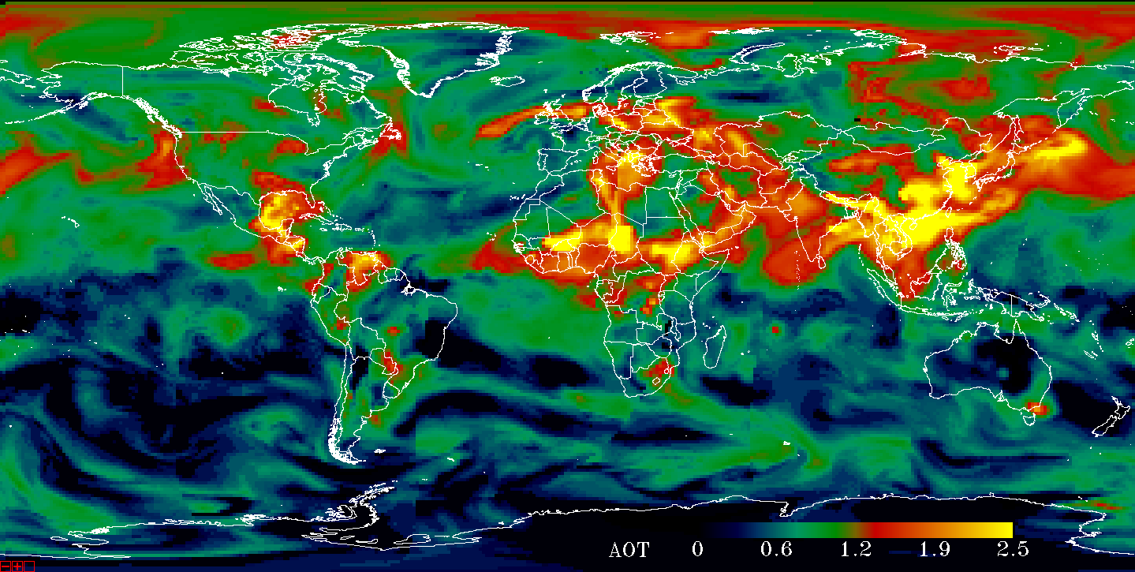
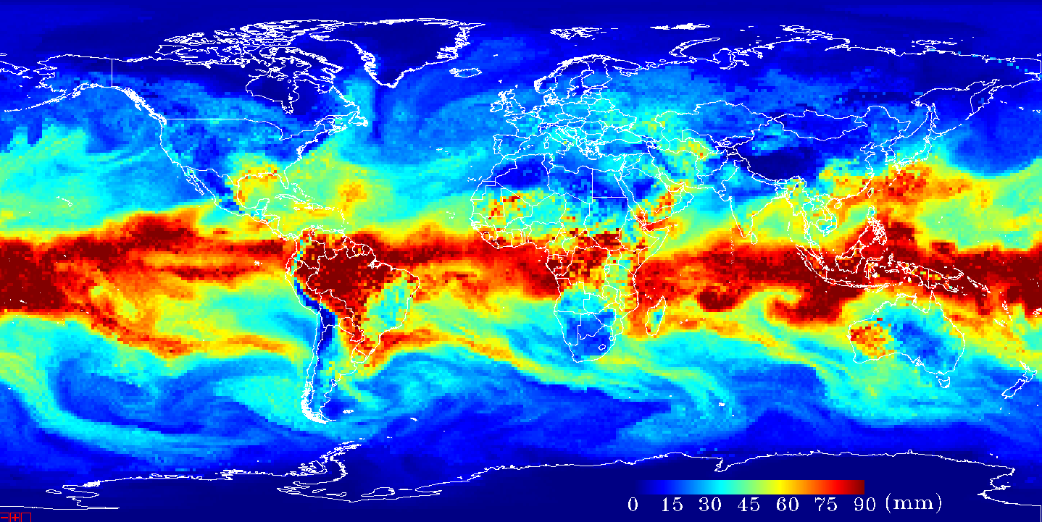
Atmospheric Correction for Nighttime DNB: Working with 6S
Inputs
TCO
NOAA/OSPO TOAST
AOT
NAAPS model (NPP VIIRS IVAOT)
TPW
NPP ATMS -> NOAA MIRS
Geometry
SatZ, SatA, SolZ, SolA
DEM: SRTM + GTOPO 30
Unified grid
1 degree Lat/Lon grid
Confined by TOAST resolution / Save computation
TCO
AOT
TPW
Date represented: 2016/4/13
Notes:
where $ρ^{∗}$is the apparent reflectance, $ρ_{a}$is the intrinsic atmosphere radiance, $ρ_{t}$ is the reflectance of the target, $S$ is the spherical albedo of the atmosphere, $T\left(θ_{s}\right)$ is downwelling transmissivity, and $T\left(θ_{v}\right)$ is upwelling transmissivity.

Slide 15
Radiative Transfer Model
$$ρ^{∗}=ρ_{a}+\frac{ρ_{t}}{1−ρ_{t}S}T\left(θ_{s}\right)T(θ_{v})$$
For nocturnal self-emitting source under zero lunar illumination
$ρ_{a}$=0 (radiance in atmosphere)
$ρ_{t}$=1$(reflectance of target)$
$T\left(θ_{s}\right)$=1 (downwelling transmissivity)
Thus apparent radiance becomes
$${I^{∗}=Iρ}^{∗}=\frac{I}{1−S}T(θ_{v})$$
Rewritten to isolate correction factor C
$$I=I^{∗}\frac{(1−S)}{T(θ_{v})}=I^{∗}C$$
Notes:
where $ρ^{∗}$is the apparent reflectance at the satellite level, $ρ_{a}$is the intrinsic atmosphere radiance, $ρ_{t}$ is the reflectance of the target, $S$ is the spherical albedo of the atmosphere, $T\left(θ_{s}\right)$ is downwelling transmissivity, and $T\left(θ_{v}\right)$ is upwelling transmissivity.

Slide 16
Band Averaging
Consider the spectral sensitivity of DNB
Averaged RSR for 16 detectors in DNB

Slide 17
Global Correction Factor Grid
Date represented: 2016/4/13
This sample global grid is generated with fixed geometry properties
SATZ=0, SATA=0, SOLZ=150,SOLA=0

Slide 18
Aggregate Level Correction

Slide 19
Nighttime Lights Composites: Next Steps
Finalize atmospheric correction algorithm
Test outlier removal/background removal algorithms on aurora
Add in Nightfire detections to identify locations of persistent flares and volcanos

